Slide 1
Analysis of Algorithms
Maximum weight matching
Uri Zwick
May 2014 Last modified: January 13, 2016
TexPoint fonts used in EMF.
Read the TexPoint manual before you delete this box.: AAAAA

Slide 2
Maximum Weight Matching
Find a matching whose total weight is maximal.
3
22
6
15
8
4
18
1
5
25
2
Maximum weight matching

Slide 3
Maximum Weight Matching
Find a matching whose total weight is maximal.
3
22
6
15
8
4
18
1
5
25
2
An augmenting path that increases the size of the matching, but not the total weight of the matching.

Slide 4
Maximum Weight Matching
The maximum matching problem in bipartite graphs can be easily reduced to a min cost flow problem.
The bipartite case, also known as the assignment problem, can be solved in $O(mn+n^{2}log⁡n)$ time [Kuhn (1955)].
The problem in non-bipartite graphs is harder. First polynomial time algorithm given by [Edmonds (1965)].
An $O(mn+n^{2}log⁡n)$-time implementation of Edmonds’ algorithm was given by [Gabow (1990)].
An $O(mn^{1/2}log⁡(nN))$-time algorithm for the non-bipartite case, where all weights are integers of absolute value at most $N$, given by [Gabow-Tarjan (1991)] [Duan-Pettie-Su (2014)].
An $O(m ε^{−1}log ε^{−1})$-time $(1−ε)$-approximation algorithm for the non-bipartite case given recently by [Duan-Pettie (2014)].

Slide 5
Alternating paths and cycles
with respect to a given matching $M$
The weight ${\overline{w}}_{M}(P)$ of an $M$-alternating path/cycle $P$ is the sum of the weights of the edges not in $M$, minus the sum of the weights of the edges in $M$
+
+
−
+
−
+
−
−
+
+
−
Lemma: If $P$ is a proper alternating path or cycle, i.e., an alternating path such that its endpoints are either unmatched, or matched by the edges touching them in $P$, then $M⊕P$ is also a matching and $w(M⊕P)=w(M)+{\overline{w}}_{M}(P)$.

Slide 6
Improving paths or cycles
Theorem: $M$ is a matching of maximum weight iff there are no proper
$M$-alternating paths or cycles of positive weight.
Proof:
If $P$ is a proper alternating path or cycle with ${\overline{w}}_{M}\left(P\right)>0$, then $w\left(M⊕P\right)=w\left(M\right)+{\overline{w}}_{M}\left(P\right)>w(M)$.
If $w\left(M^{′}\right)>w(M)$, then at least one alternating path or cycle in $M⊕M′$ must have positive weight.

Slide 7
Maximum weight augmenting paths
Theorem: Let $M$ be a maximum weight matching of size $|M|$, let $P$ be an $M$-augmenting path maximum weight ${\overline{w}}_{M}(P)$. Then, $M⊕P$ is of maximum weight matching of size $|M|+1$.
Proof:
Let $M’$ be a maximum weight matching of size $|M|+1$.
If $P$ is an $M$-augmenting path then ${\overline{w}}_{M}\left(P\right)≤w\left(M^{′}\right)−w(M)$.
If $P$ is an $M$-augmenting path in $M⊕M’$, then ${\overline{w}}_{M}\left(P\right)=w\left(M^{′}\right)−w(M)$. Otherwise $M′⊕P$ contradicts the choice of $M$, as $w\left(M^{′}⊕P\right)=w\left(M^{′}\right)−{\overline{w}}_{M}\left(P\right)>w(M)$.
M⊕M’ contains at least one augmenting path w.r.t. M

Slide 8
The assignment problem
The maximum weight matching problem in bipartite graphs is also known as the assignment problem.
Possible application: Assigning people to tasks. Each person can only perform a single task. Each task can only be performed by a single person.
The “Hungarian method” [Kuhn (1955)] [Jacobi (1865)?]
Efficient implementation in $O(mn+n2log⁡n)$time.
We shall derive it in two different ways.

Slide 9
Algorithm for the assignment problem
Start with $M_{0}=∅$. (A maximum weight matching with no edges.)
In each iteration, find a maximum weight augmenting path $P_{i}$ w.r.t. $M_{i}$ and let $M_{i+1}←M_{i}⊕P_{i}$. ($M_{i}$ is a maximum weight matching containing $i$ edges.)
Return the maximum weight matching found.
Can stop when the weight of $P_{i}$ is non-positive. (To be justified later.)
How do we find maximum weight augmenting paths?
In bipartite graphs, can be reduced to computing a shortest path.

Slide 10
Finding maximum weight augmenting paths in bipartite graphs
$$G = (U ,V ,E)$$
Direct unmatched edges from $U$ to $V$
Direct matched edges from $V$ to $U$
Add a source $s$ and a sink $t$ Connect them to unmatched vertices
Negate the weights of the edges not in the matching
Find a shortest path from $s$ to $t$
$$U$$
$$V$$
Such a shortest path is a maximum weight augmenting path

Slide 11
Finding maximum weight augmenting paths in bipartite graphs
$$G = (U ,V ,E)$$
Since $M$ is a maximum weight matching of size $|M|$, there are no negative cycles
Can use Bellman-Ford to find a shortest path in $O(mn)$ time
Yields an $O(mn^{2})$-time algorithm
Slow!
$$U$$
$$V$$
We show how to use Dijkstra and reduce time to $O(mn+n^{2}log⁡n)$

Slide 12
Modified costs

Slide 13
Finding augmenting paths

Slide 14
Finding augmenting paths

Slide 15
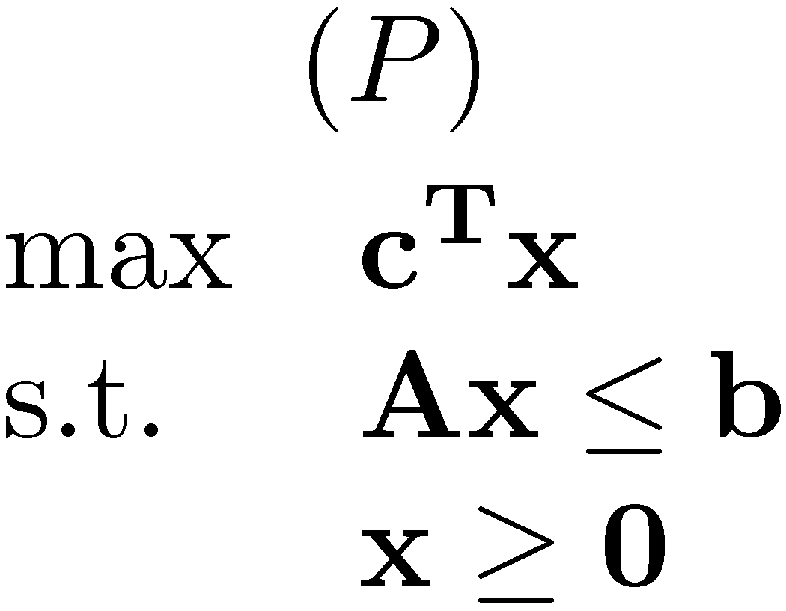
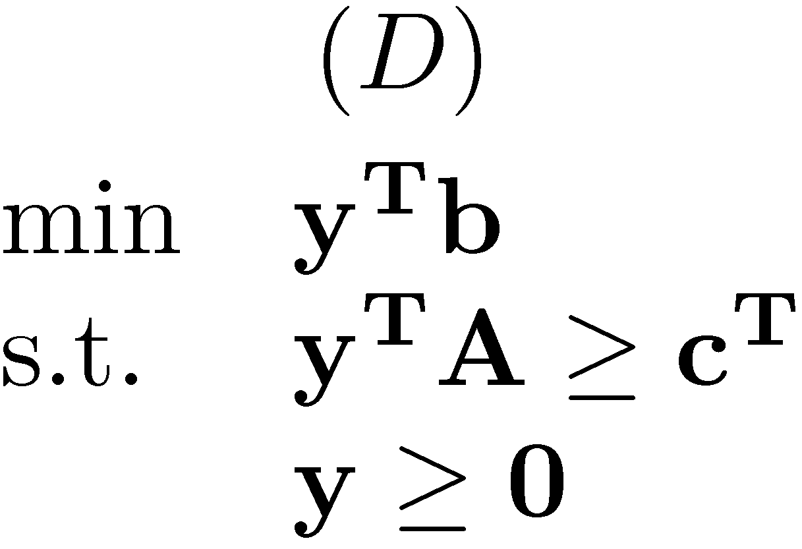
Linear Programming duality

Slide 16
Weak duality

Slide 17
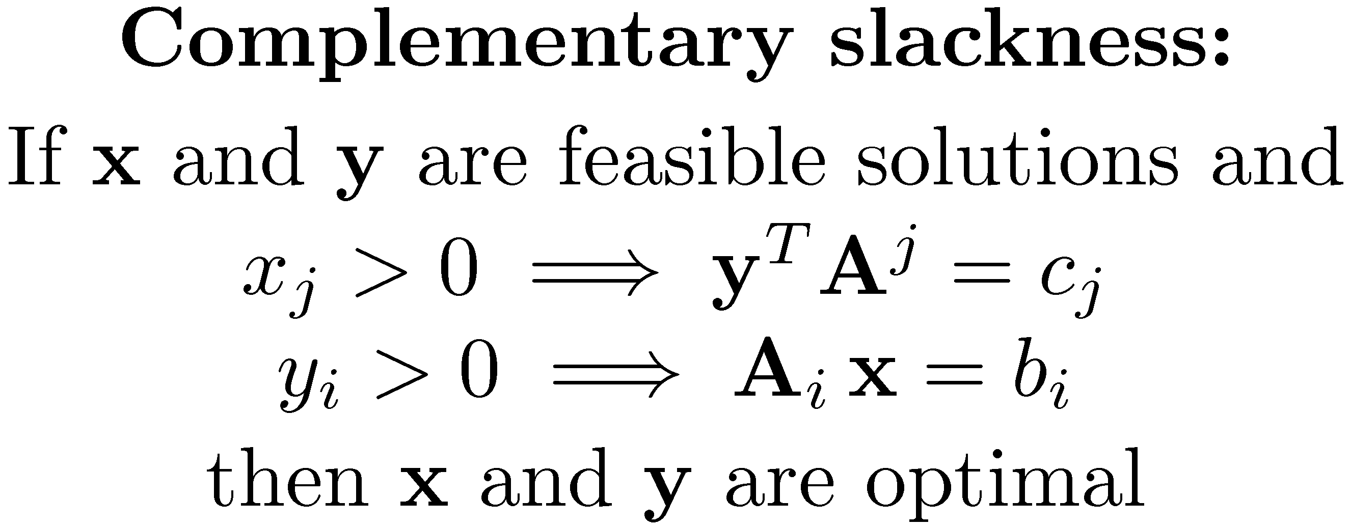
Complementary slackness

Slide 18
Linear Programming formulation of the assignment problem
Is this really a valid formulation?
Who says that (P) has an integral solution?

Slide 19
Linear Programming formulation of the assignment problem
Three different ways of showing that the formulation is valid:
1) Direct proof. If $x$ is an optimal solution, we convert it into an integral solution without decreasing its value.
2) The matrix $A$ in the LP formulation, which is just the incidence matrix of the graph, is totally unimodular, i.e., the determinant of every square submatrix is −1,0 or +1.
3) Our algorithm will always find an integral optimal solution.

Slide 20
Direct proof
Let $x_{e}$ be an optimal solution and assume that some of the values are fractional, i.e., not 0 or 1.
We show that the number of fractional values can be reduced without decreasing the value $∑x_{e}w_{e}$ of the solution.
There is either a path of fractional edges between two unsaturated vertices, or an even cycle of fractional edges.
Alternatingly, add and subtract $δ$ from the $x_{e}$ values on the path or cycle.
$$+δ$$
$$−δ$$
$$+δ$$
$δ$ can be positive or negative.
$∑x_{e}w_{e}$ does not change! (Otherwise the solution is not optimal.)
Choose δ so that at least one fractional $x_{e}$ becomes 0 or 1.

Slide 21
Incidence matrix of a (bipartite) graph
Edges
$$e$$
$$u$$
1
$$U$$
Vertices
$$v$$
1
$$V$$
Every column contains exactly two 1s
The incidence matrix of a bipartite graph is totally unimodular, i.e., the determinant of every square submatrix is −1,0 or +1.

Slide 22
The primal-dual method (a.k.a the “Hungarian method”)
Keep : 1) an integral feasible primal solution, i.e., a matching $M$. 2) A dual feasible solution $y$.
Maintain the first set of complementary slackness conditions: $\left(u,v\right)∈M$ → $y_{u}+y_{v}=w_{u,v}$
Our goal is to satisfy the second set of complementary slackness conditions: $y_{u}>0$ → $u$ matched
In each iteration we either augment $M$, or adjust $y$ so that more complementary slackness conditions are satisfied.

Slide 23
The Primal-dual method Preliminaries
Start with:
Slacks: $s_{u,v}={ y}_{u}+ y_{v}−w_{u,v} (≥0)$
An edge $\left(u,v\right)∈E$ is tight iff $s_{u,v}=0$.
All edges of $M$ are tight.

Slide 24
The Primal-dual method
$$G=(U,V,E)$$
Grow an alternating forest from all unmatched vertices of $U$ using only tight edges.
Let $S$ be the vertices of $U$ in the forest, and $T$ be the vertices of $V$ in the forest.
If an augmenting path is found, augment $M$.
Keep the dual values of all vertices.
What do we do if we are “stuck”?
(The forest cannot be extended using tight edges and the dual variables of some unmatched vertices are still positive.)

Slide 25
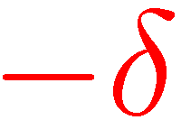
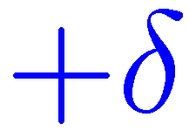
Adjusting dual variables
All edges leaving the forest, from even vertices, are not tight.
Slack of edges connecting two vertices in the forest is unchanged.
All forest edges and matched edges are still tight.
Slack of edges leaving the forest from even vertices decreases by $δ$.
If $δ=δ_{1}$, then $y_{u}=0$for every root $u$ and we are done!
If $δ=δ_{2}$, we have at least one new tight edge.

Slide 26
Adjusting dual variables
All edges leaving the forest, from even vertices, are not tight
Lemma: If $u,u^{′}∈S$ are unmatched and $u^{′′}∈S$ is matched, then $y_{u}=y_{u^{′}}≤y_{u^{′′}}$.
Thus, $δ_{1}$ is the joint $y$ value of the roots.

Slide 27
Linear Programming formulation of the general weighted matching problem [Edmonds (1965)]
Enough to have $|B|$ odd.
(P) has an exponential number of constraints.
(D) has an exponential number of variables.

Slide 28
Linear Programming formulation of the general weighted matching problem [Edmonds (1965)]
Correctness of formulation would follow from algorithm.
$B$ with $z_{B}>0$are blossoms.
Note the similarity of dual with odd vertex cover.

Slide 29
The Primal-dual method The non-bipartite case
Primal solution:
A matching $M$.
Dual values $y_{v}≥0$, for $v∈V\text{.}$ A collection of (nested) blossoms. A dual value $z_{B}≥0$ for each blossom $B$.
Dual solution:
A blossom $B$ w.r.t. $M$ is full, as it contains $(\left|B\right|−1)/2$ edges of $M$.

Slide 30
The Primal-dual method The non-bipartite case
Primal solution:
A matching $M$.
Dual values $y_{v}≥0$, for $v∈V\text{.}$ A collection of (nested) blossoms. A dual value $z_{B}≥0$ for each blossom $B$.
Dual solution:
Complementary slackness conditions:
The algorithm maintain (1) and (3). Makes progress towards (2).

Slide 31
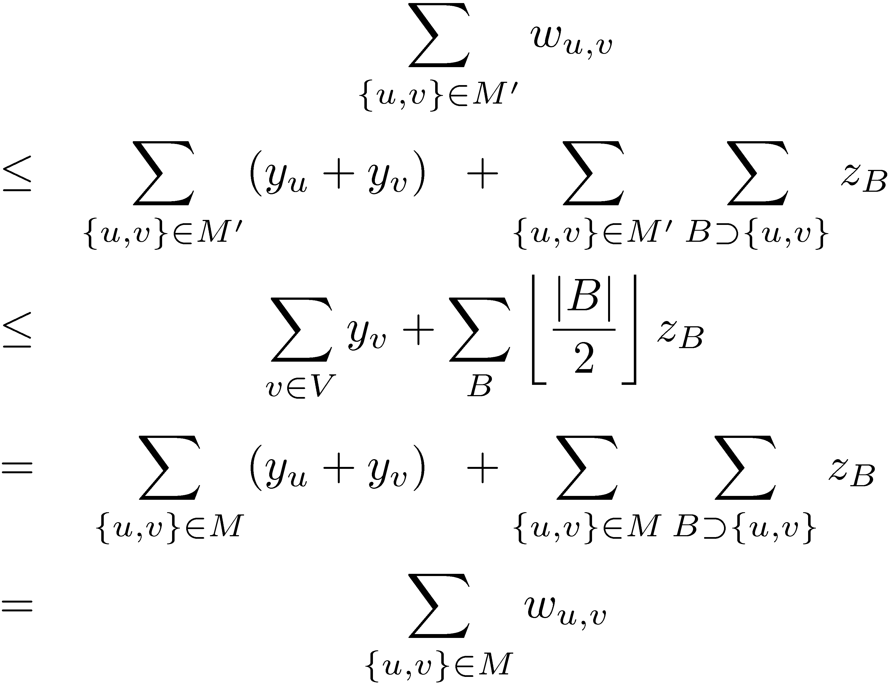
Correctness
If the algorithm terminates, correctness follows from weak duality.
Or directly:
Let $M$ be the matching found and $M’$ an arbitrary matching

Slide 32
More fun with blossoms
In the cardinality case, after each augmentation we expanded all blossoms and started from scratch.
We cannot do that here, as blossoms now have dual values.
Lemma: A blossom remains a blossom after an augmentation, possibly with no stem.
We thus start each phase with a collection of blossoms.
During a phase, new blossoms may be formed, and existing blossoms may be expanded.
In the cardinality case, blossoms were always even.
Blossoms may now be added as odd vertices.

Slide 33
The effect of an augmentation on a blossom

Slide 34
The alternating forest
All vertices are blossoms. (Some nested some trivial.)
All edges in the forest are tight.
All edges in blossoms are tight, even if they are not in the forest.
When there are no more tight edges to explore, adjust dual variables.

Slide 35
The Primal-dual method Initialization
Start with:

Slide 36
Adjusting dual variables
$S$ – vertices contained in even blossoms.
$T$ – vertices contained in odd blossoms.
All edges leaving the forest, from even vertices, are not tight.

Slide 37
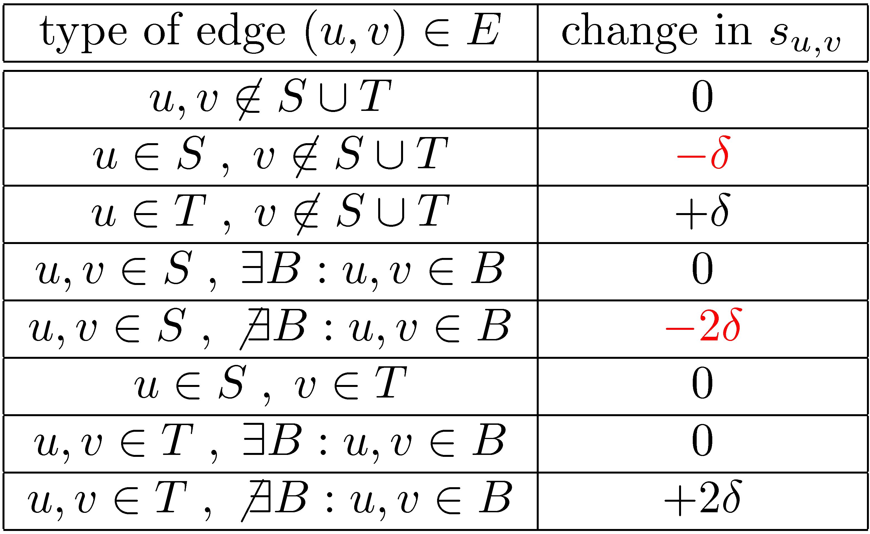
Changes in slacks

Slide 38
Case 1: $δ=δ_{1}$
After the update, $y_{v}=0$, for every unmatched $v$.
All complementary slackness conditions are satisfied.
We are done!
Case 2: $δ=δ_{2}$
After the update, at least one more edge leaving the forest from an even vertex is tight.
We can extend the forest while keeping all invariants.

Slide 39
Case 3: $δ=δ_{3}$
An edge connecting two even vertices in different blossoms becomes tight.
If the blossoms are in different trees ⇒ augmenting path
Otherwise, a new even blossom $B$ is formed. Set $z_{B}←0$.
The new even blossom swallows some odd blossoms. All vertices in these blossoms become even and tight edges leaving them may be explored.

Slide 40
Case 4: $δ=δ_{4}$
$z_{B}$ becomes 0, for some odd blossom $B$,
Expand the odd blossom $B$.
New even blossom
$$B$$
These blossoms leave the forest

Slide 41
Number of steps
Does the algorithm terminate?
The algorithm is composed of at most $n/2$ phases in which an augmenting path is found.
After each adjustment of the dual variables, either we are done, or an augmenting path is found, or the number of even vertices increases.
Thus, in each phase there are at most $n$ adjustments of the dual variables.
Total number of dual adjustment steps is $O(n^{2})$.
Algorithm is polynomial! [Edmonds (1965)]

Slide 42
Number of even vertices increases
After each adjustment of the dual variables, either we are done, or an augmenting path is found, or the number of even vertices increases.
Case 1: We are done.
Case 2: The forest is extended. The new odd blossom added is either unmatched (an augmenting path found), or an even blossom is immediately added.
Case 3: Either an augmenting path is found or a new blossom is formed. The new blossom swallows some odd vertices that are now even.
Case 4: An odd blossom is expanded. Some of its vertices become even.

Slide 43
Efficient implementation
Maintaining blossoms and finding augmenting paths
Similar to the unweighted case, though now we also have to expand blossoms.
Maintaining slacks and computing $δ$
Completely naïve implementation of each step in $O(m)$ time, giving an $O(mn^{2})$-time algorithm.
Using some (sophisticated) data structures we can implement each phase in:
$O(n^{2})$ [Gabow (1976)] [Lawler (1976)]
$O(m\log{n})$ [Galil-Micali-Gabow (1986)]
$O(m +n\log{n})$ [Gabow (1990)]

