Slide 1
Analysis of Algorithms
Minimum Cost Flow
Uri Zwick
Tel Aviv University
December 2015
Last modified: December 9, 2015

Slide 2
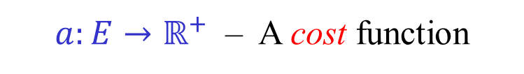


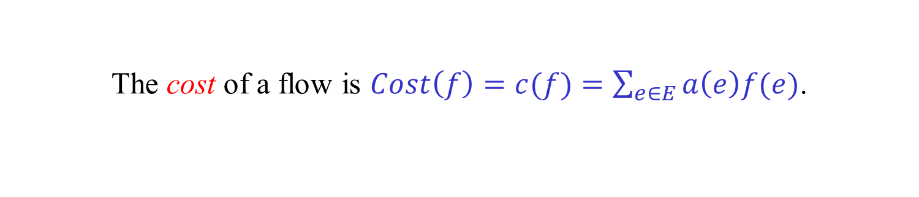
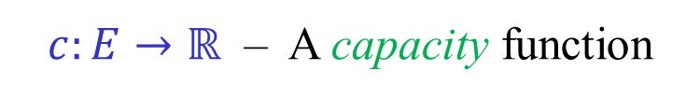
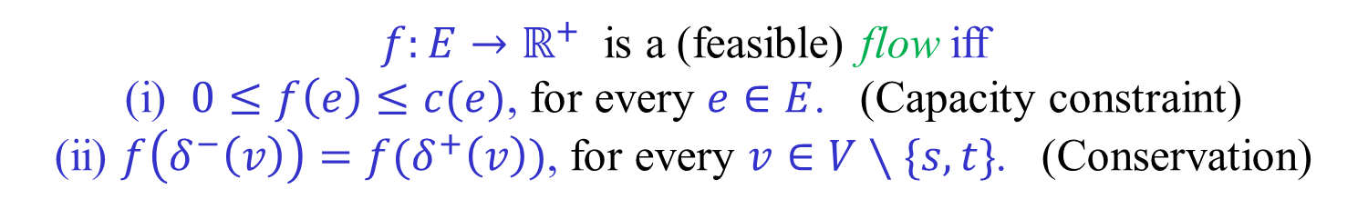
A Flow network
$$N=(G,a,c,s,t)$$
$G=(V,E)$ – A directed graph
$a:E→ℝ^{+}$ – A cost function
$s∈V$ – A source vertex
$c:E→ℝ$ – A capacity function
$t∈V$ – A sink vertex
A Flow
$f:E→ℝ^{+}$ is a (feasible) flow iff
(i) $0≤f\left(e\right)≤c(e)$, for every $e∈E$. (Capacity constraint)
(ii) $f\left(δ^{−}\left(v\right)\right)=f(δ^{+}\left(v\right))$, for every $v∈V∖\{s,t\}$. (Conservation)
The value of a flow is $Val\left(f\right)=\left|f\right|=f\left(δ^{+}\left(s\right)\right)=f(δ^{−}\left(t\right))$.
The cost of a flow is $Cost\left(f\right)=c(f)=\sum_{e∈E}{a\left(e\right)f(e)}$.
Find a maximum flow of minimum cost.

Slide 3
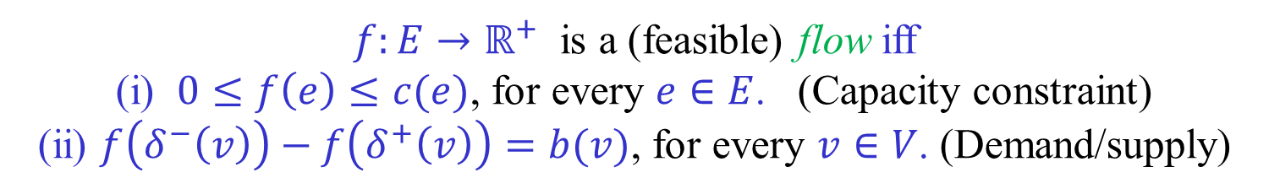
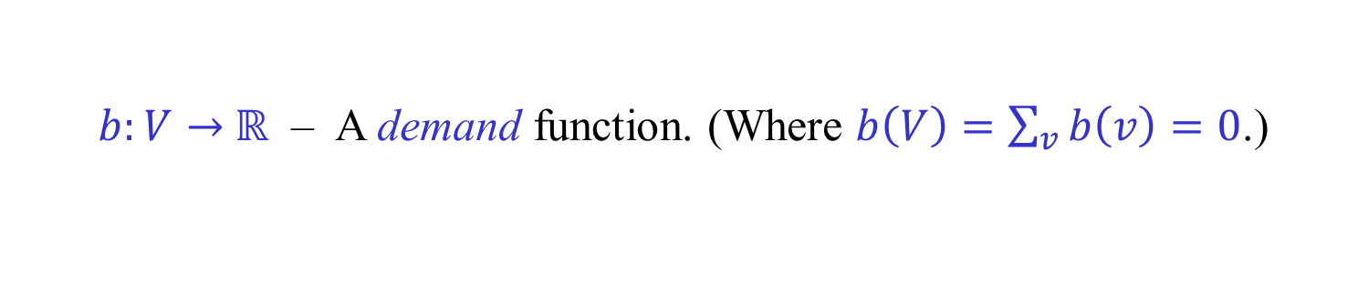
Flows with demands/supplies
$$N=(G,a,b,c)$$
$b:V→$ $ℝ$ – A demand function. (Where $b\left(V\right)=\sum_{v}{b\left(v\right)}=0$.)
$f:E→ℝ^{+}$ is a (feasible) flow iff
(i) $0≤f\left(e\right)≤c(e)$, for every $e∈E$. (Capacity constraint)
(ii) $f\left(δ^{−}\left(v\right)\right)−f\left(δ^{+}\left(v\right)\right)=b(v)$, for every $v∈V$. (Demand/supply)
Exercise: Show that the demand-supply version is
equivalent to the sink-source version.
Circulations
A flow that satisfies the conservation constraint at all vertices.
Exercise: Show that the min cost flow problem is equivalent
to the problem of finding a min cost circulation.

Slide 4
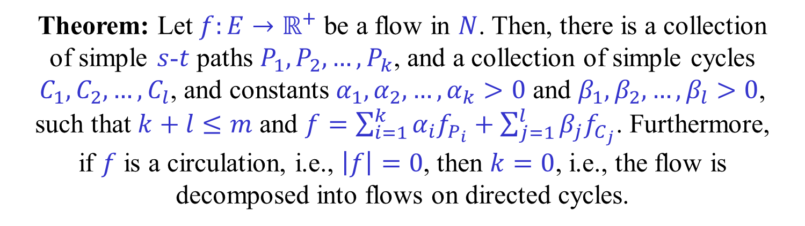

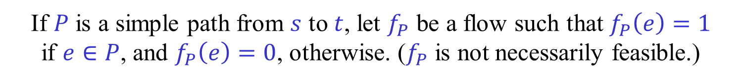
Flow Decomposition
Let $N=(G,a,c,s,t)$ be a flow network.
If $P$ is a simple path from $s$ to $t$, let $f_{P}$ be a flow such that $f_{P}\left(e\right)=1$
if $e∈P$, and $f_{P}\left(e\right)=0$, otherwise. ($f_{P}$ is not necessarily feasible.)
Similarly, if $C$ is a simple directed cycle in $G$, let $f_{C}$ be a
circulation in which one unit of flow flows on each edge of $C$.
Theorem: Let $f:E→ℝ^{+}$ be a flow in $N$. Then, there is a collection
of simple $s$-$t$ paths $P_{1},P_{2},…,P_{k}$, and a collection of simple cycles $C_{1},C_{2},…,C_{l}$, and constants $α_{1},α_{2},…,α_{k}>0$ and $β_{1},β_{2},…,β_{l}>0$,
such that $k+l≤m$ and $f=\sum_{i=1}^{k}{α_{i}f_{P_{i}}+\sum_{j=1}^{l}{β_{j}f_{C_{j}}}}$. Furthermore,
if $f$ is a circulation, i.e., $\left|f\right|=0$, then $k=0$, i.e., the flow is decomposed into flows on directed cycles.
Exercise: Prove the theorem.

Slide 5





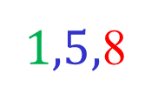





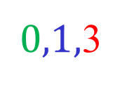


Residual Network
$$1,−8$$
$1,5,$8
$0,1,$3
$$1, 3$$
$$4, 8$$
$$1,3,7$$
$$2, 7$$
$$1, −7$$
$$0,2,5$$
$$2, 5$$
$$1, −4$$
$$1,1,4$$
$$N$$
$$N_{f}$$

