Slide 1
Minimum Spanning Trees
Uri Zwick
Tel Aviv University
October 2015
Last updated: November 18, 2015

Slide 2
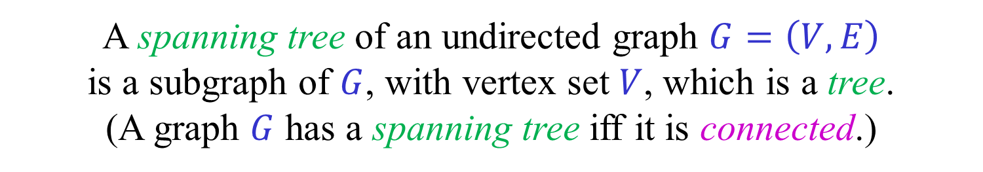
Spanning Trees
A tree is a connected acyclic graph (contains no cycles).
A forest is an acyclic graph.
A spanning tree of an undirected graph $G=\left(V,E\right)$
is a subgraph of $G$, with vertex set $V$, which is a tree.
(A graph $G$ has a spanning tree iff it is connected.)
The following conditions are equivalent:
(i) $T=(V,E_{T})$ is a spanning tree of $G$.
(ii) The addition of any edge of $G∖T$ to $T$ closes a cycle.
(iii) $T$ is connected but the removal of any edge disconnects it.
(iv) $\left|E_{T}\right|=\left|V\right|−1$ and $T$ is acyclic.
(v) $\left|E_{T}\right|=\left|V\right|−1$ and $T$ is connected.

Slide 3
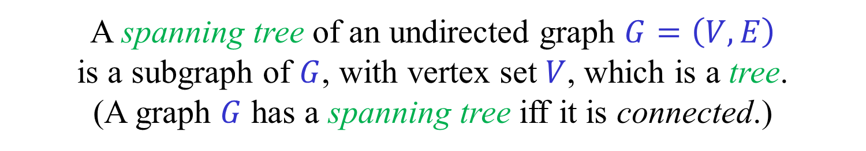
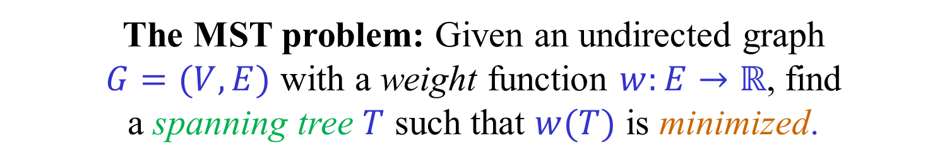
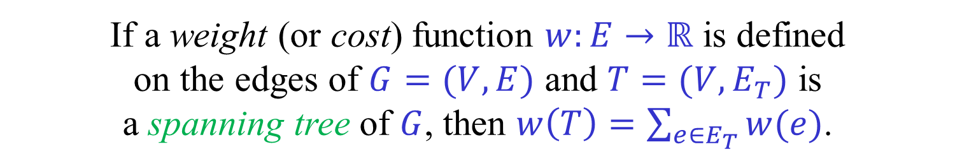
Minimum Spanning Trees
A tree is a connected acyclic graph (contains no cycles).
A spanning tree of an undirected graph $G=\left(V,E\right)$
is a subgraph of $G$, with vertex set $V$, which is a tree.
(A graph $G$ has a spanning tree iff it is connected.)
If a weight (or cost) function $w:E→ℝ$ is defined
on the edges of $G=(V,E)$ and $T=(V,E_{T})$ is
a spanning tree of $G$, then $w\left(T\right)=\sum_{e∈E_{T}}{w(e)}$.
The MST problem: Given an undirected graph
$G=(V,E)$ with a weight function $w:E→ℝ$, find
a spanning tree $T$ such that $w(T)$ is minimized.

Slide 4
A minimum spanning tree
11
16
22
17
5
8
1
13
3
18
30
12
25
9
2
15

Slide 5
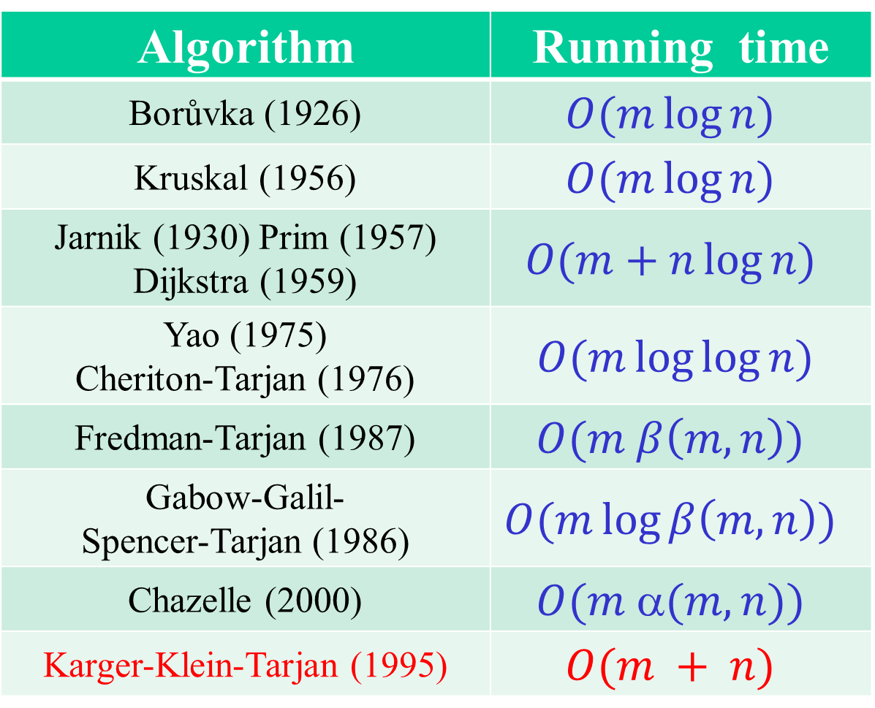
Comparison-based MST algorithms
Running time | Algorithm
$$O(m\log{n})$$ | Borůvka (1926)
$$O(m\log{n})$$ | Kruskal (1956)
$$O(m+n\log{n})$$ | Jarnik (1930) Prim (1957) Dijkstra (1959)
$$O(m\log{\log{n)}}$$ | Yao (1975) Cheriton-Tarjan (1976)
$$O(m β\left(m,n\right))$$ | Fredman-Tarjan (1987)
$$O(m\log{β\left(m,n\right)})$$ | Gabow-Galil- Spencer-Tarjan (1986)
$$O(m (m,n))$$ | Chazelle (2000)
$$O(m + n)$$ | Karger-Klein-Tarjan (1995)
Deterministic
Rand.

Slide 6
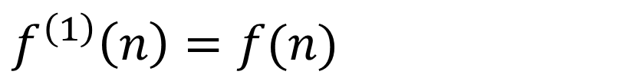
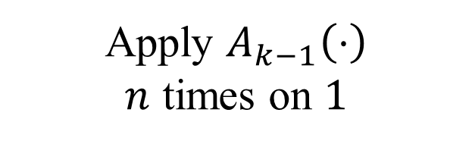
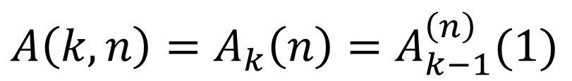

Ackermann’s function
(one of many similar variants)
$$A\left(1,n\right)=2n$$
$$A\left(k,1\right)=A\left(k−1 , 1\right) \left( =2\right) , k>1$$
$$A\left(k,n\right)=A\left(k−1 , A(k,n−1)\right) , k,n>1$$
$$A\left(k,n\right)=A_{k}\left(n\right)=A_{k−1}^{\left(n\right)}(1)$$
Apply $A_{k−1}\left(⋅\right)$
$n$ times on $1$
$$f^{\left(1\right)}\left(n\right)=f(n)$$
$k$ times
$f^{\left(k\right)}\left(n\right)=f\left(f^{\left(k−1\right)}\left(n\right)\right)=f(f(f(…f(n)…)))$

Slide 7
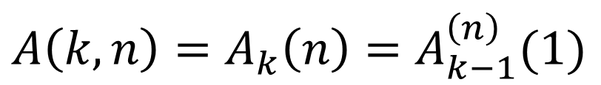

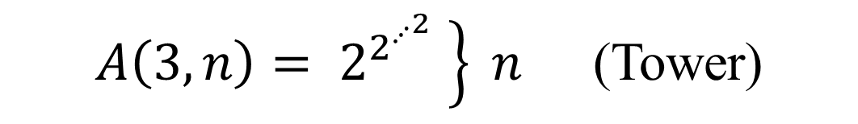

Ackermann’s function
$$A\left(k,n\right)=A_{k}\left(n\right)=A_{k−1}^{\left(n\right)}(1)$$
$$A\left(1,n\right)=2n$$
$$A\left(2,n\right)=2^{n}$$
$A\left(3,n\right)= \left.2^{2^{⋰^{2}}} \right\} n$ (Tower)

Slide 8

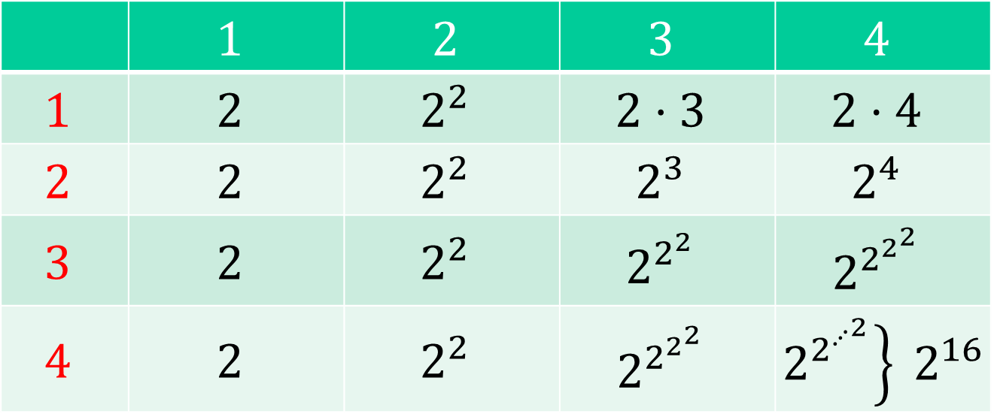

Ackermann’s function
$$n$$
$$4$$ | $$3$$ | $$2$$ | $$1$$
$$2⋅4$$ | $$2⋅3$$ | $$2^{2}$$ | $$2$$ | $$1$$
$$2^{4}$$ | $$2^{3}$$ | $$2^{2}$$ | $$2$$ | $$2$$
$$2^{2^{2^{2}}}$$ | $$2^{2^{2}}$$ | $$2^{2}$$ | $$2$$ | $$3$$
$\left.2^{2^{⋰^{2}}}\right\} 2^{16}$ | $$2^{2^{2^{2}}}$$ | $$2^{2}$$ | $$2$$ | $$4$$
$$k$$
Grows EXTREMELY fast!
Ackermann’s function is recursive
but not primitive recursive

Slide 9



Inverse Ackermann’s function
Row inverses:
$$λ_{k}\left(n\right)=\min\left\{i≥1 | A_{k}(i)≥n\right\}$$
$$λ_{1}\left(n\right)=\left\lceil \frac{n}{2}\right\rceil$$
$$λ_{2}\left(n\right)=\left\lceil \log_{2}{n}\right\rceil$$
$$λ_{3}\left(n\right)=\log^{∗}{n}=\min\left\{i≥1\right|\log^{\left(i\right)}{n≤1}\}$$
$$β\left(m,n\right)=\min\left\{i≥1\right|\log^{\left(i\right)}{n≤m/n}\}$$
$$≤\log^{∗}{n}−\log^{∗}{\frac{m}{n}}+1$$

Slide 10
Inverse Ackermann’s function
Why?
Column inverses:
$α_{r}\left(n\right)=\min\left\{k≥1 | A_{k}(r)≥n\right\}$ , $r≥3$
$α\left(m,n\right)=\min\left\{k≥1 | A_{k}(\left\lfloor \frac{3m}{n}\right\rfloor )≥n\right\}$ , $m≥n$
$α\left(m,n\right)$ is an extremely slowly growing function.
Surprisingly, it appears naturally in the analysis of
various computational problems and algorithms.
Examples: Union-find, Minimum Spanning Trees,
Davenport-Schinzel sequences.

Slide 11
Fundamental cycles
Tree + non-tree edge → unique cycle
The removal of any tree edge
from the cycle generates a new tree

Slide 12
Fundamental cuts
Removing an edge from a spanning tree generates a cut.
Adding any edge crossing the cut,
creates a new spanning tree.

Slide 13




Cut rule
Let $E\left(S,\overline{S}\right)=\left\{e∈E \right| \left|e∩S\right|=1\}$, where $S⊂V$, be a cut.
If $e∈E\left(S,\overline{S}\right)$ is the strictly lightest edge in the cut,
then $e$ is contained in all MSTs of $G$.
If $e∈E\left(S,\overline{S}\right)$ is a lightest edge in the cut,
then $e$ is contained in some MST of $G$.
$$S$$
$$\overline{S}=V∖S$$

Slide 14



Cycle rule
Let $C$ be a cycle in $G$.
If $e∈C$ is the strictly heaviest edge on the cycle,
then $e$ is not contained in any MST of $G$.
If $e∈C$ is a heaviest edge on the cycle,
then $e$ is not contained in some MST of $G$.
$$C$$

Slide 15




Cut rule - proof
$$f$$
$$S$$
$$V∖S$$
$$e$$
Let $e$ be the (stricktly) lightest edge in the cut $E\left(S,\overline{S}\right).$
Let $T$ be an MST such that $e∉T$.
Then, $T∪\{e\}$ contains a cycle $C$.
$C$ must contain another edge $f∈E\left(S,\overline{S}\right)$.
$w\left(e\right)<w(f)$, as $e$ is lightest in the cut
Thus $w\left(T∪\left\{e\right\}∖\left\{f\right\}\right)<w(T)$, a contradiction.

Slide 16


Cycle rule - proof
$$e$$
$$C$$
Let $e$ be the strictly heaviest edge on $C$.
Let $T$ be an MST that contains $e$.
Removing $e$ from $T$ creates a cut $(S,V∖S)$.
The cycle $C$ must contain another edge $f$ from the cut.
$T∪\left\{f\right\}∖\{e\}$ is also a spanning tree,
and $w\left(T∪\left\{f\right\}∖\left\{e\right\}\right)<w\left(T\right),$ a contradiction.

Slide 17
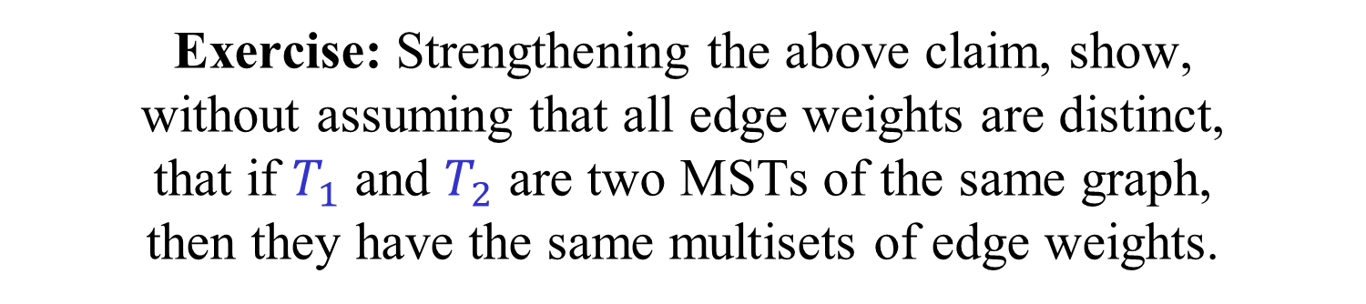
Uniqueness of MST
If all edge weights are distinct,
then the MST is unique.
Exercise: Use the cycle or cut rules to prove the claim.
Exercise: Strengthening the above claim, show,
without assuming that all edge weights are distinct,
that if $T_{1}$ and $T_{2}$ are two MSTs of the same graph,
then they have the same multisets of edge weights.
For simplicity, we will usually assume
that all edge weights are distinct.

Slide 18
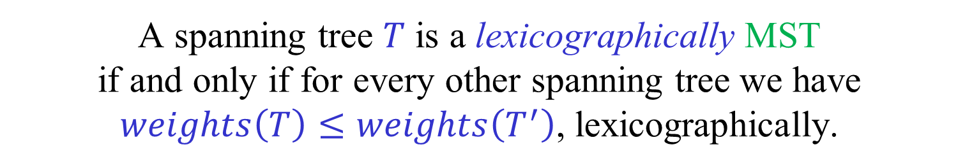
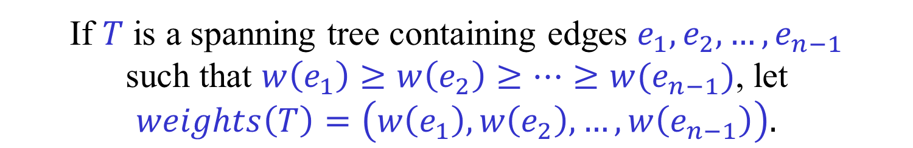

Lexicographically
Minimal Spanning Tree
If $T$ is a spanning tree containing edges $e_{1},e_{2},…,e_{n−1}$
such that $w\left(e_{1}\right)≥w\left(e_{2}\right)≥…≥w(e_{n−1})$, let
$weights\left(T\right)=\left(w\left(e_{1}\right),w\left(e_{2}\right),…,w\left(e_{n−1}\right)\right).$
A spanning tree $T$ is a lexicographically MST
if and only if for every other spanning tree we have $weights\left(T\right)≤weights\left(T^{′}\right)$, lexicographically.
Theorem: A spanning tree $T$ is an MST
if and only if it is a lexicographically MST
Exercise: Prove the theorem.

Slide 19
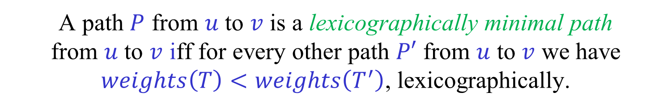

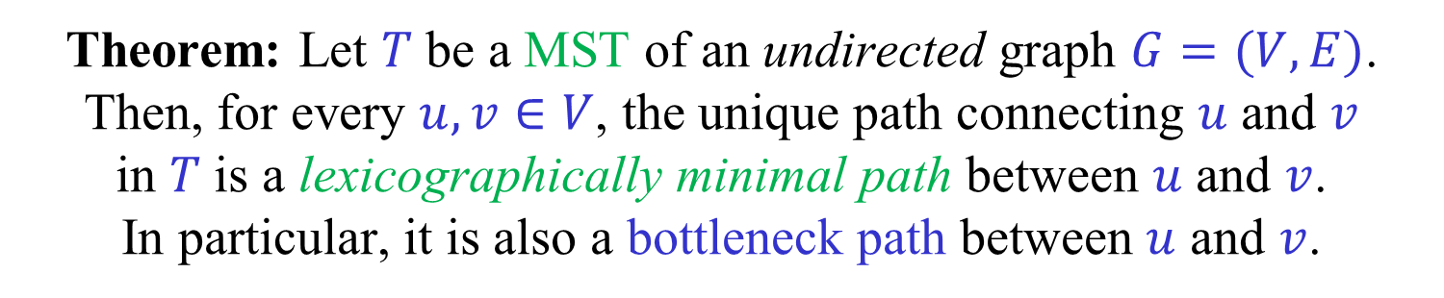
Bottleneck (min-max) paths
Lexicographically minimal paths
Assume that all edge weights are distinct
If $P$ be a path containing edges $e_{1},e_{2},…,e_{k}$
such that $w\left(e_{1}\right)>w\left(e_{2}\right)>…>w(e_{k})$, let
$weights\left(P\right)=\left(w\left(e_{1}\right),w\left(e_{2}\right),…,w\left(e_{k}\right)\right).$
A path $P$ from $u$ to $v$ is a lexicographically minimal path
from $u$ to $v$ iff for every other path $P′$ from $u$ to $v$ we have $weights\left(T\right)<weights\left(T^{′}\right)$, lexicographically.
Theorem: Let $T$ be a MST of an undirected graph $G=(V,E)$.
Then, for every $u,v∈V$, the unique path connecting $u$ and $v$
in $T$ is a lexicographically minimal path between $u$ and $v$.
In particular, it is also a bottleneck path between $u$ and $v$.
Exercise: Prove the theorem.

Slide 20
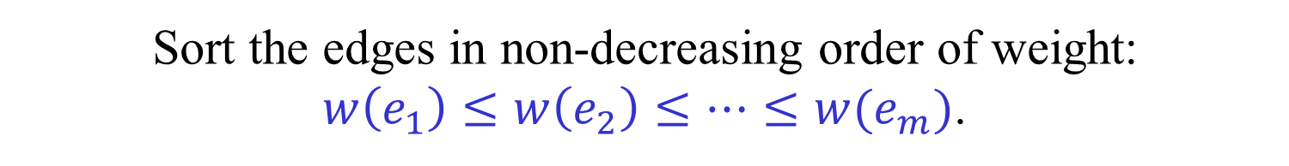
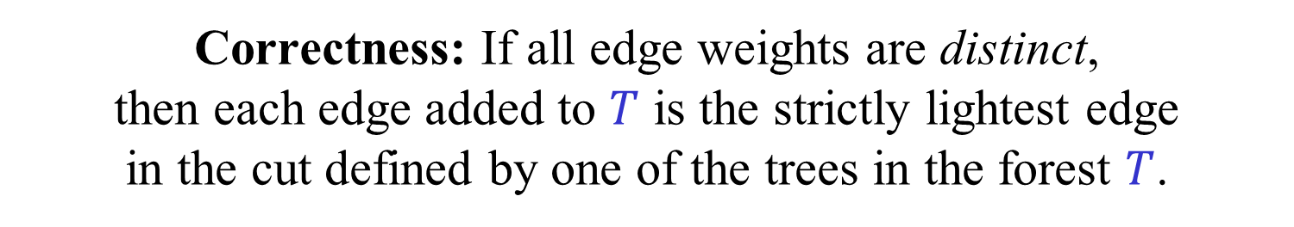

Kruskal’s algorithm
Sort the edges in non-decreasing order of weight:
$w\left(e_{1}\right)≤w\left(e_{2}\right)≤…≤w(e_{m})$.
Initialize $T←∅$. ($T$ is now a set of edges.)
For $i←1$ to $m$:
If $T∪\left\{e_{i}\right\}$ does not contain a cycle,
then $T←T∪\{e_{i}\}$.
Correctness: If all edge weights are distinct,
then each edge added to $T$ is the strictly lightest edge
in the cut defined by one of the trees in the forest $T$.

Slide 21
Kruskal’s algorithm
11
16
22
17
5
8
1
13
3
18
30
12
25
9
2
15

Slide 22





Kruskal’s algorithm
$$e_{i}$$
$$e_{i}$$
When $e_{i}$ is examined, $T$ is a forest, and
$e_{1},…,e_{i−1}$ connect vertices of the same tree.
If $e_{i}$ connects two different trees, it is the
lightest edge in the cuts defined by these trees.
The two trees containing $e_{i}$ merge.
If $e_{i}$ connects two vertices of the same tree,
it is the heaviest edge on a cycle.

Slide 23
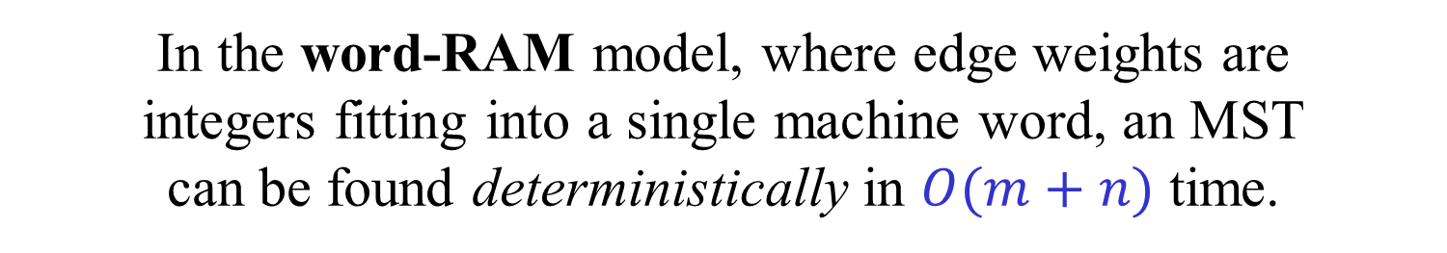
Comparison-based algorithms
An MST is a spanning tree whose
sum of edge weights is minimized.
Surprisingly, we can find such a tree by only
comparing edge weights. No additions are necessary.
A comparison-based algorithm is an algorithm that
does not perform any operation on edge weights
other than pairwise comparisons.
In the word-RAM model, where edge weights are
integers fitting into a single machine word, an MST
can be found deterministically in $O(m+n)$ time.

Slide 24
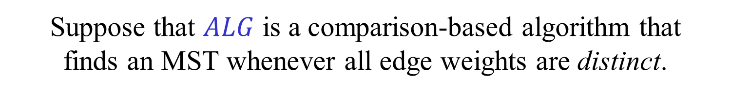

Breaking ties
Suppose that $ALG$ is a comparison-based algorithm that
finds an MST whenever all edge weights are distinct.
Convert $ALG$ into an algorithm $ALG′$, by replacing every
if $w\left(e_{1}\right)<w(e_{2})$ …
by
if $w\left(e_{1}\right)<w\left(e_{2}\right) or$
$\left(w\left(e_{1}\right)=w\left(e_{2}\right) and ind\left(e_{1}\right)<ind(e_{2})\right)$ …
where $ind(e)$ are distinct identifiers of the edges.
Then, $ALG′$ finds an MST even if weights are not distinct.
Exercise: Prove the claim.

Slide 25
The blue-red framework
Another convenient way of dealing with ties.
Initially all edges are uncolored.
Blue rule: Choose a cut that does not contain a blue edge.
Among all uncolored edges in the cut, choose an
edge of minimal weight and color it blue.
Red rule: Choose a cycle that does not contain a red edge.
Among all uncolored edges on the cycle, choose an
edge of maximal weight and color it red.
Theorem: After any sequence of applications of the blue
and red rules, there is always an MST that contains all blue
edges and none of the red edges. As long as some of the
edges are uncolored, at least one of the rules may be applied.

Slide 26
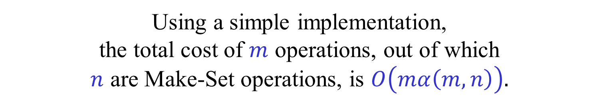
Disjoint Sets / Union-Find
Make-Set(x): Create a singleton set containing x.
Union(x,y): Unite the sets containing x and y.
Find(x): Return a representative of the set containing x.
Find(x)=Find(y) iff x and y are currently in same set.
Using a simple implementation,
the total cost of $m$ operations, out of which
$n$ are Make-Set operations, is $O\left(mα\left(m,n\right)\right).$

Slide 27
Union Find
Represent each set as a rooted tree.
The representative of each set is the root of its tree.
Union by rank
Path compression
x.p
x
The parent of a vertex x is denoted by x.p.
Find(x) traces the path from x to the root.

Slide 28






Union by rank
$$r+1$$
$$r1< r2$$
$$r2$$
$$r$$
$$r$$
0
$$r1$$
Each item is assigned a rank, initially 0.
Union by rank on its own gives $O(log⁡n)$ find time
A tree of rank $r$ contains at least $2r$ elements
At most $n/2r$ nodes of rank $ r$
If $x$is not a root, then $x.rank < x.p.rank$

Slide 29
Path Compression

Slide 30
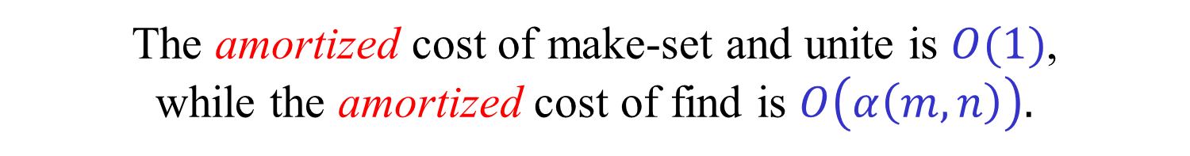
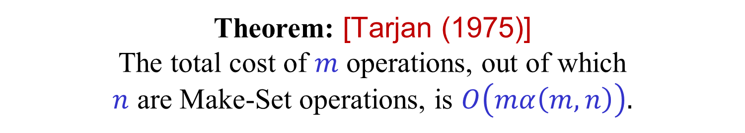
Analysis of Union-Find
While the data structure is very simple,
the analysis is far from being simple.
Theorem: [Tarjan (1975)]
The total cost of $m$ operations, out of which
$n$ are Make-Set operations, is $O\left(mα\left(m,n\right)\right).$
The amortized cost of make-set and unite is $O(1)$,
while the amortized cost of find is $O\left(α\left(m,n\right)\right).$
A simpler proof given by [Seidel-Sharir (2005)]
We shall not present the proof(s) in this course.

Slide 31
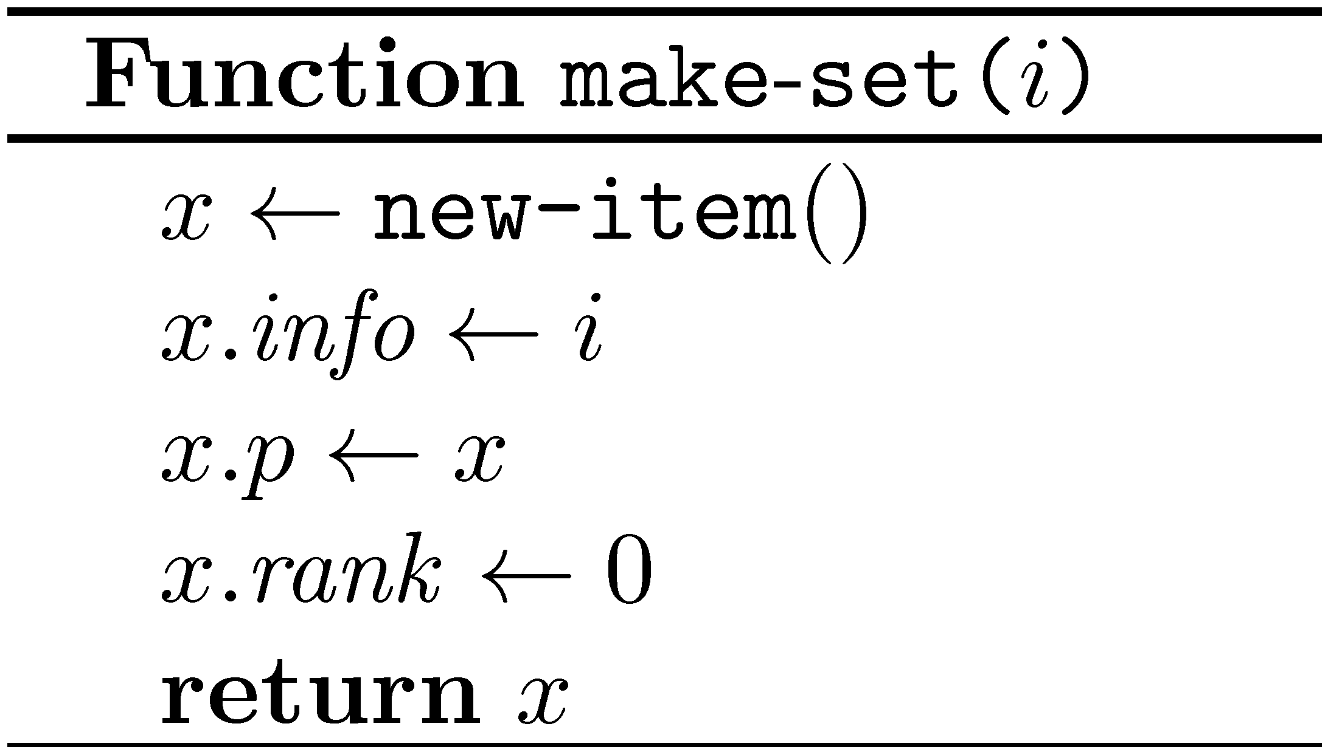
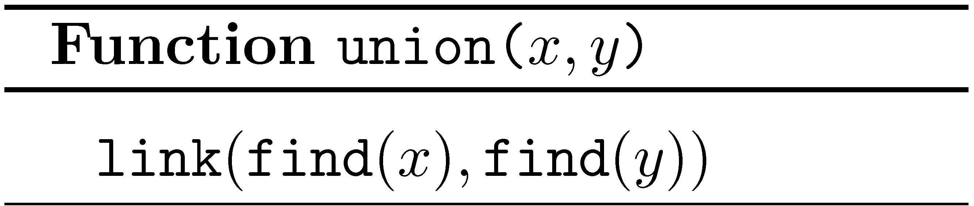
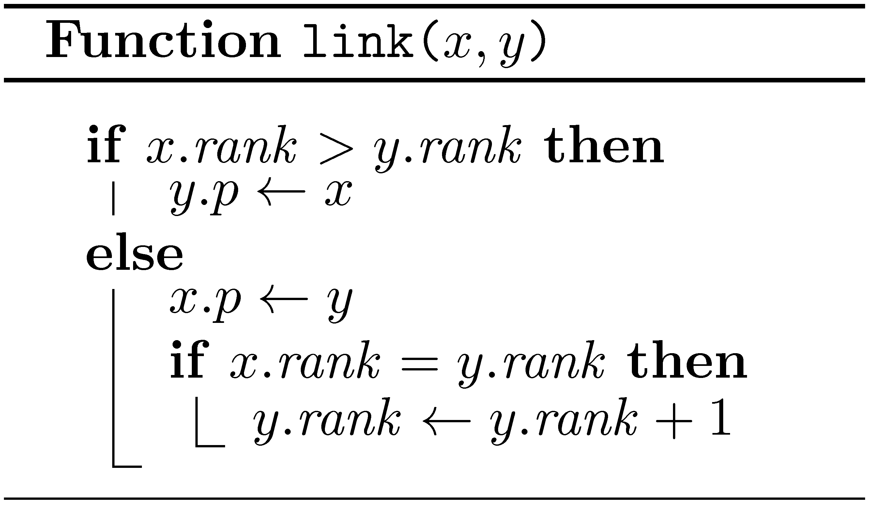
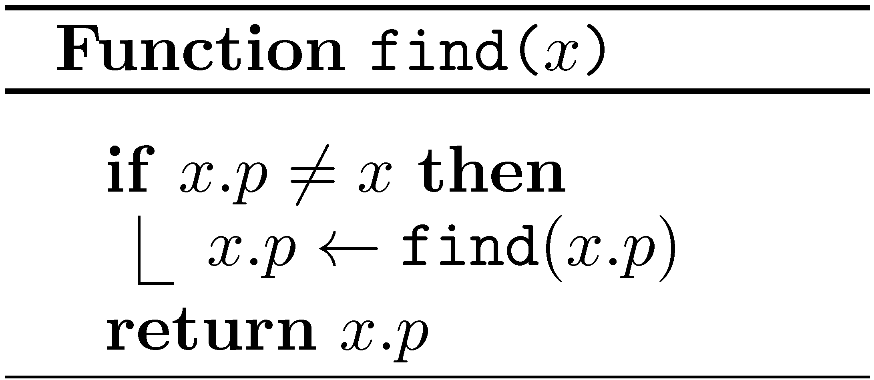
Union Find - pseudocode

Slide 32
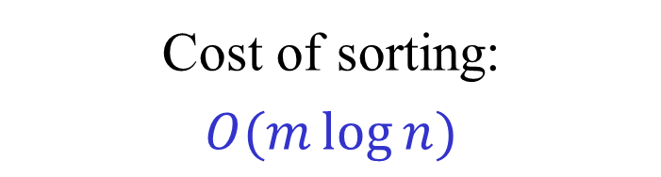
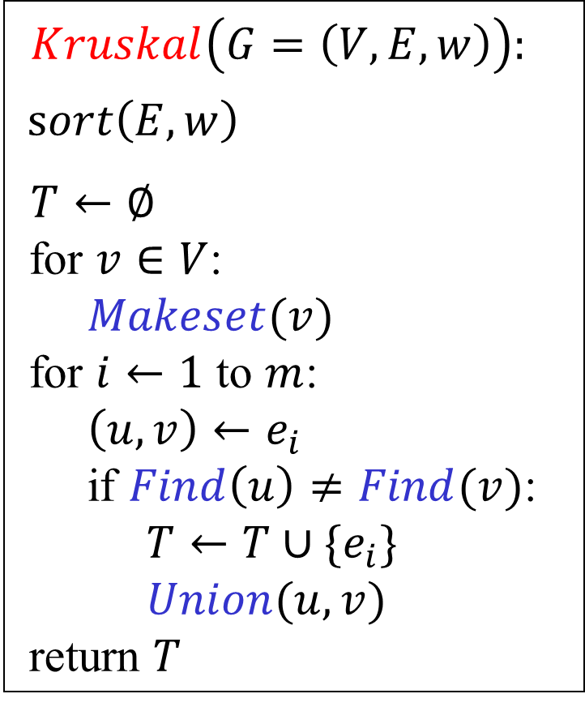

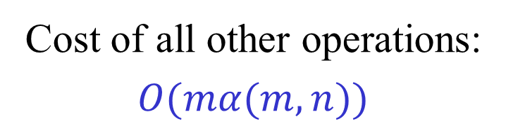
Efficient implementation
of Kruskal’s algorithm
$Kruskal\left(G=\left(V,E,w\right)\right):$
$sort\left(E,w\right)$
$T←∅$
for $v∈V$:
$Makeset(v)$
for $i←1$ to $m$:
$\left(u,v\right)←e_{i}$
if $Find\left(u\right)≠Find(v)$:
$T←T∪\{e_{i}\}$
$Union(u,v)$
return $T$
Use the union-find
data structure
Cost of sorting:
$$O(m\log{n})$$
Cost of all other operations:
$$O(mα(m,n))$$
Total cost:
$$O(m\log{n})$$

Slide 33
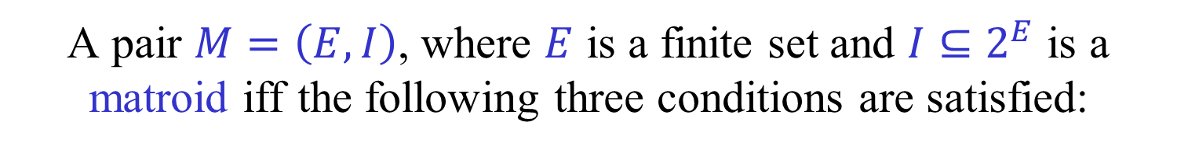

Matroids [Whitney (1935)]
A pair $M=\left(E,I\right)$, where $E$ is a finite set and $I⊆2^{E}$ is a matroid iff the following three conditions are satisfied:
(i) $∅∈I$
(ii) If $A∈I$ and $B⊂A$ then $B∈I$.
(iii) If $A,B∈I$ and $\left|B\right|<|A|$ then
there exists $e∈A∖B$ such that $B∪\{e\}∈I$.
The sets contained in $I$ are called independent sets.
A maximal independent set is called a basis.
A minimal dependent set is called a circuit.

Slide 34
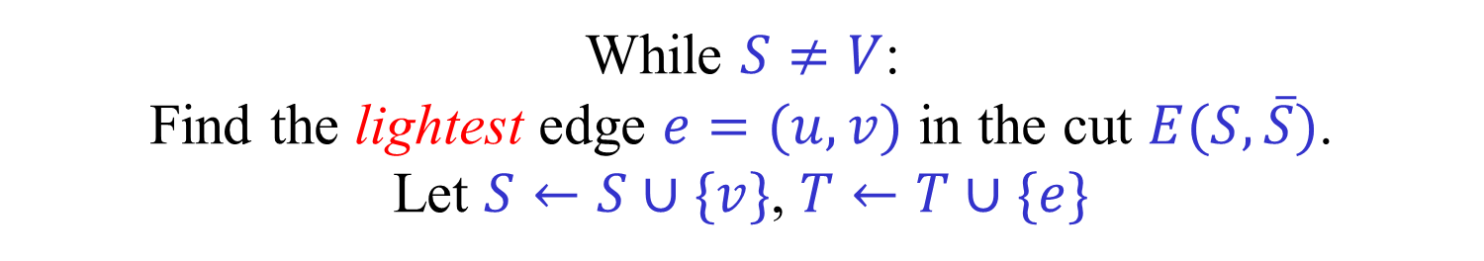


Jarnik-Prim-Dijkstra
Let $r$ be an arbitrary vertex.
Let $S←\{r\}$, $T←∅$.
While $S≠V$:
Find the lightest edge $e=(u,v)$ in the cut $E(S,\overline{S})$.
Let $S←S∪\{v\}$, $T←T∪\{e\}$
Correctness follows immediately from the cut rule.
To implement the algorithm efficiently,
use a priority-queue (heap) to hold $V∖S$.

Slide 35
Prim’s algorithm
11
16
22
17
5
8
1
13
3
18
30
12
25
9
2
15

Slide 36
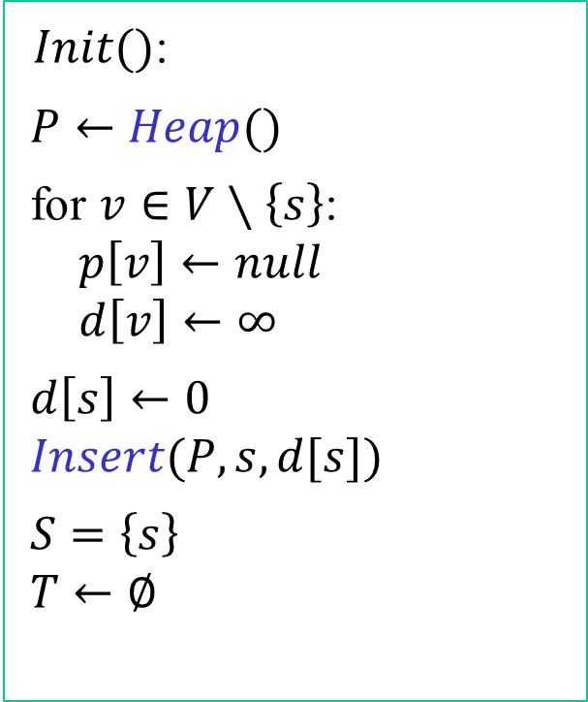
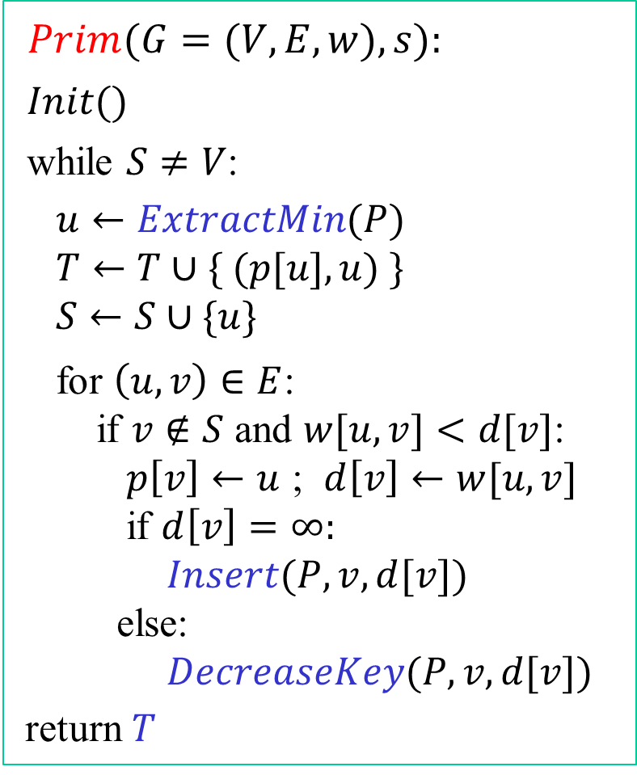
Prim’s algorithm - pseudocode
$Prim(G=(V,E,w),s):$
$Init()$
while $S≠V$:
$u←ExtractMin(P)$
$T←T∪\{ (p[u],u) \}$
$S←S∪\{u\}$
for $\left(u,v\right)∈E$:
if $v∉S$ and $w[u,v]<d[v]$:
$p\left[v\right]←u$ ; $d\left[v\right]←w[u,v]$
if $d\left[v\right]=∞:$
$Insert(P,v,d[v])$
else:
$DecreaseKey(P,v,d[v])$
return $T$
$Init()$:
$P←Heap()$
for $v∈V∖\left\{s\right\}$:
$p\left[v\right]←null$
$d\left[v\right]←∞$
$d\left[s\right]←0$
$Insert(P,s,d[s])$
$S=\left\{s\right\}$
$T←∅$

Slide 37
Prim’s algorithm - complexity
The algorithm performs at most:
$n$ – Insert operations
$n$ – Extract-Min operations
$m$ – Decrease-Key operations
Using, e.g., a Fibonacci-heap,
the running time is:
$$O(m+n\log{n})$$

Slide 38

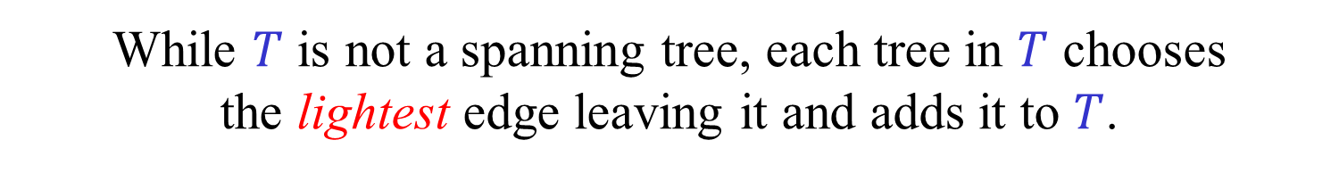
Borůvska’s algorithm (1926)
Start with $T=∅$.
($T$ defines a forest in which each tree is a singleton.)
While $T$ is not a spanning tree, each tree in $T$ chooses
the lightest edge leaving it and adds it to $T$.
(We assume that $G$ is connected
and that all edge weights are distinct.)

Slide 39
Borůvska’s algorithm (1926)
Start with $T=∅$.
($T$ defines a forest in which each tree is a singleton.)
While $T$ is not a spanning tree, each tree in $T$ chooses
the lightest edge leaving it and adds it to $T$.
(We assume that $G$ is connected
and that all edge weights are distinct.)

Slide 40
Borůvka’s algorithm
11
16
22
17
5
8
1
13
3
18
30
12
25
9
2
15

Slide 41

Borůvska’s algorithm - Analysis
In each iteration, the number of trees in $T$
is reduced by a factor of at least 2.
Hence, the number of iterations is $≤ \lg{n}$.
Each iteration can be easily implemented in $O(m)$ time.
Thus, the total running time is $O(m\log{n})$.
Borůvska’s algorithm can be parallelized.
Borůvska’s algorithm is used as a building block
in more efficient and more sophisticated algorithms.

Slide 42
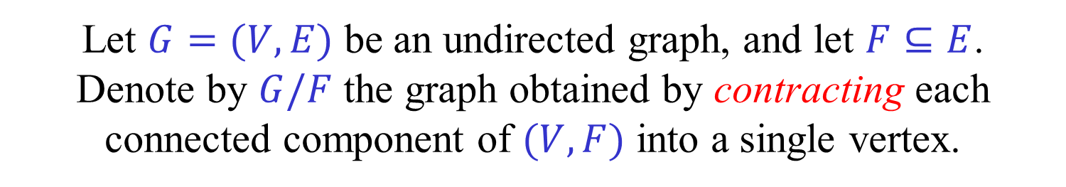
Contraction
Let $G=(V,E)$ be an undirected graph, and let $F⊆E$.
Denote by $G/F$ the graph obtained by contracting each connected component of $(V,F)$ into a single vertex.

Slide 43
Contraction
Let $G=(V,E)$ be an undirected graph, and let $F⊆E$.
Denote by $G/F$ the graph obtained by contracting each connected component of $(V,F)$ into a single vertex.

Slide 44
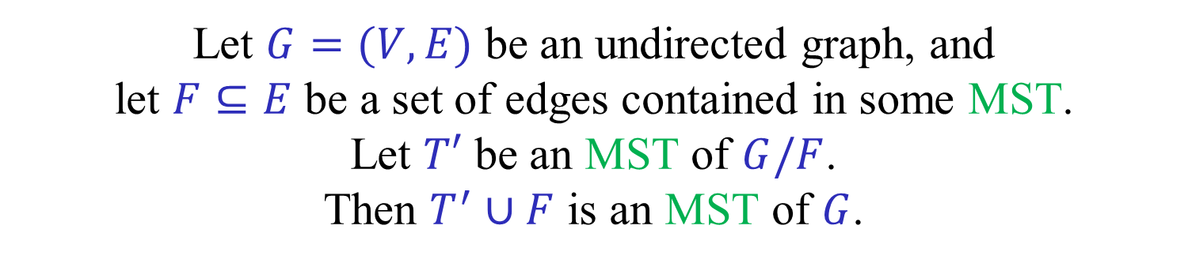
MST using contractions
Let $G=(V,E)$ be an undirected graph, and
let $F⊆E$ be a set of edges contained in some MST.
Let $T′$ be an MST of $G/F$.
Then $T^{′}∪F$ is an MST of $G$.

Slide 45
MST using contractions
Let $G=(V,E)$ be an undirected graph, and
let $F⊆E$ be a set of edges contained in some MST.
Let $T′$ be an MST of $G/F$.
Then $T^{′}∪F$ is an MST of $G$.

Slide 46
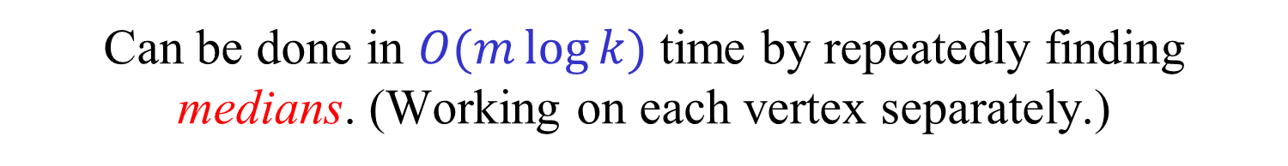

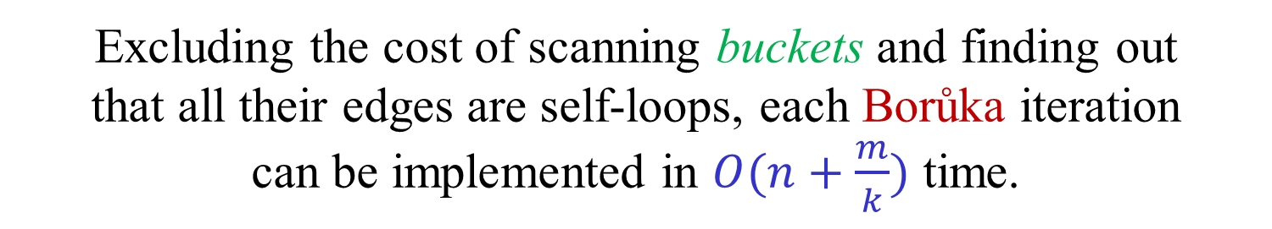
Yao’s algorithm (1976)
Partition the edges of each vertex
into $k$ equally-sized buckets.
The edges in the first bucket are all lighter
than the edges in the second bucket, etc.
Can be done in $O(m\log{k})$ time by repeatedly finding medians. (Working on each vertex separately.)
For each vertex, keep the index of the first bucket
that contains edges that are not self-loops.
Excluding the cost of scanning buckets and finding out
that all their edges are self-loops, each Borůka iteration
can be implemented in $O(n+\frac{m}{k})$ time.

Slide 47
Yao’s algorithm (1976)
Partitioning into buckets – $O(m\log{k})$
Scanning “useless” buckets – $O\left(m\right)$
Time per iteration – $O\left(n+\frac{m}{k}\right)$
Total running time:
$O\left(m\log{k }+\left(n+\frac{m}{k}\right)\log{n}\right)$
Choosing $k=\log{n}$, we get
$O(m\log{\log{n}}+n\log{n})$

Slide 48
Yao’s algorithm (1976)
$O(m\log{\log{n}}+n\log{n})$
Getting rid of the $O\left(n\log{n}\right)$ term:
Start with $O(\log{\log{n})}$ standard Borůka iterations.
Contract the resulting trees.
Run Yao’s algorithm on contracted graph.
Number of vertices in the contracted graph is at most:
$${n^{′}≤n/2}^{\log{\log{n}}}≤ n/log⁡n$$
Total running time of modified algorithm:
$O(m\log{\log{n}}+\left(m\log{\log{n^{′}}}+ n′\log{n′}\right)=O(m\log{\log{n}})$
Faster than Prim when $m≤ \frac{n\log{n}}{\log{\log{n}}}$ !

Slide 49
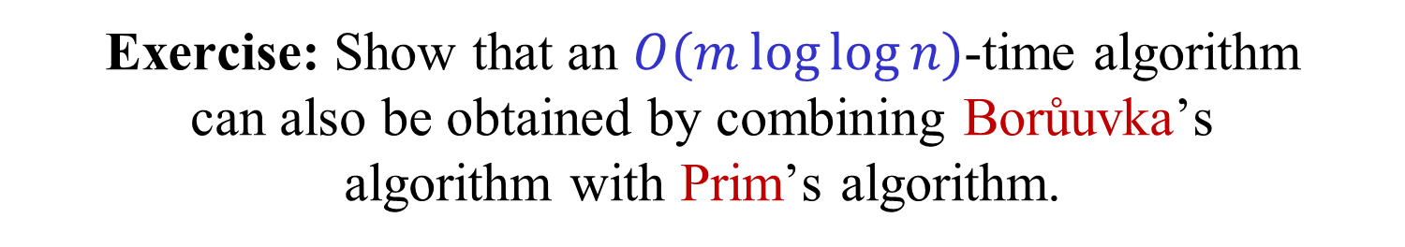
Exercise: Show that an $O(m\log{\log{n}})$-time algorithm
can also be obtained by combining Borůuvka’s
algorithm with Prim’s algorithm.
Yao’s algorithm has the advantage that it does not use
“sophisticated” data structures such as Fibonacci heaps.

Slide 50
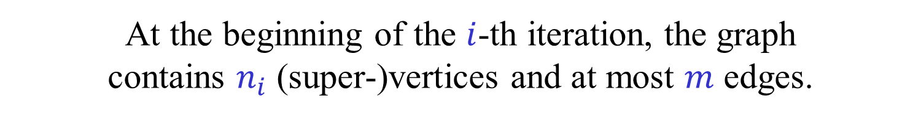
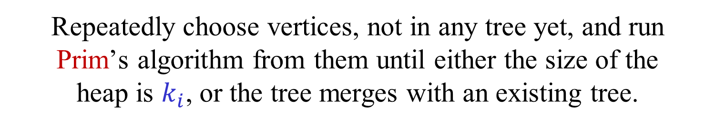
Fredman-Tarjan (1987)
The algorithm is composed of iterations.
At the beginning of the $i$-th iteration, the graph
contains $n_{i}$ (super-)vertices and at most $m$ edges.
Choose a parameter $k_{i}$.
Repeatedly choose vertices, not in any tree yet, and run
Prim’s algorithm from them until either the size of the
heap is $k_{i}$, or the tree merges with an existing tree.
At the end of each iterations, contract the trees formed.
Each tree formed has at least $k_{i}$ edges touching it.
Number of trees formed is at most $n_{i+1}≤2m/k_{i}$.
Time of the $i$-th iteration is $O(m+n_{i}\log{k_{i}})$.

Slide 51
Fredman-Tarjan (1987)
Suppose $k_{i}=3$.

Slide 52

Fredman-Tarjan (1987)
Number of trees formed is $n_{i+1}≤2m/k_{i}$.
Time of $i$-th iteration is $O(m+n_{i}\log{k_{i}})$.
Choose $k_{i}=2^{2m/n_{i} }$.
Time of $i$-th iteration is
$O\left(m+n_{i}\log{k_{i}}\right)=O(m+n_{i}\frac{2m}{n_{i}}) =O(m)$.
$$k_{1}=2^{2m/n}$$
$$k_{i+1}=2^{2m/n_{i+1} }≥2^{k_{i}}$$
$k_{i}≥n ⟹$ Last iteration
Number of iterations is $≤β(m,n)$.
Total running time is $O(m β\left(m,n\right))$.

Slide 53
Bonus material
Not covered in class this term
“Careful. We don’t want to learn from this.”
(Bill Watterson, “Calvin and Hobbes”)

Slide 54

Gabow-Galil-Spencer-Tarjan (1986)
An improvement of the Fredman-Tarjan algorithm.
New ingredient: The edges of each vertex are
partitioned, arbitrarily, into packets of size $p$.
Each packet is stored in a (tiny) Fibonacci heap.
Instead of examining all edges touching a vertex,
we examine the lightest edge in each packet.
We cannot afford to contract trees after each iteration.
Trees are maintained using a union-find data structure.
For each tree we maintain a list of the packets. Edges
in these packets may lead to vertices in the same tree.

Slide 55
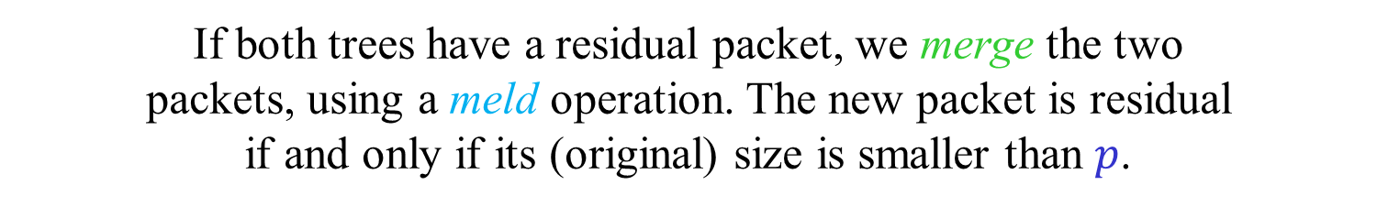
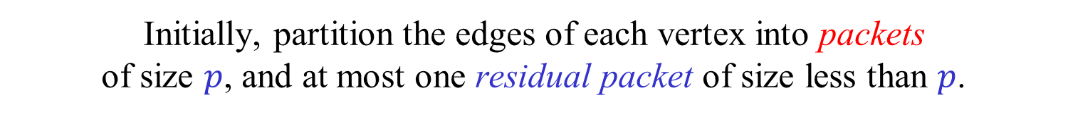
Gabow-Galil-Spencer-Tarjan (1986)
Packets – Technical details:
Let $p$ be an (integer) parameter.
Initially, partition the edges of each vertex into packets
of size $p$, and at most one residual packet of size less than $p$.
Packets have edges removed from them.
For simplicity, we consider their original size.
In the beginning of each iteration,
each tree has a list of packets associated with it.
When trees merge, we concatenate their list of packets.
If both trees have a residual packet, we merge the two
packets, using a meld operation. The new packet is residual
if and only if its (original) size is smaller than $p$.
All packets are of size $≤2p$.
Number of packets in the $i$-th iteration $≤ \frac{2m}{p}+n_{i}$

Slide 56
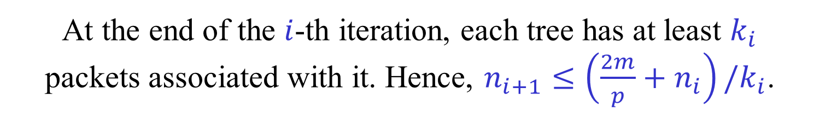
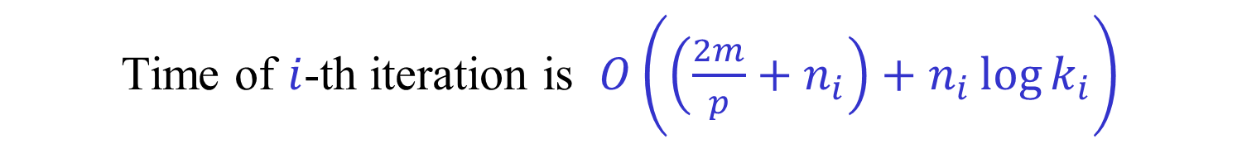

Gabow-Galil-Spencer-Tarjan (1986)
At the end of the $i$-th iteration, each tree has at least $k_{i}$
packets associated with it. Hence, $n_{i+1}≤\left(\frac{2m}{p}+n_{i}\right)/k_{i}$.
Time of $i$-th iteration is $O\left(\left(\frac{2m}{p}+n_{i}\right)+n_{i}\log{k_{i}}\right)$
As before, $k_{i}=2^{2m/n_{i} }$.
$$n_{i}\log{k_{i}}=n_{i}k_{i−1}≤\frac{2m}{p}+n_{i−1}$$
Choose $p=β(m,n)$.
Number of iterations is $≤β(m,n)$.
Total running time is $O(m\log{β\left(m,n\right)})$.

