Slide 1
Analysis of Algorithms
Minimum
Directed Spanning Trees
Uri Zwick
Tel Aviv University
October 2015
Last updated: November 27, 2015

Slide 2
Minimum Directed Spanning Trees
11
16
22
17
5
8
1
13
3
18
30
12
25
9
2
15

Slide 3
Minimum Directed Spanning Trees
11
16
22
17
5
8
1
13
3
18
30
12
25
9
2
15
Notes:
Better to use 25 and 2!

Slide 4
Minimum Directed Spanning Trees
11
16
22
17
5
8
1
13
3
18
30
12
25
9
2
15

Slide 5
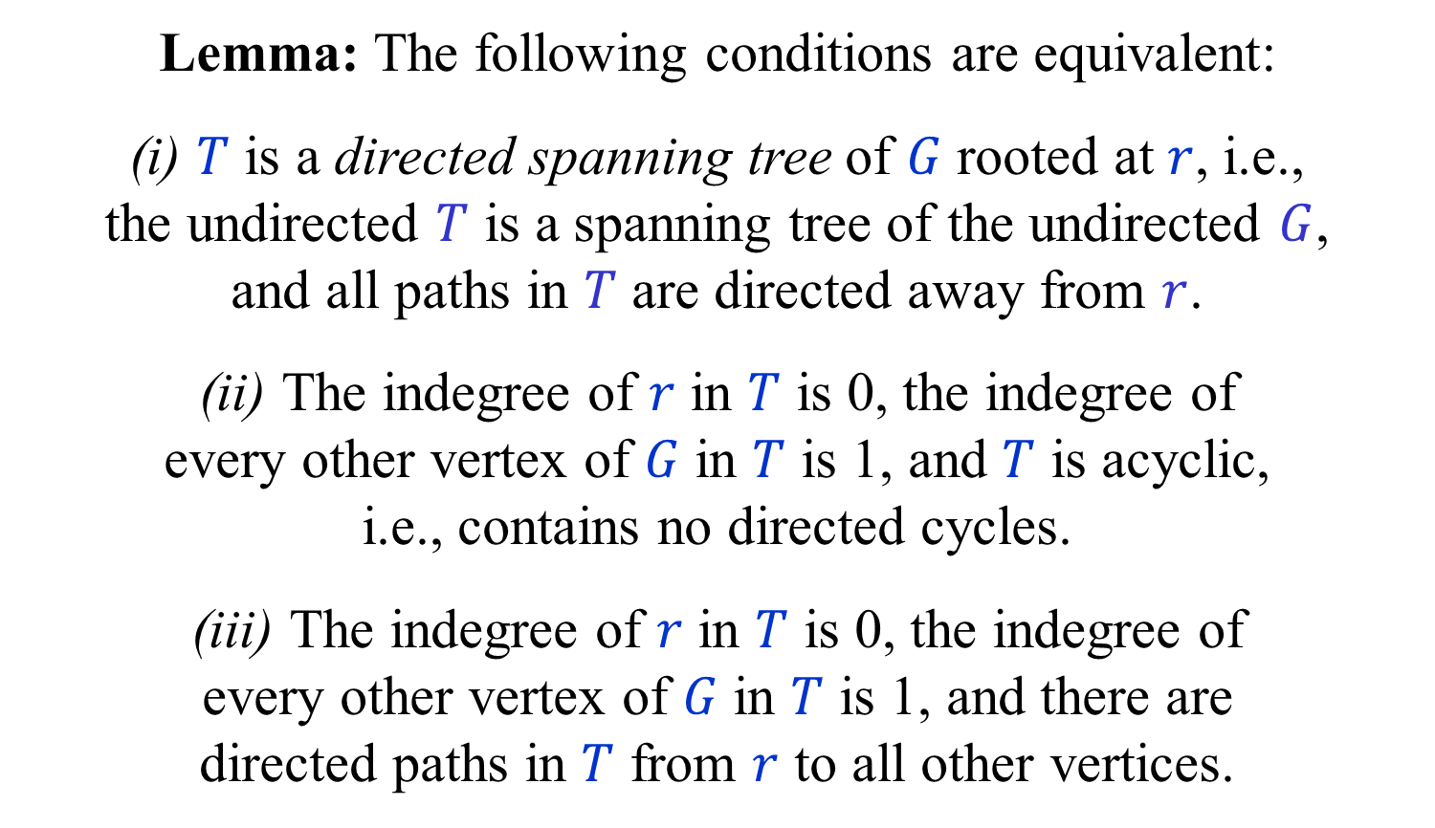
Directed Spanning Trees (DSTs)
(Also known as arborescences)
Lemma: The following conditions are equivalent:
(i) $T$ is a directed spanning tree of $G$ rooted at $r$, i.e.,
the undirected $T$ is a spanning tree of the undirected $G$,
and all paths in $T$ are directed away from $r$.
(ii) The indegree of $r$ in $T$ is 0, the indegree of
every other vertex of $G$ in $T$ is 1, and $T$ is acyclic,
i.e., contains no directed cycles.
(iii) The indegree of $r$ in $T$ is 0, the indegree of
every other vertex of $G$ in $T$ is 1, and there are
directed paths in $T$ from $r$ to all other vertices.

Slide 6
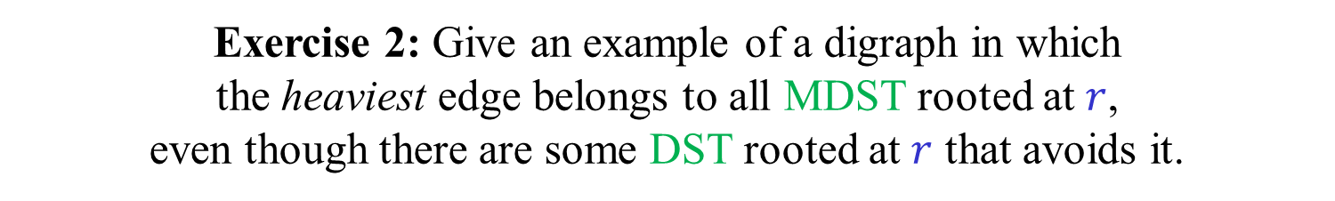
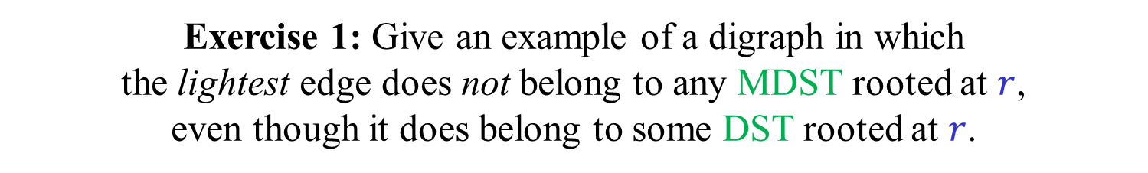
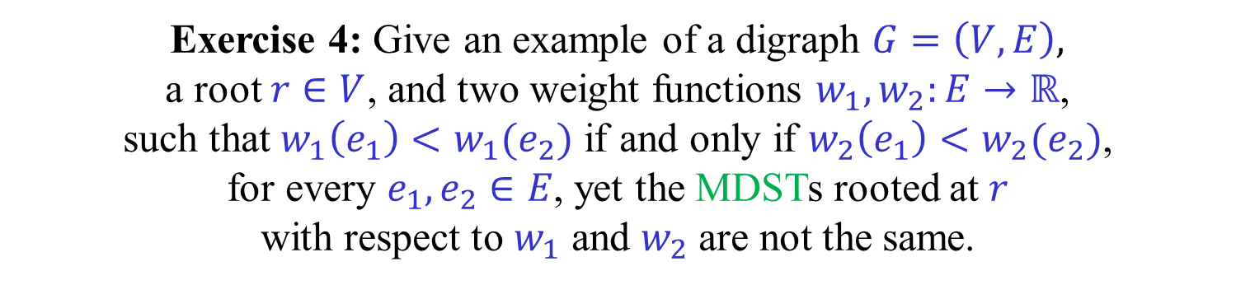
Directed cut/cycle rules?
Exercise 1: Give an example of a digraph in which
the lightest edge does not belong to any MDST rooted at $r$,
even though it does belong to some DST rooted at $r$.
Exercise 2: Give an example of a digraph in which
the heaviest edge belongs to all MDST rooted at $r$,
even though there are some DST rooted at $r$ that avoids it.
Exercise 3: Give an example of a digraph in which
all edge weights are distinct but the MDST is not unique.
Exercise 4: Give an example of a digraph $G=\left(V,E\right),$
a root $r∈V$, and two weight functions $w_{1},w_{2}:E→ℝ$,
such that $w_{1}\left(e_{1}\right)<w_{1}(e_{2})$ if and only if $w_{2}\left(e_{1}\right)<w_{2}(e_{2})$,
for every $e_{1},e_{2}∈E$, yet the MDSTs rooted at $r$
with respect to $w_{1}$ and $w_{2}$ are not the same.

Slide 7
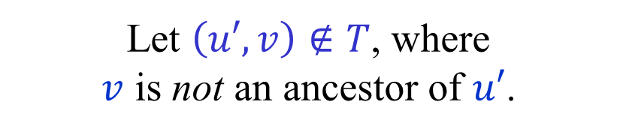






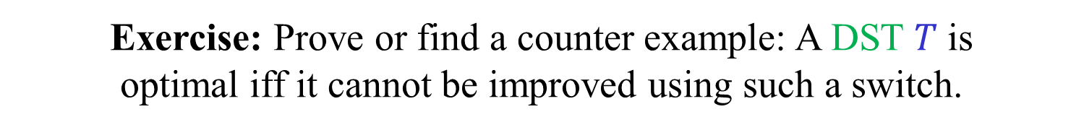

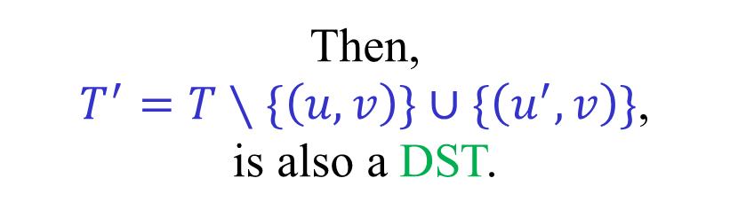
Modifying a DST
$$T$$
$$r$$
Lemma:
Let $T$ be a DST rooted at $r$.
Let $\left(u,v\right)∈T$.
$$u$$
Let $\left(u′,v\right)∉T$, where
$v$ is not an ancestor of $u′$.
Then,
$T^{′}=T∖\{\left(u,v\right)\}∪\{\left(u^{′},v\right)\}$,
is also a DST.
$$v$$
$$u′$$
Exercise: Prove or find a counter example: A DST $T$ is
optimal iff it cannot be improved using such a switch.

Slide 8
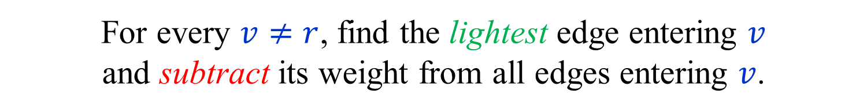
0-edges
Assume that all edge weights are non-negative.
(Otherwise, add a constant to all edge weights.)
For every $v≠r$, find the lightest edge entering $v$
and subtract its weight from all edges entering $v$.
(This does not change the MDST(s).)
Each vertex $v≠r$ now has a 0-edge entering it.
If there is a DST composed of 0-edges,
then it is of course an MDST.
Otherwise, there must be a 0-cycle.

Slide 9

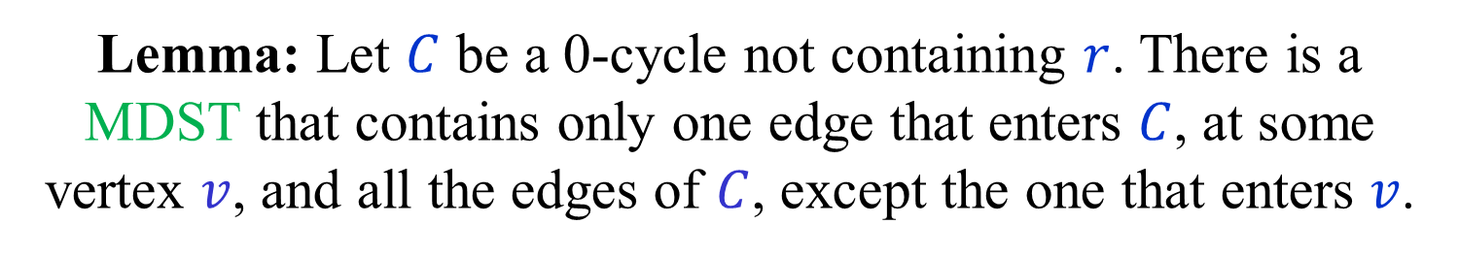


0-cycles
Lemma: Let $C$ be a 0-cycle not containing $r$. There is a MDST that contains only one edge that enters $C$, at some vertex $v$, and all the edges of $C$, except the one that enters $v$.
0
0
0
$$v$$
$$C$$
$$r$$
0
0
0

Slide 10










Let $T$ be an MDST that enters $C$ more than once.
Consider a path of $T$ from $r$ that first enters $C$ at $v_{0}$.
Let $v_{0},v_{1},…,v_{k−1},v_{k}=v_{0}$ be the vertices of $C$.
Let ${(v}_{i−1},v_{i})$be the first edge on $C$ not in $T$, where $i<k$.
Let $(u,v_{i})$be the edge of $T$ entering $v_{i}$.
$v_{i}$ is not an ancestor of $v_{i−1}$ in $T$.
Hence, $T^{′}=T∖\left\{\left(u,v_{i}\right)\right\}∪\{\left(v_{i−1},v_{i}\right)$} is a DST,
and ${w(T}^{′})≤w(T)$.
0
$$v_{i−1}$$
0
$$v_{1}$$
0
$$v_{i}$$
$$r$$
$$v_{0}$$
$$C$$
$$u$$
$$≥0$$
0
0
0
$$v_{k−1}$$

Slide 11

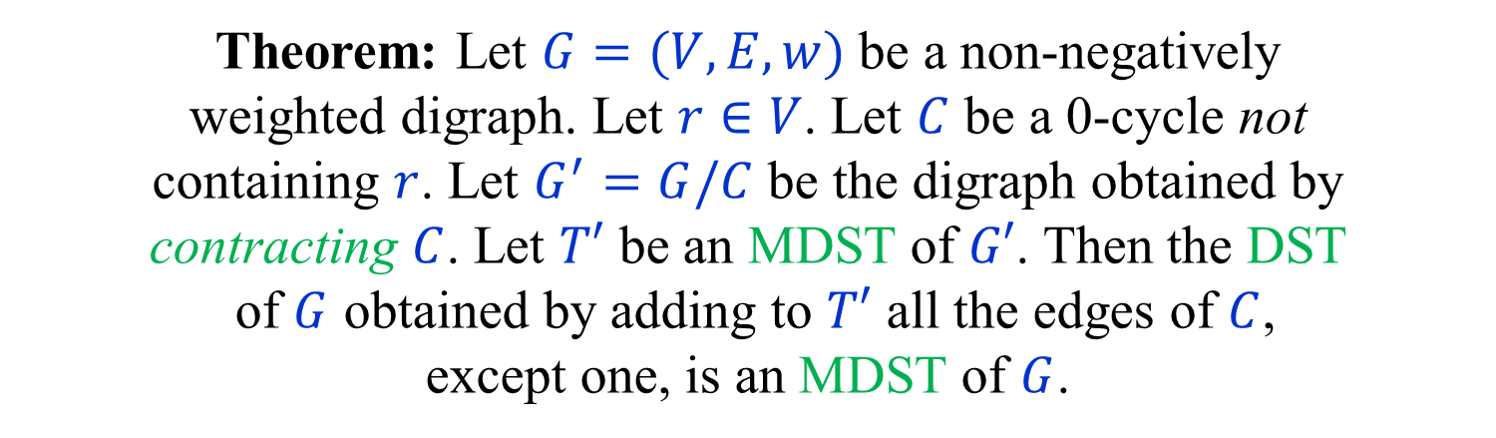

Contracting 0-cycles
Theorem: Let $G=(V,E,w)$ be a non-negatively
weighted digraph. Let $r∈V$. Let $C$ be a 0-cycle not
containing $r$. Let $G^{′}=G/C$ be the digraph obtained by
contracting $C$. Let $T′$ be an MDST of $G′$. Then the DST
of $G$ obtained by adding to $T′$ all the edges of $C$,
except one, is an MDST of $G$.
0
0
0
$$C$$
$$r$$
0
0
0

Slide 12


Contracting 0-cycles
Proof:
There is a 1-1 correspondence between DSTs of $G$
that enter $C$ only once and all DSTs of $G^{′}.$
If $T$ and $T′$ correspond to each other, then $w\left(T\right)=w(T^{′})$.
Thus $T$ is a minimal DST of $G$ satisfying the restriction
iff $T′$ is a DST of $G′$.
By the Lemma, a DST which is minimal among
the DSTs satisfying the restriction is also an MDST.
0
0
0
$$C$$
$$r$$
0
0
0

Slide 13
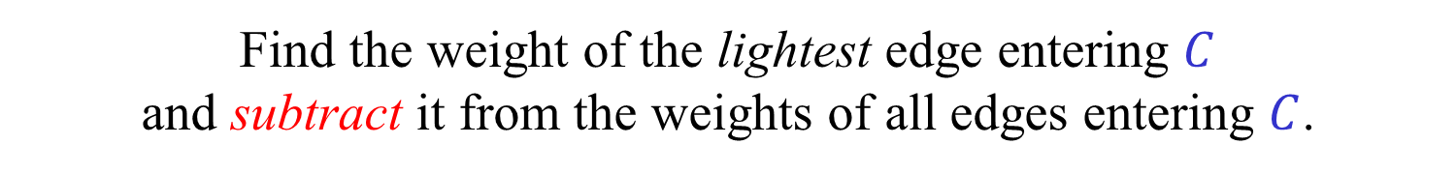
Edmonds’ algorithm
[Chin and Liu (1965)] [Edmonds (1967)] [Bock (1971)]
Assume that all edge weights are non-negative,
and that each vertex has a incoming 0-edge.
If there is a DST composed of 0-edges, we are done.
Otherwise, find a 0-cycle $C$ and contract it.
Find the weight of the lightest edge entering $C$
and subtract it from the weights of all edges entering $C$.
Recursively find an MDST in the contracted digraph
and expand it into an MDST in the original digraph.
Number of recursive calls (iterations) is at most $n$.
Simple implementation in $O(mn)$ time.

Slide 14
Minimum Directed Spanning Trees
11
0
16
22
17
5
16
0
8
0
3
1
0
13
3
0
18
30
2
0
12
12
10
25
7
9
0
2
0
15
13

Slide 15
Minimum Directed Spanning Trees
11
0
16
22
17
5
16
0
8
0
3
1
0
13
3
0
18
30
2
0
12
12
10
25
7
9
0
2
0
15
13

Slide 16
Minimum Directed Spanning Trees
11
0
16
22
17
5
16
0
8
0
3
1
0
13
3
0
18
30
2
0
5
12
12
25
10
3
0
7
9
0
2
0
15
13
6

Slide 17
Minimum Directed Spanning Trees
11
0
16
22
17
5
16
0
8
0
3
1
0
13
3
0
18
30
2
0
12
12
10
25
3
0
7
9
0
2
0
15
13
6

Slide 18

Another small example
0
1
0
$$r$$
10
0
8
0
0
2
0
All edges end up with weight 0.
But, not every DST is an MDST.
A DST is an MDST iff it enters both cycles only once.

Slide 19
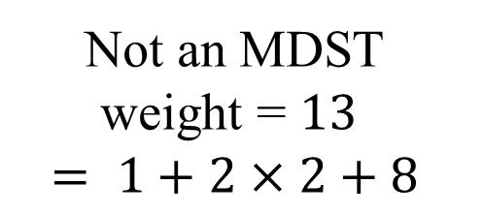
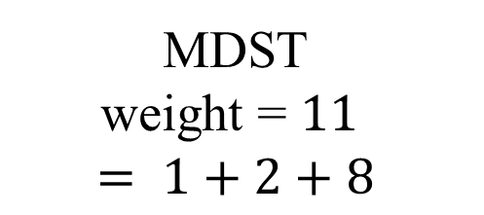


Another small example
0
1
0
MDST
weight = $11$
$$= 1+2+8$$
$$r$$
10
0
8
0
0
2
0
0
1
0
Not an MDST
weight = $13$
$$= 1+2×2+8$$
$$r$$
10
0
8
0
0
2
0

Slide 20
Expansion (undoing a contraction)
Invariant: Each contracted cycle, up to the current level,
contains exactly one edge of the final DST entering it.

Slide 21
Expansion (undoing a contraction)
At the end, each contracted cycle, at each level,
contains exactly one edge of the final DST entering it.

Slide 22
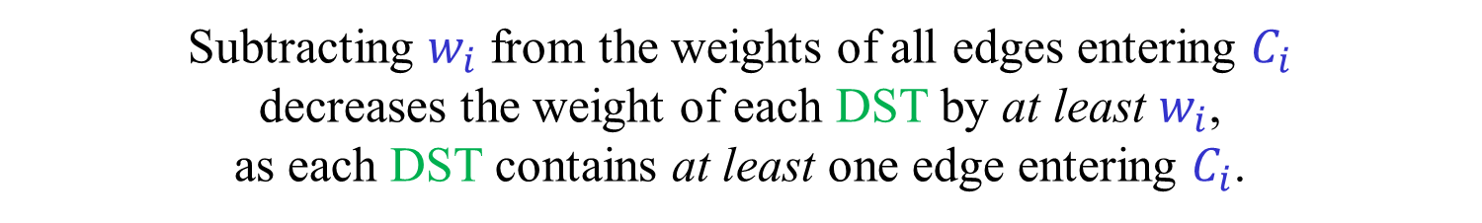
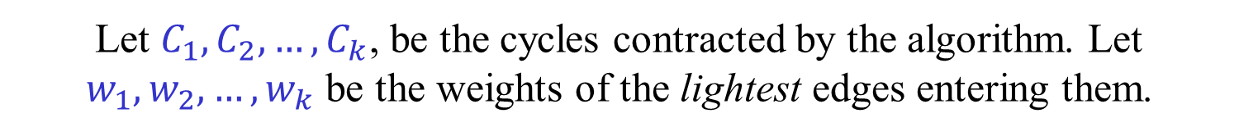
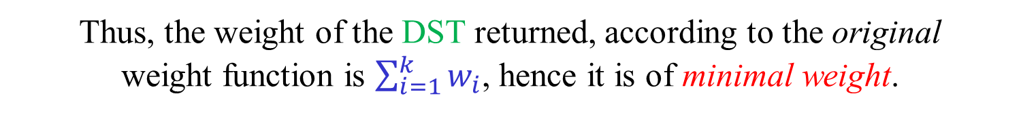

Alternative correctness proof
Let $C_{1},C_{2},…,C_{k}$, be the cycles contracted by the algorithm. Let $w_{1},w_{2},…,w_{k}$ be the weights of the lightest edges entering them.
Subtracting $w_{i}$ from the weights of all edges entering $C_{i}$
decreases the weight of each DST by at least $w_{i}$,
as each DST contains at least one edge entering $C_{i}$.
The weight of each DST of the original graph is at least $\sum_{i=1}^{k}{w_{i}}$.
The weight of the DST returned by the algorithm,
according to the final weight function, is 0.
By the invariant, for every $i$, the weight of exactly one
edge of the DST returned was decreased by $w_{i}$.
Thus, the weight of the DST returned, according to the original
weight function is $\sum_{i=1}^{k}{w_{i}}$, hence it is of minimal weight.
(As we shall see, this is LP duality at work.)

Slide 23


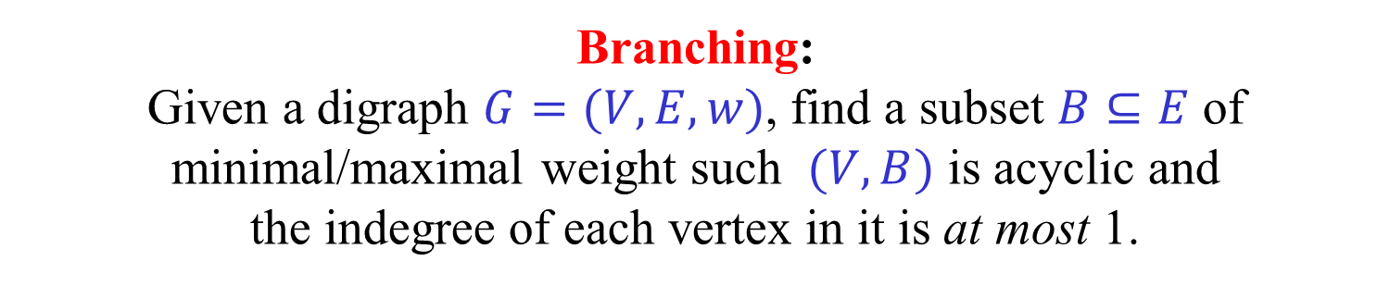
Variations
Specified root:
Given a digraph $G=\left(V,E,w\right)$ and a root $r$,
find a MDST rooted at $r$.
Unspecified root:
Given a digraph $G=(V,E,w)$,
find MDST rooted at any vertex.
Branching:
Given a digraph $G=(V,E,w)$, find a subset $B⊆E$ of minimal/maximal weight such $(V,B)$ is acyclic and
the indegree of each vertex in it is at most 1.
Exercise: Give simple reductions between the three problems.

Slide 24

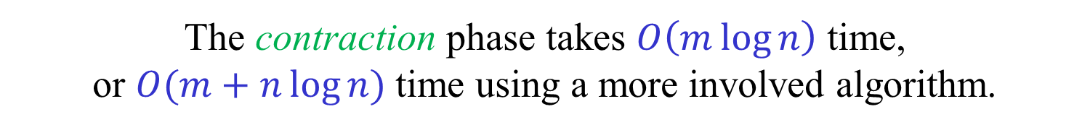

Efficient implementation
[Tarjan (1977)] [Gabow-Galil-Spencer-Tarjan (1987)]
The algorithm is composed of a contraction phase,
followed by an expansion phase.
We describe a version of the contraction phase
that does not depend on the root $r$.
The same contraction phase can be used
to find MDST with different roots.
The contraction phase takes $O\left(m\log{n}\right)$ time,
or $O(m+n\log{n})$ time using a more involved algorithm.
The expansion phase,
for a given root $r,$takes only $O\left(n\right)$ time.

Slide 25

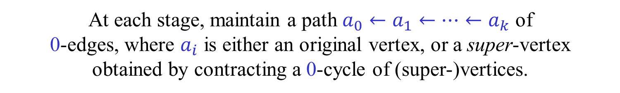
Contraction phase
[Tarjan (1977)] [Gabow-Galil-Spencer-Tarjan (1987)]
Assume, for simplicity, that the digraph is strongly connected.
At each stage, maintain a path $a_{0}←a_{1}←…←a_{k}$ of
0-edges, where $a_{i}$ is either an original vertex, or a super-vertex
obtained by contracting a 0-cycle of (super-)vertices.
Initially, the path is composed of an arbitrary vertex $a_{0}=a$.
The contraction phase ends when there is only one super-vertex.
For each (super-)vertex $a$ we maintain a meldable
heap $P\left[a\right]$ containing all its incoming edges.
The key of each edge is its current weight.
Contractions are done implicitly using
a union-find data structure.
The heaps may contain self-loops and parallel edges.
We will also need a way to update weights.

Slide 26



Growing a path and contracting
[Tarjan (1977)] [Gabow-Galil-Spencer-Tarjan (1987)]
Let $a_{0}←a_{1}←…←a_{k}=a$ be the current path.
Extract the lightest edge $\left(u,v\right)←ExtractMin(P\left[a\right])$ entering $a$.
If $find\left(a\right)=find(u)$, extract the next edge and repeat.
Subtract $w(u,v)$ from the weights of all edges entering $a$.
If ${u∉a}_{0},a_{1},…,a_{k}$, extend the path
by letting ${a←a}_{k+1}←u$ and $k←k+1$.
If ${u∈a}_{i}$, create a new super-vertex $c$ by contracting
the cycle $a_{i},a_{i+1},…,a_{k}$ and let ${a←a}_{i}←c$ , $k←i$.
The heap $P[c]$ is obtained by melding ${P[a}_{i}],{P[a}_{i+1}],…,{P[a}_{k}]$.
Update the union-find data structure so that
$find(u)$ returns $c$for any vertex $u∈c$.

Slide 27












Growing a path and contracting
$$a$$
Self-loop:
$$u$$
$$v$$
$$a$$
Growth:
$$v$$
$$u$$
$$c$$
$$d$$
$$b$$
$$a$$
$$u$$
$$v$$
Contraction:

Slide 28








































Contraction phase – An example
$$n$$
$$c$$
$$g$$
$$l$$
$$m$$
$$a$$
$$b$$
$$d$$
$$e$$
$$f$$
$$i$$
$$j$$
$$k$$
$$h$$
Contraction tree
$$n$$
$$in\left[a\right]=(b,a)$$
$$in\left[h\right]=(i,b)$$
$$in\left[b\right]=(a,b)$$
$$in\left[i\right]=(j,i)$$
$$h$$
$$in\left[c\right]=(d,b)$$
$$in\left[j\right]=(k,j)$$
$$in\left[d\right]=(e,d)$$
$$in\left[k\right]=(i,k)$$
$$c$$
$$g$$
$$l$$
$$in\left[e\right]=(f,e)$$
$$in\left[l\right]=(m,j)$$
$$in\left[f\right]=(d,f)$$
$$in\left[m\right]=(f,m)$$
$$a$$
$$b$$
$$d$$
$$e$$
$$f$$
$$i$$
$$j$$
$$k$$
$$m$$
$$in\left[g\right]=(b,e)$$

Slide 29

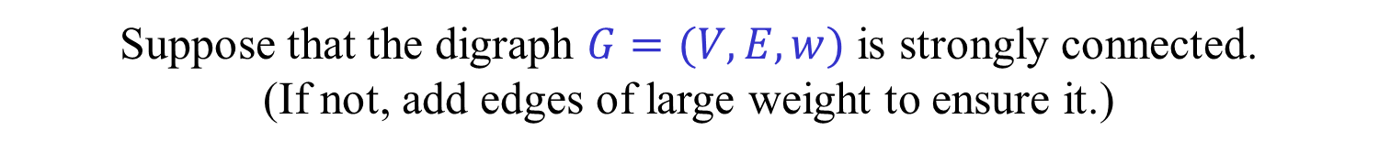


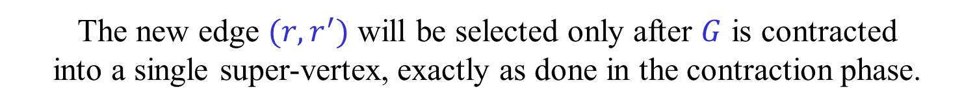

Contraction phase
Why can we ignore the root $r$ during the contraction phase?
Suppose that the digraph $G=(V,E,w)$ is strongly connected.
(If not, add edges of large weight to ensure it.)
Add an auxiliary root $r′$ and an edge $\left(r,r^{′}\right)$ of huge weight $M$.
The MDST rooted at $r′$ is the MDST rooted at $r$ plus $(r^{′},r)$.
Run Edmonds’ algorithm on the new graph $G′$.
The new edge $(r,r^{′})$ will be selected only after $G$ is contracted
into a single super-vertex, exactly as done in the contraction phase.
$$G$$
$$r′$$
$$r$$
$$M$$

Slide 30







Expansion phase – An example
$$n$$
$$c$$
$$g$$
$$l$$
$$m$$
$$a$$
$$b$$
$$d$$
$$e$$
$$f$$
$$i$$
$$j$$
$$k$$
$$h$$
$$n$$
$$in\left[a\right]=(b,a)$$
$$in\left[h\right]=(i,b)$$
$$in\left[b\right]=(a,b)$$
$$in\left[i\right]=(j,i)$$
$$h$$
$$in\left[c\right]=(d,b)$$
$$in\left[j\right]=(k,j)$$
$$in\left[d\right]=(e,d)$$
$$in\left[k\right]=(i,k)$$
$$c$$
$$g$$
$$l$$
$$in\left[e\right]=(f,e)$$
$$in\left[l\right]=(m,j)$$
$$in\left[f\right]=(d,f)$$
$$in\left[m\right]=(f,m)$$
$$a$$
$$b$$
$$d$$
$$e$$
$$f$$
$$i$$
$$j$$
$$k$$
$$m$$
$$in\left[g\right]=(b,e)$$
$$in\left[n\right]=(−,e)$$

Slide 31

Expansion phase – An example
$$n$$
$$c$$
$$g$$
$$l$$
$$m$$
$$a$$
$$b$$
$$d$$
$$e$$
$$f$$
$$i$$
$$j$$
$$k$$
$$h$$
$$n$$
$$in\left[a\right]=(b,a)$$
$$in\left[h\right]=(−,e)$$
$$in\left[b\right]=(a,b)$$
$$in\left[i\right]=(j,i)$$
$$h$$
$$in\left[c\right]=(d,b)$$
$$in\left[j\right]=(k,j)$$
$$in\left[d\right]=(e,d)$$
$$in\left[k\right]=(i,k)$$
$$c$$
$$g$$
$$l$$
$$in\left[e\right]=(f,e)$$
$$in\left[l\right]=(m,j)$$
$$in\left[f\right]=(d,f)$$
$$in\left[m\right]=(f,m)$$
$$a$$
$$b$$
$$d$$
$$e$$
$$f$$
$$i$$
$$j$$
$$k$$
$$m$$
$$in\left[g\right]=(b,e)$$
$$in\left[n\right]=(−,e)$$

Slide 32

Expansion phase – An example
$$c$$
$$g$$
$$l$$
$$m$$
$$a$$
$$b$$
$$d$$
$$e$$
$$f$$
$$i$$
$$j$$
$$k$$
$$h$$
$$in\left[a\right]=(b,a)$$
$$in\left[h\right]=(−,e)$$
$$in\left[b\right]=(a,b)$$
$$in\left[i\right]=(j,i)$$
$$h$$
$$in\left[c\right]=(d,b)$$
$$in\left[j\right]=(k,j)$$
$$in\left[d\right]=(e,d)$$
$$in\left[k\right]=(i,k)$$
$$c$$
$$g$$
$$l$$
$$in\left[e\right]=(f,e)$$
$$in\left[l\right]=(m,j)$$
$$in\left[f\right]=(d,f)$$
$$in\left[m\right]=(f,m)$$
$$a$$
$$b$$
$$d$$
$$e$$
$$f$$
$$i$$
$$j$$
$$k$$
$$m$$
$$in\left[g\right]=(−,e)$$

Slide 33

Expansion phase – An example
$$c$$
$$g$$
$$l$$
$$m$$
$$a$$
$$b$$
$$d$$
$$e$$
$$f$$
$$i$$
$$j$$
$$k$$
$$in\left[a\right]=(b,a)$$
$$in\left[b\right]=(a,b)$$
$$in\left[i\right]=(j,i)$$
$$in\left[c\right]=(d,b)$$
$$in\left[j\right]=(k,j)$$
$$in\left[d\right]=(e,d)$$
$$in\left[k\right]=(i,k)$$
$$c$$
$$g$$
$$l$$
$$in\left[e\right]=(−,e)$$
$$in\left[l\right]=(m,j)$$
$$in\left[f\right]=(d,f)$$
$$in\left[m\right]=(f,m)$$
$$a$$
$$b$$
$$d$$
$$e$$
$$f$$
$$i$$
$$j$$
$$k$$
$$m$$
$$in\left[g\right]=(−,e)$$

Slide 34


Expansion phase – An example
$$c$$
$$l$$
$$m$$
$$a$$
$$b$$
$$d$$
$$e$$
$$f$$
$$i$$
$$j$$
$$k$$
$$in\left[a\right]=(b,a)$$
$$in\left[b\right]=(d,b)$$
$$in\left[i\right]=(j,i)$$
$$in\left[c\right]=(d,b)$$
$$in\left[j\right]=(k,j)$$
$$in\left[d\right]=(e,d)$$
$$in\left[k\right]=(i,k)$$
$$c$$
$$l$$
$$in\left[e\right]=(−,e)$$
$$in\left[l\right]=(m,j)$$
$$in\left[f\right]=(d,f)$$
$$in\left[m\right]=(f,m)$$
$$a$$
$$b$$
$$d$$
$$e$$
$$f$$
$$i$$
$$j$$
$$k$$
$$m$$

Slide 35


Expansion phase – An example
$$l$$
$$m$$
$$a$$
$$b$$
$$d$$
$$e$$
$$f$$
$$i$$
$$j$$
$$k$$
$$in\left[a\right]=(b,a)$$
$$in\left[b\right]=(d,b)$$
$$in\left[i\right]=(j,i)$$
$$in\left[j\right]=(m,j)$$
$$in\left[d\right]=(e,d)$$
$$in\left[k\right]=(i,k)$$
$$l$$
$$in\left[e\right]=(−,e)$$
$$in\left[l\right]=(m,j)$$
$$in\left[f\right]=(d,f)$$
$$in\left[m\right]=(f,m)$$
$$a$$
$$b$$
$$d$$
$$e$$
$$f$$
$$i$$
$$j$$
$$k$$
$$m$$

Slide 36













$$e$$
$$a$$
$$b$$
$$e$$
$$i$$
$$h$$
$$e_{3}$$
$$c$$
$$d$$
$$g$$
$$e_{2}$$
$$f$$
$$e_{1}$$
Edge $e$ eliminates $e_{1},e_{2},e_{3}$.

Slide 37
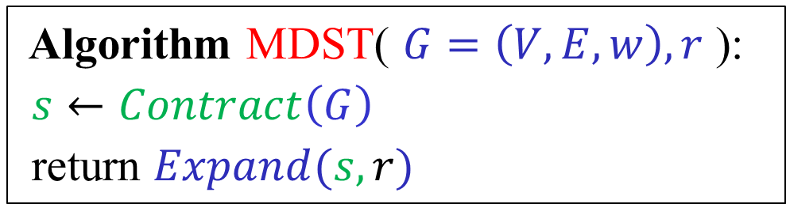
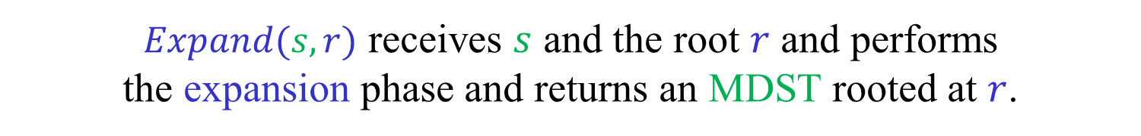

Algorithm MDST( $G=\left(V,E,w\right),r$ ):
$s←Contract\left(G\right)$
return $Expand(s,r)$
$s←Contract(G)$ performs the contraction phase,
returning the resulting super-vertex $s$.
$Expand(s,r)$ receives $s$ and the root $r$ and performs
the expansion phase and returns an MDST rooted at $r$.

Slide 38
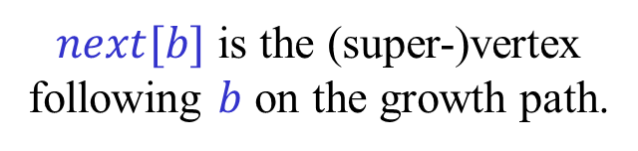
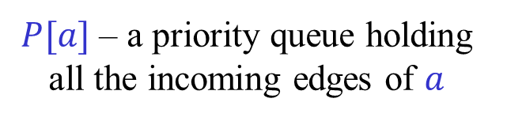
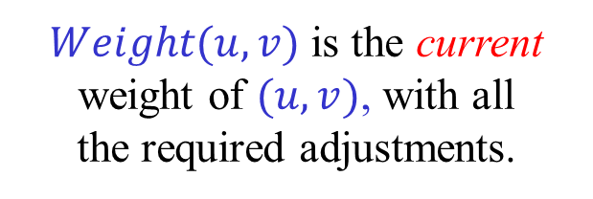
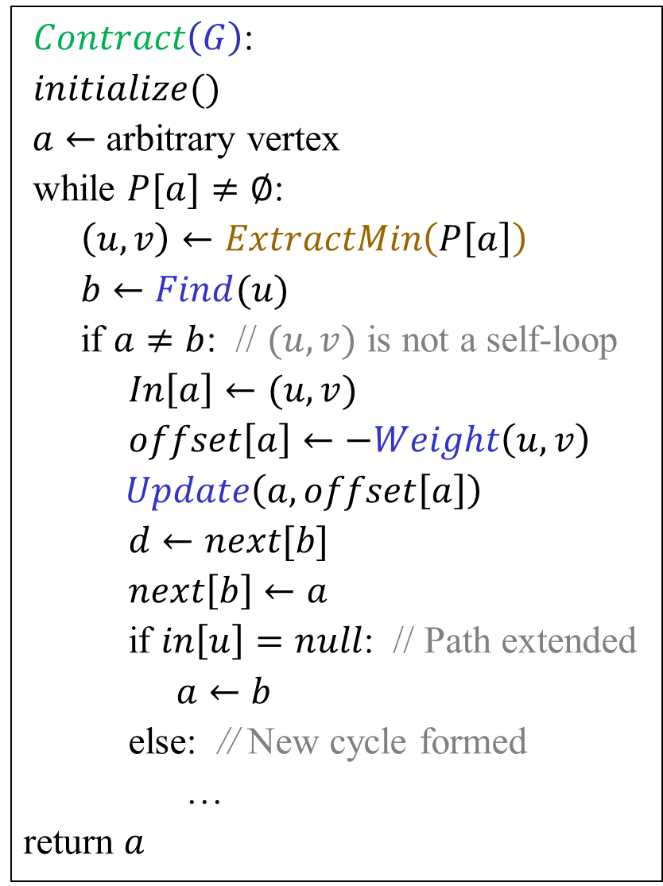
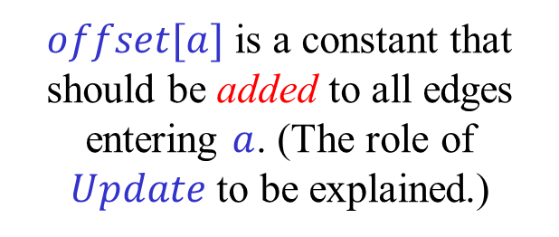

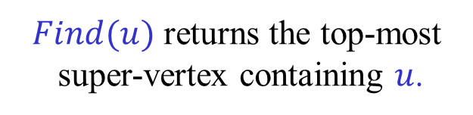
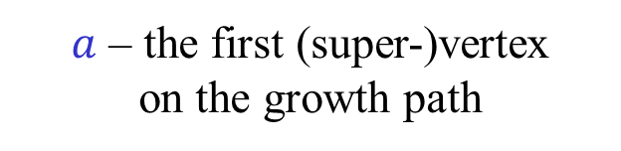
$Contract\left(G\right)$:
$initialize()$
$a←$ arbitrary vertex
while $P[a]≠∅$:
$\left(u,v\right)←ExtractMin\left(P\left[a\right]\right)$
$b←Find(u)$
if $a≠b$: // $(u,v)$ is not a self-loop
$In\left[a\right]←(u,v)$
$offset\left[a\right]←−Weight\left(u,v\right)$
$Update\left(a,offset\left[a\right]\right)$
$d←next[b]$
$next\left[b\right]←a$
if $in\left[u\right]=null$: // Path extended
$a←b$
else: // New cycle formed
…
return $a$
$a$ – the first (super-)vertex
on the growth path
$P[a]$ – a priority queue holding
all the incoming edges of $a$
$Find(u)$ returns the top-most
super-vertex containing $u$.
$in[a]$ is a 0-edge entering $a$.
$offset[a]$ is a constant that should be added to all edges entering $a$. (The role of $Update$ to be explained.)
$Weight(u,v)$ is the current
weight of $(u,v)$, with all
the required adjustments.
$next[b]$ is the (super-)vertex
following $b$ on the growth path.

Slide 39
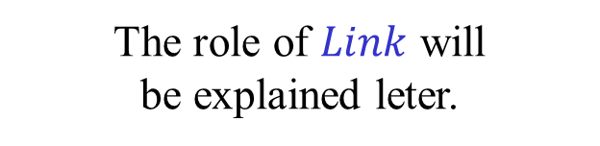
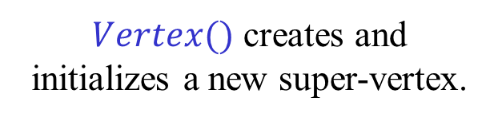
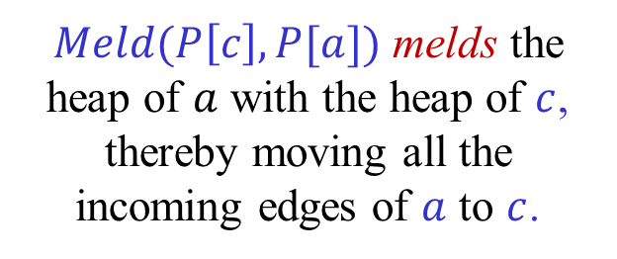
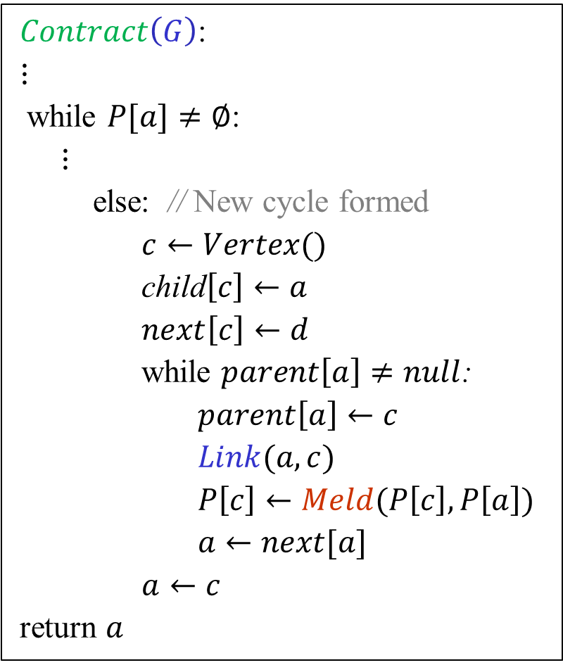
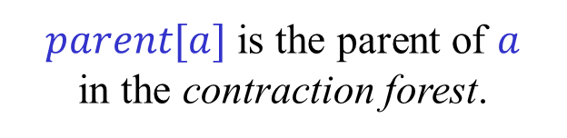
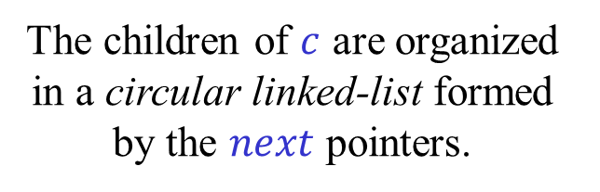
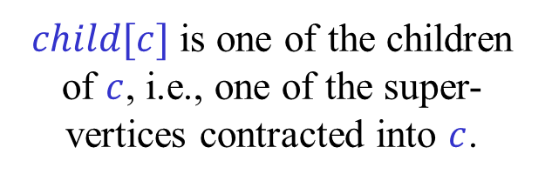
$Contract\left(G\right)$:
$⋮$
while $P[a]≠∅$:
$⋮$
else: // New cycle formed
$c←Vertex()$
child$\left[c\right]←a$
$next\left[c\right]←d$
while $parent\left[a\right]≠null$:
$parent\left[a\right]←c$
$Link(a,c)$
$P\left[c\right]←Meld(P\left[c\right],P\left[a\right])$
$a←next[a]$
$a←c$
return $a$
$Vertex()$ creates and
initializes a new super-vertex.
$child[c]$ is one of the children of $c$, i.e., one of the super-vertices contracted into $c$.
The children of $c$ are organized in a circular linked-list formed by the $next$ pointers.
$parent[a]$ is the parent of $a$
in the contraction forest.
The role of $Link$ will
be explained leter.
$Meld(P\left[c\right],P[a])$ melds the heap of $a$ with the heap of $c$, thereby moving all the incoming edges of $a$ to $c$.
Tested and corrected by Orr Fischer.

Slide 40
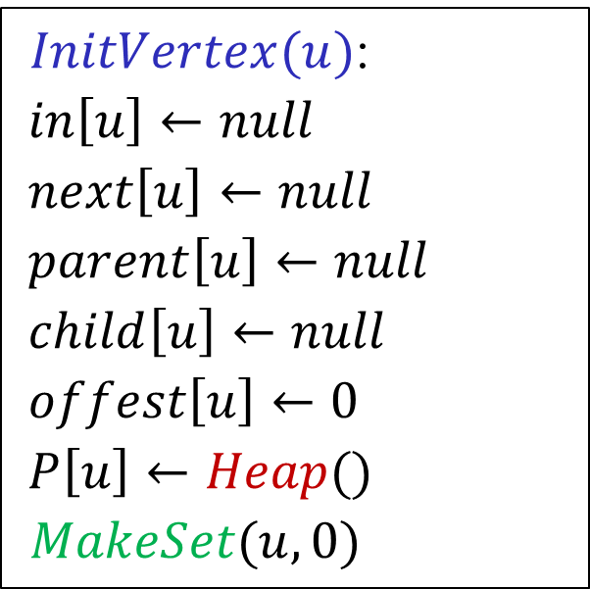
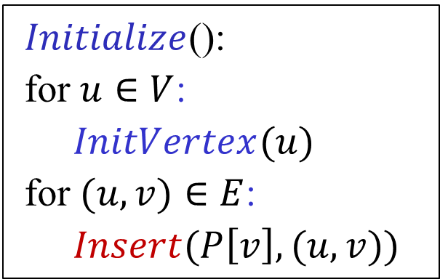
$Initialize$():
for $u∈V$:
$InitVertex(u)$
for $(u,v)∈E$:
$Insert(P\left[v\right],(u,v))$
$InitVertex(u)$:
$in\left[u\right]←null$
$next\left[u\right]←null$
$parent\left[u\right]←null$
$child\left[u\right]←null$
$offest\left[u\right]←0$
$P\left[u\right]←Heap()$
$MakeSet(u,0)$

Slide 41
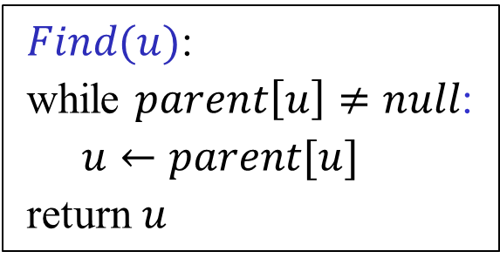
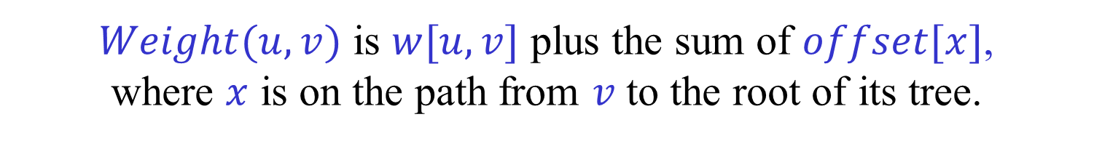

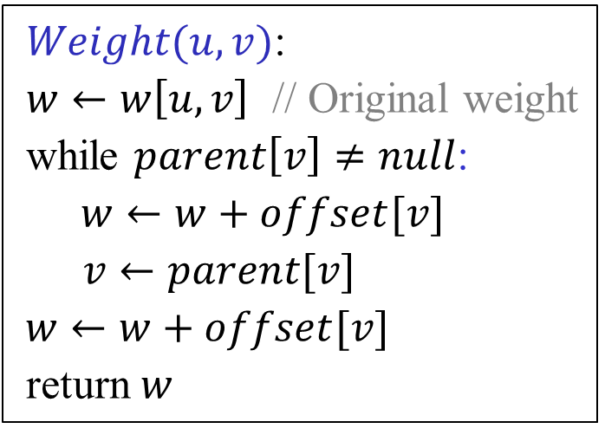
Naïve implementation of $Find$ and $Weight$
$Find(u)$:
while $parent\left[u\right]≠null$:
$u←parent[u]$
return $u$
$Weight(u,v)$:
$w←w\left[u,v\right]$ // Original weight
while $parent\left[v\right]≠null$:
$w←w+offset[v]$
$v←parent[v]$
$w←w+offset[v]$
return $w$
More efficient implementation to follow.
$Weight(u,v)$ is $w[u,v]$ plus the sum of $offset[x]$,
where $x$ is on the path from $v$ to the root of its tree.
$$Weight\left(u,v\right)=w\left[u,v\right]+Eval(v)$$

Slide 42
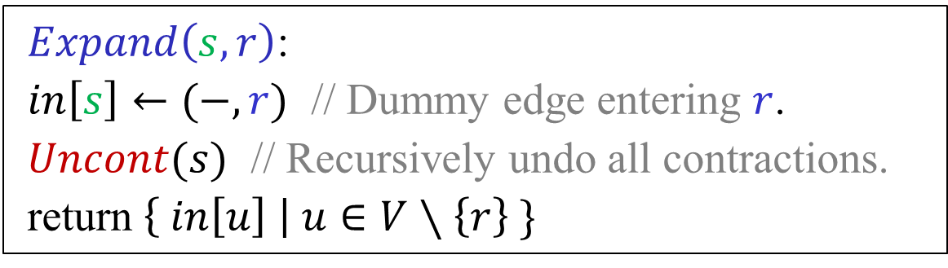
$Expand\left(s,r\right)$:
$in\left[s\right]←(−,r)$ // Dummy edge entering $r$.
$Uncont(s)$ // Recursively undo all contractions.
return $\left\{ in\left[u\right] \right| u∈V∖\left\{r\right\} \}$

Slide 43
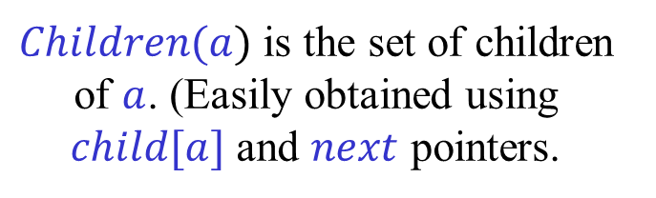

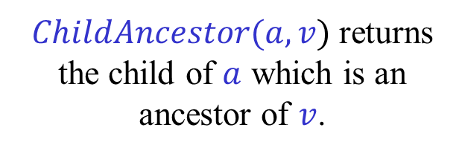
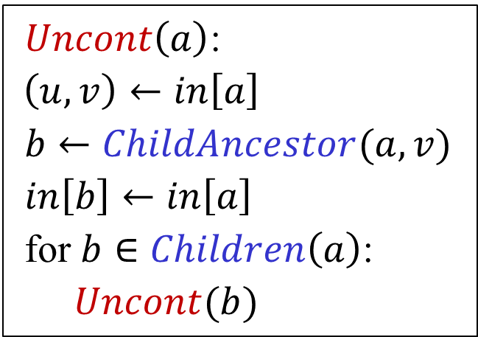

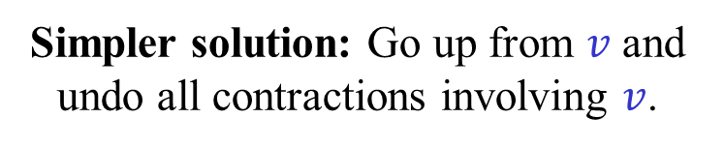

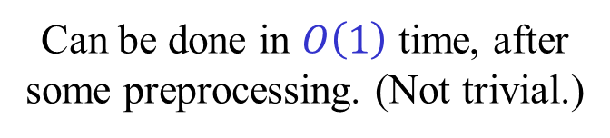

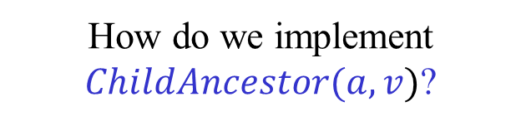
Undoing contractions (Version 1)
$v$ is a descendant of $a$.
$Uncont\left(a\right)$:
$\left(u,v\right)←in\left[a\right]$
$b←ChildAncestor(a,v)$
$in\left[b\right]←in\left[a\right]$
for $b∈Children\left(a\right)$:
$Uncont(b)$
$ChildAncestor(a,v)$ returns the child of $a$ which is an ancestor of $v$.
$Children(a)$ is the set of children of $a$. (Easily obtained using $child[a]$ and $next$ pointers.
$$a$$
How do we implement $ChildAncestor(a,v)$?
$$v$$
Can be done in $O\left(1\right)$ time, after some preprocessing. (Not trivial.)
$$b$$
Simpler solution: Go up from $v$ and undo all contractions involving $v$.

Slide 44
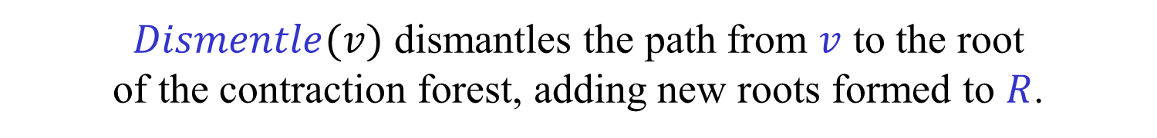



Undoing contractions (Version 2)
$Uncont\left(s\right)$:
$R←\{s\}$ // Roots of contraction forest
while $R≠∅$:
$c←Extract(R)$
$\left(u,v\right)←in[c]$
$in\left[v\right]←\left(u,v\right)$
$Dismentle(v)$
$$c$$
$$v$$
$Dismentle(v)$ dismantles the path from $v$ to the root
of the contraction forest, adding new roots formed to $R$.
End result identical to the one obtained by the previous version.

Slide 45



$Dismentle\left(u\right)$:
while $parent\left[u\right]≠null$:
$v←next[u]$
while $v≠u$:
$parent\left[v\right]←null$
$Insert(R,v)$
$u,parent\left[u\right]←parent\left[u\right],null$
The code above does not destroy the super-vertices containing $u$.
Easy to add it, making sure that original vertices are not destroyed.
The code above not use $child$ pointes, so they are not really needed.
If they are available, we can Insert $v$ to $R$ only if $child\left[v\right]≠null$.

Slide 46



Meldable Heaps with implicit keys
We need meldable heaps, i.e., heaps
that support $Insert$, $Meld$ and $ExtractMin$.
$DecreaseKey$ operations are not needed (yet).
For the time being, we can use Binomial heaps.
$Insert$, $Meld$ in $O\left(\log{n}\right)$ time ($O\left(1\right)$ amortized time).
$ExtractMin$ in $O(\log{n})$ time.
But, we need to change the weights = keys of edges.
Can we still use standard data structures?
The keys of all edges in a heap change by the same amount.
Hence, all order relations are presetved.
Thus, any comparison-based data structure that does not
store keys explicitly, but calls $Weight$ to compute
keys, when needed, still works correctly.

Slide 47




LINK-EVAL-UPDATE
To obtain a faster implementation of $Find$ and $Weight$ use a
data structure that maintains a forest under the following operations:
$MakeSet(u,x)$ – Make $u$ into a singleton tree, with value $x$.
$Link(u,v)$ – Make $u$ a child of $v$.
(Both $u$ and $v$ are assumed to be roots.)
$Find(u)$ – Return the root of the tree currently containing $u$.
$Eval(u)$ – Return the sum of the values of the nodes
on the path from $u$ to the root of its tree.
$Update(u,x)$ – Add $x$ to the value of a root $u$.
Generalization (not needed for our purposes):
Replace sum by other operations, such as $max$.

Slide 48



LINK-EVAL-UPDATE
Can we use the fast $Union$-$Find$ data structure,
which uses union by rank and path compression?
We need to maintain the roots of the trees.
We need to compute sum of values on the path to the root.
With some small modifications, we can still use the
union by rank and path compression techniques.
Thus, the (non-trivial) analysis of $Union$-$Find$ applies.
A sequence of $m$ operations on $n$ items
requires $O(m α\left(m,n\right))$ time.
In our case, the number of operations is $O\left(m\log{n}\right)$ or
$O(m+n\log{n})$, so the amortized cost of each operation is $O(1)$.

Slide 49








Path Compression
$$x_{1}$$
$$x_{1}$$
$$x_{2}$$
$$x_{2}$$
$$x_{3}$$
$${x_{2}+x}_{3}$$
$$x_{4}$$
$${x_{2}+x}_{3}+x_{4}$$

Slide 50





Virtual trees
Let $val(u)$ be the value of node $u$.
Let $sum_{T}(u)$ be the sum of the values of the
nodes on the path from $u$ to the root of $T$.
Each original tree $T$ is represented by a virtual tree $T^{′}$,
containing the same nodes but not necessarily the same root.
For every node $u$ in $T$, $sum_{T}\left(u\right)=sum_{T′}(u)$.
The root of $T′$ has a pointer to the root of $T$.
$$T$$
3
a
$$T′$$
c
5
7
b
c
2
$$−2$$
a
5
b
d
4
d
4

Slide 51

























Link by rank
Let $u^{′},v′$ be the roots of the virtual trees of $u,v$.
$$v$$
$$y$$
Perform $Eval(u)$ and $Eval(v)$.
$$u$$
$$x$$
Now either $u^{′}=u$ or $u$ is a child of $u′$.
Similarly for $v$ and $v′$.
(Assume $u≠u′$ , $v≠v′$.)
If $rank\left(u^{′}\right)≤rank(v^{′})$:
If $rank\left(u^{′}\right)>rank(v^{′})$:
$$y′$$
$$x′$$
$$+ val\left(v\right)+val(v^{′})$$
$$x′$$
$$+val(v)$$
$$v′$$
$$u′$$
$$u′$$
$$v′$$
$$y′$$
$$− val\left(u′\right)$$
$$v$$
$$u$$
$$u$$
$$v$$
new value
Luckily, we can use subtractions.

Slide 52


LP formulation of MDST
$\min{ \sum_{e∈E}{w\left(e\right)x_{e}}}$
s.t. $\sum_{e∈δ_{in} (S)}{x_{e}}≥1$ , $∅≠S⊆V∖\{r\}$
$x_{e}≥0$ , $e∈E$
(Primal)
$\max{ \sum_{∅≠S⊆V∖\{r\}}{y_{S}}}$
s.t. $\sum_{e∈δ_{in} (S)}{y_{S}}≤w(e)$ , $e∈E$
$y_{S}≥0$ , $∅≠S⊆V∖\{r\}$
(Dual)
Assuming $w\left(e\right)≥0$ for every $e∈E$.
$$δ_{in}\left(S\right)=E\left(\overline{S},S\right)=\left\{ \left(u,v\right)∈E \right| u∉S , v∈S \}$$

Slide 53

LP formulation of MDST
$\min{ \sum_{e∈E}{w\left(e\right)x_{e}}}$
s.t. $\sum_{e∈δ_{in} (S)}{x_{e}}≥1$ , $∅≠S⊆V∖\{r\}$
$x_{e}≥0$ , $e∈E$
(Primal)
$\max{ \sum_{∅≠S⊆V∖\{r\}}{y_{S}}}$
s.t. $\sum_{e∈δ_{in} (S)}{y_{S}}≤w(e)$ , $e∈E$
$y_{S}≥0$ , $∅≠S⊆V∖\{r\}$
(Dual)
Weak duality:
$$\sum_{S}{y_{S}} ≤ \sum_{S}{y_{S}\sum_{e∈δ_{in}\left(S\right)}{x_{e}}} = \sum_{e∈E}{x_{e}\sum_{e∈δ_{in}\left(S\right)}{y_{S}}} ≤ \sum_{e∈E}{w\left(e\right)x_{e}}$$

Slide 54
LP formulation of MDST
How do we know that the primal LP also has an
optimal 0,1 solution that corresponds to an MDST?
All the constraints of the primal LP are clearly necessary. Thus, the
value of the primal LP is a lower bound on the weight of an MDST.
Edmonds’ algorithm produces a feasible 0,1 solution of the primal
and a feasible solution of the dual of equal objective values.
By weak duality, they are both optimal.
Thus, this is indeed the LP formulation of the problem.
Furthermore, if all the weights are integral,
there is an integral optimal dual solution.
The system is therefore Total Dual Integral (TDI).

Slide 55

Certificate of optimality
The optimal dual solution produced by Edmonds’ algorithm
can be used as a certificate of optimality.
The certificate can be checked in $O(m+n)$ time,
faster than the time needed to find an DMST.
The certificate is given in the form of a contraction forest,
with the corresponding offset = dual value attached to each node.
To check the certificate we need to answer
(off-line) LCA queries and compute sums along paths.
Can we hope to get a linear time verification algorithm?
Not likely, see below.

Slide 56



















Contraction forest as a certificate
The leaves are the original vertices of the graph.
The non-leaves are super-vertices = cuts.
The parent of a node is the node into which it was contracted.
(The cuts used in the dual form a laminar family.)
To each node we attach the offset added to edges entering it.
What is the final weight of an edge $(u,v)$?
The original weight of $(u,v)$ plus the
sum of the offsets from $v$ to $LCA(u,v)$,
not including the offset of $LCA(u,v)$.
$$n$$
$$h$$
Check that the modified weight of all tree edges
is 0, and that all modified weights are non-negative.
$$c$$
$$g$$
$$l$$
$$q$$
$$a$$
$$b$$
$$d$$
$$e$$
$$f$$
$$i$$
$$j$$
$$k$$
$$m$$
$$o$$
$$p$$
$$r$$

Slide 57






Shortest Path → MDST
Let $G=(V,E,w)$ be a positively weighted directed graph.
Let $s,t∈V$. Want to find a shortest path from $s$ to $t$.
Add 0-edges from $t$ to all vertices of $G$.
An MDST is composed of a shortest path $P$ from $s$ to $t$,
and 0-edge from $t$ to all vertices not on $P$.
$$G$$
$$0$$
$$s$$
$$t$$
$$0$$
((Re-)discovered by Shiri Chechik.)

Slide 58
Bonus material
Not covered in class this term
“Careful. We don’t want to learn from this.”
(Bill Watterson, “Calvin and Hobbes”)

Slide 59
More efficient implementation
[Gabow-Galil-Spencer-Tarjan (1987)]
The current algorithm runs in $O\left(m\log{n}\right)$ time.
In the worst case, each edge is inserted and deleted from a heap.
Can we reduce the number of insertions and deletions?
Remove self-loops and parallel edges as soon as they occur.
Heaps hold vertices rather than edges.
Each vertex is in at most one heap.
For each vertex maintain an exit list holding,
in order, its edges to the growth path. (No parallel edges.)
The last edge on an exit list is active.
All other edges in exit lists are passive.
The tail of an active edge is in a heap.
For each vertex on the growth path, maintain
a passive set, holding the passive edges entering it.

Slide 60





Exit lists, active and passive edges
[Gabow-Galil-Spencer-Tarjan (1987)]
$$a_{0}$$
$$a_{1}$$
$$a_{2}$$
$$a_{k−1}$$
The growth path
$$u$$
Each vertex $u$ has an exit list holding, in order, its edges to the path.
Only the lightest edge from $u$ to $a_{i}$, if any, is in the exit list.
The exit list of $a_{i}$ only holds edges to vertices preceding it on the path.
The last edge on an exit list is active. All other edges are passive.
If $\left(u,v\right)$ is active, and $v∈a_{i}$, then $u∈P[a_{i}]$ with key $Weight(u,v)$.
For each $a_{i}$, $Passive[a_{i}]$ is the set of passive edges entering $a_{i}$.

Slide 61






Extension
$${v=a}_{k}$$
$$a_{0}$$
$$a_{1}$$
$$a_{k−1}$$
$$b=u$$
Let $v←ExtractMin(P\left[a_{k−1}\right])$.
If $Find\left(v\right)=v$, the path is extended.
For each edge $(u,v)$ entering $v$:
Let $b←Find(u)$ be the component of $u$.
???
If $Exit[b]=∅$, add $(u,v)$ to $Exit[b]$,
making it active, and insert $b$ to $P[v]$.
Otherwise, let $\left(u^{′′},v^{′′}\right)←Last(Exit\left[b\right])$ and let $a_{i}←Find(v^{′′})$.
Make $(u^{′′},v^{′′})$ passive and add it to $Passive[a_{i}]$.
Append $(u,v)$ to $Exit[b]$. Move $b$ from $P[a_{i}]$ to $P[a_{k}]$.

Slide 62







Contraction
$$c$$
$$a_{0}$$
$$a_{1}$$
$$a_{i}$$
$$a_{k−1}$$
$$b=u$$
Unite $a_{i},…,a_{k−1}$ to form $c$.
Meld $P[a_{i}],…,{P[a}_{k−1}]$ to form $P[c]$.
For each passive edge $(u^{′},v^{′})$ of $a_{i},…,a_{k−1}$:
If $(u^{′},v^{′})$ is lighter than the active edge of $b=Find(u^{′})$ then:
remove the currently active edge and make $(u^{′},v^{′})$ active;
Do a $DecreaseKey$ on $b$ in $P[c]$ to $Weight(u^{′},v^{′})$.
Otherwise, remove $(u^{′},v^{′})$ from the exit list of $b$.
Let $Passive\left[c\right]←∅$.

Slide 63












Complexity
Heap operations:
$Link$-$Eval$-$Update$ operations:
$MakeHeap$– $2n$ operations
$Link$– $2n$ operations
$Insert$– $n$ operations
$Update$– $2n$ operations
$ExtractMin$– $2n$ operations
$Eval$– $O\left(m+n\log{n}\right)$ operations
$DecreaseKey$– $m$ operations
(Two $Eval$ operations for
each comparison made.)
$Move$ – $m$ operations
($O(1)$ ops. for each vertex, edge.)
In general, $Move$ cannot be implemented in $O(1)$ (amortized) time without affecting the (amortized) times of the other operations.
In our case, $Move$ can be implemented in $O(1)$ (amortized) time.
Total cost of $Link$-$Eval$-$Update$ operations is $O(m+n\log{n})$.
$α\left(O\left(m+n\log{n}\right),2n\right)=O(1)$.

Slide 64


Implementing $Move$
[Gabow-Galil-Spencer-Tarjan (1987)]
Modify Fibonacci heaps as follows.
$Move(u,P,Q)$ starts with $DecreaseKey(u,P,0)$.
The key of $u$ is unchanged and it is now a root.
Move $u$ and its subtree from $P$ to $Q$.
The descendants of $u$ are now misplaced.
When an $ExtractMin(P)$ operation returns $u$,
return the misplaced children of $u$, and their subtrees,
to the heap they should be in.
Works in our case!

Slide 65










Edmonds’ algorithm and sorting
r
$$M$$
$$w_{1}<w_{2}<w_{3}<w_{4}$$
$≪M$
u
0
0
0
0
$$w_{1}$$
$$w_{2}$$
$$w_{3}$$
$$w_{4}$$
$$v_{1}$$
$$v_{2}$$
$$v_{3}$$
$$v_{4}$$
Example by Orr Fischer (and possibly others).

Slide 66





Edmonds’ algorithm and sorting
r
$$M−w_{1}$$
$$w_{1}<w_{2}<w_{3}<w_{4}$$
$≪M$
u
0
0
0
0
$$0$$
$${ w}_{2} \\ −w_{1}$$
$$w_{3}−w_{1}$$
$$w_{4}−w_{1}$$
$$v_{1}$$
$$v_{2}$$
$$v_{3}$$
$$v_{4}$$
Example by Orr Fischer (and possibly others).

Slide 67


Edmonds’ algorithm and sorting
r
But, in this case there
is a simpler optimal dual.
$$w_{1}<w_{2}<w_{3}<w_{4}$$
$≪M$
$$M$$
u
0
0
0
0
$$w_{1}$$
$$w_{2}$$
$$w_{3}$$
$$w_{4}$$
$$v_{1}$$
$$v_{2}$$
$$v_{3}$$
$$v_{4}$$

