Slide 1
Analysis of Algorithms
Maximum Matching
Uri Zwick
April 2014
Last Modified: January 12, 2015
TexPoint fonts used in EMF.
Read the TexPoint manual before you delete this box.: AAAAA

Slide 2
Matching
A subset of edges no two of which touch each other
Maximal but not maximum matching

Slide 3
Matching
A subset of edges no two of which touch each other
An augmenting path

Slide 4
Matching
A subset of edges no two of which touch each other.
A maximum (even perfect) matching.

Slide 5

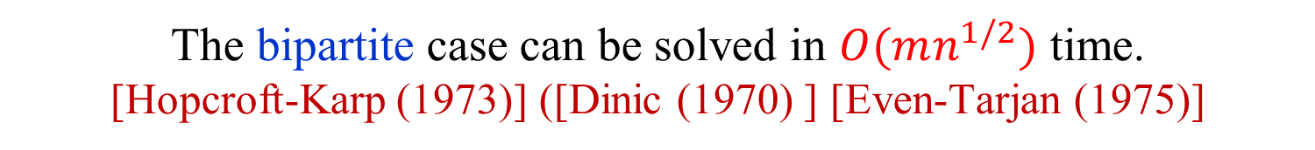

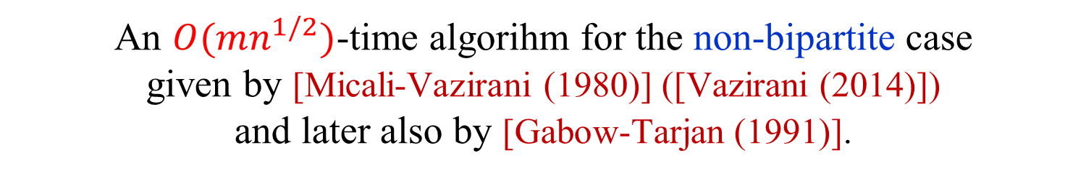
Maximum matching
The maximum matching problem in bipartite graphs can
be easily reduced to a maximum network flow problem.
The problem in non-bipartite graphs is harder.
First polynomial time algorithm given by [Edmonds (1965)].
The bipartite case can be solved in $O(mn^{1/2})$ time.
[Hopcroft-Karp (1973)] ([Dinic (1970) ] [Even-Tarjan (1975)]
The bipartite case can be solved in $O(m^{10/7})$ time,
using interior-point techniques [Madry (2013)].
An $O(mn α(m,n))$-time implementation of
Edmonds’ algorithm was given by [Gabow (1976)].
An $O(mn^{1/2})$-time algorihm for the non-bipartite case
given by [Micali-Vazirani (1980)] ([Vazirani (2014)])
and later also by [Gabow-Tarjan (1991)].

Slide 6





Maximum matching
The bipartite case can be reduced do maximum network flow.
The problem in non-bipartite graphs is harder.
First polynomial time algorithm given by [Edmonds (1965)].
The bipartite case can be solved in $O(mn^{1/2})$ time.
[Hopcroft-Karp (1973)] ([Dinic (1970) ] [Even-Tarjan (1975)]
The bipartite case can be solved in $O(m^{10/7})$ time,
using interior-point techniques [Madry (2013)].
An $O(mn α(m,n))$-time implementation of
Edmonds’ algorithm was given by [Gabow (1976)].
An $O(mn^{1/2})$-time algorihm for the non-bipartite case
given by [Micali-Vazirani (1980)] ([Vazirani (2014)])
and later also by [Gabow-Tarjan (1991)].
An $O(n^{ω})$-time algorithm using fast matrix multiplication.
[Mucha-Sankowski (2004)] [Harvey (2006)]

Slide 7
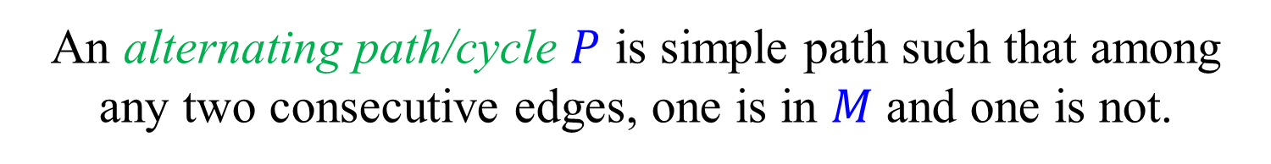
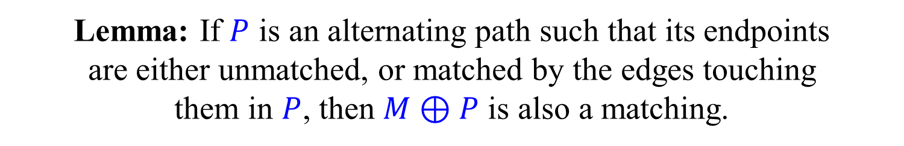
Alternating paths and cycles
with respect to a given matching $M$
An alternating path/cycle $P$ is simple path such that among
any two consecutive edges, one is in $M$ and one is not.
Lemma: If $P$ is an alternating path such that its endpoints
are either unmatched, or matched by the edges touching
them in $P$, then $M⊕P$ is also a matching.

Slide 8
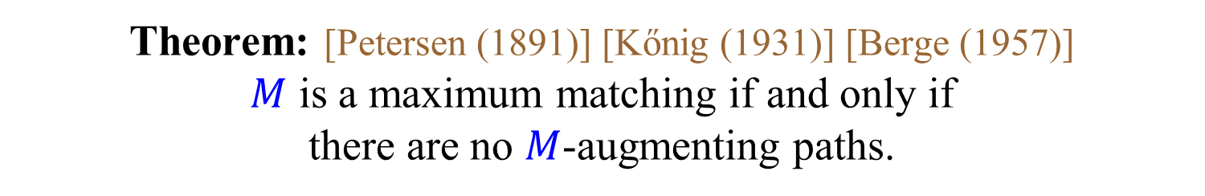
Augmenting paths
with respect to a given matching $M$
An alternating path that starts and ends in unmatched vertices.
Theorem: [Petersen (1891)] [Kőnig (1931)] [Berge (1957)]
$M$ is a maximum matching if and only if
there are no $M$-augmenting paths.
$M$-augmenting path = augmenting path w.r.t. $M$
How do we find augmenting paths?

Slide 9
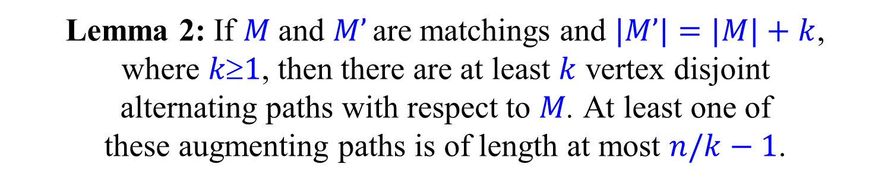
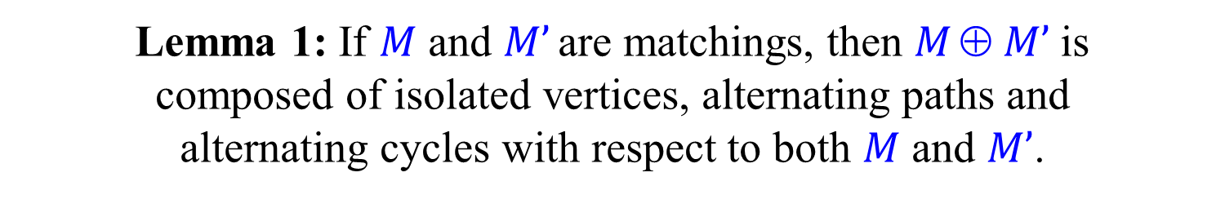
Proof of augmenting paths theorem
Lemma 1: If $M$ and $M’$ are matchings, then $M  M’$is
composed of isolated vertices, alternating paths and
alternating cycles with respect to both $M$ and $M’$.
Lemma 2: If $M$and $M’$ are matchings and $|M’|=|M|+k$,
where $k1$, then there are at least $k$ vertex disjoint
alternating paths with respect to $M$. At least one of
these augmenting paths is of length at most $n/k−1$.
The theorem follows easily.

Slide 10
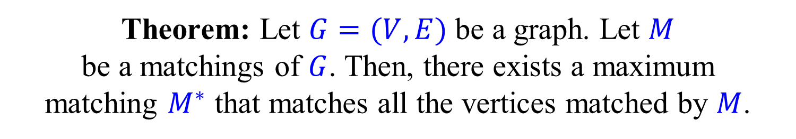
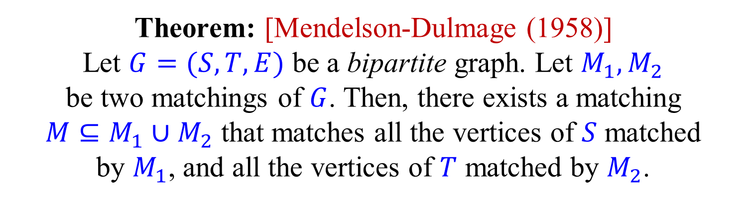
Mendelson-Dulmage Theorem
Theorem: Let $G=(V,E)$ be a graph. Let $M$
be a matchings of $G$. Then, there exists a maximum
matching $M^{∗}$ that matches all the vertices matched by $M$.
Theorem: [Mendelson-Dulmage (1958)]
Let $G=(S,T,E)$ be a bipartite graph. Let $M_{1},M_{2}$
be two matchings of $G$. Then, there exists a matching
$M⊆M_{1}∪M_{2}$ that matches all the vertices of $S$ matched
by $M_{1}$, and all the vertices of $T$ matched by $M_{2}$.
Exercise: Prove the theorems.

Slide 11
Alternating forests
even
Roots are unmatched.
odd
even
All root to leaf paths are alternating.
odd
Vertices in the forest are even or odd depending on the parity of their level.
even
odd
Scan unmatched edges of even vertices;
Scan matched edges of odd vertices;
Until an augmenting path (or a blossom) is found, or until all appropriate edges are scanned.

Slide 12

Scanning an unmatched edge
from an even vertex
(1) Edge to a matched vertex not in the forest → Tree extended.
(2) Edge to an unmatched vertex → Augmenting path found.
4
(3) Edge to an even vertex
in a different tree
→ Augmenting path found.
5
3
(4) Edge to an odd vertex
→ Ignore.
1
2
(5) Edge to an even vertex
in a same tree
→ Blossom.

Slide 13
Scanning an matched edge
from an odd vertex
(1) Edge to a vertex not in the forest → Tree extended.
(2) Edge to an odd vertex
in a different tree
→ Augmenting path found.
2
(3) Edge to an odd vertex
in a same tree
→ Blossom.
3
1
Cases (2) and (3) may be avoided if the forest is extended two edges at a time.

Slide 14
Scanning strategies
In the generic algorithms for bipartite and non-bipartite graphs, the order in which edges are scanned is arbitrary.
Fewer cases arise if when scanning an unmatched
edge leading to a matched vertex not in the forest, we
immediately scan the matched edge and add it to the forest.
We can build the trees of the forest one by one
in DFS order (again fewer cases to consider).
We can build all trees simultaneously, level by level,
in BFS order, to find shortest augmenting paths.

Slide 15
Correctness
Theorem: If there is an augmenting path, then the
scanning algorithm, with any scanning order,
finds either an augmenting path or a blossom.
e
o
e
e
If the scanning algorithm terminates, all vertices on
the augmenting path must be labeled even or odd.
If the labels alternate, then one of the endpoints is odd
and an augmenting path must have been found.
Otherwise, there must be an unmatched edge between two even vertices, or a matched edge between two odd vertices
→ augmenting path or a blossom found.

Slide 16

Vertex cover (VC)
A set $CV$ is a vertex cover if
at least one endpoint of each edge belongs to $C$
A VC must contain at least one vertex of each edge of a matching.
Hence, for every matching $M$ and VC $C$: $|M| ≤ |C|$

Slide 17
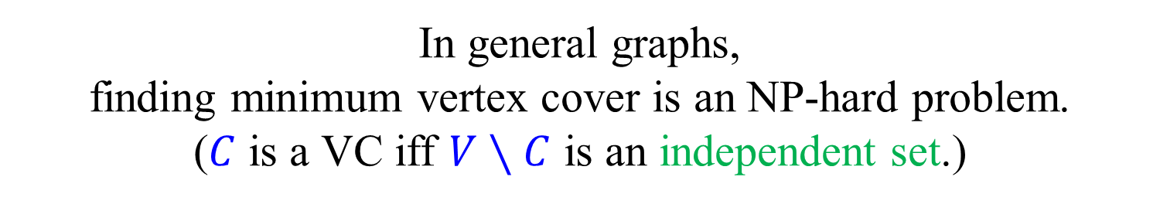
Minimum vertex cover
In general graphs,
finding minimum vertex cover is an NP-hard problem.
($C$ is a VC iff $V∖C$ is an independent set.)
In bipartite graphs, a minimum vertex cover can
be easily obtained from a maximum matching.
Theorem: [Kőnig (1931)] [Egerváry (1931)]
In a bipartite graph, the size of a maximum matching
is equal to the size of a minimum vertex cover.
Special case of the max-flow min-cut theorem,
which in turn is a special case of LP-duality.

Slide 18

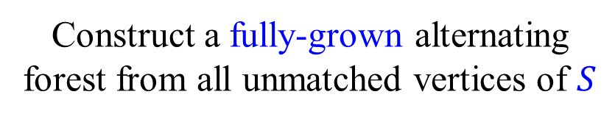

Maximum matching = Minimum vertex cover
(in bipartite graphs)
$$G=(S,T,E)$$
Construct a fully-grown alternating forest from all unmatched vertices of $S$
Take the $T$ endpoints of the edges of $M$ in the forest,
and the $S$ endpoints of the edges of $M$ not in the forest

Slide 19
Maximum matching ≠
Minimum vertex cover
(in general graphs)
But, stay tuned…

Slide 20
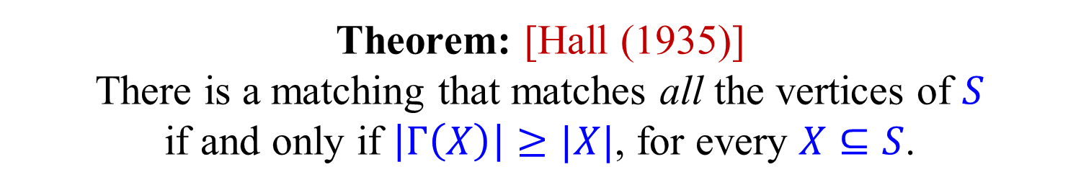
Hall’s Marriage Theorem
Let $G=(S,T,E)$ be a bipartite graph.
For $X⊆S$, let $Γ(X)$ be the neighbors of $X$ in $T$.
Theorem: [Hall (1935)]
There is a matching that matches all the vertices of $S$
if and only if $\left|Γ\left(X\right)\right|≥|X|$, for every $X⊆S$.
Exercise: Prove Hall’s thereon. (There are many
proofs. A simple proof follows by looking at
minimum vertex covers.

Slide 21


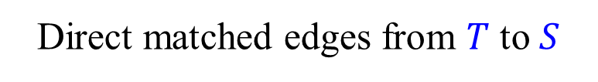
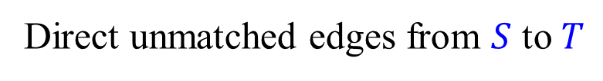
Equivalent formulation of the
scanning algorithm for Bipartite graphs
Direct unmatched edges from $S$ to $T$
Direct matched edges from $T$ to $S$
$$S$$
$$T$$

Slide 22
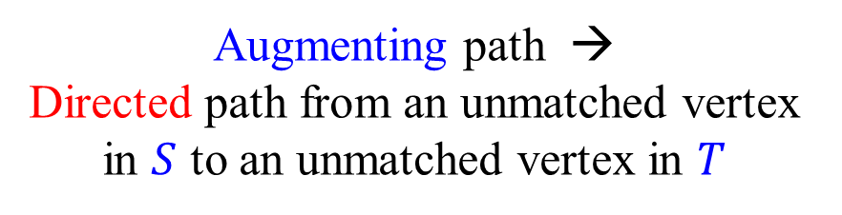
Equivalent formulation of the
scanning algorithm for Bipartite graphs
Direct unmatched edges from $S$ to $T$
Direct matched edges from $T$ to $S$
Alternating path →
Directed path
Augmenting path →
Directed path from an unmatched vertex in $S$ to an unmatched vertex in $T$
$$S$$
$$T$$
Residual flow network

Slide 23
The algorithm of Hopcroft-Karp (1973)
for bipartite graphs
Start with some (possibly empty) matching $M$.
In each phase, find a maximal collection of
vertex disjoint shortest augmenting paths.
Number of phases is at most $2n^{1/2}$.
Each phase can be implemented in $O(m)$ time.
Total running time is $O(mn^{1/2})$.

Slide 24
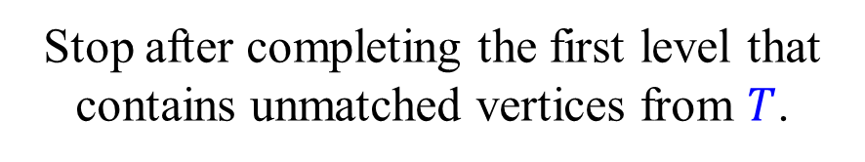
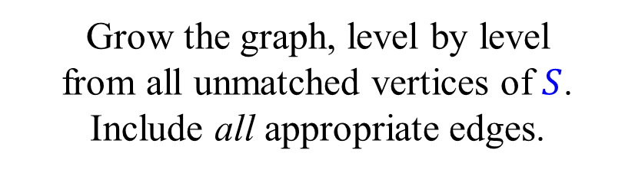
Forest → Layered graph
Grow the graph, level by level
from all unmatched vertices of $S$.
Include all appropriate edges.
Stop after completing the first level that contains unmatched vertices from $T$.
Find a maximal set of vertex disjoint shortest augmenting paths.

Slide 25

Forest → Layered graph
Grow the graph, level by level
from all unmatched vertices of $S$.
Include all appropriate edges.
Stop after completing the first level that contains unmatched vertices from $T$.
Find a maximal set of vertex disjoint shortest augmenting paths.

Slide 26
Forest → Layered graph
Grow the graph, level by level
from all unmatched vertices of $S$.
Include all appropriate edges.
Stop after completing the first level that contains unmatched vertices from $T$.
A maximal set
is enough.
Find a maximal set of vertex disjoint shortest augmenting paths.

Slide 27
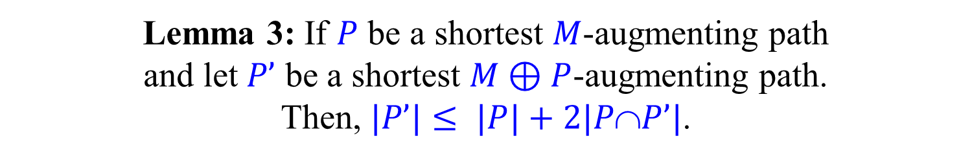

Number of phases
Lemma 3: If $P$ be a shortest $M$-augmenting path
and let $P’$ be a shortest $M⊕P$-augmenting path.
Then, $|P’|≤ |P|+2|PP’|$.
Proof:
$$N=\left(M⊕P\right)⊕P’$$
$$|N|=|M|+2$$
By Lemma 2, $M⊕N=P⊕P’$contains
two disjoint $M$-augmenting path $P1$ and $P2$
$$2\left|P\right|≤\left|P_{1}\right|+\left|P_{2}\right|≤\left|M⊕N\right|=\left|P⊕P′\right|=\left|P\right|+\left|P^{′}\right|−2\left|P∩P^{′}\right|$$

Slide 28
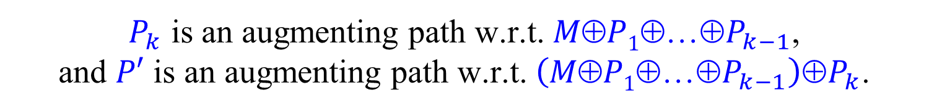
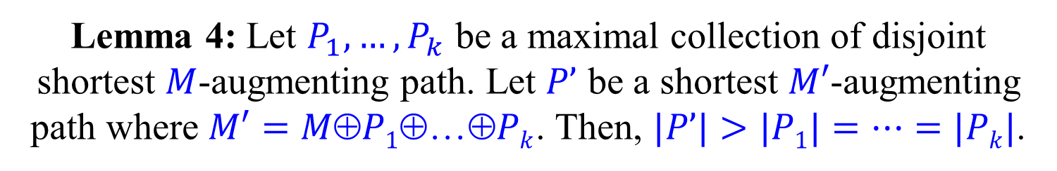
Number of phases
Lemma 4: Let $P_{1},…,P_{k}$ be a maximal collection of disjoint shortest $M$-augmenting path. Let $P’$ be a shortest $M′$-augmenting path where $M′=MP1Pk$. Then, $|P’|>|P1|=…=|Pk|$.
Proof:
If $P’$ is disjoint from $P_{1},…,P_{k}$ then $P’$ is also $M$-augmenting.
By the maximality of the collection $|P’|>|P1|=…=|Pk|$.
Assume, w.l.o.g. that $P^{′}∩P_{k}≠∅$. (Otherwise, reorder.)
$P_{k}$ is an augmenting path w.r.t. $MP1P_{k−1}$,
and $P′$ is an augmenting path w.r.t. $\left(M⊕P1⊕…⊕P_{k−1}\right)⊕P_{k}$.
By Lemma 3, $|P’|≥|P_{k}|+2|P’∩P_{k}|>|P_{k}|$.

Slide 29
Number of phases
Theorem: The algorithm of Hopcroft and Karp
finishes after at most 2n^{1/2} phases.
By Lemma 4, the augmenting paths
found in each phase get longer and longer.
After n^{1/2} phases, if algorithm is not yet done,
the augmenting paths are of length at least n^{1/2}.
By Lemma 2 on slide 8, the number of edges
missing in the current matching is at most n^{1/2}.
Thus, a maximum matching is found
after at most n^{1/2} additional phases.

Slide 30


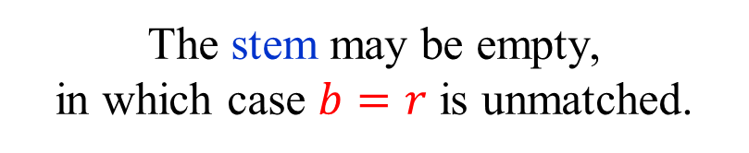
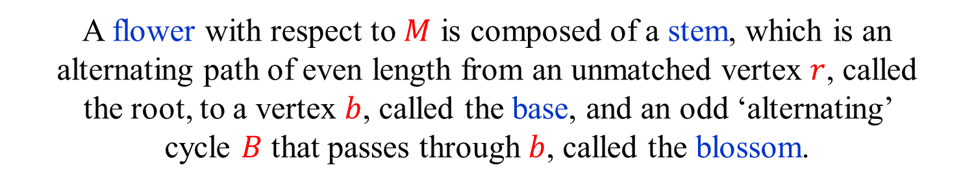


Flowers and blossoms
$$B$$
$$r$$
$$b$$
A flower with respect to $M$ is composed of a stem, which is an alternating path of even length from an unmatched vertex $r$, called
the root, to a vertex $b$, called the base, and an odd ‘alternating’
cycle $B$ that passes through $b$, called the blossom.
The stem may be empty,
in which case $b=r$ is unmatched.
An odd ‘alternating’ cycle is called a blossom only of it is a part of a flower.

Slide 31


The challenge of blossoms
o
e
o
e
e
o
e
e
o
e
e
o
o
e
o
In this scanning order,
augmenting path found.
In this scanning order,
augmenting path not found.

Slide 32
The challenge of blossoms
o
e
o
e
e
o
e
e
o
e
o
e
o
o
o
o
e
e
e
e
o
o

Slide 33
Shrinking (contracting) blossoms
Contract the blossom and consider
it to be a (super) even vertex.
Scan unmatched edges from all vertices of the blossom,
including those that were originally odd.
Theorem: (Edmonds) The original graph contains an
augmenting path if and only if the contracted graph does.

Slide 34
Augmenting path in contracted graph →
Augmenting path in original graph
Theorem: If there is an augmenting path P after shrinking a
blossom B, then there is also an augmenting path before the shrinking.
B
b
B
c
The matched edge must enter B at b.
The blossom contains an even alternating path from b to c.

Slide 35
Augmenting path in original graph →
Augmenting path in contracted graph
Theorem: If there is an augmenting path P before shrinking a
blossom B, then there is also an augmenting path after the shrinking.
If P does not pass though B, then P is also
an augmenting path in the contracted graph.
What do we do if P does pass through B?
Important to note that B is part of a flower
and thus has a (possibly empty) stem Q.

Slide 36
Is P an augmenting path
in the contracted graph?
b
B
P
P is not necessarily a simple path in the contracted graph.
P is not necessarily an alternating path in the contracted graph.

Slide 37
Augmenting path in original graph →
Augmenting path in contracted graph
Theorem: If there is an augmenting path P before shrinking a
blossom B, then there is also an augmenting path after the shrinking.
Easy case: B has an empty stem
a
b
B
P’
Rest of P
c
B is unmatched in the contracted graph.
Let P’ be the subpath of P that starts at an endpoint a of P
that is not b and continues until the first encounter with B.
P’ is an augmenting path from a to B in the contracted graph.

Slide 38
Hard(er) case: B has a non-empty stem
r
b
a
B
Rest of P
P’
c
If the first encounter of P with the flower is at the blossom B,
and not at the stem Q, than this is again an easy sub-case.

Slide 39
Hard(er) case: B has a non-empty stem
r
b
a
B
Rest of P
P’
c
If the first encounter of P with the flower is at the blossom B,
and not at the stem Q, then this is again an easy sub-case.
But, what if P, from both its sides,
first encounters the flower at its stem?
We can either face the problem head on, or bypass it.

Slide 40




Easy solution for hard(er) case
Hard(er) case: $B$ has a non-empty stem
$$r$$
$$b$$
$$B$$
$$Q$$
Let $GB$ be the contracted graph.
Let $MB= M∖B$be the matching in the contracted graph.
Let $Q$ be a stem of the flower with blossom $B$.
Let $M’=M⊕Q$.

Slide 41


Easy solution for hard(er) case
Hard(er) case: $B$ has a non-empty stem
$$r$$
$$b$$
$$M’$$
$$B$$
$$Q$$
Let $GB$ be the contracted graph.
Let $MB= M∖B$be the matching in the contracted graph.
Let $Q$ be a stem of the flower with blossom $B$.
Let $M’=M⊕Q$.
$|M’|=|M|$and $|M_{B}|=|M_{B}^{′}|$
$B$ is a blossom with an empty stem w.r.t. $M’$.
By the easy case, there is an augmenting path
w.r.t. $M_{B}^{′}$, and hence also w.r.t. $M_{B}$.

Slide 42
Direct solution for hard(er) case
Hard(er) case: B has a non-empty stem
First encounters of P with the flower are at the stem Q
r
Q
c
b
B
a
P’
Start with an endpoint a of P that is not r
P’ is the subpath of P until first encounter with the stem
If P’ meets the stem at an even vertex c,
that is again an easy sub-case

Slide 43
Direct solution for hard(er) case
Hard(er) case: B has a non-empty stem
First encounters of P with the flower are at the stem Q
r
Q
c
b
B
a
P’
Start with an endpoint a of P that is not r
P’ is the subpath of P until first encounter with the stem
If P’ meets the stem at an even vertex c,
that is again an easy sub-case

Slide 44
Direct solution for hard(er) case
Hard(er) case: B has a non-empty stem
P first encounters stem at odd vertices
r
c
b
B
a
P’
P’’
If P does not enter B, then P remains an augmenting path.
Let P’ be the subpath of P until first encounter with the stem.
Let P’’ be the subpath of P from the last time it leaves B.
Do we always get an augmenting path P’, (c to B), P’’ ???
Unfortunately not. (Why?)

Slide 45
A challenging example
P’’
r
c
b
B
P’
a
Where is the augmenting path?
Not in the picture…

Slide 46
Direct solution for hard(er) case
Hard(er) case: B has a non-empty stem
r
c
b
B
a
P’
P’’
If P be an augmenting path, and let Q be a stem of B
such that P first meets Q as close as possible to B.
P’’ be cannot intersect the path (c to B).
We thus get an augmenting path P’, (c to B) , P’’

Slide 47
1
Nested blossoms
2
Only vertex unmatched
inside a blossom
is its base.
3
4
6
14
5
7
10
28
8
18
15
20
9
There is an even alternating path from the base to any other vertex in the blossom.
11
12
19
21
16
13
Number of vertices k
in a (nested) blossom
is always odd.
17
22
24
23
25
Number of matched
edges in the blossom
is (k−1)/2.
26
27

Slide 48
1
An augmenting path through nested blossoms
2
3
4
6
14
5
7
10
28
8
18
15
20
9
11
12
19
21
16
13
17
22
24
23
25
26
27

Slide 49
1
An augmenting path through nested blossoms
2
3
4
6
14
5
7
10
28
8
18
15
20
9
11
12
19
21
How do we
find such a path?
16
13
17
22
24
23
25
26
27

Slide 50
1
Nested blossoms
2
3
4
6
14
5
7
10
8
18
15
20
9
11
12
19
21
16
13
17
22
24
23
25
26
27

Slide 51
1
Nested blossoms
2
3
4
6
14
5
7
10
8
18
15
20
9
11
12
19
21
16
13
17
22
24
23
25
26
27

Slide 52
1
Nested blossoms
2
3
4
6
14
5
7
10
8
18
15
20
9
11
12
19
21
16
13
17
22
24
23
25
26
27

Slide 53
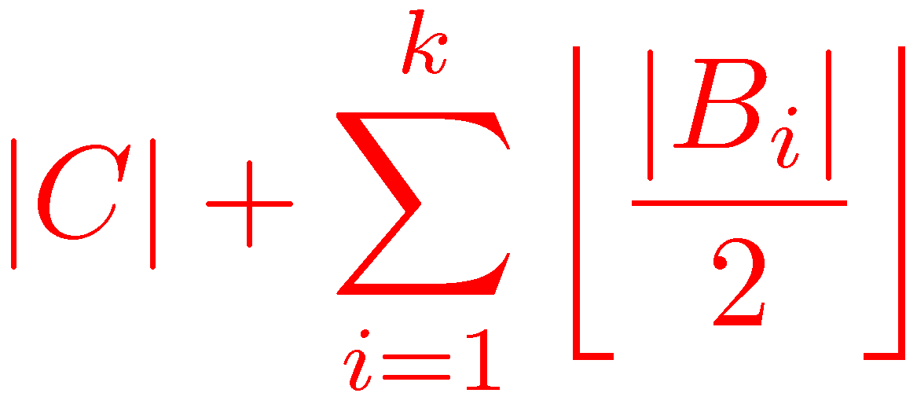
Odd Vertex Cover
A set C⊆V and a collection of subsets B₁,…,B_{k} ⊆V
is an odd vertex cover if for every edge e
either e ∩ C≠∅ or e ⊆ B_{i} for some i.
The cost of the odd vertex cover is defined to be
Without loss of generality, we may assume that
all the sets B_{i} are of odd size, hence the name,
and that C and B₁,…,B_{k} are disjoint.

Slide 54
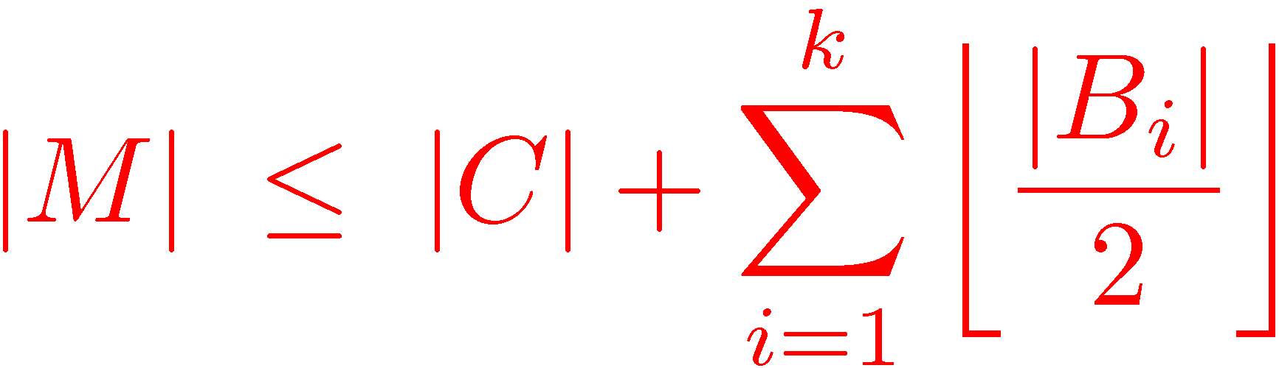
Odd Vertex Cover
Theorem: In any graph, the size of the maximum matching
is equal to the cost of the minimum odd vertex cover.
For every matching M and
every odd vertex cover C and B₁,…,B_{k} we have
To prove equality we look at the alternating forest constructed using the last (failed) iteration of Edmonds’ algorithm.

Slide 55
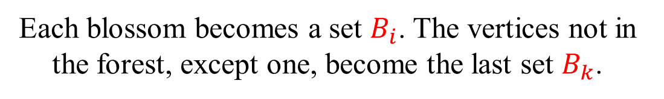
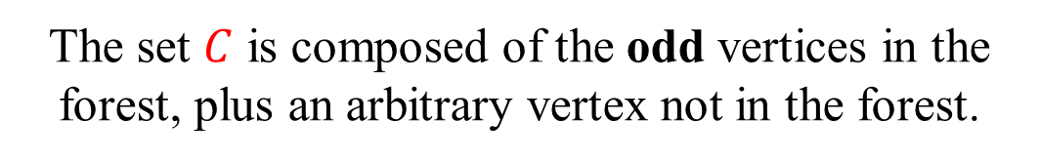

Maximum matching = Minimum odd vertex cover
Every even node in the forest
is possibly a nested blossom.
The set $C$ is composed of the odd vertices in the forest, plus an arbitrary vertex not in the forest.
Each blossom becomes a set $B_{i}$. The vertices not in the forest, except one, become the last set $B_{k}$.
$|C|$ is equal to the number of edges of $M$ not contained in the $B_{i}$’s.
The cost of each $B_{i}$ is equal to the number of edges of $M$ in it.

Slide 56
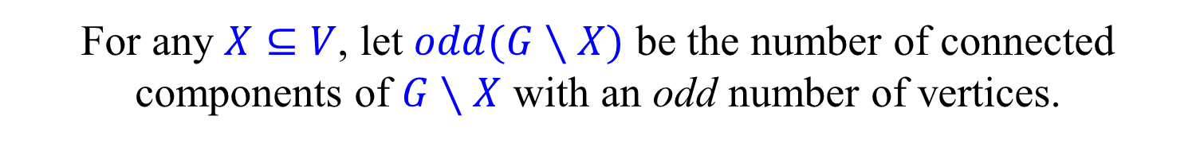
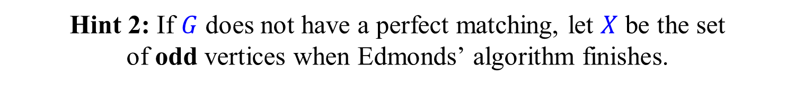
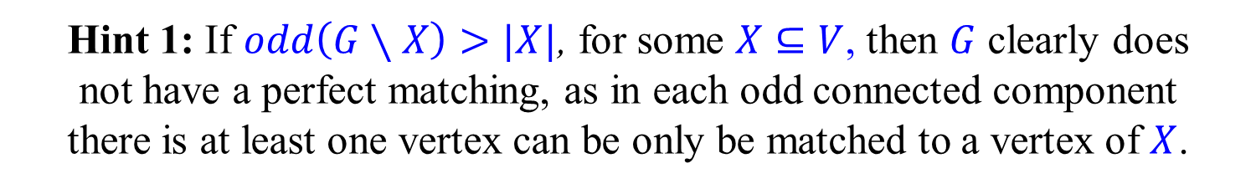

Tutte’s Theorem [Tutte (1947)]
Let $G=(V,E)$ be a graph.
For any $X⊆V$, let $odd(G∖X)$ be the number of connected components of $G∖X$ with an odd number of vertices.
Theorem: [Tutte (1947)]
A graph $G=(V,E)$ has a perfect matching
iff $odd\left(G∖X\right)≤|X|$, for every $X⊆V$.
Exercise: Prove the theorem.
Hint 1: If $odd\left(G∖X\right)>|X|$, for some $X⊆V$, then $G$ clearly does
not have a perfect matching, as in each odd connected component
there is at least one vertex can be only be matched to a vertex of $X$.
Hint 2: If $G$ does not have a perfect matching, let $X$ be the set
of odd vertices when Edmonds’ algorithm finishes.

Slide 57
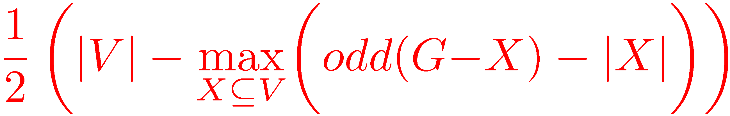

Tutte-Berge Theorem
[Tutte (1947)] [Berge (1958)]
Theorem: In any graph, the size of
the maximum matching is equal to
where odd(G−X) is the number of connected
components in G−X with an odd number of vertices.
Proof: Take $X$ to be the set of odd
vertices in the final alternating tree.

Slide 58


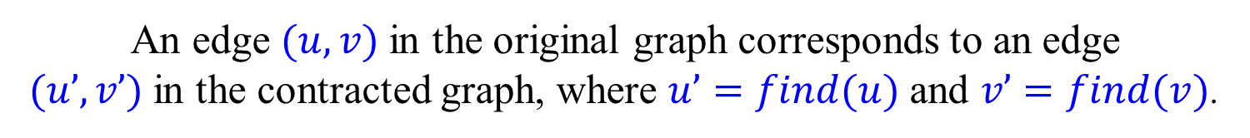

Implementing Edmonds’ algorithm
Using an explicit representation of the blossoms
we can get an $O(n3)$ implementation.
To get an $O(mn α(m,n))$implementation we represent the
blossoms implicitly using a union-find data structure.
If $v$ is in a (nested) blossom, then $find(v)$ returns its base.
If $v$ is not in a blossom, then $find(v)=v$.
An edge $(u,v)$in the original graph corresponds to an edge
$(u’,v’)$in the contracted graph, where $u’=find(u)$and $v’=find(v)$.
When a new blossom is found, we perform the appropriate
union operations, making sure that the base is the
representative item returned by find operations.

Slide 59
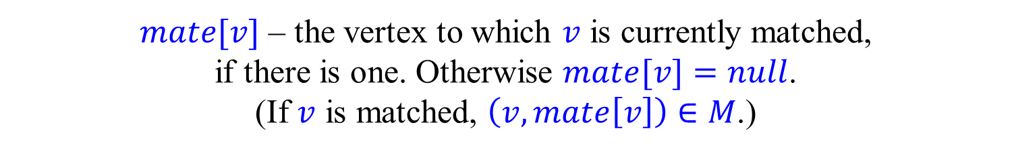

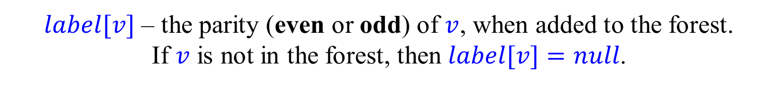
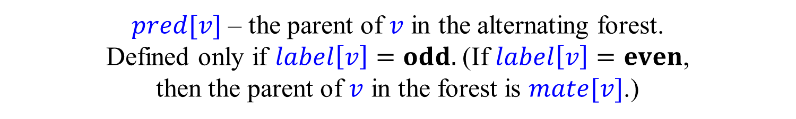
Implementing Edmonds’ algorithm
$mate[v]$ – the vertex to which $v$ is currently matched,
if there is one. Otherwise $mate[v]=null$.
(If $v$ is matched, $\left(v,mate\left[v\right]\right)∈M$.)
$label[v]$ – the parity (even or odd) of $v$, when added to the forest.
If $v$ is not in the forest, then $label[v]=null$.
$pred[v]$ – the parent of $v$ in the alternating forest.
Defined only if $label\left[v\right]=odd.$(If $label\left[v\right]=even$,
then the parent of $v$ in the forest is $mate[v]$.)
$pred[v]$ and $label[v]$ are not changed when a blossom is formed.
$bridge[v]$ – the bridge (see below) that formed the
first blossom containing the odd vertex $v$.
A vertex $v$ is said to be even if $label[find(v)]=even$.

Slide 60

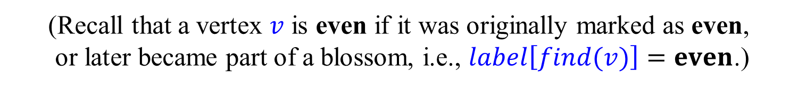

Implementing Edmonds’ algorithm
$Q$ – a list of even vertices yet to be scanned.
(Recall that a vertex $v$ is even if it was originally marked as even,
or later became part of a blossom, i.e., $label\left[find(v)\right]=even$.)
Initially, either a single unmatched vertex,
or all unmatched vertices are placed in $Q$.
By letting $Q$ be a queue or a stack,
we can implement BFS or DFS search strategies.

Slide 61
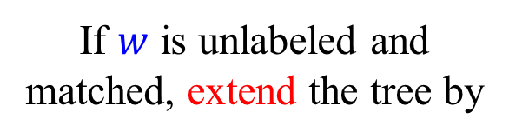

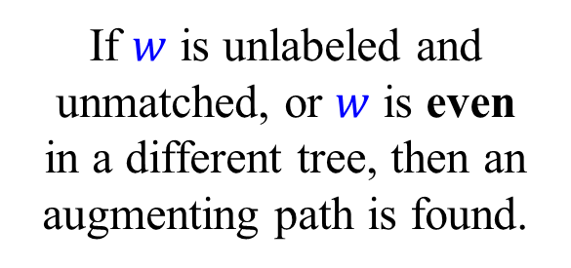
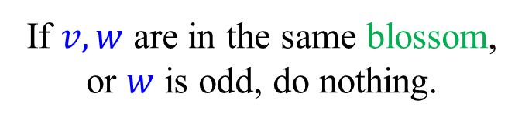
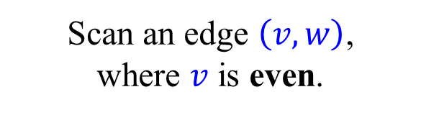
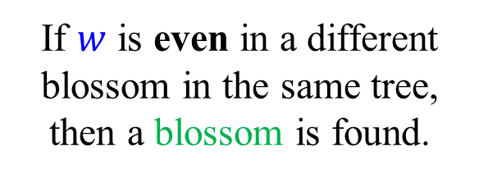



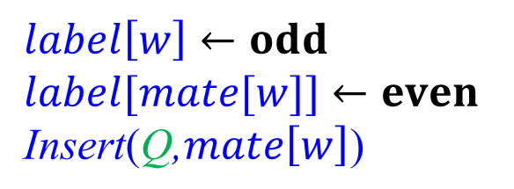
Scanning an edge and extending the tree
$$r$$
Scan an edge $\left(v,w\right)$,
where $v$ is even.
If $w$ is unlabeled and unmatched, or $w$ is even
in a different tree, then an augmenting path is found.
$$v$$
$$w$$
If $w$ is even in a different blossom in the same tree, then a blossom is found.
$$mate[w]$$
If $w$ is unlabeled and matched, extend the tree by
$$label\left[w\right]←odd \\ label[mate[w]]←even \\ \text{Insert}\text{(}\text{Q}\text{,}mate\left[w\right]\text{)}$$
If $v,w$ are in the same blossom, or $w$ is odd, do nothing.

Slide 62
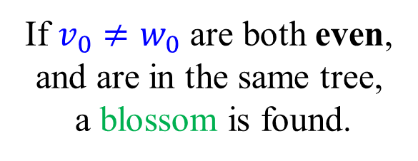
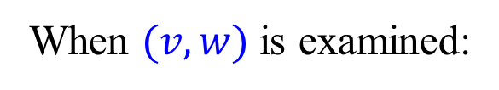
Shrinking a blossom
When $(v,w)$is examined:
b=v₂=w₁
v₀ = find(v)
w₀ = find(w)
If $v_{0}≠w_{0}$ are both even,
and are in the same tree,
a blossom is found.
v₁
w₀
w
Find the base
of the new blossom:
v₀
v₁ = find( pred[mate[v₀]] )
v₂ = find( pred[mate[v₁]] )
…
v

Slide 63
Shrinking a blossom
Climb up from v₀ and w₀, alternatingly.
First vertex already visited is b.
b=v₂=w₁
For every i do:
insert(Q,mate[v_{i}])
union(b,v_{i})
v₁
w₀
union(b,mate[v_{i}])
w
bridge[mate[v_{i}]] ← (v,w)
For every j do:
insert(Q,mate[w_{j}])
v₀
union(b, w_{j})
v
union(b,mate[w_{j}])
bridge[mate[w_{j}]] ← (w,v)

Slide 64
Shrinking a blossom
Time proportional to size of new blossom, i.e., the number of sub-blossoms, and does not depend on sizes of the sub-blossoms.
b=v₂=w₁
v₁
w₀
w
v₀
v

Slide 65
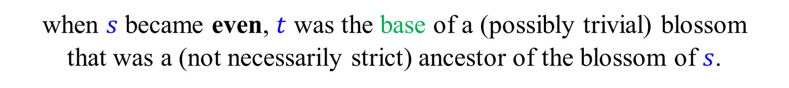
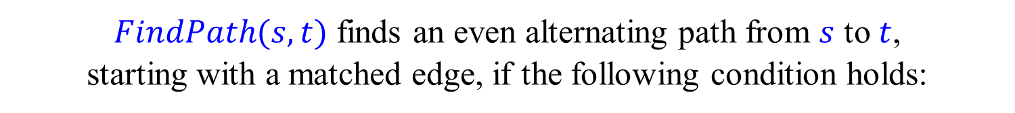
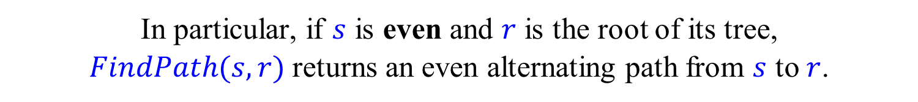

$$FindPath$$
To find augmenting paths, we use a function $FindPath$.
$FindPath(s,t)$ finds an even alternating path from $s$ to $t$,
starting with a matched edge, if the following condition holds:
when $s$ became even, $t$ was the base of a (possibly trivial) blossom
that was a (not necessarily strict) ancestor of the blossom of $s$.
($s$ becomes even either when it is labeled even,
or when it is swallowed by a blossom.)
In particular, if $s$ is even and $r$ is the root of its tree,
$FindPath(s,r)$ returns an even alternating path from $s$ to $r$.
$FindPath(s,t)$ is implemented recursively, as we shall see below.

Slide 66


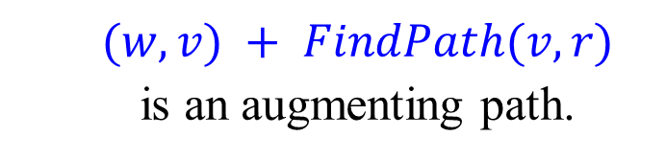

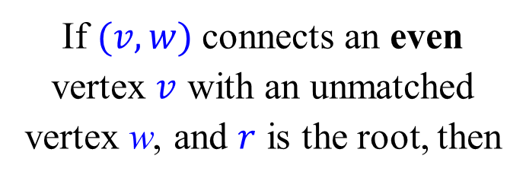
Finding an augmenting path
$$r$$
$$v$$
$$w$$
If $(v,w)$connects an even vertex $v$ with an unmatched vertex w, and $r$ is the root, then
$$(w,v) + FindPath(v,r)$$
is an augmenting path.

Slide 67


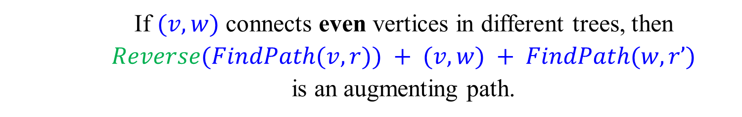


Finding an augmenting path
$$r$$
$$r′$$
$$v$$
$$w$$
If $(v,w)$ connects even vertices in different trees, then
$$Reverse(FindPath(v,r)) + (v,w) + FindPath(w,r’)$$
is an augmenting path.

Slide 68







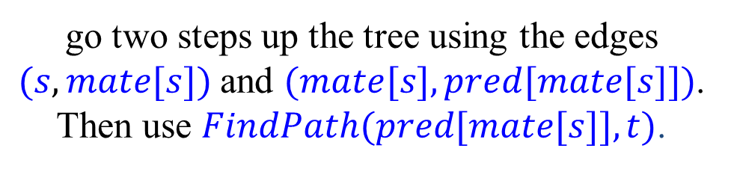
Implementing $FindPath$
$$r$$
If $label\left[s\right]=even$,
$$t$$
go two steps up the tree using the edges
$(s,mate[s])$and $(mate[s],pred[mate[s]])$.
Then use $FindPath(pred[mate[s]],t)$.
$$pred[mate\left[s\right]]$$
$$mate[s]$$
$$s$$

Slide 69












Implementing $FindPath$
$$t$$
If $label\left[s\right]=odd$:
Let $bridge\left[s\right]=(v,w)$.
When the first blossom containing $s$
was formed, $mate[s]$ was the base of
a blossom that was an ancestor of
the blossom containing $v$.
$$Q$$
$$s$$
$$mate[s]$$
Also, $t$ was the base of a blossom
that was an ancestor of the
blossom containing $w$.
$$w$$
$$P$$
Thus, $P=FindPath(v,mate\left[s\right])$
and $Q=FindPath\left(w,t\right)$ are
disjoint even alternating paths.
$$v$$
Return $\left(s,mate\left[s\right]\right)+Reverse\left(P\right)+\left(v,w\right)+Q$

Slide 70

$$FindPath$$
Find an even alternating path from $s$ to $t$. (Under some conditions.)
$FindPath(s,t)$:
if $s=t$:
return
else if $label\left[s\right]=$ even:
return $⟨ (s,mate[s]) , (mate[s],pred[mate[s]]) ⟩ +$
$FindPath(pred[mate[s]],t)$
else:
$\left(v,w\right)←bridge[s]$
return $⟨ (s,mate[s]) ⟩+Reverse(Path(v,mate[s]))+$
$\left\langle \left(v,w\right) \right\rangle +FindPath(w,t)$
+ denotes catenation of lists.
$Reverse$ can be removed, as order of the edges is not important.

Slide 71
Bonus material
Not covered in class this term
“Careful. We don’t want to learn from this.”
(Bill Watterson, “Calvin and Hobbes”)

Slide 72

Correctness proofs
Theorem: If $M$ is not a maximum matching, then
Edmonds algorithm finds an augmenting path.
We already saw two direct correctness proof,
dealing with the shrinkage of a single blossom.
The correctness also follows from the maximum matching = minimum odd set cover theorem, as the algorithm produces
a matching and a cover of the same size.
It also follows from the Tutte-Berge Theorem.
As we want to be absolutely sure, and want some practice,
we sketch another proof taken from [Tarjan (1983)]

Slide 73



Basic observations
If $\left(u,v\right)∈M$ and $u$ is odd, then $v$ is immediately labeled even.
(We assume this version of the algorithm.)
If $\left(u,v\right)∉M$, $u$ is even, and an augmenting path is not found,
then $v$ is eventually labeled, either odd or even.
If $\left(u,v\right)∉M$ and $u,v$ are even, and an augmenting path is
not found, then $u$ and $v$ eventually belong to the same blossom.
At most one vertex in any blossom is unmatched
or matched to a vertex outside the blossom.
(Easy) Exercise: Prove these basic observations.

Slide 74

A useful lemma
Lemma: Let $G=(V,E)$ be a graph, let $M$ be a matching in $G$,
and let $u_{0},u_{1},…,u_{2i}$ be an $M$-alternating path, where $u_{0}$ is unmatched. If Edmonds’ algorithm does not find an
$M$-augmenting path, then $u_{2i}$ eventually becomes even.
Exercise: Does the lemma follows from the
correctness of Edmonds’ algorithm?
We obtain below a direct proof of the lemma, leading to an alternative correctness proof of Edmonds’ algorithm.

Slide 75

Another correctness proof
Theorem: If $M$ is not a maximum matching, then
Edmonds algorithm finds an augmenting path.
Suppose, for contradiction, that an augmenting path is not found.
Let $u_{0},u_{1},…,u_{2k−2},u_{2k−1}$ be an $M$-augmenting path.
By the lemma, $u_{0},u_{2},…,u_{2k−2}$ are eventually even.
Also by the lemma, $u_{1},u_{3},…,u_{2k−1}$ are eventually even.
Thus, all vertices on the path are eventfully even
and eventually all belong to the same blossom.
This is a contradiction, as $u_{0},u_{2k−1}$ are both unmatched.

Slide 76

Proof of Lemma
Let $u_{0},u_{1},…,u_{2i}$ be an $M$-alternating path.
Suppose, by induction, that $u_{0},u_{2},…,u_{2i−2}$ are even.
Note that $\left(u_{2i−1},u_{2i}\right)∈M$.
If $u_{2i−1}$ is odd, then $u_{2i}$ is immediately even.
Suppose, for contradiction, that $u_{2i−1}$ is even but $u_{2i}$ is odd.
Let $j$ be the smallest index such that $u_{j},…,u_{2i−1}$ are all even.
As $u_{0},u_{2},…,u_{2i−2}$ are even, $j$ must be even.
Thus, $u_{j},…,u_{2i−1}$ eventually belong to the same blossom.
As $u_{j−1}$ (if it exists) and $u_{2i}$ are odd, they do not belong to this blossom.
Contradiction, as both $u_{j}$ and $u_{2i−1}$ are not matched in the blossom.
Exercise: Check the proof and fill in missing details, if needed.

Slide 77


Factor-critical graphs
A matching is also called a 1-factor.
A graph $G=(V,E)$ is factor-critical if and only if
$G∖\{v\}$ has a perfect matching for every $v∈V$.
Factor-critical graphs $⟺$ Nested blossoms
Lemma 1: Every (nested) blossom is factor-critical.
Lemma 2: Let $G=(V,E)$ be factor critical and let $M$ be a
perfect matching of $G∖v$ for some $v∈V$. Then Edmonds’ algorithm, when run on $(G,M)$ shrinks $G$ into a single blossom.
Exercise: Prove the two lemmas.

Slide 78






Edmonds-Gallai decomposition
Let $D$ be the set of vertices not covered by
at least one maximum matching of $G$.
Let $G=(V,E)$ be a graph.
Let $A$ be the set of vertices not in $D$
but adjacent to some vertex in $D$.
Let $C=V∖(A∪D)$.
Theorem:
(i) Every maximum matching of $G$ contains a perfect
matching of each component of $G[C]$ and a near-perfect
matching of each component of $G[D]$ and it matches
each vertex of $A$ with a vertex from $D$.
(ii) Each component of $G\left[D\right]$ is factor critical.
(iii) The size of each maximum matching is
$$\frac{1}{2}\left(\left|V\right|−c\left(G\left[D\right]\right)+\left|A\right|\right)$$

