Slide 1
Analysis of Algorithms
Dynamic
All-Pairs Shortest-Paths
Uri Zwick
March 2014
TexPoint fonts used in EMF.
Read the TexPoint manual before you delete this box.: AAAAA

Slide 2
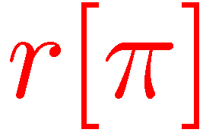

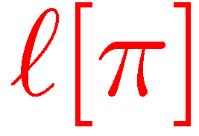
Locally Shortest Paths (LSPs)
Demetrescu-Italiano (2004)
shortest path
shortest path
π is a LSP iff l[π] and r[π] are SP
A LSP is not necessarily a SPs

Slide 3
Shortest Path Extensions
L[π] - Left SP extensions
shortest path π
R[π] - Right SP extensions

Slide 4
Demetrescu-Italiano (2004)
(Static version)
Run Dijkstra “in parallel” from all vertices
Consider only LSPs
Keep left and right extensions of SPs found
Keep candidate SPs in a priority queue

Slide 5
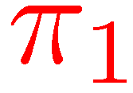
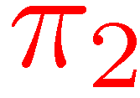
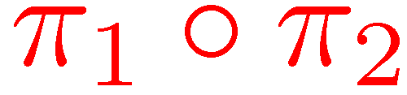
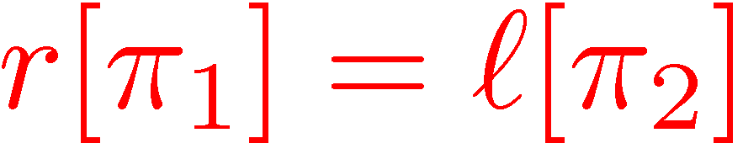
Combining two paths

Slide 6
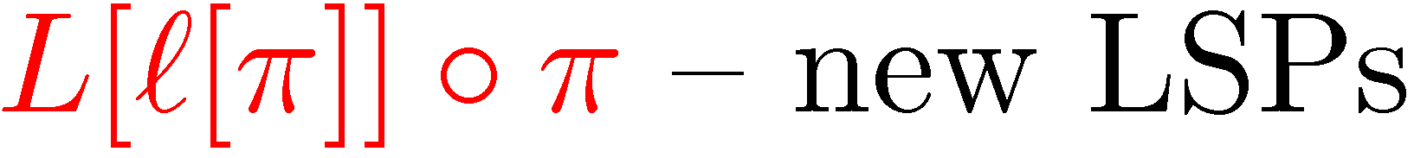
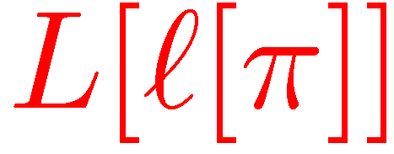
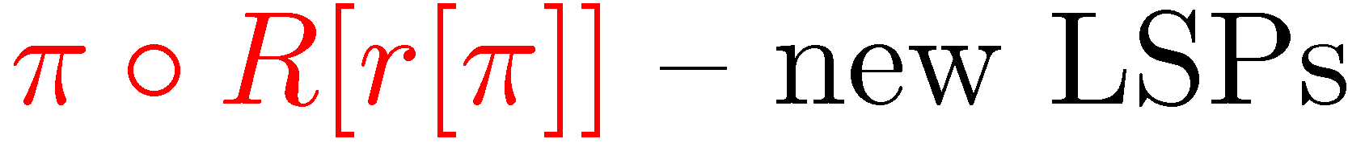
Demetrescu-Italiano (2004)
(Static version)
New shortest path π

Slide 7
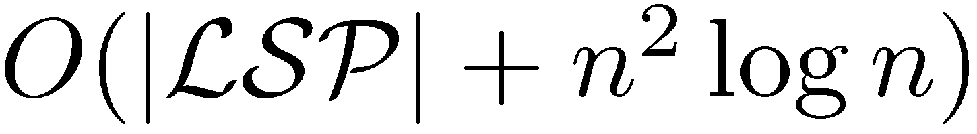
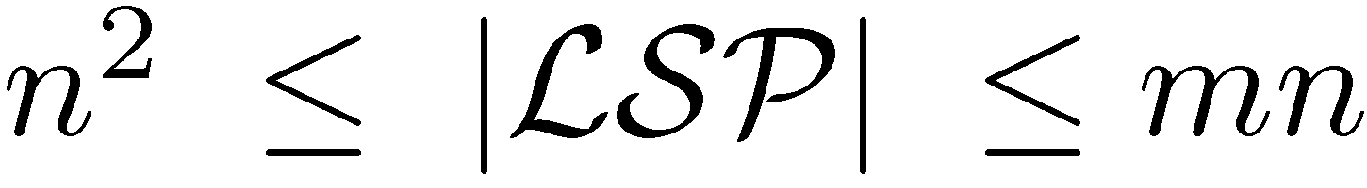
Demetrescu-Italiano (2004)
Static APSP algorithm
Running time:
Uniqueness assumption:
All shortest paths are unique

Slide 8
dist[u,v] – The length of the
shortest path from u to v found so far
p[u,v] – The second vertex on the
shortest path from u to v found so far
q[u,v] – The penultimate vertex on the
shortest path from u to v found so far
L[u,v] – A list of vertices w for which
w→SP(u,v) is known to be a shortest path
R[u,v] – A list of vertices w for which
SP(u,v) →w is known to be a shortest path
SP(u,v) denotes the shortest path from u to v
(Not explicitly maintained)

Slide 9
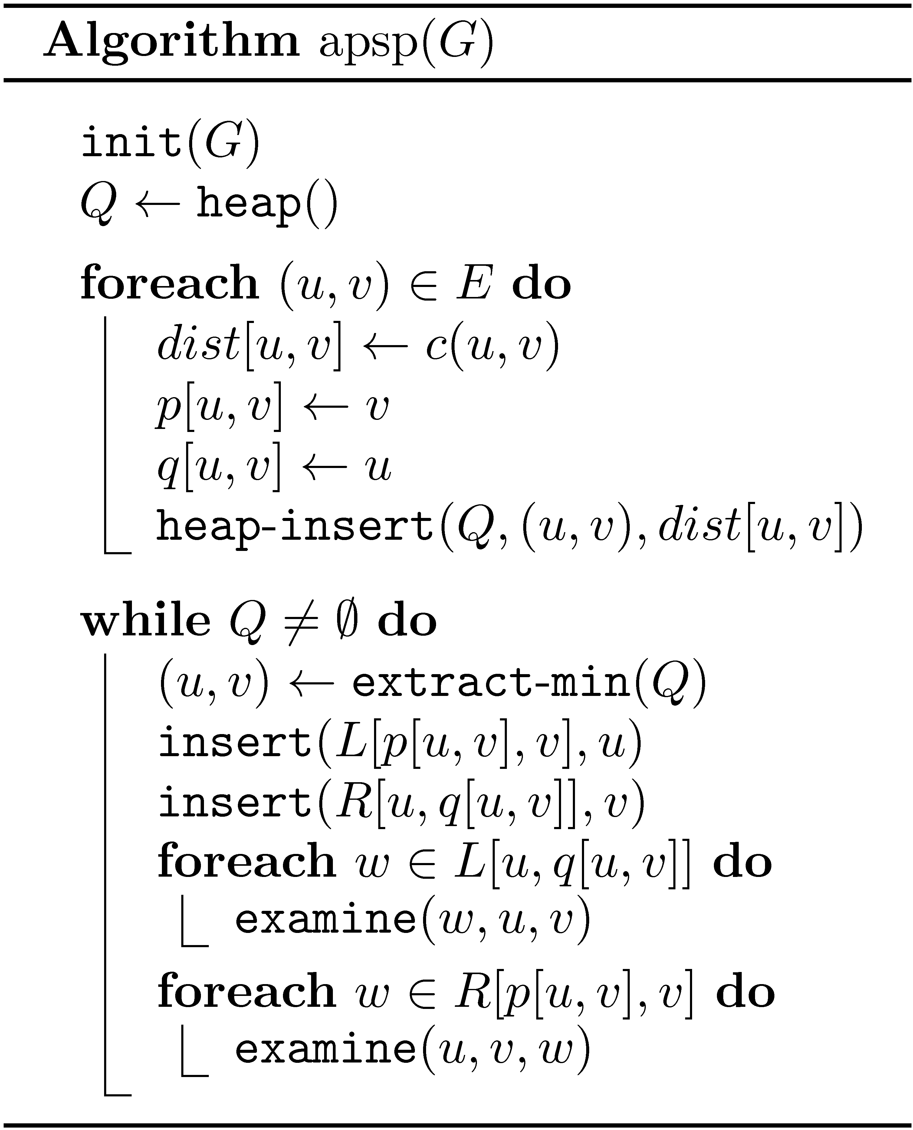
Static APSP algorithm

Slide 10
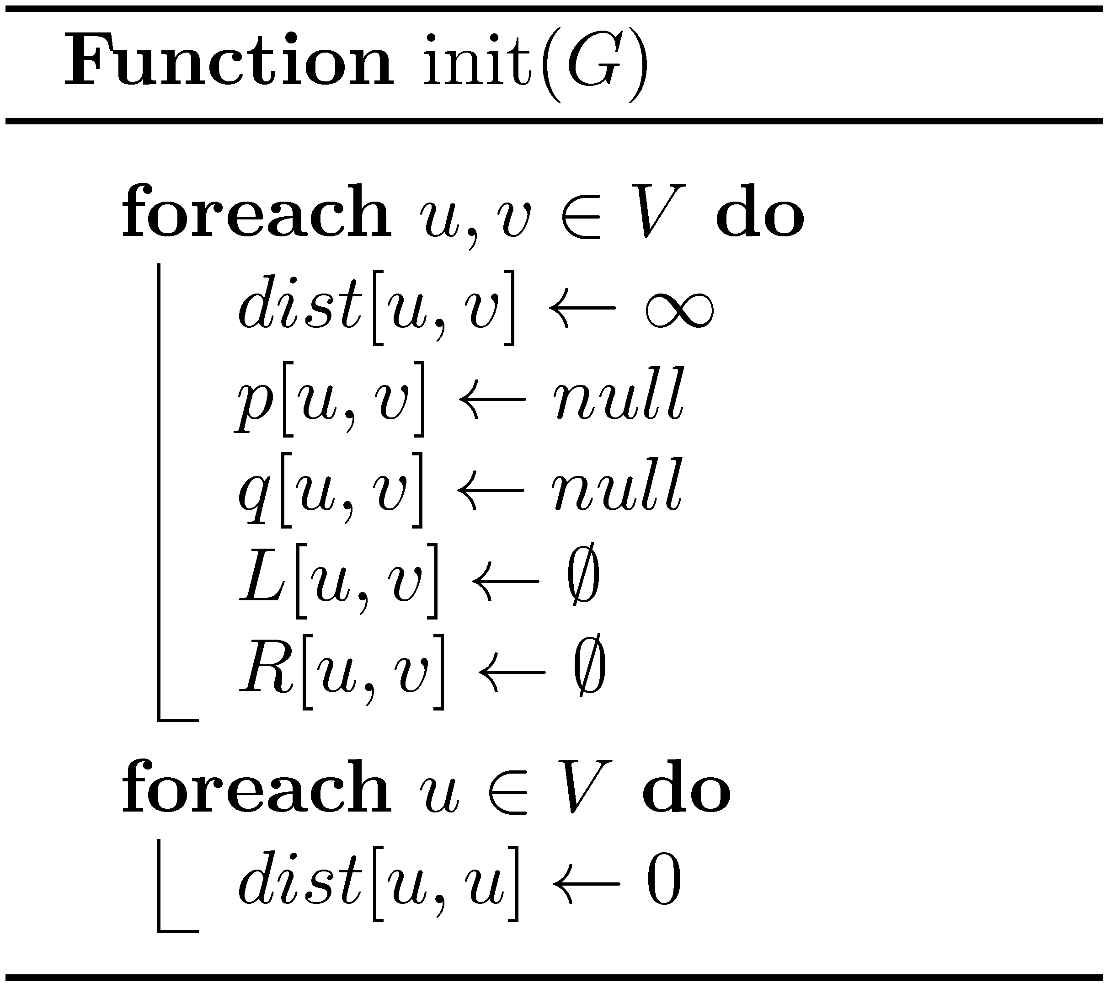
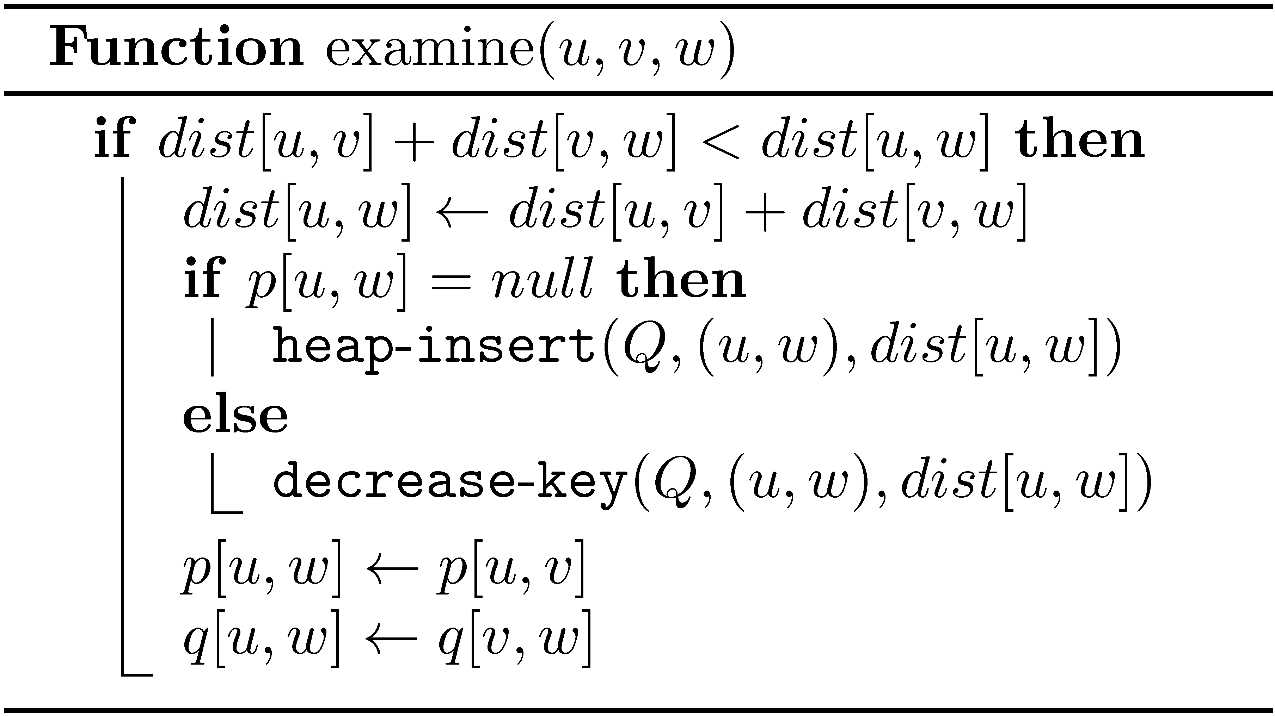

Slide 11
Dynamic algorithms
An incremental algorithm only allows insertions
An decremental algorithm only allows deletions
A fully-dynamic algorithm allows
both insertion and deletions

Slide 12
Example: Many LSPs
n
Two complete layers
Every path is an LSP – n³ paths
Can assign weights so that all SPs are unique

Slide 13
Example: Many LSP changes
0
Blue edges are significantly lighter than black edges
When red edge inserted, all previous LSPs destroyed
When red edge deleted, all previous LSPs recreated

Slide 14
Historical Paths (HPs)
A path π is historic, if it was a shortest path at some
point of time after the last update of one of its vertices
Let π be a path at time t
Let t’ be the time of the last update, before t, on π
A path π is historic at time t if and only if
there exists t’ ≤ t’’ ≤ t such that π is a SP at time t’’
A path π stops being historic
only as a result of an update on it

Slide 15
Locally Historical Paths (LHPs)
Demetrescu-Italiano (2004)
historical path
historical path
π is a LHP iff l[π] and r[π] are HP
l[π] and r[π] are not necessarily
shortest at the same time

Slide 16
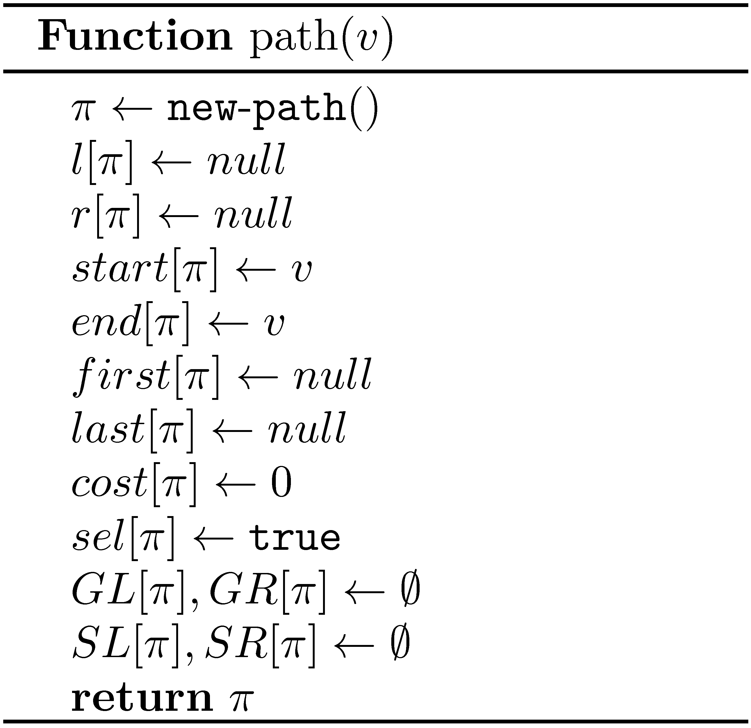
An empty vertex path

Slide 17
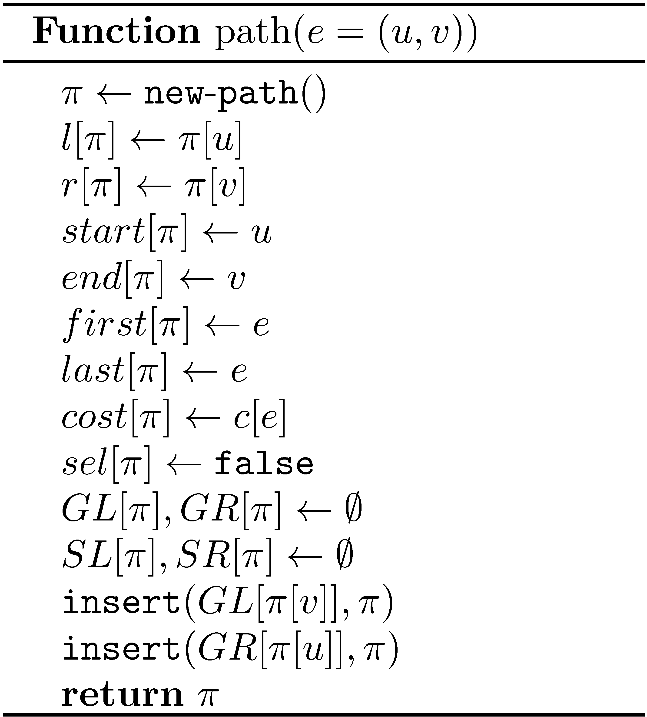
Converting an edge into a path

Slide 18
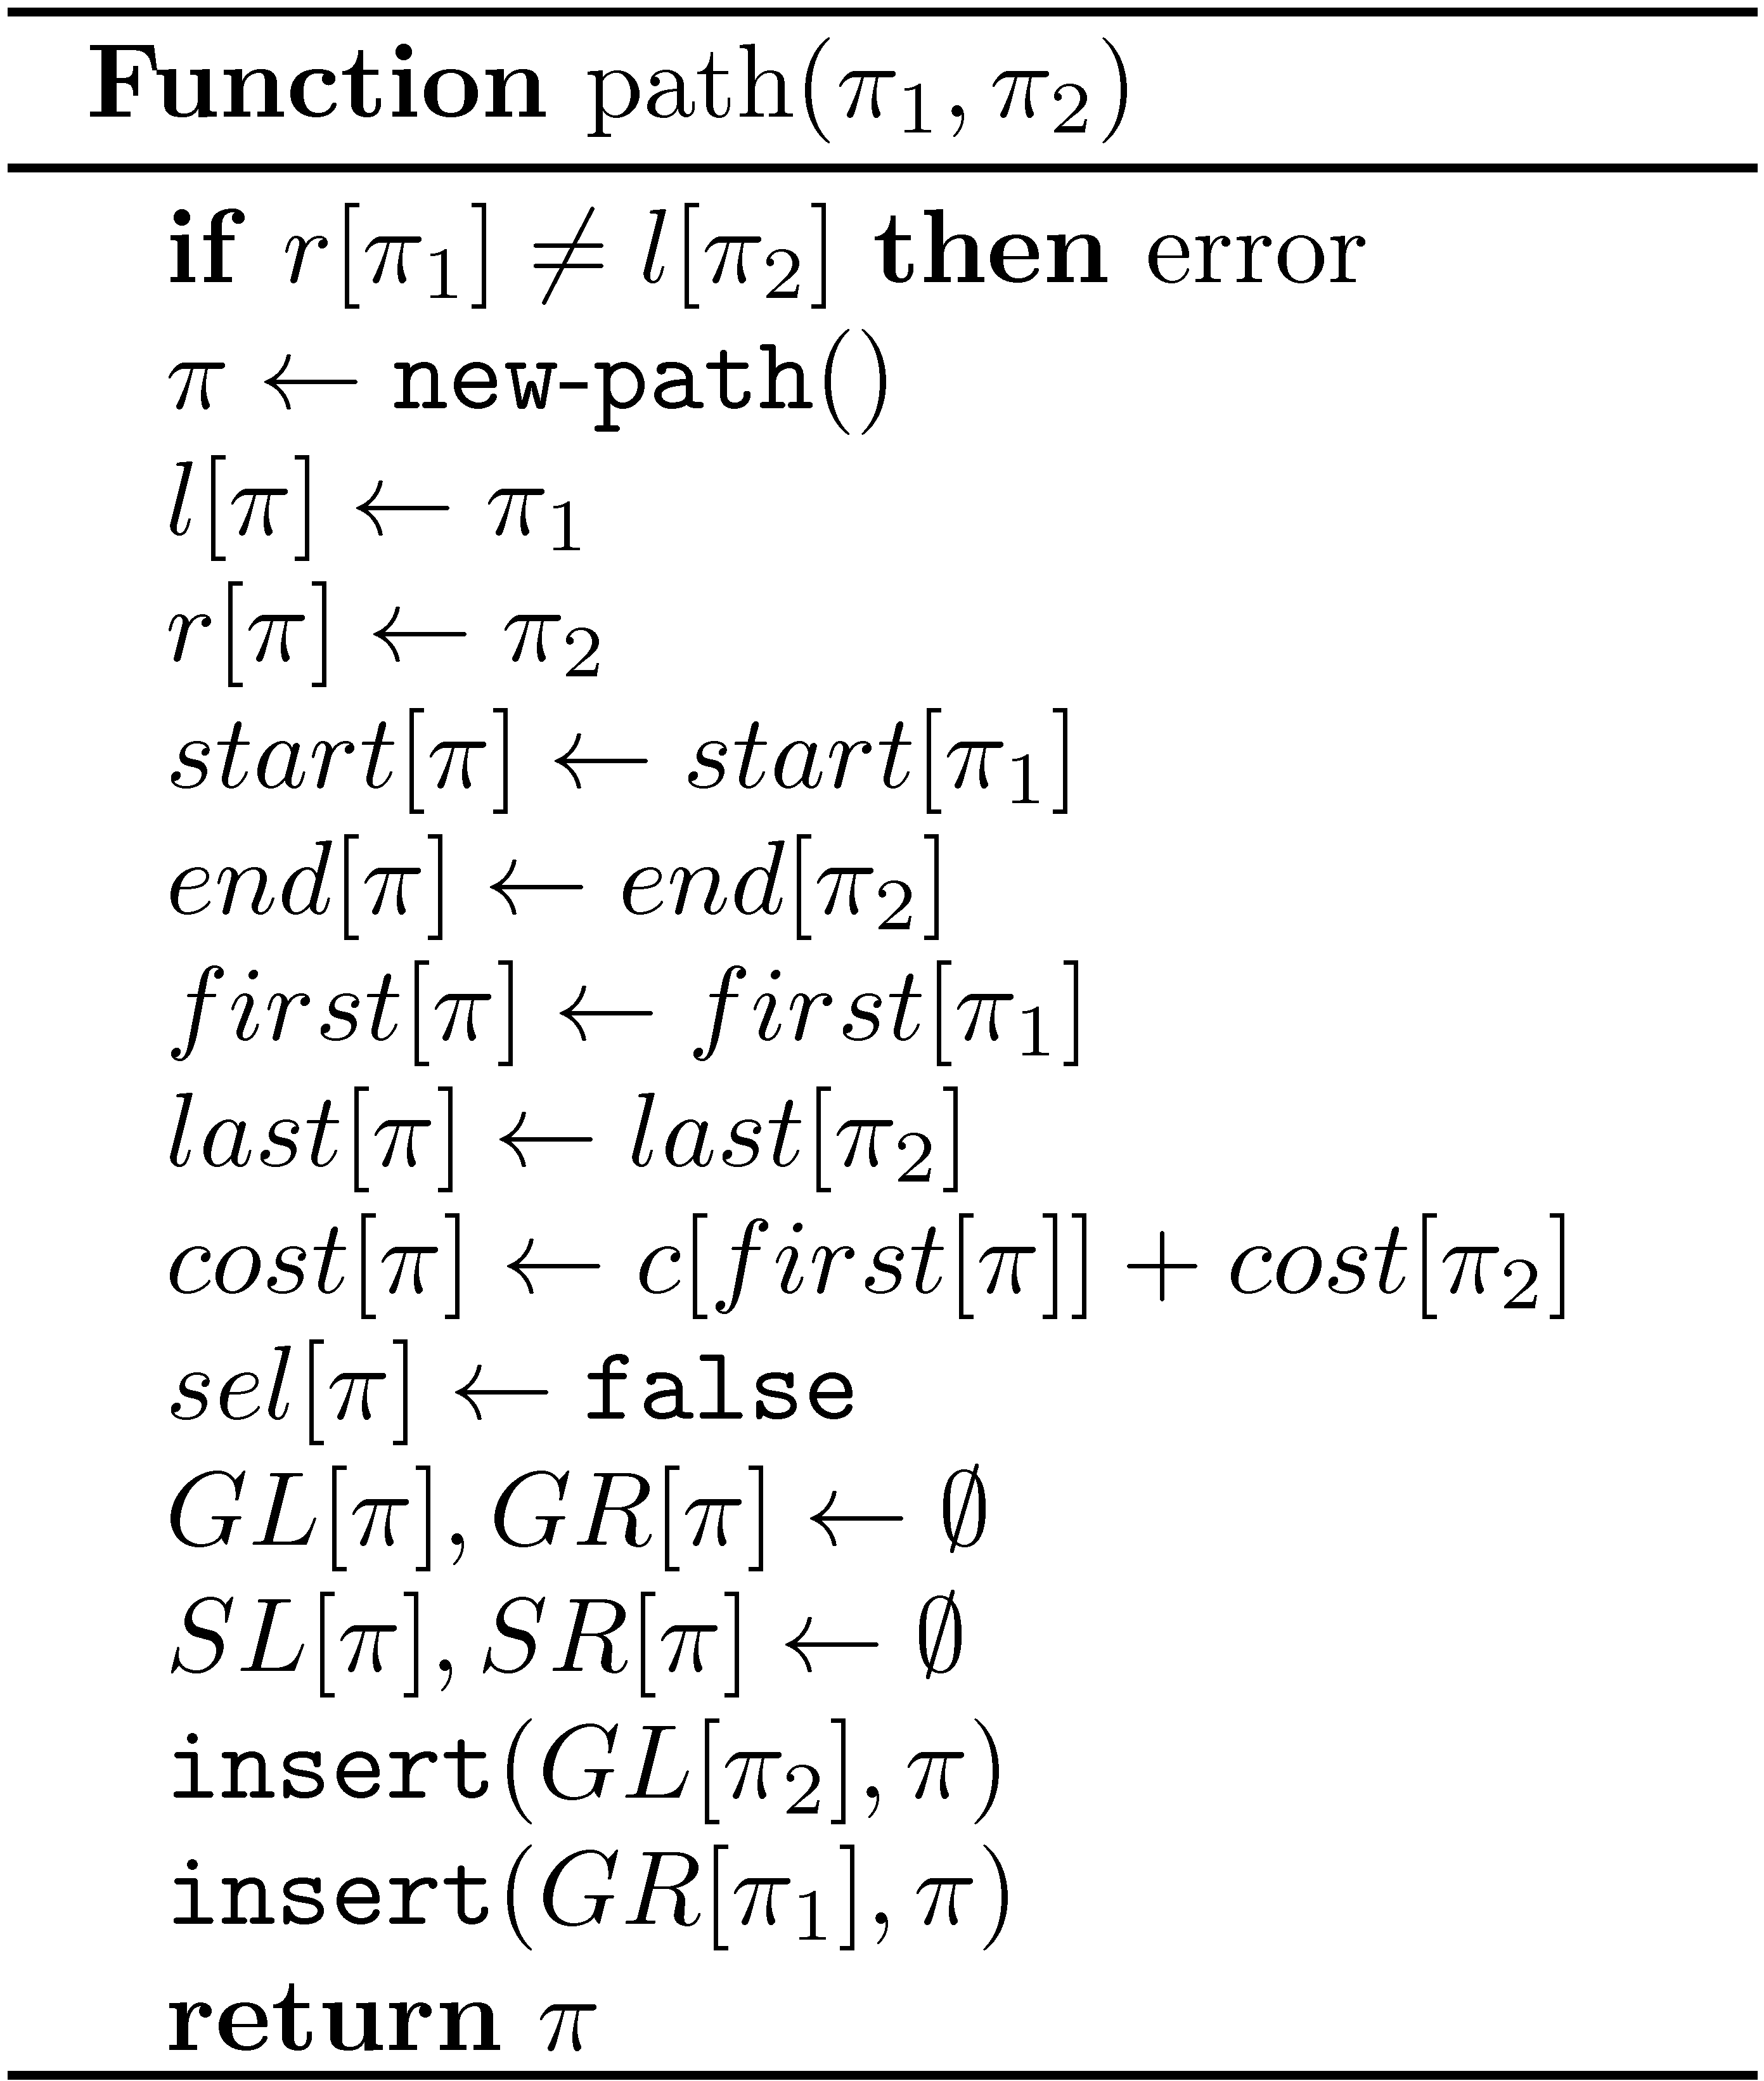
Combining two paths

Slide 19
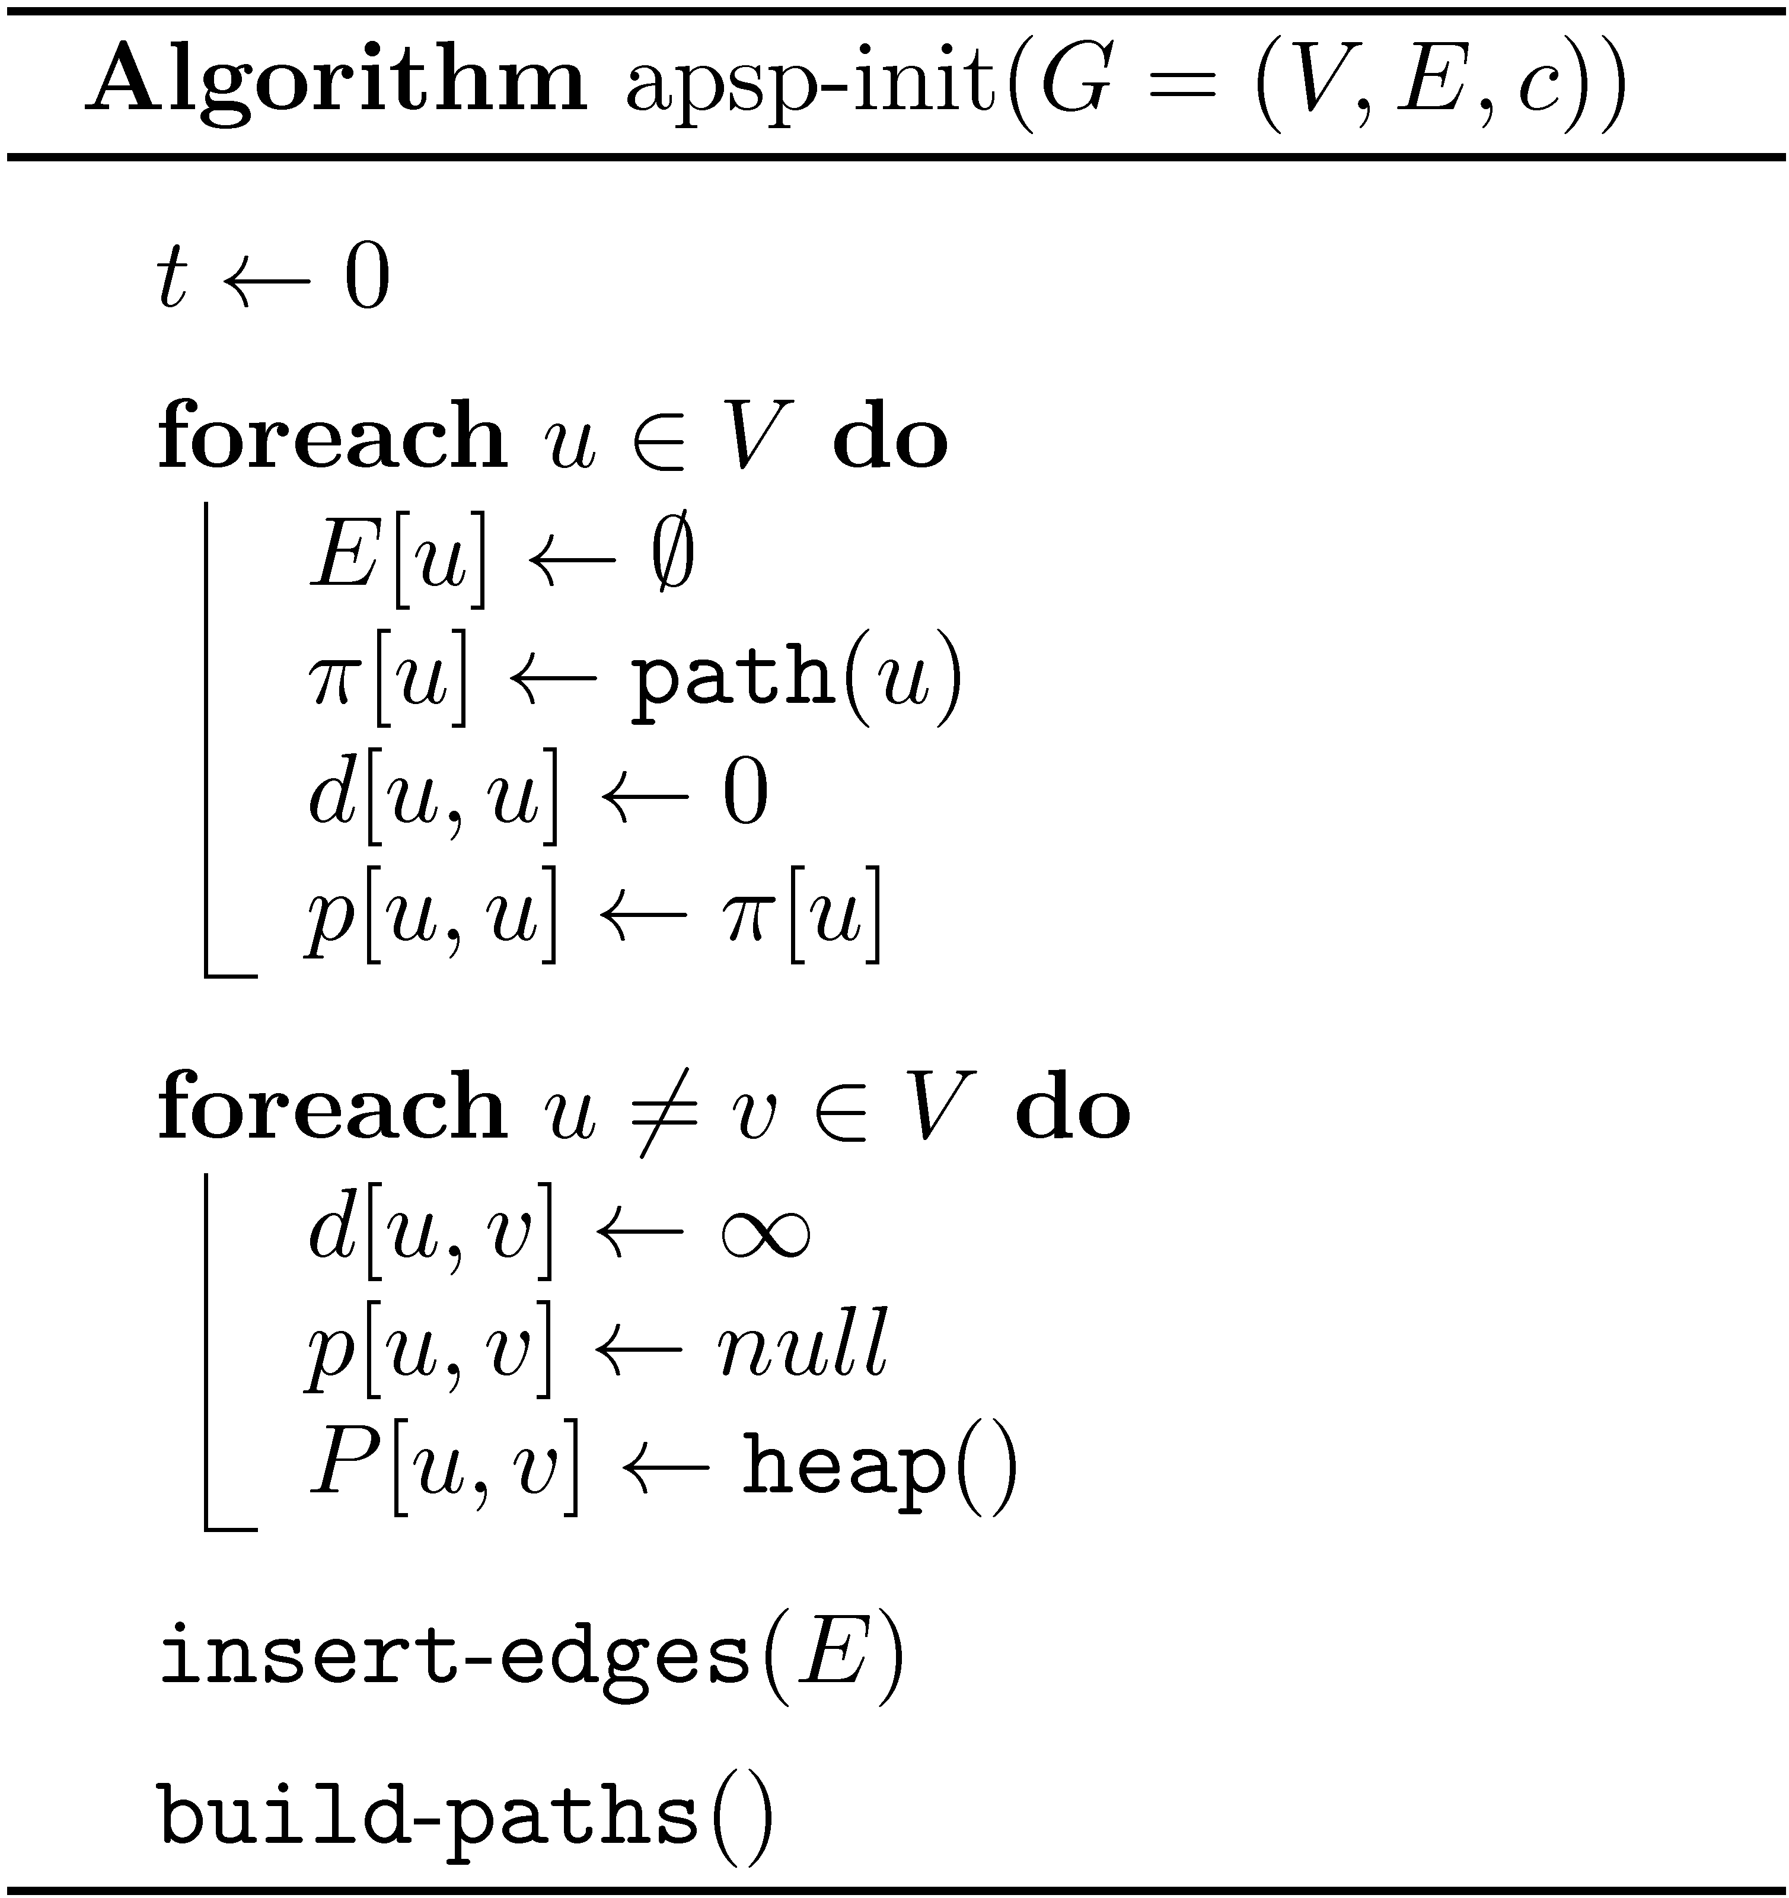
Dynamic-APSP initialization

Slide 20
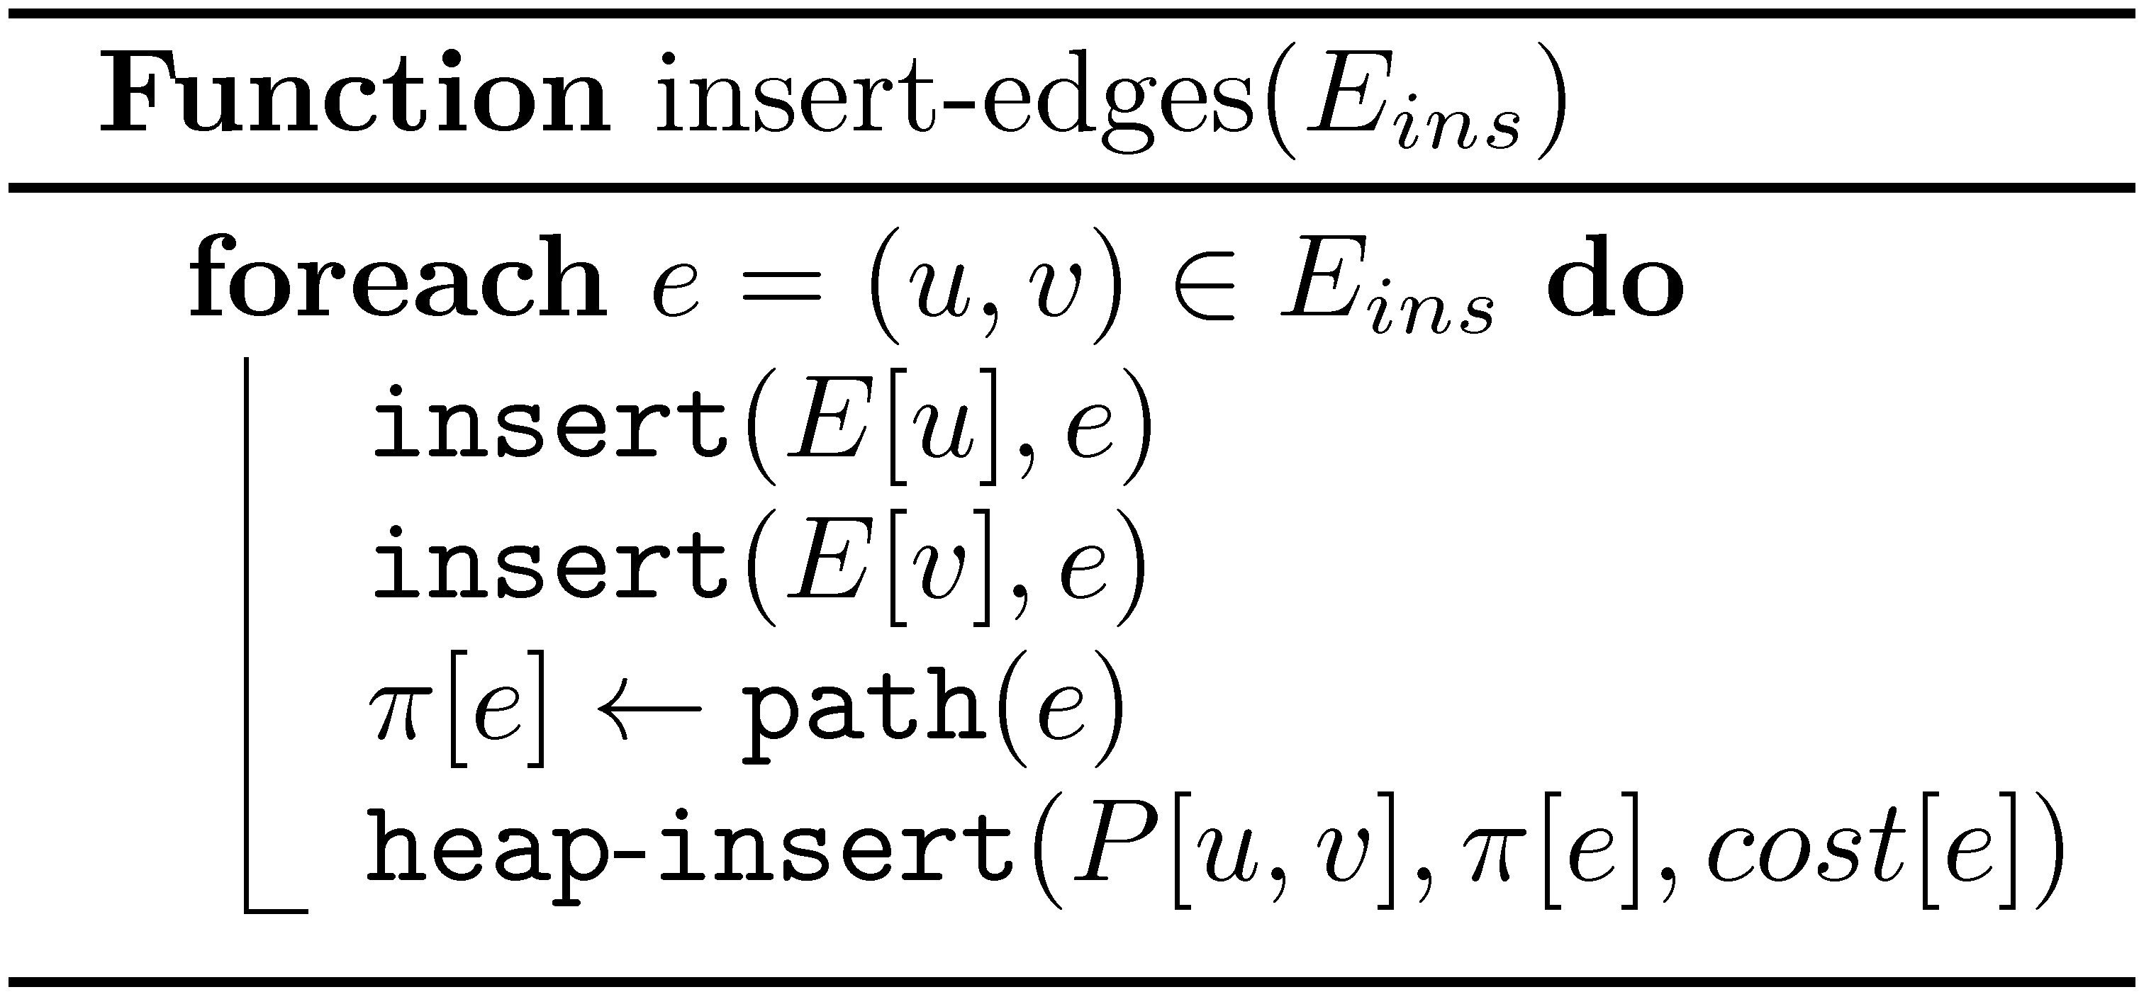
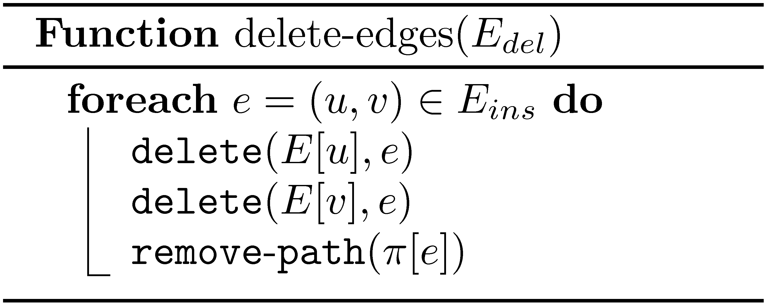
Insert and delete edges

Slide 21
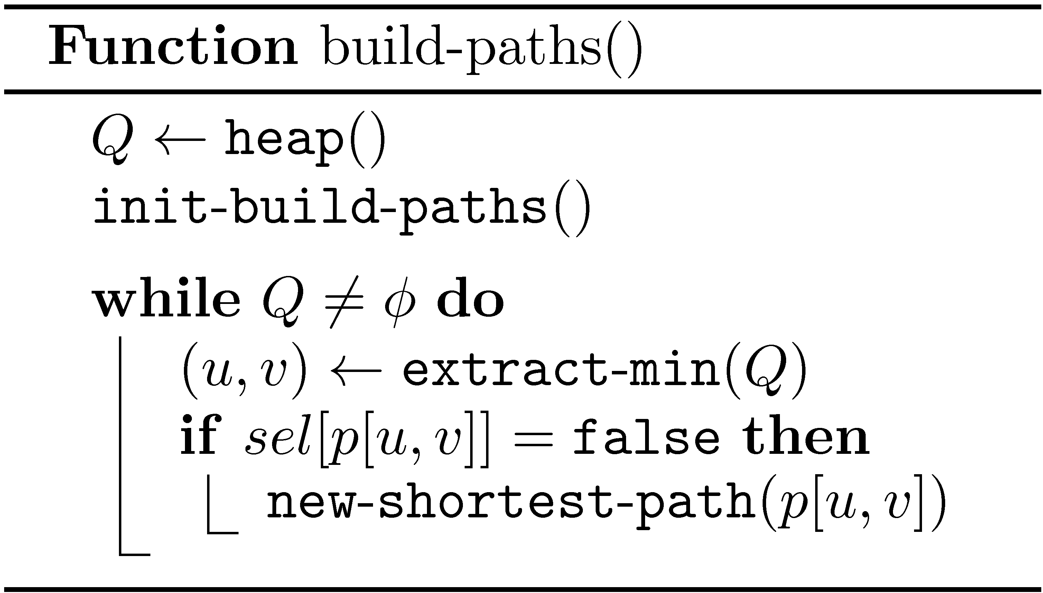
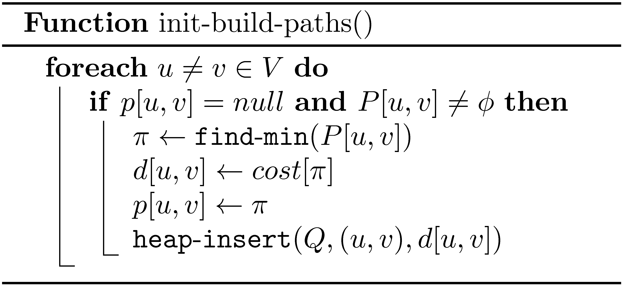
Build-Paths

Slide 22
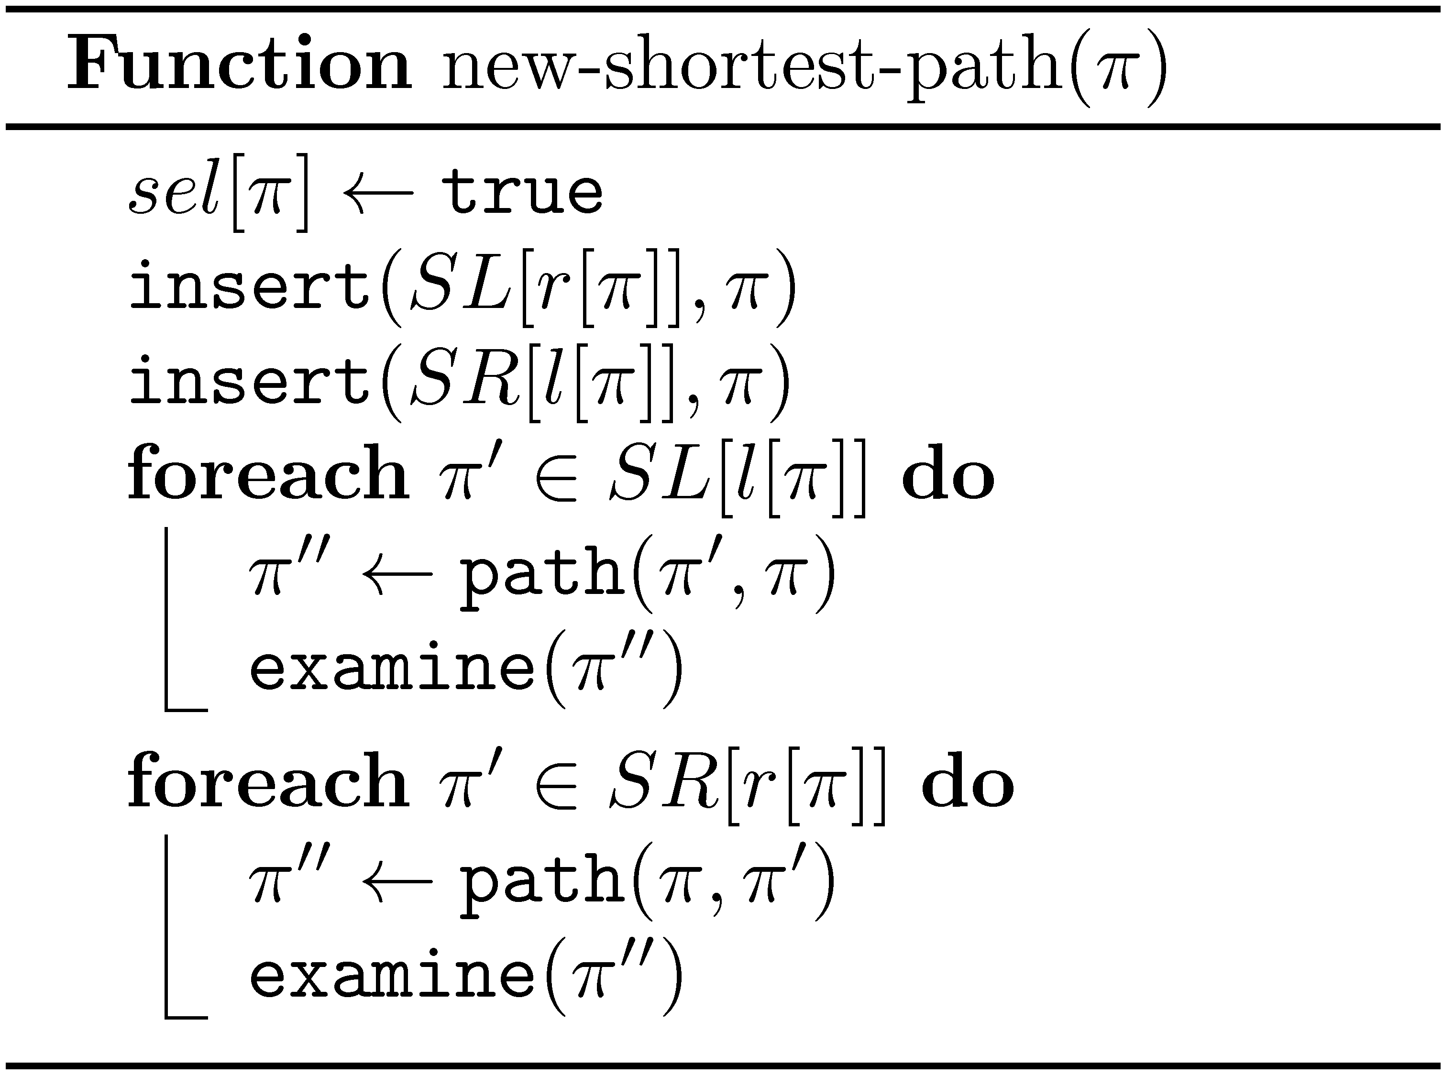
New-Shortest-Path

Slide 23
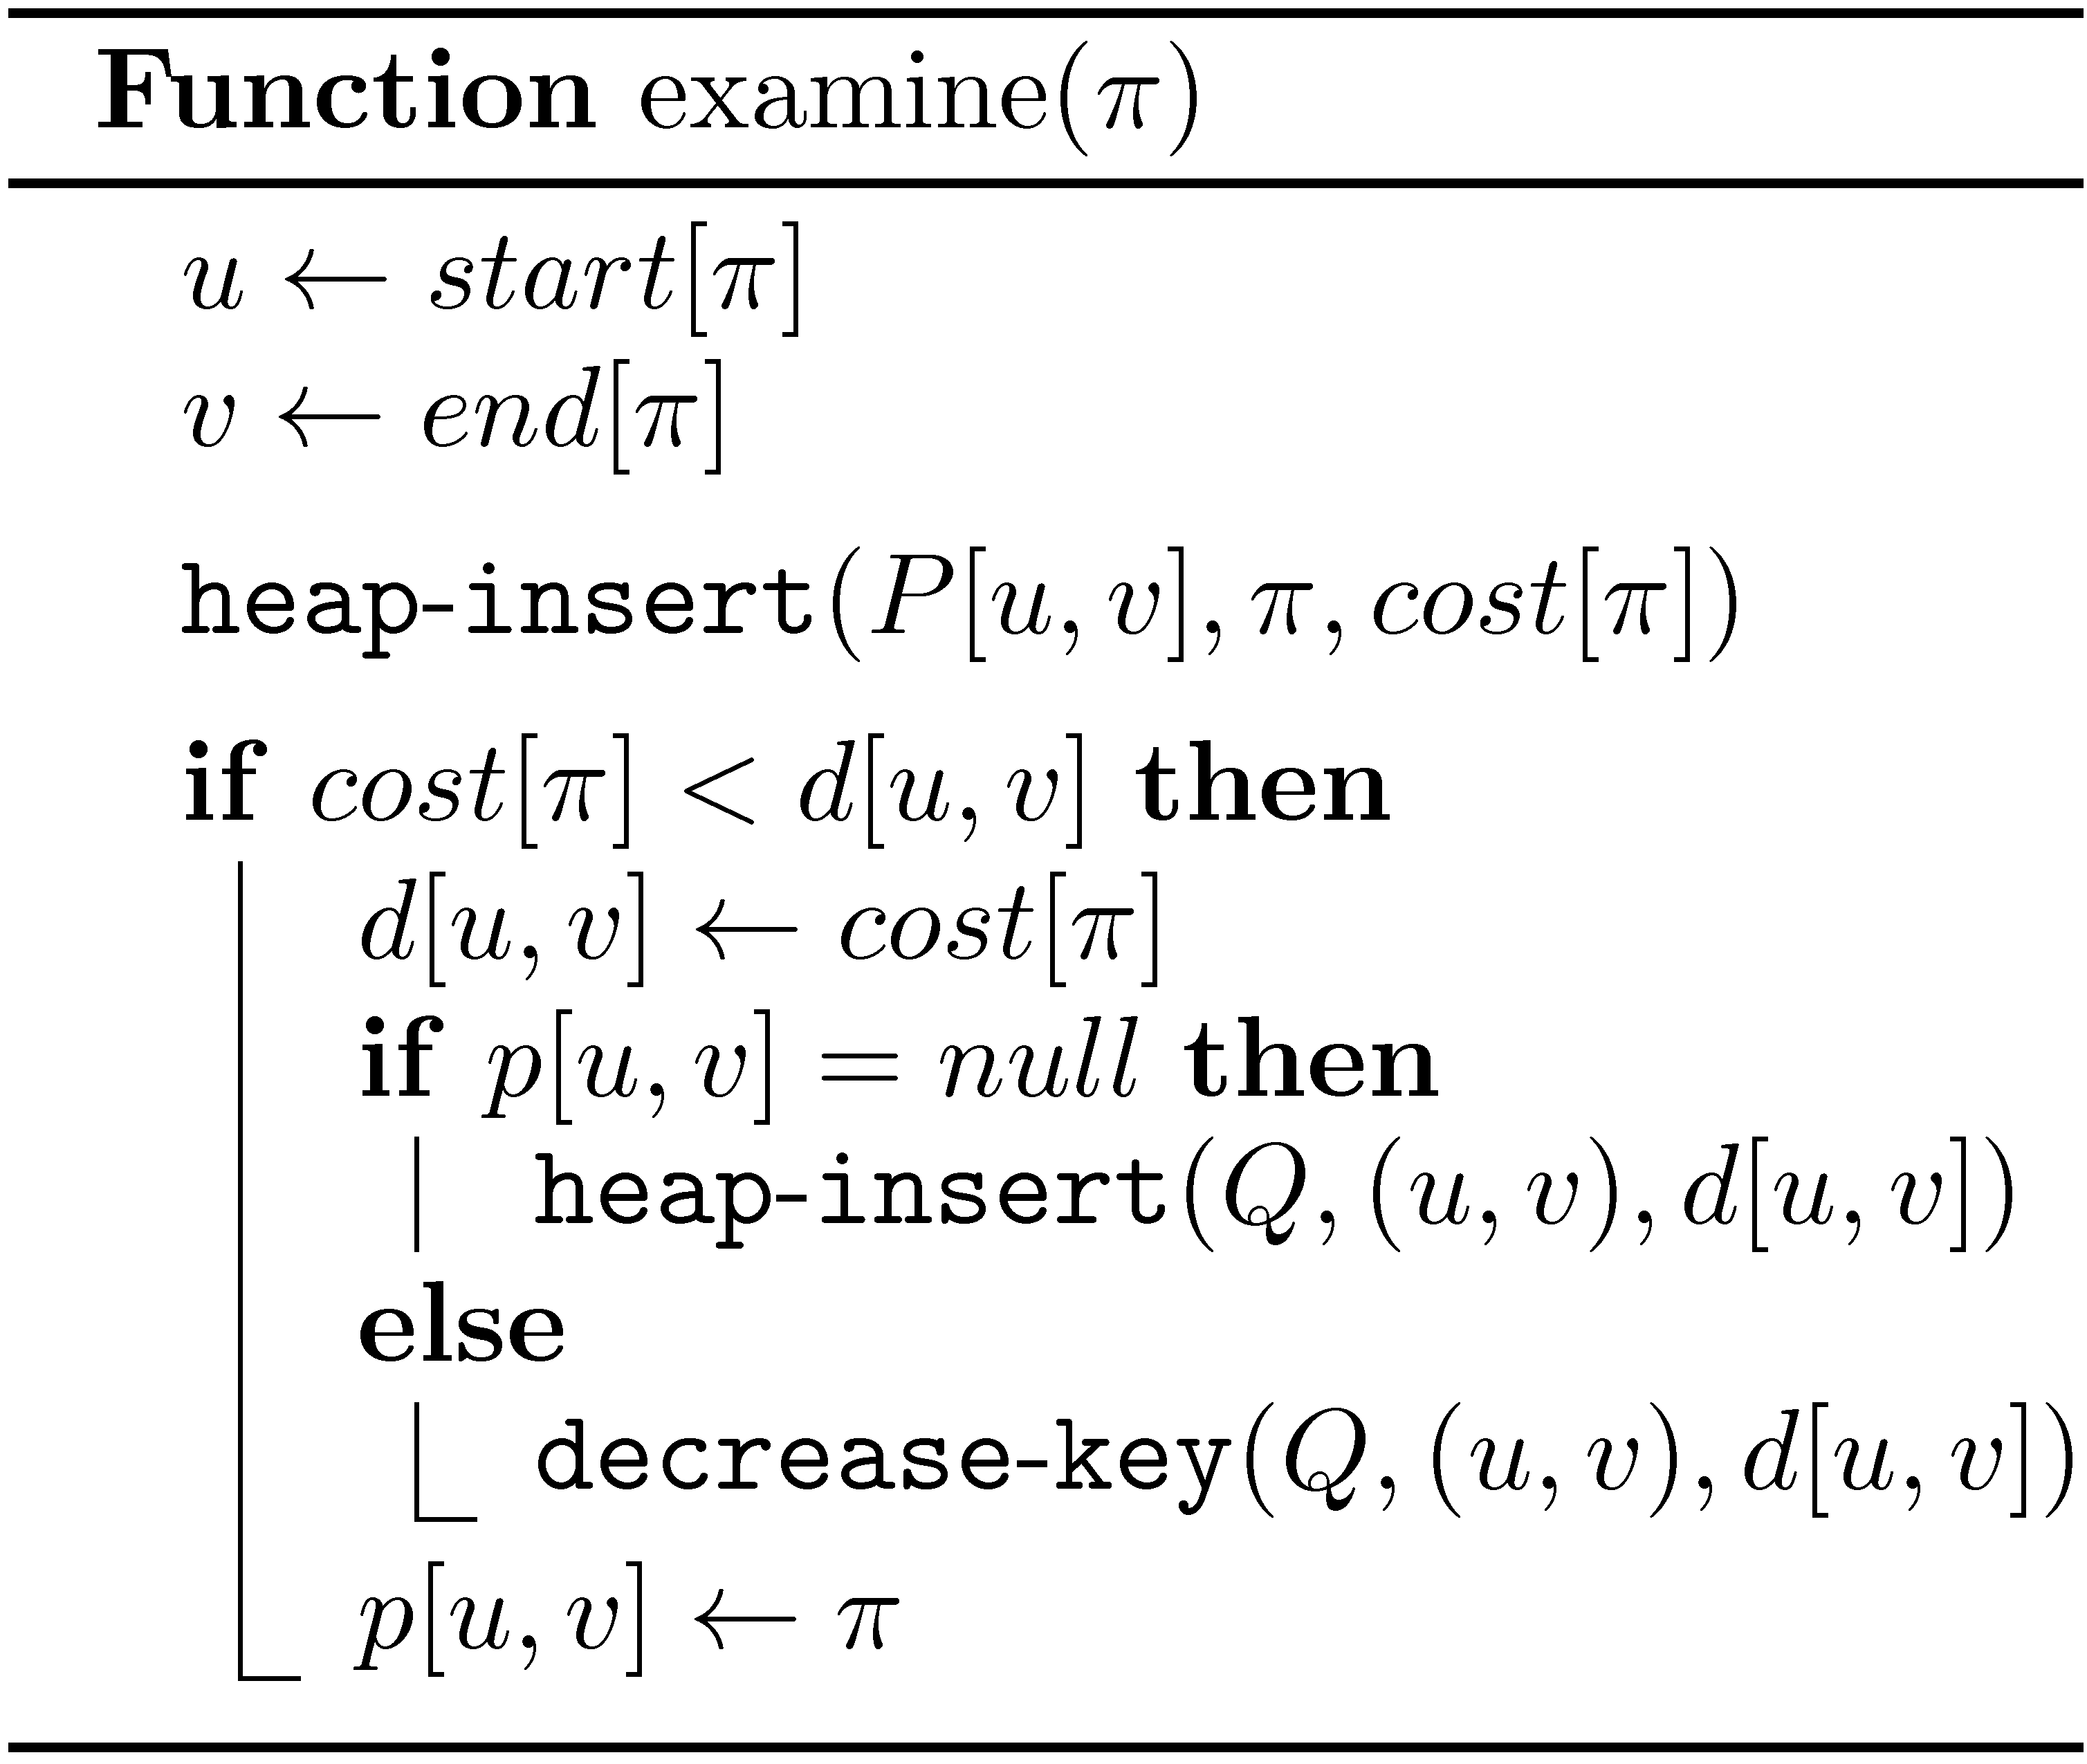
Examine a path

Slide 24
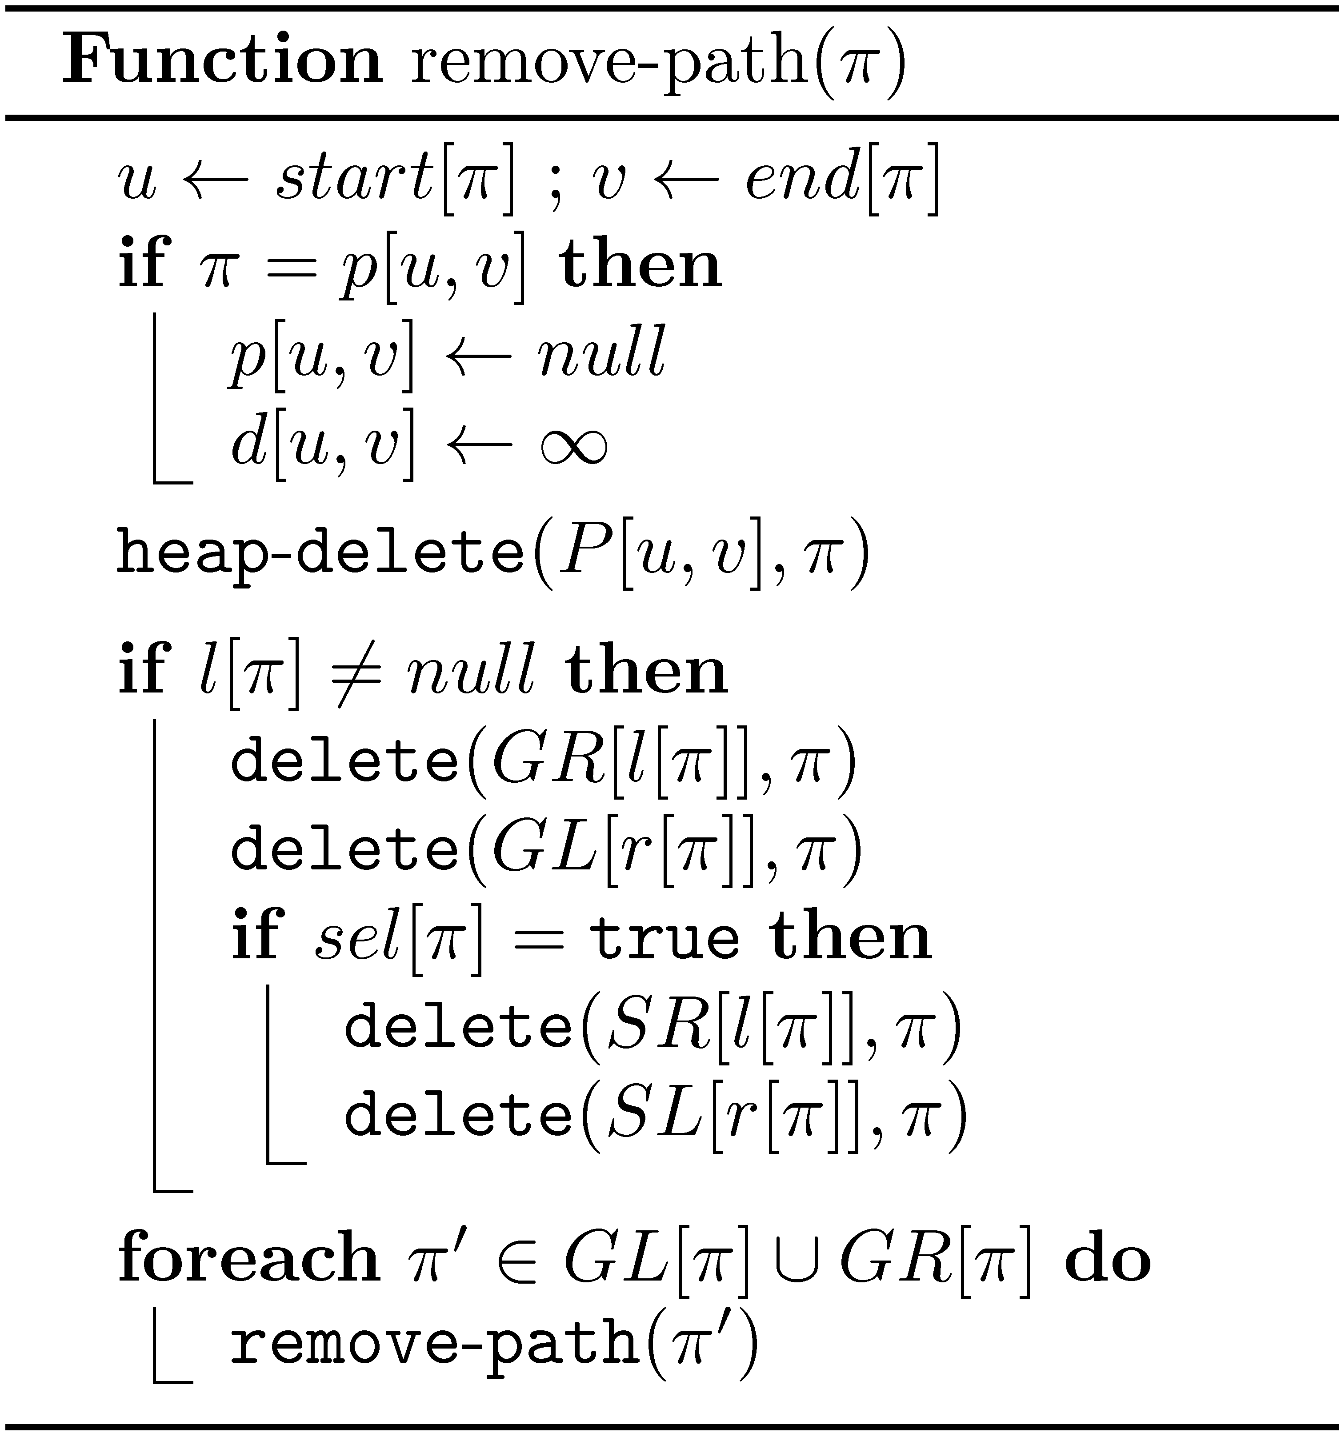
Removing a path

Slide 25
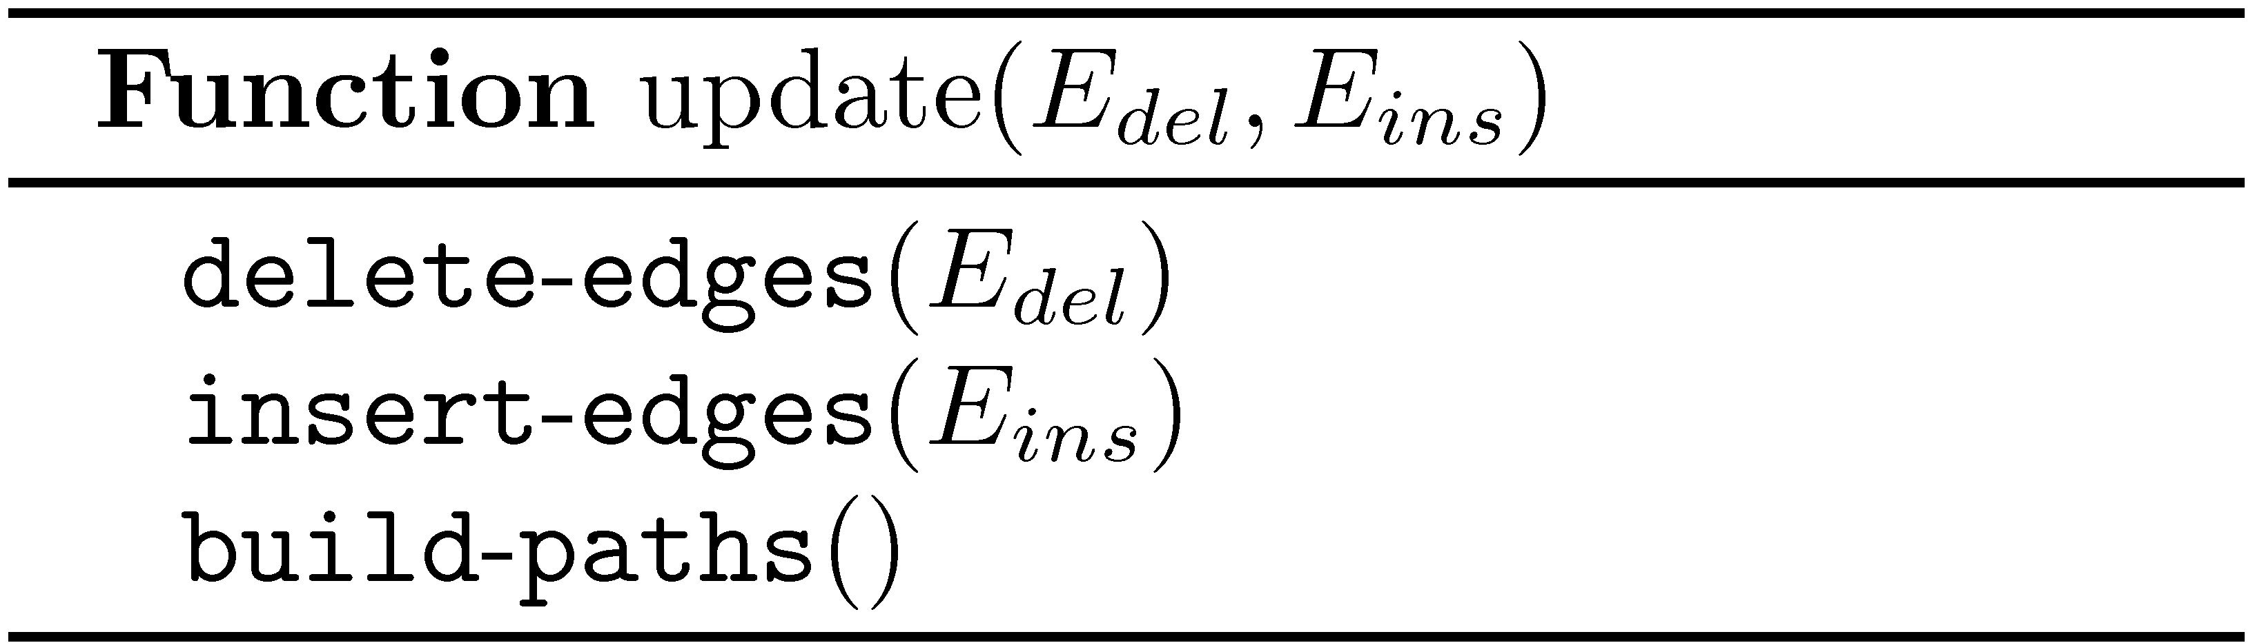
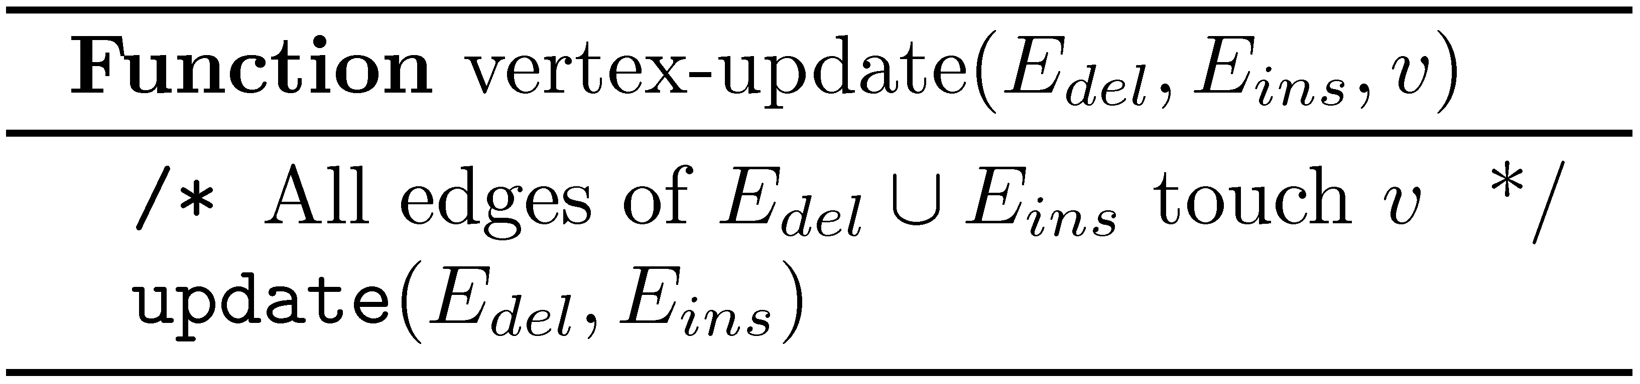

Update operations

Slide 26
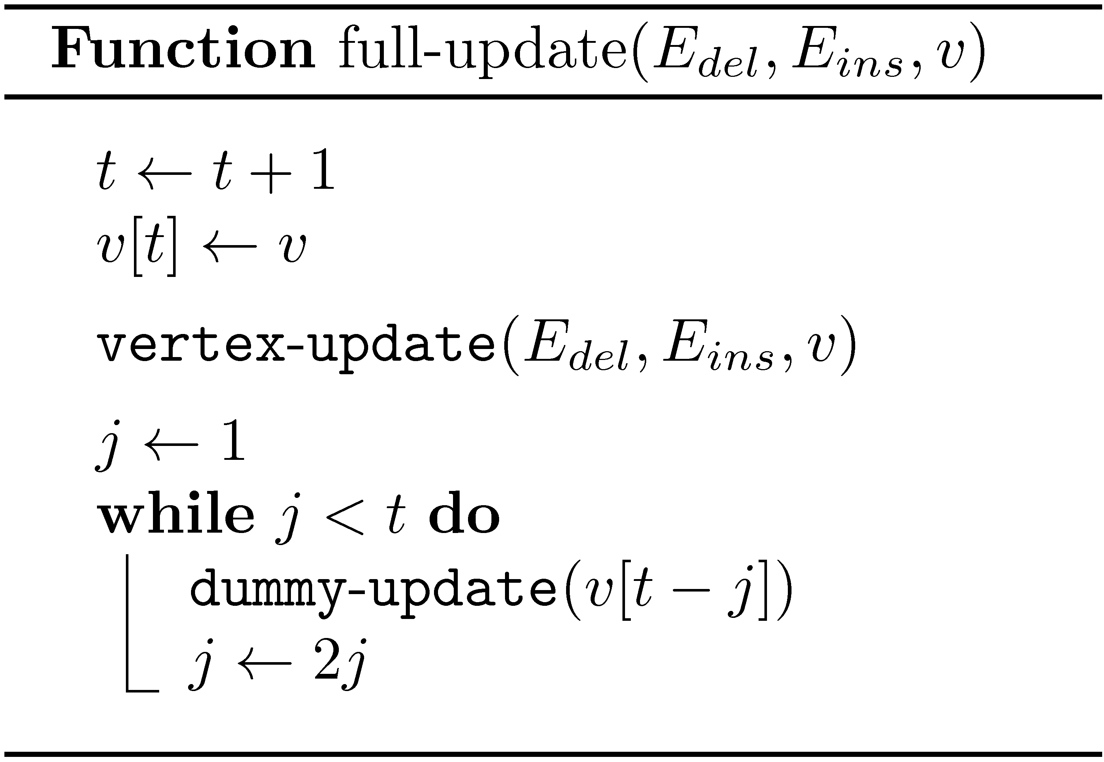
A “full update” operation

Slide 27
Example: Many HPs and LSPs
n
1
n+1
2
n
2n
n
Complete
Complete
Complete

Slide 28
Phase 1: Decrease edge weights
n
1
n−1
2
n
1
n
Complete
Complete
Complete

Slide 29
Phase 2: Increase edge weights
n
n
n−1
n−1
n
1
1
Complete
Complete
Complete

Slide 30
n³ new LHPs created at each step
n
n
n−1
2
n
1
1
Complete
Complete
Complete

