Slide 1
Games on Graphs
Uri Zwick
Tel Aviv University
Lecture 7 –
Acyclic Unique Sink Orientations
Started sometime in 2018
Last modified 02/01/2021

Slide 2
Lecture 7
(Acyclic) Unique Sink Orientations (of cubes)
Motivation
Definitions
Where do AUSOs come from?
Relation to Games.
Algorithms for finding the sink

Slide 3
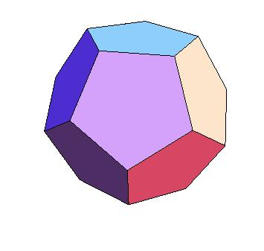
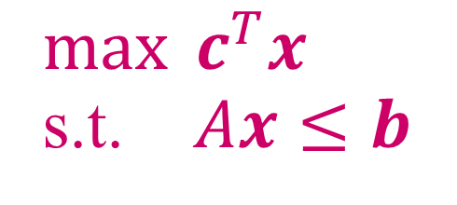
Linear Programming
$\max{c^{T}x}$
s.t. $Ax≤b$
Maximize a linear objective function subject
to a set of linear inequalities (and equalities)
Find the highest point in a polyhedron

Slide 4
The Simplex Algorithm
[Dantzig (1947)]
Start at some vertex.
Move up, from vertex to vertex,
along edges, until reaching the top.

Slide 5
Acyclic Unique Sink Orientations (AUSOs)
An AUSO is an orientation of the edges of some polytope
that satisfies the following two properties:
1. The orientation is acyclic.
2. Every face has a unique sink.
Every LP with a bounded feasibility polytope defines an AUSO.

Slide 6

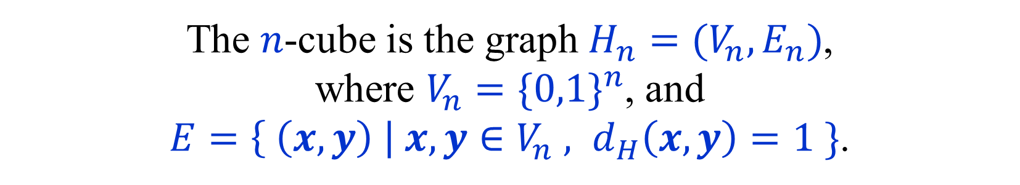
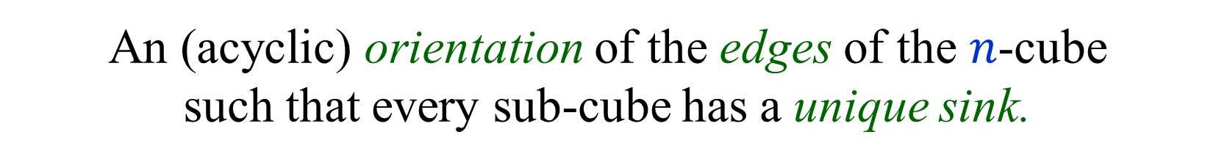
(A)USOs of $n$-cubes
[ Stickney-Watson (1978) ] [ Williamson Hoke (1988) ]
[ Szabó-Welzl (2001) ]
An (acyclic) orientation of the edges of the $n$-cube
such that every sub-cube has a unique sink.
The $n$-cube is the graph $H_{n}=(V_{n},E_{n})$,
where $V_{n}={\{0,1\}}^{n}$, and
$E=\left\{ \left(x,y\right) \right| x,y∈V_{n} , d_{H}\left(x,y\right)=1 \}$.
Sink $≡$ All edges are incoming

Slide 7
Sources of USOs and AUSOs
Cube USOs:
Linear Complementary Problems (LCP)
Geometric problems such as smallest enclosing ball
General Linear Programs (LP)
Cube AUSOs:
Linear Programs (LP) whose polytope is a cube
(Non-degenerate) binary 1-player and 2-player games

Slide 8


Binary TBSG → AUSO
Let $Γ=(S_{0}=[n_{0}],S_{1}=[n_{1}],{\left\{A_{i}\right\}}_{i∈S_{0}∪S_{1}},c,p)$ be a binary TBSG.
Binary means that $A_{i}=\left\{a_{i,0},a_{i,1}\right\}$, for every $i∈S_{0}$.
The sets $A_{i}$ for $i∈S_{1}$ may be arbitrary.
For $x∈{\left\{0,1\right\}}^{n_{0}}$, let $σ_{x}∈Σ_{0}$ be s.t. $σ_{x}\left(i\right)=a_{i,x_{i}}$, for $i∈[n_{0}]$.
Recall that $Val\left(σ\right)=Val\left(σ,τ\left(σ\right)\right).$ ($τ\left(σ\right)$ opt. counter-strategy.)
Non-degeneracy assumption:
If $d_{H}\left(x,y\right)=1$, then $Val\left(x\right)≠Val\left(y\right)$.
Let $A_{Γ}:{\left\{0,1\right\}}^{n_{0}}→{\left\{0,1\right\}}^{n_{0}}$ be such that
$A_{Γ}{\left(x\right)}_{i}=1$ iff $Val\left(σ_{x}\right)<Val(σ_{x⊕e_{i}})$.
Lemma: If $Γ$ is a non-degenerate binary game, then $A_{Γ}$ is an AUSO.
Proof follows from the correctness of strategy iteration.
Can we remove the non-degeneracy assumption?

Slide 9

(A)USOs of 1-cubes, $2$-cubes

Slide 10
(A)USOs of 3-cubes
USO
not AUSO
Unique global sink but
not AUSO
19 non-isomorphic 3-USOs

Slide 11
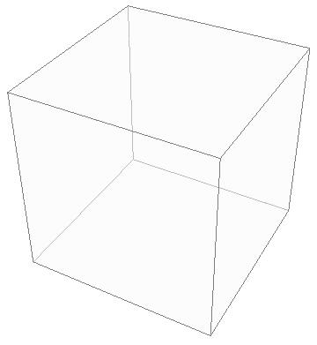

AUSOs of $n$-cubes
2n facets
2^{n} vertices
USOs and AUSOs
[ Stickney, Watson (1978) ]
[ Morris (2001) ]
[ Szabó, Welzl (2001) ]
[ Gärtner (2002) ]
The diameter is exactly n
No diameter issue!

Slide 12
(A)USOs of 5-cubes
Slide taken from a presentation by Tibor Szabó.

Slide 13
Finding the sink of an (A)USO
An $n$-AUSO has $2^{n}$ vertices and $n2^{n−1}$ edges.
If it is given explicitly, we can
find the sink in “linear time”.
More interestingly:
Suppose that the (A)USO is given via an oracle.
We can query the oracle for the
orientation of the edges at a given vertex.
How many queries do we need,
in the worst-case, to find the sink?

Slide 14


Formal definitions and notation
An orientation $A$ of the $n$-cube
is a function $A:{\left\{0,1\right\}}^{n}→{\left\{0,1\right\}}^{n}$
such that $A{\left(x\right)}_{i}≠A{\left(x⊕e_{i}\right)}_{i}$
$x \underset{→}{A} x⊕e_{i}$ $⟺ A{\left(x\right)}_{i}=1 ⟺ A{\left(x⊕e_{i}\right)}_{i}=0$
A sub-cube of $A$ is specified by $c∈{\left\{0,1,∗\right\}}^{n}$.
$$V_{c}=\left\{ x∈{\left\{0,1\right\}}^{n} \right| c_{i}≠ ∗ → x_{i}=c_{i} \}$$
Equivalently, a sub-cube is specified by $(x,C)$,
where $x∈{\left\{0,1\right\}}^{n}$ and $C=\left\{ i \right| c_{i}=∗ \}$.
Vertex $x$ is a sink of $A$ iff $A\left(x\right)=0^{n}$.

Slide 15


Flipping edges
Lemma:
If $A$ is a USO and $B\left(x\right)=A\left(x\right)⊕e_{i}$,
for every $x∈{\left\{0,1\right\}}^{n}$, then $B$ is also a USO.
$B$ is obtained from $A$ by flipping the
direction of all edges in the $i$-th dimension.
$B$ is not necessarily an AUSO even if $A$ is.

Slide 16
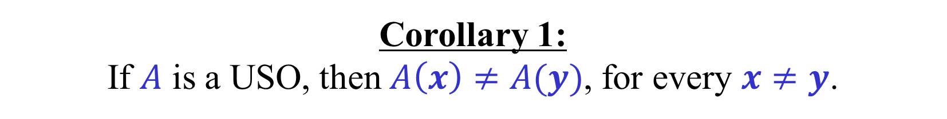
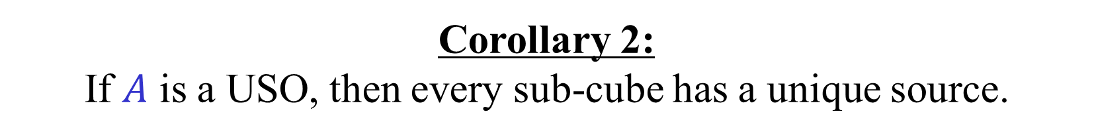
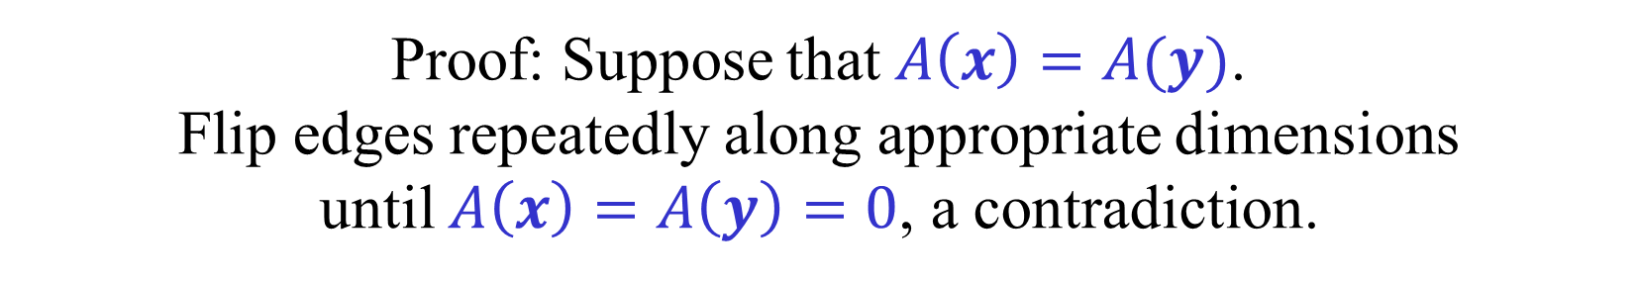
An (A)USO is a bijection
Corollary 1:
If $A$ is a USO, then $A\left(x\right)≠A(y)$, for every $x≠y$.
Proof: Suppose that $A\left(x\right)=A(y)$.
Flip edges repeatedly along appropriate dimensions
until $A\left(x\right)=A\left(y\right)=0$, a contradiction.
Corollary 2:
If $A$ is a USO, then every sub-cube has a unique source.

Slide 17


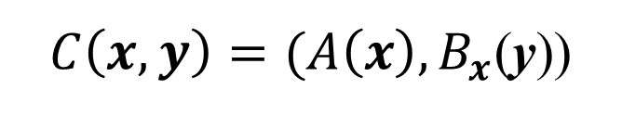

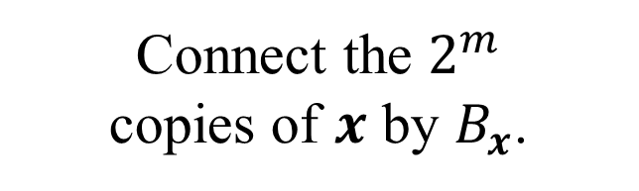


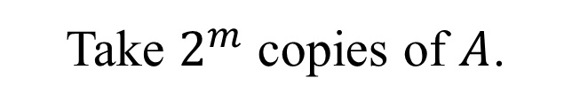




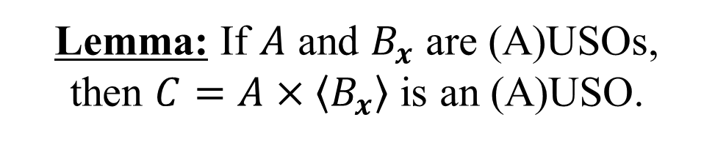
A product (blowup) construction
$$vertex$$
$$outmap$$
$$A$$
$$A:{\left\{0,1\right\}}^{n}→{\left\{0,1\right\}}^{n}$$
$$B_{x}:{\left\{0,1\right\}}^{m}→{\left\{0,1\right\}}^{m}$$
$$x∈{\left\{0,1\right\}}^{n}$$
Take $2^{m}$ copies of $A$.
Connect the $2^{m}$
copies of $x$ by $B_{x}$.
$$B_{000}$$
$$C=A×\left\langle B_{x}\right\rangle$$
$C\left(x,y\right)=(A\left(x\right),B_{x}$(y))
Lemma: If $A$ and $B_{x}$ are (A)USOs,
then $C=A×\left\langle B_{x}\right\rangle$ is an (A)USO.
$$C:{\left\{0,1\right\}}^{n+m}→{\left\{0,1\right\}}^{n+m}$$

Slide 18
Hypersink replacement
Slide by Tibor Szabó.

Slide 19

Induced (A)USO
Suppose that $A:{\left\{0,1\right\}}^{n}→{\left\{0,1\right\}}^{n}$ is an $n$-(A)USO.
We want to define a $k$-(A)USO $A_{k}$ that “represents” $A$.
$A_{k}\left(x\right)=A{\left(sink\left(A_{x∗^{n−k}}\right)\right)}_{1:k}$ , ${x∈\left\{0,1\right\}}^{k}$
$${xs}_{x}$$
$A\left(xs_{x}\right) = A_{k}\left(x\right) 0^{n−k} , {x∈\left\{0,1\right\}}^{k}$.
Lemma: $A_{k}$ is an (A)USO.
$A_{k}$ can be defined using any subset of $k$ coordinates.
Useful in obtaining recursive algorithms.

Slide 20

Induced (A)USO – Proof
Suppose that $A:{\left\{0,1\right\}}^{n}→{\left\{0,1\right\}}^{n}$ is an $n$-(A)USO.
$A_{k}\left(x\right)=A{\left(sink\left(A_{x∗^{n−k}}\right)\right)}_{1:k}$ , ${x∈\left\{0,1\right\}}^{k}$
$${xs}_{x}$$
$A\left(xs_{x}\right) = A_{k}\left(x\right) 0^{n−k} , {x∈\left\{0,1\right\}}^{k}$.
Lemma: $A_{k}$ is an (A)USO.
Let $S⊆[k]$. We need to show that ${\left(A_{k}\right)}_{S}$ has a unique sink.
Suppose that

Slide 21
Decomposition algorithm
$T(n)$ – number of queries needed to find the sink of an $n$-USO.
We show that $T\left(n\right)≤T\left(k\right)⋅T\left(n−k\right)$ $⟹$ $T\left(n\right)≤T{\left(k\right)}^{⌈n/k⌉}$
Given an $n$-USO $A$, consider the induced $k$-USO $A_{k}$.
$A_{k}\left(x\right)=A{\left(sink\left(A_{x∗^{n−k}}\right)\right)}_{1:k}$ , ${x∈\left\{0,1\right\}}^{k}$
Run the algorithm recursively on $A_{k}$.
To evaluate a vertex $x$ of $A_{k}$, run the algorithm recursively on $A_{x∗^{n−k}}$.
Each query $A_{x∗^{n−k}}(y)$, where $y∈{\left\{0,1\right\}}^{n−k}$ actually returns $A(xy)$.
For a query $x∈{\left\{0,1\right\}}^{k}$, the algorithm finds $s_{x}$, $A\left(xs_{x}\right)=A_{k}\left(x\right)0^{n−k}$.
If $x_{0}$ is the sink of $A_{k}$ then $x_{0}s_{x_{0}}$ is the sink of $A$.
$T\left(n\right)≤T\left(2\right)⋅T\left(n−2\right)≤3^{n/2}≈{1.73}^{n}$.
In particular:
$T\left(n\right)≤T\left(3\right)⋅T\left(n−3\right)≤5^{n/3}≈{1.71}^{n}$.
$T\left(n\right)≤T\left(4\right)⋅T\left(n−4\right)≤7^{n/4}≈{1.63}^{n}$.

Slide 22
Algorithm for 2-USOs
Query an arbitrary vertex.
If it is the sink, we are done.
If it is not the source, follow to the unique path to the sink.
If it is the source, jump to the antipodal vertex
and follow to the unique path to the sink.
$$T\left(2\right)=3$$
Note: We insist on evaluating the sink.

Slide 23

Fibonacci Seesaw
[ Szabó-Welzl (2001) ]
Two sub-cubes $c_{1},c_{2}∈{\left\{0,1,∗\right\}}^{n}$ are antipodal,
iff ${\left(c_{1}\right)}_{i}≠{\left(c_{2}\right)}_{i}$ whenever ${\left(c_{1}\right)}_{i},{\left(c_{2}\right)}_{i}≠∗$.
Grow two antipodal $k$-cubes whose sinks are known.
When $k=n−1$ the sink of the whole cube is known.
Start with an arbitrary pair of antipodal vertices.

Slide 24

Fibonacci Seesaw
[ Szabó-Welzl (2001) ]
Two sub-cubes $c_{1},c_{2}∈{\left\{0,1,∗\right\}}^{n}$ are antipodal,
iff ${\left(c_{1}\right)}_{i}≠{\left(c_{2}\right)}_{i}$ whenever ${\left(c_{1}\right)}_{i},{\left(c_{2}\right)}_{i}≠∗$.
Let $x_{1},x_{2}$ be the sinks of $A_{c_{1}},A_{c_{2}}$.
$A\left(x_{1}\right)≠A\left(x_{2}\right)$ → $∃i A{\left(x_{1}\right)}_{i}≠A{\left(x_{2}\right)}_{i}$
We extend the two $k$-cubes along dimension $i$.
One of the sinks is also the sink of the $\left(k+1\right)$-cube.
We need to find the sink of the other $k$-cube.

Slide 25
Fibonacci Seesaw
[ Szabó-Welzl (2001) ]
$$T\left(n\right)=2+T\left(0\right)+T\left(1\right)+ …+T\left(n−2\right)$$
$T\left(n\right)=F_{n+2}$ (Fibonacci numbers)
$$T\left(n\right)≤{1.62}^{n}$$

Slide 26
“Seven steps to Heaven”
[ Szabó-Welzl (2001) ]
$$T\left(4\right)=7$$
$$T\left(n\right)≤T\left(4\right)⋅T\left(n−4\right)≤7^{n/4}≤ {1.63}^{n}$$
Slightly worse than Fibonacci Seesaw.
Can be combined with FS to yield $T\left(n\right)≤{1.61}^{n}$
Best known deterministic algorithm
for USOs and AUSOs!

Slide 27
Randomized algorithms for USOs
$R\left(1\right)=\frac{3}{2}$
$R\left(2\right)=\frac{43}{20}$ [ Szabó-Welzl (2001) ]
$R\left(3\right)=\frac{4074633}{1369468}≈2.976$ [ Rote (2001) ]
$$R\left(n\right)≤R\left(3\right)⋅R\left(n−3\right)≤ {1.438}^{n}$$
Best known randomized algorithm for USOs.

Slide 28
Finding the sink of an AUSO
Can we use the acyclicity of AUSOs?
Path-following algorithms?
Improving algorithms?
Natural algorithms:
Arbitrary walk
Random walk (Random-Edge)
Random-Facet
Switch-All
Random-Jump

Slide 29

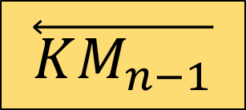
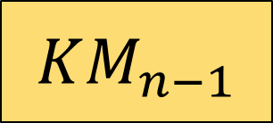
Klee-Minty cubes (1972)
011
111
001
$$\overset{⃖}{KM_{n−1}}$$
101
…
010
110
$$KM_{n−1}$$
000
100
$KM_{n}$ has a Hamiltonian path (Gray code).
Random-Edge on $KM_{n}$ takes $Θ(n^{2})$, w.h.p.
[Balogh-Pemantle (2007)]

Slide 30
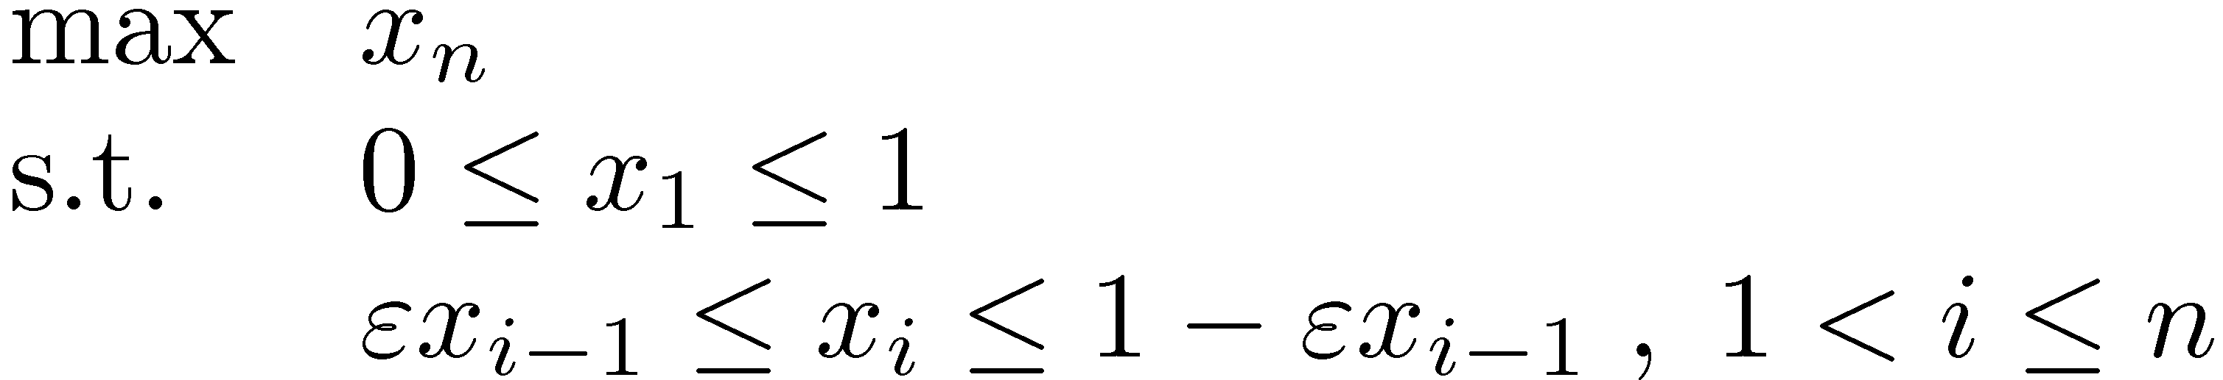
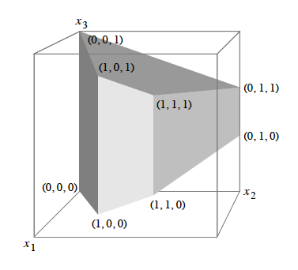
Klee-Minty cubes (1972)
Taken from a paper by Gärtner-Henk-Ziegler

Slide 31
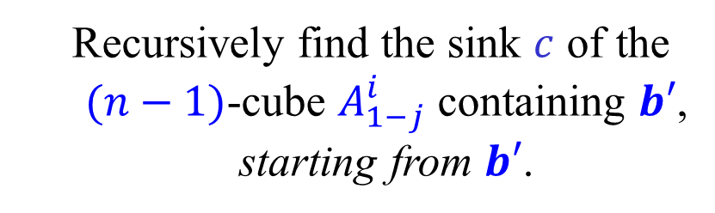

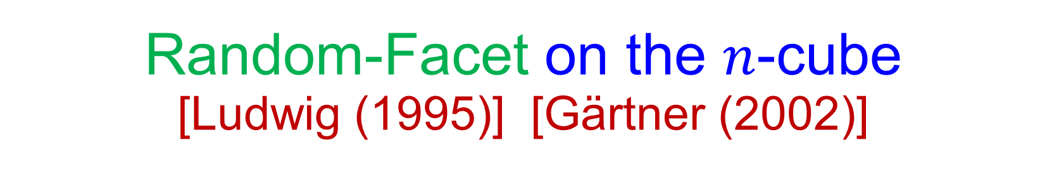
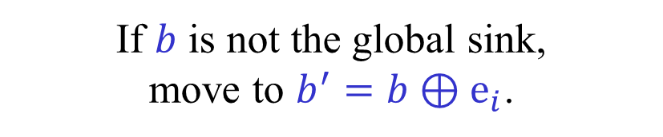

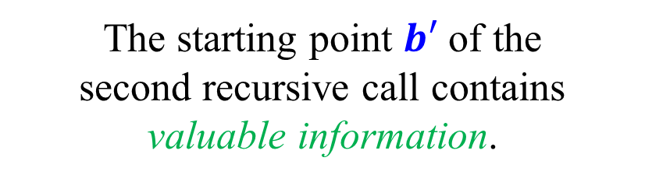
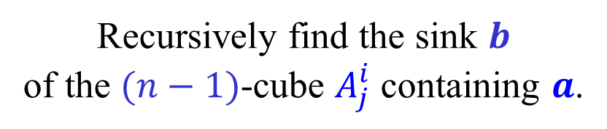

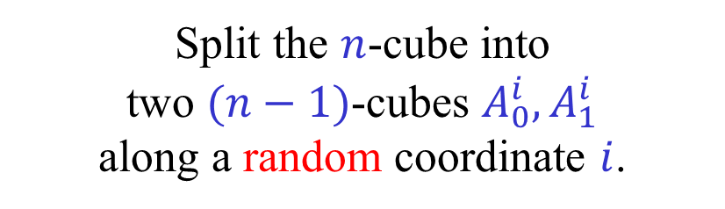



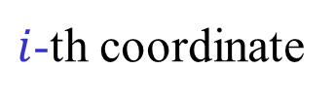

Random-Facet on the $n$-cube
[Ludwig (1995)] [Gärtner (2002)]
Start at some vertex $a$
of the $n$-cube $A$.
$i$-th coordinate
Split the $n$-cube into
two $(n−1)$-cubes $A_{0}^{i},A_{1}^{i}$
along a random coordinate $i$.
$$b$$
…
$$b′$$
$$c$$
Recursively find the sink $b$
of the $(n−1)$-cube $A_{j}^{i}$ containing $a$.
$$a$$
$$A_{0}^{i}$$
$$A_{1}^{i}$$
If $b$ is not the global sink,
move to $b^{′}=b⊕e_{i}$.
Exponential?
Sub-exponential!
  Recursively find the sink $c$ of the
  $(n−1)$-cube $A_{1−j}^{i}$ containing $b′$,
  starting from $b′$.
The starting point $b′$ of the
second recursive call contains
valuable information.

Slide 32


Switch-All on AUSO
Start from an arbitrary vertex $x∈{\left\{0,1\right\}}^{n}$.
While $x$ is not the sink, move from $x$ to $x⊕A\left(x\right)$.
Performs all improving switches simultaneously.
One of the most natural sink finding algorithms.
Switch-All performs only $O\left(\frac{2^{n}}{n}\right)$ steps.
[ Mansour-Singh (1999) ]
Switch-All performs $Ω\left(2^{n/2}\right)$ steps.
[ Schurr-Szabó (2005) ]
Conjecture/Speculation: $O\left(F_{n+2}\right)$ ???

Slide 33
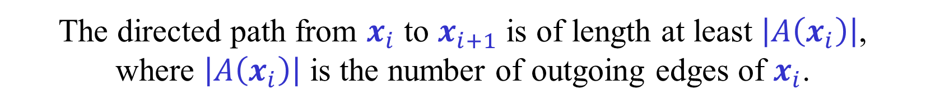
Upper bound for Switch-All
[ Mansour-Singh (1999) ]
Let $x_{1},x_{2},…,x_{N}$ be the vertices of $A$ visited by Switch-All.
We say that $x↠y$ iff there is a directed path from $x$ to $y$.
Claim: $x_{1}↠x_{2}↠…↠x_{N}$
In particular, by the acyclicity, $x_{1},x_{2},…,x_{N}$ are distinct and $N≤2^{n}$.
Consider the subcube defined by $x_{i}$ and its outgoing edges.
$x_{i}$ is the unique source of the subcube and $x_{i+1}$ is in the subcube.
The directed path from $x_{i}$ to $x_{i+1}$ is of length at least $\left|A\left(x_{i}\right)\right|$,
where $\left|A\left(x_{i}\right)\right|$ is the number of outgoing edges of $x_{i}$.
The paths from $x_{i}$ to $x_{i+1}$ are disjoint.

Slide 34
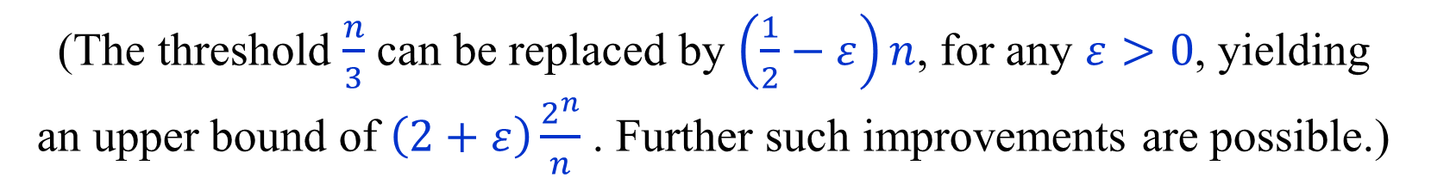
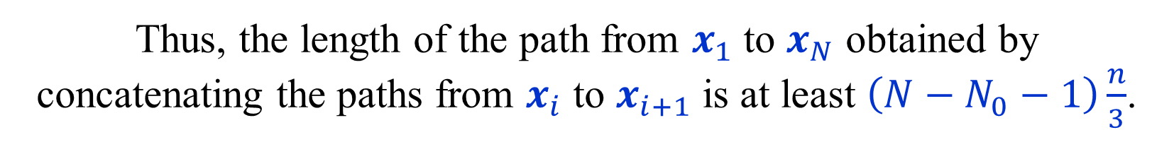
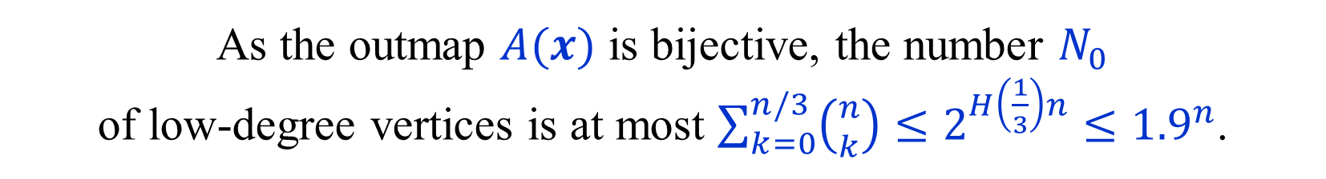
Upper bound for Switch-All
[ Mansour-Singh (1999) ]
$x_{i}$ is of low-degree iff $\left|A\left(x_{i}\right)\right|≤\frac{n}{3}$, and high-degree if $\left|A\left(x_{i}\right)\right|>\frac{n}{3}$.
As the outmap $A(x)$ is bijective, the number $N_{0}$
of low-degree vertices is at most $\sum_{k=0}^{n/3}{\left({n \atop k}\right)}≤2^{H\left(\frac{1}{3}\right)n}≤{1.9}^{n}$.
Thus, the length of the path from $x_{1}$ to $x_{N}$ obtained by
concatenating the paths from $x_{i}$ to $x_{i+1}$ is at least $\left(N−N_{0}−1\right)\frac{n}{3}$.
$$\left(N−N_{0}−1\right)\frac{n}{3} ≤ 2^{n}$$
$$N ≤3\frac{2^{n}}{n}+\left(N_{0}+1\right)≤\left(3+ε\right)\frac{2^{n}}{n}$$
(The threshold $\frac{n}{3}$ can be replaced by $\left(\frac{1}{2}−ε\right)n$, for any $ε>0$, yielding
an upper bound of $\left(2+ε\right)\frac{2^{n}}{n}$ . Further such improvements are possible.)

Slide 35
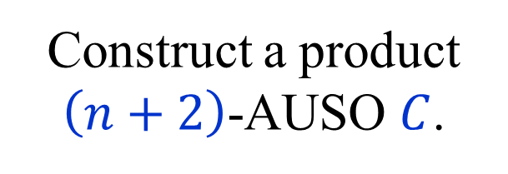

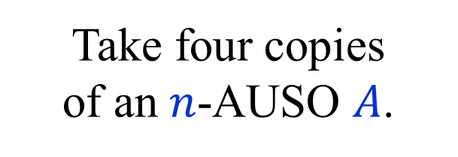




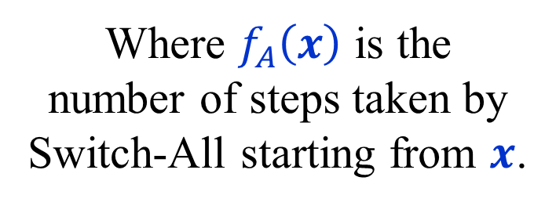

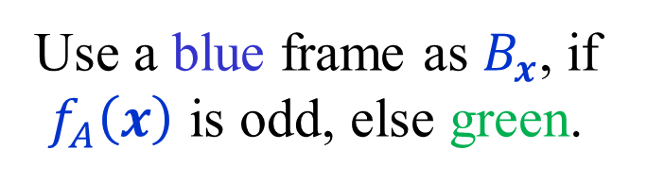
Lower bound for Switch-All
[ Schurr-Szabó (2005) ]
Take four copies
of an $n$-AUSO $A$.
$$11$$
Construct a product
$\left(n+2\right)$-AUSO $C$.
$$01$$
$$10$$
$$x_{i}01$$
odd
even
$$00$$
$$x_{i+1}10$$
Where $f_{A}\left(x\right)$ is the
number of steps taken by
Switch-All starting from $x$.
Use a blue frame as $B_{x}$, if $f_{A}\left(x\right)$ is odd, else green.

Slide 36

Lower bound for Switch-All
[ Schurr-Szabó (2005) ]
Suppose that $f_{A}\left(x_{1}\right)=N$, where $N$ is odd.
Let $x_{1},x_{2},…,x_{N}$ be the vertices of $A$ visited by Switch-All.
Start Switch-All on $C$ from $x_{1}01$.
The sequence of vertices obtained is:
$x_{1}01,x_{2}10,x_{3}01,x_{4}10,…,x_{N−1}10,x_{N}01 ,$ $x_{N}10,x_{N}00$
In $C$, the bottom copy of $A$ is a hypersink.
Replace the bottom copy of $A$ by $A′$, to obtain $C′$,
where $A^{′}\left(x\right)=A\left(x⊕\left(x_{N}⊕x_{1}\right)\right)$
On $C′$, Switch-All will perform $N−1$ more steps from $x_{N}00$.
$f_{C^{′}}\left(x_{1}01\right) = \left(N+2\right)+\left(N−1\right)=2N+1$ .

Slide 37

Lower bound for Switch-All
[ Schurr-Szabó (2005) ]
Let $f(n)$ be the maximal number of steps
performed by Switch-All on an $n$-AUSO.
We just proved that $f\left(n+2\right)≥2f\left(n\right)+1$.
$f\left(2\right)=3$. (Please check.)
By induction: $f\left(2n\right)≥2^{n}−1$.
Hence, $f\left(n\right)≥2^{n/2}−1$, for $n$ even.
Note: We count the number of evaluations,
including the evaluation of the initial vertex.

Slide 38
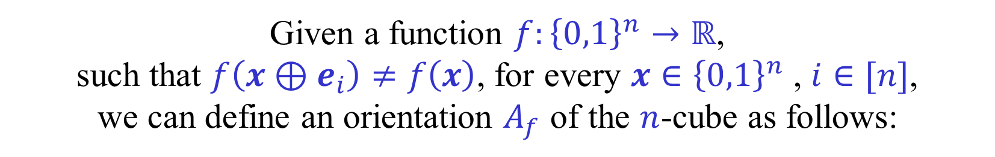


Abstract Objective Functions
[ Kalai (1992) ]
Given a function $f:{\left\{0,1\right\}}^{n}→ℝ$,
such that $f\left(x⊕e_{i}\right)≠f\left(x\right)$, for every $x∈{\left\{0,1\right\}}^{n}$ , $i∈[n]$,
we can define an orientation $A_{f}$ of the $n$-cube as follows:
$A_{f}{\left(x\right)}_{i}=1$ iff $f\left(x\right)<f(x⊕e_{i})$ , $x∈{\left\{0,1\right\}}^{n}$ , $i∈[n]$
$f$ is said to be an Abstract Objective Function (AOF)
iff $A_{f}$ is an AUSO.
Alternatively, $f$ is an AOF if in any subcube,
any local maximum is also a global maximum.
AOFs mimic the behavior of linear functions,
or value functions of games.
Lemma: If $A$ is an AUSO, then there exists $f$ such that $A_{f}=A$.
Proof: Use a topological ordering of $A$.

Slide 39
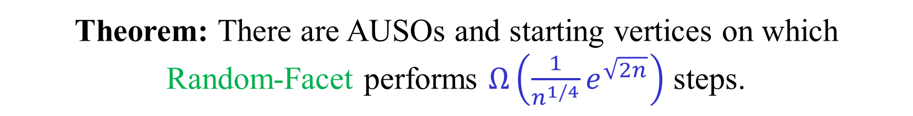

Lower bound for Random-Facet
[Matoušek (1994)] [Gärtner (2002)]
Theorem: There are AUSOs and starting vertices on which
Random-Facet performs $Ω\left(\frac{1}{n^{1/4}}e^{\sqrt{2n}}\right)$ steps.
Up to a constant in the exponent, it matches our upper bound.
The proof does not construct an explicit bad AUSO.
It shows that a random AUSO from a specific family is bad.
Most AUSOs of this family do not seem to come from games.
There is an $Ω\left(2^{n^{1/3}}\right)$ lower for non-binary games,
in fact for computing shortest paths to a sink.

Slide 40
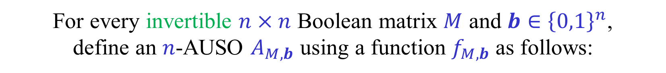
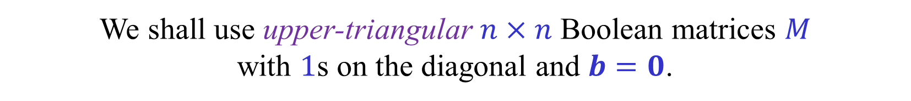
Matoušek’s AUSOs [Matoušek (1994)]
For every invertible $n×n$ Boolean matrix $M$ and $b∈{\left\{0,1\right\}}^{n}$,
define an $n$-AUSO $A_{M,b}$ using a function $f_{M,b}$ as follows:
For $x∈{\left\{0,1\right\}}^{n}$, let $f_{M,b}\left(x\right)={\left[Mx⊕b\right]}_{2}$. ($Mx$ computed over $ℤ_{2}$.)
If $y={\left(y_{0},y_{1},…,y_{n−1}\right)}^{T}∈{\left\{0,1\right\}}^{n}$, then ${\left[y\right]}_{2}=\sum_{i=0}^{n−1}{y_{i}2^{i}}$.
$A_{M,b}{\left(x\right)}_{i}=1$ iff $f_{M,b}\left(x\right)<f_{M,b}\left(x⊕e_{i}\right)$ , $x∈{\left\{0,1\right\}}^{n}$
As $M$ is invertible, $f_{M,b}:{\left\{0,1\right\}}^{n}→\left\{0,1,…,2^{n}−1\right\}$ is a bijection.
Thus $A_{M,b}$ is well-defined, and is acyclic.
The whole $n$-cube has a unique sink, namely $x=M^{−1}(b⊕1)$.
$A_{M,b}$ and $A_{M,b^{′}}$ are isomorphic. $x ⟷x⊕M^{−1}\left(b^{′}−b\right)$
Every sub-cube is of the form $A_{M^{′},b^{′}}$, and also has a unique sink.
We shall use upper-triangular $n×n$ Boolean matrices $M$
with $1$s on the diagonal and $b=0$.

Slide 41
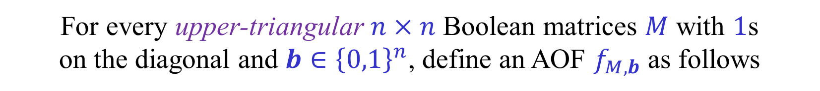
Matoušek’s AUSOs [Matoušek (1994)]
For every upper-triangular $n×n$ Boolean matrices $M$ with $1$s
on the diagonal and $b∈{\left\{0,1\right\}}^{n}$, define an AOF $f_{M,b}$ as follows
$f_{M,b}\left(x\right)={\left[Mx⊕b\right]}_{2}$ , $x∈{\left\{0,1\right\}}^{n}$ ($Mx$ computed over $ℤ_{2}$.)
If $y={\left(y_{0},y_{1},…,y_{n−1}\right)}^{T}∈{\left\{0,1\right\}}^{n}$, then ${\left[y\right]}_{2}=\sum_{i=0}^{n−1}{y_{i}2^{i}}$.
$A_{M,b}{\left(x\right)}_{i}=1$ iff $f_{M,b}\left(x\right)<f_{M,b}\left(x⊕e_{i}\right)$ , $x∈{\left\{0,1\right\}}^{n}$
$M$ is invertible and thus $f_{M,b}:{\left\{0,1\right\}}^{n}→\left\{0,1,…,2^{n}−1\right\}$ is a bijection.
Lemma: $f_{M,b}$ is an AOF and $A_{M,b}$ is an AUSO.
The whole $n$-cube has a sink, namely $s=M^{−1}(b⊕1)$.
If $x≠s$, $i$ is the largest s.t. ${\left(Mx⊕b\right)}_{i}=0$, $f_{M,b}\left(x\right)<f_{M,b}\left(x⊕e_{i}\right)$.
Hence, the whole $n$-cube has a unique sink.
Every sub-cube is of the form $A_{M^{′},b^{′}}$, and thus also has a unique sink.

Slide 42
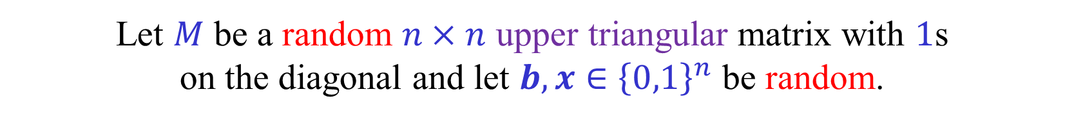
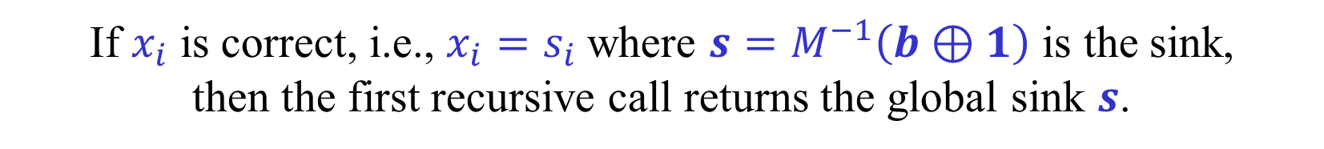



Matoušek’s Lower bound
Let $M$ be a random $n×n$ upper triangular matrix with $1$s
on the diagonal and let $b,x∈{\left\{0,1\right\}}^{n}$ be random.
Let $T(n)$ be the expected number of steps
performed by Random-Facet on $A_{M,b}$ starting from $x$.
Lemma: $T\left(n\right)=T\left(n−1\right)+\frac{1}{2n}\sum_{i=1}^{n}{(1+T\left(i−1\right))}$. $T\left(0\right)=0$.
Random-Facet chooses a random coordinate $i∈[n]$.
If $x_{i}$ is correct, i.e., $x_{i}=s_{i}$where $s=M^{−1}\left(b⊕1\right)$ is the sink,
then the first recursive call returns the global sink $s$.
Otherwise, the first recursive call returns $y$ with $y_{i+1},…,y_{n}$ correct.
After flipping the $i$-th bit, $y_{i}$ is also correct.
$y_{i+1},…,y_{n}$ would never change.
The second recursive call is on a random AUSO
of the same form of dimension $i−1$.

Slide 43
















Matoušek’s Lower bound
$$M$$
$$x$$
$$⊕$$
$$b$$
$$=$$
$$1$$
$$M_{i−1}$$
$$y$$
$$⊕$$
$$b$$
$$=$$
$$1$$
$$i$$
$$1$$
$${\overline{x}}_{i}$$
$$0$$
$$1$$

Slide 44
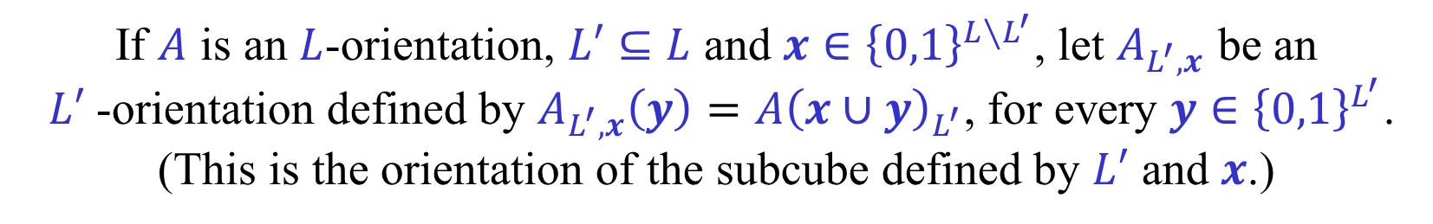
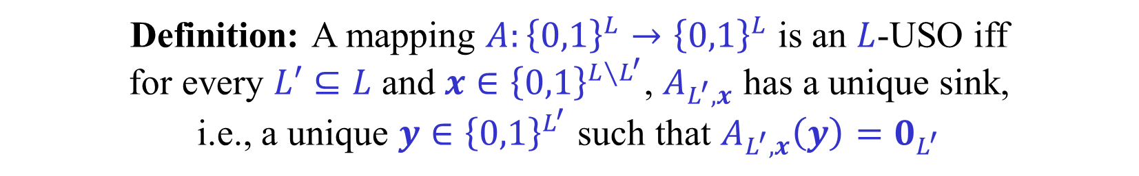
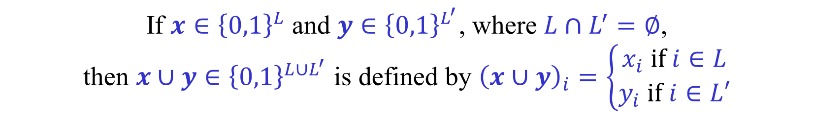
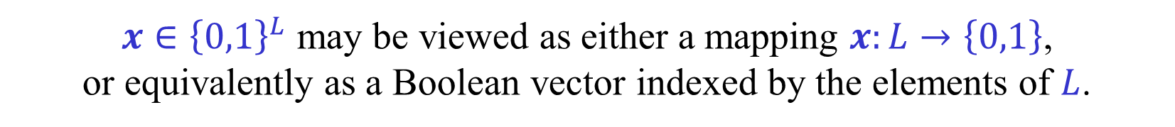
(A)USO – vector notation
If $L⊆\left[n\right]$, then an $L$-orientation $A$ is a mapping $A:{\left\{0,1\right\}}^{L}→{\left\{0,1\right\}}^{L}$.
$x∈{\left\{0,1\right\}}^{L}$ may be viewed as either a mapping $x:L→\left\{0,1\right\}$,
or equivalently as a Boolean vector indexed by the elements of $L$.
If $x∈{\left\{0,1\right\}}^{L}$ and $L′⊆L$, then $x_{L^{′}}=x_{|L^{′}}$ is the restriction of $x$ to $L′$.
If $x∈{\left\{0,1\right\}}^{L}$ and $y∈{\left\{0,1\right\}}^{L^{′}}$, where $L∩L^{′}=∅$,
then $x∪y∈{\left\{0,1\right\}}^{L∪L^{′}}$ is defined by ${\left(x∪y\right)}_{i}=\left\{\begin{aligned}x_{i} if i∈L \\ y_{i} if i∈L′\end{aligned}\right.$
If $A$ is an $L$-orientation, $L′⊆L$ and $x∈{\left\{0,1\right\}}^{L∖L^{′}}$, let $A_{L^{′},x}$ be an
$L′$-orientation defined by $A_{L^{′},x}\left(y\right)=A{\left(x∪y\right)}_{L^{′}}$, for every $y∈{\left\{0,1\right\}}^{L^{′}}$.
(This is the orientation of the subcube defined by $L′$ and $x$.)
Definition: A mapping $A:{\left\{0,1\right\}}^{L}→{\left\{0,1\right\}}^{L}$ is an $L$-USO iff
for every $L′⊆L$ and $x∈{\left\{0,1\right\}}^{L∖L^{′}}$, $A_{L^{′},x}$ has a unique sink,
i.e., a unique $y∈{\left\{0,1\right\}}^{L^{′}}$ such that $A_{L^{′},x}\left(y\right)=0_{L^{′}}$

Slide 45
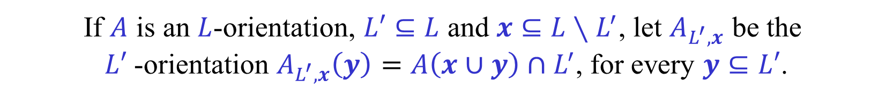
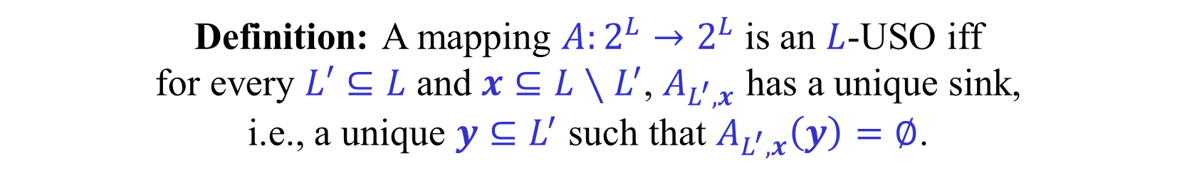
(A)USO – set notation (optional)
We can identify ${\left\{0,1\right\}}^{L}$ with $2^{L}=\{ L^{′ }|{ L}^{′}⊆L\}$ the set of subsets of $L$.
A vertex $x∈2^{L}$ of an $L$-cube is simply a subset $x⊆L$.
An $L$-orientation $A$ is a mapping $A:2^{L}→2^{L}$.
If $x⊆L$, $y⊆L′$, where $L∩L^{′}=∅$, then $x∪y$ is the standard union.
If $A$ is an $L$-orientation, $L′⊆L$ and $x⊆L∖L^{′}$, let $A_{L^{′},x}$ be the
$L′$-orientation $A_{L^{′},x}\left(y\right)=A\left(x∪y\right)∩L^{′}$, for every $y⊆L′$.
Definition: A mapping $A:2^{L}→2^{L}$ is an $L$-USO iff
for every $L′⊆L$ and $x⊆L∖L^{′}$, $A_{L^{′},x}$ has a unique sink,
i.e., a unique $y⊆L^{′}$ such that $A_{L^{′},x}\left(y\right)=∅$.
Which notation is better? Probably a matter of taste.
For the rest of the presentation we use the vector notation.

Slide 46
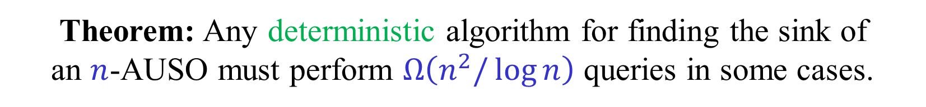

Lower bound for any deterministic algorithm [Schurr-Szabó (2004)]
Theorem: Any deterministic algorithm for finding the sink of
an $n$-AUSO must perform $Ω\left(n^{2}/\log{n}\right)$ queries in some cases.
Huge gap between the $\tilde{Ω}\left(n^{2}\right)$ lower bound and
the best deterministic $O({1.61}^{n}$) upper bound.
Lower bound obtained using an adversary argument.
Proof uses the product construction and hypersink replacement.

Slide 47

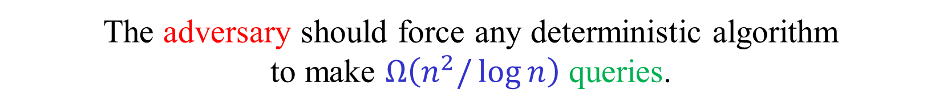
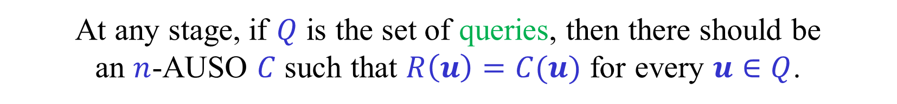
An Adversary argument
The adversary receives queries from the algorithm.
For each query $u∈{\left\{0,1\right\}}^{n}$,
the adversary should provide a reply $R\left(u\right)∈{\left\{0,1\right\}}^{n}$.
If $R\left(u\right)=0^{n}$, i.e., $u$ is the sink, the game ends.
At any stage, if $Q$ is the set of queries, then there should be
an $n$-AUSO $C$ such that $R\left(u\right)=C(u)$ for every $u∈Q$.
The adversary should force any deterministic algorithm
to make $Ω\left(n^{2}/\log{n}\right)$ queries.

Slide 48

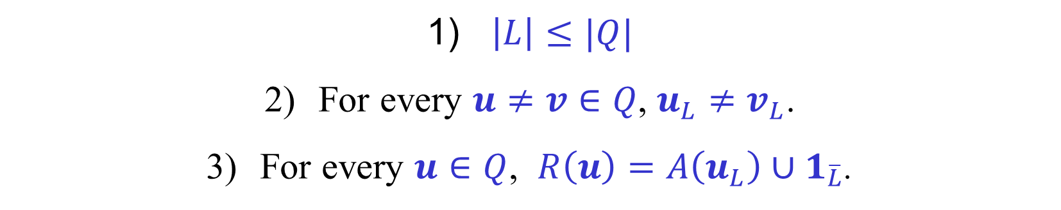


The Schurr-Szabó Adversary
We begin by explaining how the adversary
answers the first $n−\left\lceil \lg{n}\right\rceil$ queries.
Let $Q$ be the set of queries made so far.
We may assume that all the queries are distinct.
For $u∈Q$, let $R(u)$ be the reply given by the adversary.
The adversary maintains
a subset $L⊆[n]$ and an $L$-AUSO such that
$\left|L\right|≤|Q|$
For every $u≠v∈Q$, $u_{L}≠v_{L}$.
For every $u∈Q$, $R\left(u\right)=A\left(u_{L}\right)∪1_{\overline{L}}$.

Slide 49

The Schurr-Szabó Adversary
$\left|L\right|≤|Q|$
For every $u≠v∈Q$, $u_{L}≠v_{L}$.
For every $u∈Q$, $R\left(u\right)=A\left(u_{L}\right)∪1_{\overline{L}}$.
Initially $Q=L=∅$ and the invariant is satisfied.
Let $w∉Q$ be a new query.
Case 1: $w_{L}≠v_{L}$ for every $v∈Q$.
Reply with $R\left(w\right)=A\left(w_{L}\right)∪1_{\overline{L}}$. Let $Q←Q∪\left\{w\right\}$.
Case 2: $w_{L}=v_{L}$ for some (unique) $v∈Q$.
As $w≠v,$ there exists $ℓ∈\left[n\right]∖L$ such that $w_{ℓ}≠v_{ℓ}$.
Extend $A$ into an $\left(L∪\left\{ℓ\right\}\right)$-AUSO. Let $L←L∪\left\{ℓ\right\}$.
Reply with $R\left(w\right)=A\left(w_{L}\right)∪1_{\overline{L}}$. Let $Q←Q∪\left\{w\right\}$.

Slide 50


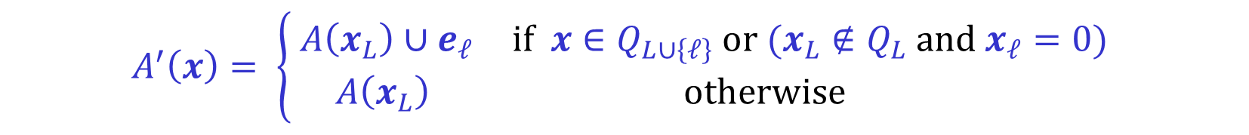
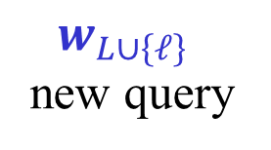



The Schurr-Szabó Adversary – Case 2
Case 2: $w_{L}=v_{L}$ for some (unique) $v∈Q$.
As $w≠v,$ there exists $ℓ∈\left[n\right]∖L$ such that $w_{ℓ}≠v_{ℓ}$.
Extend the $L$-AUSO $A$ into an $\left(L∪\left\{ℓ\right\}\right)$-AUSO $A′$.
$A′$ is composed of two copies of $A$:
$ℓ$-th dimension
$$v_{L∪\left\{ℓ\right\}}$$
$w_{L∪\left\{ℓ\right\}}$
new query
existing queries
$$A$$
$$A$$
$$A^{′}\left(x\right)= \left\{\begin{matrix} A\left(x_{L}\right)∪e_{ℓ} & if x∈Q_{L∪\left\{ℓ\right\}} or (x_{L}∉Q_{L} and x_{ℓ}=0) \\ A\left(x_{L}\right) & otherwise \end{matrix}\right.$$
$x$ corresponds to
an existing query
Consistently orienting
the other edges
$$x∈{\left\{0,1\right\}}^{L∪\left\{ℓ\right\}}$$
$A′$ is an $\left(L∪\left\{ℓ\right\}\right)$-AUSO as it is obtained by the product construction.
The invariant $R\left(u\right)=A\left(u_{L}\right)∪1_{\overline{L}}$, for $u∈Q$, is maintained.

Slide 51





The Schurr-Szabó Adversary
after answering $n−\left\lceil \lg{n}\right\rceil$ queries
$\left|L\right|≤\left|Q\right|=n−\left\lceil \lg{n}\right\rceil$
For every $u≠v∈Q$, $u_{L}≠v_{L}$.
For every $u∈Q$, $R\left(u\right)=A\left(u_{L}\right)∪1_{\overline{L}}$.
We need to show that there exists an $[n]$-AUSO $C$
such that $R\left(u\right)=C(u)$, for every $u∈Q$.
We again use the product construction.
Let $\overline{L}=\left[n\right]∖L$.
We show that for every $x∈{\left\{0,1\right\}}^{L}$ there exists an $\overline{L}$-AUSO $B_{x}$
such that $C=A×_{L}\left\langle B_{x}\right\rangle$ satisfies $R\left(u\right)=C(u)$, for every $u∈Q$.
$C\left(x∪y\right)=A\left(x\right)∪B_{x}\left(y\right)$ , $x∈{\left\{0,1\right\}}^{L}$ , $y∈{\left\{0,1\right\}}^{\overline{L}}$ .
The only requirement on $B_{x}$, for $u∈Q$, is that $B_{u_{L}}\left(u_{\overline{L}}\right)=1_{\overline{L}}$,
i.e., that $u_{\overline{L}}$ is the source of $B_{u_{L}}$, which is trivial to satisfy.

Slide 52




The Schurr-Szabó Adversary
after answering $n−\left\lceil \lg{n}\right\rceil$ queries
$\left|L\right|≤\left|Q\right|=n−\left\lceil \lg{n}\right\rceil$
For every $u≠v∈Q$, $u_{L}≠v_{L}$.
For every $u∈Q$, $R\left(u\right)=A\left(u_{L}\right)∪1_{\overline{L}}$.
As $\left|\overline{L}\right|≥\lg{n}$, we have $\left|{\left\{0,1\right\}}^{\overline{L}}\right|≥n$.
As $\left|Q\right|<n$, there exists $y_{0}∈{\left\{0,1\right\}}^{\overline{L}}$ such that $y_{0}∉Q_{\overline{L}}$
For every $u∈Q$, it is also easy to choose an $\overline{L}$-AUSO $B_{u_{L}}$
such that $u_{\overline{L}}$ is the source of $B_{u_{L}}$and $y_{0}$ is the sink of $B_{u_{L}}$.
All replies given are consistent with $C=A×_{L}\left\langle B_{x}\right\rangle$.
The subcube $C_{0}= \left\{ u∈{\left\{0,1\right\}}^{n} | u_{\overline{L}}=y_{0} \right\}$ is a hyper-sink of $C$.
$Q∩C_{0}=∅$ , i.e., none of the queries performed are in $C_{0}$.

Slide 53


The Schurr-Szabó Adversary
the final argument
All replies given are consistent with $C=A×_{L}\left\langle B_{x}\right\rangle$.
The subcube $H_{0}= \left\{ u∈{\left\{0,1\right\}}^{n} | u_{\overline{L}}=y_{0} \right\}$ is a hyper-sink of $C$.
$Q∩H_{0}=∅$ , i.e., none of the queries performed are in $H_{0}$.
By the hyper-sink replacement lemma, we can replace the
orientation of all edges inside $H_{0}$ by an arbitrary $L$-AUSO $C_{0}^{′}$
and obtain an $[n]$-AUSO $C′$ such that
1) $C^{′}$ is an $[n]$-AUSO.
2) $C^{′}$ is consistent with all the replies given.
The adversary can thus reveal the orientation of all edges
from vertices outside $H_{0}$, as specified by $C$.
The algorithm known nothing about the orientation within $H_{0}$.
The adversary can play the same game on an $\left(n−\left\lceil \lg{n}\right\rceil \right)$-AUSO.

Slide 54

The Schurr-Szabó Adversary
the analysis
Let $L(n)$ be a lower bound on the number of queries
that any deterministic algorithm must ask.
$$L\left(n\right)=\left(n−\left\lceil \lg{n}\right\rceil \right)+L\left(n−\left\lceil \lg{n}\right\rceil \right)$$
$$L\left(n\right) ≥ \left(n−\left\lceil \lg{n}\right\rceil \right)+…+\left(n−i\left\lceil \lg{n}\right\rceil \right)+L\left(n−i\left\lceil \lg{n}\right\rceil \right)$$
$L\left(n\right) ≥in −\frac{i\left(i−1\right)}{2}\left\lceil \lg{n}\right\rceil +L\left(n−i\left\lceil \lg{n}\right\rceil \right)$
$i=\frac{n}{\left\lceil \lg{n}\right\rceil }$ $⟹$ $L\left(n\right) ≥ \frac{n^{2}}{\left\lceil \lg{n}\right\rceil }−\frac{1}{2}\frac{n^{2}}{\left\lceil \lg{n}\right\rceil }=\frac{1}{2}\frac{n^{2}}{\left\lceil \lg{n}\right\rceil }$

Slide 55


AUSOs of the $n$-cube
Upper bound | Lower bound | Algorithm
$${1.8}^{n}$$ | $$2^{Ω\left(\sqrt{n\log{n}}\right)}$$ | RANDOM EDGE
$$2^{O\left(\sqrt{n}\right)}$$ | $$2^{Ω\left(\sqrt{n}\right)}$$ | RANDOM FACET
[Hansen-Z (2016)]
[Hansen-Paterson-Z (2014)]
[Matoušek (1994)]
[Gärtner (2002)]

Slide 56
END of
LECTURE 7

