Slide 1
Games on Graphs
Uri Zwick
Tel Aviv University
Lecture 5 –
Limiting Average Cost
Started 10/2020
Last modified 25/12/2020

Slide 2




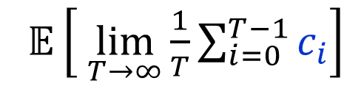
Markov Decision Processes
[Bellman ’57] [Howard ’60] …
1-player TBSGs
Total cost – infinite horizon
min/max
$𝔼\left[ \sum_{i=0}^{∞}{c_{i}}\right]$
Discounted cost
min/max
$𝔼\left[ \sum_{i=0}^{∞}{λ^{i}c_{i}}\right]$
Limiting average cost
min/max
$𝔼\left[ \lim_{T→∞}{\frac{1}{T}\sum_{i=0}^{T−1}{c_{i}}}\right]$
Optimal positional strategies can be found using LP.
Is there a strongly polynomial time algorithm?

Slide 3
Main goals
Extend the results obtained for stopping MDPs/TBSGs
with the total cost objective, to general MDPs/TBSGs
with the limiting average cost objective.
Results obtained are similar in nature.
However, the results and their derivations
are more technically involved.
In particular, we need a much
better understanding of Markov chains.

Slide 4

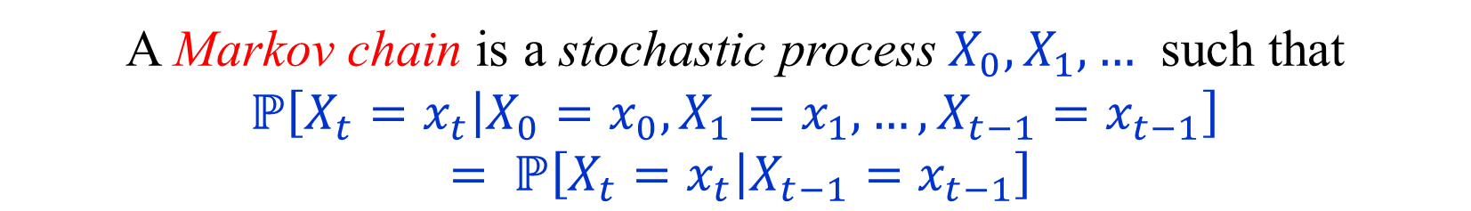
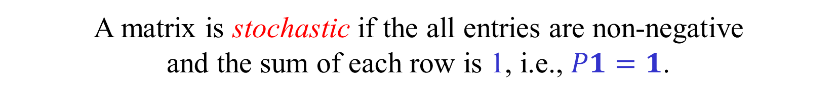
Markov chains
A Markov chain is a stochastic process $X_{0},X_{1},…$ such that $ℙ\left[X_{t}=x_{t} | X_{0}=x_{0},X_{1}=x_{1},…,X_{t−1}=x_{t−1}\right]$
$= ℙ\left[X_{t}=x_{t} | X_{t−1}=x_{t−1}\right]$
A Markov chain with $n$ states is stationary if
$ℙ\left[X_{t}=j | X_{t−1}=i\right]=p_{i,j}$, for every $t≥1$,
where $P=(p_{i,j})$ is an $n×n$ stochastic matrix.
A matrix is stochastic if the all entries are non-negative
and the sum of each row is 1, i.e., $P1=1$.
(In particular, $I−P$ is singular.)
$p_{i,j}$ – probability of moving from $i$ to $j$ in one step.
$p_{i,j}^{\left(t\right)}$ – probability of moving from $i$ to $j$ in $t$ steps.
$$P^{\left(t\right)}=\left(p_{i,j}^{\left(t\right)}\right)=P^{t}$$
What can we say about $P^{t}$ as $t→∞$ ?

Slide 5

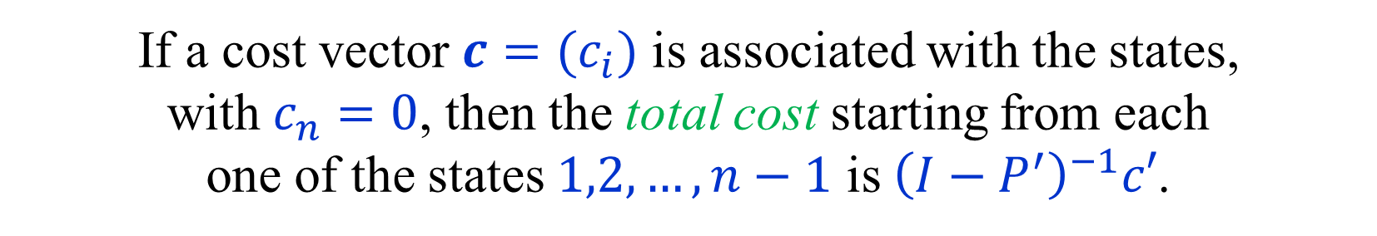

Absorbing/Stopping Markov chains
A Markov chain $P=(p_{i,j})$ is absorbing,
iff $p_{i,n}^{\left(t\right)}→1$, as $t→∞$, for $i=1,2,…n$.
This is exactly the stopping condition, with $n$ being the sink.
If $P^{′}=P_{\left[1,n−1\right],\left[1,n−1\right]}$, we saw that
$I−P′$ is invertible and ${\left(I−P^{′}\right)}^{−1}=\sum_{i≥0}{{\left(P^{′}\right)}^{i}}$.
If a cost vector $c=(c_{i})$ is associated with the states,
with $c_{n}=0$, then the total cost starting from each
one of the states $1,2,…,n−1$ is ${\left(I−P^{′}\right)}^{−1}c′$.
This is essentially all we needed to
know about absorbing Markov chains.

Slide 6
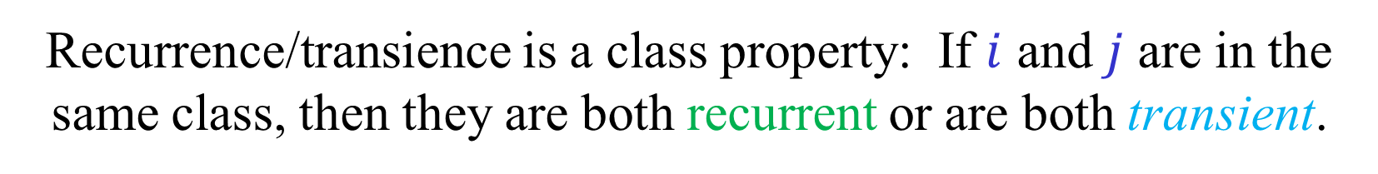
Structure of a general Markov chain
State $j$ is reachable from $i$ iff $p_{i,j}^{\left(t\right)}>0$, for some $t≥0$.
A class (or a strongly connected component) is a
maximal set of states such that every state in the set
is reachable from every state in the set.
A state $i$ is recurrent if $ℙ\left[ ∃t>0 X_{t}=i \right| X_{0}=i ]=1.$
A state $i$ is transient if $ℙ\left[ ∃t>0 X_{t}=i \right| X_{0}=i ]<1.$
Recurrence/transience is a class property: If $i$ and $j$ are in the same class, then they are both recurrent or are both transient.
There is always at least one recurrent class.
(A sink in the DAG of connected components.)
A chain is irreducible iff it is composed of one class.

Slide 7
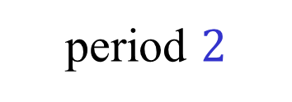
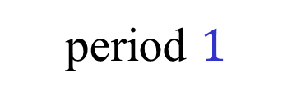
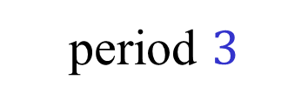
Recurrent and transient classes
period $2$
period $3$
period $1$

Slide 8
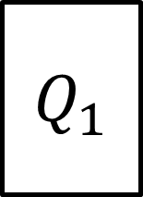


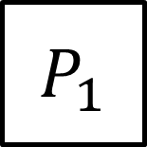
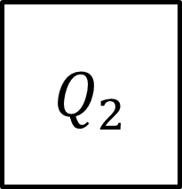
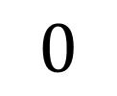
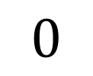
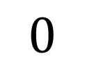
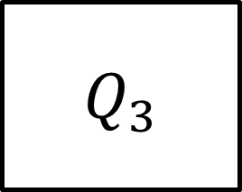
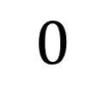
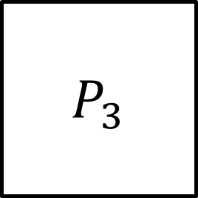
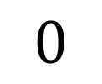
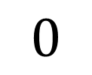
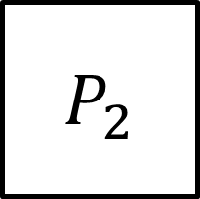

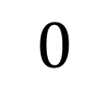
Transition matrix decomposition
Recurrent class 1
$$P_{1}$$
$$0$$
$$0$$
$$0$$
$$P_{2}$$
Recurrent class 2
$$0$$
$$0$$
$$0$$
$$P_{3}$$
Recurrent class 3
$$0$$
$$0$$
$$0$$
$$Q_{1}$$
$$Q_{2}$$
$$Q_{3}$$
$$Q_{4}$$
All transient states
Naturally extends to $m$ recurrent classes.

Slide 9
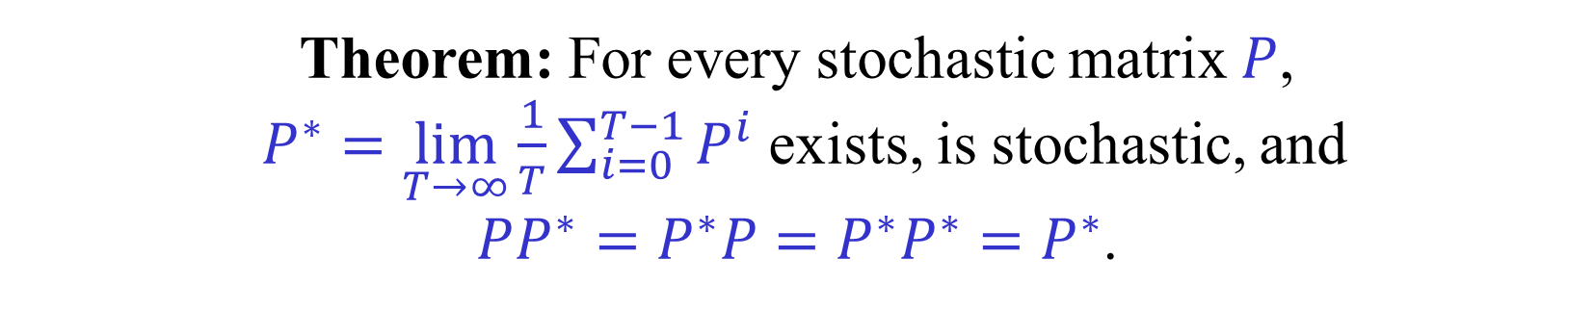
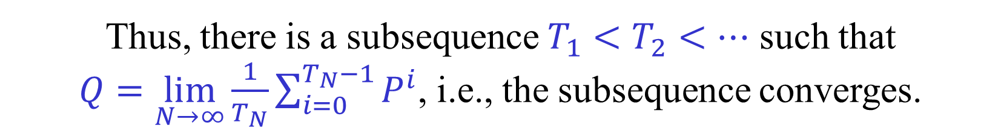
Limiting matrix
Theorem: For every stochastic matrix $P$,
$P^{∗}=\lim_{T→∞}{\frac{1}{T}\sum_{i=0}^{T−1}{P^{i}}}$ exists, is stochastic, and
$PP^{∗}=P^{∗}P=P^{∗}P^{∗}=P^{∗}$.
For every $T$, the matrix $\frac{1}{T}\sum_{i=0}^{T−1}{P^{i}}$ is stochastic.
Thus, there is a subsequence $T_{1}<T_{2}<…$ such that
$Q=\lim_{N→∞}{\frac{1}{T_{N}}\sum_{i=0}^{T_{N}−1}{P^{i}}}$, i.e., the subsequence converges.
(Stochastic matrices form a compact set (closed and bounded).)
$QP=PQ=\lim_{N→∞}{\frac{1}{T_{N}}\sum_{i=1}^{T_{N}}{P^{i}}}=Q$ .
We show that $\lim_{T→∞}{\frac{1}{T}\sum_{i=0}^{T−1}{P^{i}}=Q}$.

Slide 10

Limiting matrix – proof continued
There is a subsequence $T_{1}<T_{2}<…$
such that $Q=\lim_{N→∞}{\frac{1}{T_{N}}\sum_{i=0}^{T_{N}−1}{P^{i}}}$ .
$QP=PQ=\lim_{N→∞}{\frac{1}{T_{N}}\sum_{i=1}^{T_{N}}{P^{i}}}=Q$ .
$QP^{i}=P^{i}Q=Q$ (By induction on $i$.)
$Q\left(\frac{1}{T}\sum_{i=0}^{T−1}{P^{i}}\right)=\left(\frac{1}{T}\sum_{i=0}^{T−1}{P^{i}}\right)Q=Q$
Let $T_{1}^{′}<T_{2}^{′}<…$ be such that $Q^{′}=\lim_{N→∞}{\frac{1}{T_{N}^{′}}\sum_{i=0}^{T_{N}^{′}−1}{P^{i}}}$.
To prove that $\lim_{T→∞}{\frac{1}{T}\sum_{i=0}^{T−1}{P^{i}}}$ exists, need to show that $Q=Q′$.
But then $QQ^{′}=Q^{′}Q=Q$ and also $Q^{′}Q=QQ′=Q′$.
Thus, $Q=Q′$, as required. $∎$

Slide 11
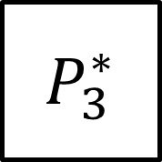




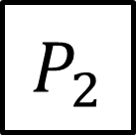


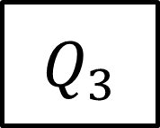

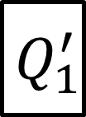




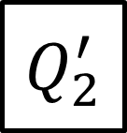





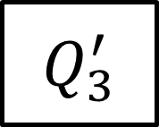
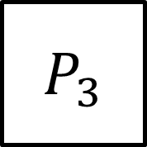
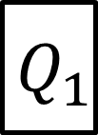


Decomposition of $P$ and $P^{∗}$
Recurrent class 1
$$P_{1}$$
$$0$$
$$0$$
$$0$$
$$P_{1}^{∗}$$
$$0$$
$$0$$
$$0$$
Recurrent class 2
$$0$$
$$P_{2}$$
$$0$$
$$0$$
$$0$$
$$P_{2}^{∗}$$
$$0$$
$$0$$
$$P_{3}$$
$$P_{3}^{∗}$$
Recurrent class 3
$$0$$
$$0$$
$$0$$
$$0$$
$$0$$
$$0$$
All transient states
$$Q_{1}$$
$$Q_{2}$$
$$Q_{3}$$
$$Q_{4}$$
$$Q_{1}^{′}$$
$$Q_{2}^{′}$$
$$Q_{3}^{′}$$
$$0$$
$$P$$
$$P^{∗}$$
All rows of $P_{1}^{∗}, P_{2}^{∗}$ and $P_{3}^{∗}$ are equal.
The rows of ${[Q}_{1}^{′},Q_{2}^{′},Q_{3}^{′},0]$ are linear combinations of the rows above.
Naturally extends to $m$ recurrent classes.

Slide 12


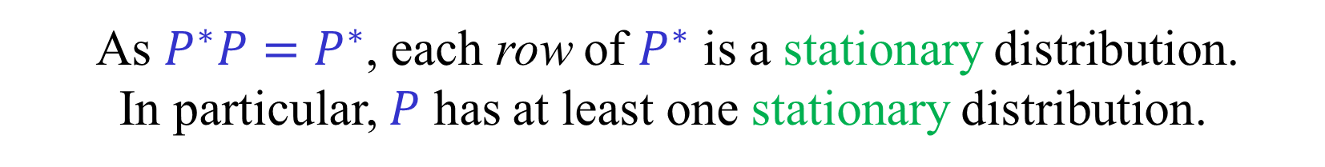
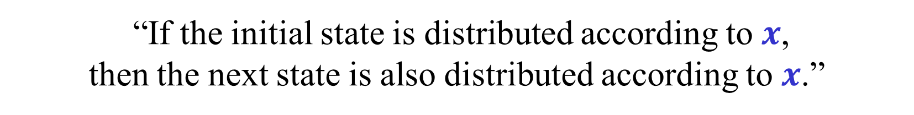

Stationary distributions
$x∈ℝ^{n}$ is a distribution if $x≥0$ and $x^{T}1=1$.
A distribution $x$ is stationary iff $x^{T}P=x^{T}.$
“If the initial state is distributed according to $x$,
then the next state is also distributed according to $x$.”
As $P^{∗}P=P^{∗}$, each row of $P^{∗}$ is a stationary distribution.
In particular, $P$ has at least one stationary distribution.
Lemma: If $P$ is irreducible,
then it has a unique stationary distribution.
Corollary: If $P$ is irreducible,
then all the rows of $P^{∗}$ are equal.
Corollary: All the rows in each one of the
matrices $P_{1}^{∗}, P_{2}^{∗},…,P_{m}^{∗}$, are equal.

Slide 13
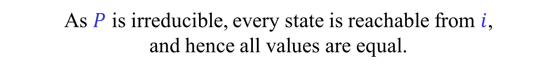



Uniqueness of Stationary distributions
(in the irreducible case)
Lemma: If $P$ is irreducible and $Py=y$,
then all the coordinates of $y$ are equal.
Corollary: If $P$ is irreducible, $rank\left(I−P\right)=n−1$.
Corollary: If $P$ is irreducible, then the
stationary distribution is unique.
Proof of Lemma:
Suppose that $Py=y$ and that $y_{i}=\max_{j}{y_{j}}$.
As $y_{i}=\sum_{j}{p_{i,j}y_{j}}$, we have $y_{i}=y_{j}$, for every $j$ such $p_{i,j}>0$.
As $P$ is irreducible, every state is reachable from $i$,
and hence all values are equal.

Slide 14
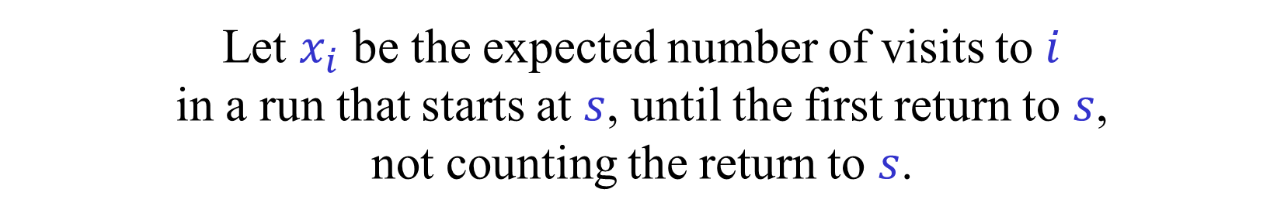
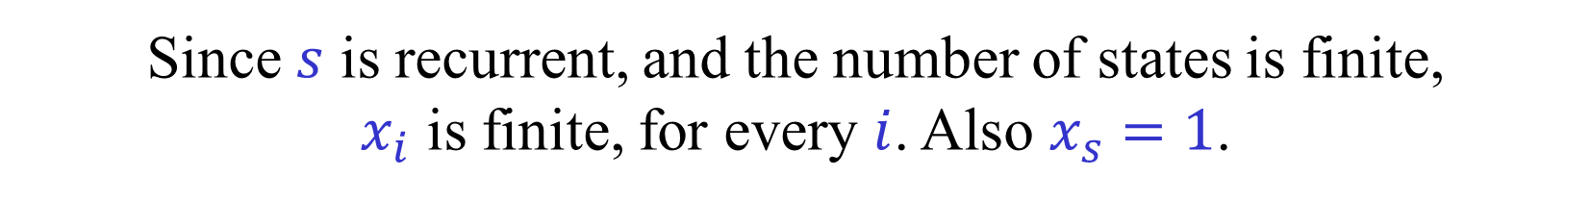

Renewals
Let $P$ be an arbitrary $n×n$ stochastic matrix.
Let $s$ be a recurrent start state.
Consider a run on the Markov chain that
starts at $s$ until its first return to $s$.
Intuitively, the behavior of such runs captures
the long-term behavior of the Markov chain.
Let $x_{i}$ be the expected number of visits to $i$
in a run that starts at $s$, until the first return to $s$,
not counting the return to $s$.
Since $s$ is recurrent, and the number of states is finite,
$x_{i}$ is finite, for every $i$. Also $x_{s}=1$.
We show that $x_{i}^{′}=x_{i}/\sum_{j}{x_{j}}$ is a stationary distribution.

Slide 15
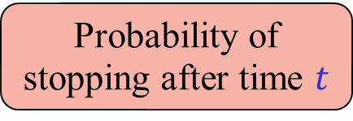
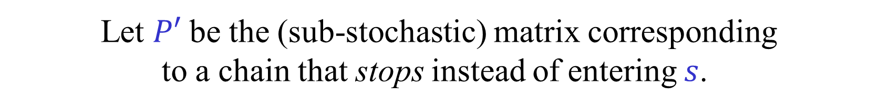
Direct existence proof of Stationary distributions
Let $P$ be an arbitrary $n×n$ stochastic matrix.
Let $s$ be a recurrent start state.
Let $P′$ be the (sub-stochastic) matrix corresponding
to a chain that stops instead of entering $s$.
$P^{′}=\left(p_{i,j}^{′}\right)$ , $p_{i,j}^{′}=\left\{\begin{aligned}p_{i,j} if j≠s \\ 0 if j=s\end{aligned}\right.$
$x_{i}=\sum_{t=0}^{∞}{p_{s,i}^{′\left(t\right)}}$ – expected number of visits to $i$.
$j≠s$ , $\sum_{i}{x_{i}p_{i,j}}=\sum_{i}{\left(\sum_{t=0}^{∞}{p_{s,i}^{′\left(t\right)}}\right)p_{i,j}^{′}}=\sum_{t=0}^{∞}{\sum_{i}{p_{s,i}^{′\left(t\right)}p_{i,j}^{′}}}$
$= \sum_{t=0}^{∞}{p_{s,j}^{′\left(t+1\right)}} = \sum_{t=1}^{∞}{p_{s,j}^{′\left(t\right)}} = x_{j}$ (as $p_{s,j}^{′\left(0\right)}=0$)
$j=s$ , $\sum_{i}{x_{i}p_{i,s}}=\sum_{i}{\left(\sum_{t=0}^{∞}{p_{s,i}^{′\left(t\right)}}\right)p_{i,s}}$
Probability of stopping after time $t$
$=\sum_{t=0}^{∞}{\left(\sum_{i}{p_{s,i}^{′\left(t\right)}p_{i,s}}\right)}=1=x_{s}$

Slide 16
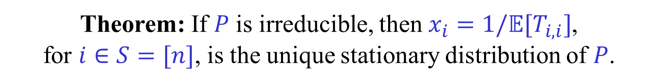
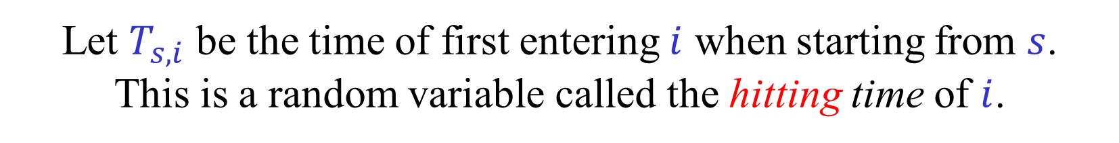
Hitting and Return times
Let $P$ be an arbitrary $n×n$ stochastic matrix.
Let $s$ be an arbitrary start state.
Let $T_{s,i}$ be the time of first entering $i$ when starting from $s$.
This is a random variable called the hitting time of $i$.
The hitting time of $i$ may be infinite.
$T_{i,i}$ is the return time to $i$.
If $i$ is recurrent, then $𝔼[T_{i,i}]$ is finite.
Theorem: If $P$ is irreducible, then $x_{i}=1/𝔼[T_{i,i}]$,
for $i∈S=[n]$, is the unique stationary distribution of $P$.
Follows easily from the previous slide.

Slide 17
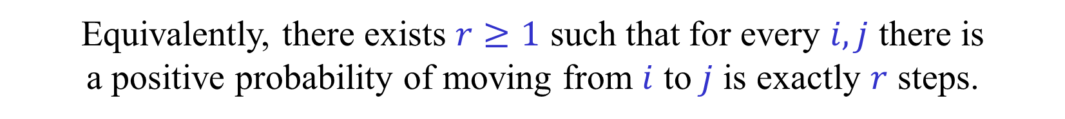
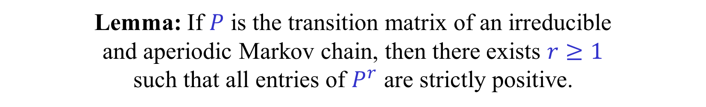
Periods and aperiodicity
The period of $i$ of a recurrent state is $\gcd\left\{t≥0 | p_{i,i}^{\left(t\right)}>0\right\}$ .
Lemma: States in the same recurrent class have the same period.
Definition: An irreducible chain is aperiodic if all periods are 1.
An irreducible and aperiodic is sometimes said to be ergodic.
Lemma: If $P$ is the transition matrix of an irreducible
and aperiodic Markov chain, then there exists $r≥1$
such that all entries of $P^{r}$ are strictly positive.
Equivalently, there exists $r≥1$ such that for every $i,j$ there is
a positive probability of moving from $i$ to $j$ is exactly $r$ steps.
The, not too complicated, proofs of the lemmas are omitted.
If $P$ is periodic, then it is easy to see that $P^{t}$ does not converge to $P^{∗}$.
This is the only case in which $P^{t}$ does not converge $P^{∗}$.

Slide 18
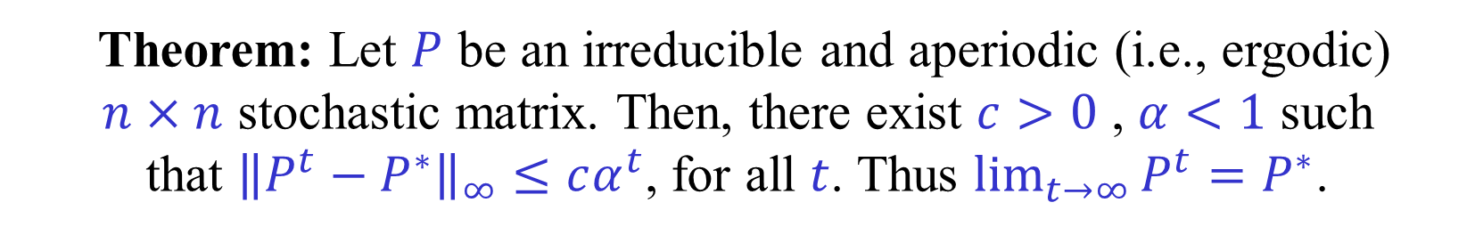




Convergence
Theorem: Let $P$ be an irreducible and aperiodic (i.e., ergodic)
$n×n$ stochastic matrix. Then, there exist $c>0$ , $α<1$ such
that ${\left\|P^{t}−P^{∗}\right\|}_{∞}≤cα^{t}$, for all $t$. Thus $\lim_{t→∞}{P^{t}}=P^{∗}$.
By the aperiodicity, there exists $r≥1$
such that all entries in $P^{r}$ are positive.
Thus, there exists $ε>0$ such that $P^{r}≥εP^{∗}$.
It follows that $P^{r}=\left(1−θ\right)P^{∗}+θQ$,
where $θ=1−ε$ and $Q$ is a stochastic matrix.
We prove by induction on $k$ that
$P^{kr}=\left(1−θ^{k}\right)P^{∗}+θ^{k}Q^{k}$.
$$P^{(k+1)r}=\left(\left(1−θ^{k}\right)P^{∗}+θ^{k}Q^{k}\right)P^{r} = \left(1−θ^{k}\right)P^{∗}+θ^{k}Q^{k}P^{r}$$
$$θ^{k}Q^{k}P^{r}=θ^{k}Q^{k}\left(\left(1−θ\right)P^{∗}+θQ\right)=θ^{k}\left(1−θ\right)Q^{k}P^{∗}+θ^{k+1}Q^{k+1}$$
(Explain why!)
$$=P^{∗}$$

Slide 19
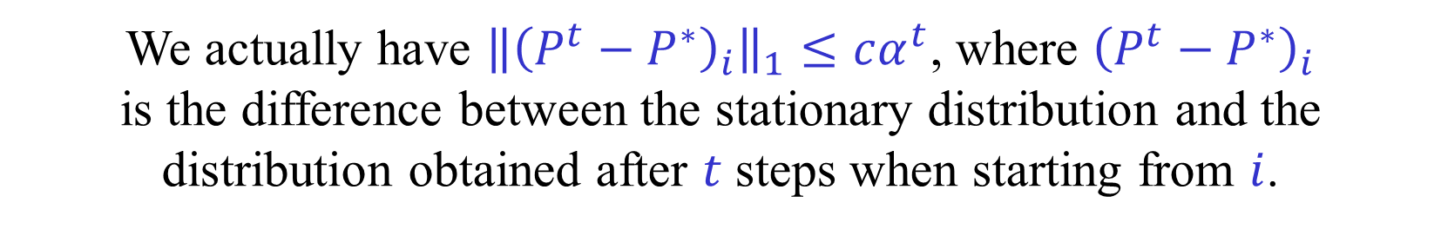
Convergence (continued)
Theorem: Let $P$ be an irreducible and aperiodic (i.e., ergodic)
$n×n$ stochastic matrix. Then, there exist $c>0$ , $α<1$ such
that ${\left\|P^{t}−P^{∗}\right\|}_{∞}≤cα^{t}$, for all $t$. Thus $\lim_{t→∞}{P^{t}}=P^{∗}$.
We proved that $P^{kr}=\left(1−θ^{k}\right)P^{∗}+θ^{k}Q^{k}$.
$P^{kr+j}=\left(\left(1−θ^{k}\right)P^{∗}+θ^{k}Q^{k}\right)P^{j}=\left(1−θ^{k}\right)P^{∗}+θ^{k}Q^{k}P^{j}$.
$P^{kr+j}−P^{∗}=θ^{k}\left(P^{∗}−Q^{k}P^{j}\right)$.
${\left\|P^{t}−P^{∗}\right\|}_{∞} ≤ θ^{\left\lfloor \frac{t}{r}\right\rfloor } ≤ cα^{t}$ ,
where $c=θ^{−r}$ and $α=θ^{1/r}$.
We actually have ${\left\|{\left(P^{t}−P^{∗}\right)}_{i}\right\|}_{1}≤cα^{t}$, where ${\left(P^{t}−P^{∗}\right)}_{i}$
is the difference between the stationary distribution and the
distribution obtained after $t$ steps when starting from $i$.

Slide 20
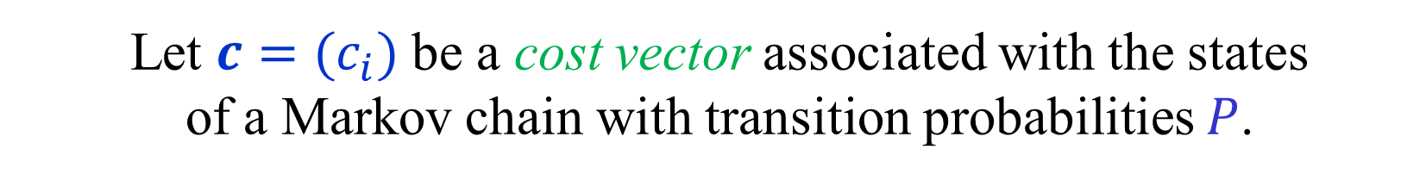


Limiting average costs
Let $c=(c_{i})$ be a cost vector associated with the states
of a Markov chain with transition probabilities $P$.
Whenever we visit state $i$, we pay $c_{i}$.
If we start from $i$, the limiting average cost is
${\overline{y}}_{i} = \lim_{T→∞}{\frac{1}{T}\sum_{t=0}^{T−1}{\sum_{j=1}^{n}{p_{i,j}^{\left(t\right)}c_{j}}}}$
In matrix notation:
$\overline{y} = \lim_{T→∞}{\frac{1}{T}\left(\sum_{t=0}^{T−1}{P^{t}}\right)c}=P^{∗}c$
In particular, the limiting average costs exist.

Slide 21

Limiting average costs and biases
The limiting average cost is
$\overline{y} = \lim_{T→∞}{\frac{1}{T}\left(\sum_{t=0}^{T−1}{P^{t}}\right)c}=P^{∗}c$
When $T$ is large: $\left(\sum_{t=0}^{T−1}{P^{t}}\right)c≈T\overline{y}$
The bias is defined as $\overline{z}=\lim_{T→∞}{ \left(\sum_{t=0}^{T−1}{P^{t}}\right)c−T\overline{y} }$
Or more precisely as $\overline{z}=\lim_{T→∞}{\frac{1}{T}\sum_{t=1}^{T}{\left(\left(\sum_{i=0}^{t−1}{P^{i}}\right)c−t\overline{y}\right)} }$
The first limit does not always exist, so we need to
take the Cesàro limit, which does always exist.
To find optimal strategies for limiting average cost
we need to work with both values and biases.
Values on their own are not enough.

Slide 22


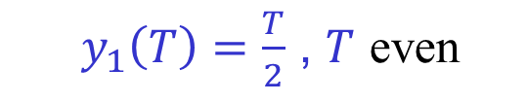






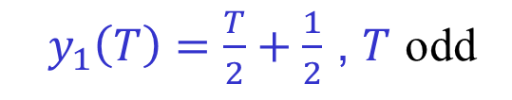






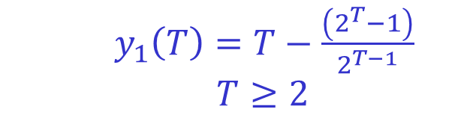



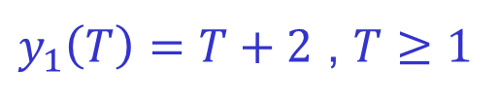










Average costs and biases - Examples
$$0$$
$\frac{1}{2}$
$$3$$
$\frac{1}{2}$
1
2
$$1$$
1
2
$$0$$
$$1$$
1
2
$$1$$
$$y_{1}=1$$
$$y_{2}=1$$
$y_{1}=\frac{1}{2}$
$y_{2}=\frac{1}{2}$
$$y_{1}=1$$
$$y_{2}=1$$
$$z_{1}=2$$
$$z_{2}=0$$
$$z_{2}=0$$
$z_{1}=\frac{1}{4}$
$z_{2}=−\frac{1}{4}$
$$z_{1}=−2$$
$y_{1}\left(T\right)=T+2$ , $T≥1$
$y_{1}\left(T\right)=T−\frac{\left(2^{T}−1\right)}{2^{T−1}}$
$$T≥2$$
$y_{1}\left(T\right)=\frac{T}{2}+\frac{1}{2}$ , $T$ odd
$$y_{2}\left(T\right)=T$$
$y_{1}\left(T\right)=\frac{T}{2}$ , $T$ even
$$y_{1}\left(T\right)→ T−2$$
Exercise: What are the
values and biases in the following 2-state example?
$1−a$
$a$
$$c_{1}$$
1
$$c_{2}$$
2
(To be solved after viewing
the next few slides.)
$b$
$1−b$

Slide 23
Strategy iteration must use biases
0
0
0
1
1
1
1
1
1
0
0
0
Non-optimal policy.
Both values are 1.
After switch.
Both values still 1.
Optimal policy.
Both values are 0.
But, there is some improvement,
as we get a 0 before getting a 1 loop.

Slide 24
Biases
$\overline{y} = \lim_{T→∞}{\frac{1}{T}\left(\sum_{t=0}^{T−1}{P^{t}}\right)c}=P^{∗}c$
$\overline{z}=C\lim_{T→∞}\left(\left(\sum_{t=0}^{T−1}{P^{t}}\right)c−T\overline{y}\right)=Hc$
$\left(\sum_{t=0}^{T−1}{P^{t}}\right)c−T\overline{y}=\left(\sum_{t=0}^{T−1}{(P^{t}}−P^{∗})\right)c→Hc$
$H=\sum_{t=0}^{∞}{(P^{t}}−P^{∗})$ (if $P^{t}→P^{∗}$)
$H=\lim_{T→∞}{\frac{1}{T}}\sum_{t=1}^{T}{\sum_{i=0}^{t−1}{(P^{t}}−P^{∗})}$ (in any case)
$\sum_{t=0}^{∞}{(P^{t}}−P^{∗})=\left(I−P^{∗}\right)+\sum_{t=1}^{∞}{{\left(P−P^{∗}\right)}^{t}}$
$=\sum_{t=0}^{∞}{{\left(P−P^{∗}\right)}^{t}} −P^{∗}={\left(I−P+P^{∗}\right)}^{−1}−P^{∗}$
Theorem: $H$, defined by the Cesàro limit, always exists.
Theorem: $I−P+P^{∗}$ is invertible.
The matrix $H$ is known as the deviation matrix.

Slide 25

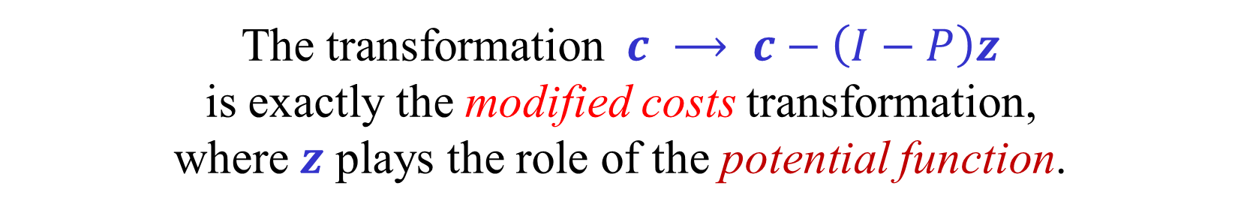
Computing Values and Biases
Suppose that
$\left(I−P\right)y=0$ , $y+\left(I−P\right)z=c$ , $P^{∗}z=0$ .
Then, $\overline{y}=y$ and $\overline{z}=z$.
$\left(\sum_{t=0}^{T−1}{P^{t}}\right)c = \left(\sum_{t=0}^{T−1}{P^{t}}\right)\left(y+\left(I−P\right)z\right)$
$=Ty+\left(I−P^{T}\right)z ⟶Ty+z$
Note that $y=Py=P^{2}y=…$
The transformation $c ⟶ c−\left(I−P\right)z$
is exactly the modified costs transformation,
where $z$ plays the role of the potential function.

Slide 26


Aperiodicity transformation
Any Markov chain can be made aperiodic by making it lazy.
Choose an arbitrary $0<ε<1$.
Let $\overline{P}=\left(1−ε\right)P+εI$.
At each step, with probability $ε$ stay in place.
With probability $1−ε$, do a step as before.
It is easy to check that ${\overline{P}}^{∗}=P^{∗}$.
Values and biases of $P$ and $\overline{P}$ with respect to $c$ are the same.
The same can be done, of course, with any MDP:
${\overline{p}}_{a,j}= \left\{\begin{aligned}ε+\left(1−ε\right)p_{a,i} if j=i \\ \left(1−ε\right)p_{a,j} if j≠i\end{aligned}\right.$ , $a∈A_{i}$
Our treatment does not assume aperiodicity.

Slide 27





MDPs with limiting average objective
Let $Γ=(P,c)$ be an MDP.
(Assume that $S=[n]$, $A=[m]$, $P∈ℝ^{m×n}$, $c∈ℝ^{m}$.)
Focus first on positional policies.
For every positional policy $π$ we get a
Markov chain with costs $(P_{π},c_{π})$.
The values $y^{π}$ and biases $z^{π}$ of $π$ are obtained by solving
$\left(I−P_{π}\right)y^{π}=0$ , $y^{π}+\left(I−P_{π}\right)z^{π}=c_{π}$ , $P_{π}^{∗}z^{π}=0$ .
A (positional) policy $π$ is value-optimal if and only if
$y^{π}≤y^{π^{′}}$, for every (positional) policy $π′$.
A (positional) policy $π$ is value-and-bias optimal
if and only if $π$ is value-optimal and for every
(positional) policy $π′$, if $y^{π}=y^{π^{′}}$, then $z^{π}≤z^{π^{′}}$.

Slide 28



Improving and maintaining actions
Let $π$ be the current policy.
Compute $y={\overline{y}}^{π}$ and $z={\overline{z}}^{π}$.
An action $a∈A_{i}$ is improving for $π$,
iff either $\sum_{j}{p_{a,j}y_{j}}<y_{i}$ or
$\sum_{j}{p_{a,j}y_{j}}=y_{i}$ and $c_{a}+\sum_{j}{p_{a,j}z_{j}}<{y_{i}+z}_{i}$.
An action $a∈A_{i}$ is maintaining for $π$,
iff $\sum_{j}{p_{a,j}y_{j}}=y_{i}$ and $c_{a}+\sum_{j}{p_{a,j}z_{j}}={y_{i}+z}_{i}$.
In matrix notation, the conditions checked are:
$\left(J−P\right)y≥0$ and $y+\left(J−P\right)z≥c$.

Slide 29



Policy iteration for limiting average cost
Let $π$ be the current policy.
Compute $y={\overline{y}}^{π}$ and $z={\overline{z}}^{π}$.
If there are no improving actions, then $π$ is value-optimal.
(But not necessarily value-and-bias-optimal.)
$$π_{i}^{′}=π_{i}$$
Otherwise, let $π′$ be such that for every $i$ $π_{i}^{′}$ is maintaining
or $π_{i}$ is improving for $π$, where at least one $π_{i}^{′}$ is improving.
Then, either ${\overline{y}}^{π^{′}}<{\overline{y}}^{π}$ or ${\overline{y}}^{π^{′}}={\overline{y}}^{π}$ and ${\overline{z}}^{π^{′}}<{\overline{z}}^{π}$ .
Thus, $({\overline{y}}^{π^{′}},{\overline{z}}^{π^{′}})<({\overline{y}}^{π},{\overline{z}}^{π})$ lexicographically.
It follows that a policy $π$ cannot be visited more than once.
As the number of positional policies is finite, the
algorithm must terminate with a value-optimal policy.

Slide 30

No improvement → value-optimality
Suppose that there are no improving actions for $π$.
The values $y^{π}$ and biases $z^{π}$ of $π$ satisfy
$\left(I−P_{π}\right)y^{π}=0$ , $y^{π}+\left(I−P_{π}\right)z^{π}=c_{π}$ , $P_{π}^{∗}z^{π}=0$ .
For any positional policy $π′$ we have $\left(I−P_{π^{′}}\right)y^{π}≤0$.
(Equivalently, $y_{i}^{π}≤\sum_{j}{p_{π_{i}^{′},j}y_{j}^{π}}$, as $π_{i}^{′}$ is not improving.)
However, we do not have $y^{π}+\left(I−P_{π^{′}}\right)z^{π}≤c_{π^{′}}$.
(Equivalent to $y_{i}^{π}+z_{i}^{π}≤c_{π_{i}^{′}}+\sum_{j}{p_{π_{i}^{′},j}y_{j}^{π}}$.)
It holds only for $i$ such that $y_{i}^{π}=\sum_{j}{p_{π_{i}^{′},j}y_{j}^{π}}$.
Thus, $z^{π}$ is not necessarily a good potential for $π′$.
Instead, we use $z=z^{π}+αy^{π}$, where $α$ is large enough.

Slide 31

No improvement → value-optimality
Suppose that there are no improving actions for $π$.
Let $π′$ be an arbitrary positional policy.
The values $y=y^{π}$ and biases $z=z^{π}$ of $π$ satisfy
$\left(I−P_{π}\right)y=0$ , $y+\left(I−P_{π}\right)z=c_{π}$ , $P_{π}^{∗}z=0$ .
Let $z′=z+αy$, where $α$ is large enough.
As we saw, $\left(I−P_{π^{′}}\right)y≤0$.
We now claim that $y+\left(I−P_{π^{′}}\right)z^{′}≤c_{π^{′}}$.
$$y+\left(I−P_{π^{′}}\right)z^{′}=α\left(I−P_{π^{′}}\right)y+\left(y+\left(I−P_{π^{′}}\right)z\right)$$
Consider the $i$-th row.
If $y_{i}<\sum_{j}{p_{π_{i}^{′},j}y_{j}}$, then for large $α$ the inequality holds.
If $y_{i}=\sum_{j}{p_{π_{i}^{′},j}y_{j}}$, follows from $y_{i}^{π}+z_{i}^{π}≤c_{π_{i}^{′}}+\sum_{j}{p_{π_{i}^{′},j}y_{j}^{π}}$

Slide 32

No improvement → value-optimality
Suppose that there are no improving actions for $π$.
Let $π′$ be an arbitrary positional policy.
Let $P^{′}=P_{π^{′}}$ and $c^{′}=c_{π^{′}}$.
We have $\left(I−P′\right)y≤0$ , $y+\left(I−P′\right)z^{′}≤c′$ .
In particular $y≤P^{′}y≤{\left(P^{′}\right)}^{2}y≤…$.
By definition $y^{π^{′}}=\lim_{T→∞}{\frac{1}{T}\sum_{t=0}^{T−1}{{\left(P^{′}\right)}^{t}c′}}$
$\frac{1}{T}\sum_{t=0}^{T−1}{{\left(P^{′}\right)}^{t}c^{′}} ≥ \frac{1}{T}\sum_{t=0}^{T−1}{{\left(P^{′}\right)}^{t}}\left(y+\left(I−P^{′}\right)z^{′}\right)$
$≥ y+\frac{1}{T}\left(I−{\left(P^{′}\right)}^{T}\right)z^{′} ⟶ y$
Thus, $y^{π}≤y^{π^{′}}$, and $π$ is value-optimal.
We proved nothing regarding $z^{π^{′}}$.
Indeed, $π$ is not necessarily value-and-bias-optimal.

Slide 33





Improvement → progress
Suppose that $π^{′}$ is obtained from $π$ using maintaining and improving actions, with at least one improving action.
We need to show that $({\overline{y}}^{π^{′}},{\overline{z}}^{π^{′}})<({\overline{y}}^{π},{\overline{z}}^{π})$.
Case 1: At least one of the changes is $y$-improving,
i.e., $\sum_{j}{p_{π_{i}^{′},j}y_{j}}<y_{i}$, for some $i∈S$.
Case 2: All changes are $y$-maintaining, with at least one
$z$-improving, i.e., $c_{π_{i}^{′}}+\sum_{j}{p_{π_{i}^{′},j}z_{j}}<{y_{i}+z}_{i}$, for some $i∈S$.
Case 2a: At least one state $i$ for which $π_{i}^{′}$ is
improving is recurrent under $π′$.
Case 2b: All states $i$ for which $π_{i}^{′}$ is
improving are transient under $π′$.

Slide 34


Improvement → progress (case 1)
Case 1: At least one of the changes is $y$-improving,
i.e., $\sum_{j}{p_{π_{i}^{′},j}y_{j}}<y_{i}$, for some $i∈S$.
Let $y=y^{π}$, $z=z^{π}$ , $z′=z+αy$ , $P^{′}=P_{π^{′}}$ , $c^{′}=c_{π^{′}}$,
where $α$ is a large enough constant.
We have $\left(I−P′\right)y>0$ , $y+\left(I−P′\right)z^{′}≥c′$.
(Using argument similar to the ones used before.)
In particular $y>P^{′}y≥{\left(P^{′}\right)}^{2}y≥…$.
$\frac{1}{T}\sum_{t=0}^{T−1}{{\left(P^{′}\right)}^{t}c^{′}}≤ \frac{1}{T}\sum_{t=0}^{T−1}{{\left(P^{′}\right)}^{t}}\left(y+\left(I−P^{′}\right)z^{′}\right)$
$≤P^{′}y+\frac{1}{T}\left(y−P^{′}y\right)+\frac{1}{T}\left(I−{\left(P^{′}\right)}^{T}\right)z^{′} ⟶ P^{′}y < y$
Thus, $y^{π^{′}}<y^{π}$.

Slide 35


Improvement → progress (case 2a)
Case 2a: All changes are $y$-maintaining.
For some $i∈S$, $π_{i}^{′}$ is $z$-improving and $i$ is recurrent under $π′$.
Let $y=y^{π}$, $z=z^{π}$ , $P^{′}=P_{π^{′}}$ , $c^{′}=c_{π^{′}}$.
We have $\left(I−P′\right)y=0$ , $y+\left(I−P′\right)z^{′}−d=c′$,
where $d>0$ and ${\left(P^{′}\right)}^{∗}d>0$. (As $p_{i,i}^{′∗}d_{i}>0$.)
In particular $y=P^{′}y={\left(P^{′}\right)}^{2}y=…$.
$\frac{1}{T}\sum_{t=0}^{T−1}{{\left(P^{′}\right)}^{t}c^{′}}≤ \frac{1}{T}\sum_{t=0}^{T−1}{{\left(P^{′}\right)}^{t}}\left(y+\left(I−P^{′}\right)z−d\right)$
$=y+\frac{1}{T}\left(I−{\left(P^{′}\right)}^{T}\right)z−\left(\frac{1}{T}\sum_{t=0}^{T−1}{{\left(P^{′}\right)}^{t}}\right)d ⟶ y−{\left(P^{′}\right)}^{∗}d$
Thus, $y^{π^{′}}<y^{π}$.

Slide 36



Improvement → progress (case 2b)
Case 2b: All changes are $y$-maintaining.
If $π_{i}^{′}$ is $z$-improving then $i$ is transient under $π′$.
Let $y=y^{π}$, $z=z^{π}$ , $P^{′}=P_{π^{′}}$ , $c^{′}=c_{π^{′}}$.
We have $\left(I−P′\right)y=0$ , $y+\left(I−P′\right)z^{′}−d=c′$, $P^{∗}z=0$ ,
where $d>0$ but ${\left(P^{′}\right)}^{∗}d=0$.
Lemma: (a) ${\left(P^{′}\right)}^{∗}z=0$. (b) $\sum_{t=0}^{∞}{{\left(P^{′}\right)}^{t}}d$ converges.
$\sum_{t=0}^{T−1}{{\left(P^{′}\right)}^{t}c^{′}}= \sum_{t=0}^{T−1}{{\left(P^{′}\right)}^{t}}\left(y+\left(I−P^{′}\right)z−d\right)$
$=Ty+\left(I−{\left(P^{′}\right)}^{T}\right)z−\sum_{t=0}^{T−1}{{\left(P^{′}\right)}^{t}}d$
$⟶^{C} Ty+z−\sum_{t=0}^{∞}{{\left(P^{′}\right)}^{t}}d$
Thus, $y^{π^{′}}=y^{π}$ and $z^{π^{′}}<z^{π}$.

Slide 37



CORRECTION
Case 2b: All changes are $y$-maintaining.
If $π_{i}^{′}$ is $z$-improving then $i$ is transient under $π′$.
For this case to go through we need to assume that
all changes when moving from $π$ to $π′$ are improving.
Correct Case 2b: For every $i∈S$, if $π_{i}^{′}≠π_{i}$
then $π_{i}^{′}$ is $z$-improving then $i$ is transient under $π′$.
Thus, in the policy iteration algorithm we are only allowed
to make improving switches, and not maintaining switches.
This complicates things when moving to 2-player games.
The stronger assumption is needed for the lemma to hold:
Lemma: (a) ${\left(P^{′}\right)}^{∗}z=0$. (b) $\sum_{t=0}^{∞}{{\left(P^{′}\right)}^{t}}d$ converges.

Slide 38


Proof of Lemma
Correct Case 2b: For every $i∈S$, if $π_{i}^{′}≠π_{i}$
then $π_{i}^{′}$ is $z$-improving then $i$ is transient under $π′$.
Lemma: (a) ${\left(P^{′}\right)}^{∗}z=0$. (b) $\sum_{t=0}^{∞}{{\left(P^{′}\right)}^{t}}d$ converges.
Let $C$ be a recurrent class under $π′$.
By our assumption, $π_{i}^{′}=π_{i}$ for every $i∈C$.
Thus, $C$ is also a recurrent class under $π$.
The rows in $P^{∗}$ and ${\left(P^{′}\right)}^{∗}$ corresponding to states in $C$
are the (unique) stationary distribution on $C$.
All other rows in ${\left(P^{′}\right)}^{∗}$ are linear combinations of these rows.
Thus, (a) follows.
Claim (b) holds as $d_{i}≠0$ only if $i$ is transient.

Slide 39










(Counter) Example
$$z_{1}=\frac{1}{2}$$
$$z_{2}=−\frac{1}{2}$$
All values are 0.
$$π′$$
$$1$$
1
2
$$π$$
$$0$$
$$−1$$
$π′$ is obtained from $π$ using a maintaining change, but the biases increase.
$$z_{1}=0$$
$$z_{2}=−1$$

Slide 40




Notions of optimality
Let $π$ be a positional policy in an MDP.
Each one of the following condition implies the next,
but not vice versa.
1) $π$ is Blackwell-optimal: there exists $0<λ^{∗}<1$such that
$π$ is $λ$-optimal, i.e., optimal in the discounted process
with discount factor $λ$, for every $λ^{∗}≤λ<1$.
2) $π$ is value-and-bias optimal: for every (positional) policy $π′$,
either $y^{π}<y^{π’}$ or $y^{π}=y^{π’}$ and $z^{π}≤z^{π’}$.
3) No action is improving for $π$: for every $i∈S$ and $a∈A_{i}$, either $\sum_{j}{p_{a,j}y_{j}^{π}}> y_{i}^{π}$ or $\sum_{j}{p_{a,j}y_{j}^{π}}= y_{i}^{π}$ but $c_{a}+\sum_{j}{p_{a,j}z_{j}^{π}}≥y_{i}^{π}$+$z_{i}^{π}$.
4) $π$ is value optimal: for every (positional) policy $π′$, $y^{π}≤y^{π’}$.
5) No action is $y$-improving for $π$:
for every $i∈S$ and $a∈A_{i}$, $\sum_{j}{p_{a,j}y_{j}^{π}}≥ y_{i}^{π}$.

Slide 41














Notions of optimality
Exercise: Prove the claim in the previous slide.
Hint: The separations can be obtained using
appropriate policies in one of the following simple MDPs.
$\frac{1}{2}$
$\frac{1}{2}$
$$0$$
$$1$$
$\frac{1}{2}$
$$1$$
$\frac{1}{2}$
$$2$$
1
2
1
2
1
2
$$2$$
$$1$$
$$0$$
$$1$$
$$0$$
$$−2$$
$$1$$
1
2
$$0$$
$$−1$$

Slide 42


Dual LP for limiting average cost
[ Manne (1964) , Denardo-Fox (1968) ]
$\max{ \sum_{i∈S}{y_{i}}}$
s.t. $y_{i}−\sum_{j∈S}{p_{a,j}y_{j}} ≤ 0$ , $i∈S$ , $a∈A_{i}$
$y_{i}+z_{i}−\sum_{j∈S}{p_{a,j}z_{j}} ≤ c_{a}$ , $i∈S$ , $a∈A_{i}$
$\max{ 1^{T}y}$
s.t. $\left(J−P\right)y ≤ 0$
$Jy+\left(J−P\right)z ≤c$

Slide 43


Primal LP for limiting average cost
[ Manne (1964) , Denardo-Fox (1968) ]
$\min{ \sum_{a∈A}{c_{a}x_{a}}}$
s.t. $\sum_{a∈A_{i}}{x_{a}}−\sum_{a∈A}{p_{a,i}}x_{a}=0$ , $i∈S$
$\sum_{a∈A_{i}}{x_{a}}+\sum_{a∈A_{i}}{x_{a}}−\sum_{a∈A}{p_{a,i}}x_{a}=0$, $i∈S$
$\min{ 1^{T}y}$
s.t. $\left(J−P\right)y ≤ 0$
$Jy+\left(J−P\right)z ≤c$

Slide 44
END of
LECTURE 5

