Slide 1
Games on Graphs
Uri Zwick
Tel Aviv University
Lecture 3 –
Turn-Based Stochastic Games
Last modified 15/11/2020

Slide 2
Lecture 3
Back to Turn-Based Stochastic Games (TBSGs)
Value iteration
Policy iteration
Linear Programming

Slide 3
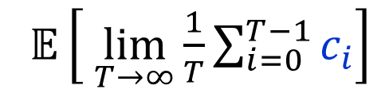





Turn-based Stochastic Games (TBSGs)
[Shapley (1953)] [Gillette (1957)] … [Condon (1992)]
Objective functions:
Total cost – finite horizon
min/max
$𝔼\left[ \sum_{i=0}^{T}{c_{i}}\right]$
(Are they well defined?)
Total cost – infinite horizon
min/max
$𝔼\left[ \sum_{i=0}^{∞}{c_{i}}\right]$
$$20$$
$$−10$$
Discounted cost
min/max
$𝔼\left[ \sum_{i=0}^{∞}{λ^{i}c_{i}}\right]$
Limiting average cost
min/max
$𝔼\left[ \lim_{T→∞}{\frac{1}{T}\sum_{i=0}^{T−1}{c_{i}}}\right]$

Slide 4
TBSG terminology
$S_{0},S_{1}$ – sets of states controlled by the two players.
$A_{i}$ – set of actions from state $i$.
$c_{a}$ – cost of action $a$.
$p_{a,j}$ – probability of moving to $j$ after action $a$.
$\sum_{j∈S}{p_{a,j}}≤1$ , for every $a∈A=⨃_{i∈S}{A_{i}}$.
With probability $1−\sum_{j∈S}{p_{a,j}}$, the game ends.
(The sink is not considered to be a state.)
Player 0 is the minimizer.
Player 1 is the maximizer.

Slide 5
Total cost TBSGs
with the stopping condition
To make the total cost well defined we assume:
Stopping condition:
For every pair of strategies of the players,
the game ends with probability 1.
Discounted cost is a special case.
Limited average cost can be solved using
similar, but more complicated, techniques.

Slide 6
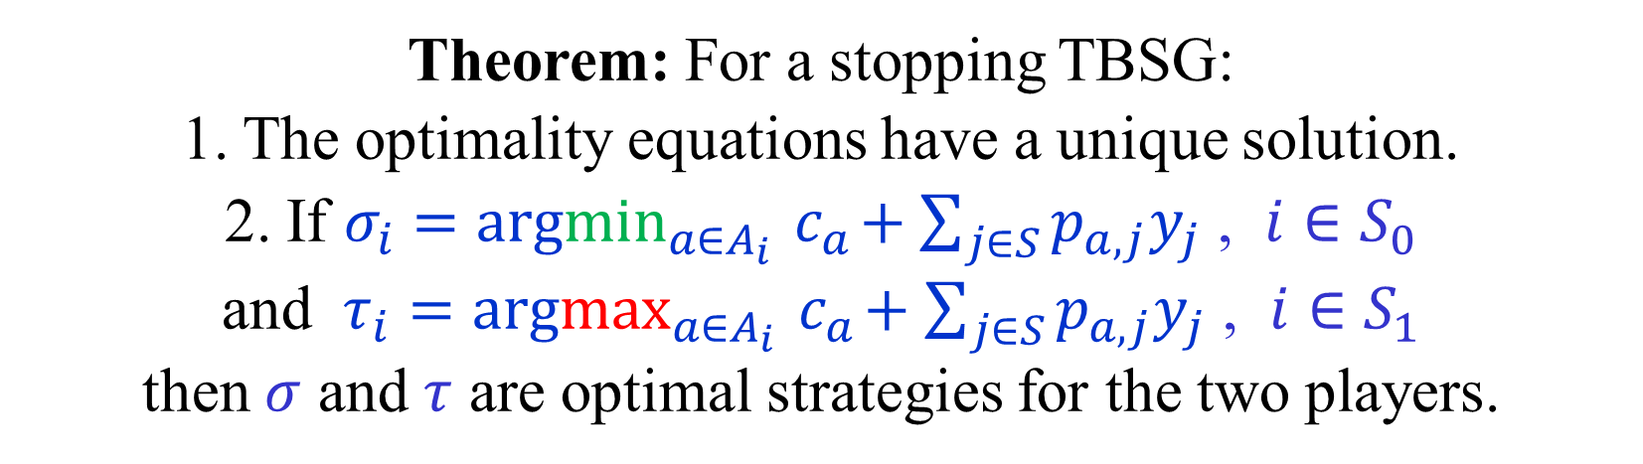
Optimality equations for TBSGs
$y_{i} = \min_{a∈A_{i}}{c_{a}+\sum_{j∈S}{p_{a,j}y_{j}}}$ , $i∈S_{0}$
$y_{i} = \max_{a∈A_{i}}{c_{a}+\sum_{j∈S}{p_{a,j}y_{j}}}$ , $i∈S_{1}$
Theorem: For a stopping TBSG:
1. The optimality equations have a unique solution.
2. If $σ_{i}=argmin_{a∈A_{i}}{ c}_{a}+\sum_{j∈S}{p_{a,j}y_{j}}$ , $i∈S_{0}$
and $τ_{i}=argmax_{a∈A_{i}}{ c}_{a}+\sum_{j∈S}{p_{a,j}y_{j}}$ , $i∈S_{1}$
then $σ$ and $τ$ are optimal strategies for the two players.
How do we solve the optimality equations?
LP does not work…
Can still use value iteration and some form of policy iteration.

Slide 7
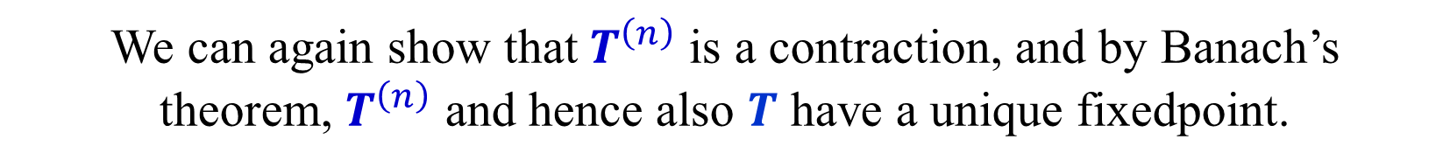


The Value Iteration Operator
$$T:ℝ^{n}→ℝ^{n}$$
${\left(T\left(y\right)\right)}_{i} = \min_{a∈A_{i}}{c_{a}+\sum_{j∈S}{p_{a,j}y_{j}}}$ , $i∈S_{0}$
${\left(T\left(y\right)\right)}_{i} = \max_{a∈A_{i}}{c_{a}+\sum_{j∈S}{p_{a,j}y_{j}}}$ , $i∈S_{1}$
$T^{\left(r\right)}(y)$ is the optimal value vector of
an $r$-step game with terminal cost vector $y$.
(Simple proof using backward induction.)
$y$ is a solution of the optimality equations iff $T\left(y\right)=y$.
In other words, $y$ is a fixed-point of $T$.
We can again show that $T^{\left(n\right)}$ is a contraction, and by Banach’s
theorem, $T^{\left(n\right)}$ and hence also $T$ have a unique fixedpoint.

Slide 8


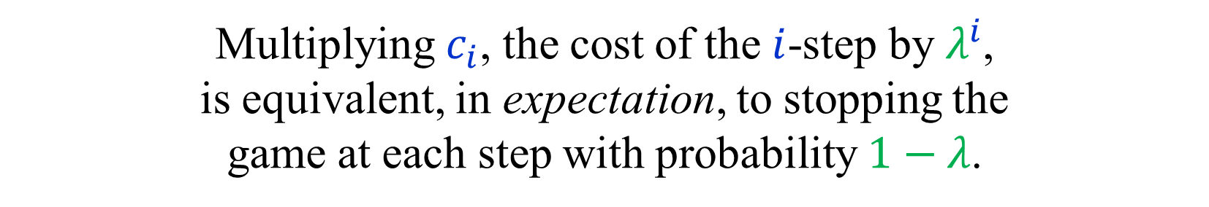





Discounted cost → Total cost
$$p_{1}$$
$${λp}_{1}$$
$$c$$
$$c$$
$$p_{2}$$
$${λp}_{2}$$
$$1−λ$$
Discount factor $λ$
Multiplying $c_{i}$, the cost of the $i$-step by $λ^{i}$,
is equivalent, in expectation, to stopping the
game at each step with probability $1−λ$.
The resulting game is stopping.

Slide 9


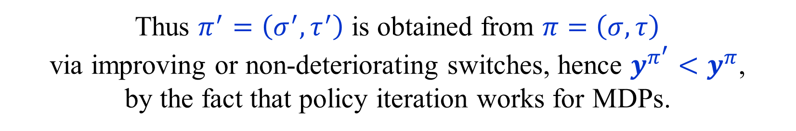
Strategy Improvement for TBSGs
Let $σ$ be a positional strategy for min.
Let $τ$ be the optimal counter-strategy of max to $σ$.
(Can be found by solving an MDP.)
Let $σ^{′}$ be a strategy obtained by performing
improving switches to $σ$, keeping $τ$ unchanged.
Let $τ′$ be the optimal counter-strategy of max to $σ′$.
Lemma: $y^{σ^{′},τ^{′}}< y^{σ,τ}$ ($y^{σ^{′},τ^{′}}≤ y^{σ,τ}$ , $y^{σ^{′},τ^{′}}≠ y^{σ,τ}$)
Proof: Consider $π=\left(σ,τ\right)$ as a policy in a 1-player min game.
As $τ$ is optimal for max, all switches are non-deteriorating for min.
Thus $π^{′}=\left(σ^{′},τ^{′}\right)$ is obtained from $π=\left(σ,τ\right)$
via improving or non-deteriorating switches, hence $y^{π^{′}}<y^{π}$,
by the fact that policy iteration works for MDPs.

Slide 10
Positional optimal strategies
The termination of the strategy iteration algorithm
proves that the optimality equations have a solution.
As with MDPs, we can “read” a pair of positional
strategies that give the corresponding values.
Using the values to modify the costs, we see that
no general strategy can possibly do any better.

Slide 11

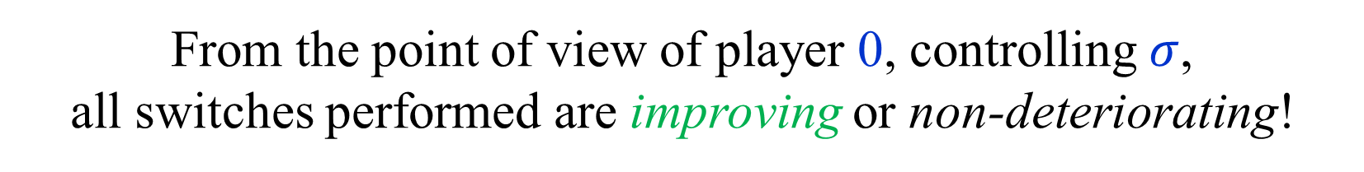
Strategy iteration for two-player games
Start with an arbitrary strategy $σ$.
Compute an optimal counter-strategy $τ$.
If there are improving switches for $σ$,
keeping $τ$ fixed, perform some of them.
Repeat until there are no improving switches.
Final strategies are optimal for the two players.
Consider the move from $(σ,τ)$ to $(σ^{′},τ^{′})$.
From the point of view of player 0, controlling $σ$,
all switches performed are improving or non-deteriorating!
Thus $y^{σ^{′},τ^{′}}< y^{σ,τ}$.

Slide 12
Repeated best response?
Policy/Strategy iteration is a asymmetric.
One of the players improves her strategy locally,
by performing improving switches.
The other player improves her strategy globally,
by computing best response.
What if both players use best response?
Or if they both improve locally?
In both cases, the algorithm may cycle!
[ Condon (1993) ]

Slide 13
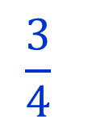
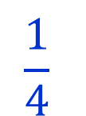

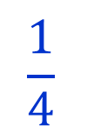
0.4
[ Condon (1993) ]
Repeated best response may cycle
$$\frac{3}{4}$$
$$\frac{1}{4}$$
1
Final payoffs
0.9
0
$$\frac{3}{4}$$
$$\frac{1}{4}$$
0.5

Slide 14

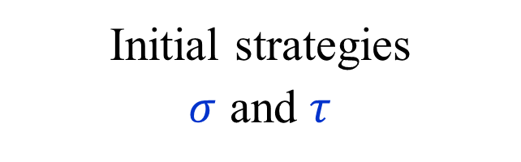
0.4
[ Condon (1993) ]
Initial strategies
$σ$ and $τ$
$$\frac{3}{4}$$
$$\frac{1}{4}$$
MAX switches
both actions
1
0.9
0
$$\frac{3}{4}$$
$$\frac{1}{4}$$
$$π_{0}$$
0.5

Slide 15

0.4
[ Condon (1993) ]
MIN switches
both actions
$$\frac{3}{4}$$
$$\frac{1}{4}$$
1
0.9
0
$$\frac{3}{4}$$
$$\frac{1}{4}$$
$$π_{1}$$
0.5

Slide 16

0.4
[ Condon (1993) ]
MAX switches
both actions
$$\frac{3}{4}$$
$$\frac{1}{4}$$
1
0.9
0
$$\frac{3}{4}$$
$$\frac{1}{4}$$
$$π_{2}$$
0.5

Slide 17

0.4
[ Condon (1993) ]
MIN switches
both actions
$$\frac{3}{4}$$
$$\frac{1}{4}$$
1
0.9
0
$$\frac{3}{4}$$
$$\frac{1}{4}$$
$$π_{3}$$
0.5

Slide 18

0.4
[ Condon (1993) ]
And we are back to
the starting position!
$$\frac{3}{4}$$
$$\frac{1}{4}$$
1
0.9
$$π_{4}=π_{0}$$
0
An essentially minimal example as each player must have at least two vertices.
$$\frac{3}{4}$$
$$\frac{1}{4}$$
0.5

Slide 19





$$0$$
MAX switches
both actions
Can be converted
to a MPGs.
$$−5$$
$$6$$
$$8$$
Note: We did not give a general strategy iteration algorithm for MPGs yet.
$$4$$

Slide 20
$$0$$
MIN switches
both actions
$$−5$$
$$6$$
$$8$$
$$4$$

Slide 21
$$0$$
MAX switches
both actions
$$−5$$
$$6$$
$$8$$
$$4$$

Slide 22
$$0$$
MIN switches
both actions
$$−5$$
$$6$$
$$8$$
$$4$$

Slide 23
$$0$$
And we are back to
the starting position!
$$−5$$
$$6$$
$$8$$
$$4$$

Slide 24
Local improvements by both players
Exercise: Construct a stopping TBSG on which
there is a sequence of alternating improving switches
by both players that cycles.
Why doesn’t the proof given for the strategy iteration
algorithm in which the first player uses improving
switches while the other player uses best response
work in this case?

Slide 25
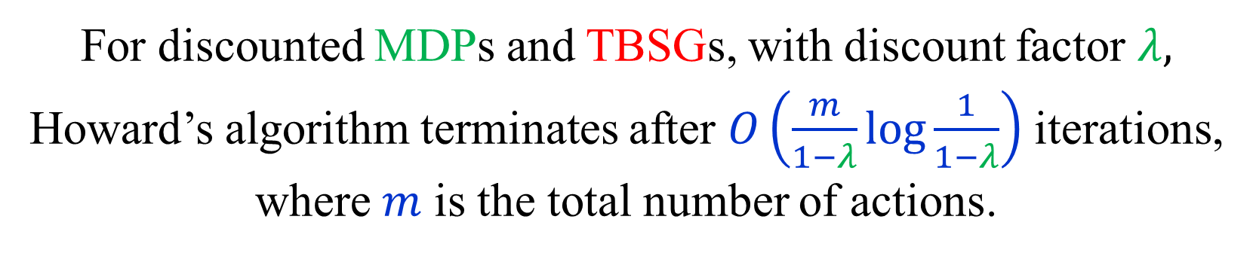
Strategy Iteration for discounted TBSGs
Greedy Strategy Iteration, also known as
SWITCH-ALL, or Howard’s algorithm:
Perform the best switch from each state of player 0.
Compute the best response of player 1.
For discounted MDPs and TBSGs, with discount factor $λ,$ Howard’s algorithm terminates after $O\left(\frac{m}{1−λ}\log{\frac{1}{1−λ}}\right)$ iterations,
where $m$ is the total number of actions.
[ Ye (2011) ] [ Hansen-Miltersen-Z (2012) ] [Sherrer (2016) ]

Slide 26



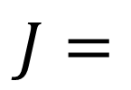

Matrix notation (reminder)
actions
1
1
1
$$A_{1}$$
states
$$p_{a,j}$$
states
$$J=$$
1
1
$$P=$$
$$A_{2}$$
State/action incidence matrix
Transition probabilities
If $π=(σ,τ)$ is a strategy profile, then
${\left(P_{π}\right)}_{i,j}=p_{π_{i},j}$ , ${\left(c_{π}\right)}_{i}=c_{π_{i}}$
$$J_{π}=I$$
Note that $J_{π}$, $P_{π}$ and $c_{π}$ are obtained by taking rows indexed by $π$.

Slide 27

Values and modified costs
Let $π=(σ,τ)$ be a strategy profile.
Let $y^{π}={\left(I−λP_{π}\right)}^{−1}c_{π}$ be the values under $π$.
Let ${\overline{c}}^{π}=c−\left(J−λP\right)y^{π}$ be the modified costs w.r.t. $y^{π}$.
(This is the same transformation we saw before.)
Lemma 1: Let $π$ and $π′$ be two strategy profiles.
Then, $y^{π}−y^{π^{′}}={\left(I−λP_{π}\right)}^{−1}{\left({\overline{c}}^{π^{′}}\right)}_{π}$.
$${\left(I−λP_{π}\right)}^{−1}{\left({\overline{c}}^{π^{′}}\right)}_{π}={\left(I−λP_{π}\right)}^{−1}\left(c_{π}−(I−λP_{π})y^{π^{′}}\right)$$
$$= y^{π}−y^{π^{′}}$$
Can you give an intuitive interpretation of the lemma?

Slide 28
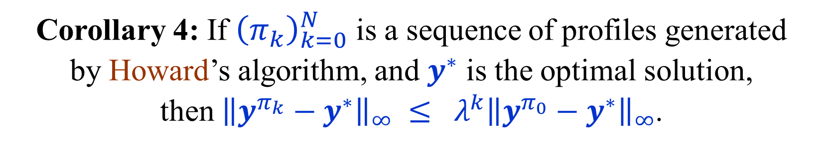
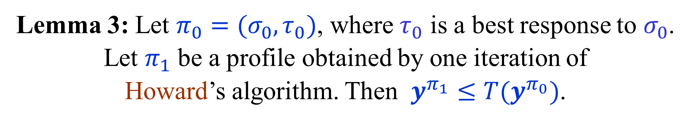
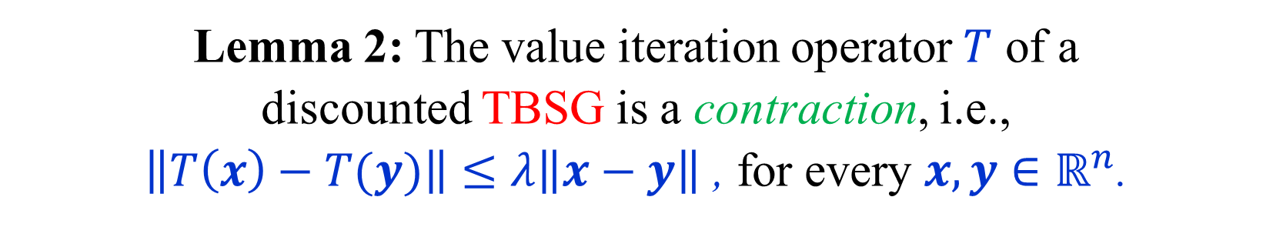
Strategy Iteration vs. Value Iteration
Lemma 2: The value iteration operator $T$ of a
discounted TBSG is a contraction, i.e.,
$\left\|T\left(x\right)−T(y)\right\|≤λ\left\|x−y\right\|$ , for every $x,y∈ℝ^{n}$.
Lemma 3: Let $π_{0}=(σ_{0},τ_{0})$, where $τ_{0}$ is a best response to $σ_{0}$. Let $π_{1}$ be a profile obtained by one iteration of
Howard’s algorithm. Then $y^{π_{1}}≤T(y^{π_{0}})$.
(In other words, strategy iteration is as fast as value iteration.)
Corollary 4: If ${\left(π_{k}\right)}_{k=0}^{N}$ is a sequence of profiles generated
by Howard’s algorithm, and $y^{∗}$ is the optimal solution,
then ${\left\|y^{π_{k}}−y^{∗}\right\|}_{∞} ≤ λ^{k}{\left\|y^{π_{0}}−y^{∗}\right\|}_{∞}$.

Slide 29
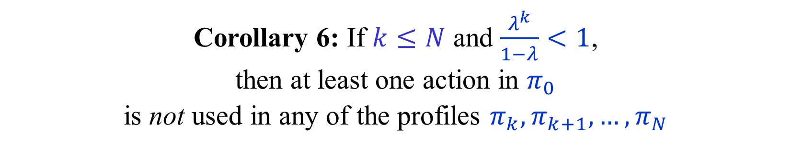
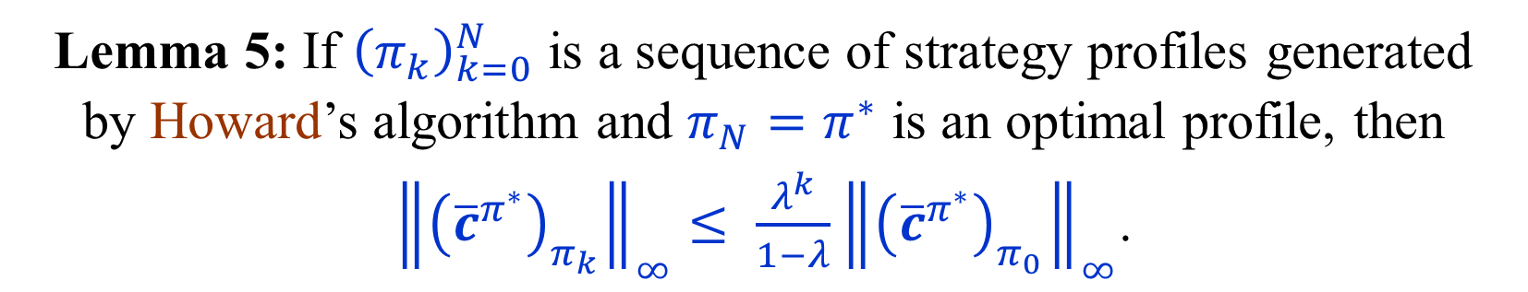
Action elimination by Strategy Iteration
Lemma 5: If ${\left(π_{k}\right)}_{k=0}^{N}$ is a sequence of strategy profiles generated
by Howard’s algorithm and $π_{N}=π^{∗}$ is an optimal profile, then
${\left\|{\left({\overline{c}}^{π^{∗}}\right)}_{π_{k}}\right\|}_{∞}≤ \frac{λ^{k}}{1−λ}{\left\|{\left({\overline{c}}^{π^{∗}}\right)}_{π_{0}}\right\|}_{∞}$.
Corollary 6: If $k≤N$ and $\frac{λ^{k}}{1−λ}<1$,
then at least one action in $π_{0}$
is not used in any of the profiles $π_{k},π_{k+1},…, π_{N}$
Proof of Corollary 6:
Let $a={argmax}_{b∈π_{0}}\left|{\overline{c}}_{b}^{π^{∗}}\right|$, so that ${\left\|{\left({\overline{c}}^{π^{∗}}\right)}_{π_{0}}\right\|}_{∞}=\left|{\overline{c}}_{a}^{π^{∗}}\right|$.
If $a∈π_{k}$, then $\left|{\overline{c}}_{a}^{π^{∗}}\right|{≤\left\|{\left({\overline{c}}^{π^{∗}}\right)}_{π_{0}}\right\|}_{∞}≤\frac{λ^{k}}{1−λ}\left|{\overline{c}}_{a}^{π^{∗}}\right|<\left|{\overline{c}}_{a}^{π^{∗}}\right|$, contradiction.

Slide 30
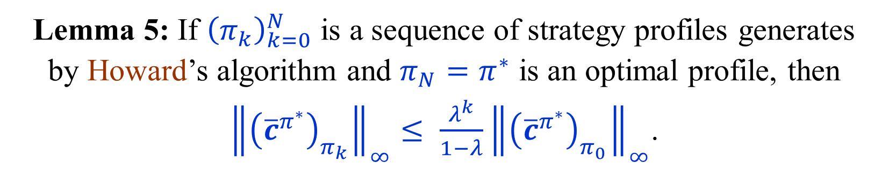
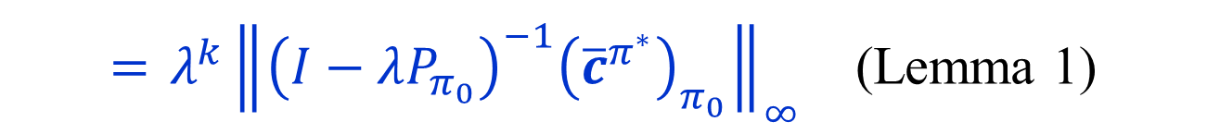
Proof of Lemma 5
Lemma 5: If ${\left(π_{k}\right)}_{k=0}^{N}$ is a sequence of strategy profiles generates
by Howard’s algorithm and $π_{N}=π^{∗}$ is an optimal profile, then
${\left\|{\left({\overline{c}}^{π^{∗}}\right)}_{π_{k}}\right\|}_{∞}≤ \frac{λ^{k}}{1−λ}{\left\|{\left({\overline{c}}^{π^{∗}}\right)}_{π_{0}}\right\|}_{∞}$.
${\left\|{\left({\overline{c}}^{π^{∗}}\right)}_{π_{k}}\right\|}_{∞}= {\left\|\left(I−λP_{π_{k}}\right)\left(y^{π_{k}}−y^{∗}\right)\right\|}_{∞}$ (Lemma 1)
$≤ {\left\|y^{π_{k}}−y^{∗}\right\|}_{∞}$ (As $P_{π_{k}}≥0$ and $y^{π_{k}}≥y^{∗}$)
$≤ λ^{k} {\left\|y^{π_{0}}−y^{∗}\right\|}_{∞}$ (Corollary 4)
$={ λ}^{k}{\left\|{\left(I−λP_{π_{0}}\right)}^{−1}{\left({\overline{c}}^{π^{∗}}\right)}_{π_{0}}\right\|}_{∞}$ (Lemma 1)
$≤ \frac{λ^{k}}{1−λ}{\left\|{\left({\overline{c}}^{π^{∗}}\right)}_{π_{0}}\right\|}_{∞}$ (Each row of ${\left(I−λP_{π_{0}}\right)}^{−1}$ sums to $\frac{1}{1−λ}$)

Slide 31
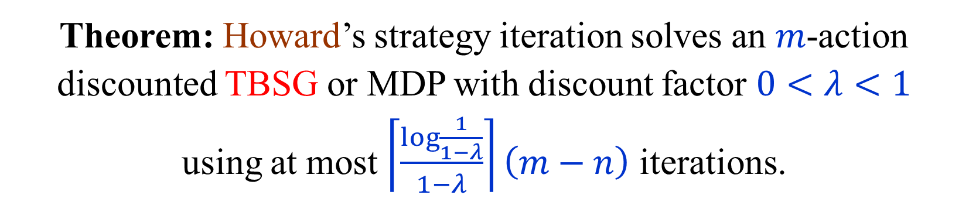

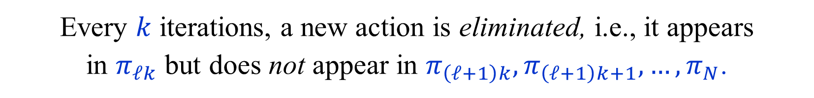
Howard’s algorithm for discounted TBSGs
Theorem: Howard’s strategy iteration solves an $m$-action
discounted TBSG or MDP with discount factor $0<λ<1$
using at most $\left\lceil \frac{\log{\frac{1}{1−λ}}}{1−λ}\right\rceil \left(m−n\right)$ iterations.
Let $k=\left\lceil \frac{\log{\frac{1}{1−λ}}}{1−λ}\right\rceil$. Then $\frac{λ^{k}}{1−λ}<1$.
Every $k$ iterations, a new action is eliminated, i.e., it appears
in $π_{ℓk}$ but does not appear in $π_{\left(ℓ+1\right)k},π_{\left(ℓ+1\right)k+1},…, π_{N}$.
Thus, the total number of iterations before an
optimal strategy profile is found is at most $k\left(m−n\right)$.

Slide 32

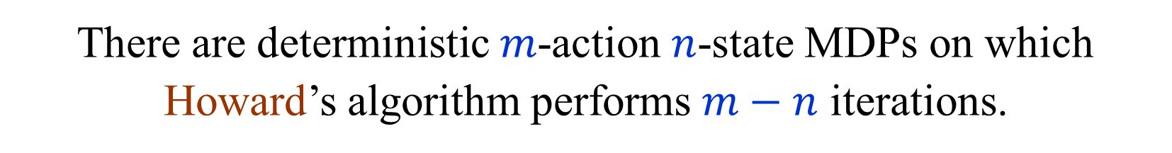
Lower bounds for Howard’s algorithm
for non-discounted problems
There are deterministic $m$-action $n$-state MDPs on which Howard’s algorithm performs $m−n$ iterations.
[ Hansen-Z (2010) ]
There are $2n$-action $n$-state MDPs on which
Howard’s algorithm performs $2^{Ω\left(n\right)}$ iterations.
[ Friedmann (2009) ] [ Fearnley (2010) ]
Results also hold for discount factors sufficiently close to 1.

Slide 33
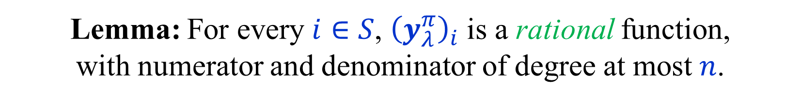
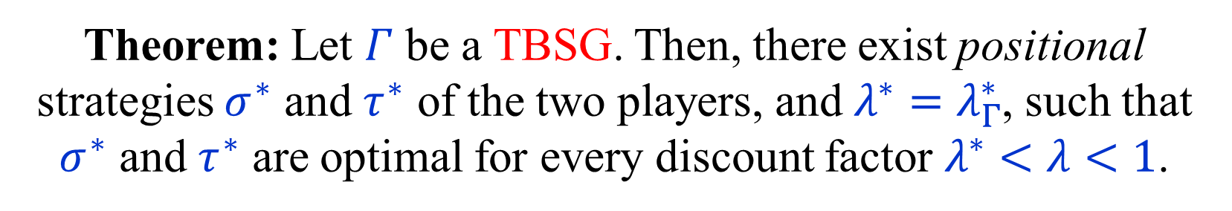
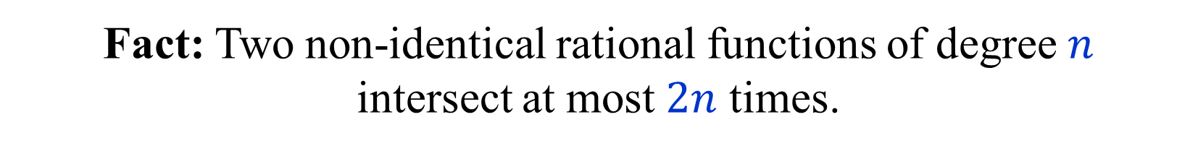
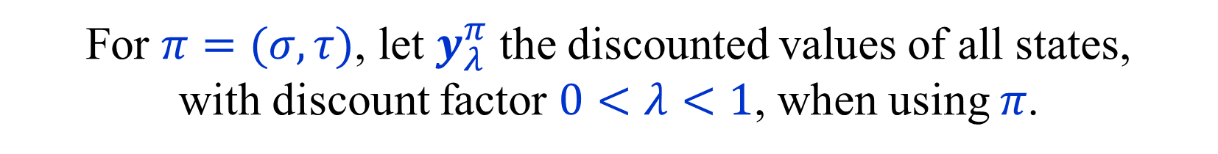
Optimal positional strategies for
discount factors close to 1
Theorem: Let $Γ$ be a TBSG. Then, there exist positional strategies $σ^{∗}$ and $τ^{∗}$ of the two players, and $λ^{∗}=λ_{Γ}^{∗}$, such that $σ^{∗}$ and $τ^{∗}$ are optimal for every discount factor $λ^{∗}<λ<1$.
For $π=(σ,τ)$, let $y_{λ}^{π}$ the discounted values of all states,
with discount factor $0<λ<1$, when using $π$.
Lemma: For every $i∈S$, ${\left(y_{λ}^{π}\right)}_{i}$ is a rational function,
with numerator and denominator of degree at most $n$.
Proof: $y_{λ}^{π}={\left(I−λP_{π}\right)}^{−1}c_{π}$ + Cramer’s rule.
Fact: Two non-identical rational functions of degree $n$
intersect at most $2n$ times.

Slide 34
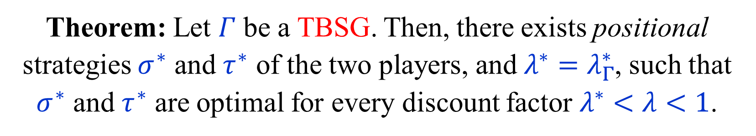
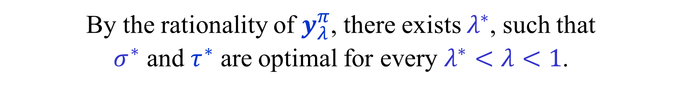

Optimal positional strategies for
discount factors close to 1
Theorem: Let $Γ$ be a TBSG. Then, there exists positional strategies $σ^{∗}$ and $τ^{∗}$ of the two players, and $λ^{∗}=λ_{Γ}^{∗}$, such that $σ^{∗}$ and $τ^{∗}$ are optimal for every discount factor $λ^{∗}<λ<1$.
For $π_{n}=(σ_{n},τ_{n})$ be positional and optimal for $λ=1−\frac{1}{n}$.
Let $π^{∗}=\left(σ^{∗},τ^{∗}\right)$ be a pair that appears an
infinite number of times in sequence ${\left(π_{n}\right)}_{n=1}^{∞}$.
By the rationality of $y_{λ}^{π}$, there exists $λ^{∗}$, such that
$σ^{∗}$ and $τ^{∗}$ are optimal for every $λ^{∗}<λ<1$.

Slide 35
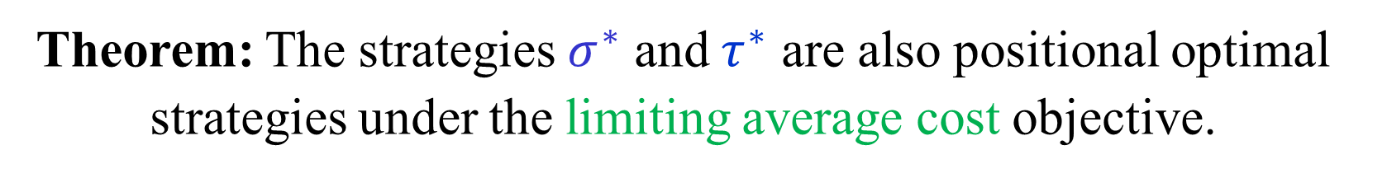

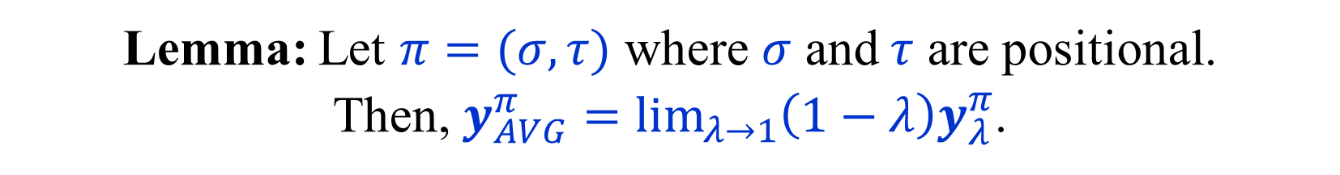
Optimal positional strategies for
TBSG with limiting average cost
Theorem: Let $Γ$ be a TBSG. Then, there exists positional strategies $σ^{∗}$ and $τ^{∗}$ of the two players, and $λ^{∗}=λ_{Γ}^{∗}$, such that $σ^{∗}$ and $τ^{∗}$ are optimal for every discount factor $λ^{∗}<λ<1$.
Theorem: The strategies $σ^{∗}$ and $τ^{∗}$ are also positional optimal strategies under the limiting average cost objective.
Lemma: Let $π=(σ,τ)$ where $σ$ and $τ$ are positional.
Then, $y_{AVG}^{π}=\lim_{λ→1}\left(1−λ\right)y_{λ}^{π}$.
Note: Here we do not assume the stopping condition.

Slide 36
END of
LECTURE 3

