Slide 1
Games on Graphs
Uri Zwick
Tel Aviv University
Lecture 2 –
Markov Decision Processes
Last modified 08/11/2020

Slide 2
Lecture 2
Markov Decision Processes
are 1-player TBSGs
Infinite-horizon MDPs have
optimal positional strategies
Value iteration
Policy iteration
Linear Programming

Slide 3




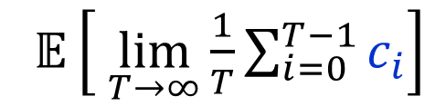
Markov Decision Processes
[Bellman ’57] [Howard ’60] …
1-player TBSGs
Total cost – infinite horizon
min/max
$𝔼\left[ \sum_{i=0}^{∞}{c_{i}}\right]$
Discounted cost
min/max
$𝔼\left[ \sum_{i=0}^{∞}{λ^{i}c_{i}}\right]$
Limiting average cost
min/max
$𝔼\left[ \lim_{T→∞}{\frac{1}{T}\sum_{i=0}^{T−1}{c_{i}}}\right]$
Optimal positional strategies can be found using LP.
Is there a strongly polynomial time algorithm?

Slide 4




Stochastic shortest paths (SSPs)
Minimize the expected cost
of getting to the target.

Slide 5
Main goals
Prove the existence of optimal positional strategies.
Design algorithms, as efficient as possible,
for finding values and optimal strategies.
Some of the algorithms used in the existence proofs.
Major open problem:
Is there a polynomial time algorithm for solving
TBSGs, MPGs, EGs, PGs ?

Slide 6
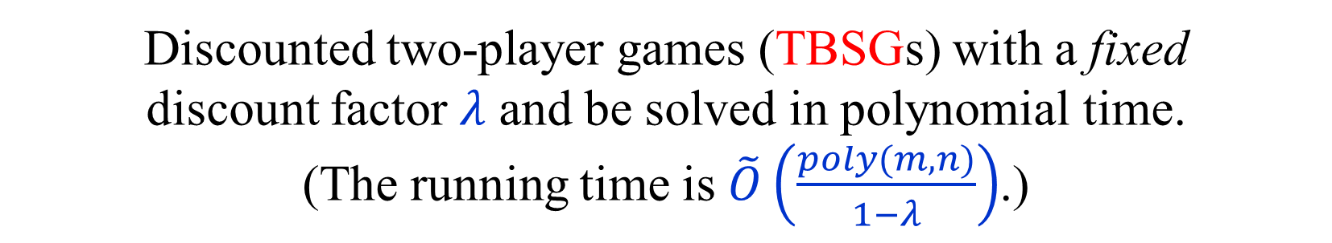
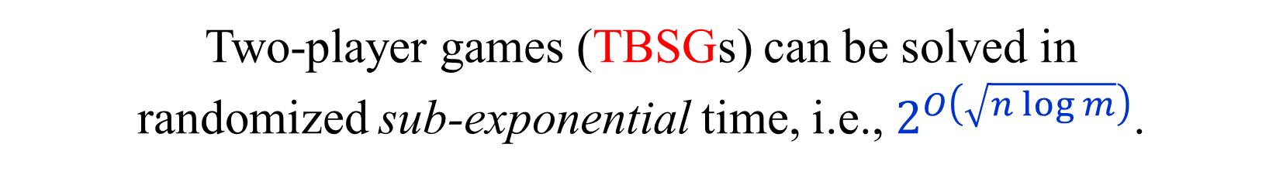
Known results
One-player stochastic games (MDPs) can be solved
in polynomial time using linear programming.
Discounted two-player games (TBSGs) with a fixed
discount factor $λ$ and be solved in polynomial time.
(The running time is $\tilde{O}\left(\frac{poly(m,n)}{1−λ}\right)$.)
Two-player games (TBSGs) can be solved in
randomized sub-exponential time, i.e., $2^{O\left(\sqrt{n log m}\right)}$.
PGs can be solves in quasi-polynomial time, i.e., $n^{O\left(\log{n}\right)}$.
Decision problem for two-player games (TBSGs)
is in NP ∩ co-NP and in CLS ⊆ PLS ∩ PPAD.

Slide 7
One-player Games
(MDPs)

Slide 8
Total cost MDPs
with the stopping condition
We start with one-player games, i.e.,
MDPs, with the total cost objective.
To make the total cost well defined we assume:
Stopping condition:
For every strategy of the player,
the game ends with probability 1.
Discounted cost is a special case.
Limited average cost can be solved using
similar, but more complicated, techniques.

Slide 9



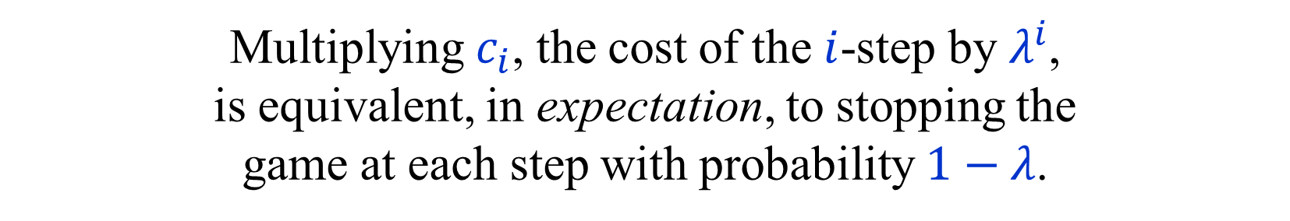

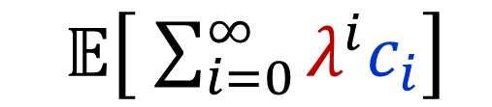



Discounted cost → Total cost
$$p_{1}$$
$${λp}_{1}$$
$$c$$
$$c$$
$$p_{2}$$
$${λp}_{2}$$
$$1−λ$$
$𝔼\left[ \sum_{i=0}^{∞}{λ^{i}c_{i}}\right]$
$𝔼\left[ \sum_{i=0}^{∞}{c_{i}}\right]$
Multiplying $c_{i}$, the cost of the $i$-step by $λ^{i}$,
is equivalent, in expectation, to stopping the
game at each step with probability $1−λ$.
The resulting game is stopping.

Slide 10
Limiting average → Discounted cost
$${Disc}_{λ}\left(c\right) \underset{→}{λ→1 } Total(c)$$
$$\left(1−λ\right){Disc}_{λ}(c) \underset{→}{λ→1 } LimAvg(c)$$
This can be used, in principle, to convert
algorithms for the discounted case to
algorithms for the limiting average case.
Usually means that we have to work with
pairs of values: “gains” and “biases”.
Total cost is simpler.

Slide 11
MDP terminology
$S$ – set of states (vertices).
$A_{i}$ – set of actions from state $i$.
$c_{a}$ – cost of action $a$.
$p_{a,j}$ – probability of moving to $j$ after action $a$.
$\sum_{j∈S}{p_{a,j}}≤1$ , for every $a∈A=⨃_{i∈S}{A_{i}}$.
With probability $1−\sum_{j∈S}{p_{a,j}}$, the game ends.
(The sink is not considered to be a state.)
(min) player $≡$ controller
strategy $≡$ policy

Slide 12

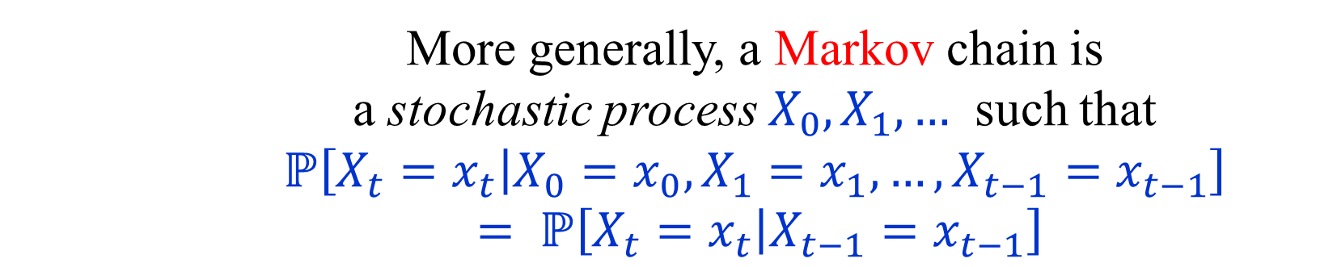
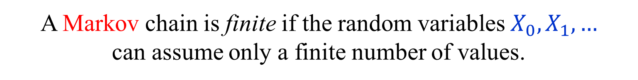
Markov chains
A Markov chain is an MDP in which there is
only one action from each state.
More generally, a Markov chain is
a stochastic process $X_{0},X_{1},…$ such that
$$ℙ\left[X_{t}=x_{t} | X_{0}=x_{0},X_{1}=x_{1},…,X_{t−1}=x_{t−1}\right]$$
$= ℙ\left[X_{t}=x_{t} | X_{t−1}=x_{t−1}\right]$
If $ℙ\left[X_{t}=a | X_{t−1}=b\right]$ does not depend on $t$
then the Markov chain is time-homogeneous.
A Markov chain is finite if the random variables $X_{0},X_{1},…$
can assume only a finite number of values.

Slide 13

Markov chains (with costs)
$S$ – finite set of states.
$c_{i}$ – cost of state $i$.
$p_{i,j}$ – probability of moving from $i$ to $j$ in one step.
${0≤p}_{i,j}≤1$ , for every $i,j∈S$.
$\sum_{j∈S}{p_{i,j}}≤1$ , for every $i∈S$.
With probability $1−\sum_{j∈S}{p_{i,j}}$, the chain stops.
${P=(p}_{i,j})$ – the transition matrix.
$P^{\left(r\right)}= \left(p_{i,j}^{\left(r\right)}\right)=P^{r}$ – the $r$-step transition matrix.
$$p_{i,j}^{\left(r\right)}=\sum_{k}{p_{i,k}p_{k,j}^{\left(r−1\right)}}=\sum_{k}{p_{i,k}^{\left(r−1\right)}p_{k,j}}$$

Slide 14
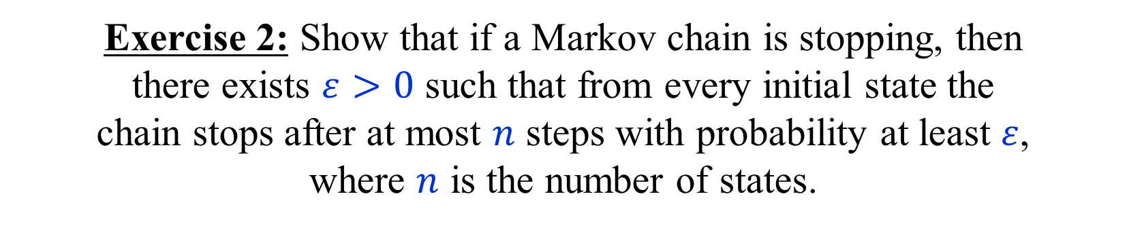
Stopping Markov chains
Stopping condition:
From every initial state,
the chain stops with probability 1.
Exercise 1: Describe a simple linear time algorithm for finding
all the states from which a chain stops with probability 1.
Exercise 2: Show that if a Markov chain is stopping, then
there exists $ε>0$ such that from every initial state the
chain stops after at most $n$ steps with probability at least $ε$,
where $n$ is the number of states.

Slide 15

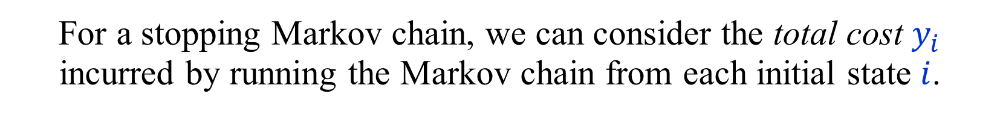
Total cost of a Markov chain
${P=(p}_{i,j})$ – the transition matrix.
${c=(c}_{i})$ – the state cost vector.
For a stopping Markov chain, we can consider the total cost $y_{i}$ incurred by running the Markov chain from each initial state $i$.
$y_{i} =\sum_{j∈S}{\sum_{r≥0}{p_{i,j}^{\left(r\right)}c_{j}}}$, $i∈S$
$y_{i} = c_{i}+\sum_{j∈S}{p_{i,j}y_{j}}$, $i∈S$
In matrix notation:
$$y=c+Py$$
$y=\left(\sum_{r≥0}{P^{r}}\right)c= {\left(I−P\right)}^{−1}c$
(Note: $P^{0}=I$ for every matrix $P$.)

Slide 16
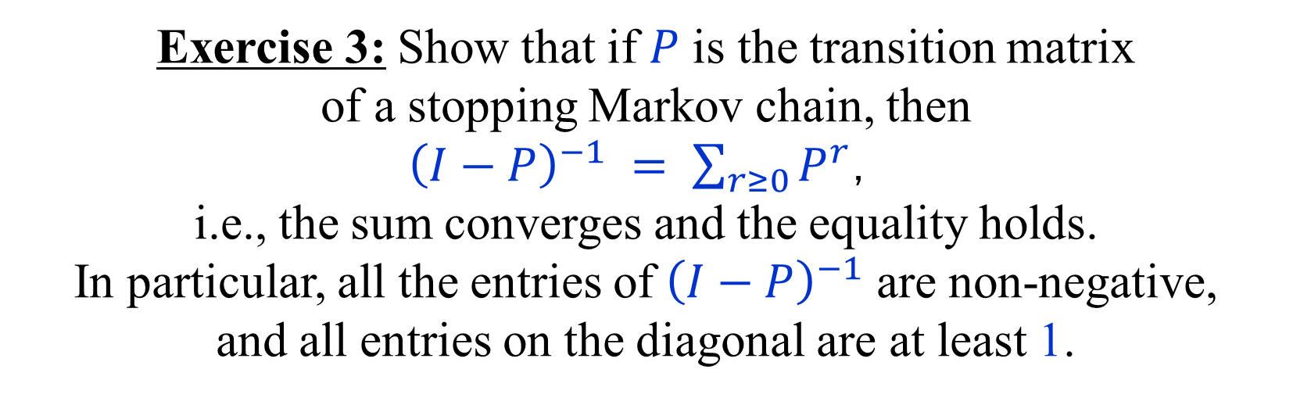

Total cost of a Markov chain
$$y=c+Py$$
$y=\left(\sum_{r≥0}{P^{r}}\right)c= {\left(I−P\right)}^{−1}c$
Exercise 3: Show that if $P$ is the transition matrix
of a stopping Markov chain, then
${\left(I−P\right)}^{−1} =$ $\sum_{r≥0}{P^{r}}$，
i.e., the sum converges and the equality holds.
In particular, all the entries of ${\left(I−P\right)}^{−1}$ are non-negative,
and all entries on the diagonal are at least 1.
(Hint: Use Exercise 2.)

Slide 17
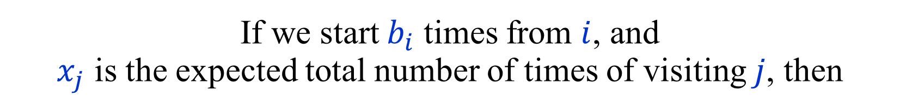

Expected number of visits
${\left(I−P\right)}^{−1} =$ $\sum_{r≥0}{P^{r}}$
Meaning of ${\left({\left(I−P\right)}^{−1}\right)}_{i,j}$:
Expected number of times of
being at state $j$ when starting at state $i$.
If we start $b_{i}$ times from $i$, and
$x_{j}$ is the expected total number of times of visiting $j$, then
$$x^{T}=b^{T}{\left(I−P\right)}^{−1}$$

Slide 18
Optimal strategies for MDPs
A policy $π$ is optimal if for every other policy $π′$,
$y_{i}^{π} = Val_{TOT}^{π}\left(Γ,i\right) ≤ Val_{TOT}^{π′}\left(Γ,i\right)$ , $i∈S$
Theorem: Every stopping MDP has an optimal strategy.
Furthermore, there is a positional strategy that is
optimal from every initial state.

Slide 19
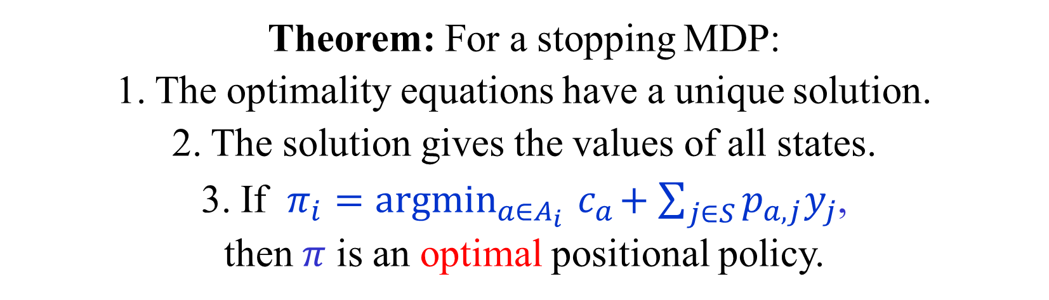
Optimality equations for MDPs
$y_{i} = \min_{a∈A_{i}}{ c_{a}+\sum_{j∈S}{p_{a,j}y_{j}}}$ , $i∈S$
Theorem: For a stopping MDP:
1. The optimality equations have a unique solution.
2. The solution gives the values of all states.
3. If $π_{i}=argmin_{a∈A_{i}}{ c}_{a}+\sum_{j∈S}{p_{a,j}y_{j}}$,
then $π$ is an optimal positional policy.
Note: The choice in (3) is not necessarily unique.

Slide 20

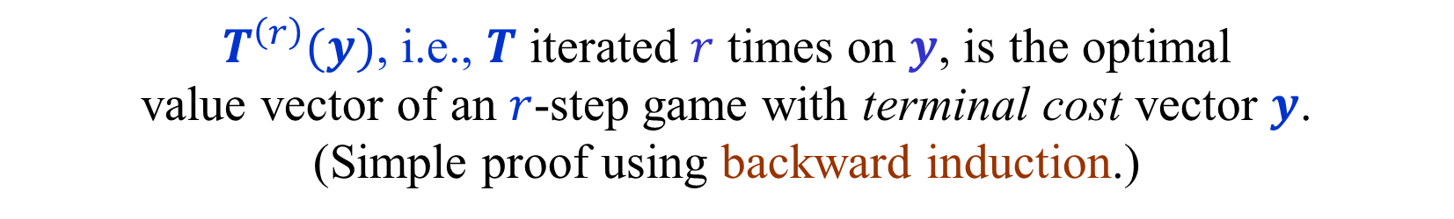

The Value Iteration Operator
$$T:ℝ^{n}→ℝ^{n}$$
${\left(T\left(y\right)\right)}_{i} = \min_{a∈A_{i}}{c_{a}+\sum_{j∈S}{p_{a,j}y_{j}}}$ , $i∈S$
$T^{\left(r\right)}(y)$, i.e., $T$ iterated $r$ times on $y$, is the optimal
value vector of an $r$-step game with terminal cost vector $y$.
(Simple proof using backward induction.)
$T^{\left(r\right)}(0)$ corresponds to having no terminal costs.
Does the sequence $T^{\left(1\right)}\left(y\right),T^{\left(2\right)}\left(y\right),…$ converge?
Note that if $y_{r}=T^{\left(r\right)}(y)$, then $y_{r}=T\left(y_{r−1}\right)$.
Does it converge to the optimal values of the infinite game?
$y$ is a solution of the optimality equations iff $T\left(y\right)=y$.
In other words, $y$ is a fixed-point of $T$.

Slide 21
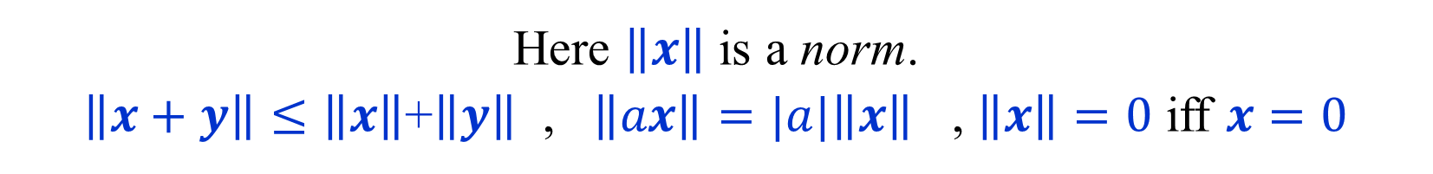
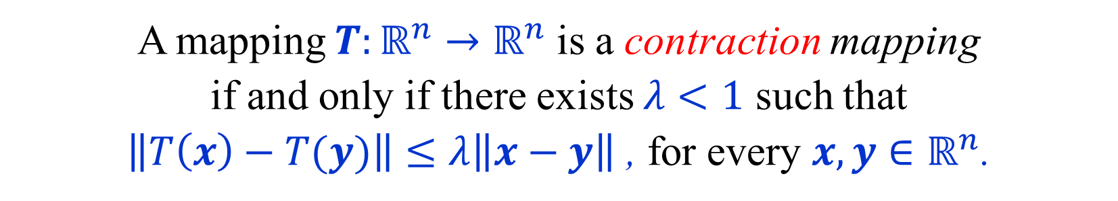
Contraction mapping
A mapping $T:ℝ^{n}→ℝ^{n}$ is a contraction mapping
if and only if there exists $λ<1$ such that
$\left\|T\left(x\right)−T(y)\right\|≤λ\left\|x−y\right\|$ , for every $x,y∈ℝ^{n}$.
Here $\left\|x\right\|$ is a norm.
$\left\|x+y\right\|≤\left\|x\right\|$+$\left\|y\right\|$ , $\left\|ax\right\|=|a|\left\|x\right\|$ , $\left\|x\right\|=0$ iff $x=0$
We shall use the $ℓ_{∞}$ norm: ${\left\|x\right\|}_{∞}=\max_{i}{|x_{i}|}$.

Slide 22
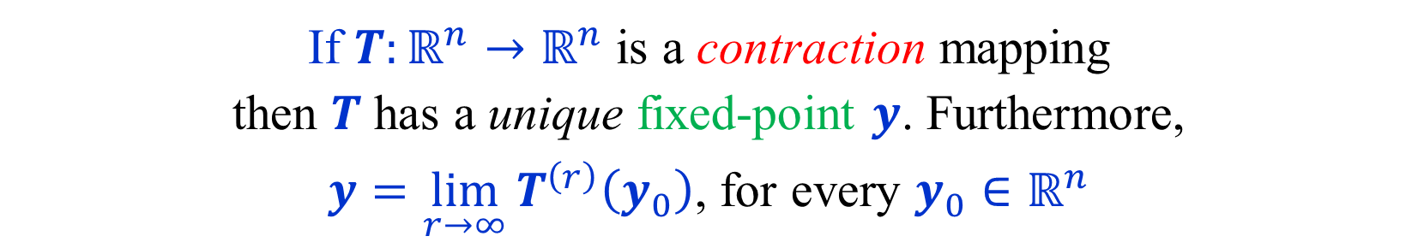
Banach fixed-point theorem
If $T:ℝ^{n}→ℝ^{n}$ is a contraction mapping
then $T$ has a unique fixed-point $y$. Furthermore,
$y=\lim_{r→∞}{T^{\left(r\right)}\left(y_{0}\right)}$, for every $y_{0}∈ℝ^{n}$
Let $y_{r}=T^{\left(r\right)}\left(y_{0}\right)$. Note that $y_{r}=T\left(y_{r−1}\right)$.
By induction $\left\|y_{r+1}−y_{r}\right\|≤λ^{r}\left\|y_{1}−y_{0}\right\|$.
To show that $\left\{y_{r}\right\}$ converges, we show that it is a Cauchy sequence.
$\left\|y_{r+s}−y_{r}\right\| ≤ \sum_{k=0}^{s−1}{ \left\|y_{r+k+1}−y_{r+k}\right\|}$
$≤ \sum_{k=0}^{s−1}{ λ^{r+k}\left\|y_{1}−y_{0}\right\|} < \frac{λ^{r}}{1−λ}\left\|y_{1}−y_{0}\right\|$
If $y$ and $y′$ are two fixed-points, then
$\left\|y−y′\right\|=\left\|T(y)−T\left(y^{′}\right)\right\|≤λ\left\|y−y′\right\|$ , so $y=y′$.

Slide 23
Discounted MDPs
${\left(T_{λ}\left(y\right)\right)}_{i} = \min_{a∈A_{i}}{c_{a}+λ\sum_{j∈S}{p_{a,j}y_{j}}}$ , $i∈S$
$y_{i} = \min_{a∈A_{i}}{c_{a}+λ\sum_{j∈S}{p_{a,j}y_{j}}}$ , $i∈S$
The mapping $T_{λ}\left(y\right)$ is a contraction.
Thus, by Banach’s theorem it has a unique fixed-point.
Is the fixed-point indeed the solution of the MDP?
What about general stopping MDPs and TBSGs?

Slide 24
Stopping MDPs
${\left(T\left(y\right)\right)}_{i} = \min_{a∈A_{i}}{c_{a}+\sum_{j∈S}{p_{a,j}y_{j}}}$ , $i∈S$
$y_{i} = \min_{a∈A_{i}}{c_{a}+\sum_{j∈S}{p_{a,j}y_{j}}}$ , $i∈S$
The mapping $T$ is not necessarily a contraction.
But, $T^{\left(n\right)}$ is a contraction.
Thus, $T^{\left(n\right)}$ has a unique fixed-point $y$.
Now, $T^{\left(n\right)}\left(T\left(y\right)\right)=T\left(T^{\left(n\right)}\left(y\right)\right)=T(y)$.
Thus, $T(y)$ is also a fixed-point of $T^{\left(n\right)}$.
By uniqueness, $T\left(y\right)=y$.
Hence $y$ is the unique fixed-point of $T$.

Slide 25


Modified costs
Let $z:S→ℝ$ be an arbitrary (potential) function.
Define modified costs with respect to $z$ as follows:
${c_{a}^{′}= c}_{a}−z_{i}+\sum_{j∈S}{p_{a,j}z_{j}}$ , $a∈A_{i}$
Lemma: For every (general) policy $π$:
${\left(y^{′}\right)}_{i}^{π}=y_{i}^{π} −z_{i}$ , $i∈S$
(Where ${\left(y^{′}\right)}_{i}^{π}$ is the value with cost function $c_{a}^{′}$.)
Similar to modified costs used by the simplex algorithm.
Used in shortest paths algorithms as:
$$c_{\left(i,j\right)}^{′}=c_{\left(i,j\right)}+z_{i}−z_{j}$$

Slide 26
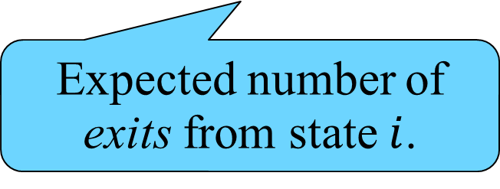

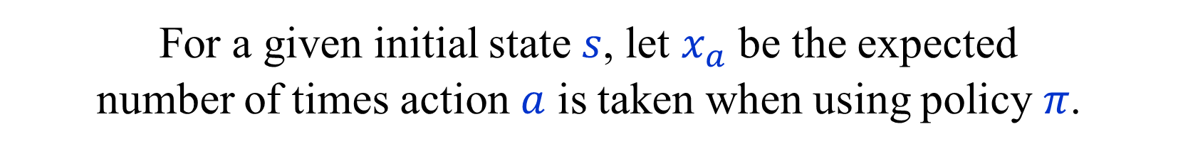


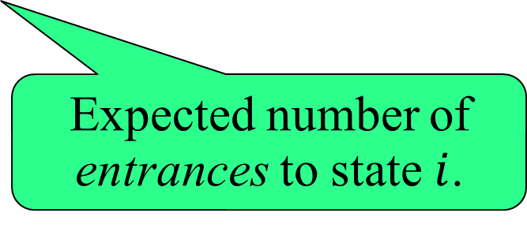
Modified costs - Proof
${c_{a}^{′}= c}_{a}−z_{i}+\sum_{j∈S}{p_{a,j}z_{j}}$
For a given initial state $s$, let $x_{a}$ be the expected
number of times action $a$ is taken when using policy $π$.
$$\sum_{a∈A_{i}}{x_{a}} −\sum_{a∈A}{x_{a}p_{a,i}}= \left\{\begin{aligned} 1 , if i=s \\ 0 , if i≠s\end{aligned}\right.$$
$$Val_{TOT}^{π}\left(Γ,s\right)−Val_{TOT}^{π}\left(Γ′,s\right)$$
Expected number of exits from state $i$.
Expected number of entrances to state $i$.
$$=\sum_{i∈S}{\sum_{a∈A_{i}}{x_{a}\left(z_{i}−\sum_{j∈S}{p_{a,j}z_{j}}\right)}}$$
$$=\sum_{i∈S}{\left(\sum_{a∈A_{i}}{x_{a}} −\sum_{a∈A}{x_{a}p_{a,i}}\right)z_{i}}=z_{s}$$

Slide 27
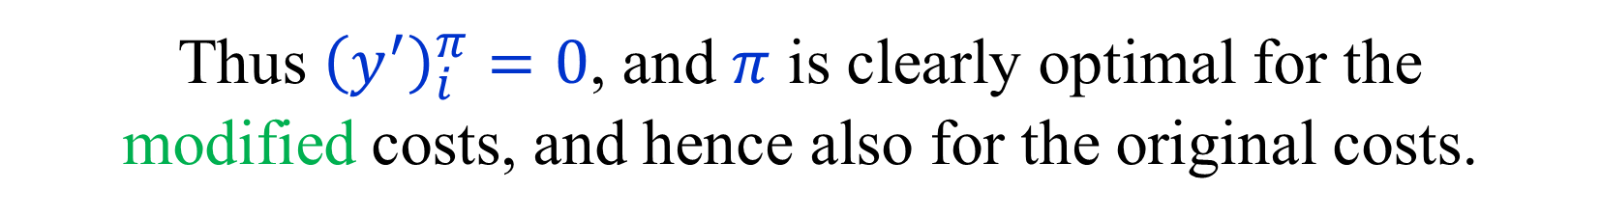
Optimality equation → Optimality
Let $y_{i}$ be a solution of the optimality equations.
Let $π_{i}=argmin_{a∈A_{i}}{ c}_{a}+\sum_{j∈S}{p_{a,j}y_{j}}$,
Define modified costs with respect to $y_{i}$
${c_{a}^{′}= c}_{a}−y_{i}+\sum_{j∈S}{p_{a,j}y_{j}}$
By the optimality equations:
$c_{a}^{′ } ≥ 0$ , $a∈A$
$c_{π_{i}}^{′}=0$ , $i∈S$
Thus ${\left(y^{′}\right)}_{i}^{π}=0$, and $π$ is clearly optimal for the
modified costs, and hence also for the original costs.

Slide 28

Evaluating a positional policy
Let $π$ be a positional policy of a stopping MDP.
$π_{i}∈A_{i}$ is the action prescribed by $π$ at $i$.
Then, the values $y_{i}^{π}$ under $π$ are the unique solution
of the following system of linear equations:
$y_{i}^{π} = c_{π_{i}}+\sum_{j∈S}{p_{π_{i},j}y_{j}^{π}}$, $i∈S$
$$y^{π}={\left(I−P_{π}\right)}^{−1}c_{π}$$
where ${\left(P_{π}\right)}_{i,j}=p_{π_{i},j}$ , ${\left(c_{π}\right)}_{i}=c_{π_{i}}$
$P_{π}$ is the transition matrix of a stopping Markov chain.
${\left(I−P_{π}\right)}^{−1}=\sum_{i≥0}{{\left(P_{π}\right)}^{i}}$.

Slide 29
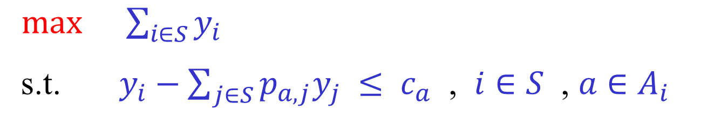
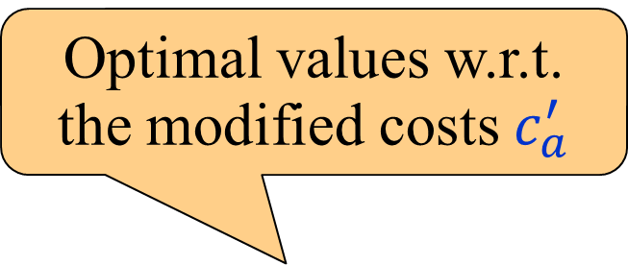
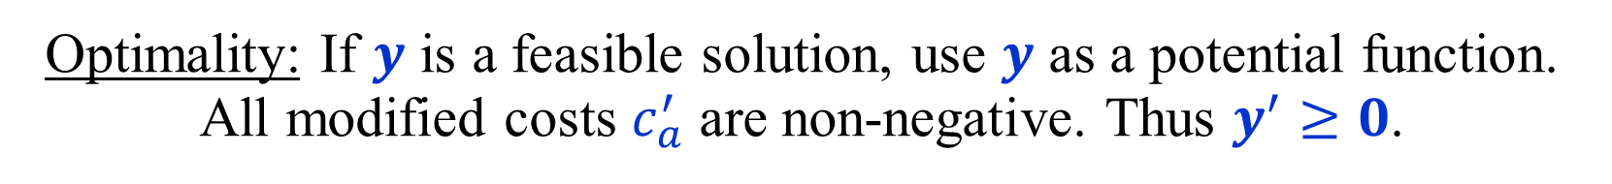
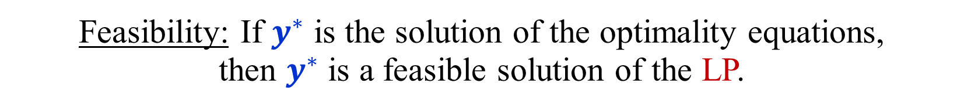
Dual LP formulation for total cost MDPs
[d’Epenoux (1964)]
$\max{ \sum_{i∈S}{y_{i}}}$
s.t. $y_{i}−\sum_{j∈S}{p_{a,j}y_{j}} ≤ c_{a}$ , $i∈S$ , $a∈A_{i}$
Theorem: For a stopping MDP, the LP has a unique optimal
solution which satisfies the optimality equations, and hence
gives the optimal values of all the states of the MDP.
Optimal values w.r.t.
the modified costs $c_{a}^{′}$
Feasibility: If $y^{∗}$ is the solution of the optimality equations,
then $y^{∗}$ is a feasible solution of the LP.
Optimality: If $y$ is a feasible solution, use $y$ as a potential function. All modified costs $c_{a}^{′}$ are non-negative. Thus $y^{′}≥0$.
But, $0≤y^{′}=y^{∗}−y$. Hence $y≤y^{∗}$ and $\sum_{i∈S}{y_{i}}≤\sum_{i∈S}{y_{i}^{∗}}$.

Slide 30
Dual LP formulation for total cost MDPs
[d’Epenoux (1964)]
$\max{ \sum_{i∈S}{y_{i}}}$
s.t. $y_{i}−\sum_{j∈S}{p_{a,j}y_{j}} ≤ c_{a}$ , $i∈S$ , $a∈A_{i}$
Optimality (Alternative proof):
If $y$ is a feasible solution, then $y≤T(y)$.
$T$ is monotone. By induction $T^{\left(r\right)}\left(y\right)≤T^{\left(r+1\right)}(y)$.
Hence $T^{\left(r\right)}\left(y\right)$ tends to $y^{∗}$ from below and $y≤y^{∗}$.
$$y≤T\left(y\right)≤T^{\left(2\right)}\left(y\right)≤…≤y^{∗}$$

Slide 31
Dual LP formulation for total cost MDPs
[d’Epenoux (1964)]
$\max{ \sum_{i∈S}{y_{i}}}$
s.t. $y_{i}−\sum_{j∈S}{p_{a,j}y_{j}} ≤ c_{a}$ , $i∈S$ , $a∈A_{i}$
Theorem:
An optimal positional strategy of a stopping MDP,
and values of all states, can be found in
polynomial time by solving an LP.
The dual LP formulation can be used to prove
the existence of an optimal positional strategy
without using Banach’s fixed-point theorem.

Slide 32
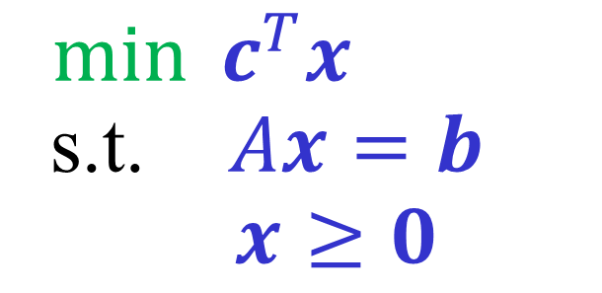
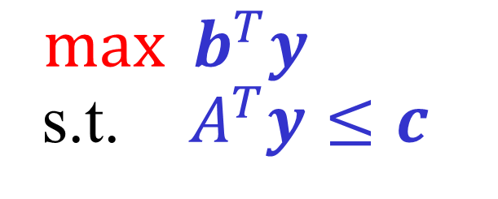
Linear Programming Duality
$\min{ c^{T}x}$
s.t. $Ax=b$
$x≥0$
$\max{ b^{T}y}$
s.t. $A^{T}y≤c$
Primal
Dual
Duality Theorem:
(a) If both LPs are feasible and bounded,
then their optimal values are equal.
(b) An LP is unbounded iff its dual is infeasible.
Weak duality: $b^{T}y={\left(Ax\right)}^{T}y=x^{T}A^{T}y≤x^{T}c=c^{T}x$
Complementary slackness: $x^{T}\left(c−A^{T}y\right)=0$

Slide 33

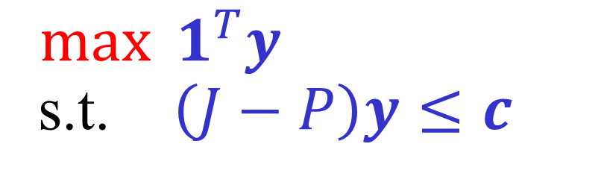

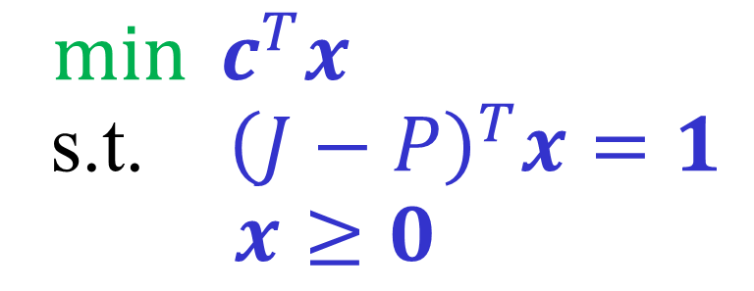


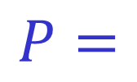
Primal and Dual LP formulations
for stopping MDPs
actions
1
1
1
$$A_{1}$$
states
$$p_{a,j}$$
states
$$J=$$
1
1
$$P=$$
$$A_{2}$$
State/action incidence matrix
Transition probabilities
$\min{ c^{T}x}$
s.t. ${\left(J−P\right)}^{T}x=1$
$x≥0$
$\max{ 1^{T}y}$
s.t. $\left(J−P\right)y≤c$

Slide 34
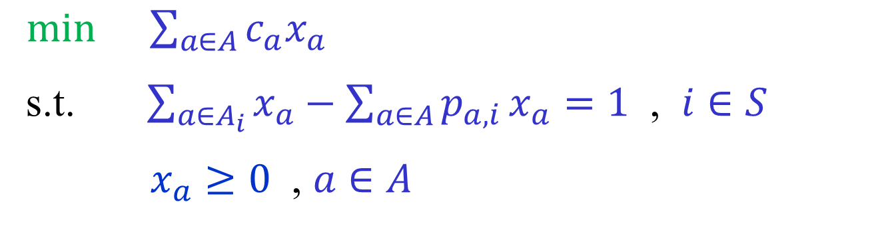

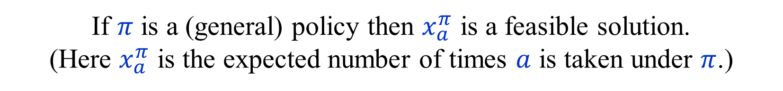

Primal LP formulation for total cost MDPs
[d’Epenoux (1964)]
$\min{ \sum_{a∈A}{c_{a}x_{a}}}$
s.t. $\sum_{a∈A_{i}}{x_{a}}−\sum_{a∈A}{p_{a,i}}x_{a}=1$ , $i∈S$
$x_{a}≥0$ , $a∈A$
$x_{a}$ – expected total number of times of
taking action $a$ when starting once from each state.
If $π$ is a (general) policy then $x_{a}^{π}$ is a feasible solution.
(Here $x_{a}^{π}$ is the expected number of times $a$ is taken under $π$.)
Does every feasible solution $x_{a}$ correspond
to $x_{a}^{π}$ for some policy $π$ ?

Slide 35
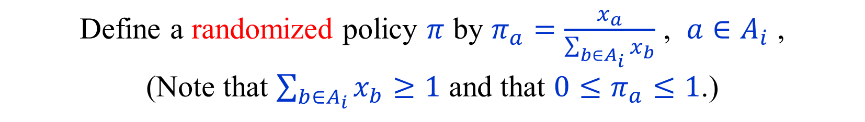
Primal LP formulation for total cost MDPs
[d’Epenoux (1964)]
Let $x_{a}$ be a feasible solution of the primal LP.
Define a randomized policy $π$ by $π_{a}=\frac{x_{a}}{\sum_{b∈A_{i}}{x_{b}}}$ , $a∈A_{i}$ ,
(Note that $\sum_{b∈A_{i}}{x_{b}}≥1$ and that $0≤π_{a}≤1$.)
$π_{a}$ is the probability of taking action $a$ in state $i$.
Policy $π$ defines a Markov chain $p_{i,j}^{π}=\sum_{a∈A_{i}}{π_{a}p_{a,j}}$.
Claim: $x_{i}^{π}=\sum_{a∈A_{i}}{x_{a}}$ and hence $x_{a}^{π}=x_{i}^{π}\frac{x_{a}}{\sum_{b∈A_{i}}{x_{b}}}=x_{a}$.
To prove the claim, we verify that $x_{i}^{π}=\sum_{a∈A_{i}}{x_{a}}$ satisfies:
$x_{i}^{π}−\sum_{j}{x_{j}^{π}p_{j,i}}=1$ , $i∈S$
(The linear system has a unique solution.)

Slide 36

Primal LP formulation for total cost MDPs
[d’Epenoux (1964)]
The calculations:
?
$x_{i}^{π}−\sum_{j}{x_{j}^{π}p_{j,i}}=1$
?
$\sum_{a∈A_{i}}{x_{a}}−\sum_{j}{\left(\sum_{b∈A_{j}}{x_{b}}\right)\sum_{a∈A_{j}}{\frac{x_{a}}{\sum_{b∈A_{j}}{x_{b}}}}p_{a,i}}=1$
!
$\sum_{a∈A_{i}}{x_{a}}−\sum_{j}{\sum_{a∈A_{j}}{x_{a}}p_{a,i}}=1$
These are exactly the constraints of the primal LP.

Slide 37
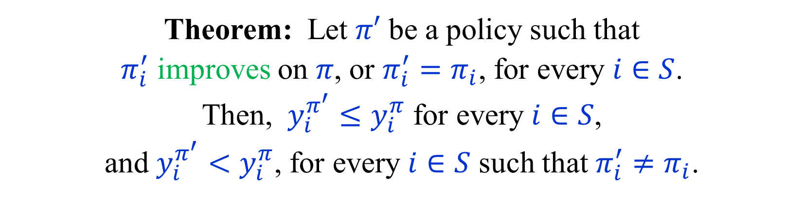

Improving a policy
Let $π$ be a positional policy of a stopping MDP.
Action $a∈A_{i}$ improves $π$ (or is an improving switch) iff
$$c_{a}+\sum_{j∈S}{p_{a,j}y_{j}^{π}} < y_{i}^{π}$$
“Taking $a$ once from $i$ and then using $π$ yields a better result”
Theorem: Let $π′$ be a policy such that
$π_{i}^{′}$ improves on $π$, or $π_{i}^{′}=π_{i}$, for every $i∈S$.
Then, $y_{i}^{π^{′}}≤y_{i}^{π}$ for every $i∈S$,
and $y_{i}^{π^{′}}<y_{i}^{π}$, for every $i∈S$ such that $π_{i}^{′}≠π_{i}$.

Slide 38

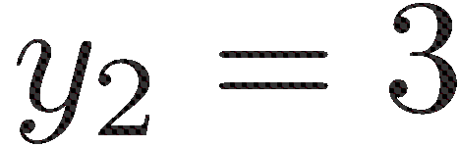


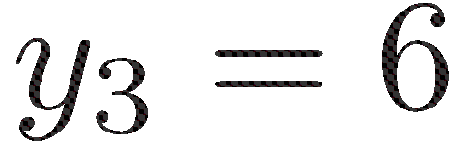
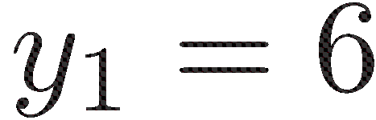
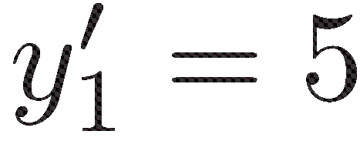

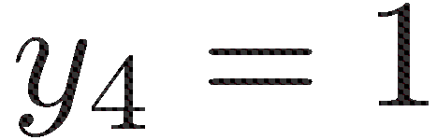

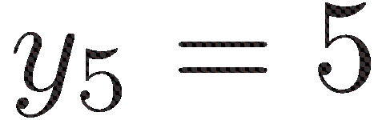
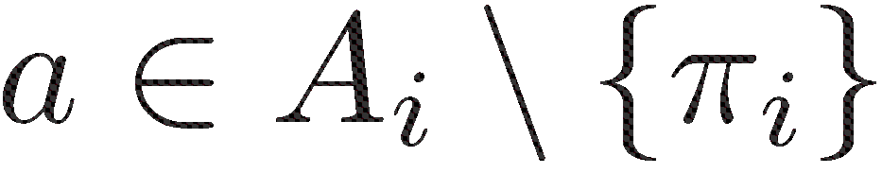
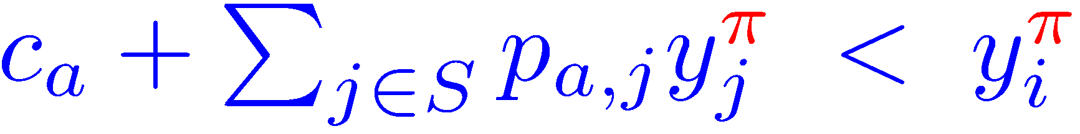
Improving switch
Corresponds to a pivoting step on the primal LP.

Slide 39
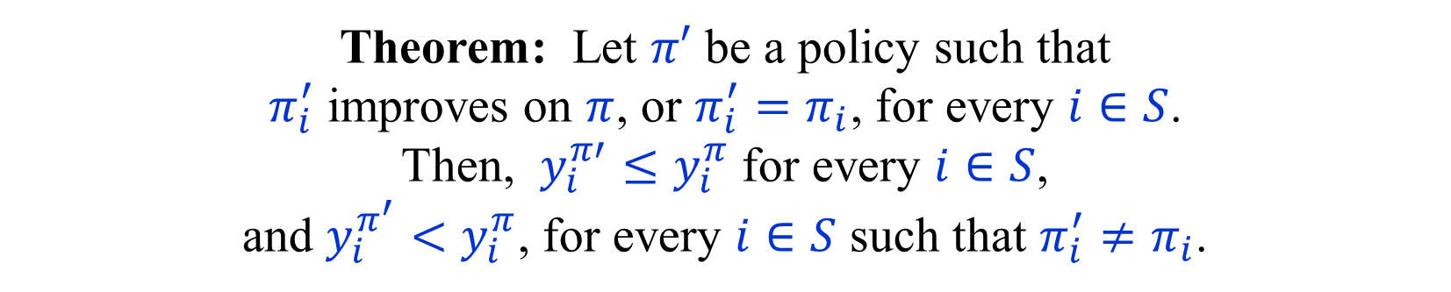
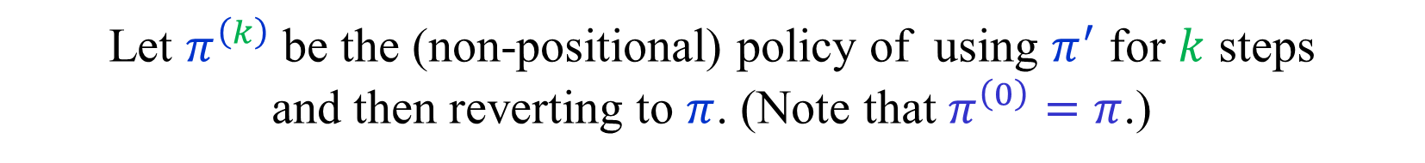
Improving a policy
Improving switch: $c_{a}+\sum_{j∈S}{p_{a,j}y_{j}^{π}} < y_{i}^{π}$ , $a∈A_{i}∖\left\{π_{i}\right\}$
Theorem: Let $π′$ be a policy such that
$π_{i}^{′}$ improves on $π$, or $π_{i}^{′}=π_{i}$, for every $i∈S$.
Then, $y_{i}^{π′}≤y_{i}^{π}$ for every $i∈S$,
and $y_{i}^{π^{′}}<y_{i}^{π}$, for every $i∈S$ such that $π_{i}^{′}≠π_{i}$.
Let $π^{\left(k\right)}$ be the (non-positional) policy of using $π^{′}$ for $k$ steps
and then reverting to $π$. (Note that $π^{\left(0\right)}=π$.)
$y_{i}^{π^{\left(k\right)}}=c_{π_{i}^{′}}+\sum_{j∈S}{p_{π_{i}^{′},j}y_{j}^{π^{\left(k−1\right)}}}$ , $k≥1$
Hence, $y_{i}^{π^{\left(1\right)}}≤y_{i}^{π}$ for every $i∈S$, with strict inequality if $π_{i}^{′}≠π_{i}$.
By induction (see next slide) $y_{i}^{π^{\left(k\right)}}≤y_{i}^{π^{\left(k−1\right)}}$for every $i∈S$.
Now $\lim_{k→∞} y_{i}^{π^{\left(k\right)}}=y_{i}^{π^{′}}$ and the theorem follows.

Slide 40
Improving a policy
The calculations
$y_{i}^{π^{\left(k\right)}}=c_{π_{i}^{′}}+\sum_{j∈S}{p_{π_{i}^{′},j}y_{j}^{π^{\left(k−1\right)}}}$ , $k≥1$
Basis of the induction:
$y_{i}^{π^{\left(1\right)}}=c_{π_{i}^{′}}+\sum_{j∈S}{p_{π_{i}^{′},j}y_{j}^{π}} < y_{i}^{π}$ , if $π_{i}^{′}≠π_{i}$
$y_{i}^{π^{\left(1\right)}}=c_{π_{i}^{′}}+\sum_{j∈S}{p_{π_{i}^{′},j}y_{j}^{π}}= y_{i}^{π}$ , if $π_{i}^{′}=π_{i}$
Induction step ($k≥1$):
$y_{i}^{π^{\left(k+1\right)}}=c_{π_{i}^{′}}+\sum_{j∈S}{p_{π_{i}^{′},j}y_{j}^{π^{\left(k\right)}}}≤c_{π_{i}^{′}}+\sum_{j∈S}{p_{π_{i}^{′},j}y_{j}^{π^{\left(k−1\right)}}}=y_{i}^{π^{\left(k\right)}}$
$\lim_{k→∞} y_{i}^{π^{\left(k\right)}}=y_{i}^{π^{′}}$ follows from the stopping condition.

Slide 41
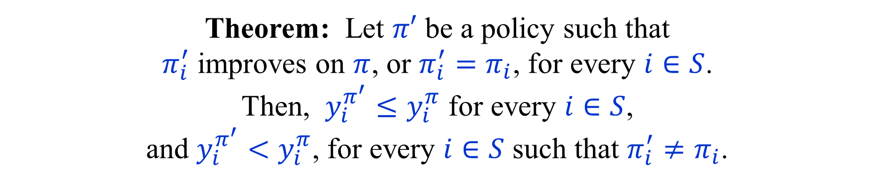
Improving a policy
Improving switch: $c_{a}+\sum_{j∈S}{p_{a,j}y_{j}^{π}} < y_{i}^{π}$ , $a∈A_{i}∖\left\{π_{i}\right\}$
Theorem: Let $π′$ be a policy such that
$π_{i}^{′}$ improves on $π$, or $π_{i}^{′}=π_{i}$, for every $i∈S$.
Then, $y_{i}^{π^{′}}≤y_{i}^{π}$ for every $i∈S$,
and $y_{i}^{π^{′}}<y_{i}^{π}$, for every $i∈S$ such that $π_{i}^{′}≠π_{i}$.
Alternative proof:
Define modified costs $c_{a}^{′}=c_{a}−y_{i}^{π}+\sum_{j∈S}{p_{a,j}y_{j}^{π}}$ w.r.t. $y_{i}^{π}$
$c_{π_{i}}^{′}=0$ , $i∈S$
$c_{π_{i}^{′}}^{′}<0$ , $π_{i}^{′}≠π_{i}$
Hence, ${\left(y^{′}\right)}_{i}^{π^{′}}≤{\left(y^{′}\right)}_{i}^{π}=0$ with a strict inequality if $π_{i}^{′}≠π_{i}$.
Thus, $y_{i}^{π^{′}}≤y_{i}^{π}$ with a strict inequality if $π_{i}^{′}≠π_{i}$.

Slide 42
Best Improving Switches
“Best” improving switch from state $i$.
The single best improving switch from all states corresponds to Dantzig’s pivoting rule on the LP.
Note: The best improving switch is not necessarily
the one that yields the largest improvement,
when the values are revaluated.

Slide 43
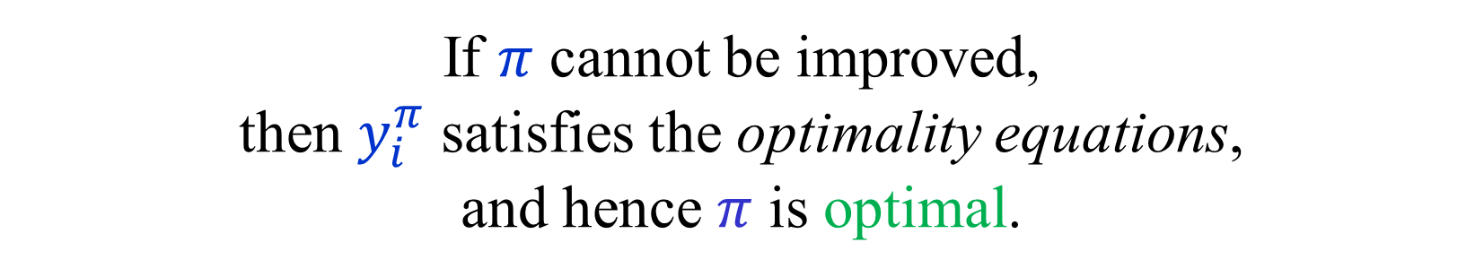
No improvement → Optimality
If $π$ cannot be improved,
then $y_{i}^{π}$ satisfies the optimality equations,
and hence $π$ is optimal.

Slide 44


Multiple improving switches
Let $π$ be a positional policy of a stopping MDP.
Suppose that $a_{1},a_{2},…,a_{k}$ improve $π$,
and belong to different states $i_{1},i_{2},…,i_{k}$.
Let $π^{′}=π^{\left\{a_{1},a_{2},…,a_{k}\right\}}$
Claim: $y_{i}^{π^{′}}<y_{i}^{π}$ , $i∈\{i_{1},i_{2},…,i_{k}\}$,
$y_{j}^{π^{′}}≤y_{j}^{π}$ , for every $j∈S$.
More switches not necessarily better than fewer switches.
Simultaneous improvement is a special feature of MDPs.
Cannot be done on general LPs.

Slide 45
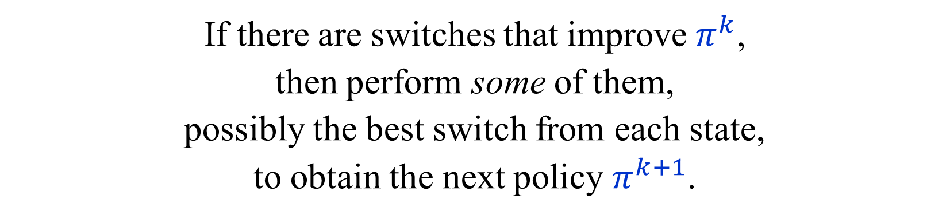

Policy iteration for MDPs [Howard ’60]
Let $π^{0}$ be a positional policy of a stopping MDP.
If there are switches that improve $π^{k}$,
then perform some of them,
possibly the best switch from each state,
to obtain the next policy $π^{k+1}$.
If there are no improving switches, $π^{k}$ is optimal.
We obtain a monotone sequence:
$$π^{0}≺π^{1}≺…≺π^{k}$$
As there is only a finite number of positional policies,
the algorithm must terminate with an optimal policy.

Slide 46
The Bellman-Ford algorithm
The Bellman-Ford algorithm for finding single-source
shortest paths in a graph with positive and negative edge weights is a special case of Howard’s algorithm.
(Howard’s algorithm actually finds shortest paths
to a single-sink, rather a single-source.
$n$ iterations are enough, if there are no negative cycles.
Each iteration takes $O\left(m\right)$ time.
Total running time is $O\left(mn\right)$.
How many iterations are needed for (stopping) MDPs?

Slide 47
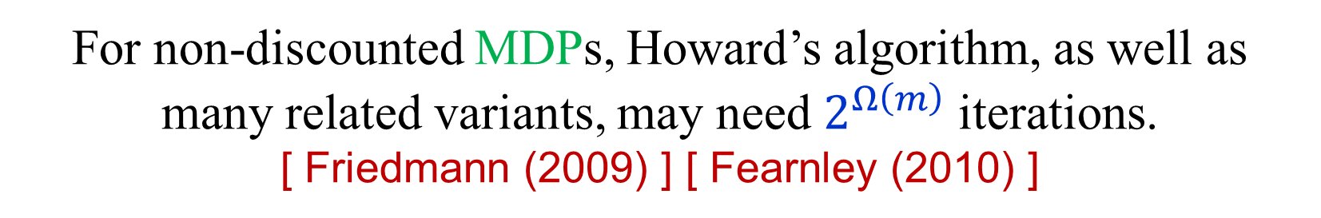
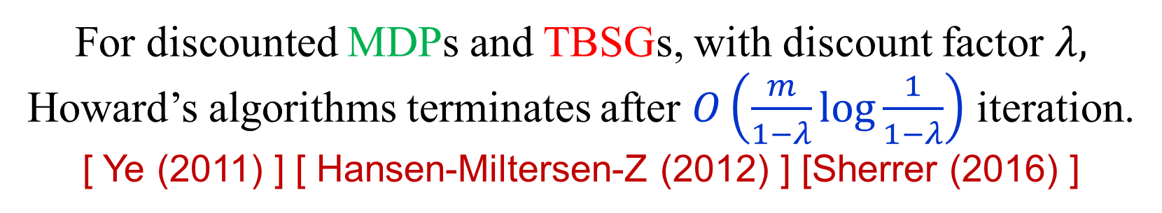
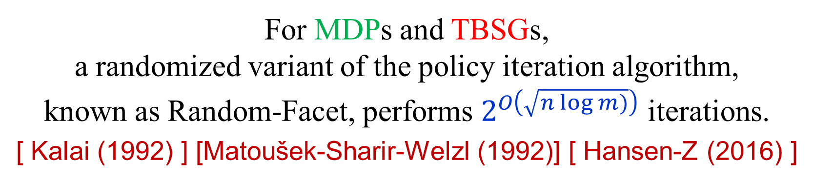
Complexity of Policy Iteration
For discounted MDPs and TBSGs, with discount factor $λ,$ Howard’s algorithms terminates after $O\left(\frac{m}{1−λ}\log{\frac{1}{1−λ}}\right)$ iteration.
[ Ye (2011) ] [ Hansen-Miltersen-Z (2012) ] [Sherrer (2016) ]
For non-discounted MDPs, Howard’s algorithm, as well as many related variants, may need $2^{Ω\left(m\right)}$ iterations.
[ Friedmann (2009) ] [ Fearnley (2010) ]
For MDPs and TBSGs,
a randomized variant of the policy iteration algorithm,
known as Random-Facet, performs $2^{O\left(\sqrt{n\log{m})}\right)}$ iterations.
[ Kalai (1992) ] [Matoušek-Sharir-Welzl (1992)] [ Hansen-Z (2016) ]

Slide 48
END of
LECTURE 2

