Slide 1
Games on Graphs
Uri Zwick
Tel Aviv University
Lecture 1 - Introduction
Last modified 25/10/2020

Slide 2
Lecture 1
Which games are we talking about?
Why are they interesting?
What will we learn throughout the semester?
Related topics we will not talk about.

Slide 3
Formalities
Graduate course, open to undergraduates.
Interesting, but complicated topics.
About 6 homework assignments.
If graded will contribute 15% to final grade.
Exam at the end of the course.
31/01/2021 and 23/02/2021
Looking for a grader.
Can be a student taking the course.

Slide 4


Turn-based Stochastic Games (TBSGs)
[Shapley (1953)] [Gillette (1957)] … [Condon (1992)]
(Possibly) Infinite duration games played by two players,
min and max, on a finite weighted directed graph.
Vertices of the graph divided among min, max and rand.
Edges emanating from min and max vertices, also called actions,
have costs (or payoff)
$$20$$
$$−10$$
Edges emanating from rand vertices
have probabilities that sum up to 1.
There might be a sink.

Slide 5
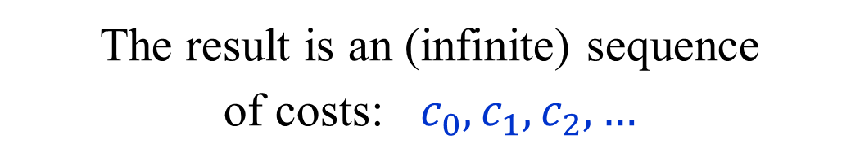
Turn-based Stochastic Games (TBSGs)
[Shapley (1953)] [Gillette (1957)] … [Condon (1992)]
How is the
game played?
A token is placed on an initial vertex.
If the token is in a min/max vertex,
then min/max chooses an action.
If the token is in a rand vertex,
a random choice is made.
$$20$$
$$−10$$
If the token reaches a sink,
the game ends.
The result is an (infinite) sequence
of costs: $c_{0},c_{1},c_{2},…$

Slide 6
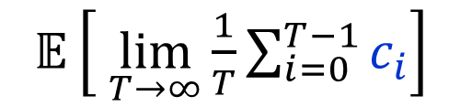



Turn-based Stochastic Games (TBSGs)
[Shapley (1953)] [Gillette (1957)] … [Condon (1992)]
Objective functions:
Total cost – finite horizon
min/max
$𝔼\left[ \sum_{i=0}^{T}{c_{i}}\right]$
(Are they well defined?)
Total cost – infinite horizon
min/max
$𝔼\left[ \sum_{i=0}^{∞}{c_{i}}\right]$
$$20$$
$$−10$$
Discounted cost
min/max
$𝔼\left[ \sum_{i=0}^{∞}{λ^{i}c_{i}}\right]$
Limiting average cost
min/max
$𝔼\left[ \lim_{T→∞}{\frac{1}{T}\sum_{i=0}^{T−1}{c_{i}}}\right]$

Slide 7
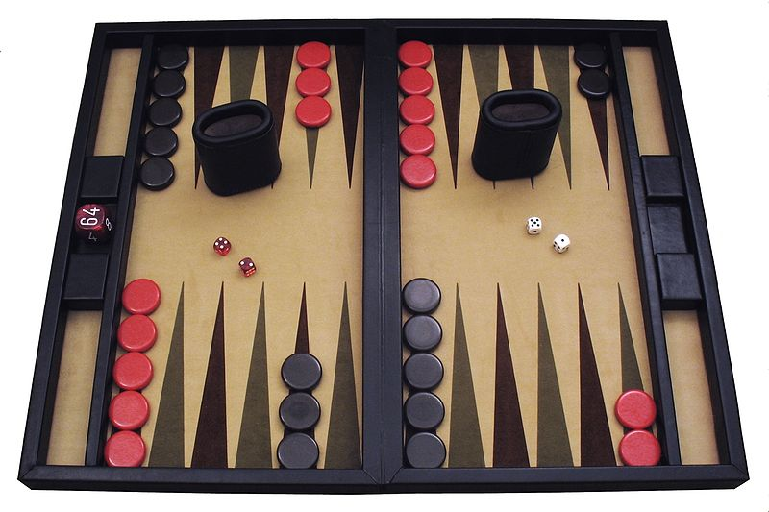
Backgammon
Author: Ptkfgs
Wikimedia Commons,
the free media repository
Backgammon is a TBSG.
A single cost/reward of $+1$ or $−1$ in the last move.
A huge number of vertices/states.
Can it be solved in polynomial time in the number of states?
(We are not going to solve backgammon in this course.)

Slide 8
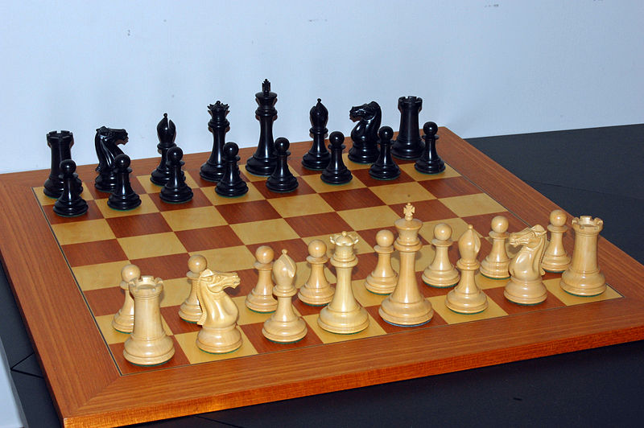
Chess
Attribution: Bubba73
at English Wikipedia
Chess is a deterministic TBSG.
A single cost/reward of $−1$, $0$ or $+1$ in the last move.
“Threefold repetition rule”
“Fifty-move rule”
Zermelo’s Theorem (1913)

Slide 9



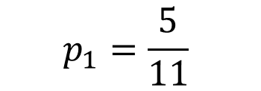
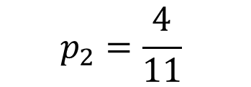
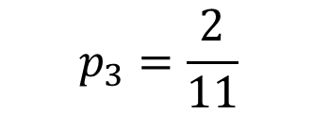
A simple TBSG
20
$$p_{1}=\frac{5}{11}$$
$$p_{2}=\frac{4}{11}$$
100
15
$$p_{3}=\frac{2}{11}$$
0
40
20
If players keep using the same actions,
we get a Markov chain.
Objective: MAX/min the
expected limiting average reward per turn

Slide 10
Is tennis, or snooker, a TBSG?
(What about judo, soccer, …)
Played by two players.
Zero sum.
Turn-based.
In each state, a player chooses an action.
The outcome of an action is stochastic.
The number of states and actions is not finite.
A player does not know all its action exactly,
let alone the actions of to her opponent.
A player can also take an action when it is not her turn.
…

Slide 11
Strategies
A deterministic strategy specifies which
action to take given every possible history.
A (general) randomized strategy is a probability
distribution over deterministic strategies.
A behavior (randomized) strategy specifies a probability distribution on actions given every possible history.
A memoryless strategy is a strategy that
depends only on the current vertex.
A positional strategy is a
deterministic memoryless strategy
A positional strategy for min/max is a
choice of an action from each min/max vertex.

Slide 12
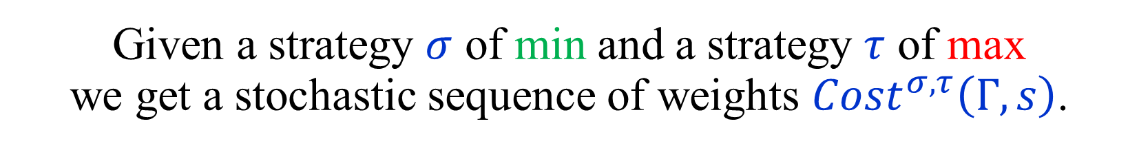



Evaluating Strategies
Let $Γ$ be a game, and $s$ a starting vertex.
Let $OBJ$ be an objective function.
Given a strategy $σ$ of min and a strategy $τ$ of max
we get a stochastic sequence of weights $Cost^{σ,τ}\left(Γ,s\right)$.
$$Val_{OBJ}^{σ,τ}\left(Γ,s\right) := 𝔼\left[ OBJ\left(Cost^{σ,τ}\left(Γ,s\right)\right) \right]$$
If $σ$ and $τ$ are positional, then $Cost^{σ,τ}\left(Γ,s\right)$
is generated by a Markov chain,
and $Val_{OBJ}^{σ,τ}\left(Γ,s\right)$ can be computed by
solving a system of linear equations.
Notes:
When the strategies are positional we get a Markov chain and y_i(sigma,tau) is easy to compute.

Slide 13
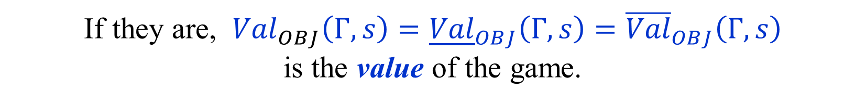
Lower and Upper Values
$$Val_{OBJ}^{σ,τ}\left(Γ,s\right) := 𝔼\left[ OBJ\left(Cost^{σ,τ}\left(Γ,s\right)\right) \right]$$
$${\underline{Val}}_{OBJ}\left(Γ,s\right) :=\sup_{τ} \inf_{σ} Val_{OBJ}^{σ,τ}\left(Γ,s\right)$$
$${\overline{Val}}_{OBJ}\left(Γ,s\right) :=\inf_{σ}{ \sup_{τ}{ Val_{OBJ}^{σ,τ}\left(Γ,s\right)}}$$
$${\underline{Val}}_{OBJ}\left(Γ,s\right)≤ {\overline{Val}}_{OBJ}\left(Γ,s\right)$$
Are ${\underline{Val}}_{OBJ}\left(Γ,s\right)$ and ${\overline{Val}}_{OBJ}\left(Γ,s\right)$ equal?
If they are, ${{Val}_{OBJ}\left(Γ,s\right)=\underline{Val}}_{OBJ}\left(Γ,s\right)={\overline{Val}}_{OBJ}\left(Γ,s\right)$
is the value of the game.

Slide 14
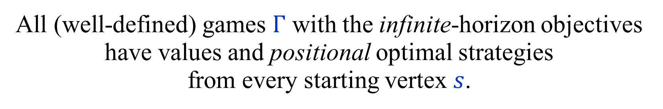
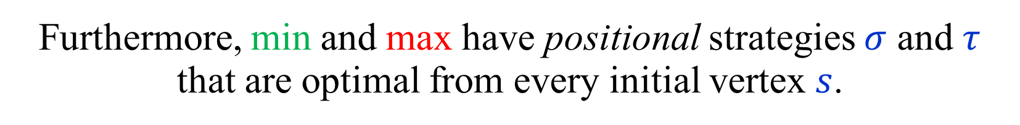
Values and optimal strategies
Theorem:
All (well-defined) games $Γ$ with the infinite-horizon objectives have values and positional optimal strategies
from every starting vertex $s$.
$${Val}_{OBJ}\left(Γ,s\right)=\max_{τ pos}{\inf_{σ} Val_{OBJ}^{σ,τ}\left(Γ,s\right)}=\min_{σ pos}{\sup_{τ}{ Val_{OBJ}^{σ,τ}\left(Γ,s\right)}}$$
Furthermore, min and max have positional strategies $σ$ and $τ$
that are optimal from every initial vertex $s$.
Games with a finite-horizon objective also have values,
but the optimal strategies may be time-dependent.

Slide 15
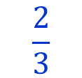

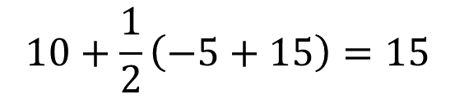

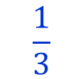



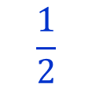




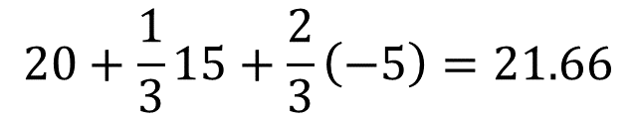



Finite games have values
(Finite number of states and finite horizon)
Game tree/DAG
$$10+\frac{1}{2}\left(−5+15\right)=15$$
Two steps to go
$$10$$
$$20$$
$$20+\frac{1}{3}15+\frac{2}{3}\left(−5\right)=21.66$$
$$\frac{1}{2}$$
$$\frac{2}{3}$$
$$15$$
$$\frac{1}{3}$$
$$\frac{1}{2}$$
One step to go
$$−5$$
$$−5$$
$$−5$$
$$0$$
$$15$$
$$−8$$
$$30$$
$$−5$$
Backward induction / Dynamic programming
In infinite-horizon problems we cannot start at the end…

Slide 16
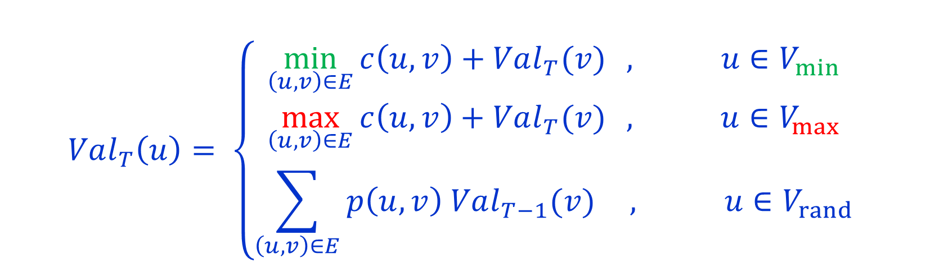
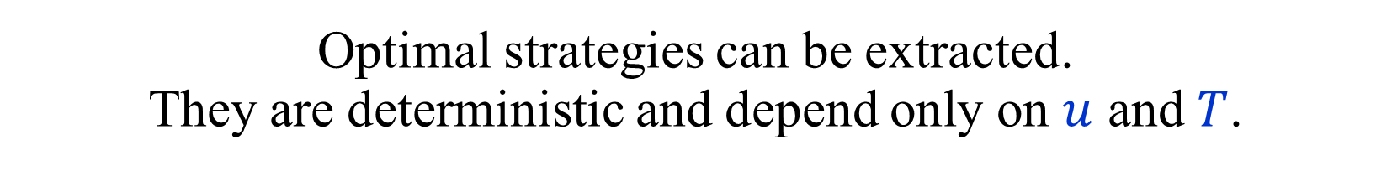

Backward induction / Dynamic programming
$Val_{T}\left(u\right)$ -- value of $u$ in a game of length $T$.
$$Val_{0}\left(u\right)=0$$
$$Val_{T}\left(u\right)= \left\{\begin{matrix}\min_{\left(u,v\right)∈E}{c\left(u,v\right)+Val_{T}(v)} , u∈V_{min} \\ \max_{\left(u,v\right)∈E}{c\left(u,v\right)+Val_{T}(v)} , u∈V_{max} \\ \sum_{\left(u,v\right)∈E}{p\left(u,v\right) Val_{T−1}(v)} , u∈V_{rand}\end{matrix}\right.$$
Optimal strategies can be extracted.
They are deterministic and depend only on $u$ and $T$.
Drawback: Running time linear in $T$.
Not polynomial if $T$ is given in binary.

Slide 17


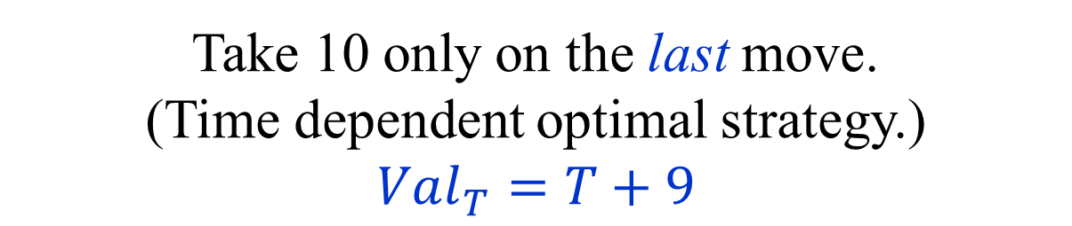

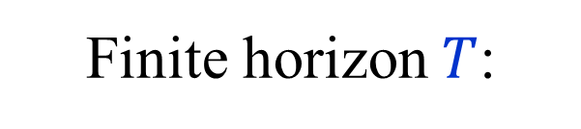

Toy example
$$10$$
$$1$$
$$0$$
Take 10 only on the last move.
(Time dependent optimal strategy.)
$$Val_{T}=T+9$$
Finite horizon $T$:
$$Val_{Tot}= +∞$$
$$Val_{Dsc_{λ}}=\max{\{ \frac{1}{1−λ} , 10 \}}$$
Infinite horizon:
$$Val_{Avg}=1$$

Slide 18

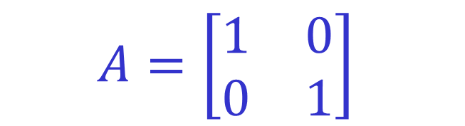


0-sum 2-player matrix games
“Matching pennies”
ROW chooses a row $i$.
$$A=\left[\begin{matrix}1 & 0 \\ 0 & 1\end{matrix}\right]$$
COLUMN chooses a column $j$.
COLUMN pays ROW $A[i,j]$.
Players move simultaneously.
$$0=\max_{i}{\min_{j}{A\left[i,j\right]}}<\min_{j}{\max_{i}{A[i,j]}=1}$$
Lower and upper values are not equal if only
pure (deterministic) strategies are considered.
But they are equal if mixed (randomized) strategies are used.
Optimal strategies of both players – choose a row or column randomly with equal probabilities. Value = ½.

Slide 19




0-sum 2-player matrix games
Randomized (mixed) strategy for ROW:
A distribution $p$ over the rows of $A$.
Randomized (mixed) strategy for COLUMN:
A distribution $q$ over the columns of $A$.
If ROW uses $p$and COLUMN uses $q$,
the expected payoff is:
$$A\left[p,q\right]=\sum_{i,j}{p_{i}q_{j}A[i,j]}=p^{T}Aq$$

Slide 20
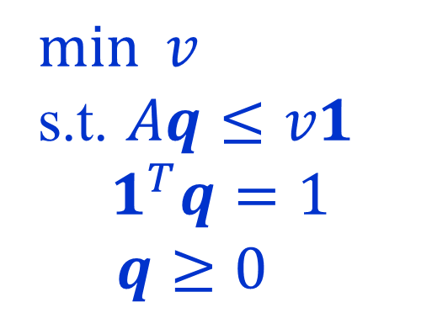

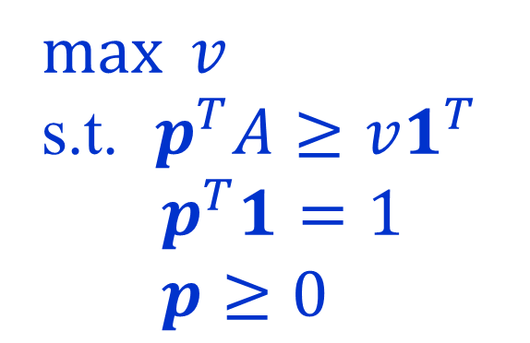

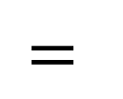

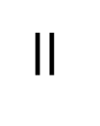

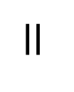
0-sum 2-player matrix games
Von Neumann’s min-max theorem (1928):
For every finite matrix $A$:
$$\max_{p}{\min_{q}{A\left[p,q\right]}} = \min_{q}{\max_{p}{A\left[p,q\right]} }$$
$$=$$
$$=$$
$$\max_{p}{\min_{j}{A\left[p,j\right]}}$$
$$\min_{q}{\max_{i}{A\left[i,q\right]}}$$
$$=$$
$$=$$
$\max{v}$
s.t. $p^{T}A≥v1^{T}$
$p^{T}1=1$
$p≥0$
$$=$$
$\min{v}$
s.t. $Aq≤v1$
$$1^{T}q=1$$
$q≥0$
LP
Duality

Slide 21
0-sum matrix games vs. TBSGs
In matrix games optimal strategies are, in general, randomized.
In TBSGs, there are always deterministic optimal strategies.
Why? What’s the difference?
In matrix games both players play simultaneously.
A player has to choose an action/strategy without knowing which action was chosen by the other player.
Matrix games are not perfect-information games.
Turn-based games are perfect-information games,
even if they are stochastic.

Slide 22
0-sum games as matrix games
Any 0-sum game can be viewed as a 0-sum matrix game,
with a huge, or possibly infinite matrix.
Strategies of player 2
The
“strategic form”
of the game.
Strategies
of player 1
outcomes
The min-max theorem, in its full generality,
holds only for finite matrices.
Thus, it cannot be used to prove that “our” games
have values and optimal strategies.

Slide 23

Infinite 0-sum game without a value
Each player guesses a number.
Higher number wins.
Draw if the guessed numbers are equal.
$$\begin{matrix}\frac{1}{2} & 0 & 0 & ⋯ \\ 1 & \frac{1}{2} & 0 & ⋯ \\ 1 & 1 & \frac{1}{2} & ⋯ \\ ⋮ & ⋮ & ⋮ & ⋱\end{matrix}$$

Slide 24








The “big-match”
[Gillette (1957)] [Blackwell-Ferguson (1968)]
min
A repeated version
of matching pennies.
$$1$$
$$0$$
$$0$$
$$1$$
When max chooses 1,
the choices of the players
are repeated for ever.
$$0$$
max
We are interested in the
limiting average reward.
$$1$$
Does the game have a value?
Do the players have
optimal strategies?
$$0$$
$$1$$
Note: This is not a TBSG.

Slide 25
The “big-match”
[Gillette (1957)] [Blackwell-Ferguson (1968)]
min
If min flips random coins,
the outcome is ½,
no matter what max does.
$$1$$
$$0$$
$$0$$
$$1$$
Can min do better?
$$0$$
max
Can max force
an outcome of at least ½ ?
$$1$$
If max flips random coins,
min chooses 0s,
and the outcome is 0.
$$0$$
$$1$$
What should max do?

Slide 26
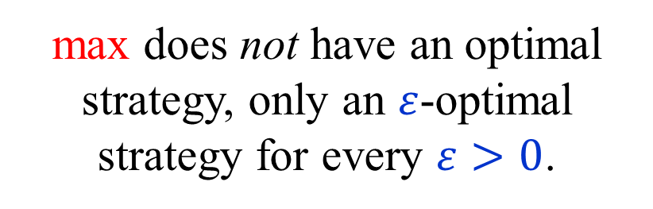
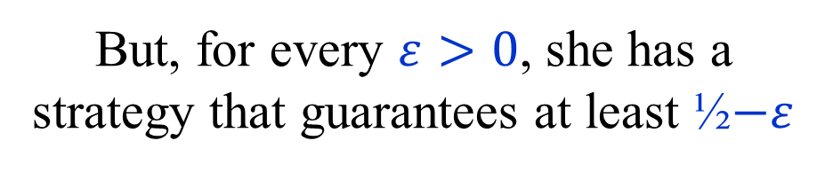
The “big-match”
[Gillette (1957)] [Blackwell-Ferguson (1968)]
min
max has no strategy that guarantees a value of at least ½ .
$$1$$
$$0$$
$$0$$
$$1$$
But, for every $ε>0$, she has a strategy that guarantees at least ½$−ε$
$$0$$
max
Thus, the value of the game is ½ .
$$1$$
min has an optimal strategy.
max does not have an optimal strategy, only an $ε$-optimal strategy for every $ε>0$.
$$0$$
$$1$$

Slide 27
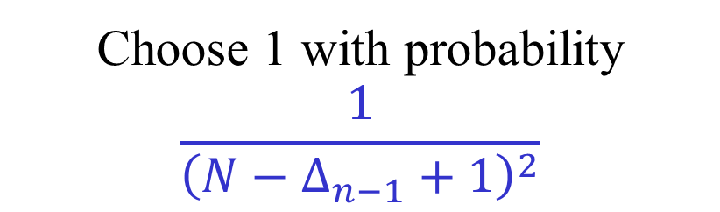
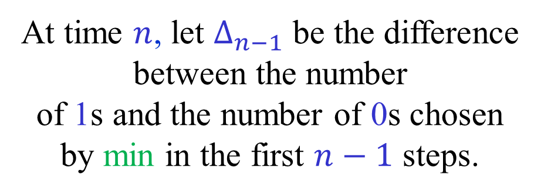
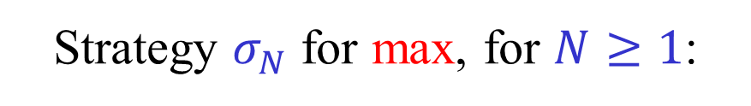
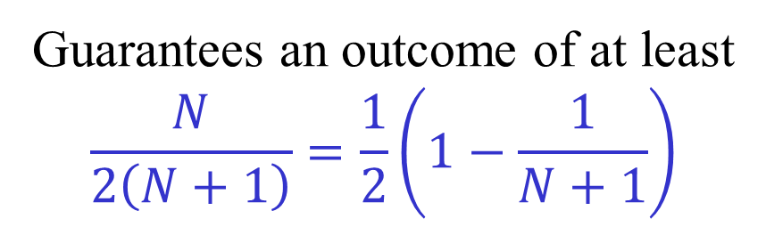
The “big-match”
[Gillette (1957)] [Blackwell-Ferguson (1968)]
min
Strategy $σ_{N}$ for max, for $N≥1$:
$$1$$
$$0$$
At time $n$, let $Δ_{n−1}$ be the difference between the number
of 1s and the number of 0s chosen
by min in the first $n−1$ steps.
$$0$$
$$1$$
$$0$$
max
$$1$$
Choose 1 with probability
$$\frac{1}{{\left(N−Δ_{n−1}+1\right)}^{2}}$$
Guarantees an outcome of at least
$$\frac{N}{2\left(N+1\right)}=\frac{1}{2}\left(1−\frac{1}{N+1}\right)$$
$$0$$
$$1$$

Slide 28
Why are TBSG interesting?
Intrinsically interesting…
Model long term planning in adversarial and/or
stochastic environments. Applications in AI and OR.
Applications in automatic verification
and automata theory.
Competitive versions of
well-known optimization problems.
Perhaps the simplest combinatorial problems
in NP ∩ co-NP not known to be in P.
Many intriguing open problems.

Slide 29



Markov Decision Processes
[Bellman ’57] [Howard ’60] …
1-player TBSGs
Total cost – infinite horizon
min/max
$𝔼\left[ \sum_{i=0}^{∞}{c_{i}}\right]$
Discounted cost
min/max
$𝔼\left[ \sum_{i=0}^{∞}{λ^{i}c_{i}}\right]$
Limiting average cost
min/max
$𝔼\left[ \lim_{T→∞}{\frac{1}{T}\sum_{i=0}^{T−1}{c_{i}}}\right]$
Optimal positional strategies can be found using LP.
Is there a strongly polynomial time algorithm?

Slide 30




Stochastic shortest paths (SSPs)
Minimize the expected cost
of getting to the target.

Slide 31
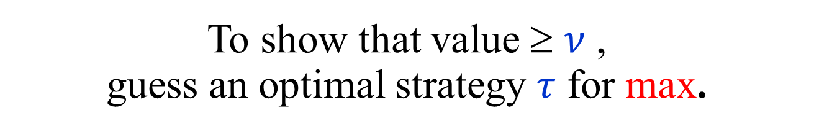
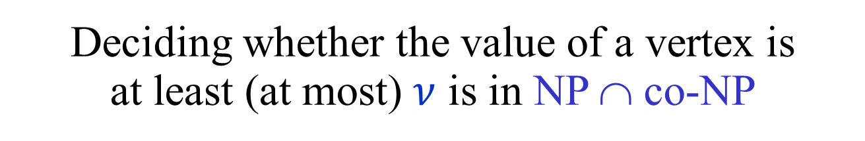
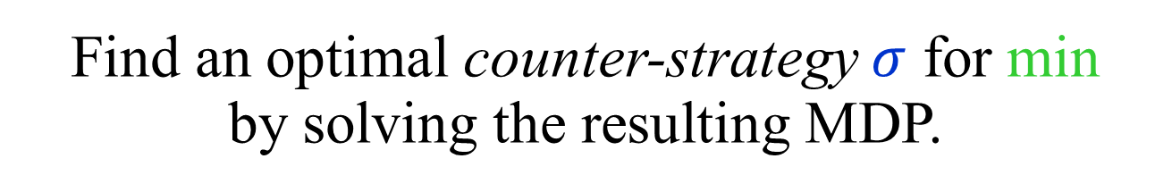
TBSG ∈ NP ∩ co-NP
Deciding whether the value of a vertex is
at least (at most) $ν$ is in NP ∩ co-NP
To show that value ≥ $ν$ ,
guess an optimal strategy $τ$ for max.
Find an optimal counter-strategy $σ$ for min
by solving the resulting MDP.
Is the problem in P ?
Cannot be NP-hard, unless NP = co-NP

Slide 32
Turn-based non-Stochastic Games
[Ehrenfeucht-Mycielski (1979)] …
Total cost – infinite horizon
min/max
$𝔼\left[ \sum_{i=0}^{∞}{c_{i}}\right]$
Mean Payoff Games
(MPGs)
Discounted cost
min/max
$𝔼\left[ \sum_{i=0}^{∞}{λ^{i}c_{i}}\right]$
Limiting average cost
min/max
$𝔼\left[ \lim_{T→∞}{\frac{1}{T}\sum_{i=0}^{T−1}{c_{i}}}\right]$
Still no polynomial time algorithms known!
(The stochasticity is not the only problem.)

Slide 33









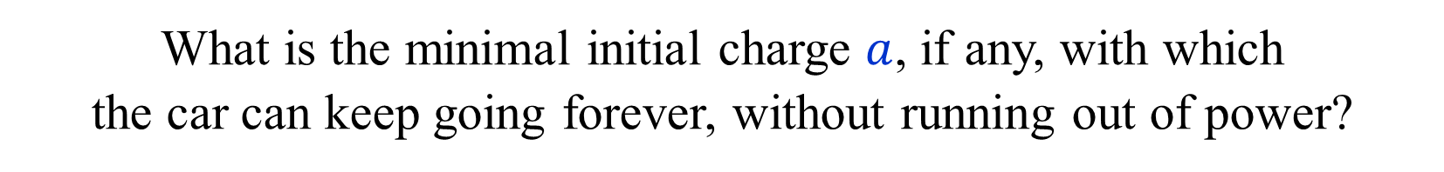











Energy Games (EGs)
$$0$$
$$−2$$
$$4$$
$$6$$
$$3$$
$$2$$
$$1$$
$$8$$
$$1$$
$$∞$$
$$6$$
$$2$$
$$∞$$
$$0$$
$$−4$$
$$−1$$
$$7$$
$$−5$$
$$6$$
The token is an electric car with a battery.
The cost of an edge is the charge needed to traverse the edge.
What is the minimal initial charge $a$, if any, with which
the car can keep going forever, without running out of power?

Slide 34
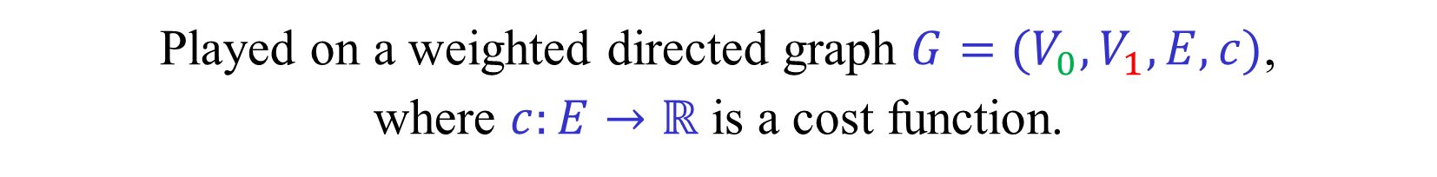


Energy Games (EGs)
Played on a weighted directed graph $G=(V_{0},V_{1},E,c)$,
where $c:E→ℝ$ is a cost function.
$c\left(u,v\right)$ is interpreted as the number of energy units
needed to traverse the edge $\left(u,v\right)$. (May be negative.)
The token is an electric car with a battery with initial charge $a$.
A play generates a sequence $c_{1},c_{2},…$ of edge costs.
The value/outcome of the play is the smallest $a≥0$
such that: $\sum_{i=1}^{k}{c_{i}}≤a$ , for every $k≥1$.
$a=ENG\left({\left(c_{i}\right)}_{i=1}^{∞}\right)= \sup_{k≥0}{\sum_{i=1}^{k}{c_{i}}} ( ≥0 )$
${Val}_{ENG}\left(u\right)$ - minimal initial charge required at $u$ to survive forever.
Values exist, positional optimal strategies, …

Slide 35
Parity Games (PGs)
A simple example
Priorities
2
3
2
1
4
1
EVEN wins if largest priority
seen infinitely often is even

Slide 36
Parity Games (PGs)
3
8
EVEN
ODD
EVEN wins if largest priority
seen infinitely often is even
Equivalent to many interesting problems
in automata and verification:
Non-emptyness of ω-tree automata
modal μ-calculus model checking

Slide 37
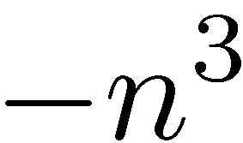
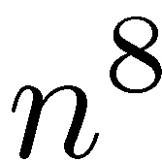
Parity Games (PGs)
Mean Payoff Games (MPGs)
[Stirling (1993)] [Puri (1995)]
8
3
EVEN
ODD
Replace priority $k$ by payoff ${\left(−n\right)}^{k}$.
Move payoffs to outgoing edges.
A cycle is positive iff its highest priority is even.

Slide 38
(A)USOs of 5-cubes
(Acyclic Unique Sink Orientations)
Slide taken from a presentation by Tibor Szabó.

Slide 39
Main goals
Prove the existence of optimal positional strategies.
Design algorithms, as efficient as possible,
for finding values and optimal strategies.
Some of the algorithms used in the existence proofs.
Major open problem:
Is there a polynomial time algorithm for solving
TBSGs, MPGs, EGs, PGs ?

Slide 40
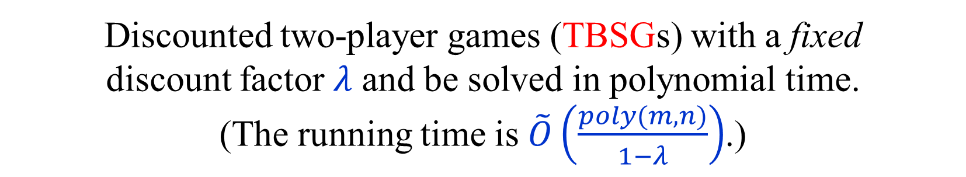
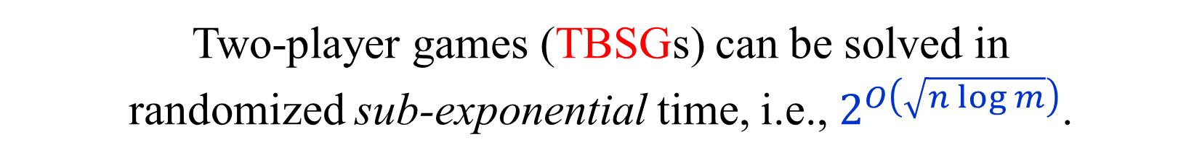
Known results
One-player stochastic games (MDPs) can be solved
in polynomial time using linear programming.
Discounted two-player games (TBSGs) with a fixed
discount factor $λ$ and be solved in polynomial time.
(The running time is $\tilde{O}\left(\frac{poly(m,n)}{1−λ}\right)$.)
Two-player games (TBSGs) can be solved in
randomized sub-exponential time, i.e., $2^{O\left(\sqrt{n log m}\right)}$.
PGs can be solves in quasi-polynomial time, i.e., $n^{O\left(\log{n}\right)}$.
Decision problem for two-player games (TBSGs)
is in NP ∩ co-NP and in CLS ⊆ PLS ∩ PPAD.

Slide 41
END of
LECTURE 1

