Slide 1
Games on Graphs
Uri Zwick
Tel Aviv University
Lecture 6 –
Parity Games
This presentation is still under construction.
For the latest version, see:
http://www.cs.tau.ac.il/~zwick/GAMES-2019/Lecture-6-PGs.pptx
December 2019
Last modified 05/01/2020

Slide 2
Lecture 6
Parity Games (PGs)
Reduction from PGs to MPGs
Quasipolynomial time algorithms
Universal trees
Separating automata
Universal graphs

Slide 3
Parity Games (PGs)
A simple example
Priorities
2
3
2
1
4
1
EVEN wins if largest priority
seen infinitely often is even
Priorities can also be placed on edges instead on vertices.

Slide 4
Parity Games (PGs)
3
8
EVEN
ODD
EVEN wins if largest priority
seen infinitely often is even
Equivalent to many interesting problems
in automata and verification:
Non-emptyness of ω-tree automata
modal μ-calculus model checking

Slide 5
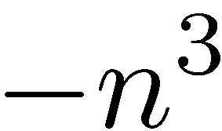
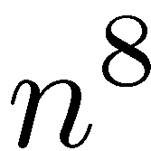

Parity Games (PGs)
Mean Payoff Games (MPGs)
[Stirling (1993)] [Puri (1995)]
8
3
EVEN
ODD
Replace priority $k$ by payoff ${\left(−n\right)}^{k}$.
Move payoffs to outgoing edges.
A cycle is positive iff its highest priority is even.

Slide 6
Algorithms for Parity Games (PGs)
Recursive algorithms
[ McNaughton (1993) ] [ Zielonka (1998) ]
Strategy improvement
[ Vöge-Jurdziński (2000) ]
Progress measure
[ Jurdziński (2000) ]
Subexponential time algorithms
[ Björklund-Sandberg-Vorobyov (2003) ]
[ Jurdziński-Paterson-Z (2006) ]

Slide 7
Quasipolynomial time algorithms
[ Calude-Jain-Khoussainov-Li-Stephan (2017) ]
Many follow-up papers:
[ Gimbert-Ibsen-Jensen (2017) ]
[Jurdziński-Lazić (2017) ]
[ Fearnley-Jain-Schewe-Stephan-Wojtczak (2017) ]
[ Lehtinen (2018) ]
[ Bojańczyk and Czerwiński (2018) ]
[ Czerwiński-Daviaud-Fijalkow-Jurdziński-Lazić-Parys (2019) ]
[ Colcombet-Fijalkow (2018) (2019) ]
[ Parys (2019) ]

Slide 8
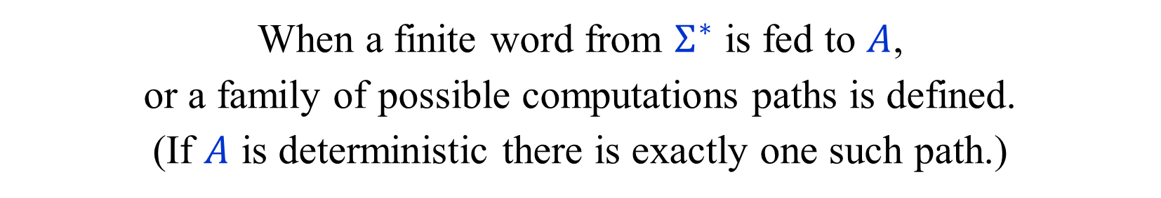
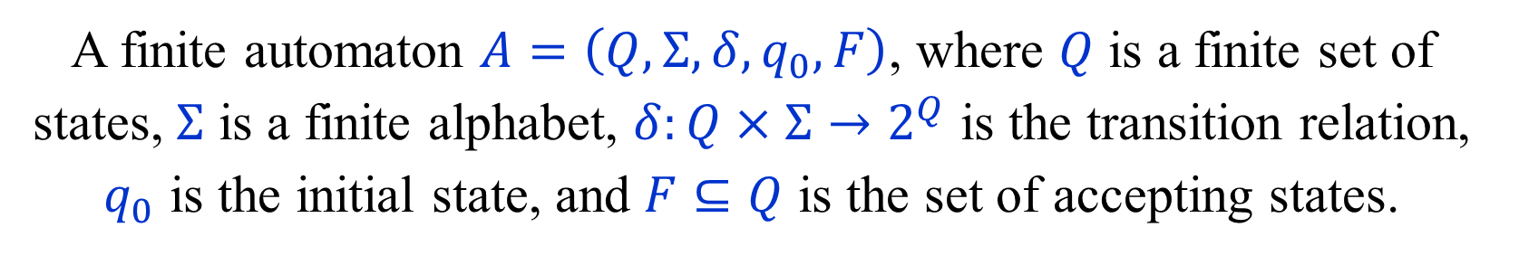
Finite Automata
A finite automaton $A=\left(Q,Σ,δ,q_{0},F\right)$, where $Q$ is a finite set of states, $Σ$ is a finite alphabet, $δ:Q×Σ→2^{Q}$ is the transition relation, $q_{0}$ is the initial state, and $F⊆Q$ is the set of accepting states.
When a finite word from $Σ^{∗}$ is fed to $A$,
or a family of possible computations paths is defined.
(If $A$ is deterministic there is exactly one such path.)
Each finite path has final state.
A word is accepted if there is a computation path in the
automata corresponding to it that ends in an accepting state.
$L\left(A\right)⊆Σ^{∗}$ is the set of words accepted by $A$.
Regular languages are languages recognized by finite automata.

Slide 9


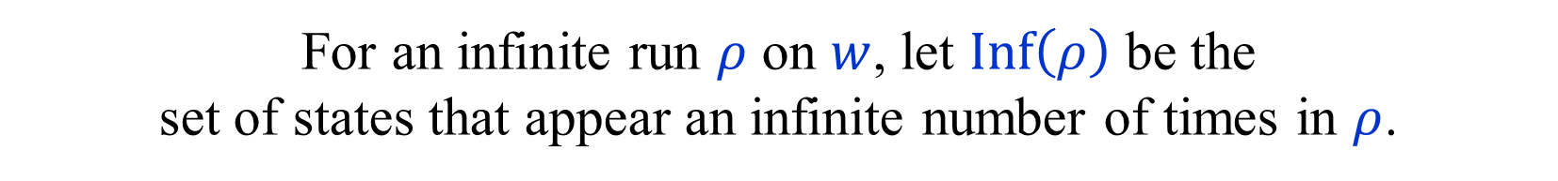


$ω$-Automata
Feed a finite automaton $A$ an infinite word $w=w_{1}w_{2}…∈Σ^{ω}$.
For an infinite run $ρ$ on $w$, let $Inf\left(ρ\right)$ be the
set of states that appear an infinite number of times in $ρ$.
Acceptance conditions:
Büchi$(F)$: $Inf\left(ρ\right)∩F≠∅$.
Parity: $max Inf\left(ρ\right)$ is even. (where $Q=[n]$.)
Rabin$\left(\left\{\left(B_{1},G_{1}\right),\left(B_{2},G_{2}\right),…,\left(B_{k},G_{k}\right)\right\}\right)$:
$$∃1≤i≤k Inf\left(ρ\right)∩B_{i}=∅ ∧Inf\left(ρ\right)∩G_{i}≠∅$$
Streett$\left(\left\{\left(B_{1},G_{1}\right),\left(B_{2},G_{2}\right),…,\left(B_{k},G_{k}\right)\right\}\right)$:
$$∀1≤i≤k Inf\left(ρ\right)∩B_{i}=∅ ∧Inf\left(ρ\right)∩G_{i}≠∅$$
Muller$(ℱ)$: $Inf\left(ρ\right)∈ℱ$. (Where $ℱ⊆2^{Q}$.)
All these models, except deterministic Büchi,
define the class of $ω$-Regular languages.

Slide 10

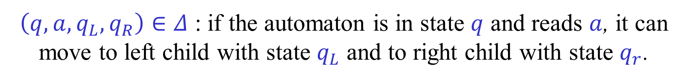








Tree Automata
A $Σ$-labelled infinite binary tree is a mapping $t:{\left\{0,1\right\}}^{∗}→Σ$.
A tree automata explores all
infinite paths in the input binary tree.
$a$
It accepts a tree if every infinite path satisfies an acceptance condition,
e.g., a parity condition.
$$a$$
$$b$$
$b$
$$a$$
$$b$$
$$a$$
Different transition rules
for going left and right.
$$⋮$$
$$⋮$$
Transition relation $Δ⊆Q×Σ×Q×Q$.
$\left(q,a,q_{L},q_{R}\right)∈Δ$ : if the automaton is in state $q$ and reads $a$, it can move to left child with state $q_{L}$ and to right child with state $q_{r}$.
Applications in logic: Decidability of monadic second-order logic.

Slide 11
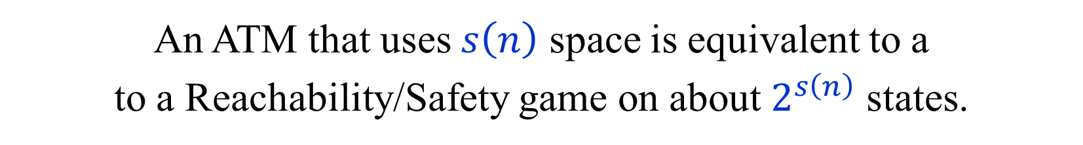
Alternating Turing Machines
[ Chandra-Kozen-Stockmeyer (1981) ]
An Alternating Turing Machine (ATM) is a non-deterministic Turing machine with existential and universal states.
A configuration with an existential (universal) state is
accepting iff there exists (for all) a transition to an
accepting configuration.
This is actually a game between two players.
An ATM that uses $s\left(n\right)$ space is equivalent to a
to a Reachability/Safety game on about $2^{s\left(n\right)}$ states.

Slide 12
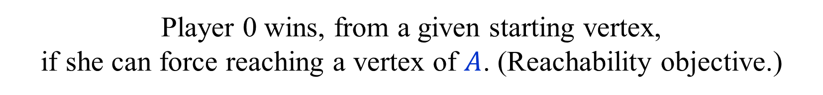

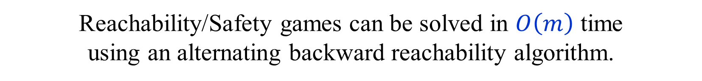
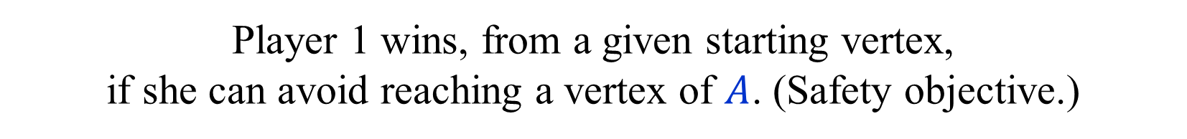
Reachability/Safety Games
A directed graph $G=(V=V_{0}⨃V_{1},E)$. No weights.
A set $A⊆V$ of accepting vertices.
Player 0 wins, from a given starting vertex,
if she can force reaching a vertex of $A$. (Reachability objective.)
Player 1 wins, from a given starting vertex,
if she can avoid reaching a vertex of $A$. (Safety objective.)
Reachability/Safety games can be solved in $O\left(m\right)$ time
using an alternating backward reachability algorithm.
Both players have optimal positional strategies.

Slide 13


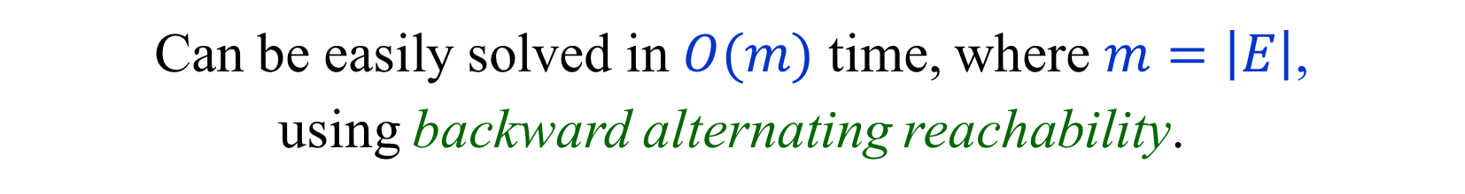

Solving Reachability/Safety Games
$$∃$$
Accept
$$A$$
$$∀$$
Can be easily solved in $O(m)$ time, where $m=\left|E\right|$,
using backward alternating reachability.

Slide 14

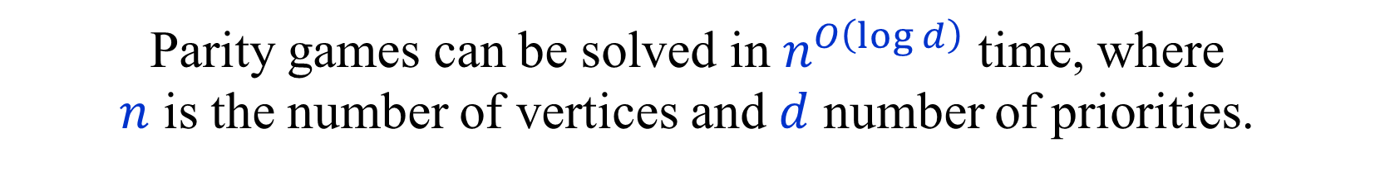
Quasipolynomial time algorithms for PGs
Parity games can be solved in $n^{O\left(\log{d}\right)}$ time, where
$n$ is the number of vertices and $d$ number of priorities.
Running time is also $O\left(2^{d}n^{4}\right)$, i.e., FPT in $d$.
When $d≤\log{n}$, running time is $O\left(n^{5}\right)$.
Original version stated in terms of ATMs.
[ Calude-Jain-Khoussainov-Li-Stephan (2017) ]
Subsequent equivalent versions in terms of
separating automata, universal trees and universal graphs.
Quasipolynomial time and quasilinear space.
[ Bojańczyk and Czerwiński (2018) ]
[ Czerwiński-Daviaud-Fijalkow-Jurdziński-Lazić-Parys (2019) ]
[ Colcombet-Fijalkow (2018) (2019) ]

Slide 15

Watching a Parity Game
Suppose we are watching an intense parity game
played on an $n$-vertex graph.
Can we decide who is winning?
Suppose the winner is using a positional winning strategy.
In particular, all cycles are even, or all cycles are odd.
For each vertex we can record the highest priority seen after
visiting the vertex. When a cycle is formed we know its parity.
(Alternatively, we just remember what happened so far.)
This requires about $n\log{d}$ bits of memory.
Can we use much less memory?
What if we only see the priorities and not the vertices visited?

Slide 16
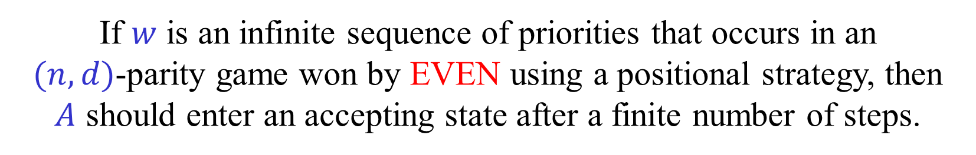
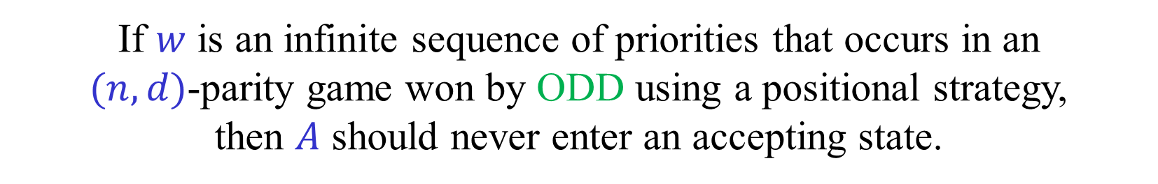
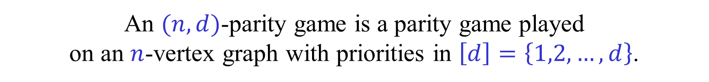

Separating automata
An $(n,d)$-parity game is a parity game played
on an $n$-vertex graph with priorities in $\left[d\right]=\left\{1,2,…,d\right\}$.
A finite automaton $A$ is an $(n,d)$-separating automaton if:
If $w$ is an infinite sequence of priorities that occurs in an
$(n,d)$-parity game won by EVEN using a positional strategy, then
$A$ should enter an accepting state after a finite number of steps.
If $w$ is an infinite sequence of priorities that occurs in an
$(n,d)$-parity game won by ODD using a positional strategy,
then $A$ should never enter an accepting state.
This is a very special case of an $ω$-automaton
known as a reachability automaton.
We can of course reverse the roles of EVEN and ODD.

Slide 17







Separating automata
$${\left[d\right]}^{ω}$$
$${AllCycEven}_{n,d}$$
$${AllCycOdd}_{n,d}$$
$${LimsupEven}_{d}$$
$${LimsupOdd}_{d}$$
$${PosCycEven}_{n,d}$$
$${PosCycOdd}_{n,d}$$
Based on a figure from [CDFJLP (2018)].

Slide 18
A simple separating automaton
For every even priority, count the number of times
this priority is seen before seeing a higher priority.
State = $\left(c_{d},c_{d−2},…,c_{2}\right)$
Initial State = $\left(0,0,…,0\right)$
When a new even priority $p$ arrives:
$$c_{p}←c_{p}+1$$
$$c_{p−2},…,c_{2}←0$$
When a new odd priority $p$ arrives:
$$c_{p−1},…,c_{2}←0$$
Accept if one of the counters reaches $n+1$.
Number of states is $n^{d/2}+1$. Huge!
We shall see that we can do much better.

Slide 19
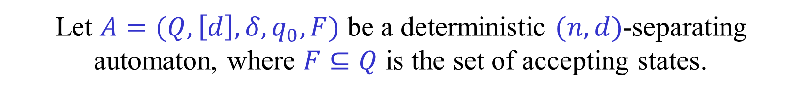
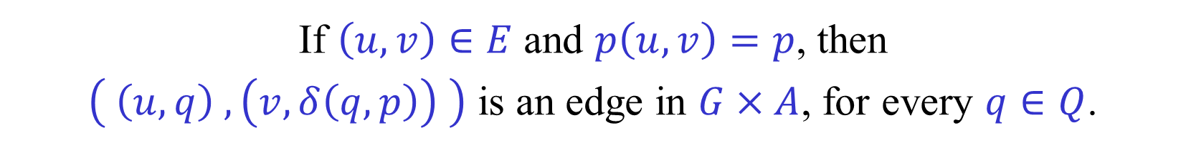
The Product of a Parity Game
and a Separating Automaton
Let $G=(V=V_{0}⨃V_{1},E,p)$, where $p:E→[d]$, be a parity game.
Let $A=(Q,\left[d\right],δ,q_{0},F)$ be a deterministic $(n,d)$-separating automaton, where $F⊆Q$ is the set of accepting states.
Define a product reachability game $G×A$ as follows.
The states are $V×Q$. States $V_{i}×Q$ belong to player $i$.
The accepting states are $V×F$.
If $\left(u,v\right)∈E$ and $p\left(u,v\right)=p$, then
$\left( \left(u,q\right) , \left(v,δ\left(q,p\right)\right) \right)$ is an edge in $G×A$, for every $q∈Q$.

Slide 20

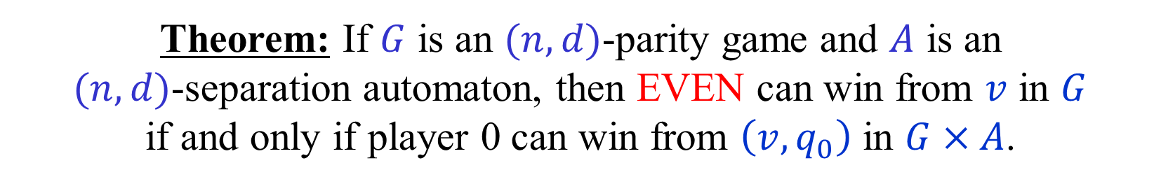
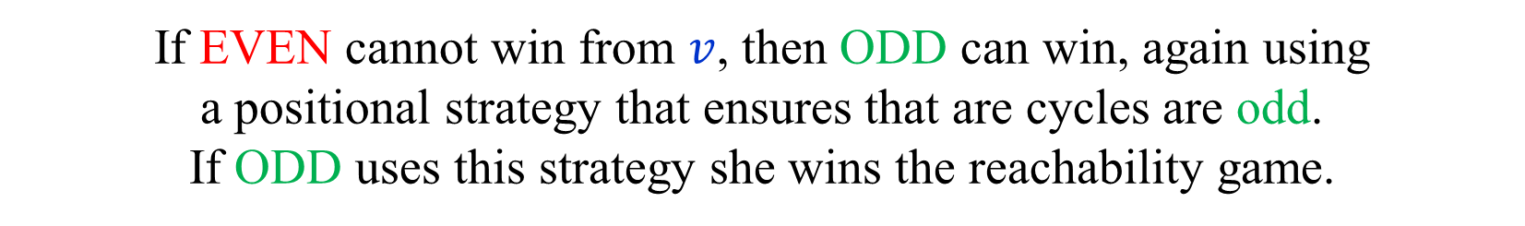
Reducing Parity Games to Reachability Games
Theorem: If $G$ is an $(n,d)$-parity game and $A$ is an
$(n,d)$-separation automaton, then EVEN can win from $v$ in $G$
if and only if player 0 can win from $\left(v,q_{0}\right)$ in $G×A$.
If EVEN can win from $v$ in the parity game $G$,
then EVEN has a positional winning strategy from $v$.
The positional winning strategy ensures that all cycles formed are even. Thus, if EVEN keeps playing according to this strategy,
she eventually wins the reachability game.
If EVEN cannot win from $v$, then ODD can win, again using
a positional strategy that ensures that are cycles are odd.
If ODD uses this strategy she wins the reachability game.

Slide 21
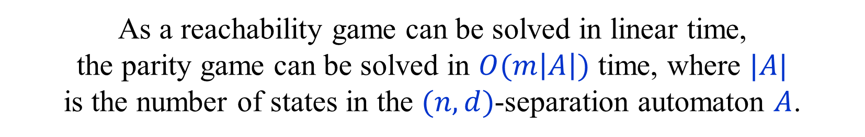
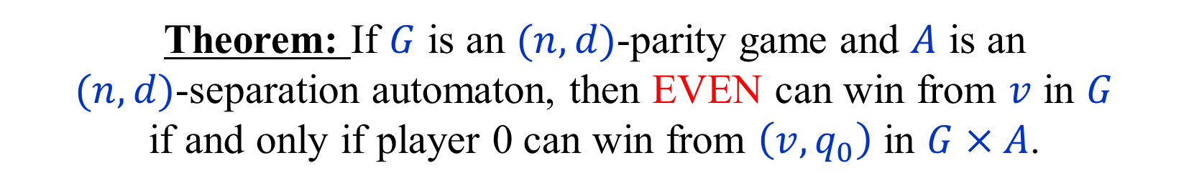
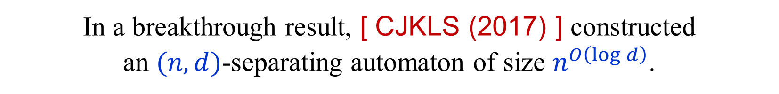
Reducing Parity Games to Reachability Games
Theorem: If $G$ is an $(n,d)$-parity game and $A$ is an
$(n,d)$-separation automaton, then EVEN can win from $v$ in $G$
if and only if player 0 can win from $\left(v,q_{0}\right)$ in $G×A$.
As a reachability game can be solved in linear time,
the parity game can be solved in $O(m\left|A\right|)$ time, where $|A|$
is the number of states in the $(n,d)$-separation automaton $A$.
In a breakthrough result, [ CJKLS (2017) ] constructed
an $(n,d)$-separating automaton of size $n^{O\left(\log{d}\right)}$.
We next describe the construction of this separation automaton.
( [ CJKLS (2017) ] described their result in terms of ATMs. )

Slide 22
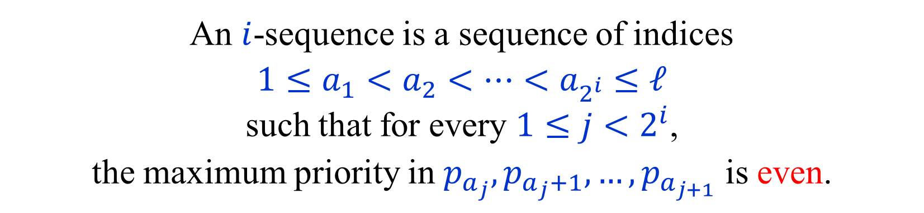

𝑖-sequences [ CJKLS (2017) ]
Let $p_{1},p_{2},…,p_{ℓ}$ be the priorities seen so far.
An $i$-sequence is a sequence of indices
$1≤a_{1}<a_{2}<…<a_{2^{i}}≤ℓ$
such that for every $1≤j<2^{i}$,
the maximum priority in $p_{a_{j}},p_{a_{j}+1},…,p_{a_{j+1}}$ is even.
If the play contains an $i$-sequence, where $2^{i}>n$,
then the play contains an even cycle.
Some vertex must appear twice, hence the cycle, and
the maximum priority on the cycle must be even.
Keeping an $i$-sequence explicitly takes too much space.

Slide 23
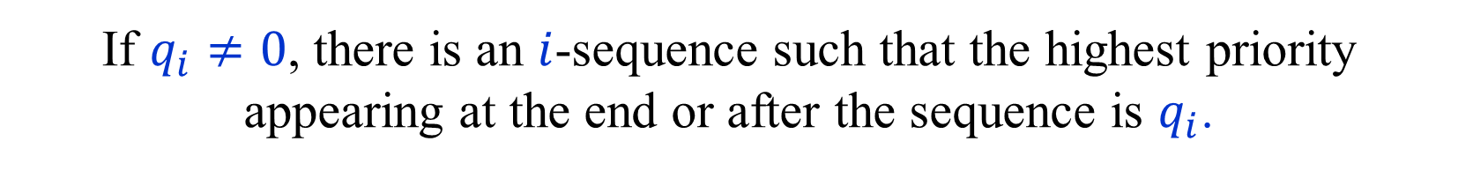
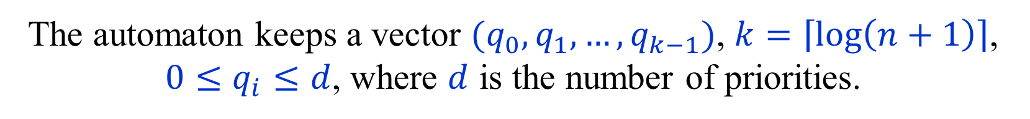

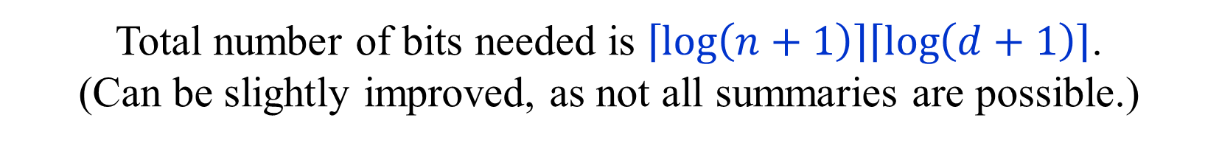

Summaries / Sketches [ CJKLS (2017) ]
The automaton keeps a vector $(q_{0},q_{1},…,q_{k−1})$, $k=\left\lceil \log\left(n+1\right)\right\rceil$, ${0≤q}_{i}≤d$, where $d$ is the number of priorities.
Total number of bits needed is $\left\lceil \log\left(n+1\right)\right\rceil \left\lceil \log\left(d+1\right)\right\rceil$.
(Can be slightly improved, as not all summaries are possible.)
If $q_{i}≠0$, there is an $i$-sequence such that the highest priority appearing at the end or after the sequence is $q_{i}$.
If $q_{i},q_{j}≠0$ and $i<j$, then the $i$-sequence appears
after an appearance of $q_{j}$ after the $j$-sequence .
Only $(q_{0},q_{1},…,q_{k−1})$ is kept.
The $i$-sequences themselves are not kept.

Slide 24
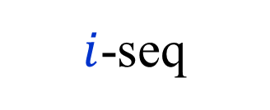
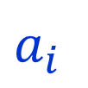

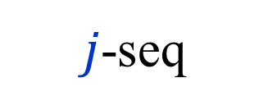
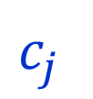

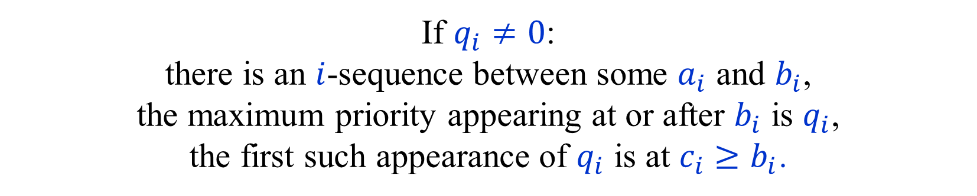


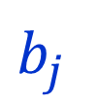

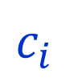
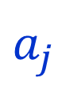


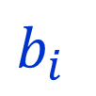
Summaries – in more detail
If $q_{i}≠0$:
there is an $i$-sequence between some $a_{i}$ and $b_{i}$,
the maximum priority appearing at or after $b_{i}$ is $q_{i}$,
the first such appearance of $q_{i}$ is at $c_{i}≥b_{i}$.
If $q_{i},q_{j}≠0$ and $i<j$,
then, $b_{j}≤c_{j}≤a_{i}$ and $b_{j}<a_{i}$.
In particular $q_{i}≤q_{j}$.
$$a_{j}$$
$$b_{j}$$
$$c_{j}$$
$$a_{i}$$
$$b_{i}$$
$$c_{i}$$
$$…$$
$$…$$
$$q_{j}$$
$$…$$
$$…$$
$$q_{i}$$
$j$-seq
$i$-seq

Slide 25
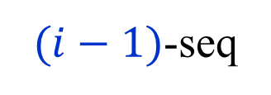
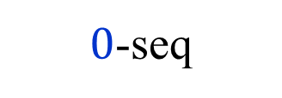

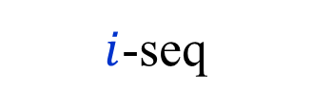






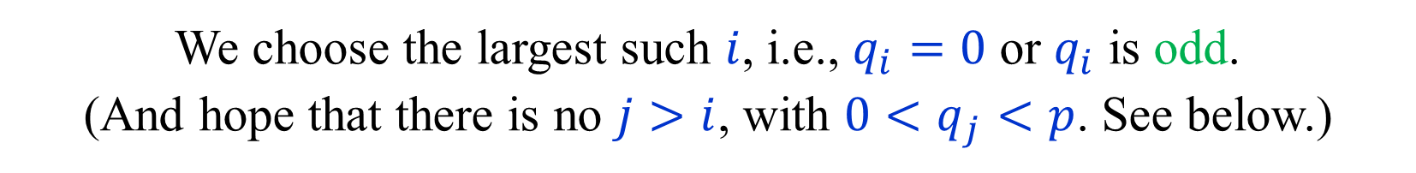
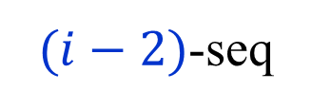

Updating summaries I
A new item of priority $p$ arrives.
If $p$ is even, and $q_{i−1},q_{i−2},…,q_{0}≠0$ and even,
a new $i$-sequence is created.
$$q_{i−1}$$
$$q_{i−2}$$
$$q_{0}$$
$$p$$
$$…$$
$$…$$
$$…$$
$(i−1)$-seq
$(i−2)$-seq
$0$-seq
$i$-seq
We choose the largest such $i$, i.e., $q_{i}=0$ or $q_{i}$ is odd.
(And hope that there is no $j>i$, with $0<q_{j}<p$. See below.)
Update: $q_{i}←p$, and $q_{i−1},q_{i−2},…,q_{0}←0$.
If $p$ is even, there is always such an update.

Slide 26
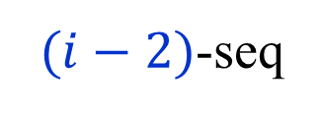

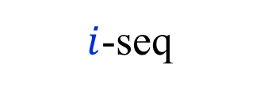






Updating summaries II
A new item of priority $p$ arrives.
Let $i$ be the largest such that $0<q_{i}<p$.
$$q_{i}$$
$$q_{i−2}$$
$$p$$
$$…$$
$$…$$
$$…$$
$i$-seq
$(i−2)$-seq
$0$-seq
$p$ is now the highest priority after the $i$-sequence.
All sequences after the $i$-sequence are destroyed…
Update: $q_{i}←p$, and $q_{i−1},q_{i−2},…,q_{0}←0$

Slide 27

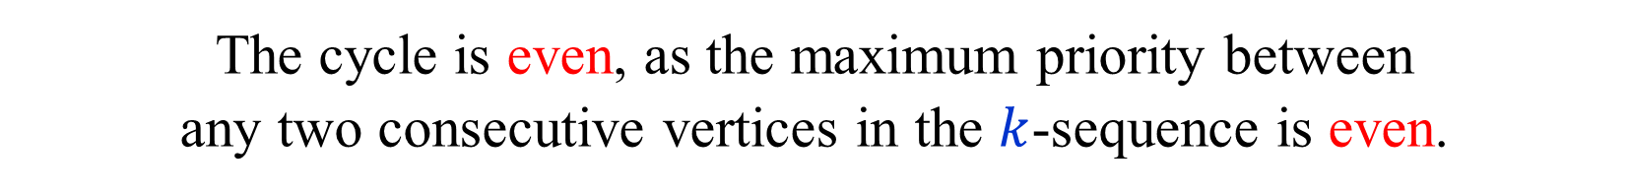
Correctness I
If at some stage $q_{k}>0$, then the play contains a $k$-sequence.
The $k$-sequence is of length $2^{k}>n$, and therefore
contains a repeated vertex, i.e., a cycle.
The cycle is even, as the maximum priority between
any two consecutive vertices in the $k$-sequence is even.
Thus, if $q_{k}>0$, the automaton accepts.
If ODD uses a positional winning strategy, there are
no even cycles in the play, and the automaton never accepts.
We need to show that if EVEN uses a positional winning
strategy, then the automaton eventually accepts.

Slide 28
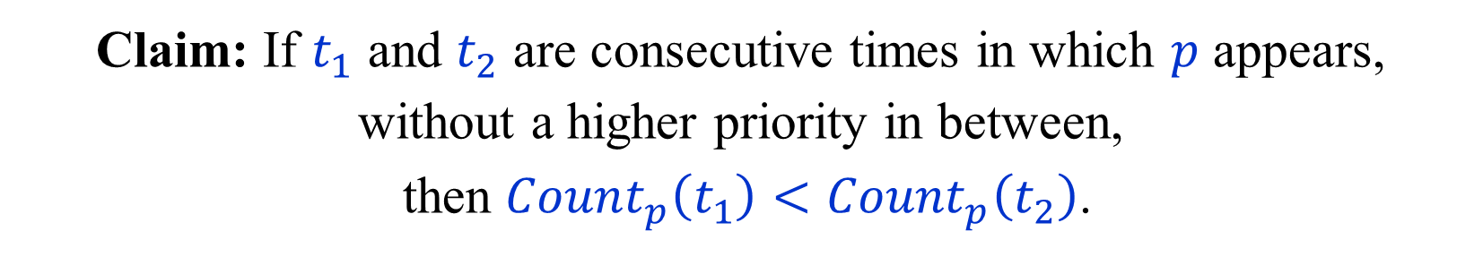

Correctness II
Suppose EVEN uses a positional winning strategy.
Consider a resulting play. ODD plays arbitrarily.
The largest priority $p$ seen infinitely often is even.
Let $q_{i}\left(t\right)$ be $q_{i}$ after time $t$.
Let $Count_{p}\left(t\right)=\sum_{\begin{matrix}q_{i}\left(t\right) ≥ p \\ q_{i}\left(t\right) even\end{matrix}}{2^{i}}$
Claim: If $t_{1}$ and $t_{2}$ are consecutive times in which $p$ appears, without a higher priority in between,
then ${Count}_{p}\left(t_{1}\right)<{Count}_{p}\left(t_{2}\right)$.
Thus, eventually ${Count}_{p}\left(t\right)≥2^{k}$, and hence $q_{k}\left(t\right)>0$.

Slide 29
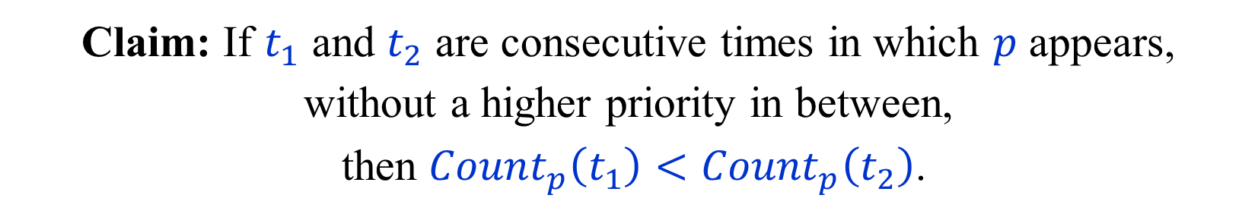
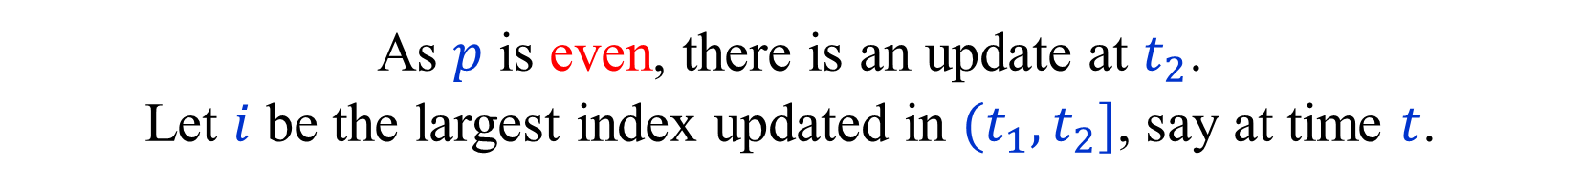



Correctness III
$Count_{p}\left(t\right)=\sum_{\begin{matrix}q_{i}\left(t\right) ≥ p \\ q_{i}\left(t\right) even\end{matrix}}{2^{i}}$
Claim: If $t_{1}$ and $t_{2}$ are consecutive times in which $p$ appears, without a higher priority in between,
then ${Count}_{p}\left(t_{1}\right)<{Count}_{p}\left(t_{2}\right)$.
As $p$ is even, there is an update at $t_{2}$.
Let $i$ be the largest index updated in $(t_{1},t_{2}]$, say at time $t$.
Then, $q_{i}\left(t_{1}\right)<p$ or $q_{i}\left(t_{1}\right)$ is odd.
Thus, $i$ does not contribute to ${Count}_{p}\left(t_{1}\right)$.
After the update at $t$: $0<q_{i}\left(t\right)≤p$.
The update at $t_{2}$ ensures that $q_{i}\left(t_{2}\right)=p$.
Thus, $i$ does contribute to ${Count}_{p}\left(t_{2}\right)$.
$${Count}_{p}\left(t_{2}\right) −{Count}_{p}\left(t_{1}\right)≥2^{i} −\left(1+2+…+2^{i−1}\right)=1$$

Slide 30

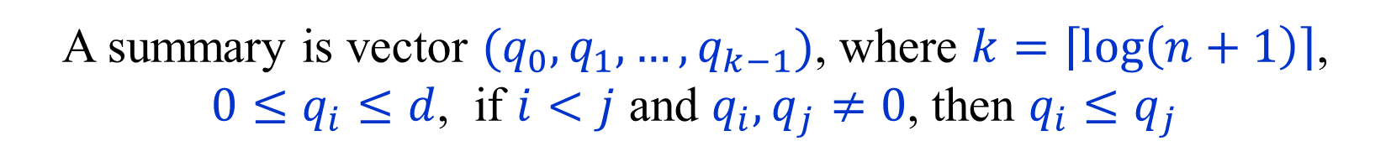
Size of separating automata
$n$ – number of vertices/states in the parity game.
$d$ – number of priorities in the parity game.
Number of states is the separating automata is the
number of possible summaries, plus 1 (an accepting state).
A summary is vector $(q_{0},q_{1},…,q_{k−1})$, where $k=\left\lceil \log\left(n+1\right)\right\rceil$,
${0≤q}_{i}≤d$, if $i<j$ and $q_{i},q_{j}≠0$, then $q_{i}≤q_{j}$
Number of summaries is a at most
${\left(d+1\right)}^{\left\lceil \log\left(n+1\right)\right\rceil } ≈ d^{\log{n}}=n^{\log{d}}$
Quasipolynomial!

Slide 31


Exact number of summaries
A summary is vector $(q_{0},q_{1},…,q_{k−1})$, where $k=\left\lceil \log\left(n+1\right)\right\rceil$,
${0≤q}_{i}≤d$, if $i<j$ and $q_{i},q_{j}≠0$, then $q_{i}≤q_{j}$
Thus, a summary is a partial non-decreasing
function from $\left\{0,1,…,k\right\}$ to $\left\{1,2,…,d\right\}$.
Number of total non-decreasing functions – $\left({d+k \atop k+1}\right)$
Number of partial non-decreasing functions – $\sum_{j=0}^{k+1}{\left({d+j+1 \atop j}\right)}$

Slide 32
What next?
Is there a simpler way to obtain
separating automata of quasipolynomial size?
Are there even smaller separating automata,
perhaps of polynomial size?
Unfortunately, the size of the separating automaton constructed
is essentially optimal, at least if we want a strong separation.
To prove the lower bound on the size of strong separating automata, we introduce the notions of universal trees and universal graphs.
Using universal trees we get a different, perhaps simpler, construction of strong separating automata of quasipolynomial size.
We first digress and describe an older exponential time
algorithm for parity games based on progress measures.

Slide 33

Progress measures [Jurdziński (2000) ]
Let $G=(V=V_{0}⨃V_{1},E,p)$, where $p:E→[d]$, be a parity game.
We assume that $d$ is even, and that priorities are now on edges.
A progress measure is a function $f:V→{\left[0,n−1\right]}^{d/2}∪\left\{∞\right\}$ s.t.
If $u∈V_{0}$ then $∃ \left(u,v\right)∈E$ , $f\left(u\right)≥_{p\left(u,v\right)}f(v)$.
If $u∈V_{1}$ then $∀ \left(u,v\right)∈E$ , $f\left(u\right)≥_{p\left(u,v\right)}f(v)$.
In both cases, if $p(u,v)$ is odd and $f\left(u\right)≠∞$,
the condition is $f\left(u\right)>_{p\left(u,v\right)}f(v)$.
$f\left(u\right)=x=\left(x_{d−1},x_{d−3},…,x_{1}\right)∈{\left[0,n\right]}^{d/2}$ or $f\left(u\right)=∞$.
${x|}_{p}=\left(x_{d−1},x_{d−3},…,x_{p}\right)$ or ${x|}_{p}=\left(x_{d−1},x_{d−3},…,x_{p+1}\right)$
$x≥_{p}y$ iff $x{\left.​\right|}_{p}≥_{lex}y{\left.​\right|}_{p}$ (lexicographic order.)
$∞≥_{p}y$ for every $y$.

Slide 34
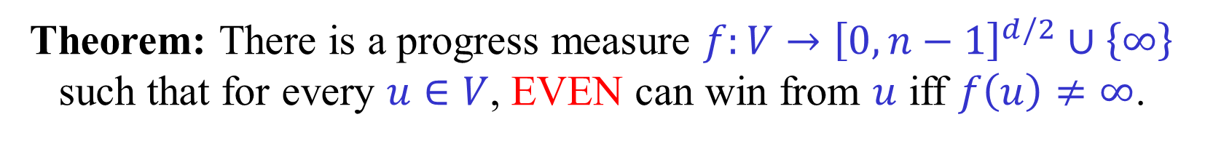


Progress measures $⇔$ Winning
Let $G=(V=V_{0}⨃V_{1},E,p)$, where $p:E→[d]$, be a parity game.
Theorem: There is a progress measure $f:V→{\left[0,n−1\right]}^{d/2}∪\left\{∞\right\}$
such that for every $u∈V$, EVEN can win from $u$ iff $f\left(u\right)≠∞$.
First direction: Suppose that $f\left(u\right)≠∞$.
From every vertex $u∈V_{0}$ EVEN chooses
an edge $\left(u,v\right)∈E$ such that $f\left(u\right)≥_{p\left(u,v\right)}f(v)$.
This condition is also satisfied by any edge chosen by ODD.
Suppose that $v_{1},v_{2},…v_{k−1},v_{k}$, where $v_{1}=v_{k}$ is an odd cycle.
Suppose that $p=p\left(v_{1},v_{2}\right)$ is the largest priority on the cycle.
$$f\left(v_{1}\right)>_{p\left(v_{1},v_{2}\right)} f\left(v_{2}\right)≥_{p\left(v_{2},v_{3}\right)} f\left(v_{3}\right)≥_{p\left(v_{3},v_{4}\right)}…≥_{p(v_{k},v_{1})} f\left(v_{1}\right)$$
$$f\left(v_{1}\right)>_{p} f\left(v_{2}\right)≥_{p} f\left(v_{3}\right)≥_{p}…≥_{p} f\left(v_{1}\right)$$
Contradiction!

Slide 35
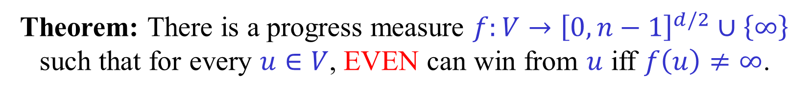




Progress measures $⇐$ Winning
Let $G=(V=V_{0}⨃V_{1},E,p)$, where $p:E→[d]$, be a parity game.
Theorem: There is a progress measure $f:V→{\left[0,n−1\right]}^{d/2}∪\left\{∞\right\}$
such that for every $u∈V$, EVEN can win from $u$ iff $f\left(u\right)≠∞$.
Second direction: Let $W_{0}$ be the set of vertices from
which EVEN can win. There is a positional strategy $σ$
using which EVEN wins from all the vertices of $W_{0}$.
Let $G_{σ}[W_{0}]$ be the induced graph on $W_{0}$ in which all edges emanating from vertices of $V_{0}$ that are not in $σ$ are removed.
The graph $G_{σ}[W_{0}]$ is even, i.e., all cycles in it are even.
Enough to prove that if $G=(V,E,p)$ is an even graph, there
exists a progress measure $f:V→{\left[0,n−1\right]}^{d/2}$ with all values finite.
Exercise: Prove that this is indeed enough.

Slide 36















Even graph $⟹$ Progress measure
A graph $G=(V,E,p)$, where $p:E→[d]$, is even
if all cycles in $G$ are even. (Assume $d$ is even.)
Let $L_{i}$ be the set of vertices from which there is a path
containing $i$ edges of priority $d−1$ and no edge of priority $d$,
but there is no such path with $i+1$ edges of priority $d−1$.
Lemma: (1) $V=∪_{i=0}^{n−1}L_{i}$
(2) If $\left(u,v\right)∈E$, $p\left(u,v\right)=d−1$, $u∈L_{j}$, $v∈L_{i}$, then $j>i$.
(3) If $\left(u,v\right)∈E$, $p\left(u,v\right)≤d−1$, $u∈L_{j}$, $v∈L_{i}$, then $j≥i$.
$$d$$
$$p<d$$
$$d−1$$
$$d−1$$
$$d−1$$
$$L_{n−1}$$
$$L_{j}$$
$$L_{i}$$
$$d$$
$$L_{1}$$
$$L_{0}$$

Slide 37



Even graph $⟹$ Progress measure
For every $i$, $G[L_{i}]$ is an even graph with only $d−2$ priorities,
after edges of priority $d$ are replaced with edges of priority $d−2$.
By induction, we have finite progress measures
on each $G[L_{i}]$ with only $d/2−1$ coordinates.
For each $u∈L_{i}$ add a leading coordinate of $i$.
Exercise: Complete the details of the proof.
(In particular, prove the lemma on the previous slide.)
What is the complexity of finding a progress measure for even graphs?
$$d$$
$$p<d$$
$$d−1$$
$$d−1$$
$$d−1$$
$$L_{n−1}$$
$$L_{j}$$
$$L_{i}$$
$$d$$
$$L_{1}$$
$$L_{0}$$

Slide 38



Progress measures Lifting
Let $G=(V=V_{0}⨃V_{1},E,p)$, where $p:E→[d]$, be a parity game.
We solve $G$ by computing the
smallest progress measure $f:V→{\left[0,n−1\right]}^{d/2}∪\left\{∞\right\}$
We start with $f\left(u\right)=(0,0,…,0)$ for every $u∈V$.
Let $f^{′}=Lift\left(f,u\right)$, where
$f^{′}(v)=f(v)$ , if $u≠v$
If $u∈V_{0}$ then $f^{′}(u)$ is the smallest $x∈{\left[0,n−1\right]}^{d/2}∪\left\{∞\right\}$
for which $∃ \left(u,v\right)∈E$ , $p(u,v)$ even $∧$ $x≥_{p\left(u,v\right)}f(v)$
or $∃ \left(u,v\right)∈E$ , $p(u,v)$ odd $∧$ $x>_{p\left(u,v\right)}f(v)$
If $u∈V_{1}$ then $f^{′}(u)$ is the smallest $x∈{\left[0,n−1\right]}^{d/2}∪\left\{∞\right\}$
for which $∀ \left(u,v\right)∈E$ , $p(u,v)$ even $⟶$ $x≥_{p\left(u,v\right)}f(v)$
and $p(u,v)$ odd $∧ x≠∞⟶x>_{p\left(u,v\right)}f(v)$

Slide 39









Progress measures and trees [JL (2017) ]
A progress measure $f:V→{\left[0,n−1\right]}^{d/2}∪\left\{∞\right\}$ can be
seen as a mapping from each vertex to a leaf in a complete
$n$-ary tree of depth $d/2$, or to $∞$ (not part of the tree).
If $f\left(u\right)=\left(x_{d−1},x_{d−3},…,x_{1}\right)$, then to reach the leaf, go to
the $x_{d−1}$-th child of the root, then to the $x_{d−3}$-th child, and so on.
Index the levels from bottom
to top by the odd priorities.
$$d−1$$
$$…$$
$$5$$
$x≥_{p}y$ iff
the ancestor of $x$ at level $p$
is equal or to the right of
the ancestor of $y$ at level $p$.
$$3$$
$$1$$
Similar definition if $p$ even.

Slide 40






Tree progress measures [JL (2017) ]
Let $T$ be an arbitrary tree of depth $d/2$.
Let $L(T)$ be the leaves of $T$.
A $T$-progress measure is a function $f:V→L(T)∪\left\{∞\right\}$ that
satisfies the same conditions as a standard progress measure,
with the relations $≥_{p}$ and $>_{p}$ defined on $T$.
If $f:V→L(T)∪\left\{∞\right\}$ is a progress measure, then EVEN
can win from each vertex $u∈V$ for which $f\left(u\right)≠∞$.
If $T$ is arbitrary, the converse does not necessarily hold.
Every standard PM yields a PM on a tree with at most $n$ leaves. Unfortunately, we do not know this tree in advance.
If there is a $T$-PM, we can find it using a
lifting algorithm on $T$ in $O\left(m\left|L\left(T\right)\right|\right)$ time.
If there is a $T$-PM then there is also a $T′$-PM
for every tree $T′$ that contains $T$ as a subtree.

Slide 41



Ordered trees and subtrees
An $(n,h)$-tree is an ordered tree with $n$ leaves at depth $h$.
An ordered tree $T_{1}$ is a subtree of an ordered tree $T_{2}$
iff it is possible to embed $T_{1}$ in $T_{2}$ in a way that
preserves the order of the children of each node.
$$≠$$
$(5,2)$-tree

Slide 42



Universal trees
[ Czerwiński-Daviaud-Fijalkow-Jurdziński-Lazić-Parys (2019) ]
An $(n,h)$-universal tree is a tree that
contains each $\left(n,h\right)$-tree as an ordered subtree.
A trivial
$(5,2)$-universal tree
$5^{2}=25$ leaves
A optimal
$(5,2)$-universal tree
11 leaves

Slide 43


PMs on a Universal tree
If $T$ is an $\left(n,\frac{d}{2}\right)$-universal tree.
Theorem: For every $(n,d)$-parity game $G$, if $f$is the smallest $T$-PM
for $G$, then for every $u∈V$, EVEN can win from $u$ iff $f\left(u\right)≠∞$.
We know that there is a “standard” PM that satisfies the condition.
This PM corresponds to progress measure on some $\left(n,\frac{d}{2}\right)$-tree $T′$.
The tree $T′$ is contained in the $\left(n,\frac{d}{2}\right)$-universal tree $T$.
Thus, if $T$ is an $\left(n,\frac{d}{2}\right)$-universal, we get an
$O\left(m\left|L\left(T\right)\right|\right)$ algorithm for $(n,d)$-parity games!

Slide 44


Recursive construction of Universal trees
[ Fijalkow (2018) ]
There are $(n,h)$-universal trees with $T(n,h)$ leaves, where
$$T\left(n,h\right)=T\left(\left\lfloor \frac{n}{2}\right\rfloor ,h\right)+T\left(n,h−1\right)+T\left(\left\lceil \frac{n}{2}\right\rceil −1,h\right)$$
$T\left(n,1\right)=n$ , $T\left(1,h\right)=1$
$≤\left\lfloor \frac{n}{2}\right\rfloor$
$≤\left\lceil \frac{n}{2}\right\rceil −1$

Slide 45




Upper bound recurrence [ Fijalkow (2018) ]
$$T\left(n,h\right)=T\left(\left\lfloor \frac{n}{2}\right\rfloor ,h\right)+T\left(n,h−1\right)+T\left(\left\lceil \frac{n}{2}\right\rceil −1,h\right)$$
$$t\left(k,h\right)=T\left(2^{k},h\right) ≤ t\left(k,h−1\right)+2t(k−1,h)$$
$$≤ 2^{k}\left({k+h−2 \atop k}\right) +2⋅2^{k−1}\left({k+h−2 \atop k−1}\right) =2^{k}\left({k+h−1 \atop k}\right)$$
$$t\left(k,h\right) ≤ 2^{k}\left({k+h−1 \atop k}\right)$$
$$\left({n−1 \atop k}\right)+\left({n−1 \atop k−1}\right)=\left({n \atop k}\right)$$
By induction:
$$T\left(n,h\right) ≤ 2^{\left\lceil \log{n}\right\rceil }\left({\left\lceil \log{n}\right\rceil +h−1 \atop \left\lceil \log{n}\right\rceil }\right)$$
Rough bound 1: $\left({\log{n}+h \atop \log{n}}\right)≤ {\left(\log{n}+h\right)}^{\log{n}}=n^{\log{(h+\log{n}})}$
Rough bound 2: $T\left(n,\log{n}\right)≤2n\left({2\log{n} \atop \log{n}}\right)≤2n^{3}$

Slide 46




Lower bound on the size of universal trees
[ Fijalkow (2018) ]
Every $(n,h)$-universal trees has at least $L(n,h)$ leaves, where
$$L\left(n,h\right)=\sum_{d=1}^{n}{L\left(\left\lfloor \frac{n}{d}\right\rfloor ,h−1\right)}$$
$L\left(n,1\right)=n$ , $L\left(1,h\right)=1$
Every $(n,h)$-universal trees contains at least $L\left(\left\lfloor \frac{n}{d}\right\rfloor ,h−1\right)$
nodes of degree at least $d$ at depth $h−1$.
If $T$ is $(n,h)$-universal, then the subtree of $T$ containing all
nodes at depth $h−1$ of degree at least $d$ is $\left(\left\lfloor \frac{n}{d}\right\rfloor ,h−1\right)$-universal.
By induction, the number of leaves of $T$
is at least $\sum_{d=1}^{n}{L\left(\left\lfloor \frac{n}{d}\right\rfloor ,h−1\right)}$.

Slide 47





Lower bound recurrence [ Fijalkow (2018) ]
$$L\left(n,h\right)=\sum_{d=1}^{n}{L\left(\left\lfloor \frac{n}{d}\right\rfloor ,h−1\right)}$$
$$ℓ\left(k,h\right)=\sum_{k=0}^{k}{ℓ\left(k−i,h−1\right)} = ℓ\left(k,h−1\right)+ℓ\left(k−1,h\right)$$
By induction $L\left(2^{k},h\right) ≥ ℓ\left(k,h\right)$
$$L\left(2^{k},h\right)≥\sum_{i=0}^{k}{L\left(2^{k−i},h−1\right)} ≥\sum_{i=0}^{k}{ℓ\left(k−i,h−1\right)}=ℓ(k,h)$$
$$ℓ\left(k,h\right)≥ \left({k+h−1 \atop k}\right)$$
$$L\left(n,h\right)≥ \left({\left\lfloor \log{n}\right\rfloor +h−1 \atop \left\lfloor \log{n}\right\rfloor }\right)$$
Define and check initial conditions…

Slide 48

Bounds on the size of Universal Trees
[ Fijalkow (2018) ]
$$\left({\left\lfloor \log{n}\right\rfloor +h−1 \atop \left\lfloor \log{n}\right\rfloor }\right) ≤ T\left(n,h\right) ≤ 2^{\left\lceil \log{n}\right\rceil }\left({\left\lceil \log{n}\right\rceil +h−1 \atop \left\lceil \log{n}\right\rceil }\right)$$
Upper and lower bounds are almost tight.
They differ by only a polynomial factor.
Upper bound is perhaps tighter.

Slide 49
Separating Automata
vs. Universal Trees (and Graphs)
We saw two quasipolynomial-time algorithms for parity games,
one using separating automata and one using universal trees.
Is there a relation between the two algorithms?
We constructed essentially optimal universal trees.
Are there smaller separating automata, e.g., of polynomial size?
We next show that strong separating automata and
universal trees are essentially equivalent notions.
The size of the smallest strong separating automata
is equal to the size of the smallest universal trees.
We also introduce a third equivalent notion: universal graphs.

Slide 50


Strong Safety Separating Automata
In the description of the algorithm of [ CJKLS (2017) ]
we used reachability separating automata.
To conform to the definition of progress measures given,
we switch to the equivalent notion of safety automata.
(This corresponds to switching the roles of EVEN and ODD.)
A strong safety $(n,d)$-separating automaton $A$ reads a $w∈{\left[d\right]}^{ω}$.
If $w∈{AllCycEven}_{n,d}$, i.e., $w$ is the sequence of priorities on an
infinite path in an even $(n,d)$-graph, $A$ never reaches a rejecting state.
If $w∈{LimsupOdd}_{d}$, i.e., the largest priority seen infinitely
often in $w$ is odd, then $A$ reaches a rejecting state.
$A$ is a strong as it separates ${AllCycEven}_{n,d}$ from ${LimsupOdd}_{d}$.
For an algorithm, enough to separate ${AllCycEven}_{n,d}$ from ${AllCycOdd}_{d}$.

Slide 51











Universal Tree $→$ Separating Automaton
Let $T$ be an $(n,d/2)$-universal tree.
Construct an automaton $A(T)$ whose states are $L\left(T\right)∪\{Reject\}$.
$$d+1$$
Let $x→_{p}y$ be
$x>_{p}y$ if $p$ odd ,
$x≥_{p}y$ if $p$ even.
$$p+2$$
$$δ\left(u,p\right)=\max\left\{v | u→_{p}v\right\}$$
$$p$$
If there is no $v$
such that $u→_{p}v$,
then $δ\left(u,p\right)=R$.
$$p+1$$
$$R$$
The initial state $u_{0}$ is the maximum, i.e., rightmost, leaf.
$$p$$
odd

Slide 52












Tree $→$Automaton
$$7$$
$$5$$
$$3$$
$$1$$
$$1$$
$$, 4$$
$$3$$
$$2$$
$$R$$
$$6$$
$$5$$

Slide 53



Universal Tree $→$ Separating Automaton
Theorem: If $T$ is an $(n,d/2)$-universal tree,
then $A(T)$ is a strong $(n,d)$-separating automaton.
First direction: $A(T)$ accepts all words in ${AllCycEven}_{n,d}$.
Suppose $w∈{AllCycEven}_{n,d}$. Let $G=(V,E,p)$ be an
even $(n,d)$-graph in which $w$ occurs on the infinite path $v_{0},v_{1},…$.
Let $f:V→L(T)$ be a $T$-progress measure. (Without $∞$’s.)
$${f(v}_{0})→_{w_{1}}f(v_{1})→_{w_{2}}f(v_{2})→_{w_{3}}…$$
Let $u_{0},u_{1},…$ be the states of $A(T)$ visited when reading $w$.
We prove by induction that $u_{i}≥{f(v}_{i})$, so $u_{i}≠R$ for every $i$.
$u_{0}≥{f(v}_{0})$ ,
$u_{i}=δ\left(u_{i−1},w_{i}\right)=\max\left\{v | u_{i−1}→_{w_{i}}v\right\}≥f\left(v_{i}\right)$.

Slide 54


Universal Tree $→$ Separating Automaton
Theorem: If $T$ is an $(n,d/2)$-universal tree,
then $A(T)$ is a strong $(n,d)$-separating automaton.
Second direction: $A(T)$ rejects all words in ${LimsupOdd}_{d}$.
Suppose $w∈{LimsupOdd}_{d}$. There is a suffix of $w$ is which
an odd priority $p$ appears an infinite number of times,
and no priority larger than $p$ appears.
In this suffix, upon reading each one of these $p$’s,
the automaton jumps left to a new subtree of level $p$.
As there are no priorities greater than $p$, it can never jump back.
More formally, let $u_{1},u_{2},…$ be the states after reading these $p$’s.
Then, $u_{i−1}>_{p}u_{i}$. Thus, after a finite number of $p$’s $R$ is reached.

Slide 55





Separating Automaton $→$ Even Graph
A $(n,d)$-multigraph is $G=\left(V,E\right)$,
where $\left|V\right|=n$ and $E⊆V×\left[d\right]×V$.
$\left(u,p,v\right)∈E$ means that there is an edge $(u,v)$ with priority $p$.
Given an automaton $A=(Q,δ,q_{0},R)$,
define a multigraph $G\left(A\right)=\left(Q∖R,E\right):$
$δ\left(u,p\right)=v$ iff $\left(u,p,v\right)∈E$.
Claim: If $A$ is a strong separating automaton in which all states
are reachable from $q_{0}$, then $G\left(A\right)$ is even (i.e., all cycles are even).
Odd cycle in $G(A)$ $⟹ A$ accepts a word $w∈{LimsupOdd}_{d}$.
Note: This is where we use strong separation.
We do not know whether the word $w$ above is in ${AllCycOdd}_{n,d}$.

Slide 56





Maximal Even Graphs [ CF (2018) ]
An even multigraph $G=\left(V,E\right)$ is maximal if adding any edge $\left(u,p,v\right)∈(V×\left[0,d\right]×V)∖E$ to $G$ creates an odd cycle.
Note: We also add, if possible, edges of (dummy) priority 0.
From now on such edges are allowed in any $(n,d)$-multigraph.
Any even $(n,d)$-multigraph $G$ is contained in a
maximal even $(n,d)$-multigraph $\overline{G}$.
Add edges to $G$ in any order, until it is not possible
to add an additional edge without creating an odd cycle.
The maximal even multigraph $\overline{G}$ obtained from $G$
usually depends on the order in which edges are added.

Slide 57




Tree-like (hierarchical) graphs
If $G=\left(V,E\right)$ is an $(n,d)$-multigraph,
let $E_{p}=\left\{ \left(u,v\right)∈V×V | \left(u,p,v\right)∈E \right\}$.
Transitivity
An $(n,d)$-multigraph $G=\left(V,E\right)$ is tree-like iff:
(1) If $\left(u,p_{1},v\right),\left(v,p_{2},w\right)∈E$ then $\left(u,\max\left(p_{1},p_{2}\right),w\right)∈E$.
(2) If $p$ is even, then $E_{p}$ is total, i.e., for every $u,v∈V$,
$\left(u,p,v\right)∈E$ or $\left(v,p,u\right)∈E$ (or both).
(3) If $p$ is odd, then for every $u,v∈V$,
$\left(u,p,v\right)∈E$ iff $\left(u,p−1,v\right)∈E$ but $\left(v,p−1,u\right)∉E$.
Lemma: A maximal even $(n,d)$-multigraph is tree-like.
Exercise 1: Prove the lemma.
Exercise 2: Prove that if $G=\left(V,E\right)$ is maximal even then:
(1) For every even $p_{1}<p_{2}$, if $\left(u,p_{1},v\right)∈E$ then $\left(u,p_{2},v\right)∈E$.
(2) For every odd $p_{1}<p_{2}$, if $\left(u,p_{2},v\right)∈E$ then $\left(u,p_{1},v\right)∈E$.

Slide 58





Tree-like graph $→$
Hierarchical decomposition
Let $G=\left(V,E\right)$ be a tree-like $(n,d)$-multigraph.
For every even $p≥0$, the set $E_{p}$ defines a total relation
that partitions $V$ into equivalence classes.
An equivalence class $C$ of $E_{p}$ is a maximal subset
of $V$ such that for every $u,v∈C$ we have $\left(u,v\right),\left(v,u\right)∈E_{p}$.
An equivalence class $C$ of $E_{p}$ is a strongly connected component
of $\left(V,E_{p}\right)$. Each such component is a directed clique.
If $C_{1},C_{2}$ are two distinct equivalence classes of $E_{p}$, then
there exists $u∈C_{1}$ and $v∈C_{2}$ such that $\left(u,v\right)∈E_{p}$ iff
for every $u∈C_{1}$ and $v∈C_{2}$ we have $\left(u,v\right)∈E_{p}$.
If this is the case, we say that $C_{1}>_{p}C_{2}$.
The relation $>_{p}$, for even $p$, is a total order on the components.

Slide 59


Tree-like graph $→$
Hierarchical decomposition
Lemma: Each equivalence class $C$ of $E_{p}$, where $p$ even,
is composed of a disjoint union of equivalence classes of $E_{p−2}$.
Exercise: Prove the lemma.

Slide 60


Tree-like graph $→$
Hierarchical decomposition $→$ Tree
Let $G=\left(V,E\right)$ be a tree-like $(n,d)$-multigraph.
The hierarchy of equivalence classes defines a tree $T=T(G)$.
The leaves are the equivalence classes of $E_{0}$.
At the level above we have the equivalence classes of $E_{2}$, etc.
The nodes at the level corresponding to an odd priority $p$
are the equivalence classes of $E_{p−1}$.
(Note: We could have said that tree levels correspond to even
priorities, and that odd priorities correspond to “half-levels”.)

Slide 61


Tree $→$Tree-like graph
Let $T$ be an $(n,d/2)$-tree.
We can define a tree-like graph $G(T)$ on the leaves of $T$
by converting $T$ into an automaton, and then taking
a maximal even graph containing it.
(The completion into a maximal even graph is this time unique.)
More directly:
$\left(u,p,v\right)∈E\left(G\left(T\right)\right)$ , $p$ even $⇔$ $u≥_{p}v$
$\left(u,p,v\right)∈E\left(G\left(T\right)\right)$ , $p$ odd $⇔$ $u>_{p}v$

Slide 62





Tree $→$Tree-like graph
$$7$$
$$5$$
$$3$$
$$1$$

Slide 63



Tree $→$Tree-like graph
$$7$$
$$5$$
$$3$$
$$0$$
$$1$$
$$0$$
$$0$$

Slide 64


Tree $→$Tree-like graph
$$7$$
$$5$$
$$3$$
$$1$$
$$1$$
$$1$$

Slide 65



Tree $→$Tree-like graph
$$7$$
$$5$$
$$3$$
$$2$$
$$1$$
$$2$$
$$2$$

Slide 66


Tree $→$Tree-like graph
$$7$$
$$5$$
$$3$$
$$1$$
$$3$$
$$3$$

Slide 67

Tree $→$Tree-like graph $→$ Tree
Let $T$ be an $(n,d/2)$-tree.
Let $G(T)$ be the tree-like graph corresponding to $T$.
Lemma 1: $T\left(G\left(T\right)\right)=T$.
Lemma 2: If $G$ is tree-like then $G\left(T\left(G\right)\right)=G$.
Exercise: Prove the lemmas.

Slide 68

Where are we?
Let $A$ be a strong $(n,d)$-separating automaton.
We defined a graph $G(A)$ and showed that it is even.
The maximal even graph $\overline{G(A)}$ is tree-like.
Thus, there is a tree $T\left(\overline{G\left(A\right)}\right)$.
All that remains is to show that
the tree $T\left(\overline{G\left(A\right)}\right)$ is $(n,d/2)$-universal.
For that we introduce
graph homomorphisms and universal graphs.

Slide 69



Graph homomorphisms and
Universal multigraphs
Let $G_{i}=\left(V_{i},E_{i}\right)$ be an $(n_{i},d)$-multigraph, for $i=1,2$.
A homomorphism $φ$from $G_{1}$ to $G_{2}$ is a function $φ:V_{1}→V_{2}$
such that if $\left(u,p,v\right)∈E_{1}$ then $\left(φ\left(u\right),p,φ\left(v\right)\right)∈E_{2}$.
Note: $φ:V_{1}→V_{2}$ is not necessarily injective.
It is possible that $φ\left(u\right)=φ\left(v\right)$ even though $u≠v$.
An even $(N,d)$-multigraph $G$ is $(n,d)$-universal
if for every even $(n,d)$-multigraph $g$
there is a homomorphism from $g$ to $G$.

Slide 70





Separating automata $→$
Universal multigraphs
Theorem: Let $A$ be a strong $\left(n,d\right)$-separating automaton.
Let $\overline{G(A)}$ be a maximal even $\left(n,d\right)$-multigraph containing $G(A)$.
Then $\overline{G(A)}$ is an $\left(n,d\right)$-universal multigraph.
We already know that $\overline{G(A)}$ is even and tree-like.
We need to show that for every even $(n,d)$-graph $g=(V,E)$
there is a homomorphism $φ$ from $g$ to $\overline{G(A)}$.
For $u∈V$, let $φ(u)$ be a minimal state in $A$, according to $E_{0}$, that
can be reached by reading the priorities on a path in $g$ that ends in $u$.
(The path can start anywhere in $g$.)
$$φ\left(u\right)=\min_{E_{0}}\left\{ δ\left(q_{0},ρ\right) \left| \begin{matrix}ρ sequence of priorities on \\ a finite path in g that ends at u\end{matrix}\right. \right\}$$

Slide 71



Separating automata $→$
Universal multigraphs
Theorem: Let $A$ be a strong $\left(n,d\right)$-separating automaton.
Let $\overline{G(A)}$ be a maximal even $\left(n,d\right)$-multigraph containing $G(A)$.
Then $\overline{G(A)}$ is an $\left(n,d\right)$-universal multigraph.
$$φ\left(u\right)=\min_{E_{0}}\left\{ δ\left(q_{0},ρ\right) \left| \begin{matrix}ρ sequence of priorities on \\ a finite path in g that ends at u\end{matrix}\right. \right\}$$
Suppose $\left(u,p,v\right)∈E\left(g\right)$. We show that $\left(φ(u),p,φ\left(v\right)\right)∈E\left(\overline{G(A)}\right)$.
Let $ρ$ be a sequence that defines $φ(u)$.
Then, $ρ⋅p$ is a candidate sequence for defining $φ(v)$.
Let $v^{′}=δ(q_{0},ρ⋅p$). Then, $\left(φ\left(u\right),p,v^{′}\right)∈E\left(G\left(A\right)\right)⊆E\left(\overline{G(A)}\right)$.
By the $E_{0}$-minimality of $φ(v)$, $\left(v′,0,φ\left(v\right)\right)∈E\left(\overline{G(A)}\right)$.
By transitivity, $\left(φ(u),p,φ\left(v\right)\right)∈E\left(\overline{G(A)}\right)$.

Slide 72

Tree embedding
The last piece of the puzzle:
Lemma: A tree $t$ is an ordered subtree of tree $T$ iff
there is a homomorphism from $G(t)$ to $G(T)$.
Exercise: Prove the lemma.

Slide 73


Separating automata $→$
Universal trees
Let $A$ be a strong $\left(n,d\right)$-separating automaton.
We saw that $\overline{G(A)}$ is an $\left(n,d\right)$-universal multigraph.
Thus, for every $\left(n,d/2\right)$-tree $t$,
there is a homomorphism from $G(t)$ to $\overline{G(A)}$.
But, $\overline{G(A)}=G\left(T\left(\overline{G\left(A\right)}\right)\right)$.
Thus $T\left(\overline{G\left(A\right)}\right)$ is an $\left(n,d/2\right)$-universal tree!

Slide 74
END of
LECTURE 6

