Slide 1
Games on Graphs
Uri Zwick
Tel Aviv University
Lecture 5 –
Randomized Subexponential Algorithms
Last modified 26/12/2019

Slide 2


Strategy iteration for two-player games
Start with an arbitrary strategy $σ$ of player 0.
Compute an optimal counter-strategy $τ$ to $σ$.
If there are improving switches for $σ$,
keeping $τ$ fixed, perform some of them.
Repeat until there are no improving switches.
Final strategies are optimal for the two players.
$⇒$ We assume this time that player 0 is the maximizer. $⇐$
Consider the move from $(σ,τ)$ to $(σ^{′},τ^{′})$.
From the point of view of player 0, controlling $σ$,
all switches performed are improving!
Thus $\left(σ,τ\right)≺(σ′,τ′)$. ($y^{σ,τ}<y^{σ^{′},τ^{′}}$)

Slide 3


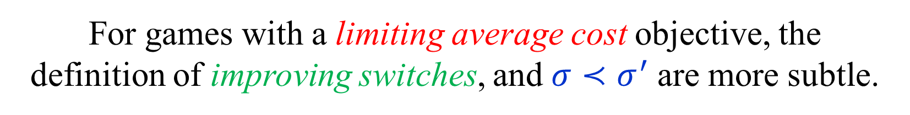

Values
$σ≺σ^{′}$ iff $\left(σ,τ\left(σ\right)\right)≺\left(σ^{′},τ\left(σ^{′}\right)\right)$
where $τ\left(σ\right)$ is a best response to $σ$.
Games with total or discounted cost objectives:
$Val\left(σ\right)=Val\left(σ,τ(σ)\right)=\sum_{s∈S}{Val^{σ,τ\left(σ\right)}(s)}$
A strategy $σ$ that maximizes $Val\left(σ\right)$
also maximizes $Val^{σ,τ\left(σ\right)}(s)$ for every $s∈S$.
If $σ^{′}$ is obtained from $σ$ by performing
improving switches, then $Val\left(σ\right)<Val(σ^{′})$.
For games with a limiting average cost objective, the
definition of improving switches, and $σ≺σ^{′}$ are more subtle.

Slide 4
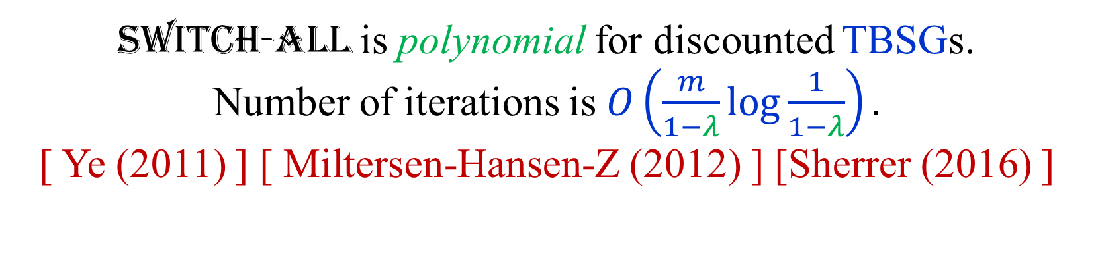
Strategy improvement algorithms
Switch-All: choose the best switch from each state.
[ Howard (1960) ]
Switch-All is polynomial for discounted TBSGs.
Number of iterations is $O\left(\frac{m}{1−λ}\log{\frac{1}{1−λ}}\right).$
[ Ye (2011) ] [ Miltersen-Hansen-Z (2012) ] [Sherrer (2016) ]
Switch-All is exponential for non-discounted MDPs.
[ Friedmann (2009) ] [ Fearnley (2010) ]
All known deterministic variants take exponential time.
A randomized variant has a sub-exponential running time.

Slide 5
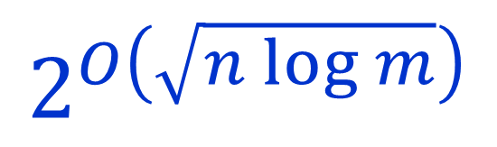
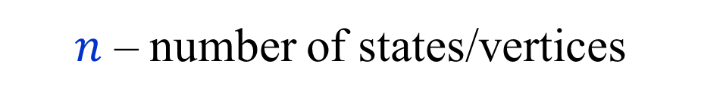
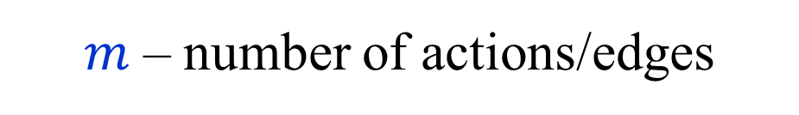
Randomized subexponential algorithms
$$2^{O\left(\sqrt{n log m}\right)}$$
$n$ – number of states/vertices
$m$ – number of actions/edges
Randomized algorithms for LP and LP-type problems
[ Kalai (1992,1997) ]
[ Matoušek-Sharir-Welzl (1992) ]
[ Gärtner (1995) ]
[ Hansen-Z (2015) ]
Applicability to games
[ Ludwig (1995) ]
[ Halman (2007) ]
[ Björklund-Sandberg-Vorobyov (2003) ]

Slide 6
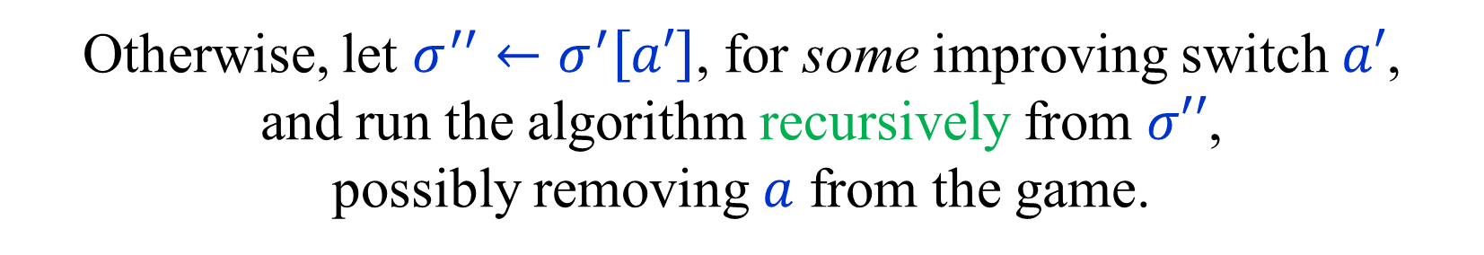
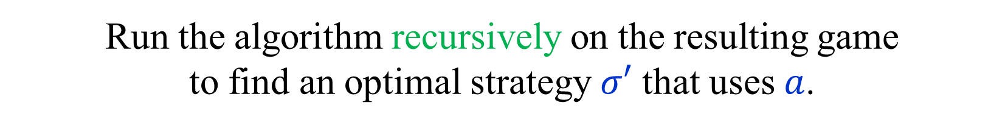
“Primal” randomized algorithm [Kalai]
Start with an arbitrary strategy $σ$ of player 0.
Compute an optimal counter-strategy $τ$ of player 1.
Randomly choose an action $a$ in $σ$ and remove its alternatives.
Run the algorithm recursively on the resulting game
to find an optimal strategy $σ′$ that uses $a$.
If there is no improving switch, then $σ′$ is optimal.
Otherwise, let $σ^{′′}←σ^{′}\left[a′\right]$, for some improving switch $a′$,
and run the algorithm recursively from $σ′′$,
possibly removing $a$ from the game.

Slide 7
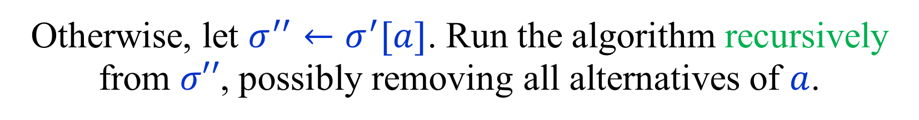
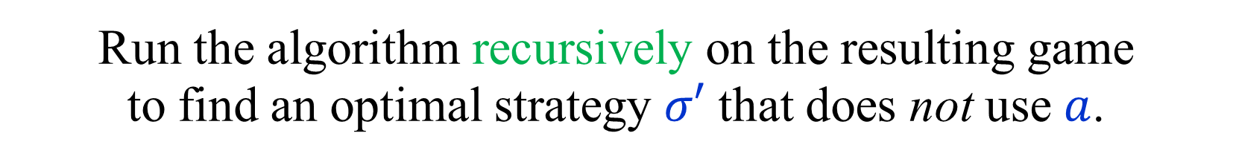
“Dual” randomized algorithm [MSW]
Start with an arbitrary strategy $σ$ of player 0.
Compute an optimal counter-strategy $τ$ of player 1.
Randomly choose an action $a$ not in $σ$ and remove it.
Run the algorithm recursively on the resulting game
to find an optimal strategy $σ′$ that does not use $a$.
If $a$ is not an improving switch, then $σ′$ is optimal.
Otherwise, let $σ^{′′}←σ^{′}[a]$. Run the algorithm recursively from $σ′′$, possibly removing all alternatives of $a$.

Slide 8
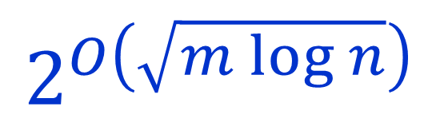
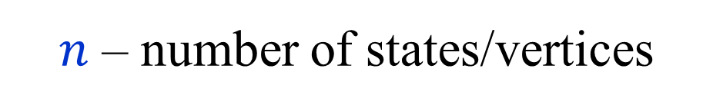
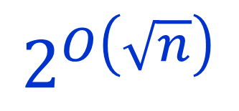

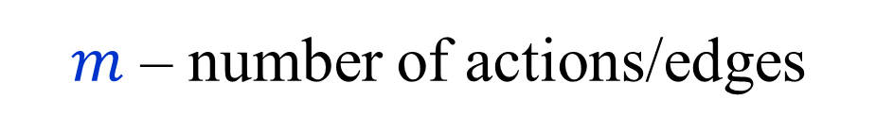
Primal vs. Dual
$$2^{O\left(\sqrt{m log n}\right)}$$
$$2^{O\left(\sqrt{n log m}\right)}$$
$n$ – number of states/vertices
$m$ – number of actions/edges
For games dual is always better.
On binary games, i.e.,
games with two actions per state,
the algorithms are identical.
$$2^{O\left(\sqrt{n}\right)}$$

Slide 9

Analysis of dual algorithm I
For every action $a$, let $Val^{−}(a)$ be the value
of the optimal strategy that does not use $a$.
Let $σ$ be the current strategy (of player 0).
Let $a_{1},a_{2},…,a_{m−n}$ be all the actions not in $σ$ s.t.
$$Val^{−}\left(a_{1}\right)≤Val^{−}\left(a_{2}\right)≤…≤Val^{−}\left(a_{m−n}\right)$$
Suppose that the algorithm chooses to exclude $a_{i}$.
Let $σ′$ be the optimal strategy not using $a_{i}$.
Let $σ^{′′}=σ^{′}\left[a_{i}\right]$, assuming $a_{i}$ is improving for $σ′$.
$Val^{−}\left(a_{1}\right)≤…≤Val^{−}\left(a_{i}\right)=Val\left(σ^{′}\right)<Val(σ^{′′})$

Slide 10

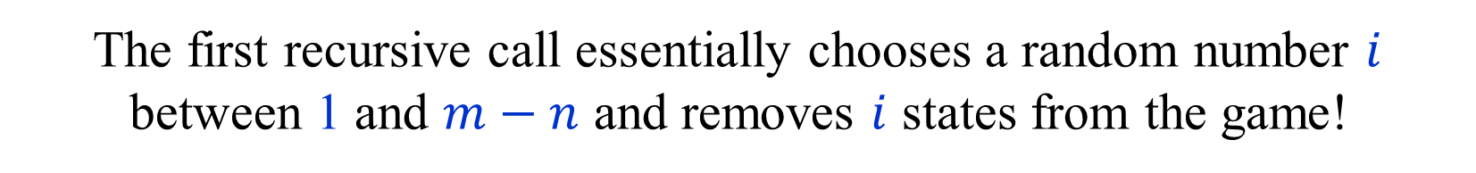

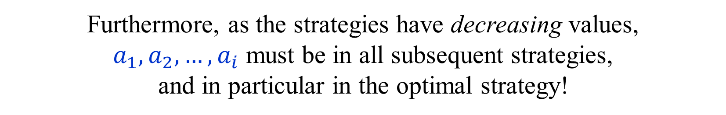
Analysis of dual algorithm II
$Val^{−}\left(a_{1}\right)≤…≤Val^{−}\left(a_{i}\right)=Val\left(σ^{′}\right)<Val(σ^{′′})$
Actions $a_{1},a_{2},…,a_{i}$ must be in $σ^{′′}$.
(In particular, they belong to different states.)
Furthermore, as the strategies have decreasing values,
$a_{1},a_{2},…,a_{i}$ must be in all subsequent strategies,
and in particular in the optimal strategy!
Thus, the states to which $a_{1},a_{2},…,a_{i}$ belong
are effectively removed from the game.
(The algorithm does not know which states are removed.)
The first recursive call essentially chooses a random number $i$ between 1 and $m−n$ and removes $i$ states from the game!
If $i≥n$, the first recursive call returns an optimal strategy.

Slide 11

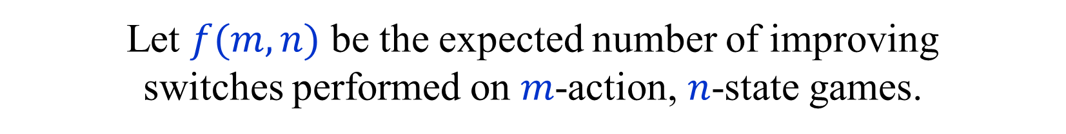
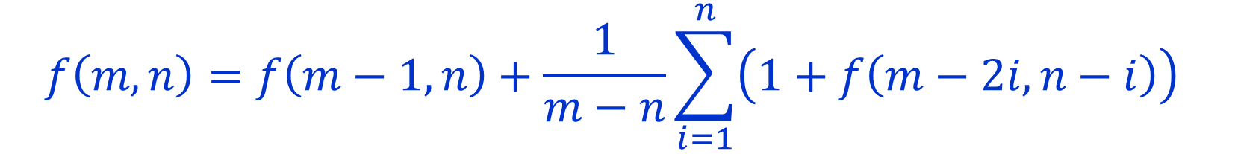
Recurrence relation
Let $f(m,n)$ be the expected number of improving
switches performed on $m$-action, $n$-state games.
Expected running time is polynomially related to $f(m,n)$.
We may assume that $m≥2n$.
(States with only one action can be ‘eliminated’.)
$$f\left(m,n\right)=f\left(m−1,n\right)+\frac{1}{m−n}\sum_{i=1}^{n}{\left(1+f\left(m−2i,n−i\right)\right)}$$
$$f\left(2n−1,n\right)=f(2n−2,n−1)$$
$$f\left(m,0\right)=0$$

Slide 12
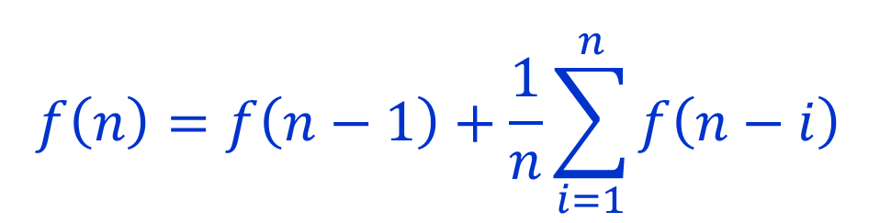
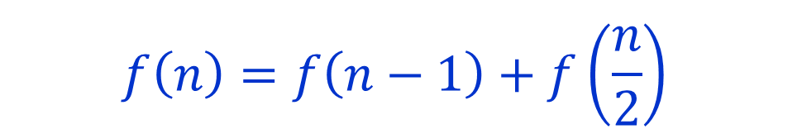
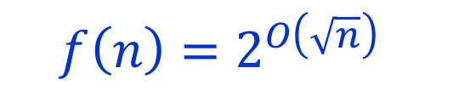
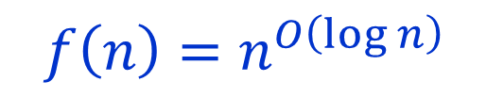
“Unusual” recurrence relations
$$f\left(n\right)=f\left(n−1\right)+f\left(\frac{n}{2}\right)$$
$$f\left(n\right)=n^{O\left(\log{n}\right)}$$
$$f\left(n\right)=f\left(n−1\right)+\frac{1}{n}\sum_{i=1}^{n}{f\left(n−i\right)}$$
$$f\left(n\right)=2^{O\left(\sqrt{n}\right)}$$
Our recurrence relation is related to the second.
Harder to analyze, but similar behavior.

Slide 13
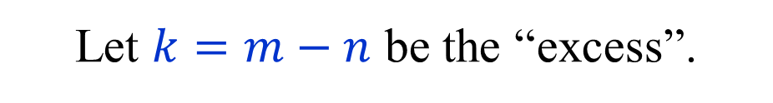
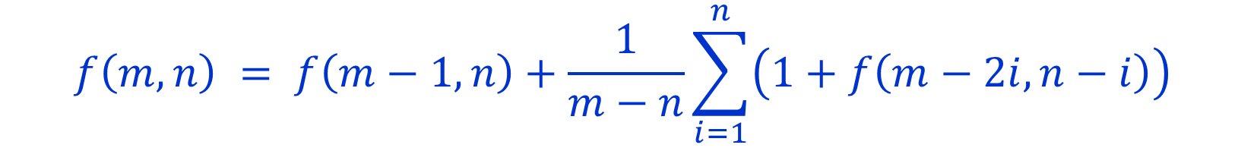
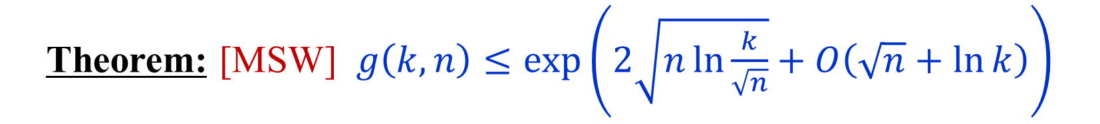


Solving the Recurrence relation
$$f\left(m,n\right) = f\left(m−1,n\right)+\frac{1}{m−n}\sum_{i=1}^{n}{\left(1+f\left(m−2i,n−i\right)\right)}$$
Let $k=m−n$ be the “excess”.
$$g\left(k,n\right)=f(n+k,n)$$
$$g\left(k,n\right) = g\left(k−1,n\right)+\frac{1}{k}\sum_{i=1}^{n}{g\left(k−i,n−i\right)}$$
Theorem: [MSW] $g\left(k,n\right)≤\exp\left(2\sqrt{n\ln{\frac{k}{\sqrt{n}}}}+O\left(\sqrt{n}+\ln{k}\right)\right)$
Complicated analysis using generating functions.

Slide 14


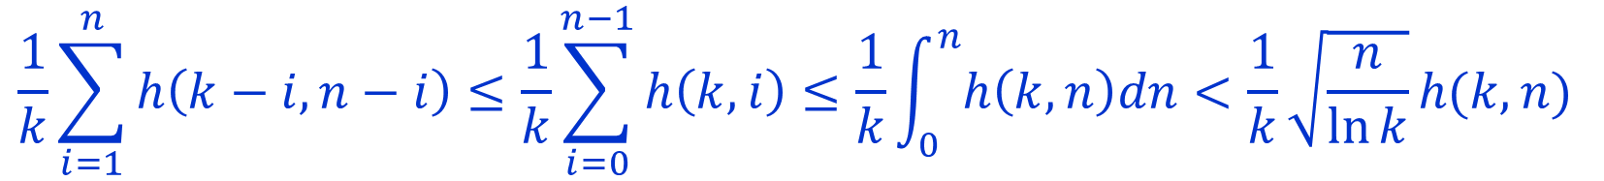
Proof by induction
$$g\left(k,n\right) = g\left(k−1,n\right)+\frac{1}{k}\sum_{i=1}^{n}{g\left(k−i,n−i\right)}$$
Claim: $g\left(k,n\right) ≤ h\left(k,n\right) = \exp\left(2\sqrt{n\ln{k}}\right)$
$$h\left(k,n\right) ≥ h\left(k−1,n\right)+\frac{1}{k}\sum_{i=1}^{n}{h\left(k−i,n−i\right)}$$
$h\left(k,n\right)−h\left(k−1,n\right) ≥ \frac{∂h}{ ∂k}\left(k,n\right) = \frac{1}{k}\sqrt{\frac{n}{\ln{k}}}h(k,n)$
$$\frac{1}{k}\sum_{i=1}^{n}{h\left(k−i,n−i\right)}≤\frac{1}{k}\sum_{i=0}^{n−1}{h\left(k,i\right)}≤\frac{1}{k}\int_{0}^{n}{h\left(k,n\right)dn}<\frac{1}{k}\sqrt{\frac{n}{\ln{k}}}h(k,n)$$
$$∫h\left(k,n\right)dn=\frac{2\sqrt{n\ln{k}}−1}{2\ln{k}}h(k,n)<\sqrt{\frac{n}{\ln{k}}}h(k,n)$$

Slide 15
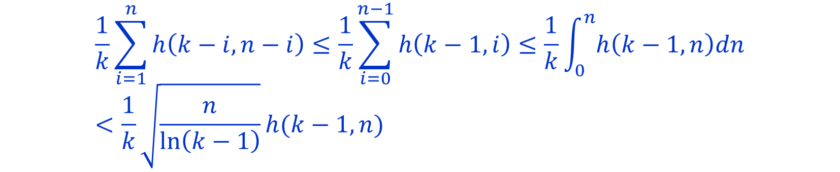
Proof by induction
$$g\left(k,n\right) = g\left(k−1,n\right)+\frac{1}{k}\sum_{i=1}^{n}{g\left(k−i,n−i\right)}$$
Claim: $g\left(k,n\right) ≤ h\left(k,n\right) = \exp\left(2\sqrt{n\ln{k}}\right)$
$$h\left(k,n\right) ≥ h\left(k−1,n\right)+\frac{1}{k}\sum_{i=1}^{n}{h\left(k−i,n−i\right)}$$
$h\left(k,n\right)−h\left(k−1,n\right) ≥ \frac{∂h}{ ∂k}\left(k−1,n\right) = \frac{1}{k−1}\sqrt{\frac{n}{\ln\left(k−1\right)}}h(k−1,n)$
$$\frac{1}{k}\sum_{i=1}^{n}{h\left(k−i,n−i\right)}≤\frac{1}{k}\sum_{i=0}^{n−1}{h\left(k−1,i\right)}≤\frac{1}{k}\int_{0}^{n}{h\left(k−1,n\right)dn}<\frac{1}{k}\sqrt{\frac{n}{\ln\left(k−1\right)}}h(k−1,n)$$
$$∫h\left(k,n\right)dn=\frac{2\sqrt{n\ln{k}}−1}{2\ln{k}}h(k,n)<\sqrt{\frac{n}{\ln{k}}}h(k,n)$$

Slide 16

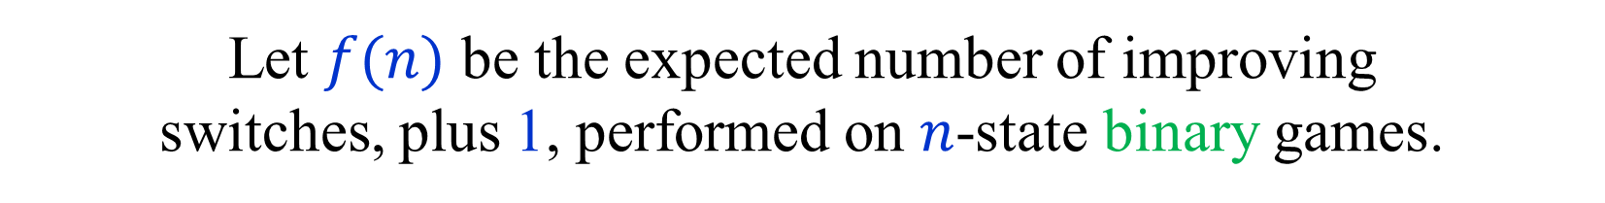
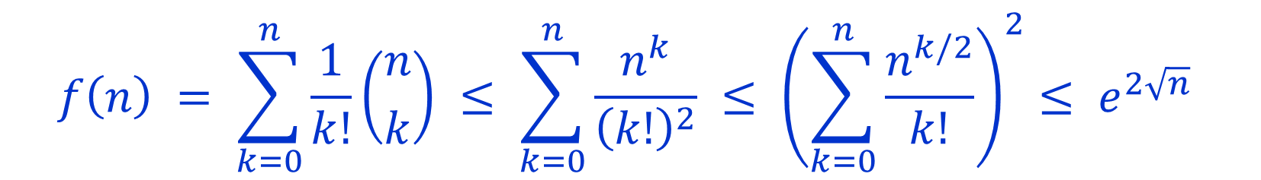
Analysis for binary games
A game is binary if every state has exactly two actions.
Let $f(n)$ be the expected number of improving
switches, plus 1, performed on $n$-state binary games.
$$f\left(n\right)= f\left(n−1\right)+\frac{1}{n}\sum_{i=1}^{n}{f\left(n−i\right)}$$
$$f\left(0\right)=1$$
$$f\left(n\right) = \sum_{k=0}^{n}{\frac{1}{k!}\left({n \atop k}\right)} ≤ \sum_{k=0}^{n}{\frac{n^{k}}{{\left(k!\right)}^{2}}} ≤ {\left(\sum_{k=0}^{n}{\frac{n^{k/2}}{k!}}\right)}^{2}≤ e^{2\sqrt{n}}$$
[ Ludwig (1995) ] [ Gärtner (2002) ]

Slide 17

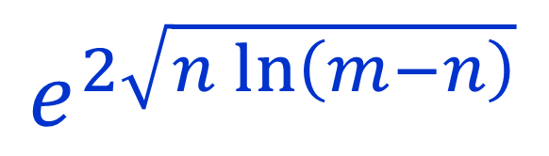

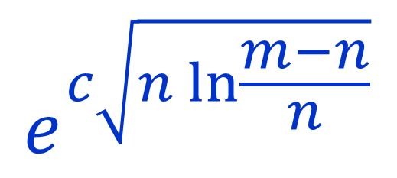
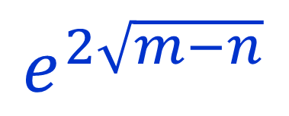
From binary to general?
A state with $d$ actions can be replaced by
a tree of $d−1$ binary states.
Total number of states becomes $m−n$.
$$e^{2\sqrt{n\ln{\frac{m−n}{\sqrt{n}}}}}$$
$$e^{2\sqrt{m−n}}$$
$$e^{2\sqrt{n\ln\left(m−n\right)}}$$
Binarized
General
General algorithm is better roughly when $m≥n\ln{n}$.
$$e^{c\sqrt{n\ln{\frac{m−n}{n}}}}$$
Improved

Slide 18
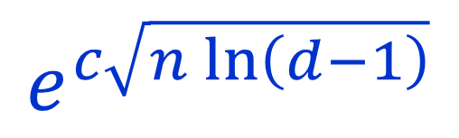
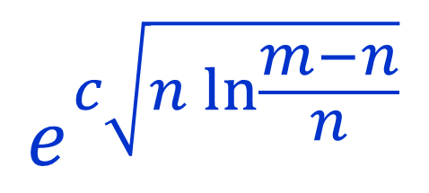
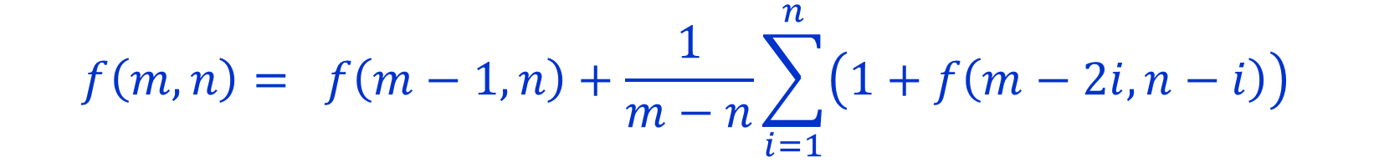
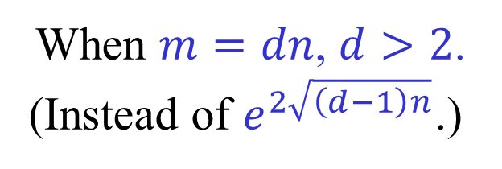
Slightly improved algorithm
[ Kalai (1997) ] [ Gärtner (2002) ] [ Hansen-Z (2015) ]
$$e^{c\sqrt{n\ln{\frac{m−n}{n}}}}$$
$$e^{c\sqrt{n\ln\left(d−1\right)}}$$
When $m=dn$, $d>2$.
(Instead of $e^{2\sqrt{\left(d−1\right)n}}$.)
$$f\left(m,n\right)= f\left(m−1,n\right)+\frac{1}{m−n}\sum_{i=1}^{n}{\left(1+f\left(m−2i,n−i\right)\right)}$$
For LPs, the algorithm needs to be changed,
and becomes much more complicated.
For games, the improved analysis
applies to the existing algorithm!

Slide 19

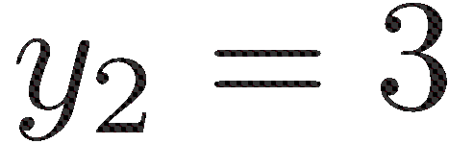


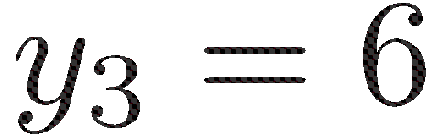
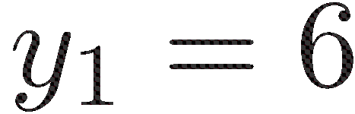
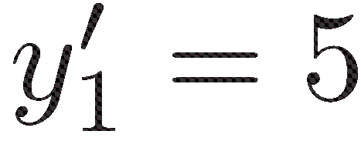

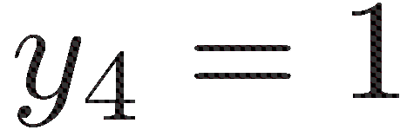

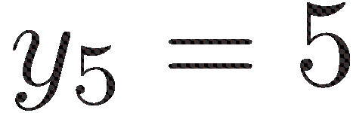
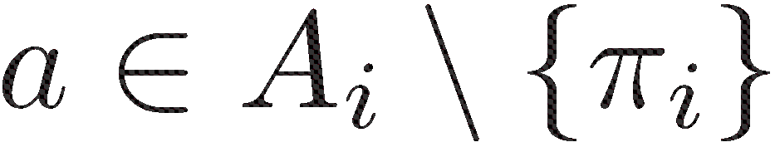
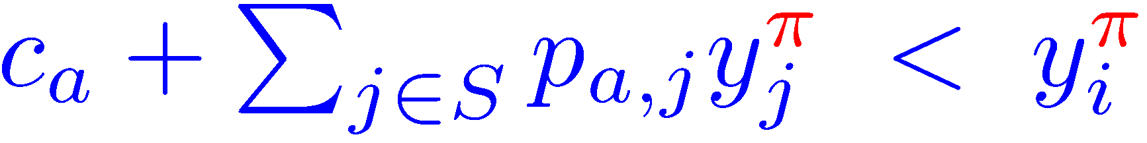
Improving switches for
total/discounted payoffs
If the strategy is not optimal, then there is a single
switch that yields strict and immediate improvement.

Slide 20
Strategy iteration for stochastic or
non-stochastic Mean Payoff Games
1
1
1
1
1
1
0
0
0
0
0
0
0
0
0
Non-optimal policy.
Both values 0.
After switch.
Both values still 0.
Optimal policy.
Both values 1.
But, there is some improvement,
as we get 1 before entering a 0 cycle.

Slide 21
END of
LECTURE 5

