Slide 1
Games on Graphs
Uri Zwick
Tel Aviv University
Lecture 4 –
Mean Payoff Games (MPGs)
and Energy Games (EGs)
Last modified 24/11/2019

Slide 2
Lecture 4
Deterministic games
Mean-Payoff Games (MPGs)
Energy Games (EGs)
Existence of values and optimal positional strategies
Finite vs. Infinite MPGs
Equivalence of MPGs and EGs
A pseudo-polynomial time algorithm for MPGs and EGs

Slide 3
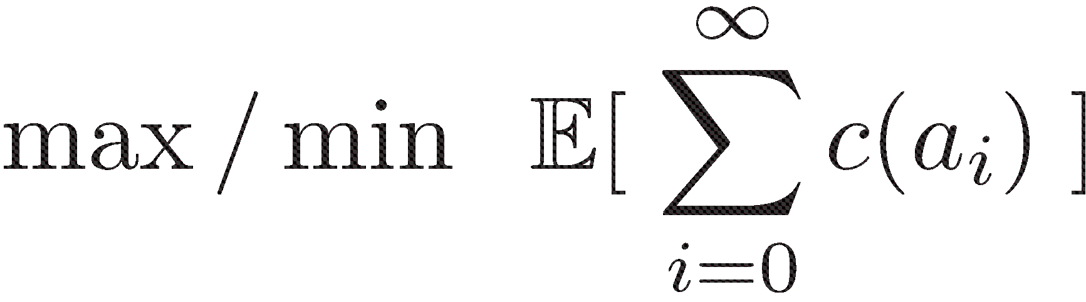


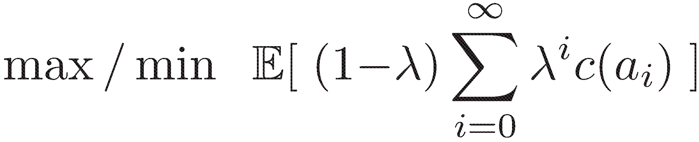

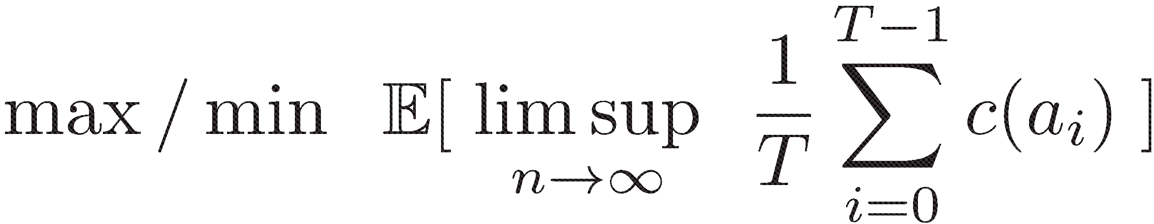
Turn-based non-Stochastic Games
[Ehrenfeucht-Mycielski (1979)] …
Total cost
Mean Payoff Games
(MPGs)
Discounted cost
Limiting average cost
Still no polynomial time algorithms known!
(Stochastic actions are not the only source of difficulty.)

Slide 4

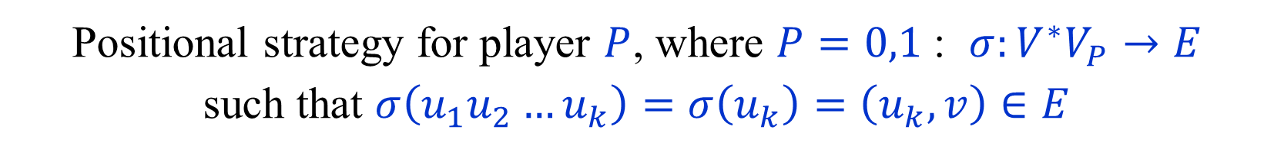
Strategies and plays in MPGs
Player 0 – minimizer
Player 1 – maximizer
Strategy for player $P$, where $P=0,1$ : $σ:V^{∗}V_{P}→E$
such that $σ\left(u_{1}u_{2}…u_{k}\right)=\left(u_{k},v\right)∈E$
Positional strategy for player $P$, where $P=0,1$ : $σ:V^{∗}V_{P}→E$
such that $σ\left(u_{1}u_{2}…u_{k}\right)=σ\left(u_{k}\right)=\left(u_{k},v\right)∈E$
${play}^{σ_{0},σ_{1}}(u)$ – play starting from $u$ using $σ_{0},σ_{1}$.
${cost}^{σ_{0},σ_{1}}\left(u\right)$ – cost sequence starting from $u$ using $σ_{0},σ_{1}$.

Slide 5


Values of plays
$$\overline{AVG}\left(c_{0},c_{1},…\right) = {\overline{lim⁡}}_{T→∞}\frac{1}{T}\sum_{i=0}^{T−1}{c_{i}}$$
$$\underline{AVG}\left(c_{0},c_{1},…\right) = {\underline{lim⁡}}_{T→∞}\frac{1}{T}\sum_{i=0}^{T−1}{c_{i}}$$
$${\overline{VAL}}^{σ_{0},σ_{1}}\left(u\right) = \overline{AVG}\left({cost}^{σ_{0},σ_{1}}\left(u\right)\right)$$
$${\underline{VAL}}^{σ_{0},σ_{1}}\left(u\right) = \underline{AVG}\left({cost}^{σ_{0},σ_{1}}\left(u\right)\right)$$

Slide 6


Positional optimality of MPGs
Theorem:
Every vertex $u$ has a value $μ=VAL(u)$ such that:
Player 0 has a strategy $σ_{0}^{∗}$ such that for every $σ_{1}$,
$${\overline{VAL}}^{σ_{0}^{∗},σ_{1}}\left(u\right)≤ μ$$
Player 1 has a strategy $σ_{1}^{∗}$ such that for every $σ_{0}$,
$${\underline{VAL}}^{σ_{0},σ_{1}^{∗}}\left(u\right) ≥ μ$$
The strategies $σ_{0}^{∗}$ and $σ_{1}^{∗}$ are called optimal strategies from $u$.
Furthermore, both players have positional strategies
that are optimal from all vertices.
(Special case of the theorem of TBSGs.)

Slide 7
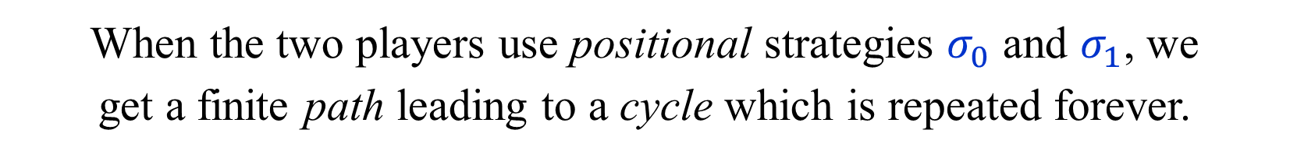
Positional strategies plays
When the two players use positional strategies $σ_{0}$ and $σ_{1}$, we
get a finite path leading to a cycle which is repeated forever.
The outcome is the average weight on the cycle.
The costs on the path are irrelevant.

Slide 8
Positional optimality of MPGs - proofs
Special case of the theorem of TBSGs.
Follows from the fact that the
optimality equations have a solution.
The existence of a solution follows, e.g.,
from the correctness of the strategy improvement algorithm.
Proofs are slightly more complicated for the
limiting average cost.
An alternative proof given by Ehrenfeucht and Mycielski (1979)
by considering an interplay between finite and infinite games.

Slide 9
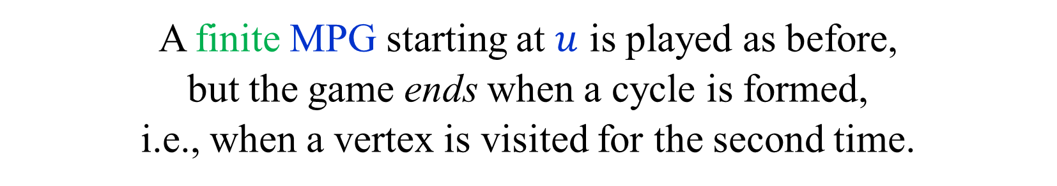
Finite MPGs
A simple and elegant proof of positional optimality
given by Ehrenfeucht and Mycielski (1979) uses
an interplay between finite and infinite games.
A finite MPG starting at $u$ is played as before,
but the game ends when a cycle is formed,
i.e., when a vertex is visited for the second time.
The outcome (value) is the average of this cycle.

Slide 10


Values of finite MPGs
Theorem:
Every vertex $u$ has a value $μ=VAL_{F}(u)$ such that:
Player 0 has a strategy $σ_{0}^{∗}$ such that for every $σ_{1}$,
$${VAL}_{F}^{σ_{0}^{∗},σ_{1}}\left(u\right) ≤ μ$$
Player 1 has a strategy $σ_{1}^{∗}$ such that for every $σ_{0}$,
$${VAL}_{F}^{σ_{0},σ_{1}^{∗}}\left(u\right) ≥ μ$$
The strategies $σ_{0}^{∗}$ and $σ_{1}^{∗}$ are called optimal strategies from $u$.
Proof:
Trivial, as the game is finite.

Slide 11





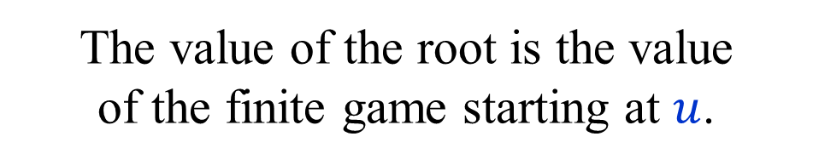



Values of finite MPGs
Construct a (huge) finite tree of all finite plays from $u$.
Assign to each leaf the value of the play,
i.e., the average of the cycle formed.
$u$
$v$
The value of an internal node is the
min/max of the values of its children.
$$w$$
$v$
The value of the root is the value
of the finite game starting at $u$.
$$w′$$
Optimal strategies easily defined.
$u$
Optimal strategies are not necessarily positional, and may depend on $u$.
$$w$$

Slide 12

Extending a strategy
Let $σ$ be a strategy in the finite game.
Then $σ$ is only defined on simple paths.
Extend $σ$ to a strategy $\hat{σ}$ in the infinite game by:
$$\hat{σ}\left(P\right)=σ(\hat{P})$$
Where $\hat{P}$ is obtained from $P$ by removing cycles:
$$\hat{σ}( a b c d e f d e g c d e f b e )$$
$$=σ ( a b e )$$

Slide 13

Values in finite and infinite games are equal
Theorem: The finite and infinite MPG started
at the same vertex have the same value.
Let $μ= {Val}_{F}\left(u\right)$.
Let $σ_{0}$ be a strategy of player 0 that ensures value $≤μ$.
Let $σ_{1}$ be a strategy of player 1 that ensures value $≥μ$.
If player 0 uses ${\hat{σ}}_{0}$ in the infinite game,
then any cycle formed as average $≤μ$.
Thus ${\hat{σ}}_{0}$ ensures a value $≤μ$ in the infinite game.
Similarly, ${\hat{σ}}_{1}$ ensures a value $≥μ$ in the infinite game.
Thus, $Val\left(u\right)=μ={Val}_{F}\left(u\right)$.
In particular, infinite MPGs have values.

Slide 14

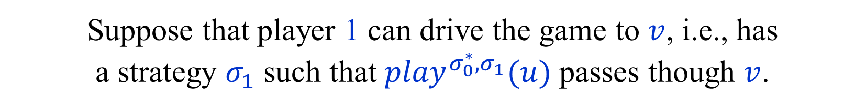
Values of reachable states
So far, we used properties of finite games
to obtain results of infinite games.
We now do the opposite to prove
the existence of positional optimal strategies
Let $σ_{0}^{∗}$ be an optimal strategy for player 0 from $u$
in the finite game.
Suppose that player 1 can drive the game to $v$, i.e., has
a strategy $σ_{1}$ such that ${play}^{σ_{0}^{∗},σ_{1}}(u)$ passes though $v$.
Claim: ${Val}_{F}\left(v\right)≤{Val}_{F}\left(u\right)$.
Player 1 can drive the game to $v$ also in the infinite game.
In the infinite game, an initial path does not matter.
Thus, ${Val}_{F}\left(v\right)=Val\left(v\right)≤Val\left(u\right)={Val}_{F}\left(u\right)\text{.}$

Slide 15

Finite games with restart
Let $s$ and $t$ be two vertices.
Start a finite game from $s$.
If $t$ is reached before a cycle is formed,
ignore the (simple) path from $s$ to $t$
and start a finite game from $t$.
Claim: For every $s$ and $t$, ${Val}_{F}\left(s,t\right)={Val}_{F}\left(s\right)$
Each player uses an optimal strategy from $s$.
If the play gets to $t$, she uses an optimal strategy from $t$.

Slide 16
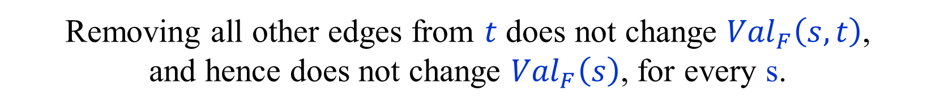


Positional optimal strategies
[ Ehrenfeucht and Mycielski (1979) ]
Theorem: Both players have positional strategies that are optimal from every starting position in the finite, and hence, infinite games.
Suppose that $t∈V_{0}$.
Consider optimal strategies of player 0 from
all vertices in the finite games with restart at $t$.
If plays arrive at $t$ all history is forgotten.
Thus, we may assume that all optimal strategies
use the same edge $\left(t,t^{′}\right)$ from $t$.
Removing all other edges from $t$ does not change ${Val}_{F}\left(s,t\right)$,
and hence does not change ${Val}_{F}\left(s\right)$, for every s.
Continuing in this way we get a positional strategy for player 0 optimal from all vertices in the finite game. (Surprising!)

Slide 17
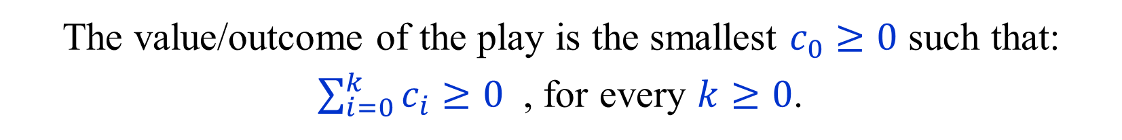
Energy Games (EGs)
Played on the same arenas as MPGs.
A play generates a sequence $c_{1},c_{2},…$ of edge costs.
The value/outcome of the play is the smallest $c_{0}≥0$ such that:
$\sum_{i=0}^{k}{c_{i}}≥0$ , for every $k≥0$.
$c_{0}=ENG\left({\left(c_{i}\right)}_{i=1}^{∞}\right)= −\inf_{k≥0}{\sum_{i=1}^{k}{c_{i}}} ( ≥0 )$
The token is an electric car with a battery whose initial charge is $c_{0}$.
$c\left(u,v\right)$ is the charge gained by traversing $\left(u,v\right)$.
The game ends, and player 0 looses, if charge $<0$.
${Val}_{ENG}\left(u\right)$ - minimal initial charge required at $u$ to survive forever.
Values exist, positional optimal strategies, …

Slide 18
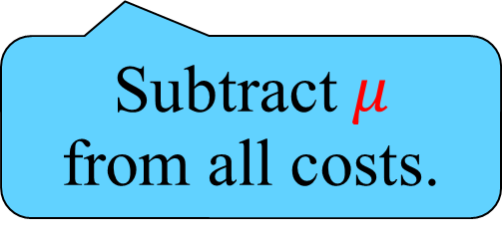


MPGs and EGs
Theorem: ${VAL}_{MPG}\left(u\right)≥0$ iff ${VAL}_{ENG}\left(u\right)<∞$
Roles of players swapped:
Player 0 in MPG is player 1 in EG
and vice versa.
${VAL}_{ENG}\left(u\right)≤\left(n−1\right)W$
$W=\max_{\left(u,v\right)∈E}\left|c\left(u,v\right)\right|$
Both conditions are equivalent to player 0/1 having a strategy
that ensures that every cycle closed is non-negative.
Corollary: ${VAL}_{MPG}\left(u\right)≥μ$ iff ${VAL}_{ENG}^{−μ}\left(u\right)<∞$
Thus, up to a binary search over possible values, solving MPGs is
equivalent to solving EGs.
Subtract $μ$
from all costs.

Slide 19
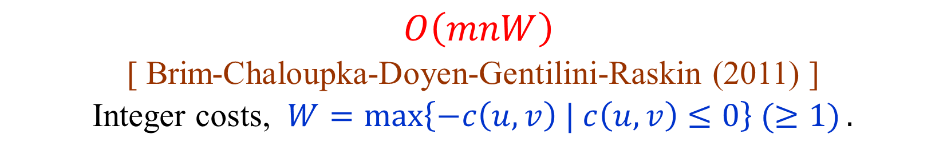
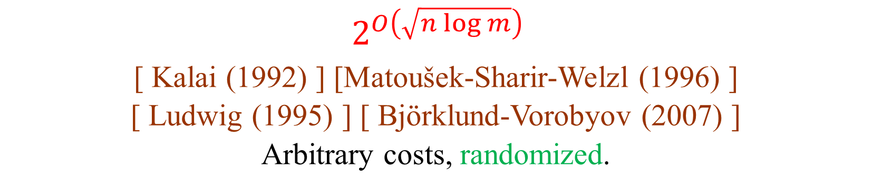
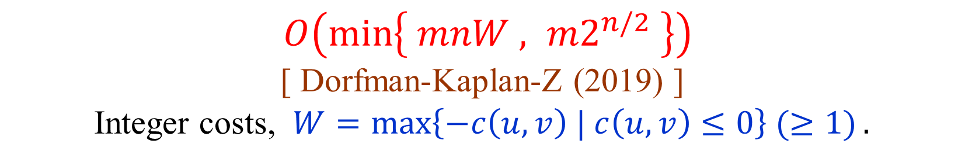
Algorithms for EGs (and MPGs)
$O\left(mnW\right)$
[ Brim-Chaloupka-Doyen-Gentilini-Raskin (2011) ]
Integer costs, $W=\max\left\{−c\left(u,v\right) | c\left(u,v\right)≤0\right\} (≥1).$
$O\left(\min\left\{ mnW , {m2}^{n/2} \right\}\right)$
[ Dorfman-Kaplan-Z (2019) ]
Integer costs, $W=\max\left\{−c\left(u,v\right) | c\left(u,v\right)≤0\right\} (≥1).$
$2^{O\left(\sqrt{n\log{m}}\right) }$
[ Kalai (1992) ] [Matoušek-Sharir-Welzl (1996) ]
[ Ludwig (1995) ] [ Björklund-Vorobyov (2007) ]
Arbitrary costs, randomized.

Slide 20
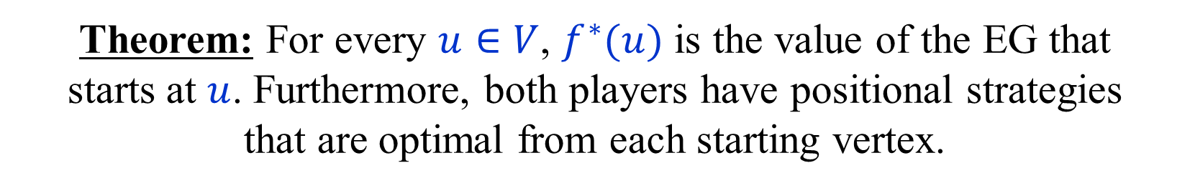
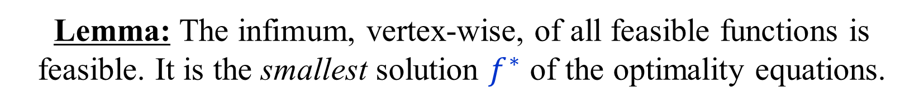
Optimality equations for EGs
$f\left(u\right)=max \left\{ 0 ,\min_{\left(u,v\right)∈E}f\left(v\right)−c\left(u,v\right) \right\}$ , $u∈V_{0}$
$f\left(u\right)=max \left\{ 0 ,\max_{\left(u,v\right)∈E}f\left(v\right)−c\left(u,v\right) \right\}$ , $u∈V_{1}$
A function $f:V→ℝ^{+}∪\{∞\}$ is feasible iff
$f\left(u\right)≥f\left(v\right)−c\left(u,v\right)$ , for some $\left(u,v\right)∈E$ , $u∈V_{0}$
$f\left(u\right)≥f\left(v\right)−c\left(u,v\right)$ , for all $\left(u,v\right)∈E$ , $u∈V_{1}$
Lemma: The infimum, vertex-wise, of all feasible functions is feasible. It is the smallest solution $f^{∗}$ of the optimality equations.
Theorem: For every $u∈V$, $f^{∗}(u)$ is the value of the EG that
starts at $u$. Furthermore, both players have positional strategies
that are optimal from each starting vertex.

Slide 21
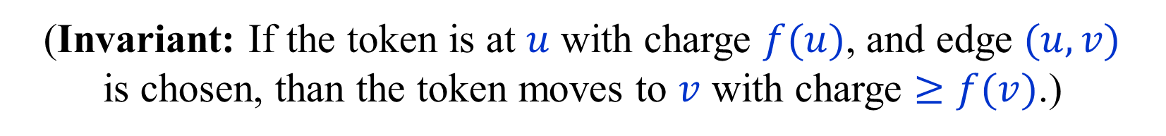
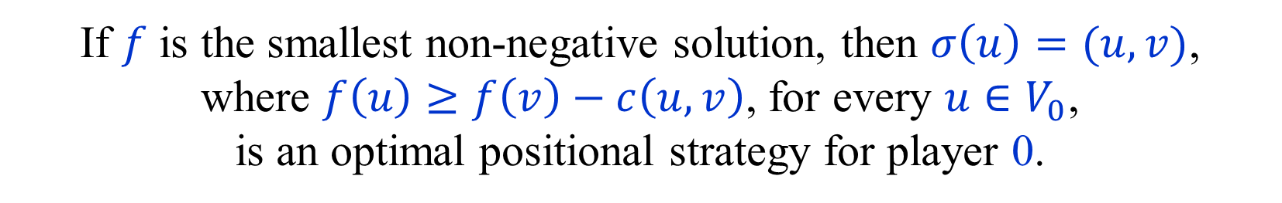
Optimality conditions for EGs
$f\left(u\right)≥f\left(v\right)−c\left(u,v\right)$ , for some $\left(u,v\right)∈E$ , $u∈V_{0}$
$f\left(u\right)≥f\left(v\right)−c\left(u,v\right)$ , for all $\left(u,v\right)∈E$ , $u∈V_{1}$
Theorem: The values of an EG form the smallest
non-negative solution of the optimality constraints.
(The smallest (vertex-wise) non-negative solution exits
by the Knaster-Tarski theorem, or by simple direct proofs.)
If $f$ is the smallest non-negative solution, then $σ\left(u\right)=(u,v)$,
where $f\left(u\right)≥f\left(v\right)−c\left(u,v\right)$, for every $u∈V_{0}$,
is an optimal positional strategy for player 0.
(Invariant: If the token is at $u$ with charge $f(u)$, and edge $(u,v)$
is chosen, than the token moves to $v$ with charge $≥f(v)$.)

Slide 22
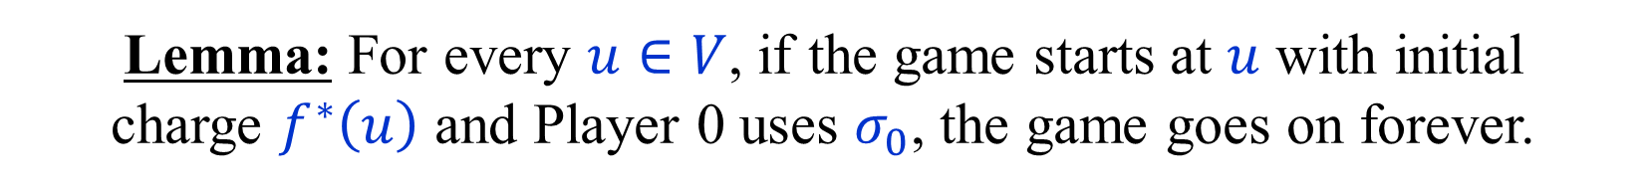
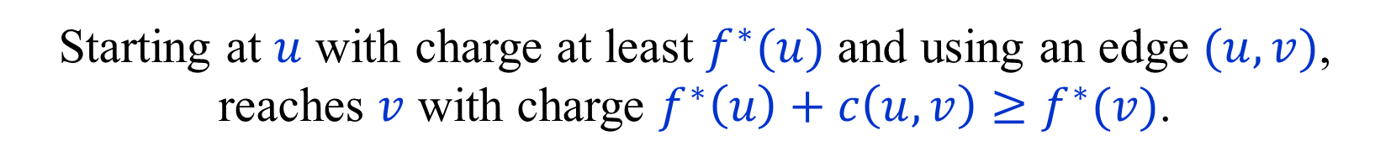
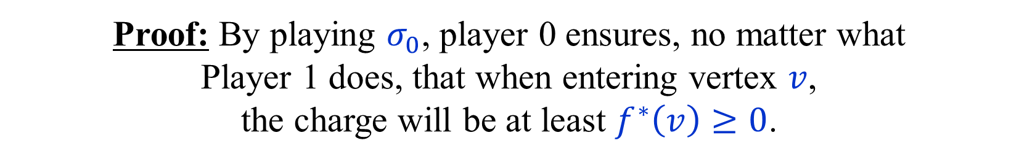
Optimal positional strategy for Player 0
Let $f^{∗}$ be the smallest solution to the optimality equations.
$σ_{0}\left(u\right)=\left(u,v\right)∈E$ such that $f^{∗}\left(u\right)≥f^{∗}\left(v\right)−c\left(u,v\right)$ , $u∈V_{0}$
Lemma: For every $u∈V$, if the game starts at $u$ with initial
charge $f^{∗}\left(u\right)$ and Player 0 uses $σ_{0}$, the game goes on forever.
Proof: By playing $σ_{0}$, player 0 ensures, no matter what
Player 1 does, that when entering vertex $v$,
the charge will be at least $f^{∗}\left(v\right)≥0$.
Starting at $u$ with charge at least $f^{∗}(u)$ and using an edge $(u,v)$,
reaches $v$ with charge $f^{∗}\left(u\right)+c\left(u,v\right)≥f^{∗}(v)$.

Slide 23
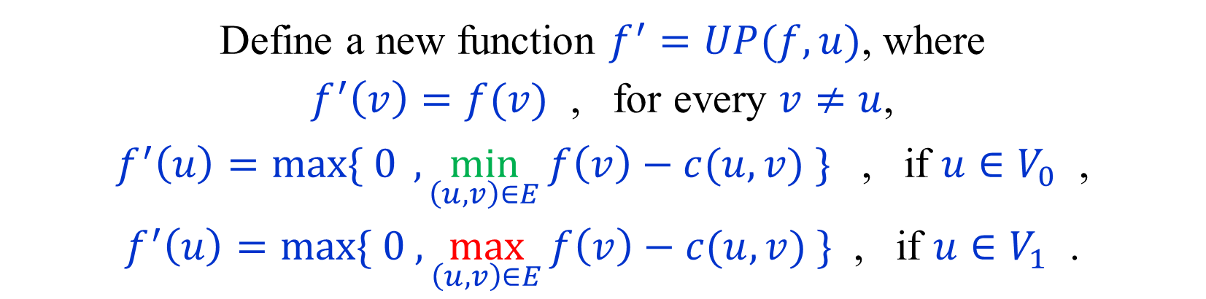
Lower bounds on values (initial credits)
$f\left(u\right)≥f\left(v\right)−c\left(u,v\right)$ , for some $\left(u,v\right)∈E$ , $u∈V_{0}$
$f\left(u\right)≥f\left(v\right)−c\left(u,v\right)$ , for all $\left(u,v\right)∈E$ , $u∈V_{1}$
Suppose that $f$ is a lower bound on values.
Suppose that the optimality conditions are violated at $u$.
Define a new function $f^{′}=UP(f,u)$, where
$f^{′}\left(v\right)=f(v)$ , for every $v≠u$,
$f^{′}\left(u\right)=\max{\{ 0} ,\min_{\left(u,v\right)∈E}{f\left(v\right)−c(u,v)} \}$ , if $u∈V_{0}$ ,
$f^{′}\left(u\right)=\max{\{ 0 ,}\max_{\left(u,v\right)∈E}{f\left(v\right)−c(u,v)} \}$ , if $u∈V_{1}$ .
Then, $UP(f,u)$ is also a lower bound on values.

Slide 24

“Small energy progress measure lifting”
[ Brim-Chaloupka-Doyen-Gentilini-Raskin (2011) ]
Start with $f≡0$.
If $f$ violates $u$, then $f←UP\left(f,u\right)$.
If the process terminates, it yields a minimal solution.
For integral costs termination is easy.
Each increase is by at least 1.
Each value increased at most $nW$ times,
after which it is replaced by $∞$.
Upon termination, $f$ is the value vector.
Optimal strategy for player 0 easily recovered.

Slide 25

Pseudo-polynomial time algorithm
[ Brim-Chaloupka-Doyen-Gentilini-Raskin (2011) ]
Implementation in $O\left(mnW\right)$ time.
Keep a list $L$ of invalid vertices.
For every vertex $u∈V_{0}$ let $count[u]$
be the number of valid edges of $u$.
A vertex $u∈V_{0}$ becomes invalid when $count[u]$ drops to 0.
Updating a vertex $u$ takes $O\left(\deg\left(u\right)\right)$ time.
Each vertex updated at most $nW$ times.
Total time: $O\left(nW\sum_{u∈V}{\deg\left(u\right)}\right) = O(mnW)$.

Slide 26







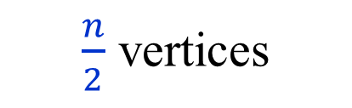





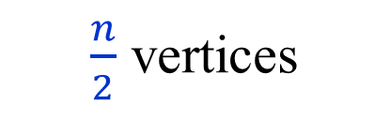



A worst-case example
$$0$$
$$0$$
$$−1$$
$$−W$$
$$−W$$
$$−W$$
$$−W$$
$$−W$$
$$−W$$
$$0$$
$\frac{n}{2}$ vertices
$$0$$
$$0$$
$\frac{n}{2}$ vertices
$$0$$
$$0$$
$$0$$
Each vertex on the cycle will get the values $0,1,…,\frac{nW}{2}+1$.
The running time will be $Θ(n^{2}W)$.

Slide 27
END of
LECTURE 4

