Slide 1
Games on Graphs
Uri Zwick
Tel Aviv University
Lecture 1 - Introduction

Slide 2
Lecture 1
Which games are we talking about?
Why are they interesting?
What will we learn throughout the semester?
Related topics we will not talk about.

Slide 3
Formalities
Graduate course, open to undergraduates.
Interesting, but complicated topics.
About 6 homework assignments.
If graded will contribute 15% to final grade.
Exam at the end of the course.
12/02/2020 and 13/03/2020
Looking for a grader.
Can be a student taking the course.

Slide 4


Turn-based Stochastic Games (TBSGs)
[Shapley (1953)] [Gillette (1957)] … [Condon (1992)]
(Possibly) Infinite duration games played by two players,
min and max, on a finite weighted directed graph.
Vertices of the graph divided among min, max and rand.
Edges emanating from min and max vertices, also called actions,
have costs (or payoff)
$$20$$
$$−10$$
Edges emanating from rand vertices
have probabilities that sum up to 1.
There might be a sink.

Slide 5
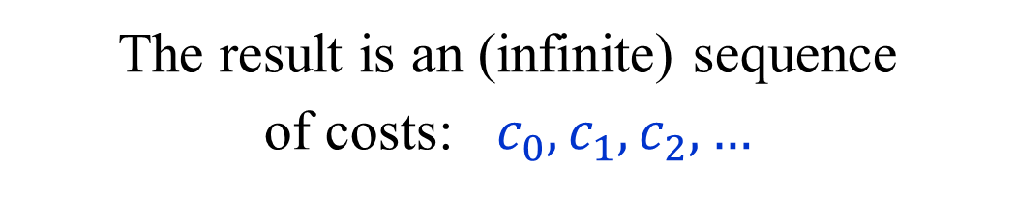
Turn-based Stochastic Games (TBSGs)
[Shapley (1953)] [Gillette (1957)] … [Condon (1992)]
How is the
game played?
A token is placed on an initial vertex.
If the token is in a min/max vertex,
then min/max chooses an action.
If the token is in a rand vertex,
a random choice is made.
$$20$$
$$−10$$
If the token reaches a sink,
the game ends.
The result is an (infinite) sequence
of costs: $c_{0},c_{1},c_{2},…$

Slide 6
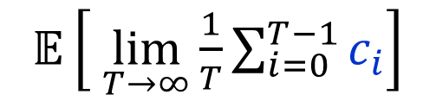



Turn-based Stochastic Games (TBSGs)
[Shapley (1953)] [Gillette (1957)] … [Condon (1992)]
Objective functions:
Total cost – finite horizon
min/max
$𝔼\left[ \sum_{i=0}^{T}{c_{i}}\right]$
(Are they well defined?)
Total cost – infinite horizon
min/max
$𝔼\left[ \sum_{i=0}^{∞}{c_{i}}\right]$
$$20$$
$$−10$$
Discounted cost
min/max
$𝔼\left[ \sum_{i=0}^{∞}{λ^{i}c_{i}}\right]$
Limiting average cost
min/max
$𝔼\left[ \lim_{T→∞}{\frac{1}{T}\sum_{i=0}^{T−1}{c_{i}}}\right]$

Slide 7
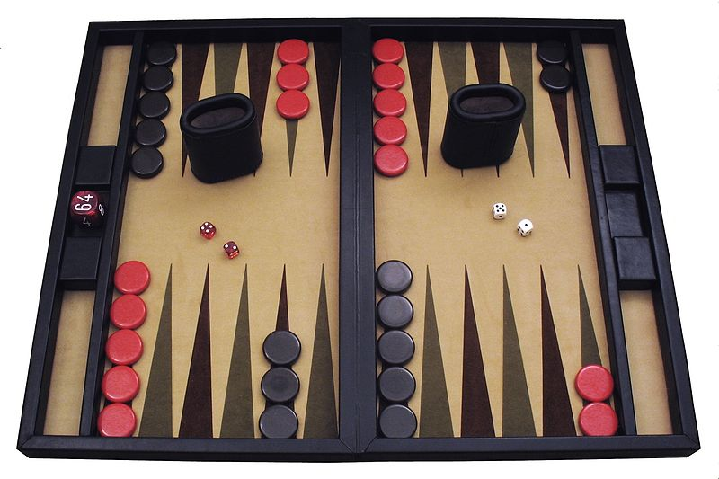
Backgammon
Author: Ptkfgs
Wikimedia Commons,
the free media repository
Backgammon is a TBSG.
A single cost/reward of $+1$ or $−1$ in the last move.
A huge number of vertices/states.
Can it be solved in polynomial time in the number of states?
(We are not going to solve backgammon in this course.)

Slide 8
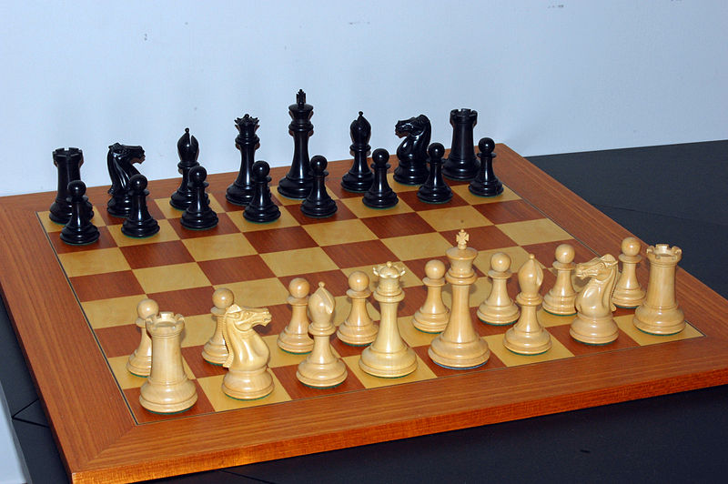
Chess
Attribution: Bubba73
at English Wikipedia
Chess is a deterministic TBSG.
A single cost/reward of $−1$, $0$ or $+1$ in the last move.
“Threefold repetition of position”
“Fivefold repetition of position” (added 2014)
Zermelo’s Theorem (1913)

Slide 9
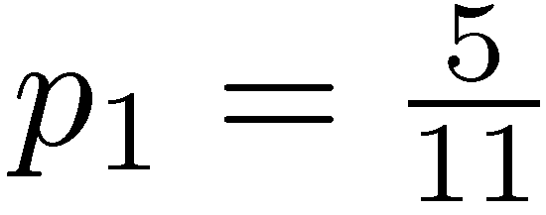
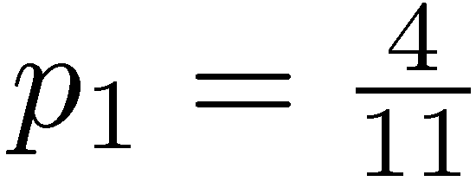
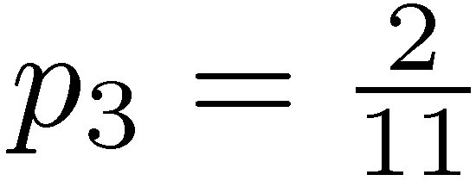



A simple TBSG
20
100
15
0
40
20
If players keep using the same actions,
we get a Markov chain.
Objective: MAX/min the
expected limiting average reward per turn

Slide 10
Is tennis, or snooker, a TBSG?
(What about judo, soccer, …)
Played by two players.
Zero sum.
Turn-based.
In each state, a player chooses an action.
The outcome of an action is stochastic.
The number of states and actions is not finite.
A player does not know all its action exactly,
let alone the actions of to her opponent.
A player can also take an action when it is not her turn.
…

Slide 11
Strategies
A deterministic strategy specifies which
action to take given every possible history.
A (general) randomized strategy is a probability
distribution over deterministic strategies.
A behavior (randomized) strategy specifies a probability distribution on actions given every possible history.
A memoryless strategy is a strategy that
depends only on the current vertex.
A positional strategy is a
deterministic memoryless strategy
A positional strategy for min/max is a
choice of an action from each min/max vertex.

Slide 12
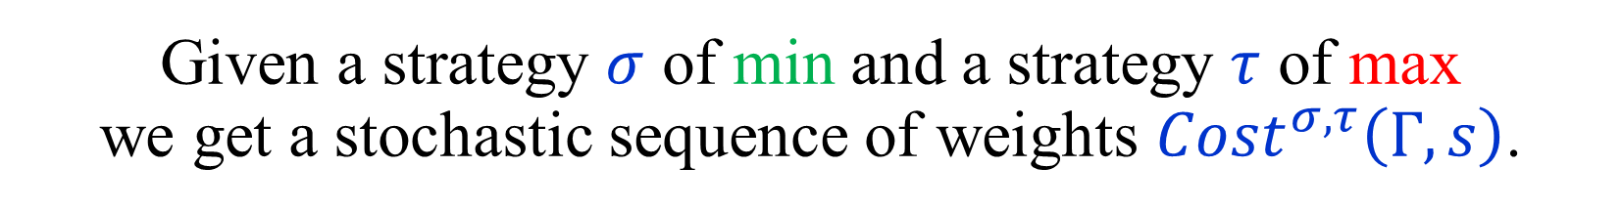



Evaluating Strategies
Let $Γ$ be a game, and $s$ a starting vertex.
Let $OBJ$ be an objective function.
Given a strategy $σ$ of min and a strategy $τ$ of max
we get a stochastic sequence of weights $Cost^{σ,τ}\left(Γ,s\right)$.
$$Val_{OBJ}^{σ,τ}\left(Γ,s\right) := 𝔼\left[ OBJ\left(Cost^{σ,τ}\left(Γ,s\right)\right) \right]$$
If $σ$ and $τ$ are positional, then $Cost^{σ,τ}\left(Γ,s\right)$
is generated by a Markov chain,
and $Val_{OBJ}^{σ,τ}\left(Γ,s\right)$ can be computed by
solving a system of linear equations.
Notes:
When the strategies are positional we get a Markov chain and y_i(sigma,tau) is easy to compute.

Slide 13
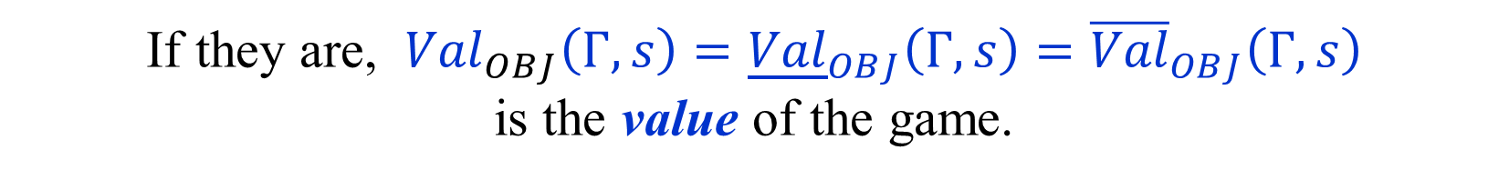
Lower and Upper Values
$$Val_{OBJ}^{σ,τ}\left(Γ,s\right) := 𝔼\left[ OBJ\left(Cost^{σ,τ}\left(Γ,s\right)\right) \right]$$
$${\underline{Val}}_{OBJ}\left(Γ,s\right) :=\sup_{τ} \inf_{σ} Val_{OBJ}^{σ,τ}\left(Γ,s\right)$$
$${\overline{Val}}_{OBJ}\left(Γ,s\right) :=\inf_{σ}{ \sup_{τ}{ Val_{OBJ}^{σ,τ}\left(Γ,s\right)}}$$
$${\underline{Val}}_{OBJ}\left(Γ,s\right)≤ {\overline{Val}}_{OBJ}\left(Γ,s\right)$$
Are ${\underline{Val}}_{OBJ}\left(Γ,s\right)$ and ${\overline{Val}}_{OBJ}\left(Γ,s\right)$ equal?
If they are, ${{Val}_{OBJ}\left(Γ,s\right)=\underline{Val}}_{OBJ}\left(Γ,s\right)={\overline{Val}}_{OBJ}\left(Γ,s\right)$
is the value of the game.

Slide 14
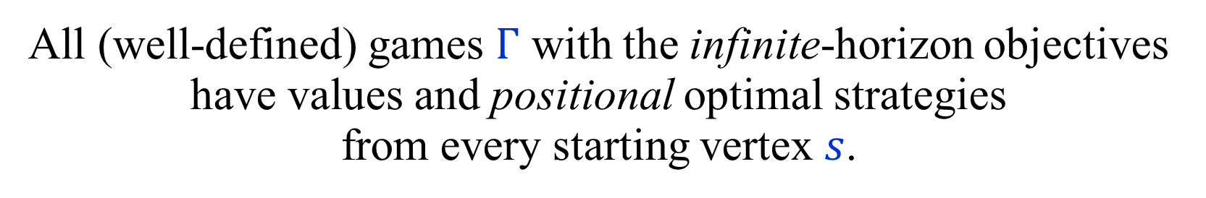
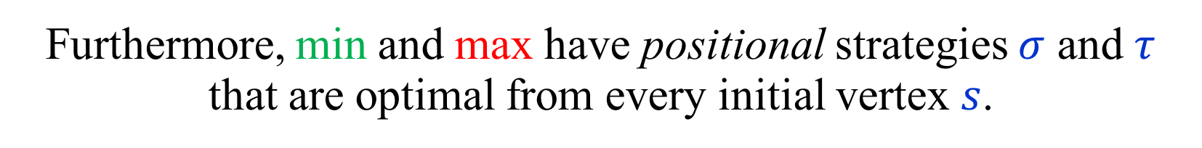
Values and optimal strategies
Theorem:
All (well-defined) games $Γ$ with the infinite-horizon objectives have values and positional optimal strategies
from every starting vertex $s$.
$${Val}_{OBJ}\left(Γ,s\right)=\max_{τ pos}{\inf_{σ} Val_{OBJ}^{σ,τ}\left(Γ,s\right)}=\min_{σ pos}{\sup_{τ}{ Val_{OBJ}^{σ,τ}\left(Γ,s\right)}}$$
Furthermore, min and max have positional strategies $σ$ and $τ$
that are optimal from every initial vertex $s$.
Games with a finite-horizon objective also have values,
but the optimal strategies may be time-dependent.

Slide 15
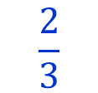

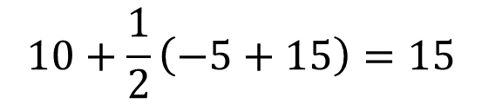

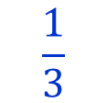



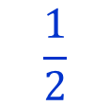




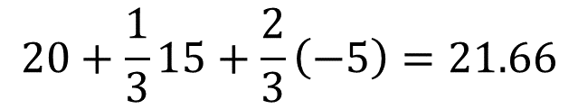



Finite games have values
(Finite number of states and finite horizon)
Game tree/DAG
$$10+\frac{1}{2}\left(−5+15\right)=15$$
Two steps to go
$$10$$
$$20$$
$$20+\frac{1}{3}15+\frac{2}{3}\left(−5\right)=21.66$$
$$\frac{1}{2}$$
$$\frac{2}{3}$$
$$15$$
$$\frac{1}{3}$$
$$\frac{1}{2}$$
One step to go
$$−5$$
$$−5$$
$$−5$$
$$0$$
$$15$$
$$−8$$
$$30$$
$$−5$$
Backward induction / Dynamic programming
In infinite-horizon problems we cannot start at the end…

Slide 16
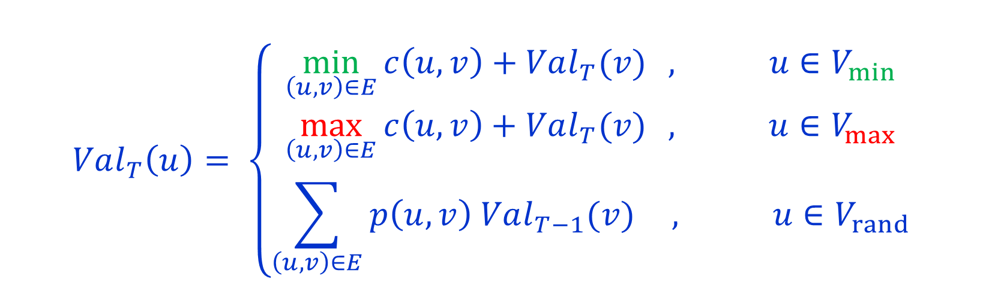
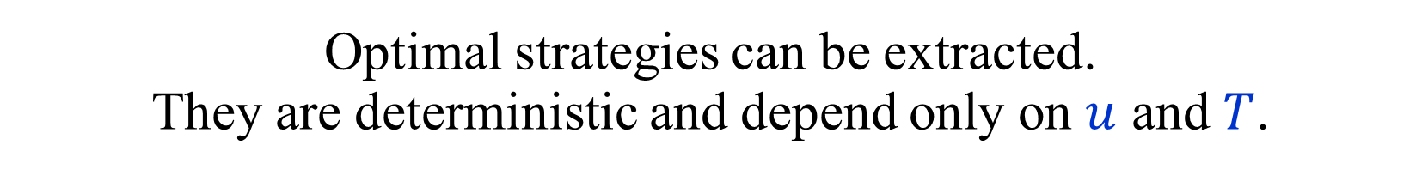

Backward induction / Dynamic programming
$Val_{T}\left(u\right)$ -- value of $u$ in a game of length $T$.
$$Val_{0}\left(u\right)=0$$
$$Val_{T}\left(u\right)= \left\{\begin{matrix}\min_{\left(u,v\right)∈E}{c\left(u,v\right)+Val_{T}(v)} , u∈V_{min} \\ \max_{\left(u,v\right)∈E}{c\left(u,v\right)+Val_{T}(v)} , u∈V_{max} \\ \sum_{\left(u,v\right)∈E}{p\left(u,v\right) Val_{T−1}(v)} , u∈V_{rand}\end{matrix}\right.$$
Optimal strategies can be extracted.
They are deterministic and depend only on $u$ and $T$.
Drawback: Running time linear in $T$.
Not polynomial if $T$ is given in binary.

Slide 17


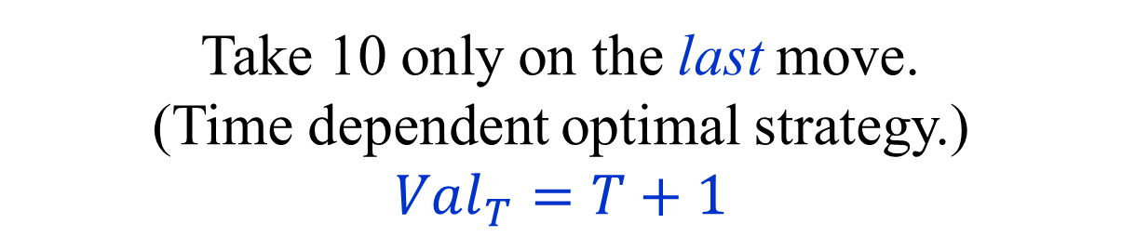

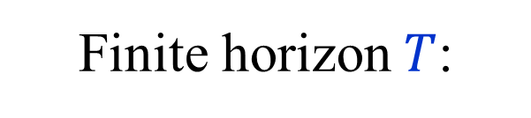

Toy example
$$10$$
$$1$$
$$0$$
Take 10 only on the last move.
(Time dependent optimal strategy.)
$$Val_{T}=T+1$$
Finite horizon $T$:
$$Val_{Tot}= +∞$$
$$Val_{Dsc_{λ}}=\max{\{ \frac{1}{1−λ} , 10 \}}$$
Infinite horizon:
$$Val_{Avg}=1$$

Slide 18

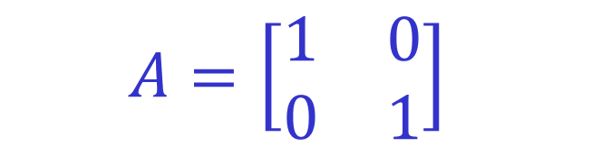


0-sum 2-player matrix games
“Matching pennies”
ROW chooses a row $i$.
$$A=\left[\begin{matrix}1 & 0 \\ 0 & 1\end{matrix}\right]$$
COLUMN chooses a column $j$.
COLUMN pays ROW $A[i,j]$.
Players move simultaneously.
$$0=\max_{i}{\min_{j}{A\left[i,j\right]}}<\min_{j}{\max_{i}{A[i,j]}=1}$$
Lower and upper values are not equal if only
pure (deterministic) strategies are considered.
But they are equal if mixed (randomized) strategies are used.
Optimal strategies of both players – choose a row or column randomly with equal probabilities. Value = ½.

Slide 19




0-sum 2-player matrix games
Randomized (mixed) strategy for ROW:
A distribution $p$ over the rows of $A$.
Randomized (mixed) strategy for COLUMN:
A distribution $q$ over the columns of $A$.
If ROW uses $p$and COLUMN uses $q$,
the expected payoff is:
$$A\left[p,q\right]=\sum_{i,j}{p_{i}q_{j}A[i,j]}=p^{T}Aq$$

Slide 20
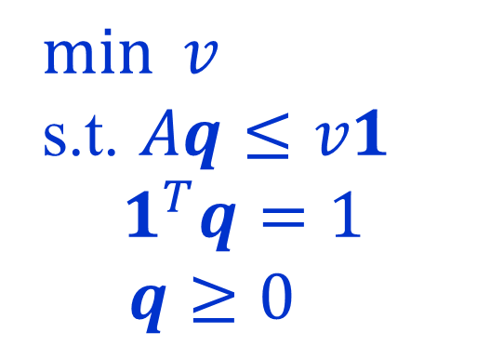

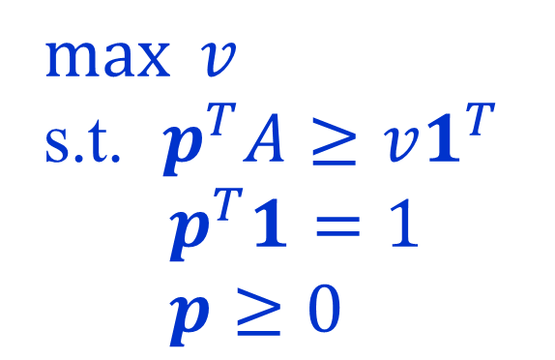
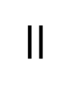
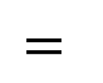

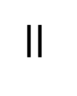

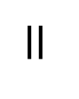
0-sum 2-player matrix games
Von Neumann’s min-max theorem (1928):
For every finite matrix $A$:
$$\max_{p}{\min_{q}{A\left[p,q\right]}} = \min_{q}{\max_{p}{A\left[p,q\right]} }$$
$$=$$
$$=$$
$$\max_{p}{\min_{j}{A\left[p,j\right]}}$$
$$\min_{q}{\max_{i}{A\left[i,q\right]}}$$
$$=$$
$$=$$
$\max{v}$
s.t. $p^{T}A≥v1^{T}$
$p^{T}1=1$
$p≥0$
$$=$$
$\min{v}$
s.t. $Aq≤v1$
$$1^{T}q=1$$
$q≥0$
LP
Duality

Slide 21
0-sum matrix games vs. TBSGs
In matrix games optimal strategies are, in general, randomized.
In TBSGs, there are always deterministic optimal strategies.
Why? What’s the difference?
In matrix games both players play simultaneously.
A player has to choose an action/strategy without knowing which action was chosen by the other player.
Matrix games are not perfect-information games.
Turn-based games are perfect-information games,
even if they are stochastic.

Slide 22
0-sum games as matrix games
Any 0-sum game can be viewed as a 0-sum matrix game,
with a huge, or possibly infinite matrix.
Strategies of player 2
The
“strategic form”
of the game.
Strategies
of player 1
outcomes
The min-max theorem, in its full generality,
holds only for finite matrices.
Thus, it cannot be used to prove that “our” games
have values and optimal strategies.

Slide 23








The “big-match”
[Gillette (1957)] [Blackwell-Ferguson (1968)]
Player 2
A repeated version
of matching pennies.
$$1$$
$$0$$
$$0$$
$$1$$
When player 1 chooses 1,
the choices of the players
are repeated for ever.
$$0$$
Player 1
We are interested in the
limiting average reward.
$$1$$
Does the game have a value?
Do the players have
optimal strategies?
$$0$$
$$1$$
Note: This is not a TBSG.

Slide 24
The “big-match”
[Gillette (1957)] [Blackwell-Ferguson (1968)]
Player 2
If player 2 flips random coins,
the outcome is ½,
no matter what player 1 does.
$$1$$
$$0$$
$$0$$
$$1$$
Can player 2 do better?
$$0$$
Player 1
Can player 1 force
an outcome of at least ½ ?
$$1$$
If player 1 flips random coins,
player 2 chooses 0s,
and the outcome is 0.
$$0$$
$$1$$
What should player 1 do?

Slide 25
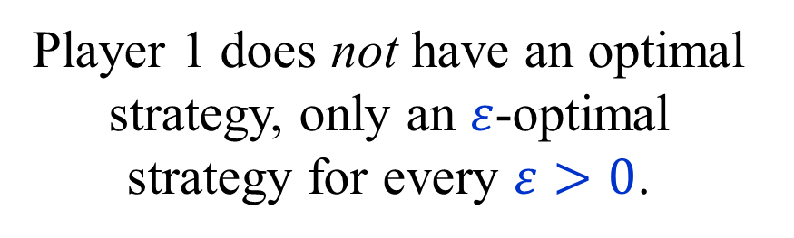
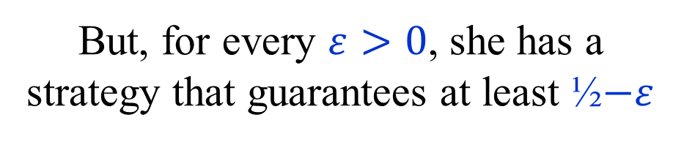
The “big-match”
[Gillette (1957)] [Blackwell-Ferguson (1968)]
Player 2
Player 1 has no strategy that guarantees a value of at least ½ .
$$1$$
$$0$$
$$0$$
$$1$$
But, for every $ε>0$, she has a strategy that guarantees at least ½$−ε$
$$0$$
Player 1
Thus, the value of the game is ½ .
$$1$$
Player 2 has an optimal strategy.
Player 1 does not have an optimal strategy, only an $ε$-optimal strategy for every $ε>0$.
$$0$$
$$1$$

Slide 26
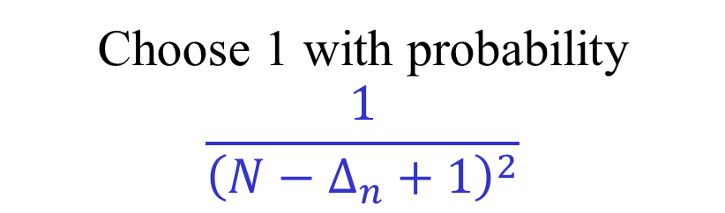
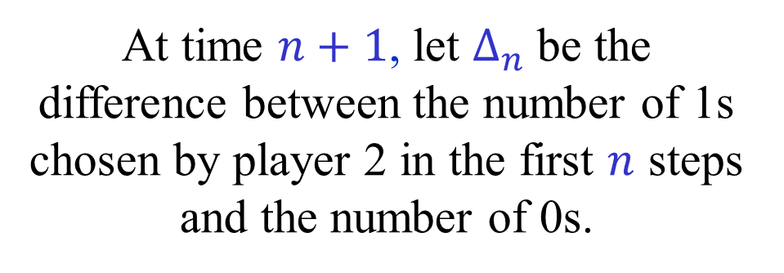
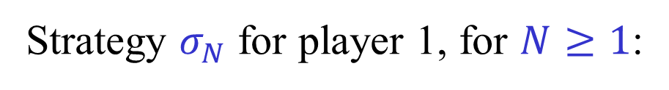
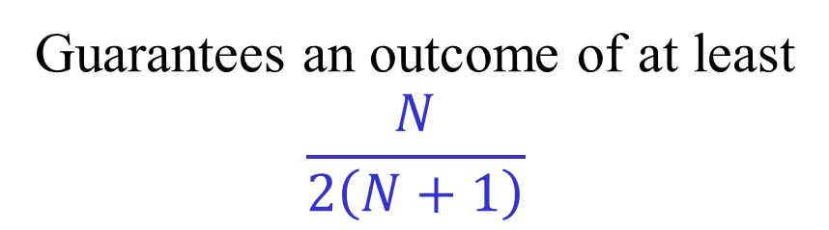
The “big-match”
[Gillette (1957)] [Blackwell-Ferguson (1968)]
Player 2
Strategy $σ_{N}$ for player 1, for $N≥1$:
$$1$$
$$0$$
At time $n+1$, let $Δ_{n}$ be the difference between the number of 1s chosen by player 2 in the first $n$ steps and the number of 0s.
$$0$$
$$1$$
$$0$$
Player 1
$$1$$
Choose 1 with probability
$$\frac{1}{{\left(N−Δ_{n}+1\right)}^{2}}$$
Guarantees an outcome of at least
$$\frac{N}{2\left(N+1\right)}$$
$$0$$
$$1$$

Slide 27
Why are TBSG interesting?
Intrinsically interesting…
Model long term planning in adversarial and/or
stochastic environments. Applications in AI and OR.
Applications in automatic verification
and automata theory.
Competitive versions of
well-known optimization problems.
Perhaps the simplest combinatorial problems
in NP ∩ co-NP not known to be in P.
Many intriguing open problems.

Slide 28
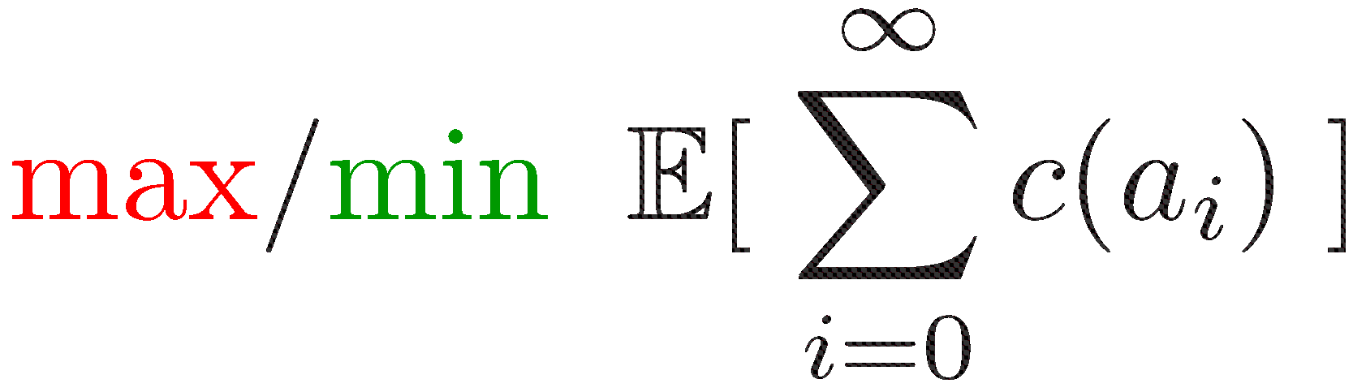


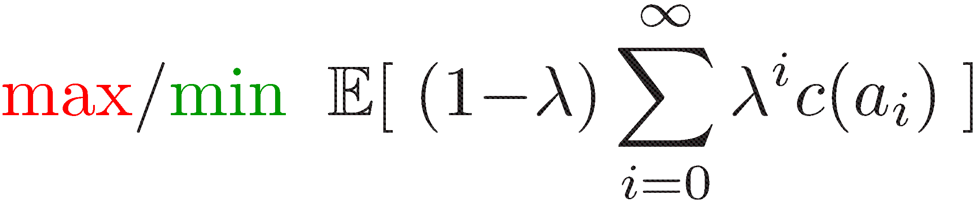
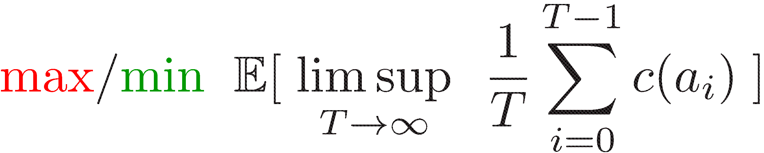
Markov Decision Processes
[Bellman ’57] [Howard ’60] …
1-player games
Total cost
Discounted cost
Limiting average cost
Optimal positional strategies can be found using LP.
Is there a strongly polynomial time algorithm?

Slide 29




Stochastic shortest paths (SSPs)
Minimize the expected cost
of getting to the target.

Slide 30
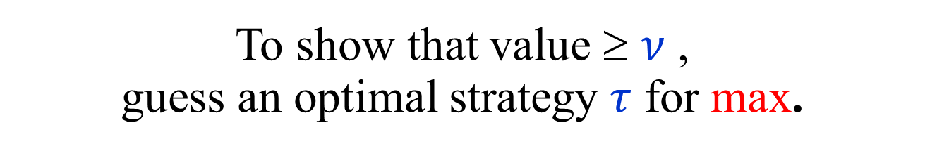
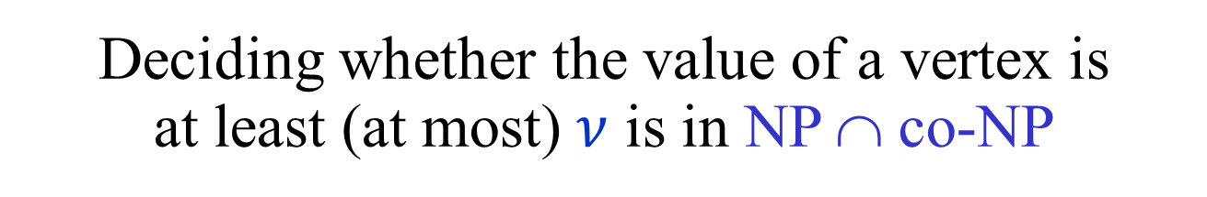
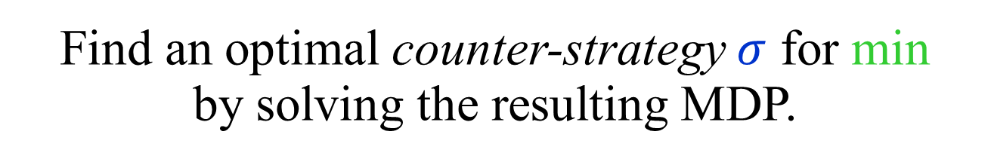
TBSG ∈ NP ∩ co-NP
Deciding whether the value of a vertex is
at least (at most) $ν$ is in NP ∩ co-NP
To show that value ≥ $ν$ ,
guess an optimal strategy $τ$ for max.
Find an optimal counter-strategy $σ$ for min
by solving the resulting MDP.
Is the problem in P ?
Cannot be NP-hard, unless NP = co-NP

Slide 31
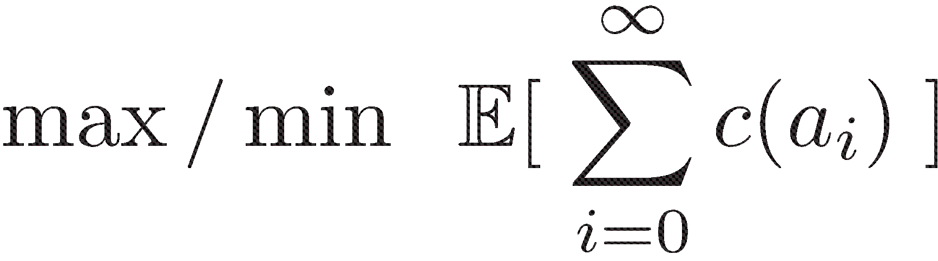
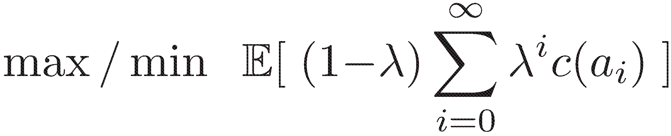
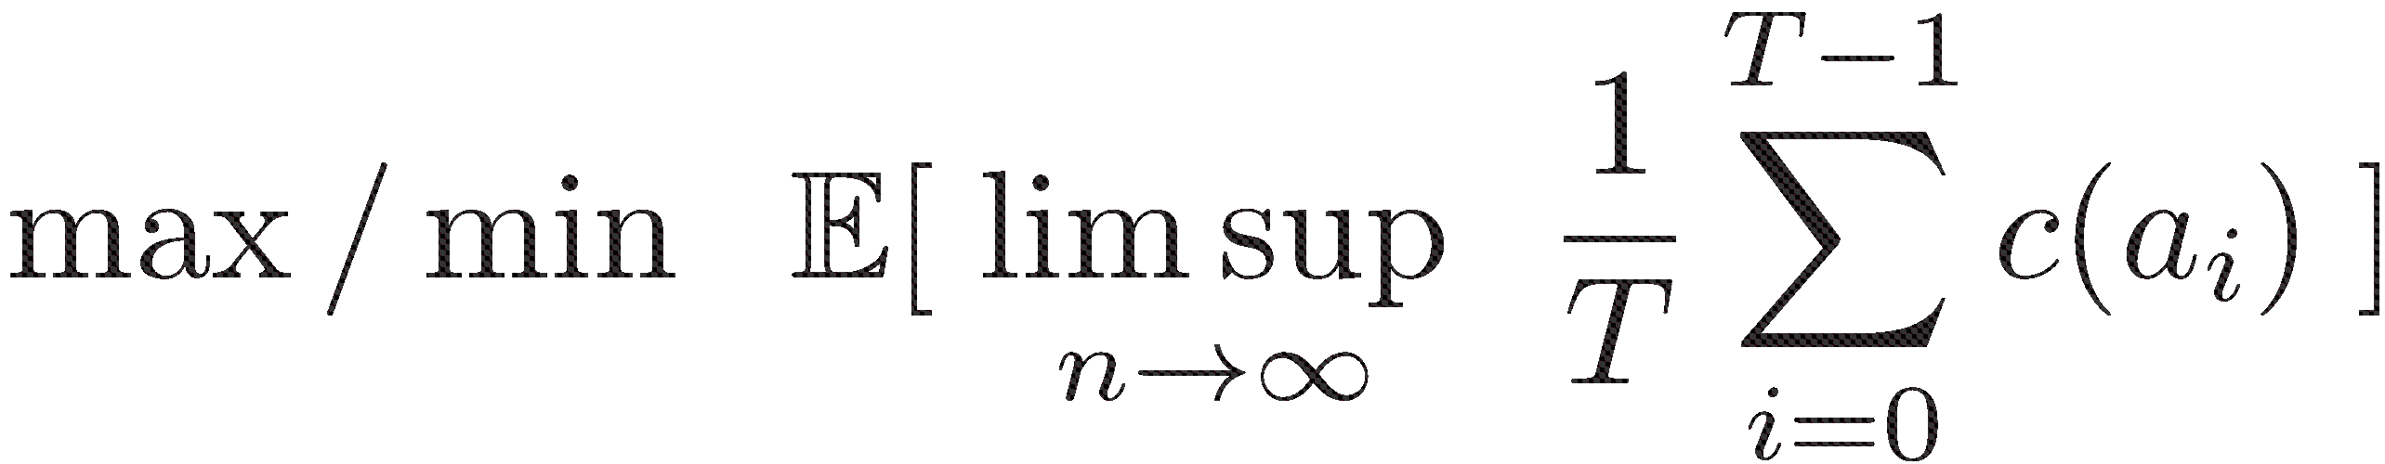
Turn-based non-Stochastic Games
[Ehrenfeucht-Mycielski (1979)] …
Total cost
Mean Payoff Games
(MPGs)
Discounted cost
Limiting average cost
Still no polynomial time algorithms known!
(The stochasticity is not the only problem.)

Slide 32





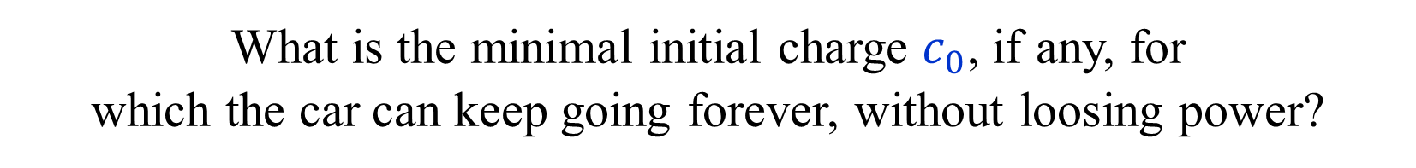
Energy Games (EGs)
$$3$$
$$−10$$
$$−5$$
$$7$$
The token is an electric car with
a battery whose initial charge is $c_{0}$.
The weight of an edge is the charge gained by using the edge.
What is the minimal initial charge $c_{0}$, if any, for
which the car can keep going forever, without loosing power?

Slide 33
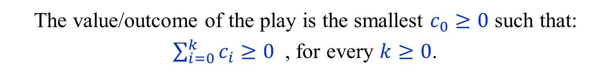
Energy Games (EGs)
Played on the same arenas as MPGs.
A play generates a sequence $c_{1},c_{2},…$ of edge costs.
The value/outcome of the play is the smallest $c_{0}≥0$ such that:
$\sum_{i=0}^{k}{c_{i}}≥0$ , for every $k≥0$.
$c_{0}=ENG\left(c_{i}\right)= −\inf_{k≥0}{\sum_{i=0}^{k}{c_{i}}}≥0$
The token is an electric car with a battery whose initial charge is $c_{0}$.
$c\left(u,v\right)$ is the charge gained by traversing $\left(u,v\right)$.
The game ends, and player 0 looses, if charge $<0$.
${Val}_{ENG}\left(u\right)$ - minimal initial charge required at $u$ to survive forever.
Values exists, positional optimal strategies, …

Slide 34
Parity Games (PGs)
A simple example
Priorities
2
3
2
1
4
1
EVEN wins if largest priority
seen infinitely often is even

Slide 35
Parity Games (PGs)
3
8
EVEN
ODD
EVEN wins if largest priority
seen infinitely often is even
Equivalent to many interesting problems
in automata and verification:
Non-emptyness of ω-tree automata
modal μ-calculus model checking

Slide 36
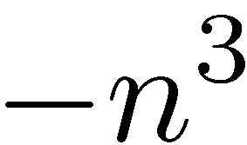
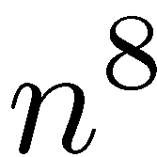
Parity Games (PGs)
Mean Payoff Games (MPGs)
[Stirling (1993)] [Puri (1995)]
8
3
EVEN
ODD
Replace priority $k$ by payoff ${\left(−n\right)}^{k}$.
Move payoffs to outgoing edges.
A cycle is positive iff its highest priority is even.

Slide 37
(A)USOs of 5-cubes
Slide taken from a presentation by Tibor Szabó.

Slide 38
Main goals
Prove the existence of optimal positional strategies.
Design algorithms, as efficient as possible,
for finding values and optimal strategies.
Some of the algorithms used in the existence proofs.
Major open problem:
Is there a polynomial time algorithm for solving
TBSGs, MPGs, EGs, PGs ?

Slide 39
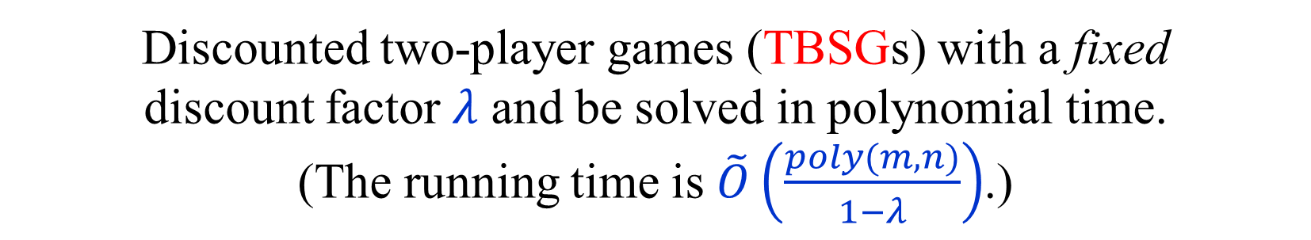
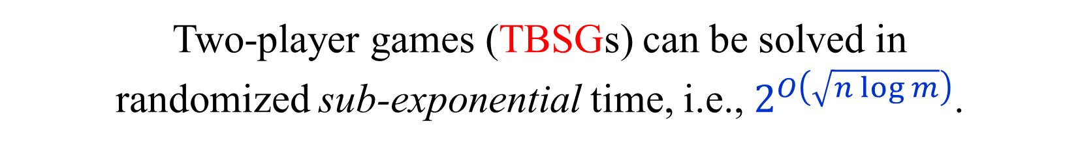
Known results
One-player stochastic games (MDPs) can be solved
in polynomial time using linear programming.
Discounted two-player games (TBSGs) with a fixed
discount factor $λ$ and be solved in polynomial time.
(The running time is $\tilde{O}\left(\frac{poly(m,n)}{1−λ}\right)$.)
Two-player games (TBSGs) can be solved in
randomized sub-exponential time, i.e., $2^{O\left(\sqrt{n log m}\right)}$.
PGs can be solves in quasi-polynomial time, i.e., $n^{O\left(\log{n}\right)}$.
Decision problem for two-player games (TBSGs)
is in NP ∩ co-NP and in CLS ⊆ PLS ∩ PPAD.

Slide 40
One-player Games
(MDPs)

Slide 41
Total cost MDPs
with the stopping condition
We start with one-player games, i.e.,
MDPs, with the total cost objective.
Discounted cost is a special case.
Limited average cost can be solved using
similar, but more complicated, techniques.
To make the total cost well defined we assume:
Stopping condition:
For every strategy of the player,
the game ends with probability 1.

Slide 42

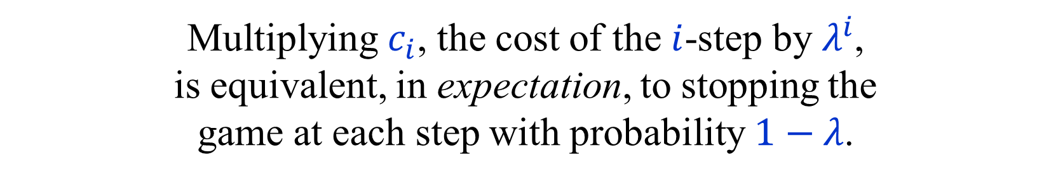




Discounted cost → Total cost
$$p_{1}$$
$${λp}_{1}$$
$$p_{2}$$
$${λp}_{2}$$
$$1−λ$$
Multiplying $c_{i}$, the cost of the $i$-step by $λ^{i}$,
is equivalent, in expectation, to stopping the
game at each step with probability $1−λ$.
The resulting game is stopping.

Slide 43
Limiting average → Discounted cost
$${Disc}_{λ}\left(c\right) \underset{→}{λ→1 } Total(c)$$
$$\left(1−λ\right){Disc}_{λ}(c) \underset{→}{λ→1 } LimAvg(c)$$
This can be used, in principle, to convert
algorithms for the discounted case to
algorithms for the limiting average case.
Usually means that we have to work with
pairs of values: “gains” and “biases”.
Total cost is simpler.

Slide 44
MDP terminology
$S$ – set of states (vertices).
$A_{i}$ – set of actions from state $i$.
$c_{a}$ – cost of action $a$.
$p_{a,j}$ – probability of moving to $j$ after action $a$.
$\sum_{j∈S}{p_{a,j}}≤1$ , for every $a∈A=⨃_{i∈S}{A_{i}}$.
With probability $1−\sum_{j∈S}{p_{a,j}}$, the game ends.
(The sink is not considered to be a state.)
(min) player $≡$ controller
strategy $≡$ policy

Slide 45
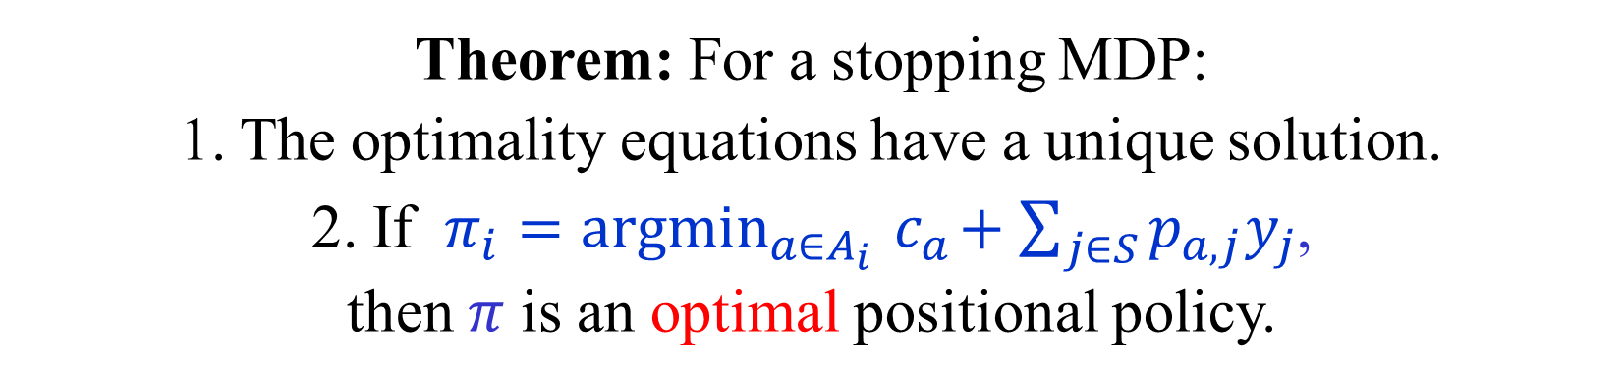
Optimality equations for MDPs
$y_{i} = \min_{a∈A_{i}}{c_{a}+\sum_{j∈S}{p_{a,j}y_{j}}}$ , $i∈S$
Theorem: For a stopping MDP:
1. The optimality equations have a unique solution.
2. If $π_{i}=argmin_{a∈A_{i}}{ c}_{a}+\sum_{j∈S}{p_{a,j}y_{j}}$,
then $π$ is an optimal positional policy.
A policy $π$ is optimal if for every other policy $π′$,
$y_{i}^{π} = Val_{TOT}^{π}\left(Γ,i\right) ≤ Val_{TOT}^{π′}\left(Γ,i\right)$ , $i∈S$

Slide 46


Evaluating a policy
Let $π$ be a positional policy of a stopping MDP.
Then, the values $y_{i}^{π}$ under $π$ are the unique solution
of the following system of linear equations:
$y_{i}^{π} = c_{π_{i}}+\sum_{j∈S}{p_{π_{i},j}y_{j}^{π}}$, $i∈S$
In matrix notation:
$$y^{π}={\left(I−P^{π}\right)}^{−1}c^{π}$$
Claim: ${\left(I−P^{π}\right)}^{−1}=\sum_{i≥0}{{\left(P^{π}\right)}^{i}}$.
(Convergence implied by the stopping condition.)
In particular, all entries of ${\left(I−P^{π}\right)}^{−1}$ are non-negative.

Slide 47

Dual LP formulation
for total cost MDPs
[d’Epenoux (1964)]
Claim: For stopping MDPs, LP has an optimal solution
which satisfies the optimality equations.

Slide 48


Primal LP formulation
for total cost MDPs
[d’Epenoux (1964)]

Slide 49



Improving a policy
Let $π$ be a positional policy of a stopping MDP.
Action $a∈A_{i}$ improves $π$ (or is an improving switch) iff
$$c_{a}+\sum_{j∈S}{p_{a.j}y_{j}^{π}} < y_{i}^{π}$$
Taking $a$ once from $i$, and then continuing
with $π$ yields a better result.
Let $π^{a}$ be the policy obtained by letting ${\left(π^{a}\right)}_{i}=a$.
Claim: If $a$ improves $π$, then $y_{i}^{π^{a}}<y_{i}^{π}$,
and $y_{j}^{π^{a}}≤y_{j}^{π}$, for every $j∈S$.
Corresponds to a pivoting step on the primal LP.

Slide 50













Improving switch
Corresponds to a pivoting step on the primal LP.

Slide 51
Best Improving Switches
“Best” improving switch from state $i$.
The single best improving switch from all states corresponds to Dantzig’s pivoting rule on the LP.

Slide 52


No improvement → Optimality
Action $a∈A_{i}$ improves $π$ iff
$$c_{a}+\sum_{j∈S}{p_{a.j}y_{j}^{π}} < y_{i}^{π}$$
If $π$ cannot be improved,
then $π$ satisfies the optimality equations,
and is hence optimal.

Slide 53


Multiple improving switches
Let $π$ be a positional policy of a stopping MDP.
Suppose that $a_{1},a_{2},…,a_{k}$ improve $π$,
and belong to different states $i_{1},i_{2},…,i_{k}$.
Let $π^{′}=π^{\left\{a_{1},a_{2},…,a_{k}\right\}}$
Claim: $y_{i}^{π^{′}}<y_{i}^{π}$ , $i∈\{i_{1},i_{2},…,i_{k}\}$,
$y_{j}^{π^{′}}≤y_{j}^{π}$ , for every $j∈S$.
More switches not necessarily better than fewer switches.
Simultaneous improvement is a special feature of MDPs.
Cannot be done on general LPs.

Slide 54


Policy iteration for MDPs [Howard ’60]
Let $π^{0}$ be a positional policy of a stopping MDP.
If there are switches that improve $π^{k}$,
then perform some of them,
possibly the best switch from each state,
to obtain the next policy $π^{k+1}$.
If there are no improving switches, $π^{k}$ is optimal.
We obtain a monotone sequence:
$$π^{0}≺π^{1}≺…≺π^{k}$$
As there is only a finite number of positional policies,
the algorithm must terminate with an optimal policy.

Slide 55


Modified costs
Let $z:S→ℝ$ be an arbitrary function.
Define modified costs as follows:
${c_{a}^{′}= c}_{a}−z_{i}+\sum_{j∈S}{p_{a,j}z_{j}}$
Lemma: For every (general) policy $π$:
${\left(y^{′}\right)}_{i}^{π}=y_{i}^{π} −z_{i}$ , $i∈S$
(Where ${\left(y^{′}\right)}_{i}^{π}$ is the value with cost function $c_{a}^{′}$.)
Similar to modified costs used by the simplex algorithm.
Used in shortest paths algorithms as:
$$c_{\left(i,j\right)}^{′}=c_{\left(i,j\right)}+z_{i}−z_{j}$$

Slide 56
Optimality equation → Optimality
Let $y_{i}$ be a solution of the optimality equations.
Let $π_{i}=argmin_{a∈A_{i}}{ c}_{a}+\sum_{j∈S}{p_{a,j}y_{j}}$,
Define modified costs with respect to $y_{i}$
${c_{a}^{′}= c}_{a}−y_{i}+\sum_{j∈S}{p_{a,j}y_{j}}$
By the optimality equations:
$c_{a}^{′}≥0$ , $a∈A$
$c_{π_{i}}^{′}=0$ , $i∈S$
Thus $y_{i}^{π}=0$, and $π$ is clearly optimal.

Slide 57
Back to
Two-player Games
(TBSGs)

Slide 58

Optimality equations for TBSGs
$y_{i} = \min_{a∈A_{i}}{c_{a}+\sum_{j∈S}{p_{a,j}y_{j}}}$ , $i∈S_{0}$
$y_{i} = \max_{a∈A_{i}}{c_{a}+\sum_{j∈S}{p_{a,j}y_{j}}}$ , $i∈S_{1}$
Theorem: For a stopping TBSG:
1. The optimality equations have a unique solution.
2. If $σ_{i}=argmin_{a∈A_{i}}{ c}_{a}+\sum_{j∈S}{p_{a,j}y_{j}}$ , $i∈S_{0}$
and $τ_{i}=argmax_{a∈A_{i}}{ c}_{a}+\sum_{j∈S}{p_{a,j}y_{j}}$ , $i∈S_{1}$
then $σ$ and $τ$ are optimal strategies for the two players.
How do we solve the optimality equations?
LP does not work…
Can still use some form of policy iteration.

Slide 59


Strategy improvement
Let $σ$ be a positional strategy for min.
Let $τ$ be the optimal counter-strategy to $σ$ for max.
Let $σ^{′}$ be a strategy obtained by performing
improving switches on $σ$, keeping $τ$ unchanged.
Let $τ′$ be the optimal counter-strategy to $σ′$ for max.
Lemma: $y^{σ^{′},τ^{′}}≺ y^{σ,τ}$
Proof: Consider $π=\left(σ,τ\right)$ as a policy in a 1-player min game.
As $τ$ is optimal for max, all switches are improving for min.
Thus $π^{′}=\left(σ^{′},τ^{′}\right)$ is obtained from $π=\left(σ,τ\right)$
via improving switches, hence $y^{π^{′}}<y^{π}$.

Slide 60
Positional optimal strategies
The termination of the strategy iteration algorithm
proves that the optimality equations have a solution.
As in MDPs, we can “read” a pair of positional
strategies that give the corresponding values.
Using the values to modify the costs, we see that
no general strategy can possibly do any better.

Slide 61

Complexity of Strategy Improvement
The Policy Iteration (PI) / Strategy Improvement (SI)
work very well in practice.
They are families of algorithms, as we need to specify
which improving switches to perform.
Perhaps the most natural is Howard’s original version:
Switch-All: choose the best switch from each state.
Switch-All is polynomial for discounted TBSGs.
Number of iterations is $\tilde{O}\left(\frac{m}{1−λ}\right).$
Switch-All is exponential even for MDPs.
A randomized variant has a sub-exponential running time.

Slide 62
END of
LECTURE 1

