Slide 1
Algorithms in Action
Haim Kaplan, Uri Zwick
Tel Aviv University
March 2017
Last updated: March 15, 2017

Slide 2
Course objective
Present elegant, powerful and influential algorithmic ideas that are not fully covered in other courses.
The algorithms should have an interesting theory behind them, as well as practical impact.
Our point of view is theoretic.

Slide 3
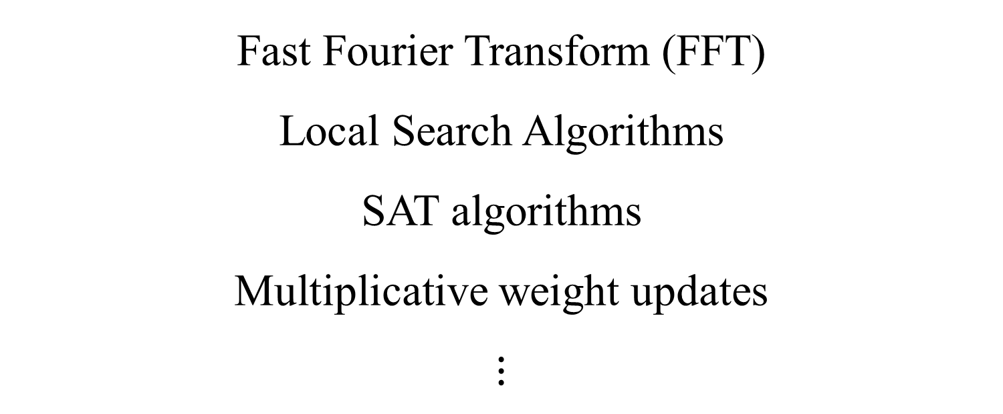
Tentative list of subjects
Fast Fourier Transform (FFT)
Local Search Algorithms
SAT algorithms
Multiplicative weight updates
$$⋮$$

Slide 4
Fast Fourier Transform
Fast computation of the Discrete Fourier Transform
Applications in Signal Processing
Multiplying polynomials
Multiplying integers
String matching problems

Slide 5
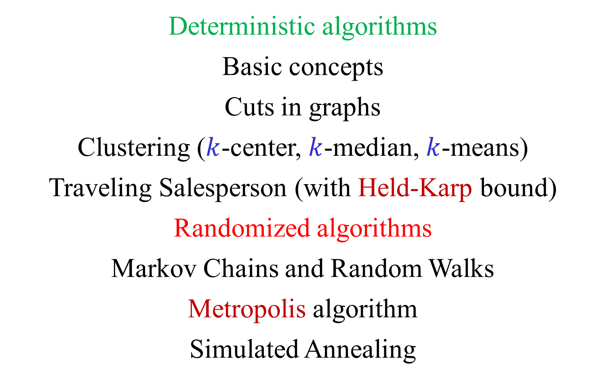
Local Search Algorithms
Deterministic algorithms
Basic concepts
Cuts in graphs
Clustering ($k$-center, $k$-median, $k$-means)
Traveling Salesperson (with Held-Karp bound)
Randomized algorithms
Markov Chains and Random Walks
Metropolis algorithm
Simulated Annealing

Slide 6
SAT algorithms
Random Walk (Schöning’s algorithm)
Resolution
Conflict Driven Clause Learning (CDCL)

Slide 7
Multiplicative weight updates
Predicting using “expert” advise
Applications in learning
Applications in optimization
Approximating Linear Programs
Approximating Semidefinite Programs
An approximation algorithm for MAX CUT

Slide 8
Administration
Up to 6 theoretical homework assignments.
Homework = about 20% of final grade
Final exam = about 80% of final grade
Exam: 15/06/16 , 04/09/16
Haim Kaplan haimk@post.tau.ac.il
Uri Zwick zwick@tau.ac.il
www.cs.tau.ac.il/~zwick/ALG-ACT-2016.html

