Slide 1
Algorithms in Action
Fast Fourier Transform
Haim Kaplan, Uri Zwick
Tel Aviv University
March 2016
Last updated: March 16, 2016

Slide 2
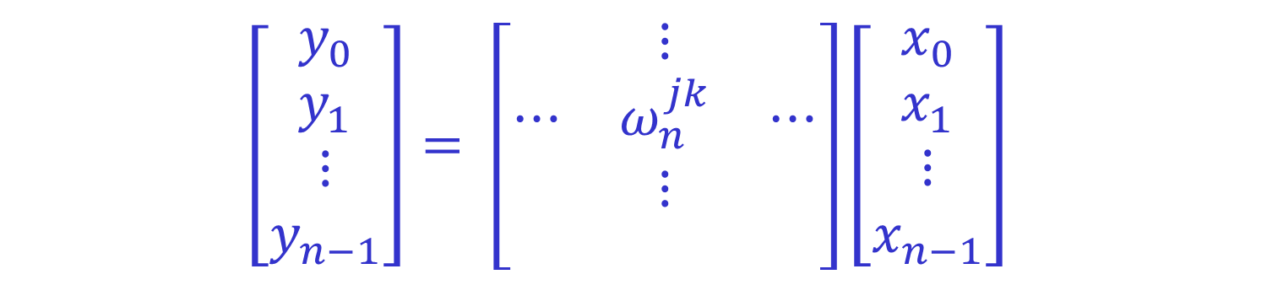
Discrete Fourier Transform (DFT)
A very special linear transformation
$$\left[\begin{matrix}y_{0} \\ y_{1} \\ \begin{matrix}⋮ \\ y_{n−1}\end{matrix}\end{matrix}\right]= \left[\begin{matrix} & ⋮ & \\ ⋯ & ω_{n}^{jk} & ⋯ \\ \begin{matrix} \\ \end{matrix} & \begin{matrix}⋮ \\ \end{matrix} & \begin{matrix} \\ \end{matrix}\end{matrix}\right]\left[\begin{matrix}x_{0} \\ x_{1} \\ \begin{matrix}⋮ \\ x_{n−1}\end{matrix}\end{matrix}\right]$$
$j$ – row index , $k$ – column index
$y_{j}=\sum_{k=0}^{n−1}{ω_{n}^{jk}x_{k}}$
$$ω =ω_{n}=e^{2πi/n}=\cos{\frac{2π}{n}}+i\sin{\frac{2π}{n}}$$
$$i=\sqrt{−1}$$

Slide 3

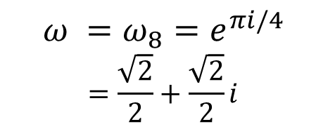
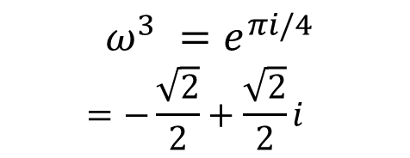
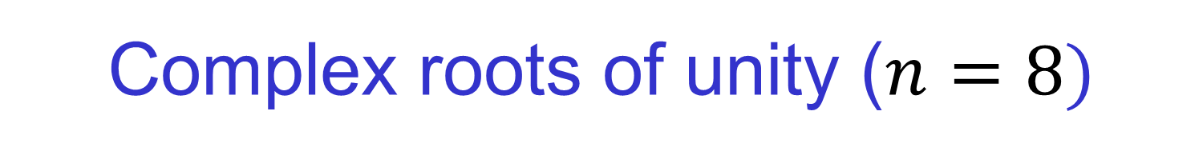





Complex roots of unity ($n=8)$
$$ω^{2}=i$$
$$ω^{3} =e^{πi/4} \\ =−\frac{\sqrt{2}}{2}+\frac{\sqrt{2}}{2}i$$
$$ω =ω_{8}=e^{πi/4} \\ =\frac{\sqrt{2}}{2}+\frac{\sqrt{2}}{2}i$$
$$ω^{4}=−1$$
$$ω^{0}=ω^{8}=1$$
$$ω^{5}$$
$$ω^{7}$$
$$ω^{4}=−i$$

Slide 4
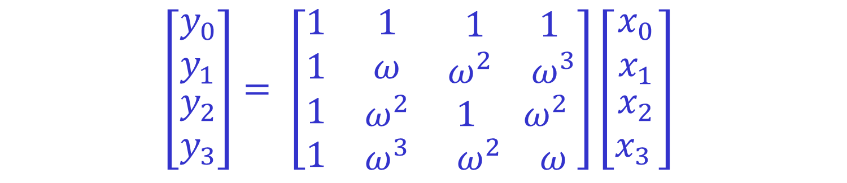
Discrete Fourier Transform (DFT)
The case $n=4$
$$\left[\begin{matrix}y_{0} \\ y_{1} \\ \begin{matrix}y_{2} \\ y_{3}\end{matrix}\end{matrix}\right]= \left[\begin{matrix}1 & 1 & \begin{matrix}1 & 1\end{matrix} \\ 1 & ω & \begin{matrix}ω^{2} & ω^{3}\end{matrix} \\ \begin{matrix}1 \\ 1\end{matrix} & \begin{matrix}ω^{2} \\ ω^{3}\end{matrix} & \begin{matrix}\begin{matrix}1 & { ω}^{2}\end{matrix} \\ \begin{matrix}ω^{2} & ω\end{matrix}\end{matrix}\end{matrix}\right]\left[\begin{matrix}x_{0} \\ x_{1} \\ \begin{matrix}x_{2} \\ x_{3 }\end{matrix}\end{matrix}\right]$$
$$ω =ω_{4}=e^{2πi/4}=i$$
In general: $ω_{n}^{k}=ω_{n}^{k mod n}$.

Slide 5

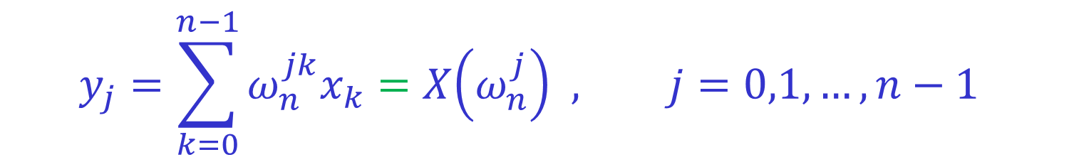
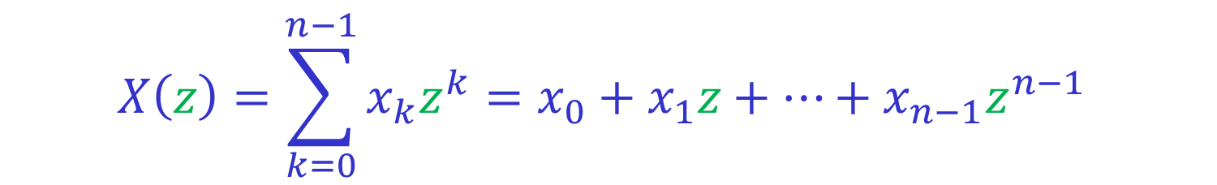
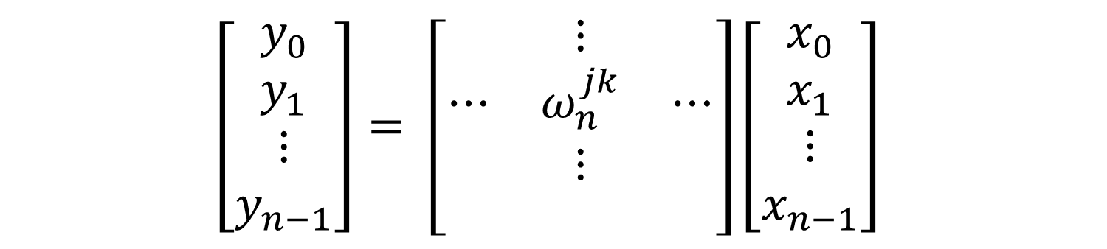
DFT as polynomial evaluation
Evaluating a polynomial at $1,ω,ω^{2},…,ω^{n−1}$
$$\left[\begin{matrix}y_{0} \\ y_{1} \\ \begin{matrix}⋮ \\ y_{n−1}\end{matrix}\end{matrix}\right]= \left[\begin{matrix} & ⋮ & \\ ⋯ & ω_{n}^{jk} & ⋯ \\ \begin{matrix} \\ \end{matrix} & \begin{matrix}⋮ \\ \end{matrix} & \begin{matrix} \\ \end{matrix}\end{matrix}\right]\left[\begin{matrix}x_{0} \\ x_{1} \\ \begin{matrix}⋮ \\ x_{n−1}\end{matrix}\end{matrix}\right]$$
“$z$-transform”
$$X\left(z\right)=\sum_{k=0}^{n−1}{x_{k}z^{k}}=x_{0}+x_{1}z+…+x_{n−1}z^{n−1}$$
$$y_{j}=\sum_{k=0}^{n−1}{ω_{n}^{jk}x_{k}}=X\left(ω_{n}^{j}\right) , j=0,1,…,n−1$$

Slide 6
Fast Fourier Transform (FFT)
FFT is an algorithm for computing DFT.
Naïve computation of DFT requires $Θ\left(n^{2}\right)$ time.
FFT computes DFT in $Θ(n\log{n)}$ time.
Developed by Cooley and Tuckey in 1965,
but similar ideas were used much earlier, e.g.,
by Runge and König in 1924 and others.
We assume that $n=2^{k}$.

Slide 7
Applications of the FFT
Digital signal processing:
Transforming signals from time to frequency domain
Computing convolutions:
Multiplication of polynomials
Multiplication of large integers
String matching problems
Quantum computing:
Used in Shor’s integer factorization algorithm
$$⋮$$

Slide 8
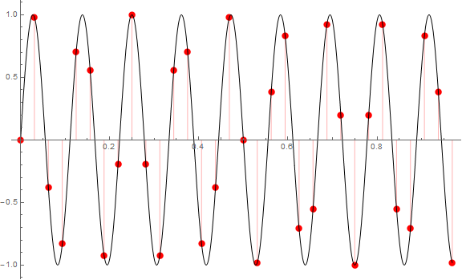

Sampling $\sin{(9\left(2πx\right))}$
Sampling rate = 32 Hz

Slide 9
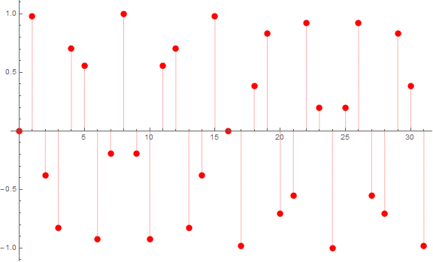
Sampling $\sin{(9\left(2πx\right))}$
Sampling rate = 32 Hz

Slide 10
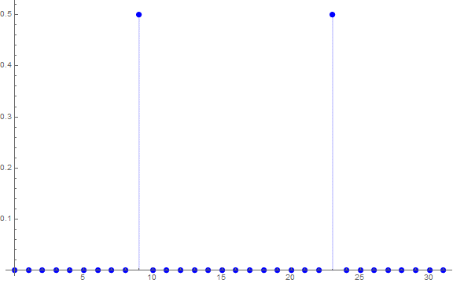

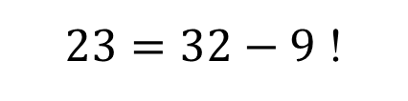
$\sin{(9\left(2πx\right))}$and its spectrum
Spectrum = absolute value
of the Fourier coefficients.
In addition to the spectrum,
we also have the phase.
9 (=9Hz) is right.
What is 23?
$23=32−9$ !

Slide 11
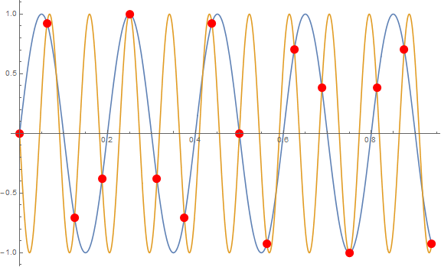
Aliasing example: $\sin\left(5\left(2πx\right)\right)$ vs. $−\sin\left(11\left(2πx\right)\right)$
Same samples at 16Hz.
$$\sin\left(2πj−x\right)=−\sin{x}$$
$$\sin\left(\left(n−f\right)2πj/n\right)=−\sin\left(f2πj/n\right)$$

Slide 12
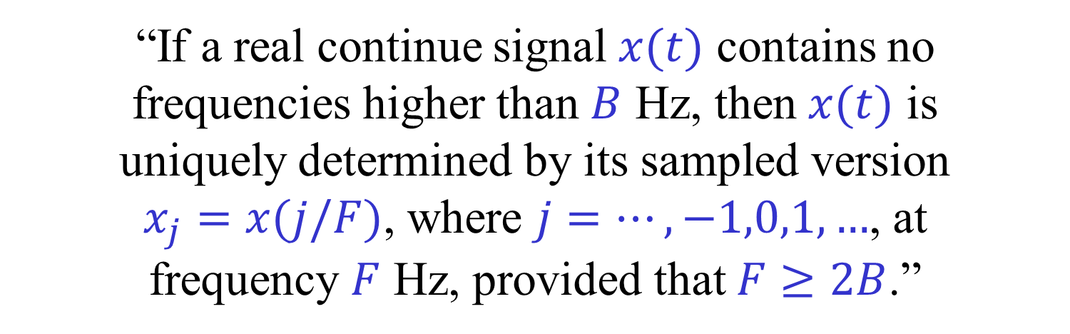
The Sampling Theorem
(Nyquist, Shannon, …)
“If a real continue signal $x(t)$ contains no
frequencies higher than $B$ Hz, then $x(t)$ is
uniquely determined by its sampled version
$x_{j}=x(j/F)$, where $j=…,−1,0,1,…$, at
frequency $F$ Hz, provided that $F≥2B$.”
For information only. Not part of this course.
We only consider finite discrete “signals”.

Slide 13
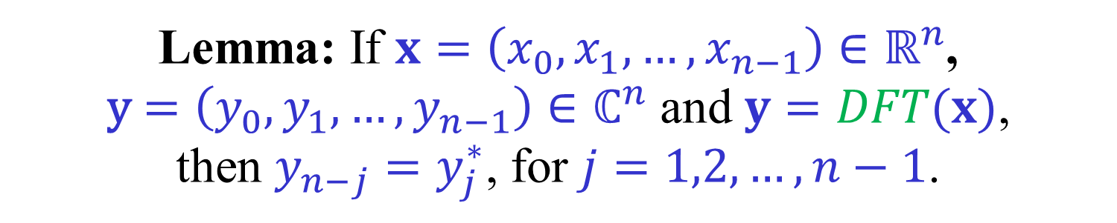
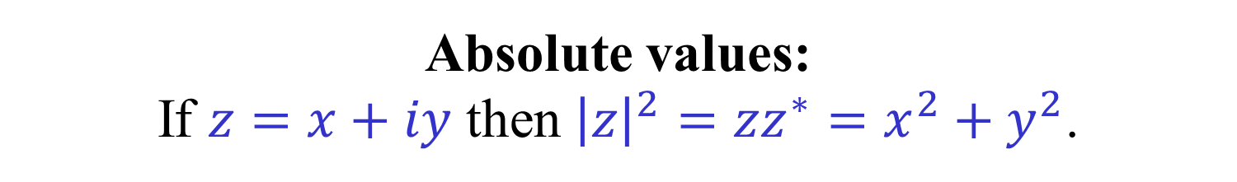

“Symmetry” of DFT for real signals
Lemma: If $x=\left(x_{0},x_{1},…,x_{n−1}\right)∈ℝ^{n}$,
y$=\left(y_{0},y_{1},…,y_{n−1}\right)∈ℂ^{n}$ and $y=DFT(x)$,
then $y_{n−j}=y_{j}^{∗}$, for $j=1,2,…,n−1$.
Complex conjugates:
If $z=x+iy$ then $z=x−iy$.
Absolute values:
If $z=x+iy$ then ${\left|z\right|}^{2}=zz^{∗}=x^{2}+y^{2}$.
Exercise: Prove the lemma.
For real inputs, the first half of the DFT
contains all the information.

Slide 14
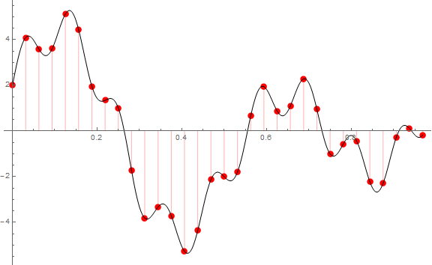
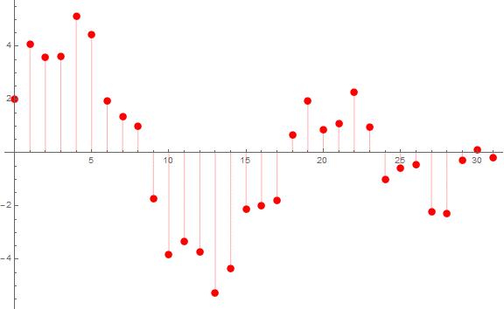
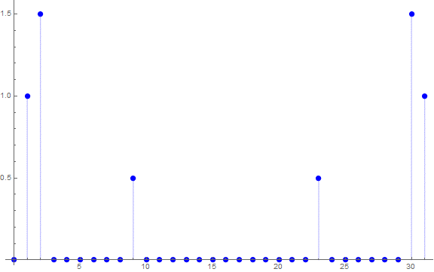
$$\sin\left(9\left(2πx\right)\right)+3 sin\left(2\left(2πx\right)\right)+2\cos\left(2πx\right)$$
Frequencies and their relative contribution correctly identified!
As we shall soon see, from the Fourier coefficients, not just their absolute values, we can reconstruct the original signal.

Slide 15
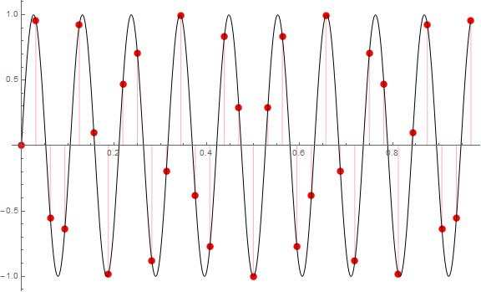
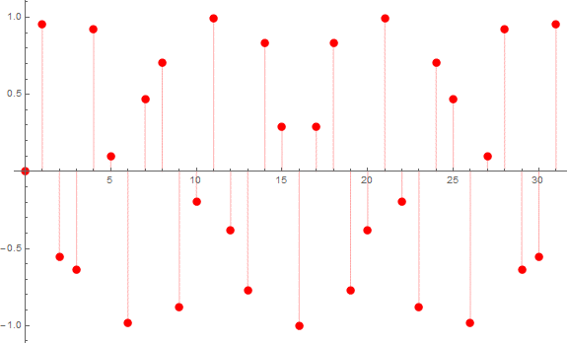
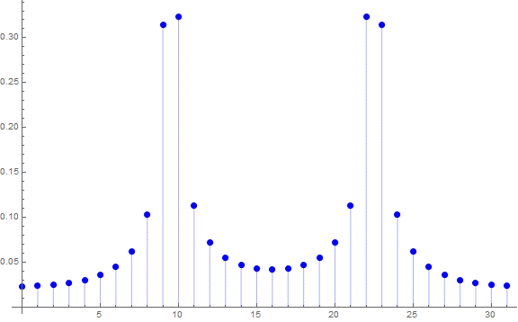
$$\sin\left(9.5\left(2πx\right)\right)$$
Basis vectors correspond
to integer frequencies.
9.5 Hz is a non-trivial
combination of basis vectors.
See below.

Slide 16
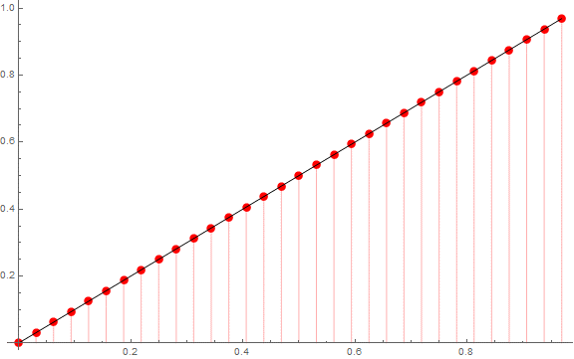
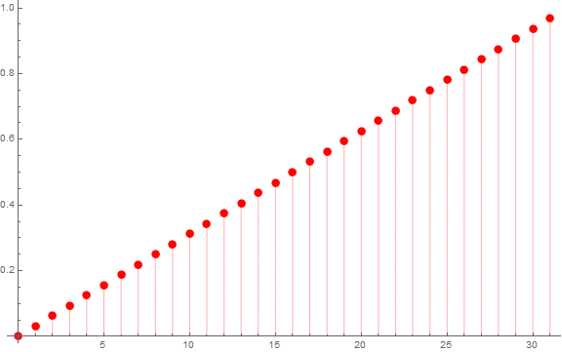
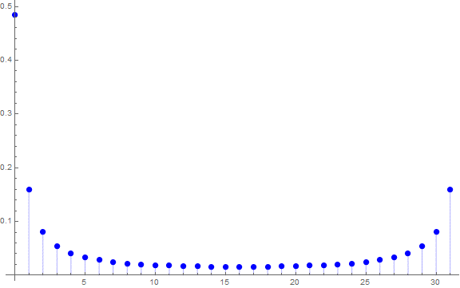
$$x$$
For more information, take
a course on digital signal processing.

Slide 17

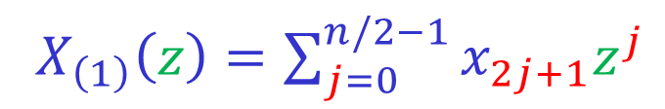


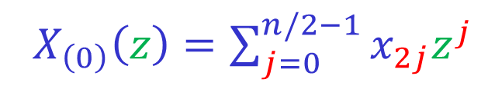


Decomposing the DFT (I)
Goal: Compute a DFT of even size $n$
by computing two DFTs of size $n/2$.
Split $x$ into even and odd parts.
$$x=\left(x_{0},x_{1},…,x_{n−1}\right)$$
$X\left(z\right)=\sum_{j=0}^{n−1}{x_{j}z^{j}}$
$$x_{(0)}=\left(x_{0},x_{2},…,x_{n−2}\right)$$
$X_{\left(0\right)}\left(z\right)=\sum_{j=0}^{n/2−1}{x_{2j}z^{j}}$
$$x_{(1)}=\left(x_{1},x_{3},…,x_{n−1}\right)$$
$X_{\left(1\right)}\left(z\right)=\sum_{j=0}^{n/2−1}{x_{2j+1}z^{j}}$
$$X\left(z\right)=X_{\left(0\right)}\left(z^{2}\right)+{z X}_{\left(1\right)}\left(z^{2}\right)$$

Slide 18

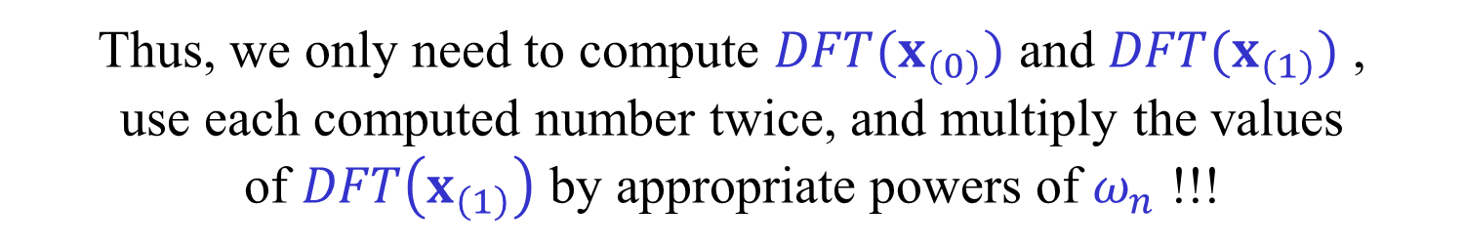

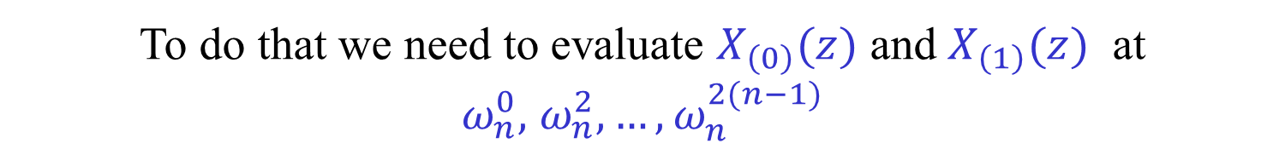
Decomposing the DFT (II)
$$X\left(z\right)=X_{\left(0\right)}\left(z^{2}\right)+{z X}_{\left(1\right)}\left(z^{2}\right)$$
We need to evaluate $X(z)$ at
$ω_{n}^{0},$ $ω_{n}^{1},…,ω_{n}^{n−1}$
To do that we need to evaluate $X_{\left(0\right)}(z)$ and $X_{\left(1\right)}(z)$ at
$ω_{n}^{0},$ $ω_{n}^{2},…,ω_{n}^{2(n−1)}$
But these $n$ points are exactly
$ω_{n/2}^{0},$ $ω_{n/2}^{1},…,ω_{n/2}^{n/2−1}$ , $ω_{n/2}^{0},$ $ω_{n/2}^{1},…,ω_{n/2}^{n/2−1}$
Thus, we only need to compute $DFT(x_{\left(0\right)})$ and $DFT(x_{\left(1\right)})$ ,
use each computed number twice, and multiply the values
of $DFT\left(x_{\left(1\right)}\right)$ by appropriate powers of $ω_{n}$ !!!

Slide 19
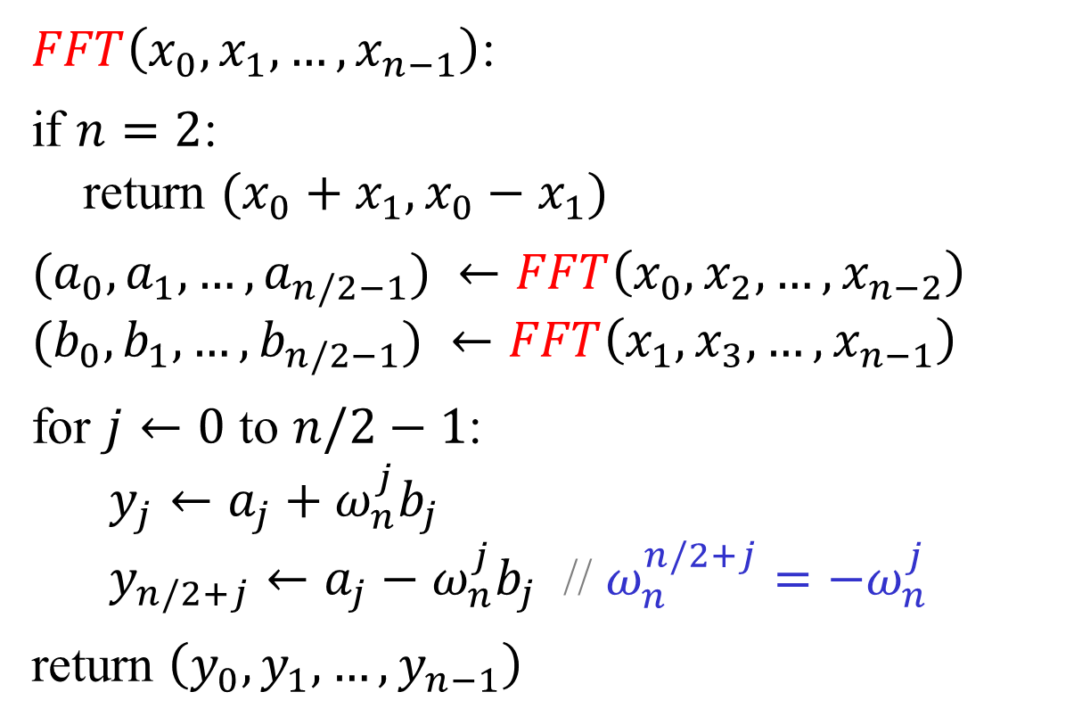
FFT – recursive version
$FFT\left(x_{0},x_{1},…,x_{n−1}\right)$:
if $n=2$:
return $(x_{0}+x_{1},x_{0}−x_{1})$
$(a_{0},a_{1},…,a_{n/2−1}) ←FFT\left(x_{0},x_{2},…,x_{n−2}\right)$
$(b_{0},b_{1},…,b_{n/2−1}) ←FFT\left(x_{1},x_{3},…,x_{n−1}\right)$
for $j←0$ to $n/2−1$:
$y_{j}←a_{j}+ω_{n}^{j}b_{j}$
$y_{n/2+j}←a_{j}−ω_{n}^{j}b_{j}$ // $ω_{n}^{n/2+j}=−ω_{n}^{j}$
return $\left(y_{0},y_{1},…,y_{n−1}\right)$

Slide 20
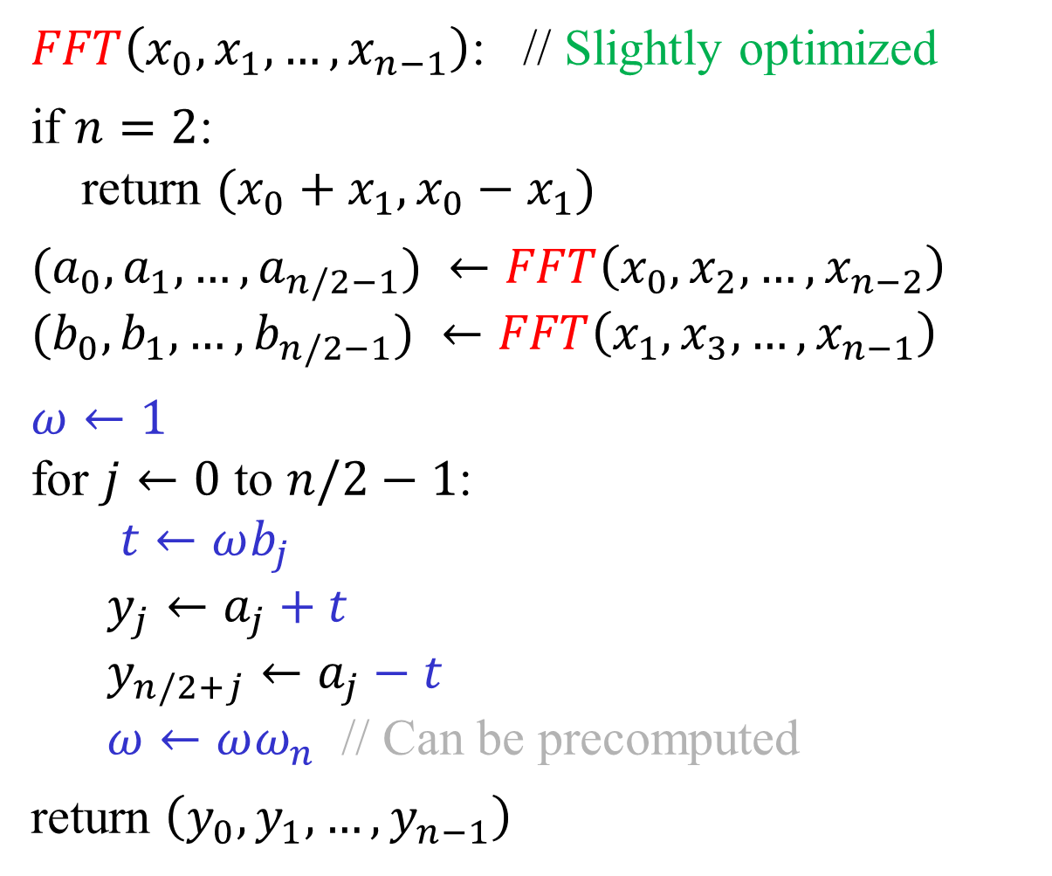
$FFT\left(x_{0},x_{1},…,x_{n−1}\right)$: // Slightly optimized
if $n=2$:
return $(x_{0}+x_{1},x_{0}−x_{1})$
$(a_{0},a_{1},…,a_{n/2−1}) ←FFT\left(x_{0},x_{2},…,x_{n−2}\right)$
$(b_{0},b_{1},…,b_{n/2−1}) ←FFT\left(x_{1},x_{3},…,x_{n−1}\right)$
$ω←1$
for $j←0$ to $n/2−1$:
$t←ωb_{j}$
$y_{j}←a_{j}+t$
$y_{n/2+j}←a_{j}−t$
$ω←ωω_{n}$ // Can be precomputed
return $\left(y_{0},y_{1},…,y_{n−1}\right)$

Slide 21






Complexity of the FFT
$T(n)$ – Cost of an FFT of size $n$.
$$T\left(n\right)=2T\left(n/2\right)+O(n)$$
$$T\left(n\right)=O(n\log{n})$$
$A(n)$ – Number of additions/subtractions in $FFT_{n}$
$M(n)$ – Number of (complex) multiplications in $FFT_{n}$
$$A\left(2\right)=2$$
$$M\left(2\right)=0$$
$$A\left(n\right)=2A\left(n/2\right)+n$$
$$M\left(n\right)=2M\left(n/2\right)+n/2$$
$$M\left(n\right)=\frac{n}{2}\log_{2}{\frac{n}{2}}$$
$$A\left(n\right)=n\log_{2}{n}$$

Slide 22










A butterfly
$$a$$
+
$$a+ωb$$
“Twiddle
factor”
$$ω$$
$$b$$
×
−
$$a−ωb$$
$$a$$
$$a+ωb$$
$$b$$
$$ω$$
$$a−ωb$$

Slide 23



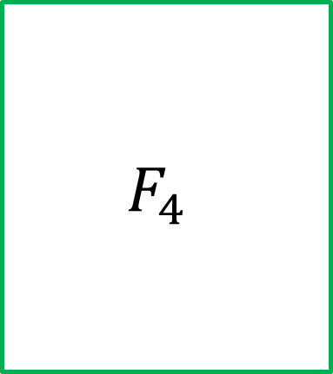




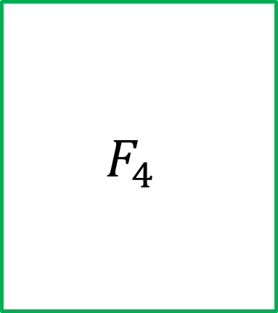













An FFT circuit
Input
permuted!
$$x_{0}$$
$$F_{4}$$
$$ω_{8}^{0}$$
$$y_{0}$$
$$x_{2}$$
$$ω_{8}^{1}$$
$$y_{1}$$
$$x_{4}$$
$$ω_{8}^{2}$$
$$y_{2}$$
$$x_{6}$$
$$ω_{8}^{3}$$
$$y_{3}$$
$$x_{1}$$
$$F_{4}$$
$$y_{4}$$
$$x_{3}$$
$$y_{5}$$
$$x_{5}$$
$$y_{6}$$
$$x_{7}$$
$$y_{7}$$

Slide 24


















An FFT circuit
Input further
permuted!
$$x_{0}$$
$$F_{2}$$
$$ω_{4}^{0}$$
$$ω_{8}^{0}$$
$$y_{0}$$
$$x_{4}$$
$$ω_{4}^{1}$$
$$ω_{8}^{1}$$
$$y_{1}$$
$$x_{2}$$
$$F_{2}$$
$$ω_{8}^{2}$$
$$y_{2}$$
$$x_{6}$$
$$ω_{8}^{3}$$
$$y_{3}$$
$$x_{1}$$
$$F_{2}$$
$$ω_{4}^{0}$$
$$y_{4}$$
$$x_{5}$$
$$ω_{4}^{1}$$
$$y_{5}$$
$$x_{3}$$
$$F_{2}$$
$$y_{6}$$
$$x_{7}$$
$$y_{7}$$

Slide 25








An FFT circuit
Input
permuted!
$$x_{0}$$
$$ω_{2}^{0}$$
$$ω_{4}^{0}$$
$$ω_{8}^{0}$$
$$y_{0}$$
$$x_{4}$$
$$ω_{4}^{1}$$
$$ω_{8}^{1}$$
$$y_{1}$$
$$x_{2}$$
$$ω_{2}^{0}$$
$$ω_{8}^{2}$$
$$y_{2}$$
$$x_{6}$$
$$ω_{8}^{3}$$
$$y_{3}$$
$$x_{1}$$
$$ω_{2}^{0}$$
$$ω_{4}^{0}$$
$$y_{4}$$
$$x_{5}$$
$$ω_{4}^{1}$$
$$y_{5}$$
$$x_{3}$$
$$ω_{2}^{0}$$
$$y_{6}$$
$$x_{7}$$
$$y_{7}$$

Slide 26




































An FFT circuit
Bit-reversal
permutation
$$x_{0}$$
$$x_{0}$$
$$ω_{2}^{0}$$
$$ω_{4}^{0}$$
$$ω_{8}^{0}$$
$$y_{0}$$
$$x_{4}$$
$$x_{1}$$
$$ω_{4}^{1}$$
$$ω_{8}^{1}$$
$$y_{1}$$
$$x_{2}$$
$$x_{2}$$
$$ω_{2}^{0}$$
$$ω_{8}^{2}$$
$$y_{2}$$
$$x_{6}$$
$$x_{3}$$
$$ω_{8}^{3}$$
$$y_{3}$$
$$x_{1}$$
$$x_{4}$$
$$ω_{2}^{0}$$
$$ω_{4}^{0}$$
$$y_{4}$$
$$x_{5}$$
$$x_{5}$$
$$ω_{4}^{1}$$
$$y_{5}$$
$$x_{3}$$
$$x_{6}$$
$$ω_{2}^{0}$$
$$y_{6}$$
$$x_{7}$$
$$x_{7}$$
$$y_{7}$$

Slide 27
An FFT circuit
Bit-reversal
permutation
$$x_{0}$$
$$x_{0}$$
$$ω_{2}^{0}$$
$$ω_{4}^{0}$$
$$y_{0}$$
$$x_{4}$$
$$x_{1}$$
$$ω_{4}^{1}$$
$$y_{1}$$
$$x_{2}$$
$$x_{2}$$
$$ω_{2}^{0}$$
$$y_{2}$$
$$x_{6}$$
$$x_{3}$$
$$y_{3}$$
$$x_{1}$$
$$x_{4}$$
$$ω_{2}^{0}$$
$$ω_{4}^{0}$$
$$y_{4}$$
$$x_{5}$$
$$x_{5}$$
$$ω_{4}^{1}$$
$$y_{5}$$
$$x_{3}$$
$$x_{6}$$
$$ω_{2}^{0}$$
$$y_{6}$$
$$x_{7}$$
$$x_{7}$$
$$y_{7}$$

Slide 28
FFT and Algorithm Engineering
In real life, constant factors matter.
A tremendous amount of work was invested
is optimizing the performance of FFT algorithms
on specific architectures.
The algorithm we saw is a radix-2 FFT.
Radix-4 and varying radices work better in practice.
A good FFT implementation should use
cache and memory cleverly, and use
parallelism if possible.

Slide 29

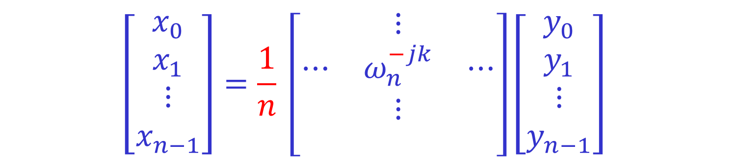
The Inverse DFT
The inverse DFT is very similar to the DFT:
$$\left[\begin{matrix}x_{0} \\ x_{1} \\ \begin{matrix}⋮ \\ x_{n−1}\end{matrix}\end{matrix}\right]=\frac{1}{n} \left[\begin{matrix} & ⋮ & \\ ⋯ & ω_{n}^{−jk} & ⋯ \\ \begin{matrix} \\ \end{matrix} & \begin{matrix}⋮ \\ \end{matrix} & \begin{matrix} \\ \end{matrix}\end{matrix}\right]\left[\begin{matrix}y_{0} \\ y_{1} \\ \begin{matrix}⋮ \\ y_{n−1}\end{matrix}\end{matrix}\right]$$
To prove it, we need show that
$$\sum_{ℓ=0}^{n−1}{ω_{n}^{jℓ}ω_{n}^{−ℓk}}= \left\{\begin{matrix} n & if j=k \\ 0 & otherwise\end{matrix}\right.$$
(Recall that if $C=AB$, then $c_{j,k}=\sum_{ℓ=0}^{n−1}{a_{j,ℓ}b_{ℓ,k}}$.)

Slide 30

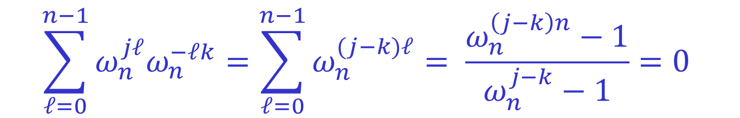
The Inverse DFT
$$\sum_{ℓ=0}^{n−1}{ω_{n}^{jℓ}ω_{n}^{−ℓk}}= \left\{\begin{matrix} n & if j=k \\ 0 & otherwise\end{matrix}\right.$$
If $j=k$, then $ω_{n}^{jℓ}ω_{n}^{−ℓk}=1$, so the claim is obvious.
If $j≠k$, then:
$$\sum_{ℓ=0}^{n−1}{ω_{n}^{jℓ}ω_{n}^{−ℓk}}=\sum_{ℓ=0}^{n−1}{ω_{n}^{(j−k)ℓ}}= \frac{ω_{n}^{\left(j−k\right)n}−1}{ω_{n}^{j−k}−1}=0$$
as $ω_{n}^{\left(j−k\right)n}={\left(ω_{n}^{n}\right)}^{j−k}=1$, while $ω_{n}^{j−k}≠1$.
(Recall that if $a≠1$, then $\sum_{ℓ=0}^{n−1}{a^{ℓ}}= \frac{a^{n}−1}{a−1}$.)

Slide 31
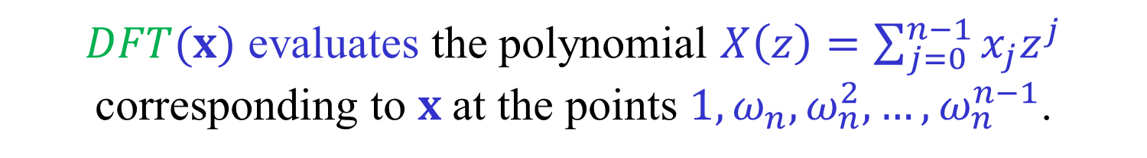

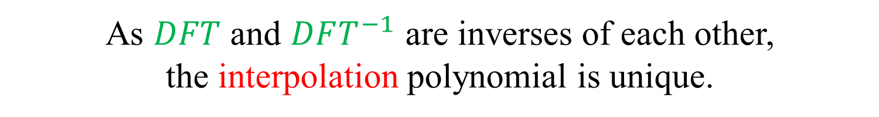
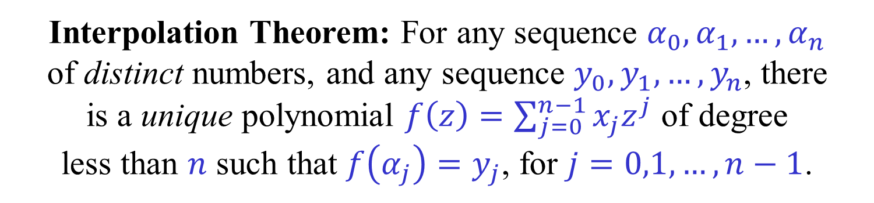
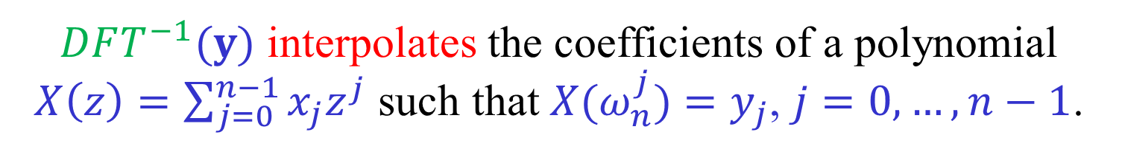
$DFT^{−1}$ as polynomial interpolation
$DFT(x)$ evaluates the polynomial $X\left(z\right)=\sum_{j=0}^{n−1}{x_{j}z^{j}}$ corresponding to $x$at the points $1,ω_{n},ω_{n}^{2},…,ω_{n}^{n−1}$.
$DFT^{−1}(y)$ interpolates the coefficients of a polynomial $X\left(z\right)=\sum_{j=0}^{n−1}{x_{j}z^{j}}$ such that $X(ω_{n}^{j})$ $=y_{j}$, $j=0,…,n−1$.
As $DFT$ and $DFT^{−1}$ are inverses of each other,
the interpolation polynomial is unique.
Interpolation Theorem: For any sequence $α_{0},α_{1},…,α_{n}$
of distinct numbers, and any sequence $y_{0},y_{1},…,y_{n}$, there
is a unique polynomial $f\left(z\right)=\sum_{j=0}^{n−1}{x_{j}z^{j}}$ of degree
less than $n$ such that $f\left(α_{j}\right)=y_{j}$, for $j=0,1,…,n−1$.

Slide 32
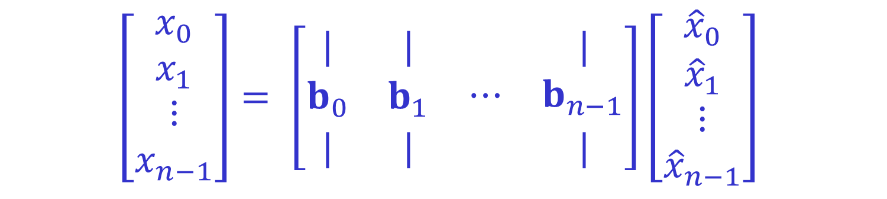
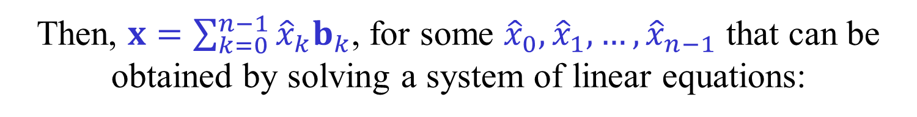
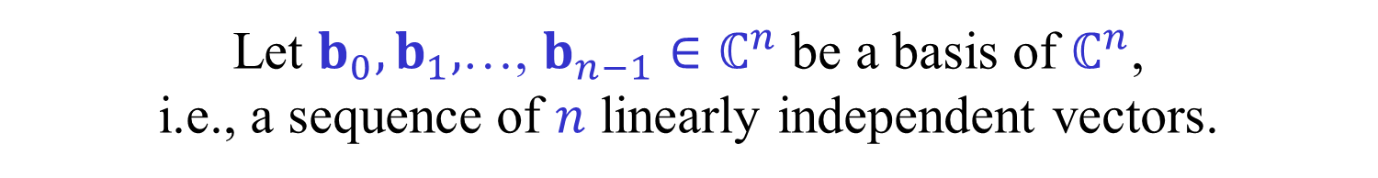
Change of basis
The standard basis of $ℂ^{n}$ is $e_{0},e_{1},$…, $e_{n−1}$.
$x={\left(x_{0},x_{1},…,x_{n−1}\right)}^{T}=\sum_{k=0}^{n−1}{x_{k}e_{k}}$
Let $b_{0},b_{1},$…, $b_{n−1}∈ℂ^{n}$ be a basis of $ℂ^{n}$,
i.e., a sequence of $n$ linearly independent vectors.
Then, $x=\sum_{k=0}^{n−1}{{\hat{x}}_{k}b_{k}}$, for some ${\hat{x}}_{0},{\hat{x}}_{1},…,{\hat{x}}_{n−1}$ that can be obtained by solving a system of linear equations:
$$\left[\begin{matrix}x_{0} \\ x_{1} \\ \begin{matrix}⋮ \\ x_{n−1}\end{matrix}\end{matrix}\right]= \left[\begin{matrix}| & | & \begin{matrix} & |\end{matrix} \\ b_{0} & b_{1} & \begin{matrix}⋯ & b_{n−1}\end{matrix} \\ | & | & \begin{matrix} & |\end{matrix}\end{matrix}\right]\left[\begin{matrix}{\hat{x}}_{0} \\ {\hat{x}}_{1} \\ \begin{matrix}⋮ \\ {\hat{x}}_{n−1}\end{matrix}\end{matrix}\right]$$

Slide 33

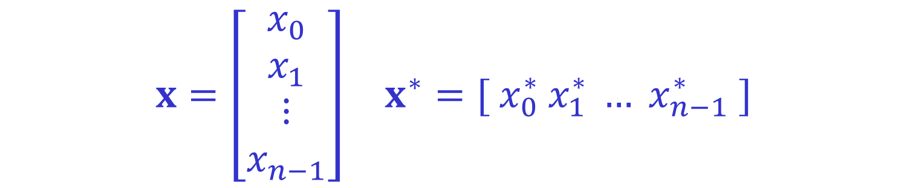
Orthonormal basis
A basis $b_{0},b_{1},$…, $b_{n−1}∈ℂ^{n}$ is orthonormal if
$$\left\langle {b_{j},b}_{k}\right\rangle =b_{j}^{∗}b_{k}= \left\{\begin{matrix} 1 & if j=k \\ 0 & otherwise\end{matrix}\right.$$
$x=\left[\begin{matrix}x_{0} \\ x_{1} \\ \begin{matrix}⋮ \\ x_{n−1}\end{matrix}\end{matrix}\right]$ $x^{∗}=[ x_{0}^{∗} x_{1}^{∗} … x_{n−1}^{∗} ]$
Conjugate transpose
$x=a+ib$ $x^{∗}=a−ib$

Slide 34
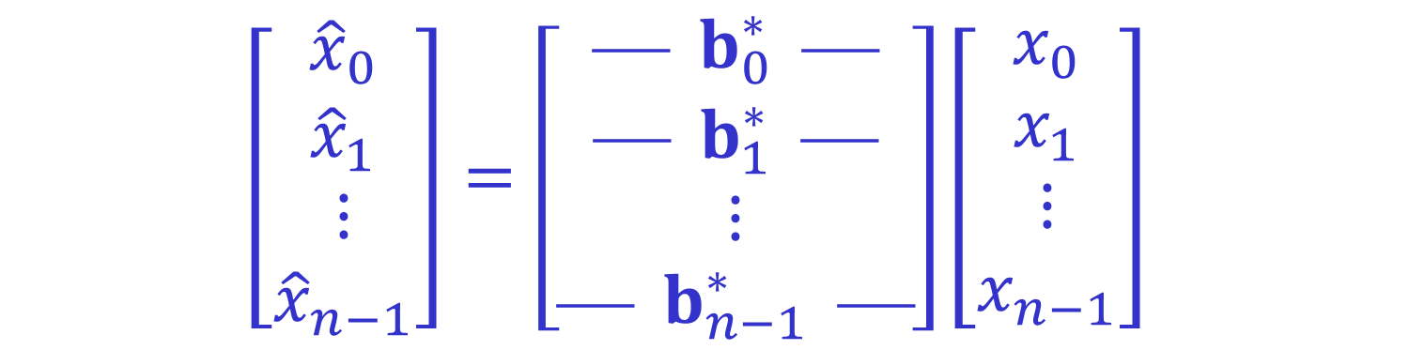
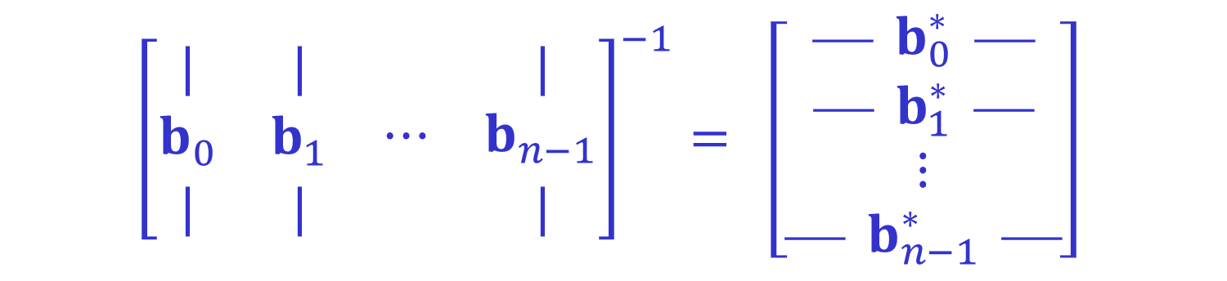
Orthonormal basis
If $b_{0},b_{1},$…, $b_{n−1}∈ℂ^{n}$ is orthonormal then
$${\left[\begin{matrix}| & | & \begin{matrix} & |\end{matrix} \\ b_{0} & b_{1} & \begin{matrix}⋯ & b_{n−1}\end{matrix} \\ | & | & \begin{matrix} & |\end{matrix}\end{matrix}\right]}^{−1}= \left[\begin{matrix} b_{0}^{∗}  \\  b_{1}^{∗}  \\ \begin{matrix}⋮ \\  b_{n−1}^{∗} \end{matrix}\end{matrix}\right]$$
$$\left[\begin{matrix}{\hat{x}}_{0} \\ {\hat{x}}_{1} \\ \begin{matrix}⋮ \\ {\hat{x}}_{n−1}\end{matrix}\end{matrix}\right]=\left[\begin{matrix} b_{0}^{∗}  \\  b_{1}^{∗}  \\ \begin{matrix}⋮ \\  b_{n−1}^{∗} \end{matrix}\end{matrix}\right]\left[\begin{matrix}x_{0} \\ x_{1} \\ \begin{matrix}⋮ \\ x_{n−1}\end{matrix}\end{matrix}\right]$$

Slide 35



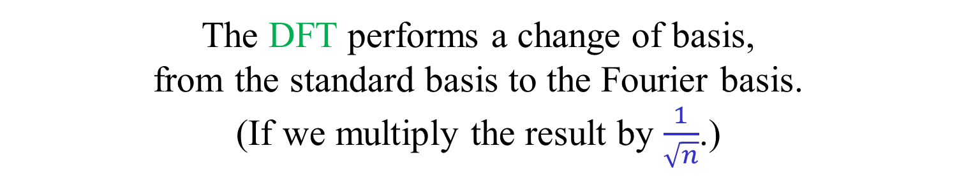
The Fourier basis
$$f_{j}=\frac{1}{\sqrt{n}}{\left(1,ω_{n}^{−j},ω_{n}^{−2j},…,ω_{n}^{−\left(n−1\right)j}\right)}^{T}$$
$$f_{j}^{∗}f_{k}= \left\{\begin{matrix} 1 & if j=k \\ 0 & otherwise\end{matrix}\right.$$
The Fourier basis is orthonormal.
The DFT performs a change of basis,
from the standard basis to the Fourier basis.
(If we multiply the result by $\frac{1}{\sqrt{n}}$.)
The minus signs can be removed from the definition of
the basis vectors $f_{j}$ and moved into the DFT matrix.

Slide 36
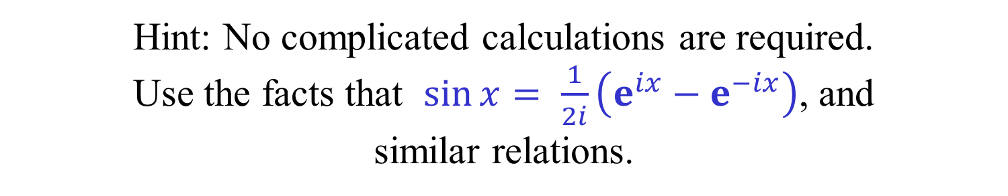
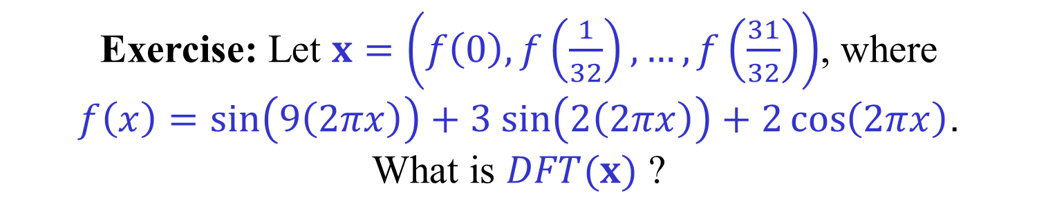
Why did the “signal processing”
examples work?
Exercise: Let $x=\left(f\left(0\right),f\left(\frac{1}{32}\right),…,f\left(\frac{31}{32}\right)\right)$, where
$f\left(x\right)=\sin\left(9\left(2πx\right)\right)+3 sin\left(2\left(2πx\right)\right)+2\cos\left(2πx\right)$.
What is $DFT(x)$ ?
Hint: No complicated calculations are required.
Use the facts that $\sin{x}= \frac{1}{2i}\left(e^{ix}−e^{−ix}\right)$, and
similar relations.
Note: The values shown on slide 14
are normalized absolute values.

Slide 37










A butterfly and its inverse
$$a$$
$$c=a+ωb$$
+
$$ω$$
$$b$$
×
−
$$d=a−ωb$$
$$2a$$
$$c=a+ωb$$
+
$$ω^{−1}$$
$$2b$$
×
−
$$d=a−ωb$$
To compute $FFT^{−1}$ we can also run the $FFT$ network backwards.
This also gives an alternative $FFT$ network.

Slide 38





Convolution
$$x=\left(x_{0},x_{1},…,x_{n−1}\right)$$
$$z=x∗y$$
$$y=\left(y_{0},y_{1},…,y_{n−1}\right)$$
$$z=\left(z_{0},z_{1},…,z_{2n−1}\right)$$
$$z_{k}=\sum_{i+j=k}{x_{i}y_{j}}=\sum_{i}{x_{i}y_{k−i}}$$
$$\max\left\{0,k−n\right\}≤i≤min⁡\{k,n\}$$
Naturally extends to $x$ and $y$ having different length.

Slide 39





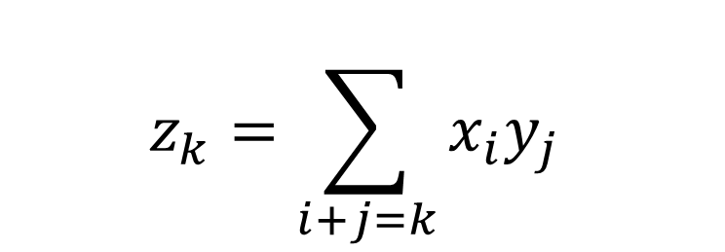








Convolution
$$x=\left(x_{0},x_{1},…,x_{n−1}\right)$$
$$z=x∗y$$
$$y=\left(y_{0},y_{1},…,y_{n−1}\right)$$
$$z=\left(z_{0},z_{1},…,z_{2n−1}\right)$$
$$z_{k}=\sum_{i+j=k}{x_{i}y_{j}}$$
$$z_{0}=x_{0}y_{0}$$
$$z_{1}=x_{0}y_{1}+x_{1}y_{0}$$
$$z_{2}=x_{0}y_{2}+x_{1}y_{1}+x_{2}y_{0}$$
$$z_{3}=x_{0}y_{3}+x_{1}y_{2}+x_{2}y_{1}+x_{3}y_{0}$$
$$z_{4}=x_{1}y_{3}+x_{2}y_{2}+x_{3}y_{1}$$
$$z_{5}=x_{2}y_{3}+x_{3}y_{2}$$
Example: $n=4$
$$z_{6}=x_{3}y_{3}$$
For
convenience
$$z_{7}=0$$

Slide 40



Convolution
$$x_{0}$$ | $$x_{1}$$ | $$x_{2}$$ | $$x_{3}$$
$$y_{0}$$ | $$y_{1}$$ | $$y_{2}$$ | $$y_{3}$$
$$y_{3}$$ | $$y_{2}$$ | $$y_{1}$$ | $$y_{0}$$
Reverse $y$.
Shift $y$ to starting position.
Compute products for each aligment.

Slide 41






Convolution
$$x_{0}$$ | $$x_{1}$$ | $$x_{2}$$ | $$x_{3}$$
$$y_{3}$$ | $$y_{2}$$ | $$y_{1}$$ | $$y_{0}$$
$$z_{0}=x_{0}y_{0}$$
$$z_{1}=x_{0}y_{1}+x_{1}y_{0}$$
$$z_{2}=x_{0}y_{2}+x_{1}y_{1}+x_{2}y_{0}$$
$$z_{3}=x_{0}y_{3}+x_{1}y_{2}+x_{2}y_{1}+x_{3}y_{0}$$
$$z_{4}=x_{1}y_{3}+x_{2}y_{2}+x_{3}y_{1}$$
$$z_{5}=x_{2}y_{3}+x_{3}y_{2}$$
$$z_{6}=x_{3}y_{3}$$

Slide 42



Convolution and
polynomial multiplication
$$A\left(x\right)=\sum_{j=0}^{n−1}{a_{j}x^{j}} B\left(x\right)=\sum_{k=0}^{n−1}{b_{k}x^{k}}$$
$$C\left(x\right)=A\left(x\right)B\left(x\right)=\left(\sum_{j=0}^{n−1}{a_{j}x^{j}}\right)\left(\sum_{k=0}^{n−1}{b_{k}x^{k}}\right)$$
$$=\sum_{i=0}^{2n−2}{\left(\sum_{j+k=i}{a_{j}b_{k}}\right)}x^{i}=\sum_{i=0}^{2k−1}{c_{i}x^{i}}$$
$$c=a∗b$$

Slide 43










Cyclic Convolution
$$x=\left(x_{0},x_{1},…,x_{n−1}\right)$$
$$z=x⊛y$$
$$y=\left(y_{0},y_{1},…,y_{n−1}\right)$$
$$z=\left(z_{0},z_{1},…,z_{n−1}\right)$$
$$z_{k}=\sum_{i+j≡k \left(mod n\right)}{x_{i}y_{j}} =\sum_{i+j=k}{x_{i}y_{j}} +\sum_{i+j=n+k}{x_{i}y_{j}}$$
$$z_{0}=x_{0}y_{0}+x_{1}y_{3}+x_{2}y_{2}+x_{3}y_{1}$$
Example:
$n=4$
$$z_{1}=x_{0}y_{1}+x_{1}y_{0}+x_{2}y_{3}+x_{3}y_{2}$$
$$z_{2}=x_{0}y_{2}+x_{1}y_{1}+x_{2}y_{0}+x_{3}y_{3}$$
$$z_{3}=x_{0}y_{3}+x_{1}y_{2}+x_{2}y_{1}+x_{3}y_{0}$$

Slide 44


Convolution → Cyclic Convolution
Cyclic convolutions can be
computed using $FFT$ and $FFT^{−1}$.
Convolutions can be reduced
to cyclic convolutions by padding.
$$n$$
$$x′=\left(x_{0},x_{1},…,x_{n−1},0,0,…,0\right)$$
$$y′=\left(y_{0},y_{1},…,y_{n−1},0,0,…,0\right)$$
$$x∗y=x′⊛y′$$

Slide 45


The Convolution Theorem
$$x⊛y={DFT}^{−1}\left(DFT\left(x\right)∙DFT\left(y\right)\right)$$
Cyclic
convolution
Point-wise
multiplication
Proof idea:
Let $XY\left(z\right)=\sum_{i=0}^{n−1}{\left(\sum_{j+k≡i}{x_{j}y_{k}}\right)z^{i}}$ be the
polynomial corresponding to $x⊛y$.
We show that $XY\left(ω_{n}^{ℓ}\right)=X\left(ω_{n}^{ℓ}\right)Y\left(ω_{n}^{ℓ}\right)$,
for every $ℓ=0,1,…,n−1$.

Slide 46


Proof of Convolution Theorem
Let $ω=ω_{n}$.
$$X\left(ω^{ℓ}\right)Y\left(ω^{ℓ}\right)=\left(\sum_{j=0}^{n−1}{x_{j}ω^{ℓj}}\right)\left(\sum_{j=0}^{n−1}{y_{k}}ω^{ℓk}\right)$$
$$=\sum_{i=0}^{2n−2}{\left(\sum_{j+k=i}{x_{j}y_{k}}\right)ω^{ℓi}}=\sum_{i=0}^{n−1}{\left(\sum_{j+k≡i}{x_{j}y_{k}}\right)ω^{ℓi}}=XY\left(ω^{ℓ}\right)$$
As $ω^{ℓ\left(n+i\right)}=ω^{ℓi}$.
The claim follows as the interpolation polynomial is unique.
Uniqueness follows from the fact that DFT is invertible.
(BTW, $XY\left(z\right)=\sum_{i=0}^{n−1}{\left(\sum_{j+k≡i}{x_{j}y_{k}}\right)z^{i}}=X\left(z\right)Y\left(z\right) (mod x^{n}−1)$.)

Slide 47




The Chirp Transform
Let $z$ be an arbitrary (but fixed) complex number.
The Chirp transform of $x∈ℂ^{n}$, w.r.t. $z$, is:
$$y_{k}=\sum_{j=0}^{n−1}{x_{j}z^{jk}}=X\left(z^{k}\right) , k=0,1,…,n−1$$
Exercise: Show that the Chirp transform, for any $z∈ℂ$,
can be computed in $O\left(n\log{n}\right)$ time. Hint: use the relation:
$$y_{k}=z^{k^{2}/2}\sum_{j=0}^{n−1}{\left(x_{j}z^{j^{2}/2}\right)\left(z^{−{\left(k−j\right)}^{2}/2}\right)}, k=0,1,…,n−1$$
Exercise: Show that $DFT$ of size $n$can be computed in $O\left(n\log{n}\right)$ time for every $n$, not necessarily a power of 2.

Slide 48




Polynomial arithmetic
Let $A\left(x\right)=\sum_{j=0}^{n−1}{a_{j}x^{j}}$and $B\left(x\right)=\sum_{k=0}^{n−1}{b_{k}x^{k}}$
be two polynomials of degree less than $n$,
with real or complex coefficients.
The coefficients of $A\left(x\right)+B(x)$ can be easily
computed using $n$ additions.
A naïve computations of the coefficients
of $A\left(x\right)B(x)$ requires $Θ\left(n^{2}\right)$ operations.
Using FFT we can compute the coefficients of
$A\left(x\right)B(x)$ using only $Θ\left(n\log{n}\right)$ operations!

Slide 49



Karatsuba’s algorithm
When $n$ is only moderately large, the following polynomial multiplication algorithm works better in practice.
$$A\left(x\right)=A_{0}\left(x\right)+{x^{n/2}A}_{1}\left(x\right)$$
$$B\left(x\right)=B_{0}\left(x\right)+{x^{n/2}B}_{1}\left(x\right)$$
$$C_{0}\left(x\right)={A_{0}(x)B}_{0}\left(x\right)$$
$$C_{1}\left(x\right)={(A_{0}\left(x\right)+A}_{1}\left(x\right)){(B_{0}\left(x\right)+B}_{1}\left(x\right))$$
$$C_{2}\left(x\right)={A_{1}(x)B}_{1}\left(x\right)$$
$$A\left(x\right)B\left(x\right)=C_{0}\left(x\right)+x^{n/2}\left(C_{1}\left(x\right)−C_{0}\left(x\right)−C_{2}\left(x\right)\right)+x^{n}C_{2}(x)$$
$$T\left(n\right)=3 T\left(\frac{n}{2}\right)+O(n)$$
$$T\left(n\right)=O\left(n^{\log_{2}{3}}\right)=O(n^{1.59})$$

Slide 50

Numerical issues
So far, we assumed that all
arithmetical operations are exact.
This is not a realistic assumption,
as $ω_{n}$ is usually irrational.
The FFT algorithm is well-behaved numerically.
The errors introduced if all operations are done
using floating-point arithmetic are relatively small.
In signal processing applications
small errors are acceptable.

Slide 51


Integer Polynomial Multiplication
We now want to add and multiply
polynomials with integer coefficients.
We want an exact result.
If we use high enough precision,
we can use $FFT$ and $FFT^{−1}$ and
round the results obtained to the nearest integers.
To multiply two polynomials of degree at most $n$
with integer coefficients of absolute value at most $n$,
$O(\log{n})$ bits of precision are enough.
(Proof omitted.)

Slide 52

Integer Multiplication
There are practical applications, e.g., cryptography,
that require multiplying very large integers.
The naïve method for multiplying two $n$-bit
numbers requires $Θ\left(n^{2}\right)$ bit operations.
Can we use FFTs to obtain a
aster integer multiplication algorithm/circuit?
Yes, as integer multiplication can be
reduced to polynomial multiplication.

Slide 53
Schönhage-Strassen’s algorithm
Basic idea
$x={\left(x_{n−1}…x_{1} x_{0}\right)}_{2}=\sum_{i=0}^{n−1}{x_{i}2^{i}}=X\left(2\right)$
$y={\left(y_{n−1}…y_{1} y_{0}\right)}_{2}=\sum_{i=0}^{n−1}{y_{i}2^{i}}=Y\left(2\right)$
Compute $Z\left(t\right)=X\left(t\right)Y(t)$ (polynomial multiplication)
$x∙y=z={\left(z_{2n−1}…z_{1} z_{0}\right)}_{2}=\sum_{i=0}^{2n−1}{z_{i}2^{i}}=Z\left(2\right)$
We are not done yet, as the $z_{i}$ are not binary.
But, as $0≤z_{i}<n$ this is not a serious problem.
Some clever tricks are used to speed-up the algorithm.
The first trick is to use base $n=2^{k}$ rather than 2.

Slide 54

















Schönhage-Strassen’s algorithm
$$k=\log{n}$$
$$k$$
$$k$$
$$k$$
$n=2^{k}$
$x=$
$$x_{n/k−1}$$
$x_{n/k−2}$
$$…$$
$$x_{1}$$
$x_{0}$
$y=$
$$y_{n/k−1}$$
$y_{n/k−2}$
$$…$$
$$y_{1}$$
$y_{0}$
$x={\left(x_{n/k−1}… x_{1} x_{0}\right)}_{n}=\sum_{i=0}^{n/k−1}{x_{i}2^{ki}}=X\left(2^{k}\right)$
$y={\left(y_{n/k−1}… y_{1} y_{0}\right)}_{n}=\sum_{i=0}^{n/k−1}{y_{i}2^{ki}}=Y\left(2^{k}\right)$
Compute $Z\left(t\right)=X\left(t\right)Y(t)$ (polynomial multiplication)
$x∙y=z={\left(z_{2n/k−1}…z_{1} z_{0}\right)}_{n}=\sum_{i=0}^{2n/k−1}{z_{i}2^{ki}}=Z\left(2^{k}\right)$

Slide 55
Schönhage-Strassen’s algorithm
$x = \sum_{i=0}^{n/k−1}{x_{i}2^{ki}}$ $y = \sum_{i=0}^{n/k−1}{y_{i}2^{ki}}$
$z = \sum_{i=0}^{2n/k−1}{z_{i}2^{ki}}$ $z_{i} = \sum_{j+ℓ=i}{{x_{j}y}_{ℓ}}$
$0≤x_{j},y_{k}<2^{k}=n$ ${0≤z}_{i}≤\left(n/log⁡n\right)n^{2}<n^{3}$
Each $z_{i}$ is a 3-digit number in base $n$.
We can thus pack all the $z_{i}$ into 3 long integers.
Adding these 3 integers gives us the final answer.

Slide 56












Schönhage-Strassen’s algorithm
The final step
$$3k=3 log{n}$$
$$k=\log{n}$$
$…$
$z_{3}$
$z_{0}$
$…$
$z_{4}$
$z_{1}$
$…$
$z_{5}$
$z_{2}$
Adding 3 $2n$-bit numbers can be
easily done using $O(n)$ bit operations.

Slide 57





Schönhage-Strassen’s algorithm
To multiply two $n$-bit numbers, we compute
two $FFT$s and one $FFT^{−1}$ of size $n/k=n/log⁡n$.
Each input number is an integer between $0$ and $n−1$.
Each output number is an integer between 0 and $n^{3} −1$.
It is enough to perform all arithmetical operations using
a precision of $O(\log{n)}$ bits. (Stated without proof.)
Let $M\left(n\right)$ be the total number of bit operations performed.
$M\left(n\right)=O\left(\frac{n}{\log{n}}\log{\frac{n}{\log{n}}}×M\left(O\left(\log{n}\right)\right)\right)=O(n M(O(\log{n))) }$
Number of arithmetical operations
in an $FFT$ of size $n/\log{n}$.
Number of bit operations per
each arithmetical operation.

Slide 58
Schönhage-Strassen’s algorithm
$$M\left(n\right)=O\left(n^{2}\right)$$
$M\left(n\right)=O(n M(O(\log{n))) }$
$$M\left(n\right)=O\left(n{\left(\log{n}\right)}^{2}\right)$$
$$M\left(n\right)=O\left(n\log{n}{\left(log log{n}\right)}^{2}\right)$$
$$M\left(n\right)=O\left(n\log{n}(log log{n}){\left(log log log{n}\right)}^{2}\right)$$
$$⋮$$

Slide 59

Integer Multiplication
[Schönhage-Strassen (1971)] obtained an improved
version of their algorithm with a running time of
???
$$M\left(n\right)=O\left(n\log{n}(\log{\log{n}})\right)$$
Improvement obtained by performing the $FFT$s in a suitable
integer ring in which $ω=2$ is a primitive root of unity.
Multiplications by powers of $ω$ are essentially free!
No numerical issues!
[Fürer (2007)] and [De-Kurur-Saha-Saptharishi (2008)]
improved the running time to
$$M\left(n\right)=O\left(n\log{n}2^{O\left(\log^{∗}{n}\right)}\right)$$

Slide 60



DFT and FFT in rings
To define $DFT$ and $DFT^{−1}$ over a ring
we need an primitive $n$-th root of unity $ω$.
If $DFT$ and $DFT^{−1}$ are well defined, then
the $FFT$ algorithm can be used to compute them.
An element $ω$ is a primitive $n$-th root of unity in $R$ iff:
(i) $ω^{n}=1$,
(ii) $\sum_{j=0}^{n−1}{ω^{jk}}=0$, for $k=0,1,…,n−1$,
(iii) $n$ has an inverse in $R$.
In $ℂ$, $ω_{n}=e^{2πi/n}$ is a primitive $n$-th root of unity.
So is $ω_{n}^{j}=e^{2πij/n},$ if $j$ is relatively prime to $n$.
In $ℝ$, there is such a root only for $n=2$…
Are there other useful rings in which $DFT$ can be performed?

Slide 61




Rings
A (commutative) ring $\left(R, ∙ ,+\right)$ is a set $R$ with two
binary operations $∙,+:R×R→R$ such that:
$\left(R,+\right)$ is an abelian group:
$$∀a,b∈R . a+b=b+a$$
$∀a,b,c∈R . a+\left(b+c\right)=\left(a+b\right)+c$
$$∃ 0∈R . ∀ a∈R . a+0=a$$
$$∀ a∈R . ∃ −a∈R . a+(−a)=0$$
$\left(R,∙\right)$ is a commutative monoid:
$$∀a,b∈R . a∙b=b∙a$$
$∀a,b,c∈R . a∙\left(b∙c\right)=\left(a∙b\right)∙c$
$$∃ 1∈R . ∀ a∈R . a∙1=a$$
Distributive law:
$$∀a,b,c∈R . a∙\left(b+c\right)=a∙c+b∙c$$

Slide 62




Rings and Fields
A (commutative) ring $\left(R, ∙ ,+\right)$ is a field
if there are also multiplicative inverses:
$\left(R∖\left\{0\right\}, ∙\right)$ is an abelian group, not just a monoid:
$$∀ a∈R∖\{0\} . ∃ a^{−1}∈R . a∙a^{−1}=1$$
Examples:
$\left(ℕ, ∙ ,+\right)$ - The natural numbers do not form a ring.
$\left(ℤ, ∙ ,+\right)$ - The integers form a ring, but not a field.
$\left(ℝ, ∙ ,+\right)$ - The real numbers form a field.
$\left(ℂ, ∙ ,+\right)$ - The complex numbers form a field.
More Examples:
$\left(ℤ_{m}, ∙ ,+\right)$ - The integers modulo $m$ (see next slide).
$\left(R[x], ∙ ,+\right)$ - The ring of polynomials (in $x$) over a ring.
$$…$$

Slide 63

Modular arithmetic
$( ℤ_{m}=\left\{0,1,…,m−1\right\} , ∙ ,+ )$
Addition and multiplication performed modulo $m$.
For example, if $m=12$, then $7+6=1$ and $4∙3=0$.
Lemma: $ℤ_{m}$ is a ring, for every integer $m$.
Theorem: $ℤ_{m}$ is a field, if and only if $m$ is prime.
For example, if $m=17$, then $5^{−1}=7$. (Why?)
Addition, multiplication modulo $m$ can be performed using addition, multiplication and division of numbers up to $m^{2}$.

Slide 64




Generators of prime fields
Theorem: If $p$ is prime, then in $ℤ_{p}$ has a generator,
i.e., an element $g$ such that $g^{p−1}=1$
but $g^{i}≠1$, for $i=2,3,…,p−2$.
(Fermat’s Little Theorem: If $p$ is prime,
then for every $a≠0$ in $ℤ_{p}$ we have $a^{p−1}=1$.)
$2$ is not a generator of $ℤ_{17}$, as $2^{8}≡1 (mod 17)$ .
But $g=3$ is a generator of $ℤ_{17}$:
$g^{i}$, for $i=1,…,16$ evaluates to
3,9, 10, 13, 5, 15, 11, 16, 14, 8, 7, 4, 12, 2, 6, 1
Lemma: If $p$ is prime and $n | p−1$ and $k=(p−1)/n$,
then $ω=g^{k}$ is a primitive $n$-th root of unity in $ℤ_{p}$.

Slide 65



FFT in prime fields
Example: Multiply two integer polynomials of degree < 512.
We need to compute $FFT$ and $FFT^{−1}$ with $n=1024$.
Find a prime $p$ such that $1024 | p−1$.
For example, $p=12∙1024+1=12,289$.
But, we will get the coefficients modulo 12,289 …
Suppose the input coefficients are in the range $0,1,…,1023.$
The output coefficients are in the range $0,1,…,{1024}^{3}−1.$
Find a prime $p>{1024}^{3}$ such that $1024 | p−1$.
For example, $p=({1024}^{2}+8)∙1024+1=1,073,750,017$.
(Still fits in one 32-bit word.)
We can take $g=5$, and $ω=g^{(p−1)/1024}=\text{381}\text{,}\text{780}\text{,}\text{781}$.

Slide 66


FFT in prime fields
Example: Multiply two integer polynomials of degree < 512.
What do we gain by working modulo $1,073,750,017$
instead of working over the complex numbers?
Modular arithmetic may be more “elegant”.
We don’t have to worry about numerical errors.
But, modular arithmetic is not necessarily faster than
working with floating point complex numbers.
We need to find appropriate prime numbers and generators.
The prime number theorem: The number of prime
numbers less than $n$ is about $n/\ln{n}$.

Slide 67




FFT using modular arithmetic
To support DFT and FFT a ring does not have to be a field.
The main advantage of using modular arithmetic comes from choosing rings with very special primitive roots of unity.
Lemma: Let $n$ and $ω$ be positive powers of 2. Then, $ω$ is a primitive $n$-th root of unity in $ℤ_{m}$, where $m=ω^{n/2}+1$.
$ω$ is a power of 2.
$m$ is one more than a power of 2.
Multiplications by $ω^{k}$ or $ω^{−k}=ω^{n−k}$ are just shifts!
Mod $m$ is a very simple operation.
$m−1=ω^{n/2}=2^{b}$ , $b=\left(n/2\right)log ω$
$x=x_{1}2^{b}+x_{0}$ → $x mod m=x_{0}−x_{1}$

Slide 68




Schönhage-Strassen’s algorithm
FFT performs $O\left(n\log{n}\right)$ arithmetical operations.
However, they are all either additions or multiplications by $ω^{k}$.
To compute a convolution, we only need $n$ multiplications,
other than multiplications by $ω^{k}$.
Break two $n$-bit integers to $n_{1}$ blocks of $n_{2}$-bits each.
$$M\left(n\right)=O\left(n_{1}\log{n_{1}}×M\left(O(n_{2})\right) \right)$$
If multiplications by $ω^{k}$ are essentially additions, then
$$M\left(n\right)=O\left(n_{1}\log{n_{1}}O(n_{2})+n_{1}M\left(O(n_{2})\right)\right)$$
There are many technical problems to overcome.
We have to choose $n_{1}=\sqrt{n}$ rather than $n_{1}=n/\log{n}$.
The end result is an integer multiplication algorithm
that performs only $O(n\log{n}\log{\log{n}})$ bit operations.

Slide 69


String Matching
abraabracadabracadabraabara
abracadabra
abracadabra
Given a text of length $n$ and a pattern of length $m$,
find all occurrences of the pattern in the text.
The naïve algorithm runs in $O\left(mn\right)$ time.
Several classical algorithms run in $O\left(m+n\right)$ time.
[Knuth-Morris-Pratt (1977)] [Boyer-Moore (1977)]

Slide 70

More String Matching Problems
abraabracadabracadabraabara
abracadabra
abracadabra
Count the number of matches/mismatches
in each alignment of the pattern with the text.
Find all aligments with at most $k$ mismatches.
Allow a wildcard (“don’t care”) ($∗$) that match
any (single) symbol in the pattern and/or text.
“Traditional” string matching techniques
are not so efficient for these extensions.

Slide 71






(Cross-)Correlation
$$x_{0}$$ | $$x_{1}$$ | $$x_{2}$$ | $$x_{3}$$
$$y_{0}$$ | $$y_{1}$$ | $$y_{2}$$ | $$y_{3}$$
$$z_{−3}=x_{0}y_{3}$$
$$z_{−2}=x_{0}y_{2}+x_{1}y_{3}$$
$$z_{−1}=x_{0}y_{1}+x_{1}y_{2}+x_{2}y_{3}$$
$$z_{0}=x_{0}y_{0}+x_{1}y_{1}+x_{2}y_{2}+x_{3}y_{3}$$
$$z_{1}=x_{1}y_{0}+x_{2}y_{1}+x_{3}y_{2}$$
$$z_{2}=x_{2}y_{0}+x_{3}y_{1}$$
$$z_{3}=x_{3}y_{0}$$

Slide 72





(Cross-)Correlation
A convolution without the initial reversal, with a shift of indices.
$$z_{k}=\sum_{i}{x_{i}y_{i−k}}=\sum_{j}{x_{j+k}y_{j}}={\left(x∗y^{R}\right)}_{k+m−1}$$
If $x$ is of length $n$ and $y$ of length $m$,
where $m≤n$, then $k=1−m,…,n−1$.
Sometimes, only the values $k=0,…,n−m$, corresponding
to a full overlap of $x$ with a shift of $y$, are of interest.
The correlation of two vectors of length $n$
can be computed in $O\left(n\log{n}\right)$ time.
Exercise: The correlation of two vectors of length $n$ and $m$,
where $m≤n$, can be computed in $O\left(n\log{m}\right)$ time.

Slide 73


Counting mismatches
[Fischer-Paterson (1974)]
Let $Σ$ be the alphabet of the pattern and text.
We may assume that $\left|Σ\right|≤m+1$. (Why?)
For every $a∈Σ$ create two Boolean strings:
$P_{a}\left[j\right]=1$ iff $P\left[j\right]=a$
$T_{a}\left[i\right]=1$ iff $T\left[i\right]≠a$
Correlation of $P_{a}$ and $T_{a}$ counts mismatches involving $a$.
Summing over all $a∈Σ$ we get the total no. of mismatches.
Complexity: $O(\left|Σ\right| n\log{m})$ word operations.
(Each word assumed to hold $Θ\left(\log{n}\right)$ bits.)
Fast only if $\left|Σ\right|$ is small.

Slide 74


Counting mismatches with wildcards
[Fischer-Paterson (1974)]
For every $a∈Σ$ create two Boolean strings:
$P_{a}\left[j\right]=1$ iff $P\left[j\right]=a$
$T_{a}\left[i\right]=1$ iff $T\left[i\right]≠a$ and $T\left[i\right]≠ ∗$
Complexity: $O(\left|Σ\right|n\log{m})$ word operations.
If we only want to find exact matches, replace each
character $a∈Σ$ by a $\left\lceil \log_{2}{|Σ|}\right\rceil$ bit string.
Complexity drops to $O(\log\left|Σ\right|n\log{m})$.
Can we get rid of the dependence on $|Σ|$ ?

Slide 75





$L_{2}$-matching
[Lipsky-Porat (2011)]
Standard string matching uses the Hamming distance.
Two characters either match or they do not.
$a$ is not closer to $b$ than to $z$.
Suppose that each “character” is a real number.
We want to find approximate matches.
For each $k=0,1,…,n−m$ we want to compute
$$d_{k}=\sum_{j=0}^{m−1}{{\left(p_{j}−t_{k+j}\right)}^{2}}$$
$L_{2}$-distance: ${\left\|x−y\right\|}_{2}=\sqrt{\sum_{j=0}^{m−1}{{\left(x_{j}−y_{j}\right)}^{2}}}$

Slide 76





$L_{2}$-matching
[Lipsky-Porat (2011)]
$$\sum_{j=0}^{m−1}{{\left(p_{j}−t_{k+j}\right)}^{2}}=\sum_{j=0}^{m−1}{p_{j}^{2}}−2\sum_{j=0}^{m−1}{p_{j}t_{k+j}}+\sum_{j=0}^{m−1}{t_{k+j}^{2}}$$
Constant.
$O(m)$ time.
Correlation.
$O\left(n\log{m}\right)$ time.
Easy in
$O\left(n\right)$ time.
$L_{2}$-matching can be computed in $O(n\log{m})$ time.

Slide 77

Exact matches with wildcards
[Clifford-Clifford (2007)]
Replace each character by a positive integer.
Replace the wildcard by 0.
For each $k=0,1,…,n−m$ compute
$$d_{k}=\sum_{j=0}^{m−1}{p_{j}t_{k+j}{\left(p_{j}−t_{k+j}\right)}^{2}}$$
There is an exact match at position $k$ iff $d_{k}=0.$

Slide 78



Exact matches with wildcards
[Clifford-Clifford (2007)]
$$d_{k}=\sum_{j=0}^{m−1}{{p_{j}t_{k+j}\left(p_{j}−t_{k+j}\right)}^{2}}$$
$$= \sum_{j=0}^{m−1}{p_{j}^{3}t_{k+j}}−2\sum_{j=0}^{m−1}{p_{j}^{2}t_{k+j}^{2}}+\sum_{j=0}^{m−1}{p_{j}t_{k+j}^{3}}$$
Compute three correlations of
appropriate sequences in $O\left(m\log{n}\right)$ time.
Running time is independent of $|Σ|$ !
Assuming that each character fits in an $Θ\left(\log{n}\right)$-bit word
and that operations on such words takes constant time.

Slide 79

Bonus material
Not covered in class this term
“Careful. We don’t want to learn from this.”
(Calvin in Bill Watterson’s “Calvin and Hobbes”)

Slide 80


Continuous Fourier Transform
If $f:ℝ→ℂ$, then its Fourier transform $\hat{f}:ℝ→ℂ$ is:
$$\hat{f}(y)=\int_{−∞}^{∞}{f(x)e^{−2πixy}dx}$$
$$f(x)=\int_{−∞}^{∞}{\hat{f} (y)e^{2πixy}dy}$$
(Some conditions apply.)

Slide 81


Fourier series
If $f:[−π,π]→ℂ$, then its Fourier series is:
$$f\left(x\right)= \sum_{k=−∞}^{∞}{c_{k}e^{ikx}}$$
where:
$$c_{k}= \frac{1}{2π}\int_{−π}^{π}{f\left(x\right)e^{−ikx}dx}$$
(Some conditions apply.)

Slide 82


Polynomial interpolation
$x_{1},x_{2},…,x_{n}∈𝔽$ distinct
$y_{1},y_{2},…,y_{n}∈𝔽$ (not necessarily distinct)
There is a unique polynomial $p\left(x\right)= \sum_{i=0}^{n−1}{a_{i}x^{i}}$
such that $p\left(x_{1}\right)=y_{1} , p\left(x_{2}\right)=y_{2} , …, p\left(x_{n}\right)=y_{n}$
which can be found by solving by solving the linear equations:
$$\left(\begin{matrix}1 & x_{1} & … & x_{1}^{n−1} \\ 1 & x_{2} & … & x_{2}^{n−1} \\ ⋮ & ⋮ & ⋱ & ⋮ \\ 1 & x_{k} & … & x_{k}^{n−1}\end{matrix}\right)\left(\begin{matrix}a_{0} \\ a_{1} \\ ⋮ \\ a_{n−1}\end{matrix}\right)=\left(\begin{matrix}y_{1} \\ y_{2} \\ ⋮ \\ y_{n}\end{matrix}\right)$$
A solution exists and is unique because the matrix,
known as a Vandermonde matrix, is non-singular.

Slide 83

Vandermonde Determinant
$$det\left(\begin{matrix}1 & x_{1} & … & x_{1}^{n−1} \\ 1 & x_{2} & … & x_{2}^{k−1} \\ ⋮ & ⋮ & ⋱ & ⋮ \\ 1 & x_{k} & … & x_{k}^{n−1}\end{matrix}\right) = \prod_{i<j}{\left(x_{j}−x_{i}\right)}$$

Slide 84


Lagrange formula
$x_{1},x_{2},…,x_{n}∈𝔽$ distinct
$y_{1},y_{2},…,y_{n}∈𝔽$ (not necessarily distinct)
The unique polynomial $p\left(x\right)= \sum_{i=0}^{n−1}{a_{i}x^{i}}$
such that $p\left(x_{1}\right)=y_{1} , p\left(x_{2}\right)=y_{2} , …, p\left(x_{n}\right)=y_{n}$
can be obtained as follows:
$$p\left(x\right)=\sum_{k=0}^{n−1}{y_{k}\frac{\prod_{j≠k }{x−x_{j}}}{\prod_{j≠k }{x_{k}−x_{j}}}}$$

Slide 85

$FFT$ decomposition
Suppose that $n=n_{1}n_{2}$.
To compute an $FFT$ of $n$ numbers:
Input the numbers row by row into an $n_{1}×n_{2}$ matrix.
Do an $FFT$ of dimension $n_{1}$ on each column.
Multiply the $j$-th column by $ω_{n}^{j}$.
Do an $FFT$ of dimension $n_{2}$ on each row.
Output the numbers in the matrix column by column.
In the standard algorithm, $n_{1}=n/2$ and $n_{2}=2$.

Slide 86




Rader’s $FFT$ algorithm
When $n$ is prime, $DFT$ reduces to cyclic convolution.
Let $g$ be a generator of $ℤ_{n}^{∗}$.
$1,g,g^{2},..,g^{n−2}$ and $1,g^{−1},g^{−2},..,g^{−(n−2)}$,
computed mod $n$, are permutations of $1,2,…,n−1$.
$$y_{j}=\sum_{k=0}^{n−1}{ω_{n}^{jk}x_{k}}=x_{0}+\sum_{k=0}^{n−2}{ω^{jg^{−k}}}x_{g^{−k}}, j=0,1,…,n−1$$
$$y_{g^{j}}=x_{0}+\sum_{k=0}^{n−2}{ω^{g^{j}g^{−k}}}x_{g^{−k}}=x_{0}+\sum_{k=0}^{n−2}{ω^{g^{j−k}}}x_{g^{−k}} , j=0,1,…,n−2$$
$x_{j}^{′}=y_{g^{−j}}$, $y_{j}^{′}=y_{g^{j}}−x_{0}$, $w_{j}=ω^{g^{j}}$, $j=0,1,…,n−2$,
$y^{′}=w⊛x′$

Slide 87



Rader’s $FFT$ algorithm
Example: $n=7$, $g=3$ (without first row and column)
$$\left[\begin{matrix}y_{1} \\ y_{2} \\ \begin{matrix}y_{3} \\ \begin{matrix}y_{4} \\ y_{5} \\ y_{6}\end{matrix}\end{matrix}\end{matrix}\right] = \left[\begin{matrix}ω^{1} & ω^{2} & ω^{3} & ω^{4} & ω^{5} & ω^{6} \\ ω^{2} & ω^{4} & ω^{6} & ω^{1} & ω^{3} & ω^{5} \\ ω^{3} & ω^{6} & ω^{2} & ω^{5} & ω^{1} & ω^{4} \\ ω^{4} & ω^{1} & ω^{5} & ω^{2} & ω^{6} & ω^{3} \\ ω^{5} & ω^{3} & ω^{1} & ω^{6} & ω^{4} & ω^{2} \\ ω^{6} & ω^{5} & ω^{4} & ω^{3} & ω^{2} & ω^{1}\end{matrix}\right]\left[\begin{matrix}x_{1} \\ x_{2} \\ \begin{matrix}x_{3} \\ \begin{matrix}x_{4} \\ x_{5} \\ x_{6}\end{matrix}\end{matrix}\end{matrix}\right]$$
$$\left[\begin{matrix}y_{1} \\ y_{3} \\ \begin{matrix}y_{2} \\ \begin{matrix}y_{6} \\ y_{4} \\ y_{5}\end{matrix}\end{matrix}\end{matrix}\right] = \left[\begin{matrix}ω^{1} & ω^{5} & ω^{4} & ω^{6} & ω^{2} & ω^{3} \\ ω^{3} & ω^{1} & ω^{5} & ω^{4} & ω^{6} & ω^{2} \\ ω^{2} & ω^{3} & ω^{1} & ω^{5} & ω^{4} & ω^{6} \\ ω^{6} & ω^{2} & ω^{3} & ω^{1} & ω^{5} & ω^{4} \\ ω^{4} & ω^{6} & ω^{2} & ω^{3} & ω^{1} & ω^{5} \\ ω^{5} & ω^{4} & ω^{6} & ω^{2} & ω^{3} & ω^{1}\end{matrix}\right]\left[\begin{matrix}x_{1} \\ x_{5} \\ \begin{matrix}x_{4} \\ \begin{matrix}x_{6} \\ x_{2} \\ x_{3}\end{matrix}\end{matrix}\end{matrix}\right]$$

Slide 88




Rader’s $FFT$ algorithm
When $n$ is prime, $DFT$ reduces to cyclic convolution.
Cyclic convolution can be computed using $FFT$s
of a larger size, e.g., a power of 2, by padding.
We thus get an $O\left(n\log{n}\right)$ algorithm for computing
a $DFT$ of size $n$ when $n$ is prime.
When $n$ is composite, we can decompose the problem.
The end result is an $O\left(n\log{n}\right)$ algorithm for
computing a $DFT$ for any $n$.
When $n=2^{k}$, the algorithm is most efficient.

Slide 89



Negative Cyclic Convolution
Convolution:
$$z_{k}=\sum_{i+j=k }{x_{i}y_{j}}$$
Cyclic Convolution:
$$z_{k}=\sum_{i+j≡k \left(mod n\right)}{x_{i}y_{j}} =\sum_{i+j=k}{x_{i}y_{j}} +\sum_{i+j=n+k}{x_{i}y_{j}}$$
Negative Cyclic Convolution:
$$z_{k}=\sum_{i+j=k}{x_{i}y_{j}} −\sum_{i+j=n+k}{x_{i}y_{j}}$$

Slide 90
Negative Cyclic Convolution
Polynomial multiplication modulo $x^{n}+1$.
A naïve way of computing the negative cyclic convolution
is to first compute the non-cyclic convolution.
Let $ω$ be an $n$-th primitive root of unity.
Let $ψ$ be such that $ψ^{2}=ω$.
$ψ=(1,ψ,…,ψ^{n−1})$ , $ψ^{−1}=(1,ψ^{−1},…,ψ^{−\left(n−1\right)})$
The negative cyclic convolution of $x$ and $y$ is:
$$ψ^{−1}DFT^{−1}\left(DFT\left(ψ∙x\right)∙DFT\left(ψ∙y\right)\right)$$
This saves a factor of 2 and plays an important
role in the modular Schönhage-Strassen algorithm.

Slide 91
Modular Schönhage-Strassen
Let $u,v$ be two $n$-bit integers.
The algorithm computes $uv mod (2^{n}+1)$.
$n=2^{k}$ , $b=2^{\left\lfloor k/2\right\rfloor }$ , $l=n/b$
Break $u,v$ into $b$ $l$-bit blocks. Note that $b|l$.
$$u=u_{b−1}2^{\left(b−1\right)l}+…+u_{1}2^{l}+u_{0}$$
$$v=v_{b−1}2^{\left(b−1\right)l}+…+v_{1}2^{l}+v_{0}$$
$$uv =y_{2b−2}2^{\left(2b−2\right)l}+…+y_{1}2^{l}+y_{0}$$
$$uv mod \left(2^{n}+1\right) =w_{b−1}2^{\left(b−1\right)l}+…+w_{1}2^{l}+w_{0}$$
$w_{i}=y_{i}−y_{n+i}$ is the negative cyclic convolution of $u$ and $v$.
$${−\left(b−\left(i+1\right)\right)2^{2l}<w}_{i} <\left(i+1\right)2^{2l}$$
Enough to compute each $w_{i}$ modulo $2^{2l}+1$ and modulo $b$.

Slide 92


Modular Schönhage-Strassen
$$uv mod \left(2^{n}+1\right) =w_{b−1}2^{\left(b−1\right)l}+…+w_{1}2^{l}+w_{0}$$
$w_{i}=y_{i}−y_{n+i}$ is the negative cyclic convolution of $u$ and $v$.
Enough to compute each $w_{i}$ modulo $2^{2l}+1$ and modulo $b$.
To compute $w_{i} mod b$, pack the $u_{i},v_{i}$ into two large integers,
with some padding between consecutive digits, and preform
one integer product using Karatsuba’s algorithm.
As $b=O\left(\sqrt{n}\right)$, the cost of this step is $O\left(n\right).$
To compute $w_{i} mod (2^{2l}+1)$, compute a negative circular convolution modulo ${m=2}^{2l}+1$ using $FFT$ and $FFT^{−1}$.
$ω=2^{4l/b}$ , $ω^{b/2}=2^{2l}≡−1$ , $ω^{b}≡1 (mod m)$
$ω$ is a $b$-th primitive root of unity in $ℤ_{m}$.

Slide 93

Modular Schönhage-Strassen
$$M\left(n\right)≤c n\log{n}+b M(2l)$$
$$M^{′}(n)=M(n)/n$$
$$M^{′}\left(n\right) ≤c\log{n}+2M′\left(4\sqrt{n}\right)$$
$n_{0}=n$ , $n_{k}=4\sqrt{n_{k−1}}$ $⟹$ $n_{k}≤16n^{2^{−k}}$
$$M^{′}\left(n\right) ≤c(\log{n_{0}}+2\log{n_{1}}+4\log{n_{2}}+…)$$
$$M^{′}\left(n\right)≤c\sum_{k=0}^{\log{\log{n}}−1}{2^{k}\log{n_{k}}}≈c\sum_{k=0}^{\log{\log{n}}−1}{\log{n}}=c\log{n}\log{\log{n}}$$
$$M\left(n\right)≈cn\log{n}\log{\log{n}}$$

