Slide 1
Sum-product theorems over finite fields

Slide 2
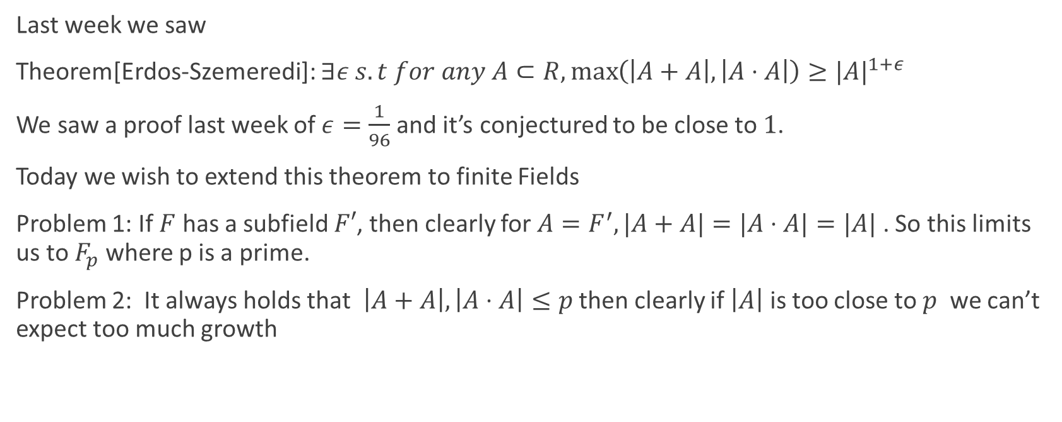
Goal
Last week we saw
Theorem[Erdos-Szemeredi]: $∃ε s.t for any A⊂R,\max\left(\left|A+A\right|,\left|A⋅A\right|\right)≥|{A|}^{1+ε}$
We saw a proof last week of $ε=\frac{1}{96}$ and it’s conjectured to be close to $1$.
Today we wish to extend this theorem to finite Fields
Problem 1: If $F$ has a subfield $F′$, then clearly for $A=F^{′}, |A+A|=|A⋅A|=|A|$ . So this limits us to $F_{p}$ where p is a prime.
Problem 2: It always holds that $\left|A+A\right|,\left|A⋅A\right|≤p$ then clearly if $\left|A\right|$ is too close to $p$ we can’t expect too much growth

Slide 3
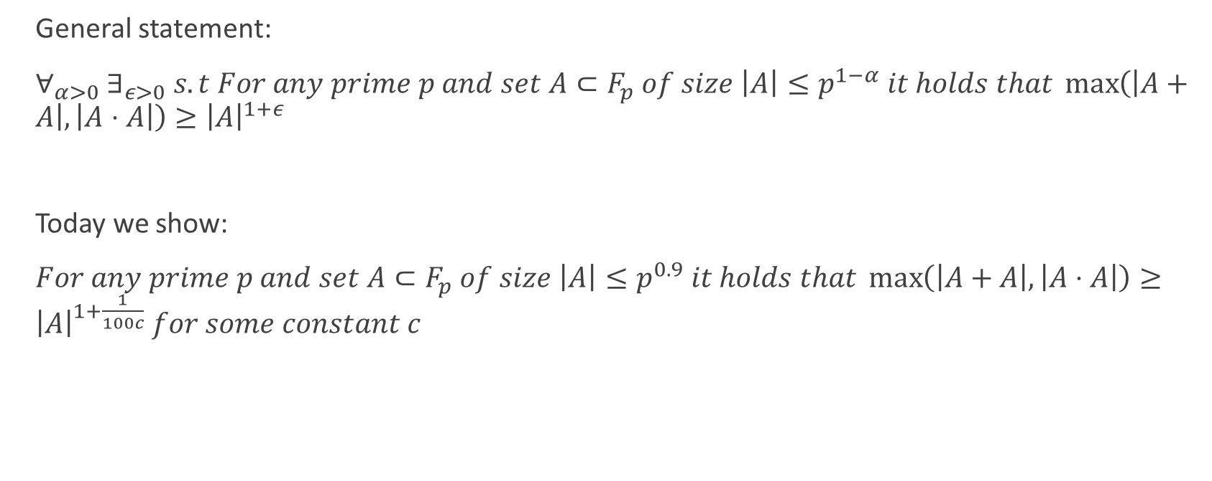
Goal
General statement:
$∀_{α>0} ∃_{ε>0} s.t For any prime p and set A⊂F_{p} of size \left|A\right|≤p^{1−α} it holds that \max\left(\left|A+A\right|,\left|A⋅A\right|\right)≥{\left|A\right|}^{1+ε}$
Today we show:
$For any prime p and set A⊂F_{p} of size \left|A\right|≤p^{0.9} it holds that \max\left(\left|A+A\right|,\left|A⋅A\right|\right)≥{\left|A\right|}^{1+\frac{1}{100c}} for some constant c$

Slide 4
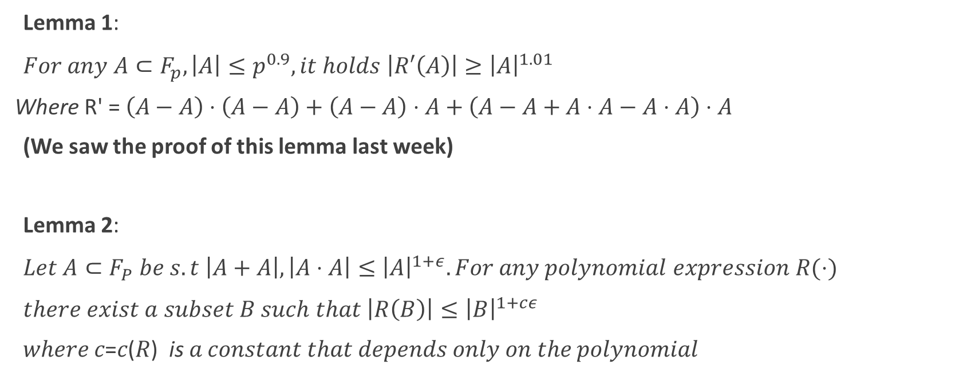
Plan
Lemma 1:
$For any A⊂F_{p}, \left|A\right|≤p^{0.9}, it holds \left|R′\left(A\right)\right|≥{\left|A\right|}^{1.01}$
Where $\text{R}\text{′}\text{ = }\left(A−A\right)⋅\left(A−A\right)+\left(A−A\right)⋅A+\left(A−A+A⋅A−A⋅A\right)⋅A$
(We saw the proof of this lemma last week)
Lemma 2:
$Let A⊂F_{P} be s.t \left|A+A\right|,\left|A⋅A\right|≤{\left|A\right|}^{1+ε}. For any polynomial expression R(⋅)$
$there exist a subset B such that \left|R\left(B\right)\right|≤{\left|B\right|}^{1+cε}$
𝑤ℎ𝑒𝑟𝑒 𝑐=𝑐(𝑅) is 𝑎 𝑐𝑜𝑛𝑠𝑡𝑎𝑛𝑡 𝑡ℎ𝑎𝑡 𝑑𝑒𝑝𝑒𝑛𝑑𝑠 𝑜𝑛𝑙𝑦 𝑜𝑛 𝑡ℎ𝑒 𝑝𝑜𝑙𝑦𝑛𝑜𝑚𝑖𝑎𝑙

Slide 5
Proof of Theorem (Using lemmas)
Let $\left|A\right|≤p^{0.9}$ and let $ε$ be such that $\left|A+A\right|,\left|A⋅A\right|≤ {|A|}^{1+ε}$.
Using lemma 2 with R’ gives us that exists $B⊂A$ such that ${\left|R^{′}\left(B\right)\right|≤|B|}^{1+c(R^{′})ε}$
But by lemma 1 we know that ${\left|R^{′}\left(B\right)\right|≥|B|}^{1.01}$
Meaning $ε≥\frac{1}{100c(R^{′})}$ as requested.

Slide 6
Lemma 2 plan
From now until the end of the talk, we aim to prove lemma 2:
$Let A⊂F_{P} be s.t \left|A+A\right|,\left|A⋅A\right|≤{\left|A\right|}^{1+ε}. For any polynomial expression R(⋅)$
$there exist a subset B such that \left|R\left(B\right)\right|≤{\left|B\right|}^{1+cε}$
𝑤ℎ𝑒𝑟𝑒 𝑐=𝑐(𝑅) is 𝑎 𝑐𝑜𝑛𝑠𝑡𝑎𝑛𝑡 𝑡ℎ𝑎𝑡 𝑑𝑒𝑝𝑒𝑛𝑑𝑠 𝑜𝑛𝑙𝑦 𝑜𝑛 𝑡ℎ𝑒 𝑝𝑜𝑙𝑦𝑛𝑜𝑚𝑖𝑎𝑙

Slide 7
Proving Lemma 2
Lemma 3:
Let A be a subset of an Abelian group s.t $\left|A+A\right|≤ K|A|$. Then exists $B⊂ A$ of size $\left|B\right|≥ K^{−O\left(1\right)}|A|$ s.t any $b_{1} – b_{2}∈B−B$ can be written as:
$b_{1}−b_{2}=\sum_{i=1}^{12}{a_{i},} a_{i}∈A∪−A$
In at least $K^{−O\left(1\right)}{\left|A\right|}^{11}$ distinct ways
and any $b_{1}+ b_{2}∈B+B$ can be written as
$b_{1}+b_{2}=\sum_{i=1}^{12}{a_{i},} a_{i}∈A∪−A$
In at least $K^{−O\left(1\right)}{\left|A\right|}^{11}$ distinct ways
Notes:
Write statement on board

Slide 8
Proving Lemma 3 (1/4)
We will use the BSG theorem (distinct paths of length 3 in dense bipartite graph)
Let $N = |A|$; Let K s.t $\left|A+A\right|≤ K|A|$
Let $C⊂ A+A$be the set of elements that can be written as $c = a_{1}+a_{2}$ in $\frac{N}{2k}$ distinct ways.
We note that $\left|C\right|≥\frac{N}{2k}$ (Shown on board)
Denote H as the following bipartite graph: each element in $a∈ A$ has a vertex in both the left and the right side.
$E(H) = \{(a_{1},a_{2})|a_{1}+a_{2}∈ C\}$

Slide 9
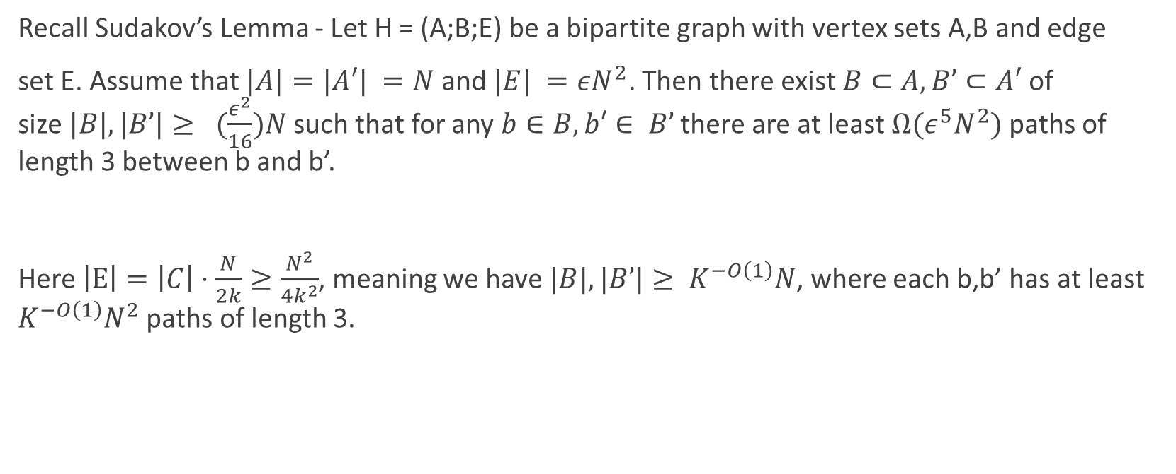
Proving Lemma 3 (2/4)
Recall Sudakov’s Lemma - Let H = (A;B;E) be a bipartite graph with vertex sets A,B and edge
set E. Assume that $|A|=|A′| =N$ and $|E| =εN^{2}$. Then there exist $B⊂A,B’⊂A′$ of size$|B|,|B’|≥ (\frac{ε^{2}}{16})N$such that for any $b∈B, b′∈ B’$ there are at least $Ω(ε^{5}N^{2})$ paths of length 3 between b and b’.
Here $\left|E\right|=\left|C\right|⋅\frac{N}{2k}≥\frac{N^{2}}{4k^{2}}$, meaning we have $|B|,|B’|≥ K^{−O\left(1\right)}N$, where each b,b’ has at least $K^{−O\left(1\right)}N^{2}$ paths of length 3.

Slide 10
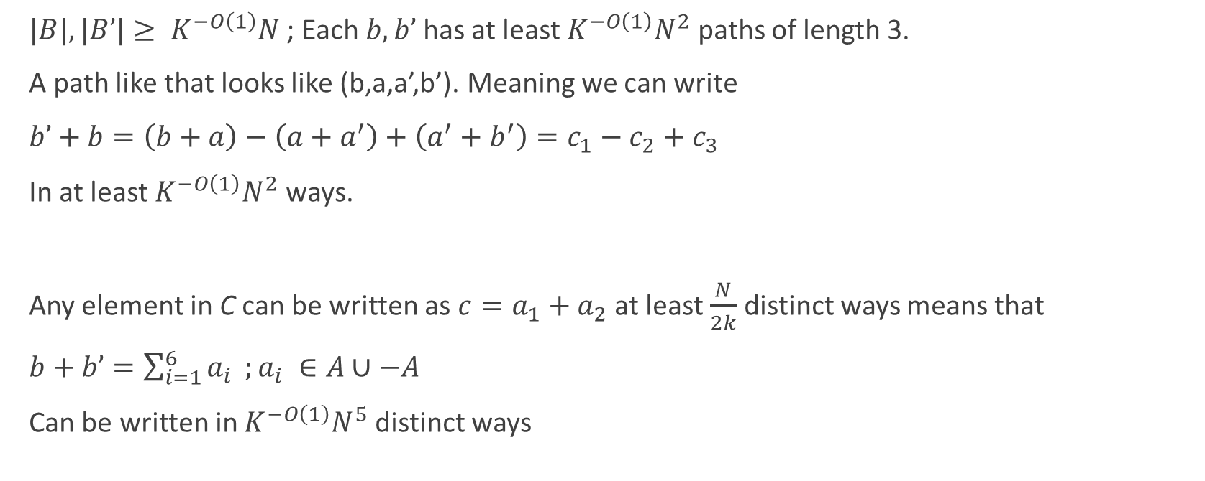
Proving Lemma 3 (3/4)
$|B|,|B’|≥ K^{−O\left(1\right)}N$ ; Each $b,b’$ has at least $K^{−O\left(1\right)}N^{2}$ paths of length 3.
A path like that looks like (b,a,a’,b’). Meaning we can write
$b’+b=\left(b+a\right)−\left(a+a^{′}\right)+\left(a^{′}+b^{′}\right)=c_{1}−c_{2}+c_{3}$
In at least $K^{−O\left(1\right)}N^{2}$ ways.
Any element in C can be written as $c=a_{1}+a_{2}$ at least $\frac{N}{2k}$ distinct ways means that
$b+b’=\sum_{i=1}^{6}{a_{i}} ;a_{i} ∈A∪−A$
Can be written in $K^{−O\left(1\right)}N^{5}$ distinct ways

Slide 11

Proving Lemma 3 (4/4)
So we can express any $b_{1}−b_{2}∈B−B$ as $(b_{1}+b’) – (b_{2}+b’)$ for any $b’∈ B′$ so overall we can express
$b_{1}−b_{2}=\sum_{i=1}^{12}{a_{i}};a_{i} ∈A∪−A$
in $K^{−O\left(1\right)}N^{5}⋅K^{−O\left(1\right)}N^{5}⋅K^{−O\left(1\right)}N=K^{−O\left(1\right)}N^{11}$ ways.
$B+B$ proven in similar way

Slide 12
Lemma 4
We proceed to prove by induction that any polynomial expression does not grow (which is the original goal of lemma 2)
Lemma 4: For any integers t,s there exists a constant c = c(t,s) > 0 such that the following holds.
If $\left|A+A\right|,\left|A⋅A\right|≤ {\left|A\right|}^{1+ε}$ then there exists $B⊂ A$ of size $\left|B\right|≥ {\left|A\right|}^{1−cε}$ such that
$|\left(B^{t}−B^{t}\right)B^{s} B^{−s}| ≤{\left|B\right|}^{1+cε}$

Slide 13
Lemma 2 Proof From Lemma 4
Reminder: Plünneke–Ruzsa theorem
$If \left|A−A\right|or \left|A+A\right|≤ K\left|A\right|then \left|mA−lA\right|≤ K^{m+l}\left|A\right|$ for any $m,l∈N$
Note that this is a stronger than lemma 2 for the case of linear functions

Slide 14
Lemma 2 Proof From Lemma 4
If $\left|A+A\right|,\left|A⋅A\right|≤ {\left|A\right|}^{1+ε}$ then there exists $B⊂ A$ of size $\left|B\right|≥{\left|A\right|}^{1−cε}$ such that
$|\left(B^{t}−B^{t}\right)B^{s} B^{−s}| ≤{\left|B\right|}^{1+cε}$
Plug $s=0$. we get that $|\left(B^{t}−B^{t}\right)| ≤{\left|B\right|}^{1+cε}$ .
By Plünneke–Ruzsa theorem, there exists c’ such that $|\left({tB}^{t}−{tB}^{t}\right)| ≤{\left|B\right|}^{1+c′ε}$. So we get that any monomial any sum of monomials over degree t is not large. Take t to be the degree of R(B) and we get that R(B) isn’t too large

Slide 15
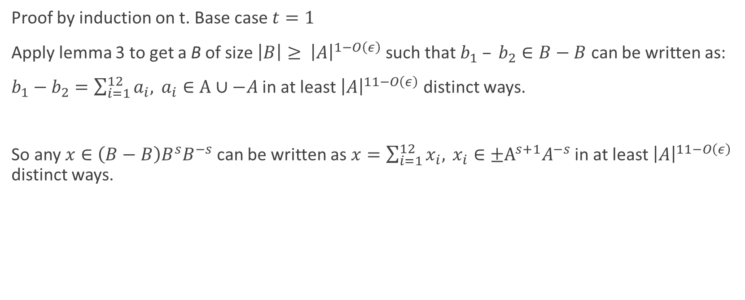
Proving Lemma 4 (1/8)
Proof by induction on t. Base case $t=1$
Apply lemma 3 to get a B of size $\left|B\right|≥ {\left|A\right|}^{1−O\left(ε\right)}$ such that $b_{1} – b_{2}∈B−B$ can be written as:
$b_{1}−b_{2}=\sum_{i=1}^{12}{a_{i},} a_{i}∈A∪−A$ in at least ${\left|A\right|}^{11−O\left(ε\right)}$ distinct ways.
So any $x∈\left(B−B\right)B^{s}B^{−s}$ can be written as $x=\sum_{i=1}^{12}{x_{i},} x_{i}∈{±A}^{s+1}A^{−s}$ in at least ${\left|A\right|}^{11−O\left(ε\right)}$ distinct ways.

Slide 16
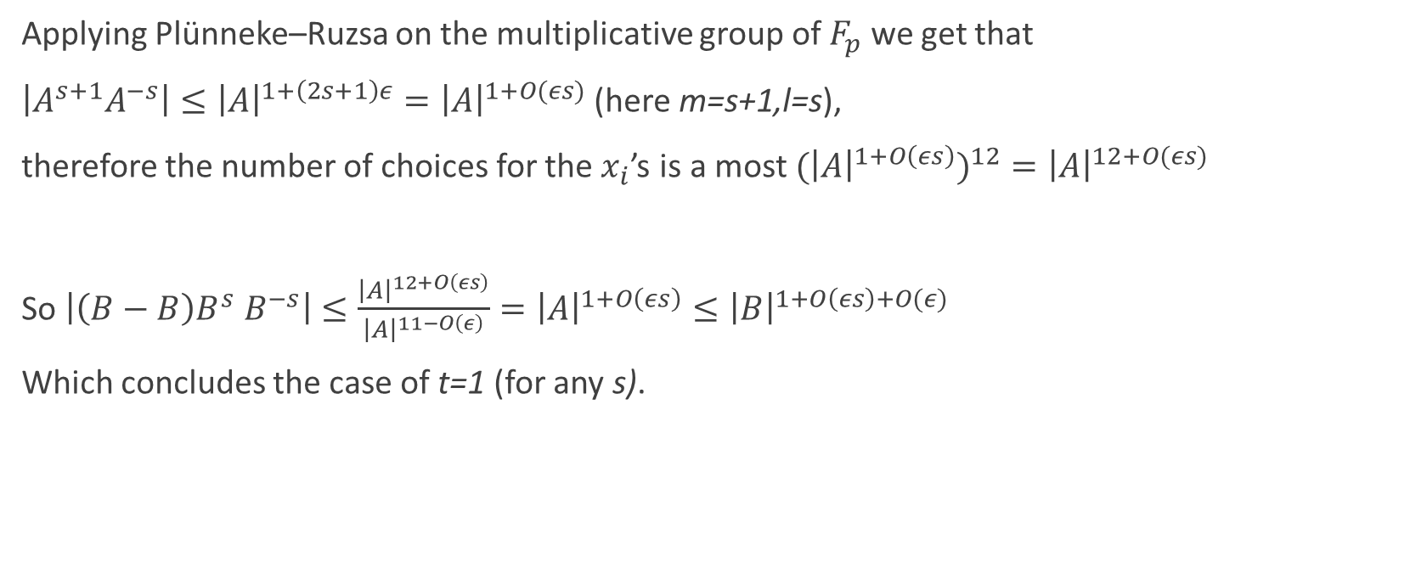
Proving Lemma 4 (2/8)
Applying Plünneke–Ruzsa on the multiplicative group of $F_{p}$ we get that
$\left|A^{s+1}A^{−s}\right|≤{\left|A\right|}^{1+\left(2s+1\right)ε}={\left|A\right|}^{1+O(εs)}$ (here m=s+1,l=s),
therefore the number of choices for the $x_{i}$’s is a most ${{(\left|A\right|}^{1+O\left(εs\right)})}^{12}={\left|A\right|}^{12+O(εs)}$
So $\left|\left(B−B\right)B^{s} B^{−s}\right|≤\frac{{\left|A\right|}^{12+O\left(εs\right)}}{{\left|A\right|}^{11−O\left(ε\right)}}={\left|A\right|}^{1+O\left(εs\right)}≤{\left|B\right|}^{1+O\left(εs\right)+O(ε)}$
Which concludes the case of t=1 (for any s).

Slide 17
Proving Lemma 4 (3/8)
Assume correctness for t, and we’ll show that it holds for t+1. Let l(t,s)=t+s+12.
By induction we assume that there exists $B⊂ A$ of size $\left|B\right|≥ {\left|A\right|}^{1−cε}$ s.t $|\left(B^{t}−B^{t}\right)B^{l} B^{−l}| ≤{\left|B\right|}^{1+cε}$.
In particular $\left|B⋅ B\right|≤ {\left|B\right|}^{1+cε}$, so applying lemma 3 to the multiplicative group of $F_{p}$, we get that there exists $C⊂ B$ of size $\left|C\right|≥ {\left|B\right|}^{1−O\left(cε\right)}$ s.t any $x∈ C⋅C$ can be written as
$x=Π_{i=1}^{12}b_{i} b_{i}∈B∪B^{−1}$ in at least ${\left|B\right|}^{11−O\left(cε\right)}$ distinct ways.

Slide 18
Proving Lemma 4 (4/8)
We can assume (and lose a constant factor) that for some $1≤m≤ 12$ , $b_{1},…,b_{m}∈ B$and $b_{m+1},…,b_{12}∈ B^{−1}$ (i.e elements in B are consecutive, and elements in $B^{−1}$ are consecutive)
Multiplying by an element in $C^{t−1}$ we get that we can write any element $x∈ C^{t+1}$ as
$x=Π_{i=1}^{12}b_{i} ;b_{1}∈B^{t},b_{2},…,b_{m}∈B,b_{m+1},…b_{12}∈B^{−1}$ in at least ${\left|B\right|}^{11−O\left(cε\right)}$ distinct ways.
Now we look at $x,y∈ C^{t+1},$ and look at $x=x_{1}⋅x_{2}⋅…⋅x_{12}, y=y_{1}⋅y_{2}⋅…⋅y_{12}$
$x_{1},y_{1}∈B^{t},$
$x_{i},y_{i}∈B for 2≤i≤m,$
$x_{i},y_{i}∈B^{−1} for m+1≤i≤12$

Slide 19

Proving Lemma 4 (5/8)
$x−y=x_{1}⋅x_{2}⋅…⋅x_{12}−y_{1}⋅y_{2}⋅…⋅y_{12}=$
$\left(x_{1}−y_{1}\right)x_{2}x_{3}…x_{12}+$
$y_{1}\left(x_{2}−y_{2}\right)x_{3}…x_{12}+$
$y_{1}y_{2}\left(x_{3}−y_{3}\right)x_{4}…x_{12}+$
… +
$y_{1}y_{2}…y_{11}(x_{12}−y_{12})$
(This is a telescopic sum)

Slide 20
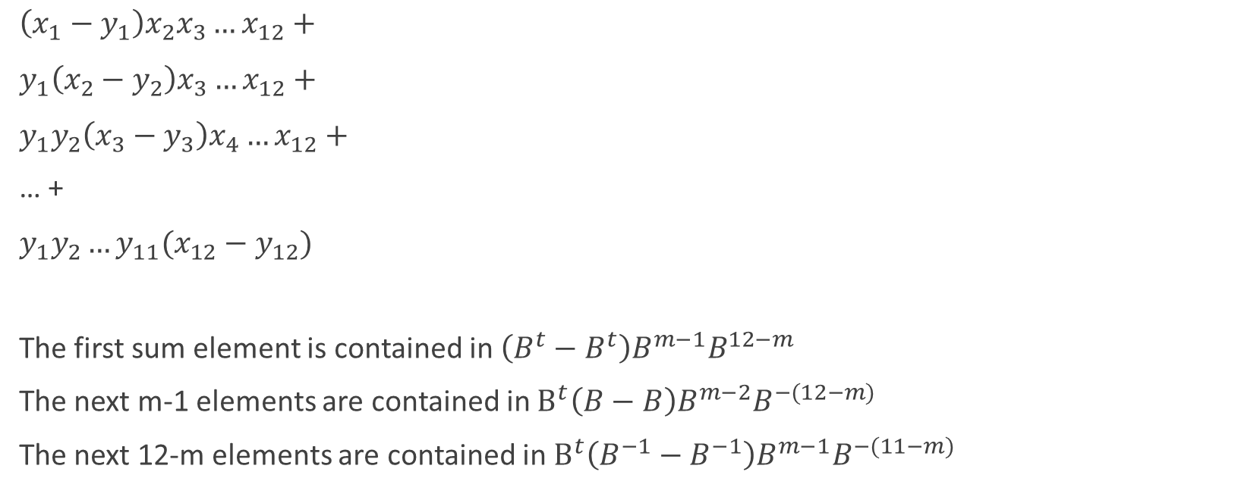
Proving Lemma 4 (6/8)
$\left(x_{1}−y_{1}\right)x_{2}x_{3}…x_{12}+$
$y_{1}\left(x_{2}−y_{2}\right)x_{3}…x_{12}+$
$y_{1}y_{2}\left(x_{3}−y_{3}\right)x_{4}…x_{12}+$
… +
$y_{1}y_{2}…y_{11}(x_{12}−y_{12})$
The first sum element is contained in $\left(B^{t}−B^{t}\right)B^{m−1}B^{12−m}$
The next m-1 elements are contained in $B^{t}\left(B−B\right)B^{m−2}B^{−(12−m)}$
The next 12-m elements are contained in $B^{t}\left(B^{−1}−B^{−1}\right)B^{m−1}B^{−(11−m)}$

Slide 21
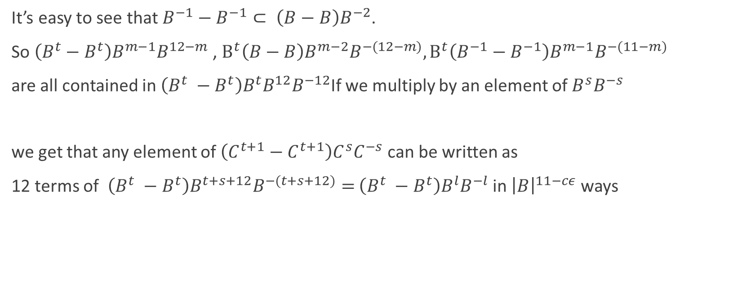
Proving Lemma 4 (7/8)
It’s easy to see that $B^{−1}−B^{−1}⊂ \left(B−B\right)B^{−2}$.
So $\left(B^{t}−B^{t}\right)B^{m−1}B^{12−m}$ , $B^{t}\left(B−B\right)B^{m−2}B^{−(12−m)},B^{t}\left(B^{−1}−B^{−1}\right)B^{m−1}B^{−(11−m)}$
are all contained in $\left(B^{t} −B^{t}\right)B^{t}B^{12}B^{−12}$If we multiply by an element of $B^{s}B^{−s}$
we get that any element of $\left(C^{t+1}−C^{t+1}\right)C^{s}C^{−s}$ can be written as
12 terms of $\left(B^{t} −B^{t}\right)B^{t+s+12}B^{−(t+s+12)}=$ $\left(B^{t} −B^{t}\right)B^{l}B^{−l}$ in ${\left|B\right|}^{11−cε}$ ways

Slide 22
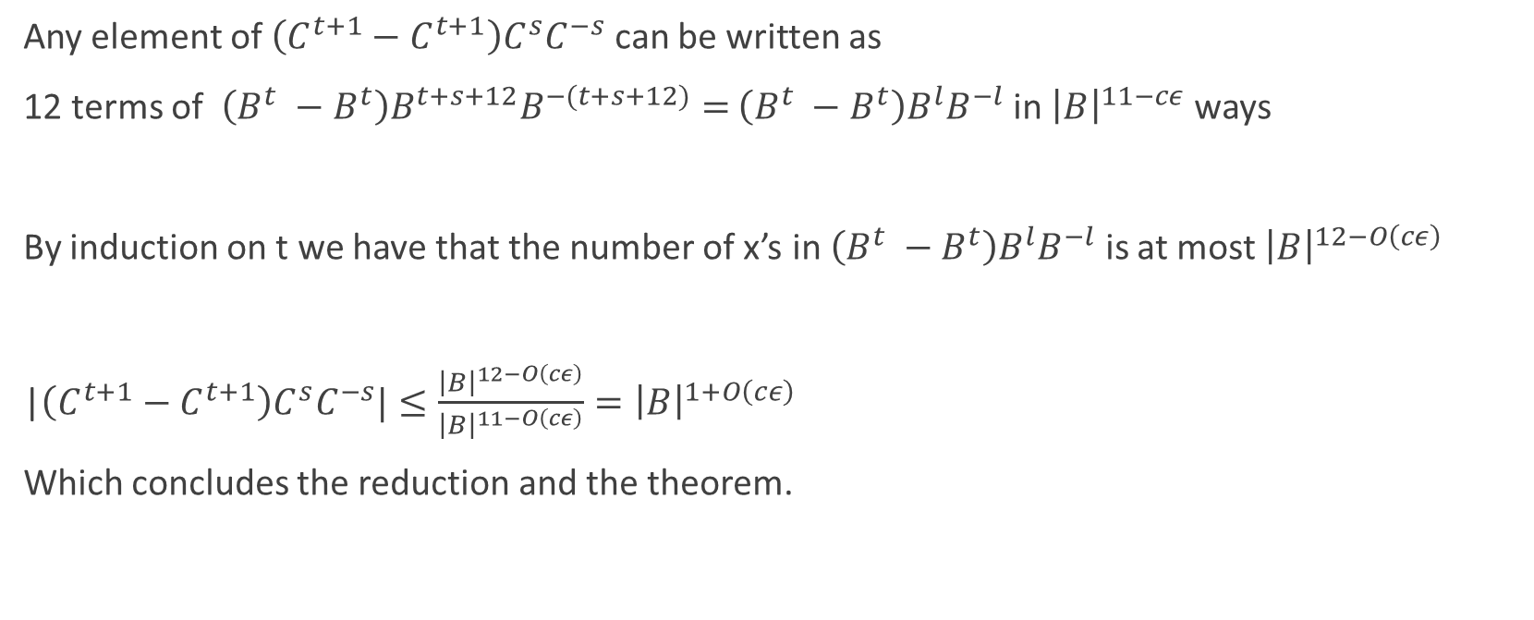
Proving Lemma 4 (8/8)
Any element of $\left(C^{t+1}−C^{t+1}\right)C^{s}C^{−s}$ can be written as
12 terms of $\left(B^{t} −B^{t}\right)B^{t+s+12}B^{−(t+s+12)}=$ $\left(B^{t} −B^{t}\right)B^{l}B^{−l}$ in ${\left|B\right|}^{11−cε}$ ways
By induction on t we have that the number of x’s in $\left(B^{t} −B^{t}\right)B^{l}B^{−l}$ is at most ${\left|B\right|}^{12−O\left(cε\right)}$
|$\left(C^{t+1}−C^{t+1}\right)C^{s}C^{−s}|≤\frac{{\left|B\right|}^{12−O\left(cε\right)}}{{\left|B\right|}^{11−O\left(cε\right)}}={\left|B\right|}^{1+O\left(cε\right)}$
Which concludes the reduction and the theorem.

Slide 23
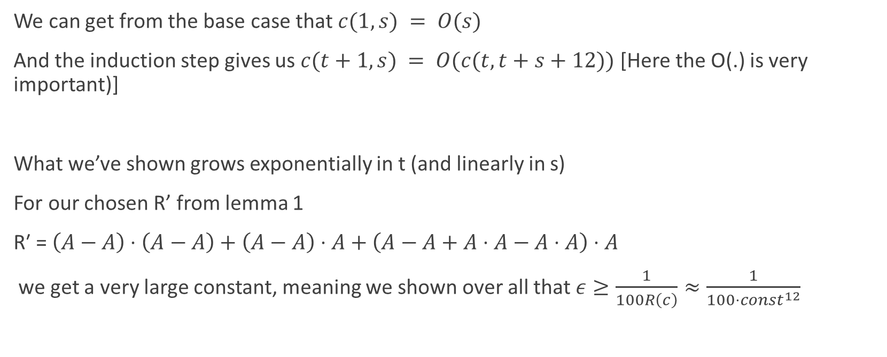
Considering the constants
We can get from the base case that $c(1,s) = O(s)$
And the induction step gives us $c(t+1,s) = O(c(t,t+s+12))$ [Here the O(.) is very important)]
What we’ve shown grows exponentially in t (and linearly in s)
For our chosen R’ from lemma 1
$\text{R}\text{′ = }\left(A−A\right)⋅\left(A−A\right)+\left(A−A\right)⋅A+\left(A−A+A⋅A−A⋅A\right)⋅A$
we get a very large constant, meaning we shown over all that $ε≥\frac{1}{100R\left(c\right)}≈\frac{1}{100⋅const^{12}}$

