Slide 1
Extractors
  Additive Combinatorics and its Applications in Theoretical CS
  Section 4.3.1,4.3.2
  Shachar Lovett
  Presented by Lior Shultz

Slide 2
Overview
Definitions – extractors and entropy
The Hadamard two-source extractor
An extractor for multiple sources

Slide 3
Extractors
Deterministic functions for “extracting” randmoness from “weak” random sources.

Slide 4
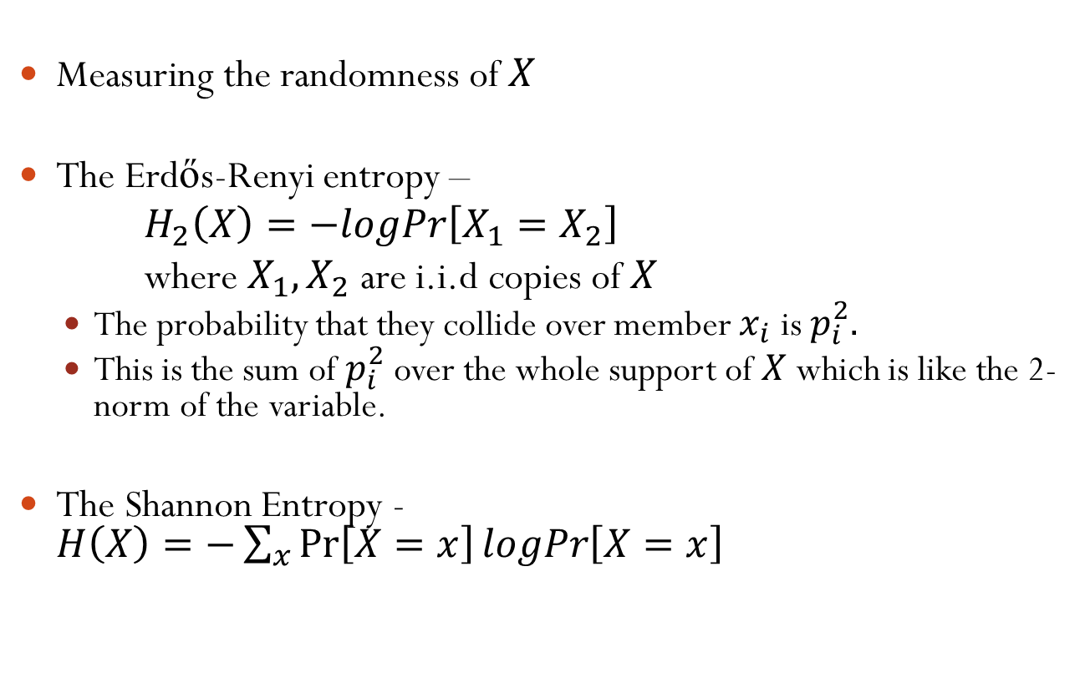
Entropy
Measuring the randomness of $X$
The Erdős-Renyi entropy –
$H_{2}\left(X\right)=−logPr\left[X_{1}=X_{2}\right]$
where $X_{1},X_{2}$ are i.i.d copies of $X$
  The probability that they collide over member $x_{i}$ is $p_{i}^{2}.$
  This is the sum of $p_{i}^{2}$ over the whole support of $X$ which is like the 2-norm of the variable.
The Shannon Entropy - $H\left(X\right)=−\sum_{x}{\operatorname{Pr}\left[X=x\right]logPr\left[X=x\right]}$

Slide 5
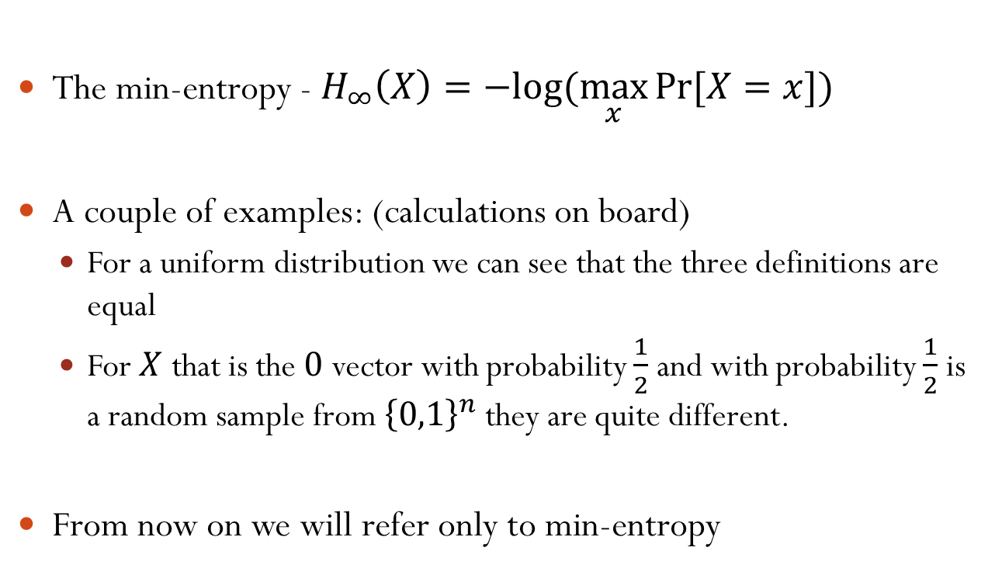
Entropy Cont.
The min-entropy - $H_{∞}\left(X\right)=−log⁡(\max_{x}{Pr⁡[X=x])}$
A couple of examples: (calculations on board)
  For a uniform distribution we can see that the three definitions are equal
  For $X$ that is the $0$ vector with probability $\frac{1}{2}$ and with probability $\frac{1}{2}$ is a random sample from ${\left\{0,1\right\}}^{n}$ they are quite different.
From now on we will refer only to min-entropy

Slide 6
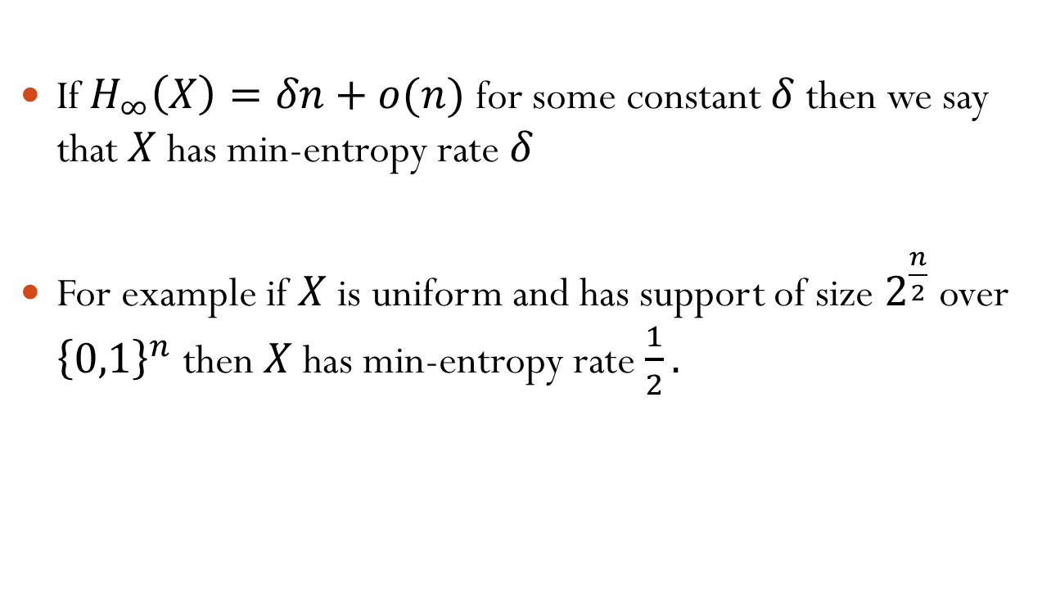
Min-Entropy Rate
If $H_{∞}\left(X\right)=δn+o(n)$ for some constant $δ$ then we say that $X$ has min-entropy rate $δ$
For example if $X$ is uniform and has support of size $2^{\frac{n}{2}}$ over ${\left\{0,1\right\}}^{n}$ then $X$ has min-entropy rate $\frac{1}{2}.$

Slide 7
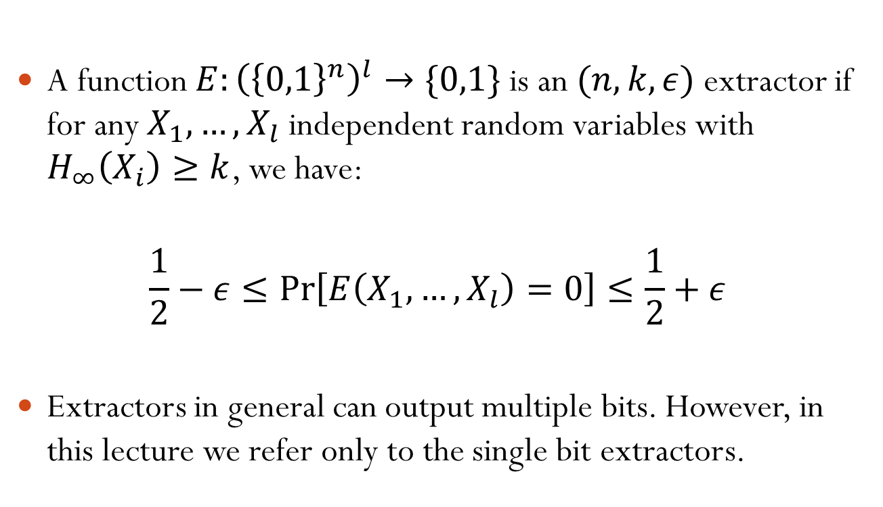
Multi-Source Extractors
A function $E:{\left({\left\{0,1\right\}}^{n}\right)}^{l}→\{0,1\}$ is an $(n,k,ε)$ extractor if for any $X_{1},…,X_{l}$ independent random variables with $H_{∞}\left(X_{i}\right)≥k$, we have:
$$\frac{1}{2}−ε≤\operatorname{Pr}\left[E\left(X_{1},…,X_{l}\right)=0\right]≤\frac{1}{2}+ε$$
Extractors in general can output multiple bits. However, in this lecture we refer only to the single bit extractors.

Slide 8
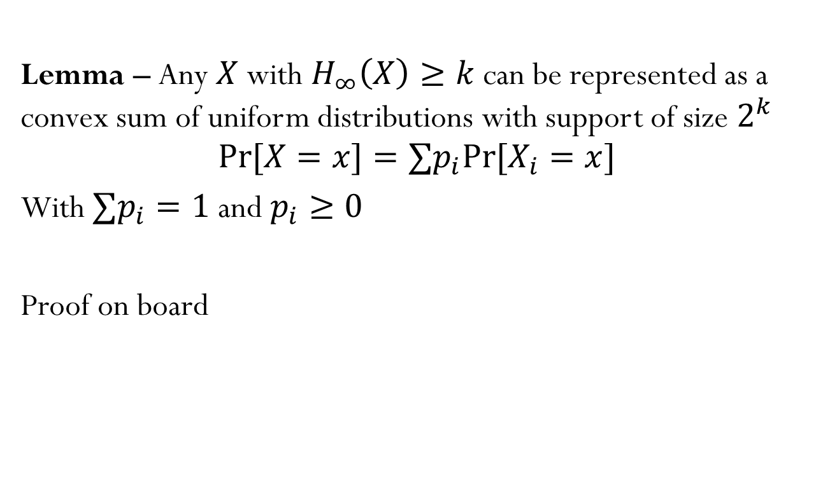
Combinations of Uniform Distributions
Lemma – Any $X$ with $H_{∞}\left(X\right)≥k$ can be represented as a convex sum of uniform distributions with support of size $2^{k}$
$$\operatorname{Pr}{[X=x]}=∑p_{i}Pr⁡[X_{i}=x]$$
With $∑p_{i}=1$ and $p_{i}≥0$
Proof on board

Slide 9
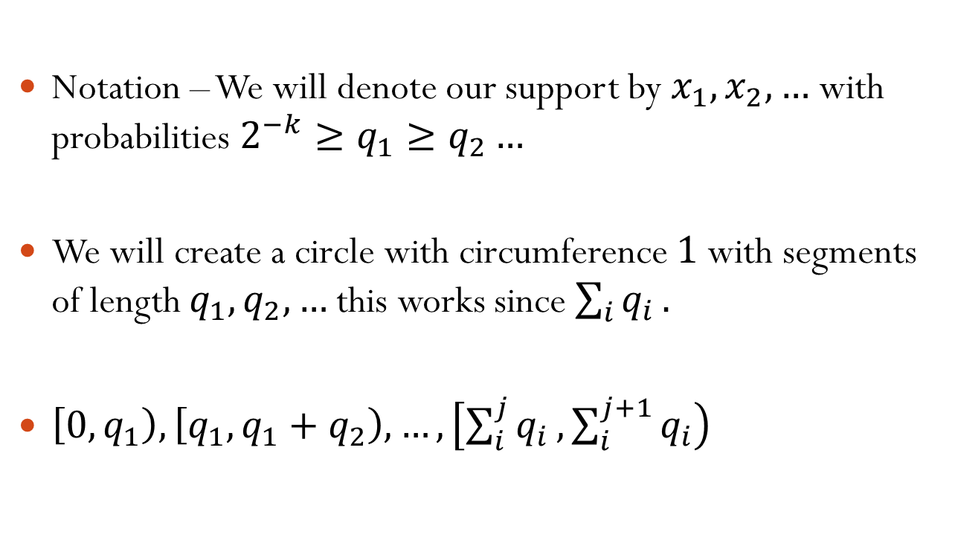
Proof of Lemma 1/4
Notation – We will denote our support by $x_{1},x_{2},…$ with probabilities $2^{−k}≥q_{1}≥q_{2}…$
We will create a circle with circumference $1$ with segments of length $q_{1},q_{2},…$ this works since $\sum_{i}{q_{i}}.$
$\left[0,q_{1}\right),\left[q_{1},q_{1}+q_{2}\right),…,\left[\sum_{i}^{j}{q_{i}},\sum_{i}^{j+1}{q_{i}}\right)$

Slide 10



Proof of Lemma 2/4
$$q_{1}$$
$$q_{2}$$
$$q_{3}$$

Slide 11
Proof of Lemma 3/4
$$q_{1}$$
$$q_{2}$$
$$q_{3}$$
Notes:
Need to say that no 2 points can be in the same segment

Slide 12
Proof of Lemma 4/4
The amount of “time” that points are in each segment is exactly equal to the segment size.
No two points are in the same segment.
Thus we can create the required probability.

Slide 13
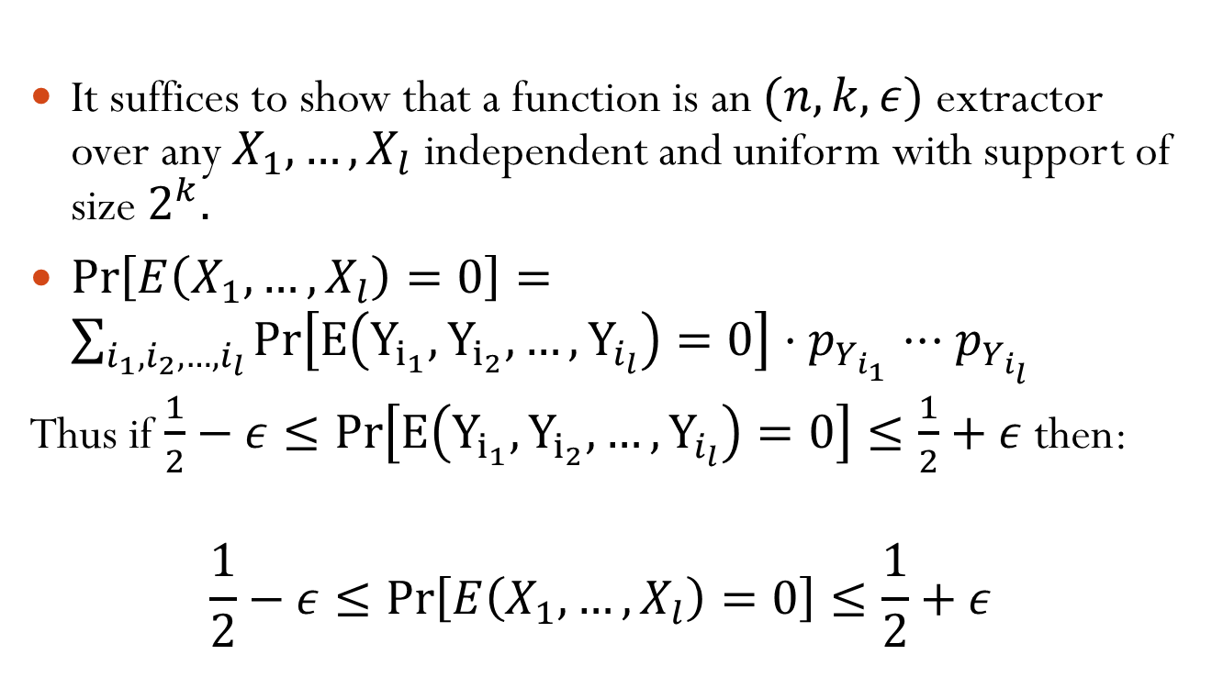
Corollary
It suffices to show that a function is an $(n,k,ε)$ extractor over any $X_{1},…,X_{l}$ independent and uniform with support of size $2^{k}.$
$\operatorname{Pr}\left[E\left(X_{1},…,X_{l}\right)=0\right]=\sum_{i_{1},i_{2},…,i_{l}}{Pr\left[E\left(Y_{i_{1}},Y_{i_{2}},…,Y_{i_{l}}\right)=0\right]⋅p_{Y_{i_{1}}}⋅⋅⋅p_{Y_{i_{l}}}}$
Thus if $\frac{1}{2}−ε≤Pr\left[E\left(Y_{i_{1}},Y_{i_{2}},…,Y_{i_{l}}\right)=0\right]≤\frac{1}{2}+ε$ then:
$$\frac{1}{2}−ε≤\operatorname{Pr}\left[E\left(X_{1},…,X_{l}\right)=0\right]≤\frac{1}{2}+ε$$

Slide 14
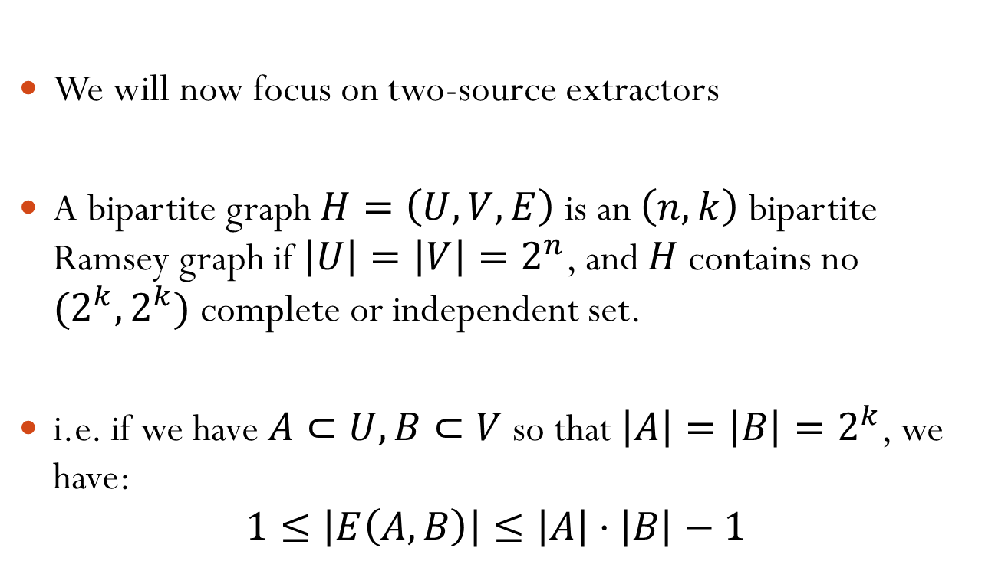
Ramsey Graphs
We will now focus on two-source extractors
A bipartite graph $H=\left(U,V,E\right)$ is an $\left(n,k\right)$ bipartite Ramsey graph if $\left|U\right|=\left|V\right|=2^{n}$, and $H$ contains no $(2^{k},2^{k})$ complete or independent set.
i.e. if we have $A⊂U,B⊂V$ so that $\left|A\right|=\left|B\right|=2^{k}$, we have:
$$1≤\left|E\left(A,B\right)\right|≤\left|A\right|⋅\left|B\right|−1$$

Slide 15
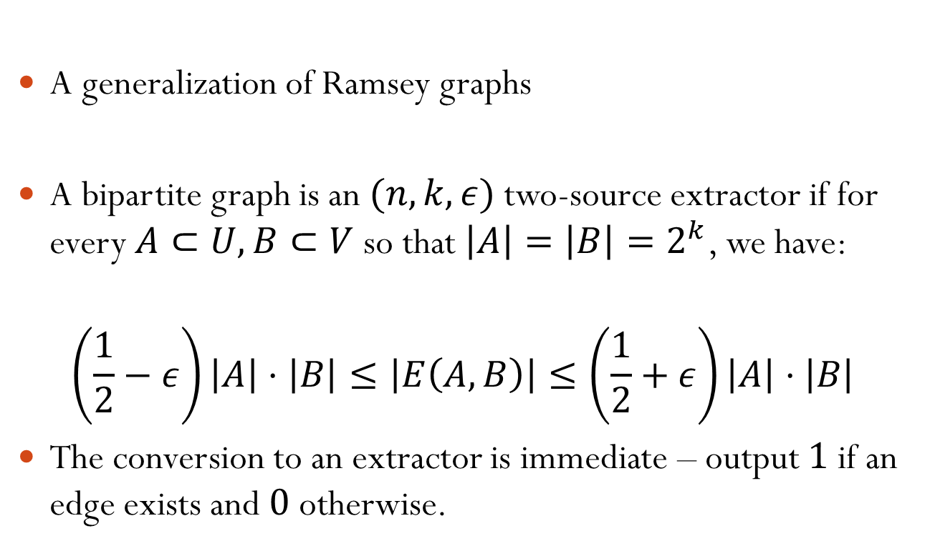
Extractors Graphs
A generalization of Ramsey graphs
A bipartite graph is an $(n,k,ε)$ two-source extractor if for every $A⊂U,B⊂V$ so that $\left|A\right|=\left|B\right|=2^{k}$, we have:
$$\left(\frac{1}{2}−ε\right)\left|A\right|⋅\left|B\right|≤\left|E\left(A,B\right)\right|≤\left(\frac{1}{2}+ε\right)\left|A\right|⋅\left|B\right|$$
The conversion to an extractor is immediate – output $1$ if an edge exists and $0$ otherwise.

Slide 16
The Hadamard Two-Source Extractor

Slide 17

The Hadamard Two-Source Extractor
$U=V=𝔽_{2}^{n}$ and $E=\{\left(u,v\right)∈𝔽_{2}^{n}×𝔽_{2}^{n}:\left\langle u,v\right\rangle =0\}$

Slide 18

Claim
$E_{Had}$ is an $(n,k)$ bipartite Ramsey graph for $k=\frac{n}{2}+1.$

Slide 19
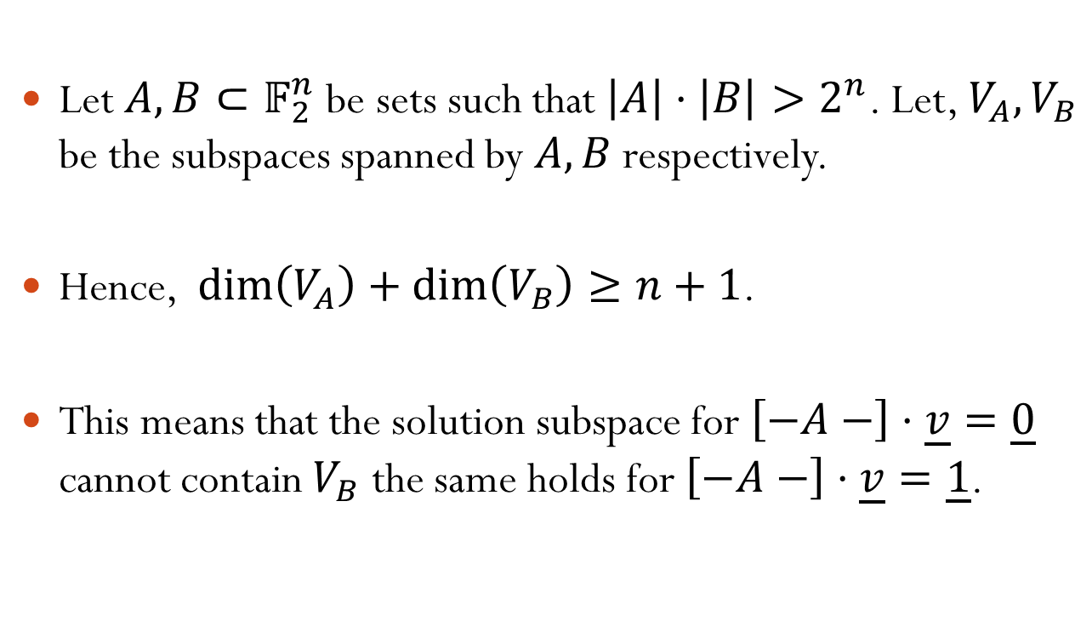
Proof
Let $A,B⊂𝔽_{2}^{n}$ be sets such that $\left|A\right|⋅\left|B\right|>2^{n}$. Let, $V_{A},V_{B}$ be the subspaces spanned by $A,B$ respectively.
Hence, $\dim\left(V_{A}\right)+\dim\left(V_{B}\right)≥n+1$.
This means that the solution subspace for $\left[−A−\right]⋅\underline{v}=\underline{0}$ cannot contain $V_{B}$ the same holds for $\left[−A−\right]⋅\underline{v}=\underline{1}$.

Slide 20
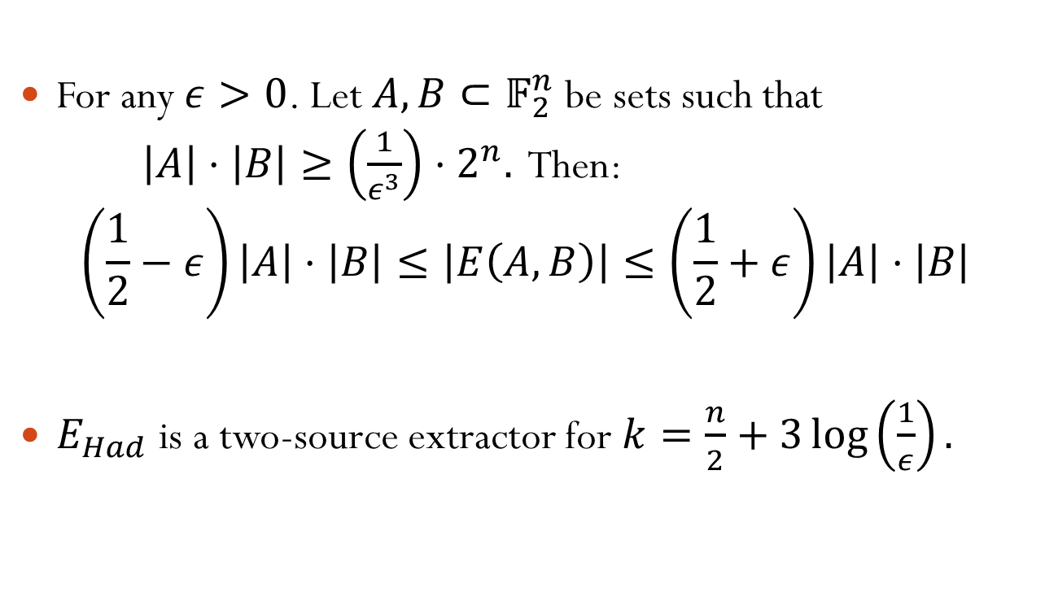
Claim
For any $ε>0$. Let $A,B⊂𝔽_{2}^{n}$ be sets such that $\left|A\right|⋅\left|B\right|≥\left(\frac{1}{ε^{3}}\right)⋅2^{n}.$ Then:
$$\left(\frac{1}{2}−ε\right)\left|A\right|⋅\left|B\right|≤\left|E\left(A,B\right)\right|≤\left(\frac{1}{2}+ε\right)\left|A\right|⋅\left|B\right|$$
$E_{Had}$ is a two-source extractor for $k=\frac{n}{2}+3\log\left(\frac{1}{ε}\right).$

Slide 21

Hadamard Extractor Proof 1/6
An equivalent statement:
$$\left|𝔼_{a∈A,b∈B}\left[{\left(−1\right)}^{\left\langle a,b\right\rangle }\right]\right|≤2ε$$
Where $A,B$ are sampled uniformly and independently.

Slide 22
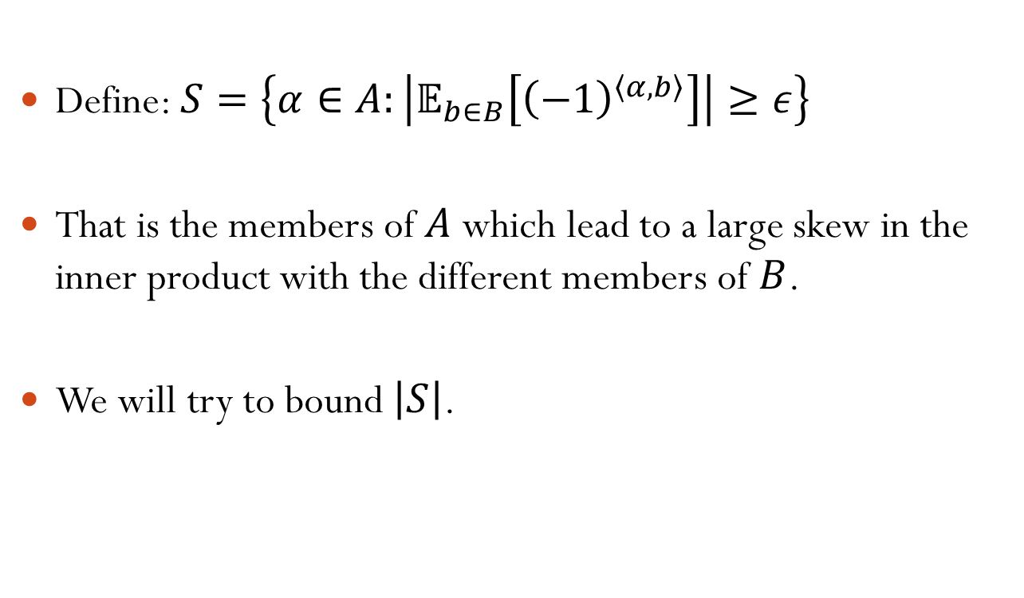
Hadamard Extractor Proof 2/6
Define: $S=\left\{α∈A:\left|𝔼_{b∈B}\left[{\left(−1\right)}^{\left\langle α,b\right\rangle }\right]\right|≥ε\right\}$
That is the members of $A$ which lead to a large skew in the inner product with the different members of $B$.
We will try to bound $\left|S\right|$.

Slide 23
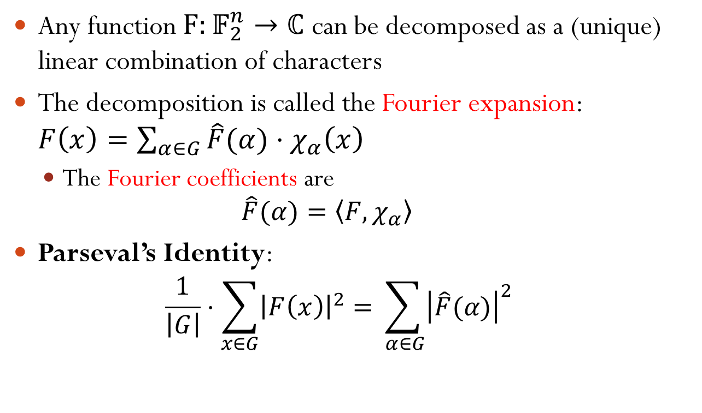

Reminder - Fourier Expansion
Any function $F:𝔽_{2}^{n}→ℂ$ can be decomposed as a (unique) linear combination of characters
The decomposition is called the Fourier expansion: $F\left(x\right)=\sum_{α∈G}{\hat{F}(α)⋅χ_{α}\left(x\right)}$
  The Fourier coefficients are
    $$\hat{F}(α)=\left\langle F,χ_{α}\right\rangle$$
Parseval’s Identity:
  $$\frac{1}{\left|G\right|}⋅\sum_{x∈G}{{\left|F\left(x\right)\right|}^{2}}=\sum_{ α∈G}{{\left|\hat{F}(α)\right|}^{2}}$$
$$©Oleg Z.$$

Slide 24
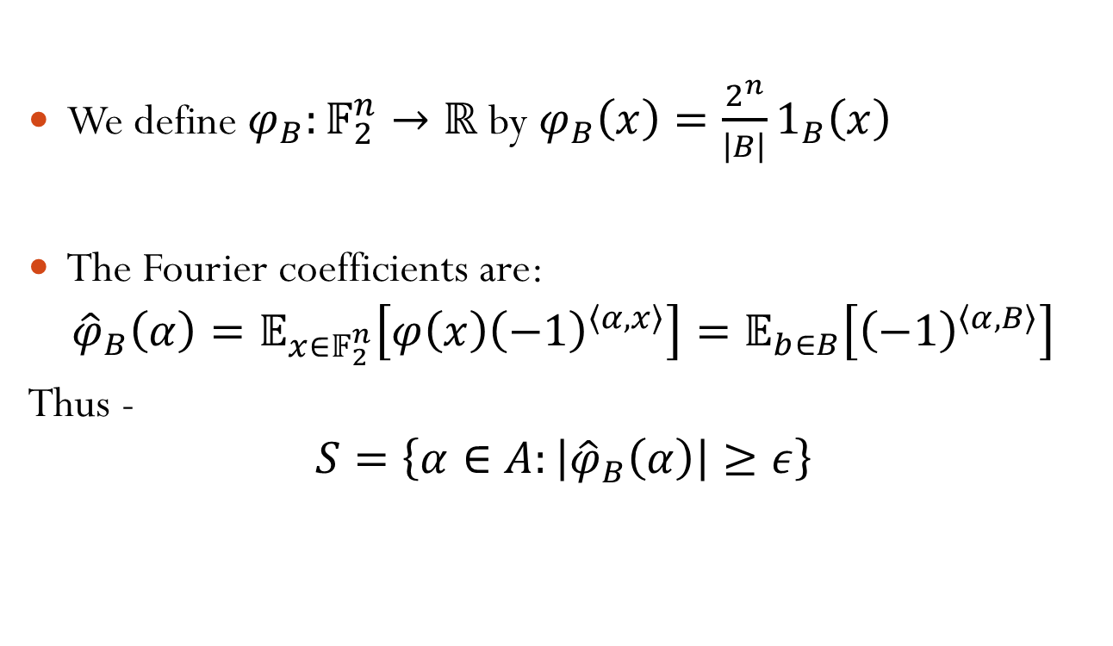
Hadamard Extractor Proof 3/6
We define $φ_{B}:𝔽_{2}^{n}→ℝ$ by $φ_{B}\left(x\right)=\frac{2^{n}}{\left|B\right|}1_{B}\left(x\right)$
The Fourier coefficients are:
$${\hat{φ}}_{B}\left(α\right)=𝔼_{x∈𝔽_{2}^{n}}\left[φ\left(x\right){\left(−1\right)}^{\left\langle α,x\right\rangle }\right]=𝔼_{b∈B}\left[{\left(−1\right)}^{\left\langle α,B\right\rangle }\right]$$
Thus -
$$S=\left\{α∈A:\left|{\hat{φ}}_{B}\left(α\right)\right|≥ε\right\}$$

Slide 25
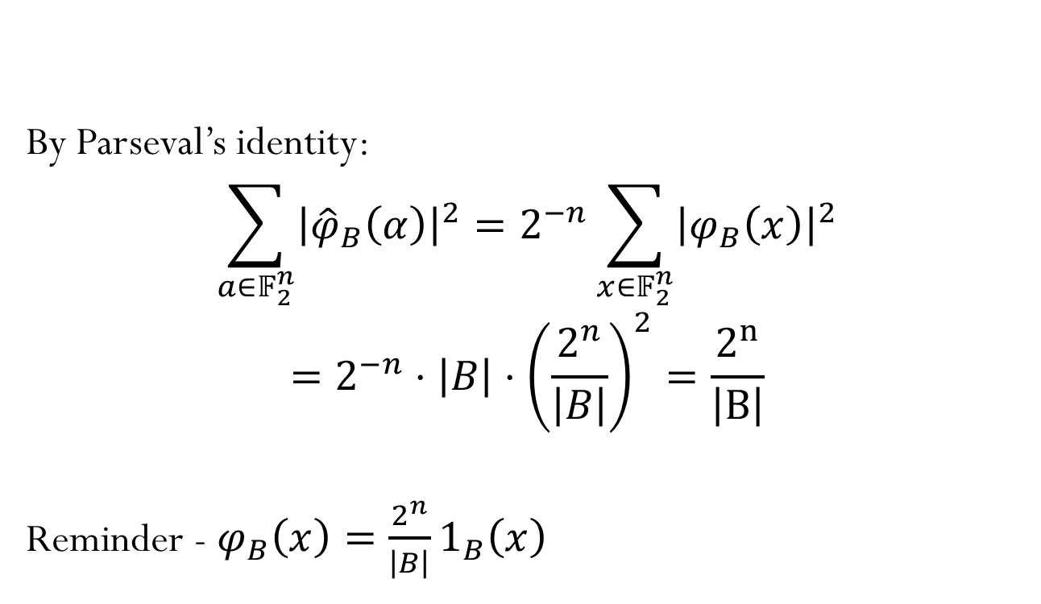
Hadamard Extractor Proof 4/6
By Parseval’s identity:
$$\sum_{a∈𝔽_{2}^{n}}{{\left|{\hat{φ}}_{B}\left(α\right)\right|}^{2}}=2^{−n}\sum_{x∈𝔽_{2}^{n}}{{\left|φ_{B}\left(x\right)\right|}^{2}}$$
$$=2^{−n}⋅\left|B\right|⋅{\left(\frac{2^{n}}{\left|B\right|}\right)}^{2}=\frac{2^{n}}{\left|B\right|}$$
Reminder - $φ_{B}\left(x\right)=\frac{2^{n}}{\left|B\right|}1_{B}\left(x\right)$

Slide 26

Hadamard Extractor Proof 5/6
Thus because $\left|{\hat{φ}}_{B}\left(α\right)\right|≥ε$ for all $α∈S$:
$$\left|S\right|⋅ε^{2}≤\frac{2^{n}}{\left|B\right|}$$
$$\left|S\right|≤\frac{1}{ε^{2}}⋅\frac{2^{n}}{\left|B\right|}$$
And because $\left|A\right|⋅\left|B\right|≥\frac{1}{ε^{3}}⋅2^{n}$:
$$\left|S\right|≤ε\left|A\right|$$

Slide 27

Hadamard Extractor Proof 6/6
$$\left|𝔼_{a∈A,b∈B}\left[{\left(−1\right)}^{\left\langle a,b\right\rangle }\right]\right|≤\frac{1}{\left|A\right|}\left(\left|S\right|+\sum_{a∈A\backslash S}{\left|𝔼_{b∈B}\left[{\left(−1\right)}^{\left\langle a,b\right\rangle }\right]\right|}\right)≤2ε$$
$∎$

Slide 28

Multi-Source Extractor for any $δ$

Slide 29
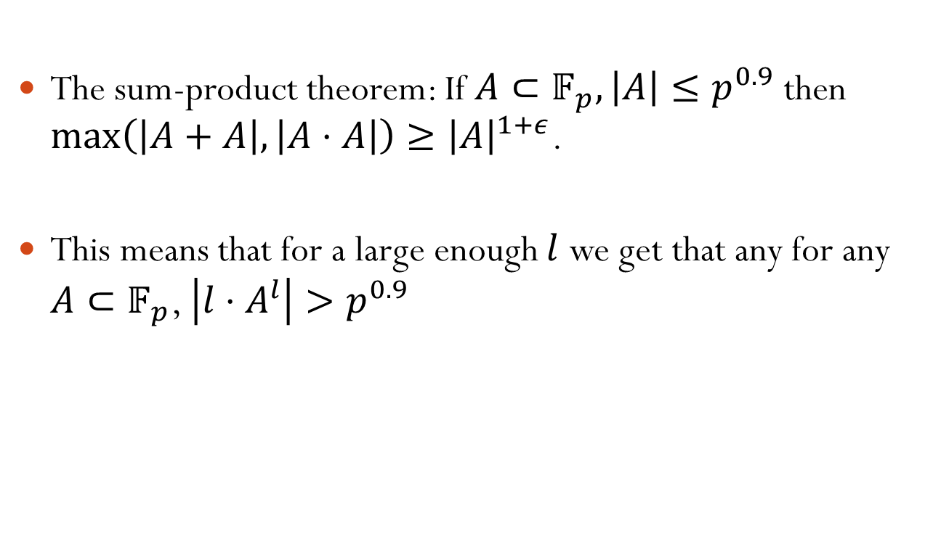
Reminder
The sum-product theorem: If $A⊂𝔽_{p},\left|A\right|≤p^{0.9}$ then $\max\left(\left|A+A\right|,\left|A⋅A\right|\right)≥{\left|A\right|}^{1+ε}$.
This means that for a large enough $l$ we get that any for any $A⊂𝔽_{p}$, $\left|l⋅A^{l}\right|>p^{0.9}$

Slide 30
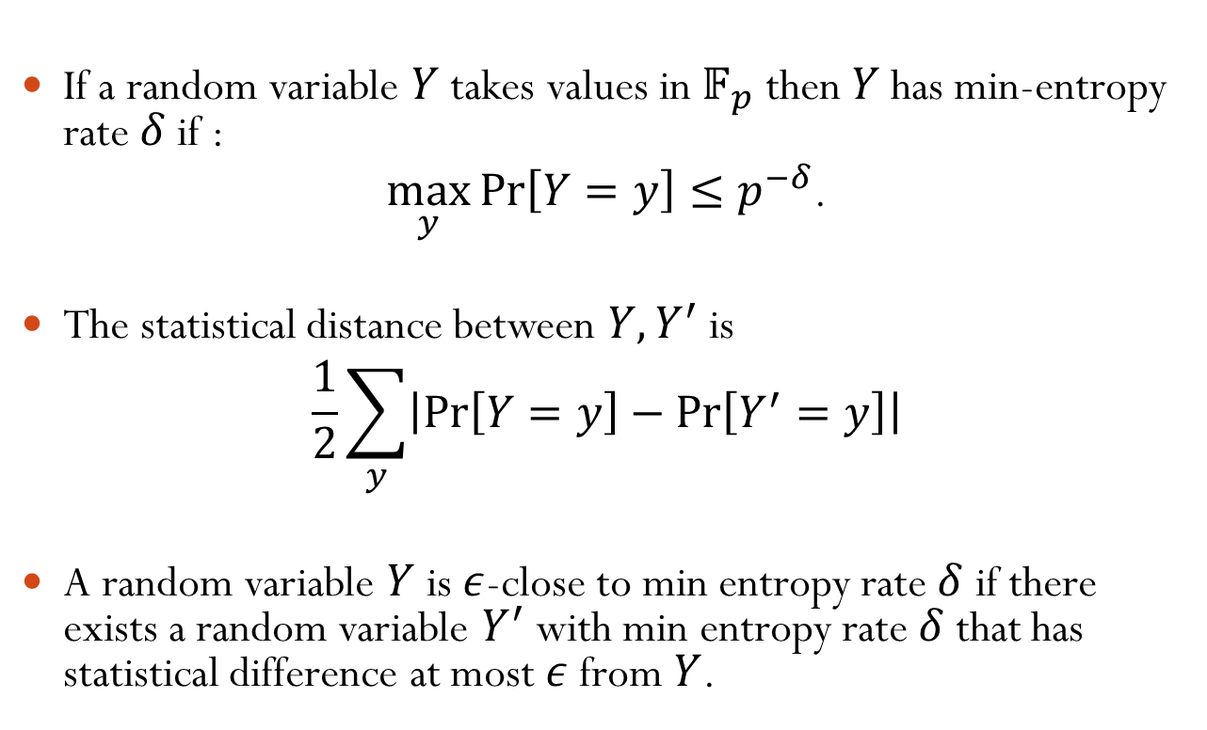
Statistical Analogy - Notation
If a random variable $Y$ takes values in $𝔽_{p}$ then $Y$ has min-entropy rate $δ$ if :
$\max_{y}{\operatorname{Pr}\left[Y=y\right]}≤p^{−δ}$.
The statistical distance between $Y,Y^{′}$ is
$$\frac{1}{2}\sum_{y}{\left|\operatorname{Pr}\left[Y=y\right]−\operatorname{Pr}\left[Y^{′}=y\right]\right|}$$
A random variable $Y$ is $ε$-close to min entropy rate $δ$ if there exists a random variable $Y^{′}$ with min entropy rate $δ$ that has statistical difference at most $ε$ from $Y$.

Slide 31
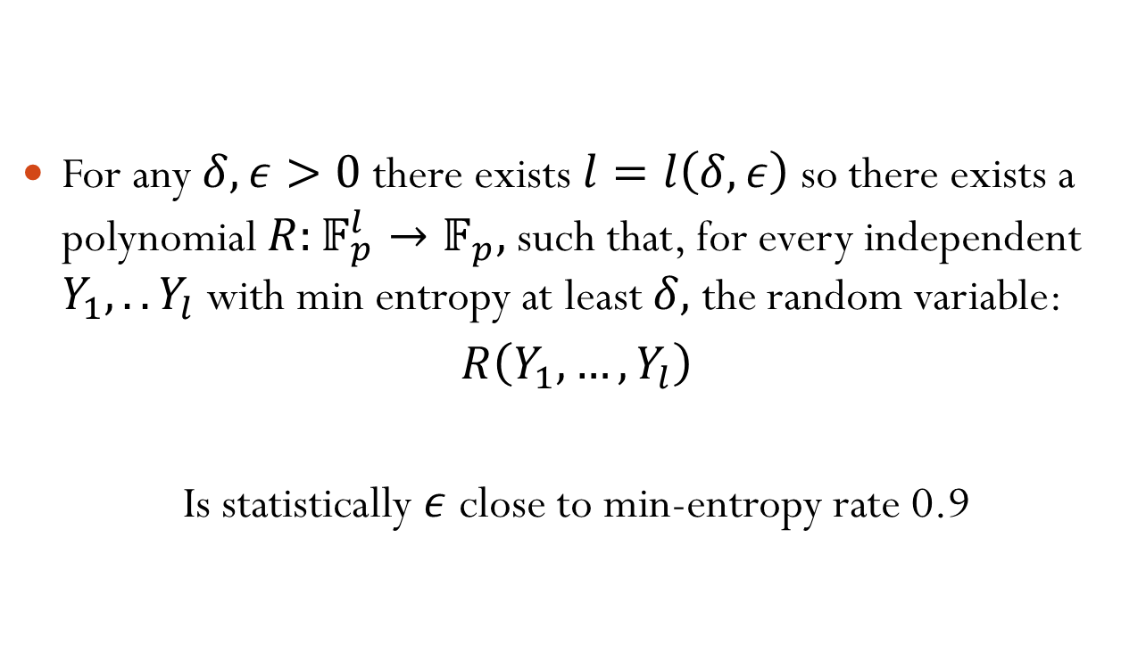
Statistical Analogy - Theorem
For any $δ,ε>0$ there exists $l=l\left(δ,ε\right)$ so there exists a polynomial $R:𝔽_{p}^{l}→𝔽_{p},$ such that, for every independent $Y_{1},..Y_{l}$ with min entropy at least $δ,$ the random variable:
$R\left(Y_{1},…,Y_{l}\right)$
Is statistically $ε$ close to min-entropy rate 0.9
BARAK, IMPAGLIAZZO, WIGDERSON 2006

Slide 32
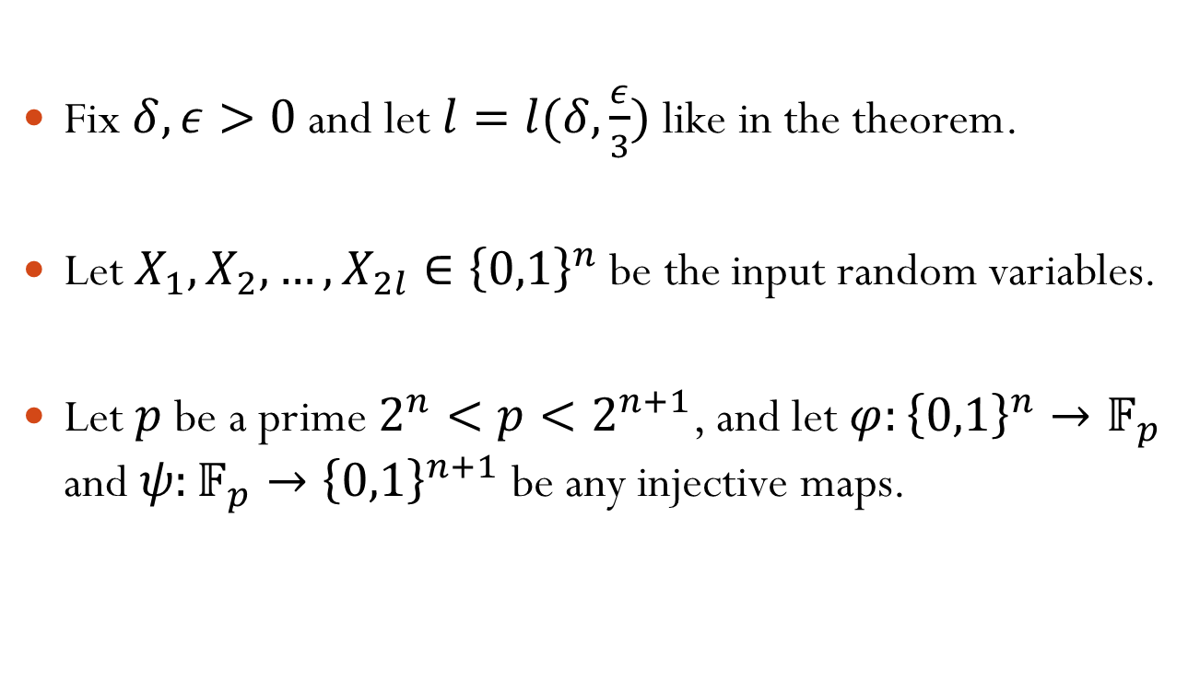
Extractor Theorem - Notations
Fix $δ,ε>0$ and let $l=l(δ,\frac{ε}{3})$ like in the theorem.
Let $X_{1},X_{2},…,X_{2l}∈{\left\{0,1\right\}}^{n}$ be the input random variables.
Let $p$ be a prime $2^{n}<p<2^{n+1}$, and let $φ:{\left\{0,1\right\}}^{n}→𝔽_{p}$ and $ψ:𝔽_{p}→{\left\{0,1\right\}}^{n+1}$ be any injective maps.

Slide 33
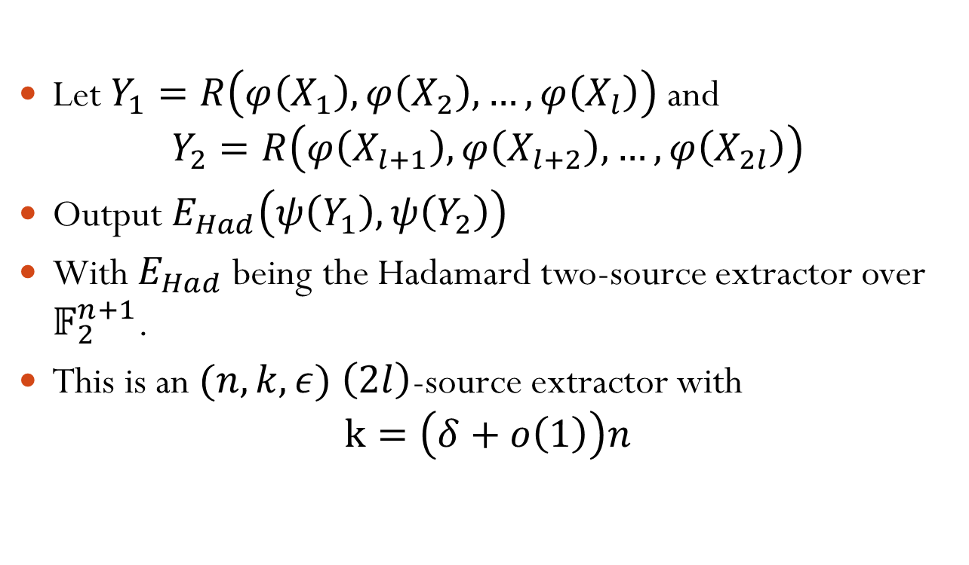
Extractor Theorem - Algorithm
Let $Y_{1}=R\left(φ\left(X_{1}\right),φ\left(X_{2}\right),…,φ\left(X_{l}\right)\right)$ and
$Y_{2}=R\left(φ\left(X_{l+1}\right),φ\left(X_{l+2}\right),…,φ\left(X_{2l}\right)\right)$
Output $E_{Had}\left(ψ\left(Y_{1}\right),ψ\left(Y_{2}\right)\right)$
With $E_{Had}$ being the Hadamard two-source extractor over $𝔽_{2}^{n+1}$.
This is an $(n,k,ε)$ $\left(2l\right)$-source extractor with
$k=\left(δ+o\left(1\right)\right)n$

Slide 34
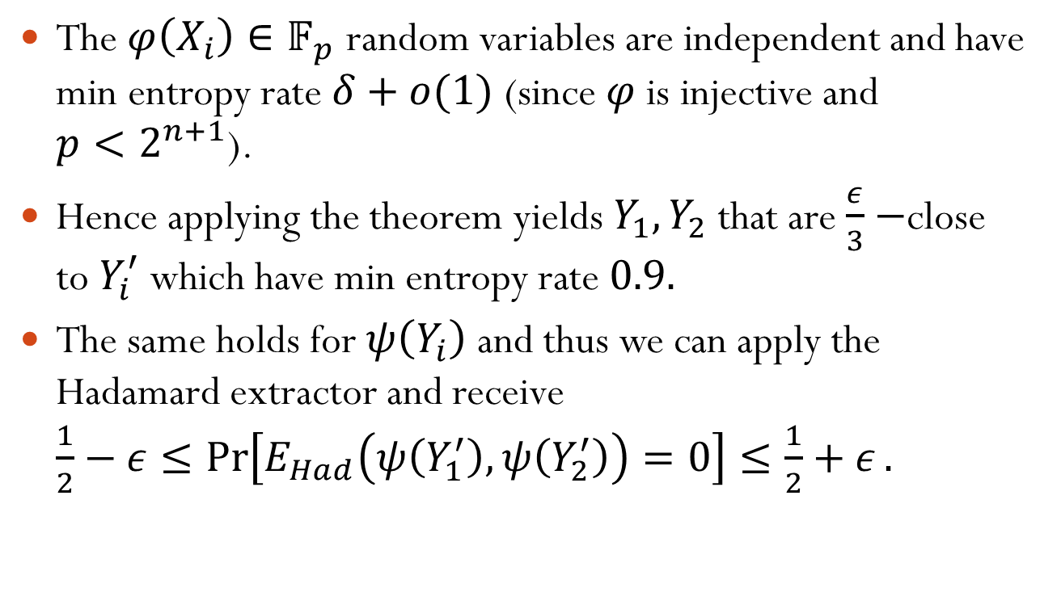
Extractor Algorithm - Proof
The $φ\left(X_{i}\right)∈𝔽_{p}$ random variables are independent and have min entropy rate $δ+o(1)$ (since $φ$ is injective and $p<2^{n+1}$).
Hence applying the theorem yields $Y_{1},Y_{2}$ that are $\frac{ε}{3}−$close to $Y_{i}^{′}$ which have min entropy rate $0.9.$
The same holds for $ψ\left(Y_{i}\right)$ and thus we can apply the Hadamard extractor and receive $\frac{1}{2}−ε≤\operatorname{Pr}\left[E_{Had}\left(ψ\left(Y_{1}^{′}\right),ψ\left(Y_{2}^{′}\right)\right)=0\right]≤\frac{1}{2}+ε.$

Slide 35
Questions?

