Slide 1
On the resemblance and containment of documents
(MinHash)
Andrei Z. Broder
Ori Press
oripress@mail.tau.ac.il
Veronica Latzinnik
latzinnik.veronica@gmail.com

Slide 2
Agenda
Motivation
Some definitions
Estimating resemblance and containment
Implementation Details
Experimental results
Summary

Slide 3
Motivation
How do we determine if two documents are similar or contained in each other?
Standard distance metrics (like Hamming) are defined on strings, and require the pairwise comparison of entire documents - not feasible for a large amount!
Notes:
The technique presented in this paper was initially used in the AltaVista search engine to detect duplicate web pages and eliminate them from search results, and later by Google for news personalization.
The MinHash algorithm has been adapted for bioinformatics, where the problem of comparing genome content has a similar theoretical underpinning to that of comparing documents on the web.

Slide 4
Resemblance and Containment
Let A, B be two documents. Our goal is to estimate their resemblance and containment:
r(A, B) - a number between 0 and 1, such that when the it is close to 1 it is likely that the documents are roughly the same.
c(A, B) - a number between 0 and 1 that, when close to 1, indicates that A is roughly contained within B.
d(A, B)=1 − r(A, B)

Slide 5
General idea
We’ll be able to calculate resemblance/containment only using a small “sketch” of the document.
The sketch will be computed relatively fast (linear in the size of the document)
Resemblance and containment will be computed in linear time in the size of the sketches.
Resemblance requires a fixed size sketch
Containment required a sketch proportional to the document size (but it’s not that bad)

Slide 6
Preprocessing
Tokenize the document (ignore punctuation, capitalization, and formatting)
Tokens can be individual words, groups of words, or whole lines
Each document can now be viewed as a sequence of tokens

Slide 7
Definitions - 1
Label a given document with D
S(D, w) is the set of subsequences of tokens associated with D.
We would like to obtain S(D, w). How?

Slide 8
Definitions - 2
A continuous subsequence in D is called a shingle.
w-shingle is a shingle of size w (=k-mer)
The multiset containing all of the shingles of D of size w is called the w-shingling of D - S(D, w).

Slide 9
Two options for defining S(D, w):
D =
Option A - labelling each element of a w-shingling with its occurrence number.
Option B - take S(D, w) to be the set of shingles in D.
Notes:
Option A keeps more information about the document; option B is more efficient.

Slide 10
Defining resemblance and containment
Now that we defined S(D, w) and have chosen w, we can define:
Notes:
As an example if A = (a,rose,is,a,rose,is,a,rose) and B = (a,rose,is,a,flower,which,is,a,rose) then under the first option A resembles B 70% for shingle size 1, 50% for size 2, 30% for size 3, etc. Under the second option, A resembles B 60% for size 1, 50% for size 2, 42.85% for size 3, etc.
Several things to note:
r(A, A) = 1
resemblance is not transitive
resemblance distance (dw(A, B)=1 − rw(A, B)) is a metric
even under option A, if A resembles B 100% for shingle size 1, it only means that B is an arbitrary permutation of A; for larger sizes if A resembles B 100% it is still the case that B could be a permutation of A but only certain permutations are possible.To make resemblance more sensitive to permutation changes we have to take a larger size; on the other hand a large size is possibly over-sensitive to small alterations since the change in one token affects w shingles.
The goal of MinHash is to estimate J(A,B) quickly, without explicitly computing the intersection and union.

Slide 11
Recap
We wanted to define metrics to estimate similarity and containment of documents.
We defined how we want these metrics to behave.
We defined S(D,w) as the set of subsequences representing the document.
We defined r(A, B) and c(A, B) using S(D,w).
Now we will present how r(A, B) and c(A, B) can be estimated.

Slide 12
Estimating the resemblance and the containment
Our goal is to represent documents with relatively smaller “sketches”
We want to be able to compute resemblance/containment using these sketches
We’ll show 2 ways to generate sketches from a given document, and prove that they’re good

Slide 13
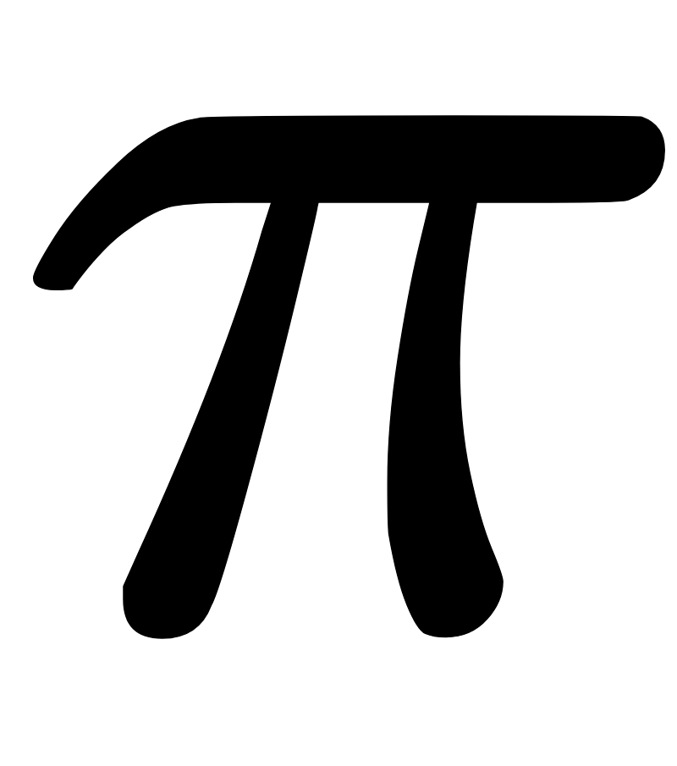
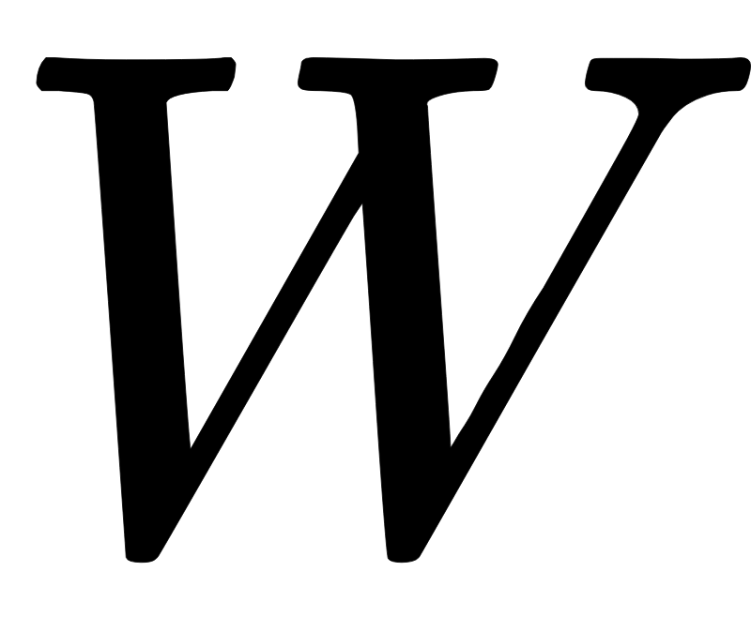
Some more definitions
For a given w, let be the set of all shingles of size w. WLOG we assume that is totally ordered.
Let be a permutation on chosen uniformly at random.
For a set define to be the smallest elements of
Define
Note: This is a random variable

Slide 14
Theorem 1 (part 1)
The value
is an unbiased estimator for the resemblance of A and B

Slide 15
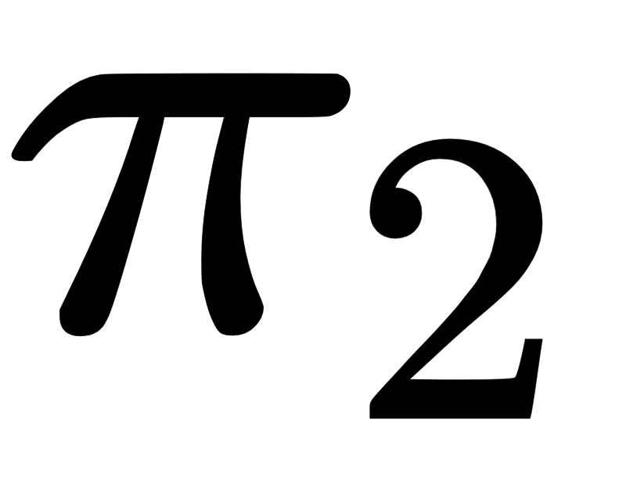
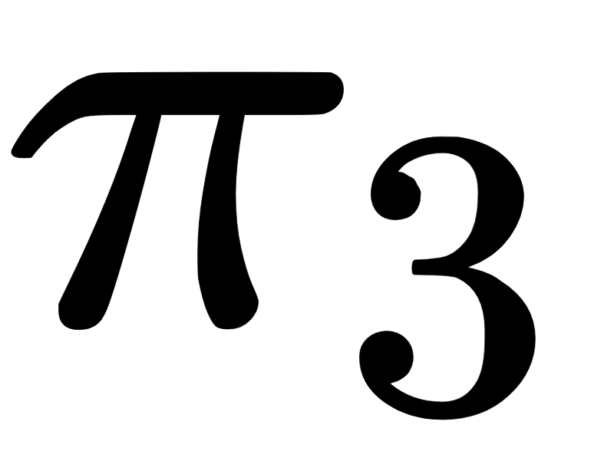
Example
We’ll calculate the value of the random variable for and

Slide 17
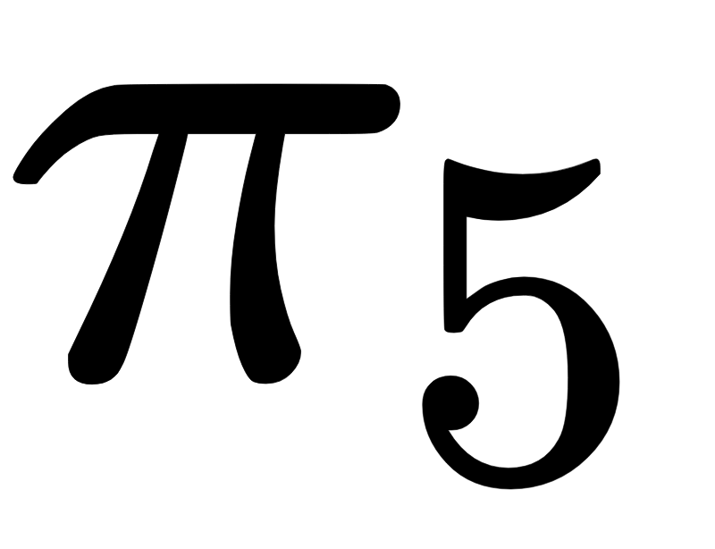
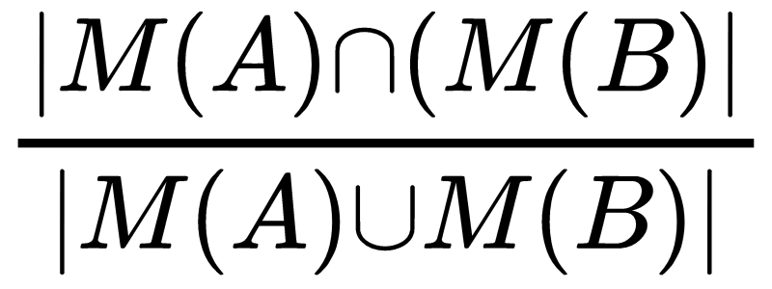
For and , we get a value of 1. For the rest, it’s 0. What’s the expected value?
One thing to note - why not just use ?
A counter example:

Slide 18
Proof of Theorem 1 (part 1)
The general idea: we want to calculate how likely an element in the union
also an element in the intersection.
We’ll do this for all the elements in the union

Slide 19
Proof continued
Let’s rewrite the denominator

Slide 20
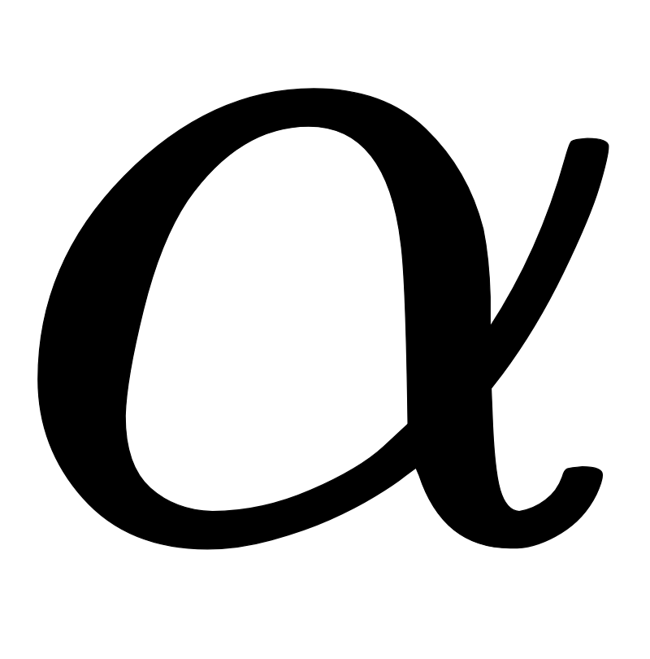
Part 1, continued:
Let be the smallest element of . Then:

Slide 21
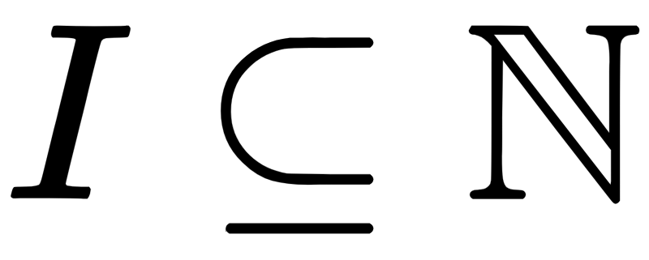
Theorem 1 (part 2):
Let be an arbitrary injection.
For a set define:
Let

Slide 22
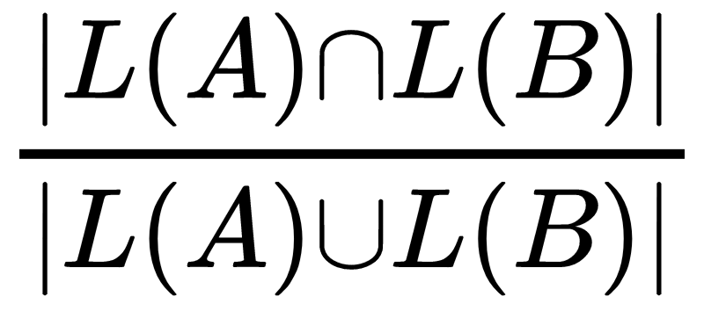
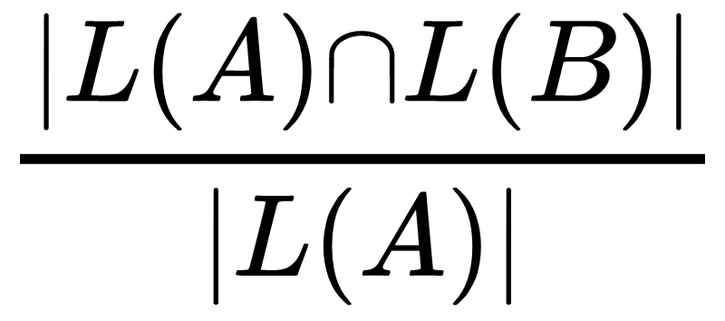
Part 2, continued:
The value
is an unbiased estimator of the resemblance of A and B.
The value
is an unbiased estimator of the containment of A in B.

Slide 23
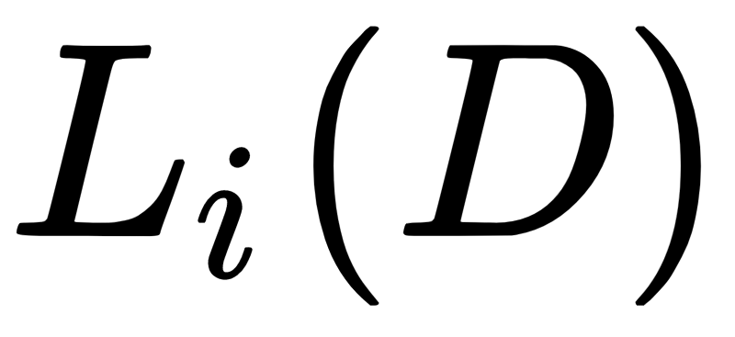
Estimating the Resemblance - continued
We can now use the sketches to estimate the resemblance of any pair of documents
Which should we use? (Both have their advantages and disadvantages)
We can use the following trick:
For documents of size in , take
The expected size of is between 50 and 100.
Still, it’s not perfect (short document compared to a longer one)

Slide 24
BREAK
Motivation V
Some definitions V
Estimating resemblance and containment V
Implementation Details
Experimental results
Summary

Slide 25
Choosing a random permutation and a sample
The size of a shingle can be large: if a shingle contains ~7 words in English, it’s size will be 40-50 bytes. So, instead of storing them, we associate each shingle with an id of l bits, and take to be a random permutation of the set .
Storage - accuracy tradeoff: if we take a large l we can ensure a small number of collisions but we will have to pay a storage penalty. On the other hand, a large number of collisions will degrade our estimate.
Let be the function that produces ids.
(If l is substantially larger than logn)
Notes:
In other words in this case we can ignore the effect of multiple collisions

Slide 26
Choosing a random permutation and a sample
We get that with probability better than 99.9%:
So instead of estimating
We would rather estimate

Slide 27
Rabin fingerprints
A good choice for f is Rabin’s fingerprinting function, in which the probability of collision of two strings s1 and s2 is bounded by .
Strings are viewed as polynomials over .
=
Notes:
In an actual implementation, f is not totally random, and the probability of collision might be higher.
A good choice is to take f to be Rabin’s fingerprinting function [10] in which case the probability of collision of two strings s1 and s2 can be bounded (in a adversarial model for s1 and s2) by max(|s1| , |s2|)/2l−1 where |s1| is the length of the string s1 in bits.
Furthermore Rabin fingerprints can be computed very efficiently in software and we can take advantage of their algebraic properties when we compute the fingerprints of “sliding windows.”
Equations taken from http://www.cs.cmu.edu/afs/cs/academic/class/15451-f14/www/lectures/lec6/karp-rabin-09-15-14.pdf

Slide 28
Rabin fingerprints
The efficient rolling hash calculation allows us to compute the fingerprints of all shingles in O(n) instead of O(wn).
In general - if a word is shorter we can pad, if it is longer we can split.

Slide 29
Choosing a random permutation and a sample
We need a random permutation to produce a sample.
However, we can imagine that the fingerprints implement : if the underlying polynomial is first multiplied by a suitable power, or equivalently, a suitable number of nulls are appended to the underlying string. This causes the fingerprints to appear “more random” without additional computing cost.
Notes:
(Without this trick two strings that differ only in the last letter will differ only in the last bit of their fingerprint.)

Slide 30
Storing the minimum set
Instead of keeping we can keep .
Recall option A and option B:
For option A: a max-heap
For option B: a balanced binary search tree or a heap with a hash table.
Notes:
A new fingerprint should replace the current root whenever it is smaller than it and then we should re-heapify. The expected number of times this happens is O(s log(n/m)) where n is the number of tokens in the document and m is the modulus discussed above, because the probability that the k’th element of a random permutation has to go into the heap is s/k. The cost per heap operation is O(log s) and thus the expected total cost for the heap operations is O(s log s log(n/m)).
For option B the cost is still O(s log s log(n/m)) but the constant factor is probably larger.
B - we don’t want duplicates! if we use a tree, we will implicitly not have any duplicates, and if we use a heap than we need a hash table to check for duplicates so we won’t insert an item twice.
A - no problem since we want the duplicates to be in.

Slide 31
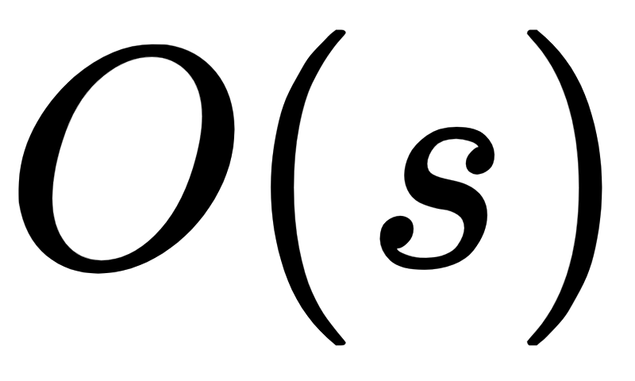
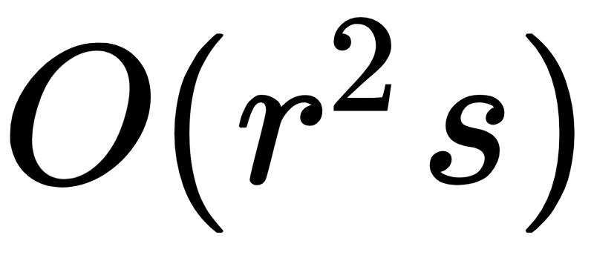
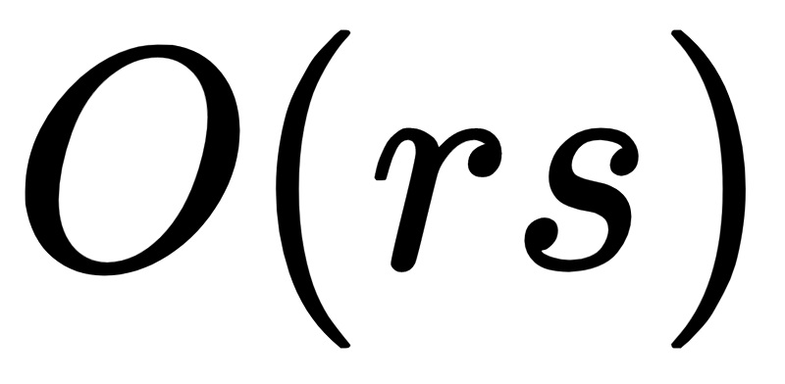
Evaluating resemblance
Store each sketch in increasing order, then merge sort and count the duplicates - (in the first elements)
Still, computing similarities between r documents takes
Can we get better runtime?
Greedy clustering: assume that every fingerprint only belongs to a few clusters, and keep a hash table from fingerprints to clusters.
Start with 0 clusters -> If a fingerprint of a document belongs to a cluster, add the document to it. Otherwise, create a new cluster containing the document. Choose a representative.

Slide 32
The size of the sample
The larger the sample the more accurate our approximation will be
The probability that our sample will be within is given by:
If the resemblance is high, the probability of our sample being close it is high
less than 0.1% chance that a pair with will estimated as resembling more than 90%

Slide 33
Experimental results
A clustering experiment of a collection of over 30,000,000 documents, total input data > 150Gb
Sketching each document with 10-words long shingles
Running Rabin fingerprints with l = 40 to produce 40-bit fingerprints
Keeping 1 in 25 shingles
Mapping every shingle to the documents it appears in a sorted <shingle, ID> list
Creating <ID, ID, 1> triples for every shingle that 2 documents share
Summing the triples to <ID, ID, count> triples
Setting resemblance threshold to 50%, assigning documents to clusters and holding them in a union-find structure (in memory)
Resulted in 3.6 million clusters containing a total of 12.3 million documents
2.1 million clusters contained 5.3 million identical documents
1.5 million clusters contained 7 million documents (identical and similar)
Notes:
Size of a typical shingle set - 1000
Length of a shingle - 400 bit
They use a “divide, compute, and merge” approach - an early name of map-reduce
Explained in https://www.microsoft.com/en-us/research/wp-content/uploads/1997/01/src-tn-1997-015.pdf

Slide 34
Summary
We presented an approach to estimating similarity and containment between documents.
This approach is modeled as set intersection problem. The relative size of the intersections is evaluated by a process of random sampling; We showed that applying a good hash function and comparing only the minimum representative sets under it is a sufficient estimator.
The process is done independently for each document, in linear time.

Slide 35
Any questions?
Thank you!

