Slide 1
Obfuscation for
Evasive Functions
Boaz Barak, Nir Bitansky, Ran Canetti,
Yael Tauman Kalai, Omer Paneth, Amit Sahai

Slide 2
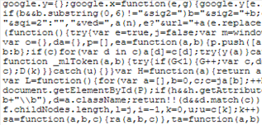
Program Obfuscation
Approved
Document
Signature
Verify and sign
Obfuscation
Obfuscated Program

Slide 3


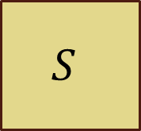



Virtual Black-Box (VBB)
[Barak-Goldreich-Impagliazzo-Rudich-Sahai-Vadhan-Yang 01]
Algorithm $𝒪$ is an obfuscator for a family of functions $\left\{f_{k}\right\}$ if:
For every adversary $A$ there exists a simulator $S$
such that for every key $k$ and predicate $P$:
$$f_{k}$$
$$A$$
$$S$$
$$𝒪(f_{k})$$
$$P(k)$$

Slide 4
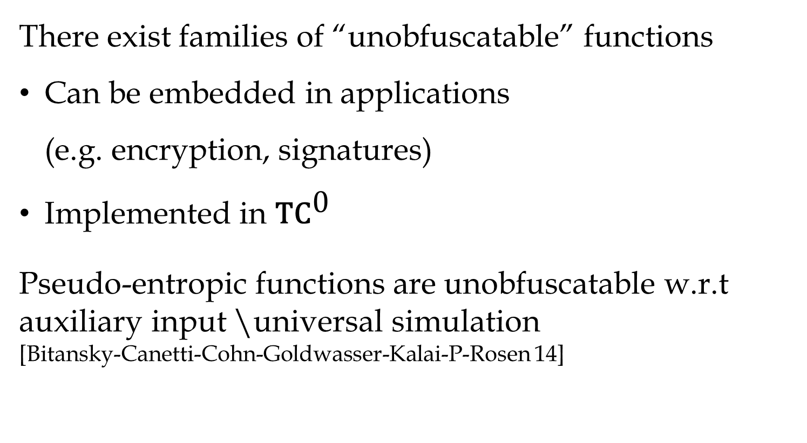
Impossibilities for VBB
[Barak-Goldreich-Impagliazzo-Rudich-Sahai-Vadhan-Yang 01]
There exist families of “unobfuscatable” functions
Can be embedded in applications
(e.g. encryption, signatures)
Implemented in $\text{T}{\text{C}}^{\text{0}}$
Pseudo-entropic functions are unobfuscatable w.r.t auxiliary input \universal simulation
[Bitansky-Canetti-Cohn-Goldwasser-Kalai-P-Rosen 14]

Slide 5
Positive results
Constructions for simple functions
[Can97, CMR98, LPS04, DS05,Wee05, CD08, CV09, CRV10,BR13]
General constructions in idealized models
[CV13,BR13,BGKPS13]

Slide 6
Which functions are
VBB obfuscatable?
Find rich classes of functions
that can be VBB obfuscated

Slide 7
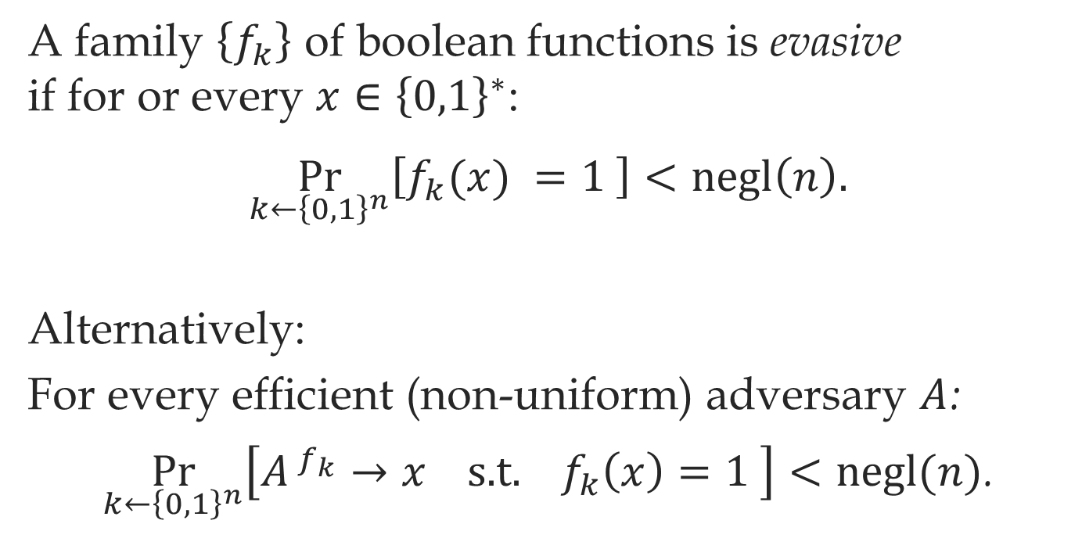
Evasive Functions
A family $\left\{f_{k}\right\}$ of boolean functions is evasive
if for or every $x∈{\left\{0,1\right\}}^{∗}$:
$$\underset{k←{\left\{0,1\right\}}^{n}}{Pr}\left[f_{k}(x) =1 \right]<\text{negl}\left(n\right).$$
Alternatively:
For every efficient (non-uniform) adversary $A$:
$\underset{k←{\left\{0,1\right\}}^{n}}{Pr}\left[A^{{ f}_{k}}→x \text{s}\text{.}\text{t}\text{. }f_{k}\left(x\right)=1 \right]<\text{negl}(n)$.

Slide 8
Applications
Evasive Functions
Disjunctions
Hyperplanes
Fuzzy point functions
Digital Lockers
Point
functions

Slide 9
Example
Output
Buggy software
Good input
Input
Patch
Crash
Bad input
Bad input
Error message

Slide 10
No impossibility for
VBB obfuscation* of evasive functions
*for the right notion of VBB

Slide 11
VBB for Evasive Functions
Turing machine
Circuit
Worst-case
Impossible
Impossible
Average-case
No known impossibility
Impossible

Slide 12
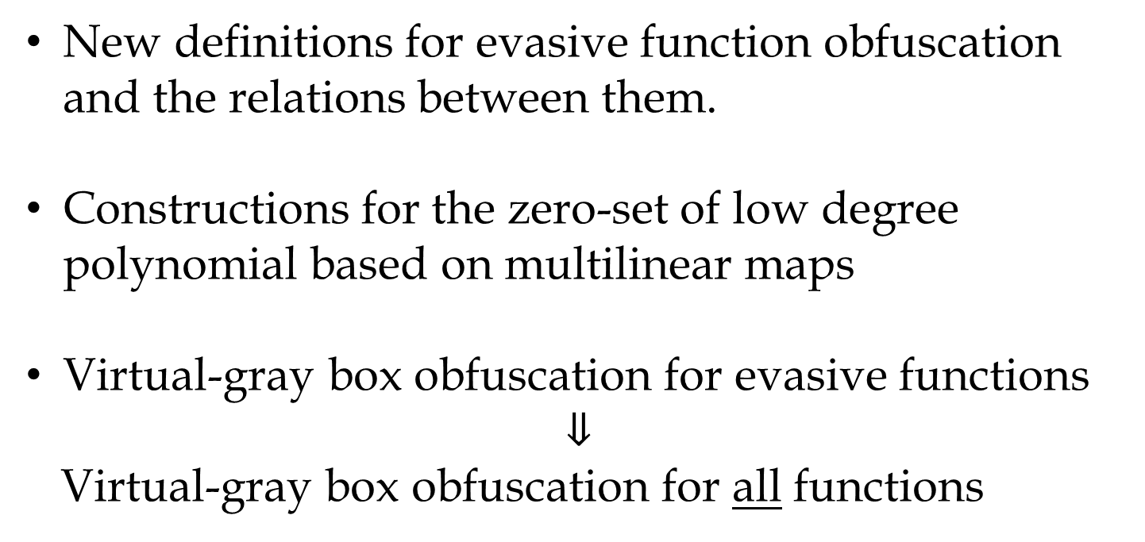
Contributions
New definitions for evasive function obfuscation and the relations between them.
Constructions for the zero-set of low degree polynomial based on multilinear maps
Virtual-gray box obfuscation for evasive functions
$$⇓$$
Virtual-gray box obfuscation for all functions

Slide 13
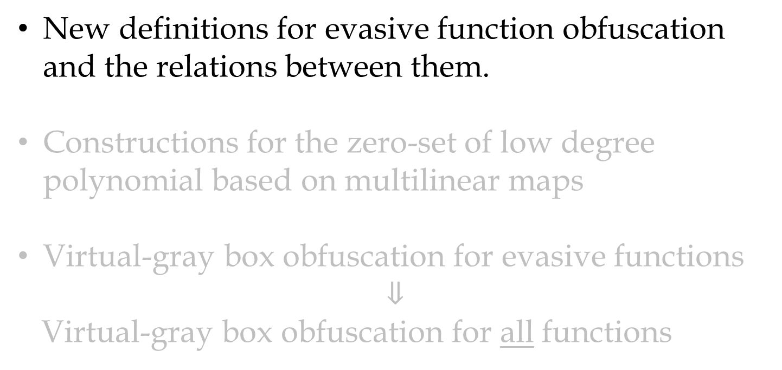
New definitions for evasive function obfuscation and the relations between them.
Constructions for the zero-set of low degree polynomial based on multilinear maps
Virtual-gray box obfuscation for evasive functions
$$⇓$$
Virtual-gray box obfuscation for all functions

Slide 14

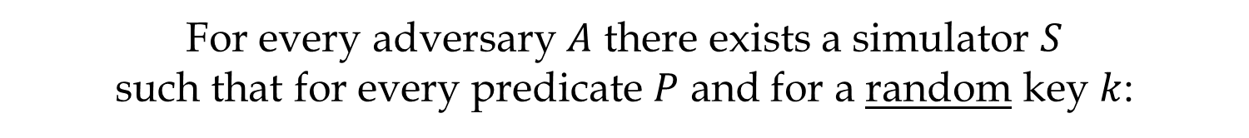


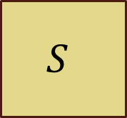
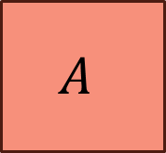
Average-case VBB
For every adversary $A$ there exists a simulator $S$
such that for every predicate $P$ and for a random key $k$:
$$f_{k}$$
$$A$$
$$S$$
$$𝒪(f_{k})$$
$$P(k)$$

Slide 15
Input-Hiding Obfuscation
For every adversary $A:$
$\underset{k←{\left\{0,1\right\}}^{n}}{Pr}\left[A\left(𝒪\left(f_{k}\right)\right)→x \text{s}\text{.}\text{t}\text{. }f_{k}\left(x\right)=1\right]<\text{negl}\left(n\right).$
Only achievable for evasive functions
Incomparable to average-case VBB

Slide 16
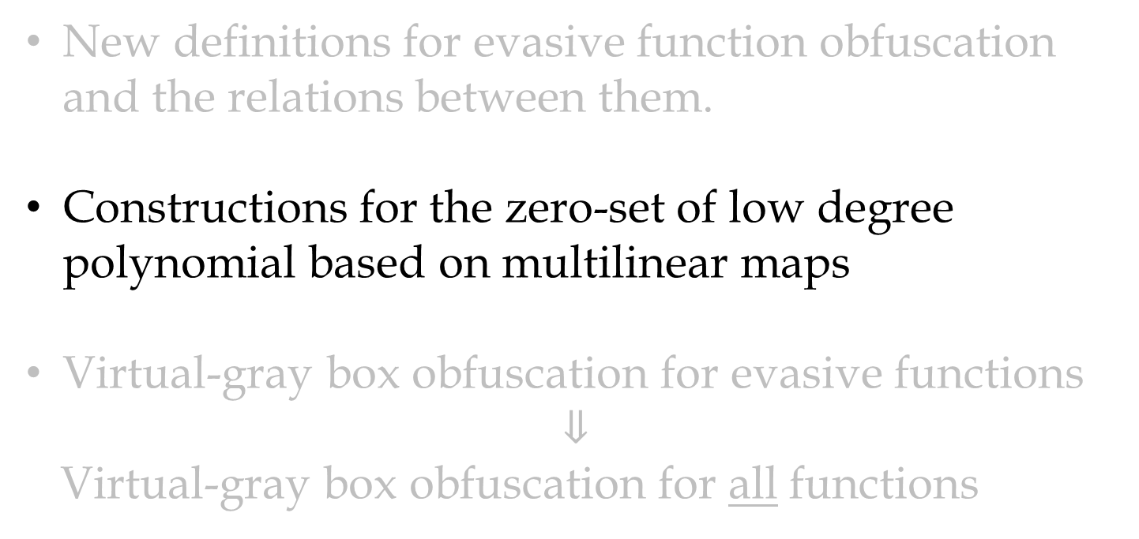
New definitions for evasive function obfuscation and the relations between them.
Constructions for the zero-set of low degree polynomial based on multilinear maps
Virtual-gray box obfuscation for evasive functions
$$⇓$$
Virtual-gray box obfuscation for all functions

Slide 17
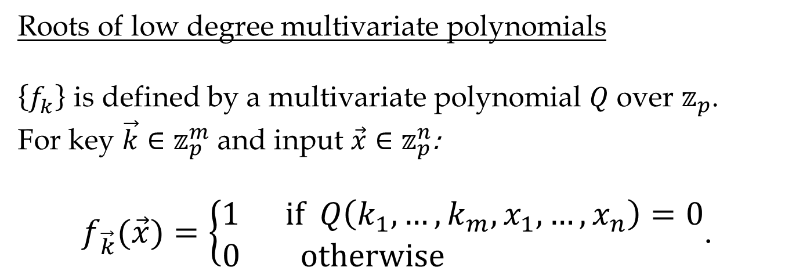
Constructions
Average-case VBB and Input-hiding obfuscation for a subclass of evasive function:
Roots of low degree multivariate polynomials
$\left\{f_{k}^{}\right\}$ is defined by a multivariate polynomial $Q$ over $𝕫_{p}$.
For key $\vec{k}∈𝕫_{p}^{m}$ and input $\vec{x}∈𝕫_{p}^{n}$:
$f_{\vec{k}}(\vec{x})=\left\{\begin{matrix}1 \text{if} Q\left(k_{1},…,k_{m},x_{1},…,x_{n}\right)=0 \\ 0 \text{otherwise} \end{matrix}\right.$.

Slide 18
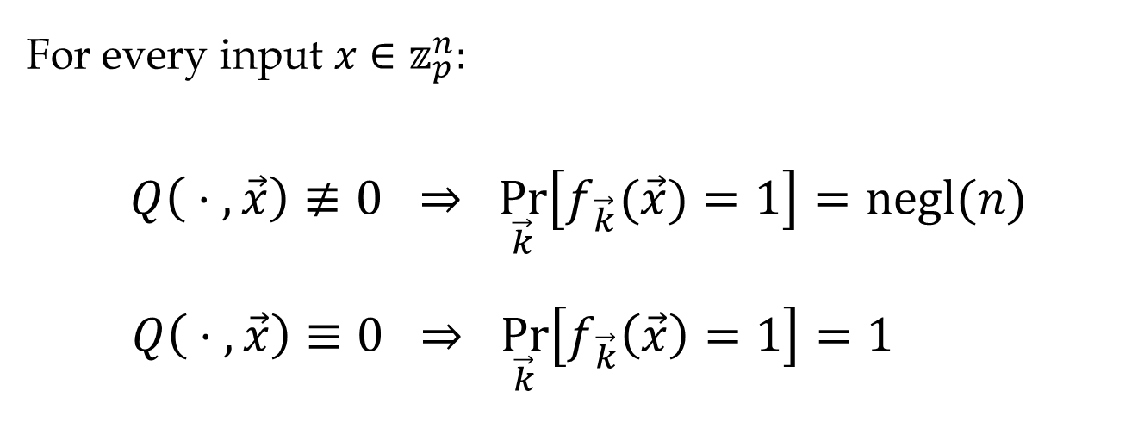
Is the Root Set Evasive?
For every input $x∈𝕫_{p}^{n}:$
$$Q\left( ⋅ ,\vec{x}\right)≢0 ⇒ \underset{\vec{k}}{Pr}\left[f_{\vec{k}}(\vec{x})=1\right]=\text{negl}(n)$$
$$Q\left( ⋅ ,\vec{x}\right)≡0 ⇒ \underset{\vec{k}}{Pr}\left[f_{\vec{k}}\left(\vec{x}\right)=1\right]=1$$
$f_{\vec{k}}(\vec{x})=\left\{\begin{matrix}1 \text{if} Q\left(k_{1},…,k_{m},x_{1},…,x_{n}\right)=0 \\ 0 \text{otherwise} \end{matrix}\right.$.

Slide 19
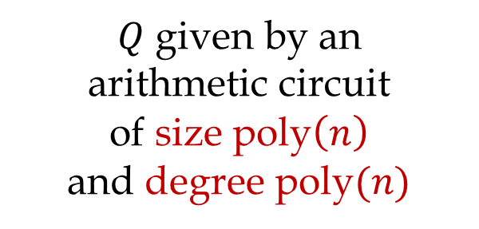
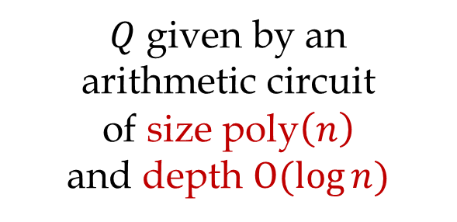
Two Constructions
Security notion
Function families
Assumption
Input-hiding
Average-case VBB
$Q$ given by an
arithmetic circuit
of size $\text{poly}\left(n\right)$
and degree $\text{poly}(n)$
$Q$ given by an
arithmetic circuit
of size $\text{poly}\left(n\right)$
and depth $O(log{n})$
One-way graded encoding
Perfectly-hiding
graded encoding

Slide 20
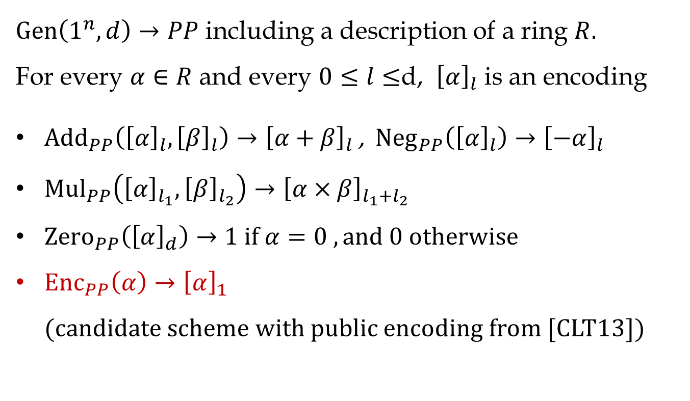
Graded Encodings
[Garg-Gentry-Halevi 13]
$\text{Gen}\left(1^{n},d\right)→PP$ including a description of a ring $R.$
For every $α∈R$ and every $0≤l≤$d, ${\left[α\right]}_{l}$ is an encoding
${\text{Add}}_{PP}\left({\left[α\right]}_{l},{\left[β\right]}_{l}\right)→{\left[α+β\right]}_{l}$ , ${\text{Neg}}_{PP}\left({\left[α\right]}_{l}\right)→{\left[−α\right]}_{l}$
${\text{Mul}}_{PP}\left({\left[α\right]}_{l_{1}},{\left[β\right]}_{l_{2}}\right)→{\left[α×β\right]}_{l_{1}+l_{2}}$
${\text{Zero}}_{PP}\left({\left[α\right]}_{d}\right)→1 \text{if} α=0 , \text{and} 0 \text{otherwise}$
${\text{Enc}}_{PP}\left(α\right)→{\left[α\right]}_{1}$
(candidate scheme with public encoding from [CLT13])

Slide 21

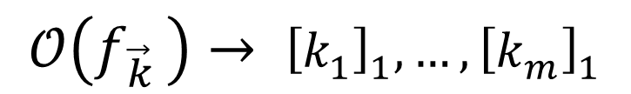

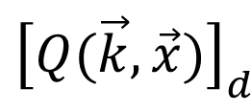


Input-Hiding
$$0/1$$
Zero
$$\text{Gen}\left(1^{n},d\right)→PP$$
$$d=\text{degree}(Q)$$
$${\left[Q(\vec{k},\vec{x})\right]}_{d}$$
Evaluate $Q$ using
$$\text{Add}\text{, }\text{Neg}\text{, }\text{Mul}$$
$$𝒪\left(f_{\vec{k} }\right)→ {\left[k_{1}\right]}_{1},…,{\left[k_{m}\right]}_{1}$$
$${\left[x_{1}\right]}_{1}, …,{\left[x_{n}\right]}_{1} ←\text{Enc}(\vec{x})$$

Slide 22
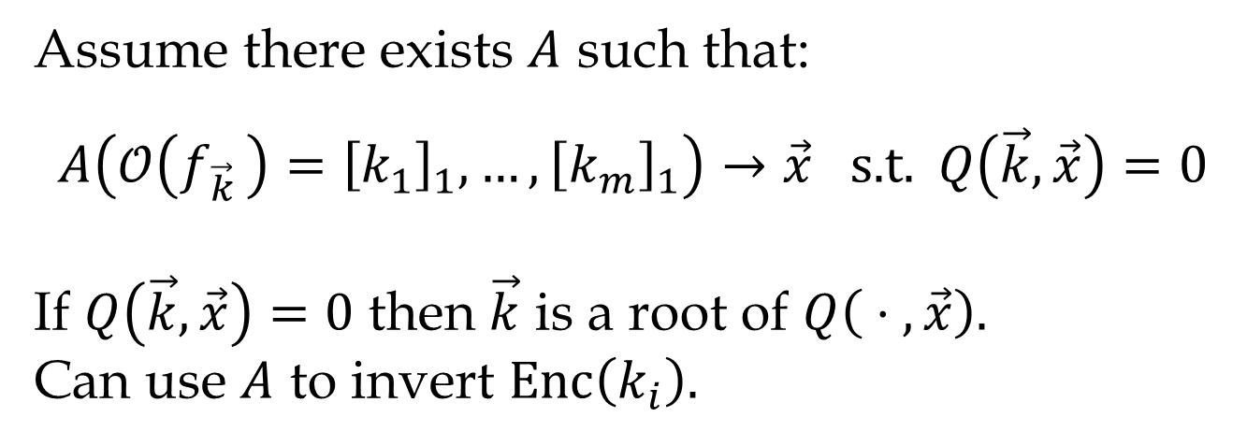
Proof Idea
Assume there exists $A$ such that:
$$A\left(𝒪\left(f_{\vec{k} }\right)={\left[k_{1}\right]}_{1},…,{\left[k_{m}\right]}_{1}\right)→\vec{x} \text{s}\text{.}\text{t}\text{.} Q\left(\vec{k}, \vec{x}\right)=0$$
If $Q\left(\vec{k}, \vec{x}\right)=0$ then $\vec{k}$ is a root of $Q\left( ⋅ , \vec{x}\right).$
Can use $A$ to invert $\text{Enc}\left(k_{i}\right).$

Slide 23
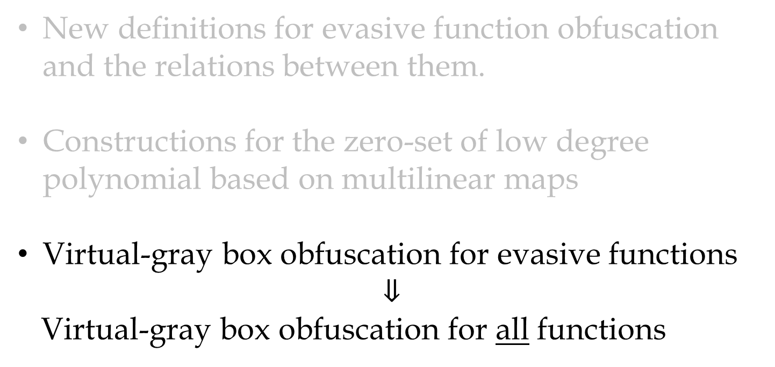
New definitions for evasive function obfuscation and the relations between them.
Constructions for the zero-set of low degree polynomial based on multilinear maps
Virtual-gray box obfuscation for evasive functions
$$⇓$$
Virtual-gray box obfuscation for all functions

Slide 24

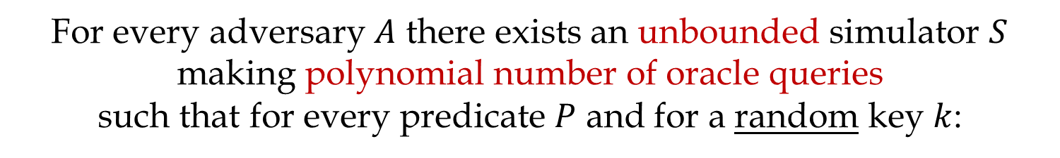


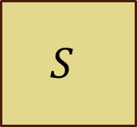

Virtual Grey-Box (VGB)
[Bitansky-Canetti 10]
For every adversary $A$ there exists an unbounded simulator $S$ making polynomial number of oracle queries
such that for every predicate $P$ and for a random key $k$:
$$f_{k}$$
$$A$$
$$S$$
$$𝒪(f_{k})$$
$$P(k)$$
Polynomial # of queries
Computationally unbounded

Slide 25
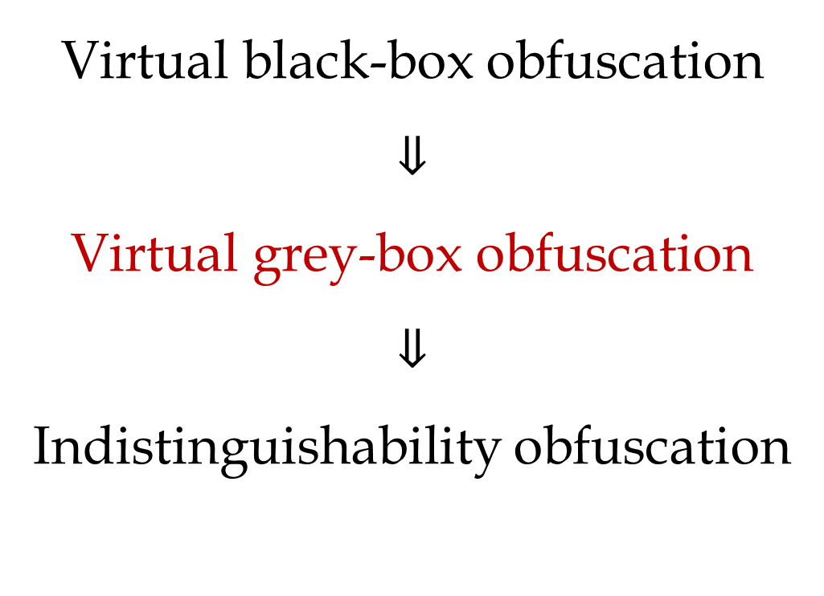
Why VGB?
Virtual black-box obfuscation
$$⇓$$
Virtual grey-box obfuscation
$$⇓$$
Indistinguishability obfuscation

Slide 26
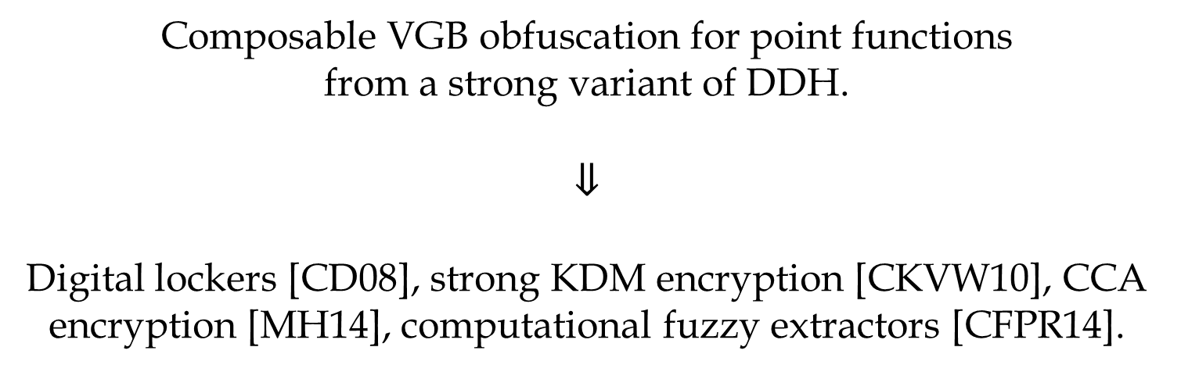
Applications of VGB
[Bitansky-Canetti 10]
Composable VGB obfuscation for point functions
from a strong variant of DDH.
$$⇓$$
Digital lockers [CD08], strong KDM encryption [CKVW10], CCA encryption [MH14], computational fuzzy extractors [CFPR14].

Slide 27
Virtual Grey-Box
Virtual grey-box is not always meaningful.
Example: pseudorandom functions
For what functions is
virtual grey-box meaningful?

Slide 28

VGB for Evasive Functions
For evasive functions ,
Average-case VBB $⇔$ average-case VGB
$$f_{k}$$
$$A$$
$$S$$
$$𝒪(f_{k})$$
$$P(k)$$
Polynomial # of queries
Computationally unbounded

Slide 29
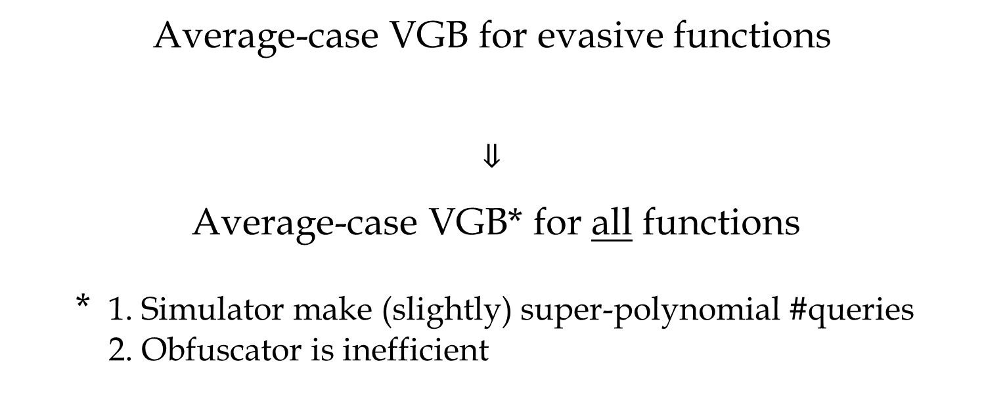
Theorem
Average-case VGB for evasive functions
$$⇓$$
Average-case VGB* for all functions
* 1. Simulator make (slightly) super-polynomial #queries 2. Obfuscator is inefficient
+ indistinguishability obfuscation for all functions

Slide 30

Proof Idea
Any function family $\left\{f_{k}\right\}$ can be decomposed to:
$$f_{k}=g_{k}+h_{k}$$
Can be learned by the VGB simulator
Evasive
$$𝒪\left(f_{k}\right)=g_{k}+𝒪(h_{k})$$

Slide 31

Decomposition via Learning
$$f_{k}$$

Slide 32
Decomposition via Learning
$$f_{k}$$

Slide 33
Decomposition via Learning
$$f_{k}$$

Slide 34
Decomposition via Learning
$$f_{k}$$

Slide 35
Decomposition via Learning
$$f_{k}$$

Slide 36
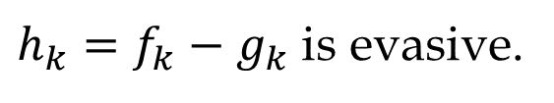

Decomposition via Learning
$$g_{k}$$
$$f_{k}$$
$h_{k}=f_{k}−g_{k}$ is evasive.

Slide 37
Thank You!
$$g_{k}$$
$$f_{k}$$

