Slide 1
Public-Coin Concurrent
Zero-Knowledge in the Global Hash Model
Ran Canetti, Huijia (Rachel) Lin, Omer Paneth

Slide 2



Zero-Knowledge Proofs
Completeness
Soundness
$$x∈ℒ?$$
$$𝒫$$
$$𝒱$$

Slide 3


Zero-Knowledge Proofs
Completeness
Soundness
Zero-knowledge
$$x∈ℒ$$
$$𝒫$$
$$𝒱$$
$$𝒱^{∗}$$

Slide 4
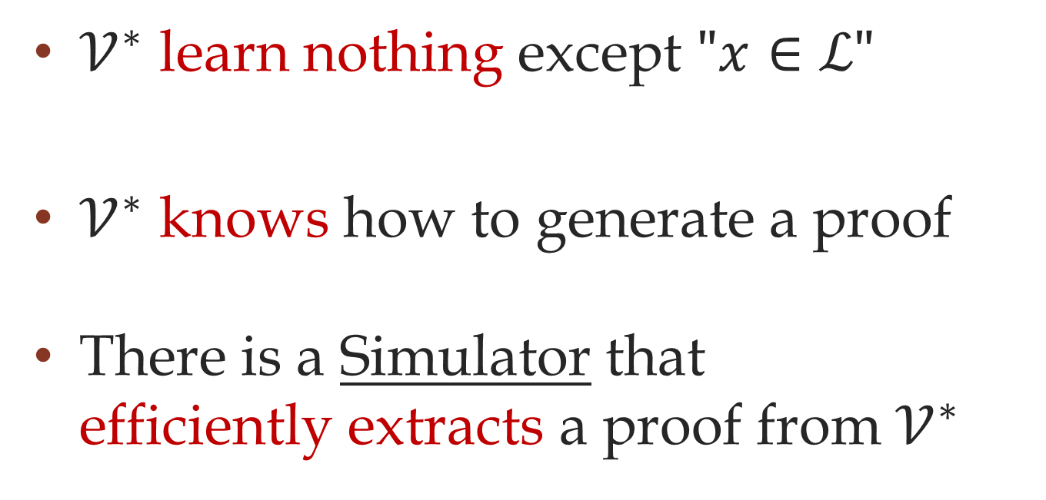
Zero-Knowledge
[Goldwasser-Micali-Rackoff 85]
$𝒱^{∗}$ learn nothing except $"x∈ℒ"$
$𝒱^{∗}$ knows how to generate a proof
There is a Simulator that
efficiently extracts a proof from $𝒱^{∗}$

Slide 5
Two Types of
Zero-Knowledge proofs

Slide 6






Public-Coin Protocols
$$𝒫$$
$$r_{1}←U$$
$$𝒱$$
$$m_{1}$$
$$r_{2}←U$$
$$m_{2}$$

Slide 7











Concurrent Composition
$$𝒫$$
$$𝒫$$
$$m_{1}$$
$$𝒱^{∗}$$
$$m_{2}$$
$$m_{1}$$
$$m_{2}$$
$$m_{3}$$
$$m_{3}$$
$$m_{4}$$
$$m_{4}$$

Slide 8

State of the Art
Constant-round public-coin
zero-knowledge
[Barak 01]
Concurrent zero-knowledge
[Richardson-Kilian 99]
[Kilian-Petrank 01]
[Prabhakaran-Rosen-Sahai 02]

Slide 9
Question
Is there a
public-coin concurrent
zero-knowledge protocol?
Yes! (well, almost)

Slide 10
Technical Motivation
Combine state of the art
simulation techniques
Applications to concurrent 2PC
[Goyal 13]

Slide 11
What are the existing
simulation techniques?

Slide 12

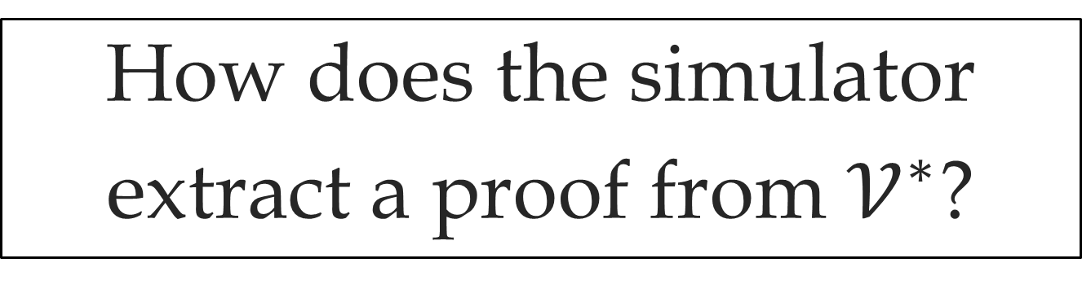
The Simulator
Simulator
proof transcript
$$𝒱^{∗}$$
How does the simulator
extract a proof from $𝒱^{∗}$?

Slide 13
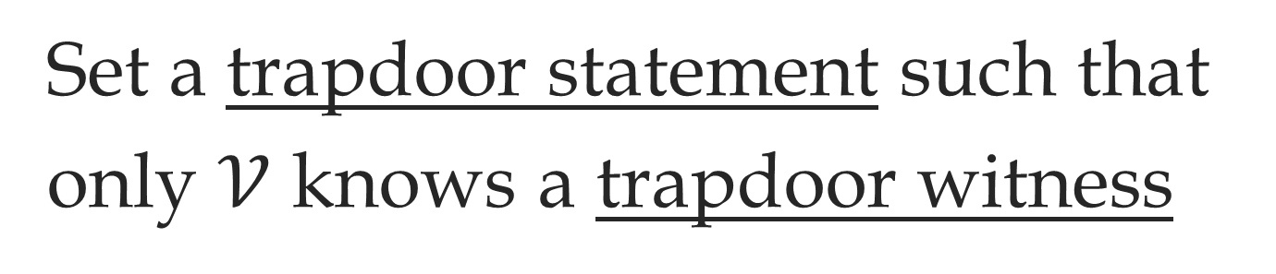
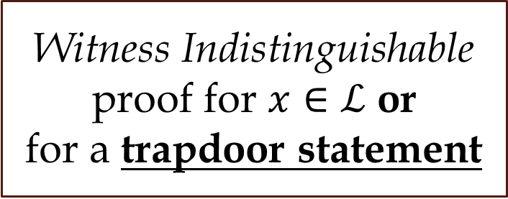


The FLS Paradigm
[Feige-Lapidot-Shamir 90]
Set a trapdoor statement such that
only $𝒱$ knows a trapdoor witness
$$𝒫$$
$$𝒱$$
Witness Indistinguishable proof for $x∈ℒ$ or
for a trapdoor statement

Slide 14

The FLS Paradigm
Simulator
proof transcript
trapdoorwitness
$$𝒱^{∗}$$
How does the simulator
extract a trapdoor witness?

Slide 15






Rewinding
$$𝒫$$
$$m_{1}$$
$$𝒱$$
$$q$$
$$a$$
$$m_{4}$$
Question-answer
slot

Slide 16









Rewinding
$$𝒮$$
$$m_{1}$$
$$𝒱^{∗}$$
$$q$$
$$q′$$
$$a$$
$$a′$$
$a+a′=$ Trapdoor witness
$$m_{4}$$

Slide 17
Other Techniques
Public-coin protocols
[Goldreich-Krawczyk 96]
Concurrent composition
[Dwork-Naor-Sahai 98]

Slide 18



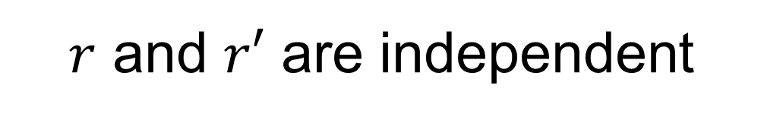


Public-Coin Protocols
$$𝒮$$
$$r_{0}$$
$$𝒱^{∗}$$
$$q$$
$$q′$$
Goldreich-Krawczyk 96:
No black-box simulator
$$r$$
$$r′$$
$r$ and $r′$ are independent

Slide 19
Public-Coin Protocols
The solution:
Non-black-box simulation
[Barak 01]

Slide 20











Concurrent Composition
$$m_{1}$$
$$𝒫$$
$$𝒫$$
$$𝒱^{∗}$$
$$q$$
$$m_{1}$$
$$q$$
$$a$$
$$m_{4}$$
$$a$$
$$m_{4}$$

Slide 21













Concurrent Composition
$$m_{1}$$
$$𝒮$$
$$𝒱^{∗}$$
$$q$$
$$q′$$
$$m_{1}$$
$$m_{1}′$$
$$q$$
$$q′$$
$$a$$
$$a′$$
$$m_{4}$$
$$m_{4}′$$
$$a$$
$$a′$$

Slide 22
















Concurrent Composition
$$m_{1}$$
$$𝒮$$
$$𝒱^{∗}$$
$$q$$
$$q′$$
$$m_{1}$$
$$m_{1}′$$
$$q$$
$$q′$$
$$q′′$$
$$q′′′$$
$$a$$
$$a′$$
$$a′′$$
$$a′′′$$
$$m_{4}$$
$$m_{4}′$$
$$a$$
$$a′$$

Slide 23
Concurrent Composition
The solution:
Rewinding with many slots
[Richardson-Kilian 99]
[Kilian-Petrank 01]
[Prabhakaran-Rosen-Sahai 02]

Slide 24
Current Techniques
rewinding
rewinding with
many slots
stand-alone
private-coin
zero-knowledge
concurrent
zero-knowledge
[RK,KP,PRS]
non-black-box
simulation
public-coin
zero-knowledge
[Barak 01]
This work
public-coin
concurrent zero-knowledge

Slide 25
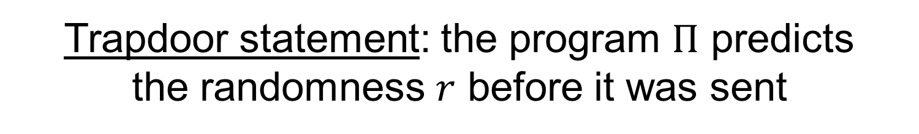

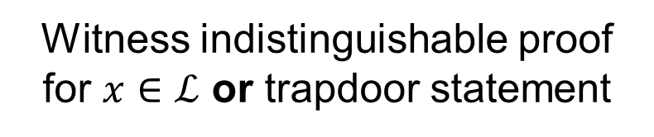



Barak’s Protocol (sketch)
$$c=\text{COM}(Π)$$
$$𝒫$$
$$𝒱$$
$$r$$
Witness indistinguishable proof
for $x∈ℒ$ or trapdoor statement
Trapdoor statement: the program $Π$ predicts
the randomness $r$ before it was sent

Slide 26

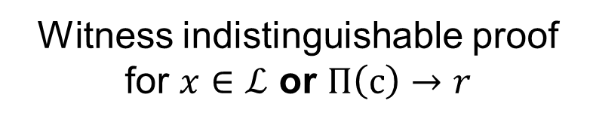
Barak’s Protocol
$$c=\text{COM}(Π)$$
$$𝒫$$
$$𝒱$$
$$r$$
Witness indistinguishable proof
for $x∈ℒ$ or $Π\left(c\right)→r$
Trapdoor statement:
$$∃Π:c=\text{COM}\left(Π\right)∧Π\left(c\right)→r$$

Slide 27
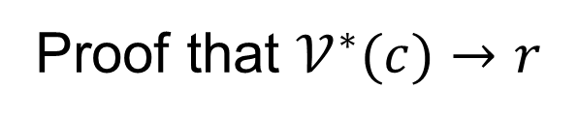

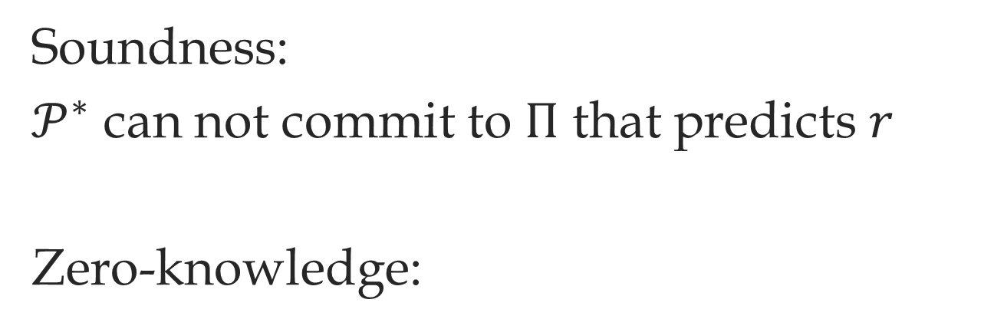








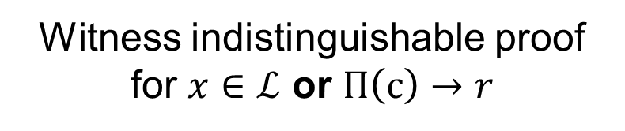
Barak’s Protocol
Soundness:
$𝒫^{∗}$ can not commit to $Π$ that predicts $r$
Zero-knowledge:
$$c=\text{COM}(Π)$$
$$𝒫$$
$$𝒱$$
$$c=\text{COM}(𝒱^{∗})$$
$$𝒮$$
$$𝒱^{∗}$$
$${Π= 𝒱}^{∗}$$
$$r$$
$$r$$
Witness indistinguishable proof
for $x∈ℒ$ or $Π\left(c\right)→r$
Proof that $𝒱^{∗}(c)→r$

Slide 28






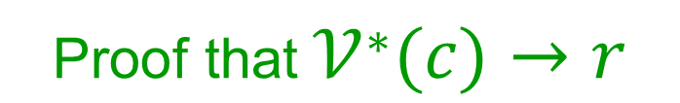
Concurrent Barak
$$𝒮$$
$$𝒱^{∗}$$
$$c=\text{COM}(𝒱^{∗})$$
$$c$$
$$r$$
Proof
$$r$$
$$\text{Proof} \text{that} 𝒱^{∗}(c)→r$$

Slide 29

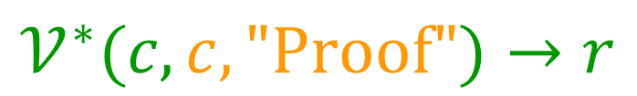
Concurrent Barak
$$𝒮$$
$$𝒱^{∗}$$
$$c=\text{COM}(𝒱^{∗}\left(⋅,c,\text{"}\text{Proof}\text{"}\right))$$
$$c$$
$$r$$
Proof
$$r$$
$$𝒱^{∗}(c,c,\text{"}\text{Proof}\text{"})→r$$

Slide 30
Folklore Approach
[Deng-Goyal-Sahai 09]
[Pass-Rosen-Tseng 11]
[Goyal-Jain-Ostrovsky-Richelson-Visconti 13]

Slide 31

Folklore Approach
$$𝒮$$
$$𝒱^{∗}$$
$$c=\text{COM}(𝒱^{∗}\left(⋅,c,\text{"}\text{Proof}\text{"}\right))$$
$$c$$
$$r$$
Proof
$$r$$

Slide 32


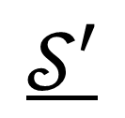
Folklore Approach
$$𝒮$$
$$c=\text{COM}(𝒮′)$$
$$𝒱^{∗}$$
$$𝒮′$$
$$c$$
$$r$$
Proof
$$r$$
$$\text{Proof} \text{that} 𝒮′(c)→r$$

Slide 33

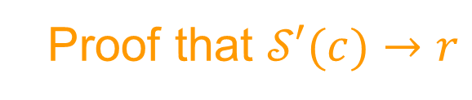


Simulation Running Time
$$𝒮$$
$$c=\text{COM}(𝒮′)$$
$$𝒱^{∗}$$
$$c=\text{COM}(𝒮′)$$
$$𝒮′$$
$$r$$
$$𝒮′$$
Proof that $𝒮′(c)→r$
$$r$$
$$\text{Proof} \text{that} 𝒮′(c)→r$$

Slide 34
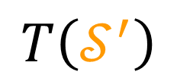
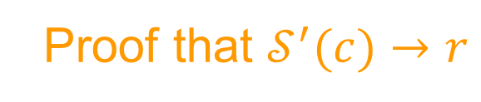
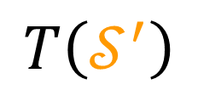
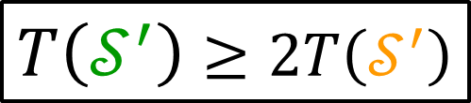

Simulation Running Time
$T\left(𝒮^{′}\right)$ $≥2T\left(𝒮^{′}\right)$
$$𝒮′$$
$$T\left(𝒮^{′}\right)$$
$$𝒮′$$
Proof that $𝒮^{′}(c)→r$
$$T\left(𝒮^{′}\right)$$
$$\text{Proof} \text{that} 𝒮′(c)→r$$

Slide 35






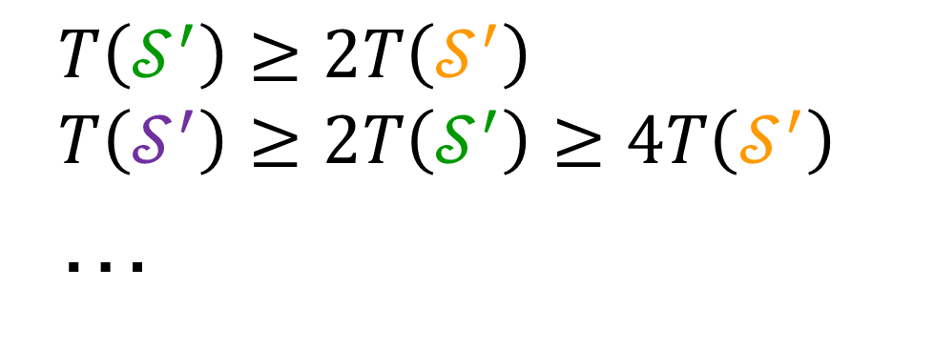
Simulation Running Time
$$T\left(𝒮^{′}\right)≥2T\left(𝒮^{′}\right)$$
$T\left(𝒮^{′}\right)≥2T\left(𝒮^{′}\right)$ $≥4T\left(𝒮^{′}\right)$
…
$$𝒮′$$
$$𝒮′$$
$$𝒮′$$
Proof that $𝒮^{′}(c)→r$
$$\text{Proof} \text{that} 𝒮′(c)→r$$
$$\text{Proof} \text{that} 𝒮′(c)→r$$

Slide 36












Recursive Rewinding
$$m_{1}$$
$$𝒮$$
$$𝒱^{∗}$$
$$m_{2}$$
$$m_{2}′$$
$$m_{1}$$
$$m_{1}′$$
$$m_{2}$$
$$m_{2}′$$
$$m_{2}′′$$
$$m_{2}′′′$$
$$m_{3}$$
$$m_{3}′$$
$$m_{3}′′$$
$$m_{3}′′′$$
$$m_{4}$$
$$m_{4}′$$
$$m_{3}$$
$$m_{3}′$$

Slide 37
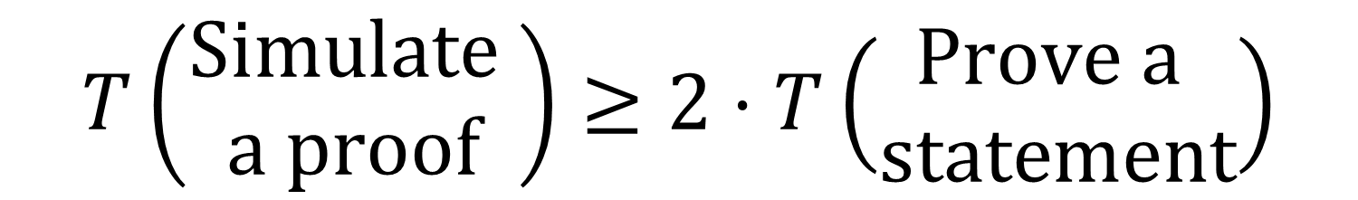
The Problem
$$T\left(\begin{aligned}\text{Simulate} \\ \text{a} \text{proof}\end{aligned}\right)≥2⋅T\left(\begin{aligned}\text{Prove} \text{a} \\ \text{statement}\end{aligned}\right)$$

Slide 38
Roadmap
add slots
stand-alone
private-coin
zero-knowledge
concurrent
zero-knowledge
[RK,KP,PRS]
simulation runtime is exponential
non-black-box
simulation
concurrent
compassion
public-coin
zero-knowledge
[Barak 01]
public-coin
concurrent zero-knowledge

Slide 39








Concurrent Zero-Knowledge
$$𝒫$$
$$m_{1}$$
$$𝒱$$
$$q_{1}$$
$$a_{1}$$
$$q_{2}$$
$$a_{2}$$
Slot
$$m_{6}$$
Slot

Slide 40










Concurrent Zero-Knowledge
$$𝒮$$
$$m_{1}$$
$$𝒱^{∗}$$
$$q_{1}$$
$$q_{1}′$$
$$a_{1}$$
$$a_{1}′$$
$$q_{2}$$
$$a_{2}$$
$$m_{6}$$
$$a_{1}+a_{1}′$$

Slide 41







Concurrent Zero-Knowledge
$$𝒮$$
$$m_{1}$$
$$𝒱^{∗}$$
$$q_{1}$$
$$a_{1}$$
$$q_{2}$$
$$q_{2}′$$
$$a_{2}$$
$$a_{2}′$$
$$m_{6}$$
$$a_{2}+a_{2}′$$

Slide 42
Concurrent Zero-Knowledge
$$𝒫$$
$$𝒫$$
$$𝒱^{∗}$$

Slide 43


Concurrent Zero-Knowledge
$$𝒮$$
$$𝒱^{∗}$$

Slide 44
Concurrent Zero-Knowledge
$$𝒮$$
$$𝒱^{∗}$$

Slide 45
The KP-PRS Strategy

Slide 46
The KP-PRS Strategy

Slide 47


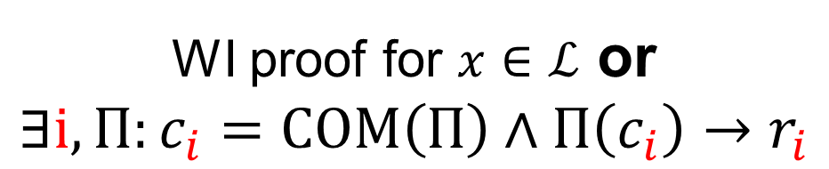

The Protocol
$$𝒫$$
$$c_{1}=\text{COM}(Π)$$
$$𝒱$$
$$r_{1}$$
Slot
Slot
…
$$c_{k}=\text{COM}(Π)$$
$$r_{k}$$
WI proof for $x∈ℒ$ or
$$∃i,Π:c_{i}=\text{COM}\left(Π\right)∧Π\left(c_{i}\right)→r_{i}$$

Slide 48
Simulation
Black-box world - Rewinding
Non-black-box world – Proving

Slide 49







Simulation
$$𝒮$$
$$𝒱^{∗}$$
$$c_{i}=\text{COM}(𝒮′)$$
KP-PRS
Block
$$𝒮′$$
$$r_{i}$$
Round complexity
$\left(\log^{1+ε}{n}\right)$ for $ε>0$
Proof that $𝒮^{′}(c_{i})→r_{i}$

Slide 50
A Caveat
Simulation constructs many long proof
Solved by using memory delegation
Need all session to use one hash function

Slide 51
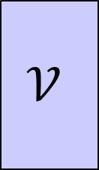
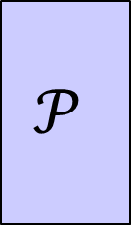


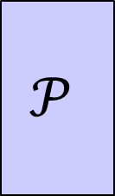

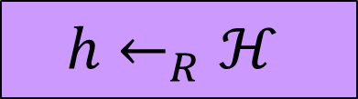
The Global Hash Model
$$h←_{R}ℋ$$
collision-resistant hash function
$$𝒫$$
$$𝒱$$
$$𝒫$$
$$𝒱$$
$$𝒫$$
$$𝒱$$

Slide 52
The Global Hash Model
Explicit uniform
reduction
Breaking soundness
Finding collisions

Slide 53






The Global Hash Model
Uniform Hash Function
$$𝒫$$
$$𝒱$$
$$𝒫$$
$$𝒱$$
$$𝒫$$
$$𝒱$$
Protocol in the plain model
against uniform adversaries

Slide 54
The Global Hash Model
SHA-256
$$𝒫$$
$$𝒱$$
$$𝒫$$
$$𝒱$$
$$𝒫$$
$$𝒱$$
Protocol in the plain model
from human ignorance [Rogaway 06]

Slide 55
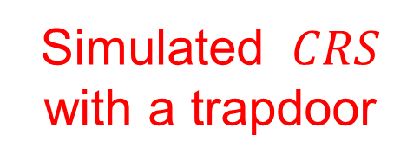
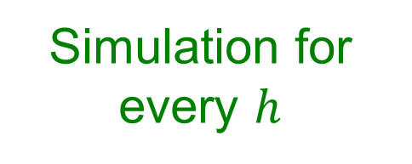
GHM vs. CRS
Common reference string model
Global hash model
Simulated $CRS$ with a trapdoor
Simulation for every $h$
Public-coin concurrent zero-knowledge
Black-box impossibility
[Pass-Tseng-Wikström]
NIZK

Slide 56
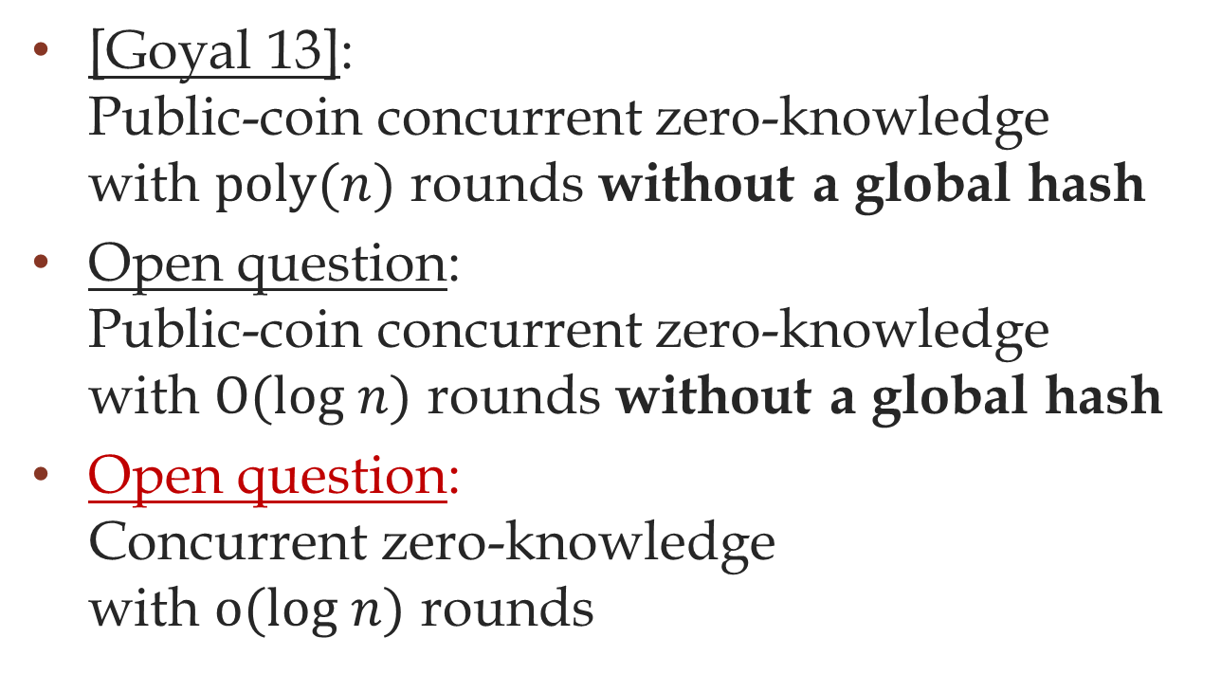
What is next?
[Goyal 13]:
Public-coin concurrent zero-knowledge
with $\text{poly}(n)$ rounds without a global hash
Open question:
Public-coin concurrent zero-knowledge
with $O(\text{l}\text{og} n)$ rounds without a global hash
Open question:
Concurrent zero-knowledge
with $o(\text{log} n)$ rounds

Slide 57
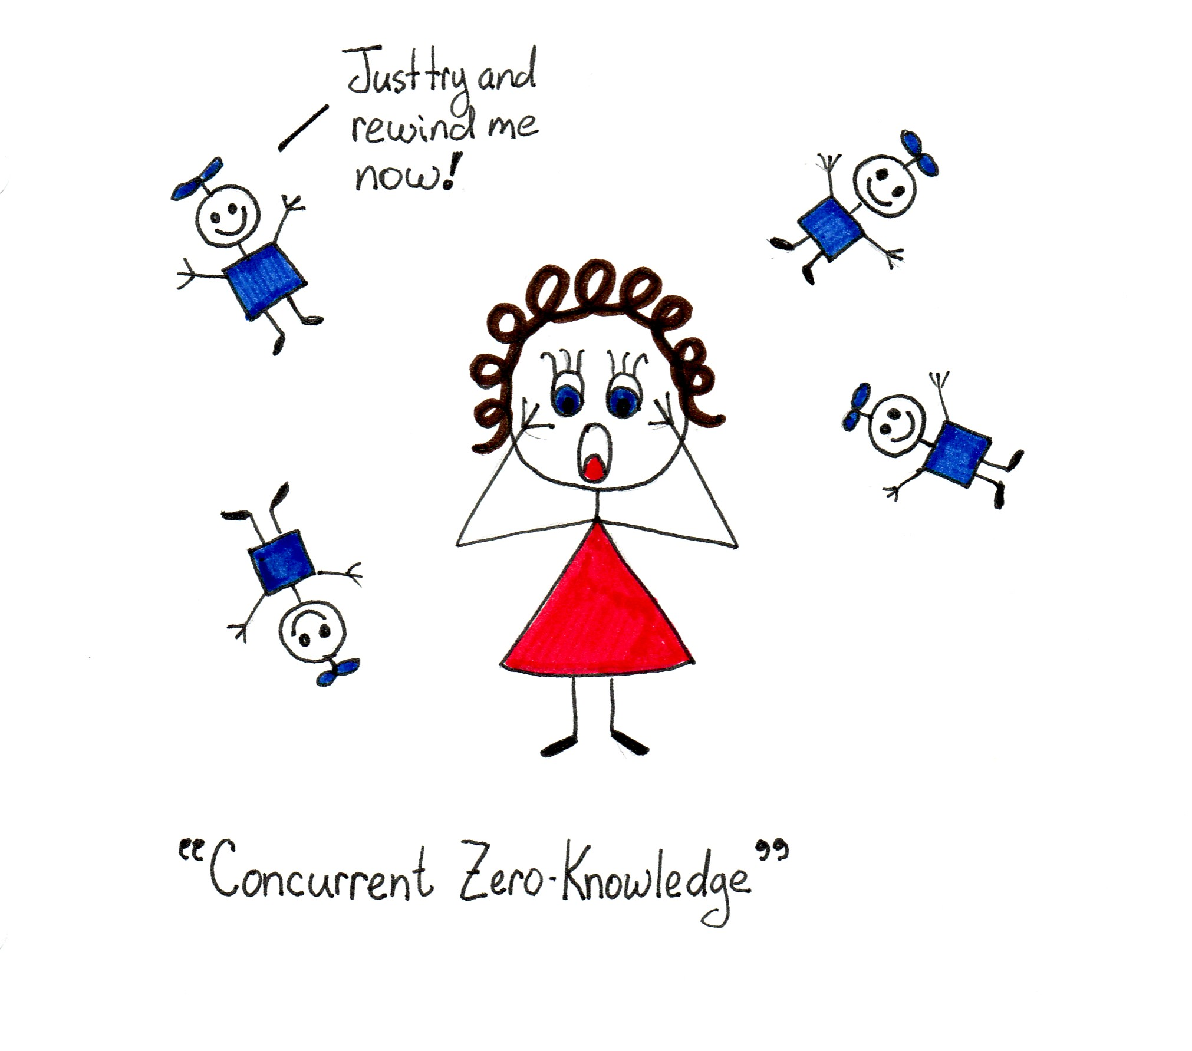
[slide: Mira Blenekiy]

