Slide 1
From Point Obfuscation To 3-Round Zero-Knowledge
Nir Bitansky and Omer Paneth

Slide 2
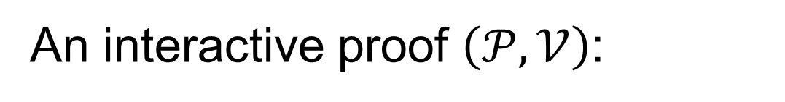



Interactive Proofs
An interactive proof $\left(𝒫,𝒱\right)$:
$$x∈ℒ?$$
$$𝒫$$
$$𝒱$$

Slide 3


Interactive Proofs
Negligible soundness error
$$x∉ℒ$$
$$𝒫^{∗}$$
$$𝒱$$

Slide 4
Prover’s security
Zero-Knowledge
[Goldwasser-Micali-Rackoff-85]
Weak Zero-Knowlage
[Dwork-Naor-Reingold-Stockmeyer-99]
Witness Hiding
[Feige-Shamir-90]
Witness Indistinguishability
[Feige-Shamir-90]

Slide 5





Prover’s security
Zero-Knowledge (ZK)
Weak Zero-Knowlage
Witness Hiding (WI)
Witness Indistinguishability (WH)
$$𝒮$$
$$𝒱^{∗}$$
$$𝒫$$
$$𝒱^{∗}$$
$$≈$$

Slide 6



Prover’s security
Zero-Knowledge (ZK)
Weak Zero-Knowlage
Witness Hiding (WI)
Witness Indistinguishability (WH)
$$D$$
$$𝒮$$
$$𝒱^{∗}$$
$$𝒫$$
$$𝒱^{∗}$$
$$≈$$
$$D$$

Slide 7
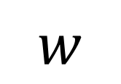


Prover’s security
Zero-Knowledge (ZK)
Weak Zero-Knowlage
Witness Hiding (WI)
Witness Indistinguishability (WH)
$$𝒫$$
$$𝒱^{∗}$$
$$w$$

Slide 8



Prover’s security
Zero-Knowledge (ZK)
Weak Zero-Knowlage
Witness Hiding (WI)
Witness Indistinguishability (WH)
$$w_{2}$$
$$𝒱^{∗}$$
$$w_{1}$$
$$𝒫$$
$$𝒫$$
$$𝒱^{∗}$$
$$≈$$

Slide 9
Relation Between Notions
Zero-Knowledge
Weak ZK
WI
WH
Only if every instance hes two independent witnesses [FS90]

Slide 10




The Round-Complexity of ZK
$$2$$
$$3$$
$$4$$
$$5$$
# rounds
Impossible
[Goldreich-Oren-94]
?
Arguments
[Feige-Shamir-90]
[Bellare-Jakobsson-Yung-97]
Proofs
[Goldreich-
Kahan-96]

Slide 11





Black-Box vs. Non-Black-Box Simulation
Non-black-box simulation
Black-box simulation
$$𝒮$$
$$𝒱^{∗}$$
$$𝒮$$
$$𝒱^{∗}$$

Slide 12
Getting 3-Round ZK –
The Challenge [GK96]:
Theorem:
3-round ZK protocols with
black-box simulator
exist only for trivial languages

Slide 13
Relaxations of ZK
Black-box reduction \ simulation is impossible | Black-box reduction \ simulation exist | Notion (3-round)
[GK96] |  | ZK
[GK96] |  | Weak ZK
 | [FS90] | WI
[HRS09] (One witness case) | [FS90] (Two witnesses case) | WH

Slide 14
Non-Black-Box Techniques
Barak’s Non-black-box ZK protocol [B01]:
Overcomes black-box impossibilities
But: too many rounds

Slide 15

An Alternative: Assumptions
Example:
Assume parallel repetition of some basic ZK protocol is also ZK. [GMW91,B86]
.
For every:
There exists:
$$𝒱^{∗}$$
Non-Black-Box Transformation
S

Slide 16
Under what assumptions
do 3-round ZK protocols exist?

Slide 17
3-Round ZK from Other Assumptions
Work | Assumption | Result
[Hada-Tanaka-98] [Bellare-Palacio-04] | Knowledge of Exponent [D91] | 3-round ZK argument
[Lepinski-Micali-01] | A specific number theoretic protocol is a POK | 3-round ZK Proof
[Canetti-Dakdouk-08] [Goldwasser-Lin-Rubinstein-12] | Extractable 1-to-1 OWF | 3-round ZK argument

Slide 18
3-Round ZK from
Non-Standard Assumptions
All of the assumptions used imply the existence of Extractable OWFs
[D91] [HT98] [LM01] [BP04] [CD08] [GLR12]
Extractable OWF

Slide 19
Are extractable OWFs necessary?
- We do not know.
Can we get 3-round ZK
from different assumptions?

Slide 20
Our Results:
From:
Auxiliary Input Point Obfuscation
To:
Relaxations of ZK

Slide 21
Our Results:
Auxiliary Input Point Obfuscation
Indistinguishability definition (weaker)
3-Round
Witness hiding

Slide 22
Our Results:
Auxiliary Input Point Obfuscation
Indistinguishability definition (weaker)
Simulation
definition (stronger)
3-Round
Witness hiding
3-Round
Weak ZK

Slide 23
Definitions
Point Obfuscation
Witness Hiding

Slide 24
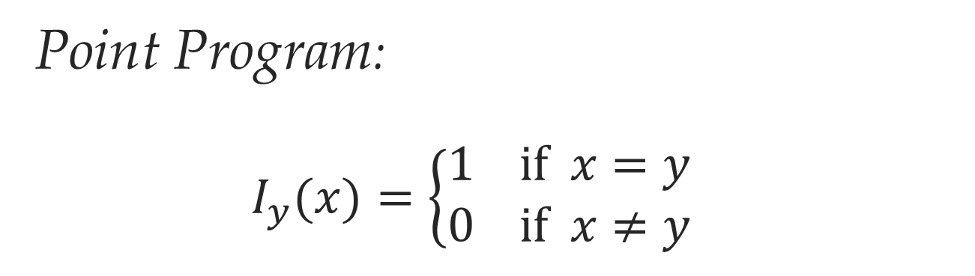
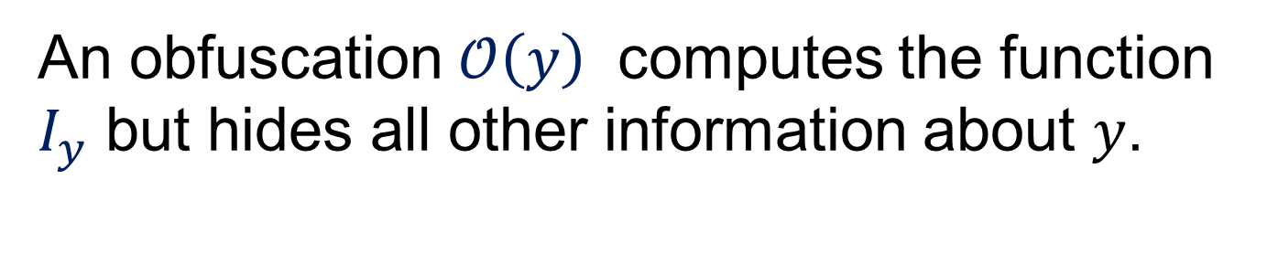
Point Obfuscation
Point Program:
$$I_{y}(x)=\left\{\begin{matrix}1 \text{if} x=y \\ 0 \text{if} x≠y\end{matrix}\right.$$
An obfuscation $𝒪\left(y\right)$ computes the function $I_{y}$ but hides all other information about $y$.

Slide 25

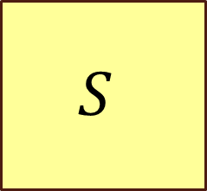




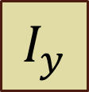

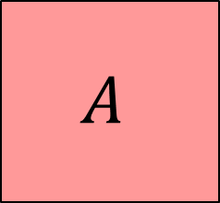

Virtual Black-Box [BGI+01]
For every $A$ there exists $S$:
$$𝒪\left(y\right)$$
$$I_{y }$$
$$A$$
$$S$$
$$z$$
$$z$$
$$b$$
$$≈$$
$$b′$$

Slide 26
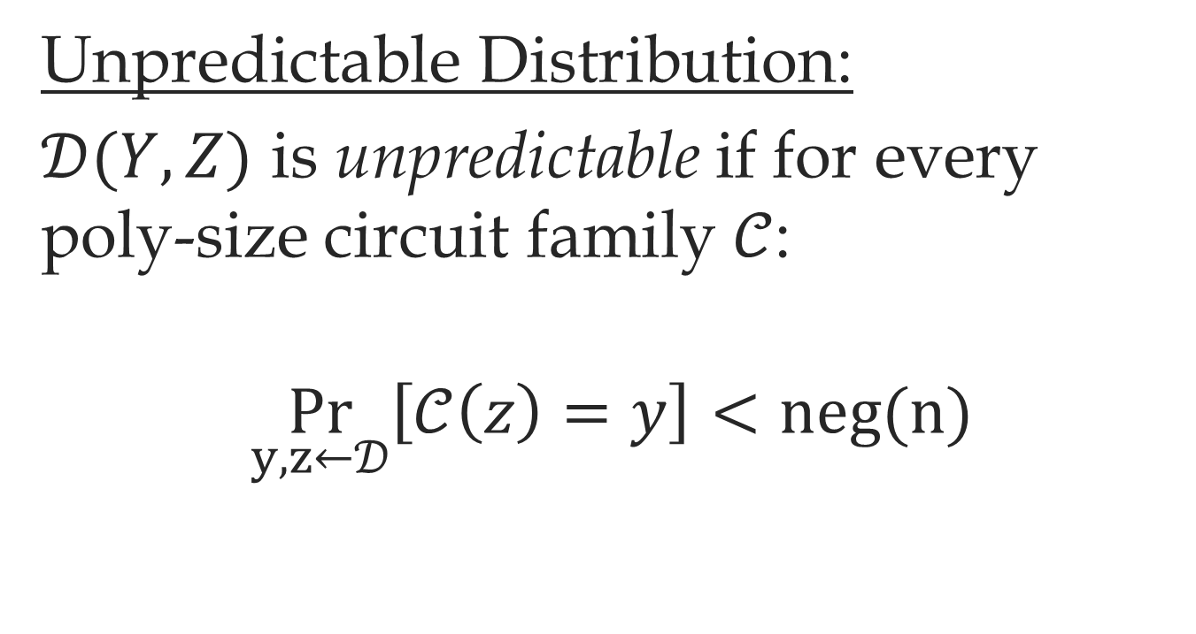
Indistinguishability Definition
Unpredictable Distribution:
$𝒟(Y,Z)$ is unpredictable if for every poly-size circuit family $𝒞$:
$$\underset{y,z←𝒟}{Pr}\left[𝒞\left(z\right)=y\right]<\text{neg}\text{(}\text{n}\text{)}$$

Slide 27
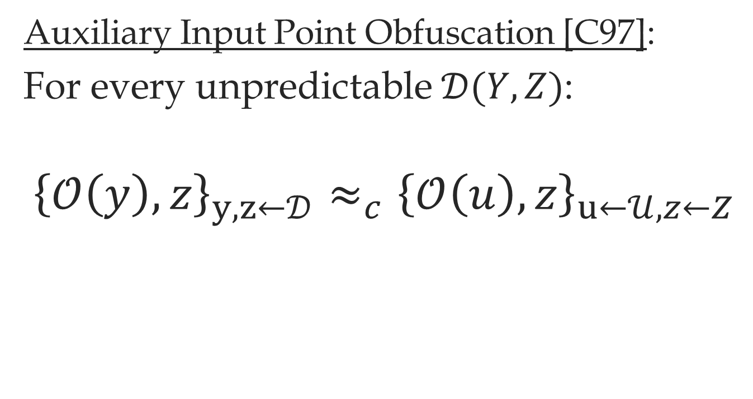
Indistinguishability Definition
Auxiliary Input Point Obfuscation [C97]:
For every unpredictable $𝒟(Y,Z)$:
$${\left\{𝒪\left(y\right),z\right\}}_{y,z←𝒟}≈_{c}{\left\{𝒪\left(u\right),z\right\}}_{u←𝒰,z←Z}$$
Constructions: [Canetti97], extensions of [Wee05]

Slide 28

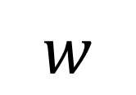


Witness Hiding
$$w,x$$
$$𝒫$$
$$𝒱^{∗}$$
$$w$$

Slide 29
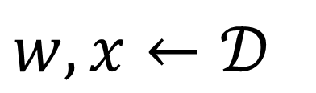
Witness Hiding
$$w,x←𝒟$$
$$𝒫$$
$$𝒱^{∗}$$
$$w$$

Slide 30
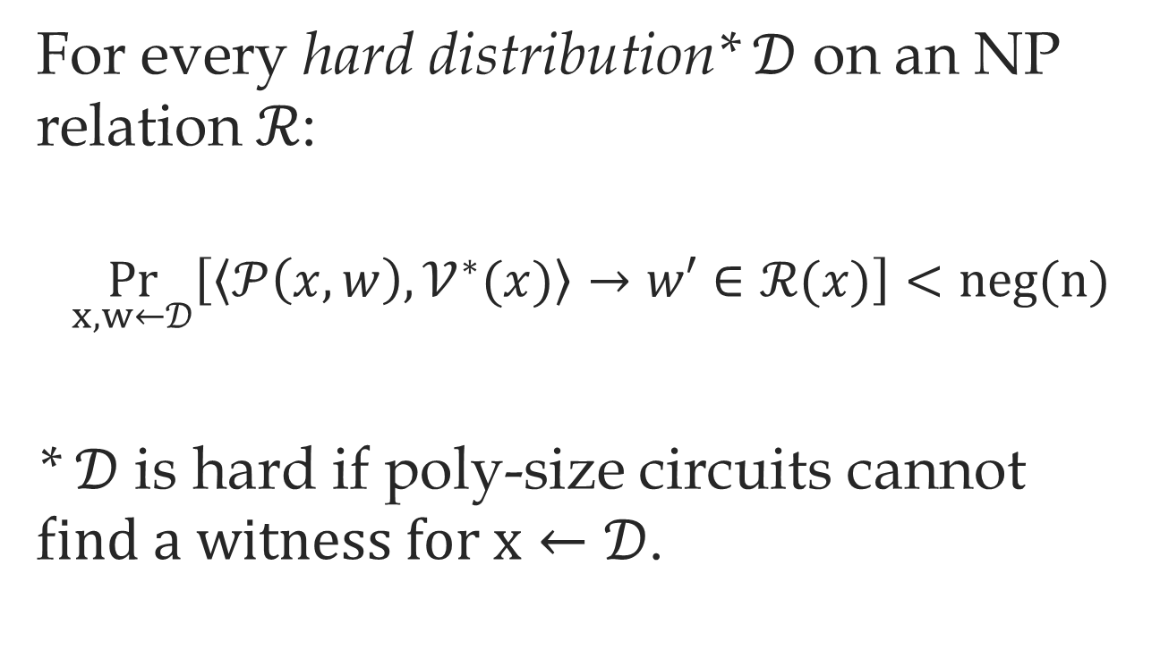
Witness Hiding
For every hard distribution* $𝒟$ on an NP relation $ℛ$:
$$\underset{x,w←𝒟}{Pr}\left[\left\langle 𝒫\left(x,w\right),𝒱^{∗}(x)\right\rangle →w′∈ℛ(x)\right]<\text{neg}\text{(}\text{n}\text{)}$$
* $𝒟$ is hard if poly-size circuits cannot f$ind a witness for x←𝒟$.

Slide 31
Our Witness Hiding Protocol

Slide 32





Our Witness Hiding Protocol
$V_{ℒ}\left(x,w\right)→0/1$ – The NP verification circuit of $ℒ$.
$$x,w$$
$$x$$
$$𝒫$$
$$𝒱$$
2-party computation
$$V_{ℒ}\left(x,w\right)$$

Slide 33






3-Round Witness Hiding (1)
${\text{OT}}_{1}$, ${\text{OT}}_{2}$ - 2-message malicious oblivious transfer
$$x,w$$
$$x$$
$$𝒫$$
$$𝒱$$
$${\text{OT}}_{1}(w)$$
$$\text{Garbled} \text{Circuit} \text{for} V_{ℒ}(x,⋅)$$
$$V_{ℒ}(x,w)$$
$${\text{OT}}_{2}$$

Slide 34


3-Round Witness Hiding (1)
$\text{Enc}$ – A 1-hop homomorphic encryption [GHV10]
$$x,w$$
$$x$$
$$𝒫$$
$$𝒱$$
$$\text{Enc}(w)$$
$$\hat{\text{Enc}} (V_{ℒ}(x,w))$$
$$V_{ℒ}(x,w)$$

Slide 35




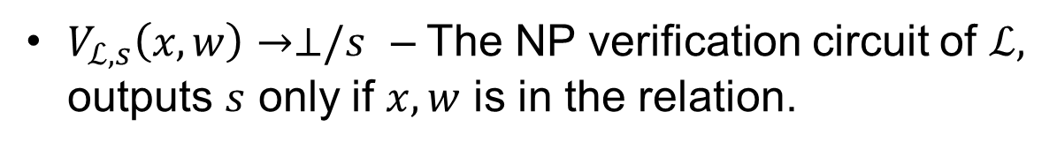

3-Round Witness Hiding (2)
$V_{ℒ,s}\left(x,w\right)→⊥/s$ – The NP verification circuit of $ℒ,$ outputs $s$ only if $x,w$ is in the relation.
$$x,w$$
$$x$$
$$𝒫$$
$$\text{Enc}(w)$$
$$𝒱$$
$$s←𝒰$$
$$\hat{\text{Enc}}(V_{ℒ,s}(x,w))$$
$$s$$
$$s$$

Slide 36


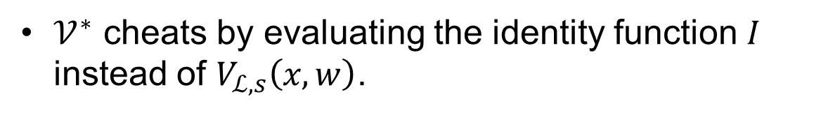


Attack on Witness Hiding
$𝒱^{∗}$ cheats by evaluating the identity function $I$ instead of $V_{ℒ,s}\left(x,w\right)$.
$$x,w$$
$$x$$
$$𝒫$$
$$\text{Enc}(w)$$
$$𝒱^{∗}$$
$$\hat{\text{Enc}} (I(w))$$
$$w$$
$$w$$

Slide 37



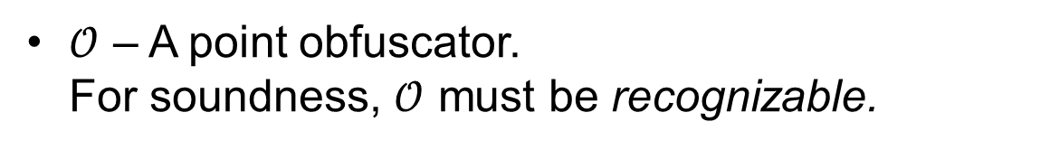

The Final Protocol
$𝒪$ – A point obfuscator.
For soundness, $𝒪$ must be recognizable.
$$x,w$$
$$x$$
$$𝒫$$
$$\text{Enc}(w)$$
$$𝒱$$
$$s←𝒰$$
$$\text{Enc}(V_{ℒ,s}(x,w))$$
$$s$$
$$𝒪(s)$$

Slide 38
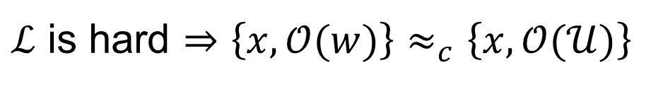

Fixing the Attack
$ℒ$ is hard $⇒\left\{x,𝒪(w)\right\}≈_{c}\left\{x,𝒪(𝒰)\right\}$
$$x,w$$
$$x$$
$$𝒫$$
$$\text{Enc}(w)$$
$$𝒱^{∗}$$
$$\hat{\text{Enc}} (I(w))$$
$$w$$
$$𝒪(w)$$

Slide 39
Fixing the Attack
$ℒ$ is hard $⇒\left\{x,𝒪(w)\right\}≈_{c}\left\{x,𝒪(𝒰)\right\}$
$$x,w$$
Given
$$x$$
$$𝒫$$
$$\text{Enc}(w)$$
$$𝒱^{∗}$$
$$\hat{\text{Enc}} (I(w))$$
$$w$$
$$𝒪(w)$$

Slide 40

Fixing the Attack
$ℒ$ is hard $⇒\left\{x,𝒪(w)\right\}≈_{c}\left\{x,𝒪(𝒰)\right\}$
$$x,w$$
$$x$$
$$𝒫$$
$$\text{Enc}(w)$$
$$𝒱^{∗}$$
$$\hat{\text{Enc}} (I(w))$$
$$𝒪(𝒰)$$

Slide 41


Fixing the Attack
$ℒ$ is hard $⇒\left\{x,𝒪(w)\right\}≈_{c}\left\{x,𝒪(𝒰)\right\}$
$$x,w$$
$$x$$
$$𝒫$$
$$\text{Enc}(0^{n})$$
$$𝒱^{∗}$$
$$𝒪(𝒰)$$

Slide 42






Properties of the Protocol
Protocol is not zero-knowledge.
Protocol is a proof-of-knowledge.
Unconditional soundness (proof).
Attack on ZK:
$$𝒫$$
$$\text{Enc}(w)$$
$$𝒱^{∗}$$
$$s_{0},s_{1}$$
$$\hat{\text{Enc}} (P\left(w\right)→s_{0}\backslash s_{1} )$$
$$𝒪(s_{0}\backslash s_{1})$$

Slide 43
What is the non-black-box
component in our reduction?

Slide 44

Auxiliary Input Point Obfuscation
For every unpredictable $𝒟(Y,Z)$:
$${\left\{𝒪\left(y\right),z\right\}}_{y,z←𝒟}≈_{c}{\left\{𝒪\left(u\right),z\right\}}_{u←𝒰,z←Z}$$

Slide 45






Auxiliary Input Point Obfuscation
For every distinguisher there exists a predictor
$$y,z←𝒟$$
$$z$$
$$𝒪\left(y\right)/𝒪\left(𝒰\right)$$
$$z$$
Distinguisher
Predictor
Non-Black-Box Transformation
$$0/1$$
$$y$$

Slide 46

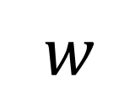
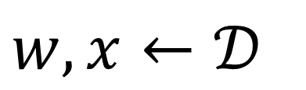

The Non-Black-Box Component
$$w,x←𝒟$$
$$𝒫$$
$$𝒱^{∗}$$
$$w$$

Slide 47


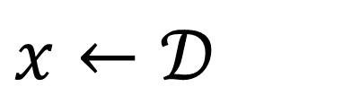
The Non-Black-Box Component
$$x←𝒟$$
$$𝒱^{∗}$$
$$𝒪\left(w\right)\backslash 𝒪\left(𝒰\right)$$
$$0/1$$

Slide 48
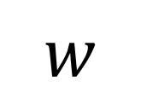


The Non-Black-Box Component
$$x←𝒟$$
Predictor
$$𝒱^{∗}$$
$$w$$
$$𝒪\left(w\right)\backslash 𝒪\left(𝒰\right)$$
$$0/1$$

Slide 49

Conclusion
Some assumptions give us a
non-black-box transformation:
Some 3-round protocol is indeed ZK
Extructable OWF \ Knowledge of Exponent
Auxiliary Input Point Obfuscation
$$𝒱^{∗}$$
S
Non-Black-Box Transformations
Distinguisher
Predictor

Slide 50
Conclusion
Given such assumptions we can get
3-round ZK.
How to compare these assumptions?
What type of non-black-box transformation is required for
3-round ZK?

Slide 51
?

