Slide 1
Extractable Functions
Nir Bitansky, Ran Canetti, Omer Paneth, Alon Rosen

Slide 2
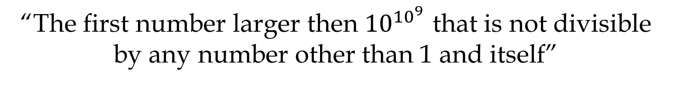
Largest Known Prime
2^{57,885,161} − 1
Electronic Frontier Foundation offers
$250,000 prize for a prime with at least a billion digits
“The first number larger then ${10}^{{10}^{9}}$ that is not divisible by any number other than 1 and itself”

Slide 3
Knowledge
Algorithm
Polynomial Time
Extraction Procedure
Knowledge

Slide 4



Proofs of Knowledge
$$x∈ℒ$$
$$P$$
$$V$$
Hide the Witness
Extraction
Witness
Secrecy : Zero-Knowledge \ Witness indistinguishability
Goal: Extract knowledge that is not publicly available

Slide 5








CCA Encryption
$$PK$$
$$Enc(b)$$
Reduction
To CPA
$$A$$
$$Enc(x)$$
Extraction
$$Dec$$
$$x$$
$$x$$
$$b$$

Slide 6
More Knowledge
Reduction
$$A$$
Extraction
$$x$$
Zero-knowledge Proofs, Signatures, Non-malleable Commitments, Multi-party Computation, Obfuscation,…

Slide 7
How to Extract?
Algorithm
Extraction?
Knowledge

Slide 8
Extraction by Interaction
Or : Black-Box Extraction
Public Parameters
Adversary
Extraction

Slide 9

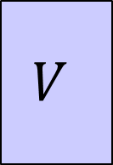


Out of Reach Applications
2-Message
Succinct Argument
(SNARG)
3-Message
Zero-Knowledge
$$P$$
$$P$$
$$V$$
$$V$$

Slide 10
Out of Reach Applications
Black-Box Security Proof is Impossible
[Gentry-Wichs]
[Goldreich-Krawczyk]
$$P$$
$$P$$
$$V$$
$$V$$

Slide 11



Knowledge of Exponent
[Damgård 92]
Adversary
$$g,h$$
Extraction
Non-Black-Box Extraction
$$x$$
$$g^{x},h^{x}$$
$∀A ∃E \text{s}\text{.}\text{t}\text{. }A\left(g,h\right)→g^{x},h^{x} ⇒ E\left(g,h\right)→x$

Slide 12
Applications of KEA
[HT98,BP04,Mie08,G10,L12,BCCT13,GGPR13,BCIOP13]
Knowledge of Exponent Assumption* (KEA)
* and variants
2-Message
Succinct Argument
(SNARG)
3-Message
Zero-Knowledge

Slide 13


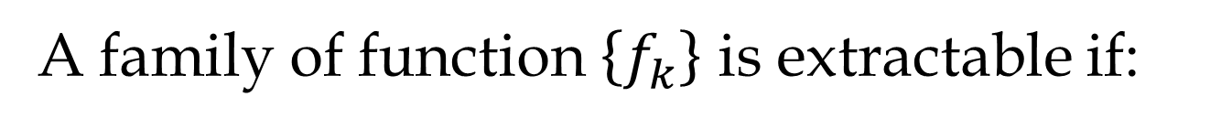

Extractable Functions
[Canetti-Dakdouk 08]
A family of function $\left\{f_{k}\right\}$ is extractable if:
Adversary
$$k←\$$$
Extraction
$$x$$
$$f_{k}(x)$$
$∀A ∃E \text{s}\text{.}\text{t}\text{. }A\left(k\right)→f_{k}(x) ⇒ E\left(k\right)→x$

Slide 14

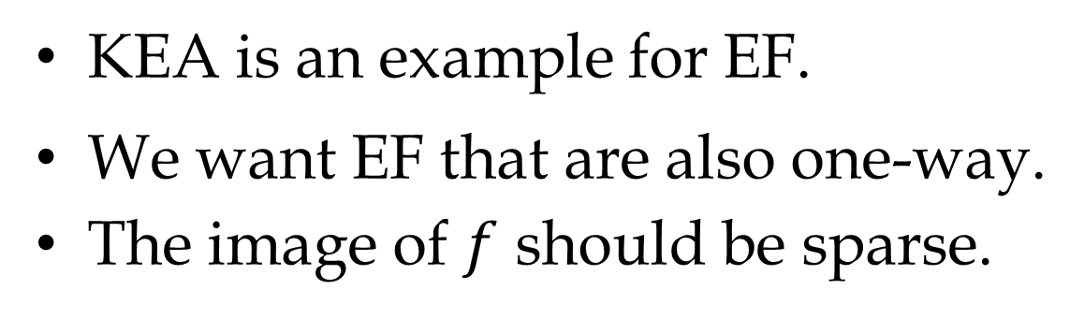


Remarks on EF
KEA is an example for EF.
We want EF that are also one-way.
The image of $f$ should be sparse.
Adversary
$$k←\$$$
Extraction
$$x$$
$$f_{k}(x)$$
OWF, CRHF

Slide 15
Applications of EF
[BCCT12,GLR12,DFH12]
Knowledge of Exponent
Extractable One-Way
Functions (EOWF)
Extractable Collision-Resistant
Hash Functions (ECRH)
3-Message
Zero-Knowledge
2-Message
Succinct Argument
(Privately Verifiable)

Slide 16
What is missing?
Clean assumptions
Candidates
Strong applications

Slide 17




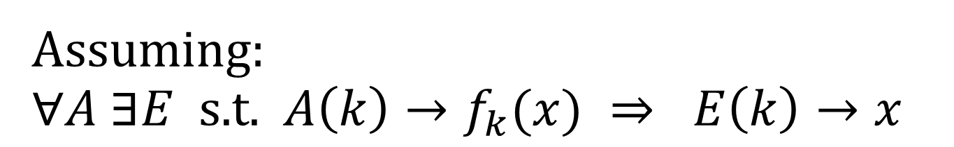

A Reduction Using EF
Assuming:
$∀A ∃E \text{s}\text{.}\text{t}\text{. }A\left(k\right)→f_{k}(x) ⇒ E\left(k\right)→x$
Reduction
$$A$$
$$k←\$$$
$$E$$
$$x$$
$$f_{k}(x)$$

Slide 18
Do Extractable One-Way
Functions with an Explicit Extractor Exist?

Slide 19
It depends on the Auxiliary Input.

Slide 20






Example: Zero-Knowledge
Auxiliary input
$$x∈ℒ$$
$$x$$
$$k$$
$$P$$
$$V$$
$$f_{k}\left(t\right)$$

Slide 21
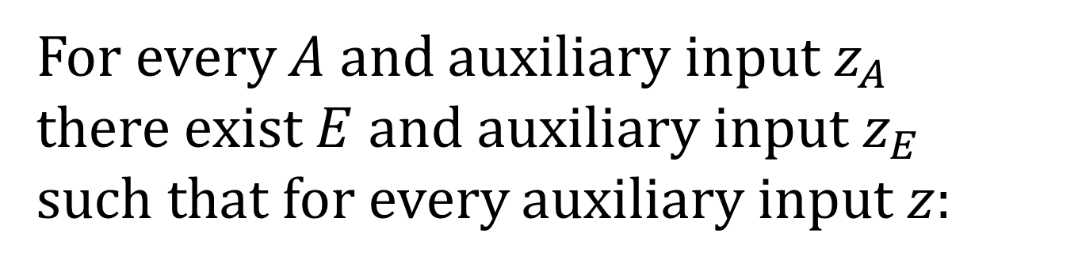
Definition of EF with A.I.
For every $A$ and auxiliary input$z_{A}$
there exist $E$ and auxiliary input$z_{E}$
such that for every auxiliary input $z$:
$A\left(z_{A},z,k\right)→f_{k}(x) ⇒ E\left(z_{E},z, k\right)→x$

Slide 22
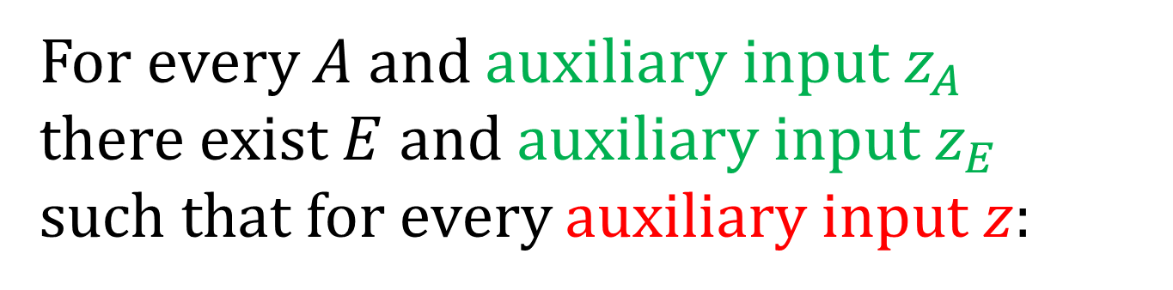
Types of A.I.
For every $A$ and auxiliary input$z_{A}$
there exist $E$ and auxiliary input$z_{E}$
such that for every auxiliary input $z$:
$A\left(z_{A},z,k\right)→f_{k}(x) ⇒ E\left(z_{E},z, k\right)→x$
Individual \ Common
Bounded \ Unbounded

Slide 23
What type of A.I. do we need?

Slide 24
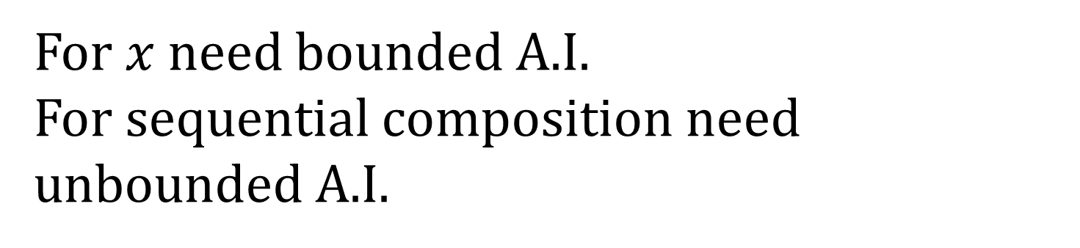
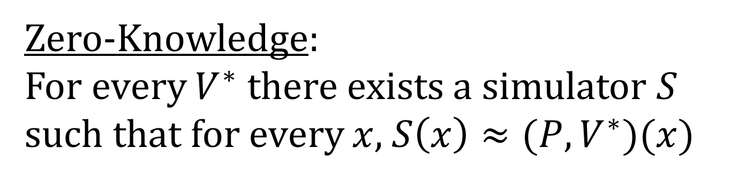
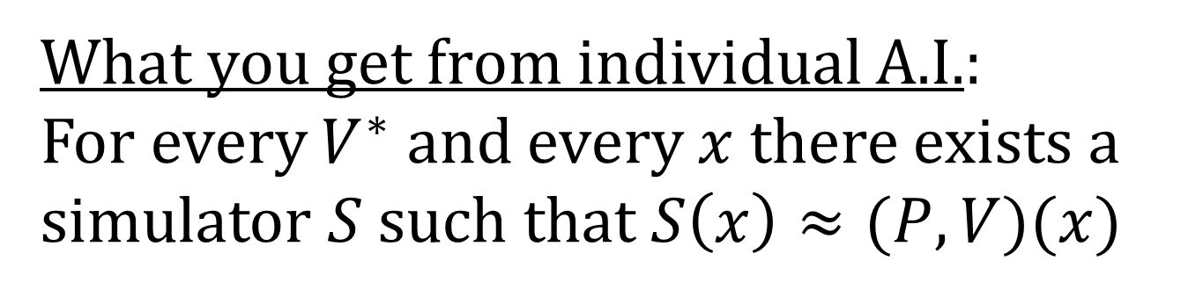
Example: Zero-Knowledge
Zero-Knowledge:
For every $V^{∗}$ there exists a simulator $S$ such that for every $x$, $S\left(x\right)≈(P,V^{∗})(x)$
For $x$ need bounded A.I.
For sequential composition need unbounded A.I.
What you get from individual A.I.:
For every $V^{∗}$ and every $x$ there exists a simulator $S$ such that $S\left(x\right)≈(P,V)(x)$

Slide 25
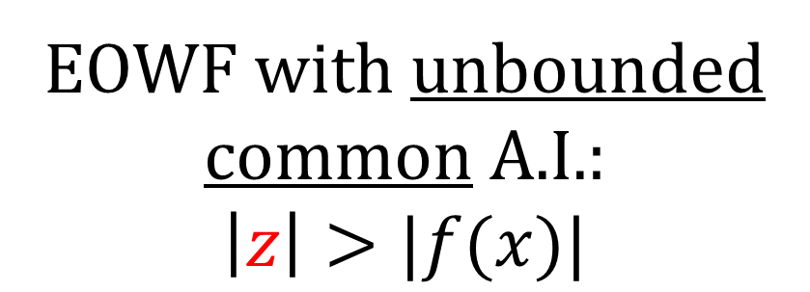
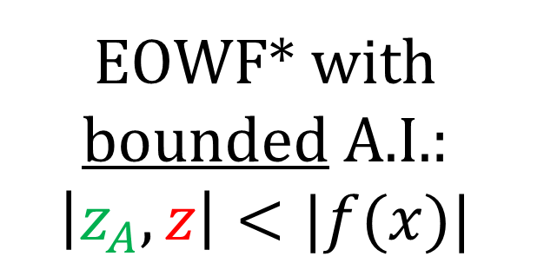
EOWF with unbounded common A.I.:
$$\left|z\right|>|f(x)|$$
EOWF* with bounded A.I.:
$$\left|z_{A},z\right|<|f(x)|$$
Explicit
Extractor
Impossible
Open
Possible
Delegation for P
from Subexp-PIR
[Kalai-Raz-Rothblum13]
Indistinguishability
Obfuscation
Subexp-LWE

Slide 26
Generalized EOWF
EOWF* = Privately-Verifiable Generalized EOWF
EOWF* suffices for applications of EOWF.
The impossibility results holds also for EOWF*
Can remove * assuming publicly-verifiable delegation for P (P-certificates)

Slide 27



Application
[BCCGLRT13]
$$⇒$$
3-Message Zero-Knowledge
EOWF
EOWF with
bounded A.I.
$$⇒$$
3-Message Zero-Knowledge
For verifiers w. bounded A.I.
$$⇒$$
EOWF* with
bounded A.I.

Slide 28
Survey
Construction
Impossibility

Slide 29
Construction
EOWF* with Bounded A.I from
Privately-Verifiable Delegation for P
EOWF with Bounded A.I from
Publicly-Verifiable Delegation for P

Slide 30
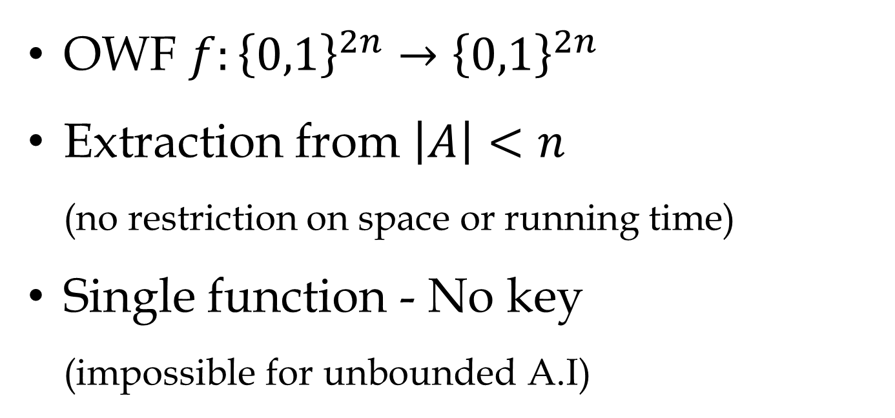
First Attempt
OWF $f:{\left\{0,1\right\}}^{2n}→{\left\{0,1\right\}}^{2n}$
Extraction from $\left|A\right|<n$
(no restriction on space or running time)
Single function - No key
(impossible for unbounded A.I)

Slide 31

First Attempt
$$i,s∈{\left\{0,1\right\}}^{n},\text{PRG}:{\left\{0,1\right\}}^{n}→{\left\{0,1\right\}}^{n}$$
$$f(i,s)=\left\{\begin{matrix}\text{P}\text{RG}\left(s\right) \text{if} i≠0^{n} \\ \end{matrix}\right.$$

Slide 32
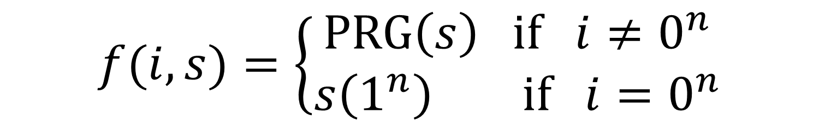

First Attempt
$$i,s∈{\left\{0,1\right\}}^{n},\text{PRG}:{\left\{0,1\right\}}^{n}→{\left\{0,1\right\}}^{n}$$
$$f(i,s)=\left\{\begin{matrix}\text{P}\text{RG}\left(s\right) \text{if} i≠0^{n} \\ s\left(1^{n}\right) \text{if} i=0^{n}\end{matrix}\right.$$
Interpert $s$ as a program outputting $2n$ bits

Slide 33

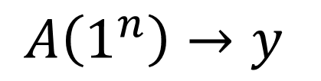
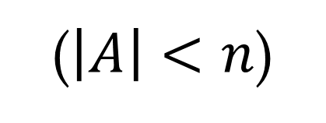


Extraction
$$A\left(1^{n}\right)→y$$
($\left|A\right|<n$)
$$f\left(0^{n},A\right)=A\left(1^{n}\right)=y$$
$$E\left(1^{n}\right)→0^{n},A$$
$$f(i,s)=\left\{\begin{matrix}\text{P}\text{RG}\left(s\right) \text{if} i≠0^{n} \\ s\left(1^{n}\right) \text{if} i=0^{n}\end{matrix}\right.$$

Slide 34
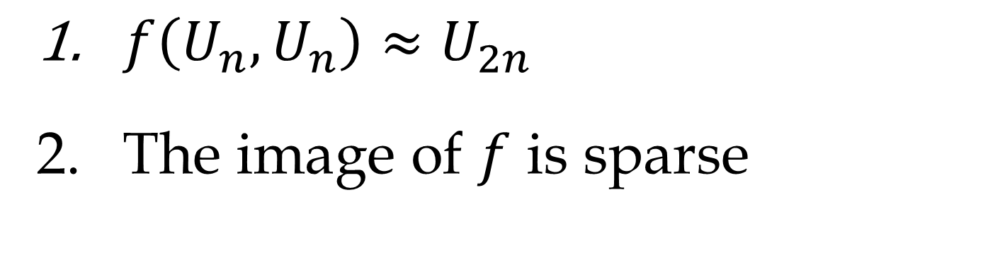
One-Wayness
$f\left(U_{n},U_{n}\right)≈U_{2n}$
The image of $f$ is sparse
$$f(i,s)=\left\{\begin{matrix}\text{P}\text{RG}\left(s\right) \text{if} i≠0^{n} \\ s\left(1^{n}\right) \text{if} i=0^{n}\end{matrix}\right.$$

Slide 35


Problem
$f$ is not poly-time computable!
Solution: Delegation for P
(following the protocols of [B01,BLV03])
$$f(i,s)=\left\{\begin{matrix}PRG_{s}\left(s\right) \text{if} i≠0^{n} \\ s\left(1^{n}\right) \text{if} i=0^{n}\end{matrix}\right.$$

Slide 36






Delegation for P
$$\text{Gen}\left(\$\right)→σ$$
$$P$$
$$V$$
$$π:M\left(1^{n}\right)→y$$
$$\text{poly}\left(T_{M}\right)$$
$$\text{polylog}\left(T_{M}\right)<n$$

Slide 37

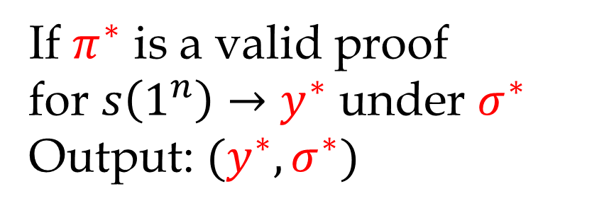
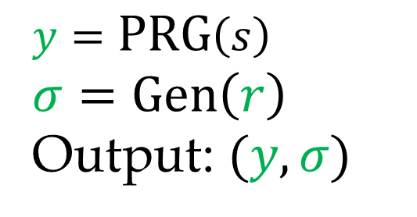

Final Construction
$$f(i,s,r,y^{∗},σ^{∗},π^{∗})$$
$$i≠0^{n}$$
$$i=0^{n}$$
$$y=\text{P}\text{RG}\left(s\right)$$
$$σ=\text{Gen}\left(r\right)$$
Output: $(y,σ)$
If $π^{∗}$ is a valid proof
for $s\left(1^{n}\right)→y^{∗}$ under $σ^{∗}$
Output: $(y^{∗},σ^{∗})$

Slide 38

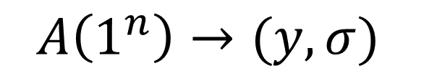


Extraction
$$A\left(1^{n}\right)→(y,σ)$$
$$f$$
$$E\left(1^{n}\right)→(0^{n},A,r,y,σ,π^{∗})$$
When $π^{∗}$ is a proof that $A\left(1^{n}\right)→y$ under $σ$

Slide 39
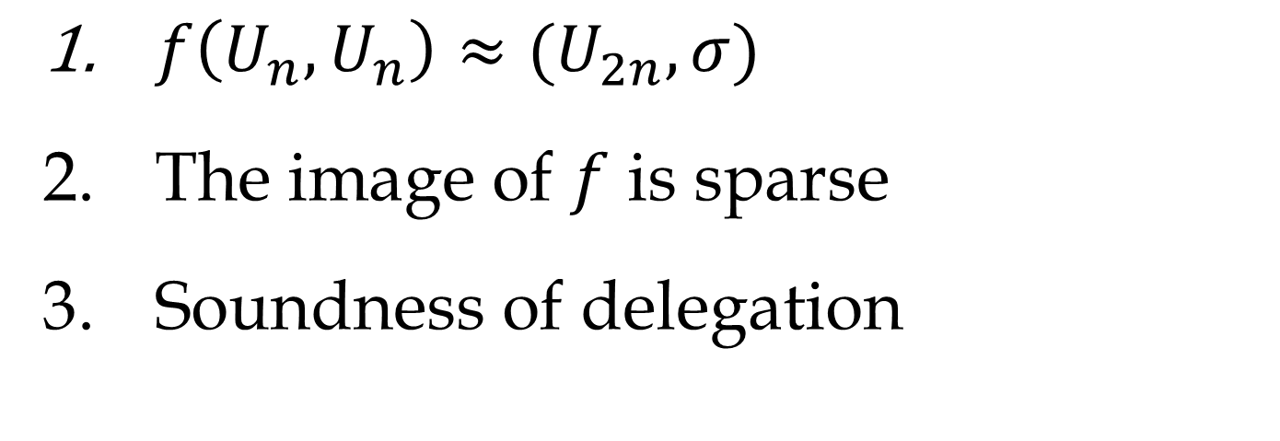
One-Wayness
$f\left(U_{n},U_{n}\right)≈(U_{2n},σ)$
The image of $f$ is sparse
Soundness of delegation

Slide 40
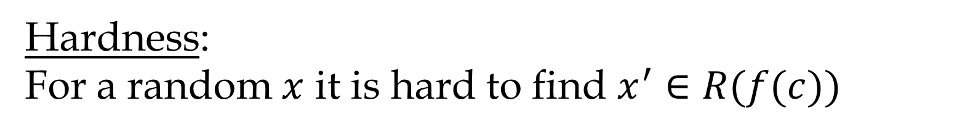


Generalized EOWF
$$R(f\left(x\right),x′)$$
Hardness:
For a random $x$ it is hard to find $x^{′}∈R(f(c))$
Extraction:
For every $A$ there exists $E$ such that
$$A→f\left(x\right)⇒ E→x^{′}∈R(f(x))$$
Privately-Verifiable GEOWF:
Can efficiently test $x∈R(f(x))$ only given $x$

Slide 41
Impossibility
Assuming indistinguishability obfuscation,
there is not EOWF with unbounded
common auxiliary input

Slide 42




Intuition
Non-Black-Box Extractor
Adversary
$$k$$
Adversary
$$x$$
$$f_{k}\left(x\right)$$
Common A.I $⇒$ Universal Extractor
There exists $E$ s.t. for every $A$ and $z$:
$$A\left(z,k\right)→f_{k}(x) ⇒ E\left(A,z, k\right)→x$$

Slide 43
Plan
Assuming virtual black-box obfuscation
[Goldreich, Hada-Tanaka]
Assuming indistinguishability obfuscation

Slide 44
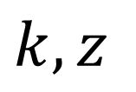

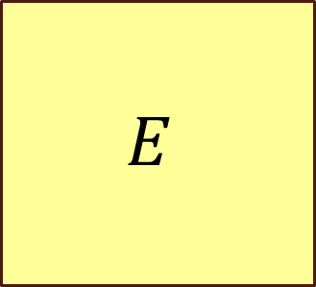

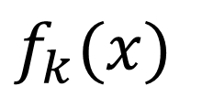
Common A.I.
$$A$$
$$f_{k}(x)$$
$$k,z$$
$$E$$
$$x$$

Slide 45



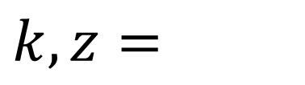
Universal Extraction
Universal Adversary
$$A$$
$$f_{k}(x)$$
$$k$$
$$A$$
$$k,z=$$
Universal Extractor
$$x$$

Slide 46


Black-Box Extraction
Universal Adversary
Black-box obfuscation
$$A$$
$$f_{k}(x)$$
$$k$$
$$A$$
$$k,z=$$
Universal Extractor
$$x$$

Slide 47





Black-Box Extraction
Black-Box Extractor
Adversary
Adversary
$$x_{k}$$
$$k$$
$$x_{k}=U_{n}$$
$$x_{k}=PRF_{s}(k)$$
$$f_{k}(x_{k})$$

Slide 48



Indistinguishability Obfuscation
$$C_{2}$$
$$≡$$
$$C_{1}$$
Compute the same function

Slide 49
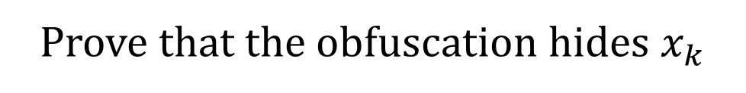
Indistinguishability Obfuscation
Extractor
Adversary
$$x_{k}$$
$$k$$
$$x_{k}=PRF_{s}(k)$$
$$f_{k}(x_{k})$$
Prove that the obfuscation hides $x_{k}$

Slide 50






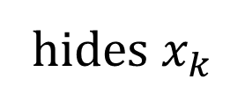


Indistinguishability Obfuscation
Extractor
$$x_{k}$$
$$k$$
$$x_{k}=PRF_{s}(k)$$
$$f_{k}(x_{k})$$
$$≈$$
Extractor
$$x_{k}$$
Alternative adversary
$$k$$
$$f_{k}(x_{k})$$
hides $x_{k}$

Slide 51




Alternative Adversary
Using the Sahai-Waters puncturing technique
$$PRF_{s}$$
$$f_{k}$$
$$k$$
$$f_{k}(x_{k})$$

Slide 52
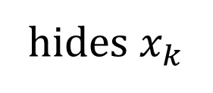
Indistinguishability Obfuscation
Extractor
$$x_{k}$$
$$k$$
$$f_{k}(x_{k})$$
hides $x_{k}$

Slide 53
Back to the Construction?

Slide 54

EOWF with
unbounded individual A.I.
$$|z_{A}|>|f(x)|$$
Extractable
CRHF\COM\1-to-1 OWF
Impossible
Open
Possible

Slide 55
Thank You

