Slide 1
Protecting Obfuscation Against Algebraic Attacks
Boaz Barak
Sanjam Garg
Yael Tauman Kalai
Omer Paneth
Amit Sahai

Slide 2
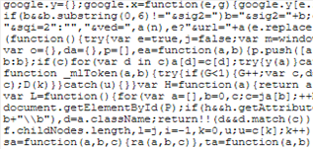





Program Obfuscation
$$m$$
$$\text{cipher}$$
$$Enc_{sk}(m)$$
Obfuscation
$$m$$
$$\text{cipher}$$
Public Key

Slide 3

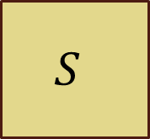
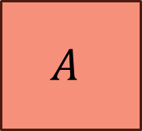

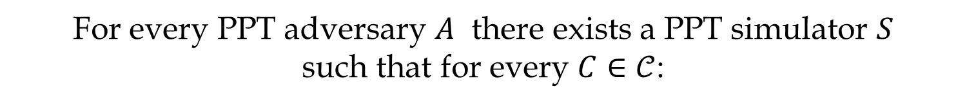


Virtual Black-Box (VBB)
[Barak-Goldreich-Impagliazzo-Rudich-Sahai-Vadhan-Yang 01]
Algorithm $𝒪$ is an obfuscator for a class $𝒞$ if:
For every PPT adversary $A$ there exists a PPT simulator $S$
such that for every $C∈𝒞$:
$$C$$
$$A$$
$$S$$
$$≈$$
$$𝒪(C)$$
$$P(C)$$

Slide 4
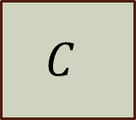
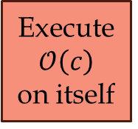
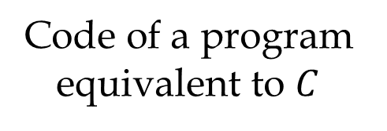
VBB Impossibility
[Barak-Goldreich-Impagliazzo-Rudich-Sahai-Vadhan-Yang 01]
There exists contrived “unobfuscatable” programs.
Code of a program equivalent to $C$
$$C$$
Secret
$$C$$
Execute $𝒪\left(c\right)$
on itself
$$S$$
$$𝒪(C)$$
Secret

Slide 5
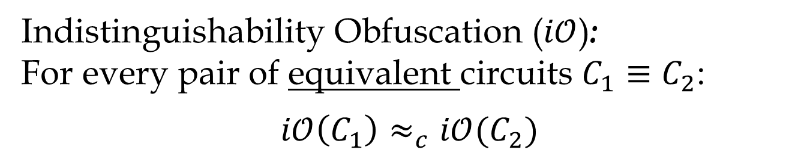
First Candidate Obfuscation
[Garg-Gentry-Halevi-Raykova-Sahai-Waters 13]
What is the security of the candidate?
Assumption:
The [GGHRSW13] obfuscator is an Indistingushability Obfuscator.
No known attacks except [BGIRSVY01].
Indistinguishability Obfuscation ($i𝒪$):
For every pair of equivalent circuits $C_{1}≡C_{2}$:
$$i𝒪\left(C_{1}\right)≈_{c}i𝒪(C_{2})$$

Slide 6
This Work
A variant of the [GGHRSW13] obfuscator is VBB for all circuits
in a generic model
(underlying algebra is idealized)

Slide 7
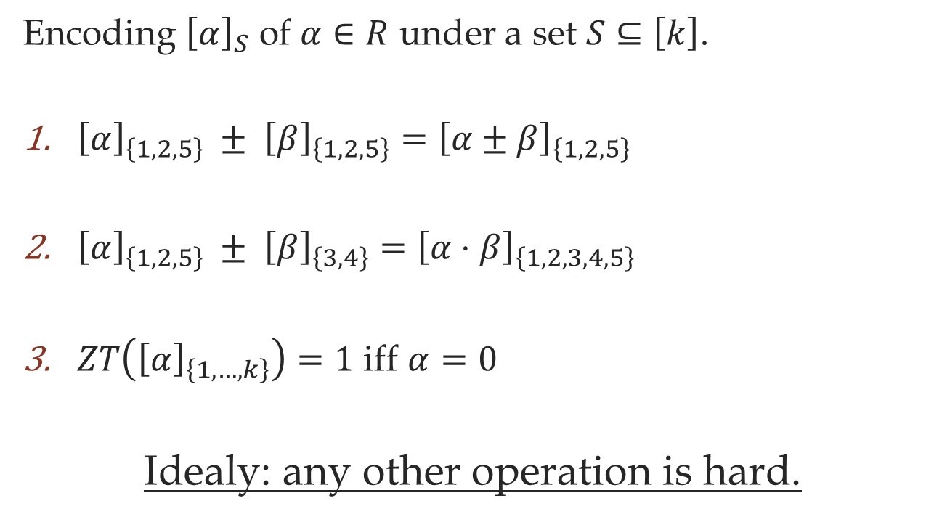
Multilinear Maps
[Boneh-Silverberg 03, Garg-Gentry-Halevi 13]
Encoding ${\left[α\right]}_{S}$ of $α∈R$ under a set $S⊆\left[k\right]$.
${\left[α\right]}_{\left\{1,2,5\right\}} ± {\left[β\right]}_{\left\{1,2,5\right\}}={\left[α±β\right]}_{\left\{1,2,5\right\}}$
${\left[α\right]}_{\left\{1,2,5\right\}} ± {\left[β\right]}_{\left\{3,4\right\}}={\left[α⋅β\right]}_{\left\{1,2,3,4,5\right\}}$
$ZT\left({\left[α\right]}_{\left\{1,…,k\right\}}\right)=1$ iff $α=0$
Idealy: any other operation is hard.

Slide 8




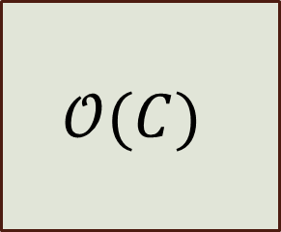
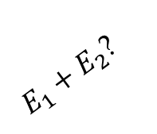

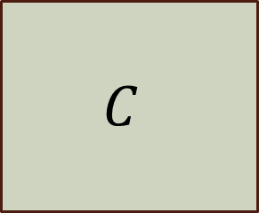


The Generic MM Model
Add
Multiply
ZT
$$x$$
$$x$$
$E_{1}+E_{2}$?
$$E_{11}$$
$$C$$
$$𝒪(C)$$
$E_{1},E_{2},E_{3},E_{4},E_{5}$
$E_{6},E_{7},E_{8},E_{9},E_{10}$
$$C(x)$$
$$C(x)$$

Slide 9
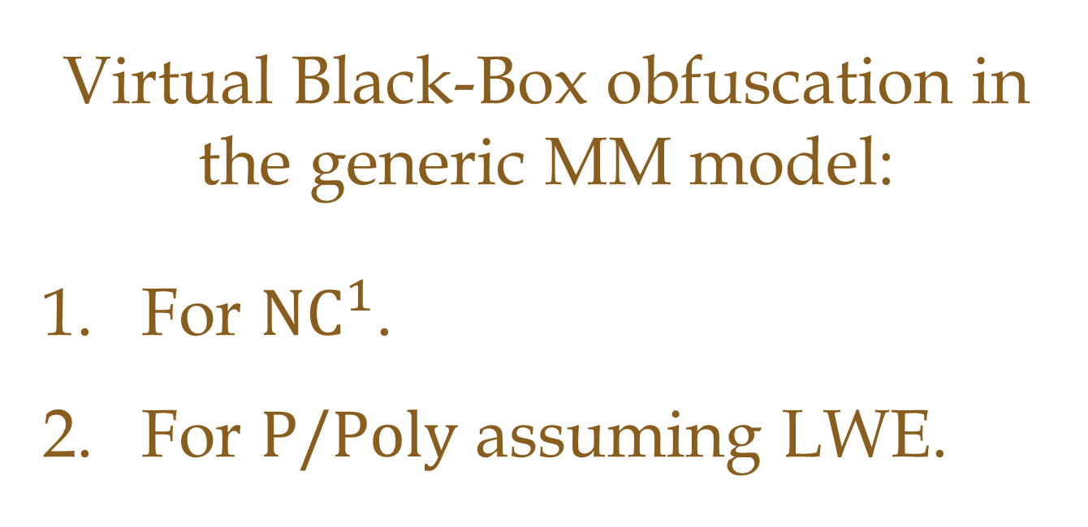
Our Result
Virtual Black-Box obfuscation in the generic MM model:
For $\text{N}{\text{C}}^{1}$.
For $\text{P}\text{/}\text{Poly}$ assuming LWE.

Slide 10
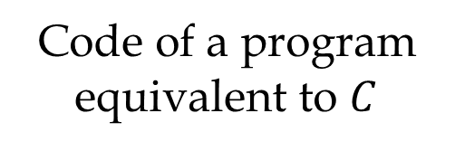


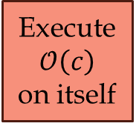
Avoiding VBB Impossibility
In the Generic MM Model
Code of a program equivalent to $C$
$$C$$
Secret
Add
Mul
ZT
Execute $𝒪\left(c\right)$
on itself
$$𝒪(C)$$
Secret

Slide 11
Interpretation
Secure obfuscation against “algebraic attacks”.
Warning:
Non-algebraic attacks do exist [BGIRSVY01].

Slide 12
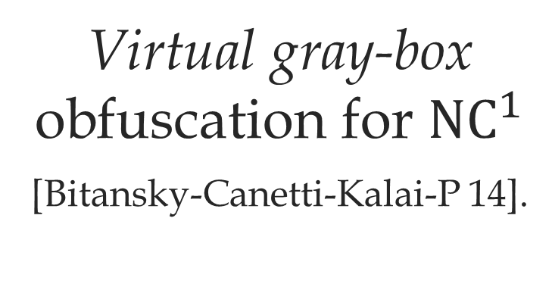
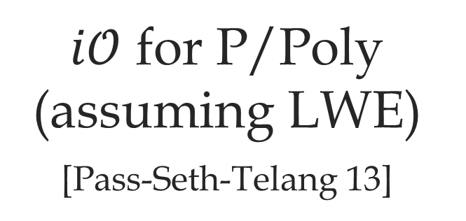

Interpretation II
This Work:
VBB with Generic Multilinear Maps
Multi-Message Semantically-Secure Multilinear Maps
[Pass-Seth-Telang 13]
$$+$$
$i𝒪$ for P/Poly
(assuming LWE)
[Pass-Seth-Telang 13]
Virtual gray-box obfuscation for $\text{N}{\text{C}}^{1}$
[Bitansky-Canetti-Kalai-P 14].

Slide 13
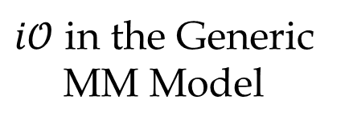

Previous Works
[GGHRSW13]
[Canetti-Vaikuntanathan13]
$i𝒪$ in the Generic Colored Matrix Model
VBB from Black-Box Pseudo-Free Groups
[Brakerski-Rothblum13]
This Work
$i𝒪$ in the Generic
MM Model
VBB in the Generic
MM Model
[Brakerski-Rothblum13]
Assuming BSH

Slide 14

The Construction
Construction for $\text{N}{\text{C}}^{1}$ via branching programs
Bootstrap to P/Poly assuming LWE
(leveled-FHE with decryption in $\text{N}{\text{C}}^{1}$)

Slide 15


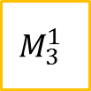
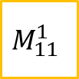
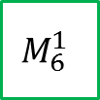
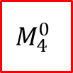




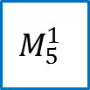

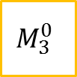


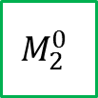


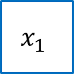




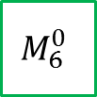




Branching Programs
Program:
$$M_{1}^{0}$$
$$M_{2}^{0}$$
$$M_{3}^{0}$$
$$M_{4}^{0}$$
$$M_{5}^{0}$$
$$M_{6}^{0}$$
$$M_{7}^{0}$$
$$M_{8}^{0}$$
$$M_{9}^{0}$$
$$M_{10}^{0}$$
$$M_{11}^{0}$$
$$M_{12}^{0}$$
$$M_{1}^{1}$$
$$M_{2}^{1}$$
$$M_{3}^{1}$$
$$M_{4}^{1}$$
$$M_{5}^{1}$$
$$M_{6}^{1}$$
$$M_{7}^{1}$$
$$M_{8}^{1}$$
$$M_{9}^{1}$$
$$M_{10}^{1}$$
$$M_{11}^{1}$$
$$M_{12}^{1}$$
Input:
$$x_{1}$$
$$x_{2}$$
$$x_{3}$$
$$x_{4}$$

Slide 16
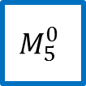



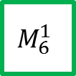
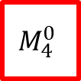
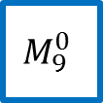

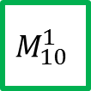


















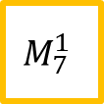


BP Evaluation
Program:
$$M_{1}^{0}$$
$$M_{2}^{0}$$
$$M_{3}^{0}$$
$$M_{4}^{0}$$
$$M_{5}^{0}$$
$$M_{6}^{0}$$
$$M_{7}^{0}$$
$$M_{8}^{0}$$
$$M_{9}^{0}$$
$$M_{10}^{0}$$
$$M_{11}^{0}$$
$$M_{12}^{0}$$
$$M_{1}^{1}$$
$$M_{2}^{1}$$
$$M_{3}^{1}$$
$$M_{4}^{1}$$
$$M_{5}^{1}$$
$$M_{6}^{1}$$
$$M_{7}^{1}$$
$$M_{8}^{1}$$
$$M_{9}^{1}$$
$$M_{10}^{1}$$
$$M_{11}^{1}$$
$$M_{12}^{1}$$
Input:
$$0$$
$$1$$
$$1$$
$$0$$
Output:
$$⊤$$
or
$$⊥$$

Slide 17
Obfuscating BP
Randomizing [Kilian 88]
Encoding

Slide 18
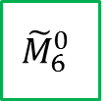
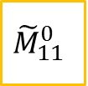
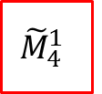
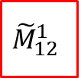
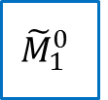
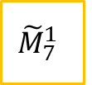
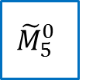
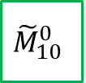



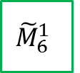
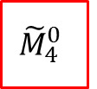

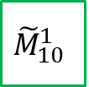


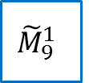



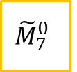

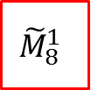
Step 1: Randomizing
Program:
$${\tilde{M}}_{1}^{0}$$
$${\tilde{M}}_{2}^{0}$$
$${\tilde{M}}_{3}^{0}$$
$${\tilde{M}}_{4}^{0}$$
$${\tilde{M}}_{5}^{0}$$
$${\tilde{M}}_{6}^{0}$$
$${\tilde{M}}_{7}^{0}$$
$${\tilde{M}}_{8}^{0}$$
$${\tilde{M}}_{9}^{0}$$
$${\tilde{M}}_{10}^{0}$$
$${\tilde{M}}_{11}^{0}$$
$${\tilde{M}}_{12}^{0}$$
$${\tilde{M}}_{1}^{1}$$
$${\tilde{M}}_{2}^{1}$$
$${\tilde{M}}_{3}^{1}$$
$${\tilde{M}}_{4}^{1}$$
$${\tilde{M}}_{5}^{1}$$
$${\tilde{M}}_{6}^{1}$$
$${\tilde{M}}_{7}^{1}$$
$${\tilde{M}}_{8}^{1}$$
$${\tilde{M}}_{9}^{1}$$
$${\tilde{M}}_{10}^{1}$$
$${\tilde{M}}_{11}^{1}$$
$${\tilde{M}}_{12}^{1}$$
Input:
$$x_{1}$$
$$x_{2}$$
$$x_{3}$$
$$x_{4}$$
Output:
$$⊤$$
or
$$⊥$$

Slide 19
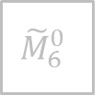























Step 1: Randomizing
Program:
$${\tilde{M}}_{1}^{0}$$
$${\tilde{M}}_{2}^{0}$$
$${\tilde{M}}_{3}^{0}$$
$${\tilde{M}}_{4}^{0}$$
$${\tilde{M}}_{5}^{0}$$
$${\tilde{M}}_{6}^{0}$$
$${\tilde{M}}_{7}^{0}$$
$${\tilde{M}}_{8}^{0}$$
$${\tilde{M}}_{9}^{0}$$
$${\tilde{M}}_{10}^{0}$$
$${\tilde{M}}_{11}^{0}$$
$${\tilde{M}}_{12}^{0}$$
$${\tilde{M}}_{1}^{1}$$
$${\tilde{M}}_{2}^{1}$$
$${\tilde{M}}_{3}^{1}$$
$${\tilde{M}}_{4}^{1}$$
$${\tilde{M}}_{5}^{1}$$
$${\tilde{M}}_{6}^{1}$$
$${\tilde{M}}_{7}^{1}$$
$${\tilde{M}}_{8}^{1}$$
$${\tilde{M}}_{9}^{1}$$
$${\tilde{M}}_{10}^{1}$$
$${\tilde{M}}_{11}^{1}$$
$${\tilde{M}}_{12}^{1}$$
Input:
$$0$$
$$1$$
$$1$$
$$0$$
Output:
$$⊤$$
or
$$⊥$$

Slide 20















Step 2: Encoding
Program:
$${\tilde{M}}_{1}^{0}$$
$${\tilde{M}}_{2}^{0}$$
$${\tilde{M}}_{3}^{0}$$
$${\tilde{M}}_{4}^{0}$$
$${\tilde{M}}_{5}^{0}$$
$${\tilde{M}}_{6}^{0}$$
$${\tilde{M}}_{7}^{0}$$
$${\tilde{M}}_{8}^{0}$$
$${\tilde{M}}_{9}^{0}$$
$${\tilde{M}}_{10}^{0}$$
$${\tilde{M}}_{11}^{0}$$
$${\tilde{M}}_{12}^{0}$$
$${\tilde{M}}_{1}^{1}$$
$${\tilde{M}}_{2}^{1}$$
$${\tilde{M}}_{3}^{1}$$
$${\tilde{M}}_{4}^{1}$$
$${\tilde{M}}_{5}^{1}$$
$${\tilde{M}}_{6}^{1}$$
$${\tilde{M}}_{7}^{1}$$
$${\tilde{M}}_{8}^{1}$$
$${\tilde{M}}_{9}^{1}$$
$${\tilde{M}}_{10}^{1}$$
$${\tilde{M}}_{11}^{1}$$
$${\tilde{M}}_{12}^{1}$$
$$\{1\}$$
$$\{2\}$$
$$\{3\}$$
$$\{4\}$$
$$\{5\}$$
$$\{6\}$$
$$\{7\}$$
$$\{8\}$$
$$\{9\}$$
$$\{10\}$$
$$\{11\}$$
$$\{12\}$$
Obfuscation includes the encodings:
$$\left\{{\left[{\tilde{M}}_{i}^{b}\right]}_{\left\{i\right\}} | ∀ \text{level} i, bit b \right\},{\left[⊤\right]}_{\left[12\right]}$$
$$⊤$$
$$\{1,…,12\}$$

Slide 21


























Proof of Security
$${\tilde{M}}_{1}^{0}$$
$${\tilde{M}}_{4}^{0}$$
$${\tilde{M}}_{5}^{0}$$
$${\tilde{M}}_{8}^{0}$$
$${\tilde{M}}_{9}^{0}$$
$${\tilde{M}}_{12}^{0}$$
$${\tilde{M}}_{2}^{1}$$
$${\tilde{M}}_{3}^{1}$$
$${\tilde{M}}_{6}^{1}$$
$${\tilde{M}}_{7}^{1}$$
$${\tilde{M}}_{10}^{1}$$
$${\tilde{M}}_{11}^{1}$$
$$+$$
…
$${\tilde{M}}_{2}^{0}$$
$${\tilde{M}}_{6}^{0}$$
$${\tilde{M}}_{10}^{0}$$
$${\tilde{M}}_{1}^{1}$$
$${\tilde{M}}_{3}^{1}$$
$${\tilde{M}}_{4}^{1}$$
$${\tilde{M}}_{5}^{1}$$
$${\tilde{M}}_{7}^{1}$$
$${\tilde{M}}_{8}^{1}$$
$${\tilde{M}}_{9}^{1}$$
$${\tilde{M}}_{11}^{1}$$
$${\tilde{M}}_{12}^{1}$$
$$?$$
$+ α⋅$
$$⊤$$
$$=0$$

Slide 22

















Simulation Outline
Test every monomial separately:
$${\tilde{M}}_{1}^{0}$$
$${\tilde{M}}_{4}^{0}$$
$${\tilde{M}}_{5}^{0}$$
$${\tilde{M}}_{8}^{0}$$
$${\tilde{M}}_{9}^{0}$$
$${\tilde{M}}_{12}^{0}$$
$${\tilde{M}}_{2}^{1}$$
$${\tilde{M}}_{3}^{1}$$
$${\tilde{M}}_{6}^{1}$$
$${\tilde{M}}_{7}^{1}$$
$${\tilde{M}}_{10}^{1}$$
$${\tilde{M}}_{11}^{1}$$
By querying $C\left(\begin{matrix} \\ \end{matrix} \right)$
$$0$$
$$1$$
$$1$$
$$0$$

Slide 23












Problems
1. Inconsistent monomials:
$${\tilde{M}}_{1}^{0}$$
$${\tilde{M}}_{4}^{0}$$
$${\tilde{M}}_{8}^{0}$$
$${\tilde{M}}_{9}^{0}$$
$${\tilde{M}}_{12}^{0}$$
$${\tilde{M}}_{2}^{1}$$
$${\tilde{M}}_{3}^{1}$$
$${\tilde{M}}_{5}^{1}$$
$${\tilde{M}}_{6}^{1}$$
$${\tilde{M}}_{7}^{1}$$
$${\tilde{M}}_{10}^{1}$$
$${\tilde{M}}_{11}^{1}$$
2. Too many monomials:
$$\left({\tilde{M}}_{1}^{0}+{\tilde{M}}_{1}^{1}\right)⋅\left({\tilde{M}}_{2}^{0}+{\tilde{M}}_{2}^{1}\right)⋅…⋅\left({\tilde{M}}_{12}^{0}+{\tilde{M}}_{12}^{1}\right)$$

Slide 24
























Changing the Sets
$$\{1\}$$
$$\{2\}$$
$$\{3\}$$
$$\{4\}$$
$$\{5\}$$
$$\{6\}$$
$$\{7\}$$
$$\{8\}$$
$$\{9\}$$
$$\{10\}$$
$$\{11\}$$
$$\{12\}$$
$${\tilde{M}}_{1}^{0}$$
$${\tilde{M}}_{2}^{0}$$
$${\tilde{M}}_{3}^{0}$$
$${\tilde{M}}_{4}^{0}$$
$${\tilde{M}}_{5}^{0}$$
$${\tilde{M}}_{6}^{0}$$
$${\tilde{M}}_{7}^{0}$$
$${\tilde{M}}_{8}^{0}$$
$${\tilde{M}}_{9}^{0}$$
$${\tilde{M}}_{10}^{0}$$
$${\tilde{M}}_{11}^{0}$$
$${\tilde{M}}_{12}^{0}$$
$${\tilde{M}}_{1}^{1}$$
$${\tilde{M}}_{2}^{1}$$
$${\tilde{M}}_{3}^{1}$$
$${\tilde{M}}_{4}^{1}$$
$${\tilde{M}}_{5}^{1}$$
$${\tilde{M}}_{6}^{1}$$
$${\tilde{M}}_{7}^{1}$$
$${\tilde{M}}_{8}^{1}$$
$${\tilde{M}}_{9}^{1}$$
$${\tilde{M}}_{10}^{1}$$
$${\tilde{M}}_{11}^{1}$$
$${\tilde{M}}_{12}^{1}$$
$$\{1\}$$
$$\{2\}$$
$$\{3\}$$
$$\{4\}$$
$$\{5\}$$
$$\{6\}$$
$$\{7\}$$
$$\{8\}$$
$$\{9\}$$
$$\{10\}$$
$$\{11\}$$
$$\{12\}$$
$$⊤$$
$$\{1,…,12\}$$

Slide 25










































Changing the Sets
$$\left\{\begin{matrix}1 \\ 1′\end{matrix}\right\}$$
$$\left\{\begin{matrix}2 \\ 2′\end{matrix}\right\}$$
$$\left\{\begin{matrix}3 \\ 3′\end{matrix}\right\}$$
$$\left\{\begin{matrix}4 \\ 4′\end{matrix}\right\}$$
$$\left\{\begin{matrix}5 \\ 5′\end{matrix}\right\}$$
$$\left\{\begin{matrix}6 \\ 6′\end{matrix}\right\}$$
$$\left\{\begin{matrix}7 \\ 7′\end{matrix}\right\}$$
$$\left\{\begin{matrix}8 \\ 8′\end{matrix}\right\}$$
$$\left\{\begin{matrix}9 \\ 9′\end{matrix}\right\}$$
$$\left\{\begin{matrix}10 \\ 10′\end{matrix}\right\}$$
$$\left\{\begin{matrix}11 \\ 11′\end{matrix}\right\}$$
$$\left\{\begin{matrix}12 \\ 12′\end{matrix}\right\}$$
$${\tilde{M}}_{1}^{0}$$
$${\tilde{M}}_{2}^{0}$$
$${\tilde{M}}_{3}^{0}$$
$${\tilde{M}}_{4}^{0}$$
$${\tilde{M}}_{5}^{0}$$
$${\tilde{M}}_{6}^{0}$$
$${\tilde{M}}_{7}^{0}$$
$${\tilde{M}}_{8}^{0}$$
$${\tilde{M}}_{9}^{0}$$
$${\tilde{M}}_{10}^{0}$$
$${\tilde{M}}_{11}^{0}$$
$${\tilde{M}}_{12}^{0}$$
$${\tilde{M}}_{1}^{1}$$
$${\tilde{M}}_{2}^{1}$$
$${\tilde{M}}_{3}^{1}$$
$${\tilde{M}}_{4}^{1}$$
$${\tilde{M}}_{5}^{1}$$
$${\tilde{M}}_{6}^{1}$$
$${\tilde{M}}_{7}^{1}$$
$${\tilde{M}}_{8}^{1}$$
$${\tilde{M}}_{9}^{1}$$
$${\tilde{M}}_{10}^{1}$$
$${\tilde{M}}_{11}^{1}$$
$${\tilde{M}}_{12}^{1}$$
$$\left\{\begin{matrix}1 \\ 1′\end{matrix}\right\}$$
$$\left\{\begin{matrix}2 \\ 2′\end{matrix}\right\}$$
$$\left\{\begin{matrix}3 \\ 3′\end{matrix}\right\}$$
$$\left\{\begin{matrix}4 \\ 4′\end{matrix}\right\}$$
$$\left\{\begin{matrix}5 \\ 5′\end{matrix}\right\}$$
$$\left\{\begin{matrix}6 \\ 6′\end{matrix}\right\}$$
$$\left\{\begin{matrix}7 \\ 7′\end{matrix}\right\}$$
$$\left\{\begin{matrix}8 \\ 8′\end{matrix}\right\}$$
$$\left\{\begin{matrix}9 \\ 9′\end{matrix}\right\}$$
$$\left\{\begin{matrix}10 \\ 10′\end{matrix}\right\}$$
$$\left\{\begin{matrix}11 \\ 11′\end{matrix}\right\}$$
$$\left\{\begin{matrix}12 \\ 12′\end{matrix}\right\}$$
$$⊤$$
$$\left\{\begin{matrix}1,…,12 \\ 1′,…,12′\end{matrix}\right\}$$

Slide 26












Changing the Sets
$$\left\{\begin{matrix}1 \\ 1′\end{matrix}\right\}$$
$$\left\{\begin{matrix}5 \\ 5′\end{matrix}\right\}$$
$$\left\{\begin{matrix}9 \\ 9′\end{matrix}\right\}$$
$${\tilde{M}}_{1}^{0}$$
$${\tilde{M}}_{5}^{0}$$
$${\tilde{M}}_{9}^{0}$$
$${\tilde{M}}_{1}^{1}$$
$${\tilde{M}}_{5}^{1}$$
$${\tilde{M}}_{9}^{1}$$
$$\left\{\begin{matrix}1 \\ 1′\end{matrix}\right\}$$
$$\left\{\begin{matrix}5 \\ 5′\end{matrix}\right\}$$
$$\left\{\begin{matrix}9 \\ 9′\end{matrix}\right\}$$

Slide 27





Straddling Set System
$$\left\{\begin{matrix}1 \\ 1′\end{matrix}\right\}$$
$$\left\{\begin{matrix}5 \\ 5′\end{matrix}\right\}$$
$$\left\{\begin{matrix}9 \\ 9′\end{matrix}\right\}$$
$${\tilde{M}}_{1}^{0}$$
$${\tilde{M}}_{5}^{0}$$
$${\tilde{M}}_{9}^{0}$$
$${\tilde{M}}_{1}^{1}$$
$${\tilde{M}}_{5}^{1}$$
$${\tilde{M}}_{9}^{1}$$
$$\left\{\begin{matrix}1 \\ 5′\end{matrix}\right\}$$
$$\left\{\begin{matrix}5 \\ 9′\end{matrix}\right\}$$
$$\left\{\begin{matrix}9 \\ 1′\end{matrix}\right\}$$
$$\left\{\begin{matrix}1,5,9 \\ 1′,5′,9′\end{matrix}\right\} = \left\{\begin{matrix}1 \\ 1′\end{matrix}\right\}∪\left\{\begin{matrix}5 \\ 5^{′}\end{matrix}\right\}∪\left\{\begin{matrix}9 \\ 9^{′}\end{matrix}\right\} = \left\{\begin{matrix}1 \\ 5′\end{matrix}\right\}∪\left\{\begin{matrix}5 \\ 9′\end{matrix}\right\}∪\left\{\begin{matrix}9 \\ 1′\end{matrix}\right\}$$
$0$-matrices
$1$-matrices

Slide 28









Straddling Set System
$$\left\{\begin{matrix}1 \\ 1′\end{matrix}\right\}$$
$$\left\{\begin{matrix}5 \\ 5′\end{matrix}\right\}$$
$$\left\{\begin{matrix}9 \\ 9′\end{matrix}\right\}$$
$${\tilde{M}}_{1}^{0}$$
$${\tilde{M}}_{5}^{0}$$
$${\tilde{M}}_{9}^{0}$$
$${\tilde{M}}_{1}^{1}$$
$${\tilde{M}}_{5}^{1}$$
$${\tilde{M}}_{9}^{1}$$
$$\left\{\begin{matrix}1 \\ 5′\end{matrix}\right\}$$
$$\left\{\begin{matrix}5 \\ 9′\end{matrix}\right\}$$
$$\left\{\begin{matrix}9 \\ 1′\end{matrix}\right\}$$

Slide 29
























Straddling Set System
$$\left\{\begin{matrix}1 \\ 1′\end{matrix}\right\}$$
$$\left\{\begin{matrix}2 \\ 2′\end{matrix}\right\}$$
$$\left\{\begin{matrix}3 \\ 3′\end{matrix}\right\}$$
$$\left\{\begin{matrix}4 \\ 4′\end{matrix}\right\}$$
$$\left\{\begin{matrix}5 \\ 5′\end{matrix}\right\}$$
$$\left\{\begin{matrix}6 \\ 6′\end{matrix}\right\}$$
$$\left\{\begin{matrix}7 \\ 7′\end{matrix}\right\}$$
$$\left\{\begin{matrix}8 \\ 8′\end{matrix}\right\}$$
$$\left\{\begin{matrix}9 \\ 9′\end{matrix}\right\}$$
$$\left\{\begin{matrix}10 \\ 10′\end{matrix}\right\}$$
$$\left\{\begin{matrix}11 \\ 11′\end{matrix}\right\}$$
$$\left\{\begin{matrix}12 \\ 12′\end{matrix}\right\}$$
$$\left\{\begin{matrix}1 \\ 5′\end{matrix}\right\}$$
$$\left\{\begin{matrix}2 \\ 6′\end{matrix}\right\}$$
$$\left\{\begin{matrix}3 \\ 7′\end{matrix}\right\}$$
$$\left\{\begin{matrix}4 \\ 8′\end{matrix}\right\}$$
$$\left\{\begin{matrix}5 \\ 9′\end{matrix}\right\}$$
$$\left\{\begin{matrix}6 \\ 10′\end{matrix}\right\}$$
$$\left\{\begin{matrix}7 \\ 11′\end{matrix}\right\}$$
$$\left\{\begin{matrix}8 \\ 12′\end{matrix}\right\}$$
$$\left\{\begin{matrix}9 \\ 1′\end{matrix}\right\}$$
$$\left\{\begin{matrix}10 \\ 2′\end{matrix}\right\}$$
$$\left\{\begin{matrix}11 \\ 3′\end{matrix}\right\}$$
$$\left\{\begin{matrix}12 \\ 4′\end{matrix}\right\}$$

Slide 30
Too Many Monomials
$$\left({\tilde{M}}_{1}^{0}{\tilde{M}}_{5}^{0}{\tilde{M}}_{9}^{0}+{\tilde{M}}_{1}^{1}{\tilde{M}}_{5}^{1}{\tilde{M}}_{9}^{1}\right)⋅…⋅\left({\tilde{M}}_{4}^{0}{\tilde{M}}_{8}^{0}{\tilde{M}}_{12}^{0}+{\tilde{M}}_{4}^{1}{\tilde{M}}_{8}^{1}{\tilde{M}}_{12}^{1}\right)$$
$$\left(\begin{matrix} & & \\ & & \end{matrix}+\begin{matrix} & & \\ & & \end{matrix}\right)⋅…⋅\left(\begin{matrix} & & \\ & & \end{matrix}+\begin{matrix} & & \\ & & \end{matrix}\right)$$

Slide 31
Pairing Level Together

Slide 32
















From Two Levels to One
$$\left\{\begin{matrix}10 \\ 10′\end{matrix}\right\}$$
$$\left\{\begin{matrix}8 \\ 8′\end{matrix}\right\}$$
$${{\tilde{M}}_{9}^{0}\tilde{M}}_{10}^{0}$$
$$\left\{\begin{matrix}10,8 \\ {10}^{′},8′\end{matrix}\right\}$$
$${\tilde{M}}_{9}^{0}$$
$${\tilde{M}}_{10}^{0}$$
$${{\tilde{M}}_{9}^{0}\tilde{M}}_{10}^{1}$$
$$\left\{\begin{matrix}10,8 \\ {10}^{′},12′\end{matrix}\right\}$$
$${\tilde{M}}_{9}^{1}$$
$${\tilde{M}}_{10}^{1}$$
$${{\tilde{M}}_{9}^{1}\tilde{M}}_{10}^{0}$$
$$\left\{\begin{matrix}10,8 \\ 2^{′},8′\end{matrix}\right\}$$
$$\left\{\begin{matrix}10 \\ 2′\end{matrix}\right\}$$
$$\left\{\begin{matrix}8 \\ 12′\end{matrix}\right\}$$
$${{\tilde{M}}_{9}^{1}\tilde{M}}_{10}^{1}$$
$$\left\{\begin{matrix}10,8 \\ 2^{′},12′\end{matrix}\right\}$$

Slide 33
From Two Levels to One

Slide 34
Dual-Input BP
Input:
$$x_{1}$$
$$x_{2}$$
$$x_{3}$$
$$x_{4}$$

Slide 35

Too Many Monomials
$$\left(\begin{matrix}\begin{matrix} \\ \end{matrix} & & \begin{matrix} & \end{matrix} \\ & & \begin{matrix} & \end{matrix} \\ \begin{matrix} \\ \end{matrix} & \begin{matrix} \\ \end{matrix} & \begin{matrix}\begin{matrix} & \end{matrix} \\ \begin{matrix} & \end{matrix}\end{matrix}\end{matrix}+\begin{matrix} & & \begin{matrix} & \begin{matrix} \\ \end{matrix}\end{matrix} \\ & & \begin{matrix} & \end{matrix} \\ \begin{matrix} \\ \end{matrix} & \begin{matrix} \\ \end{matrix} & \begin{matrix}\begin{matrix} & \end{matrix} \\ \begin{matrix} & \begin{matrix} \\ \end{matrix}\end{matrix}\end{matrix}\end{matrix}\right)$$
$$\left(\begin{matrix}\begin{matrix} \\ \end{matrix} & & \begin{matrix} & \end{matrix} \\ & & \begin{matrix} & \end{matrix} \\ \begin{matrix} \\ \end{matrix} & \begin{matrix} \\ \end{matrix} & \begin{matrix}\begin{matrix} & \end{matrix} \\ \begin{matrix} & \end{matrix}\end{matrix}\end{matrix}+\begin{matrix} & & \begin{matrix} & \begin{matrix} \\ \end{matrix}\end{matrix} \\ & & \begin{matrix} & \end{matrix} \\ \begin{matrix} \\ \end{matrix} & \begin{matrix} \\ \end{matrix} & \begin{matrix}\begin{matrix} & \end{matrix} \\ \begin{matrix} & \begin{matrix} \\ \end{matrix}\end{matrix}\end{matrix}\end{matrix}\right)$$

Slide 36
Thank You!

