Slide 1
Client-Server Concurrent Zero Knowledge with Constant Rounds and Guaranteed Complexity
Ran Canetti, Abhishek Jain and Omer Paneth

Slide 2
Zero-Knowledge Protocols
[Goldwasser-Micali-Rackoff 85]
Completeness
Soundness
Zero knowledge
$$x∈L?$$
$$P$$
$$V$$

Slide 3
Completeness
$$w$$
$$x∈L$$
$$P$$
$$V$$
Accept

Slide 4
Soundness
$$x∉L$$
$$P^{∗}$$
$$V$$
reject

Slide 5
Zero-knowledge
$$x∈L$$
$$P$$
$$V^{∗}$$
$$S$$
$$≈_{c}$$

Slide 6
Why do we care about zero-knowledge?
Used as a sub-protocol
in larger cryptographic protocols and systems
Secure composition?

Slide 7
Concurrent Composition
$$x∈L$$
$$P$$
$$V$$
$$x∈L$$
$$w$$
$$P$$
$$V$$
$$x∈L$$
$$P$$
$$V$$
Session

Slide 8
Concurrent Zero Knowledge
[Dwork-Naor-Sahai 98]
$$x∈L$$
$$P$$
$$V^{∗}$$
$$S$$
$$x∈L$$
$$w$$
$$P$$
$$≈_{c}$$
$$x∈L$$
$$P$$

Slide 9
Rounds
Assumption
Stand
-
alone zero
knowledge
[
Feige
-
Shamir 89]
4
OWF
[
Bellare
-
Jakobson
-
Yung
97]
Concurrent zero
knowledge
[
Richardson
-
Kilian
99
]
OWF
[
Kilian
-
Petrank
01
]
[
Prabhakaran
-
Rosen
-
Sahai 02
]
Strong assumption:
[Gupta
-
Sahai
12]
interactive knowledge
assumptions
[Chung
-
Lin
-
Pass 13]
statistically sound P
-
certificates
[Pandey
-
Prabhakaran
-
Sahai
13]
differing input obfuscation

Slide 10
Today
Constant-round protocols
from standard assumptions
Weaker notions of concurrent security

Slide 11
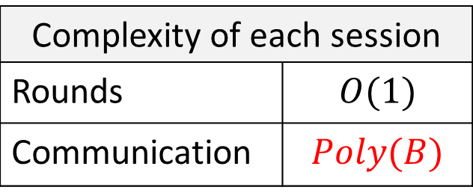
Bounded Concurrent ZK
[Barak 01]
Assuming collision-resistant hash functions. For bound $B$:
Barak
$$P$$
$$V$$
Barak
$≤B$ sessions
$$P$$
$$V$$
…
Complexity of each session
Rounds | $$O(1)$$
Communication | $$Poly(B)$$
Barak
$$P$$
$$V$$

Slide 12
Barak’s Protocol
The bound on the number of concurrent sessions is set at protocol design time
Barak
This is too early
Server
Client
Barak
Client
Barak
Client
[Persiano-Visconti 05]:
set the bound only at protocol run time

Slide 13
Standard Model for Concurrent ZK
$$x∈L$$
$$P$$
$$V$$
$$x∈L$$
$$w$$
$$P$$
$$V$$
$$x∈L$$
$$P$$
$$V$$

Slide 14
Client-Server Concurrent ZK
[Persiano-Visconti 05]
Server
Clients
$$x∈L$$
$$P$$
$$V$$
$$x∈L$$
$$w$$
$$V$$
$$x∈L$$
$$V$$
Increase the communication as more session start

Slide 15
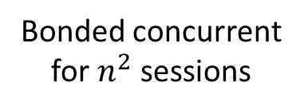
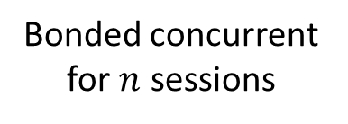
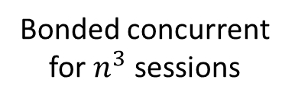
The Persiano-Visconti Protocol
A single session:
Concurrent sessions:
$$P$$
$$V$$
Bonded concurrent for $n$ sessions
…
$>n$ active sessions
Bonded concurrent for $n^{2}$ sessions
…
$>n^{2}$ active sessions
Bonded concurrent for $n^{3}$ sessions
…
$<n^{3}$ active sessions
Finish session

Slide 16
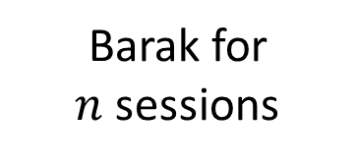
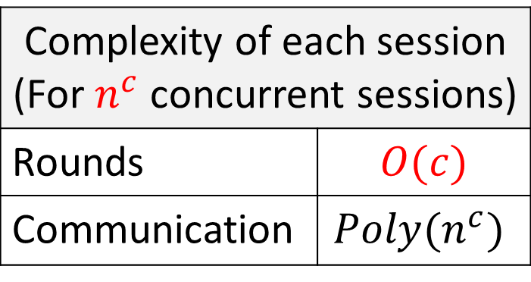
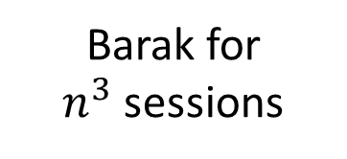
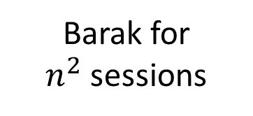
Protocol Complexity
$$P$$
$$V$$
Barak for
$n$ sessions
Complexity of each session (For $n^{c}$ concurrent sessions)
Rounds | $$O(c)$$
Communication | $$Poly(n^{c})$$
Barak for
$n^{2}$ sessions
Barak for
$n^{3}$ sessions
Almost the same as bounded concurrent ZK!
Finish session

Slide 17
The Persiano-Visconti Protocol
The communication complexity
is changing at protocol run time
Persiano-Visconti
This is too late
Server
Client
Persiano-Visconti
Client
Persiano-Visconti
Client
Client does not know what will be the communication complexity of the session!

Slide 18
Example: Call Center
“All our lines are currently busy. please hold and your call will be answered shortly…”
“The estimated waiting time is 7 minutes.”
This work: the communication complexity is set at the beginning of every session

Slide 19
Our Result
Assuming collision-resistant hash functions
there is a concurrent zero-knowledge protocol
in the client-server model with constant-rounds and guaranteed complexity.
Guaranteed complexity:
The communication complexity of each session is determined in the beginning of the session

Slide 20
This work
[Persiano-Visconti]
Round
complexity
6
$O(c)$ for $n^{c}$ concurrent sessions
Communication
complexity
determined in the
beginning of the session
not determined
until the session terminates

Slide 21
The Protocol
Every session runs Barak’s protocol with some bound
$$P$$
First $n$ sessions to start run Barak’s protocol with bound $n$.
Start session
Start session
Next $n^{2}−n$ sessions run Barak’s protocol with bound $n^{2}$.
Start session
Next $n^{3}−n^{2}$ sessions run Barak’s protocol with bound $n^{3}$.

Slide 22
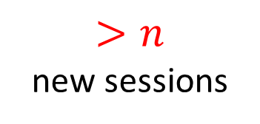
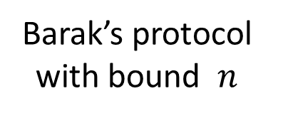
The Challenge
Cannot rely directly on bounded concurrency
$$P$$
Start session
$$V^{∗}$$
Start session
Barak’s protocol with bound $n$
…
$>n$
new sessions
Start session

Slide 23
Barak’s simulation
$$S$$
Barak
$$V^{∗}$$
Barak
$≤B$ sessions
…
Barak

Slide 24
Barak’s simulation
$$S$$
Barak
$$V^{∗}$$
Barak
$$S$$
$≤B$ sessions
…
$$S$$
$$S$$
Barak

Slide 25
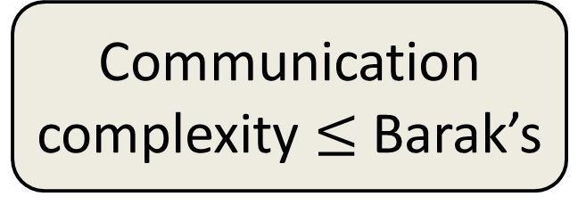
Barak’s simulation
$$S$$
Barak
$$V^{∗}$$
Other protocol
$$P$$
$≤B$ sessions
…
Communication complexity $≤$ Barak’s
Other protocol
$$P$$

Slide 26
Proof
A session is of level-$i$
if it runs Barak’s protocol with bound $n^{i}$.
Observation:
If $V^{∗}$ starts ${≤n}^{c}$ sessions, sessions of level $c$ are easy to simulate.

Slide 27
$$P$$
…
$$V^{∗}$$
Level $c$
Level $c−1$
Level $c$
Level $c−2$
Level $c$
Level $c−1$
Level $c$
…

Slide 28
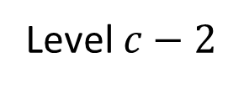
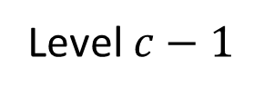
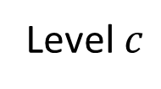
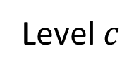
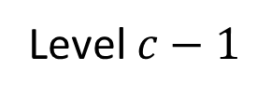
$$P$$
$$S_{0}$$
Level $c$
$$V^{∗}$$
Level $c−1$
Level $c$
Level $c−2$
Level $c$
Level $c−1$
Level $c$

Slide 29
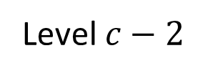
$$P$$
$$S_{1}$$
$$S_{0}$$
Level $c$
$$V^{∗}$$
Level $c−1$
Level $c$
Level $c−2$
Level $c$
Level $c−1$
Level $c$

Slide 30
$$S_{2}$$
$$S_{1}$$
$$S_{0}$$
Level $c$
$$V^{∗}$$
Level $c−1$
Level $c$
…
Level $c−2$
Level $c$
Level $c−1$
Level $c$

Slide 31
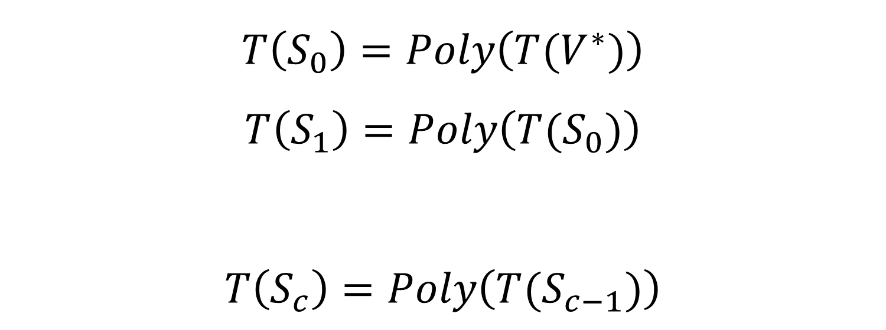
Simulation Running Time
$$T\left(S_{0}\right)=Poly\left(T(V^{∗})\right)$$
$$T\left(S_{1}\right)=Poly\left(T(S_{0})\right)$$
$$T\left(S_{c}\right)=Poly\left(T(S_{c−1})\right)$$
…

Slide 32
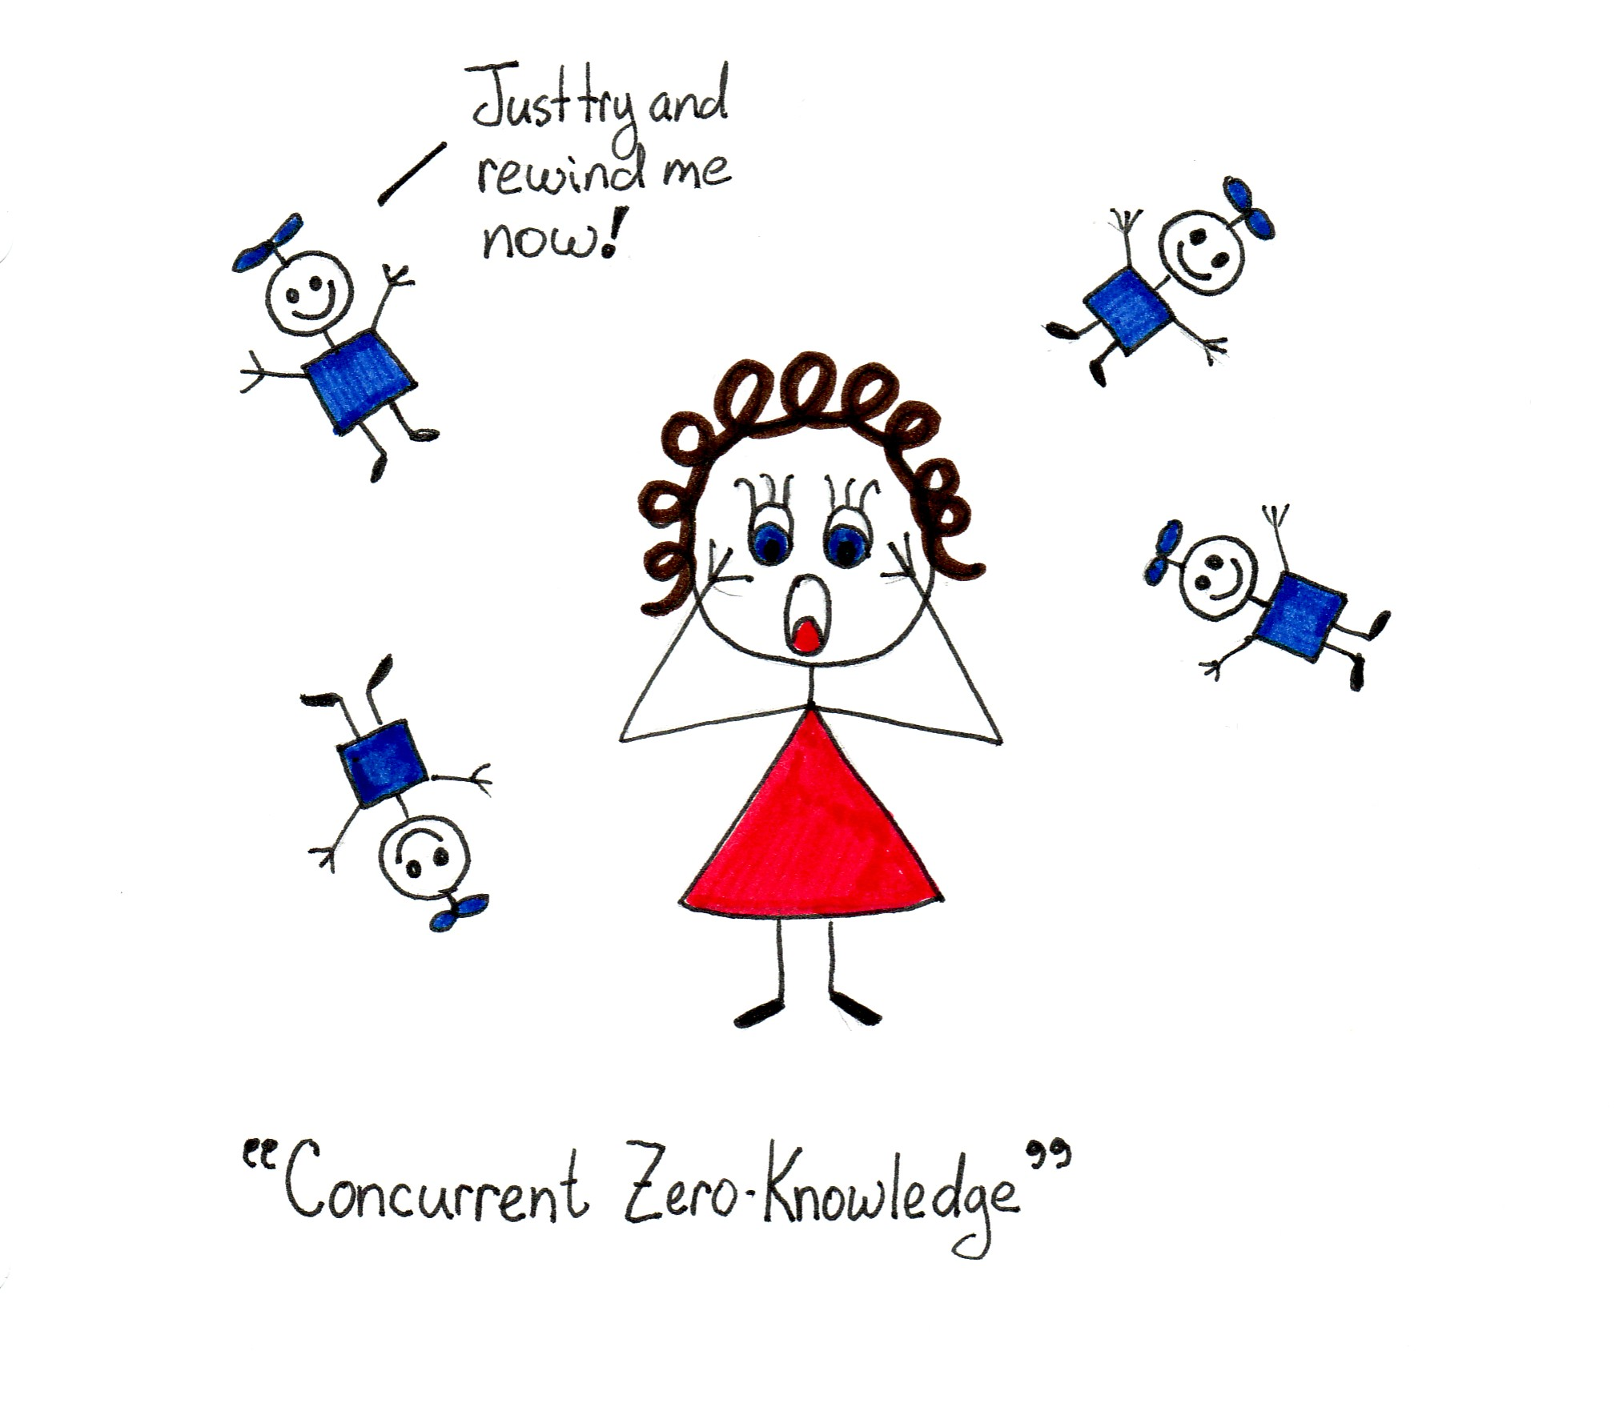
Thanks!
[slide: Mira Belenkiy]

