Slide 1
The Impossibility of Obfuscation with
Auxiliary Input or a Universal Simulator
Nir Bitansky
Ran Canetti
Henry Cohn
Shafi Goldwasser
Yael Tauman-Kalai
Omer Paneth
Alon Rosen

Slide 2
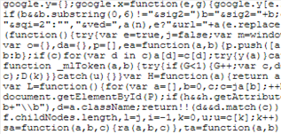




Program Obfuscation
$$x$$
$$\text{y}$$
Program
Obfuscation
$$x$$
$$\text{y}$$
Obfuscated program

Slide 3





Private Key to Public Key
$$m$$
$$\text{cipher}$$
$$Enc_{sk}(m)$$
Obfuscation
$$m$$
$$\text{cipher}$$
Public Key

Slide 4
Ideal Obfuscation
Hides everything about the program
except for its input\output behavior
Point Function etc.
[Canetti 97, Wee 05, Bitansky-
Canetti 10, Canetti-Rothblum-Varia 10]
Unobfuscatable Functions
[Barak-Goldreich-Impagliazzo-
Rudich-Sahai-Vadhan-Yang 01]
All functions
?

Slide 5
Obfuscation Constructions
Before 2013: No general solution.
All functions
All functions

Slide 6
Obfuscation Constructions
Before 2013: No general solution.
2013: Candidate obfuscation for all circuits
[Garg-Gentry-Halevi-Raykova-Sahai-Waters 13]
All functions
All functions

Slide 7
New Impossibility Result
Under computational assumptions,
a natural notion of ideal obfuscation
cannot be achieved
for a large family of cryptographic functionalities.
(strengthen the impossibility of [Goldwasser-Kalai 05])

Slide 8


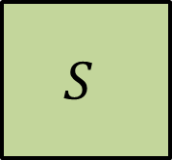
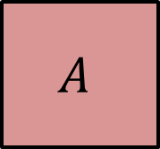


Virtual Black-Box (VBB)
[Barak-Goldreich-Impagliazzo-Rudich-Sahai-Vadhan-Yang 01]
Algorithm $𝒪$ is an obfuscator for a class $𝒞$ if:
For every PPT adversary $A$ there exists a PPT simulator $S$
such that for every $C∈𝒞$ and every predicate $π(C)$:
$$C$$
$$A$$
$$S$$
$$𝒪(C)$$
$$π(C)$$
Inefficient!

Slide 9




Using Obfuscation
Reduction
$$S$$
$$N=p⋅q$$
$$p,q$$
$$A$$

Slide 10
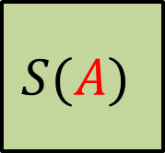

VBB with a Universal Simulator
Algorithm $𝒪$ is an obfuscator for a class $𝒞$ if:
There exists a PPT simulator $S$ such that for every PPT adversary $A$
such that for every $C∈𝒞$ and every predicate $π(C)$:
$$C$$
$$A$$
$$S(A)$$
$$𝒪(C)$$
$$π(C)$$

Slide 11
Universal Simulation
Universal
Simulators
Black-box
Simulators
Barak’s ZK
simulator

Slide 12
New Impossibility Result
Under computational assumptions,
VBB obfuscation with a universal simulator
cannot be achieved
for a large family of cryptographic functionalities.

Slide 13
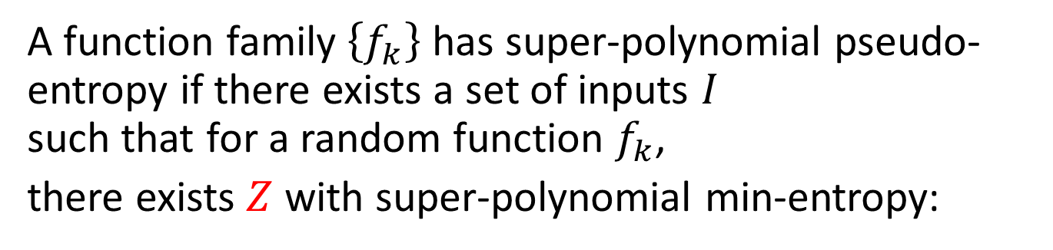
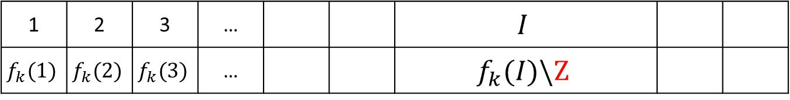


Pseudo-Entropic functions
A function family $\left\{f_{k}\right\}$ has super-polynomial pseudo-entropy if there exists a set of inputs $I$
such that for a random function $f_{k}$,
there exists $Z$ with super-polynomial min-entropy:
$$D$$
$$≈_{c}$$
1 | 2 | 3 | … |  |  | $$I$$
$$f_{k}(1)$$ | $$f_{k}(2)$$ | $$f_{k}(3)$$ | … |  |  | $$f_{k}(I)\backslash Z$$

Slide 14





Examples
Pseudo-random functions
Semantically-secure encryption
(when the randomness is a PRF of the message)
$$m$$
$$Enc_{sk}$$
$$\text{cipher}$$
$$r$$
$$PRF_{s}$$

Slide 15
New Impossibility Result
Under computational assumptions,
VBB obfuscation with a universal simulator
is impossible for any pseudo-entropic function

Slide 16






Indistinguishability Obfuscation
[Barak-Goldreich-Impagliazzo-Rudich-Sahai-Vadhan-Yang 01]
$$C_{1}$$
$$≡$$
$$C_{2}$$
$${𝒪(C}_{1})$$
$$≈_{c}$$
$${𝒪(C}_{2})$$
Assumption:
indistinguishability obfuscation for all circuits
(A candidate construction given in [GGHRSW13])

Slide 17
This Work
Assuming indistinguishability obfuscation,
VBB obfuscation with a universal simulator
is impossible for any pseudo-entropic function

Slide 18
This Work
Average-case VBB
with a universal simulator
Worst-case VBB
with a universal simulator
Is Impossible for
pseudo-entropic functions
Is Impossible for
pseudo-entropic functions
Assuming
indistinguishability obfuscation
for all functions
Assuming
indistinguishability obfuscation
for point-filter functions
or equivalently,
witness encryption

Slide 19
Average-case VBB
with a universal simulator
Worst-case VBB
with a universal simulator
[Goldwasser-Kalai 05]:
Is Impossible for
Filter functions
Is Impossible for
pseudo-entropic functions
Unconditionally
Assuming
VBB obfuscation
for point-filter functions
This work:
Is Impossible for
pseudo-entropic functions
Is Impossible for
pseudo-entropic functions
Assuming
indistinguishability obfuscation
for all functions
Assuming
indistinguishability obfuscation
for point-filter functions

Slide 20

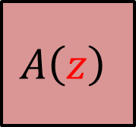



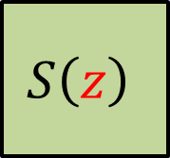
Universal Simulation and Auxiliary Input
For every PPT adversary $A$ there exists a PPT simulator $S$
such that for every $C∈𝒞$, every predicate $π\left(C\right)$
and every auxiliary input $z$:
$$C$$
$$A\left(z\right)$$
$$S\left(z\right)$$
$$𝒪(C)$$
$$π(C)$$
VBB with a universal simulator

Slide 21
Universal Simulation and Auxiliary Input
Average-case VBB
with a universal simulator
Worst-case VBB
with a universal simulator
Average-case VBB with
independent auxiliary input
Worst-case VBB with
dependent auxiliary input

Slide 22
Proof Idea
What can we do with an obfuscated code
that we cannot do with black-box access?
[Goldwasser-Kalai 05]:
Find a polynomial size circuit computing the function!

Slide 23
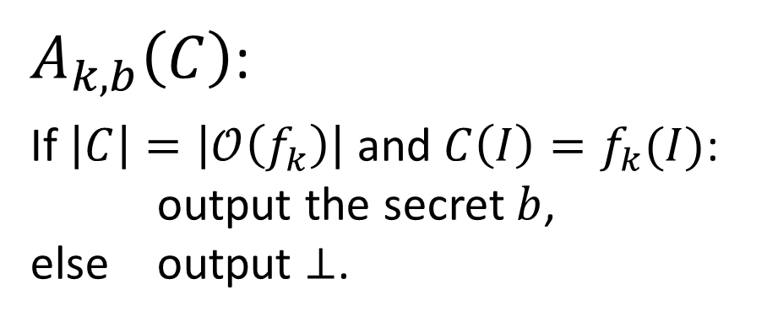

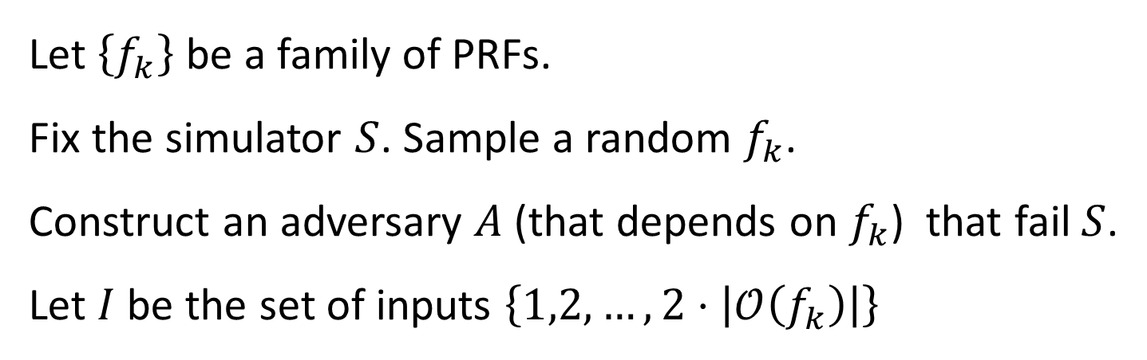



Impossibility for Worst-Case VBB
Let $\left\{f_{k}\right\}$ be a family of PRFs.
Fix the simulator $S$. Sample a random $f_{k}$.
Construct an adversary $A$(that depends on $f_{k}$) that fail $S$.
Let $I$ be the set of inputs $\left\{1,2,…,2⋅\left|𝒪\left(f_{k}\right)\right|\right\}$
$$A$$
$$b\backslash ⊥$$
$A_{k,b}\left(C\right)$:
If $\left|C\right|=\left|𝒪\left(f_{k}\right)\right|$ and $C\left(I\right)=f_{k}(I)$:
output the secret $b$,
else output $⊥$.
$$C$$
$$I$$
$$f_{k}(I)$$

Slide 24





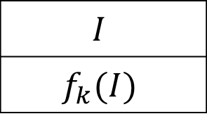



Impossibility for Worst-Case VBB
$$f_{k}$$
$$A$$
$$b\backslash ⊥$$
$$A$$
$$S$$
$$𝒪(f_{k})$$
$$b$$
$$I$$
$$f_{k}(I)$$
$$b$$

Slide 25

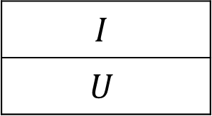








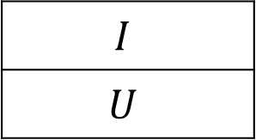







Using Indistinguishability Obfuscation
$$A$$
$$b\backslash ⊥$$
$$A$$
$$b\backslash ⊥$$
$$A$$
$$⊥$$
$$≈_{c}$$
$$≡$$
$$I$$
$$f_{k}(I)$$
$$I$$
$$U$$
$$A$$
$$b\backslash ⊥$$
$$A$$
$$b\backslash ⊥$$
$$A$$
$$⊥$$
$$≈_{c}$$
$$≈_{c}$$
$$I$$
$$f_{k}(I)$$
$$I$$
$$U$$

Slide 26






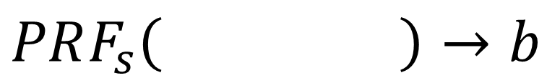

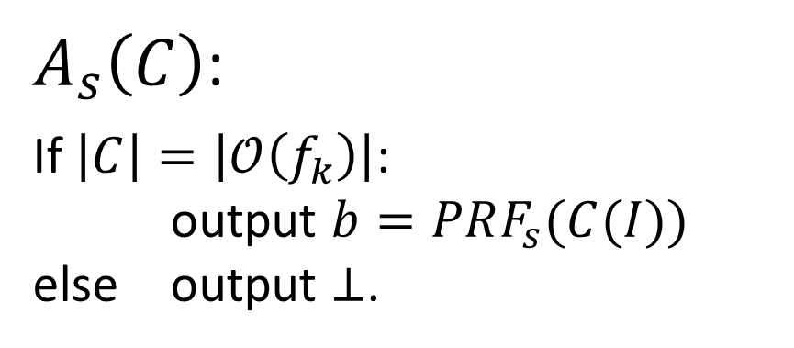
Impossibility for Average-Case VBB
$$A$$
$$A$$
$$b\backslash ⊥$$
$$I$$
$$C$$
$$I$$
$$f_{k}(I)$$
$$PRF_{s}\left( \right)→b$$
$$C(I)$$
$A_{s}\left(C\right)$:
If $\left|C\right|=\left|𝒪\left(f_{k}\right)\right|$:
output $b=PRF_{s}(C(I))$
else output $⊥$.

Slide 27
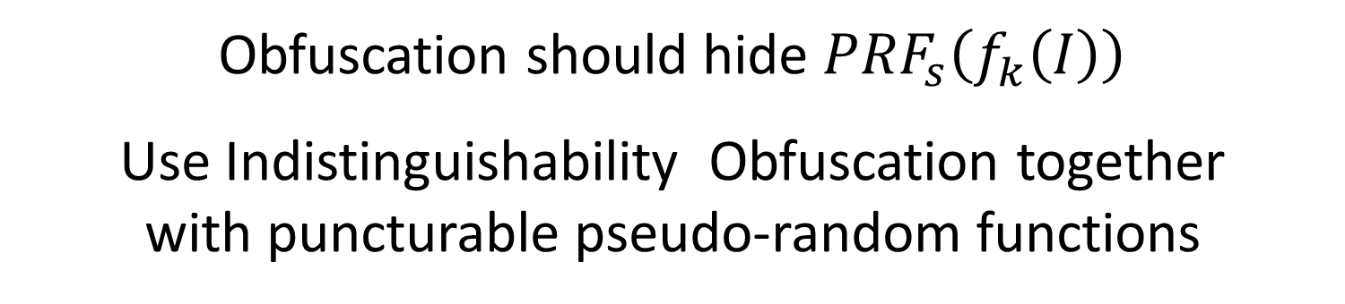
Impossibility for Average-Case VBB
$$A$$
$$I$$
$$PRF_{s}\left( \right)→b$$
$$C(I)$$
Obfuscation should hide $PRF_{s}\left(f_{k}\left(I\right)\right)$
Use Indistinguishability Obfuscation together
with puncturable pseudo-random functions

Slide 28
Thanks!

