Slide 1
On Obfuscation with Random Oracles
Ran Canetti, Yael Kalai, Omer Paneth

Slide 2
[Lynn-Prabhakaran-Sahai 04]:
Can simulation based obfuscation
be constructed with a Random Oracle?
Today:
Impossible in general!

Slide 3

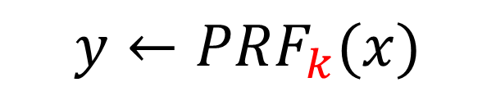

A Candidate Obfuscator
[Garg-Gentry-Halevi-Raykova-Sahai-Waters 13]
Multilinear
Maps
$$x$$
$$y$$
$$y←PRF_{k}(x)$$
Barrington's theorem
Kilian’s randomization

Slide 4
What is the security of the
candidate obfuscator?
Other candidate obfuscators:
[Brakerski-Rothblum 13, Barak-Garg-Kalai-P-Sahai 13, Pass-Seth-Telang 13, Ananth-Gupta-Ishai-Sahai 14, Gentry-Lewko-Sahai-Waters 14, Zimmerman 14, Applebaum-Brakerski 15, Badrinarayanan-Miles-Sahai-Zhandry 15]

Slide 5


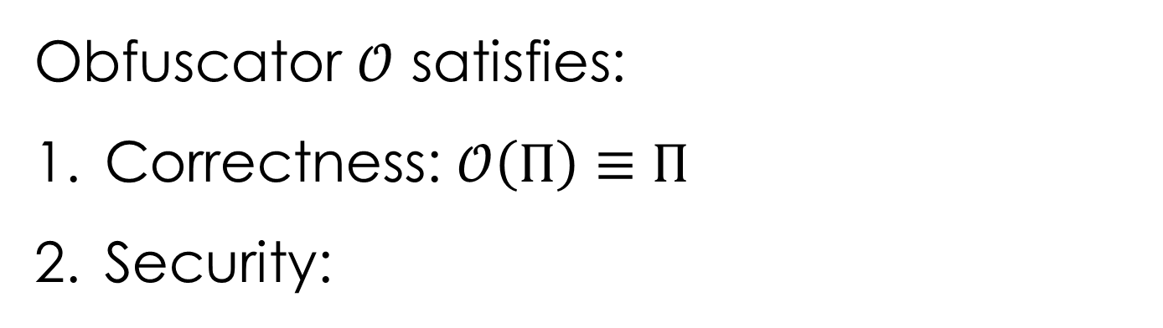

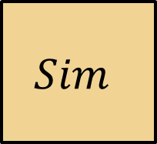
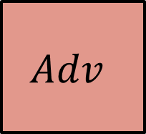
Virtual-Black-Box Obfuscation (VBB)
[Barak-Goldreich-Impagliazzo-Rudich-Sahai-Vadhan-Yang 01]
Obfuscator $𝒪$ satisfies:
Correctness: $𝒪\left(Π\right)≡Π$
Security:
$$Π$$
$$Adv$$
$$Sim$$
$$𝒪\left(Π\right)$$
$$≈$$

Slide 6
What is the security of the
candidate obfuscators?

Slide 7
Virtual-black-box obfuscation
Indistinguishability
obfuscation
[BGIRSVY 01]
Impossible
[BGIRSVY 01]
PC differing-inputs
obfuscation
[BGIRSVY 01]
[Ishai-Pandey-Sahai 14]
Ideal model
security
Virtual-grey-box
obfuscation
[Bitansky-Canetti 10]
Plausible
Provable
[BR 14, BGKPS 14]

Slide 8
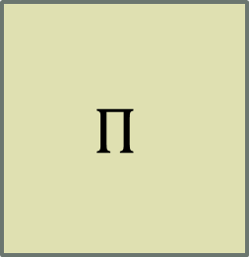





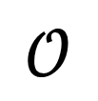
The Ideal Multilinear-Map Model
Add \ Subtract
Multiply (multilinear only)
$$\begin{matrix}\begin{matrix}α & β\end{matrix} & \begin{matrix}γ & δ\end{matrix}\end{matrix}$$
$$\begin{matrix}\begin{matrix}2 & 3\end{matrix} & \begin{matrix}7 & 5\end{matrix}\end{matrix}$$
$$\left[α\right]+\left[β\right]?$$
$$\left[δ\right]$$
$$Π$$
$$𝒪$$
$$𝒪\left(Π\right)$$
$\left[α\right],\left[β\right],\left[γ\right],\left[δ\right]$

Slide 9
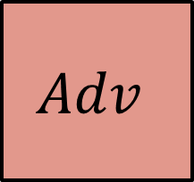



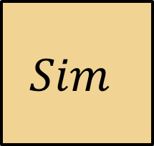
Security
[Brakerski-Rothblum 14, Barak-Garg-Kalai-P-Sahai 14]
Ideal
MMap
Oracle
$$Π$$
$$Adv$$
$$≈$$
$$Sim$$
$$𝒪\left(Π\right)$$
The [BGIRSVI01] does not extend!

Slide 10

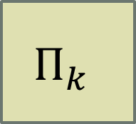


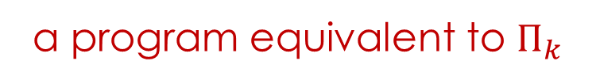




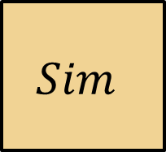
Unobfuscatable Functions
[Barak-Goldreich-Impagliazzo-Rudich-Sahai-Vadhan-Yang 01]
$$x$$
$$PRF_{k}(x)$$
$$Π_{k}$$
a program equivalent to $Π_{k}$
$$k$$
Oracle
$$Π_{k}$$
$$Adv$$
$$Sim$$
$$𝒪\left(Π_{k}\right)$$
$$k$$

Slide 11

[Miles-Sahai-Weiss 14, Pass-Seth-Telang 13, Bitansky-Canetti-Kalai-P 14]
Virtual-black-box obfuscation
Indistinguishability
obfuscation
Reduction
Heuristic
PC differing-inputs
Obfuscation
Obfuscation in the ideal mmap model
Virtual-grey-box
obfuscation
$$+$$
Mmap construction

Slide 12
Can we get obfuscation
in other ideal models?
Ideal
Multilinear Map
Generic group model?
Random oracle model?
Plain Model

Slide 13
Constructions in Other Ideal Models
Obfuscation with secure hardware
[Goyal-Ishai-Sahai-Venkatesan-Wadia 10,
Bitansky-Canetti-Goldwasser-Halevi-Kalai-Rothblum 11, …]
Ideal pseudo-free groups
[Canetti-Vaikuntanathan 13]
Multilinear maps with relaxed security
[Miles-Sahai-Weiss 14]

Slide 14
A Different Motivation
What is the best security we can hope for?
VBB
Obfuscation
Plausible
Impossible

Slide 15
A Different Motivation
Indistinguishability
obfuscation
Virtual-black-box obfuscation
Impossible
PC differing-inputs
obfuscation
Virtual-grey-box
obfuscation
Ideal model
security

Slide 16
A Different Motivation
What structures are needed?
Ideal
Multilinear Map
Generic group model?
Random oracle model?
Plain Model

Slide 17
Motivation – Summary
Alternative heuristic obfuscators
in the plain model
Understand the structures needed
for general purpose obfuscation

Slide 18
The Result
First negative result
with respect to a non-trivial oracle!
Ideal
Multilinear Map
Generic group model?
Random oracle model
Plain Model

Slide 19
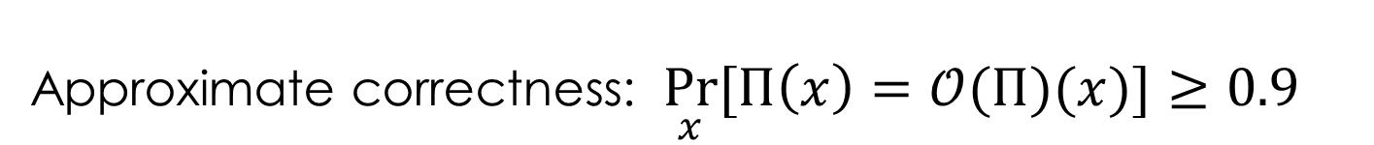
Main Lemma
Any function that
can be obfuscated with a random oracle,
can also be VBB obfuscated in the plain model
with approximate correctness.
Approximate correctness: $\underset{x}{Pr}{[Π\left(x\right)=𝒪(Π)(x)]}≥0.9$

Slide 20
Proof Outline
Main Lemma +
Theorem [Bitansky-P 13]:
Assuming trapdoor permutations,
there exist “robust” unobfuscatable functions
that cannot be obfuscated (in the plain model) even with approximate correctness.

Slide 21
Proof Outline
Main Lemma + [Bitansky-P 13]
Robust unobfuscatable functions
cannot be obfuscated with random oracles

Slide 22
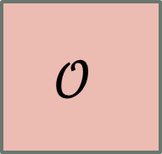
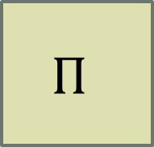
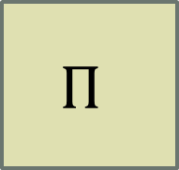
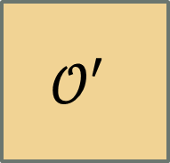
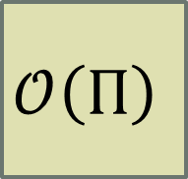
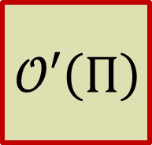
Main Lemma
Randomoracle
$$Π$$
$$𝒪$$
$$𝒪\left(Π\right)$$
$$Π$$
$$𝒪′$$
$$𝒪′\left(Π\right)$$
Approximately correct

Slide 23
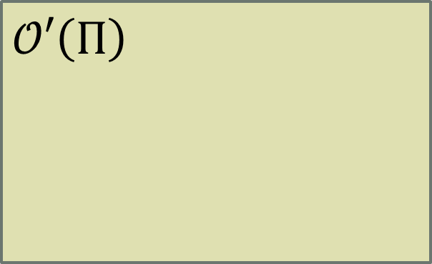


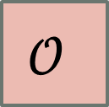

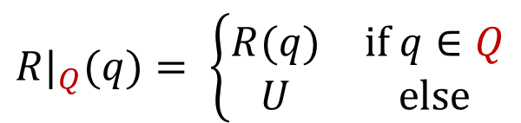




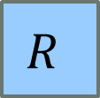
Naïve Attempt
Perfect correctness
No security
$${R|}_{Q}(q)= \left\{\begin{matrix}R(q) & if q∈Q \\ U & else\end{matrix}\right.$$
$$x$$
$$𝒪′$$
$$𝒪′\left(Π\right)$$
$$R$$
$${R|}_{Q}$$
$$Q$$
$$Π$$
$$𝒪$$
$$𝒪\left(Π\right)$$
$$𝒪\left(Π\right)$$

Slide 24


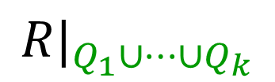
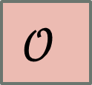



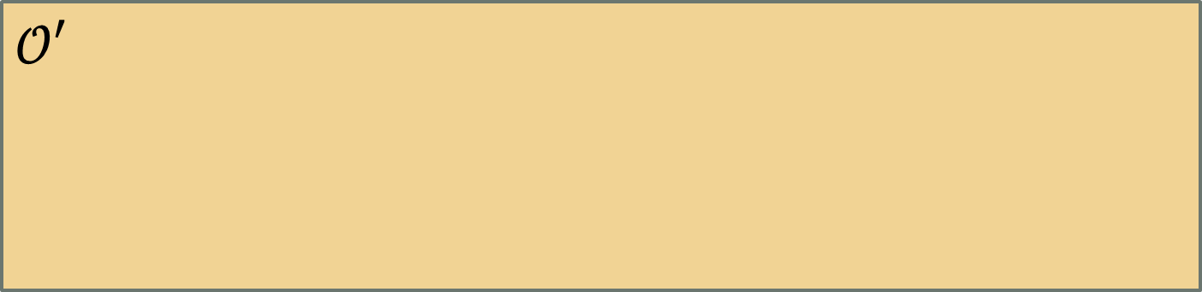










$$Π$$
$$𝒪′$$
$$R$$
$$R$$
$$R$$
$$Q$$
$$U→x_{1}$$
$$Q_{1}$$
$$U→x_{k}$$
$$Q_{k}$$
$$…$$
$$𝒪$$
$$𝒪\left(Π\right)$$
$$𝒪\left(Π\right)$$
$$𝒪′\left(Π\right)$$
$${R|}_{Q_{1}∪…∪Q_{k}}$$
$$x$$
$$𝒪\left(Π\right)$$

Slide 25



















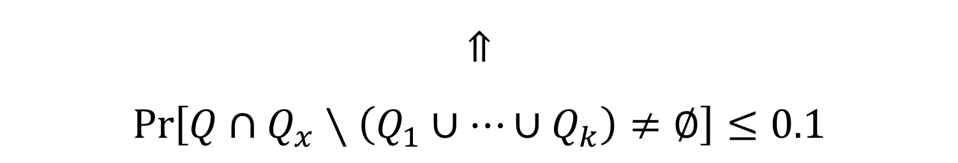
Approximate Correctness
$$x$$
$$𝒪′$$
$$𝒪′\left(Π\right)$$
$$R$$
$$R$$
$$R$$
$${R|}_{Q_{1}∪…∪Q_{k}}$$
$$Q$$
$$U→x_{1}$$
$$Q_{1}$$
$$U→x_{k}$$
$$Q_{k}$$
$$Q_{x}$$
$$…$$
$$𝒪$$
$$𝒪\left(Π\right)$$
$$𝒪\left(Π\right)$$
$$𝒪\left(Π\right)$$
$$\underset{x}{Pr}{[Π\left(x\right)≠𝒪(Π)(x)]}≤0.1$$
$$⇑$$
$$\operatorname{Pr}\left[Q∩Q_{x}∖\left(Q_{1}∪…∪Q_{k}\right)≠∅\right]≤0.1$$

Slide 26




Approximate Correctness
$$x$$
$$𝒪′$$
$$𝒪′\left(Π\right)$$
$$R$$
$$R$$
$$R$$
$${R|}_{Q_{1}∪…∪Q_{k}}$$
$$Q$$
$$U→x_{1}$$
$$q_{1}$$
$$U→x_{k}$$
$$q_{k}$$
$$q_{x}$$
$$…$$
$$𝒪$$
$$𝒪\left(Π\right)$$
$$𝒪\left(Π\right)$$
$$𝒪\left(Π\right)$$
$$\operatorname{Pr}\left[q_{x}∈Q∖\left\{q_{1},…,q_{k}\right\}\right]≤0.1$$
$$≤\frac{\left|Q\right|}{k}$$
$$\operatorname{Pr}\left[∃p∈Q s.t. \left(p=q_{x}\right)∧∀i(p≠q_{i})\right]$$

Slide 27
Comparison with [Impagliazzo-Rrudich 95]
Information theoretic
key agreement
with random oracle
Obfuscation
with random oracle
[IR 95]
Today
Information theoretic
key agreement
In the plain model
Approximately correct obfuscation
in the plain model

Slide 28
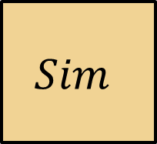
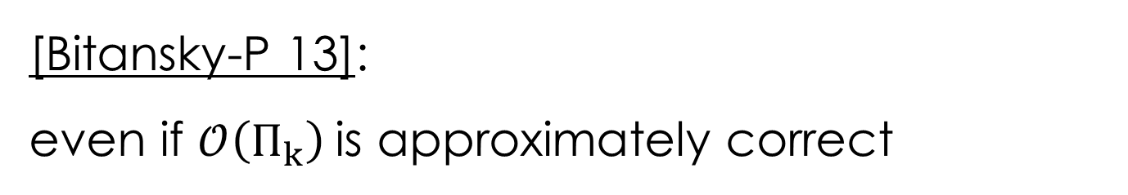
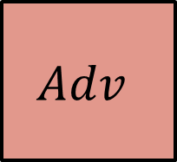



Robust Unobfuscatable Functions
[Barak-Goldreich-Impagliazzo-Rudich-Sahai-Vadhan-Yang 01]
$$Π_{k}$$
$$Adv$$
$$Sim$$
$$𝒪\left(Π_{k}\right)$$
$$k$$
[Bitansky-P 13]:
even if $𝒪\left(Π_{k}\right)$is approximately correct

Slide 29



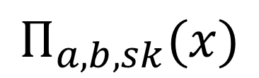
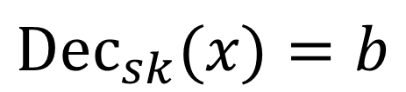










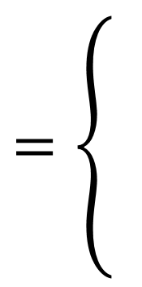
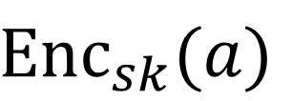

$$0^{n}$$
$$Enc\left(a\right)$$
$$Enc\left(b\right)$$
$$Π$$
$$Π$$
$$a$$
$$b$$
$$Π$$
$$=\left\{\begin{matrix}\begin{matrix} \\ \end{matrix} \\ \begin{matrix} \\ \end{matrix}\end{matrix}\right.$$
$$b$$
$$x=a$$
$$Enc_{sk}(a)$$
$$x=0^{n}$$
$$Π_{a,b,sk}(x)$$
$$b$$
$$Dec_{sk}(x)=b$$
$$⊥$$
$$\text{o}\text{.}\text{w}\text{.}$$

Slide 30



$$0^{n}$$
$$Enc\left(a\right)$$
$$Enc\left(b\right)$$
$$Π$$
$$Π$$
$$a$$
$$b$$
$$Π$$
$$Π$$
$$Sim$$
$$b$$

Slide 31







$$0^{n}$$
$$Enc\left(a\right)$$
$$Enc\left(b\right)$$
$$𝒪\left(Π\right)$$
$$𝒪\left(Π\right)$$
$$𝒪\left(Π\right)$$
$$a$$
$$b$$
$$𝒪\left(Π\right)$$
$$Adv$$
$$𝒪\left(Π\right)$$
$$b$$

Slide 32



$$0^{n}$$
$$Enc\left(a\right)$$
$$Enc\left(b\right)$$
$$𝒪\left(Π\right)$$
$$𝒪\left(Π\right)$$
$$𝒪\left(Π\right)$$
$$a$$
$$b$$
$$𝒪\left(Π\right)$$
approximately
correct
$$Adv$$
$$𝒪\left(Π\right)$$
$$b$$

Slide 33
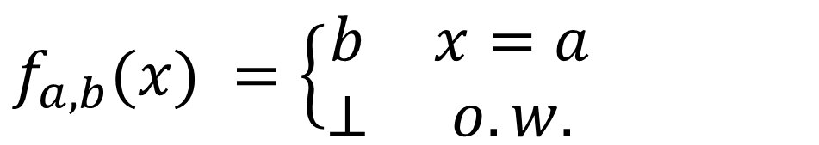
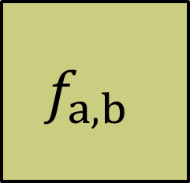


A Taste of the Construction
$$f_{a,b}(x) =\left\{\begin{matrix}b & x=a \\ ⊥ & o.w.\end{matrix}\right.$$
Q: Find $g$ such that:
$g$ with $10\%$ errors
$$f_{a,b}$$

Slide 34

Getting Robustness
$$f_{a,b}(x) =\left\{\begin{matrix}b & x=a \\ ⊥ & o.w.\end{matrix}\right.$$
$$g_{a,b,k}\left(x\right)= {b⊕\text{PRF}}_{k}\left(x\right)$$
$$h_{a,b,k}\left(x\right)= {\text{PRF}}_{k}\left(a⊕x\right)$$

Slide 35














$$r←U$$
$$f$$
$$r$$
$$b⊕PRF(r)$$
$$g$$
$$b$$
$(w.p. 0.8)$
$$a$$
$$⊕$$
$$a⊕r$$
$$PRF(r)$$
$$h$$
$g,h$ with $10\%$ errors
$$f_{a,b}$$
$$g_{a,b,k}\left(x\right)= {b⊕\text{PRF}}_{k}\left(x\right)$$
$$h_{a,b,k}\left(x\right)= {\text{PRF}}_{k}\left(a⊕x\right)$$

Slide 36




$$g,h$$
$$A$$
$A$ queries $g$ on $x$ and $A$queries $h$ on $a⊕x$
$$a$$
$$a$$
$$b$$
$$g,h$$
$$f_{a,b}$$
$$g_{a,b,k}\left(x\right)= {b⊕\text{PRF}}_{k}\left(x\right)$$
$$h_{a,b,k}\left(x\right)= {\text{PRF}}_{k}\left(a⊕x\right)$$

Slide 37


Robust Unobfuscatable Functions
$$=\left\{\begin{matrix}\begin{matrix}b \\ Enc_{sk}(a)\end{matrix} & \begin{matrix}x=a \\ {x=0}^{n}\end{matrix} \\ \begin{matrix}b \\ ⊥\end{matrix} & \begin{matrix}Dec_{sk}(x)=b \\ o.w.\end{matrix}\end{matrix}\right.$$
$$f_{a,b,sk}(x)$$

Slide 38
Thank You!
Ideal
Multilinear Map
Generic group model?
Random oracle model
Plain Model

