Slide 1
Automatic Software Verification
Instructor: Mooly Sagiv
TA: Oded Padon
Slides from Eran Yahav and the Noun Project, Wikipedia

Slide 2
Course Requirements
Summarize one lecture
10% one lecture notes
45% homework assignment
45% exam/project

Slide 3
Inspired by Other Courses
CS395T: Automated Logical Reasoning (UT Austin) Isil Dillig
SAT/SMT Solver and Applications Graduate Seminar
W2013 University of Waterloo (Vijay Ganesh)

Slide 4

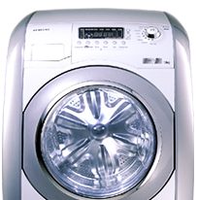
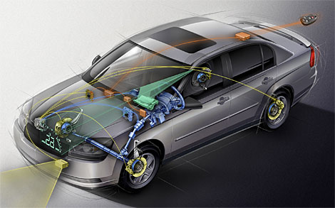
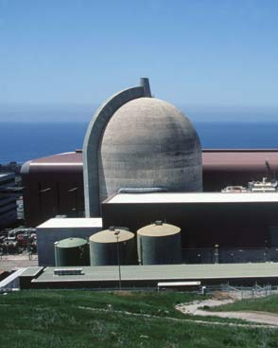
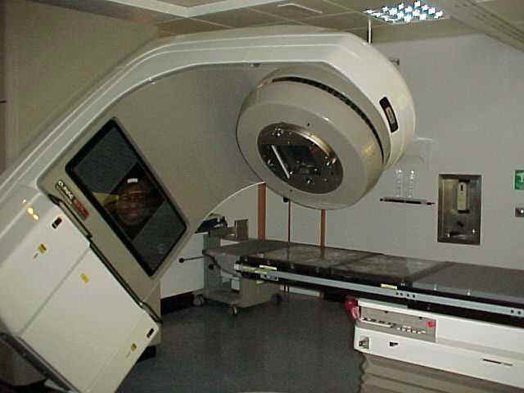

Software is Everywhere

Slide 5
Software is Everywhere
Exploitable

Slide 6
Exploitable Software is Everywhere
The Sony PlayStation Network breach: An identity-theft bonanza
Massive Sony PlayStation data breach puts about 77 million people at higher risk of fraud
(April 2011)
RSA hacked, information leaks
RSA's corporate network suffered what RSA describes as a successful advanced persistent threat attack, and "certain information" was stolen that can somehow affect the security of SecurID authentication
(March 2011)
Stuxnet Worm Still Out of Control at Iran's Nuclear Sites, Experts Say
The Stuxnet worm, named after initials found in its code, is the most sophisticated cyberweapon ever created.
(December 2010)
Security Advisory for Adobe Flash Player, Adobe Reader and Acrobat
This vulnerability could cause a crash and potentially allow an attacker to take control of the affected system. There are reports that this vulnerability is being exploited in the wild in targeted attacks via a Flash (.swf) file embedded in a Microsoft Excel (.xls) file delivered as an email attachment.
(March 2011)
RSA tokens may be behind major network security problems at Lockheed Martin
Lockheed Martin remote access network, protected by SecurID tokens, has been shut down
(May 2011)

Slide 7
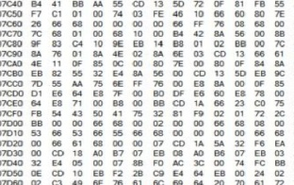
Buffer Overrun
strcpy
void foo (char *x) {
char buf[2];
strcpy(buf, x);
}
int main (int argc, char *argv[]) {
foo(argv[1]);
}
foo
main
…
source code
return address
da
> ./a.out abracadabra
Segmentation fault
Saved FP
ca
char* x
ra
buf[2]
ab
terminal
memory

Slide 8
Buffer Overrun Exploits
int check_authentication(char *password) {
int auth_flag = 0;
char password_buffer[16];
strcpy(password_buffer, password);
if(strcmp(password_buffer, "brillig") == 0) auth_flag = 1;
if(strcmp(password_buffer, "outgrabe") == 0) auth_flag = 1;
return auth_flag;
}
int main(int argc, char *argv[]) {
if(check_authentication(argv[1])) {
printf("\n-=-=-=-=-=-=-=-=-=-=-=-=-=-\n");
printf(" Access Granted.\n");
printf("-=-=-=-=-=-=-=-=-=-=-=-=-=-\n"); }
else
printf("\nAccess Denied.\n");
}
(source: “hacking – the art of exploitation, 2nd Ed”)

Slide 9


Attack
evil input
Application
AAAAAAAAAAAA
-=-=-=-=-=-=-=-=-=-=-=-=-=-
Access Granted. 65
-=-=-=-=-=-=-=-=-=-=-=-=-=-

Slide 10
Automatic Program Verification
Program
P
Desired
Properties ϕ
Solver
Is there a behavior
of P that violates ϕ?
Counterexample
Proof
Notes:
The dream of program verification is to build a Solver (algorithm) which checks correctness at compile-time

Slide 11
Example
int check_authentication(char *password) {
int auth_flag = 0;
char password_buffer[16];
strcpy(password_buffer, password);
if(strcmp(password_buffer, "brillig") == 0) auth_flag = 1;
if(strcmp(password_buffer, "outgrabe") == 0) auth_flag = 1;
return auth_flag;
}
int main(int argc, char *argv[]) {
if(check_authentication(argv[1])) {
printf("\n-=-=-=-=-=-=-=-=-=-=-=-=-=-\n");
printf(" Access Granted.\n");
printf("-=-=-=-=-=-=-=-=-=-=-=-=-=-\n"); }
else
printf("\nAccess Denied.\n");
}

Slide 12
Undecidability
The Halting Problem
  Does the program P terminate on input I
Rice’s Theorem
  Any non-trivial property of partial functions, there is no general and effective method to decide if program computes a partial function with that property

Slide 13
Handling Undecidability
Permits occasional divergence
Limited programs (not Turing Complete)
Unsound Verification
  Explore limited program executions
Incomplete Verification
  Explore superset of program executions
Programmer Assistance
  Inductive loop invariants

Slide 14
Limited Programs
Finite state programs
  Finite state model checking
    Explicit state SPIN, CHESS
    Symbolic model checking SMV
Loop free programs
  Configuration files

Slide 15
Unsound Verification
Dynamic checking
  Valgrind, Parasoft Insure, Purify, Eraser
Bounded Model Checking
Concolic Executions

Slide 16
The SAT Problem
Given a propositional formula (Boolean function)
  ϕ = (a ∨ b) ∧(¬ a∨ ¬b ∨ c)
Determine if ϕ is valid
Determine if ϕ is satisfiable
  Find a satisfying assignment or report that such does not exit
For n variables, there are 2^{n} possible truth assignments to be checked
Effective heuristics exit
a
0
1
b
b
0
1
0
1
c
c
c
c
0
1
0
1
0
1
0
1

Slide 17
Bounded Model Checking
Program P
Input
Bound k
Desired
Properties ϕ
FrontEnd
Propositional Formula
←P(k)→ ∧ ϕ
SAT Solver
Assignment
UNSAT

Slide 18
A Simple Example
Program
Constraints
SAT
counterexample found!
int x;
int y=8,z=0,w=0;
if (x)
z = y – 1;
else
w = y + 1;
assert (z == 5 ||
w == 9)
y = 8,
z = x ? y – 1 : 0,
w = x ? 0 :y + 1,
z != 5,
w != 9
y = 8, x = 1, w = 0, z = 7

Slide 19
A Simple Example
Program
Constraints
UNSAT
Assertion always holds!
int x;
int y=8,z=0,w=0;
if (x)
z = y – 1;
else
w = y + 1;
assert (z == 7 ||
w == 9)
y = 8,
z = x ? y – 1 : 0,
w = x ? 0 :y + 1,
z != 7,
w != 9

Slide 20
Summary Bounded Model Checking
Excellent tools exist (CBMC, Alloy)
Many bugs occur on small inputs
Useful for designs too
Scalability is an issue
Challenging features
  Bounded arithmetic
  Pointers and Heap
  Procedures
  Concurrency

Slide 21
Concolic Testing
Combine runtime testing and symbolic execution
Runtime testing
  Effectiveness depends on input test
Symbolic Execution
read(x);
y = 2 * x ;
assert y != 12;
  Need constraint solver
  Can be complex
Concolic testing aims to improve both

Slide 22
A Motivating Example
void f(int x, int y) {
int z = 2*y;
if (x == 100000) {
if (x < z) {
assert(0); /* error */
}
}
}

Slide 23
The Concolic Testing Algorithm
Classify input variables into symbolic / concrete
Instrument to record symbolic vars and path conditions
Choose an arbitrary input
Execute the program
Symbolically re-execute the program
Negate the unexplored last path condition
F
Is there an input satisfying constraint
T

Slide 24
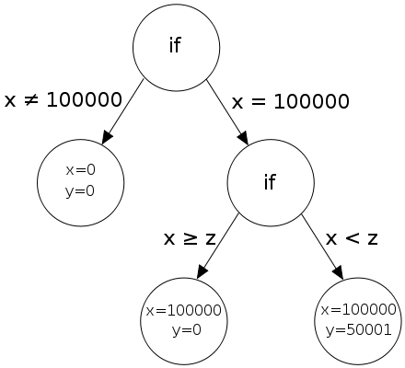
Example Concolic Testing
void f(int x, int y) {
int z = 2*y;
if (x == 100000) {
if (x < z) {
assert(0); /* error */
}
}
}

Slide 25
Summary Concolic Testing
Quite effective:
  SAGE (Microsoft Research)
  Datarace detection (Candea, EPFL)
Instrumentation can be tricky
Scalability is an issue
Coverage is an issue
Limitations of theorem provers
Data structures

Slide 26
Invariant
An assertion I is an invariant at program location if I holds whenever the execution reaches this location
An invariant is inductive at a loop
“while B do C” if whenever C is executed on a state which satisfies B and I it can only produce states satisfying I

Slide 27
Temporary Cycle Creation
rotate(List first, List last) {
  if ( first != NULL) {
  last → next = first;
  first = first → next;
  last = last → next;
  last → next = NULL;
  }
}
first
n
n
n
last
first
n
n
n
last
n
first
n
n
n
last
n
first
last
n
n
n
n
first
last
n
n
n

Slide 28
Inductive Invariants
x = 2;
while true do {x >0}
x = 2* x - 1
Non-inductive
Inductive
x>0
x>1

Slide 29
Deductive Verification
Program P
Goal F
Candidate Invariant inv
VC gen
Inv is inductive w.r.t. P
Inv F
SAT Solver
Counterexample
Proof

Slide 30
Summary Deductive Verification
Existing Tools
  ESCJava, Dafny, CAVEAT
Hard to write inductive invariants
  Need to consider all corner cases
  Small program change can lead to huge change in the invariant
  The lack of specification languages
Deduction can be hard

Slide 31
Deduction
x = 2;
while true do {x >1}
x = (2*x*x + x – 1) / (x + 1)

Slide 32
Transition Systems
The program semantics can be described as (potentially infinite) graph of reachable states
  Values of program variables
Program statements and conditions are relations between states
Proving a safety property usually means showing that certain state cannot be reached
  A bad reachable state indicate a bug
Bounded model checking and concolic testing explore subsets of reachable states

Slide 33
Example Transition System
pc:x
1: x = 2;
2: while true do
3: x = 2* x – 1
4:
1: 0
2: 2
2: 3
2: 5
3: 2
3: 3
4: 3
4: 5

Slide 34
Abstract Interpretation
Automatically prove that the program is correct by also considering infeasible executions
Abstract interpretation of program statements/conditions
Conceptually explore a superset of reachable states
Sound but incomplete reasoning
Automatically infer sound inductive invariants

Slide 35
Automatic Program Verification
Program
P
Desired
Properties ϕ
Solver
Is there a behavior
of P that violates ϕ?
Counterexample
Unknown
Proof
Notes:
The dream of program verification is to build a Solver (algorithm) which checks correctness at compile-time

Slide 36
Interval Based Abstract Interpretation
pc: int(x)
1: x = 2;
2: while true {x > 0} do
3: x = 2* x – 1
4:
1: [0, 0]
2: [2, 2]
2: [2, 3 ]
3: [2, 2]
4: [3, 3]

Slide 37
Interval Based Abstract Interpretation
pc: int(x)
1: x = 2;
2: while true {x > 0} do
3: x = 2* x – 1
4:
1: [0, 0]
2: [2, 2]
2: [2, ∞]
3: [2, 2]
3: [2, ∞]
4: [3, 3]
4,:[3, ∞]

Slide 38
Interval Based Abstract Interpretation
pc: int(x), int(y)
1: x = 2, y = 2
2: while true {x =y} do
3: x = 2* x – 1,
y = 2*y -1
4:
1: [0, 0], [0, 0]
2: [2, 2], [2, 2]
2: [2, 3 ], [2, 3]
3: [2, 2], [2, 2]
4: [3, 3], [3, 3]

Slide 39
Shape-Based Abstract Interpretation
node search(node h, int v) {
1: node x = h;
2: while (h != NULL) {
3: if (x->d == v) return x;
4: assert x != null; x = x->n ;
}
5: return (node) NULL
1::
n
1::
h
h
n
h
2::
2:
h
x
h
h
3,4:
3,4::
x

Slide 40
Shape-Based Abstract Interpretation
node search(node h, int v) {
1: node x = h;
2: while (x != NULL) {
3: if (x->d == v) return x;
4: assert x != null; x = x->n ;
}
5: return (node) NULL
1::
n
1::
h
h
n
2:
h
h
2::
x
2::
n
h
h
n
3,4::
x
2::
n
2::
n
h
h
n
n

Slide 41
Odd/Even Abstract Interpretation
1: while (x !=1) do {
2: if (x %2) == 0
{ 3: x := x / 2; }
else
{ 4 : x := x * 3 + 1;
5: assert (x %2 ==0); }
6: }
1: ?
6: O
2: ?
3: E
4: O
5: E
/* x=O*/

Slide 42
Abstract Interpretation
γ
α
α
Abstract
Concrete
α
Descriptors of
sets of stores
Sets of stores

Slide 43
Odd/Even Abstract Interpretation
All concrete states
{-2, 1, 5}
?
{x: x  Even}
{0,2}
γ
E
O
{0}
{2}
∅

α

Slide 44
Odd/Even Abstract Interpretation
All concrete states
γ
α
{-2, 1, 5}
?
{x: x  Even}
α
{0,2}
α
E
O
{0}
{2}
α
∅


Slide 45
Odd/Even Abstract Interpretation
γ
α
All concrete states
{-2, 1, 5}
?
α
{x: x  Even}
{0,2}
E
O
{0}
{2}
∅


Slide 46
(Best) Abstract Transformer
Concrete Transition
Concrete Representation
Concrete Representation
St
Concretization
Abstraction
Abstract Representation
St
Abstract Representation
Abstract Transition

Slide 47
Odd/Even Abstract Interpretation
1: while (x !=1) do {
2: if (x %2) == 0
{ 3: x := x / 2; }
else
{ 4 : x := x * 3 + 1;
5: assert (x %2 ==0); }
6: }
1: ?
6: O
2: ?
3: E
4: O
5: E
/* x=O*/

Slide 48
Summary Abstract Interpretation
Conceptual method for building static analyzers
A lot of techniques:
  join, meet, widening, narrowing, procedures
Can be combined with theorem provers

Slide 49
Tentative Schedule
Date | Class
10/3 | Introduction
20/3 10-13, Scriber 309 | SAT Solvers for propositional logic
24/3 | Beyond propositional logic: SMT Solvers
14/4 | Symbolic Reasoning with SMT Solvers
21/4 | Concolic Testing
28/4 | Bounded Model Checking
5/5 | SAT based inductive reasoning(Interpolants)
12/5 | Introduction to Abstract Interpretation
29/5 | Pointers and Shape Analysis
2/6 | Applications to Shape Analysis
9/6 | Property Directed Abstract Interpretation

