Slide 1
Bounded Model Checking
Mooly Sagiv
Slides from Arie Gurfinkel & Sagar Chaki

Slide 2
Model Checking
Does a given model M satisfy a property P, MP
  M is usually a finite directed graph
  P is usually a formula in temporal logic
Examples:
  Is every request to this bus arbiter eventually acknowledged?
  Does this program every dereference a null pointer?

Slide 3
Bounded Model Checking
Given
  A finite transition system M
  A property P
Determine
  Does M allow a counterexample to P of k transitions of fewer?
This problem can be translated to a SAT problem

Slide 4
Bounded Model Checking of Loops
Does the program reach an error within at most k unfolding of the loop
Special kind of symbolic evaluation

Slide 5
CBMC: C Bounded Model Checker
Developed at CMU by Daniel Kroening et al.
Available at: http://www.cs.cmu.edu/~modelcheck/cbmc/
Supported platafoms: Windows (requires VisualStudio’s` CL), Linux
Provides a command line and Eclipse-based interfaces
Known to scale to programs with over 30K LOC
Was used to find previously unknown bugs in MS Windows device drivers

Slide 6
What about loops?!
SAT Solver can only explore finite length executions!
Loops must be bounded (i.e., the analysis is incomplete)
Program
Analysis
Engine
CNF
SAT
Solver
Claim
Bound (n)
SAT
(counterexample exists)
UNSAT
(no counterexample of
bound n is found)

Slide 7
How does it work
Transform a programs into a set of equations
Simplify control flow
Unwind all of the loops
Convert into Single Static Assignment (SSA)
Convert into equations
Bit-blast
Solve with a SAT Solver
Convert SAT assignment into a counterexample

Slide 8
Control Flow Simplifications
All side effect are removal
  e.g., j=i++ becomes j=i;i=i+1
Control Flow is made explicit
  continue, break replaced by goto
All loops are simplified into one form
  for, do while replaced by while

Slide 9
Loop Unwinding
All loops are unwound
  can use different unwinding bounds for different loops
  to check whether unwinding is sufficient special “unwinding assertion” claims are added
If a program satisfies all of its claims and all unwinding assertions then it is correct!
Same for backward goto jumps and recursive functions

Slide 10
Loop Unwinding
void f(...) {
...
while(cond) {
Body;
}
Remainder;
}
while() loops are unwound iteratively
Break / continue replaced by goto

Slide 11
Loop Unwinding
void f(...) {
...
if(cond) {
Body;
while(cond) {
Body;
}
}
Remainder;
}
while() loops are unwound iteratively
Break / continue replaced by goto

Slide 12
Loop Unwinding
void f(...) {
...
if(cond) {
Body;
if(cond) {
Body;
while(cond) {
Body;
}
}
}
Remainder;
}
while() loops are unwound iteratively
Break / continue replaced by goto

Slide 13
Unwinding assertion
void f(...) {
...
if(cond) {
Body;
if(cond) {
Body;
if(cond) {
Body;
while(cond) {
Body;
}
}
}
}
Remainder;
}
while() loops are unwound iteratively
Break / continue replaced by goto
Assertion inserted after last iteration: violated if program runs longer than bound permits

Slide 14
Unwinding assertion
void f(...) {
...
if(cond) {
Body;
if(cond) {
Body;
if(cond) {
Body;
assert(!cond);
}
}
}
}
Remainder;
}
while() loops are unwound iteratively
Break / continue replaced by goto
Assertion inserted after last iteration: violated if program runs longer than bound permits
Positive correctness result!
Unwinding
assertion

Slide 15
Example: Sufficient Loop Unwinding
void f(...) {
j = 1
while (j <= 2)
j = j + 1;
Remainder;
}
void f(...) {
j = 1
if(j <= 2) {
j = j + 1;
if(j <= 2) {
j = j + 1;
if(j <= 2) {
j = j + 1;
assert(!(j <= 2));
}
}
}
}
Remainder;
}
unwind = 3

Slide 16
Example: Insufficient Loop Unwinding
void f(...) {
j = 1
while (j <= 10)
j = j + 1;
Remainder;
}
void f(...) {
j = 1
if(j <= 10) {
j = j + 1;
if(j <= 10) {
j = j + 1;
if(j <= 10) {
j = j + 1;
assert(!(j <= 10));
}
}
}
}
Remainder;
}
unwind = 3

Slide 17
Transforming Loop-Free Programs Into Equations (1)
Easy to transform when every variable is only assigned once!
Program
Constraints
x = a;
y = x + 1;
z = y – 1;
x = a &&
y = x + 1 &&
z = y – 1 &&

Slide 18
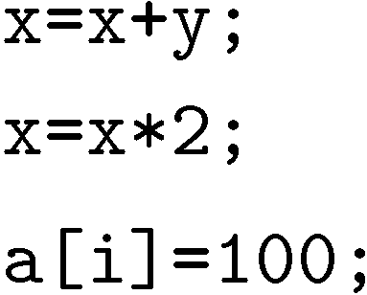
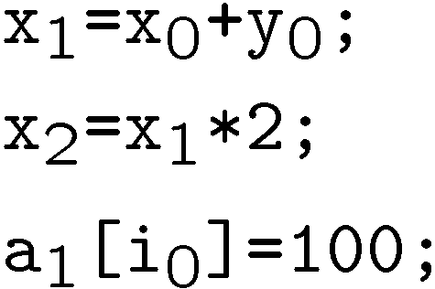

Transforming Loop-Free Programs Into Equations (2)
When a variable is assigned multiple times,
use a new variable for the RHS of each assignment
Program
SSA Program

Slide 19
What about conditionals?
Program
SSA Program
if (v)
x = y;
else
x = z;
w = x;
if (v₀)
x₀ = y₀;
else
x₁ = z₀;
w₁ = x??;
What should ‘x’ be?

Slide 20
What about conditionals?
Program
SSA Program
if (v)
x = y;
else
x = z;
w = x;
if (v₀)
x₀ = y_{0;}
else
x₁ = z_{0;}
x₂ = v₀ ? x₀ : x₁;
w₁ = x₂
For each join point, add new variables with selectors

Slide 21
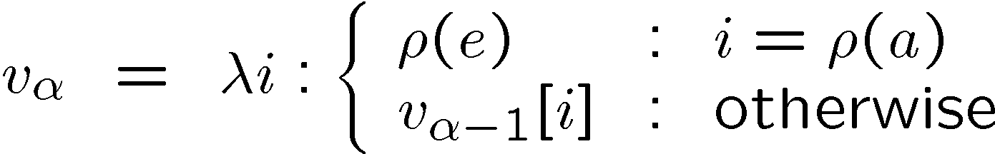

Adding Unbounded Arrays
Arrays are updated “whole array” at a time
A[1] = 5;
A[2] = 10;
A[k] = 20;
A₁=λ i : i == 1 ? 5 : A₀[i]
A₂=λ i : i == 2 ? 10 : A₁[i]
A₃=λ i : i == k ? 20 : A₂[i]
Examples:
A₂[2] == 10 A₂[1]==5 A₂[3] == A₀[3]
A₃[2] == (k==2 ? 20 : 10)
Uses only as much space as there are uses of the array!

Slide 22
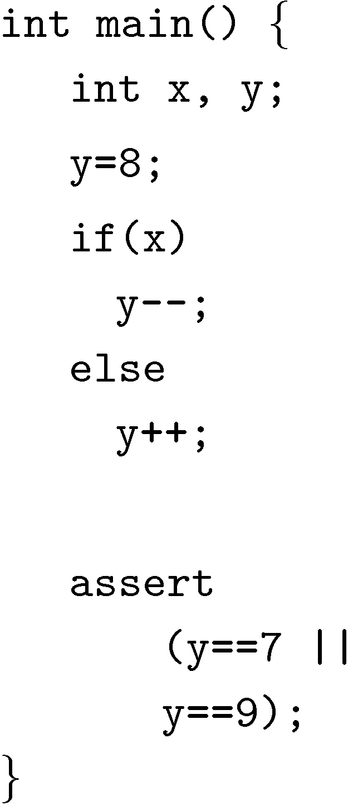
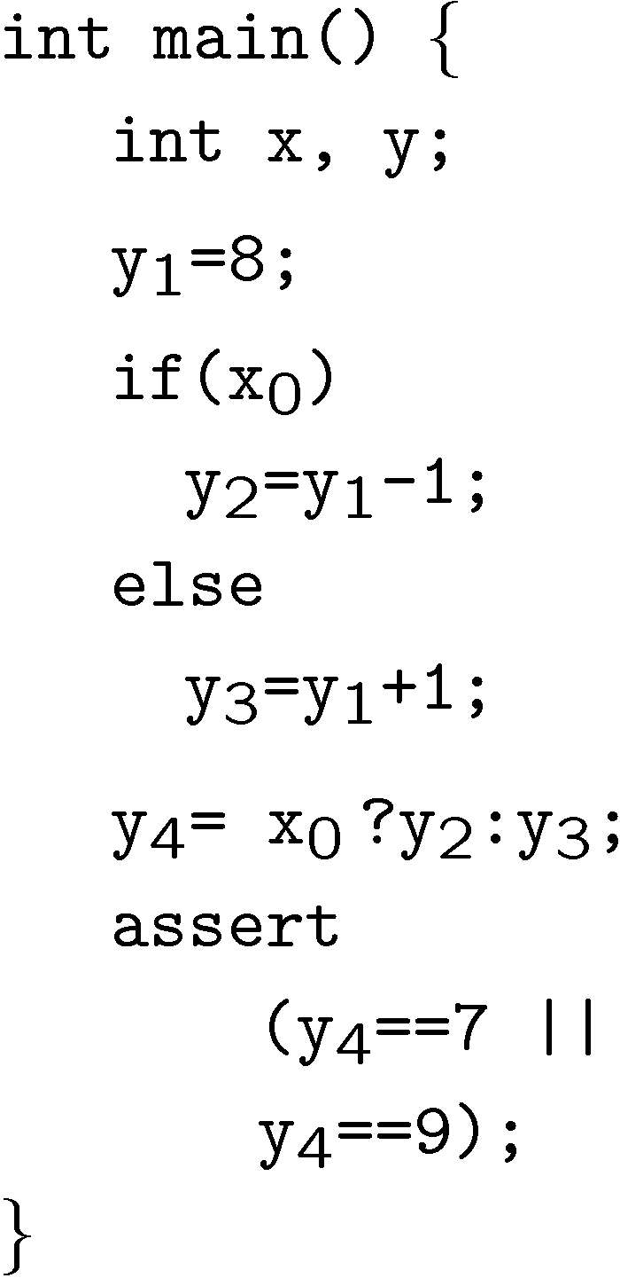
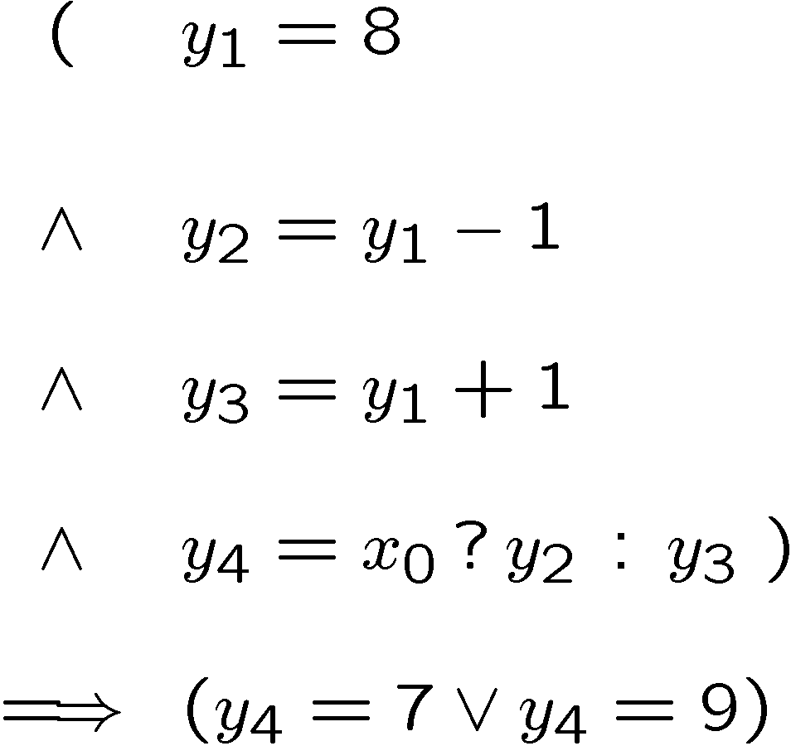
Example

Slide 23
Pointers
While unwinding, record right hand side of assignments to pointers
This results in very precise points-to information
  Separate for each pointer
  Separate for each instance of each program location
Dereferencing operations are expanded into
case-split on pointer object (not: offset)
  Generate assertions on offset and on type

Slide 24
Deciding Bit-Vector Logic with SAT
Pro: all operators modeled with their precise semantics
Arithmetic operators are flattened into circuits
  Not efficient for multiplication, division
  Fixed-point for float/double
Unbounded arrays
  Use uninterpreted functions to reduce to equality logic
  Similar implementation in UCLID
  But: Contents of array are interpreted
Problem: SAT solver happy with first satisfying assignment that is found. Might not look nice.

Slide 25
Example
void f (int a, int b, int c)
{
int temp;
if (a > b) {
temp = a; a = b; b = temp;
}
if (b > c) {
temp = b; b = c; c = temp;
}
if (a < b) {
temp = a; a = b; b = temp;
}
assert (a<=b && b<=c);
}
State 1-3
a=-8193 (11111111111111111101111111111111)
b=-402 (11111111111111111111111001101110)
c=-2080380800 (10000011111111111110100010…)
temp=0 (00000000000000000000000000000000)
State 4 file sort.c line 10
temp=-402 (11111111111111111111111001101110)
State 5 file sort.c line 11
b=-2080380800 (10000011111111111110100010…)
State 6 file sort.c line 12
c=-402 (11111111111111111111111001101110)
Failed assertion: assertion file
sort.c line 19
CBMC

Slide 26
Problem (I)
Reason: SAT solver performs DPLL backtracking search
Very first satisfying assignment that is found is reported
Strange values artifact from bit-level encoding
Hard to read
Would like nicer values

Slide 27
Problem (II)
Might not get shortest counterexample!
Not all statements that are in the formula actually get executed
There is a variable for each statement that decides if it is executed or not (conjunction of if-guards)
Counterexample trace only contains assignments that are actually executed
The SAT solver picks some…

Slide 28
Example
void f (int a, int b,
int c)
{
if(a)
{
a=0;
b=1;
}
assert(c);
}
from
SSA
{-1} b_1#2 == (a_1#0?b_1#1:b_1#0)
{-2} a_1#2 == (a_1#0?a_1#1:a_1#0)
{-3} b_1#1 == 1
{-4} a_1#1 == 0
{-5} \guard#1 == a_1#0
{-6} \guard#0 == TRUE
|--------------------------
{1} c_1#0
CBMC
assign-ments

Slide 29
Example
void f (int a, int b,
int c)
{
if(a)
{
a=0;
b=1;
}
assert(c);
}
State 1-3
a=1 (00000000000000000000000000000001)
b=0 (00000000000000000000000000000000)
c=0 (00000000000000000000000000000000)
State 4 file length.c line 5
a=0 (00000000000000000000000000000000)
State 5 file length.c line 6
b=1 (00000000000000000000000000000001)
Failed assertion: assertion
file length.c line 11
CBMC

Slide 30
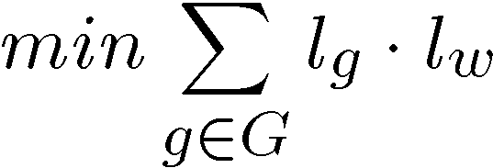
Basic Solution
Counterexample length typically considered to be most important
  e.g., SPIN iteratively searches for shorter counterexamples
Phase one: Minimize length
l_{g}: Truth value (0/1) of guard,
l_{w}: Weight = number of assignments
Phase two: Minimize values

Slide 31
Pseudo Boolean Solver (PBS)
Input:
  CNF constraints
  Pseudo Boolean constraints
    2x + 3y + 6z <= 7, where x, y, z are Boolean variables
  Pseudo Boolean objective function
Output:
  Decision (SAT/UNSAT)
  Optimizatioin (Minimize/Maximize an objective function)
Some implementations:
  PBS http://www.eecs.umich.edu/~faloul/Tools/pbs
  MiniSat+ (from MiniSat web page)

Slide 32
Example
void f (int a, int b, int c)
{
int temp;
if (a > b) {
temp = a; a = b; b = temp;
}
if (b > c) {
temp = b; b = c; c = temp;
}
if (a < b) {
temp = a; a = b; b = temp;
}
assert (a<=b && b<=c);
}
State 1-3
a=0 (00000000000000000000000000000000)
b=0 (00000000000000000000000000000000)
c=-1 (11111111111111111111111111111111)
temp=0 (00000000000000000000000000000000)
State 4 file sort.c line 10
temp=0 (00000000000000000000000000000000)
State 5 file sort.c line 11
b=-1 (11111111111111111111111111111111)
State 6 file sort.c line 12
c=0 (00000000000000000000000000000000)
Failed assertion: assertion file
sort.c line 19
CBMC
+
Mini-
mization

Slide 33
Modeling with CBMC (1)
CBMC provides 2 modeling (not in ANSI-C) primitives
xxx nondet_xxx ()
Returns a non-deterministic value of type xxx
int nondet_int (); char nondet_char ();
Useful for modeling external input, unknown environment, library functions, etc.

Slide 34
Using nondet for modeling
Library spec:
“foo is given non-deterministically, but is taken until returned”
CMBC stub:
int nondet_int ();
int is_foo_taken = 0;
int grab_foo () {
if (!is_foo_taken)
is_foo_taken = nondet_int ();
return is_foo_taken; }
int return_foo ()
{ is_foo_taken = 0; }

Slide 35
Assume-Guarantee Reasoning (1)
Is foo correct?
int foo (int* p) { … }
void main(void) {
…
foo(x);
…
foo(y);
…
}
Check by splitting on the argument of foo

Slide 36
Assume-Guarantee Reasoning (2)
(A) Is foo correct assuming p is not NULL?
int foo (int* p) { __CPROVER_assume(p!=NULL); … }
(G)Is foo guaranteed to be called with a non-NULL argument?
void main(void) {
…
assert (x!=NULL);// foo(x);
…
assert (y!=NULL); //foo(y);
…}

Slide 37
Dangers of unrestricted assumptions
Assumptions can lead to vacuous satisfaction
if (x > 0) {
__CPROVER_assume (x < 0);
assert (0); }
This program is passed by CMBMC!
Assume must either be checked with assert or used as an idiom:
x = nondet_int ();
y = nondet_int ();
__CPROVER_assume (x < y);

Slide 38
Summary
Bounded model checking is effective for bug finding
Tricky points
  PL semantics
  Procedure Summaries
  Pointers
  Loops

