Slide 1
On Complexity, Sampling,
and ε-Nets and ε-Samples
Matan Liber

Slide 2
Overview
1. VC Dimension
1.1 Range Space
1.2 Measure
1.3 Estimate
1.4 Radon’s Theorem
2. Shattering Dimension and Dual Range Space
2.1 Growth Function
2.2 Sauer’s Lemma
2.3 Shatter Function
2.4 Dual Range Space
3. ε-Nets and ε-Sampling
3.1 ε-Sampling Theorem
3.2 ε-Net Theorem

Slide 3
Motivation
Understanding geometrical complexity.
Quantify geometrical complexity.
Capturing the complexity of a set by a small subset.

Slide 4
Range Space
A range space S is a pair (X,R).
X is the ground set (finite or infinite).
R is a (finite or infinite) family of subsets of X.
Elements in X are points.
Elements in R are ranges.

Slide 5
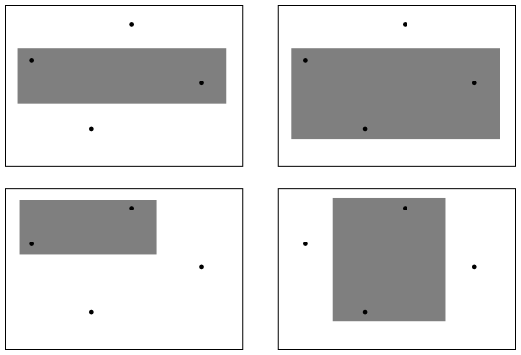
Examples
S = (ℝ, {[a,b] | a ≤ b ∈ ℝ})
S = (People in Tel Aviv, {Age(x,y) | 0 ≤ x ≤y ≤ 120})
S = (ℝ², {D | D is a rectangle in the plane})

Slide 6


Measure
Let S = (X,R).
Let x ⊆ X (x is finite).
For r ∈ R, its measure is $\overline{m}$(r) = $\frac{\text{|}\text{r}∩x\text{|}}{|x|}$
$\overline{m}$(r) = $\frac{2}{8}$ = $\frac{1}{4}$

Slide 7

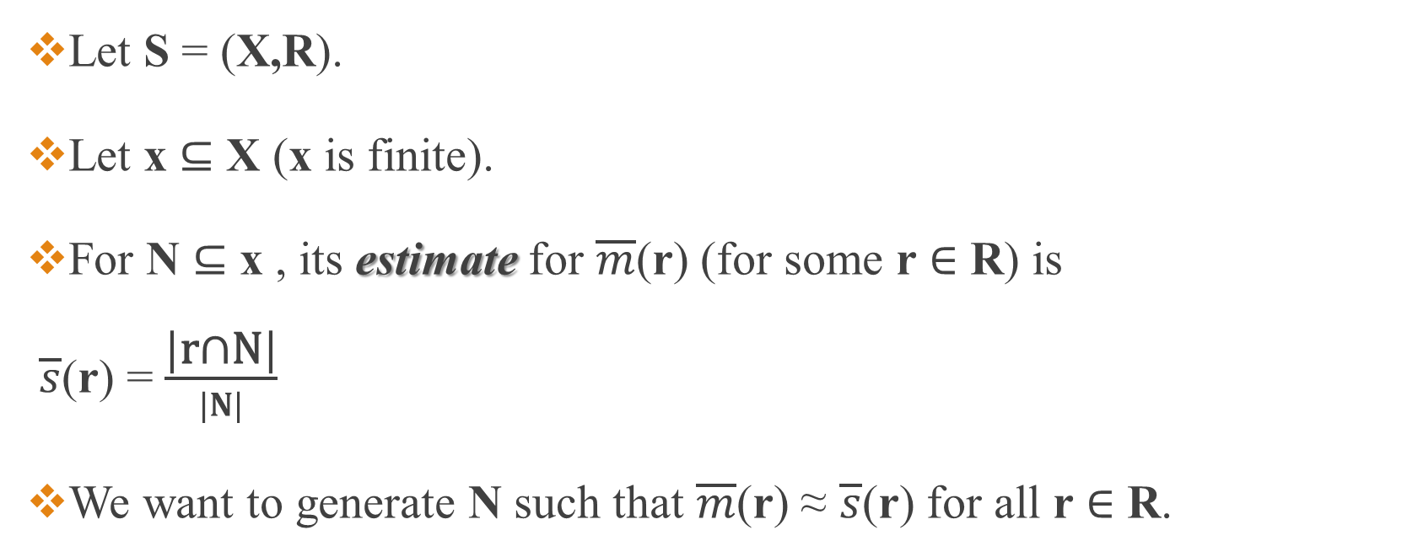
Estimate
Let S = (X,R).
Let x ⊆ X (x is finite).
For N ⊆ x , its estimate for $\overline{m}$(r) (for some r ∈ R) is $\overline{s}$(r) = $\frac{\text{|}\text{r}\text{∩}\text{N}\text{|}}{|N|}$
We want to generate N such that $\overline{m}$(r) ≈ $\overline{s}$(r) for all r ∈ R.
$\overline{s}$(r) = $\frac{1}{4}$ = $\overline{m}$(r)

Slide 8
Projection and VC Dimension
Let S = (X,R).
Let Y ⊆ X.
R_{|Y} = {r∩Y | r∈R} is the projection of R on Y.
p
s
q
R_{|Y={p,q,s}} = {∅,{s},{p, s}}

Slide 9
Shattering
If R_{|Y} contains all subsets of Y (for finite Y, |R_{|Y}| = 2^{|Y|})
We say that Y is shattered by R.

Slide 10
VC Dimension
Let S = (X,R), the VC Dimension (Vapnik and Chervonenkis) of S is
dim_{vc}(S) = max({k∈ℕ | ∃B⊆X,|B|=k, B is shattered by R})
1
2
p
q
s

Slide 11
VC Dimension
Let S = (X,R).
dim_{vc}(S) = ∞⬄∀ k∈ℕ ∃ B⊆X,|B|=k, B is shattered by R

Slide 12
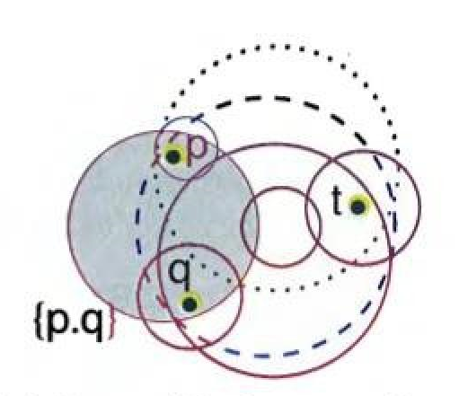
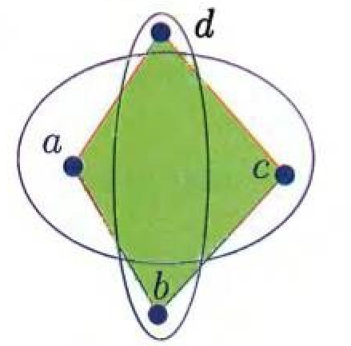
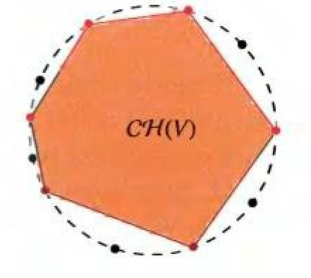
Examples
dim_{vc}(S) = ∞
dim_{vc}(S) = 3
dim_{vc}(S) < 4

Slide 13
Complement Space
Let S = (X,R) with dim_{vc}(S) = δ.
S = (X,R) is the complement space where
R = {X∖r | r∈R}

Slide 14
Complement Space: VC Dimension
Let S = (X,R) with dim_{vc}(S) = δ.
S = (X,R) is the complement space.
Claim: dim_{vc}(S) = dim_{vc}(S).

Slide 15
Complement Space VC Dimension
Proof:
If S shatters B then ∀ Z⊆B, ∃ r∈R, r∩B = B∖Z.
So for r = X∖r, r∩B = Z.
We get that S shatters B.

Slide 16
Halfspaces

Slide 17
Range Space example: Halfspaces
Let P = {p₁,…., p_{d+2}} ⊆ ℝ^{d}.
Claim:
∃β₁,…., β_{d+2} ∈ℝ not all 0.
∑_{i} β_{i}·p_{i} = 0 and ∑_{i} β_{i} = 0.

Slide 18
Range Space example: Halfspaces
Proof:
Set Q = {q_{i} | q_{i =} (p_{i},1)∈ℝ^{d+1}}.
q₁,….,q_{d+2} are linearly dependent (|Q| > d+1).

Slide 19
Range Space example: Halfspaces
So ∃β₁,…., β_{d+2} ∈ℝ not all 0
∑_{i=1} (β_{i}·q_{i}) = ∑_{i=1} (β_{i}·(p_{i},1)) = (0,….,0).
So , ∑_{i=1} (β_{i}·p_{i}) = (0,….,0).
And ∑_{i})β_{i}1·) = 0.
d+2
d+2
d+1
d

Slide 20
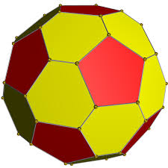
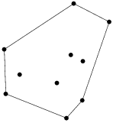
Convex Hull
Let P = {p₁,…., p_{k}} ⊆ ℝ^{d}.
CH(P) = {q | ∃β₁,…., β_{k} ≥ 0, ∑_{i}β_{i} = 1, ∑_{i}(β_{i}·p_{i}) = q}

Slide 21
Radon’s Theorem
Let P = {p₁,…., p_{d+2}} ⊆ ℝ^{d}.
∃ C,D⊂P, C∩D=∅, C∪D=P and CH(C)∩CH(D) ≠ ∅.
c₁
c₁
d₁
d₁
d₂
c₂
c₃
c₂

Slide 22
Radon’s Theorem
Proof:
By previous claim
∃β₁,…., β_{d+2} ∈ℝ not all 0.
∑_{i} (β_{i}·p_{i}) = 0 and ∑_{i} β_{i} = 0.
Assume β₁,…., β_{k} ≥ 0, and β_{k+1},…., β_{d+2} < 0.

Slide 23
Radon’s Theorem
Let μ = ∑_{i=1} β_{i} = -∑_{i=k+1} β_{i}.
Also, ∑_{i=1} (β_{i}·p_{i}) = -∑_{i=k+1} (β_{i}·p_{i}).
k
d+2
k
d+2

Slide 24
Radon’s Theorem
If we take v = ∑_{i=1} ((β_{i}/μ)· p_{i}) then v∈CH({p₁,…., p_{k}}).
Also, v = ∑_{i=k+1} (-(β_{i}/μ)· p_{i}) and v∈CH({p_{k+1},…., p_{d+2}}).
So for C = {p₁,…., p_{k}}, D = {p_{k+1},…., p_{d+2}}
C∩D=∅, C∪D=P, and v∈CH(C)∩CH(D).
k
d+2

Slide 25
Lemma
Let P⊆ℝ^{d} ,|P| < ∞.
Let s∈CH(P).
Let h⁺ be a halfspace, s∈h⁺.
Then ∃p∈P, p∈h⁺.
.
s
.p

Slide 26
VC Dimension of Halfspaces
Let S = (ℝ^{d},R) where R is all (closed) halfspaces in ℝ^{d}.
dim_{vc}(S) = d+1.

Slide 27
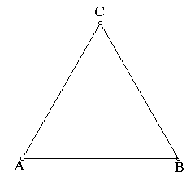
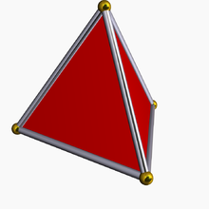
VC Dimension of Halfspaces
Simplex: (convex hull of) d+1 points in ℝ^{d}.
d=1
d=2
d=3

Slide 28
VC Dimension of Halfspaces
Proof:
dim_{vc}(S) ≥ d+1.

Slide 29
VC Dimension of Halfspaces
By Radon’s Theorem if Q⊆ℝ^{d}, |Q| = d+2
∃ C,D⊂P, C∩D=∅, C∪D=P and CH(C)∩CH(D) ≠ ∅.
Let v∈CH(C)∩CH(D).
If ∀c∈C, c∈h⁺ then CH(C) ⊆ h⁺.
So, v∈h⁺.

Slide 30
VC Dimension of Halfspaces
Also, v∈h⁺∩CH(D).
By previous claim ∃d∈D, d∈h⁺.
So ∄ h⁺∈R, h⁺∩Q=C.
Which means Q is not shattered by S.
So, dim_{vc}(S) ≥ d+1 and dim_{vc}(S) > d+2 ⇒ dim_{vc}(S) = d+1.
c₁
v
d₂
d₁
c₂

Slide 31
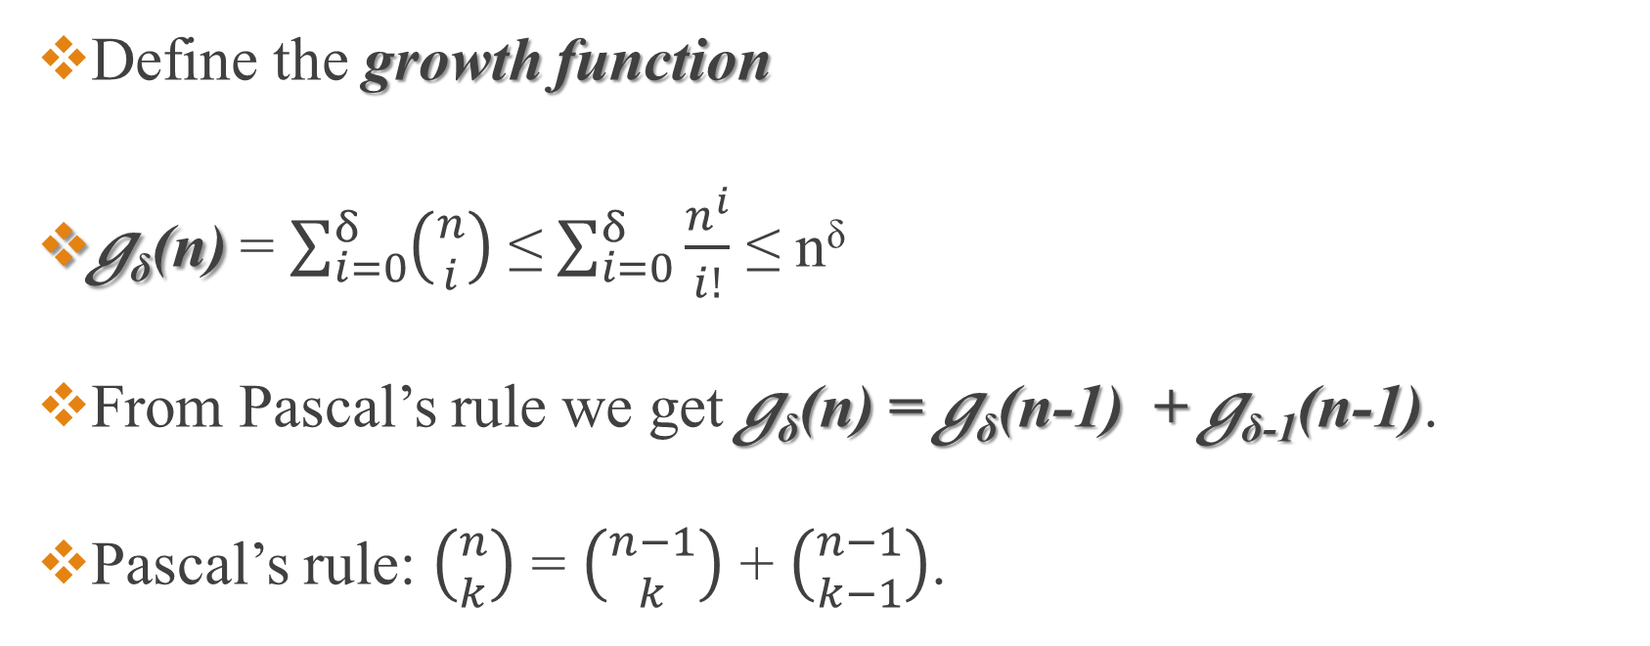
Growth Function
Define the growth function
g_{δ}(n) = $\sum_{i=0}^{δ}{\left({n \atop i}\right)}$ ≤ $\sum_{i=0}^{δ}{\frac{n^{i}}{i!}}$ ≤ n^{δ}
From Pascal’s rule we get g_{δ}(n) = g_{δ}(n-1) + g_{δ-1}(n-1).
Pascal’s rule: $\left({n \atop k}\right)$ = $\left({n−1 \atop k}\right)$ + $\left({n−1 \atop k−1}\right)$.

Slide 32
Sauer’s Lemma
Let S = (Y,R) with dim_{vc}(S) = δ.
|Y| = n.
Where Y ⊆ X and R = R’_{|Y} for some S’ = (X,R’), .
Then |R| ≤ g_{δ}(n).

Slide 33
Sauer’s Lemma
Proof:
Easy for δ = 0 or n = 0 (0 ≤ 0).
Let x ∈ Y.

Slide 34
Sauer’s Lemma
R_{x} = {r ∖{x} | r∪{x} ∈ R and r∖{x} ∈ R}
R_{∖{x}} = {r ∖{x} | r ∈ R}
|R| = |R_{x}| + |R_{∖{x}}| (explanation on board).
B⊆Y∖{x} is shattered by R_{x} ⇒ B∪{x} is shattered by R.
dim_{vc}(S) = δ ⇒ dim_{vc}((Y ∖{x}, R_{x})) = δ-1.

Slide 35
Sauer’s Lemma
|R| = |R_{x}| + |R_{∖{x}}| ≤ g_{δ-1}(n-1) + g_{δ}(n-1) = g_{δ}(n).
We get that for |Y| = n, |R| ≤ n^{δ}.
by
induction
Including x
Not including x

Slide 36

Growth Function Bounds
For n ≥ 2δ and δ ≥1
$(\frac{n}{\text{δ}})$^{δ} ≤ g_{δ}(n) ≤ $2(\frac{ne}{\text{δ}})$^{δ}

Slide 37
Shatter Function
Let S = (X,R).
π_{s}(m) = max|R_{|B}|.
B⊆X
|B|=m

Slide 38
Shattering Dimension
Let S = (X,R).
The shattering dimension of S is the smallest d such that π_{s}(m) = O(m^{d}).

Slide 39
VC vs. Shattering Dimension
Let S = (X,R) with dim_{vc}(S) = δ.
B⊆X, |B| ≤ ∞.
|R_{|B}| ≤ π_{s}(|B|) ≤ g_{δ}(|B|)
That is, the shattering dimension ≤ δ.

Slide 40
VC vs. Shattering Dimension
Proof:
Let n = |B|.
|R_{|B}| ≤ π_{s}(n) (= the maximum for any subset of size n of X)
|R_{|B}| ≤ g_{δ}(n) ≤ n^{δ}
π_{s}(n) = |R_{|Bmax}| ≤ g_{δ}(n) = O(n^{δ}) ⇒ shattering dimension ≤ δ.

Slide 41
Lemma: VC Dimension Bounds
Let S = (X,R) with shattering dimension d.
Then dim_{vc}(S) = O(d·log(d)).

Slide 42
Shattering Dimension Example
S = (X,R) where X = ℝ², R = {D | D is a disk in the plane}
The shattering dimension of S is 3.

Slide 43
Shattering Dimension Example
Proof:
Let P = {p₁,…., p_{n}} ⊆ ℝ².
F = R_{|P}, we will show |F| ≤ 4n³.

Slide 44
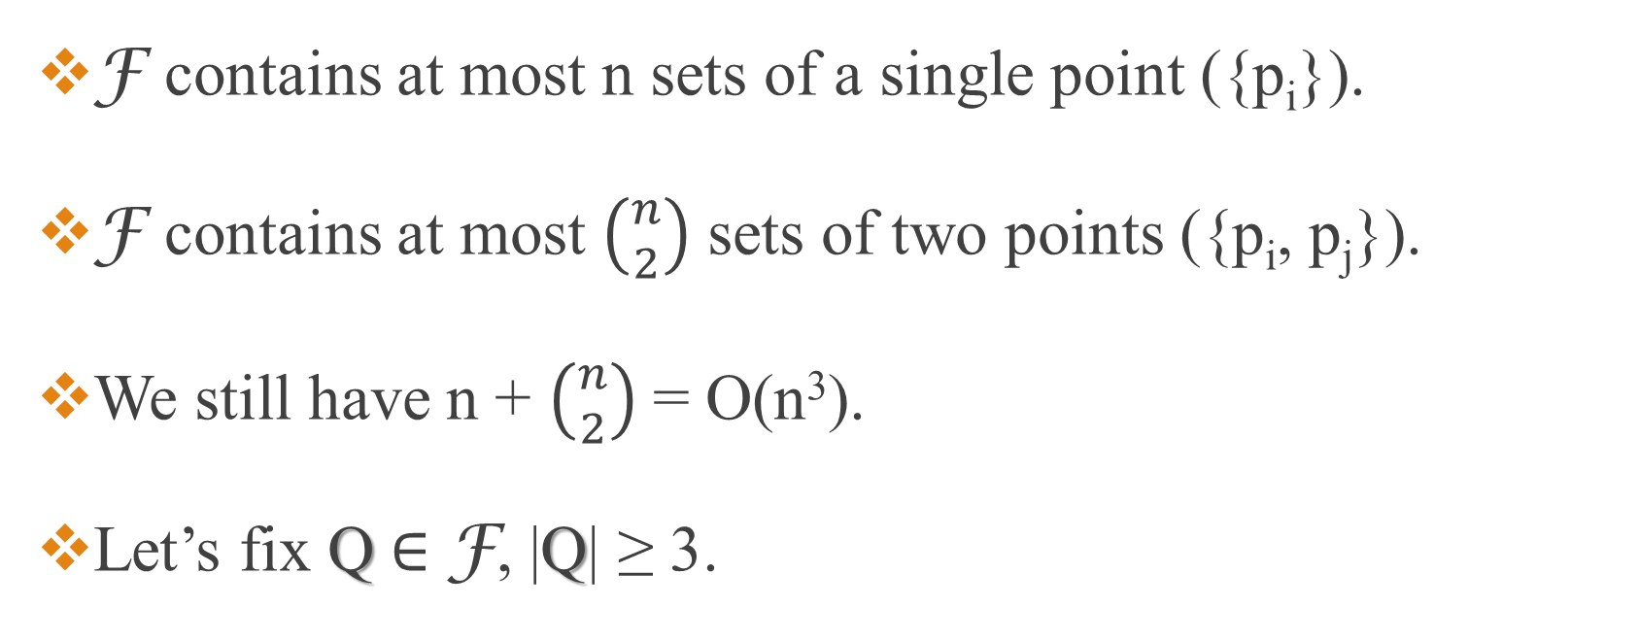
Shattering Dimension Example
F contains at most n sets of a single point ({p_{i}}).
F contains at most $\left({n \atop 2}\right)$ sets of two points ({p_{i}, p_{j}}).
We still have n + $\left({n \atop 2}\right)$ = O(n³).
Let’s fix Q ∈ F, |Q| ≥ 3.

Slide 45
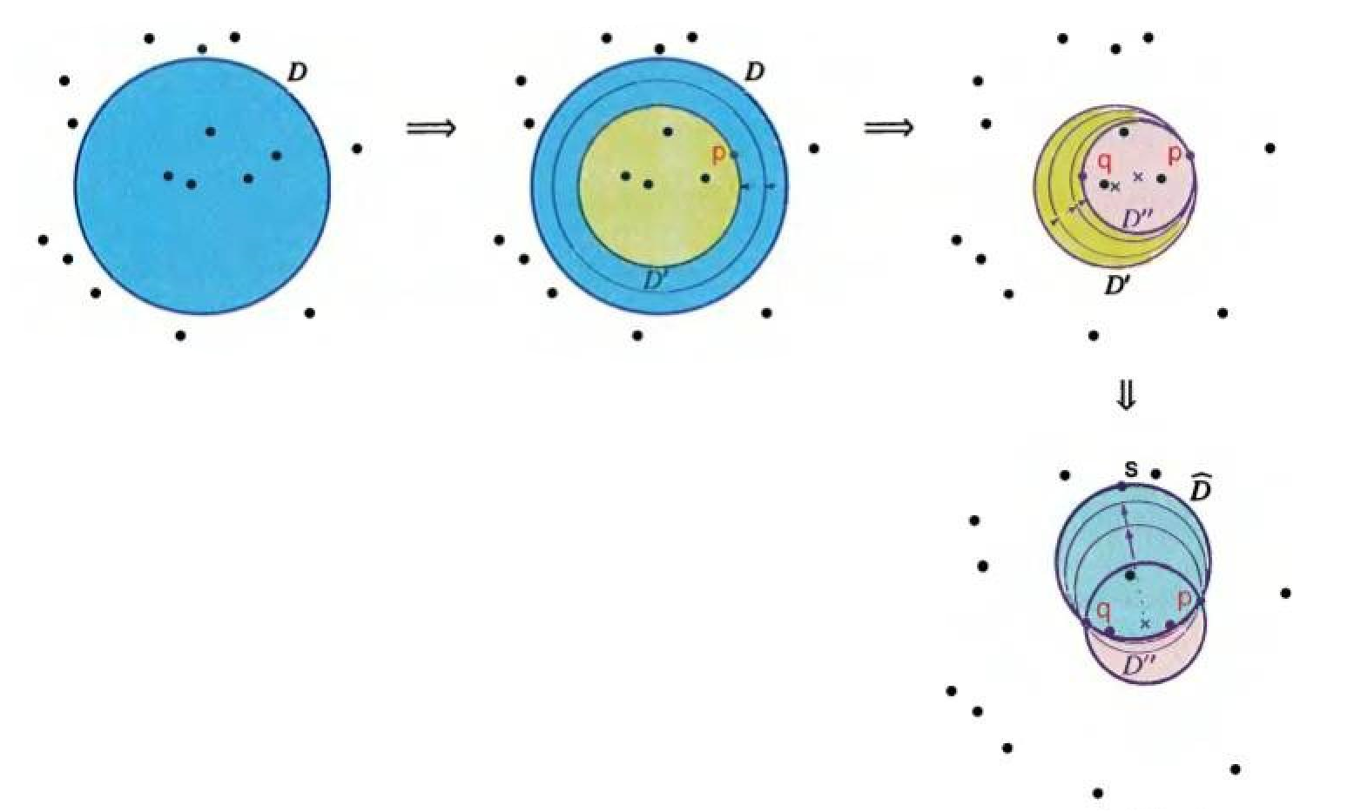

Shattering Dimension Example

Slide 46
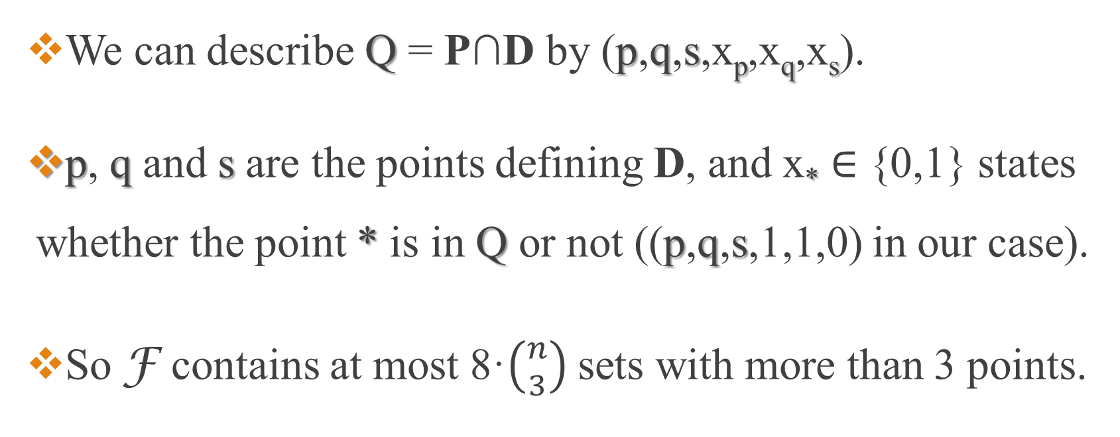
Shattering Dimension Example
We can describe Q = P∩D by (p,q,s,x_{p},x_{q},x_{s}).
p, q and s are the points defining D, and x* ∈ {0,1} states whether the point * is in Q or not ((p,q,s,1,1,0) in our case).
So F contains at most 8·$\left({n \atop 3}\right)$sets with more than 3 points.

Slide 47
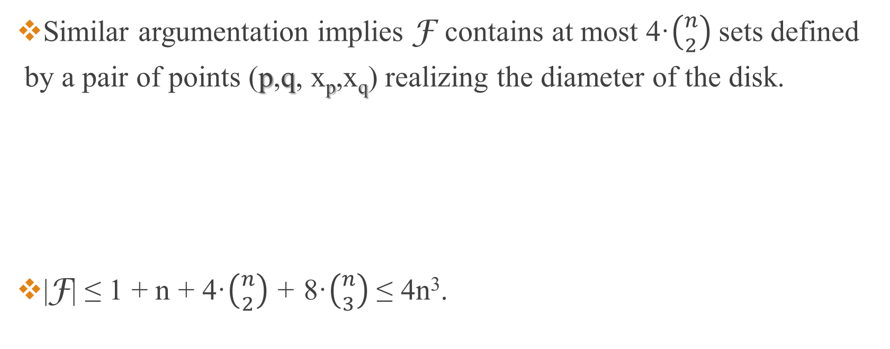
Shattering Dimension Example
Similar argumentation implies F contains at most 4·$\left({n \atop 2}\right)$sets defined by a pair of points (p,q, x_{p},x_{q}) realizing the diameter of the disk.
|F| ≤ 1 + n + 4·$\left({n \atop 2}\right)$ + 8·$\left({n \atop 3}\right)$ ≤ 4n³.
p
p
q
q

Slide 48
Corollary
This geometric argumentation gives us a powerful tool.
The shattering dimension of S = (X,R) where R is a family of shapes ≤ # points that determine a shape in the family.

Slide 49
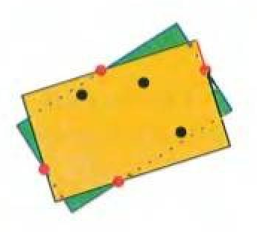
Corollary
Example: S = (ℝ², {D | D is a rectangle in the plane}) shattering dimension of S ≤ (=) 5.

Slide 50
Dual Range Space
Let S = (X,R), p ∈ X.
R_{p} = {r | r∈R, the range r contains p}

Slide 51
Dual Range Space
X* = {R_{p} | p ∈ X}.
The dual range space to S = (X,R) is S* = (R,X*).
Ranges become points and points become ranges.

Slide 52
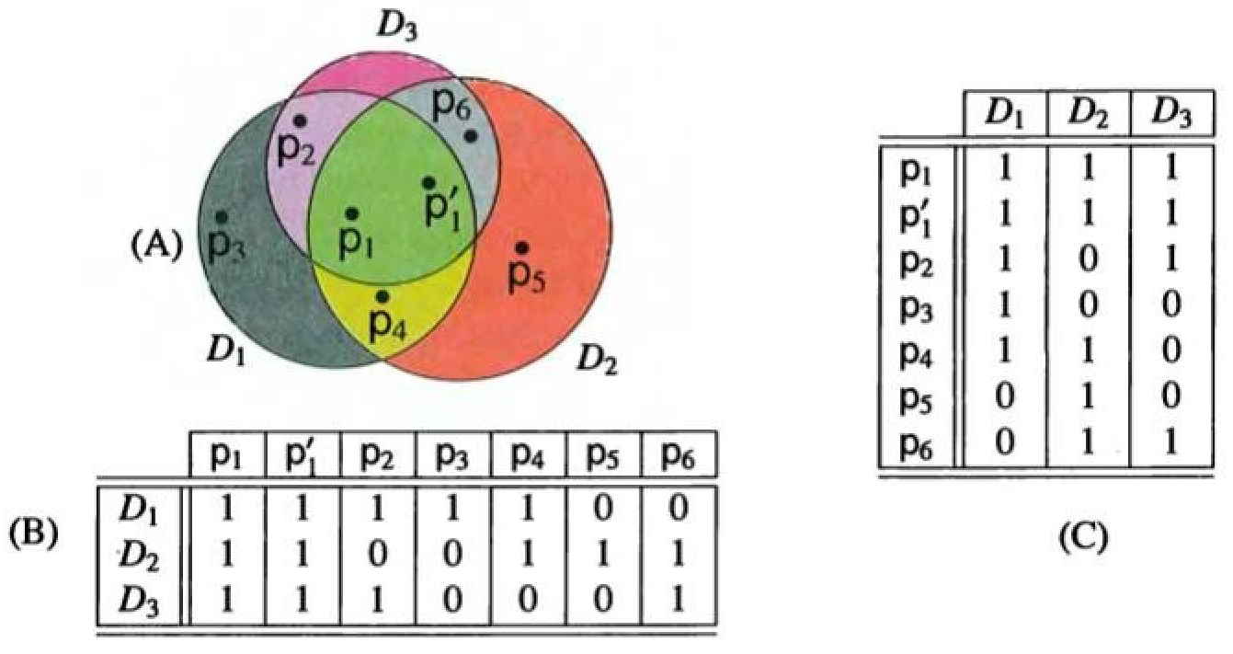

Slide 53
Dual Range Space
Claim:
Let S = (X,R), R is a set of shapes whose boundaries can intersect at most s times.
The complexity of the arrangement of n shapes is O(sn²).

Slide 54

Dual Range Space
Proof:
Explanation on board
O(2·$\left({n \atop 2}\right)$) = O(n²)

Slide 55
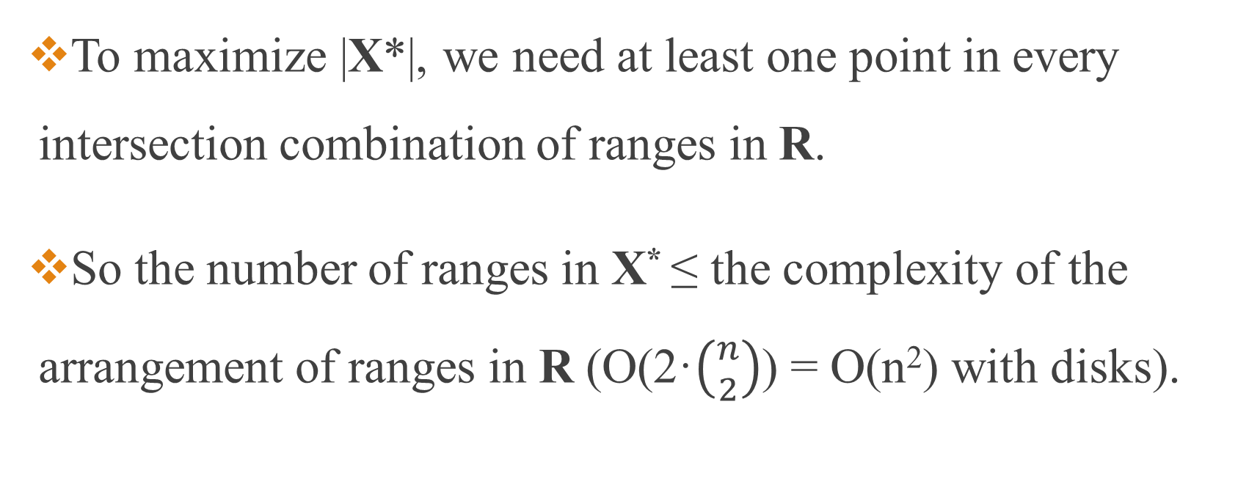
Dual Range Space
To maximize |X*|, we need at least one point in every intersection combination of ranges in R.
So the number of ranges in X* ≤ the complexity of the arrangement of ranges in R (O(2·$\left({n \atop 2}\right)$) = O(n²) with disks).

Slide 56
Dual Shattering Function
Let the dual shattering function of a range space S be π*_{s}(m) = π_{s*}(m) where S* is the dual range space to S.

Slide 57
Dual Shattering Dimension
The dual shattering dimension of a range space S = the shattering dimension of S*.

Slide 58
Dual VC Dimension Bounds
Let S = (X,R) with dim_{vc}(S) = δ.
dim_{vc}(S*) ≤ 2^{δ+1}.

Slide 59
Dual VC Dimension Bounds
Proof:
Assume S* shatters a set F = {r₁,…., r_{k}} ⊆ R.
So, ∃ P⊆X of m = 2^{k} points that shatters F.
Formally ∀ V⊆F ∃ p∈P, F_{p} = V.
r₁
r₂

Slide 60
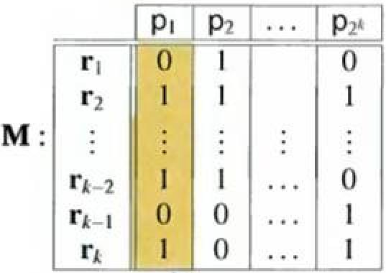
Dual VC Dimension Bounds
Consider M a matrix (k x 2^{k}).
M[i,j] = 1 ⇔ r_{i} contains p_{j} (0 otherwise).
Since P shatters F ∀ e∈{0,1}^{2k} ∃ 1≤j≤ 2^{k}, so that the j-th column in M is e.

Slide 61
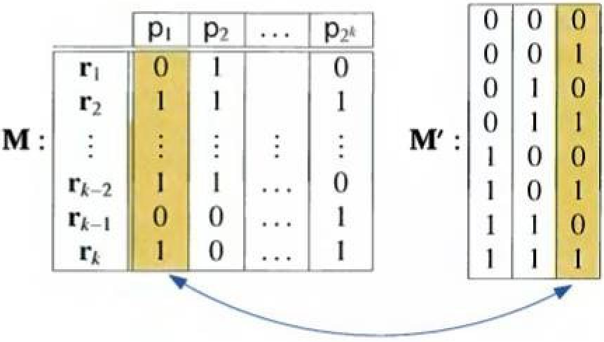
Dual VC Dimension Bounds
Let k’ = 2^{[log(k)]} ≤ k.
Consider M’ a matrix (k’ x log(k’)).
The i-th row in M’ is i-1 in binary representation.
For every column in M’ exists a column in M (corresponding to a point p_{t}) , identical to it in the top k’ bits.

Slide 62
Dual VC Dimension Bounds
Q = {The set of all points p_{t} representing a column in M’}.
|Q| = log(k’).
∀ Z⊆Q ∃ r_{z}∈F, r_{z}∩Q = Z (since M and M’ are identical in the relevant log(k’) columns of M’.

Slide 63
Dual VC Dimension Bounds
So, F shatters Q ⇒ |Q| ≤ δ (The orginal dim_{vc}(S)).
|Q| = log(k’) = [log(k)] ≤ δ ⇒ log(k) ≤ δ+1 ⇒ k ≤ 2^{δ+1}.

Slide 64
Dimensional Bounds
Let S = (X,R) with dual shattering dimension d.
dim_{vc}(S) ≤ d^{O(d)}.

Slide 65
Dimensional Bounds
Proof:
The shattering dimension of S* is d ⇒ dim_{vc}(S*) ≤ d’.
d’ = O(d·log(d)) (by a previous claim).
The dual range space to S* is S ⇒ dim_{vc}(S) ≤ 2^{d’+1} = d^{O(d)}.

Slide 66
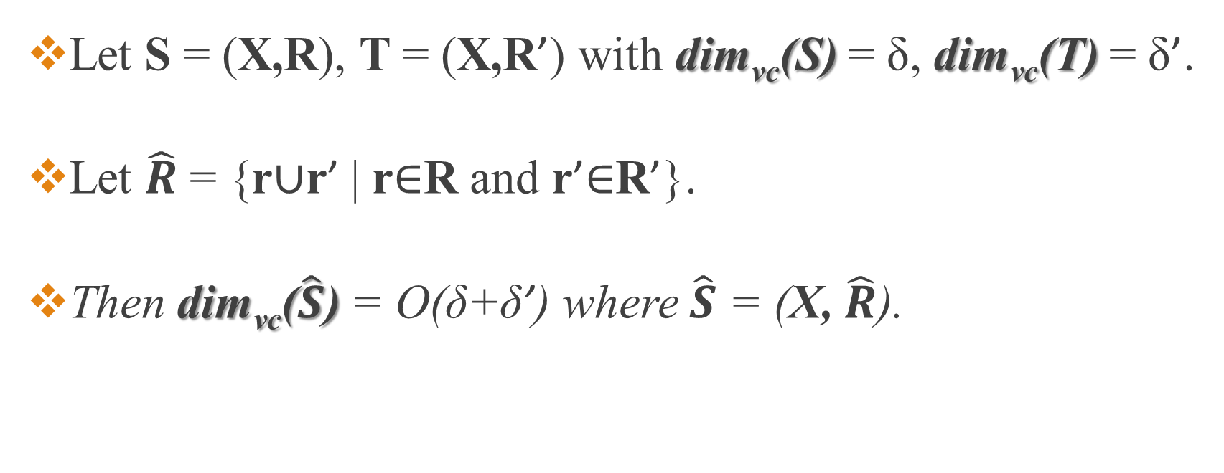
Mixing Range Spaces
Let S = (X,R), T = (X,R’) with dim_{vc}(S) = δ, dim_{vc}(T) = δ’.
Let $\hat{R}$ = {r∪r’ | r∈R and r’∈R’}.
Then dim_{vc}($\hat{S}$) = O(δ+δ’) where $\hat{S}$ = (X, $\hat{R}$).

Slide 67
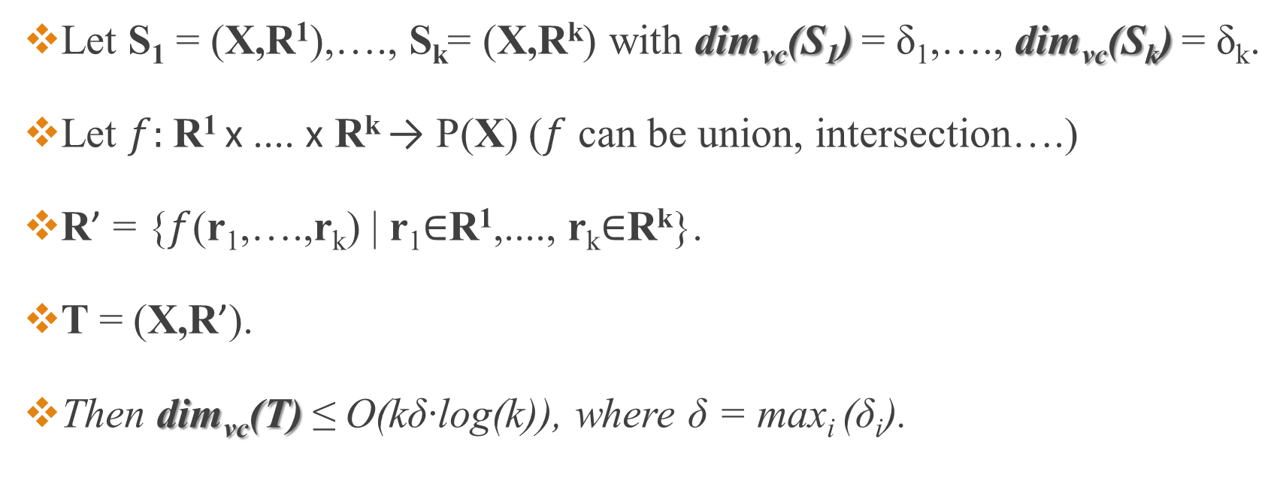
Mixing Range Spaces
Let S₁ = (X,R¹),…., S_{k}= (X,R^{k}) with dim_{vc}(S₁) = δ₁,…., dim_{vc}(S_{k}) = δ_{k}.
Let $f:$R¹ x .... x R^{k} → P(X) ($f$ can be union, intersection….)
R’ = {$f$(r₁,….,r_{k}) | r₁∈R¹,...., r_{k}∈R^{k}}.
T = (X,R’).
Then dim_{vc}(T) ≤ O(kδ·log(k)), where δ = max_{i} (δ_{i}).

Slide 68
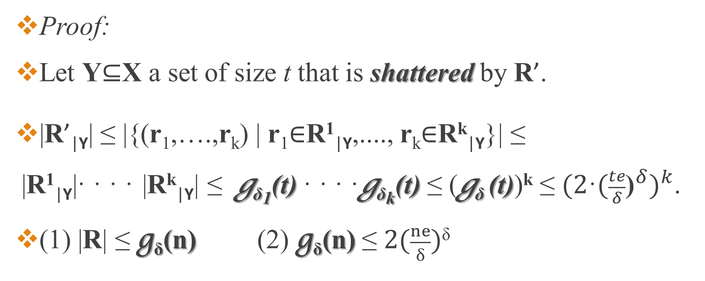
Mixing Range Spaces
Proof:
Let Y⊆X a set of size t that is shattered by R’.
|R’_{|Y}| ≤ |{(r₁,….,r_{k}) | r₁∈R¹_{|Y},...., r_{k}∈R^{k}_{|Y}}| ≤ |R¹_{|Y}| · · · ·|R^{k}_{|Y}| ≤ g_{δ1}(t) · · · ·g_{δk}(t) ≤ (g_{δ} (t))^{k} ≤ ${{(2\text{·}(\frac{te}{δ}\text{)}}^{δ})}^{k}$.
(1) |R| ≤ g_{δ}(n) (2) g_{δ}(n) ≤ $2(\frac{ne}{\text{δ}})$^{δ}
(1)
(2)

Slide 69

Mixing Range Spaces
Since Y is shattered by R’, |R’_{|Y}| = 2^{t}.
After a bit of algebra we get t ≤12kδ$\text{·}$ln(6k) = O(kδ·log(k)).

Slide 70
Corollary
Any finite sequence of combining range spaces with finite VC Dimension (by intersecting, complementing, or taking their union) results in a range space with a finite VC Dimension.

Slide 71
Motivation (now smarter)
Why do we care about finite VC Dimension?
It the right condition for an efficient sampling.
We can represent the behavior of a big set with a smaller sample.

Slide 72
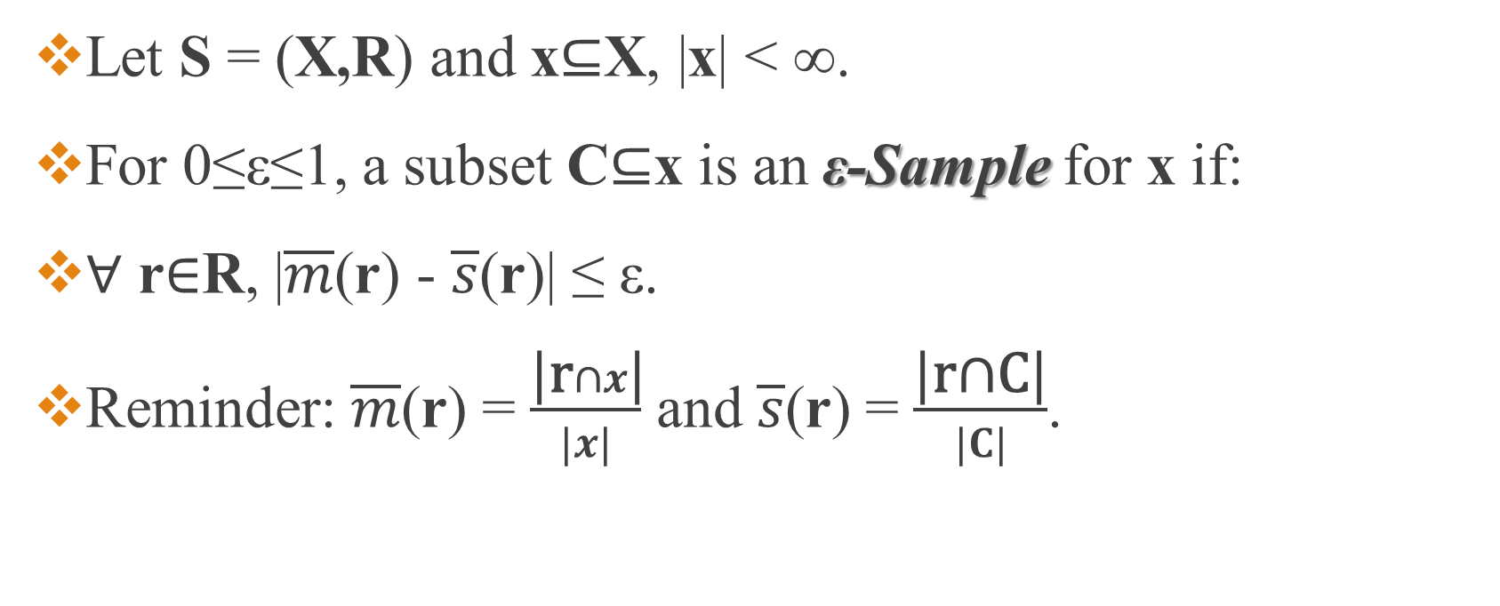
ε-Sample
Let S = (X,R) and x⊆X, |x| < ∞.
For 0≤ε≤1, a subset C⊆x is an ε-Sample for x if:
∀ r∈R, |$\overline{m}$(r) - $\overline{s}$(r)| ≤ ε.
Reminder: $\overline{m}$(r) = $\frac{\text{|}\text{r}∩x\text{|}}{|x|}$ and $\overline{s}$(r) = $\frac{\text{|}\text{r}\text{∩}\text{C}\text{|}}{|C|}$.
r

Slide 73
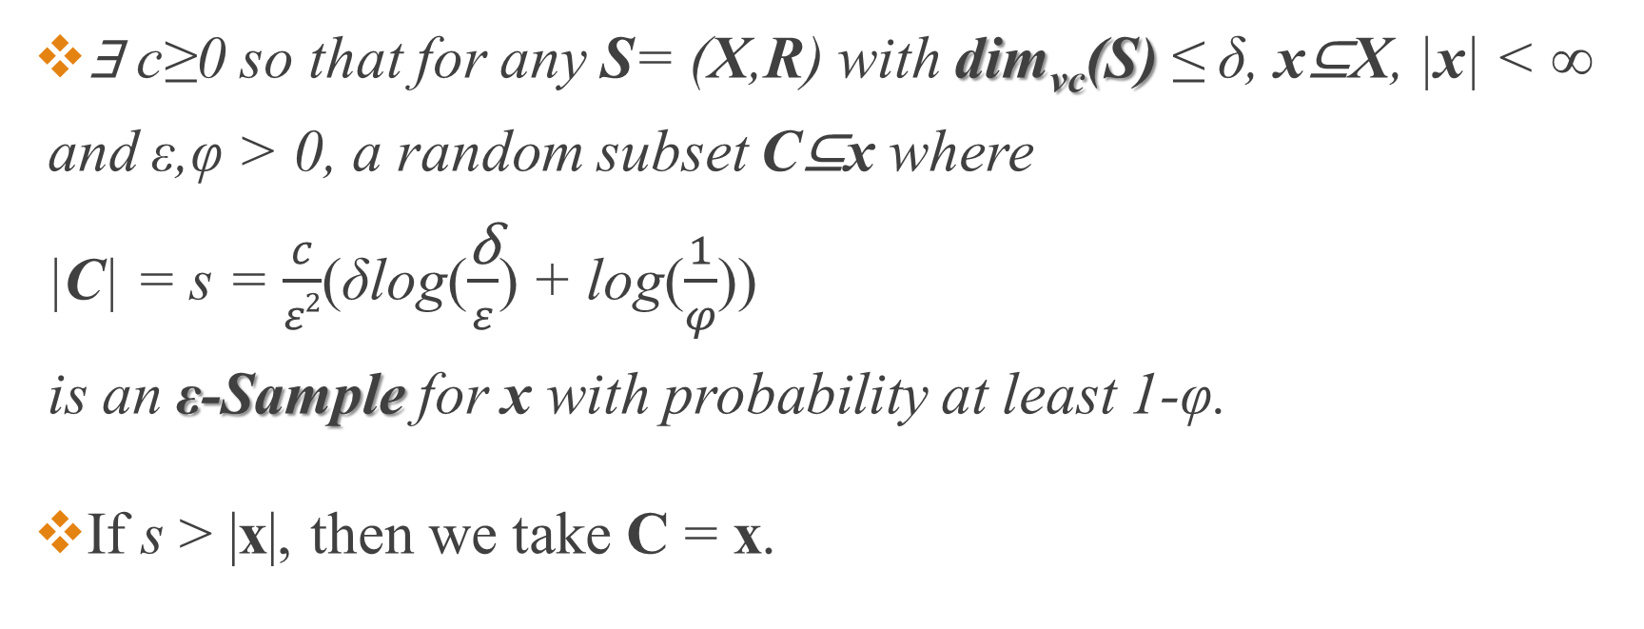
ε-Sample Theorem (Vapnik - Chervonenkis)
∃ c≥0 so that for any S= (X,R) with dim_{vc}(S) ≤ δ, x⊆X, |x| < ∞ and ε,φ > 0, a random subset C⊆x where |C| = s = $\frac{c}{ε2}$(δlog($\frac{\text{δ}}{ε}$) + log($\frac{1}{φ}$)) is an ε-Sample for x with probability at least 1-φ.
If s > |x|, then we take C = x.

Slide 74

ε-Net
A set N⊆x is an ε-Net for x if ∀r∈R, $\overline{m}$(r) ≥ ε ⇒ r∩N ≠ ∅.

Slide 75
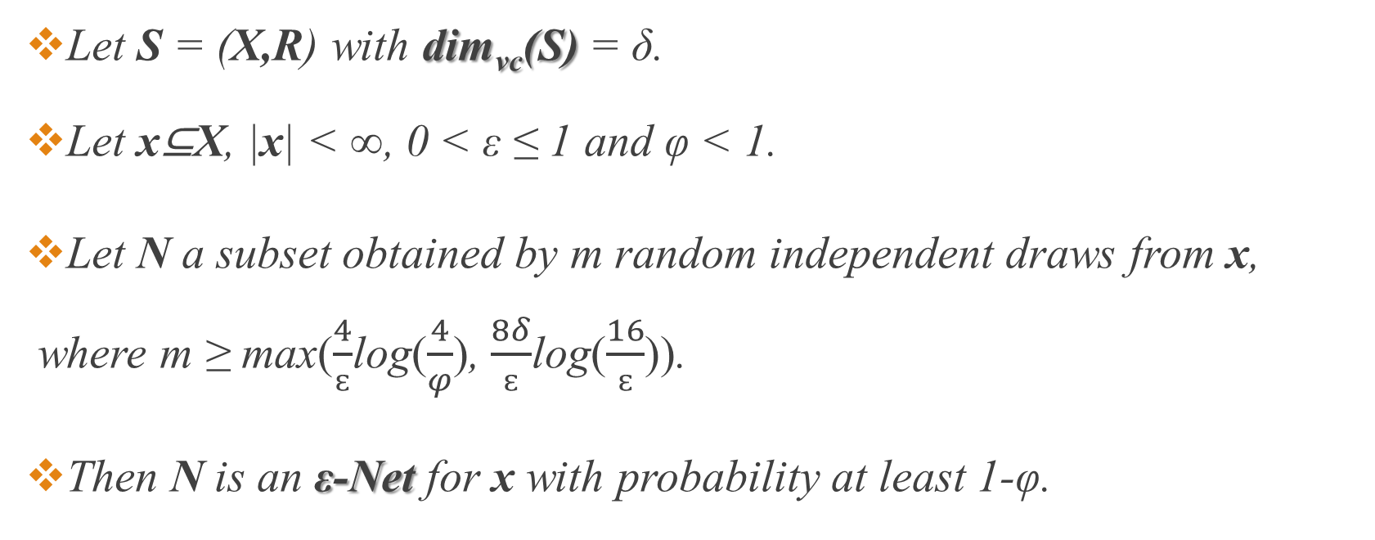
ε-Net Theorem (Haussler – Welzl)
Let S = (X,R) with dim_{vc}(S) = δ.
Let x⊆X, |x| < ∞, 0 < ε ≤ 1 and φ < 1.
Let N a subset obtained by m random independent draws from x, where m ≥ max($\frac{4}{ɛ}$log($\frac{4}{φ}$), $\frac{8δ}{ɛ}$log($\frac{16}{ɛ}$)).
Then N is an ε-Net for x with probability at least 1-φ.

Slide 76
To be continued…

