Slide 1

The Power of Grids
By Sariel Har-Peled
Presentation: Yuval Bertocchi
Power
Grid

Slide 2
Foreword
Today we are going to discuss approximation algorithms to two geometric problems:
The closest pair problem
The K-enclosing disc problem
We will demonstrate the usage of grids to solve these problems in linear time.

Slide 3
Timeline
Preliminaries
Closest pair
  Slow algorithm
  Linear time algorithm
K-enclosing disk
  Slow algorithm
  Linear time algorithm
Bibliography

Slide 4
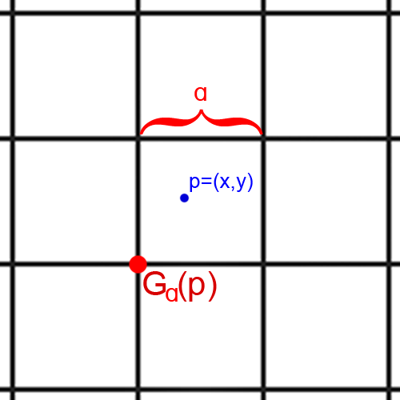

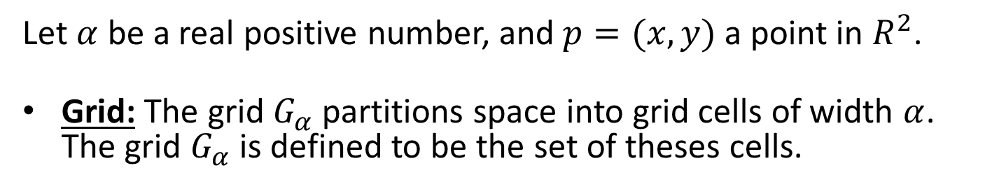
Preliminaries
Let $α$ be a real positive number, and $p=(x,y)$ a point in $R^{2}$.
Grid: The grid $G_{α}$ partitions space into grid cells of width $α$.
The grid $G_{α}$ is defined to be the set of theses cells.
Partition: For a point set P, the partition of P into subsets by the grid $G_{α}$ is denoted by $G_{α}(P)$.
Notes:
Take note to discern between capital P and lowercase p here

Slide 5

Preliminaries
Grid point: $G_{α}(p)$ is defined to be $\left(\left\lfloor \frac{x}{α}\right\rfloor α,\left\lfloor \frac{y}{α}\right\rfloor α\right)$.
Grid sidelength: For $G_{α}$, $α$ is called the grid sidelength
Notes:
Take note to discern between capital P and lowercase p here

Slide 6
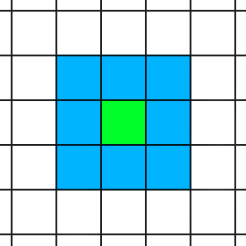
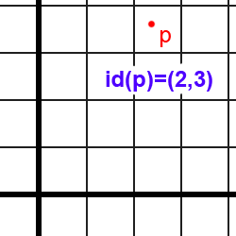
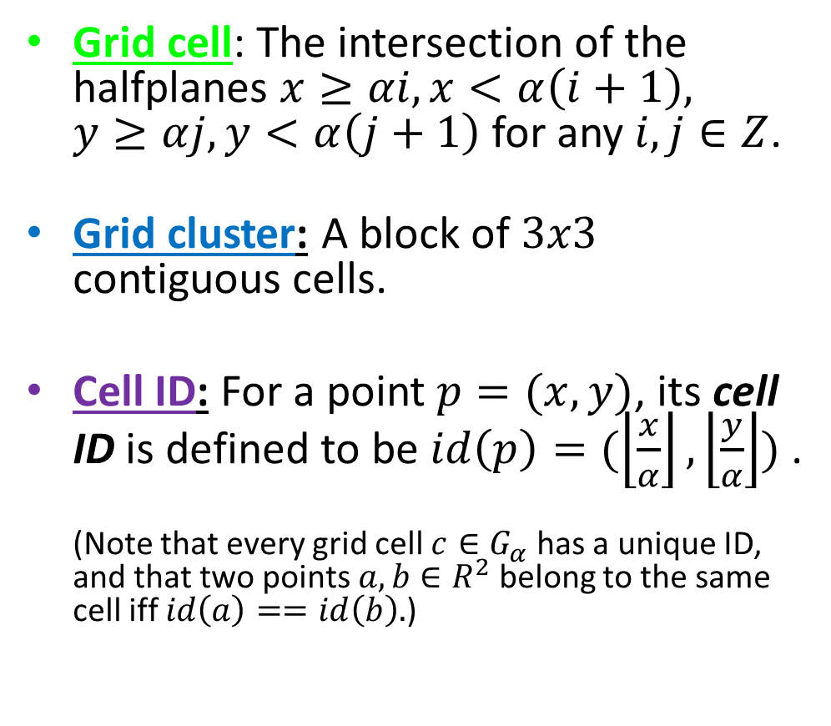
Preliminaries – cont.
Grid cell: The intersection of the halfplanes $x≥αi, x<α\left(i+1\right),$
$y≥αj, y<α\left(j+1\right)$ for any $i,j∈Z$.
Grid cluster: A block of $3x3$ contiguous cells.
Cell ID: For a point $p=(x,y)$, its cell ID is defined to be $id\left(p\right)=(\left\lfloor \frac{x}{α}\right\rfloor , \left\lfloor \frac{y}{α}\right\rfloor )$ .
(Note that every grid cell $c∈G_{α}$ has a unique ID, and that two points $a,b∈R^{2}$ belong to the same cell iff $id\left(a\right)==id\left(b\right).$)

Slide 7
Preliminaries – the last, I promise
The grid’s data structure:
For P a set of points, we associate with each unique cell ID a linked list that stores all the points of P falling into this cell.
These lists are saved in a hash table, hashed by their unique cell ID.
We assume that every hashing operation takes (worst case) constant time.
2,3
p
Notes:
We need this slide to assume that operations on the points themselves (pulling them, storing them) take constant time for each point; so we don’t have to dabble with this again.
This assumption comes from true randomness of the points, and can be achieved for instance by perfect hashing.
If anyone asks to elaborate: tell him to ask during recess, as this is not in the scope of the lecture.

Slide 8
Timeline
Preliminaries
Closest pair
  Slow algorithm
  Linear time algorithm
K-enclosing disk
  Slow algorithm
  Linear time algorithm
Bibliography

Slide 9
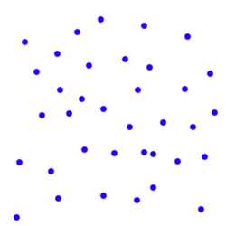

Closest pair
Problem: Given a set P of n points in the plane, find the pair of points closest to each other.
Formally, return the pair of points realizing $CP\left(P\right)=\min_{p≠q|p,q∈P}{|\left|p−q\right||}$.

Slide 10

Closest pair
Lemma 1.5: Let $P$ be a set of points contained inside a square $s$ such that the sidelength of $s$ is $α=CP(P)$. Then $\left|P\right|≤4$.

Slide 11
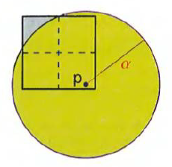

Closest pair
Proof:
Partition $s$, the square that contains P into four equal squares $s_{1},s_{2},s_{3},s_{4}$, and observe that each has diameter $\frac{\sqrt{2}α}{2}<α$.
Thus, each such square can contain at most one point of P (otherwise, $α$ is not the minimum distance between two points of P).
Lemma 1.5: Let $P$ be a set of points contained inside a square $s$ such that the sidelength of $s$ is $α$ the distance of $CP(P)$. Then $\left|P\right|≤4$.
Notes:
The diameter is the fartherst two points inside the square can be, and it equals the length of the square’s diagonal.
The square that contains P has a diagonal of sqrt(a^2+a^2), so each square’s diagonal is half that.
Note that the set P can have four points if it is the four corners of s

Slide 12

Closest pair
Proof:
Therefore, since $P$ is contained in $s$, and each of the four parts of $s$ can only hold one point, we derive that $\left|P\right|≤4$. $∎$
Lemma 1.5: Let $P$ be a set of points contained inside a square $s$ such that the sidelength of $s$ is $α$ the distance of $CP(P)$. Then $\left|P\right|≤4$.
Notes:
The diameter is the fartherst two points inside the square can be, and it equals the length of the square’s diagonal.
The square that contains P has a diagonal of sqrt(a^2+a^2), so each square’s diagonal is half that.
Note that the set P can have four points if it is the four corners of s

Slide 13

Closest pair
Lemma 1.6: Given a set P of n points in the plane and a distance $α$, one can verify in linear time whether $CP\left(P\right)<α, CP\left(P\right)=α, or CP\left(P\right)>α$.

Slide 14
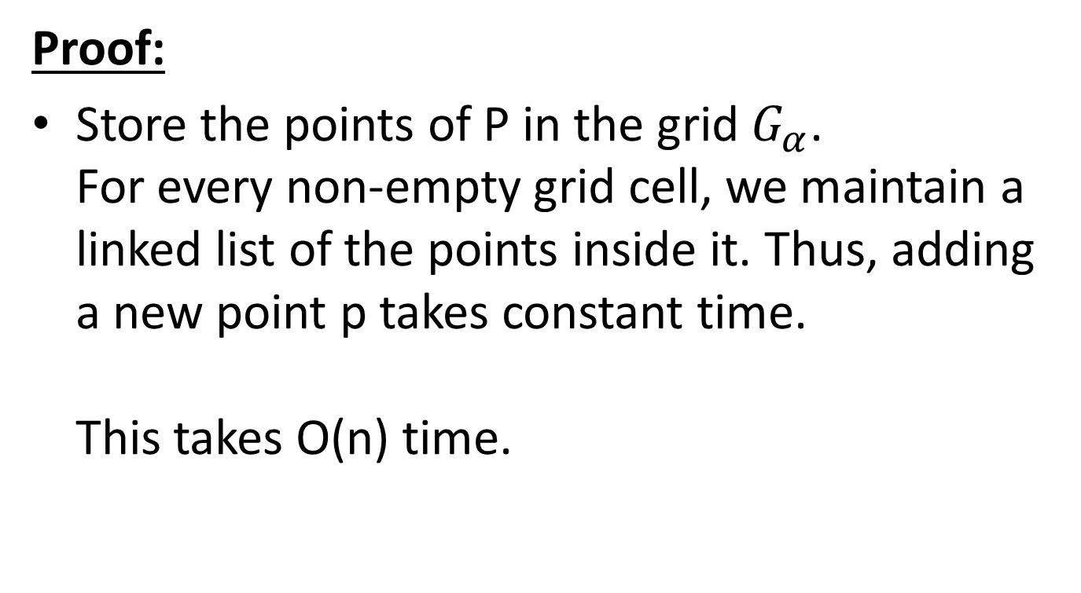
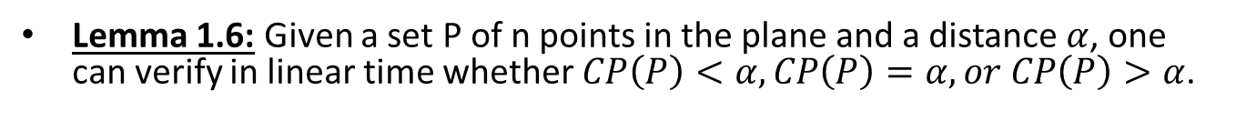
Closest pair
Proof:
Store the points of P in the grid $G_{α}$.
For every non-empty grid cell, we maintain a linked list of the points inside it. Thus, adding a new point p takes constant time.
This takes O(n) time.
Lemma 1.6: Given a set P of n points in the plane and a distance $α$, one can verify in linear time whether $CP\left(P\right)<α, CP\left(P\right)=α, or CP\left(P\right)>α$.
Notes:
*Adding point p in constant time: compute id(p), check if id(p) already appears in the hash table, if not, create a new linked list for the cell with this ID number, and store p in it. If a linked list already exists for id(p), just add p to it. This takes O(n) time overall for all n points.
*We divide the cell into 4 equal squares like in lemma 1.5. The cell has more than 4 points, then according the the שובח היונים, one such square holds 2 or more points. Therefore, the distance between those points is at most sqrt(2)*a/2 < a; and since that is >=CP(P), it is concluded that CP(P)<a.

Slide 15






Closest pair
Proof:
If any grid cell in $G_{α}(P)$ contains more than 4 points of P, then by lemma 1.5 it must be that $CP\left(P\right)<α$.
$$CP\left(P\right)<$$
$$\frac{\sqrt{2}α}{2}$$
$$<α$$
$$α$$
$$\sqrt{2}α$$
Lemma 1.6: Given a set P of n points in the plane and a distance $α$, one can verify in linear time whether $CP\left(P\right)<α, CP\left(P\right)=α, or CP\left(P\right)>α$.
Notes:
*Adding point p in constant time: compute id(p), check if id(p) already appears in the hash table, if not, create a new linked list for the cell with this ID number, and store p in it. If a linked list already exists for id(p), just add p to it. This takes O(n) time overall for all n points.
*We divide the cell into 4 equal squares like in lemma 1.5. The cell has more than 4 points, then according the the שובח היונים, one such square holds 2 or more points. Therefore, the distance between those points is at most sqrt(2)*a/2 < a; and since that is >=CP(P), it is concluded that CP(P)<a.

Slide 16
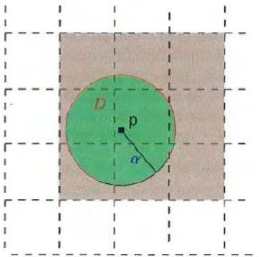
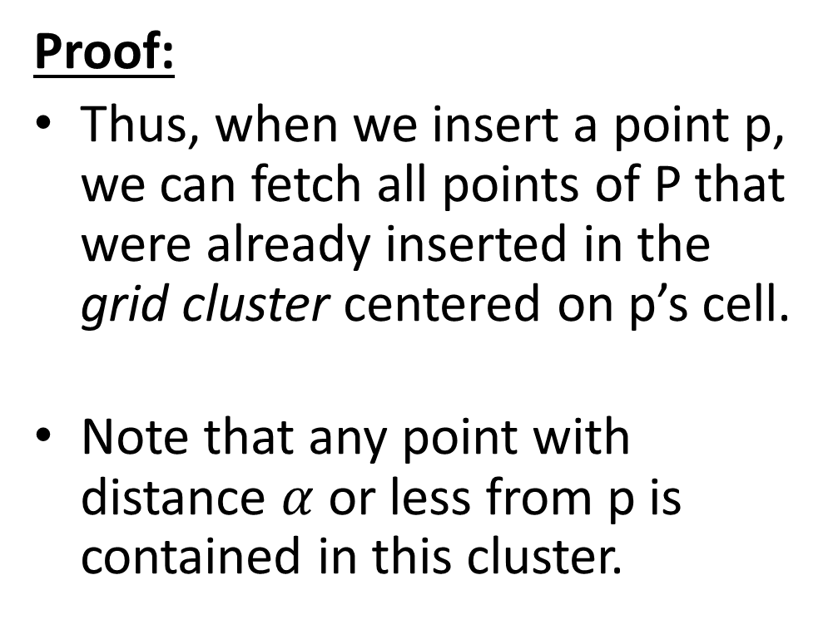
Closest pair
Proof:
Thus, when we insert a point p, we can fetch all points of P that were already inserted in the grid cluster centered on p’s cell.
Note that any point with distance $α$ or less from p is contained in this cluster.
Lemma 1.6: Given a set P of n points in the plane and a distance $α$, one can verify in linear time whether $CP\left(P\right)<α, CP\left(P\right)=α, or CP\left(P\right)>α$.
Notes:
*This is the grid cluster centered at p’s cell

Slide 17
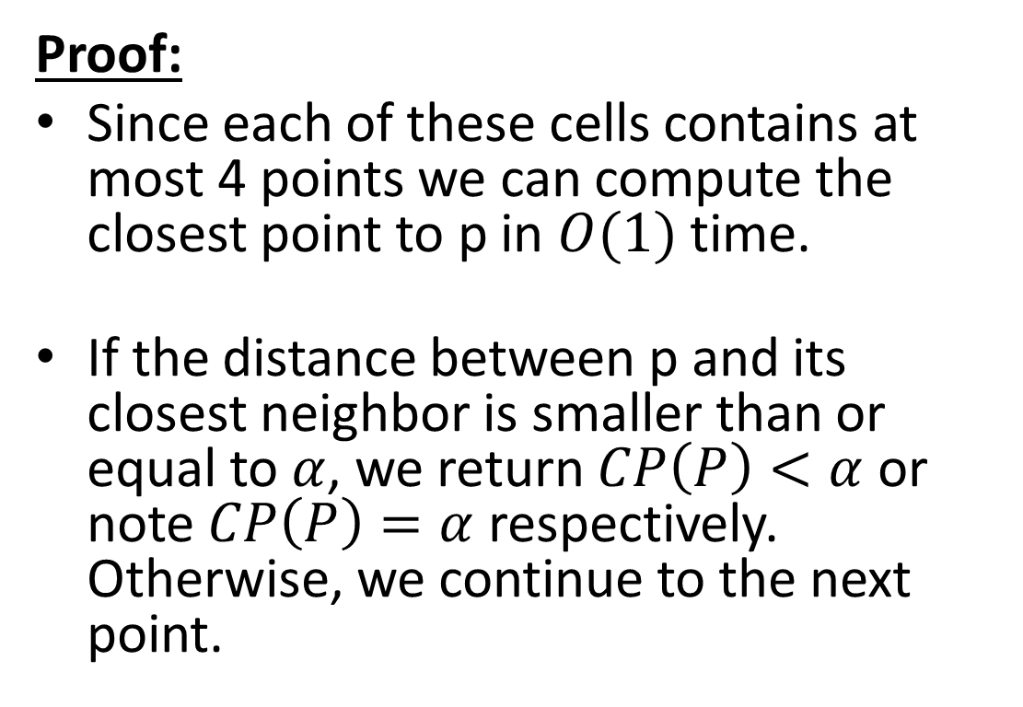
Closest pair
Proof:
Since each of these cells contains at most 4 points we can compute the closest point to p in $O(1)$ time.
If the distance between p and its closest neighbor is smaller than or equal to $α$, we return $CP\left(P\right)<α$ or note $CP\left(P\right)=α$ respectively.
Otherwise, we continue to the next point.
Lemma 1.6: Given a set P of n points in the plane and a distance $α$, one can verify in linear time whether $CP\left(P\right)<α, CP\left(P\right)=α, or CP\left(P\right)>α$.
Notes:
*-(otherwise, we would’ve stopped with $CP\left(P\right)<α$)
-as there are at most $4∗9=O(1)$ points in this grid cluster.
*note that any point so far inserted that is as close to p as a or better must be contained in a circle of radius a centered on p, which in turn is contained in this grid cluster.

Slide 18
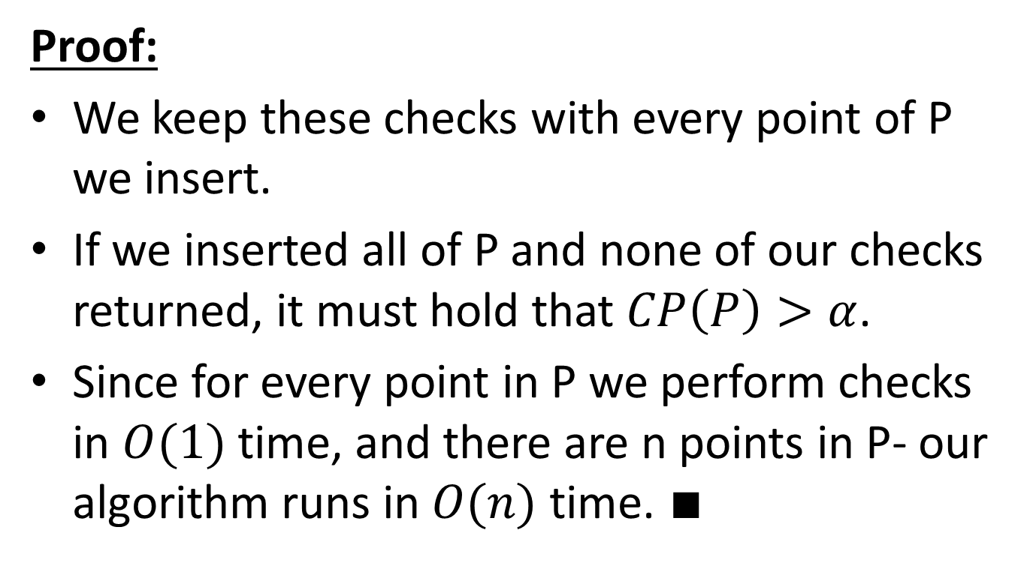
Closest pair
Proof:
We keep these checks with every point of P we insert.
If we inserted all of P and none of our checks returned, it must hold that $CP\left(P\right)>α$.
Since for every point in P we perform checks in $O(1)$ time, and there are n points in P- our algorithm runs in $O(n)$ time. $∎$
Lemma 1.6: Given a set P of n points in the plane and a distance $α$, one can verify in linear time whether $CP\left(P\right)<α, CP\left(P\right)=α, or CP\left(P\right)>α$.
Notes:
Tell the class that the drawings are over for a while and to expect text bombardment. Not much to do, as there isn’t much to draw that can help.

Slide 19
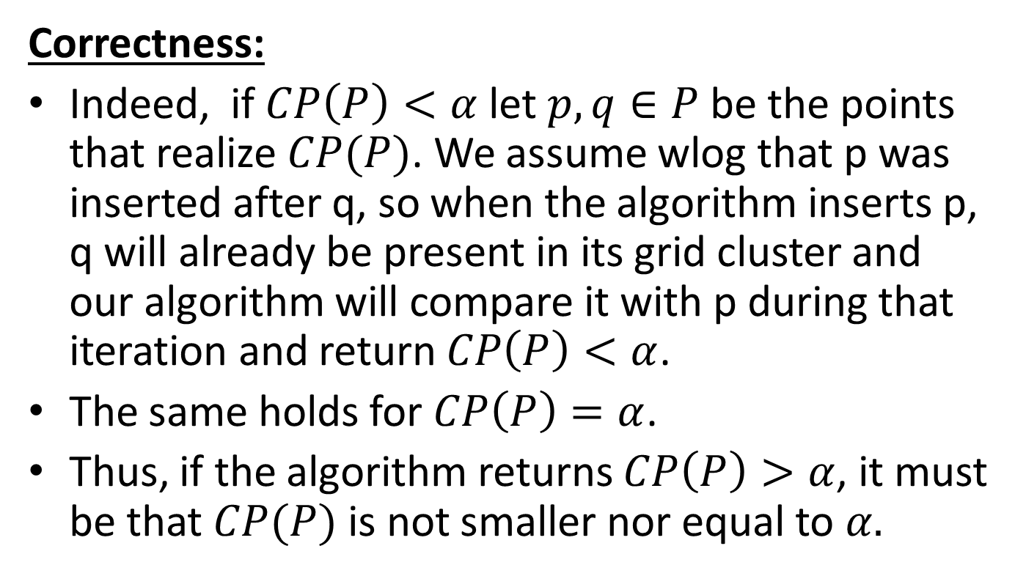
Closest pair
Correctness:
Indeed, if $CP\left(P\right)<α$ let $p,q∈P$ be the points that realize $CP(P)$. We assume wlog that p was inserted after q, so when the algorithm inserts p, q will already be present in its grid cluster and our algorithm will compare it with p during that iteration and return $CP\left(P\right)<α$.
The same holds for $CP\left(P\right)=α$.
Thus, if the algorithm returns $CP\left(P\right)>α$, it must be that $CP(P)$ is not smaller nor equal to $α.$
Lemma 1.6: Given a set P of n points in the plane and a distance $α$, one can verify in linear time whether $CP\left(P\right)<α, CP\left(P\right)=α, or CP\left(P\right)>α$.

Slide 20
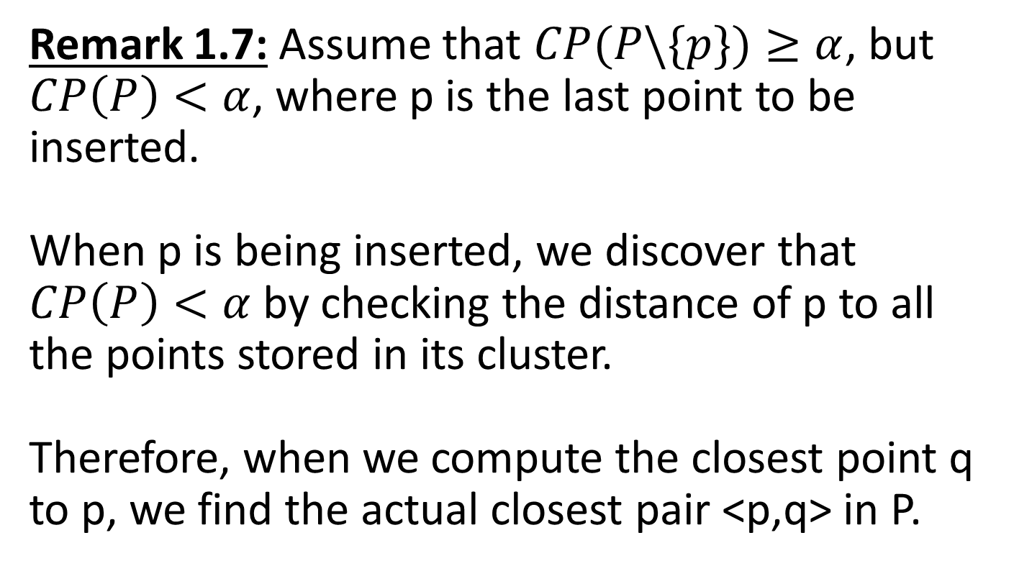
Closest pair
Remark 1.7: Assume that $CP(P\backslash \{p\})≥α$, but $CP\left(P\right)<α$, where p is the last point to be inserted.
When p is being inserted, we discover that $CP\left(P\right)<α$ by checking the distance of p to all the points stored in its cluster.
Therefore, when we compute the closest point q to p, we find the actual closest pair <p,q> in P.
Notes:
This is just a remark to show a case where the checking algorithm itself of lemma 1.6 can actually solve the problem in linear time

Slide 21
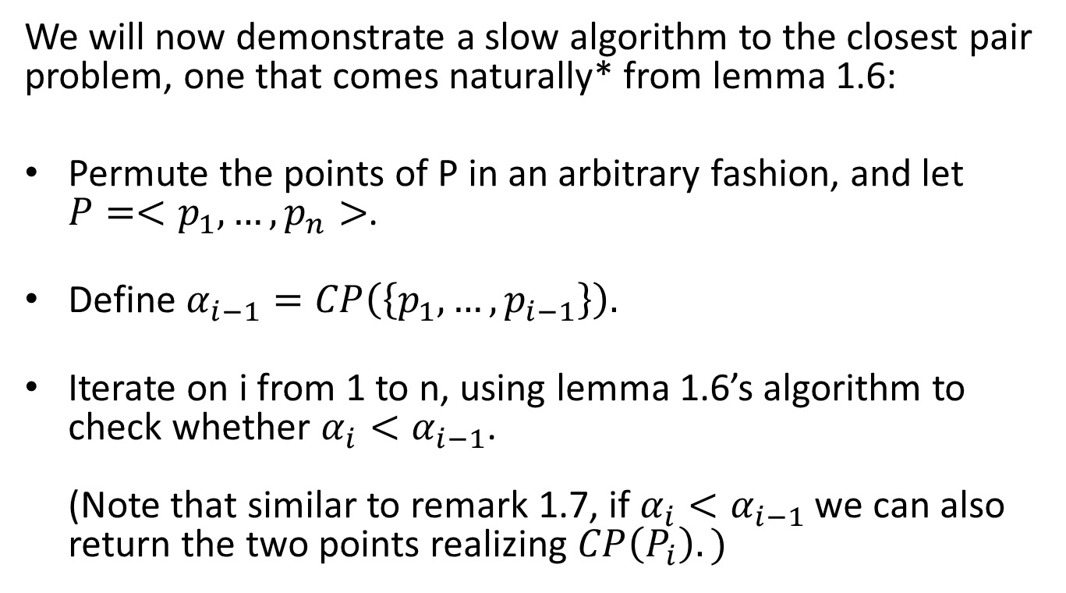
Closest pair – Slow algorithm
We will now demonstrate a slow algorithm to the closest pair problem, one that comes naturally* from lemma 1.6:
Permute the points of P in an arbitrary fashion, and let $P=<p_{1},…,p_{n}>$.
Define $α_{i−1}=CP\left(\left\{p_{1},…,p_{i−1}\right\}\right).$
Iterate on i from 1 to n, using lemma 1.6’s algorithm to check whether $α_{i}<α_{i−1}$.
(Note that similar to remark 1.7, if $α_{i}<α_{i−1}$ we can also return the two points realizing $CP\left(P_{i}\right).)$
*Comes naturally to Sariel Har-Peled.
Notes:
*
*
*one of those points being pi

Slide 22
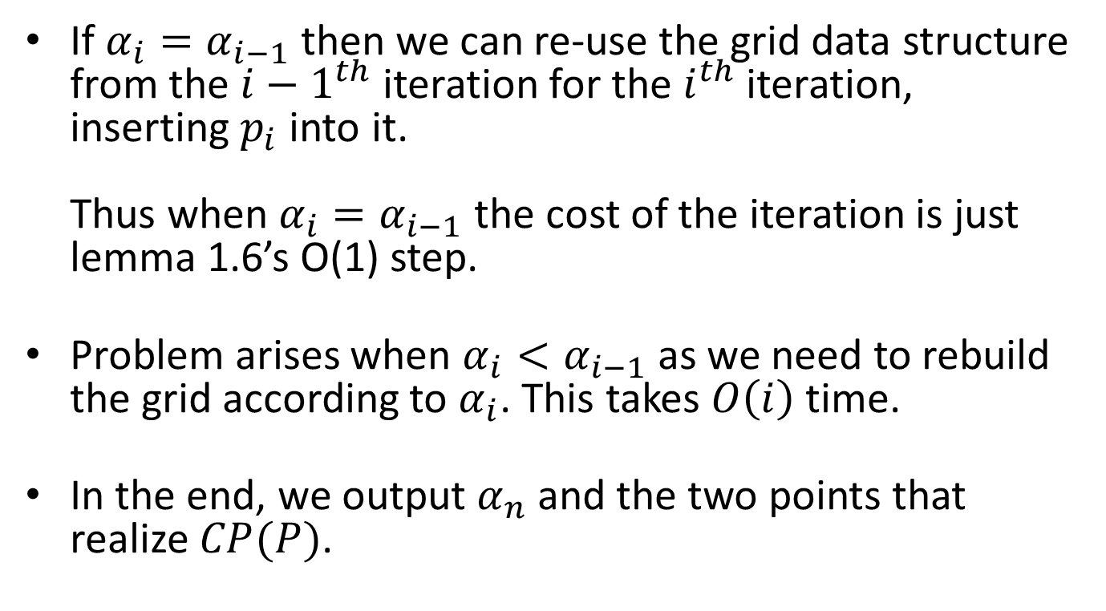
Closest pair – Slow algorithm
If $α_{i}=α_{i−1}$ then we can re-use the grid data structure from the $i−1^{th}$ iteration for the $i^{th}$ iteration, inserting $p_{i}$ into it.
Thus when $α_{i}=α_{i−1}$ the cost of the iteration is just lemma 1.6’s O(1) step.
Problem arises when $α_{i}<α_{i−1}$ as we need to rebuild the grid according to $α_{i}$. This takes $O\left(i\right)$ time.
In the end, we output $α_{n}$ and the two points that realize $CP(P)$.
Notes:
If we inserted pi and did lemma 1.6’s O(1) check, and found the CP did not change, we don’t need to rebuild the grid data structure, as the grid in the ith and the i-1th iteration would be the same anyway.
It’s O(|$P_{i}$|)=O(i) since $\left|P_{i}\right|=i$.

Slide 23
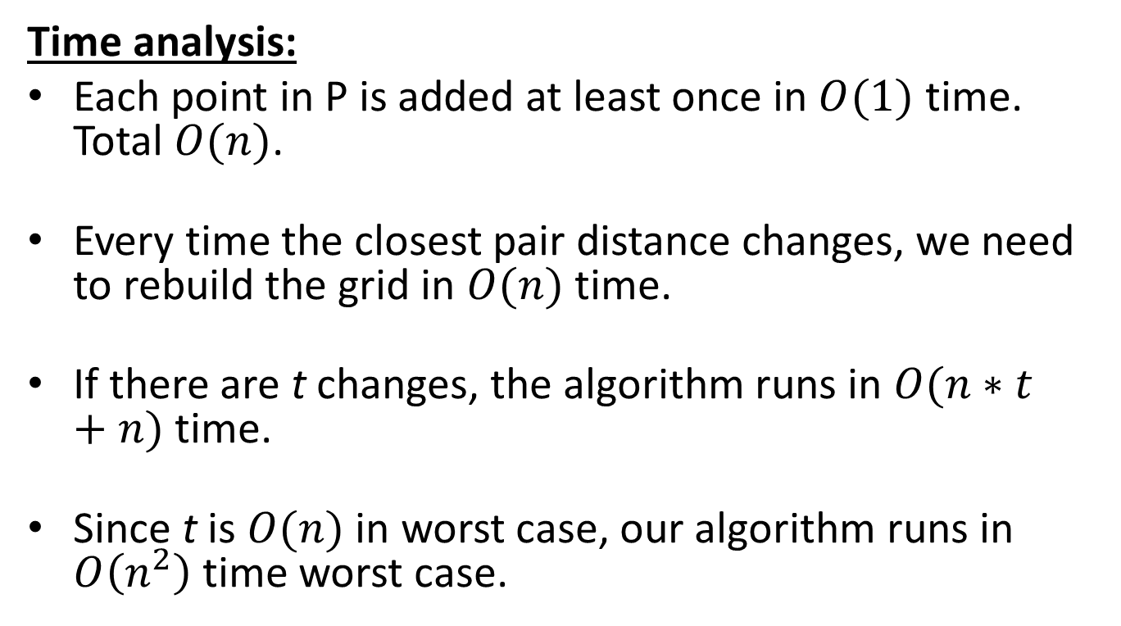
Closest pair – Slow algorithm
Time analysis:
Each point in P is added at least once in $O(1)$ time. Total $O(n)$.
Every time the closest pair distance changes, we need to rebuild the grid in $O(n)$ time.
If there are t changes, the algorithm runs in $O(n∗t+n)$ time.
Since t is $O(n)$ in worst case, our algorithm runs in $O\left(n^{2}\right)$ time worst case.
Notes:
.

Slide 24
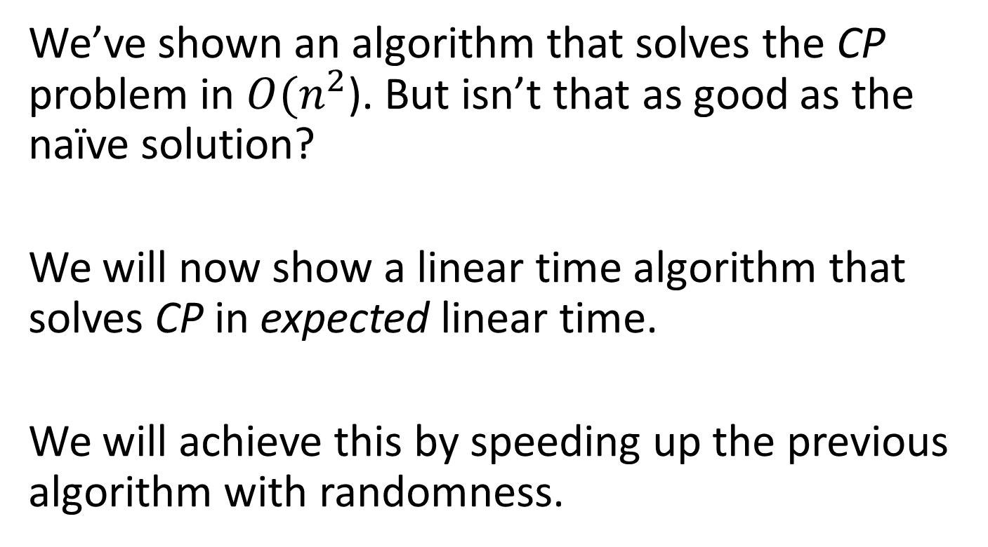
Closest pair
We’ve shown an algorithm that solves the CP problem in $O(n^{2}$). But isn’t that as good as the naïve solution?
We will now show a linear time algorithm that solves CP in expected linear time.
We will achieve this by speeding up the previous algorithm with randomness.
Notes:
“expected linear time” because was use probabilities. This is not worst case

Slide 25
Timeline
Preliminaries
Closest pair
  Slow algorithm
  Linear time algorithm
K-enclosing disk
  Slow algorithm
  Linear time algorithm
Bibliography

Slide 26
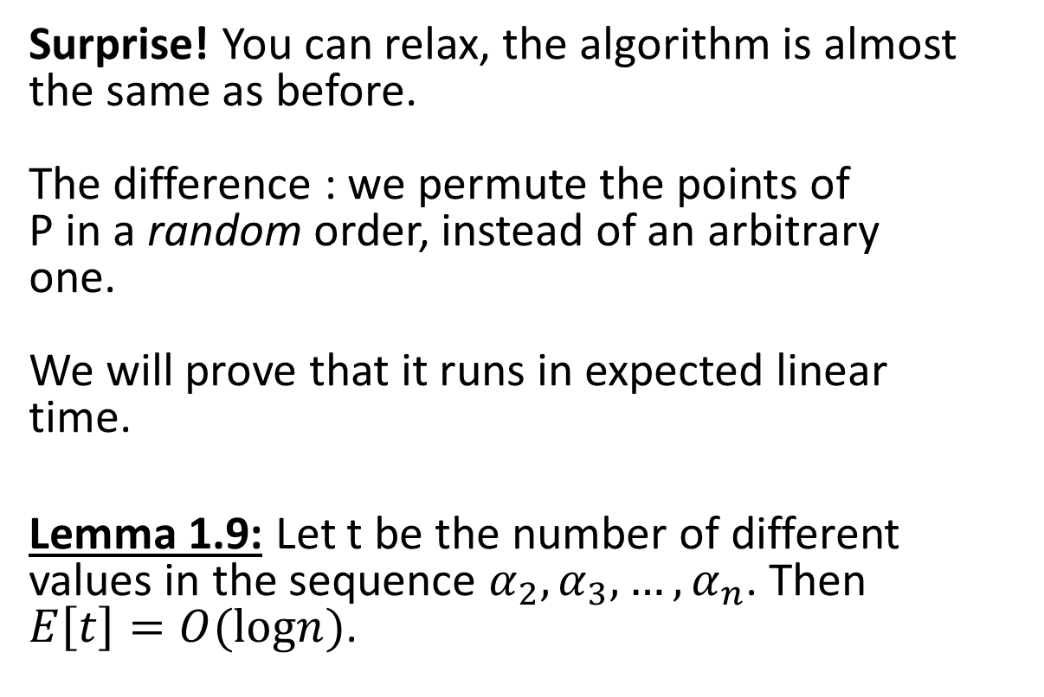
Closest pair – linear time algorithm
Surprise! You can relax, the algorithm is almost the same as before.
The difference : we permute the points of
P in a random order, instead of an arbitrary
one.
We will prove that it runs in expected linear
time.
Lemma 1.9: Let t be the number of different values in the sequence $α_{2},α_{3},…,α_{n}$. Then $E\left[t\right]=O(logn)$.
Notes:
*t is the number of changes of the closest distance during the algorithm iterations

Slide 27
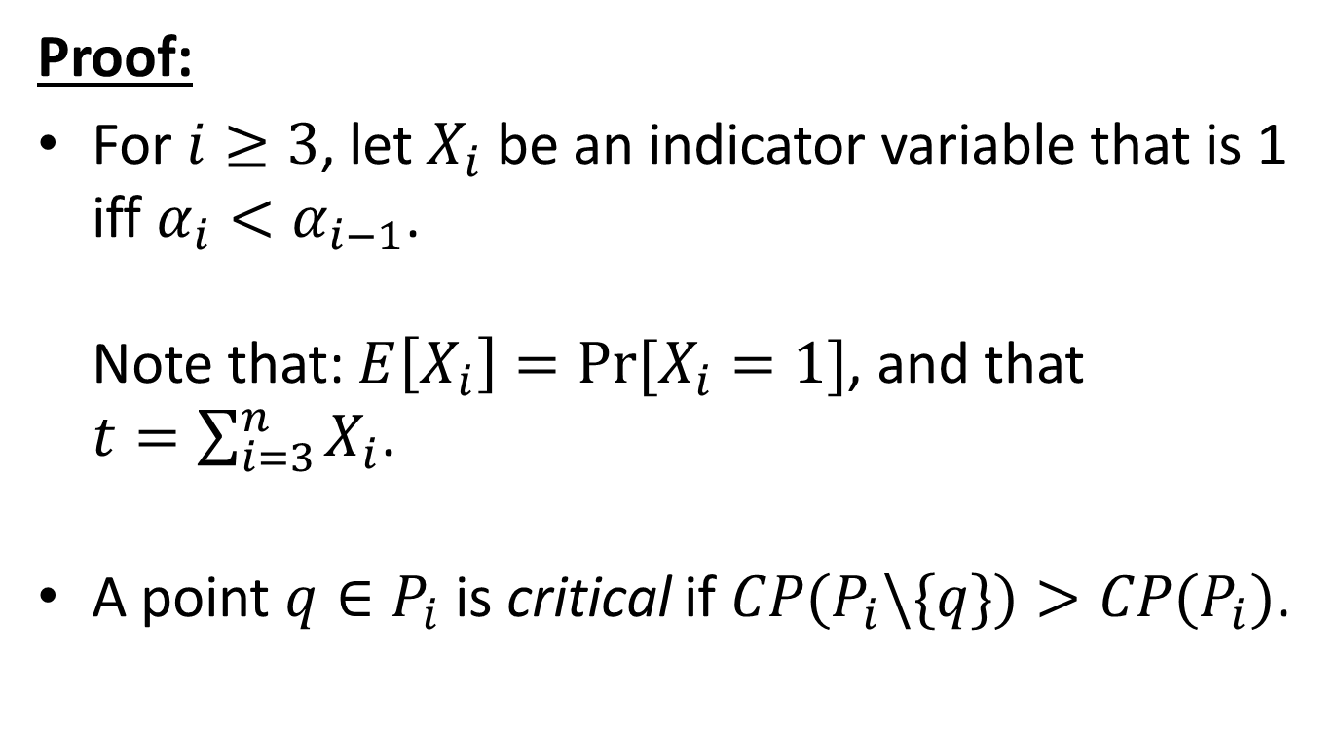
Closest pair – linear time algorithm
Proof:
For $i≥3$, let $X_{i}$ be an indicator variable that is 1 iff $α_{i}<α_{i−1}$.
Note that: $E\left[X_{i}\right]=Pr⁡[X_{i}=1]$, and that $t=\sum_{i=3}^{n}{X_{i}}$.
A point $q∈P_{i}$ is critical if $CP(P_{i}\backslash \{q\})>CP(P_{i})$.
Notes:
*Since Xi is an indicator variable.
*This happens, for example, if there are two pairs of points realizing the closest distance in $Pi$.

Slide 28
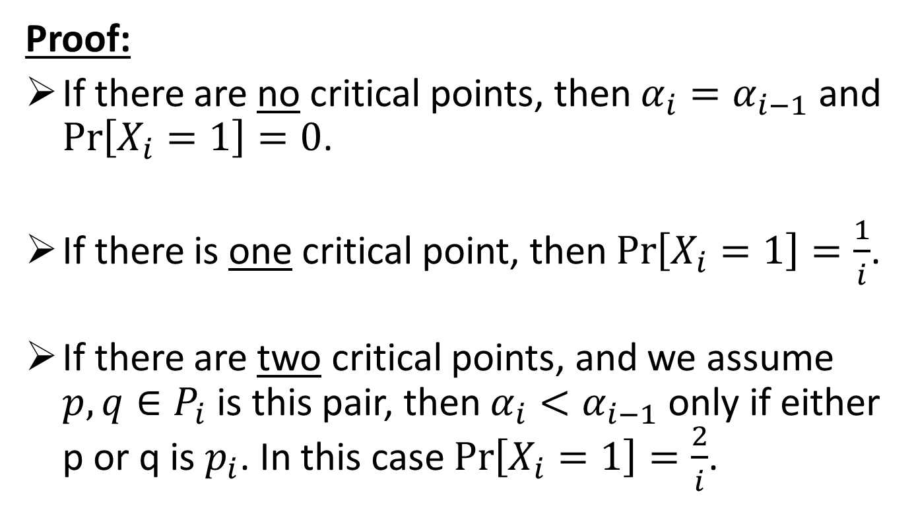
Closest pair – linear time algorithm
Proof:
If there are no critical points, then $α_{i}=α_{i−1}$ and $\operatorname{Pr}\left[X_{i}=1\right]=0$.
If there is one critical point, then $\operatorname{Pr}\left[X_{i}=1\right]=\frac{1}{i}$.
If there are two critical points, and we assume $p,q∈P_{i}$ is this pair, then $α_{i}<α_{i−1}$ only if either p or q is $p_{i}$. In this case $\operatorname{Pr}\left[X_{i}=1\right]=\frac{2}{i}$.
*Remember, we chose a random permutation of P in the beginning of the algorithm.
Notes:
Explain here that 1/i and 2/i derive from the random order of the points of P

Slide 29
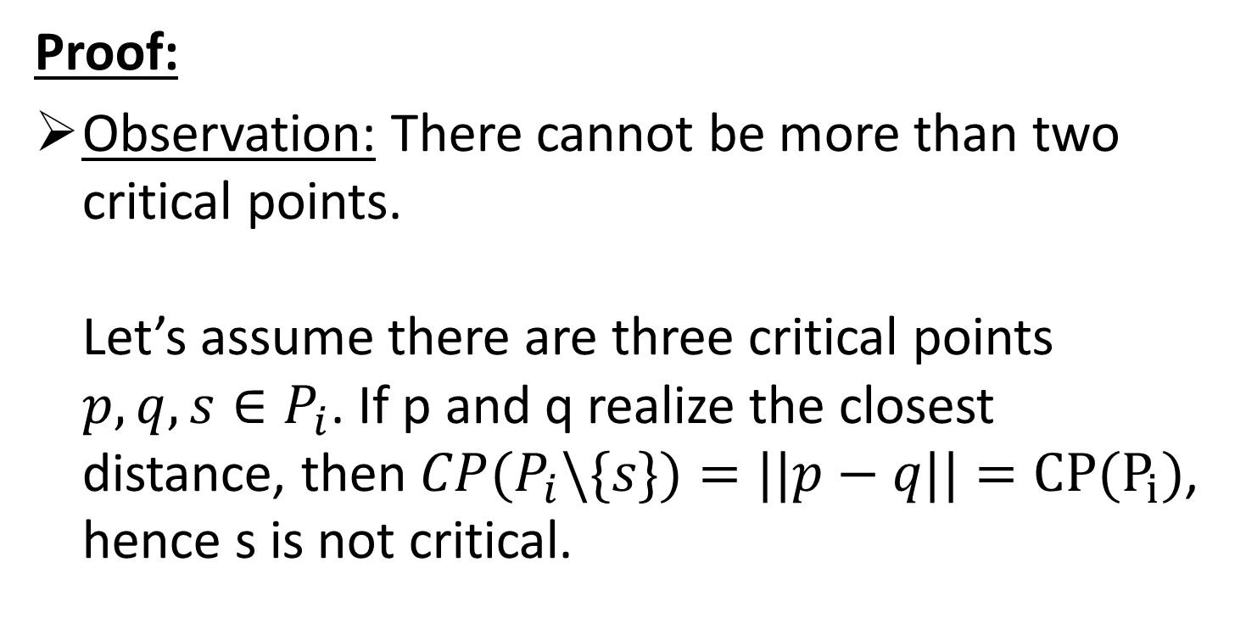
Closest pair – linear time algorithm
Proof:
Observation: There cannot be more than two critical points.
Let’s assume there are three critical points $p,q,s∈P_{i}$. If p and q realize the closest distance, then $CP(P_{i}\backslash \{s\})=||p−q||=CP(P_{i})$, hence s is not critical.
*Note that two critical points have to be the pair that realizes the closest distance.
Notes:
Two critical points have to realize the closest distance. Without one or the other the closest distance is larger.

Slide 30
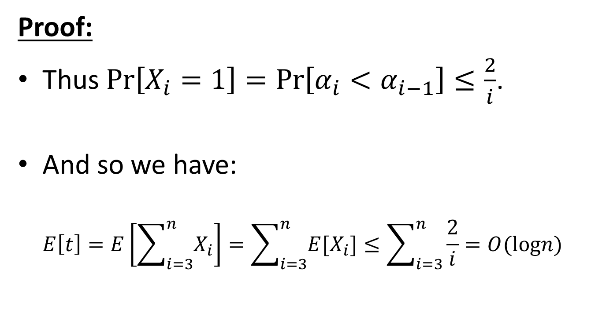
Closest pair – linear time algorithm
Proof:
Thus $\operatorname{Pr}\left[X_{i}=1\right]=\operatorname{Pr}\left[α_{i}<α_{i−1}\right]≤\frac{2}{i}$.
And so we have:
$E\left[t\right]=E\left[\sum_{i=3}^{n}{X_{i}}\right]=\sum_{i=3}^{n}{E[X_{i}]}≤\sum_{i=3}^{n}{\frac{2}{i}}=O(logn)$
Notes:
By linearity of expectations

Slide 31
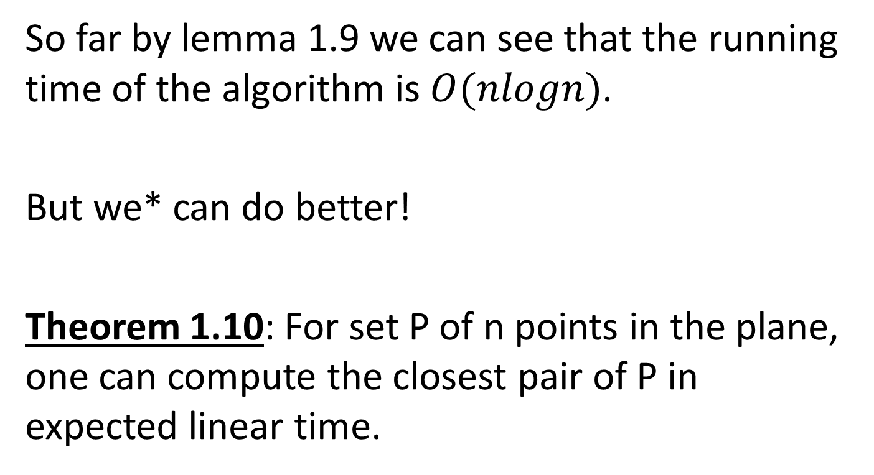
Closest pair – linear time algorithm
So far by lemma 1.9 we can see that the running time of the algorithm is $O(nlogn)$.
But we* can do better!
Theorem 1.10: For set P of n points in the plane, one can compute the closest pair of P in expected linear time.
*We = Sariel Har-Peled
Notes:
O(n+n*logn). There are logn changes and every change is O(n) to rebuild the grid.

Slide 32
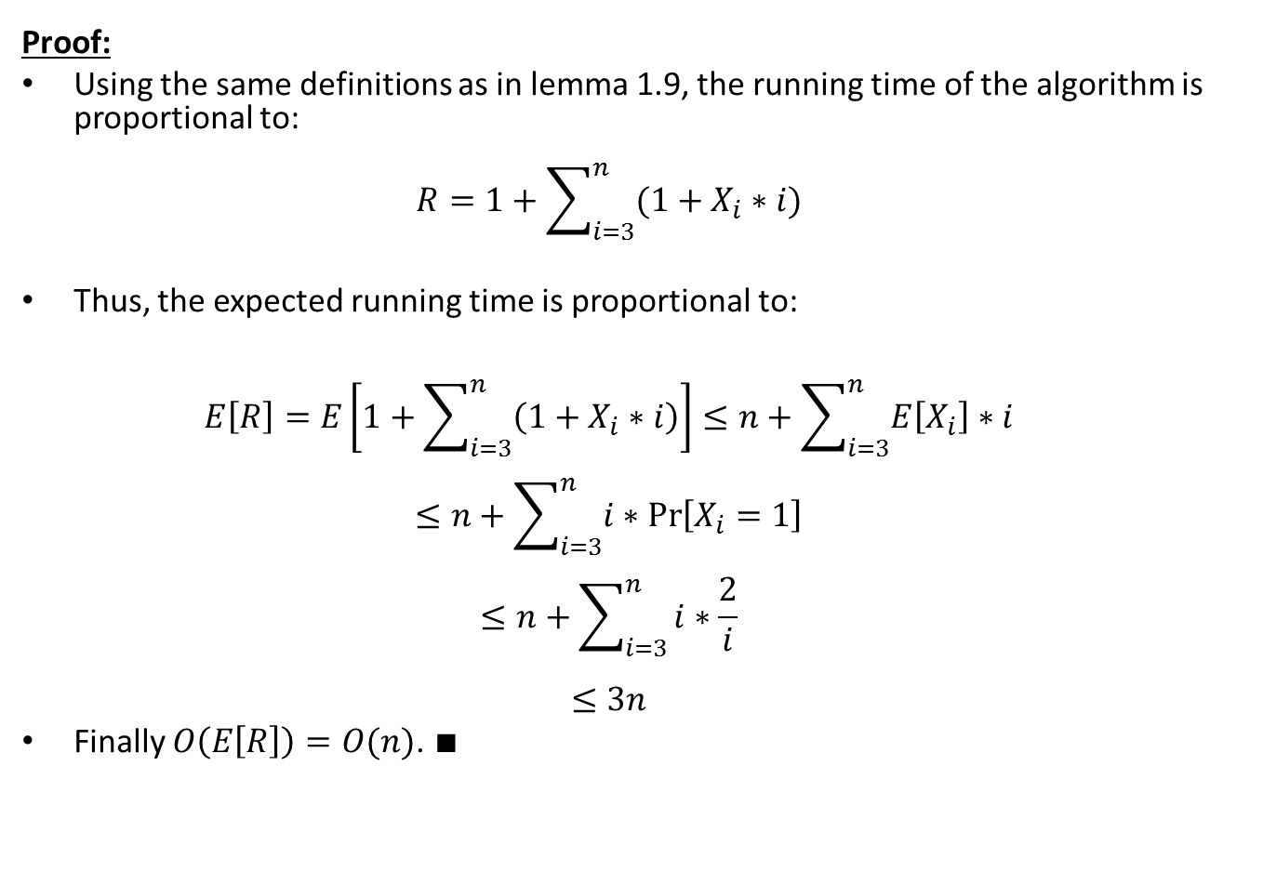
Closest pair – linear time algorithm
Proof:
Using the same definitions as in lemma 1.9, the running time of the algorithm is proportional to:
$R=1+\sum_{i=3}^{n}{(1+X_{i}∗i)}$
Thus, the expected running time is proportional to:
$E\left[R\right]=E\left[1+\sum_{i=3}^{n}{\left(1+X_{i}∗i\right)}\right]≤n+\sum_{i=3}^{n}{E\left[X_{i}\right]∗i}$
$≤n+\sum_{i=3}^{n}{i∗\operatorname{Pr}\left[X_{i}=1\right]}$
$≤n+\sum_{i=3}^{n}{i∗\frac{2}{i}}$
$≤3n$
Finally $O\left(E\left[R\right]\right)=O(n)$. $∎$
Notes:
*first 1 is computing $α_{2}.$ Then in each iteration: the 1 is the lemma 1.6 check, Xi is whether or not we had to rebuild the grid, and i is the cost of rebuilding.
*by linearity of expectation and since $E\left[X_{i}\right]=\operatorname{Pr}\left[X_{i}=1\right]$ and since $\operatorname{Pr}\left[X_{i}=1\right]≤\frac{2}{i}$.
Also say what the trick is: at iteration i we pay only i instead of n!

Slide 33
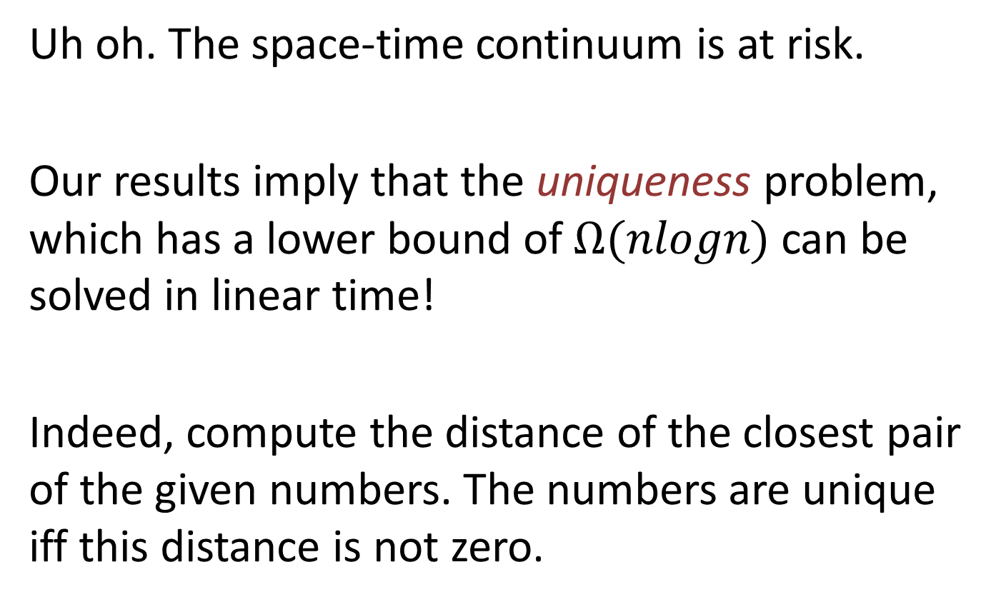
Closest pair – did we break reality?
Uh oh. The space-time continuum is at risk.
Our results imply that the uniqueness problem, which has a lower bound of $Ω(nlogn)$ can be solved in linear time!
Indeed, compute the distance of the closest pair of the given numbers. The numbers are unique iff this distance is not zero.
Notes:
Uniqueness: for an input of n real numbers, return true iff they are all unique.
The proof of the lower bound is beyond the scope of this lecture

Slide 34

Closest pair – did we break reality?
This “reality dysfunction” can be explained once one realizes that the computation model of theorem 1.10 is considerably stronger, using hashing, randomization, and the floor function.
Notes:
Uniqueness: for an input of n real numbers, return true iff they are all unique.
The proof of the lower bound is beyond the scope of this lecture

Slide 35
Timeline
Preliminaries
Closest pair
  Slow algorithm
  Linear time algorithm
K-enclosing disk
  Slow algorithm
  Linear time algorithm
Bibliography

Slide 36
K-enclosing disk
Problem: Given a set P of n points in the plane, and a positive real number k, find the smallest disk containing k points of P.
K=3
Notes:
Note here: there might be few smallest disks

Slide 37
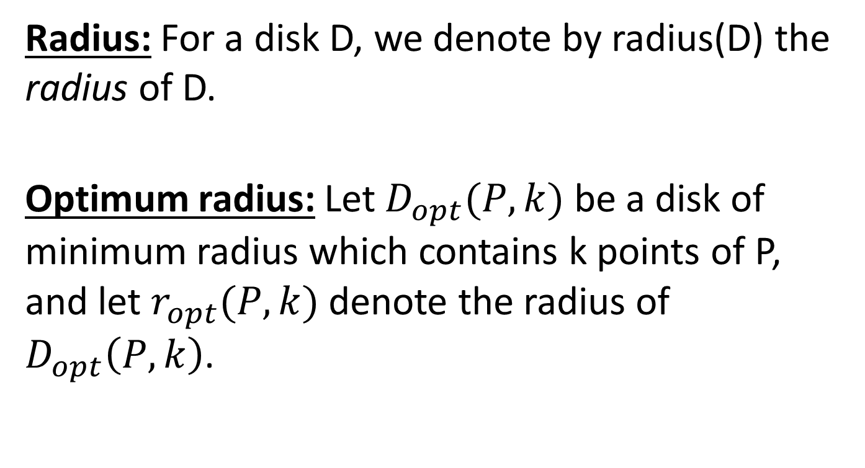
K-enclosing disk - definitions
Radius: For a disk D, we denote by radius(D) the radius of D.
Optimum radius: Let $D_{opt}(P,k)$ be a disk of minimum radius which contains k points of P, and let $r_{opt}(P,k)$ denote the radius of $D_{opt}\left(P,k\right)$.

Slide 38
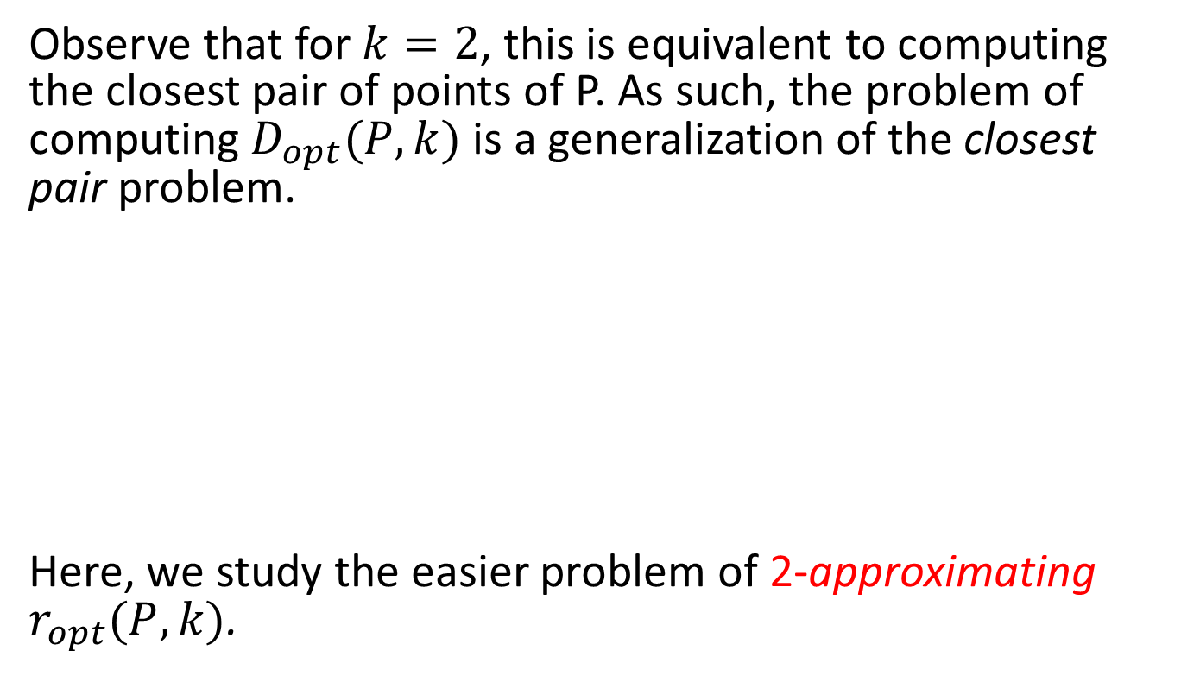
K-enclosing disk
Observe that for $k=2$, this is equivalent to computing the closest pair of points of P. As such, the problem of computing $D_{opt}(P,k)$ is a generalization of the closest pair problem.
Here, we study the easier problem of 2-approximating $r_{opt}(P,k)$.

Slide 39
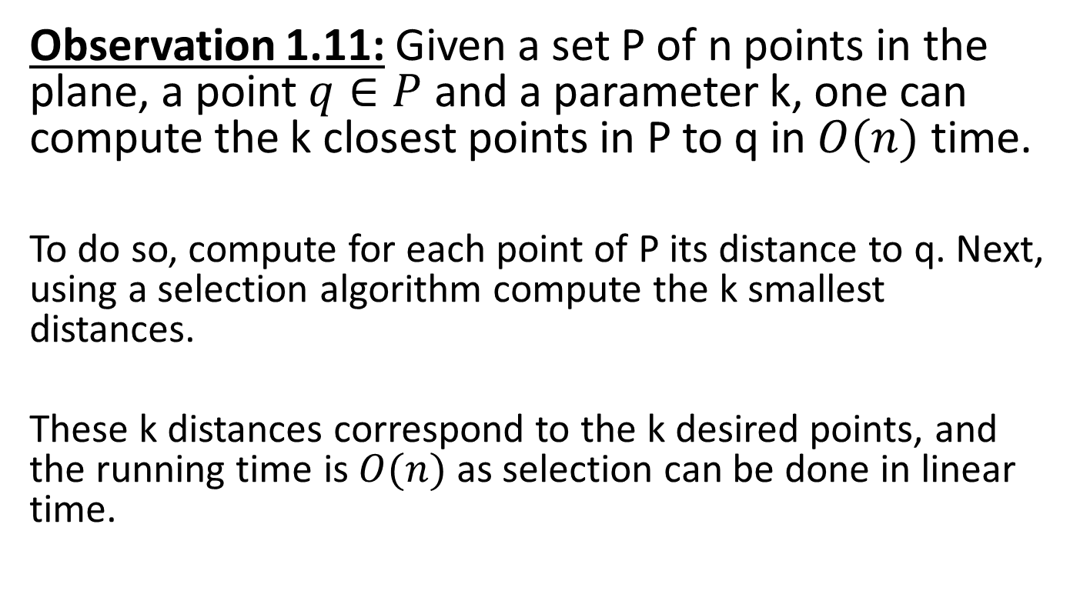
K-enclosing disk
Observation 1.11: Given a set P of n points in the plane, a point $q∈P$ and a parameter k, one can compute the k closest points in P to q in $O(n)$ time.
To do so, compute for each point of P its distance to q. Next, using a selection algorithm compute the k smallest distances.
These k distances correspond to the k desired points, and the running time is $O(n)$ as selection can be done in linear time.
Notes:
For instance: select the kth element in O(n)
Go over all points and pick those who are closer than the kth element.

Slide 40
Timeline
Preliminaries
Closest pair
  Slow algorithm
  Linear time algorithm
K-enclosing disk
  Slow algorithm
  Linear time algorithm
Bibliography

Slide 41
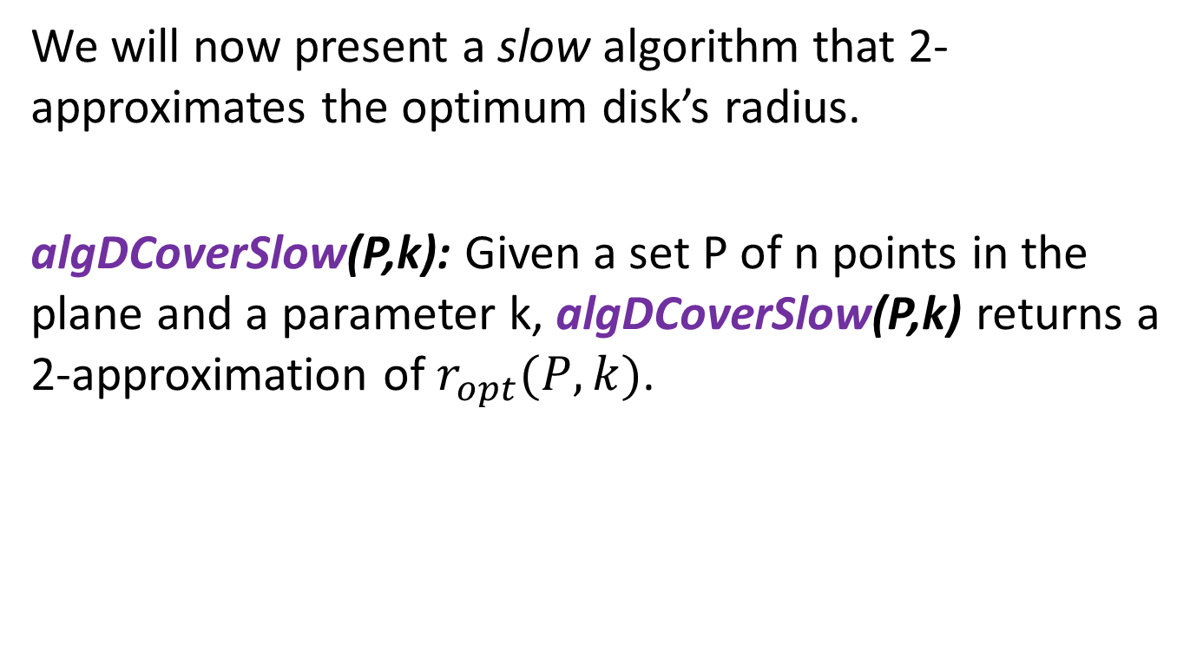
K-enclosing disk – algDCoverSlow
We will now present a slow algorithm that 2-approximates the optimum disk’s radius.
algDCoverSlow(P,k): Given a set P of n points in the plane and a parameter k, algDCoverSlow(P,k) returns a 2-approximation of $r_{opt}(P,k)$.

Slide 42
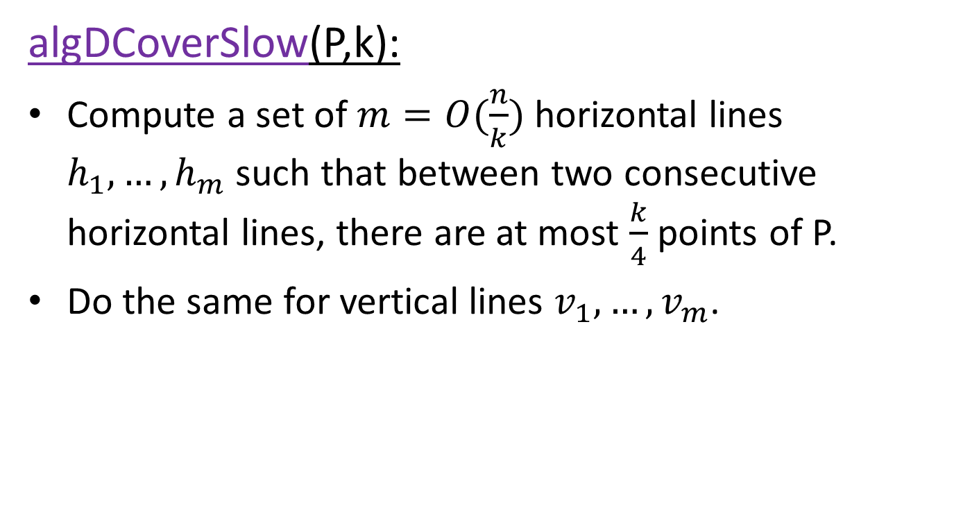
K-enclosing disk – algDCoverSlow
algDCoverSlow(P,k):
Compute a set of $m=O(\frac{n}{k})$ horizontal lines $h_{1},…,h_{m}$ such that between two consecutive horizontal lines, there are at most $\frac{k}{4}$ points of P.
Do the same for vertical lines $v_{1},…,v_{m}$.
Notes:
*
*
*recursion stops for subproblems of size <= k/4, so the recursion tree depth is O(log(n/k)).

Slide 43
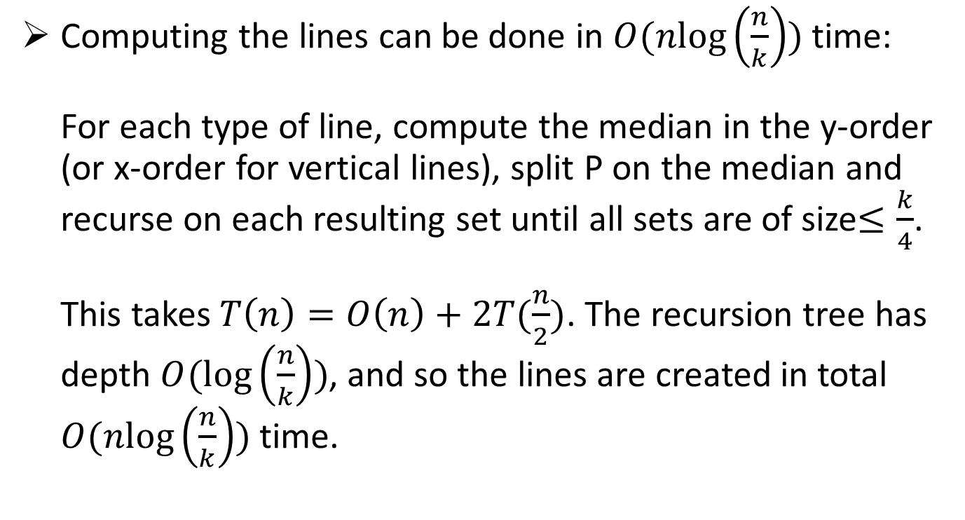
K-enclosing disk – algDCoverSlow
Computing the lines can be done in $O(nlog\left(\frac{n}{k}\right))$ time:
For each type of line, compute the median in the y-order (or x-order for vertical lines), split P on the median and recurse on each resulting set until all sets are of size$≤\frac{k}{4}$.
This takes $T\left(n\right)=O\left(n\right)+2T(\frac{n}{2})$. The recursion tree has depth $O(\log\left(\frac{n}{k}\right))$, and so the lines are created in total $O(nlog\left(\frac{n}{k}\right))$ time.
Notes:
*
*
*recursion stops for subproblems of size <= k/4, so the recursion tree depth is O(log(n/k)).

Slide 44
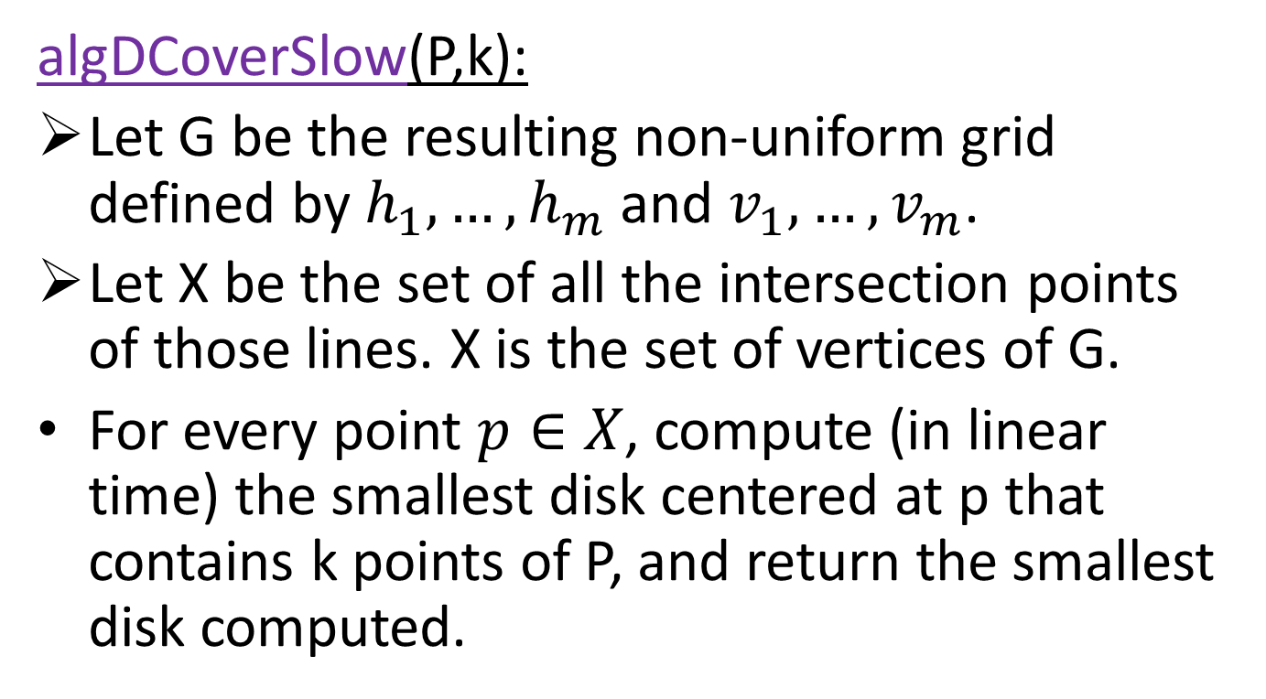
K-enclosing disk – algDCoverSlow
algDCoverSlow(P,k):
Let G be the resulting non-uniform grid defined by $h_{1},…,h_{m}$ and $v_{1},…,v_{m}$.
Let X be the set of all the intersection points of those lines. X is the set of vertices of G.
For every point $p∈X$, compute (in linear time) the smallest disk centered at p that contains k points of P, and return the smallest disk computed.
Notes:
Remember that Dopt must contain a vertex of X. If it doesn’t, it is contained entirely in a grid cell of G- but the most that such a cell can contain is k/2 points- which is smaller than k! Thus Dopt contains at least one vertex of X.

Slide 45
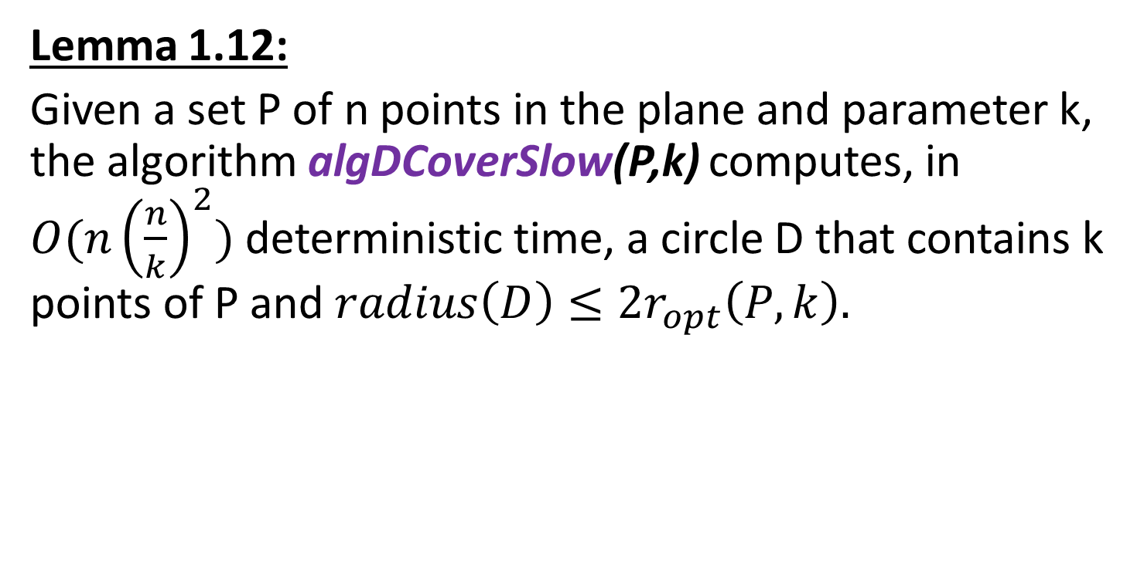
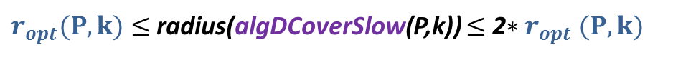


K-enclosing disk – algDCoverSlow
Lemma 1.12:
Given a set P of n points in the plane and parameter k, the algorithm algDCoverSlow(P,k) computes, in
$O(n{\left(\frac{n}{k}\right)}^{2})$ deterministic time, a circle D that contains k points of P and $radius\left(D\right)≤2r_{opt}\left(P,k\right).$
$D_{opt}$(P,k)
$$r_{opt}(P,k)$$
$r_{opt}(P,k)$ $≤$ radius(algDCoverSlow(P,k)) $≤$ 2${∗r}_{opt}(P,k)$

Slide 46
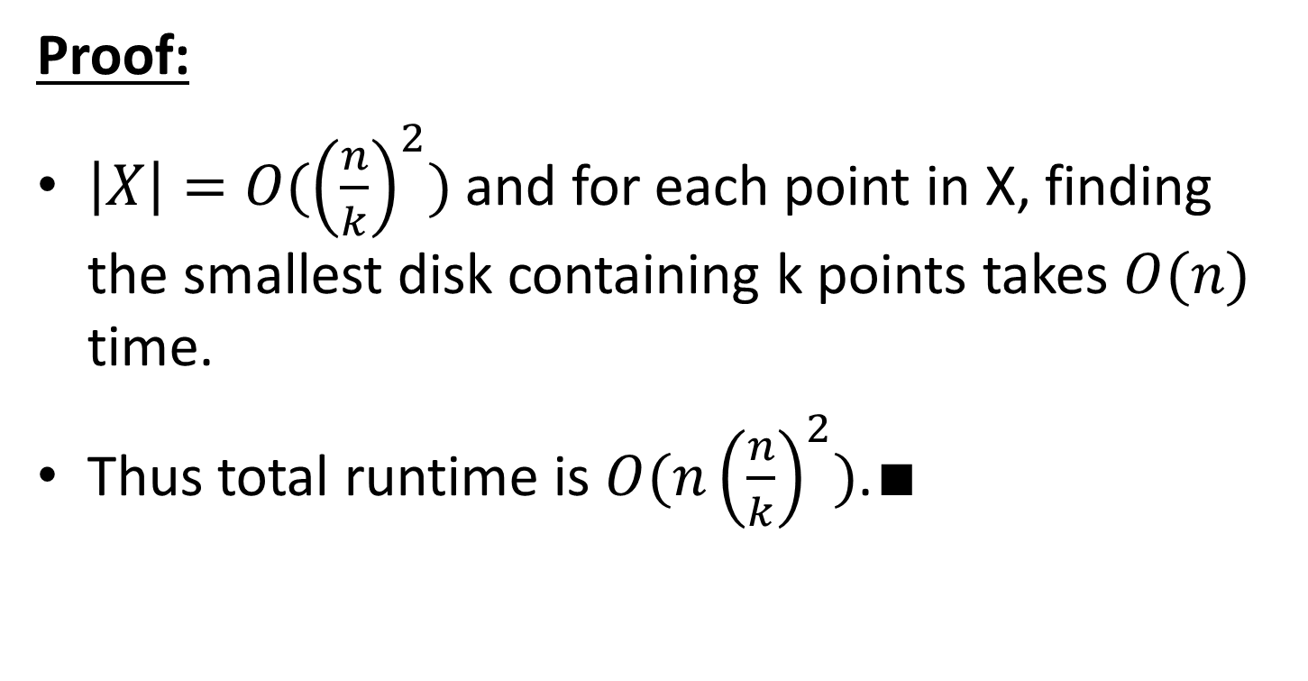
K-enclosing disk – algDCoverSlow
Proof:
$\left|X\right|=O({\left(\frac{n}{k}\right)}^{2})$ and for each point in X, finding the smallest disk containing k points takes $O(n)$ time.
Thus total runtime is $O(n{\left(\frac{n}{k}\right)}^{2})$.$∎$
Lemma 1.12:
Given a set P of n points in the plane and parameter k, the algorithm algDCoverSlow(P,k) computes, in $O(n{\left(\frac{n}{k}\right)}^{2})$ deterministic time, a circle D that contains k points of P and $radius\left(D\right)≤2r_{opt}\left(P,k\right).$
Notes:
*
*
*
-Note that u can’t be on the corners of a grid cell, otherwise Dopt would contain a point in X.

Slide 47
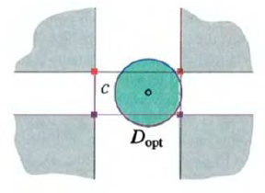
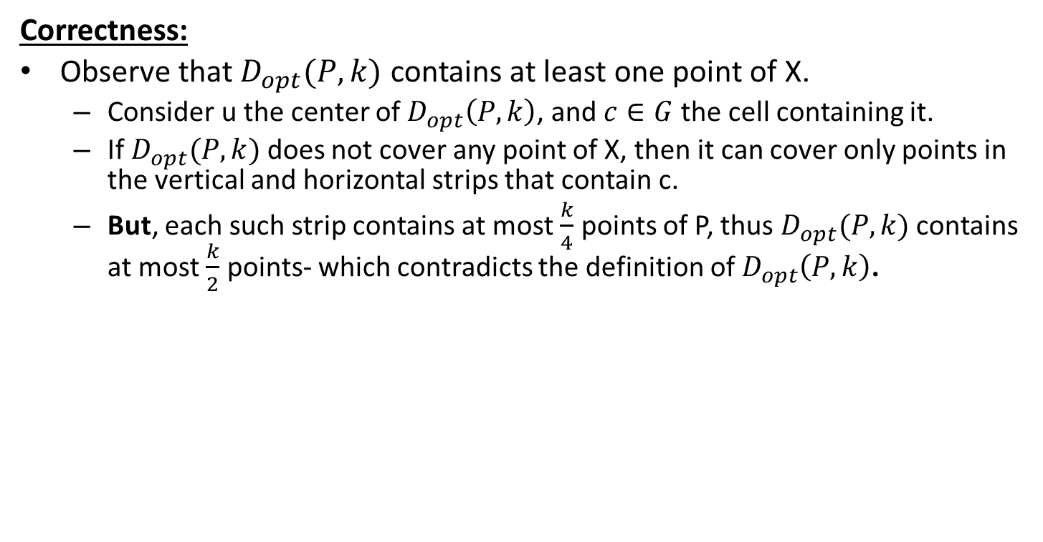
K-enclosing disk – algDCoverSlow
Correctness:
Observe that $D_{opt}(P,k)$ contains at least one point of X.
  Consider u the center of $D_{opt}\left(P,k\right)$, and $c∈G$ the cell containing it.
  If $D_{opt}(P,k)$ does not cover any point of X, then it can cover only points in the vertical and horizontal strips that contain c.
  But, each such strip contains at most $\frac{k}{4}$ points of P, thus $D_{opt}(P,k)$ contains at most $\frac{k}{2}$ points- which contradicts the definition of $D_{opt}\left(P,k\right)$.
Lemma 1.12:
Given a set P of n points in the plane and parameter k, the algorithm algDCoverSlow(P,k) computes, in $O(n{\left(\frac{n}{k}\right)}^{2})$ deterministic time, a circle D that contains k points of P and $radius\left(D\right)≤2r_{opt}\left(P,k\right).$
Notes:
*
*
*
-Note that u can’t be on the corners of a grid cell, otherwise Dopt would contain a point in X.

Slide 48
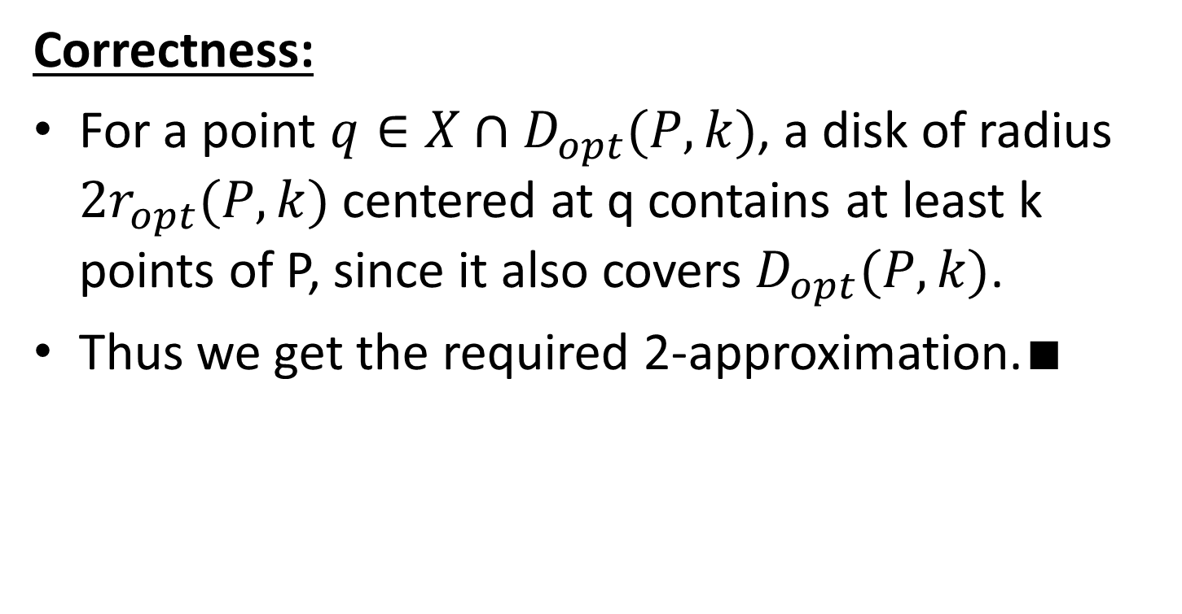

K-enclosing disk – algDCoverSlow
Correctness:
For a point $q∈X∩D_{opt}(P,k)$, a disk of radius $2r_{opt}(P,k)$ centered at q contains at least k points of P, since it also covers $D_{opt}(P,k)$.
Thus we get the required 2-approximation.$∎$
$$D_{opt}$$
Lemma 1.12:
Given a set P of n points in the plane and parameter k, the algorithm algDCoverSlow(P,k) computes, in $O(n{\left(\frac{n}{k}\right)}^{2})$ deterministic time, a circle D that contains k points of P and $radius\left(D\right)≤2r_{opt}\left(P,k\right).$
Notes:
*
*Since the disk we get will be ropt<radius(returned)<2ropt

Slide 49

K-enclosing disk – algDCoverSlow
Corollary 1.13:
Given a set P of n points and a parameter $k=Ω(n)$, one can compute in linear time a circle D that contains k points of P and $radius\left(D\right)≤2r_{opt}(P,k)$.
Notes:
Remember that the algorithm runs in O(n(n/k)^2) time

Slide 50
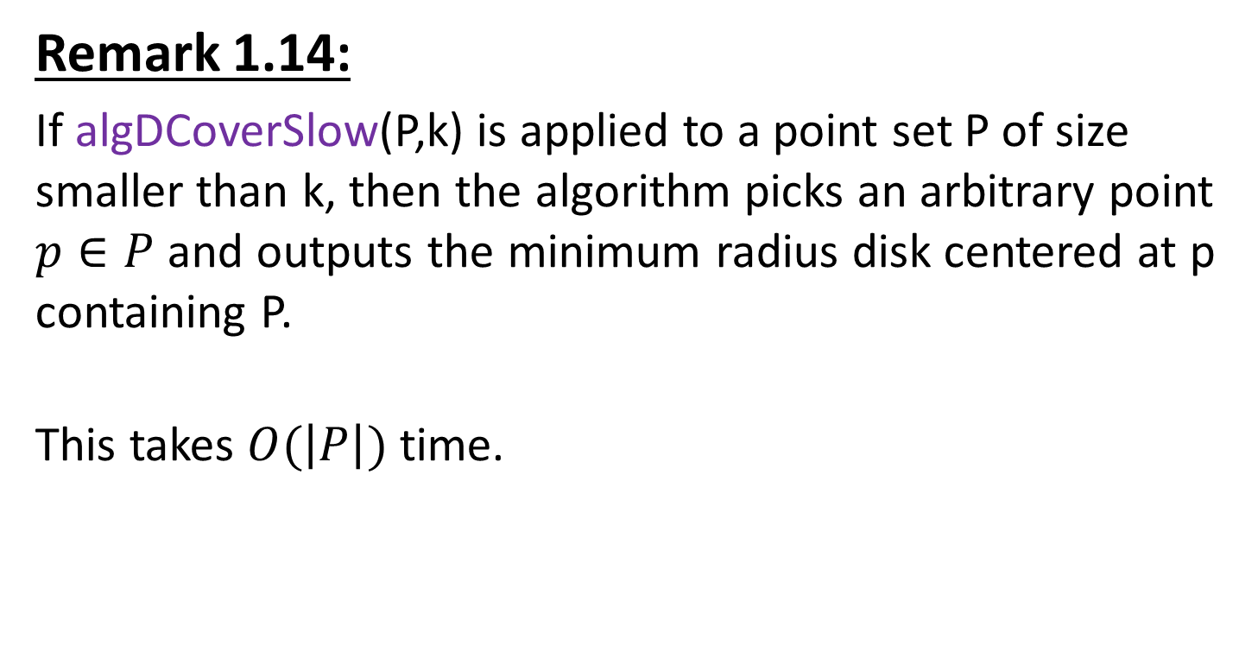
K-enclosing disk – algDCoverSlow
Remark 1.14:
If algDCoverSlow(P,k) is applied to a point set P of size smaller than k, then the algorithm picks an arbitrary point $p∈P$ and outputs the minimum radius disk centered at p containing P.
This takes $O(\left|P\right|)$ time.
Notes:
We have to say this, after all.
It artificially populates X with one arbitrary point and returns a disk with the farthest distance of a point from what’s in X as the disk radius centered at that point.

Slide 51

K-enclosing disk – algDCoverSlow
Lemma 1.16: (Extension of lemma 1.12)
Given a set P of n points in $R^{d}$ and parameter k, one can compute, in $O(n{\left(\frac{n}{k}\right)}^{d})$ deterministic time, a ball b that contains k points of P and $radius\left(b\right)≤2r_{opt}(P,k)$ where $r_{opt}(P,k)$ is the radius of the smallest ball in $R^{d}$ containing k points of P.
Notes:
The same algorithm as before, but more dimensions of lines.
This is just to highlight that the algorithm also holds for higher dimensions.

Slide 52


K-enclosing disk – algDCoverSlow
Remark 1.15:
The output disk of algDCoverSlow is centered on a point $p∈P$ and has radius $r$; and p resides on an intersection of a horizontal and vertical lines of the non-uniform grid.
As such, the result of algDCoverSlow can be encoded as (q,s,t) where:
  $q∈P$ is the point defining the vertical line p resides on.
  $s∈P$ is the point defining the horizontal line p resides on.
  $t∈P$ is the point that defined r.
  Namely, it’s the $k^{th}$ distant point to p.
Notes:
We will need this remark for the next algorithm.
-Remember how we constructed the non-uniform grid: the construction assures us that each horizontal/vertical line passes through a point in P
-
-
This here is important because it emphasizes we have O(n^3) possibilities

Slide 53
Timeline
Preliminaries
Closest pair
  Slow algorithm
  Linear time algorithm
K-enclosing disk
  Slow algorithm
  Linear time algorithm
Bibliography

Slide 54

K-enclosing disk – algDCover
We will now present a linear time algorithm algDCover for approximating the minimum enclosing disk.
As before, we construct a grid which partitions the points into small ($O(k)$ sized) groups.
The key idea behind speeding up the grid computation is to start with a small set of points, and incrementally insert the remaining points, while adjusting the grid at each step.

Slide 55

K-enclosing disk – algDCover Preliminaries
Definition 1.17:
Given a set P of n points, a k-gradation $(P_{1},…,P_{m})$ of P is a sequence of subsets of P, such that:
  $P_{m}=P$
  $P_{i}$ is formed by picking each point of $P_{i+1}$ with probability $\frac{1}{2}$.
  $\left|P_{1}\right|≤k$
  $\left|P_{2}\right|>k$
Notes:
We start with Pm and go down until we reach P1<=k

Slide 56

K-enclosing disk – algDCover Preliminaries
Definition 1.18:
Let $gd_{α}(P)$ denote the maximum number of points of P mapped to a single cell by the partition $G_{α}=G_{α}(P)$.
Let $depth(P,α$) be the maximum number of points of P that a circle of radius $α$ can contain.

Slide 57

K-enclosing disk – algDCover Preliminaries
Lemma 1.19:
For any point set P and $α>0$, we have that if $α≤2r_{opt}(P,k)$, then any cell of the grid $G_{α}$ contains at most $5k$ points; that is, $gd_{α}\left(P\right)≤5k$.

Slide 58


K-enclosing disk – algDCover Preliminaries
Proof:
Let C be the grid cell of $G_{α}$ that realizes $gd_{α}(P)$.
Place 4 points at the corners of C and one point in the center of C.
Placing at each of those points a disk of
radius $r_{opt}(P,k)$ completely covers C.
Thus, $\left|P∩C\right|=gd_{α}\left(P\right)≤5depth\left(P,r_{opt}\left(P,k\right)\right)=5k$.
Lemma 1.19: For any point set P and $α>0$, we have that if $α≤2r_{opt}(P,k)$, then any cell of the grid $G_{α}$ contains at most $5k$ points; that is, $gd_{α}\left(P\right)≤5k$.
Notes:
*
*
*since the sidelength of C is at most $2r_{opt}(P,k)$.

Slide 59

K-enclosing disk – algDCover
Algorithm:
Compute a k-gradation $(P_{1},…,P_{m})$ of P.
Use algDCoverSlow on $P_{1}$ to get an approximation $α_{1}$ for ${r_{opt}}_{1}$.
We iteratively refine this approximation moving from one set in the gradation to the next one, maintaining these invariants at the end of the $i^{th}$ round:
  There is a distance $α_{i}$ such that $gd_{α_{i}}\left(P_{i}\right)≤5k$.
  There’s a grid cluster in $G_{α_{i}}$ containing k or more points of $P_{i}$.
  $r_{opt}\left(P_{i},k\right)≤α_{i}$.
Notes:
II comes from III, as Dopt will be contained in some grid cluster with cells sidelength of $α_{i}$.

Slide 60

K-enclosing disk – algDCover
Algorithm:
At the $i^{th}$ round, construct a grid $G_{i−1}$ for points in $P_{i}$ using $α_{i−1}$ as the grid width.
We use the slow algorithm (algDCoverSlow) on each of the non-empty grid clusters, to compute $α_{i}$.
In the end, $α_{m}$ is the desired approximation.

Slide 61

K-enclosing disk – algDCover
Algorithm:
Notes:
*algGrow: grid clusters with less than k will not hold the optimum circle anyway.
*algGrow returns the minimal radius it has encountered

Slide 62

K-enclosing disk – algDCover
Intuition:
During its execution, the algorithm never maps too many points to a single grid cell.
We know that no grid cell of $G_{α_{i−1}}$ contains more than 5k points of $P_{i−1}$.
Notes:
-
-Lemma 1.19

Slide 63

K-enclosing disk – algDCover
Intuition:
In an optimistic scenario, every cluster of $G_{i−1}(P_{i})$ has $O(k)$ points, and running algDCoverSlow on such clusters costs $O\left(k{\left(\frac{k}{k}\right)}^{2}\right)=O(k)$.
Since every point is in a constant number of clusters, the total cost of algGrow at stage $i$ is expected to be linear in the size of $P_{i}$.
Notes:
-
-Lemma 1.19

Slide 64

K-enclosing disk – algDCover
Correctness
Lemma 1.20:
For $i=1,…,m$ we have $r_{opt}\left(P_{i},k\right)≤α_{i}≤2r_{opt}(P_{i},k)$, and the heaviest cell in $G_{α_{i}}(P_{i})$ contains at most $5k$ points of $P_{i}$.

Slide 65

K-enclosing disk – algDCover
Correctness
Proof:
Let $D_{i}$ be the disk that realizes $r_{opt}(P_{i},k)$.
There is a cluster $c$ of $G_{α_{i−1}}$ that contains $D_{i}$, as $α_{i−1}≥α_{i}$.
Thus, when algGrow handles c, we have $D_{i}∩P_{i}⊆c$.
The first part of the lemma is correct as algDCoverSlow ensures that $α_{i}$ is a 2-approximation of $r_{opt}(P_{i},k)$.
The second part follows by lemma 1.19.$∎$
Lemma 1.20:
For $i=1,…,m$ we have $r_{opt}\left(P_{i},k\right)≤α_{i}≤2r_{opt}(P_{i},k)$, and the heaviest cell in $G_{α_{i}}(P_{i})$ contains at most $5k$ points of $P_{i}$.
Notes:
Lemma 1.19:
For any point set P and $α>0$, we have that if $α≤2r_{opt}(P,k)$, then any cell of the grid $G_{α}$ contains at most $5k$ points; that is, $gd_{α}\left(P\right)≤5k$.

Slide 66

K-enclosing disk – algDCover
Correctness
Lemma 1.20 implies the correctness of the algorithm by applying it for $i=m$.
Lemma 1.20:
For $i=1,…,m$ we have $r_{opt}\left(P_{i},k\right)≤α_{i}≤2r_{opt}(P_{i},k)$, and the heaviest cell in $G_{α_{i}}(P_{i})$ contains at most $5k$ points of $P_{i}$.

Slide 67

K-enclosing disk – algDCover
Running time analysis
Lemma 1.21:
Given a set $P$, a k-gradation of $P$ can be computed in linear time.

Slide 68

K-enclosing disk – algDCover
Running time analysis
Proof:
The sampling time is $O(\sum_{i=1}^{m}{\left|P_{i}\right|})$, where m is the length of the sequence.
$E\left[\left|P_{m}\right|\right]=|P_{m}|$=n.
$E\left[\left|P_{i}\right|\right]=E[E[|P_{i}|\left|\left|P_{i+1}\right|\right.]]=E[\frac{\left|P_{i+1}\right|}{2}]=\frac{1}{2}E[|P_{i+1}|]$
Lemma 1.21:
Given a set $P$, a k-gradation of $P$ can be computed in linear time.
Notes:
*
*
*Remind everyone of the magic of תוחלות

Slide 69

K-enclosing disk – algDCover
Running time analysis
Proof:
By induction, we get
$E\left[\left|P_{m−i}\right|\right]=\frac{n}{2^{i}}$
Thus, total running time is
$O\left(E\left[\sum_{i=1}^{m}{\left|P_{i}\right|}\right]\right)=O\left(\sum_{i=1}^{m}{\frac{n}{2^{i}}}\right)=O(n)∎$
Lemma 1.21:
Given a set $P$, a k-gradation of $P$ can be computed in linear time.

Slide 70

K-enclosing disk – algDCover
Running time analysis
Since $\left|P_{1}\right|≤k$, the call $α_{1}←algDCoverSlow(P_{1},k)$ in algDCover takes $O(k)$ time.
Now we will upper-bound the number of cells of $G_{α_{i−1}}$ that contain “too many” points of $P_{i}$.

Slide 71

K-enclosing disk – algDCover
Running time analysis
Since $P_{i−1}$ was chosen from $P_{i}$ with probability $\frac{1}{2}$ for each point, we can express this bound as a sum of independent random variables, and we can bound this using tail-bounds.
Notes:
Tail bounds like the chernoff inequality

Slide 72

K-enclosing disk – algDCover
Running time analysis
Definition 1.22:
For a point set $P$ and parameters $k$ and $α$, the excess of $G_{α}(P)$ is:
$$ε\left(P,α\right)=\sum_{c∈Cells(G_{α})}{\left\lfloor \frac{\left|c∩P\right|}{50k}\right\rfloor }≤\frac{\left|P\right|}{50k}$$
A cell is considered heavy if it contains at least 50k points.
$100k∗ε(P,α)$ is an upper bound on the number of points of P in a heavy cell of $G_{α}(P)$.
Notes:
*
*
*Place it in the definition of excess and you will get $ε=2ε$, and $ε>0$

Slide 73

K-enclosing disk – algDCover
Running time analysis
Reminder:
We’ve shown that for a set $P$ of n points, the result $α$returned by algDCoverSlow can be defined by a triplet of points (q,s,t) of P.
Note that there are $O(n^{3}$) such triplets.

Slide 74

K-enclosing disk – algDCover
Running time analysis
This implies that throughout the execution of algDCover, the only grids that would be considered would be one of (at most) $n^{3}$ possible grids.
In particular, let $Γ=Γ(P)$ be this set
of possible grids.

Slide 75

K-enclosing disk – algDCover
Running time analysis
Lemma 1.23:
For any $t>0$, let $γ=\frac{\left\lceil 3lnn\right\rceil }{8k}$ and $β=t+γ$.
The probability that $G_{α_{i−1}}(P_{i})$ has excess $ε\left(P_{i},α_{i−1}\right)≥β$ is at most $exp⁡(−8kt)$.

Slide 76

K-enclosing disk – algDCover
Running time analysis
Proof:
Fix a grid $G∈Γ(P)$ with excess $ε\left(P_{i},sl\left(G\right)\right)≥β$, where $sl(G)$ is the sidelength of a cell of G.
Let $U=\{\left\{P_{i}∩c\right\} \left|c∈G, \left|P_{i}∩c\right|≥50k\}\right.$
be the sets of points stored in the heavy cells of $G$.
Lemma 1.23: For any $t>0$, let $γ=\frac{\left\lceil 3lnn\right\rceil }{8k}$ and $β=t+γ$. The probability that $G_{α_{i−1}}(P_{i})$ has excess $ε\left(P_{i},α_{i−1}\right)≥β$ is at most $exp⁡(−8kt)$.
Notes:
Intuition: fix a grid that we want to estimate the probability of $G_{α_{i−1}}(P_{i})$ to be, and then bound the probability that it’s the same one.

Slide 77



K-enclosing disk – algDCover
Running time analysis
Proof:
Let $V=\bigcup_{X∈U}{\prod{(X,50k)}}$,
where $\prod{(X,v)}$ denotes a partition of the set X into disjoint subsets, such that each of them contains $v$ points, except for the last one which may contain between $v$ and $2v−1$ points.
$$X$$
$$\prod{(X,3)}$$
Lemma 1.23: For any $t>0$, let $γ=\frac{\left\lceil 3lnn\right\rceil }{8k}$ and $β=t+γ$. The probability that $G_{α_{i−1}}(P_{i})$ has excess $ε\left(P_{i},α_{i−1}\right)≥β$ is at most $exp⁡(−8kt)$.
Notes:
V partitions all heavy sets into disjoint sets which are either 50k in size, or some might be between 50k and 100k-1

Slide 78

K-enclosing disk – algDCover
Running time analysis
Proof:
V partitions the points inside each heavy cell into groups of size at least $50k$.
Since each group lies inside a single cell of $G$, for $G$ to be the grid computed for $P_{i−1}$ (that is, $G_{α_{i−1}}$), it must be that every such group “promoted” at most $5k$ points from $P_{i}$ to $P_{i−1}$.
Lemma 1.23: For any $t>0$, let $γ=\frac{\left\lceil 3lnn\right\rceil }{8k}$ and $β=t+γ$. The probability that $G_{α_{i−1}}(P_{i})$ has excess $ε\left(P_{i},α_{i−1}\right)≥β$ is at most $exp⁡(−8kt)$.
Notes:
*
*by lemma 1.20. each cell of $G_{α_{i−1}}\left(P_{i−1}\right)$ has at most 5k points.

Slide 79

K-enclosing disk – algDCover
Running time analysis
Proof:
Now, we notice that $\left|V\right|=ε(P_{i},sl\left(G\right))$.
We also notice that for any $S∈V$, we have that $μ=E\left[\left|S∩P_{i−1}\right|\right]≥25k$.
Lemma 1.23: For any $t>0$, let $γ=\frac{\left\lceil 3lnn\right\rceil }{8k}$ and $β=t+γ$. The probability that $G_{α_{i−1}}(P_{i})$ has excess $ε\left(P_{i},α_{i−1}\right)≥β$ is at most $exp⁡(−8kt)$.
Notes:
*Think how much a “heavy” heavy cell contributes to the excess definition
*Sum of indicators ב"ת with probability ½. And there are at least 50k indicators like that.
Article says: “Indeed, we promote each point of $S⊆P_{i}$, independently, with probability ½, to be in $P_{i−1}$ and $\left|S\right|≥50k$.

Slide 80

K-enclosing disk – algDCover
Running time analysis
Proof:
By the Chernoff inequality, for $δ=\frac{4}{5}$, we have:
$\operatorname{Pr}\left[\left|S∩P_{i−1}\right|≤5k\right]≤Pr⁡[\left|S∩P_{i−1}\right|≤\left(1−δ\right)μ]$
$<\exp\left(−\frac{μδ^{2}}{2}\right)≤\exp\left(−\frac{25k{\left(\frac{4}{5}\right)}^{2}}{2}\right)=exp⁡(−8k)$
Lemma 1.23: For any $t>0$, let $γ=\frac{\left\lceil 3lnn\right\rceil }{8k}$ and $β=t+γ$. The probability that $G_{α_{i−1}}(P_{i})$ has excess $ε\left(P_{i},α_{i−1}\right)≥β$ is at most $exp⁡(−8kt)$.
Notes:
Chernoff: Pr(sumXi <=(1-a)u < exp(-ua^2/2)
*This is the probability that a group in V promoted at most 5k points to $P_{i−1}$.

Slide 81

K-enclosing disk – algDCover
Running time analysis
Proof:
Since we wish for $G=G_{α_{i−1}}$, each cell of G must contain at most 5k points of $P_{i−1}$, by lemma 1.20.
The probability of that is:
$\operatorname{Pr}\left[G_{α_{i−1}}=G\right]≤\prod_{S∈V}{\operatorname{Pr}\left[\left|S∩P_{i−1}\right|≤5k\right]}$
$≤\exp\left(−8k\left|V\right|\right)=\exp\left(−8kε\left(P_{i},sl\left(G\right)\right)\right)≤exp⁡(−8kβ)$
Lemma 1.23: For any $t>0$, let $γ=\frac{\left\lceil 3lnn\right\rceil }{8k}$ and $β=t+γ$. The probability that $G_{α_{i−1}}(P_{i})$ has excess $ε\left(P_{i},α_{i−1}\right)≥β$ is at most $exp⁡(−8kt)$.
Notes:
A single product is less than/equal exp(-8k), and we have |V| of those products.
The beta comes into the picture since $excess≥β$. It’s shown in the lower part of the screen.

Slide 82

K-enclosing disk – algDCover
Running time analysis
Proof:
Since there are at most $n^{3}$ grids in $Γ(P)$, we have:
$\operatorname{Pr}\left[ε\left(P_{i},α_{i−1}\right)≥β\right]=\operatorname{Pr}\left[\bigcup_{\begin{aligned}G∈Γ\left(P\right), \\ ε\left(P_{i},sl\left(G\right)\right)≥β\end{aligned}}{\left(G=G_{α_{i−1}}\right)}\right]$
$≤ \sum_{\begin{aligned}G∈Γ\left(P\right), \\ ε\left(P_{i},sl\left(G\right)\right)≥β\end{aligned}}{Pr⁡[G=G_{α_{i−1}}}]≤n^{3}exp⁡(−8kβ)$
$≤\exp\left(3lnn−8k\left(t+\frac{3\left\lceil lnn\right\rceil }{8k}\right)\right)≤exp\left(−8kt\right)∎$
Lemma 1.23: For any $t>0$, let $γ=\frac{\left\lceil 3lnn\right\rceil }{8k}$ and $β=t+γ$. The probability that $G_{α_{i−1}}(P_{i})$ has excess $ε\left(P_{i},α_{i−1}\right)≥β$ is at most $exp⁡(−8kt)$.
Notes:
Apologize for the mess of these slides…. There is not other way.

Slide 83

K-enclosing disk – algDCover
Running time analysis
Now that that’s over with, let’s get back to business and bound the running time of the $i^{th}$ iteration.
Lemma 1.24:
In expectation, the running time of the algorithm in the $i^{th}$ iteration is $O(\left|P_{i}\right|+γ^{4}k)$, where $γ=\frac{\left\lceil 3lnn\right\rceil }{8k}$.

Slide 84

K-enclosing disk – algDCover
Running time analysis
Proof:
Let Y be the random variable which is the excess of $G_{α_{i−1}}(P_{i})$.
Note that there are at most Y cells which are heavy in $G_{α_{i−1}}\left(P_{i}\right)$, and each such cell contains $O(Yk)$ points.
Invoking algDCoverSlow on such heavy cells takes $O\left(Yk∗{\left(\frac{Yk}{k}\right)}^{2}\right)=O(Y^{3}k)$.
Lemma 1.24: In expectation, the running time of the algorithm in the $i^{th}$ iteration is $O(\left|P_{i}\right|+γ^{4}k)$, where $γ=\frac{\left\lceil 3lnn\right\rceil }{8k}$.
Notes:
*
>Because a heavy cell can contain at most 100k*excess=100k*Y points.

Slide 85

K-enclosing disk – algDCover
Running time analysis
Proof:
Overall, the running time of algGrow in the $i^{th}$ iteration is:
$T\left(Y\right)=O\left(\left|P_{i}\right|+Y∗Y^{3}k\right)=O(\left|P_{i}\right|+Y^{4}k)$
Lemma 1.24: In expectation, the running time of the algorithm in the $i^{th}$ iteration is $O(\left|P_{i}\right|+γ^{4}k)$, where $γ=\frac{\left\lceil 3lnn\right\rceil }{8k}$.

Slide 86

K-enclosing disk – algDCover
Running time analysis
Proof:
Set $γ=\frac{\left\lceil 3lnn\right\rceil }{8k}$. The expected running time in the $i^{th}$ iteration is:
$$R_{i}=O\left(\sum_{t=0}^{\frac{n}{k}}{\operatorname{Pr}\left[Y=t\right]\left(\left|P_{i}\right|+Y^{4}k\right)}\right) \\ =O\left(\left|P_{i}\right|+\operatorname{Pr}\left[Y≤γ\right]γ^{4}k+\sum_{t=1}^{\frac{n}{k}}{\operatorname{Pr}\left[Y=t+γ\right]{\left(t+γ\right)}^{4}k}\right) \\ =O\left(\left|P_{i}\right|+γ^{4}k+\sum_{t=1}^{\frac{n}{k}}{\exp\left(−8kt\right){\left(t+γ\right)}^{4}k}\right) \\ =O(\left|P_{i}\right|+γ^{4}k)$$
Lemma 1.24: In expectation, the running time of the algorithm in the $i^{th}$ iteration is $O(\left|P_{i}\right|+γ^{4}k)$, where $γ=\frac{\left\lceil 3lnn\right\rceil }{8k}$.

Slide 87

K-enclosing disk – algDCover
Running time analysis
Proof:
Where the last step is due to the summation being bounded by:
$O\left(\sum_{t=1}^{\frac{n}{k}}{\exp\left(−8kt\right){\left(t+γ\right)}^{4}k}\right)$
$=O\left(\sum_{t=1}^{\frac{n}{k}}{16t^{4}γ^{4}kexp\left(−8kt\right)}\right)$
$=O\left(γ^{4}k\sum_{t=1}^{\frac{n}{k}}{t^{4}\exp\left(−8kt\right)}\right)$
$=O\left(γ^{4}k\right) ∎$
Lemma 1.24: In expectation, the running time of the algorithm in the $i^{th}$ iteration is $O(\left|P_{i}\right|+γ^{4}k)$, where $γ=\frac{\left\lceil 3lnn\right\rceil }{8k}$.

Slide 88

K-enclosing disk – algDCover
Running time analysis
Thus, by lemma 1.24 and by lemma 1.21, the total expected running time of algDCover inside the inner loop is:
$$O\left(\sum_{i=1}^{m}{\left(\left|P_{i}\right|+γ^{4}k\right)}\right)$$
$$=O\left(n+{\left(\frac{3lnn}{8k}\right)}^{4}km\right)$$
$$=O\left(n\right)$$
Since $m=O(logn)$ with high probability.
Lemma 1.21: Given a set $P$, a k-gradation of $P$ can be computed in linear time.
Lemma 1.24: In expectation, the running time of the algorithm in the $i^{th}$ iteration is $O(\left|P_{i}\right|+γ^{4}k)$, where $γ=\frac{\left\lceil 3lnn\right\rceil }{8k}$.

Slide 89

K-enclosing disk – algDCover
Finally, we are done, and we can proudly pronounce:
Theorem 1.25:
Given a set $P$ of n points in the plane and a parameter $k$, the algorithm algDCover computes, in expected linear time, a radius $α$, such that $r_{opt}\left(P,k\right)≤α≤2r_{opt}(P,k)$, where $r_{opt}(P,k)$ is the minimum radius of a disk covering k points of $P.$

Slide 90
Timeline
Preliminaries
Closest pair
  Slow algorithm
  Linear time algorithm
K-enclosing disk
  Slow algorithm
  Linear time algorithm
Bibliography

Slide 91


Bibliography
Everything in this presentation is taken from Sariel Har-Peled’s book:
Geometric Approximation Algorithms
Chapter 1: The Power of Grids
The article’s bibliographical notes:

