Slide 1
Program Analysis and Verification 0368-4479
Noam Rinetzky
Lecture 8: Interprocedural Analysis
Slides credit: Roman Manevich, Mooly Sagiv, Eran Yahav

Slide 2
What about procedures?

Slide 3
Procedural program
void main() {
int x;
x = p(7);
x = p(9);
}
int p(int a) {
return a + 1;
}

Slide 4
Effect of procedures
foo()
bar()
call bar()
The effect of calling a procedure is the effect of executing its body

Slide 5
Interprocedural Analysis
foo()
bar()
call bar()
goal: compute the abstract effect of calling a procedure

Slide 6
Reduction to intraprocedural analysis
Procedure inlining
Naive solution: call-as-goto

Slide 7
Reminder: Constant Propagation

Variable not a constant
-1
0
1
-
…
…


No information


Z

Slide 8
Reminder: Constant Propagation
L = (Var  Z ,  )
1  2 iff x: 1(x) ’ 2(x)
’ ordering in the Z lattice
Examples:
[x  , y  42, z  ]  [x  , y  42, z  73]
[x  , y  42, z  73]  [x  , y  42, z  ]




13

Slide 9
Reminder: Constant Propagation
Conservative Solution
Every detected constant is indeed constant
But may fail to identify some constants
Every potential impact is identified
Superfluous impacts

Slide 10
Procedure Inlining
void main() {
int x;
x = p(7);
x = p(9);
}
int p(int a) {
return a + 1;
}

Slide 11
Procedure Inlining
void main() {
int x;
x = p(7);
x = p(9);
}
int p(int a) {
return a + 1;
}
void main() {
int a, x, ret;
a = 7; ret = a+1; x = ret;
a = 9; ret = a+1; x = ret;
}
[a ⊥, x ⊥, ret ⊥]
[a 7, x 8, ret 8]
[a 9, x 10, ret 10]

Slide 12
Procedure Inlining
Pros
Simple
Cons
Does not handle recursion
Exponential blow up
Reanalyzing the body of procedures
p1 {
call p2
…
call p2
}
p2 {
call p3
…
call p3
}
p3{
}

Slide 13
A Naive Interprocedural solution
Treat procedure calls as gotos

Slide 14
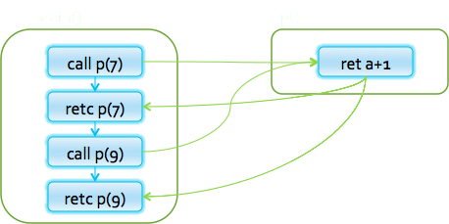
Simple Example
int p(int a) {
return a + 1;
}
void main() {
int x ;
x = p(7);
x = p(9) ;
}

Slide 15
Simple Example
int p(int a) {
[a 7]
return a + 1;
}
void main() {
int x ;
x = p(7);
x = p(9) ;
}

Slide 16
Simple Example
int p(int a) {
[a 7]
return a + 1;
[a 7, $$ 8]
}
void main() {
int x ;
x = p(7);
x = p(9) ;
}

Slide 17
Simple Example
int p(int a) {
[a 7]
return a + 1;
[a 7, $$ 8]
}
void main() {
int x ;
x = p(7);
[x 8]
x = p(9) ;
[x 8]
}

Slide 18
Simple Example
int p(int a) {
[a 7]
return a + 1;
[a 7, $$ 8]
}
void main() {
int x ;
x = p(7);
[x 8]
x = p(9) ;
[x 8]
}

Slide 19
Simple Example
int p(int a) {
[a 7] [a 9]
return a + 1;
[a 7, $$ 8]
}
void main() {
int x ;
x = p(7);
[x 8]
x = p(9) ;
[x 8]
}

Slide 20
Simple Example
int p(int a) {
[a ]
return a + 1;
[a 7, $$ 8]
}
void main() {
int x ;
x = p(7);
[x 8]
x = p(9) ;
[x 8]
}

Slide 21
Simple Example
int p(int a) {
[a ]
return a + 1;
[a , $$ ]
}
void main() {
int x ;
x = p(7);
[x 8]
x = p(9);
[x 8]
}

Slide 22
Simple Example
int p(int a) {
[a ]
return a + 1;
[a , $$ ]
}
void main() {
int x ;
x = p(7) ;
[x ]
x = p(9) ;
[x ]
}

Slide 23
A Naive Interprocedural solution
Treat procedure calls as gotos
Pros:
Simple
Usually fast
Cons:
Abstract call/return correlations
Obtain a conservative solution

Slide 24
analysis by reduction
Call-as-goto
Procedure inlining
void main() {
int x ;
x = p(7) ;
[x ]
x = p(9) ;
[x ]
}
int p(int a) {
[a ]
return a + 1;
[a , $$ ]
}
void main() {
int a, x, ret;
a = 7; ret = a+1; x = ret;
a = 9; ret = a+1; x = ret;
}
[a ⊥, x ⊥, ret ⊥]
[a 7, x 8, ret 8]
[a 9, x 10, ret 10]
why was the naive solution less precise?

Slide 25
Stack regime
call
P() {
…
R();
…
}
Q() {
…
R();
…
}
R(){
…
}
call
return
return
R
P

Slide 26
Guiding light
Exploit stack regime
Precision
Efficiency
Notes:
Main idea / guiding light

Slide 27
Simplifying Assumptions
Parameter passed by value
No procedure nesting
No concurrency
Recursion is supported

Slide 28
Topics Covered
Procedure Inlining
The naive approach
Valid paths
The callstring approach
The Functional Approach
IFDS: Interprocedural Analysis via Graph Reachability
IDE: Beyond graph reachability
The trivial modular approach

Slide 29
Join-Over-All-Paths (JOP)
Let paths(v) denote the potentially infinite set paths from start to v (written as sequences of edges)
For a sequence of edges [e₁, e₂, …, e_{n}] define f [e₁, e₂, …, e_{n}]: L ◊ L by composing the effects of basic blocks f [e₁, e₂, …, e_{n}](l) = f(e_{n}) (… (f(e₂) (f(e₁) (l)) …)
JOP[v] = {f [e₁, e₂, …,e_{n}](ι) | [e₁, e₂, …, e_{n}]  paths(v)}

Slide 30
Join-Over-All-Paths (JOP)
Paths transformers:
f[e1,e2,e3,e4]
f[e1,e2,e7,e8]
f[e5,e6,e7,e8]
f[e5,e6,e3,e4]
f[e1,e2,e3,e4,e9, e1,e2,e3,e4]
f[e1,e2,e7,e8,e9, e1,e2,e3,e4,e9,…]
…
e1
e5
e9
e2
e6
e3
e7
JOP:
f[e1,e2,e3,e4](initial) 
f[e1,e2,e7,e8](initial) 
f[e5,e6,e7,e8](initial) 
f[e5,e6,e3,e4](initial)  …
e4
e8
Number of program paths is unbounded due to loops
9

Slide 31
The lfp computation approximates JOP
JOP[v] = {f [e₁, e₂, …,e_{n}](ι) | [e₁, e₂, …, e_{n}]  paths(v)}
LFP[v] = {f [e](LFP[v’]) | e =(v’,v)}
JOP  LFP - for a monotone function
f(x  y)  f(x)  f(y)
JOP = LFP - for a distributive function
f(x  y) = f(x)  f(y)
LFP[v0] = ι
JOP may not be precise enough for interprocedural analysis!

Slide 32
Interprocedural analysis
P
Q
R
Entry node
s_{P}
s_{Q}
f_{c2e}
s_{R}
Call node
Call node
f₁
f_{c2e}
f₁
f₁
f₁
n₄
n₆
n₁
n₂
Call Q
Call Q
f₂
f₃
n₅
f₁
n₇
n₃
Return node
Return node
f_{x2r}
f₅
f₃
f_{x2r}
f₆
e_{P}
e_{R}
e_{Q}
Supergraph
Exit node

Slide 33
Paths
s
paths(n) the set of paths from s to n
( (s,n₁), (n₁,n₃), (n₃,n₁) )
f₁
f₁
n₁
n₂
f₂
f₃
f₁
n₃
f₃
e

Slide 34
Interprocedural Valid Paths
f₁
f₂
call_{q}
ret
f_{k-1}
f_{k}
f₃
(
)
f_{k-2}
enter_{q}
exit_{q}
f₄
f_{k-3}
f₅
IVP: all paths with matching calls and returns
And prefixes

Slide 35
Interprocedural Valid Paths
IVP set of paths
Start at program entry
Only considers matching calls and returns
aka, valid
Can be defined via context free grammar
matched ::= matched (_{i} matched )_{i} | ε
valid ::= valid (_{i} matched | matched
paths can be defined by a regular expression

Slide 36
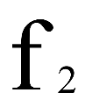
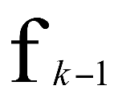
Join Over All Paths (JOP)
i
start
n
⟦fk o ... o f1⟧
L ◊ L
JOP[v] = {[[e₁, e₂, …,e_{n}]](ι) | (e₁, …, e_{n})  paths(v)}
JOP  LFP
Sometimes JOP = LFP
precise up to “symbolic execution”
Distributive problem

Slide 37
The Join-Over-Valid-Paths (JVP)
vpaths(n) all valid paths from program start to n
JVP[n] = {[[e₁, e₂, …, e]](ι) | (e₁, e₂, …, e)  vpaths(n)}
JVP  JOP
In some cases the JVP can be computed
(Distributive problem)

Slide 38
The Call String Approach
The data flow value is associated with sequences of calls (call string)
Use Chaotic iterations over the supergraph

Slide 39
supergraph
P
Q
R
Entry node
s_{P}
s_{Q}
f_{c2e}
s_{R}
Call node
Call node
f₁
f_{c2e}
f₁
f₁
f₁
n₄
n₆
n₁
n₂
Call Q
Call Q
f₂
f₃
n₅
f₁
n₇
n₃
Return node
Return node
f_{x2r}
f₅
f₃
f_{x2r}
f₆
e_{P}
e_{R}
e_{Q}
Exit node

Slide 40
Simple Example
int p(int a) {
return a + 1;
}
void main() {
int x ;
c1: x = p(7);
c2: x = p(9) ;
}

Slide 41
Simple Example
int p(int a) {
c1: [a 7]
return a + 1;
}
void main() {
int x ;
c1: x = p(7);
c2: x = p(9) ;
}

Slide 42
Simple Example
int p(int a) {
c1: [a 7]
return a + 1;
c1:[a 7, $$ 8]
}
void main() {
int x ;
c1: x = p(7);
c2: x = p(9) ;
}

Slide 43
Simple Example
int p(int a) {
c1: [a 7]
return a + 1;
c1:[a 7, $$ 8]
}
void main() {
int x ;
c1: x = p(7);
ε: x  8
c2: x = p(9) ;
}

Slide 44
Simple Example
int p(int a) {
c1:[a 7]
return a + 1;
c1:[a 7, $$ 8]
}
void main() {
int x ;
c1: x = p(7);
ε: [x  8]
c2: x = p(9) ;
}

Slide 45
Simple Example
int p(int a) {
c1:[a 7] c2:[a 9]
return a + 1;
c1:[a 7, $$ 8]
}
void main() {
int x ;
c1: x = p(7);
ε : [x  8]
c2: x = p(9) ;
}

Slide 46
Simple Example
int p(int a) {
c1:[a 7] c2:[a 9]
return a + 1;
c1:[a 7, $$ 8] c2:[a 9, $$ 10]
}
void main() {
int x ;
c1: x = p(7);
ε : [x  8]
c2: x = p(9) ;
}

Slide 47
Simple Example
int p(int a) {
c1:[a 7] c2:[a 9]
return a + 1;
c1:[a 7, $$ 8] c2:[a 9, $$ 10]
}
void main() {
int x ;
c1: x = p(7);
ε : [x  8]
c2: x = p(9) ;
ε : [x  10]
}

Slide 48
The Call String Approach
The data flow value is associated with sequences of calls (call string)
Use Chaotic iterations over the supergraph
To guarantee termination limit the size of call string (typically 1 or 2)
Represents tails of calls
Abstract inline

Slide 49
Another Example (|cs|=2)
void main() {
int x ;
c1: x = p(7);
ε : [x  16]
c2: x = p(9) ;
ε :: [x  20]
}
int p(int a) {
c1:[a 7] c2:[a 9]
return c3: p1(a + 1);
c1:[a 7, $$ 16] c2:[a 9, $$ 20]
}
int p1(int b) {
c1.c3:[b 8]
c2.c3:[b 10]
return 2 * b;
c1.c3:[b 8,$$16]
c2.c3:[b 10,$$20]
}

Slide 50
Another Example (|cs|=1)
void main() {
int x ;
c1: x = p(7);
ε : [x  ]
c2: x = p(9) ;
ε : [x  ]
}
int p(int a) {
c1:[a 7] c2:[a 9]
return c3: p1(a + 1);
c1:[a 7, $$ ] c2:[a 9, $$ ]
}
int p1(int b) {
(c1|c2)c3:[b ]
return 2 * b;
(c1|c2)c3:[b , $$]
}

Slide 51
Handling Recursion
void main() {
c1: p(7);
ε : [x ]
}
int p(int a) {
c1: [a  7] c1.c2+: [a  ]
if (…) {
c1: [a  7] c1.c2+: [a  ]
a = a -1 ;
c1: [a  6] c1.c2+: [a  ]
c2: p (a);
c1.c2*: [a  ]
a = a + 1;
c1.c2*: [a  ]
}
c1.c2*: [a  ]
x = -2*a + 5;
c1.c2*: [a  , x]
}

Slide 52
Summary Call String
Easy to implement
Efficient for very small call strings
Limited precision
Often loses precision for recursive programs
For finite domains can be precise even with recursion (with a bounded callstring)
Order of calls can be abstracted
Related method: procedure cloning

Slide 53
The Functional Approach
The meaning of a procedure is mapping from states into states
The abstract meaning of a procedure is function from an abstract state to abstract states
Relation between input and output
In certain cases can compute JVP

Slide 54
The Functional Approach
Two phase algorithm
Compute the dataflow solution at the exit of a procedure as a function of the initial values at the procedure entry (functional values)
Compute the dataflow values at every point using the functional values

Slide 55
Phase 1
void main() {
p(7);
}
int p(int a) {
if (…) {
a = a -1 ;
p (a);
a = a + 1;
}
x = -2*a + 5;
}
[a a₀, x x₀]
[a a₀, x x₀]
[a a₀-1, x x₀]
[a a₀-1, x -2a₀+7]
[a a₀, x -2a₀+7]
[a a₀, x x₀]
[a a₀, x ]
p(a₀,x₀) = [a a₀, x -2a₀ + 5]
[a a₀, x  -2*a₀+5]

Slide 56
Phase 2
void main() {
p(7);
}
int p(int a) {
if (…) {
a = a -1 ;
p (a);
a = a + 1;
}
x = -2*a + 5;
}
[a 7, x 0]
[a , x 0]
[x  -9]
[a 7, x 0]
[a , x 0]
[a 6, x 0]
[a , x 0]
[a 6, x 0]
[a 6, x -7]
[a , x ]
[a 7, x -7]
[a , x ]
p(a₀,x₀) = [a a₀, x -2a₀ + 5]
[a 7, x 0]
[a , x ]
[a 7, x -9]
[a , x ]

Slide 57
Summary Functional approach
Computes procedure abstraction
Sharing between different contexts
Rather precise
Recursive procedures may be more precise/efficient than loops
But requires more from the implementation
Representing (input/output) relations
Composing relations

Slide 58
Issues in Functional Approach
How to guarantee that finite height for functional lattice?
It may happen that L has finite height and yet the lattice of monotonic function from L to L do not
Efficiently represent functions
Functional join
Functional composition
Testing equality

Slide 59
Tabulation
Special case: L is finite
Data facts: d  L  L
Initialization:
f_{start,start}= (,) ; otherwise (,)
S[start, ] = 
Propagation of (x,y) over edge e = (n,n’)
Maintain summary: S[n’,x] = S[n’,x]  ←n→ (y))
n intra-node: ➔ n’: (x, ←n→ (y))
n call-node:
➔ n’: (y,y) if S[n’,y] =  and n’= entry node
➔ n’: (x,z) if S[exit(call(n),y] = z and n’= ret-site-of n
n return-node: ➔ n’: (u,y) ; n_{c} = call-site-of n’, S[n_{c},u]=x

Slide 60
Tabulation
Special case: L is finite
Data facts: d  L  L
Initialization:
f_{start,start}= (,) ; otherwise (,)
S[start, ] = 
Propagation of (x,y) over edge e = (n,n’)
Maintain summary: S[n’,x] = S[n’,x]  ←n→ (y))
n intra-node: ➔ n’: (x, ←n→ (y))
n call-node:
➔ n’: (y,y) if S[n’,y] =  and n’= entry node
➔ n’: (x,z) if S[exit(call(n),y] = z and n’= ret-site-of n
n return-node: ➔ n’: (u,y) ; n_{c} = call-site-of n’, S[n_{c},u]=x

Slide 61
CFL-Graph reachability
Special cases of functional analysis
Finite distributive lattices
Provides more efficient analysis algorithms
Reduce the interprocedural analysis problem to finding context free reachability

Slide 62
IDFS / IDE
IDFS Interprocedural Distributive Finite Subset Precise interprocedural dataflow analysis via graph reachability. Reps, Horowitz, and Sagiv, POPL’95
IDE Interprocedural Distributive Environment Precise interprocedural dataflow analysis with applications to constant propagation. Reps, Horowitz, and Sagiv, FASE’95, TCS’96
More general solutions exist

Slide 63
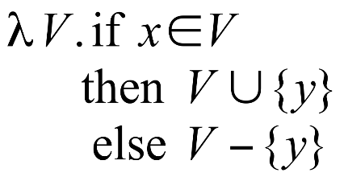
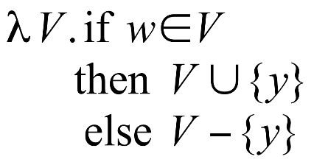
Possibly Uninitialized Variables
{}
Start
{w,x,y}
x = 3
{w,y}
if . . .
{w,y}
y = x
{w,y}
{w}
y = w
w = 8
{}
{w,y}
printf(y)
{w,y}

Slide 64
IFDS Problems
Finite subset distributive
Lattice L = (D)
 is 
 is 
Transfer functions are distributive
Efficient solution through formulation as CFL reachability

Slide 65
Encoding Transfer Functions
Enumerate all input space and output space
Represent functions as graphs with 2(D+1) nodes
Special symbol “0” denotes empty sets (sometimes denoted ☹)
Example: D = { a, b, c } f(S) = (S – {a}) U {b}
0
a
b
c
207
0
a
b
c

Slide 66
Efficiently Representing Functions
Let f:2^{D}→2^{D} be a distributive function
Then:
f(X) = f() 4 (4 { f({z}) | z  X })
f(X) = f() 4 (4 { f({z}) \ f() | z  X })

Slide 67
Representing Dataflow Functions
a
b
c
Identity Function
a
b
c
Constant Function

Slide 68
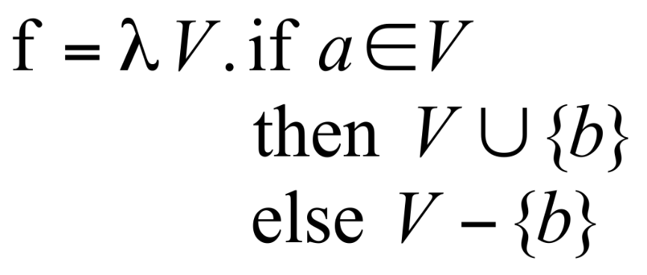
Representing Dataflow Functions
a
b
c
“Gen/Kill” Function
Non-“Gen/Kill” Function
a
b
c

Slide 69
x
y
start p(a,b)
a
b
start main
if . . .
x = 3
b = a
p(x,y)
p(a,b)
return from p
return from p
printf(y)
printf(b)
exit main
exit p

Slide 70
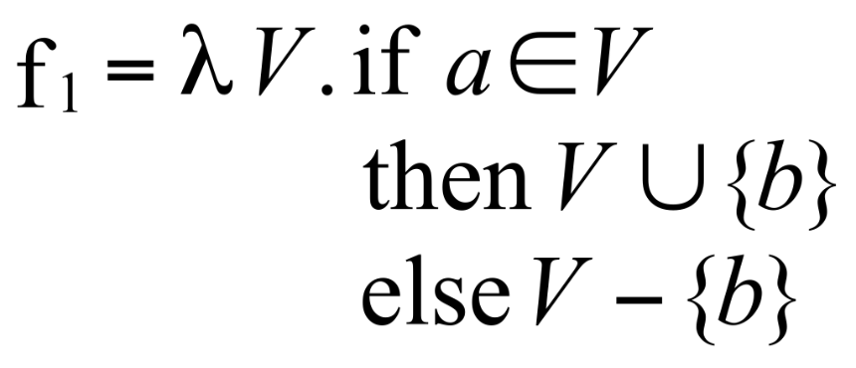
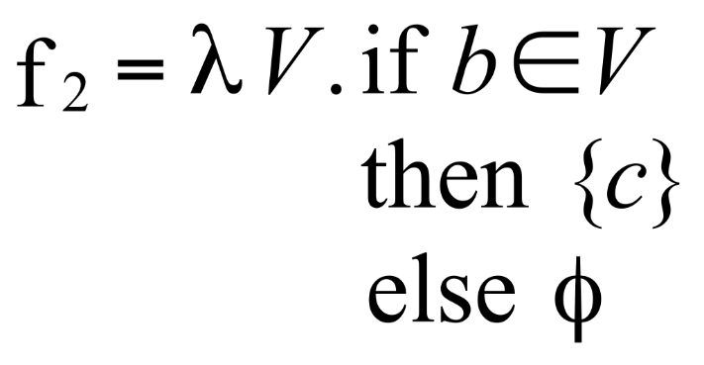
Composing Dataflow Functions
a
a
b
b
c
c
a
b
c

Slide 71
(
x
y
(
start p(a,b)
a
b
start main
if . . .
x = 3
Might b be
uninitialized
here?
Might y be
uninitialized
here?
b = a
p(x,y)
p(a,b)
return from p
return from p
printf(y)
printf(b)
NO!
YES!
exit main
)
exit p
]

Slide 72
The Tabulation Algorithm
Worklist algorithm, start from entry of “main”
Keep track of
Path edges: matched paren paths from procedure entry
Summary edges: matched paren call-return paths
At each instruction
Propagate facts using transfer functions; extend path edges
At each call
Propagate to procedure entry, start with an empty path
If a summary for that entry exits, use it
At each exit
Store paths from corresponding call points as summary paths
When a new summary is added, propagate to the return node

Slide 73
Interprocedural Dataflow Analysis via CFL-Reachability
Graph: Exploded control-flow graph
L: L(unbalLeft)
unbalLeft = valid
Fact d holds at n iff there is an L(unbalLeft)-path from

Slide 74
Asymptotic Running Time
CFL-reachability
Exploded control-flow graph: ND nodes
Running time: O(N³D³)
Exploded control-flow graph Special structure
Running time: O(ED³)
Typically: E  N, hence O(ED³)  O(ND³)
“Gen/kill” problems: O(ED)

Slide 75
IDE
Goes beyond IFDS problems
Can handle unbounded domains
Requires special form of the domain
Can be much more efficient than IFDS

Slide 76
Example Linear Constant Propagation
Consider the constant propagation lattice
The value of every variable y at the program exit can be represented by: y =  {(a_{x}x + b_{x} )| x ‾ Var* }  c a_{x} ,c ‾ Z 4{, } b_{x} ‾ Z
Supports efficient composition and “functional” join
[z := a * y + b]
What about [z:=x+y]?

Slide 77
Linear constant propagation
Point-wise representation of environment transformers

Slide 78
IDE Analysis
Point-wise representation closed under composition
CFL-Reachability on the exploded graph
Compose functions

Slide 79
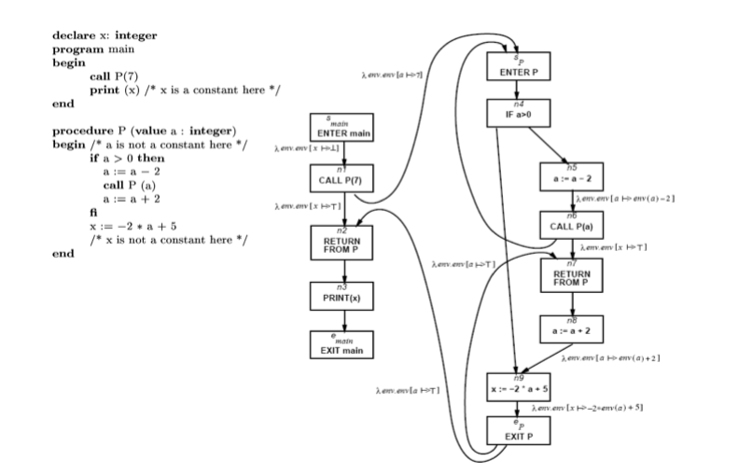

Slide 80
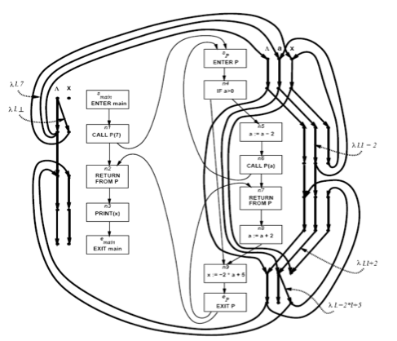

Slide 81
Costs
O(ED³)
Class of value transformers F  L→L
idF
Finite height
Representation scheme with (efficient)
Application
Composition
Join
Equality
Storage

Slide 82
Conclusion
Handling functions is crucial for abstract interpretation
Virtual functions and exceptions complicate things
But scalability is an issue
Small call strings
Small functional domains
Demand analysis

Slide 83
Challenges in Interprocedural Analysis
Respect call-return mechanism
Handling recursion
Local variables
Parameter passing mechanisms
The called procedure is not always known
The source code of the called procedure is not always available

Slide 84
A trivial treatment of procedure
Analyze a single procedure
After every call continue with conservative information
Global variables and local variables which “may be modified by the call” have unknown values
Can be easily implemented
Procedures can be written in different languages
Procedure inline can help

Slide 85
Disadvantages of the trivial solution
Modular (object oriented and functional) programming encourages small frequently called procedures
Almost all information is lost

Slide 86
Bibliography
Textbook 2.5
Patrick Cousot & Radhia Cousot. Static determination of dynamic properties of recursive procedures In IFIP Conference on Formal Description of Programming Concepts, E.J. Neuhold, (Ed.), pages 237-277, St-Andrews, N.B., Canada, 1977. North-Holland Publishing Company (1978).
Two Approaches to interprocedural analysis by Micha Sharir and Amir Pnueli
IDFS Interprocedural Distributive Finite Subset Precise interprocedural dataflow analysis via graph reachability. Reps, Horowitz, and Sagiv, POPL’95
IDE Interprocedural Distributive Environment Precise interprocedural dataflow analysis with applications to constant propagation. Sagiv, Reps, Horowitz, and TCS’96

Slide 87
Example: Pointer Analysis

Slide 88
Plan
Understand the problem
Mention some applications
Simplified problem
Only variables (no object allocation)
Reference analysis
Andersen’s analysis
Steensgaard’s analysis
Generalize to handle object allocation

Slide 89
Constant propagation example
x = 3;
y = 4;
z = x + 5;

Slide 90
Constant propagation example with pointers
x = 3;
*p = 4;
z = x + 5;
Is x always 3 here?

Slide 91
Constant propagation example with pointers
pointers affect
most program analyses
p = &y;
x = 3;
*p = 4;
z = x + 5;
if (?)
p = &x;
else
p = &y;
x = 3;
*p = 4;
z = x + 5;
p = &x;
x = 3;
*p = 4;
z = x + 5;
x is always 3
x is always 4
x may be 3 or 4
(i.e., x is unknown in our lattice)

Slide 92
Constant propagation example with pointers
p = &y;
x = 3;
*p = 4;
z = x + 5;
if (?)
p = &x;
else
p = &y;
x = 3;
*p = 4;
z = x + 5;
p = &x;
x = 3;
*p = 4;
z = x + 5;
p always
points-to y
p always
points-to x
p may point-to x or y

Slide 93
Points-to Analysis
Determine the set of targets a pointer variable could point-to (at different points in the program)
“p points-to x”
“p stores the value &x”
“*p denotes the location x”
targets could be variables or locations in the heap (dynamic memory allocation)
p = &x;
p = new Foo(); or p = malloc (…);
must-point-to vs. may-point-to

Slide 94
Constant propagation example with pointers
Can *p denote the
same location as *q?
*q = 3;
*p = 4;
z = *q + 5;
what values can
this take?

Slide 95
More terminology
*p and *q are said to be aliases (in a given concrete state) if they represent the same location
Alias analysis
Determine if a given pair of references could be aliases at a given program point
*p may-alias *q
*p must-alias *q

Slide 96
Pointer Analysis
Points-To Analysis
may-point-to
must-point-to
Alias Analysis
may-alias
must-alias

Slide 97
Applications
Compiler optimizations
Method de-virtualization
Call graph construction
Allocating objects on stack via escape analysis
Verification & Bug Finding
Datarace detection
Use in preliminary phases
Use in verification itself

Slide 98
Points-to analysis: a simple example
p = &x;
q = &y;
if (?) {
q = p;
}
x = &a;
y = &b;
z = *q;
We will usually drop variable-equality information
{p=&x}
{p=&x  q=&y}
{p=&x  q=&x}
{p=&x  (q=&y  q=&x)}
{p=&x  (q=&y  q=&x)  x=&a}
{p=&x  (q=&y  q=&x)  x=&a  y=&b}
{p=&x  (q=&yq=&x)  x=&a  y=&b  (z=xz=y)}
How would you construct an abstract domain to represent these abstract states?

Slide 99
Points-to lattice
Points-to
PT-factoids[x] = { x=&y | y ∈ Var}  false PT[x] = (2^{PT-factoids}, ⊆, ,  , false, PT-factoids[x]) (interpreted disjunctively)
How should combine them to get the abstract states in the example? {p=&x  (q=&yq=&x)  x=&a  y=&b}

Slide 100
Points-to lattice
Points-to
PT-factoids[x] = { x=&y | y ∈ Var}  false PT[x] = (2^{PT-factoids}, ⊆, ,  , false, PT-factoids[x]) (interpreted disjunctively)
How should combine them to get the abstract states in the example? {p=&x  (q=&yq=&x)  x=&a  y=&b}
D[x] = Disj(VE[x])  Disj(PT[x])
For all program variables: D = D[x₁]  …  D[x_{k}]

Slide 101
Points-to analysis
a = &y x = &a;
y = &b;
if (?) {
p = &x;
} else {
p = &y;
}
*x = &c;
*p = &c;
How should we handle this statement?
Strong update
{x=&a  y=&b  (p=&xp=&y)  a=&y}
{x=&a  y=&b  (p=&xp=&y)  a=&c}
{(x=&ax=&c)  (y=&by=&c)  (p=&xp=&y)}
Weak update
Weak update

Slide 102
Questions
When is it correct to use a strong update? A weak update?
Is this points-to analysis precise?
What does it mean to say
p must-point-to x at program point u
p may-point-to x at program point u
p must-not-point-to x at program u
p may-not-point-to x at program u

Slide 103
Points-to analysis, formally
We must formally define what we want to compute before we can answer many such questions

Slide 104
PWhile syntax
A primitive statement is of the form
x := null
x := y
x := *y
x := &y;
*x := y
skip
(where x and y are variables in Var)
Omitted (for now)
Dynamic memory allocation
Pointer arithmetic
Structures and fields
Procedures

Slide 105
PWhile operational semantics
State : (Var→Z)  (Var→Var{null})
← x = y → s =
← x = *y → s =
← *x = y → s =
← x = null → s =
← x = &y → s =

Slide 106
PWhile operational semantics
State : (Var→Z)  (Var→Var{null})
← x = y → s = s[xs(y)]
← x = *y → s = s[xs(s(y))]
← *x = y → s = s[s(x)s(y)]
← x = null → s = s[xnull]
← x = &y → s = s[xy]
must say what happens if null is dereferenced

Slide 107
PWhile collecting semantics
CS[u] = set of concrete states that can reach program point u (CFG node)

Slide 108
Ideal PT Analysis: formal definition
Let u denote a node in the CFG
Define IdealMustPT(u) to be
{ (p,x) | forall s in CS[u]. s(p) = x }
Define IdealMayPT(u) to be
{ (p,x) | exists s in CS[u]. s(p) = x }

Slide 109
May-point-to analysis: formal Requirement specification
May/Must Point-To Analysis
Compute R: V -> 2^{Vars’} such that
R(u)⊇IdealMayPT(u)
may
For every vertex u in the CFG,
compute a set R(u) such that
R(u) ⊆ { (p,x) | ∃s∈CS[u]. s(p) = x }
must
Var’ = Var U {null}

Slide 110
May-point-to analysis: formal Requirement specification
Compute R: V -> 2^{Vars’} such that
R(u) ⊇ IdealMayPT(u)
An algorithm is said to be correct if the solution R it computes satisfies
∀u∈V. R(u) ⊇ IdealMayPT(u)
An algorithm is said to be precise if the solution R it computes satisfies
∀u∈V. R(u) = IdealMayPT(u)
An algorithm that computes a solution R₁ is said to be more precise than one that computes a solution R₂ if
∀u∈V. R₁(u) ⊆ R₂(u)

Slide 111
(May-point-to analysis) Algorithm A
Is this algorithm correct?
Is this algorithm precise?
Let’s first completely and formally define the algorithm

Slide 112
Points-to graphs
x = &a;
y = &b;
if (?) {
p = &x;
} else {
p = &y;
}
*x = &c;
*p = &c;
{x=&a  y=&b  (p=&xp=&y)}
{x=&a  y=&b  (p=&xp=&y)  a=&c}
{(x=&ax=&c)  (y=&by=&c)  (p=&xp=&y)  a=&c}
a
x
The points-to set of x
p
c
y
b

Slide 113
Algorithm A: A formal definition the “Data Flow Analysis” Recipe
Define join-semilattice of abstract-values
PTGraph ::= (Var, VarVar’)
g₁  g₂ = ?
 = ?
 = ?
Define transformers for primitive statements
←stmt→# : PTGraph → PTGraph

Slide 114
Algorithm A: A formal definition the “Data Flow Analysis” Recipe
Define join-semilattice of abstract-values
PTGraph ::= (Var, VarVar’)
g₁  g₂ = (Var, E₁  E₂)
 = (Var, {})
 = (Var, VarVar’)
Define transformers for primitive statements
←stmt→# : PTGraph → PTGraph

Slide 115
Algorithm A: transformers
Abstract transformers for primitive statements
← stmt →# : PTGraph → PTGraph
← x := y →# (Var, E) = ?
← x := null →# (Var, E) = ?
← x := &y →# (Var, E) = ?
← x := *y →# (Var, E) = ?
← *x := &y →# (Var, E) = ?

Slide 116
Algorithm A: transformers
Abstract transformers for primitive statements
← stmt →# : PTGraph → PTGraph
← x := y →# (Var, E) = (Var, E[succ(x)=succ(y)]
← x := null →# (Var, E) = (Var, E[succ(x)={null}]
← x := &y →# (Var, E) = (Var, E[succ(x)={y}]
← x := *y →# (Var, E) = (Var, E[succ(x)=succ(succ(y))]
← *x := &y →# (Var, E) = ???

Slide 117
Correctness & precision
We have a complete & formal definition of the problem
We have a complete & formal definition of a proposed solution
How do we reason about the correctness & precision of the proposed solution?

Slide 118
Points-to analysis (abstract interpretation)
MayPT(u)
α
⊆
α
CS(u)
IdealMayPT(u)
2^{State}
PTGraph
α(Y) = { (p,x) | exists s in Y. s(p) = x }
IdealMayPT (u) = α ( CS(u) )

Slide 119
Concrete transformers
CS[stmt] : State → State
← x = y → s = s[xs(y)]
← x = *y → s = s[xs(s(y))]
← *x = y → s = s[s(x)s(y)]
← x = null → s = s[xnull]
← x = &y → s = s[xy]
CS*[stmt] : 2^{State} → 2^{State}
CS*[st] X = { CS[st]s | s ∈ X }

Slide 120
Abstract transformers
← stmt →# : PTGraph → PTGraph
← x := y →# (Var, E) = (Var, E[succ(x)=succ(y)]
← x := null →# (Var, E) = (Var, E[succ(x)={null}]
← x := &y →# (Var, E) = (Var, E[succ(x)={y}]
← x := *y →# (Var, E) = (Var, E[succ(x)=succ(succ(y))]
← *x := &y →# (Var, E) = ???

Slide 121
Algorithm A: transformers Weak/Strong Update
x: &y
y: &x
z: &a
γ
x: {&y}
y: {&x,&z}
z: {&a}
x: &y
y: &z
z: &a
f
f#
*y = &b;
*y = &b;
x: &b
y: &x
z: &a
α
x: {&y,&b}
y: {&x,&z}
z: {&a,&b}
x: &y
y: &z
z: &b

Slide 122
Algorithm A: transformers Weak/Strong Update
x: &y
y: &x
z: &a
γ
x: {&y}
y: {&x,&z}
z: {&a}
x: &y
y: &z
z: &a
f
f#
*x := &b;
*x := &b;
x: &y
y: &b
z: &a
α
x: {&y}
y: {&b}
z: {&a}
x: &y
y: &b
z: &a

Slide 123
Abstract transformers
← *x := &y →# (Var, E) = if succ(x) = {z} then (Var, E[succ(z)={y}] else succ(x)={z₁,…,z_{k}} where k>1 (Var, E[succ(z₁)=succ(z₁){y}] … [succ(z_{k})=succ(z_{k}){y}]

Slide 124
Some dimensions of pointer analysis
Intra-procedural / inter-procedural
Flow-sensitive / flow-insensitive
Context-sensitive / context-insensitive
Definiteness
May vs. Must
Heap modeling
Field-sensitive / field-insensitive
Representation (e.g., Points-to graph)

Slide 125
Andersen’s Analysis
A flow-insensitive analysis
Computes a single points-to solution valid at all program points
Ignores control-flow – treats program as a set of statements
Equivalent to merging all vertices into one (and applying Algorithm A)
Equivalent to adding an edge between every pair of vertices (and applying Algorithm A)
A (conservative) solution R: Vars → 2^{Vars’} such that
R ⊇ IdealMayPT(u) for every vertex u

Slide 126
Flow-sensitive analysis
L1: x = &a;
L2: y = x;
L3: x = &b;
L4: z = x; L5:
L1
x
b
a
y
z
L2
x
L4
x
b
a
y
b
a
y
z
z
L3
x
L5
x
b
a
y
b
a
y
z
z

Slide 127
Flow-insensitive analysis
L1: x = &a;
L2: y = x;
L3: x = &b;
L4: z = x; L5:
L1-5
x
b
a
y
z

Slide 128
Andersen’s analysis
Strong updates?
Initial state?

Slide 129
Why flow-insensitive analysis?
Reduced space requirements
A single points-to solution
Reduced time complexity
No copying
Individual updates more efficient
No need for joins
Number of iterations?
A cubic-time algorithm
Scales to millions of lines of code
Most popular points-to analysis
Conventionally used as an upper bound for precision for pointer analysis

Slide 130
Andersen’s analysis as set constraints
← x := y →# PT[x] ⊇ PT[y]
← x := null →# PT[x] ⊇ {null}
← x := &y →# PT[x] ⊇ {y}
← x := *y →# PT[x] ⊇ PT[z] for all z∈PT[y]
← *x := &y →# PT[z] ⊇ PT[y] for all z∈PT[x]

Slide 131
Cycle elimination
Andersen-style pointer analysis is O(n³) for number of nodes in graph
Improve scalability by reducing n
Important optimization
Detect strongly-connected components in PTGraph and collapse to a single node
Why? In the final result all nodes in SCC have same PT
How to detect cycles efficiently?
Some statically, some on-the-fly

Slide 132
Steensgaard’s Analysis
Unification-based analysis
Inspired by type inference
An assignment lhs := rhs is interpreted as a constraint that lhs and rhs have the same type
The type of a pointer variable is the set of variables it can point-to
“Assignment-direction-insensitive”
Treats lhs := rhs as if it were both lhs := rhs and rhs := lhs

Slide 133
Steensgaard’s Analysis
An almost-linear time algorithm
Uses union-find data structure
Single-pass algorithm; no iteration required
Sets a lower bound in terms of performance

Slide 134
Steensgaard’s analysis initialization
L1: x = &a;
L2: y = x;
L3: x = &b;
L4: z = x; L5:
z
x
y
a
b

Slide 135
Steensgaard’s analysis x=&a
L1: x = &a;
L2: y = x;
L3: x = &b;
L4: z = x; L5:
z
x
y
a
b

Slide 136
Steensgaard’s analysis y=x
L1: x = &a;
L2: y = x;
L3: x = &b;
L4: z = x; L5:
z
x y
a
b

Slide 137
Steensgaard’s analysis x=&b
L1: x = &a;
L2: y = x;
L3: x = &b;
L4: z = x; L5:
z
x y
Automatically sets y=&b
a
b

Slide 138
Steensgaard’s analysis z=x
L1: x = &a;
L2: y = x;
L3: x = &b;
L4: z = x; L5:
z x y
Automatically sets z=&a and z=&b
a
b

Slide 139
Steensgaard’s analysis final result
L1: x = &a;
L2: y = x;
L3: x = &b;
L4: z = x; L5:
z x y
a
b

Slide 140
Andersen’s analysis final result
L1: x = &a;
L2: y = x;
L3: x = &b;
L4: z = x; L5:
z
x
y
a
b

Slide 141
Another example
L1: x = &a;
L2: y = x;
L3: y = &b;
L4: b = &c; L5:

Slide 142
Andersen’s analysis result = ?
L1: x = &a;
L2: y = x;
L3: y = &b;
L4: b = &c; L5:

Slide 143
Another example
L1: x = &a;
L2: y = x;
L3: y = &b;
L4: b = &c; L5:
x
y
a
b
c

Slide 144
Steensgaard’s analysis result = ?
L1: x = &a;
L2: y = x;
L3: y = &b;
L4: b = &c; L5:

Slide 145
Steensgaard’s analysis result =
L1: x = &a;
L2: y = x;
L3: y = &b;
L4: b = &c; L5:
x
y
a
b
c

Slide 146
May-points-to analyses
Ideal-May-Point-To
???
Algorithm A
more efficient / less precise
Andersen’s
more efficient / less precise
Steensgaard’s

Slide 147
Ideal points-to analysis
A sequence of states s₁s₂ … s_{n} is said to be an execution (of the program) iff
s₁ is the Initial-State
s_{i} | s_{i+1} for 1 <= I < n
A state s is said to be a reachable state iff there exists some execution s₁s₂ … s_{n} is such that s_{n} = s.
CS(u) = { s | (u,s) is reachable }
IdealMayPT (u) = { (p,x) | ∃ s ∈ CS(u). s(p) = x }
IdealMustPT (u) = { (p,x) | ∀ s ∈ CS(u). s(p) = x }

Slide 148
Does Algorithm A compute the most precise solution?

Slide 149
Ideal vs. Algorithm A
Abstracts away correlations between variables
Relational analysis vs.
Independent attribute (Cartesian)
x: &y
y: &x
x: &y
y: &z
x: &b
y: &x
γ
x: &b
y: &z
x: {&y,&b}
y: {&x,&z}
α
x: &b
y: &x
x: &y
y: &z

Slide 150
Does Algorithm A compute the most precise solution?

Slide 151
Is the precise solution computable?
Claim: The set CS(u) of reachable concrete states (for our language) is computable
Note: This is true for any collecting semantics with a finite state space

Slide 152
Computing CS(u)

Slide 153
Precise points-to analysis: decidability
Corollary: Precise may-point-to analysis is computable.
Corollary: Precise (demand) may-alias analysis is computable.
Given ptr-exp1, ptr-exp2, and a program point u, identify if there exists some reachable state at u where ptr-exp1 and ptr-exp2 are aliases.
Ditto for must-point-to and must-alias
… for our restricted language!

Slide 154
Precise Points-To Analysis: Computational Complexity
What’s the complexity of the least-fixed point computation using the collecting semantics?
The worst-case complexity of computing reachable states is exponential in the number of variables.
Can we do better?
Theorem: Computing precise may-point-to is PSPACE-hard even if we have only two-level pointers

Slide 155
May-Point-To Analyses
Ideal-May-Point-To
more efficient / less precise
Algorithm A
more efficient / less precise
Andersen’s
more efficient / less precise
Steensgaard’s

Slide 156
Precise points-to analysis: caveats
Theorem: Precise may-alias analysis is undecidable in the presence of dynamic memory allocation
Add “x = new/malloc ()” to language
State-space becomes infinite
Digression: Integer variables + conditional-branching also makes any precise analysis undecidable

Slide 157
High-level classification
Ideal (with Int, with Malloc)
Ideal (with Int)
Ideal (with Malloc)
Ideal (no Int, no Malloc)
Algorithm A
Andersen’s
Steensgaard’s

Slide 158
Handling memory allocation
s: x = new () / malloc ()
Assume, for now, that allocated object stores one pointer
s: x = malloc ( sizeof(void*) )
Introduce a pseudo-variable V_{s} to represent objects allocated at statement s, and use previous algorithm
Treat s as if it were “x = &V_{s}”
Also track possible values of V_{s}
Allocation-site based approach
Key aspect: V_{s} represents a set of objects (locations), not a single object
referred to as a summary object (node)

Slide 159
Dynamic memory allocation example
x
L1: x = new O;
L2: y = x;
L3: *y = &b;
L4: *y = &a;
L1
y
a
b
How should we handle these statements

Slide 160
Summary object update
x
L1: x = new O;
L2: y = x;
L3: *y = &b;
L4: *y = &a;
L1
y
a
b

Slide 161
Object fields
Field-insensitive analysis
x
class Foo {
A* f;
B* g;
}
L1: x = new Foo()
x->f = &b;
x->g = &a;
L1
a
b

Slide 162
Object fields
Field-sensitive analysis
x
class Foo {
A* f;
B* g;
}
L1: x = new Foo()
x->f = &b;
x->g = &a;
L1
f
g
a
b

Slide 163
Other Aspects
Context-sensitivity
Indirect (virtual) function calls and call-graph construction
Pointer arithmetic
Object-sensitivity

