Slide 1
Program Analysis and Verification
0368-4479
Noam Rinetzky
Lecture 1: Introduction & Overview
Slides credit: Tom Ball, Dawson Engler, Roman Manevich, Erik Poll, Mooly Sagiv, Jean Souyris, Eran Tromer, Avishai Wool, Eran Yahav

Slide 2
Admin
Lecturer: Noam Rinetzky
  maon@cs.tau.ac.il
  http://www.cs.tau.ac.il/~maon
13 Lessons
  Thursday, 13:00-16:00, Dan David

Slide 3
Grades
2-3 theoretical assignments (35%)
1 practical assignment (15%)
Final project (50%)
  In groups of 1-2

Slide 4
Today
Motivation
Introduction

Slide 5

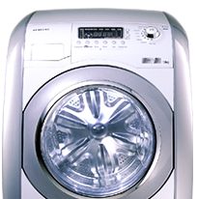
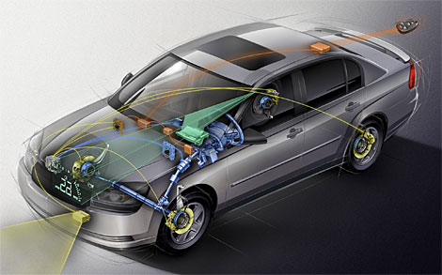
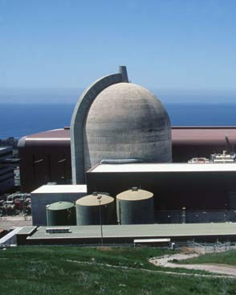
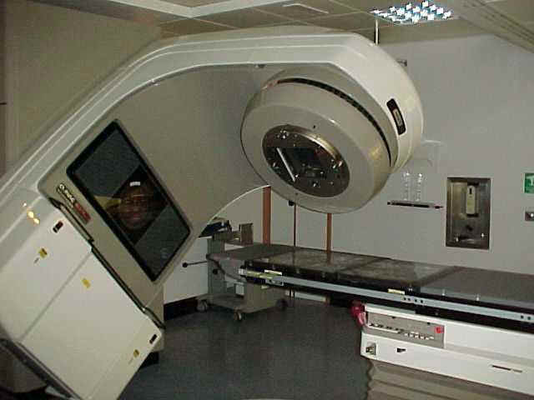

Software is Everywhere

Slide 6
Software is Everywhere
Unreliable

Slide 7
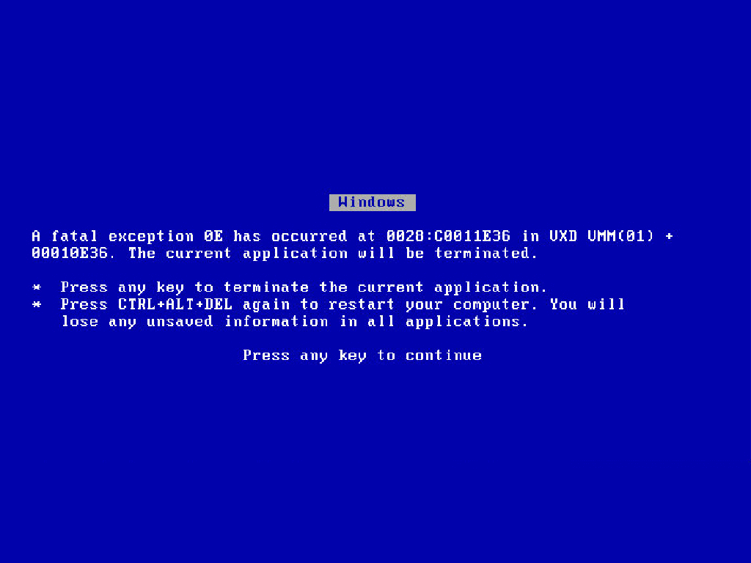

Slide 8
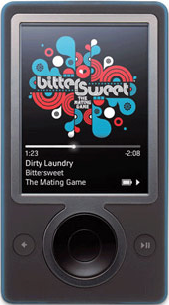
30GB Zunes all over the world fail en masse
December 31, 2008

Slide 9
Zune bug
1 while (days > 365) {
2 if (IsLeapYear(year)) {
3 if (days > 366) {
4 days -= 366;
5 year += 1;
6 }
7 } else {
8 days -= 365;
9 year += 1;
10 }
11 }
December 31, 2008

Slide 10
Zune bug
1 while (366 > 365) {
2 if (IsLeapYear(2008)) {
3 if (366 > 366) {
4 days -= 366;
5 year += 1;
6 }
7 } else {
8 days -= 365;
9 year += 1;
10 }
11 }
December 31, 2008
Suggested solution: wait for tomorrow

Slide 11
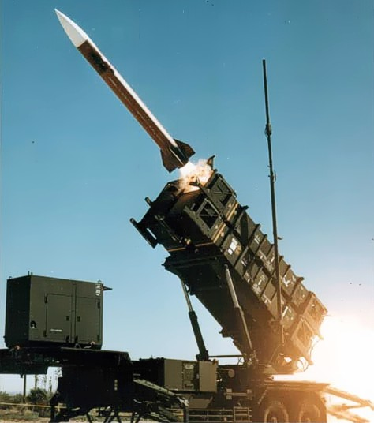
Patriot missile failure
On the night of the 25th of February, 1991, a Patriot missile system operating in Dhahran, Saudi Arabia, failed to track and intercept an incoming Scud. The Iraqi missile impacted into an army barracks, killing 28 U.S. soldiers and injuring another 98.
February 25, 1991

Slide 12
Patriot bug – rounding error
Time measured in 1/10 seconds
Binary expansion of 1/10: 0.0001100110011001100110011001100....
24-bit register
  0.00011001100110011001100
error of
  0.0000000000000000000000011001100... binary, or ~0.000000095 decimal
After 100 hours of operation error is 0.000000095×100×3600×10=0.34
A Scud travels at about 1,676 meters per second, and so travels more than half a kilometer in this time
Suggested solution: reboot every 10 hours

Slide 13
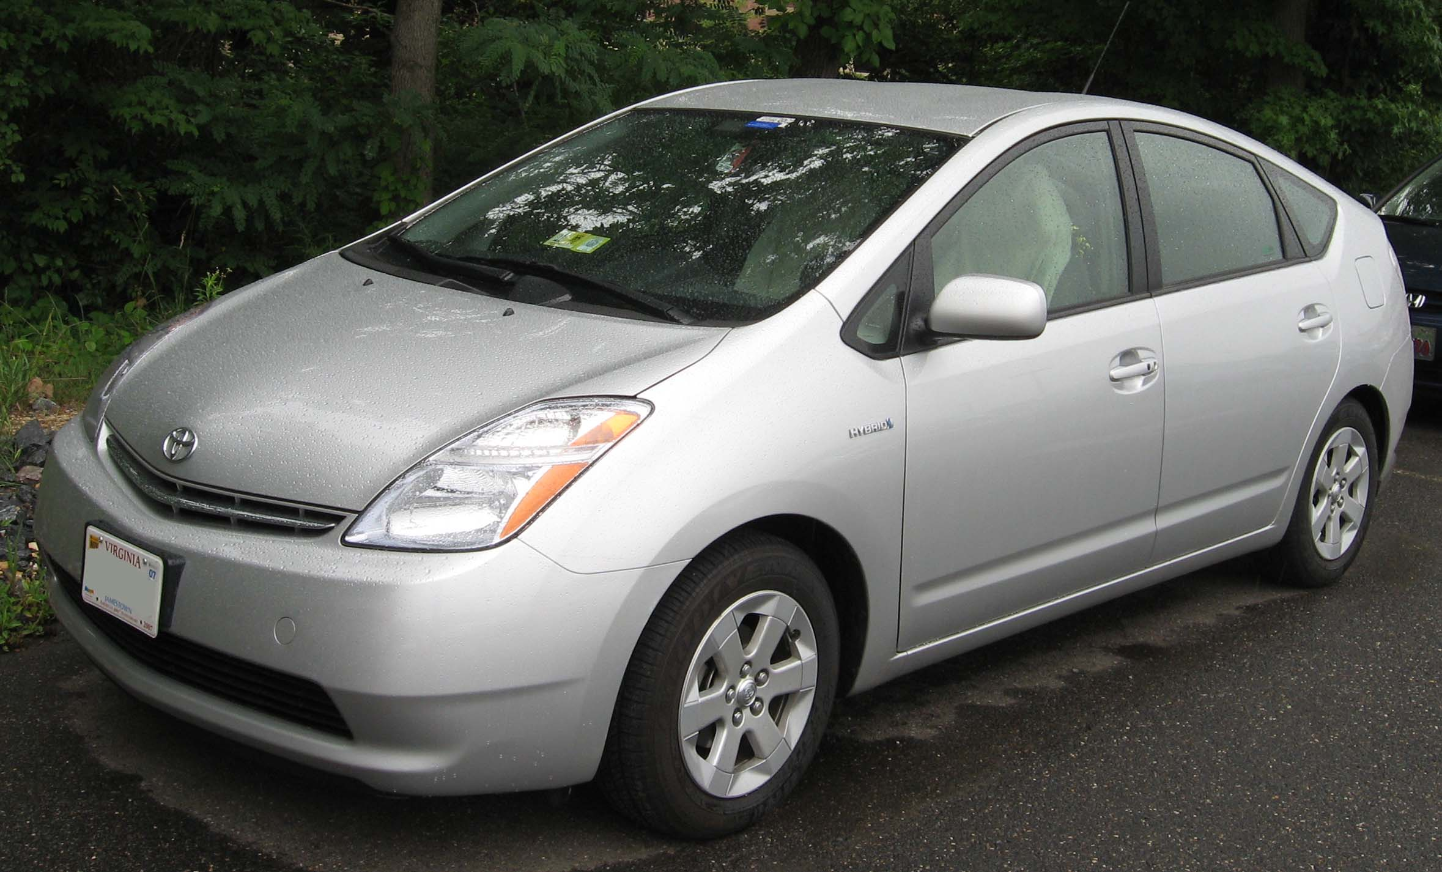
Toyota recalls 160,000 Prius hybrid vehicles
Programming error can activate all warning lights, causing the car to think its engine has failed
October 2005

Slide 14
Therac-25 leads to 3 deaths and 3 injuries
Software error exposes patients to radiation overdose (100X of intended dose)
1985 to 1987
Notes:
“… There was only one person programming the code for this system and he largely did all the testing. The machine was tested for only 2700 hours of use, but for code which controls such a critical machine, many more hours should have been put in to the testing phase…”

Slide 15

Northeast Blackout
14 August, 2003
Notes:
A software bug known as a race condition existed in General Electric Energy's Unix-based XA/21 energy management system. Once triggered, the bug stalled FirstEnergy's control room alarm system for over an hour. System operators were unaware of the malfunction; the failure deprived them of both audio and visual alerts for important changes in system state.^{[12][13]} After the alarm system failure, unprocessed events queued up and the primary server failed within 30 minutes. Then all applications (including the stalled alarm system) were automatically transferred to the backup server, which itself failed at 14:54. The server failures slowed the screen refresh rate of the operators' computer consoles from 1–3 seconds to 59 seconds per screen. The lack of alarms led operators to dismiss a call from American Electric Power about the tripping and reclosure of a 345 kV shared line in northeast Ohio. Technical support informed control room personnel of the alarm system failure at 15:42
The incident contributed to at least 11 deaths and cost an estimated $6 billion.

Slide 16
Northeast Blackout
  A race condition stalled FirstEnergy's control room alarm system for over 1 HOUR, depriving operators from both audio and visual alerts
  Unprocessed events queued up and the primary server failed within 30 minutes
  All applications (including the alarm system) automatically transferred to the backup server, which itself failed
  The server failed, slowing screen refresh rate of the operators' computer consoles from 1–3 seconds to 59 seconds per screen, leading operators to dismiss a call from American Electric Power about the problem
  Technical support informed control room personnel of the alarm system failure 50 MINUTES after the backup failed
    Bottom line: at least 11 deaths and $6 billion damages
14 August, 2003
Notes:
A software bug known as a race condition existed in General Electric Energy's Unix-based XA/21 energy management system. Once triggered, the bug stalled FirstEnergy's control room alarm system for over an hour. System operators were unaware of the malfunction; the failure deprived them of both audio and visual alerts for important changes in system state.^{[12][13]} After the alarm system failure, unprocessed events queued up and the primary server failed within 30 minutes. Then all applications (including the stalled alarm system) were automatically transferred to the backup server, which itself failed at 14:54. The server failures slowed the screen refresh rate of the operators' computer consoles from 1–3 seconds to 59 seconds per screen. The lack of alarms led operators to dismiss a call from American Electric Power about the tripping and reclosure of a 345 kV shared line in northeast Ohio. Technical support informed control room personnel of the alarm system failure at 15:42
The incident contributed to at least 11 deaths and cost an estimated $6 billion.

Slide 17
Unreliable Software is Exploitable
The Sony PlayStation Network breach: An identity-theft bonanza
Massive Sony PlayStation data breach puts about 77 million people at higher risk of fraud
(April 2011)
RSA hacked, information leaks
RSA's corporate network suffered what RSA describes as a successful advanced persistent threat attack, and "certain information" was stolen that can somehow affect the security of SecurID authentication
(March 2011)
Stuxnet Worm Still Out of Control at Iran's Nuclear Sites, Experts Say
The Stuxnet worm, named after initials found in its code, is the most sophisticated cyberweapon ever created.
(December 2010)
Security Advisory for Adobe Flash Player, Adobe Reader and Acrobat
This vulnerability could cause a crash and potentially allow an attacker to take control of the affected system. There are reports that this vulnerability is being exploited in the wild in targeted attacks via a Flash (.swf) file embedded in a Microsoft Excel (.xls) file delivered as an email attachment.
(March 2011)
RSA tokens may be behind major network security problems at Lockheed Martin
Lockheed Martin remote access network, protected by SecurID tokens, has been shut down
(May 2011)

Slide 18
Billy Gates why do you make this possible ? Stop making money
and fix your software!!
(W32.Blaster.Worm)
August 13, 2003

Slide 19
Windows exploit(s)
Buffer Overflow
Memory
addresses
void foo (char *x) {
char buf[2];
strcpy(buf, x);
}
int main (int argc, char *argv[]) {
foo(argv[1]);
}
./a.out abracadabra
Segmentation fault
…
Previous frame
br
Return address
da
Saved FP
ca
char* x
ra
buf[2]
ab
Stack grows
this way

Slide 20
Buffer overrun exploits
int check_authentication(char *password) {
int auth_flag = 0;
char password_buffer[16];
strcpy(password_buffer, password);
if(strcmp(password_buffer, "brillig") == 0) auth_flag = 1;
if(strcmp(password_buffer, "outgrabe") == 0) auth_flag = 1;
return auth_flag;
}
int main(int argc, char *argv[]) {
if(check_authentication(argv[1])) {
printf("\n-=-=-=-=-=-=-=-=-=-=-=-=-=-\n");
printf(" Access Granted.\n");
printf("-=-=-=-=-=-=-=-=-=-=-=-=-=-\n"); }
else
printf("\nAccess Denied.\n");
}
(source: “hacking – the art of exploitation, 2nd Ed”)

Slide 21


Input Validation
evil input
Application
1234567890123456
-=-=-=-=-=-=-=-=-=-=-=-=-=-
Access Granted.
-=-=-=-=-=-=-=-=-=-=-=-=-=-

Slide 22
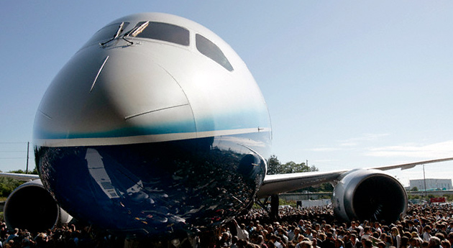
Boeing's 787 Vulnerable to Hacker Attack
security vulnerability in onboard computer networks could allow passengers to access the plane's control systems
January 2008

Slide 23

Apple's SSL/TLS bug (22 Feb 2014)
Affects iOS (probably OSX too)
static OSStatus
SSLVerifySignedServerKeyExchange(…)
{
OSStatus err;
...
if ((err = SSLHashSHA1.f1(...)) != 0)
goto fail;
if ((err = SSLHashSHA1.f2(...)) != 0)
goto fail;
goto fail;
if ((err = SSLHashSHA1.f3(...)) != 0)
goto fail;
...
fail:
SSLFreeBuffer(&signedHashes);
SSLFreeBuffer(&hashCtx);
return err;
}
(Quoted from http://opensource.apple.com/source/Security/Security-55471/libsecurity_ssl/lib/sslKeyExchange.c )

Slide 24
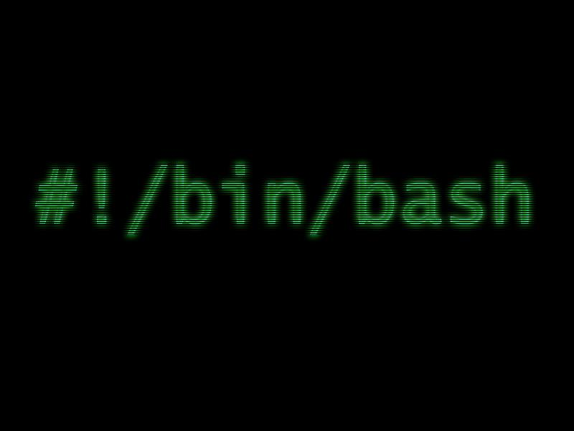
Shellshock bug (24/Sep/2014)
Affects Linux & OSX
22 years old bug!
GNU Bash through 4.3 processes trailing strings after function definitions in the values of environment variables, which allows remote attackers to execute arbitrary code via a crafted environment
30 Sep 2014
Notes:
GNU Bash through 4.3 processes trailing strings after function definitions in the values of environment variables, which allows remote attackers to execute arbitrary code via a crafted environment, as demonstrated by vectors involving the ForceCommand feature in OpenSSH sshd, the mod_cgi and mod_cgid modules in the Apache HTTP Server, scripts executed by unspecified DHCP clients, and other situations in which setting the environment occurs across a privilege boundary from Bash execution.
- NIST

Slide 25
What can we do about it?

Slide 26
What can we do about it?
I just want to say LOVE YOU SAN!!soo much
Billy Gates why do you make this possible ? Stop making money
and fix your software!!
(W32.Blaster.Worm / Lovesan worm)
August 13, 2003
Notes:
Microsoft originally released this bulletin and patch on July 16, 2003, to correct a security vulnerability in a Windows Distributed Component Object Model (DCOM) Remote Procedure Call (RPC) interface. The patch was and still is effective in eliminating the security vulnerability. However, the "mitigating factors" and "workarounds" discussions in the original security bulletin did not clearly identify all the ports by which the vulnerability could potentially be exploited. Microsoft has updated this bulletin to more clearly enumerate the ports over which RPC services can be invoked and to make sure that customers who choose to implement a workaround before installing the patch have the information that they must have to protect their systems. Customers who have already installed the patch are protected from attempts to exploit this vulnerability and do not have to take further action.
Remote Procedure Call (RPC) is a protocol that is used by the Windows operating system. RPC provides an inter-process communication mechanism that allows a program that is running on one computer to seamlessly run code on a remote computer. The protocol itself is derived from the Open Software Foundation (OSF) RPC protocol. The RPC protocol that is used by Windows includes some additional Microsoft-specific extensions.
Wiki:
According to court papers, the original Blaster was created after security researchers from the Chinese group Xfocus reverse engineered the original Microsoft patch that allowed for execution of the attack.[3]
The worm spread by exploiting a buffer overflow discovered by the Polish security research group Last Stage of Delirium[4] in the DCOM RPC service on the affected operating systems, for which a patch had been released one month earlier in MS03-026 and later in MS03-039. This allowed the worm to spread without users opening attachments simply by spamming itself to large numbers of random IP addresses. Four versions have been detected in the wild.[5]
The worm was programmed to start a SYN flood against port 80 of windowsupdate.com if the system date is after August 15th and before December 31st and after the 15th day of other months, thereby creating a distributed denial of service attack (DDoS) against the site.[6] The damage to Microsoft was minimal as the site targeted was windowsupdate.com instead of windowsupdate.microsoft.com to which it was redirected. Microsoft temporarily shut down the targeted site to minimize potential effects from the worm.
MSR:
There is a vulnerability in the part of RPC that deals with message exchange over TCP/IP. The failure results because of incorrect handling of malformed messages. This particular vulnerability affects a Distributed Component Object Model (DCOM) interface with RPC, which listens on RPC-enabled ports. This interface handles DCOM object activation requests that are sent by client machines (for example, Universal Naming Convention [UNC] path requests) to the server. An attacker who successfully exploited this vulnerability would be able to run code with Local System privileges on an affected system. The attacker would be able to take any action on the system, including installing programs, viewing data, changing data, deleting data, or creating new accounts with full privileges.
To exploit this vulnerability, an attacker would have to send a specially formed request to the remote computer on specific RPC ports.
Mitigating Factors
To exploit this vulnerability, the attacker must be able to send a specially crafted request to port 135, port 139, port 445, or any other specifically configured RPC port on the remote computer. For intranet environments, these ports are typically accessible, but for Internet-connected computers, these ports are typically blocked by a firewall. If these ports are not blocked, or in an intranet environment, the attacker does not have to have any additional privileges.
Best practice recommendations include blocking all TCP/IP ports that are not actually being used. By default, most firewalls, including the Windows Internet Connection Firewall (ICF), block those ports. For this reason, most computers that are attached to the Internet should have RPC over TCP or UDP blocked. RPC over UDP or TCP is not intended to be used in hostile environments, such as the Internet. More robust protocols, such as RPC over HTTP, are provided for hostile environments.

Slide 27
What can we do about it?
Monitoring
Testing
Static Analysis
Formal Verification
Specification
Run time
Design Time
Notes:
There are several things that we can do as programmer

Slide 28
Monitoring (e.g., for security)
StackGuard
ProPolice
PointGuard
Security monitors (ptrace)
user space
monitored
application
(Outlook)
monitor
open(“/etc/passwd”, “r”)
OS Kernel
Notes:
Stackguard – canary that protects return addresses
Pointguard – all code pointers
ProPolice – adding buffers after pointers/arguments

Slide 29

Testing
build it
Notes:
Long time tradition
1884 Jumbo 21 elephants

Slide 30

Testing
build it; try it on a some inputs
  printf (“x == 0 => should not get that!”)
build it;
Notes:
Long time tradition
1884 Jumbo 21 elephants

Slide 31
Testing
Valgrind memory errors, race conditions, taint analysis
  Simulated CPU
  Shadow memory
Invalid read of size 4
at 0x40F6BBCC: (within /usr/lib/libpng.so.2.1.0.9)
by 0x40F6B804: (within /usr/lib/libpng.so.2.1.0.9)
by 0x40B07FF4: read_png_image(QImageIO *) (kernel/qpngio.cpp:326)
by 0x40AC751B: QImageIO::read() (kernel/qimage.cpp:3621)
Address 0xBFFFF0E0 is not stack'd, malloc'd or free'd
Notes:
From $0
From simulating cpu to instrumentation
Various usages
Valgring x30 slowdown
Actually a framework

Slide 32
Testing
Valgrind memory errors, race conditions
Parasoft Jtest/Insure++ memory errors + visualizer, race conditions, exceptions …
IBM Rational Purify memory errors
IBM PureCoverage detect untested paths
Daikon dynamic invariant detection
Notes:
From 0 – 15000$
From simulating cpu to instrumentation
Various usages
Valgirg x5 slowdown
Avalanche is an open source tool that generates input data demonstrating crashes in the analysed program.
BoundsChecker: Memory error detection for Windows based applications. Part of Micro Focus DevPartner.
Cenzic: publishes a line of dynamic application security tools that scans web applications for security vulnerabilities.
ClearSQL: is a review and quality control and a code illustration tool for PL/SQL.
Daikon (system) is an implementation of dynamic invariant detection. Daikon runs a program, observes the values that the program computes, and then reports properties that were true over the observed executions, and thus likely true over all executions.
Dmalloc, library for checking memory allocation and leaks. Software must be recompiled, and all files must include the special C header file dmalloc.h.
DynInst is a runtime code-patching library that is useful in developing dynamic program analysis probes and applying them to compiled executables. Dyninst does not require source code or recompilation in general, however, non-stripped executables and executables with debugging symbols are easier to instrument.
Gcov is the GNU source code coverage program.
HP Security Suite is a suite of Tools at various stages of development. QAInspect and WebInspect are generally considered Dynamic Analysis Tools, while DevInspect is considered a static code analysis tool.
IBM Rational AppScan is a suite of application security solutions targeted for different stages of the development lifecycle. The suite includes two main dynamic analysis products - IBM Rational AppScan Standard Edition, and IBM Rational AppScan Enterprise Edition. In addition, the suite includes IBM Rational AppScan Source Edition - a static analysis tool.
Intel Thread Checker is a runtime threading error analysis tool which can detect potential data races and deadlocks in multithreaded Windows or Linux applications.
Intel Parallel Inspector performs run time threading and memory error analysis in Windows.
Parasoft Insure++ is runtime memory analysis and error detection tool. Its Inuse component provides a graphical view of memory allocations over time, with specific visibility into overall heap usage, block allocations, possible outstanding leaks, etc.
Parasoft Jtest uses runtime error detection to expose defects such as race conditions, exceptions, resource & memory leaks, and security attack vulnerabilities.
Purify: mainly memory corruption detection and memory leak detection.
Valgrind runs programs on a virtual processor and can detect memory errors (e.g., misuse of malloc and free) and race conditions in multithread programs.
VB Watch injects dynamic analysis code into Visual Basic programs to monitor their performance, call stack, execution trace, instantiated objects, variables and code coverage.
Vector FabricsPareon uses code simulation to analyse code behavior. The tool will then suggest code optimizations based on parallelization.

Slide 33
Testing
Useful and challenging
  Random inputs
  Guided testing (coverage)
  Bug reproducing
But …
  Observe some program behaviors
  What can you say about other behaviors?
Notes:
Not only test case we etie our selves
Random
Coverage
Reproduction of a bug

Slide 34
Testing is not enough
Observe some program behaviors
What can you say about other behaviors?
Concurrency makes things worse
Smart testing is useful
  requires the techniques that we will see in the course

Slide 35
What can we do about it?
Monitoring
Testing
Static Analysis
Formal Verification
Specification
Run time
Design Time
Notes:
There are several things that we can do as programmer

Slide 36
Program Analysis & Verification
x = ?
if (x > 0) {
y = 42;
} else {
y = 73;
foo();
}
assert (y == 42);
?
Is assertion true?

Slide 37
Program Analysis & Verification
y = ?; x = y * 2
if (x % 2 == 0) {
y = 42;
} else {
y = 73;
foo();
}
assert (y == 42);
?
Is assertion true? Can we prove this? Automatically?
Bad news: problem is generally undecidable

Slide 38
Formal verification
Mathematical model of software
  ρ: Var →Z
  ρ= [x➔0, y➔1]
Logical specification
  { 0 < x } = {ρ ∈ State | 0 < ρ (x) }
Machine checked formal proofs
{ 0 < x ∧ y = x } → { 0 < y }
{ 0 < x } y:= x { 0 < x ∧ y = x }
{ 0 < y } y:= y+1 { 1< y }
{ 0 < x } y:= x ; y:=y+1 { 1 < y }
{ ? }

Slide 39
Formal verification
Mathematical model of software
  State = Var ➔ Integer
  S = [x➔0, y➔1]
Logical specification
  { 0 < x } = { S ε State | 0 < S(x) }
Machine checked formal proofs
Q’ → P’
{ P } stmt1 { Q’ }
{ P’ } stmt2 { Q }
{ P } stmt1; stmt2 { Q }

Slide 40
Program Verification
{true}
y = ?; x = 2 * y;
{x = 2 * y}
if (x % 2 == 0) {
{x = 2 * y}
y = 42;
{ z. x = 2 * z∧ y = 42 }
} else {
{ false }
y = 73;
foo();
{ false }
}
{ z. x = 2 * z∧ y = 42 }
assert (y == 42);
E
E
Is assertion true? Can we prove this? Automatically?
Can we prove this manually?

Slide 41
Central idea: use approximation
Over Approximation
Exact set of configurations/
behaviors
Under Approximation
universe

Slide 42
Program Verification
{true}
y = ?; x = 2 * y;
{x = 2 * y}
if (x % 2 == 0) {
{x = 2 * y}
y = 42;
{ z. x = 2 * z∧ y = 42 }
} else {
{ false }
y = 73;
foo();
{ false }
}
{ z. x = 2 * z∧ y = 42 } {x = ?∧ y = 42 } { x = 4∧ y = 42 }
assert (y == 42);
E
E
Is assertion true? Can we prove this? Automatically?
Can we prove this manually?

Slide 43
L4.verified [Klein⁺,’09]
Microkernel
  IPC, Threads, Scheduling, Memory management
Functional correctness (using Isabelle/HOL)
  No null pointer de-references.
  No memory leaks.
  No buffer overflows.
  No unchecked user arguments
  …
Kernel/proof co-design
  Implementation - 2.5 py (8,700 LOC)
  Proof – 20 py (200,000 LOP)

Slide 44
Static Analysis
Lightweight formal verification
Formalize software behavior in a mathematical model (semantics)
Prove (selected) properties of the mathematical model
  Automatically, typically with approximation of the formal semantics

Slide 45
Why static analysis?
Some errors are hard to find by testing
  arise in unusual circumstances/uncommon execution paths
    buffer overruns, unvalidated input, exceptions, ...
  involve non-determinism
    race conditions
Full-blown formal verification too expensive

Slide 46
Is it at all doable?
x = ?
if (x > 0) {
y = 42;
} else {
y = 73;
foo();
}
assert (y == 42);
Bad news: problem is generally undecidable

Slide 47
Central idea: use approximation
Over Approximation
Exact set of configurations/
behaviors
Under Approximation
universe

Slide 48
Goal: exploring program states
bad
states
reachable
states
initial
states

Slide 49
Technique: explore abstract states
bad
states
reachable
states
initial
states

Slide 50
Technique: explore abstract states
bad
states
reachable
states
initial
states

Slide 51
Technique: explore abstract states
bad
states
reachable
states
initial
states

Slide 52
Technique: explore abstract states
bad
states
reachable
states
initial
states

Slide 53
Sound: cover all reachable states
bad
states
reachable
states
initial
states

Slide 54
Unsound: miss some reachable states
bad
states
reachable
states
initial
states

Slide 55
Imprecise abstraction
False alarms
bad
states
reachable
states
initial
states

Slide 56
A sound message
x = ?
if (x > 0) {
y = 42;
} else {
y = 73;
foo();
}
assert (y == 42);
Assertion may be violated

Slide 57
Precision
Avoid useless result
Low false alarm rate
Understand where precision is lost
UselessAnalysis(Program p) {
printf(“assertion may be violated\n”);
}

Slide 58
A sound message
y = ?; x = y * 2
if (x % 2 == 0) {
y = 42;
} else {
y = 73;
foo();
}
assert (y == 42);
Assertion is true

Slide 59
How to find “the right” abstraction?
Pick an abstract domain suited for your property
  Numerical domains
  Domains for reasoning about the heap
  …
Combination of abstract domains

Slide 60
Intervals Abstraction
y
6
5
y  [3,6]
4
3
2
1
0
1
2
3
4
x
x  [1,4]

Slide 61
Interval Lattice
[- ,]
…
…
[- ,2]
[-2,]
…
…
[-,1]
[-2,2]
[-1,]
…
…
[- ,0]
[-2,1]
[-1,2]
[0,]
…
…
[-,-1]
[-2,0]
[-1,1]
[0,2]
[1,]
…
…
[- ,-2]
[-2,-1]
[-1,0]
[2,]
[0,1]
[1,2]
…
…
[-2,-2]
[-1,-1]
[0,0]
[1,1]
[2,2]
…
…
…
(infinite lattice, infinite height)


Slide 62
Example
x  
x=0
int x = 0;
if (?) x++;
if (?) x++;
x  [0,0]
if
x  [0,0]
x++
x  [1,1]
x  [0,1]
if
x++
x  [1,2]
x  [0,2]
exit
[a1,a2]  [b1,b2] = [min(a1,b1), max(a2,b2)]

Slide 63

Polyhedral Abstraction
abstract state is an intersection of linear inequalities of the form a₁x₂+a₂x₂+…a_{n}x_{n}  c
represent a set of points by their convex hull
(image from http://www.cs.sunysb.edu/~algorith/files/convex-hull.shtml)

Slide 64
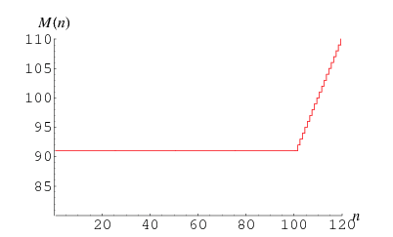

McCarthy 91 function

Slide 65
McCarthy 91 function
proc MC (n : int) returns (r : int) var t1 : int, t2 : int;
begin
if n > 100 then
r = n - 10;
else
t1 = n + 11;
t2 = MC(t1);
r = MC(t2);
endif;
end
var a : int, b : int;
begin /* top */
b = MC(a);
end
if (n>=101) then n-10 else 91

Slide 66
McCarthy 91 function
proc MC (n : int) returns (r : int) var t1 : int, t2 : int;
begin
/* top */
if n > 100 then
/* [|n-101>=0|] */
r = n - 10; /* [|-n+r+10=0; n-101>=0|] */
else
/* [|-n+100>=0|] */
t1 = n + 11; /* [|-n+t1-11=0; -n+100>=0|] */
t2 = MC(t1); /* [|-n+t1-11=0; -n+100>=0;
-n+t2-1>=0; t2-91>=0|] */
r = MC(t2); /* [|-n+t1-11=0; -n+100>=0;
-n+t2-1>=0; t2-91>=0; r-t2+10>=0;
r-91>=0|] */
endif; /* [|-n+r+10>=0; r-91>=0|] */
end
var a : int, b : int;
begin /* top */
b = MC(a); /* [|-a+b+10>=0; b-91>=0|] */
end
if (n>=101) then n-10 else 91
if (n>=101) then n-10 else 91

Slide 67
McCarthy 91 function
proc MC (n : int) returns (r : int) var t1 : int, t2 : int;
begin
/* (L6 C5) top */
if n > 100 then
/* (L7 C17) [|n-101>=0|] */
r = n - 10; /* (L8 C14) [|-n+r+10=0; n-101>=0|] */
else
/* (L9 C6) [|-n+100>=0|] */
t1 = n + 11; /* (L10 C17) [|-n+t1-11=0; -n+100>=0|] */
t2 = MC(t1); /* (L11 C17) [|-n+t1-11=0; -n+100>=0;
-n+t2-1>=0; t2-91>=0|] */
r = MC(t2); /* (L12 C16) [|-n+t1-11=0; -n+100>=0;
-n+t2-1>=0; t2-91>=0; r-t2+10>=0;
r-91>=0|] */
endif; /* (L13 C8) [|-n+r+10>=0; r-91>=0|] */
end
var a : int, b : int;
begin
/* (L18 C5) top */
b = MC(a); /* (L19 C12) [|-a+b+10>=0; b-91>=0|] */
end
if (n>=101) then n-10 else 91

Slide 68
What is Static analysis
Develop theory and tools for program correctness and robustness
Reason statically (at compile time) about the possible runtime behaviors of a program
“The algorithmic discovery of properties of a program by inspection of its source text¹”
-- Manna, Pnueli
1 Does not have to literally be the source text, just means w/o running it

Slide 69
Static analysis definition
Reason statically (at compile time) about the possible runtime behaviors of a program
“The algorithmic discovery of properties of a program by inspection of its source text¹”
-- Manna, Pnueli
1 Does not have to literally be the source text, just means w/o running it

Slide 70
Some automatic tools

Slide 71
Challenges
class SocketHolder { Socket s; }
Socket makeSocket() { return new Socket(); // A }
open(Socket l) { l.connect(); }
talk(Socket s) { s.getOutputStream()).write(“hello”); }
main() {
Set<SocketHolder> set = new HashSet<SocketHolder>();
while(…) {
SocketHolder h = new SocketHolder();
h.s = makeSocket();
set.add(h);
}
for (Iterator<SocketHolder> it = set.iterator(); …) {
Socket g = it.next().s;
open(g);
talk(g);
}
}

Slide 72
(In)correct usage of APIs
Application trend: Increasing number of libraries and APIs
  Non-trivial restrictions on permitted sequences of operations
Typestate: Temporal safety properties
  What sequence of operations are permitted on an object?
  Encoded as DFA
  e.g. “Don’t use a Socket unless it is connected”
close()
getInputStream()
getOutputStream()
init
connected
closed
connect()
close()
err
getInputStream()
getOutputStream()
getInputStream()
getOutputStream()
*

Slide 73
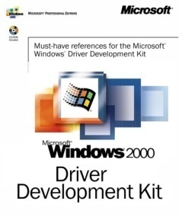
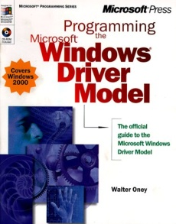
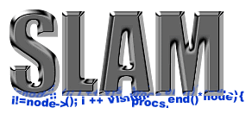
Static Driver Verifier
Rules
Static Driver Verifier
Precise
API Usage Rules
(SLIC)
Environment
model
Defects
100% path
coverage
Driver’s Source Code in C

Slide 74
State machine for locking
SLAM
Locking rule in SLIC
state {
enum {Locked,Unlocked}
s = Unlocked;
}
KeAcquireSpinLock.entry {
if (s==Locked) abort;
else s = Locked;
}
KeReleaseSpinLock.entry {
if (s==Unlocked) abort;
else s = Unlocked;
}
Rel
Acq
Unlocked
Locked
Rel
Acq
Error

Slide 75
SLAM (now SDV) [Ball⁺,’11]
100 drivers and 80 SLIC rules.
  The largest driver ~ 30,000 LOC
  Total size ~450,000 LOC
The total runtime for the 8,000 runs (driver x rule)
  30 hours on an 8-core machine
  20 mins. Timeout
Useful results (bug / pass) on over 97% of the runs
Caveats: pointers (imprecise) & concurrency (ignores)

Slide 76
The Astrée Static Analyzer
Patrick Cousot
Radhia Cousot
Jérôme Feret
Laurent Mauborgne
Antoine Miné
Xavier Rival
ENS France

Slide 77
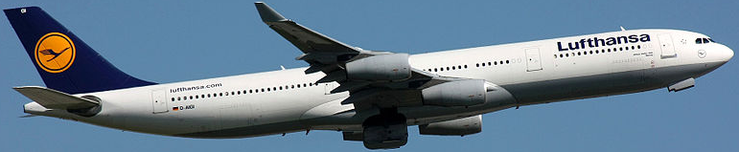
Objectives of Astrée
Prove absence of errors in safety critical C code
ASTRÉE was able to prove completely automatically the absence of any RTE in the primary flight control software of the Airbus A340 fly-by-wire system
  a program of 132,000 lines of C analyzed
By Lasse Fuss (Own work) [CC-BY-SA-3.0 (http://creativecommons.org/licenses/by-sa/3.0)], via Wikimedia Commons

Slide 78
Scaling
false positives
bad
states
bad
states
reachable
states
reachable
states
false negatives
initial
states
initial
states
Sound
Complete

Slide 79
Unsound static analysis
false positives
bad
states
reachable
states
false negatives
initial
states

Slide 80
Unsound static analysis
Static analysis
  No code execution
Trade soundness for scalability
  Do not cover all execution paths
  But cover “many”

Slide 81
FindBugs [Pugh⁺,’04]
Analyze Java programs (bytecode)
Looks for “bug patterns”
Bug patterns
  Method() vs method()
  Override equal(…) but not hashCode()
  Unchecked return values
  Null pointer dereference
App17 | KLOC | NP bugs | Other Bugs | Bad Practice | Dodgy
Sun JDK 1.7 | 597 | 68 | 180 | 594 | 654
Eclipse 3.3 | 1447 | 146 | 259 | 1079 | 653
Netbeans 6 | 1022 | 189 | 305 | 3010 | 1112
glassfish | 2176 | 146 | 154 | 964 | 1222
jboss | 178 | 30 | 57 | 263 | 214
Notes:
f you just want to try running FindBugs against your own code, you can run FindBugs using Java Webstart. This will use our new gui under Java 1.5+ and our old gui under Java 1.4. The new gui provides a number of new features, but requires Java 1.5+. Both use exactly the same analysis engine.
This web page provides results of running FindBugs 1.2.0 against several open source applications. We provide a summary of the number of bugs we found, as well as a generated HTML listing of the bugs and a Java WebStart demo of the new GUI we've introduced in FindBugs version 1.1, displaying the warnings and the relevant source.
The applications and versions of them we report on are somewhat arbitrary. In some cases, they are release versions, in other cases nightly builds. We find lots of bugs in every large code base we examine; these applications are certainly not the worst we have seen. I have been allowed to confidentially examine the results of running FindBugs against several closed commercial code bases by well respected companies; the results I've seen there are not significantly different from what I've observed in open source code bases.
Experimental details: These results are from running FindBugs 1.2.0 at standard effort level. Our results do not include any low priority warnings or any warnings about vulnerabilities to malicious code. Although we have (repeatedly) manually audited the results, we haven't manually filtered out false positives from these warnings, so that you can get a feeling for the quality of the warnings generated by FindBugs.
Some of the bugs contain audit comments: they are marked as to whether we thought the warning indicated a bug that should or must be fixed, or whether it was not, in fact, a bug.
In the webstart versions, we've only included the bugs for which we were able to identify source files. The number of lines of non-commenting source statements in the table below (KNCSS) is derived from the same files that we analyzed and in which we report bugs; we actually compute KNCSS from the classfiles, not the source files.
Vulnerability disclosure: Thankfully, Java isn't C or C++. Dereferencing a null pointer or accessing outside the bounds of an array generates a runtime exception rather than a shell exploit. We do not believe that any of the warnings here represents a security vulnerability, although we have not audited them to verify that. These projects are all aware of the existence of FindBugs, and FindBugs is already open source and available for use both by developers and attackers, we don't believe that making these results available constitutes a reckless disclosure.
Recommendations: First, review the correctness warnings. We feel confident that developers would want to fix most of the high and medium priority correctness warnings we report. Once you've reviewed those, you might want to look at some of the other categories.
In other categories, such as Bad practice and Dodgy code, we accept more false positives. You might decide that a pattern bug pattern isn't relevant for your code base (e.g., you never use Serialization for persistent storage, so you never care about the fact that you didn't define a serializationUID), and even for the bug patterns relevant to your code base, perhaps only a minority will reflect problems serious enough to convince you to change your code.
Please be patient The Web start versions not only have to download the applications, they need to download about 10 megabytes of data and source files. Please be patient. Sorry we don't have a progress bar for the data and source download; the ability to remotely download a data and source archive is a little bit of a hack. We've provided small versions of some of the data sets that include only the correctness bugs and the source files containing those warnings. The small datasets are about a quarter of the sizes of the full datasets.
Application Details Correctness bugs Bad Practice Dodgy KNCSS
HTML WebStart NP bugs Other
Sun JDK 1.7.0-b12 All All Small 68 180 954 654 597
eclipse-SDK-3.3M7-solaris-gtk All All Small 146 259 1,079 643 1,447
netbeans-6_0-m8 All All Small 189 305 3,010 1,112 1,022
glassfish-v2-b43 All All Small 146 154 964 1,222 2,176
jboss-4.0.5 All All Small 30 57 263 214 178
KNCSS - Thousands of lines of non-commenting source statements
Bug categories
Correctness bug
Probable bug - an apparent coding mistake resulting in code that was probably not what the developer intended. We strive for a low false positive rate.
Bad Practice
Violations of recommended and essential coding practice. Examples include hash code and equals problems, cloneable idiom, dropped exceptions, serializable problems, and misuse of finalize. We strive to make this analysis accurate, although some groups may not care about some of the bad practices.
Dodgy
Code that is confusing, anomalous, or written in a way that leads itself to errors. Examples include dead local stores, switch fall through, unconfirmed casts, and redundant null check of value known to be null. More false positives accepted. In previous versions of FindBugs, this category was known as Style.

Slide 82
PREfix [Pincus⁺,’00]
Developed by Pinucs, purchased by Microsoft
Automatic analysis of C/C++ code
  Memory errors, divide by zero
  Inter-procedural bottom-up analysis
  Heuristic - choose “100” paths
  Minimize effect of false positive
Program | KLOC | Time
Mozilla browser | 540 | 11h
Apache | 49 | 15m
2-5 warnings per KLOC
Notes:
Program Language Mozilla C++
Apache C GDI Demo C
Number of files
603
69 9
Number of lines
540 613
48 393 2655
PREfix parse time
2 h 28 min
6 min 1 s
PREfix simulation time
8 h 27 min
9 min 15 s
Detects errors in C/C++ code
● null pointer, memory allocation, uninitialized value, resource
state, library usage, ...
■ Interprocedural
● bottom up traversal of call graph
● models routine by examining limited set of paths (100)  apply model at call site
● expensive, batch computation for large systems
■ Large effort to minimize effects of false positives  filtering and prioritizing error reports
● heuristics tuned to reduce noise (at cost of precision)

Slide 83
PREfast
Analyze Microsoft kernel code + device drivers
  Memory errors, races, …
Part of Microsoft visual studio
Intra-procedural analysis
User annotations
memcpy( __out_bcount( length ) dest, __in_bcount( length ) src, length );
PREfix + PREfast found 1/6 of bugs fixed in Windows Server’03
Notes:
memcpy( dest, __in_bcount( length ) src, length );
which tells PREfast that the number of bytes in src is given by length.
memcpy() also requires a second annotation to tell PREfast how many bytes of output are going to be produced. Since this is the same as the number of input bytes, the final annotation is:
memcpy( __out_bcount( length ) dest, __in_bcount( length ) src, length );

Slide 84
Coverity [Engler⁺, ‘04]
Looks for bug patterns
  Enable/disable interrupts, double locking, double locking, buffer overflow, …
Learns patterns from common
Robust & scalable
  150 open source program -6,000 bugs
  Unintended acceleration in Toyota

Slide 85
Sound SA vs. Testing
Sound SA
Unsound SA
Testing
Can find rare errors
Can raise false alarms
Cost ~ program’s complexity
Can handle limited classes of programs and still be useful
Can miss errors
Can raise false alarms
Cost ~ program’s complexity
No need to efficiently handle rare cases
Can miss errors
Finds real errors
Cost ~ program’s execution
No need to efficiently handle rare cases

Slide 86
Sound SA vs. Formal verification
Sound Static Analysis
Formal verification
Fully automatic
Applicable to a programming language
Can be very imprecise
May yield false alarms
Requires specification and loop invariants
Program specific
Relatively complete
Provides counter examples
Provides useful documentation
Can be mechanized using theorem provers

Slide 87
Operational Semantics

Slide 88
Agenda
What does semantics mean?
  Why do we need it?
  How is it related to analysis/verification?
Operational semantics
  Natural operational semantics
  Structural operational semantics

Slide 89
Program analysis & verification
y = ?; x = ?;
x = y * 2
if (x % 2 == 0) {
y = 42;
} else {
y = 73;
foo();
}
assert (y == 42);
?

Slide 90
What does P do?
y = ?; x = ?;
x = y * 2
if (x % 2 == 0) {
y = 42;
} else {
y = 73;
foo();
}
assert (y == 42);
?

Slide 91
What does P mean?
y = ?; x = ?;
x = y * 2
if (x % 2 == 0) {
y = 42;
} else {
y = 73;
foo();
}
assert (y == 42);
…
syntax
semantics

Slide 92
“Standard” semantics
y = ?;
x = y * 2
if (x % 2 == 0) {
y = 42;
} else {
y = 73;
foo();
}
assert (y == 42);
…-1,0,1, …
…-1,0,1,…
y
x

Slide 93
“Standard” semantics
(“state transformer”)
y = ?;
x = y * 2
if (x % 2 == 0) {
y = 42;
} else {
y = 73;
foo();
}
assert (y == 42);
…-1,0,1, …
…-1,0,1,…
y
x

Slide 94
“Standard” semantics
(“state transformer”)
y = ?; y=3, x=9
x = y * 2
if (x % 2 == 0) {
y = 42;
} else {
y = 73;
foo();
}
assert (y == 42);
…-1,0,1, …
…-1,0,1,…
y
x

Slide 95
“Standard” semantics
(“state transformer”)
y = ?; y=3, x=9
x = y * 2 y=3, x=6
if (x % 2 == 0) { y=3, x=6
y = 42; y=42, x=6
} else {
y = 73; …
foo(); …
}
assert (y == 42); y=42, x=6
…-1,0,1, …
…-1,0,1,…
y
x

Slide 96
“State transformer” semantics
bad
states
y=3,x=6
reachable
states
y=3,x=6
y=3,x=9
initial
states

Slide 97
“State transformer” semantics
bad
states
reachable
states
initial
states
y=4,x=8
y=4,x=8
y=4,x=1

Slide 98
“State transformer” semantics
bad
states
reachable
states
initial
states
y=4…,x=…

Slide 99
“State transformer” semantics
Main idea: find (properties of) all reachable states*
bad
states
y=3,x=6
reachable
states
y=3,x=6
y=3,x=9
y=4,x=1
y=4,x=8
initial
states
y=4,x=8
y=4…,x=…

Slide 100
“Standard” (collecting) semantics
(“sets-of states-transformer”)
y = ?; x = ?; {(y,x) | y,x ∈ Nat}
x = y * 2
if (x % 2 == 0) {
y = 42;
} else {
y = 73;
foo();
}
assert (y == 42);

Slide 101
“Standard” (collecting) semantics
(“sets-of states-transformer”)
y = ?; {(y=3, x=9),(y=4,x=1),(y=…, x=…)}
x = y * 2 {(y=3, x=6),(y=4,x=8),(y=…, x=…)}
if (x % 2 == 0) { {(y=3, x=6),(y=4,x=8),(y=…, x=…)}
y = 42; {(y=42, x=6),(y=42,x=8),(y=42, x=…)}
} else {
y = 73; { }
foo(); { }
}
assert (y == 42); {(y=42, x=6),(y=42,x=8),(y=42, x=…)}
Yes

Slide 102
“Set-of-states transformer” semantics
bad
states
y=3,x=6
reachable
states
y=3,x=6
y=3,x=9
y=4,x=1
initial
states
y=4,x=1
y=4,x=1

Slide 103
Program semantics
State-transformer
  Set-of-states transformer
  Trace transformer
Predicate-transformer
Functions

Slide 104
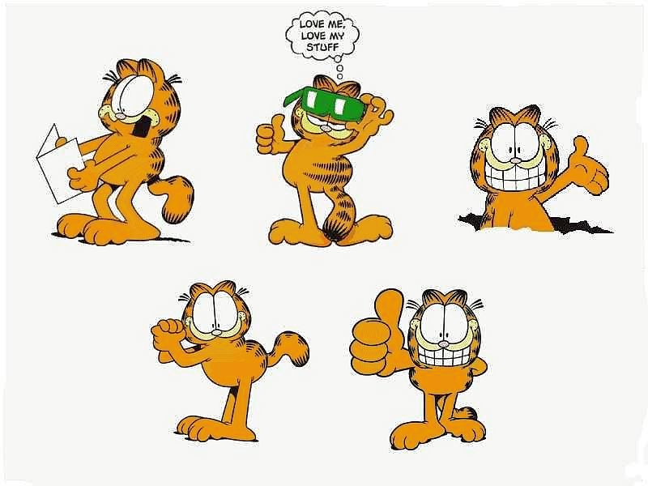
Program semantics
State-transformer
  Set-of-states transformer
  Trace transformer
Predicate-transformer
Functions
Cat-transformer

Slide 105
Program semantics & verification

Slide 106
“Abstract-state transformer” semantics
y = ?; y=T, x=T
x = y * 2
if (x % 2 == 0) {
y = 42;
} else {
y = 73;
foo();
}
assert (y == 42);
T
T
O
E
O
E
T
T
y
x
(y=E,x=E)={(0,0), (0,2), (-4,10),…}

Slide 107
“Abstract-state transformer” semantics
y = ?; y=T, x=T
x = y * 2 y=T, x=E
if (x % 2 == 0) { y=T, x=E
y = 42; y=T, x=E
} else {
y = 73; …
foo(); …
}
assert (y == 42); y=E, x=E
T
T
O
E
O
E
T
T
y
x
(y=E,x=E)={(0,0), (0,2), (-4,10),…}
Yes/?/No

Slide 108
“Abstract-state transformer” semantics
y = ?; y=T, x=T
x = y * 2 y=T, x=E
if (x % 2 == 0) { y=T, x=E
y = 42; y=T, x=E
} else {
y = 73; …
foo(); …
}
assert (y == 42); y=E, x=E
T
T
O
E
O
E
T
T
y
x
(y=E,x=E)={(0,0), (0,2), (-4,10),…}
Yes/?/No

Slide 109
“Abstract-state transformer” semantics
y = ?; y=T, x=T
x = y * 2 y=T, x=E
if (x % 2 == 0) { y=T, x=E
y = 42; y=E, x=E
} else {
y = 73; …
foo(); …
}
assert (y%2 == 0) y=E, x=E
T
T
O
E
O
E
T
T
y
x
(y=E,x=E)={(0,0), (0,2), (-4,10),…}
?

Slide 110
“Abstract-state transformer” semantics
bad
states
reachable
states
initial
states

Slide 111
“Abstract-state transformer” semantics
bad
states
reachable
states
initial
states

Slide 112
“Abstract-state transformer” semantics
bad
states
reachable
states
initial
states

Slide 113
How do we say what P mean?
y = ?; x = ?;
x = y * 2
if (x % 2 == 0) {
y = 42;
} else {
y = 73;
foo();
}
assert (y == 42);
…
syntax
semantics

Slide 114
Agenda
Operational semantics
  Natural operational semantics
  Structural operational semantics

Slide 115
Programming Languages
Syntax
    “how do I write a program?”
  BNF
  “Parsing”
Semantics
    “What does my program mean?”
  …

Slide 116
Program semantics
State-transformer
  Set-of-states transformer
  Trace transformer
Predicate-transformer
Functions

Slide 117
Program semantics
State-transformer
  Set-of-states transformer
  Trace transformer
Predicate-transformer
Functions

Slide 118
What semantics do we want?
Captures the aspects of computations we care about
  “adequate”
Hides irrelevant details
  “fully abstract”
Compositional

Slide 119
What semantics do we want?
Captures the aspects of computations we care about
  “adequate”
Hides irrelevant details
  “fully abstract”
Compositional

Slide 120
Formal semantics
“Formal semantics is concerned with rigorously specifying the meaning, or behavior, of programs, pieces of hardware, etc.”
Semantics with Applications – a Formal Introduction (Page 1)
Nielsen & Nielsen

Slide 121
Formal semantics
  “This theory allows a program to be manipulated like a formula –
  that is to say, its properties can be calculated.”
  Gérard Huet & Philippe Flajolet homage to Gilles Kahn

Slide 122
Why formal semantics?
Implementation-independent definition of a programming language
Automatically generating interpreters
  and some day maybe full fledged compilers
Verification and debugging
  if you don’t know what it does, how do you know its incorrect?

Slide 123
Why formal semantics?
Implementation-independent definition of a programming language
Automatically generating interpreters
  and some day maybe full fledged compilers
Verification and debugging
  if you don’t know what it does, how do you know its incorrect?

Slide 124
Levels of abstractions and applications
Static Analysis
(abstract semantics)

Program Semantics

Assembly-level Semantics
(Small-step)

Slide 125
Semantic description methods
Operational semantics
  Natural semantics (big step) [G. Kahn]
  Structural semantics (small step) [G. Plotkin]
    Trace semantics
    Collecting semantics
    [Instrumented semantics]
Denotational semantics [D. Scott, C. Strachy]
Axiomatic semantics [C. A. R. Hoare, R. Floyd]
Notes:
Christopher Strachey & Dana S. Scott

Slide 126
Operational Semantics

Slide 127
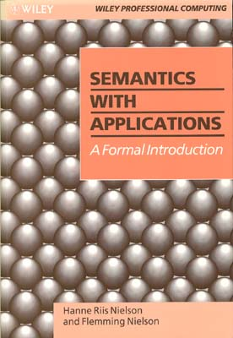
http://www.daimi.au.dk/~bra8130/Wiley_book/wiley.html

Slide 128
A simple imperative language: While
Abstract syntax:
  a ::= n | x | a₁ + a₂ | a₁  a₂ | a₁ – a₂
  b ::= true | false
  | a₁ = a₂ | a₁  a₂ | b | b₁  b₂
  S ::= x := a | skip | S₁; S₂
  | if b then S₁ else S₂
  | while b do S

Slide 129
Concrete syntax vs. abstract syntax
z:=x; x:=y; y:=z
S
S
S
;
S
S
;
S
z
:=
a
S
;
S
S
;
S
y
:=
a
x
x
:=
a
y
:=
a
z
:=
a
x
:=
a
z
y
z
x
y
z:=x; (x:=y; y:=z)
(z:=x; x:=y); y:=z

Slide 130
Exercise: draw an AST
y:=1; while (x=1) do (y:=y*x; x:=x-1)
S
S
;
S

Slide 131
Syntactic categories
  n  Num numerals
  x  Var program variables
  a  Aexp arithmetic expressions
  b  Bexp boolean expressions
  S  Stm statements

Slide 132
Semantic categories
  Z Integers {0, 1, -1, 2, -2, …}
  T Truth values {ff, tt}
  State Var  Z
  Example state: s=[x5, y7, z0]
  Lookup: s x = 5
  Update: s[x6] = [x6, y7, z0]

Slide 133
Example state manipulations
[x1, y7, z16] y =
[x1, y7, z16] t =
[x1, y7, z16][x5] =
[x1, y7, z16][x5] x =
[x1, y7, z16][x5] y =

Slide 134
Semantics of arithmetic expressions
Arithmetic expressions are side-effect free
Semantic function A ← Aexp → : State → Z
Defined by induction on the syntax tree
  A ← n → s = n
  A ← x → s = s x
  A ← a₁ + a₂ → s = A ← a₁ → s + A ← a₂ → s
  A ← a₁ - a₂ → s = A ← a₁ → s - A ← a₂ → s
  A ← a₁ * a₂ → s = A ← a₁ → s × A ← a₂ → s
  A ← (a₁) → s = A ← a₁ → s --- not needed
  A ← - a → s = 0 - A ← a₁ → s
Compositional
Properties can be proved by structural induction

Slide 135
Arithmetic expression exercise
Suppose s x = 3
Evaluate A ←x+1→ s

Slide 136
Semantics of boolean expressions
Boolean expressions are side-effect free
Semantic function B ← Bexp → : State → T
Defined by induction on the syntax tree
  B ← true → s = tt
  B ← false → s = ff
  B ← a₁ = a₂→ s =
  B ← a₁  a₂ → s =
  B ← b₁  b₂ → s =
  B ←  b → s =

Slide 137
Operational semantics
Concerned with how to execute programs
  How statements modify state
  Define transition relation between configurations
Two flavors
  Natural semantics: describes how the overall results of executions are obtained
    So-called “big-step” semantics
  Structural operational semantics: describes how the individual steps of a computations take place
    So-called “small-step” semantics

Slide 138
The End

