Slide 1
Compilation
0368-3133
Course summary: Putting it all together
Noam Rinetzky

Slide 2
Course Goals
What is a compiler
How does it work
(Reusable) techniques & tools

Slide 3
Course Goals
What is a compiler
How does it work
(Reusable) techniques & tools
Programming language implementation
  runtime systems
Execution environments
  Assembly, linkers, loaders, OS

Slide 4
What is a Compiler?
“A compiler is a computer program that transforms source code written in a programming language (source language) into another language (target language).
The most common reason for wanting to transform source code is to create an executable program.”
--Wikipedia

Slide 5
Compiler
A program which transforms programs
Input a program (P)
Output an object program (O)
  For any x, “O(x)” “=“ “P(x)”
Compiler
Source
text
txt
Executable
code
exe
P
O

Slide 6
Interpreter
A program which executes a program
Input a program (P) + its input (x)
Output the computed output (P(x))
Interpreter
Source
text
txt
Output
Input

Slide 7
Compiler vs. Interpreter
Source
Code
Executable
Code
Machine
preprocessing
processing
Source
Code
Intermediate
Code
Interpreter
processing
preprocessing

Slide 8
Interpreter vs. Compiler
Conceptually simpler
  “define” the prog. lang.
Can provide more specific error report
Easier to port
Faster response time
[More secure]
How do we know the translation is correct?
Can report errors before input is given
More efficient code
  Compilation can be expensive
  move computations to compile-time
compile-time + execution-time < interpretation-time is possible
Notes:
More secure

Slide 9
Lexical Analysis

Slide 10
Conceptual Structure of a Compiler
Compiler
Source
text
txt
Executable
code
exe
Frontend
Semantic
Representation
Backend
Lexical
Analysis
Syntax Analysis
Parsing
Semantic
Analysis
Intermediate
Representation
(IR)
Code
Generation

Slide 11
Conceptual Structure of a Compiler
Compiler
Source
text
txt
Executable
code
exe
Frontend
Semantic
Representation
Backend
Lexical
Analysis
Syntax Analysis
Parsing
Semantic
Analysis
Intermediate
Representation
(IR)
Code
Generation
words
sentences

Slide 12
What does Lexical Analysis do?
Partitions the input into stream of tokens
  Numbers
  Identifiers
  Keywords
  Punctuation
Usually represented as (kind, value) pairs
  (Num, 23)
  (Op, ‘*’)
  “word” in the source language
  “meaningful” to the syntactical analysis

Slide 13
Some basic terminology
Lexeme (aka symbol) - a series of letters separated from the rest of the program according to a convention (space, semi-column, comma, etc.)
Pattern - a rule specifying a set of strings.
Example: “an identifier is a string that starts with a letter and continues with letters and digits”
  (Usually) a regular expression
Token - a pair of (pattern, attributes)

Slide 14
Regular languages
Formal languages
  Σ = finite set of letters
  Word = sequence of letter
  Language = set of words
Regular languages defined equivalently by
  Regular expressions
  Finite-state automata

Slide 15

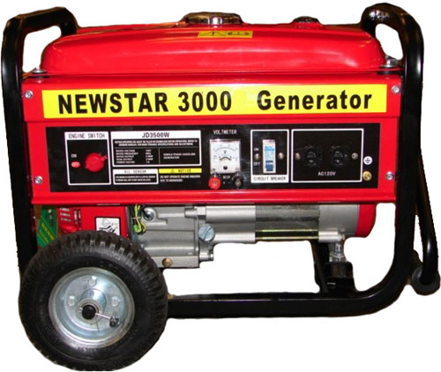
From regular expressions to NFA
Step 1: assign expression names and obtain pure regular expressions R₁…R_{m}
Step 2: construct an NFA M_{i} for each regular expression R_{i}
Step 3: combine all M_{i} into a single NFA
Ambiguity resolution: prefer longest accepting word

Slide 16
Scanning with DFA
Run until stuck
  Remember last accepting state
Go back to accepting state
Return token

Slide 17
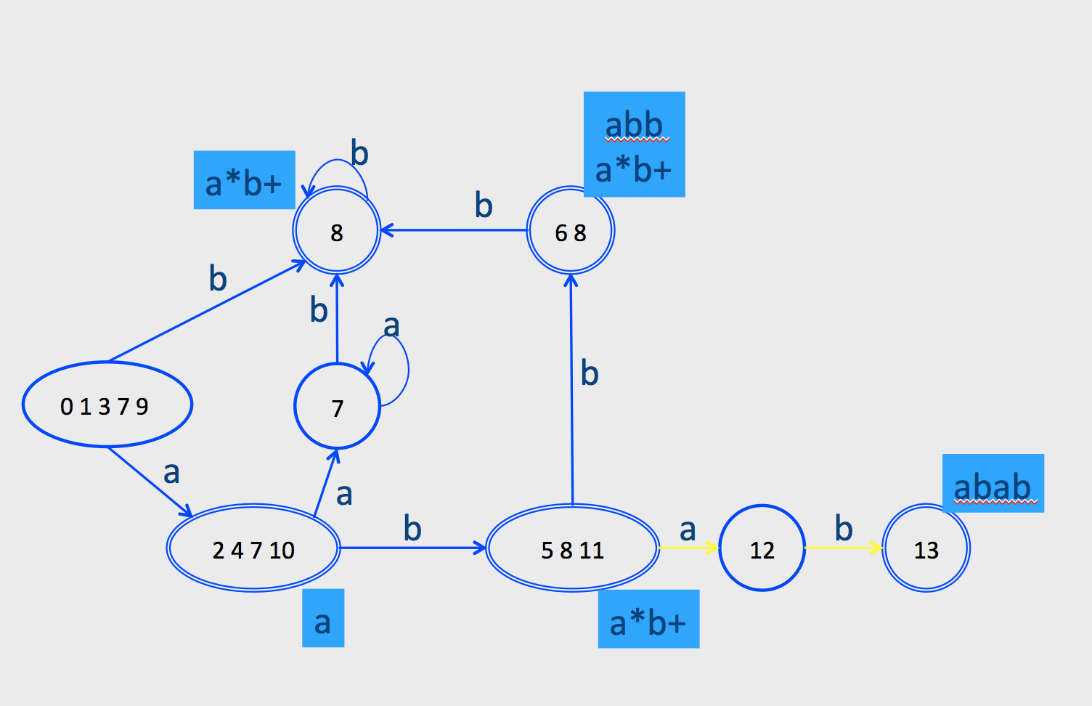
Ambiguity resolution
Longest word
Tie-breaker based on order of rules when words have same length

Slide 18
Creating a Scanner using Flex
int num_lines = 0;
%%
\n ++num_lines;
. ;
%%
main() {
yylex();
printf( "# of lines = %d\n", num_lines);
}

Slide 19
Syntax Analysis

Slide 20
Frontend: Scanning & Parsing
program text
((23 + 7) * x)
Lexical
Analyzer
token stream
) | x | * | ) | 7 | + | 23 | ( | (
RP | Id | OP | RP | Num | OP | Num | LP | LP
Grammar:
E → ... | Id
Id → ‘a’ | ... | ‘z’
Parser
syntax
error
valid
Op(*)
Abstract Syntax Tree
Op(+)
Id(b)
Num(23)
Num(7)

Slide 21
From scanning to parsing
program text
((23 + 7) * x)
Lexical
Analyzer
token stream
) | x | * | ) | 7 | + | 23 | ( | (
RP | Id | OP | RP | Num | OP | Num | LP | LP
Grammar:
E → ... | Id
Id → ‘a’ | ... | ‘z’
Parser
syntax
error
valid
Op(*)
Abstract Syntax Tree
Op(+)
Id(b)
Num(23)
Num(7)

Slide 22
Context free grammars (CFG)
G = (V,T,P,S)
V – non terminals (syntactic variables)
T – terminals (tokens)
P – derivation rules
  Each rule of the form V  (T  V)*
S – start symbol

Slide 23
Pushdown Automata (PDA)
Nondeterministic PDAs define all CFLs
Deterministic PDAs model parsers.
  Most programming languages have a deterministic PDA
  Efficient implementation

Slide 24
CFG terminology
Derivation - a sequence of replacements of non-terminals using the derivation rules
Language - the set of strings of terminals derivable from the start symbol
Sentential form - the result of a partial derivation
  May contain non-terminals

Slide 25
Derivations
Show that a sentence ω is in a grammar G
  Start with the start symbol
  Repeatedly replace one of the non-terminals by a right-hand side of a production
  Stop when the sentence contains only terminals
Given a sentence αNβ and rule N→µ
αNβ => αµβ
ω is in L(G) if S =>* ω

Slide 26
Ambiguity
x := y+z*w
S → S ; S
S → id := E | …
E → id | E + E | E * E | …
S
S
id
:=
E
id
:=
E
E
+
E
E
*
E
id
E
*
E
E
+
E
id
id
id
id
id

Slide 27

“dangling-else” example
p. 174
Ambiguous grammar
S → if E then S
S | if E then S else S
| other
Unambiguous grammar
?
This is what we usually want: match else to closest
unmatched then
if E₁ then if E₂ then S₁ else S₂
if E₁ then (if E₂ then S₁ else S₂)
if E₁ then (if E₂ then S₁) else S₂
S
S
if
E
then
S
if
E
then
S
else
S
E₁
E₁
S₂
if
E
then
S
else
S
if
E
then
S
E₂
S₁
S₂
E₂
S₁

Slide 28
Broad kinds of parsers
Top-down parsers
  Construct parse tree in a top-down matter
  Find the leftmost derivation
Bottom-up parsers
  Construct parse tree in a bottom-up manner
  Find the rightmost derivation in a reverse order

Slide 29
Predictive parsing
Given a grammar G and a word w attempt to derive w using G
Idea
  Apply production to leftmost nonterminal
  Pick production rule based on next input token
General grammar
  More than one option for choosing the next production based on a token
Restricted grammars (LL)
  Know exactly which single rule to apply
  May require some lookahead to decide

Slide 30
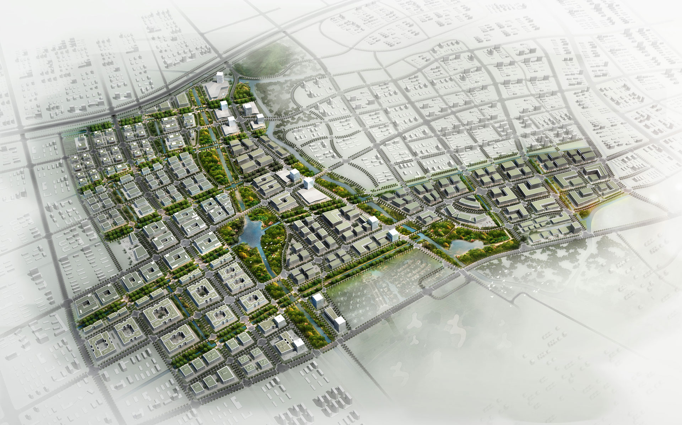
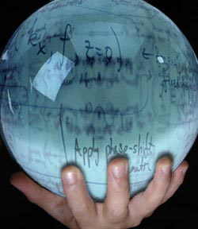
Top-Down Parsing: Predictive parsing
Recursive descent
LL(k) grammars

Slide 31
Recursive descent parsing
Define a function for every nonterminal
Every function work as follows
  Find applicable production rule
  Terminal function checks match with next input token
  Nonterminal function calls (recursively) other functions
If there are several applicable productions for a nonterminal, use lookahead

Slide 32
LL(k) grammars
A grammar is in the class LL(K) when it can be derived via:
  Top-down derivation
  Scanning the input from left to right (L)
  Producing the leftmost derivation (L)
  With lookahead of k tokens (k)
A language is said to be LL(k) when it has an LL(k) grammar

Slide 33
FIRST sets
FIRST(X) = { t | X →* t β} ∪{ℇ | X →* ℇ}
  FIRST(X) = all terminals that α can appear as first in some derivation for X
    + ℇ if can be derived from X

Slide 34
FIRST sets
No intersection between FIRST sets => can always pick a single rule
If the FIRST sets intersect, may need longer lookahead
  LL(k) = class of grammars in which production rule can be determined using a lookahead of k tokens
  LL(1) is an important and useful class

Slide 35
LL(1) grammars
A grammar is in the class LL(K) iff
  For every two productions A → α and A → β we have
    FIRST(α) ∩ FIRST(β) = {} // including ε
    If ε ∈ FIRST(α) then FIRST(β) ∩ FOLLOW(A) = {}
    If ε ∈ FIRST(β) then FIRST(α) ∩ FOLLOW(A) = {}

Slide 36
FOLLOW sets
p. 189
What do we do with nullable (ε) productions?
  A → B C D B → ε C → ε
  Use what comes afterwards to predict the right production
For every production rule A → α
  FOLLOW(A) = set of tokens that can immediately follow A
Can predict the alternative A_{k} for a non-terminal N when the lookahead token is in the set
  N → … | A_{k} | …
  FIRST(A_{k}) → (if A_{k} is nullable then FOLLOW(N))

Slide 37
FOLLOW sets: Constraints
$ ∈ FOLLOW(S)
FIRST(β) – {ℇ} ⊆ FOLLOW(X)
  For each A → α X β
FOLLOW(A) ⊆ FOLLOW(X)
  For each A → α X or
  A → α X β and ℇ ∈ FIRST(β)

Slide 38
Prediction Table
A → α
T[A,t] = α if t ∈FIRST(α)
T[A,t] = α if ℇ ∈ FIRST(α) and t ∈ FOLLOW(A)
  t can also be $
T is not well defined ➔ the grammar is not LL(1)

Slide 39
Problem 1: productions with common prefix
term → ID | indexed_elem
indexed_elem → ID [ expr ]
FIRST(term) = { ID }
FIRST(indexed_elem) = { ID }
FIRST/FIRST conflict

Slide 40
Solution: left factoring
Rewrite the grammar to be in LL(1)
term → ID | indexed_elem
indexed_elem → ID [ expr ]
term → ID after_ID
After_ID → [ expr ] | ε
Intuition: just like factoring x*y + x*z into x*(y+z)

Slide 41
Problem 2: null productions
S → A a b
A → a | ε
FIRST(S) = { a } FOLLOW(S) = { }
FIRST(A) = { a , ε } FOLLOW(A) = { a }
FIRST/FOLLOW conflict

Slide 42
Solution: substitution
S → A a b
A → a | ε
Substitute A in S
S → a a b | a b
Left factoring
S → a after_A
after_A → a b | b

Slide 43
Problem 3: left recursion
E → E - term | term
Left recursion cannot be handled with a bounded lookahead
What can we do?

Slide 44
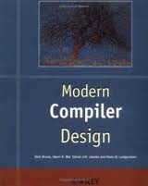
Left recursion removal
p. 130
N → Nα | β
N → βN’
N’ → αN’ | ε
G₁
G₂
L(G₁) = β, βα, βαα, βααα, …
L(G₂) = same
Can be done algorithmically.
Problem: grammar becomes mangled beyond recognition
For our 3rd example:
E → E - term | term
E → term TE | term
TE → - term TE | ε

Slide 45

Bottom-up parsing

Slide 46
Bottom-up parsing:
LR(k) Grammars
A grammar is in the class LR(K) when it can be derived via:
  Bottom-up derivation
  Scanning the input from left to right (L)
  Producing the rightmost derivation (R)
  With lookahead of k tokens (k)
A language is said to be LR(k) if it has an LR(k) grammar
The simplest case is LR(0)

Slide 47
Terminology: Reductions & Handles
The opposite of derivation is called reduction
  Let A ➔ α be a production rule
  Derivation: βAµ ➔ βαµ
  Reduction: βαµ ➔ βAµ
A handle is the reduced substring
  α is the handles for βαµ

Slide 48
Detecting Handles
Unambiguous grammar ➔
Single rightmost derivation ➔
Identify handles in reverse order
Assume last (RM-)derivations: CA➔βAµ ➔ βαµ
  C → βA , A → α
  A is the last non-terminal , C penultimate non-terminal
Goal: Identify Handles going over text from left to right

Slide 49
How does the parser know what to do?
A state will keep the info gathered on handle(s)
  A state in the “control” of the PDA
  Also (part of) the stack alpha bet
A table will tell it “what to do” based on current state and next token
  The transition function of the PDA
A stack will records the “nesting level”
  Prefixes of handles
  Set of LR(0) items

Slide 50
Constructing an LR parsing table
Construct a (determinized) transition diagram from LR items
If there are conflicts – stop
Fill table entries from diagram

Slide 51
LR item
Already matched
To be matched
Input
N → α•β
Hypothesis about αβ being a possible handle, so far we’ve matched α, expecting to see β

Slide 52
Types of LR(0) items
N → α•β
Shift Item
N → αβ•
Reduce Item

Slide 53
LR(0) automaton example
reduce state
shift state
q₆
E → T•
q₀
T
T
q₇
Z → •E$
E → •T
E → •E + T
T → •i
T → •(E)
T → (•E)
E → •T
E → •E + T
T → •i
T → •(E)
(
q₅
i
T → i•
i
E
(
E
(
i
q₁
Z → E•$
E → E•+ T
q₃
q₈
E → E+•T
T → •i
T → •(E)
T → (E•)
E → E•+T
+
+
$
)
q₂
q₉
Z → E$•
T → (E) •
T
q₄
E → E + T•

Slide 54
LR(0) conflicts
T
…
q₀
Z → •E$
E → •T
E → •E + T
T → •i
T → •(E)
T → •i[E]
(
…
q₅
i
T → i•
T → i•[E]
E
Shift/reduce conflict
…
Z → E $
E → T
E → E + T
T → i
T → ( E )
T → i[E]

Slide 55
LR(0) conflicts
T
…
q₀
Z → •E$
E → •T
E → •E + T
T → •i
T → •(E)
T → •i[E]
(
…
q₅
i
T → i•
V → i•
E
reduce/reduce conflict
…
Z → E $
E → T
E → E + T
T → i
V → i
T → ( E )

Slide 56
LR(0) conflicts
Any grammar with an ε-rule cannot be LR(0)
Inherent shift/reduce conflict
  A → ε• – reduce item
  P → α•Aβ – shift item
  A → ε• can always be predicted from P → α•Aβ

Slide 57
LR variants
LR(0) – what we’ve seen so far
SLR(0)
  Removes infeasible reduce actions via FOLLOW set reasoning
LR(1)
  LR(0) with one lookahead token in items
LALR(0)
  LR(1) with merging of states with same LR(0) component

Slide 58
SLR parsing
A handle should not be reduced to a non-terminal N if the lookahead is a token that cannot follow N
A reduce item N → α• is applicable only when the lookahead is in FOLLOW(N)
  If b is not in FOLLOW(N) we proved there is no derivation
  S ➔* βNb.
  Thus, it is safe to remove the reduce item from the conflicted state
Differs from LR(0) only on the ACTION table
  Now a row in the parsing table may contain both shift actions and reduce actions and we need to consult the current token to decide which one to take

Slide 59
LR(1) grammars
In SLR: a reduce item N → α• is applicable only when the lookahead is in FOLLOW(N)
But FOLLOW(N) merges lookahead for all alternatives for N
  Insensitive to the context of a given production
LR(1) keeps lookahead with each LR item
Idea: a more refined notion of follows computed per item

Slide 60
LR(1) items
LR(1) item is a pair
  LR(0) item
  Lookahead token
Meaning
  We matched the part left of the dot, looking to match the part on the right of the dot, followed by the lookahead token
Example
  The production L → id yields the following LR(1) items
LR(1) items
(0) S’ → S
(1) S → L = R
(2) S → R
(3) L → * R
(4) L → id
(5) R → L
[L → ● id, *]
[L → ● id, =]
[L → ● id, id]
[L → ● id, $]
[L → id ●, *]
[L → id ●, =]
[L → id ●, id]
[L → id ●, $]
LR(0) items
[L → ● id]
[L → id ●]

Slide 61
LR(1) items
LR(1) item is a pair
  LR(0) item
  Lookahead token
Meaning
  We matched the part left of the dot, looking to match the part on the right of the dot, followed by the lookahead token
Example
  The production L → id yields the following LR(1) items
Reduce only if the the expected lookhead matches the input
  [L → id ●, =] will be used only if the next input token is =

Slide 62
LALR(1)
LR(1) tables have huge number of entries
Often don’t need such refined observation (and cost)
Idea: find states with the same LR(0) component and merge their lookaheads component as long as there are no conflicts
LALR(1) not as powerful as LR(1) in theory but works quite well in practice
  Merging may not introduce new shift-reduce conflicts, only reduce-reduce, which is unlikely in practice

Slide 63
Grammar Hierarchy
Non-ambiguous CFG
LR(1)
LALR(1)
LL(1)
SLR(1)
LR(0)

Slide 64
Semantic Analysis

Slide 65
Abstract Syntax Tree
AST is a simplification of the parse tree
Can be built by traversing the parse tree
  E.g., using visitors
Can be built directly during parsing
  Add an action to perform on each production rule
  Similarly to the way a parse tree is constructed

Slide 66
Abstract Syntax Tree
The interface between the parser and the rest of the compiler
  Separation of concerns
  Reusable, modular and extensible
The AST is defined by a context free grammar
  The grammar of the AST can be ambiguous!
    E→ E + E
    Is this a problem?
Keep syntactic information
  Why?

Slide 67
What we want
Potato potato;
Carrot carrot;
x = tomato + potato + carrot
Lexical analyzer
…<id,tomato>,<PLUS>,<id,potato>,<PLUS>,<id,carrot>,EOF
Parser
AddExpr
left
right
symbol | kind | type | properties
x | var | ?
tomato | var | ?
potato | var | Potato
carrot | var | Carrot
AddExpr
left
right
LocationExpr
LocationExpr
LocationExpr
id=tomato
id=potato
id=carrot
‘tomato’ is undefined
‘potato’ used before initialized
Cannot add Potato and Carrot

Slide 68
Context Analysis
Check properties contexts of in which constructs occur
  Properties that cannot be formulated via CFG
    Type checking
    Declare before use
      Identifying the same word “w” re-appearing – wbw
    Initialization
    …
  Properties that are hard to formulate via CFG
    “break” only appears inside a loop
    …
Processing of the AST

Slide 69
Context Analysis
Identification
  Gather information about each named item in the program
  e.g., what is the declaration for each usage
Context checking
  Type checking
  e.g., the condition in an if-statement is a Boolean

Slide 70
Scopes
Typically stack structured scopes
Scope entry
  push new empty scope element
Scope exit
  pop scope element and discard its content
Identifier declaration
  identifier created inside top scope
Identifier Lookup
  Search for identifier top-down in scope stack

Slide 71
Scope and symbol table
Scope x Identifier -> properties
  Expensive lookup
A better solution
  hash table over identifiers

Slide 72
Types
What is a type?
  Simplest answer: a set of values + allowed operations
  Integers, real numbers, booleans, …
Why do we care?
  Code generation: $1 := $1 + $2
  Safety
    Guarantee that certain errors cannot occur at runtime
  Abstraction
    Hide implementation details
  Documentation
  Optimization

Slide 73
Typing Rules
If E1 has type int and E2 has type int,
then E1 + E2 has type int
E1 : int
E2 : int
E1 + E2 : int

Slide 74
Syntax Directed Translation
Semantic attributes
  Attributes attached to grammar symbols
Semantic actions
  How to update the attributes
Attribute grammars

Slide 75
Attribute grammars
Attributes
  Every grammar symbol has attached attributes
    Example: Expr.type
Semantic actions
  Every production rule can define how to assign values to attributes
    Example:
    Expr → Expr + Term
    Expr.type = Expr1.type when (Expr1.type == Term.type)
    Error otherwise

Slide 76
Example
float x,y,z
D
float
Production | Semantic Rule
D → T L | L.in = T.type
T → int | T.type = integer
T → float | T.type = float
L → L1, id | L1.in = L.in addType(id.entry,L.in)
L → id | addType(id.entry,L.in)
float
T
L
float
float
L
id1
float
L
id2
id3

Slide 77
Attribute Evaluation
Build the AST
Fill attributes of terminals with values derived from their representation
Execute evaluation rules of the nodes to assign values until no new values can be assigned
  In the right order such that
    No attribute value is used before its available
    Each attribute will get a value only once

Slide 78
Dependencies
A semantic equation a = b1,…,bm
requires computation of b1,…,bm to determine the value of a
The value of a depends on b1,…,bm
  We write a → bi

Slide 79
Example
float x,y,z
float
float
float
1
5
6
type
in
dmy
ent1
7
10
float
2
float
in
dmy
entry
8
9
float
3
float
in
dmy
entry
ent2
4
entry
ent3

Slide 80
Inherited vs. Synthesized Attributes
Synthesized attributes
  Computed from children of a node
Inherited attributes
  Computed from parents and siblings of a node
Attributes of tokens are technically considered as synthesized attributes

Slide 81
example
float x,y,z
D
Production | Semantic Rule
D → T L | L.in = T.type
T → int | T.type = integer
T → float | T.type = float
L → L1, id | L1.in = L.in addType(id.entry,L.in)
L → id | addType(id.entry,L.in)
float
float
T
L
float
float
L
id1
float
L
id2
inherited
synthesized
id3

Slide 82
S-attributed Grammars
Special class of attribute grammars
Only uses synthesized attributes (S-attributed)
No use of inherited attributes
Can be computed by any bottom-up parser during parsing
Attributes can be stored on the parsing stack
Reduce operation computes the (synthesized) attribute from attributes of children

Slide 83
L-attributed grammars
L-attributed attribute grammar when every attribute in a production A → X1…Xn is
  A synthesized attribute, or
  An inherited attribute of Xj, 1 <= j <=n that only depends on
    Attributes of X1…Xj-1 to the left of Xj, or
    Inherited attributes of A

Slide 84
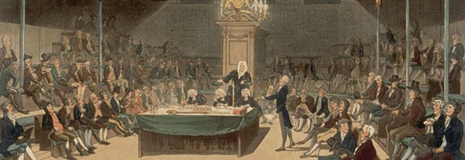
Intermediate Representation

Slide 85
Three-Address Code IR
Chapter 8
A popular form of IR
High-level assembly where instructions have at most three operands

Slide 86
Variable assignments
var = constant;
var₁ = var₂;
var₁ = var₂ op var₃;
var₁ = constant op var₂;
var₁ = var₂ op constant;
var = constant₁ op constant₂;
Permitted operators are +, -, *, /, %
In the impl. var is replaced by a pointer to the symbol table
A compiler-generated temporary can be used instead of a var

Slide 87
Control flow instructions
Label introduction
_label_name:
Indicates a point in the code that can be jumped to
Unconditional jump: go to instruction following label L
Goto L;
Conditional jump: test condition variable t;
if 0, jump to label L
IfZ t Goto L;
Similarly : test condition variable t;
if not zero, jump to label L
IfNZ t Goto L;

Slide 88
Procedures / Functions
A procedure call instruction pushes arguments to stack and jumps to the function label
A statement x=f(a1,…,an); looks like
Push a1; … Push an;
Call f;
Pop x; // pop returned value, and copy to it
Returning a value is done by pushing it to the stack (return x;)
Push x;
Return control to caller (and roll up stack)
Return;

Slide 89
TAC generation
At this stage in compilation, we have
  an AST
  annotated with scope information
  and annotated with type information
To generate TAC for the program, we do recursive tree traversal
  Generate TAC for any subexpressions or substatements
  Using the result, generate TAC for the overall expression

Slide 90
cgen for binary operators
cgen(e₁ + e₂) = {
Choose a new temporary t
Let t₁ = cgen(e₁)
Let t₂ = cgen(e₂)
Emit( t = t₁ + t₂ )
Return t
}

Slide 91
cgen for if-then-else
Let _t = cgen(e)
Let L_{true} be a new label
Let L_{false} be a new label
Let L_{after} be a new label
Emit( IfZ _t Goto L_{false}; )
cgen(s₁)
Emit( Goto L_{after}; )
Emit( L_{false}: )
cgen(s₂)
Emit( Goto L_{after};)
Emit( L_{after}: )
cgen(if (e) s₁ else s₂)

Slide 92

IR Optimization

Slide 93
Optimization points
source
code
Front
end
Code
generator
target
code
IR
User
profile program
change algorithm
Compiler
intraprocedural IR
Interprocedural IR
IR optimizations
Compiler
register allocation
instruction selection
peephole transformations
now

Slide 94
Overview of IR optimization
Formalisms and Terminology
  Control-flow graphs
  Basic blocks
Local optimizations
  Speeding up small pieces of a procedure
Global optimizations
  Speeding up procedure as a whole
The dataflow framework
  Defining and implementing a wide class of optimizations

Slide 95
Visualizing IR
start
main:
  _tmp0 = Call _ReadInteger;
  a = _tmp0;
  _tmp1 = Call _ReadInteger;
  b = _tmp1;
_L0:
  _tmp2 = 0;
  _tmp3 = b == _tmp2;
  _tmp4 = 0;
  _tmp5 = _tmp3 == _tmp4;
  IfZ _tmp5 Goto _L1;
  c = a;
  a = b;
  _tmp6 = c % a;
  b = _tmp6;
  Goto _L0;
_L1:
  Push a;
  Call _PrintInt;
_tmp0 = Call _ReadInteger;
a = _tmp0;
_tmp1 = Call _ReadInteger;
b = _tmp1;
_tmp2 = 0;
_tmp3 = b == _tmp2;
_tmp4 = 0;
_tmp5 = _tmp3 == _tmp4;
IfZ _tmp5 Goto _L1;
c = a;
a = b;
_tmp6 = c % a;
b = _tmp6;
Goto _L0;
Push a;
Call _PrintInt;
end

Slide 96
Control-Flow Graphs
A control-flow graph (CFG) is a graph of the basic blocks in a function
The term CFG is overloaded – from here on out, we'll mean “control-flow graph” and not “context free grammar”
Each edge from one basic block to another indicates that control can flow from the end of the first block to the start of the second block
There is a dedicated node for the start and end of a function

Slide 97
Common Subexpression Elimination
If we have two variable assignments
v1 = a op b
…
v2 = a op b
and the values of v1, a, and b have not changed between the assignments, rewrite the code as
v1 = a op b
…
v2 = v1
Eliminates useless recalculation
Paves the way for later optimizations

Slide 98
Common Subexpression Elimination
If we have two variable assignments
v1 = a op b [or: v1 = a]
…
v2 = a op b [or: v2 = a]
and the values of v1, a, and b have not changed between the assignments, rewrite the code as
v1 = a op b [or: v1 = a]
…
v2 = v1
Eliminates useless recalculation
Paves the way for later optimizations

Slide 99
Copy Propagation
If we have a variable assignment
v1 = v2
then as long as v1 and v2 are not reassigned, we can rewrite expressions of the form
a = … v1 …
as
a = … v2 …
provided that such a rewrite is legal

Slide 100
Dead Code Elimination
An assignment to a variable v is called dead if the value of that assignment is never read anywhere
Dead code elimination removes dead assignments from IR
Determining whether an assignment is dead depends on what variable is being assigned to and when it's being assigned

Slide 101
Live variables
The analysis corresponding to dead code elimination is called liveness analysis
A variable is live at a point in a program if later in the program its value will be read before it is written to again
Dead code elimination works by computing liveness for each variable, then eliminating assignments to dead variables

Slide 102
Local vs. global optimizations
An optimization is local if it works on just a single basic block
An optimization is global if it works on an entire control-flow graph of a procedure
An optimization is interprocedural if it works across the control-flow graphs of multiple procedure
  We won't talk about this in this course

Slide 103
Abstract Interpretation
Theoretical foundations of program analysis
Cousot and Cousot 1977
Abstract meaning of programs
  Executed at compile time

Slide 104
Join semilattices and ordering
Greater
{a, b, c}
{a, b}
{a, c}
{b, c}
{a}
{b}
{c}
{}
Lower

Slide 105
A semilattice for constant propagation
One possible semilattice for this analysis is shown here (for each variable):
Not-a-constant
...
-2
-1
0
1
2
...
Undefined
The lattice is infinitely wide

Slide 106
Monotone transfer functions
A transfer function f is monotone iff
if x  y, then f(x)  f(y)
Intuitively, if you know less information about a program point, you can't “gain back” more information about that program point
Many transfer functions are monotone, including those for liveness and constant propagation
Note: Monotonicity does not mean that
x  f(x)
  (This is a different property called extensivity)

Slide 107
The grand result
Theorem: A dataflow analysis with a finite-height semilattice and family of monotone transfer functions always terminates
Proof sketch:
  The join operator can only bring values up
  Transfer functions can never lower values back down below where they were in the past (monotonicity)
  Values cannot increase indefinitely (finite height)

Slide 108
Code generation for procedure calls
Compile time generation of code for procedure invocations
Activation Records (aka Stack Frames)

Slide 109
Supporting Procedures
Stack: a new computing environment
  e.g., temporary memory for local variables
Passing information into the new environment
  Parameters
Transfer of control to/from procedure
Handling return values

Slide 110
Abstract Activation Record Stack
Stack
grows this way
main
…
Proc_{k}
Proc₁
Proc_{k+1}
Proc₂
…
Proc_{k}
Stack frame for procedure
Proc_{k+1}(a₁,…,a_{N})
Proc_{k+1}
Proc_{k+2}
…
Proc_{k+2}
…

Slide 111
Abstract Stack Frame
…
Proc_{k}
Param N
Parameters
(actual arguments)
Param N-1
…
Param 1
Stack frame for procedure
Proc_{k+1}(a₁,…,a_{N})
_t0
…
Locals and temporaries
_tk
x
…
y
Proc_{k+2}
…

Slide 112
Static (lexical) Scoping
main ( )
{
int a = 0 ;
int b = 0 ;
{
int b = 1 ;
{
int a = 2 ;
printf (“%d %d\n”, a, b)
}
{
int b = 3 ;
printf (“%d %d\n”, a, b) ;
}
printf (“%d %d\n”, a, b) ;
}
printf (“%d %d\n”, a, b) ;
}
a name refers to its (closest) enclosing scope
known at compile time
B₂
B₀
B₁
Declaration | Scopes
a=0 | B0,B1,B3
b=0 | B0
b=1 | B1,B2
a=2 | B2
b=3 | B3
B₃
B₃

Slide 113
Dynamic Scoping
Each identifier is associated with a global stack of bindings
When entering scope where identifier is declared
  push declaration on identifier stack
When exiting scope where identifier is declared
  pop identifier stack
Evaluating the identifier in any context binds to the current top of stack
Determined at runtime

Slide 114
Call Sequences
…
Push caller-save registers
Push actual parameters (in reverse order)
caller
Caller push code
push return address (+ other admin info)
Jump to call address
call
Push current base-pointer
bp = sp
Push local variables
Push callee-save registers
Callee push code
(prologue)
callee
Callee pop code
(epilogue)
Pop callee-save registers
Pop callee activation record
Pop old base-pointer
return
pop return address
Jump to address
Caller pop code
caller
Pop return value + parameters
Pop caller-save registers
…

Slide 115
“To Callee-save or to Caller-save?”
Callee-saved registers need only be saved when callee modifies their value
Some heuristics and conventions are followed

Slide 116
Nested Procedures
problem: a routine may need to access variables of another routine that contains it statically
solution: lexical pointer (a.k.a. access link) in the activation record
lexical pointer points to the last activation record of the nesting level above it
  in our example, lexical pointer of d points to activation records of c
lexical pointers created at runtime
number of links to be traversed is known at compile time

Slide 117
Lexical Pointers
program p(){
int x;
procedure a(){
int y;
procedure b(){ c() };
procedure c(){
int z;
procedure d(){
y := x + z
};
… b() … d() …
}
… a() … c() …
}
a()
}
Possible call sequence:
p  a  a  c  b  c  d
a
y
a
y
P
c
z
a
a
b
c
b
c
c
z
d
d

Slide 118
Register allocation

Slide 119
Register allocation
Number of registers is limited
Need to allocate them in a clever way
  Using registers intelligently is a critical step in any compiler
    A good register allocator can generate code orders of magnitude better than a bad register allocator

Slide 120
Sethi-Ullman translation
Algorithm by Ravi Sethi and Jeffrey D. Ullman to emit optimal TAC
  Minimizes number of temporaries
Main data structure in algorithm is a stack of temporaries
  Stack corresponds to recursive invocations of _t = cgen(e)
  All the temporaries on the stack are live
    Live = contain a value that is needed later on

Slide 121
Example
_t0 = cgen( a+(b+(c*d)) )
+ and * are commutative operators
left child first
right child first
_t0
+
_t0
+
_t0
a
_t1
+
_t1
a
_t0
+
_t1
b
_t2
*
_t1
b
_t0
*
_t2
c
d
_t3
_t1
c
_t0
d
4 temporaries
2 temporary

Slide 122
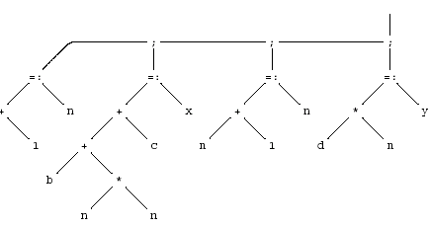
AST for a Basic Block
{
int n;
n := a + 1;
x := b + n * n + c;
n := n + 1;
y := d * n;
}

Slide 123
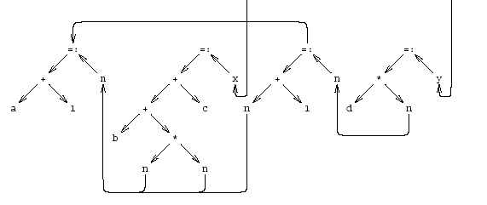
Dependency graph
{
int n;
n := a + 1;
x := b + n * n + c;
n := n + 1;
y := d * n;
}

Slide 124
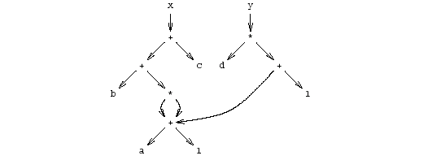
Simplified Data Dependency Graph
{
int n;
n := a + 1;
x := b + n * n + c;
n := n + 1;
y := d * n;
}

Slide 125
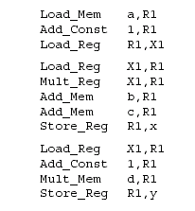
Pseudo Register Target Code

Slide 126
“Global” Register Allocation
Input:
  Sequence of machine instructions (“assembly”)
    Unbounded number of temporary variables
      aka symbolic registers
  “machine description”
    # of registers, restrictions
Output
  Sequence of machine instructions using machine registers (assembly)
  Some MOV instructions removed

Slide 127
Variable Liveness
A statement x = y + z
  defines x
  uses y and z
A variable x is live at a program point if its value (at this point) is used at a later point
y = 42
z = 73
x = y + z
print(x);
x undef, y live, z undef
x undef, y live, z live
x is live, y dead, z dead
x is dead, y dead, z dead
(showing state after the statement)

Slide 128
Main idea
For every node n in CFG, we have out[n]
  Set of temporaries live out of n
Two variables interfere if they appear in the same out[n] of any node n
  Cannot be allocated to the same register
Conversely, if two variables do not interfere with each other, they can be assigned the same register
  We say they have disjoint live ranges
How to assign registers to variables?

Slide 129
Interference graph
Nodes of the graph = variables
Edges connect variables that interfere with one another
Nodes will be assigned a color corresponding to the register assigned to the variable
Two colors can’t be next to one another in the graph

Slide 130
Graph coloring
This problem is equivalent to graph-coloring, which is NP-hard if there are at least three registers
No good polynomial-time algorithms (or even good approximations!) are known for this problem
  We have to be content with a heuristic that is good enough for RIGs that arise in practice

Slide 131
Coloring by simplification [Kempe 1879]
How to find a k-coloring of a graph
Intuition:
  Suppose we are trying to k-color a graph and find a node with fewer than k edges
  If we delete this node from the graph and color what remains, we can find a color for this node if we add it back in
  Reason: fewer than k neighbors  some color must be left over

Slide 132
Coloring by simplification [Kempe 1879]
How to find a k-coloring of a graph
Phase 1: Simplification
  Repeatedly simplify graph
  When a variable (i.e., graph node) is removed, push it on a stack
Phase 2: Coloring
  Unwind stack and reconstruct the graph as follows:
  Pop variable from the stack
  Add it back to the graph
  Color the node for that variable with a color that it doesn’t interfere with
simplify
color

Slide 133
Handling precolored nodes
Some variables are pre-assigned to registers
  Eg: mul on x86/pentium
    uses eax; defines eax, edx
  Eg: call on x86/pentium
    Defines (trashes) caller-save registers eax, ecx, edx
To properly allocate registers, treat these register uses as special temporary variables and enter into interference graph as precolored nodes

Slide 134
Optimizing move instructions
Code generation produces a lot of extra mov instructions
mov t5, t9
If we can assign t5 and t9 to same register, we can get rid of the mov
  effectively, copy elimination at the register allocation level
Idea: if t5 and t9 are not connected in inference graph, coalesce them into a single variable; the move will be redundant
Problem: coalescing nodes can make a graph
un-colorable
  Conservative coalescing heuristic

Slide 135
Constrained Moves
A instruction T ← S is constrained
  if S and T interfere
May happen after coalescing
Constrained MOVs are not coalesced
X
Y
X ← Y
Y ← Z
Z

Slide 136
Constrained Moves
A instruction T ← S is constrained
  if S and T interfere
May happen after coalescing
Constrained MOVs are not coalesced
X,Y
X ← Y
Y ← Z
Z

Slide 137
Constrained Moves
A instruction T ← S is constrained
  if S and T interfere
May happen after coalescing
Constrained MOVs are not coalesced
X,Y
X ← Y
Y ← Z
Z

Slide 138
Graph Coloring with Coalescing
Build: Construct the interference graph
Special case: merged node has less than k heavy neighbors
Simplify: Recursively remove non-MOV nodes with less than K neighbors; Push removed nodes into stack
Coalesce: Conservatively merge unconstrained MOV related nodes with fewer than K “heavy” neighbors
All non-MOV related nodes are “heavy”
Freeze: Give-Up Coalescing on some MOV related nodes with low degree of interference edges
Potential-Spill: Spill some nodes and remove nodes
Push removed nodes into stack
Select: Assign actual registers (from simplify/spill stack)
Actual-Spill: Spill some potential spills and repeat the process

Slide 139
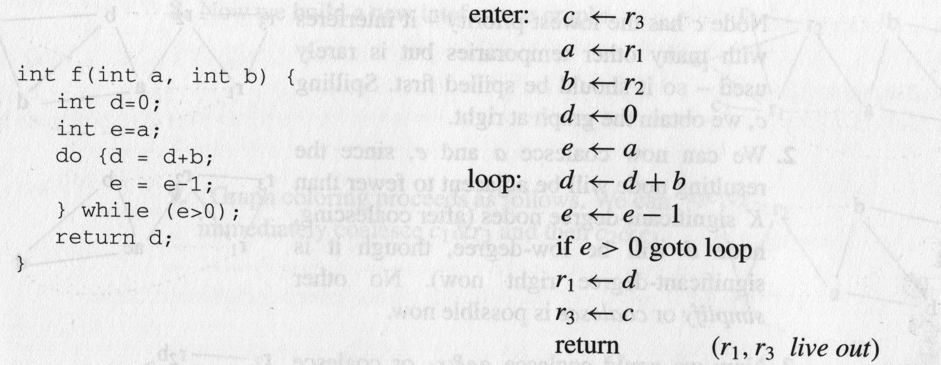
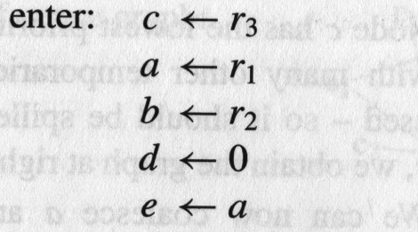
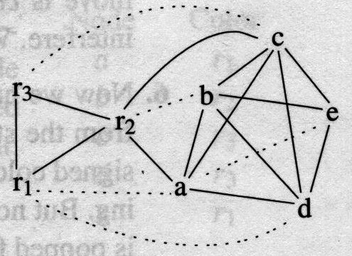
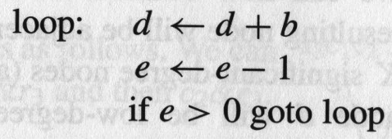
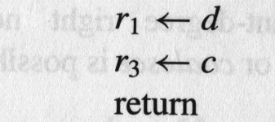
A Complete Example
Callee-saved registers
Caller-saved registers

Slide 140
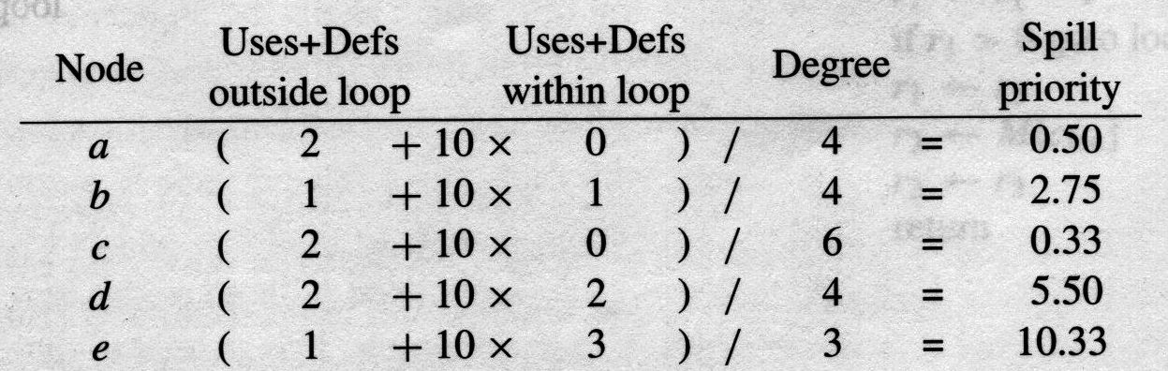
A Complete Example

Slide 141
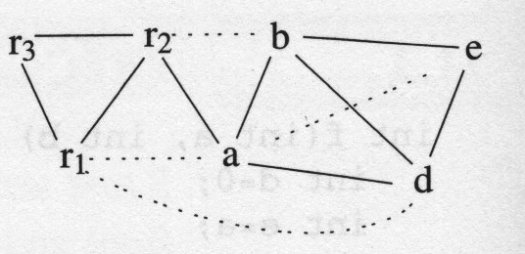
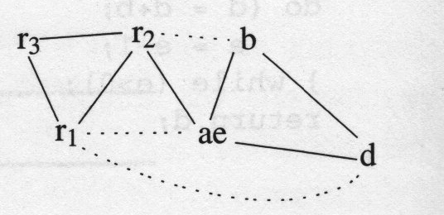
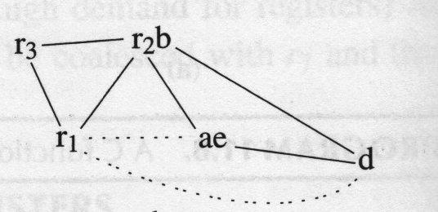
A Complete Example
Spill c
c
Deg. of r1,ae,d < K
a & e
c
r2 & b
(Alt: ae+r1)
c

Slide 142
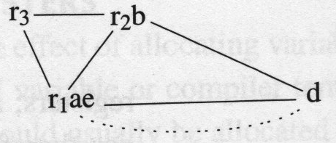

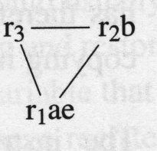
A Complete Example
ae & r1
(Alt: …)
c
freeze r₁ae-d
Simplify d
pop c …
dc
d
pop d
(Alt: ae+r1)
c

Slide 143
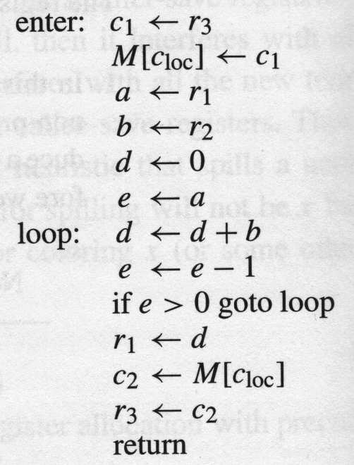
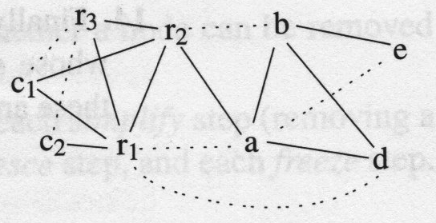
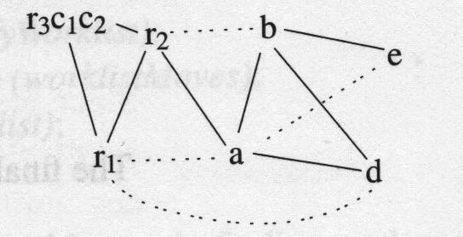
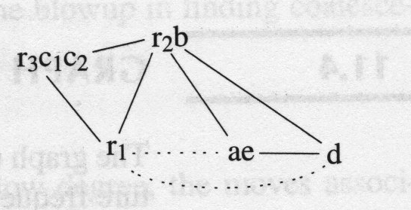
A Complete Example
c1&r3, c2 &r3
a&e, b&r2

Slide 144
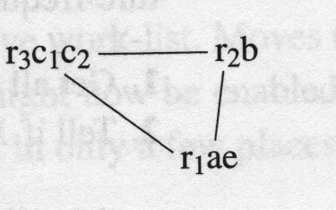
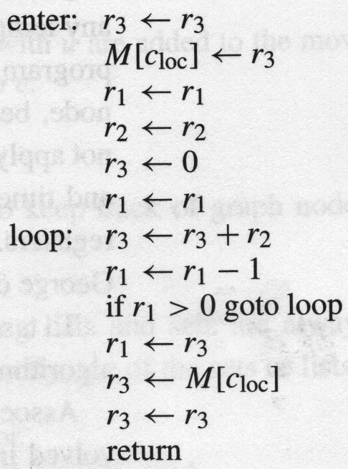
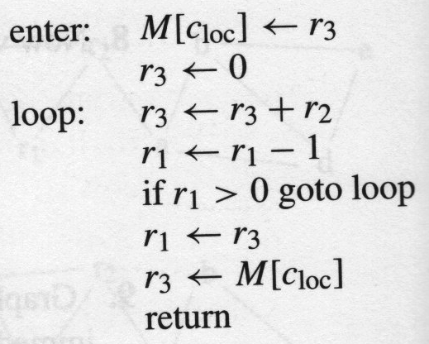
A Complete Example
ae & r1
Simplify d
Pop d
d
“opt”
gen code

Slide 145
Compiling OO Programs

Slide 146
Features of OO languages
Inheritance
  Subclass gets (inherits) properties of superclass
Method overriding
  Multiple methods with the same name with different signatures
Abstract (aka virtual) methods
Polymorphism
  Multiple methods with the same name and different signatures but with different implementations
Dynamic dispatch
  Lookup methods by (runtime) type of target object

Slide 147
Compiling OO languages
“Translation into C”
Powerful runtime environment
Adding “gluing” code

Slide 148
Runtime Environment
Mediates between the OS and the programming language
Hides details of the machine from the programmer
  Ranges from simple support functions all the way to a full-fledged virtual machine
Handles common tasks
  Runtime stack (activation records)
  Memory management
Runtime type information
  Method invocation
  Type conversions

Slide 149
Handling Single Inheritance
Simple type extension
class A {
field a1;
field a2;
method m1() {…}
method m2() {…}
}
class B extends A {
field b1;
method m3() {…}
}

Slide 150
Adding fields
Fields aka Data members, instance variables
Adds more information to the inherited class
  “Prefixing” fields ensures consistency
class A {
field a1;
field a2;
method m1() {…}
method m2() {…}
}
class B extends A {
field b1;
method m2() {…}
method m3() {…}
}
typedef struct {
field a1;
field a2;
} A;
void m1A_A(A* this){…}
void m2A_A(A* this){…}
typedef struct {
field a1;
field a2;
field b1;
} B;
void m2A_B(B* this) {…}
void m3B_B(B* this) {…}

Slide 151
Method Overriding
Redefines functionality
  More specific
  Can access additional fields
class A {
field a1;
field a2;
method m1() {…}
method m2() {…}
}
class B extends A {
field b1;
method m2() {
… b1 …
}
method m3() {…}
}

Slide 152
Handling Polymorphism
When a class B extends a class A
  variable of type pointer to A may actually refer to object of type B
Upcasting from a subclass to a superclass
Prefixing fields guarantees validity
class B *b = …;
class A *a = b ;
classA *a = convert_ptr_to_B_to_ptr_A(b) ;
Pointer to B
a1
Pointer to A inside B (also)
A
a2
B
b1

Slide 153
Dynamic Binding
An object (“pointer”) o declared to be of class A can actually be (“refer”) to a class B
What does ‘o.m()’ mean?
  Static binding
  Dynamic binding
Depends on the programming language rules
How to implement dynamic binding?
  The invoked function is not known at compile time
  Need to operate on data of the B and A in consistent way

Slide 154
Virtual function table
typedef struct {
field a1;
field a2;
} A;
void m1A_A(A* this){…}
void m2A_A(A* this, int x){…}
typedef struct {
field a1;
field a2;
field b1;
} B;
void m2A_B(A* thisA, int x){
Class_B *this =
convert_ptr_to_A_to_ptr_to_B(thisA);
…
}
void m3B_B(B* this){…}
convert_ptr_to_B_to_ptr_to_A(p)
p.m2(3);
p→dispatch_table→m2A( , 3);
Runtime object
(Runtime) Dispatch Table
p
vtable
m1A_A
a1
m2A_B
a2
m3B_B
b1

Slide 155
Multiple Inheritance
class C {
field c1;
field c2;
method m1(){…}
method m2(){…}
}
class D {
field d1;
method m3() {…}
method m4(){…}
}
class E extends C, D {
field e1;
method m2() {…}
method m4() {…}
method m5(){…}
}

Slide 156
Multiple Inheritance
Allows unifying behaviors
But raises semantic difficulties
  Ambiguity of classes
  Repeated inheritance
Hard to implement
  Semantic analysis
  Code generation
    Prefixing no longer work
    Need to generate code for downcasts
Hard to use

Slide 157
A simple implementation
Merge dispatch tables of superclases
Generate code for upcasts and downcasts

Slide 158
A simple implementation
class C {
field c1;
field c2;
method m1(){…}
method m2(){…}
}
class D {
field d1;
method m3() {…}
method m4(){…}
}
class E extends C, D {
field e1;
method m2() {…}
method m4() {…}
method m5(){…}
}
Pointer to
- E
- C inside E
Runtime object
(Runtime) Dispatch Table
vtable
m1C_C
c1
m2C_E
c2
Pointer to
- D inside E
m3D_D
vtable
m4D_E
d1
m5E_E
e1

Slide 159
Dependent multiple Inheritance
class A{
field a1;
field a2;
method m1(){…}
method m3(){…}
}
class C extends A {
field c1;
field c2;
method m1(){…}
method m2(){…}
}
class D extends A {
field d1;
method m3(){…}
method m4(){…}
}
class E extends C, D {
field e1;
method m2() {…}
method m4() {…}
method m5(){…}
}

Slide 160
Implementation
class A{
field a1;
field a2;
method m1(){…}
method m3(){…}
}
class C
extends A{
field c1;
field c2;
method m1(){…}
method m2(){…}
}
class D
extends A{
field d1;
method m3(){…}
method m4(){…}
}
class E
extends C,D{
field e1;
method m2() {…}
method m4() {…}
method m5(){…}
}
Runtime E object
vtable
(Runtime) Dispatch Table
Index tab
m1A_C
a1
m3A_A
Pointer to
- E
- C inside E
a2
m2C_E
c1
m1A_A
c2
m3A_D
vtable
m4D_E
Pointer to
- D inside E
Index tab
m5E_E
d1
Index tables
2
3
4
5
8
9
-4
-3
2
e1
160

Slide 161
Interface Types
Java supports limited form of multiple inheritance
Interface consists of several methods but no fields
A class can implement multiple interfaces
Simpler to implement/understand/use
public interface Comparable {
public int compare(Comparable o);
}

Slide 162
Interface Types
Implementation: record with 2 pointers:
  A separate dispatch table per interface
  A pointer to the object
vtable
interface table
a1
a1
i. table
vtable
b1
a2
object
field1
a2
field2

Slide 163
Assembly ➔ Image
Source file (e.g., utils)
Source file (e.g., main)
library
Compiler
Compiler
Compiler
Assembly (.s)
Assembly (.s)
Assembly (.s)
Assembler
Assembler
Assembler
Object (.o)
Object (.o)
Object (.o)
Linker
Executable (“.elf”)
Loader
Image (in memory):

Slide 164
Assembler
Converts (symbolic) assembler to binary (object) code
    Object files contain a combination of machine instructions, data, and information needed to place instructions properly in memory
  Yet another(simple) compiler
    One-to one translation
Converts constants to machine repr. (3➔0…011)
Resolve internal references
Records info for code & data relocation

Slide 165
Object File Format
Header
Text Segment
Data
Segment
Relocation Information
Symbol Table
Debugging Information
Header: Admin info + “file map”
Text seg.: machine instruction
Data seg.: (Initialized) data in machine format
Relocation info: instructions and data that depend on absolute addresses
Symbol table: “exported” references + unresolved references

Slide 166
Resolving Internal Addresses
Two scans of the code
  Construct a table label → address
  Replace labels with values
One scan of the code (Backpatching)
  Simultaneously construct the table and resolve symbolic addresses
    Maintains list of unresolved labels
  Useful beyond assemblers

Slide 167
Handling External Addresses
Record symbol table in “external” table
  Exported (defined) symbols
    G, foo()
  Imported (required) symbols
    Extern_G, extern_bar(), printf()
Relocation bits
  Mark instructions that depend on absolute (fixed) addresses
    Instructions using globals,

Slide 168
Linker
Merges object files to an executable
  Enables separate compilation
Combine memory layouts of object modules
  Links program calls to library routines
    printf(), malloc()
  Relocates instructions by adjusting absolute references
  Resolves references among files

Slide 169
Linker
0
foo
0
foo
Code Segment 1
ext_bar()
Code Segment 1
100
100
Data
Segment 1
Code Segment 2
ext_bar
250
120
zoo
280
200
400
Data
Segment 1
420
0
150
Code Segment 2
ext_bar
zoo
180
500
Data
Segment 2
300
Data
Segment 2
650
580
450
380

Slide 170
External References
The code may include references to external names (identifiers)
  Library calls
  External data
Stored in external symbol table

Slide 171
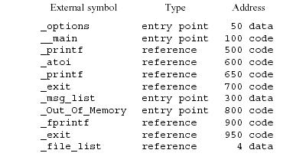
Example of External Symbol Table

Slide 172
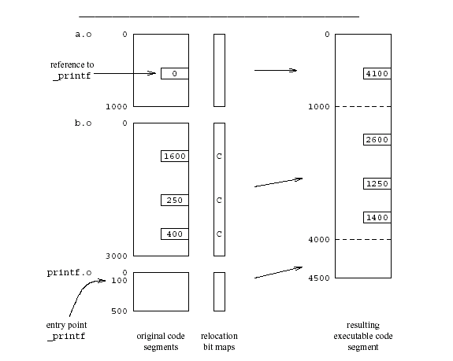
Example

Slide 173
Loader (Summary)
Initializes the runtime state
Part of the operating system
  Privileged mode
Does not depend on the programming language
“Invisible activation record”

Slide 174
Memory Management
Manual memory management
Automatic memory management

Slide 175
Free-list Allocation
A data structure records the location and size of free cells of memory.
The allocator considers each free cell in turn, and according to some policy, chooses one to allocate.
Three basic types of free-list allocation:
  First-fit
  Next-fit
  Best-fit

Slide 176
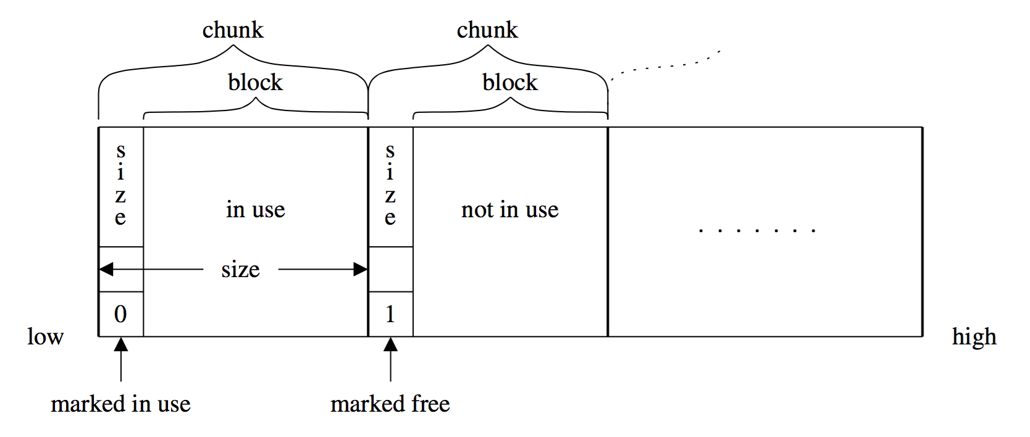
Memory chunks

Slide 177
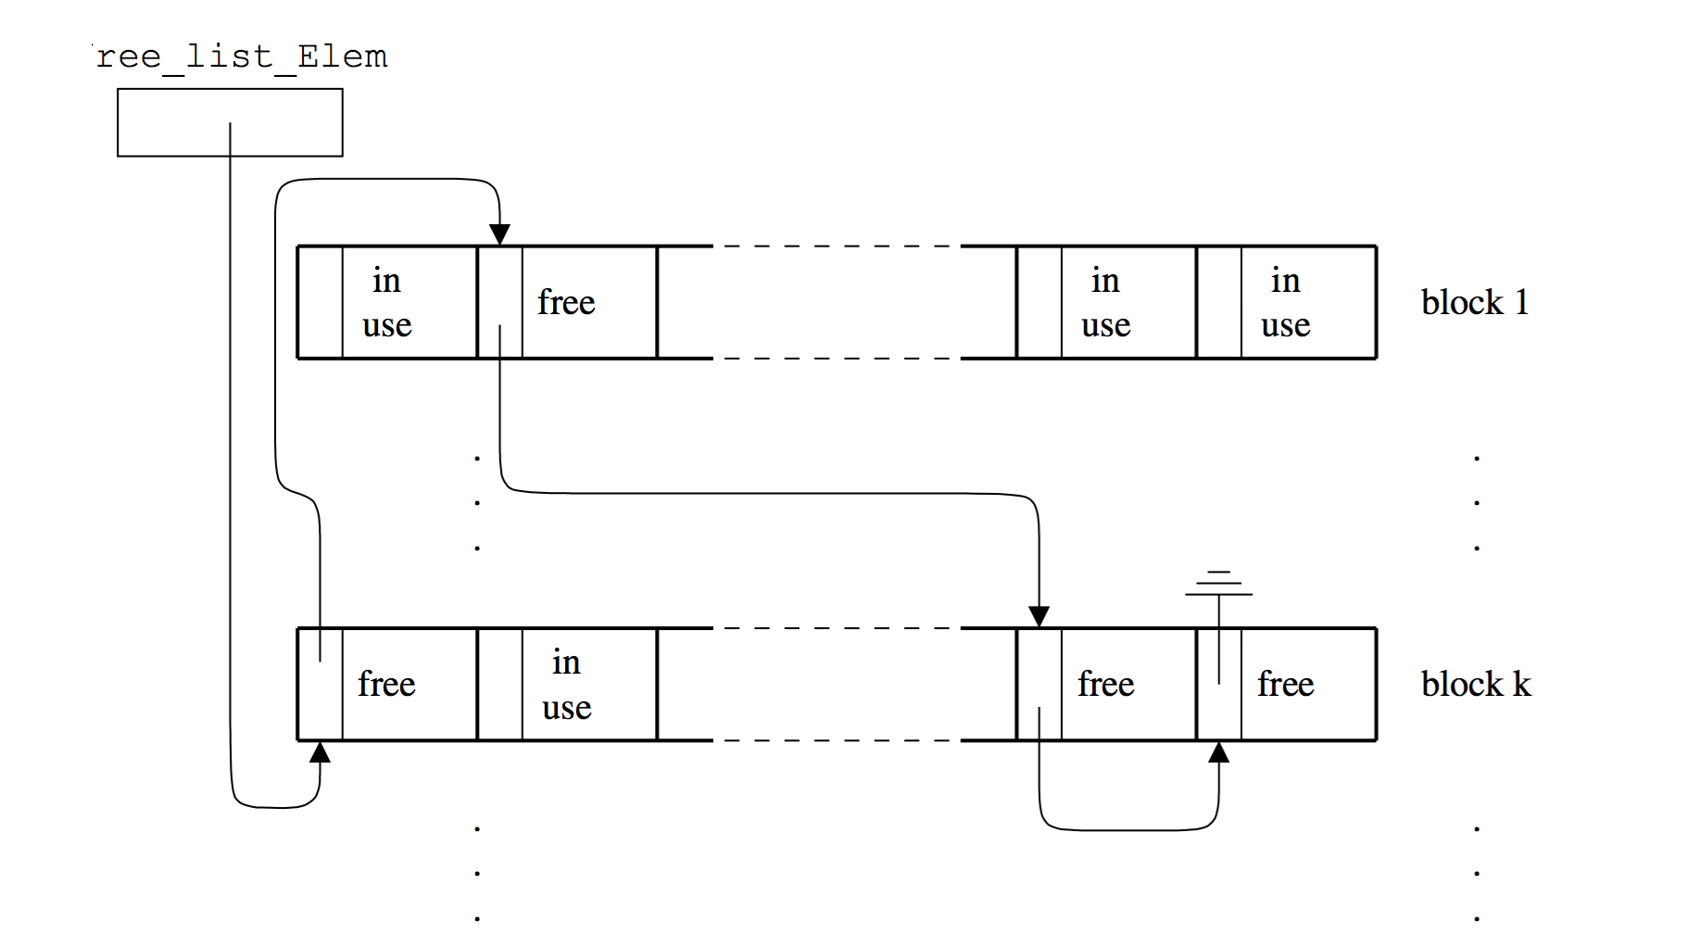
Free list

Slide 178
free
Free too late – waste memory (memory leak)
Free too early – dangling pointers / crashes
Free twice – error

Slide 179
Garbage collection
approximate reasoning about object liveness
use reachability to approximate liveness
assume reachable objects are live
  non-reachable objects are dead

Slide 180
Garbage Collection – Classical Techniques
reference counting
mark and sweep
copying

Slide 181
GC using Reference Counting
add a reference-count field to every object
  how many references point to it
when (rc==0) the object is non reachable
  non reachable => dead
  can be collected (deallocated)

Slide 182
The Mark-and-Sweep Algorithm
[McCarthy 1960]
Marking phase
  mark roots
  trace all objects transitively reachable from roots
  mark every traversed object
Sweep phase
  scan all objects in the heap
  collect all unmarked objects

Slide 183
Mark&Sweep in Depth
mark(Obj)=
if mark_bit(Obj) == unmarked
mark_bit(Obj)=marked
for C in Children(Obj)
mark(C)
How much memory does it consume?
  Recursion depth?
  Can you traverse the heap without worst-case O(n) stack?
    Deutch-Schorr-Waite algorithm for graph marking without recursion or stack (works by reversing pointers)

Slide 184
Copying GC
partition the heap into two parts
  old space
  new space
Copying GC algorithm
  copy all reachable objects from old space to new space
  swap roles of old/new space

Slide 185
Example
old
new
B
A
Roots
C
D
E

Slide 186
Example
old
new
B
A
A
Roots
C
C
D
E

