Slide 1
BOOSTING & ADABOOST
Lecturer: Yishay Mansour
Itay Dangoor

Slide 2
Overview
Introduction to weak classifiers
Boosting the confidence
Equivalence of weak & strong learning
Boosting the accuracy - recursive construction
AdaBoost

Slide 3
Weak Vs. Strong Classifiers
PAC (Strong) classifier
Renders classification of arbitrary accuracy
Error Rate: ε is arbitrarily small
Confidence: 1 - δ is arbitrarily close to 100%
Weak classifier
Only slightly better than random guess
Error Rate: ε < 50%
Confidence: 1 - δ ≥ 50%

Slide 4
Weak Vs. Strong Classifiers
It is easier to find a hypothesis that is correct only 51 percent of the time, rather than to find a hypothesis that is correct 99 percent of the time

Slide 5
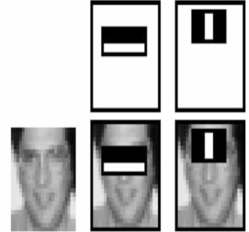
Weak Vs. Strong Classifiers
It is easier to find a hypothesis that is correct only 51 percent of the time, rather than to find a hypothesis that is correct 99 percent of the time
Some examples
The category of one word in a sentence
The gray level of one pixel in an image
Very simple patterns in image segments
Degree of a node in a graph

Slide 6
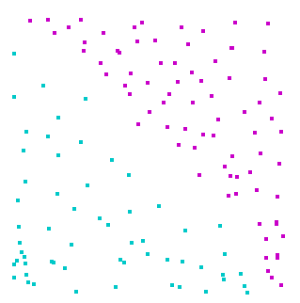
Weak Vs. Strong Classifiers
Given the following data

Slide 7
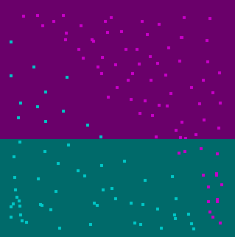
Weak Vs. Strong Classifiers
A threshold in one dimension will be a weak classifier

Slide 8
Weak Vs. Strong Classifiers
A suitable half plane might be a strong classifier

Slide 9
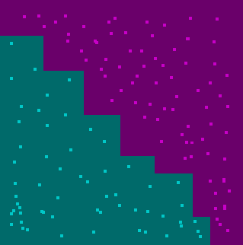
Weak Vs. Strong Classifiers
A combination of weak classifiers could render a good classification

Slide 10
Boost to the confidence
Given an algorithm A, which returns with probability δ≥½ a hypothesis h s.t error(h, c*)≤ε we can build a PAC learning algorithm from A.
Algorithm Boost-Confidence(A)
Select ε’=ε/2, and run A for k=log(2/δ) times (new data each time) to get output hypothesis h₁…h_{k}
Draw new sample S of size m=(2/ε²)ln(4k/δ) and test each hypothesis h_{i} on it. The observed error is marked error(h_{i}(S)).
Return h* s.t error(h*) = min(error(h_{i}(S)))

Slide 11
Boost to the confidence Alg. Correctness - I
After the first stage (run A for k times),
with probability at most (½)^{k}
∀i. error(h_{i}) > ε/2
⇒With probability at least 1 - (½)^{k} ∃i. error(h_{i}) ≤ ε/2
⇒ Setting k=log(2/δ) gives With probability 1- δ/2 ∃i. error(h_{i}) ≤ ε/2

Slide 12
Boost to the confidence Alg. Correctness - II
After the second stage (test all h_{i} on a new sample),
with probability 1- δ/2 output h_{i}* s.t
error(h_{i}*) ≤ ε/2 + min(error(h_{i})) ≤ ε
Proof
Using Chernoff bound, derive a bound for the probability for a “bad” event
Pr[|error(h_{i}) - error(h_{i})| ≥ ε/2] ≤ 2e^{-2m(ε/2)2}
Bound the probability for a “bad” event, to any of the k hypotheses by δ/2, Using a union bound,
2ke^{-m(ε/2)2} ≤ δ/2

Slide 13
Boost to the confidence Alg. Correctness - II
After the second stage (test all h_{i} on a new sample),
with probability 1- δ/2 output h_{i}* s.t
error(h_{i}*) ≤ ε/2 + min(error(h_{i})) ≤ ε
Proof
Chernoff: Pr[|error(h_{i}) - error(h_{i})| ≥ ε/2] ≤ 2e^{-2m(ε/2)2}
Union bound: 2ke^{-m(ε/2)2} ≤ δ/2
Now isolate m:
m ≥ (2/ε²)ln(4k/δ)

Slide 14
Boost to the confidence Alg. Correctness - II
After the second stage (test all h_{i} on a new sample),
with probability 1- δ/2 output h_{i}* s.t
error(h_{i}*) ≤ ε/2 + min(error(h_{i})) ≤ ε
Proof
Chernoff: Pr[|error(h_{i}) - error(h_{i})| ≥ ε/2] ≤ 2e^{-2m(ε/2)2}
Union bound: 2ke^{-m(ε/2)2} ≤ δ/2
Isolate m: m ≥ (2/ε²)ln(4k/δ)
With probability 1-δ/2, for a sample of size at least m:
∀i . error(h_{i}) - error(h_{i}) < ε/2

Slide 15
Boost to the confidence Alg. Correctness - II
After the second stage (test all h_{i} on a new sample),
with probability 1- δ/2 output h_{i}* s.t
error(h_{i}*) ≤ ε/2 + min(error(h_{i})) ≤ ε
Proof
Chernoff: Pr[|error(h_{i}) - error(h_{i})| ≥ ε/2] ≤ 2e^{-2m(ε/2)2}
Union bound: 2ke^{-m(ε/2)2} ≤ δ/2
Isolate m: m ≥ (2/ε²)ln(4k/δ)
With probability 1-δ/2, for a sample of size at least m:
∀i . error(h_{i}) - error(h_{i}) < ε/2
So:
error(h*) – min(error(h_{i})) < ε/2

Slide 16
Boost to the confidence Alg. Correctness
From the first stage: ∃i. error(h_{i}) ≤ ε/2 ⇒ min(error(h_{i})) ≤ ε/2
From the second stage: error(h*) - min(error(h_{i})) < ε/2
All together: error(h_{i}*) ≤ ε/2 + min(error(h_{i})) ≤ ε
Q.E.D

Slide 17
Weak learning definition
Algorithm A learn Weak-PAC a concept class C with H if
∃ γ > 0 - the replacement of ∀ε
∀ c*∈ C, ∀ D, ∀ δ < ½ - identical to PAC
With probability 1 - δ: Algorithm A will output h ∈ H, s.t error(h) ≤ ½ - γ.

Slide 18
Equivalence of weak & strong learning
Theorem: If a concept class has a Weak-PAC learning algorithm, it also has a PAC learning algorithm.

Slide 19
Equivalence of weak & strong learning
Given
Input sample: x₁ … x_{m}
Labels: c*(x₁) … c*(x_{m})
Weak hypothesis class: H
Use a Regret Minimization algorithm
for each step t:
Choose a distribution D_{t} over x₁ … x_{m}
For each correct classification increment the loss by 1
After T steps MAJ(h₁(x)…h_{T}(x)) classify all the samples correctly

Slide 20
Equivalence of weak & strong learning - RM correctness
The loss is at least (½+γ)T since at each step we return a weak learner h that classifies correctly at least (½+γ) of the samples
Suppose that MAJ doesn’t classify correctly some x_{i}, than the loss for x_{i} is at most T/2
2√Tlog(m) is the regret bound of RM
(½+γ)T ≤ loss(RM) ≤ T/2 + 2√Tlog(m)
T ≤ (4 log m)/ γ²
Executing the RM algorithm (4 log m)/ γ² steps renders a consistent hypothesis
By Occam’s Razor we can PAC learn the class

Slide 21
Recursive construction
Given a weak learning algorithm A with error probability p
We can generate a better performing algorithm by running A multiple times

Slide 22
Recursive construction
Step 1: Run A on the initial distribution D₁ to obtain h₁ (err ≤ ½ - γ)
Step 2: Define a new distribution D₂ D₂ (x) =
p = D₁(S_{c})
S_{c} = {x| h₁(x) = c*(x) } S_{e} = {x| h₁(x) ≠ c*(x) }
D₂ gives the same weight to h₁ errors and non errors
D₂(S_{c}) = D₂(S_{e}) = ½
Run A on D₂ to obtain h₂

Slide 23
Recursive construction
Step 1: Run A on D₁ to obtain h₁
Step 2: Run A on D₂ (D₂(Sc) = D₂(Se) = ½ ) to obtain h₂
Step 3: Define a distribution D₃ only on examples x for which h₁(x) ≠ h₂(x) D₃ (x) =
Where Z = P[ h₁(x) ≠ h₂(x) ]
Run A on D₃ to obtain h₃

Slide 24
Recursive construction
Step 1: Run A on D₁ to obtain h₁
Step 2: Run A on D₂ (D₂(Sc) = D₂(Se) = ½ ) to obtain h₂
Step 3: Run A on D₃ (examples that satisfy h₁(x) ≠ h₂(x)) to obtain h₃
Return a combined hypothesis H(x) = MAJ(h₁(x), h₂(x), h₃(x))

Slide 25
Recursive construction Error rate
Intuition: Suppose h₁, h₂, h₃ independently errors with probability p. what would be the error of MAJ(h₁, h₂, h₃) ?

Slide 26
Recursive construction Error rate
Intuition: Suppose h₁, h₂, h₃ independently errors with probability p. what would be the error of MAJ(h₁, h₂, h₃) ? Error = 3p²(1-p) + p³ = 3p² - 2p³

Slide 27
Recursive construction Error rate
Define
S_{cc} = {x| h₁(x) = c*(x) ∧ h₂(x) = c*(x)}
S_{ee} = {x| h₁(x) ≠ c*(x) ∧ h₂(x) ≠ c*(x) }
S_{ce} = {x| h₁(x) ≠ c*(x) ∧ h₂(x) = c*(x) }
S_{ec} = {x| h₁(x) = c*(x) ∧ h₂(x) ≠ c*(x) }
P_{cc} = D₁(S_{cc})
P_{ee} = D₁(S_{ee})
P_{ce} = D₁(S_{ce})
P_{ec} = D₁(S_{ec})

Slide 28
Recursive construction Error rate
Define
S_{cc} = {x| h₁(x) = c*(x) ∧ h₂(x) = c*(x)}
S_{ee} = {x| h₁(x) ≠ c*(x) ∧ h₂(x) ≠ c*(x) }
S_{ce} = {x| h₁(x) ≠ c*(x) ∧ h₂(x) = c*(x) }
S_{ec} = {x| h₁(x) = c*(x) ∧ h₂(x) ≠ c*(x) }
P_{cc} = D₁(S_{cc})
P_{ee} = D₁(S_{ee})
P_{ce} = D₁(S_{ce})
P_{ec} = D₁(S_{ec})
The error probability for D₁ is P_{ee}+ (P_{ce}+ P_{ec})p

Slide 29
Recursive construction Error rate
Define α = D₂(S_{ce})
From the definition of D₂, in terms of D₁: P_{ce} = 2(1 - p)α
D₂(S_{*e}) = p, and therefore
D₂(S_{ee}) = p - α
P_{ee} = 2p(p - α)
Also, from the construction of D₂:
D₂(S_{ec}) = ½ - (p - α)
P_{ec} = 2p(½ - p + α)
The total error: P_{ee}+ (P_{ce}+ P_{ec})p = 2p(p-α) + p(2p(½-p+α) + 2(1-p)α) = 3p² - 2p³

Slide 30
Recursive construction recursion step
Let the initial error probability be p₀ = ½ - γ₀
Each step improves upon the previous : ½ - γ_{t+1} = 3(½ - γ_{t})² - 2(½ - γ_{t})³ ≤ ½ - γ_{t}(3/2 - γ_{t})
Termination condition: obtain an error of ε
For γ_{t} > ¼ , p < ¼, and than p_{t+1} ≤ 3p_{t}² - 2p_{t}³ ≤ 2p_{t}² < ½
Recursion depth: O( log(1/γ) + log(log(1/ε)) )
Number of nodes: 3^{depth} = poly(1/γ, log(1/ε))

Slide 31
AdaBoost
An iterative boosting algorithm to create a strong learning algorithm using a weak learning algorithm
Maintains a distribution on the input sample, and increase the weight of the “harder” to classify examples, so the algorithm would focus on them
Easy to implement, runs efficiently and removes the need of knowing the γ parameter

Slide 32
AdaBoost Algorithm description
Input
Set of m classified examples S = { <x_{i}, y_{i}> } where i ∈ {1…m} y_{i} ∈ {-1, 1}
Weak learning algorithm A
Define
D_{t} - the distribution at time t
D_{t}(i) - the weight of example x_{i} at time t
Initialize: D₁(i) = 1/m ∀i ∈ {1…m}

Slide 33
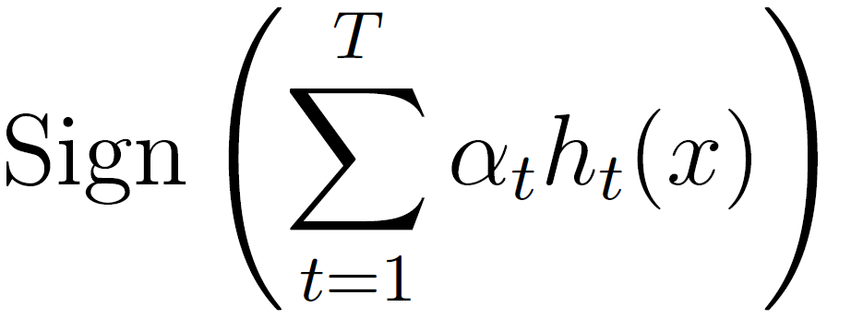
AdaBoost Algorithm description
Input S = {<x_{i}, y_{i}>} and a weak learning algorithm A
Maintain a distribution D_{t} for each step t Initialize: D₁(i) = 1/m
Step
Run A on D_{t} to obtain h_{t}
define ε_{t} = P_{Dt}[ h_{t}(x) ≠ c*(x) ]
D_{t+1}(i) = e^{-yiαtht(xi)}D_{t}(i)/Z_{t} where Z_{t} is a normalizing factor, α_{t} = ½ln( (1- ε_{t}) / ε_{t})
Output H(x) =

Slide 34
AdaBoost error bound
Theorem Let H be the output hypothesis of AdaBoost, then:
Notice that this means the error drops exponentially fast in T.

Slide 35
AdaBoost error bound
Proof structure
Step 1: express D_{T+1} D_{T+1}(i) = D₁(i)e^{-yif(xi)}/ Π_{t=1}^{T} Z_{t}
Step 2: bound the training error error (H) ≤ Π_{t=1}^{T} Z_{t}
Step 3: express Z_{t} in terms of ε_{t} Z_{t} = 2 √ε_{t}(1- ε_{t})
The last inequality is derived from: 1 + x ≤ e^{x}.

Slide 36
AdaBoost error bound
Proof Step 1
By definition: D_{T+1}(i) = e^{-yiαtht(xi)}D_{t}(i)/Z_{t}
D_{T+1}(i) = D₁(i) Π_{t=1}^{T} [e^{-yiαtht(xi)} / Z_{t}]
D_{T+1}(i) = D₁(i) e^{-yi} ^{Σt=1T} ^{αtht(xi)}/ Π_{t=1}^{T} Z_{t}
Define f(x) = Σ_{t=1}^{T} α_{t}h_{t}(x)
Summarize D_{T+1}(i) = D₁(i)e^{-yif(xi)}/ Π_{t=1}^{T} Z_{t}

Slide 37
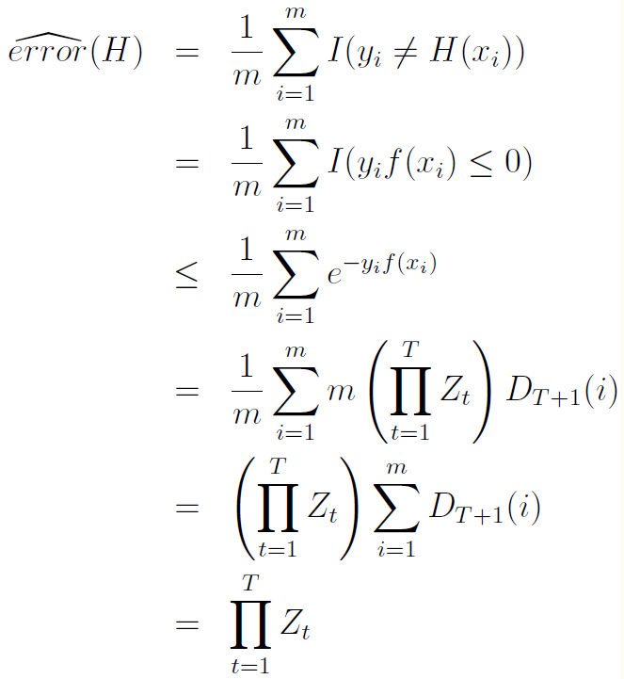
AdaBoost error bound
Proof Step 2 (indicator function) (step 1) (D_{T+1} is a prob. dist.)

Slide 38
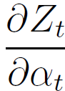
AdaBoost error bound
Proof Step 3
By definition: Z_{t} = Σ_{i=1}^{m} D_{t}(i) e^{-yiαtht(xi)}
Z_{t} = Σ_{yi=ht(xi)} D_{t}(i) e^{-αt} + Σ_{yi≠ht(xi)} D_{t}(i) e^{αt} From the definition of ε_{t}:
Z_{t} = (1- ε_{t})e^{-αt} + ε_{t}e^{αt}
The last expression holds for all α_{t}. Find the minimum of error (H): = -(1- ε_{t})e^{-αt} + ε_{t}e^{αt} = 0
α_{t} = ½ ln ((1- ε_{t}) / ε_{t})
error (H) ≤ Π_{t=1}^{T} (2 √ε_{t}(1- ε_{t}))
QED

