Slide 1
LAGRANGIAN RELAXATION AND NETWORK OPTIMIZATION
Alexey Pechorin
17/06/13

Slide 2
An example: Constrained Shortest Paths
Shortest paths with costs $c_{i,j}$, times $t_{i,j}$ and time constraint T:
Minimize $\sum_{(i,j)∈A}{c_{i,j}x_{i,j}}$
Subject to:
$$\sum_{\{j:(i,j)∈A\}}{x_{i,j}−}\sum_{\{j:(j,i)∈A\}}{x_{j,i}=}\left\{\begin{aligned}1 for i=1 \\ 0 for i∈N−\{1,n\} \\ −1 for i=n\end{aligned}\right.$$
$$\sum_{(i,j)∈A}{t_{i,j}x_{i,j}}≤T$$
$$x_{i,j}∈\left\{0,1\right\}∀(i,j)∈A$$

Slide 3
An example: Constrained Shortest Paths

Slide 4
An example: Constrained Shortest Paths
Bounding Principle
For any nonnegative value of the toll μ, the length $l(μ)$ of the modified shortest path with costs $c_{i,j}+μt_{i,j}$ minus μ T is a lower bound on the length of the constrained shortest path.
Example for usefulness of bounds:
Branch and bound in integer programming – on board

Slide 5
Lagrangian relaxation technique
Generic optimization model of problem P:
$$z^{∗}=\min{cx}$$
Subject to:
$$Ax=b$$
$$x∈X$$
Lagrangian relaxation PL:
Minimize $cx+μ\left(Ax−b\right)$
Subject to:
$$x∈X$$
Lagrangian function:
$$L\left(μ\right)=min⁡\{cx+μ\left(Ax−b\right):x∈X\}$$

Slide 6
Lagrangian relaxation technique
Lagrangian Bounding Principle:
For any vector μ of the Lagrangian multipliers, the value L(μ) of the Lagrangian function is a lower bound on the optimal objective function value z* of the original optimization problem (P)
Proof:
$$z^{∗}=\min\left\{cx:Ax=b,x∈X\right\}=$$
$$\min\left\{cx+μ\left(Ax−b\right):Ax=b,x∈X\right\}≥≥\min\left\{cx+μ\left(Ax−b\right):x∈X\right\}=L(μ)$$

Slide 7
Lagrangian relaxation technique
Lagrangian multiplier problem:
L* = $\max_{μ}{L(μ)}$
Sharpest lower bound on z*
Weak Duality:
The optimal objective function value L* of the Lagrangian multiplier problem is always a lower bound on the optimal objective function value of the problem (P) (i.e., L* $≤$ z*)
Overall we have the following inequalities for feasible x in P
L($μ$)$≤$ L* $≤$z*$≤$cx

Slide 8
Lagrangian relaxation technique
Optimality Test:
(a)
$μ$ - vector of Lagrangian multipliers
x - feasible solution to (P) s.t.
L($μ$) = cx $⟹$
L* = L($μ$)
cx=z*.
(b)
If for some $μ$, the solution x* of the Lagrangian relaxation is feasible in (P) $⟹$
x* is an optimal solution to (P)
$μ$ is an optimal solution to the Lagrangian multiplier problem.

Slide 9
Lagrangian relaxation and inequality constraints
Lagrangian multiplier problem:
L* = $\max_{μ≥0}{L(μ)}$
Optimality Test (b)
(P≤) – min {cx: Ax≤b, x $∈$X}
Relax Ax≤b
For some μ, the solution x* of the Lagrangian relaxation:
feasible in (P≤),
satisfies the complementary slackness condition μ(Ax* - b) = 0
⟹ x* is an optimal solution to (P≤) and L($μ$)=L*
Proof:
By assumption, L(μ) = cx* + μ(Ax* - b).
Since μ(Ax* - b) = 0, L(μ) = cx*.
x* is feasible in (P≤), and so by Optimality test (a), x* solves (P≤).

Slide 10
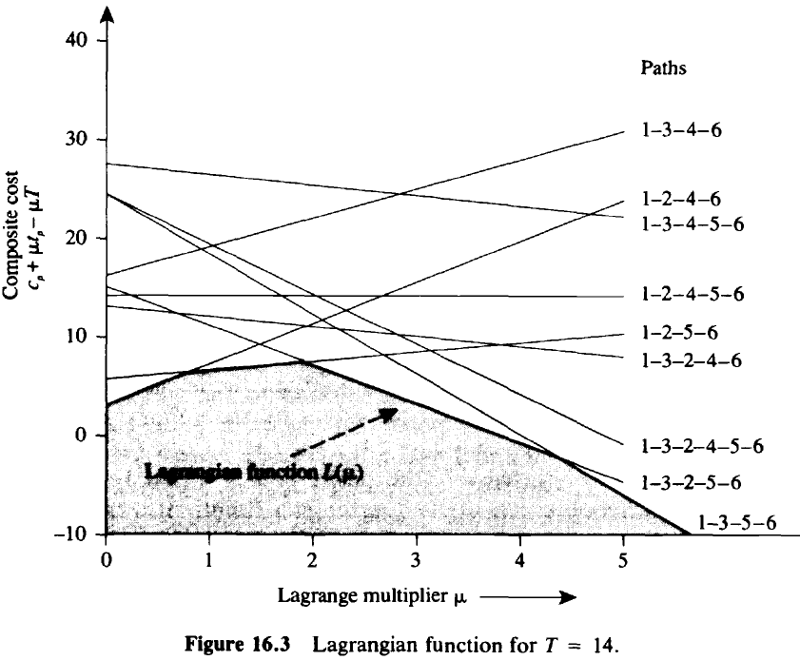
Solving the Lagrangian Multiplier Problem

Slide 11
Solving the Lagrangian Multiplier Problem
Non-linear constraints - $X=\left\{x^{1},x^{2},…,x^{K}\right\}$
Optimization problem - $\min\left\{cx:Ax=b,x∈X\right\}$
$cx^{k}+μ\left(Ax^{k}−b\right)$ - hyperplane
Langrangian multiplier function -$L\left(μ\right)=\min\left\{cx+μ\left(Ax−b\right):x∈X\right\}≤$
$≤cx^{k}+μ\left(Ax^{k}−b\right)∀k=1…K$
Langrangian multiplier problem - L* = $\max_{μ}{L(μ)}$
Equivalent linear programming problem - $\max\left\{w:w≤cx^{k}+μ\left(Ax^{k}−b\right):k=1…K\right\}$

Slide 12
Subgradient Optimization Technique
Update rule: $μ^{k+1}=μ^{k}+θ_{k}(Ax^{k}−b)$
$x^{k}$ - any solution to relaxation with $μ^{k}$
$θ_{k}$ - some (small) step size. How small?
$$θ_{k}→0,\sum{θ_{k}}→∞, e.g.θ_{k}=\frac{1}{k}$$

Slide 13
Subgradient Optimization Technique
Variation on Newton’s method:
$Linear approximation of L\left(μ\right)− r(μ)=x^{k}+μ(Ax^{k}−b)$
Suppose we know L* - pick a new point so the approximation reaches L*:
$r\left(μ^{k+1}\right)=x^{k}+μ^{k+1}\left(Ax^{k}−b\right)=L^{∗}$, so the step size is:
$θ_{k}=\frac{L^{∗}−L(μ^{k})}{{\left\|Ax^{k}−b\right\|}^{2}}$ (proof on board)
Since we don’t know L*:
$θ_{k}=\frac{λ_{k}[UB−L\left(μ^{k}\right)]}{{\left\|Ax^{k}−b\right\|}^{2}}$, UB is an upper bound on z*≥L*, ${0<λ}_{k}<2$
Inequality constraints:${ μ}_{i}^{k+1}=max⁡(0,{ μ}_{i}^{k+1}$)

Slide 14
Linear Programming reminder
$$min\sum_{j=1}^{q}{c_{j}x_{j}}$$
Subject to:
$$\sum_{j=1}^{q}{a_{i,j}x_{j}=b\left(i\right), i=1,…,p}$$
$$x_{j}≥0,j=1,…,q$$
Handle inequalities by introducing slack variables
The set of feasible solutions is a polyhedron
Extreme point – not a convex combination of other two points in the polyhedron
Every LP has an extreme point as an optimal solution

Slide 15
Linear Programming reminder
(B,L) – basic structure
Optimality criteria for feasible basic structure - $c_{}^{π}≥0$
Simplex method – iterate from extreme point (basic feasible solution) to another one ↔ swap basic variable with $c_{}^{π}<0$ with nonbasic variable

Slide 16
Linear Programming reminder
Primal:
$$min\sum_{j=1}^{q}{c_{j}x_{j}}$$
Subject to:
$$\sum_{j=1}^{q}{a_{i,j}x_{j}≥b\left(i\right), i=1,…,p}$$
$$x_{j}≥0,j=1,…,q$$
Dual:
$$max\sum_{i=1}^{p}{b(i)π(i)}$$
Subject to:
$$\sum_{i=1}^{p}{a_{i,j}π(i)≤c_{j}, j=1,…,q}$$
$$π(i)≥0,i=1,…,p$$

Slide 17
Linear Programming reminder
Weak duality: $\sum_{i=1}^{p}{b(i)π(i)}≤\sum_{j=1}^{q}{c_{j}x_{j}}$
Strong Duality:If anyone of the pair of primal and dual problems has a finite optimal solution, so does the other one and both have the same objective function values.
Complementary Slackness Optimality Conditions:
Feasible (x,π) are optimal iff:
$π(i)\left[\sum_{j=1}^{q}{a_{i,j}x_{j}−b\left(i\right) }\right]$=0, $i=1,…,p$
$$x_{j}\left[c_{j}−\sum_{i=1}^{p}{a_{i,j}π\left(i\right)} \right]=0,j=1,…,q$$

Slide 18
LAGRANGIAN RELAXATION AND LINEAR PROGRAMMING
LP - $z^{∗}=min⁡\{cx:Ax=b, Dx≤q, x≥0\}$
L(μ)=$min⁡\{cx+μ\left(Ax−b\right): Dx≤q, x≥0\}$
L*=$\max_{μ}\left\{L(μ)\right\}=z^{∗}$
Proof:
x* - LP optimal solution, π*, γ* dual optimal solution (π* - for equality constraints, γ* - inequality)
Dual feasibility - c+π*A+γ*D≥0
Complementary slackness – [c+π*A+γ*D]x*=0, γ*[Dx*-q]=0
$L\left(π^{∗}\right)=\min_{x}{\{cx+}π^{∗}\left(Ax−b\right):Dx≤q,x≥0\}$= $cx^{∗}+π^{∗}\left(Ax^{∗}−b\right)$=$cx^{∗}$=z*

Slide 19
LAGRANGIAN RELAXATION AND LINEAR PROGRAMMING
$X=\left\{x:Dx≤q, x≥0, x integer\right\}=\{x^{1},…,x^{K}\}$
P - $min\left\{cx :Ax=b, x∈X\right\}$
LP relaxation - $z^{0}=min\left\{cx :Ax=b,Dx≤q, x≥0\right\}≤z^{∗}$
Convex combination - $x=\sum_{k=1}^{K}{λ_{k}x^{k}}$, $\sum_{k=1}^{K}{λ_{k}=1}$
Convex Hull – H(X) – all convex combinations of X
H(X) is a polyhedron and can be defined by a finite amount of inequalities
Each extreme point solution of H(X) lies in X, and if we optimize a linear objective function over H(X), some solution in X will be an optimal solution
$H(X)⊆${x: $Dx≤q, x≥0$}

Slide 20
LAGRANGIAN RELAXATION AND LINEAR PROGRAMMING
L* equals the optimal objective function value of the linear program $min⁡\{cx :Ax=b, x∈H(X)\}$, and L*≥z⁰
Proof:
L(μ)=$min⁡\{cx+μ\left(Ax−b\right):x∈X\}$=$min⁡\{cx+μ\left(Ax−b\right):x∈H(X)\}$
So it’s a Lagrangian relaxation of LP $\min\left\{cx:Ax=b,x∈H\left(X\right)\right\}$, thus the optimal objective function value is equal. q.e.d.
CP – convexified problem - $\min\left\{cx:Ax=b,x∈H\left(X\right)\right\}$

Slide 21
LAGRANGIAN RELAXATION AND LINEAR PROGRAMMING
When L*=z⁰?
Integrality property:
The problem $\min\left\{dx:Dx≤q,x≥0 and integer\right\}$ has integer optimal solution for each d even when we relax the integrality constraint ⟹
$∀μ$ L(μ)=$\min\left\{cx+μ\left(Ax−b\right):Dx≤q,x≥0\right\}=$
$$=\min\left\{cx+μ\left(Ax−b\right):Dx≤q,x≥0, x is integer\right\}$$
Proof:
Every extreme point of $\{x:Dx≤q,x≥0 \}$is integer ⟹
$\{x:Dx≤q,x≥0 \}$=H($\{x:Dx≤q,x≥0 and integer\}$)=H(X)
$$LP domain=\left\{x:Ax=b,Dx≤q,x≥0 \right\}=\left\{x:Ax=b,x∈H(X)\right\}=CP domain$$

Slide 22
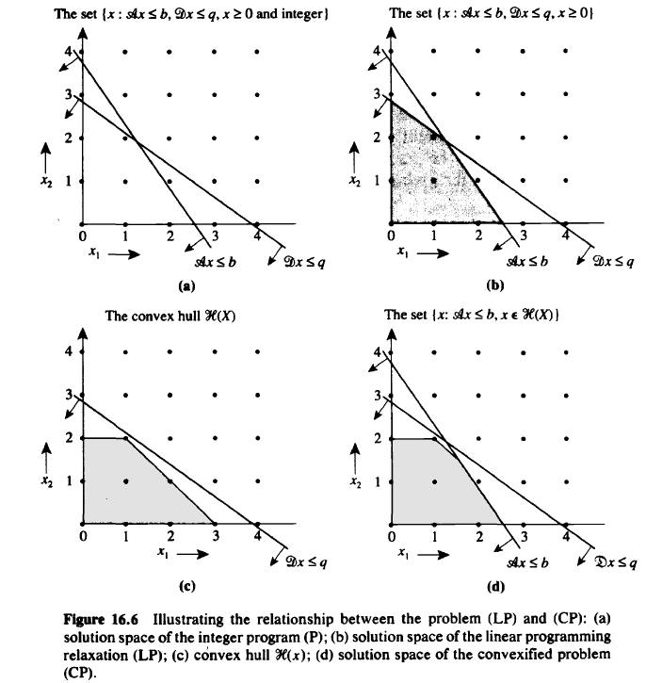
LAGRANGIAN RELAXATION AND LINEAR PROGRAMMING

Slide 23
Example for application - Network flow
Minimize cx
Subject to:
$$Ax≤b,$$
$$Nx=q,$$
$$l≤x≤u,$$
$$x_{i,j} integer for \left(i,j\right)∈E$$
$L\left(μ\right)=min⁡\{cx+μ\left(Ax−b\right):Nx=q,l≤x≤u\}$ - regular network flow problem, we have integrality property.
Solve by subgradient optimization, each iteration is a simple network flow problem.

Slide 24
Questions?

