Slide 1
Lower Bounds for Differential Privacy
Dwork and A. Roth
The algorithmic foundations of differential privacy, 2014
Gefen Morami
TAU Differential Privacy Seminar, Decmenber 25th 2019

Slide 2
How inaccurate must responses be in order not to completely destroy any reasonable notion of privacy?
Notes:
דיברנו על הטריידאוף הזה בין פרטיות לדיוק הרבה ואנחנו רוצים להראות בהמשך על מכניסם מסוג אפסילון דלתא פרטי שחייב להיות חסם תחתון על הפרטיות המחוייבת על מנת שלא יהיה לנו

Slide 3

Definition 8.1.
A mechanism is blatantly non-private if an adversary can construct a candidate database c that agrees with the real database d in all but O(n) entries, i.e., ${\text{∥}\text{c}\text{ − }\text{d}\text{∥}}_{0}$ $∈ O(n)$.
Notes:
In other words, a mechanism is blatantly non-private if it permits a reconstruction attack that allows the adversary to correctly guess the secret bit of all but o(n) members of the database. (There is no requirement that the adversary know on which answers it is correct.)
Show that it implies the mechanism is not differential private check with book#2

Slide 4
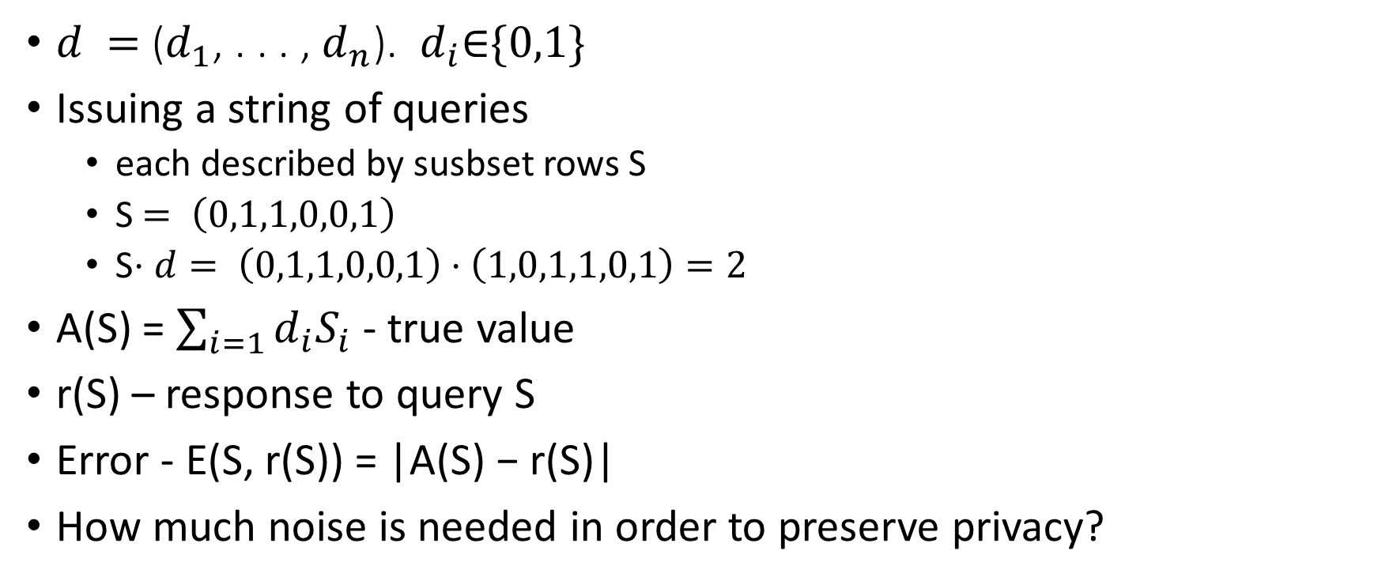
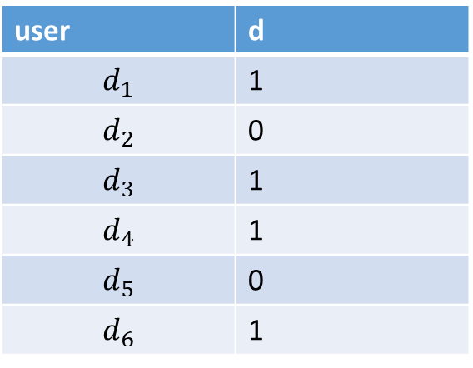
Reconstruction attacks
user | d
$$d_{1}$$ | 1
$$d_{2}$$ | 0
$$d_{3}$$ | 1
$$d_{4}$$ | 1
$$d_{5}$$ | 0
$$d_{6}$$ | 1
$d =$($d_{1}$, . . . , $d_{n}$). $d_{i}\text{∈}\{0,1\}$
Issuing a string of queries
  each described by susbset rows S
  S$= \left(0,1,1,0,0,1\right)$
  S$⋅d= \left(0,1,1,0,0,1\right)⋅\left(1,0,1,1,0,1\right)=2$
A(S) = $\sum_{i=1}{d_{i}S_{i} }$- true value
r(S) – response to query S
Error - E(S, r(S)) = |A(S) − r(S)|
How much noise is needed in order to preserve privacy?
Notes:
עכשיו נדבר על מכניזם רגיל שהוא אינו אפסילון דלתא דיפרנציאל פרייט

Slide 5
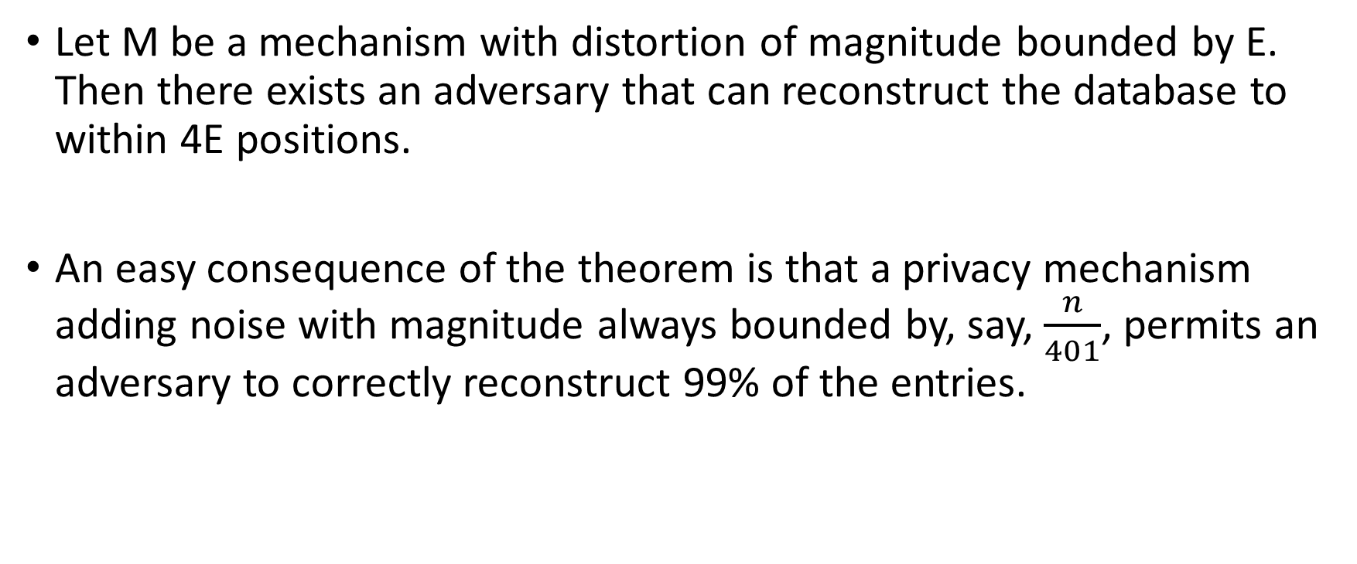
Theorem 8.1.
Let M be a mechanism with distortion of magnitude bounded by E. Then there exists an adversary that can reconstruct the database to within 4E positions.
An easy consequence of the theorem is that a privacy mechanism adding noise with magnitude always bounded by, say, $\frac{n}{401}$, permits an adversary to correctly reconstruct 99% of the entries.
Notes:
נשים לב שפה אין הגבלה על כמות השאילתות שניתן לשאול

Slide 6
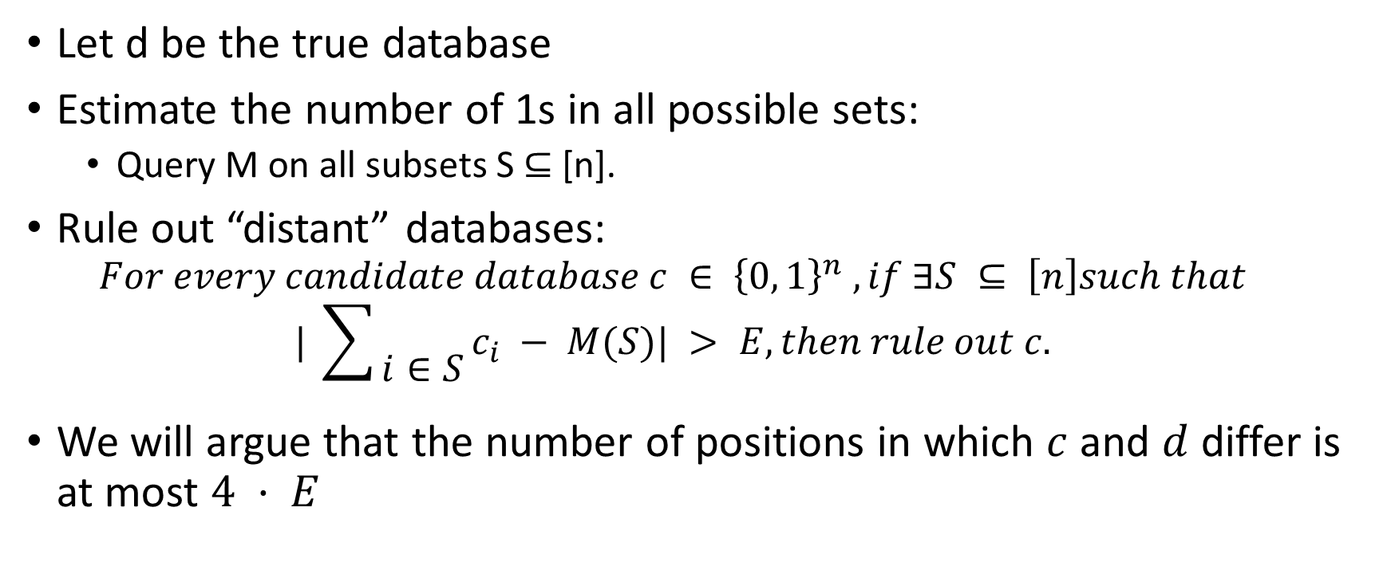
Proof
Let d be the true database
Estimate the number of 1s in all possible sets:
  Query M on all subsets S ⊆ [n].
Rule out “distant” databases:
  $$For every candidate database c ∈ {\left\{0, 1\right\}}^{n} , if ∃S ⊆ \left[n\right]such that$$
  $$| \sum{\begin{aligned} \\ i∈S\end{aligned}}c_{i} − M(S)| > E, then rule out c.$$
We will argue that the number of positions in which $c$ and $d$ differ is at most $4 · E$
Notes:
Since M(S) never errs by more than E
the real database will not be ruled out
2^n queries
Give examples

Slide 7
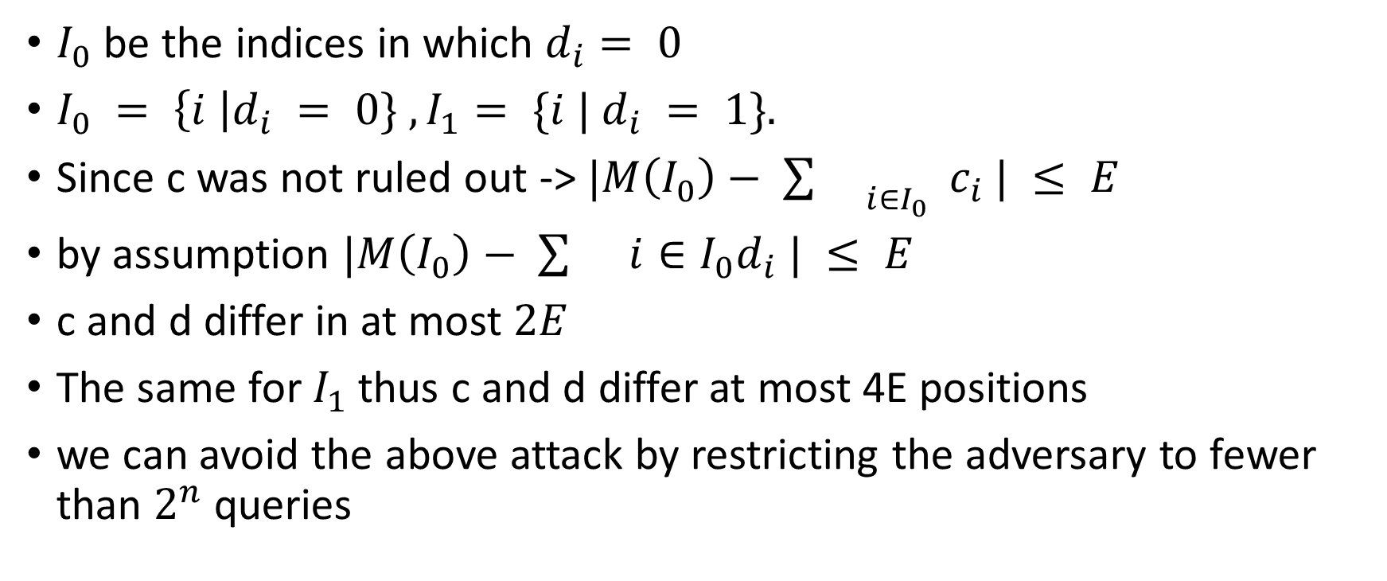
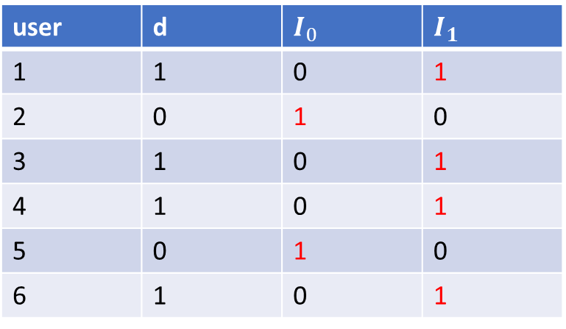
4E
user | d | $$I_{0}$$ | $$I_{1}$$
1 | 1 | 0 | 1
2 | 0 | 1 | 0
3 | 1 | 0 | 1
4 | 1 | 0 | 1
5 | 0 | 1 | 0
6 | 1 | 0 | 1
$I_{0}$ be the indices in which $d_{i}= 0$
$I_{0} = \left\{i \right|d_{i} = 0\} ,I_{1}= \{i | d_{i} = 1\}.$
Since c was not ruled out -> $|M\left(I_{0}\right)− {\sum{}}_{i∈I_{0}} c_{i} | ≤ E$
by assumption $|M\left(I_{0}\right)− \sum{}i∈I_{0}d_{i} | ≤ E$
c and d differ in at most $2E$
The same for $I_{1}$thus c and d differ at most 4E positions
we can avoid the above attack by restricting the adversary to fewer than $2^{n}$ queries

Slide 8
What if we consider more realistic bounds on the number of queries?

Slide 9
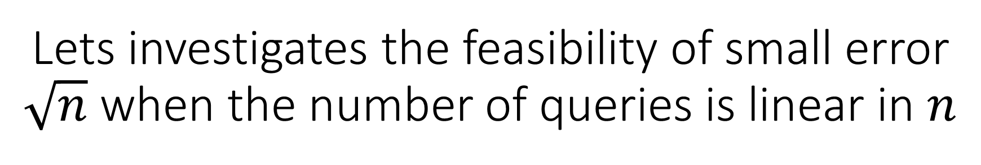
Lets investigates the feasibility of small error $\sqrt{n}$when the number of queries is linear in $n$

Slide 10

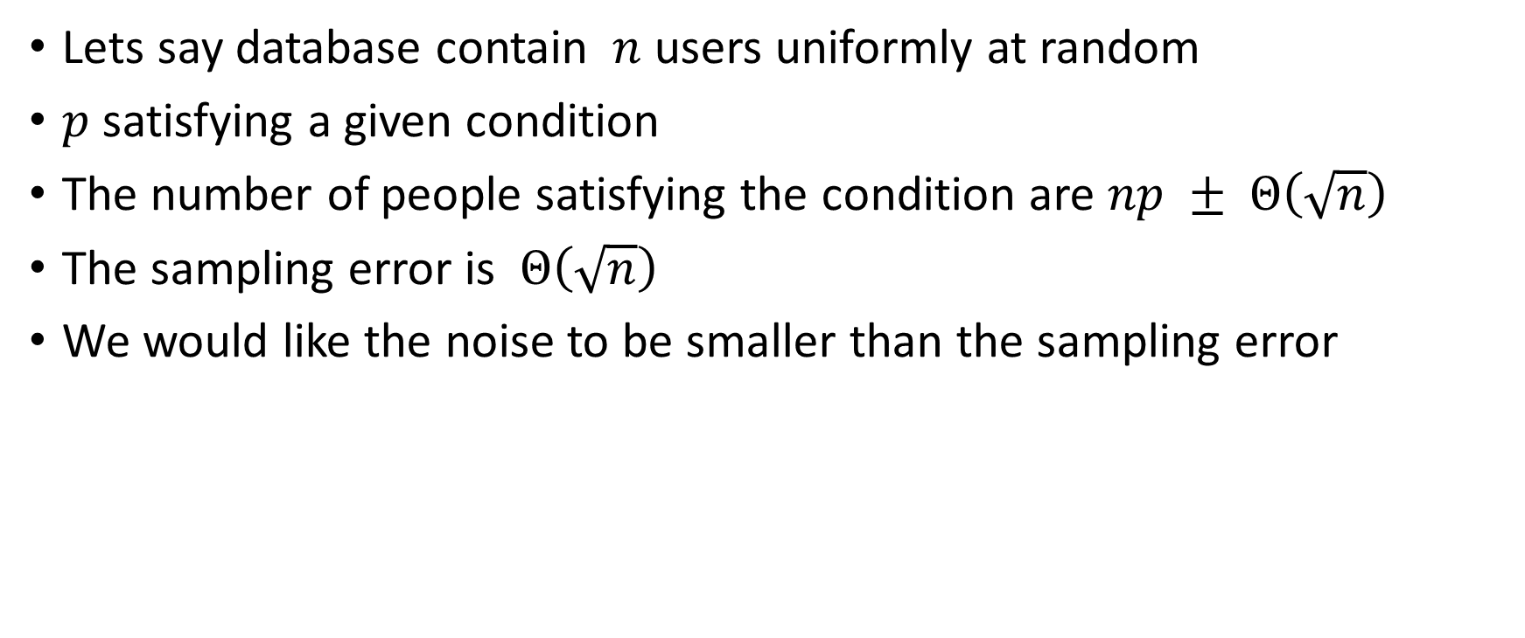
Why $\sqrt{n}$threshold as threshold on noise?
Lets say database contain $n$ users uniformly at random
$p$ satisfying a given condition
The number of people satisfying the condition are $np ± Θ\left(\sqrt{n}\right)$
The sampling error is $Θ\left(\sqrt{n}\right)$
We would like the noise to be smaller than the sampling error

Slide 11

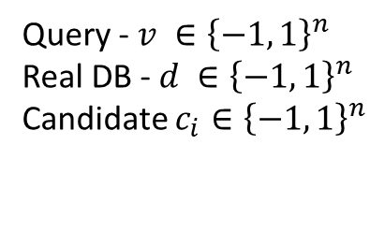
Query - $v ∈{\left\{−1, 1\right\}}^{n}$
Real DB - $d ∈{\left\{−1, 1\right\}}^{n}$
Candidate $c_{i}∈{\left\{−1, 1\right\}}^{n}$
$$\sqrt{n}$$
d*v

Slide 12
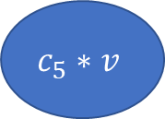

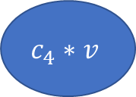

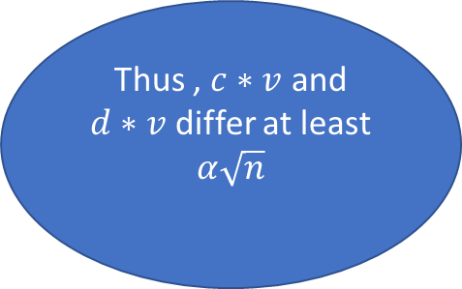
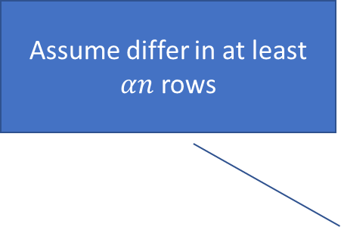
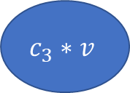


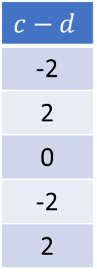

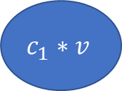

Query - $v ∈{\left\{−1, 1\right\}}^{n}$
Real DB - $d ∈{\left\{−1, 1\right\}}^{n}$
Candidate $c_{i}∈{\left\{−1, 1\right\}}^{n}$
Assume differ in at least $αn$ rows
$$c−d$$
-2
2
0
-2
2
$$c_{2}∗v$$
$$c_{4}∗v$$
$$≥α\sqrt{n}$$
$$≥α\sqrt{n}$$
$$\sqrt{n}$$
d*v
Thus , $c∗v$ and
$d∗v$ differ at least
$α\sqrt{n}$
$$≥α\sqrt{n}$$
$$≥α\sqrt{n}$$
$$≥α\sqrt{n}$$
$$c_{1}∗v$$
$$c_{3}∗v$$
$$c_{5}∗v$$

Slide 13
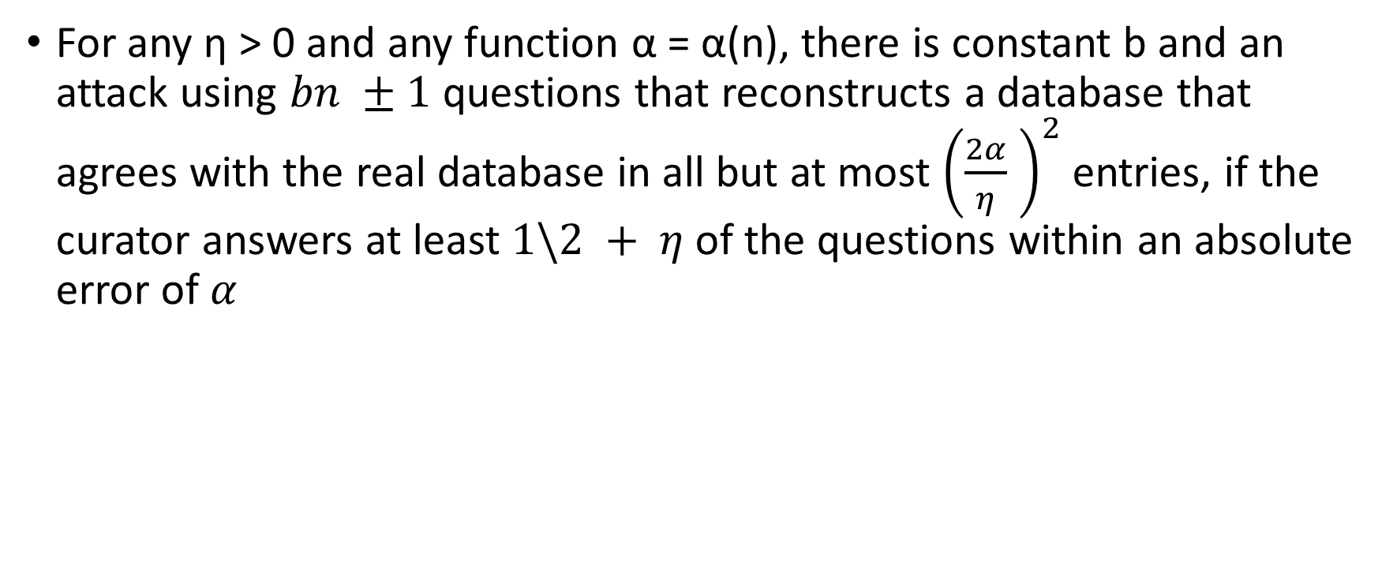
Theorem 8.2.
For any η > 0 and any function α = α(n), there is constant b and an attack using $bn ±1$ questions that reconstructs a database that agrees with the real database in all but at most ${\left(\frac{2α}{η} \right)}^{2}$entries, if the curator answers at least $1\backslash 2 + η$of the questions within an absolute error of $α$

Slide 14
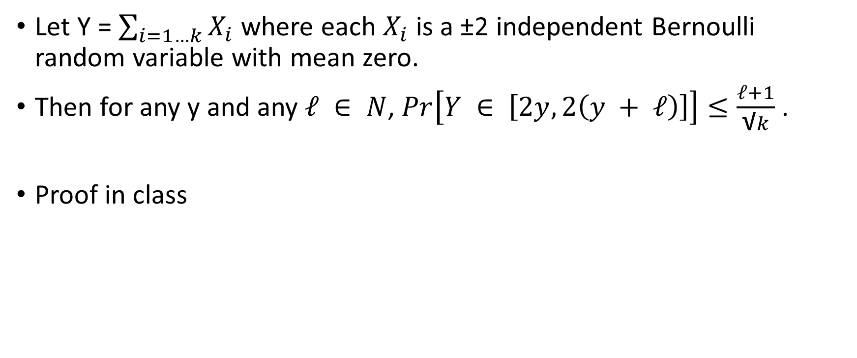
Lemma 8.3.
Let Y = $\sum_{i=1…k}{X_{i}}$where each $X_{i}$ is a ±2 independent Bernoulli random variable with mean zero.
Then for any y and any $ℓ ∈ N$, $Pr\left[Y ∈ \left[2y, 2\left(y + ℓ\right)\right]\right]≤\frac{ℓ+1}{\text{√}k}$ .
Proof in class

Slide 15
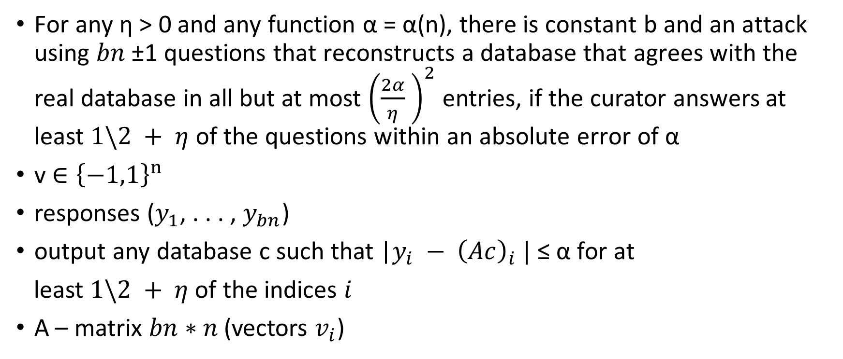
Back to Theorem 8.2
For any η > 0 and any function α = α(n), there is constant b and an attack using $bn$ ±1 questions that reconstructs a database that agrees with the real database in all but at most ${\left(\frac{2α}{η} \right)}^{2}$ entries, if the curator answers at least $1\backslash 2 + η$ of the questions within an absolute error of α
v $∈{\left\{−1,1\right\}}^{n}$
responses ($y_{1}$, . . . , $y_{bn}$)
output any database c such that |$y_{i} − {\left(Ac\right)}_{i} |$ ≤ α for at
least $1\backslash 2 + η$ of the indices $i$
A – matrix $bn∗n$ (vectors $v_{i}$)

Slide 16
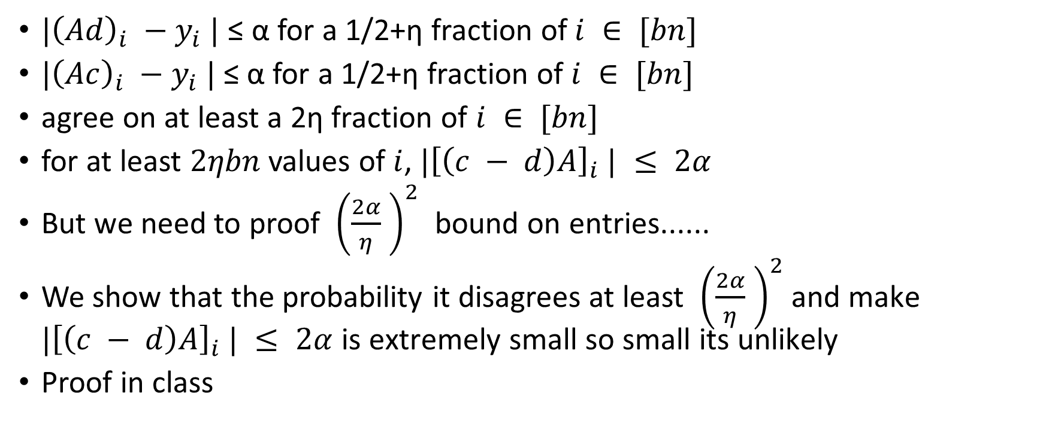
Proof
$|{\left(Ad\right)}_{i} −y_{i} |$ ≤ α for a 1/2+η fraction of$i ∈ [bn]$
$|{\left(Ac\right)}_{i} −y_{i} |$≤ α for a 1/2+η fraction of $i ∈ [bn]$
agree on at least a 2η fraction of $i ∈ [bn]$
for at least $2ηbn$ values of $i$, $|{\left[\left(c − d\right)A\right]}_{i} | ≤ 2α$
But we need to proof ${\left(\frac{2α}{η} \right)}^{2}$ bound on entries......
We show that the probability it disagrees at least ${\left(\frac{2α}{η} \right)}^{2}$ and make $|{\left[\left(c − d\right)A\right]}_{i} | ≤ 2α$ is extremely small so small its unlikely
Proof in class

Slide 17
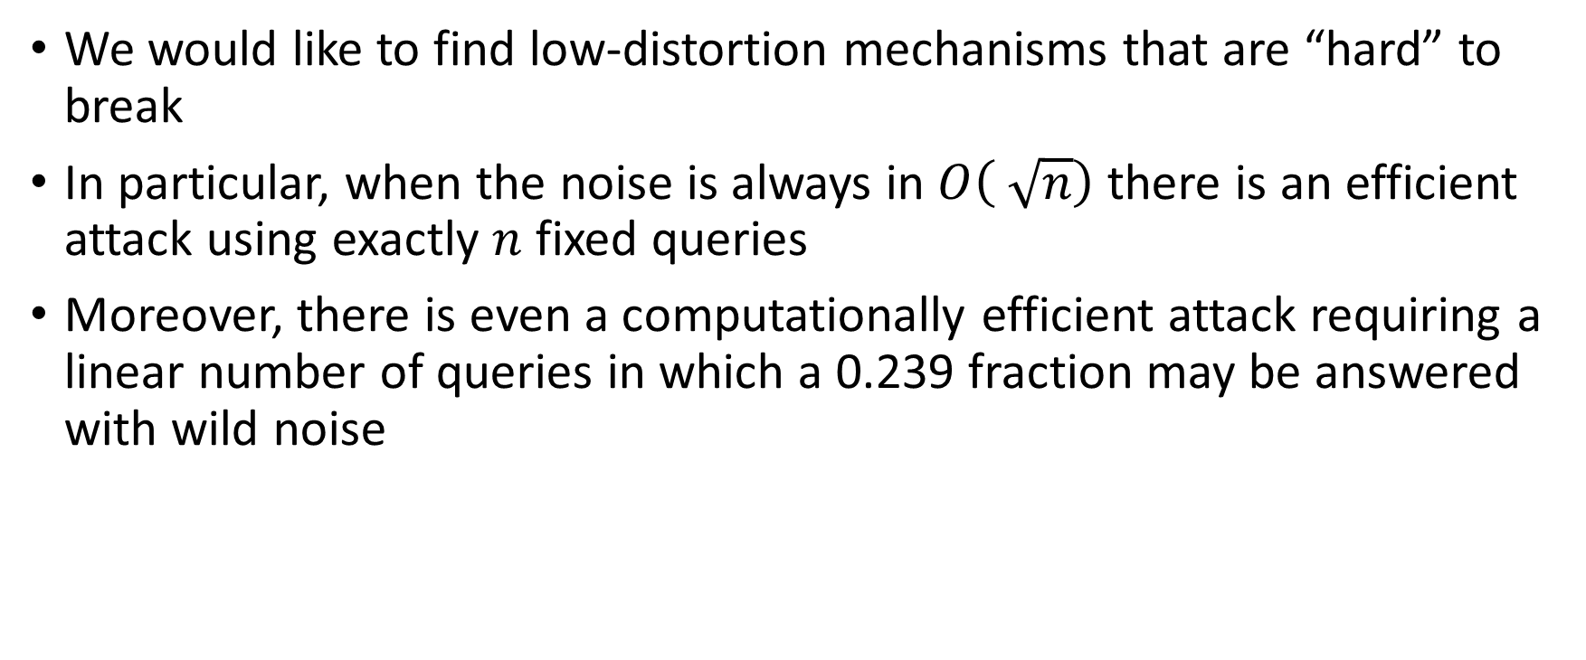
Better Defense
We would like to find low-distortion mechanisms that are “hard” to break
In particular, when the noise is always in $O\left( \sqrt{n}\right)$there is an efficient attack using exactly $n$ fixed queries
Moreover, there is even a computationally efficient attack requiring a linear number of queries in which a 0.239 fraction may be answered with wild noise

Slide 18
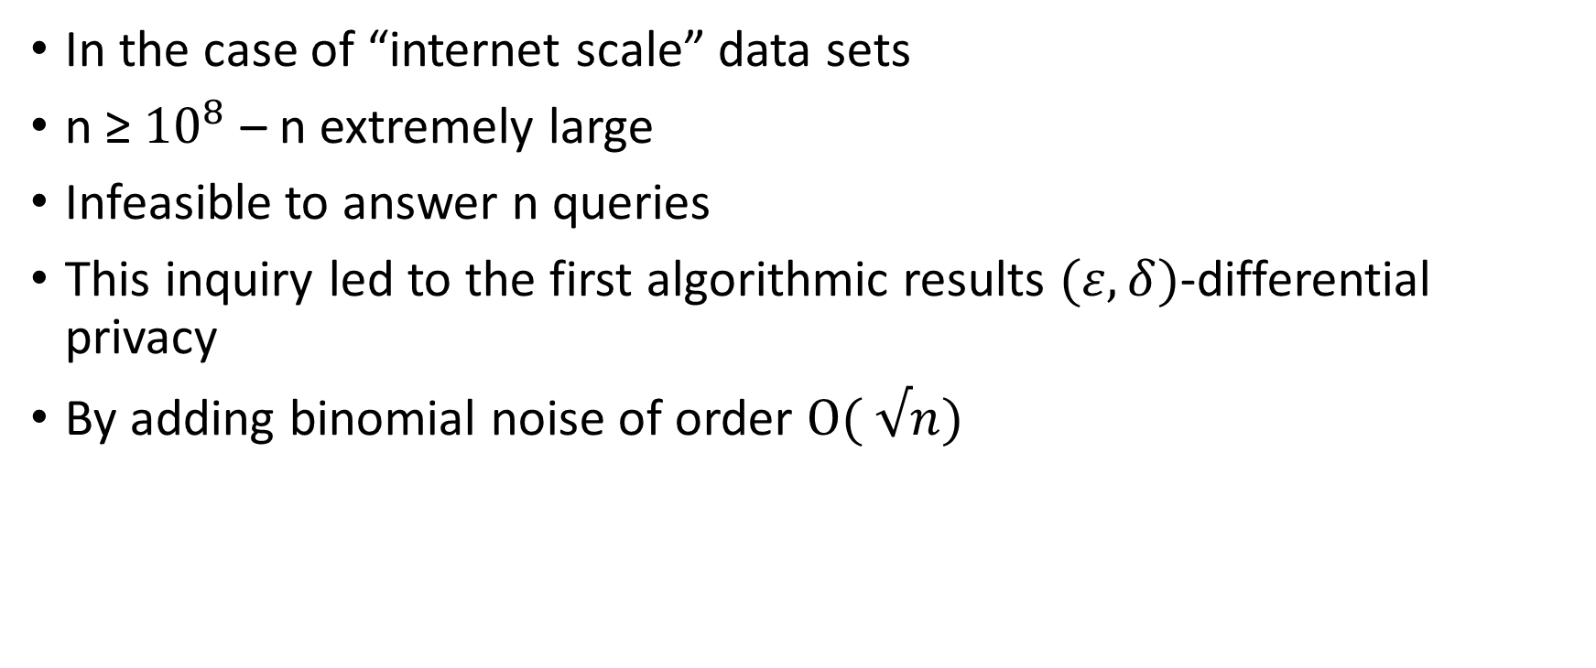
Internet Scale
In the case of “internet scale” data sets
n ≥ ${10}^{8}$ – n extremely large
Infeasible to answer n queries
This inquiry led to the first algorithmic results $(ε, δ)$-differential privacy
By adding binomial noise of order $O( √n)$

Slide 19
Lower bounds for differential privacy

Slide 20
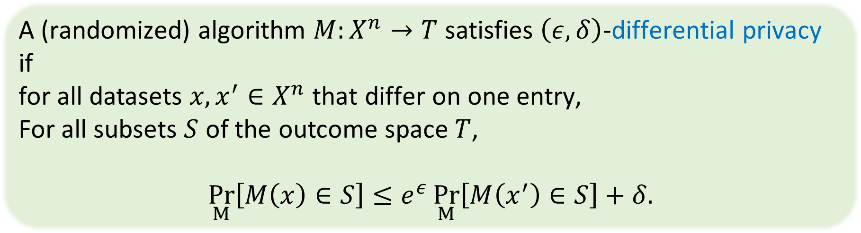
Lower bounds for differential privacy
The results of the previous section yielded lower bounds on distortion needed to ensure any reasonable notion of privacy
In contrast, the result in this section is specific to differential privacy
A (randomized) algorithm $M:X^{n}→T$ satisfies $\left(ε,δ\right)$-differential privacy if
for all datasets $x,x^{′}∈X^{n}$ that differ on one entry,
For all subsets $S$ of the outcome space $T$,
$$\underset{M}{Pr}\left[M\left(x\right)∈S\right]≤e^{ε}\underset{M}{Pr}\left[M\left(x^{′}\right)∈S\right]+δ.$$

Slide 21
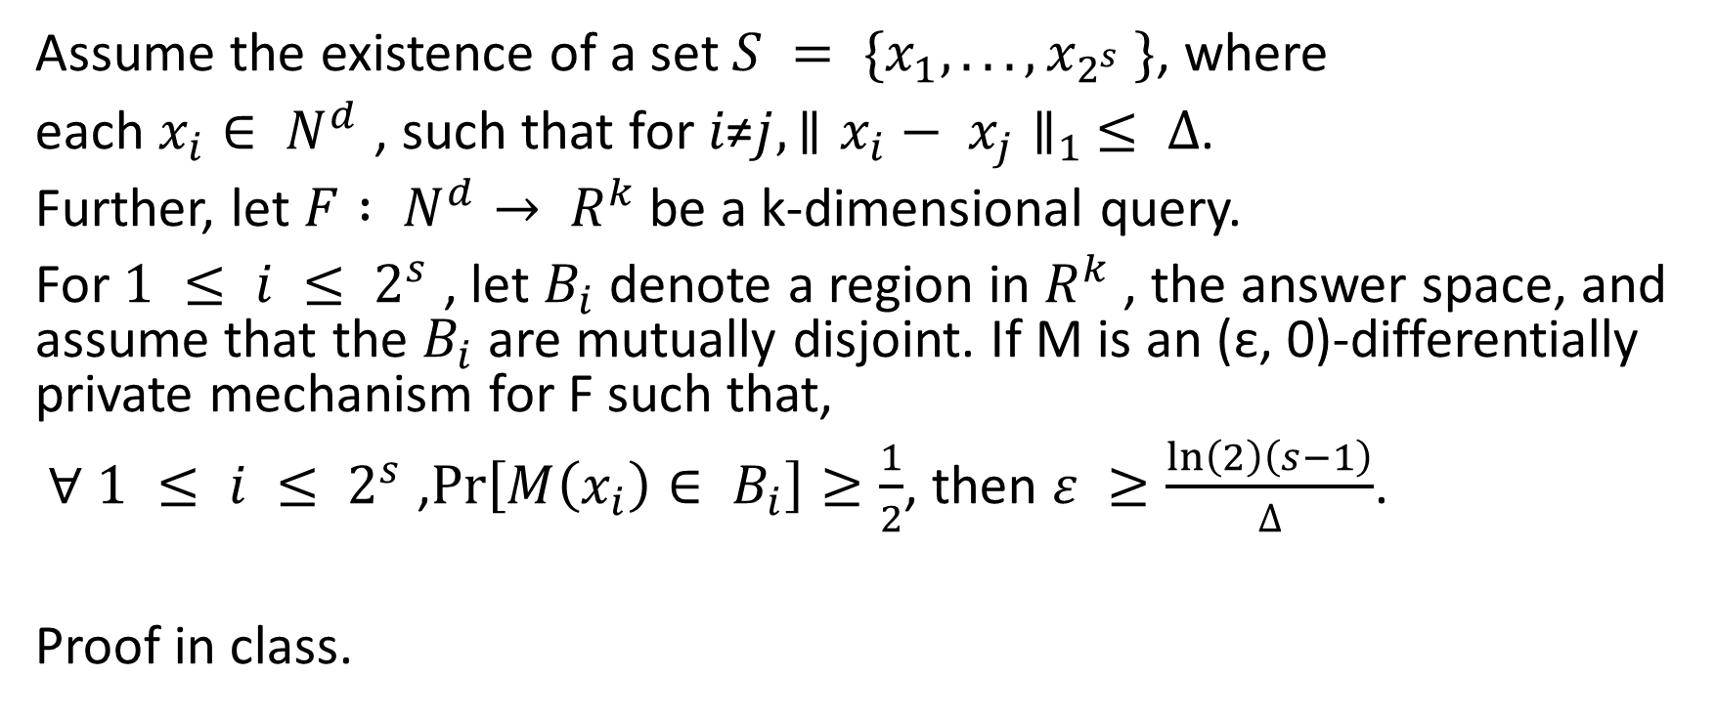
Lemma 8.4.
Assume the existence of a set $S = \{x_{1}, . . . , x_{2^{s}} \}$, where
each $x_{i}∈ N^{d}$ , such that for $i\text{≠}j, ∥x_{i}− x_{j}∥_{1} ≤ ∆$.
Further, let $F : N^{d}→ R^{k}$ be a k-dimensional query.
For $1 ≤ i ≤ 2^{s}$ , let $B_{i}$ denote a region in $R^{k}$ , the answer space, and assume that the $B_{i}$ are mutually disjoint. If M is an (ε, 0)-differentially private mechanism for F such that,
∀ $1 ≤ i ≤ 2^{s}$ ,$\operatorname{Pr}\left[M\left(x_{i}\right)∈ B_{i}\right]≥\frac{1}{2}$, then $ε ≥\frac{\ln\left(2\right)\left(s−1\right)}{∆}$.
Proof in class.

Slide 22








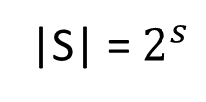


USERS
|S| = $2^{s}$
$$R^{k}$$
$$B_{1}$$
$$x_{1}$$
$$B_{1}$$
$$\operatorname{Pr}\left[M\left(x_{i}\right)∈ B_{i}\right]≥\frac{1}{2}$$
∆
$$B_{2}$$
$$x_{2}$$
∆
$$B_{3}$$
∆
$$x_{3}$$
$$F\left(x_{2}\right)$$
Notes:
נניח שאיכשהוא התוקף הצליח לצמצם את מרחב הדאטהבייסים האפשריים לקבוצה קטנה אס שיש בה 2 בחזקת אס וקטורים כאשר יש ביניהם מרחק של דלטא גדול
האיקסים אלו דאטה בייסים קיימים 2 בחזקת אס דאטה בייסים שכל אחד מהם שונה בדלטא רשומות אחד מהשני
נניח שקיימת פונקציה אף שהמרחקי תוצאה שלה אחד מהשני גדולים והתחומים המורעשים הם לא נחתכים

Slide 23
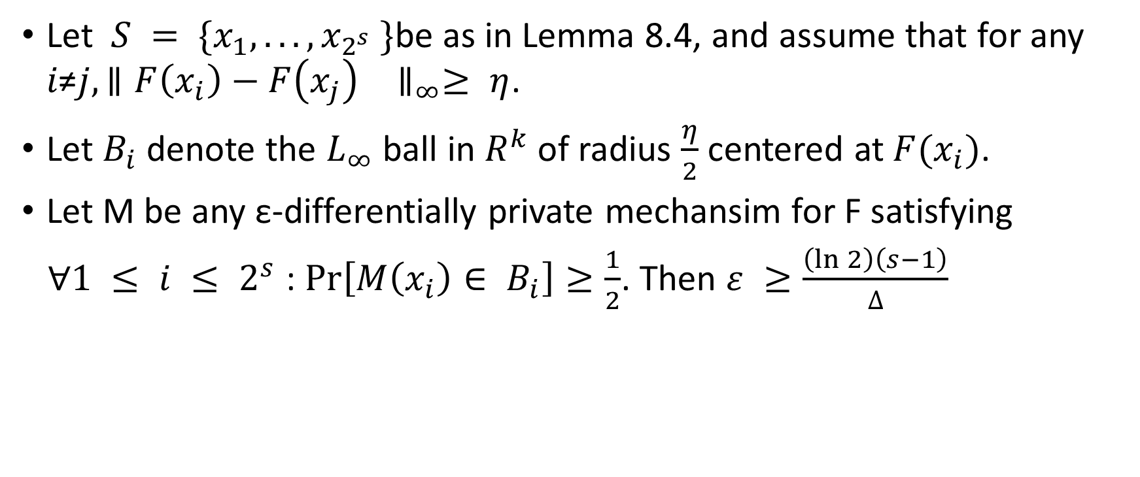
Corollary 8.5.
Let $S = \{x_{1}, . . . , x_{2^{s}} \}$be as in Lemma 8.4, and assume that for any $i\text{≠}j, ∥F\left(x_{i}\right)−F{\left(x_{j}\right)}_{}∥_{∞}≥ η$.
Let $B_{i}$ denote the $L_{∞}$ ball in $R^{k}$ of radius $\frac{η}{2}$ centered at$F(x_{i})$.
Let M be any ε-differentially private mechansim for F satisfying
∀$1 ≤ i ≤ 2^{s}$ : $\operatorname{Pr}\left[M\left(x_{i}\right)∈ B_{i}\right]≥\frac{1}{2}$. Then $ε ≥\frac{\left(\ln{2}\right)\left(s−1\right)}{∆}$
Notes:
Proof. The regions B1, . . . , B2 s are disjoint by definition of minimum distance and radius , so the conditions of Lemma 8.4 are satisfied.
The corollary follows by applying the lemma and taking logarithms.

Slide 24






USERS
|S| = $2^{s}$
$$B_{1}$$
$$R^{k}$$
$$x_{1}$$
$$B_{1}$$
$$\operatorname{Pr}\left[M\left(x_{i}\right)∈ B_{i}\right]≥\frac{1}{2}$$
∆
$$\frac{η}{2}$$
$$B_{2}$$
$$x_{2}$$
$$≥ η$$
∆
$$B_{3}$$
∆
$$x_{3}$$
$$F\left(x_{2}\right)$$
Notes:
עכשיו אנחנו משתמשים בפונקצייה שידוע לנו שהתחומים מוגבלים ברדיוס של אטה חלקי 2 ושהמרחק בין שני תוצאות גדול שווה לאטה ולכן התחומים הם לא נחתכים ולכן נוכל להשתמש בלמה 8.4 ולקחת לוג

Slide 25

Claim 8.6
To obtain (ε, 0)- differential privacy for $ε≤\frac{\left(\ln{2}\right)\left(s−1\right)}{∆}$ , the mechanism must add noise with $L_{∞}$norm greater than $\frac{η}{2}$ with probability exceeding $\frac{1}{2}$.

Slide 26
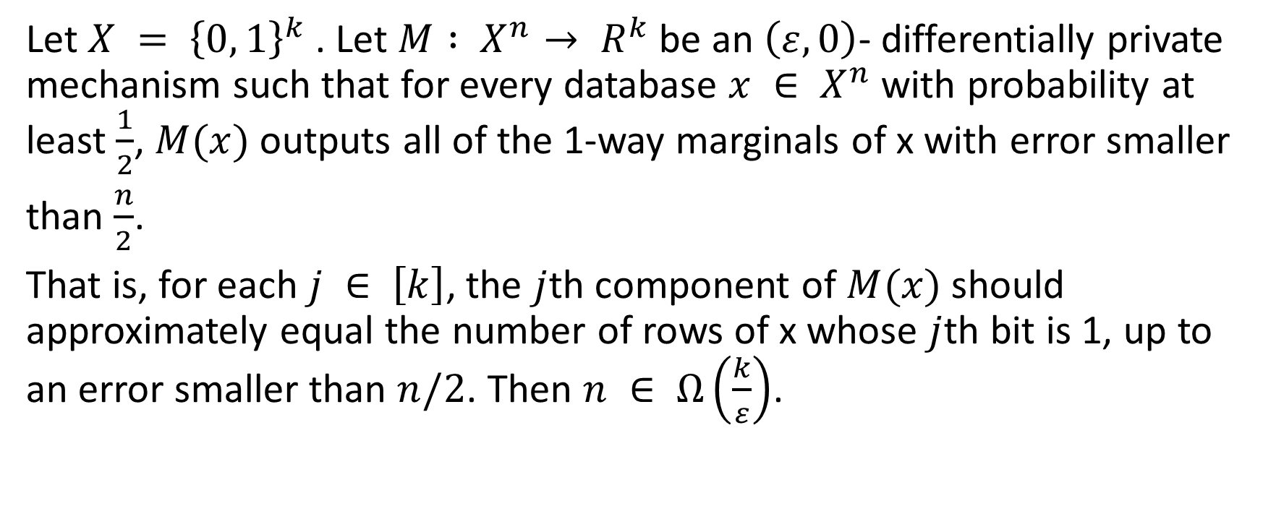
Theorem 8.7
Let $X = {\left\{0, 1\right\}}^{k}$ . Let $M : X^{n}→ R^{k}$ be an $\left(ε, 0\right)$- differentially private mechanism such that for every database $x ∈ X^{n}$ with probability at least $\frac{1}{2}$, $M(x)$ outputs all of the 1-way marginals of x with error smaller
than $\frac{n}{2}$.
That is, for each $j ∈ \left[k\right]$, the $j$th component of $M(x)$ should approximately equal the number of rows of x whose $j$th bit is 1, up to an error smaller than $n/2$. Then $n ∈ Ω\left(\frac{k}{ε}\right)$.
Notes:
5.14 book #2
Counting queries
1/epsilon n
Add more painting

Slide 27

Proof
For every string $w ∈ {\left\{0, 1\right\}}^{k}$ , consider the database $x_{w}$ consisting of $n$ identical rows, all of which equal w.
Let $B_{w}∈ R^{k}$consist of all tuples of numbers that provide answers to
the 1-way marginals on x with error less than $\frac{n}{2}$.
That is, $B_{w}= \left\{\left(a_{1}, . . . , a_{k}\right)\right\}∈ R^{k}: ∀i ∈ [k] |a_{i}− nw_{i} | < n/2\}.$

Slide 28
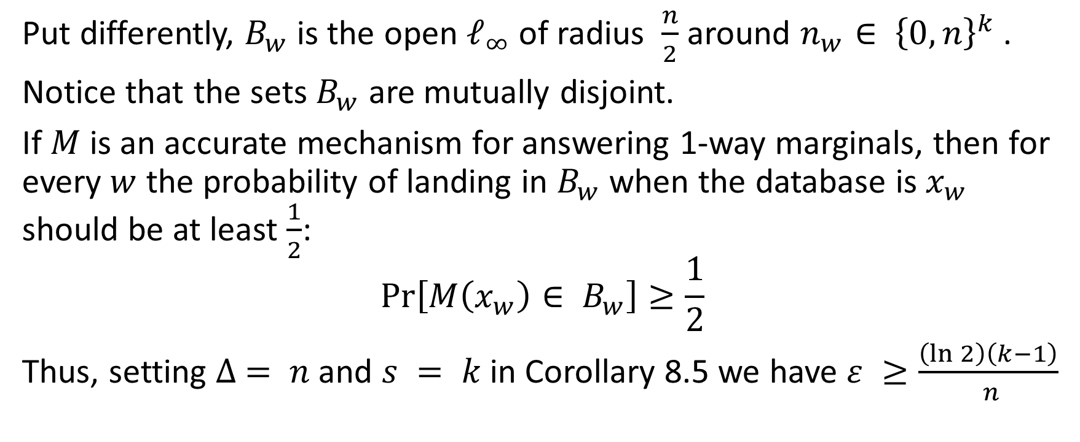
Proof
Put differently, $B_{w}$ is the open $ℓ_{∞}$ of radius $\frac{n}{2}$ around $n_{w}∈ {\left\{0, n\right\}}^{k}$ .
Notice that the sets $B_{w}$ are mutually disjoint.
If $M$ is an accurate mechanism for answering 1-way marginals, then for every $w$ the probability of landing in $B_{w}$ when the database is $x_{w}$ should be at least $\frac{1}{2}$:
$$\operatorname{Pr}\left[M\left(x_{w}\right)∈ B_{w}\right]≥\frac{1}{2}$$
Thus, setting $∆ = n$ and $s = k$ in Corollary 8.5 we have $ε ≥\frac{\left(\ln{2}\right)\left(k−1\right)}{ n}$

Slide 29


Real word problem
Lets define user $x_{i}$ with $k$ attributes such that the $k$th attribute of $x_{i}$ indicate if user $x_{i}$ had vaccine or not (0/1)
 | Flu | Polio | Hepatitis B | HPV
$$x_{1}$$ | 1 | 0 | 0 | 1
$$x_{2}$$ | 0 | 1 | 1 | 1
$$x_{3}$$ | 1 | 1 | 1 | 0
Notes:
אנחנו נרצה להראות שקיימת בעיה בעולם האמיתי המתאימה לסטינגס של ההגדרה שלנו

Slide 30






$$X_{0,0,0,0}$$ | Flu | Polio | Hepatitis B | HPV
User-1 | 0 | 0 | 0 | 0
$$X_{0,0,1,1}$$ | Flu | Polio | Hepatitis B | HPV
User-4 | 0 | 0 | 1 | 1
$$X_{0,0,0,1}$$ | Flu | Polio | Hepatitis B | HPV
User-2 | 0 | 0 | 0 | 1
$$X_{0,1,0,0}$$ | Flu | Polio | Hepatitis B | HPV
User-5 | 0 | 1 | 0 | 0
$$X_{0,0,1,0}$$ | Flu | Polio | Hepatitis B | HPV
User-3 | 0 | 0 | 1 | 0
$$X_{1,1,1,1}$$ | Flu | Polio | Hepatitis B | HPV
User-$2^{k}$ | 1 | 1 | 1 | 1
Notes:
Now we want to represent each user as database , lets take all possible users w and represent them as Xw

Slide 31


$$X_{w}$$
Flu | Polio | Hepatitis B | HPV
0 | 0 | 0 | 1
0 | 0 | 0 | 1
0 | 0 | 0 | 1
0 | 0 | 0 | 1
0 | 0 | 0 | 1
$Sum$ – $a_{k}$
0 | 0 | 0 | n

Slide 32

The error bound to privacy
Note that this bound is tight to within a constant factor, by the simple composition theorem, and that it separates:
Laplace noise with parameter $\left(\frac{k}{ε}\right)$needed for $(ε, 0)$-differential privacy Thus, its tight bound for $(ε, 0)$-differential privacy
Laplace noise with parameter $\left(\frac{ \sqrt{k\ln\left(\frac{1}{δ}\right)}}{2ε}\right)$ with $δ = 2^{− \log^{2}n}$
needed for (ε, δ)-differential privacy so the upper bound is lower than
the lower bound of $(ε, 0)$-differential privacy
Notes:
להראות חסם הדוק על אפסילון אפס
להראות שהחסם עליון של אפסילון דלתא קטן יותר מהחסם הדוק על אפסילון אפס

Slide 33

Counting Queries
A basic type of query that we will examine extensively is a counting query, which is specified by a predicate on rows $q : X → \left\{0, 1\right\}$
Extended to datasets $x ∈ X^{n}$ by counting the fraction of people in the dataset satisfying the predicate:
$q(x) = \frac{1}{n}$ $\sum_{i=1}^{n}{q(x_{i} )}$
Notes:
על כל ערך בשורה בדיבי יהיה לי ערך 0 או 1
ויש על זה גם הרחבה

Slide 34

Families of counting queries
Point Functions (Histograms): $q_{y}: X → \left\{0, 1\right\}$ for each $y ∈ X$ $Q^{pt}= Q^{pt}(X)$
Threshold Functions (CDFs): $q_y(z) that outputs 1 iff z ≤ y$ foreach $y∈X Q^{thr}= Q^{thr}(X)$
Attribute Means (1-way Marginals): Here $X = {\left\{0, 1\right\}}^{d}$ , $q_{j}: {\left\{0, 1\right\}}^{d}→ \left\{0, 1\right\}$ , $q_{j}\left(w\right)= w_{j}for j = 1, . . . , d$ $Q^{means}= Q^{means}(d)$

Slide 35

Theorem 5.14
Let $Q = \{q : X → \{0, 1\}\}$be any class of counting queries that distinguish all the elements of X.
That is, for all $w ≠ w’∈ X$, there is a query $q ∈ Q$ such that
$q(w) ≠ q(w’)$. Suppose $M : X^{n}→ R^{Q}$is an (ε, δ)-differentially private mechanism that with high probability answers every query in Q with error at most $α$.
$$α ≥\min\left\{Ω \left(\frac{\log\left|X\right|}{εn}\right), Ω \left(\frac{\log\left(\frac{1}{δ}\right)}{εn}\right),\frac{1}{2}\right\}$$
Notes:
מכיוון שדיברנו עד עכשיו רק על חסם כאשר דלתא היא אפס אז אפשר כרגע להתעלם מהחסם כאשר יש דלתא

Slide 36

Proof
Trivial (0, 0)-differentially private algorithm that answers $\frac{1}{2}$ for all queries.
Notes:
ל- 0 נחזיר חצי ולכן טעינו חצי
ל-1 נחזיר חצי ולכן טעינו בחצי

Slide 37












Datasets - C
$$\left|X\right|$$
$$x_{w}∈ X^{n}$$
$$G_{x}$$
$$R^{Q}$$
$$x_{1}$$
$$B_{1}$$
$$\operatorname{Pr}\left[M\left(x\right)∈G_{x}\right]≥\frac{1}{2}$$
$$m$$
$$G_{x}$$
$$α$$
$$x_{2}$$
$$m$$
>2$α$
$$G_{x}$$
$$m$$
$$x_{3}$$
$$q{\left(x\right)}_{q∈Q}$$

Slide 38

Proof
We will now construct a set C of $|X|$ datasets for which the $G_{x}$’s are disjoint.
Specifically, for each $w ∈ X$, let $x\left(w\right)∈ X^{n}$ be the dataset whose first m = $2αn + 1$ rows are all equal to $w$, and whose remaining n − m rows are all equal to $w_{0}$for a fixed element $w_{0}∈ X$
C = $\{x(w) : w ∈ X\}$

Slide 39


$G_{x\left(w\right)}$ and $G_{x\left(w’\right)}$are disjoint for $w ≠ w’$
$w ≠ w’$ - > let $q$ be a query such that $q(w) ≠ q(w’)$
$|q(x(w)) − q(x(w’))|$ = $\frac{m}{n}> 2α$
The datasets in C are all at distance at most $m$ from the dataset $x\left(w_{0}\right)$
by Theorem 5.13, we deduce that :
  $\frac{1}{\left|X\right|}≥\frac{e^{−εm}}{4}$
  m = $2αn + 1$
  $α ≥ Ω(log⁡|X|/εn).$

Slide 40

Theorem 8.8.
For any $k, d, n ∈ N$and $ε ∈ \left(0,\frac{1}{40}\right]$, where $n ≥\min\left\{\frac{k}{ε},\frac{d}{ε}\right\}$, there is a query $F : N^{d}→ R^{k}$with per-coordinate sensitivity at most 1 such that any (ε, 0)-differentially private mechanism adds noise of $L_{∞}$ norm $Ω\left(\min\left\{\frac{k}{ε},\frac{d}{ε}\right\}\right)$ with probability at least $\frac{1}{2}$ on some databases of weight at most n.
Note that $d = |X |$need not be large here, in contrast to the requirement in Theorem 8.7.
Notes:
d = 2^k

Slide 41
Thank you for your time :)

