Slide 1
Subset Convolution Seminar on exact exponential algorithms
Ido Bayda

Slide 2
Today’s Lecture
Subset Convolution
Zeta Transform
Möbius Transform
Fast Subset Convolution
Applications and Variants
k-partitions
Domatic Number
Counting Spanning Forests
The Steiner Tree Problem

Slide 3
Subset Convolution

Slide 4
Subset Convolution
Define the convolution $f∗g$ for all $S⊆N$by
$$(f∗g)(S)\text{=}\sum_{T⊆S}{f\left(T\right)g(S\backslash T)}$$
or, equivalently, in a more symmetric form
$$(f∗g)(S)\text{=}\sum_{\begin{aligned}U, V⊆S \\ U∪V=S \\ U∩V=∅\end{aligned}}{f\left(U\right)g(V)}$$
It follows that the convolution operation is associative (and commutative if R is commutative).
Notes:
Each node has at most d_G(v) packets

Slide 5
Subset Convolution
Function $f$ given by $$f \left(∅\right)=f \left(\left\{2\right\}\right)=f \left(\left\{4\right\}\right)=f \left(\left\{1,2,4\right\}\right)=f \left(\left\{1,3,4\right\}\right)=1, \\ f \left(\left\{1\right\}\right)=f \left(\left\{1,2\right\}\right)=f \left(\left\{1,3\right\}\right) \\ =f \left(\left\{2,4\right\}\right)=2,$$ $f(X)=0$ otherwise
Function $g$ given by $$g \left(\left\{4\right\}\right)=g \left(\left\{1,2\right\}\right)=g \left(\left\{3\right\}\right)=g \left(\left\{1,4\right\}\right)=g \left(\left\{2,4\right\}\right)=g \left(\left\{3,4\right\}\right)=g \left(\left\{2,3,4\right\}\right)=1, \\ g \left(\left\{1,3\right\}\right)=g \left(\left\{1,2,3\right\}\right)=g \left(\left\{1,2,4\right\}\right)=2,$$ $g(X)=0$ otherwise
$$f$$
$$g$$
Notes:
Each node has at most d_G(v) packets

Slide 6
Subset Convolution
$$(f∗g)(S)\text{=}\sum_{T⊆S}{f\left(T\right)g(S\backslash T)}$$
$$f$$
$$g$$
Notes:
Each node has at most d_G(v) packets

Slide 7
Applications and Variants

Slide 8
Partition Problems
Let $U$ be a set of $n$ elements and let $F$ be a family of subsets of $U$, denote the input as $(U,F)$
Pairwise disjoint sets $S_{1},S_{2},…,S_{k}$ form a $k$-partition of $U$ into $F$ if $S_{i}∈F, 1≤i≤k$ and $S_{1}∪S_{2}∪…∪S_{k} = U$
We assume that for every $S⊆U$, there is a polynomial time algorithm checking whether $S∈F$

Slide 9
Partition Problems - Example
Example:
Not a partition
Not a partition
A partition

Slide 10
Partition Problems
Theorem: Let $U$ be a set of $n$ elements and let $F$ be a family of subsets of $U$. For any $k≥1$, the number of $k$-partitions of $U$ into $F$ is computable in time $O^{∗}\left(2^{n}\right)$
Proof:
Let $f:2^{U}→\{0,1\}$ be an indicator function, i.e. for any $S⊆U,$ $f (S) = 1$ if and only if $S∈F$. Then the number of k-partitions is
$$\sum_{\begin{aligned}Y_{1},Y_{2},…,Y_{k}⊆S \\ \bigcup_{i=1}^{k}{Y_{i}=S} \\ Y_{i}∩Y_{j}=∅ if i≠j\end{aligned}}{\prod_{i=1}^{k}{f(Y_{i})}}$$

Slide 11
Partition Problems
Theorem: Let $U$ be a set of $n$ elements and let $F$ be a family of subsets of $U$. For any $k≥1$, the number of $k$-partitions of $U$ into $F$ is computable in time $O^{∗}\left(2^{n}\right)$
Proof:
Let $f^{∗k}:2^{U}→ℤ$ be a function defined as follows
$$f^{∗k}=f∗f∗…∗f$$
By the definition of convolution
$$f^{∗k}\left(S\right)=\sum_{\begin{aligned}Y_{1},Y_{2},…,Y_{k}⊆S \\ \bigcup_{i=1}^{k}{Y_{i}=S} \\ Y_{i}∩Y_{j}=∅ if i≠j\end{aligned}}{\prod_{i=1}^{k}{f(Y_{i})}}$$
$$(f∗g)(S)\text{=}\sum_{\begin{aligned}U, V⊆S \\ U∪V=S \\ U∩V=∅\end{aligned}}{f\left(U\right)g(V)}$$
$$k times$$

Slide 12
Partition Problems
Theorem: Let $U$ be a set of $n$ elements and let $F$ be a family of subsets of $U$. For any $k≥1$, the number of $k$-partitions of $U$ into $F$ is computable in time $O^{∗}\left(2^{n}\right)$
Proof:
The number of $k$-partitioning of $U$ is equal to $f^{∗k}(U)$
We can compute for every $S⊆U$, $f^{∗2}\left(S\right),f^{∗3}\left(S\right),…,f^{∗k}(S)$ in $k−1$ subset convolutions
Each step uses fast subset convolutions and can be performed in time $O^{∗}(2^{n})$

Slide 13
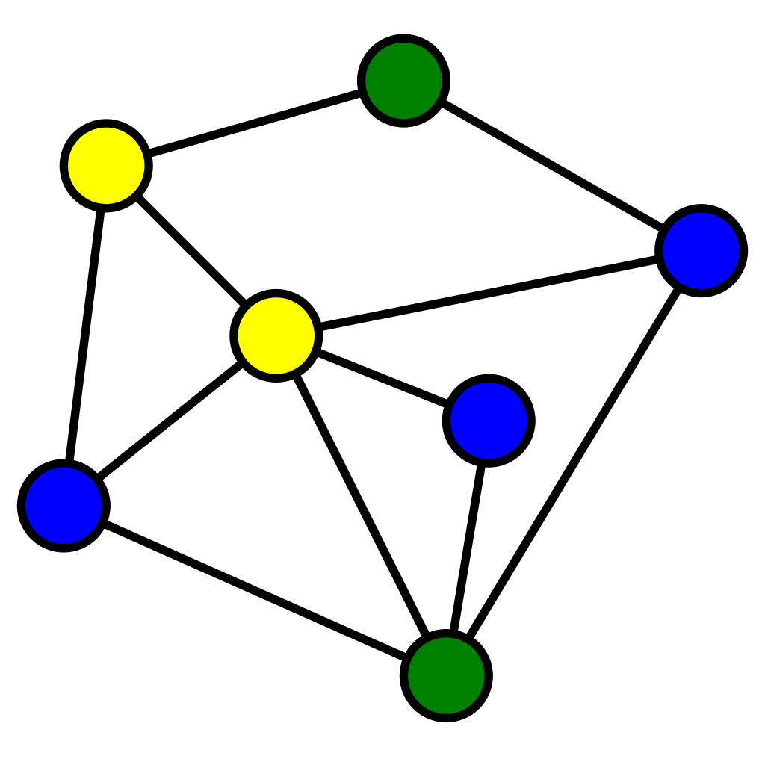
Domatic Number
Let $G=(V,E)$ be a graph
A Domatic number is partition of $V$ into disjoints sets $V_{1},V_{2},…,V_{k}$ such that each $V_{i}$ is a dominating set for $G$
Example: k=3

Slide 14
Domatic Number
Theorem: We can count the number of $k$-domatic partitions in time $O^{∗}(2^{n})$
Proof:
Define $f\left(S\right)=1$ iff $S$ is a dominating set
$$f^{∗k}\left(S\right)=\sum_{\begin{aligned}Y_{1},Y_{2},…,Y_{k}⊆S \\ \bigcup_{i=1}^{k}{Y_{i}=S} \\ Y_{i}∩Y_{j}=∅ if i≠j\end{aligned}}{\prod_{i=1}^{k}{f(Y_{i})}}$$
The same as before we can count the convolution in $O^{∗}(2^{n})$

Slide 15
Zeta and Möbius transform

Slide 16
Zeta Transform
For a universe $U$, we consider functions from $2^{U}$ (the family of all subsets of $U$) to $ℤ$. For such a function $f:2^{U}→ℤ$, the zeta transform of $f$ is a function $\hat{f}:2^{U}→Z$defined by
$$\hat{f}\left(S\right)=\sum_{X⊆S}{f(X)}$$

Slide 17
Möbius Transform
Given the Zeta transform $\hat{f}$, the original function $f$ may be recovered via the Möbius inversion formula
$$f\left(S\right)=\sum_{X⊆S}{{\left(−1\right)}^{\left|S\backslash X\right|}\hat{f}(X)}$$

Slide 18
Zeta and Möbius Transform
Function $f$ given by $f (\{4\})=f (\{1, 2, 4\})=1, f (\{1, 3\})=2 and f(X)=0$ otherwise
$$f$$
$$\hat{f}$$

Slide 19
Möbius Transform
Lemma: $f\left(S\right)=\sum_{X⊆S}{{\left(−1\right)}^{\left|S\backslash X\right|}\hat{f}(X)}$
Proof:
$$\sum_{X⊆S}{{\left(−1\right)}^{\left|S\backslash X\right|}\hat{f}(X)}=\sum_{X⊆S}{{\left(−1\right)}^{\left|S\backslash X\right|}\sum_{Y⊆X}{f(Y)}}$$
$$\sum_{Y⊆S}{\left(\sum_{Y⊆X⊆S}{{\left(−1\right)}^{\left|S\backslash X\right|}}\right)}f\left(Y\right)$$

Slide 20
Möbius Transform
Lemma: $f\left(S\right)=\sum_{X⊆S}{{\left(−1\right)}^{\left|S\backslash X\right|}\hat{f}(X)}$
Proof:
$$\sum_{Y⊆S}{\left(\sum_{Y⊆X⊆S}{{\left(−1\right)}^{\left|S\backslash X\right|}}\right)}f\left(Y\right)$$
Every nonempty set has equal number of even and odd-sized subsets, therefore if $|S\backslash Y|=k > 0$, then the inner summand is equal to $0$
$$\sum_{Y⊆S}{\left(\sum_{Y⊆X⊆S}{{\left(−1\right)}^{\left|S\backslash X\right|}}\right)}f\left(Y\right)=f\left(S\right)$$
$=0 if \{\left|S\backslash Y\right|=k > 0$}

Slide 21
Zeta Transform - Fast Zeta Transform
The fast Zeta transform is the following algorithm for computing the Zeta transform in $O(n2^{n})$ ring operations (addition, subtraction, multiplication)
We may assume that $N = \left\{1, 2, . . . , n\right\}$
To compute $\hat{f}$ given $f$, let initially
$${\hat{f}}_{0}\left(X\right)=f(X)$$

Slide 22
Zeta Transform – Dynamic Programming Algorithm
The algorithm builds a table of entries of ${\hat{f}}_{i}\left(X\right)$ for all $S⊆U$ and for all $i∈\{0,1,…,n\}$ such that
$${\hat{f}}_{i}\left(X\right)=\sum_{X\backslash \{1,2,…,i\}⊆S⊆X}{f(S)}$$

Slide 23
Zeta Transform – Dynamic Programming Algorithm
for all $X⊆N$, and then iterate for all $j = 1, 2, . . . , n$ and $X⊆N$ as follows:
$${\hat{f}}_{j}\left(X\right)=\left\{\begin{aligned}{\hat{f}}_{j−1}\left(X\right), j∉X \\ &{\hat{f}}_{j−1}(X\backslash \{j\})+{\hat{f}}_{j−1}(X), j∈X\end{aligned}\right.$$
It is straightforward to verify by induction on $j$ that this recurrence gives ${\hat{f}}_{n}(X) = \hat{f}(X)$ for all $X⊆N$ in $O(n2^{n})$ring operations.

Slide 24
Zeta and Möbius Inversion Transform
Function $f$ given by $f (\{4\})=f (\{1, 2, 4\})=1, f (\{1, 3\})=2 and f(X)=0$ otherwise
$$f$$
$$\hat{f}$$

Slide 25
Möbius inversion Transform - Dynamic Programming Algorithm
The inversion operation can be implemented in a similar fashion.
$$f_{0}(S) = \hat{f}(S)$$
Similarly The algorithm builds a table of entries of $f_{i}\left(X\right)$ for all $S⊆U$ and for all $i∈\{0,1,…,n\}$ such that
$$f_{i}\left(S\right)=\sum_{S\backslash \{1,2,…,i\}⊆X⊆S}{{\left(−1\right)}^{\left|S\backslash X\right|}f(X)}$$
for all S$⊆N$, and then iterate for all $j = 1, 2, . . . , n$ and $S⊆N$ as follows:
$$f_{j}\left(S\right)=\left\{\begin{aligned}f_{j−1}\left(S\right), j∉S \\ −&f_{j−1}(S\backslash \{j\})+f_{j−1}(S), j∈S\end{aligned}\right.$$
When $f_{n}\left(S\right)=f\left(S\right)$

Slide 26
Ranked Zeta Transform
The ranked zeta transform $\hat{f}$ of a function $f:2^{U}→ℤ$ is defined for all $S⊆U$ and all $k∈\{0,1,…,n\}$ as follows
$$\hat{f}(k,S) =\sum_{\begin{aligned}X⊆S \\ |X| = k\end{aligned}}{f(X)}$$
Now we can write the classical Möbius transform using the ranked version
$$\hat{f}\left(S\right)=\sum_{k=0}^{\left|S\right|}{\hat{f}(k,S)}$$

Slide 27
Ranked Möbius Inversion
For the ranked transform, inversion is achieved by
$$f\left(S\right)=\hat{f}\left(\left|S\right|,S\right)$$
And in a different form
$$f\left(S\right)=\sum_{X⊆S}{{\left(−1\right)}^{\left|S\backslash X\right|}\hat{f}\left(\left|S\right|,X\right)}$$
This form will be useful for fast evaluation of the subset convolution

Slide 28
Subset Convolution

Slide 29
Subset Convolution
Define the convolution $f∗g$ for all $S⊆N$ by
$$(f∗g)(S)\text{=}\sum_{T⊆S}{f\left(T\right)g(S\backslash T)}$$
or, equivalently, in a more symmetric form
$$(f∗g)(S)\text{=}\sum_{\begin{aligned}U, V⊆S \\ U∪V=S \\ U∩V=∅\end{aligned}}{f\left(U\right)g(V)}$$
It follows that the convolution operation is associative (and commutative if R is commutative).
Notes:
Each node has at most d_G(v) packets

Slide 30
Subset Convolution
$$(f∗g)(S)\text{=}\sum_{T⊆S}{f\left(T\right)g(S\backslash T)}$$
$$f$$
$$g$$
Notes:
Each node has at most d_G(v) packets

Slide 31
Fast Subset Convolution
For two ranked Zeta transforms, $\hat{f}$ and $\hat{g}$, define the convolution $\hat{f}⊛\hat{g}$for all $k = 0, 1, . . . , n$ and $X⊆N$ by
$\left(\hat{f}⊛\hat{g}\right)\left(k,S\right)=\sum_{j=0}^{k}{\hat{f}\left(j,S\right)\hat{g}(k−j,S)}$

Slide 32
Fast Subset Convolution
Theorem: Let $f,g:2^{U}→𝕫$and let $\hat{f}$ and $\hat{g}$ be their ranked zeta transforms. Then
$$\left(f∗g\right)\left(S\right)=\sum_{X⊆S}{{\left(−1\right)}^{\left|S\backslash X\right|}}\left(\hat{f}⊛\hat{g}\right)\left(\left|S\right|,X\right)$$
Proof:
$$\sum_{X⊆S}{{\left(−1\right)}^{\left|S\backslash X\right|}}\left(\hat{f}⊛\hat{g}\right)\left(\left|S\right|,X\right)$$
By applying the ranked Möbius inversion transform and the convolution definition , we get

Slide 33
Fast Subset Convolution
Theorem: Let $f,g:2^{U}→𝕫$and let $\hat{f}$ and $\hat{g}$ be their ranked zeta transforms. Then
$$\left(f∗g\right)\left(S\right)=\sum_{X⊆S}{{\left(−1\right)}^{\left|S\backslash X\right|}}\left(\hat{f}⊛\hat{g}\right)\left(\left|S\right|,X\right)$$
Proof:
$$=\sum_{X⊆S}{{\left(−1\right)}^{\left|S\backslash X\right|}}\sum_{j=0}^{|S|}{\hat{f}\left(j,X\right)\hat{g}(|S|−j,X)}$$
$$=\sum_{X⊆S}{{\left(−1\right)}^{\left|S\backslash X\right|}}\sum_{j=0}^{|S|}{\sum_{\begin{aligned}U,V⊆X \\ \left|U\right|=j \\ \left|V\right|=\left|S\right|−j\end{aligned}}{f\left(U\right)g(V)}}$$

Slide 34
Fast Subset Convolution
$$\sum_{X⊆S}{{\left(−1\right)}^{\left|S\backslash X\right|}}\sum_{j=0}^{|S|}{\sum_{\begin{aligned}U,V⊆X \\ \left|U\right|=j \\ \left|V\right|=\left|S\right|−j\end{aligned}}{f\left(U\right)g(V)}}$$
Every ordered pair $(U, V)$ of subsets of S satisfying $|U|+|V |=|S|$, the term $f(U)g(V)$ occurs in the sum with sign ${\left(−1\right)}^{\left|S\backslash X\right|}$ exactly once for every $X$ satisfying $U∪V⊆X⊆S$
No other terms occur in the sum
The coefficient of $f(U)g(V)$ is

Slide 35
Fast Subset Convolution
The coefficient of $f(U)g(V)$ is
$$=\left\{\begin{aligned}1 if \left|U∪V\right|=|S| \\ 0 otherwise \end{aligned}\right.$$
Because $\left|U\right|+\left|V\right|=\left|S\right|$and $\left|U∪V\right|=\left|S\right|$ Imply $U∪V=S$
and $U∩V =∅$ it follows that
$$\sum_{X⊆S}{{\left(−1\right)}^{\left|S\backslash X\right|}}\sum_{j=0}^{|S|}{\sum_{\begin{aligned}U,V⊆X \\ \left|U\right|=j \\ \left|V\right|=\left|S\right|−j\end{aligned}}{f\left(U\right)g(V)}}=\sum_{\begin{aligned}U, V⊆S \\ U∪V=S \\ U∩V=∅\end{aligned}}{f\left(U\right)g(V)}=\left(f∗g\right)\left(S\right)$$

Slide 36
Fast Subset Convolution
$$\left(f∗g\right)\left(S\right)=\sum_{X⊆S}{{\left(−1\right)}^{\left|S\backslash X\right|}}\left(\hat{f}⊛\hat{g}\right)\left(\left|S\right|,X\right)$$
Given $f$ and $g$, we can now evaluate $f∗g$ in $O(n^{2}2^{n})$ ring operations
First computing the fast ranked Möbius transform of $f$ and $g$
Then taking the convolution of the transforms $\hat{f}$ and $\hat{g}$, and inverting the result using fast ranked Möbius inversion.

Slide 37
Fast Subset Convolution – Model of Computation
Up to this point we have worked with an abstract ring $R$, and have considered only the number of ring operations required to carry out the computations
The model of computation is the random-access machine
with the restriction that arithmetic operations are considered unit-time only for constant-size integers.
Two b-bit integers can be added, subtracted, and compared in $O(b)$ time, and multiplied in $O(b log⁡b log⁡log⁡b) = \tilde{O} (b)$

Slide 38
Fast Subset Convolution - integer sum–product ring
Theorem: The subset convolution over the integer sum–product ring can be computed in $\tilde{O}(2^{n}logM)$ time, provided that the range of the input functions is $\{−M,−M + 1, . . . ,M\}$.
Proof:
We know that the subset convolution can be computed in $O(n^{2}2^{n})$ring operations.
Any intermediate results, for which ring operations are performed, are $O(n logM)$-bit integers.
The ranked Möbius transform of an input function can be computed with integers between $−M2^{n}$ and $M2^{n}$.

Slide 39
Fast Subset Convolution - integer sum–product ring
Theorem: The subset convolution over the integer sum–product ring can be computed in $\tilde{O}(2^{n}logM)$ time, provided that the range of the input functions is $\{−M,−M + 1, . . . ,M\}$.
Proof:
Note that the convolution of ranked transforms can be computed with $O(n logM)$-bit integers.
Finally, the ranked Möbius inversion is computed by $O(n logM)$-bit integers $O(2^{n})$times.

Slide 40
Fast Subset Convolution - Integer Max–Sum and Min–Sum
Theorem: The subset convolution over the integer max–sum (min–sum) semiring can be computed in $\tilde{O}(2^{n}M)$ time, provided that the range of the input functions is $\{−M,−M + 1, . . . ,M\}$
For example:
$$\max_{X⊆S}{f\left(X\right)+g\left(S\backslash X\right)}$$
Or
$$\min_{X⊆S}{f\left(X\right)+g\left(S\backslash X\right)}$$

Slide 41
Fast Subset Convolution - Integer Max–Sum and Min–Sum
Theorem: The subset convolution over the integer max–sum (min–sum) semiring can be computed in $\tilde{O}(2^{n}M)$ time, provided that the range of the input functions is $\{−M,−M + 1, . . . ,M\}$
Proof:
Let $f$ and $g$ be the two input functions
Let $β=2^{n} + 1$and $M′ = β^{M}$
Define $f′$ and $g′$:
$$f^{′}=β^{f}$$
$$g^{′}=β^{g}$$

Slide 42
Fast Subset Convolution - Integer Max–Sum and Min–Sum
Theorem: The subset convolution over the integer max–sum (min–sum) semiring can be computed in $\tilde{O}(2^{n}M)$ time, provided that the range of the input functions is $\{−M,−M + 1, . . . ,M\}$
Proof:
We can compute $f^{′}∗g′$ in $\tilde{O}\left(2^{n}logM^{′}\right)=\tilde{O}\left(2^{n}M\right)$
We get
$\left(f^{′}∗g^{′}\right)\left(S\right)=\sum_{T⊆S}{f^{′}\left(T\right)g^{′}\left(S\backslash T\right)}=\sum_{T⊆S}{β^{f\left(T\right)+g\left(S\backslash T\right)}}$
$$=α_{0}\left(S\right)+α_{1}\left(S\right)β+…+α_{2M}\left(S\right)β^{2M}$$

Slide 43
Fast Subset Convolution - Integer Max–Sum and Min–Sum
Theorem: The subset convolution over the integer max–sum (min–sum) semiring can be computed in $\tilde{O}(2^{n}M)$ time, provided that the range of the input functions is $\{−M,−M + 1, . . . ,M\}$
Proof:
$$\left(f^{′}∗g^{′}\right)\left(S\right)=\sum_{T⊆S}{f^{′}\left(T\right)g^{′}\left(S\backslash T\right)}=\sum_{T⊆S}{β^{f\left(T\right)+g\left(S\backslash T\right)}}$$
$$=α_{0}\left(S\right)+α_{1}\left(S\right)β+…+α_{2M}\left(S\right)β^{2M}$$
Each coefficient $α_{r}(S)$ is uniquely determined and equals the number of subsets $T$ of $S$ for which $f(T)+g(S\backslash T)=r$
For each $S⊆N$, we can find the largest $r$ for which $α_{r}(S)>0$ in $\tilde{O}(M)$ time.

Slide 44
Applications and Variants

Slide 45
Counting Spanning Forests
Definition: A spanning forest of a graph $G$ is an acyclic graph $F$ spanning all vertices of $G$
Example for spanning forest of $K3$:
$$k=1:$$
$$k=3:$$
$$k=2:$$

Slide 46
Counting Spanning Forests
The number of spanning trees in a graph is computable in polynomial time – with the determinant of a maximal principal submatrix of the Laplacian of G, the result known as Kirchhoff’s Matrix Tree Theorem
Counting spanning Forests is a #P-complete problem

Slide 47
Counting Spanning Forests
For a set $S⊆V$, let $τ\left(S\right)$ be the number if trees in the subgraph of $G\left(V,E\right)$ induced by $S$.
For every $S$, $τ\left(S\right)$ is computable in a polynomial time
The number of spanning forests in $G$ for k connected components is:
$$τ^{∗k}\left(S\right)=\sum_{\begin{aligned}Y_{1},Y_{2},…,Y_{k}⊆S \\ \bigcup_{i=1}^{k}{Y_{i}=S} \\ Y_{i}∩Y_{j}=∅ if i≠j\end{aligned}}{\prod_{i=1}^{k}{τ(Y_{i})}}$$
$τ^{∗k}$ can be computed in $O^{∗}\left(2^{n}\right)$ as before

Slide 48
The Steiner Tree Problem
Given an undirected graph $G = (V,E)$, a weight $w(e) > 0$ for each edge $e∈E = E(G)$, and a set of vertices $K⊆V = V (G)$,
The task is to find a subgraph $H$ of $G$ that connects the vertices in $K$ and has the minimum total weight $∑_{e∈E\left(H\right)}w(e)$ among all such subgraphs of $G$
The given set of vertices $K$ is called Terminal Vertices and other vertices that are used to construct Steiner tree are called Steiner vertices

Slide 49
The Steiner Tree Problem
Example:

Slide 50
The Steiner Tree Problem
First note that every leaf of a minimum Steiner tree must be a terminal
Every interior node is either a terminal or a Steiner vertex.
For a vertex subset $Y⊆V$, denote by $W\left(Y\right)$ the total weight of a Steiner tree connecting $Y$ in $G$

Slide 51
The Steiner Tree Problem - Dreyfus-Wagner Algorithm
The Dreyfus-Wagner algorithm recursively computes $W(\left\{q\right\}∪X)$ for all $X⊆Y$ and $q∈V$
In the “generic case", the new terminal $q∈V$is a leaf of the Steiner tree $W(\left\{q\right\}∪X)$ and q is joined by a min cost path $P_{pq}$ to an interior node $p∈X$
$p$ has a degree of at least 3
Let $D⊂Y\backslash \{q\}$ be a nonempty proper subset, the node $q$ splits $W\left(\left\{q\right\}∪X\right)\backslash P_{pq}$ into two parts, $W\left(\left\{p\right\}∪D\right)$and $W\left(\left\{p\right\}∪\left(X\backslash D\right)\right)$ for some nontrivial bipartition

Slide 52
The Steiner Tree Problem
Example:
Pink vertices = terminals
Green vertices = Steiner vertices
$$q$$
$D⊂Y\backslash \{q\}$
$$p$$
$$W\left(\left\{p\right\}∪D\right)$$
$$W\left(\left\{p\right\}∪\left(X\backslash D\right)\right)$$

Slide 53
The Steiner Tree Problem - Dreyfus-Wagner algorithm
$$W\left(\left\{q\right\}∪X\right)=\min_{p∈V}{P_{pq}+g_{p}\left(X\right) }$$
$$g_{p}\left(X\right)=\min_{∅⊂D⊂X}{W\left(\left\{p\right\}∪D\right)+W\left(\left\{p\right\}∪\left(X\backslash D\right)\right)}$$
The above recursion is also valid in the “non-generic cases“
when the new terminal $q$ is not a leaf of $W\left(\left\{q\right\}∪X\right)$ (choose $p =q$) or
when $q$ is joined by $P_{pq}$ to a leaf of $W\left(X\right)$, and $p$ has only degree 2 (then $X\backslash D=∅$in this case).
The Steiner tree problem can be solved by computing the weight $W(K)$ via this recursion. A bottom-up evaluation of $W(K)$ relying on dynamic programming takes the claimed $O^{∗}(3^{k}n + 2^{k}n^{2})$

Slide 54
Expediting the Dreyfus–Wagner Recursion
We cannot simply do fast subset convolution as each $g_{p}\left(X\right)$ is defined in terms of other values $g_{r}(Z)$, for $Z⊂X$ and $r∈V$
For each level $l = 2, 3, . . . , k−1$, assume the value $W(\left\{q\right\}∪X)$ has been computed and stored for all $X⊂K$ with $\left|X\right|≤l−1$and $q∈V \backslash X$.

Slide 55
Expediting the Dreyfus–Wagner Recursion
Define the function $f_{p}$ for all $X⊆K$ by
$$f_{p}\left(X\right)=\left\{\begin{aligned}W\left(\left\{p\right\}∪X\right) if 1≤\left|X\right|≤l−1 \\ ∞ otherwise \end{aligned}\right.$$
Let $∞$ denote an integer sufficiently large, for example $(n−1)M+1$
We get $g_{p}\left(X\right)=\left(f_{p}∗f_{p}\right)\left(X\right)$ holds for all $X⊆K$ with $\left|X\right|≤l$

Slide 56
Expediting the Dreyfus–Wagner Recursion
$g_{p}\left(X\right)$ can be calculated for all $p∈V$ and $X⊂K$ with $\left|X\right|=l$ using $n$ evaluations of the subset convolution in $\tilde{O}\left(2^{k}n^{2}\right)$
Computing $W(\left\{q\right\}∪X)$ for all $X⊂K$ and $q∈V\backslash X$ with $|X|=l$ in $\tilde{O}\left(\left({k \atop l}\right)n^{2}\right)$ time
Computing the above steps for all levels $l=2, 3, . . . , k − 1$ takes $\tilde{O}\left(2^{k}n^{2}+nm\right)$total time, including the time needed for computing all-pairs shortest paths

Slide 57
THE END
Any Questions?

