Slide 1
VC-Dimensions
Vapnik–Chervonenkis Dimension

Slide 2
Example
Consider a database consisting of the salary and age for a random sample of the adult population in the United States.
We are interested in using the database to answer the question:
What fraction of the adult population in the US has:
- age between 35 and 45
- salary between 50,000$ and 70,000$ ?
70,000
50,000
35
45
Notes:
מתחילים עם דוגמא: אנחנו רוצים למצוא את אחוז האנשים בארה"ב בגילאים 35-45 עם משכורת 50,000-70,000$. מדובר במלבן שמקביל לצירים. יש לנו מסד נתונים ואנחנו יכולים לעבור עליו ולבדוק מה האחוז שעונה על השאלה הזו. נרצה לדעת כמה גדול צריך להיות מסד הנתונים שלנו, כך שבסבירות

Slide 3
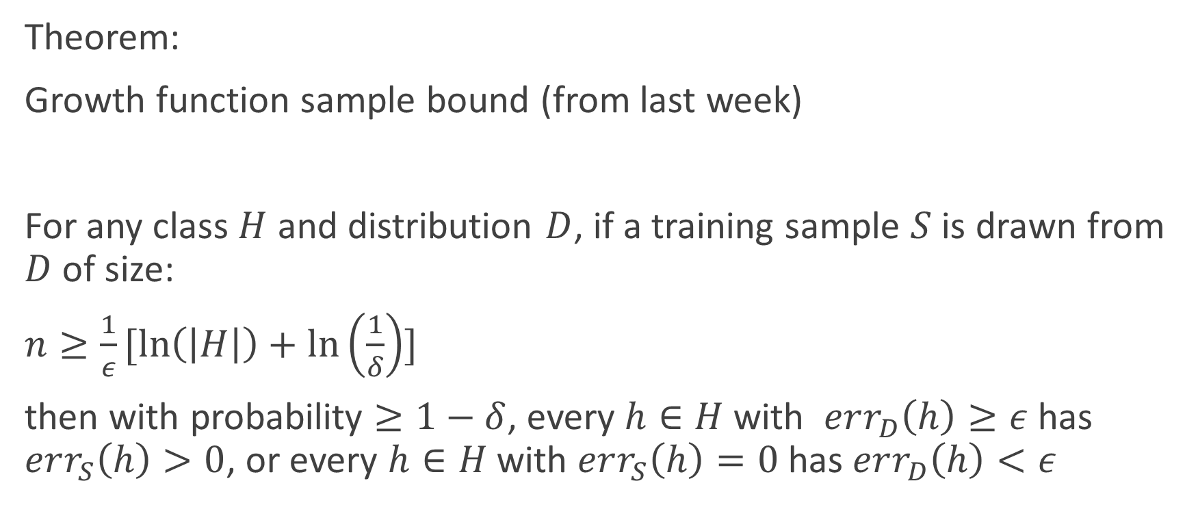
How large does our database need to be?
Theorem:
Growth function sample bound (from last week)
For any class $H$ and distribution $D$, if a training sample $S$ is drawn from $D$ of size:
$n≥\frac{1}{ε}[\ln\left(\left|H\right|\right)+\ln\left(\frac{1}{δ}\right)]$
then with probability $≥1−δ$, every $h∈H$ with $err_{D}\left(h\right)≥ε$ has $err_{S}\left(h\right)>0$, or every $h∈H$ with $err_{S}\left(h\right)=0$ has $err_{D}\left(h\right)<ε$

Slide 4
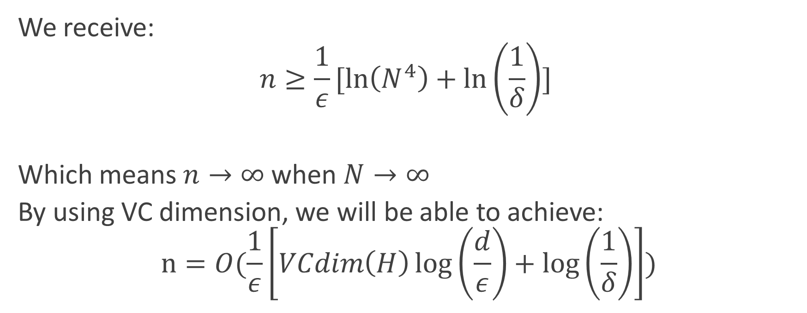

There are N adults in the US,
So there are at most $N^{4}$ rectangles, so $\left|H\right|≤N^{4}$
We receive:
$$n≥\frac{1}{ε}[\ln\left(N^{4}\right)+\ln\left(\frac{1}{δ}\right)]$$
Which means $n→∞$ when $N→∞$
By using VC dimension, we will be able to achieve:
$$n=O(\frac{1}{ε}\left[VCdim\left(H\right)\log\left(\frac{d}{ε}\right)+\log\left(\frac{1}{δ}\right)\right])$$

Slide 5
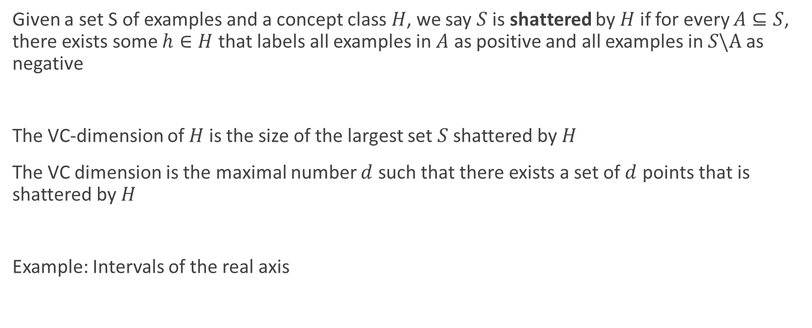
Definitions
Given a set S of examples and a concept class $H$, we say $S$ is shattered by $H$ if for every $A⊆S$, there exists some $h∈H$ that labels all examples in $A$ as positive and all examples in $S\backslash A$ as negative
The VC-dimension of $H$ is the size of the largest set $S$ shattered by $H$
The VC dimension is the maximal number $d$ such that there exists a set of $d$ points that is shattered by $H$
Example: Intervals of the real axis
Notes:
דוגמא על הלוח: הסט שלנו הוא 4 נקודות שניתנות לחלוקה ע"י מלבנים. לא עבור כל 4 נקודות הדבר אפשרי, עבור 5 בהכרח לא. ולכן המימד הוא 4.

Slide 6
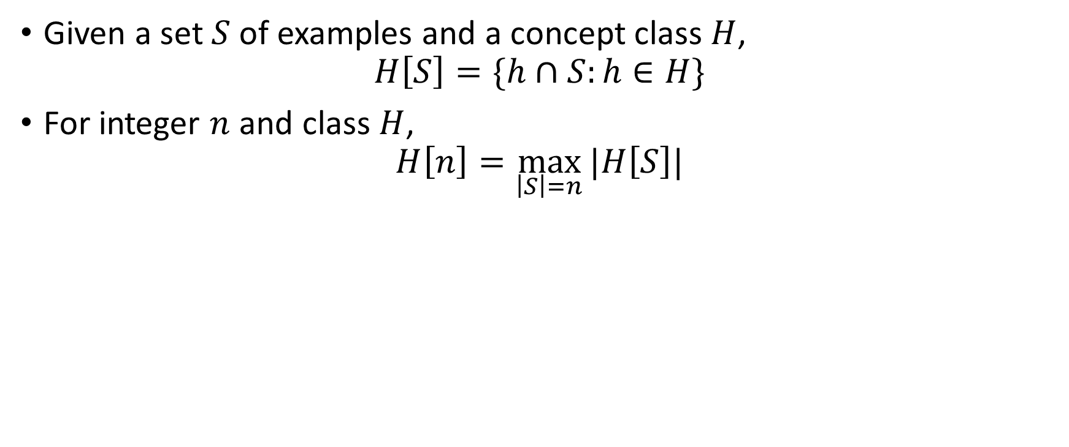
Growth Function / Shatter Function
Given a set $S$ of examples and a concept class $H$,
$H\left[S\right]=\{h∩S:h∈H\}$
For integer $n$ and class $H$,
$H\left[n\right]=\max_{\left|S\right|=n}{|H\left[S\right]|}$

Slide 7
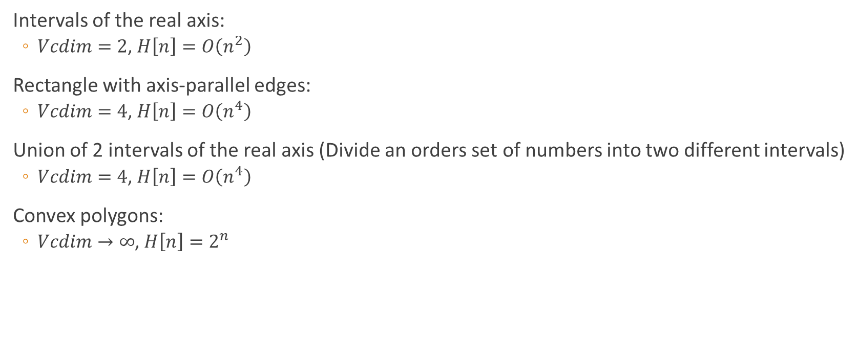
Examples
Intervals of the real axis:
  $Vcdim=2$, $H\left[n\right]=O\left(n^{2}\right)$
Rectangle with axis-parallel edges:
  $Vcdim=4$, $H\left[n\right]=O\left(n^{4}\right)$
Union of 2 intervals of the real axis (Divide an orders set of numbers into two different intervals)
  $Vcdim=4$, $H\left[n\right]=O\left(n^{4}\right)$
Convex polygons:
  $Vcdim→∞$, $H\left[n\right]=2^{n}$

Slide 8

Half spaces in d dimensions
$VCdim=d+1$
Proof:
$$VCdim≥d+1$$
  S: d unit coordinate vectors + origin
  A subset of S (Assume includes the origin)
  Vector w has 1-s in the coordinates corresponding to vectors not in A
  For each $x∈A$, $w^{T}x≤0$ and for each $x∉A, w^{T}x>0$

Slide 9
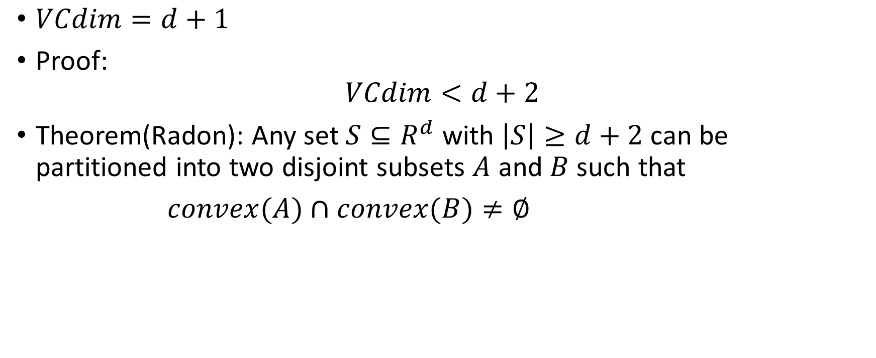
Half spaces in d dimensions
$VCdim=d+1$
Proof:
$$VCdim<d+2$$
Theorem(Radon): Any set $S⊆R^{d}$ with $\left|S\right|≥d+2$ can be partitioned into two disjoint subsets $A$ and $B$ such that
$convex(A)∩convex(B)≠∅$

Slide 16

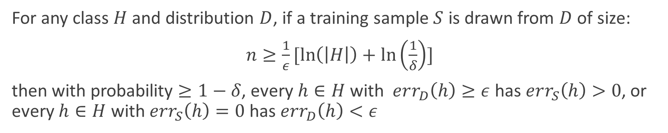
Growth function sample bound
For any class $H$ and distribution $D$, if a training sample $S$ is drawn from $D$ of size:
$n≥\frac{1}{ε}[\ln\left(\left|H\right|\right)+\ln\left(\frac{1}{δ}\right)]$
then with probability $≥1−δ$, every $h∈H$ with $err_{D}\left(h\right)≥ε$ has $err_{S}\left(h\right)>0$, or every $h∈H$ with $err_{S}\left(h\right)=0$ has $err_{D}\left(h\right)<ε$
If we use VD-dimension:
$$n≥\frac{2}{ε}[\log_{2}{(2H\left[2n\right])}⁡+log_{2}\left(\frac{1}{δ}\right)]$$
And later we will see:
$$n=O(\frac{1}{ε}\left[d\log\left(\frac{d}{ε}\right)+\log\left(\frac{1}{δ}\right)\right])$$
Where $d=VCdim(H)$

Slide 17

Sauer’s Lemma
If Vcdim(H)=d, then $H\left[n\right]≤\sum_{i=0}^{d}{\left({n \atop i}\right)≤{\left(\frac{en}{d}\right)}^{d}}$

Slide 18

proof
Instead of $H\left[n\right]≤\sum_{i=0}^{d}{\left({n \atop i}\right)}$,
it is sufficient to prove a stronger claim:
Given any set $S s.t \left|S\right|=n$: $\left|H\left[S\right]\right|≤|\{B⊆S:H shatters B\}|$

Slide 19
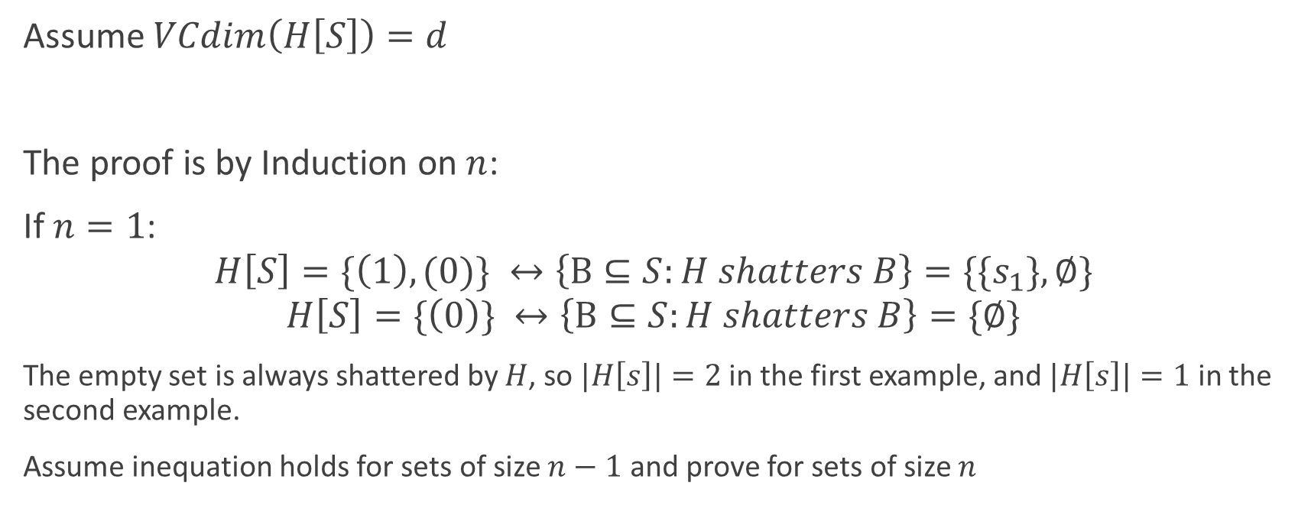
proof
Assume $VCdim\left(H\left[S\right]\right)=d$
The proof is by Induction on $n$:
If $n=1$:
$$H\left[S\right]=\{\left(1\right),(0)\} ↔\left\{B⊆S:H shatters B\right\}=\{{\{s}_{1}\},∅\}$$
$$H\left[S\right]=\{\left(0\right)\} ↔\left\{B⊆S:H shatters B\right\}=\{∅\}$$
The empty set is always shattered by $H$, so $|H\left[s\right]|=2$ in the first example, and $|H\left[s\right]|=1$ in the second example.
Assume inequation holds for sets of size $n−1$ and prove for sets of size $n$

Slide 20

proof
Let $S=\{s_{1},…,s_{n}\}$ and define:
$Y_{0}=\{\left(y_{2},…,y_{n}\right):\left(0,y_{2}…,y_{n}\right)∈H[S] or \left(1,y_{2},…,y_{n}\right)∈H[S]\}$
$Y_{1}=\{\left(y_{2},…,y_{n}\right):\left(0,y_{2}…,y_{n}\right)∈H[S] and \left(1,y_{2},…,y_{n}\right)∈H[S]\}$
$\left|Y_{0}\right|+\left|Y_{1}\right|= ?$

Slide 21

proof
Let $S=\{s_{1},…,s_{n}\}$ and define:
$Y_{0}=\{\left(y_{2},…,y_{n}\right):\left(0,y_{2}…,y_{n}\right)∈H[S] or \left(1,y_{2},…,y_{n}\right)∈H[S]\}$
$Y_{1}=\{\left(y_{2},…,y_{n}\right):\left(0,y_{2}…,y_{n}\right)∈H[S] and \left(1,y_{2},…,y_{n}\right)∈H[S]\}$
$\left|Y_{0}\right|+\left|Y_{1}\right|=\left|H[S]\right|$

Slide 22
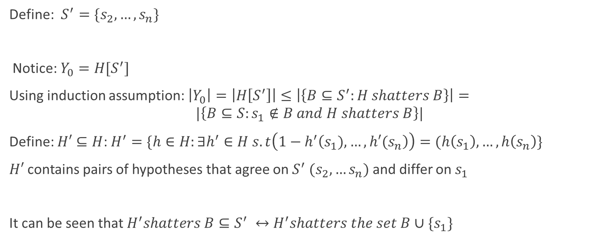
proof
Define: $S^{′}=\{s_{2},…,s_{n}\}$
Notice: $Y_{0}=H[S^{′}]$
Using induction assumption: $\left|Y_{0}\right|=\left|H\left[S^{′}\right]\right|≤\left|\left\{B⊆S^{′}:H shatters B\right\}\right|=$
$$|\left\{B⊆S:s_{1}∉B and H shatters B\right\}|$$
Define: $H′⊆H$: $H^{′}=\{h∈H:∃h^{′}∈H s.t\left(1−h^{′}\left(s_{1}),…,h′(s_{n}\right)\right)=(h\left(s_{1}\right),…,h\left(s_{n}\right)\}$
$H′$ contains pairs of hypotheses that agree on $S^{′} (s_{2},…s_{n})$ and differ on $s_{1}$
It can be seen that $H^{′}shatters B⊆S^{′} ↔H^{′}shatters the set B∪\{s_{1}\}$

Slide 23
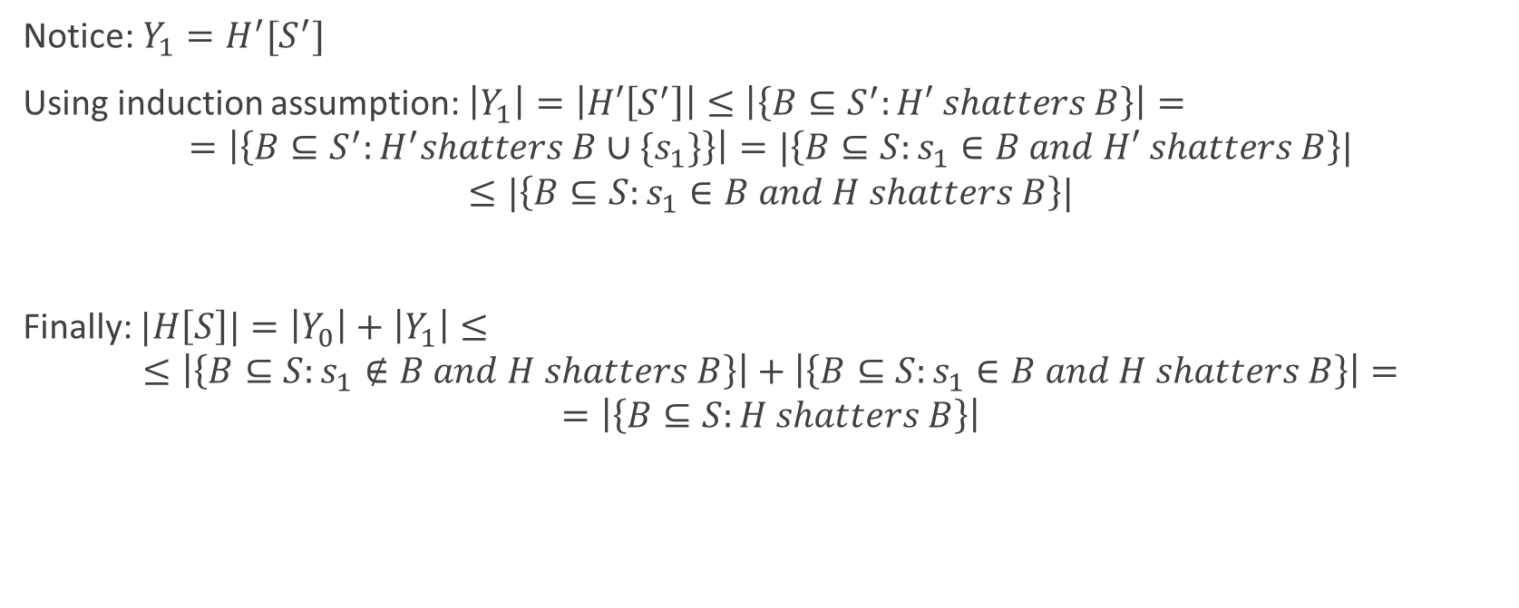
proof
Notice: $Y_{1}=H^{′}[S^{′}]$
Using induction assumption: $\left|Y_{1}\right|=\left|H′\left[S^{′}\right]\right|≤\left|\left\{B⊆S^{′}:H′ shatters B\right\}\right|=$
$$=\left|\left\{B⊆S^{′}:H^{′}shatters B∪\{s_{1}\}\right\}\right|=|\left\{B⊆S:s_{1}∈B and H′ shatters B\right\}|$$
$$≤|\left\{B⊆S:s_{1}∈B and H shatters B\right\}|$$
Finally: $|H\left[S\right]|=\left|Y_{0}\right|+\left|Y_{1}\right|≤$
$$≤\left|\left\{B⊆S:s_{1}∉B and H shatters B\right\}\right|+\left|\left\{B⊆S:s_{1}∈B and H shatters B\right\}\right|=$$
$$=\left|\left\{B⊆S:H shatters B\right\}\right|$$

Slide 24
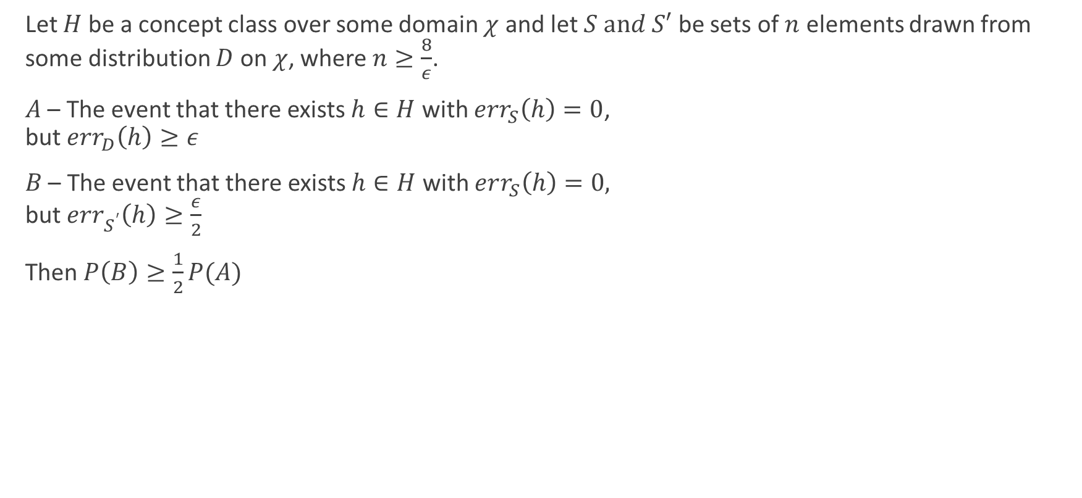
Lemma
Let $H$ be a concept class over some domain $χ$ and let $S and S′$ be sets of $n$ elements drawn from some distribution $D$ on $χ$, where $n≥\frac{8}{ε}$.
$A$ – The event that there exists $h∈H$ with $err_{S}\left(h\right)=0$,
but $err_{D}\left(h\right)≥ε$
$B$ – The event that there exists $h∈H$ with $err_{S}\left(h\right)=0,$
but $err_{S^{′}}\left(h\right)≥\frac{ε}{2}$
Then $P\left(B\right)≥\frac{1}{2}P(A)$

Slide 25

Proof
Clearly, $P\left(B\right)≥P\left(A∩B\right)=P\left(A\right)∙P(B|A)$
Let’s find $P(B|A)$:
Let $h∈H$ with $err_{S}\left(h\right)=0$ and $err_{D}\left(h\right)≥ε$
Draw set $S′$:
  $E\left(err_{S^{′}}\left(h\right)\right)=err_{D}\left(h\right)≥ε$

Slide 26
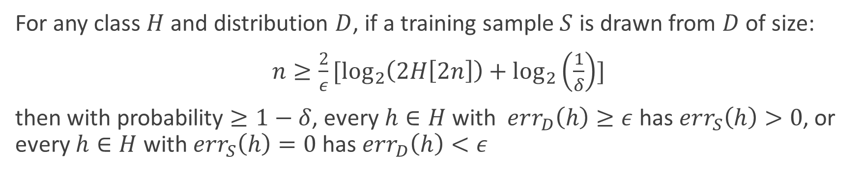
Growth function sample bound
For any class $H$ and distribution $D$, if a training sample $S$ is drawn from $D$ of size:
$n≥\frac{2}{ε}[\log_{2}\left(2H\left[2n\right]\right)+\log_{2}\left(\frac{1}{δ}\right)]$
then with probability $≥1−δ$, every $h∈H$ with $err_{D}\left(h\right)≥ε$ has $err_{S}\left(h\right)>0$, or every $h∈H$ with $err_{S}\left(h\right)=0$ has $err_{D}\left(h\right)<ε$

Slide 27
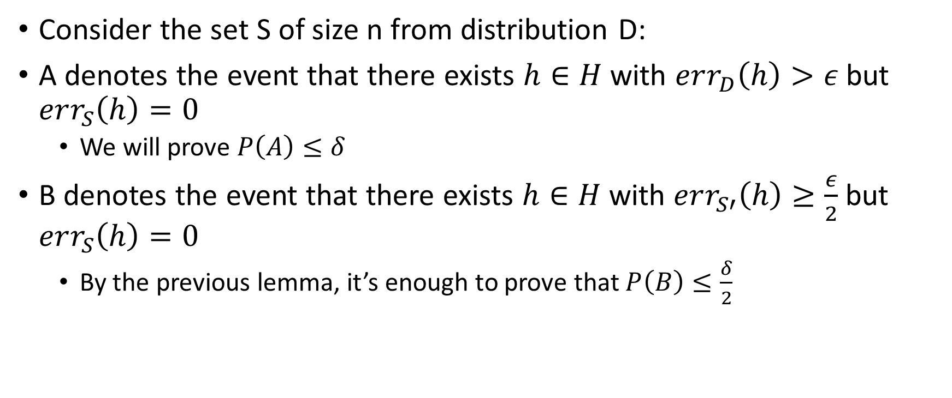
Proof
Consider the set S of size n from distribution D:
A denotes the event that there exists $h∈H$ with $err_{D}\left(h\right)>ε$ but $err_{S}\left(h\right)=0$
  We will prove $P\left(A\right)≤δ$
B denotes the event that there exists $h∈H$ with $err_{S′}\left(h\right)≥\frac{ε}{2}$ but $err_{S}\left(h\right)=0$
  By the previous lemma, it’s enough to prove that $P\left(B\right)≤\frac{δ}{2}$

Slide 28
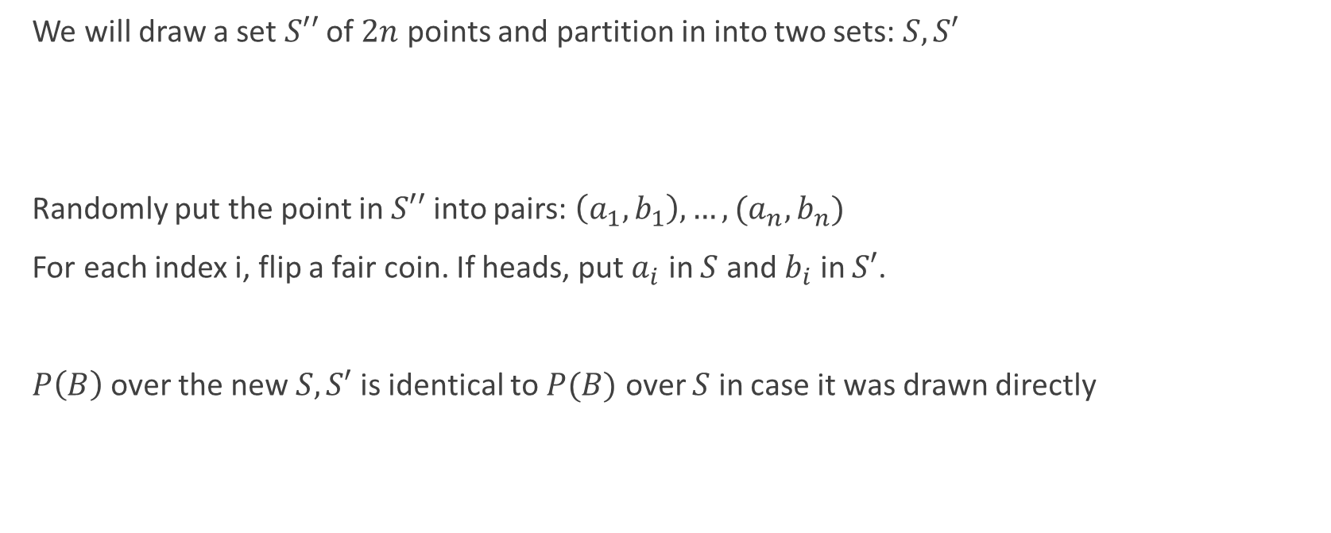
Proof
We will draw a set $S′′$ of $2n$ points and partition in into two sets: $S, S′$
Randomly put the point in $S′′$ into pairs: $\left(a_{1},b_{1}\right), …,(a_{n},b_{n})$
For each index i, flip a fair coin. If heads, put $a_{i}$ in $S$ and $b_{i}$ in $S′$.
$P\left(B\right)$ over the new $S, S′$ is identical to $P(B)$ over $S$ in case it was drawn directly

Slide 29
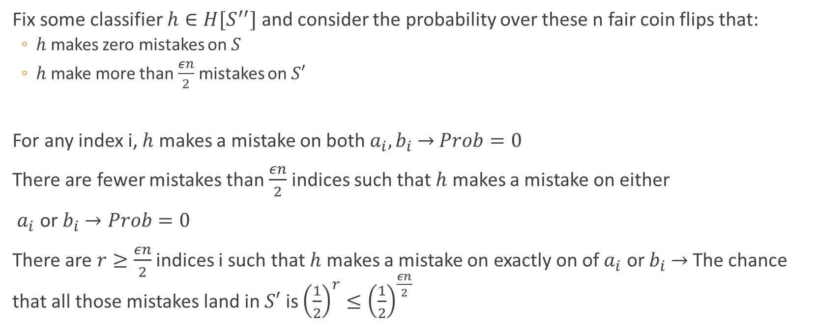
Proof
Fix some classifier $h∈H[S^{′′}]$ and consider the probability over these n fair coin flips that:
  $h$ makes zero mistakes on $S$
  $h$ make more than $\frac{εn}{2}$ mistakes on $S′$
For any index i, $h$ makes a mistake on both $a_{i},b_{i}$ $→$ $Prob=0$
There are fewer mistakes than $\frac{εn}{2}$ indices such that $h$ makes a mistake on either
$a_{i}$ or $b_{i}$ $→Prob=0$
There are $r≥\frac{εn}{2}$ indices i such that $h$ makes a mistake on exactly on of $a_{i}$ or $b_{i}$ $→$ The chance that all those mistakes land in $S′$ is ${\left(\frac{1}{2}\right)}^{r}≤{\left(\frac{1}{2}\right)}^{\frac{εn}{2}}$

Slide 30
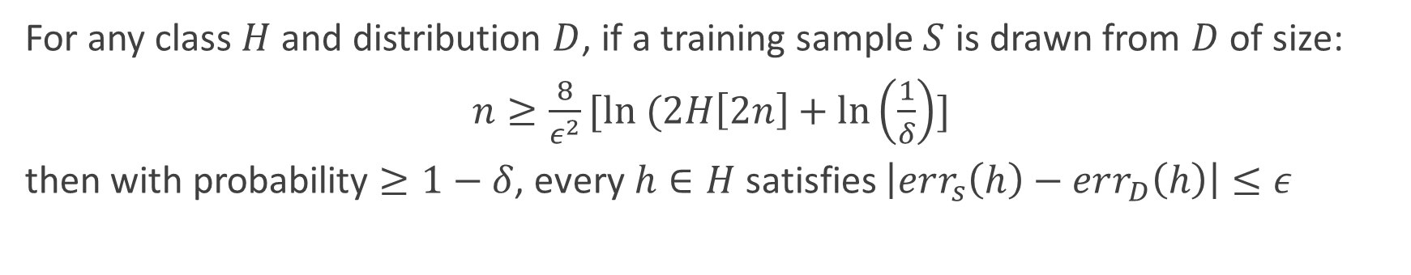
Growth function uniform convergence
For any class $H$ and distribution $D$, if a training sample $S$ is drawn from $D$ of size:
$n≥\frac{8}{ε^{2}}[ln (2H\left[2n\right]+\ln\left(\frac{1}{δ}\right)]$
then with probability $≥1−δ$, every $h∈H$satisfies $\left|err_{s}\left(h\right)−err_{D}\left(h\right)\right|≤ε$

Slide 31

When we combine Sauer’s lemma with the theorems..
$n≥\frac{2}{ε}[\log_{2}\left(2H\left[2n\right]\right)+\log_{2}\left(\frac{1}{δ}\right)]=\frac{2}{ε}[\log_{2}\left(2{\left(\frac{2εn}{d}\right)}^{d}\right)+\log_{2}\left(\frac{1}{δ}\right)]$
$n≥\frac{2}{ε}\left[1+d∙\log_{2}{n}+d∙\log_{2}\left(\frac{2ε}{d}\right)+\log_{2}\left(\frac{1}{δ}\right)\right]$
And the inequation is solved with:
$$n=O(\frac{1}{ε}\left[d\log\left(\frac{d}{ε}\right)+\log\left(\frac{1}{δ}\right)\right])$$
Where $d=VCdim(H)$

Slide 32
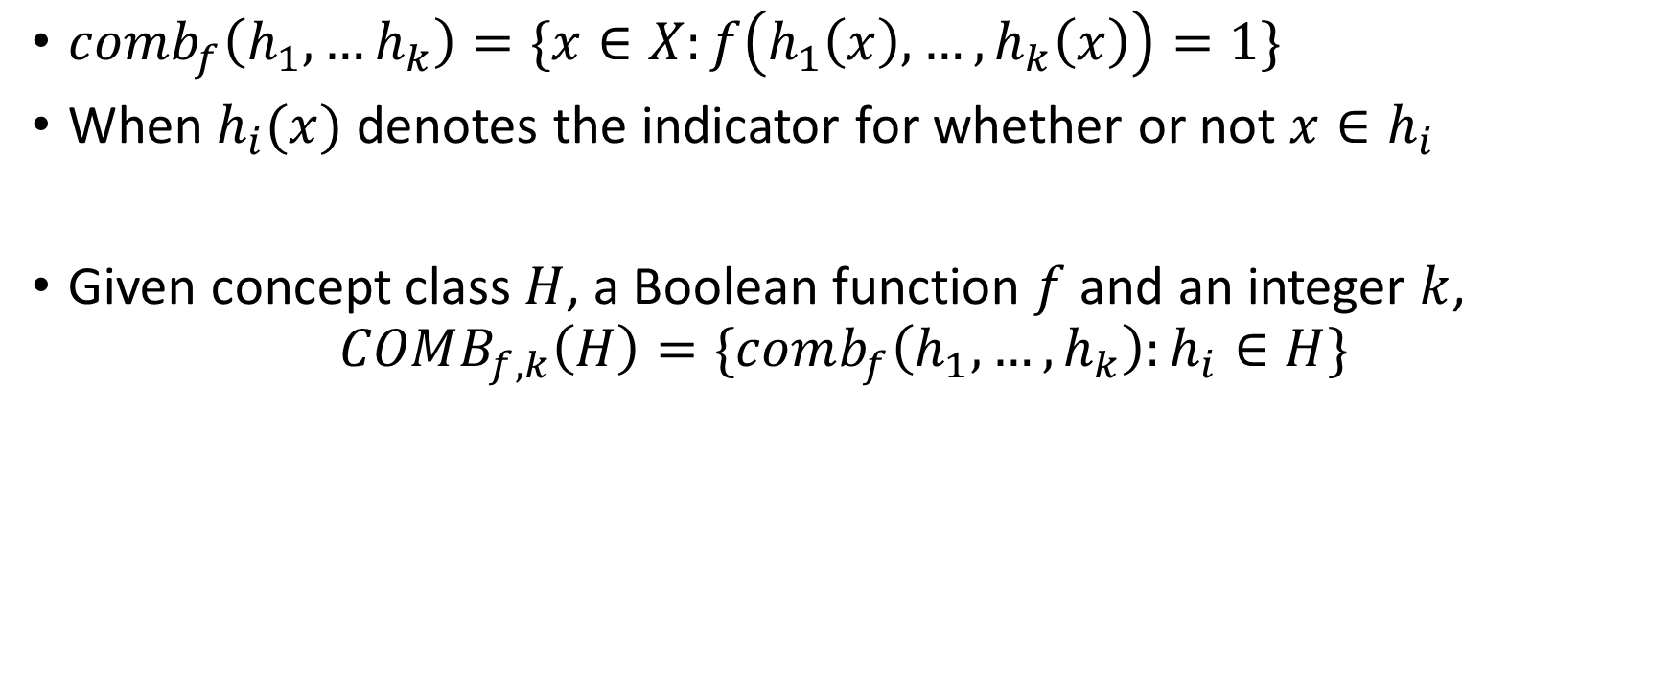
VC-dimensions of Combination of Concepts
$comb_{f}\left(h_{1},…h_{k}\right)=\{x∈X:f\left(h_{1}\left(x\right),…,h_{k}\left(x\right)\right)=1\}$
When $h_{i}(x)$ denotes the indicator for whether or not $x∈h_{i}$
Given concept class $H$, a Boolean function $f$ and an integer $k$,
$$COMB_{f,k}\left(H\right)=\{comb_{f}\left(h_{1},…,h_{k}\right):h_{i}∈H\}$$

Slide 33

Corollary
If the $VC\dim\left(H\right)=d$, then for any combination function $f$,
$$VCdim\left(COMB_{f,k}\left(H\right)\right)=O\left(kdlog\left(kd\right)\right)$$

Slide 34
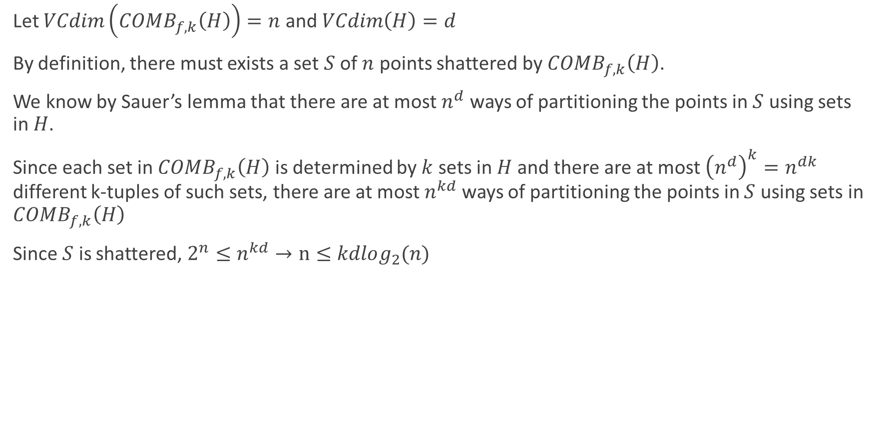
Proof
Let $VCdim\left(COMB_{f,k}\left(H\right)\right)=n$ and $VCdim\left(H\right)=d$
By definition, there must exists a set $S$ of $n$ points shattered by $COMB_{f,k}\left(H\right)$.
We know by Sauer’s lemma that there are at most $n^{d}$ ways of partitioning the points in $S$ using sets in $H$.
Since each set in $COMB_{f,k}\left(H\right)$ is determined by $k$ sets in $H$ and there are at most ${\left(n^{d}\right)}^{k}=n^{dk}$ different k-tuples of such sets, there are at most $n^{kd}$ ways of partitioning the points in $S$ using sets in $COMB_{f,k}\left(H\right)$
Since $S$ is shattered, $2^{n}≤n^{kd}→n≤kdlog_{2}(n)$

