Slide 1
Analysis of Thompson Sampling for the Multi-armed Bandit Problem
Yoav chai

Slide 2
What’s for today
Thomason sampling algorithm
Brief for stochastic multi-armed bandit problem
Main focus on regret bound for stochastic two-armed bandit problem
Cover in high level the challenges for N arm

Slide 3
Motivation for the paper
Thompson (1933) proposed a natural randomized Bayesian algorithm to minimize regret.
Existing theoretical analyses provide weak bound of $o(T)$ on expected regret.
Thompson Sampling algorithm has experimentally been shown to be close to optimal.
In the paper, for the first time, was showed that TS algorithm achieves $O(Log(T))$ expected regret.

Slide 4
Motivation for Thompson Sampling
Chapelle and Li (2011) demonstrate that empirically TS achieves regret comparable to the lower bound of Lai and Robbins (1985);
TS shows competitive to or better result than popular methods such as UCB in applications like display advertising and news article recommendation.
Microsoft’s adPredictor (2010) for CTR prediction of search ads on Bing uses the idea of Thompson Sampling

Slide 5
Thompson Sampling Basic idea
The algorithm is known as Thompson Sampling (TS).
The algorithm assume that the reward distribution of every arm are fixed, though unknown.
The basic idea is at any time step, play an arm according to its posterior probability of being the best arm.

Slide 6
Bayesian approach – coin tosses
A simple example, we have a coin (Bernoulli i.i.d):
$$P(x_{i})=\left\{\begin{matrix}1 & θ \\ 0 & 1−θ\end{matrix}\right.$$
Dataset $D=\{x_{1},…,x_{n}\}$ of tosses, need to estimate $θ$.
For specific D exists: $p\left(D | θ\right)=θ^{α}{(1−θ)}^{β}$
Bayesian approach: treat the unknown parameter $θ$ as a random variable with simple prior: $θ\sim Uniform\left[0,1\right]$
$$p\left(D\right)=\int_{0}^{1}{θ^{α}{(1−θ)}^{β}dθ=\frac{α!β! }{\left(α+β+1\right)!}}$$
Posterior distribution:
$$p\left(θ | D\right)=\frac{p\left(D | θ\right)p(θ)}{p(D)} = \frac{\left(α+β+1\right)!}{α!β!}θ^{α}{(1−θ)}^{β}=Beta(α+1,β+1)$$

Slide 7
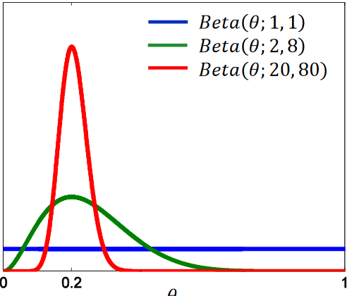
Beta & Gamma function
$Beta(α,β)$ PDF for $0≤θ≤1$, and $α, β > 0$:
$$f\left(θ | α,β\right) = \frac{Γ\left(α+β\right)}{Γ(α)Γ(β)}θ^{α−1}{(1−θ)}^{β−1}$$
$$α,β integer = \frac{\left(α+β−1\right)!}{α−1!β−1!}θ^{α−1}{(1−θ)}^{β−1}$$
The mean of $Beta(α, β )$is $α/(α+ β)$
The higher $α, β$, the tighter is the concentration of Beta around the mean.
Gamma function for positive integer:

Slide 8
Reminder - The stochastic multi-armed bandit problem
Given $N$ slot machine arms
At each time $t = 1,2,3,…,T$need to choose an arm
For each play we get reward according to some fixed (unknown) distribution with support in $[0,1]$.
The random reward of each arm are i.i.d. and independent of the plays of the other arms.
The reward is observed immediately after playing the arm.

Slide 9
Notations and total regret
$μ_{i}$- the (unknown) expected reward for arm $i$.
$k_{i}(t)$ - number of times arm $i$ has been played up to step $t−1$
Let
And
$i(t)$- is the arm played in step $t$
So the expected total regret at time $T$:

Slide 10
Bernoulli bandit problem
For simplicity, lets first start with Thompson Sampling algorithm for the Bernoulli bandit problem.
The rewards are either 0 or 1, and for arm $i$ the probability of success (reward =1) is $µ_{i}$.
if the prior distribution is $f\left(θ | α,β\right)=Beta(α, β )$,
=> the posterior distribution is
for success $Beta(α+1, β).$
for failure $Beta(α, β+1)$.

Slide 11
Thompson Sampling Algorithm for Bernoulli bandits
$Beta(1, 1)$is the uniform distribution on $[0,1]$.
$S_{i}(t)$ - num of successes until $t$ (reward = 1)
$F_{i}(t)$ - num of failures until $t$ (reward = 0)
$k_{i}(t) = S_{i}(t) + F_{i}(t)$plays of arm $i$

Slide 12
Bernoulli TS algorithm back to general stochastic bandits
Rewards for arm $i$ are generated $\tilde{r_{t}}∈[0,1]$ with mean $µ_{i}$.
We modify TS - after observing reward $\tilde{r_{t}},$ we performs a Bernoulli trial $r_{t}$with success probability $\tilde{r_{t}}$.
The algorithm:

Slide 13
Thompson Sampling Algorithm for general stochastic bandits
Lets first find the expected reward for modify TS :
The expected reward are the same for TS , modify TS and Bernoulli TS.
This allows us to replace, for the purpose of analysis, the problem with general stochastic bandits with Bernoulli bandits with the same means.
${E\left[R(T)\right]}_{TS}={E\left[R(T)\right]}_{Ber−TS}≤O(…)$

Slide 14
Assumptions and target
From now on, without loss of generality, we will assume that the first arm is the best arm.
unique optimal arm – adding more arms with the same $µ$* can only decrease the expected regret.
Our target is to get bound for the expected regret, as we saw, we want to bound $k_{i}\left(T\right).$
$E\left[k_{i}\left(T\right)\right]≤O(\frac{\ln\left(T\right)}{Some contstant based on \left(∆_{i}\right)}+1), (optimal)$

Slide 15
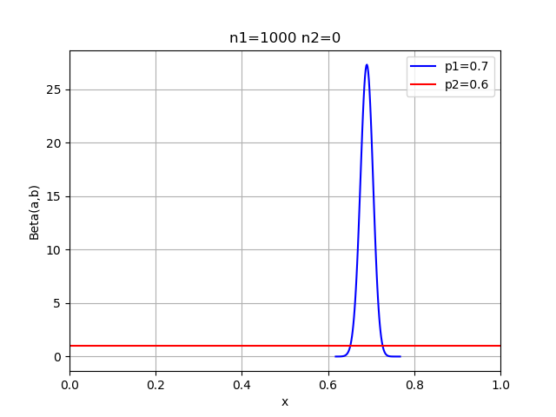
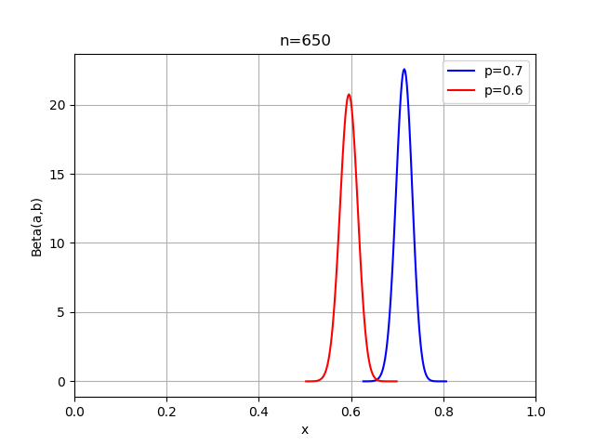
Main technical difficulties – two arms
For simplicity we will first analyze the result for $N=2$.
We can see the following observations:
If $k_{1}\left(t\right)=0$, and $k_{2}\left(t\right)$is big. The probability to play the second arm is ~ $µ_{2}$(constant).
If both arms have been played large number of times, $θ_{1}\sim µ_{1} and{ θ}_{2}\sim µ_{2}$

Slide 16
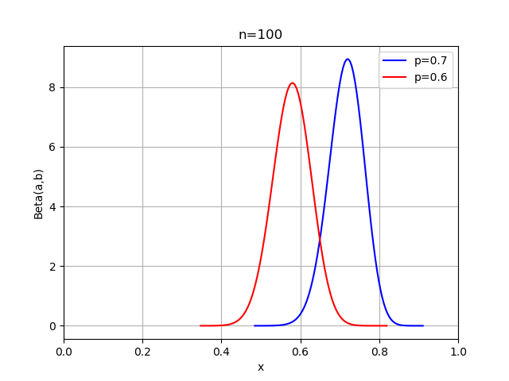
Main technical difficulties – two arms
As a result, in order to bound the probability of playing the second arm need to consider the number of previous plays of the first arm.

Slide 17
Regret bound for the two-armed bandit problem - notations
$t_{j}$ - time step at which the $j$ play of the first arm happens ($t_{0} = 0$).
$j_{0}$ - number of plays of the first arm until $L$ plays of the second arm.
$Y_{j}=t_{j+1}– t_{j} − 1$measure the number of time steps between the $j$ and $(j + 1)$plays of the first arm.
$s(j)$ - the number of successes in the first $j$ plays of the first arm.
Thus ,
How will you choose L?

Slide 18
Proof outline for two arms setting
Firstly, we will bound the regret during the first L plays of the second arm.
Only the plays of the second arm produce an expected regret, because regret is 0 when the first arm is played.

Slide 19
Proof outline for two arms setting
The first arm would be played at time $t$ if $θ_{1}\left(t\right)>{ θ}_{2}\left(t\right).$
After $k_{2}\left(t\right)>L$ times, with high probability ${ θ}_{2}\sim µ_{2}$, thus the first arm would be played if $θ_{1}\left(t\right)>{ µ}_{2}$ (roughly).
Lets assume ${ θ}_{2}=µ_{2}$, how do you think can we model:
$Y_{j}$ = $t_{j+1}– t_{j} − 1$ ??

Slide 20
Proof outline for two arms setting
The first arm would be played at time $t$ if $θ_{1}\left(t\right)>{ θ}_{2}\left(t\right).$
After $k_{2}\left(t\right)>L$ times, with high probability ${ θ}_{2}\sim µ_{2}$, thus the first arm would be played if $θ_{1}\left(t\right)>{ µ}_{2}$ (roughly).
Under the assumption (${ θ}_{2}=µ_{2}$), we can model $Y_{j}$as a geometric random variable with parameter ${Pr⁡(θ}_{1}\left(t\right)>µ_{2})$.
Denote this random variable as${ Y}_{j}\sim X(j,s,µ_{2})$
$θ_{1}\sim Beta(s+1, j − s+1)$

Slide 21
Geometric distribution refresh
The probability distribution of the number $X$ of Bernoulli trials needed to get one success (with probability for success $p$)
$Y =X−1$- the number of failures until we get one success

Slide 22
Proof outline for two arms setting
How do you think can we bound $Y_{j}$ = $t_{j+1}– t_{j} − 1$ without the assumption ${ θ}_{2}=µ_{2}$???
Reminder: $k_{2}\left(t\right)>L$

Slide 23
Proof outline for two arms setting
To understand $E(Y_{j})$, we will perform the following experiment until it succeeds:
check if a $Beta(s+1, j − s+1)$distributed random variable exceeds a threshold y.
$X(j,s,y)$ - the number of trials before succeeds.
$X(j,s,y)$ - is a geometric random variable with parameter (success) $1−F_{s+1,j−s+1}^{beta}(y)$
**$F$ is the CDF of the beta distribution
**$y$ will be $µ_{2}+∆/2$

Slide 24
Lemma 4
- The CDF of the binomial distribution with parameters $(n, p)$.
Fact 1 - for all positive integers $α, β$exists that (without proof):
Thus:

Slide 25
Fact 1
Lets generate $X_{1},…,X_{α+β −1}$ variables from uniform distribution [0,1]. Let $X_{1}^{↑},…,X_{α+β −1}^{↑}$ be the sorted increasing order.
Lets find ${Pr⁡(X}_{α}^{↑}≤y)$ :
$$Pr⁡(X_{i}≤y)=y$$
On the one hand, lets consider this scenario:
$X_{1}^{↑},…,$ $X_{α−1}^{↑}∈ [0,z]$ , $X_{α}^{↑}∈dz$, and $X_{α+1}^{↑},…,X_{α+β −1}^{↑}∈\left[z,1\right]$
${Pr⁡(X}_{α}^{↑}≤y)$ $=$ $\int_{0}^{y}{ \frac{\left(α+β−2\right)!}{α−1!β−1!}z^{α−1}{(1−z)}^{β−1}\left(α+β−1\right)dz}$= $F_{α,β}^{beta}(y)$

Slide 26
Fact 1
On the other Hand:
the probability that for at most $α−1$ of the $X_{i}$’s get $X_{i}≤y$:
$\sum_{k=0}^{α−1}{f\left(n=α+β−1,p=y,k\right)=}$ $F_{α+β−1,y}^{B}\left(α−1\right)$
probability for at least $α−1$ of the $X_{i}$’s gets $X_{i}≤y$:
$${Pr⁡(X}_{α}^{↑}≤y)=1−F_{α+β−1,y}^{B}\left(α−1\right)$$
So we get:
$1−F_{α+β−1,y}^{B}\left(α−1\right)=F_{α,β}^{beta}(y)$

Slide 27
Regret bound for the two-armed bandit problem
$Y_{j}$ is the number of steps before $θ_{1}(t) >θ_{2}\left(t\right)$ for the first time (between $t_{j}$ and $t_{j+1}$). We want to bound it using:
The first time $θ_{1}\left(t\right)>µ_{2}+Δ/2$is distributed ~$X(j, s\left(j\right), µ_{2}+Δ/2 )$.
However, $Y_{j}$ can be larger than this number if at some time step $t$, ${\overline{A}: θ}_{2}\left(t\right)> µ_{2}+Δ/2$. In this case we can bound $Y_{j}$ by $T$.
$E\left[Y_{j}\right]≤E\left[min\left\{X\left(j,s\left(j\right),µ_{2}+\frac{Δ}{2}\right),T\right\}\right]+T∙\sum_{t=t_{j}+1}^{t_{j+1}−1}{Pr(θ_{2}\left(t\right)> µ_{2}+Δ/2)}$
Since we are interested only in $j≥j_{0} ,$for Summing all $Y_{j}$:
$$E\left[\sum_{j=j_{0}}^{T−1}{Y_{j}}\right]≤\sum_{j=0}^{T−1}{E\left[min\left\{X\left(j,s\left(j\right),µ_{2}+\frac{Δ}{2}\right),T\right\}\right]+}T∙\sum_{t=1}^{T}{Pr(θ_{2}\left(t\right)> µ_{2}+\frac{Δ}{2},k_{2}\left(t\right)≥L)}$$

Slide 28
Lemma 5
We want to bound $T∙\sum_{t=1}^{T}{Pr(θ_{2}\left(t\right)> µ_{2}+\frac{Δ}{2},k_{2}\left(t\right)≥L)}$, we denote the event below by $E_{2}(t)$
$θ_{2}\left(t\right)> µ_{2}+\frac{Δ}{2},k_{2}\left(t\right)≥L$
From lemma 5 we get:
And we get the following bound:

Slide 29
Lemma 5 - proof
Lets define the event
We will upper bound the probability below
This happen because:

Slide 30
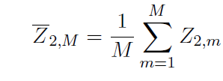
Lemma 5 - proof
Let define:
- number of successes over the first $M$ plays of the second arm divided by M.
- output of the $mth$ play of the second arm
Then,
Now, for all $t$ exists:
**The second last inequality is by applying Chernoff bounds

Slide 31
Lemma 5 - proof
In a similar way we can bound:
Which can lead us to the result of Lemma 5:

Slide 32
Lemma 6
For $j≥4ln⁡(T)/∆^{′^{2}}$we split the bound into 2 cases:
For $s≥\left(y+\frac{∆^{′}}{2}\right)j=\left(µ_{1}−\frac{Δ}{4}\right)j$, using Chernoff to bound $E[X\left(,,,\right)|s]$.
We bound $Pr\left[s<\left(µ_{1}−\frac{Δ}{4}\right)j\right]$ using Chernoff , In this case we will use the bound T.

Slide 33
Lemma 6
For $j<4ln⁡(T)/∆^{′^{2}}$, prove by the definition of expectation:
For large $S>y\left(j+1\right)=(µ_{2}+\frac{Δ}{2})\left(j+1\right)$, the expected failures for geometry variable is small ($≤1$).
For $S<yj=j(µ_{2}+\frac{Δ}{2}),$ the probability is very small, so we get small bound.

Slide 34
Lemma 6
For $j≥4ln⁡(T)/∆^{′^{2}}$ for $s≥\left(y+∆^{′}/2\right)j$ using Chernoff
We already showed that From
Thus:
We can bound the probability below using Chernoff :
$Pr\left[S< \left(y+∆^{′}/2\right)j\right]≤\frac{8}{T^{2}}$
In this case we will use the bound T for the below.

Slide 35
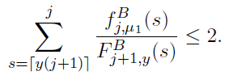
Lemma 6
For $j<4ln⁡(T)/∆^{′^{2}}$we will bound:
For $s≥y\left(1+j\right)$ exists (see Jogdeo and Samuels (1968)):
Therefore:
for

Slide 36
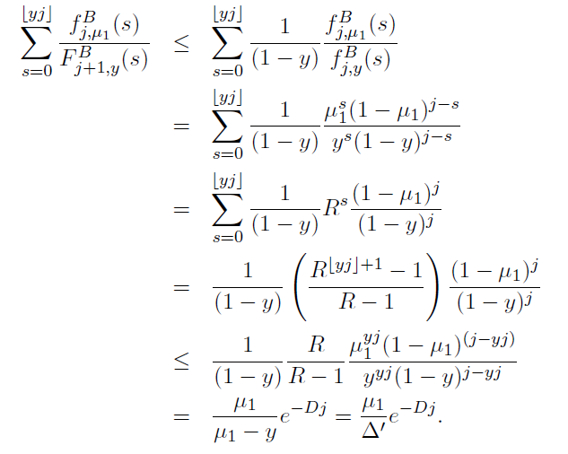
Lemma 6
Reminder:
$$≤R^{yj}$$

Slide 37
Lemma 6
** the second is without proof (very similar to previous slide)

Slide 38
Lemma 6

Slide 39
Total regret bound for two arms
Using Lemma 5, and Lemma 6 for $y = µ_{2}+Δ/2$, and $Δ’=Δ/2$, we can bound the expected number of plays of the second arm as:
Which gives the regret bound:

Slide 40
Proof outline for N arms setting
Back to N arms
At any step $t$, we divide the set of suboptimal arms into two subsets: saturated and unsaturated. The saturated $C(t)$ arms at time $t$ consists of arms that $k_{i}\left(t\right)≥L_{a}:$
$L_{a}=\frac{24\left(\ln{T}\right)}{Δ_{a}^{2} }$
As earlier, we try to estimate $Y_{j}$. $Y_{j}$ get the earliest time $t$ such that

Slide 41
Proof outline for N arms setting
The number of steps before $θ_{1}\left(t\right)>θ_{a}(t)$ of all saturated arms can be approximated by using a geometric random variable with parameter close to:
However, even if above happens, we might get $θ_{u}(t)$> $θ_{1}(t)$ for unsaturated arm $u$. Lets call this event an “interruption”.

Slide 42
Proof outline for N arms setting
For the weaker bound , they show that $Y_{j}$ can be upper bounded by the product of the expected value of a geometric random variable and the number of interruptions.
An arm u becomes saturated after $L_{u}$ plays, so the expected regret due to interruptions by unsaturated arms is bounded by:

Slide 43
Proof outline for N arms setting
The proof of the bound requires a slightly more careful analysis of the regret (due to playing saturated arms).
They prove that the total regret due to playing saturated arms as:

Slide 44
Proof outline for N arms setting
Summing the regret due to saturated and unsaturated arms, we obtain the result:

