Slide 1

Dijkstra’s algorithm
Solves SSSP when $w\left(u,v\right)≥0$ $∀\left(u,v\right)∈E$
A greedy strategy

Slide 3
Example

Slide 6
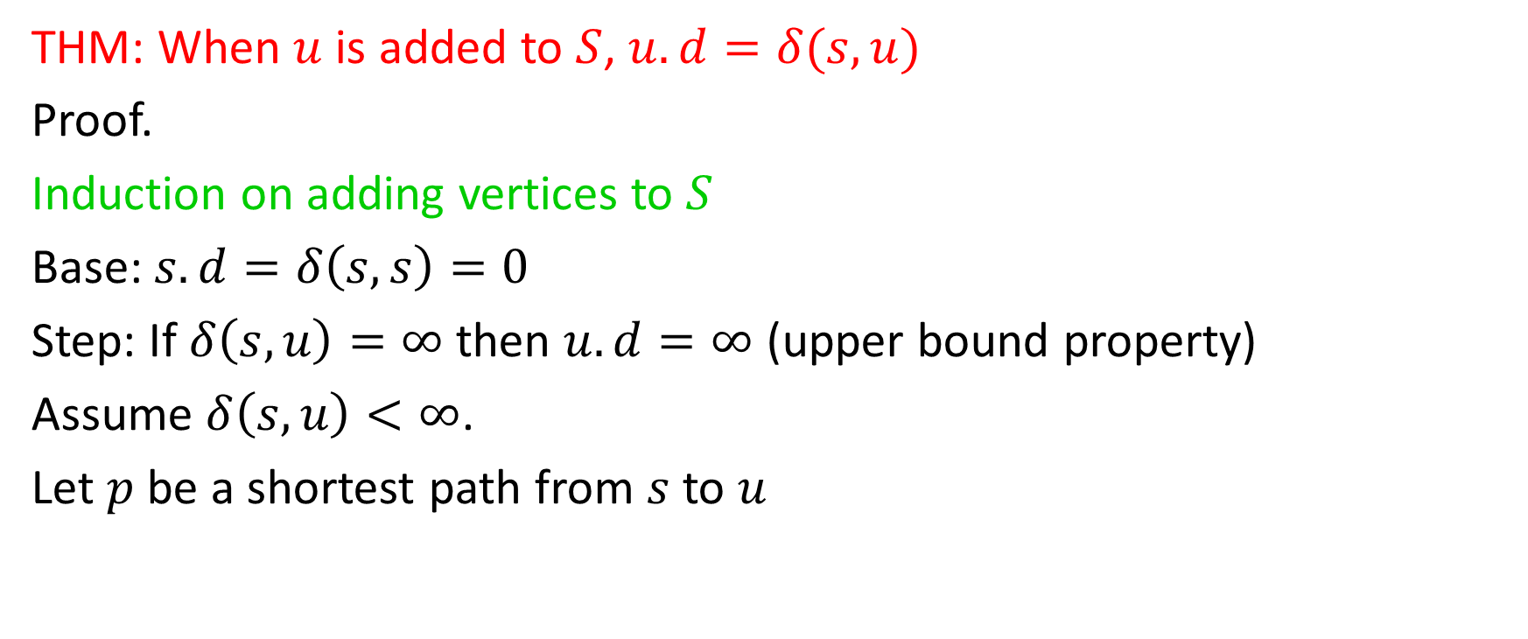
Correctness (1)
THM: When $u$ is added to $S$, $u.d=δ(s,u)$
Proof.
Induction on adding vertices to $S$
Base: $s.d=δ\left(s,s\right)=0$
Step: If $δ\left(s,u\right)=∞$ then $u.d=∞$ (upper bound property)
Assume $δ\left(s,u\right)<∞$.
Let $p$ be a shortest path from $s$ to $u$

Slide 7
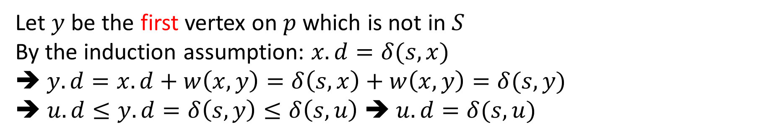
Correctness (2)
Let $y$ be the first vertex on $p$ which is not in $S$
By the induction assumption: $x.d=δ(s,x)$
$y.d=x.d+w\left(x,y\right)=δ\left(s,x\right)+w\left(x,y\right)=δ(s,y)$
➔ $u.d≤y.d=δ\left(s,y\right)≤δ\left(s,u\right)$ ➔ $u.d=δ(s,u)$

Slide 8
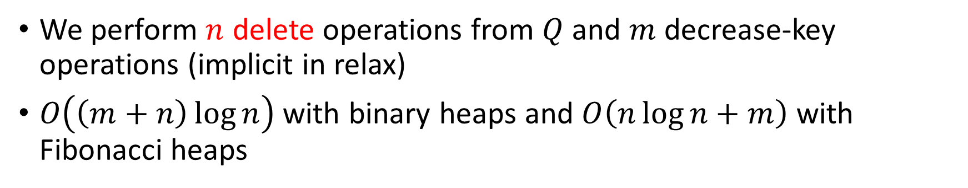
Running time
We perform $n$ delete operations from $Q$ and $m$ decrease-key operations (implicit in relax)
$O\left(\left(m+n\right)\log{n}\right)$ with binary heaps and $O\left(n\log{n}+m\right)$ with Fibonacci heaps

Slide 9
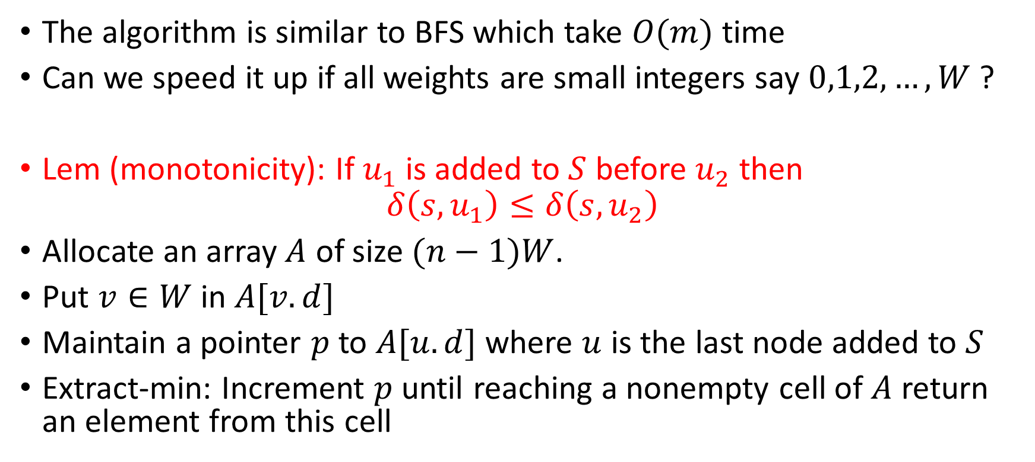
Dial’s implementation
The algorithm is similar to BFS which take $O(m)$ time
Can we speed it up if all weights are small integers say $0,1,2,…,W$ ?
Lem (monotonicity): If $u_{1}$ is added to $S$ before $u_{2}$ then
$$δ\left(s,u_{1}\right)≤δ\left(s,u_{2}\right)$$
Allocate an array $A$ of size $(n−1)W$.
Put $v∈W$ in $A[v.d]$
Maintain a pointer $p$ to $A[u.d]$ where $u$ is the last node added to $S$
Extract-min: Increment $p$ until reaching a nonempty cell of $A$ return an element from this cell

Slide 10







y
z
3
$$∞$$
$$∞$$
1
2
$$0$$
1
2
3
$$∞$$
t
s
2
3
$$∞$$
$$∞$$
2
x
u
s
0 | 1 | 2 | 3 | 4 | 5 | 6 | 7 | 8 | 9 | 10 | 11 | 12 | 13 | 14 | 15
$$(n−1)W$$
p
W=3

Slide 11


y
z
3
$$1$$
$$∞$$
1
2
$$0$$
1
2
3
$$∞$$
t
s
2
3
$$3$$
$$∞$$
2
x
u
y
x
0 | 1 | 2 | 3 | 4 | 5 | 6 | 7 | 8 | 9 | 10 | 11 | 12 | 13 | 14 | 15
$$(n−1)W$$
p
W=3

Slide 12
y
z
3
$$1$$
$$∞$$
1
2
$$0$$
1
2
3
$$∞$$
t
s
2
3
$$3$$
$$∞$$
2
x
u
y
x
0 | 1 | 2 | 3 | 4 | 5 | 6 | 7 | 8 | 9 | 10 | 11 | 12 | 13 | 14 | 15
$$(n−1)W$$
p
W=3

Slide 13




y
z
3
$$1$$
$$4$$
1
2
$$0$$
1
2
3
$$∞$$
t
s
2
3
$$2$$
$$3$$
2
x
u
x
u
z
0 | 1 | 2 | 3 | 4 | 5 | 6 | 7 | 8 | 9 | 10 | 11 | 12 | 13 | 14 | 15
$$(n−1)W$$
p
W=3

Slide 14
y
z
3
$$1$$
$$4$$
1
2
$$0$$
1
2
3
$$∞$$
t
s
2
3
$$2$$
$$3$$
2
x
u
x
u
z
0 | 1 | 2 | 3 | 4 | 5 | 6 | 7 | 8 | 9 | 10 | 11 | 12 | 13 | 14 | 15
$$(n−1)W$$
p
W=3

Slide 15

y
z
3
$$1$$
$$4$$
1
2
$$0$$
1
2
3
$$∞$$
t
s
2
3
$$2$$
$$3$$
2
x
u
u
z
0 | 1 | 2 | 3 | 4 | 5 | 6 | 7 | 8 | 9 | 10 | 11 | 12 | 13 | 14 | 15
$$(n−1)W$$
p
W=3

Slide 16
y
z
3
$$1$$
$$4$$
1
2
$$0$$
1
2
3
$$∞$$
t
s
2
3
$$2$$
$$3$$
2
x
u
u
z
0 | 1 | 2 | 3 | 4 | 5 | 6 | 7 | 8 | 9 | 10 | 11 | 12 | 13 | 14 | 15
$$(n−1)W$$
p
W=3

Slide 17


y
z
3
$$1$$
$$4$$
1
2
$$0$$
1
2
3
$$5$$
t
s
2
3
$$2$$
$$3$$
2
x
u
z
t
0 | 1 | 2 | 3 | 4 | 5 | 6 | 7 | 8 | 9 | 10 | 11 | 12 | 13 | 14 | 15
$$(n−1)W$$
p
W=3

Slide 18

Analysis of Dial’s implementation
$O\left(m+nW\right)$
Space $O\left(nW\right)$
Very fast if $W$ is small

