Slide 1
Social Networks
Amos Fiat
Fall 2014
Social Welfare, Arrow + Gibbard-Satterthwaite, VCG+CPP
TexPoint fonts used in EMF.
Read the TexPoint manual before you delete this box.: AAAAAAAA

Slide 2
Social choice or Preference Aggregation
Collectively choose among outcomes
  Elections,
  Choice of Restaurant
  Rating of movies
  Who is assigned what job
  Goods allocation
  Should we build a bridge?
Participants have preferences over outcomes
A social choice function aggregates those preferences and picks an outcome

Slide 3
Voting
If there are two options and an odd number of voters
Each having a clear preference between the options
Natural choice: majority voting
Sincere/Truthful
Monotone
Merging two sets where the majorities are the same preserves majority
Order of queries has no significance

Slide 4
When there are more than two options:
If we start pairing the alternatives:
Order may matter
Assumption: n voters give their complete ranking on set A of alternatives
L – the set of linear orders on A (permutations).
Each voter i provides Á_{i} 2 L
  Input to the aggregator/voting rule is (Á₁, Á₂,… , Á_{n} )
Goals
A function f: L^{n}  A is called a social choice function
  Aggregates voters preferences and selects a winner
A function W: L^{n}  L is called a social welfare function
  Aggergates voters preference into a common order
a₁₀, a₁, … , a₈
a_{m}
a₂
a₁
A

Slide 5

Examples of voting rules
Scoring rules: defined by a vector (a₁, a₂, …, a_{m})
  Being ranked ith in a vote gives the candidate a_{i} points
Plurality: defined by (1, 0, 0, …, 0)
  Winner is candidate that is ranked first most often
Veto: is defined by (1, 1, …, 1, 0)
  Winner is candidate that is ranked last the least often
Borda: defined by (m-1, m-2, …, 0)
Plurality with (2-candidate) runoff: top two candidates in terms of plurality score proceed to runoff.
Single Transferable Vote (STV, aka. Instant Runoff): candidate with lowest plurality score drops out; for voters who voted for that candidate: the vote is transferred to the next (live) candidate
  Repeat until only one candidate remains
Jean-Charles de Borda 1770

Slide 6
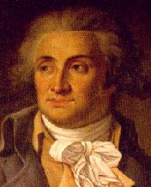
Marquis de Condorcet
Marie Jean Antoine Nicolas de Caritat, marquis de Condorcet
1743-1794
There is something wrong with Borda! [1785]

Slide 7
Condorcet criterion
A candidate is the Condorcet winner if it wins all of its pairwise elections
Does not always exist…
Condorcet paradox: there can be cycles
  Three voters and candidates:
  a > b > c, b > c > a, c > a > b
  a defeats b, b defeats c, c defeats a
Many rules do not satisfy the criterion
For instance: plurality:
  b > a > c > d
  c > a > b > d
  d > a > b > c
a is the Condorcet winner, but not the plurality winner
Candidates a and b:
Comparing how often a is ranked above b, to how often b is ranked above a
Also Borda:
  a > b > c > d > e
  a > b > c > d > e
  c > b > d > e > a

Slide 8
Even more voting rules…
Kemeny:
  Consider all pairwise comparisons.
  Graph representation: edge from winner to loser
  Create an overall ranking of the candidates that has as few disagreements as possible with the pairwise comparisons.
    Delete as few edges as possible so as to make the directed comparison graph acyclic
Approval [not a ranking-based rule]: every voter labels each candidate as approved or disapproved. Candidate with the most approvals wins
How do we choose one rule from all of these rules?
What is the “perfect” rule?
We list some natural criteria
Honor societies
General Secretary of the UN

Slide 9
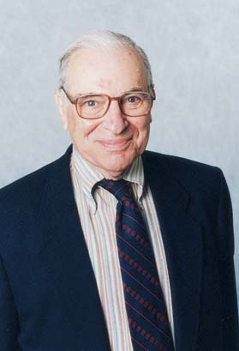
Arrow’s Impossibility Theorem
Skip to the 20th Centrury
  Kenneth Arrow, an economist. In his PhD thesis, 1950, he:
  Listed desirable properties of voting scheme
  Showed that no rule can satisfy all of them.
Properties
Unanimity
Independence of irrelevant alternatives
Not Dictatorial
Kenneth Arrow
1921-

Slide 10
Independence of irrelevant alternatives
Independence of irrelevant alternatives: if
  the rule ranks a above b for the current votes,
  we then change the votes but do not change which is ahead between a and b in each vote
then a should still be ranked ahead of b.
None of our rules satisfy this property
  Should they?
b
a
a
¼
a
a
b
b
b
a
b
b
a

Slide 11
Arrow’s Impossibility Theorem
Every Social Welfare Function W over a set A of at least 3 candidates:
If it satisfies
  Independence of irrelevant alternatives
  Pareto efficiency:
    If for all i a Á_{i} b
    then a Á b where W(Á₁, Á₂,… , Á_{n} ) = Á
  Then it is dictatorial : for all such W there exists an index i such that for all Á₁, Á₂,… , Á_{n} 2 L, W(Á₁, Á₂,… , Á_{n} ) = Á_{i}

Slide 12
Proof of Arrow’s Theorem
Claim: Let W be as above, and let
Á₁, Á₂,…, Á_{n} and Á’₁, Á’₂,…, Á’_{n} be two profiles s.t.
  Á=W(Á₁, Á₂,…, Á_{n}) and Á’=W(Á’₁, Á’₂,…, Á’_{n})
  and where for all i
a Á_{i} b ⇔ c Á’_{i} d
Then a Á b ⇔ c Á’ d
Proof: suppose a Á b and c≠ b
Create a single preference π_{i} from Á_{i} and Á’_{i}: where c is just below a and d just above b.
Let Á_{π}=W(Á₁, Á₂,…, Á_{n})
We must have: (i) a Á_{π} b (ii) c Á_{π} a and (iii) b Á_{π} d
And therefore c Á_{π} d and c Á’ d
Why?? – next slide

Slide 13
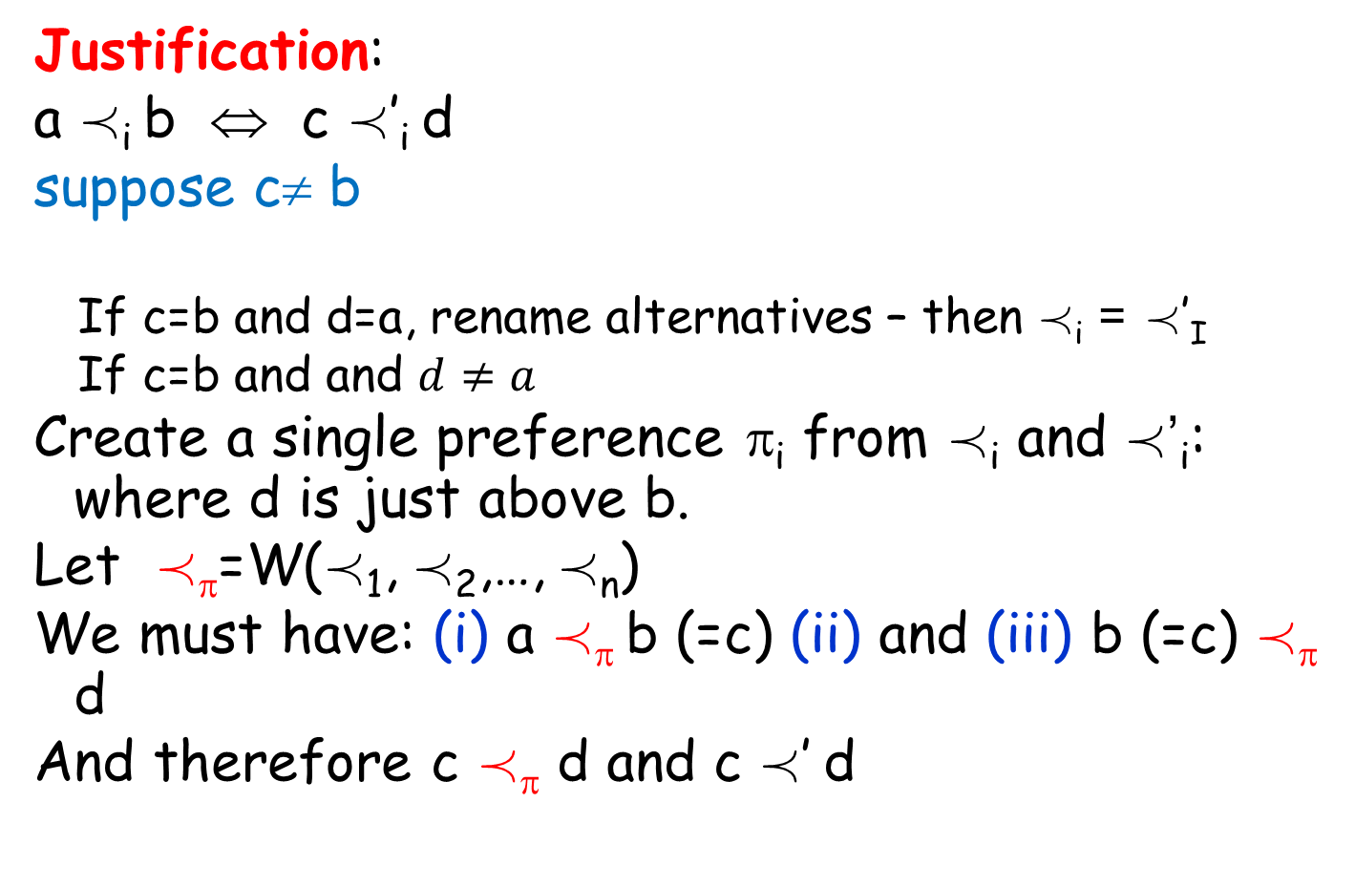
Proof of Arrow’s Theorem
Justification:
a Á_{i} b ⇔ c Á’_{i} d
suppose c≠ b
  If c=b and d=a, rename alternatives – then Á_{i} = Á’_{I}
  If c=b and and $d≠a$
Create a single preference π_{i} from Á_{i} and Á’_{i}: where d is just above b.
Let Á_{π}=W(Á₁, Á₂,…, Á_{n})
We must have: (i) a Á_{π} b (=c) (ii) and (iii) b (=c) Á_{π} d
And therefore c Á_{π} d and c Á’ d

Slide 14
Proof of Arrow’s Theorem: Find the Dictator
Claim: For arbitrary a,b 2 A consider profiles
Voters
b
a
a
b
a
b
a
b
Hybrid argument
1
2
Change must happen at some profile i*
  Where voter i* changed his opinion
b
a
b
a
a
b
b
a
b
a
…
b
a
b
a
a
b
n
Claim: this i* is the dictator!
0
1
2
n
a Á b
Profiles
b Á a

Slide 15
Proof of Arrow’s Theorem: i* is the dictator
Claim: for any Á₁, Á₂,…, Á_{n} and Á=W(Á₁,Á₂,…,Á_{n}) and c,d 2 A. If c Á_{i*} d then c Á d.
Proof: take e ≠ c, d and
for i<i* move e to the bottom of Á_{i}
for i>i* move e to the top of Á_{i}
for i* put e between c and d
For resulting preferences:
  Preferences of e and c like a and b in profile i*.
  Preferences of e and d like a and b in profile i*-1.
c Á e
e Á d
Therefore c Á d

Slide 16
Social welfare vs. Social Choice
A function f: L^{n}  A is called a social choice function
  Aggregates voters preferences and selects a winner
A function W: L^{n}  L is called a social welfare function
  Aggergates voters preference into a common order
We’ve seen:
  Arrows Theorem: Limitations on Social Welfare functions
Next:
  Gibbard-Satterthwaite Theorem: Limitations on Incentive Compatible Social Choice functions

Slide 17
Strategic Manipulations
A social choice function f can be manipulated by voter i if for some Á₁, Á₂,…, Á_{n} and Á’_{i} and we have a=f(Á₁,…Á_{i},…,Á_{n}) and a’=f(Á₁,…,Á’_{i},…,Á_{n}) but a Á_{i} a’
voter i prefers a’ over a and can get it by changing her vote from her true preference Á_{i} to Á’_{i}
f is called incentive compatible if it cannot be manipulated

Slide 18
Gibbard-Satterthwaite Impossibility Theorem
Suppose there are at least 3 alternatives
There exists no social choice function f that is simultaneously:
  Onto
    for every candidate, there are some preferences so that the candidate alternative is chosen
  Nondictatorial
  Incentive compatible

Slide 19
Proof of the Gibbard-Satterthwaite Theorem: Via Contradiction to Arrow
Given non-manipulable, onto, non dictator social choice function f,
Construct a Social Welfare function W_{f} (total order) based on f.
W_{f}(Á₁,…,Á_{n}) =Á
where aÁb iff
f(Á₁^{{a,b}},…,Á_{n}^{{a,b}}) =b
Keep everything in order but move a and b to top

Slide 20
What we need to show
That is “well formed”
  Antisymmetry
  Transitivity
  Unanimity
  IIA
  Non-dictatorship
Contradiction to Arrow

Slide 21
Proof of the Gibbard-Satterthwaite Theorem
Claim: for all Á₁,…,Á_{n} and any S ½ A we have f(Á₁^{S},…,Á_{n}^{S,}) 2 S
Take a 2 S. There is some Á’₁, Á’₂,…, Á’_{n} where
f(Á’₁, Á’₂,…, Á’_{n})=a.
Sequentially change Á’_{i} to Á^{S}_{i}
At no point does f output b 2 S.
Due to the non-manipulation
Keep everything in order but move elements of S to top

Slide 22
Proof of Well Form Lemma
Antisymmetry: implied by claim for S={a,b}
Transitivity: Suppose we obtained contradicting cycle a Á b Á c Á a
  take S={a,b,c} and suppose a = f(Á₁^{S},…,Á_{n}^{S})
  Sequentially change Á^{S}_{i} to Á_{i}^{{a,b}}
  Non manipulability implies that
  f(Á₁^{{a,b}},…,Á_{n}^{{a,b}}) =a and b Á a.
Unanimity: if for all i b Á_{i} a then
(Á_{i}^{{a,b}})^{{a}} =Á_{i}^{{a,b}} and f(Á₁^{{a,b}},…,Á_{n}^{{a,b}}) =a

Slide 23
Proof of Well Form Lemma
Independence of irrelevant alternatives:
  Again, non-manulpulation,
  if there are two profiles Á₁, Á₂,…, Á_{n} and Á’₁, Á’₂,…, Á’_{n} where for all i bÁ_{i} a iff bÁ’_{i} a, then
  f(Á₁^{{a,b}},…,Á_{n}^{{a,b}}) = f(Á’₁^{{a,b}},…,Á’_{n}^{{a,b}})
  by sequentially flipping from Á_{i}^{{a,b}} to Á’_{i}^{{a,b}}
Non dictator: preserved

Slide 24
Mechanism Design

Slide 25
Social choice in the quasi linear setting
Set of alternatives A
  Who wins the auction
  Which path is chosen
  Who is matched to whom
Each participant: a type function t_{i}:A  R
  Note: real value, not only order
Participant = agent/bidder/player/etc.

Slide 26
Mechanism Design
We want to implement a social choice function
  (a function of the agent types)
  Need to know agents’ types
  Why should they reveal them?
Idea: Compute alternative (a in A) and payment vector p
Utility to agent i of alternative a with payment p_{i} is t_{i}(a)-p_{i}
Quasi linear preferences

Slide 27
The setting
A social planner wants to choose an alternative according to players’ types:
f : T₁ × ... × T_{n} → A
Problem: the planner does not know the types.

Slide 28
Example: Vickrey’s Second Price Auction
Single item for sale
Each player has scalar value z_{i} – value of getting item
If he wins item and has to pay p: utility z_{i}-p
If someone else wins item: utility 0
Second price auction: Winner is the one with the highest declared value z_{i}. Pays the second highest bid
p*=max_{j ≠ i} z_{j}
Theorem (Vickrey): for any every z₁, z₂,…,z_{n} and every z_{i}’. Let u_{i} be i’s utility if he bids z_{i} and u’_{i} if he bids z_{i}’. Then u_{i} ¸ u’_{i.}.

Slide 29
Direct Revelation Mechanism
A direct revelation mechanism is a social choice function
f: T₁ × T₂ × … × T_{n}  A
and payment functions p_{i}: T₁ × T₂ × … × T_{n}  R
Participant i pays p_{i}(t₁, t₂, … t_{n})
A mechanism (f,p₁, p₂,… p_{n}) is
incentive compatible in dominant strategies
if for every t=(t₁, t₂, …,t_{n}), i and t_{i}’ 2 T_{i}: if a = f(t_{i},t_{-i}) and a’ = f(t’_{i},t_{-i}) then
t_{i}(a)-p_{i}(t_{i},t_{-i}) ¸ t_{i}(a’) -p_{i}(t’_{i},t_{-i})
t=(t₁, t₂,… t_{n})
t_{-i}=(t₁, t₂,… t_{i-1} ,t_{i+1} ,… t_{n})

Slide 30
Vickrey Clarke Grove Mechanism
A mechanism (f,p₁, p₂,… p_{n} ) is called Vickrey-Clarke-Grove (VCG) if
f(t₁, t₂, … t_{n}) maximizes ∑_{i} t_{i}(a) over A
  Maximizes welfare
There are functions h₁, h₂,… h_{n} where
h_{i}: T₁ × T₂ × … T_{i-1} × T_{i+1} × … T_{n}  R
we have that:
p_{i}(t₁, t₂, … t_{n}) = h_{i}(t_{-i}) - ∑_{j ≠ i} t_{j}(f(t₁, t₂,… t_{n}))
Does not depend on t_{i}
t=(t₁, t₂,… t_{n})
t_{-i}=(t₁, t₂,… t_{i-1} ,t_{i+1} ,… t_{n})

Slide 31
Example: Second Price Auction
Recall: f assigns the item to one participant and
t_{i}(j) = 0 if j ≠ i and t_{i}(i)=z_{i}
f(t₁, t₂, … t_{n}) = i s.t. z_{i} =max_{j}(z₁, z₂,… z_{n})
h_{i}(t_{-i}) = max_{j}(z₁, z₂, … z_{i-1}, z_{i+1} ,…, z_{n})
p_{i}(t) = h_{i}(v_{-i}) - ∑_{j ≠ i} t_{j}(f(t₁, t₂,… t_{n}))
If i is the winner p_{i}(t) = h_{i}(t_{-i}) = max_{j ≠ i} z_{j}
and for j ≠ i
p_{j}(t)= z_{i} – z_{i} = 0
A={i wins|I 2 I}

Slide 32
VCG is Incentive Compatible
Theorem: Every VCG Mechanism (f,p₁, p₂,… p_{n}) is incentive compatible
Proof:
Fix i, t_{-i}, t_{i} and t’_{i}. Let a=f(t_{i},t_{-i}) and a’=f(t’_{i},t_{-i}).
Have to show
t_{i}(a)-p_{i}(t_{i},t_{-i}) ¸ t_{i} (a’) -p_{i}(t’_{i},t_{-i})
Utility of i when declaring t_{i}: t_{i}(a) + ∑_{j ≠ i} t_{j}(a) - h_{i}(t_{-i})
Utility of i when declaring t’_{i}: t_{i}(a’)+ ∑_{j ≠ i} t_{j}(a’)- h_{i}(t_{-i})
Since a maximizes social welfare
t_{i}(a) + ∑_{j ≠ i} t_{j}(a) ¸ t_{i}(a’) + ∑_{j ≠ i} t_{j}(a’)

Slide 33
Clarke Pivot Rule
What is the “right”: h?
Individually rational: participants always get non negative utility
t_{i}(f(t₁, t₂,… t_{n})) - p_{i}(t₁, t₂,… t_{n}) ¸ 0
No positive transfers: no participant is ever paid money
p_{i}(t₁, t₂,… t_{n}) ¸ 0
Clark Pivot rule: Choosing h_{i}(t_{-i}) = max_{b 2 A} ∑_{j ≠ i} t_{j}(b)
Payment of i when a=f(t₁, t₂,…, t_{n}):
p_{i}(t₁, t₂,… t_{n}) = max_{b 2 A} ∑_{j ≠ i} t_{j}(b) - ∑_{j ≠ i} t_{j}(a)
  i pays an amount corresponding to the total “damage” he causes other players: difference in social welfare caused by his participation

Slide 34
Rationality of Clarke Pivot Rule
Theorem: Every VCG Mechanism with Clarke pivot payments makes no positive Payments. If t_{i}(a) ¸ 0 then it is Individually rational
Proof:
Let a=f(t₁, t₂,… t_{n}) maximize social welfare
Let b 2 A maximize ∑_{j ≠ i} t_{j}(b)
Utility of i:
t_{i}(a) + ∑_{j ≠ i} t_{j}(a) - ∑_{j ≠ i} t_{j}(b)
¸ ∑_{j} t_{j}(a) - ∑_{j} t_{j}(b) ¸ 0
Payment of i: ∑_{j ≠ i} t_{j}(b) - ∑_{j ≠ i} t_{j}(a) ¸ 0 from choice of b
maximizes ∑_{i} t_{i}(a) over A

Slide 35
Examples: Second Price Auction
Second Price auction:
h_{i}(t_{-i}) = max_{j}(w₁, w₂,…, w_{i-1}, w_{i+1},…, w_{n})
= max_{b 2 A} ∑_{j ≠ i} t_{j}(b)
Multiunit auction: if k identical items are to be sold to k individuals. A={S wins |S ½ I, |S|=k} and
v_{i}(S) = 0 if i2S and v_{i}(i)=w_{i} if i 2 S
Allocate units to top k bidders. They pay the k+1st price
Claim: this is
max_{S’ ½ I\{i} |S’| =k} ∑_{j ≠ i} v_{j}(S’)-∑_{j ≠ i} v_{j}(S)

Slide 36
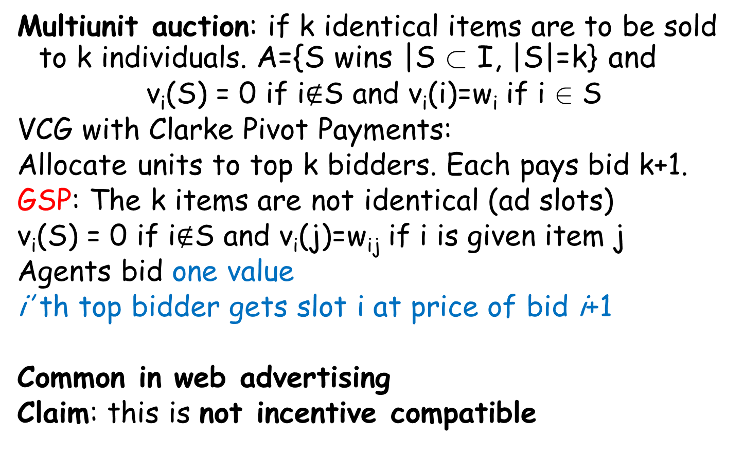
Generalized Second Price Auctions
Multiunit auction: if k identical items are to be sold to k individuals. A={S wins |S ½ I, |S|=k} and
v_{i}(S) = 0 if i$∉$S and v_{i}(i)=w_{i} if i 2 S
VCG with Clarke Pivot Payments:
Allocate units to top k bidders. Each pays bid k+1.
GSP: The k items are not identical (ad slots)
v_{i}(S) = 0 if i$∉$S and v_{i}(j)=w_{ij} if i is given item j
Agents bid one value
i’ th top bidder gets slot i at price of bid i+1
Common in web advertising
Claim: this is not incentive compatible

Slide 37
VCG with Public Project
Want to build a bridge:
  Cost is C (if built) (One more player – the “state”)
  Value to each individual v_{i}
  Want to built iff ∑ _{i} v_{j} ¸ C
Player with v_{j} ¸ 0 pays only if pivotal
∑_{j ≠ i} v_{j} < C but ∑ _{j} v_{j} ¸ C
  in which case pays p_{j} = C- ∑_{j ≠ i} v_{j}
In general: ∑ _{i} p_{j} < C
Payments do not cover project cost’s
Subsidy necessary!
A={build, not build}
Equality only when
∑ _{i} v_{j} = C

Slide 38
Buying a (Short) Path in a Graph
A Directed graph G=(V,E) where each edge e is “owned” by a different player and has cost c_{e}.
Want to construct a path from source s to destination t.
How do we solicit the real cost c_{e}?
  Set of alternatives: all paths from s to t
  Player e has cost: 0 if e not on chosen path and –c_{e} if on
  Maximizing social welfare: finding shortest s-t path:
  min_{paths} ∑_{e 2 path} c_{e}
A VCG mechanism pays 0 to those not on path p: pay each e₀ 2 p: ∑_{e 2 p’} c_{e} - ∑_{e 2 p\{e0}} c_{e}
  where p’ is shortest path without e_{o}
Set A of alternatives: all s-t paths
If e₀ would not have woken up in the morning, what would other
edges earn? If he does wake up, what would other edges earn?

Slide 39
VCG (+CPP) is not perfect
Requires payments & quasilinear utility functions
In general money needs to flow away from the system
  Strong budget balance = payments sum to 0
  Impossible in general [Green & Laffont 77]
Vulnerable to collusions
Maximizes sum of players’ valuations (social welfare)
  (not counting payments, but does include “COST” of alternative)
But: sometimes [usually, often??] the mechanism is not interested in maximizing social welfare:
  E.g. the center may want to maximize revenue
  Minimize time
  Maximize fairness
  Etc., Etc.

Slide 40
Bayes Nash Implementation

Slide 41
Bayes Nash Implementation
There is a distribution D_{i} on the types T_{i} of Player i
It is known to everyone
The actual type of agent i, t_{i} 2_{Di}T_{i} is the private information i knows
A profile of strategis s_{i} is a Bayes Nash Equilibrium if for i all t_{i} and all t’_{i}
E_{d-i}[u_{i}(t_{i}, s_{i}(t_{i}), s_{-i}(t_{-i}) )] ¸ E_{d-i}[u_{i}(t’_{i}, s_{-i}(t_{-i})) ]

Slide 42
Bayes Nash: First Price Auction
First price auction for a single item with two players.
Private values (types) t₁ and t₂ in T₁=T₂=[0,1]
Does not make sense to bid true value – utility 0.
There are distributions D₁ and D₂
Looking for s₁(t₁) and s₂(t₂) that are best replies to each other
Suppose both D₁ and D₂ are uniform.
Claim: The strategies s₁(t₁) = t_{i}/2 are in Bayes Nash Equilibrium
t₁
Win half the time
Cannot win

Slide 43
Characterization of Equilibria

Slide 44
Characterization of Equilibria

Slide 45
Expected Revenues
Expected Revenue:
  For first price auction: max(T₁/2, T₂/2) where T₁ and T₂ uniform in [0,1]
  For second price auction min(T₁, T₂)
  Which is better?
  Both are 1/3.
  Coincidence?
Theorem [Revenue Equivalence]: under very general conditions, every two Bayesian Nash implementations of the same social choice function
  if for some player and some type they have the same expected payment then
  All types have the same expected payment to the player
  If all player have the same expected payment: the expected revenues are the same

