Slide 1
Analysis of Algorithms
Directed Minimum Spanning Trees
Uri Zwick
February 2014

Slide 2
Directed minimum spanning trees
11
16
22
17
5
8
1
13
3
18
30
12
25
9
2
15

Slide 3
Directed minimum spanning trees
11
16
22
17
5
8
1
13
3
18
30
12
25
9
2
15

Slide 4
Directed minimum spanning trees
11
16
22
17
5
8
1
13
3
18
30
12
25
9
2
15

Slide 5
Directed spanning trees
Lemma: The following conditions are equivalent:
(i) T is a directed spanning tree of G rooted at r.
(ii) The indegree of r in T is 0, the indegree of every other vertex of G in T is 1, and T is acyclic,
i.e., contains no directed cycles.
(iii) The indegree of r in T is 0, the indegree of every other vertex of G in T is 1, and there are
directed paths in T from r to all other vertices.

Slide 6
Directed spanning trees

Slide 7
Cheapest entering edges
Select the cheapest edge entering each vertex, other than the specified root r.
If, magically, we get a directed spanning tree rooted at r, then it is of course an optimal tree

Slide 8
Cheapest entering edges
Select the cheapest edge entering each vertex, other than the specified root r.
We may, of course, get cycles…

Slide 9
Cheapest entering edges
Lemma: If C is a cycle composed of cheapest entering edges, then there is a MDST T that contains all edges of C, except for one.

Slide 10
Cheapest entering edges
Lemma: If C is a cycle composed of cheapest entering edges, then there is a MDST T that contains all edges of C, except for one.

Slide 11
Growing a path and contracting

Slide 12
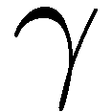
Contraction phase – An example

Slide 13
Expansion phase – An example

Slide 14
Expansion phase – Another example

Slide 16
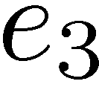
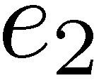
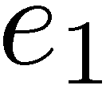

Slide 18
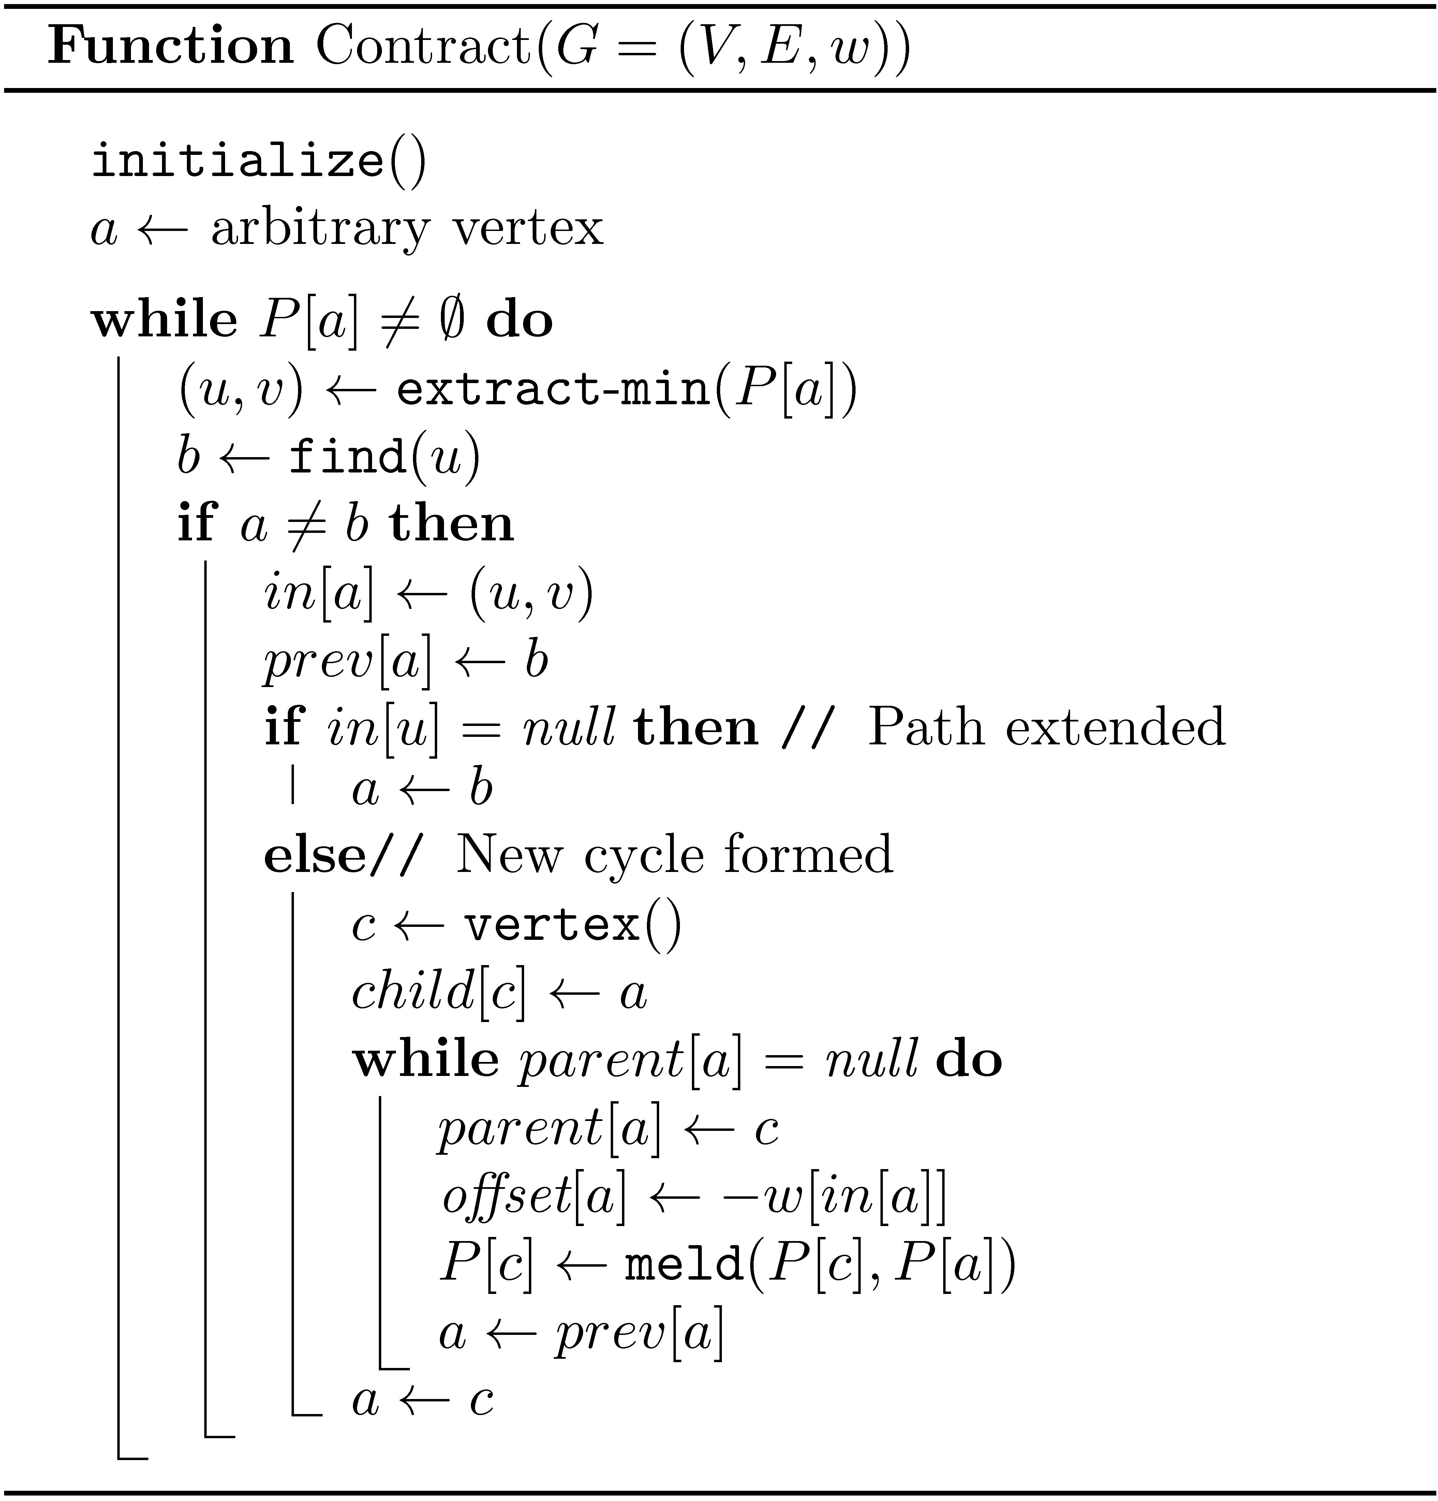

Slide 19
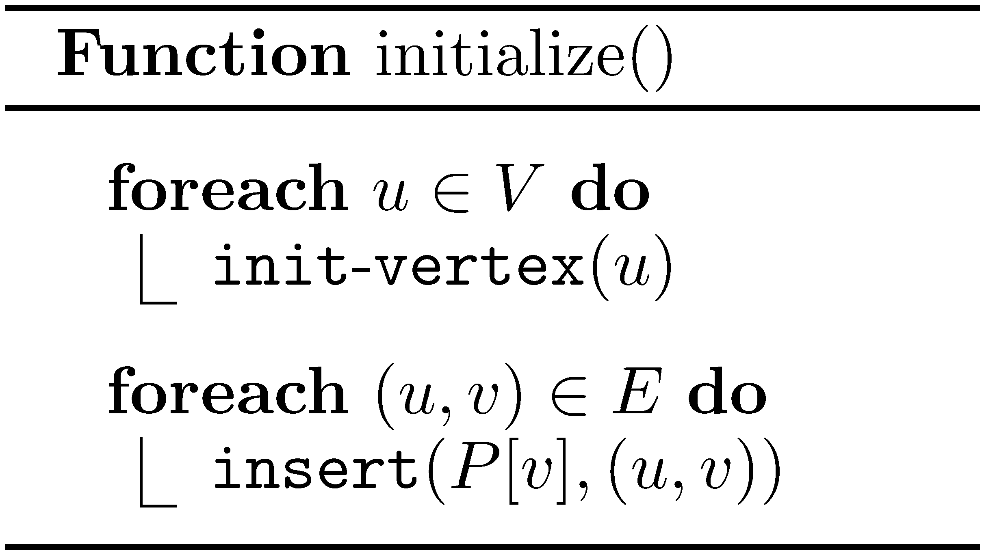
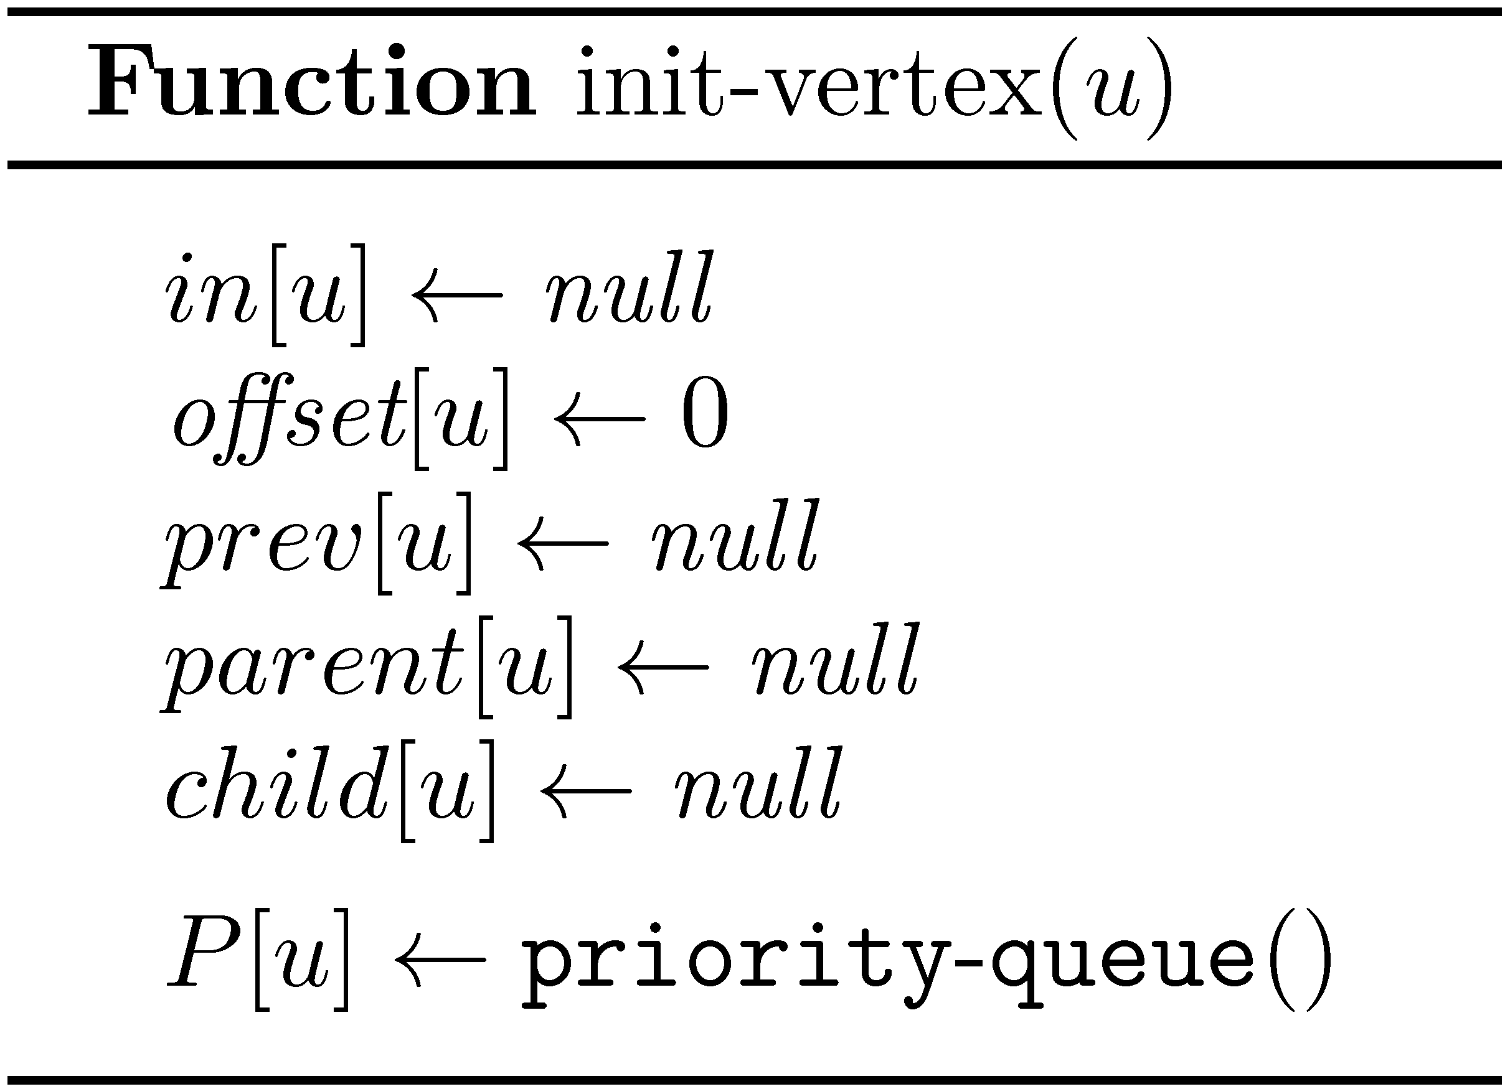

Slide 20
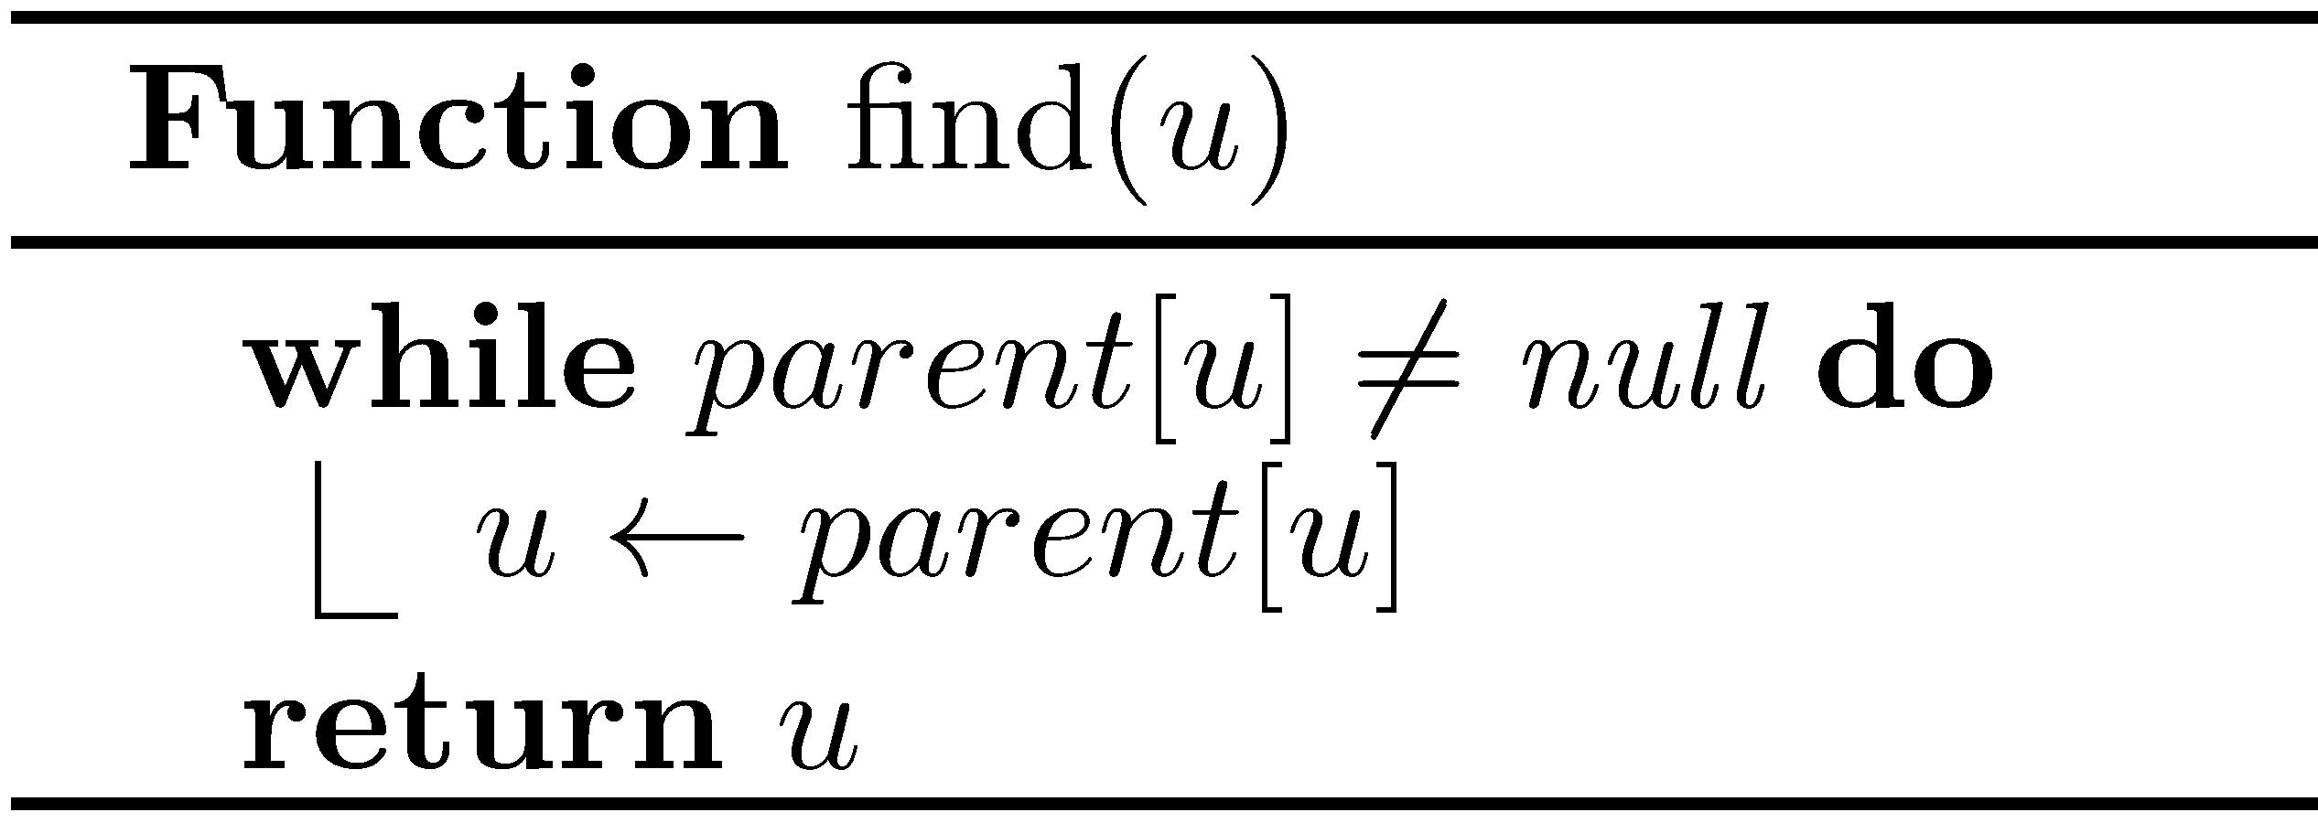
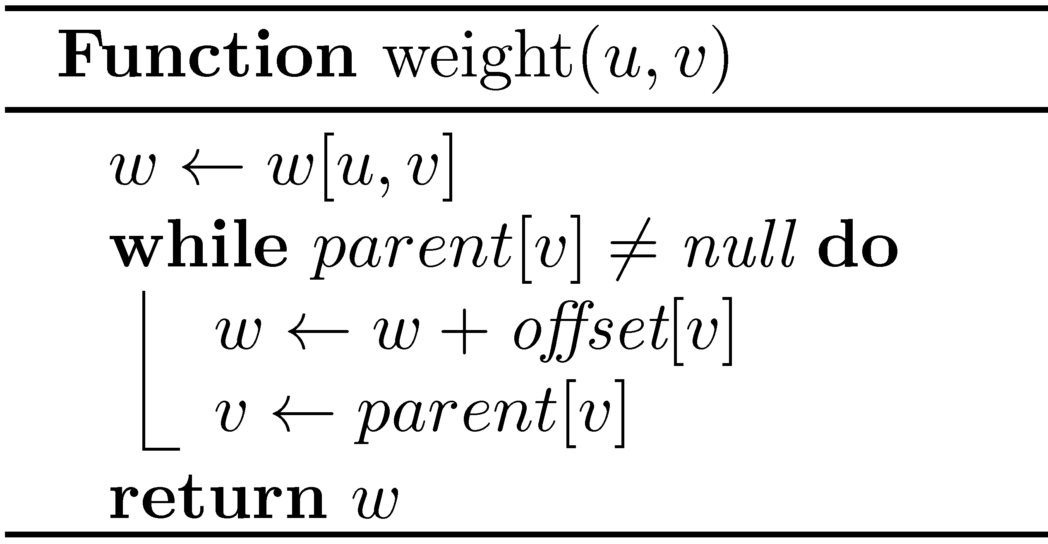

Slide 21
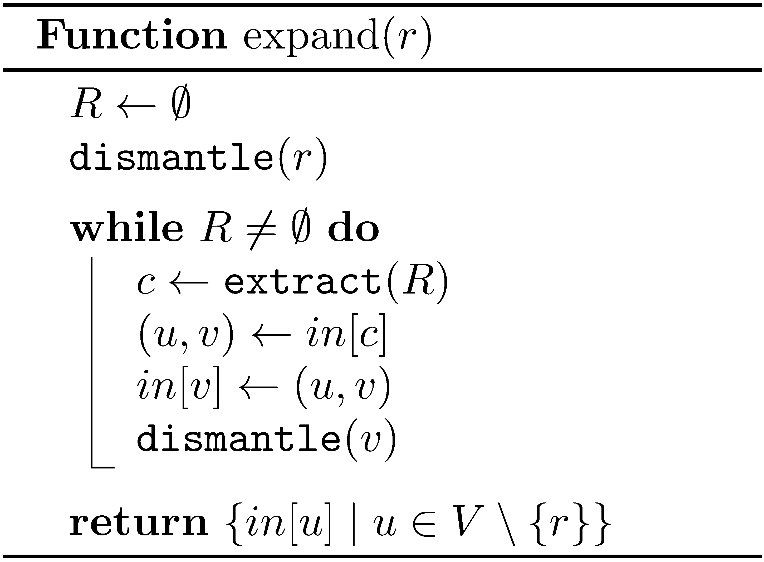

Slide 22
