Slide 1
Matrix Multiplication and Graph Algorithms
Uri Zwick
Tel Aviv University

Slide 2
Outline
Algebraic matrix multiplication
Strassen’s algorithm
Rectangular matrix multiplication
Boolean matrix multiplication
Simple reduction to integer matrix multiplication
Computing the transitive closure of a graph.
Min-Plus matrix multiplication
Equivalence to the APSP problem
Expensive reduction to algebraic products
Fredman’s trick

Slide 3
APSP in undirected graphs
An O(n^{2.38}) algorithm for unweighted graphs (Seidel)
An O(Mn^{2.38}) algorithm for weighted graphs (Shoshan-Zwick)
APSP in directed graphs
An O(M^{0.68}n^{2.58}) algorithm (Zwick)
An O(Mn^{2.38}) preprocessing / O(n) query answering algorithm (Yuster-Zwick)
An O(n^{2.38}log M) (1+ε)-approximation algorithm
Summary and open problems

Slide 4
Short introduction to Fast matrix multiplication

Slide 5
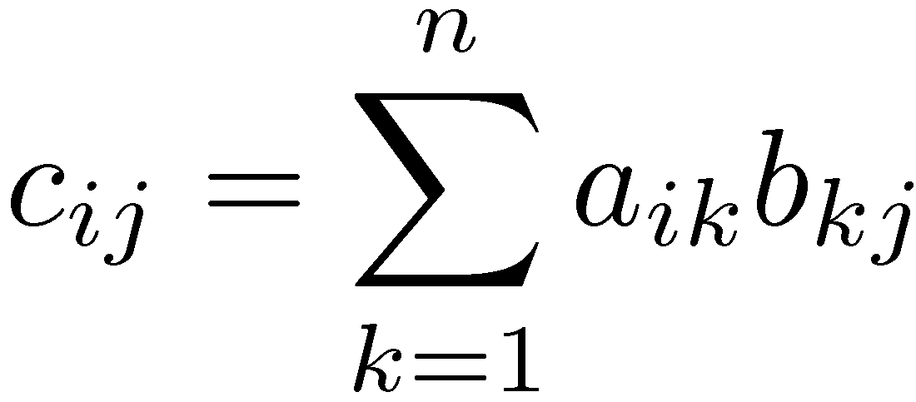
Algebraic Matrix Multiplication
j
i
×
=
Can be computed naively in O(n³) time.

Slide 6
Matrix multiplication algorithms
Authors | Complexity
— | n³
Strassen (1969) | n^{2.81}
…
Coppersmith, Winograd (1990) | n^{2.38}
Conjecture/Open problem: n^{2+o(1)} ???

Slide 7
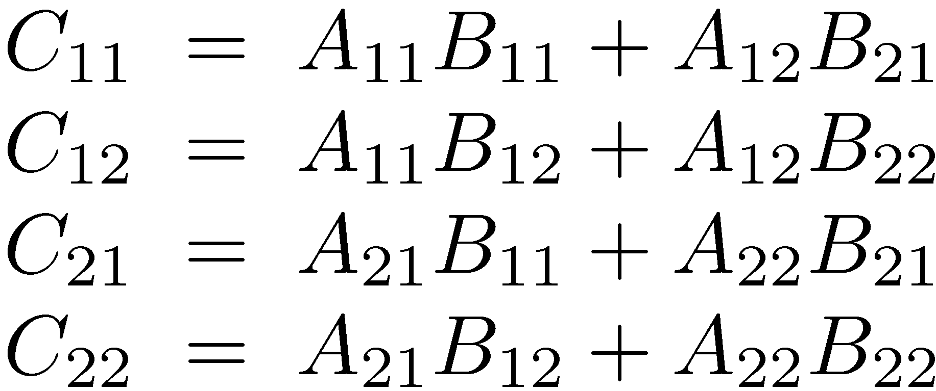
Multiplying 2×2 matrices
8 multiplications 4 additions
Works over any ring!

Slide 8
Multiplying n×n matrices
8 multiplications 4 additions
T(n) = 8 T(n/2) + O(n²)
T(n) = O(n^{log8/log2})=O(n³)

Slide 9
Strassen’s 2×2 algorithm
Subtraction!
7 multiplications 18 additions/subtractions
Works over any ring!

Slide 10
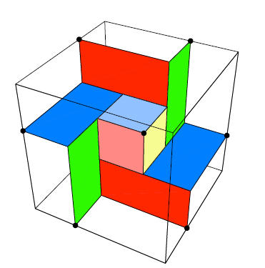
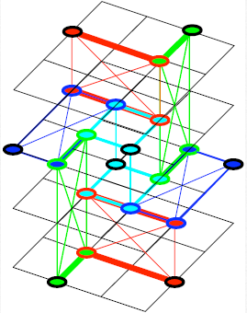
“Strassen Symmetry” (by Mike Paterson)

Slide 11
Strassen’s n×n algorithm
View each n × n matrix as a 2 × 2 matrix whose elements are n/2 × n/2 matrices.
Apply the 2×2 algorithm recursively.
T(n) = 7 T(n/2) + O(n²)
T(n) = O(n^{log7/log2})=O(n^{2.81})

Slide 12
Matrix multiplication algorithms
The O(n^{2.81}) bound of Strassen was improved by Pan, Bini-Capovani-Lotti-Romani, Schönhage and finally by Coppersmith and Winograd to O(n^{2.38}).
The algorithms are much more complicated…
New group theoretic approach [Cohn-Umans ‘03] [Cohn-Kleinberg-szegedy-Umans ‘05]
We let 2 ≤ ω < 2.38 be the exponent of matrix multiplication.
Many believe that ω=2+o(1).

Slide 13
Determinants / Inverses
The title of Strassen’s 1969 paper is: “Gaussian elimination is not optimal”
Other matrix operations that can be performed in O(n^{ω}) time:
Computing determinants: det A
Computing inverses: A⁻¹
Computing characteristic polynomials

Slide 14
Matrix Multiplication Determinants / Inverses
What is it good for?
Transitive closure
Shortest Paths
Perfect/Maximum matchings
Dynamic transitive closure
k-vertex connectivity
Counting spanning trees

Slide 15
Rectangular Matrix multiplication
p
n
n
n
×
p
=
n
Naïve complexity: n²p
[Coppersmith ’97]: n^{1.85}p^{0.54}+n^{2+o(1)}
For p ≤ n^{0.29}, complexity = n^{2+o(1)} !!!

Slide 16
BOOLEAN MATRIX MULTIPLICATION and TRANSIVE CLOSURE

Slide 17
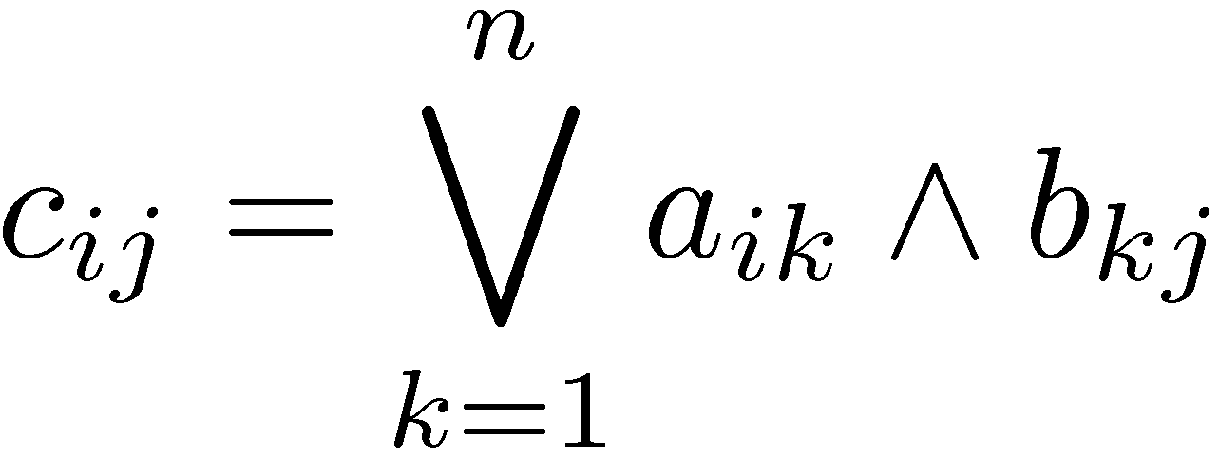
Boolean Matrix Multiplication
j
i
×
=
Can be computed naively in O(n³) time.

Slide 18
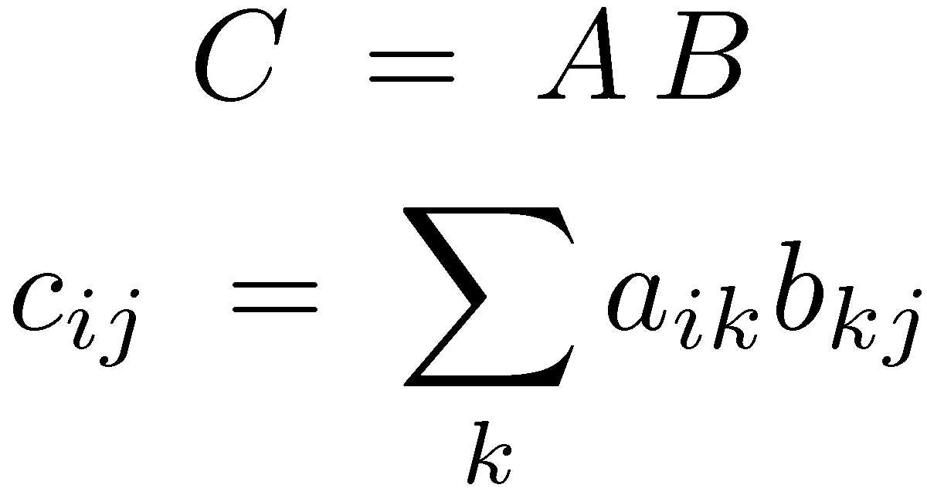
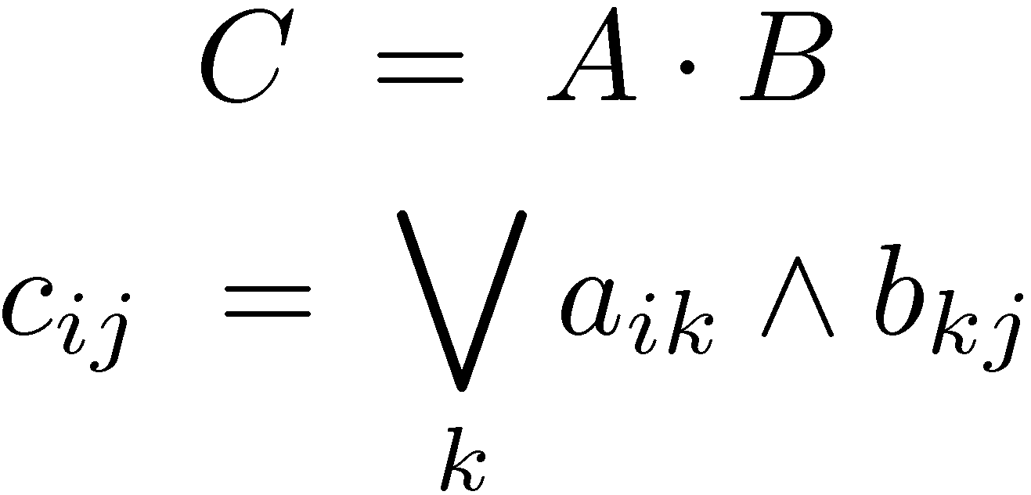
Algebraic Product
Boolean Product
?
O(n^{2.38}) algebraic operations
O(n^{2.38}) operations on O(log n) bit words
But, we can work over the integers! (modulo n+1)
Logical or (∨) has no inverse!

Slide 19
Transitive Closure
Let G=(V,E) be a directed graph.
The transitive closure G*=(V,E*) is the graph in which (u,v)∈E* iff there is a path from u to v.
Can be easily computed in O(mn) time.
Can also be computed in O(n^{ω}) time.

Slide 20
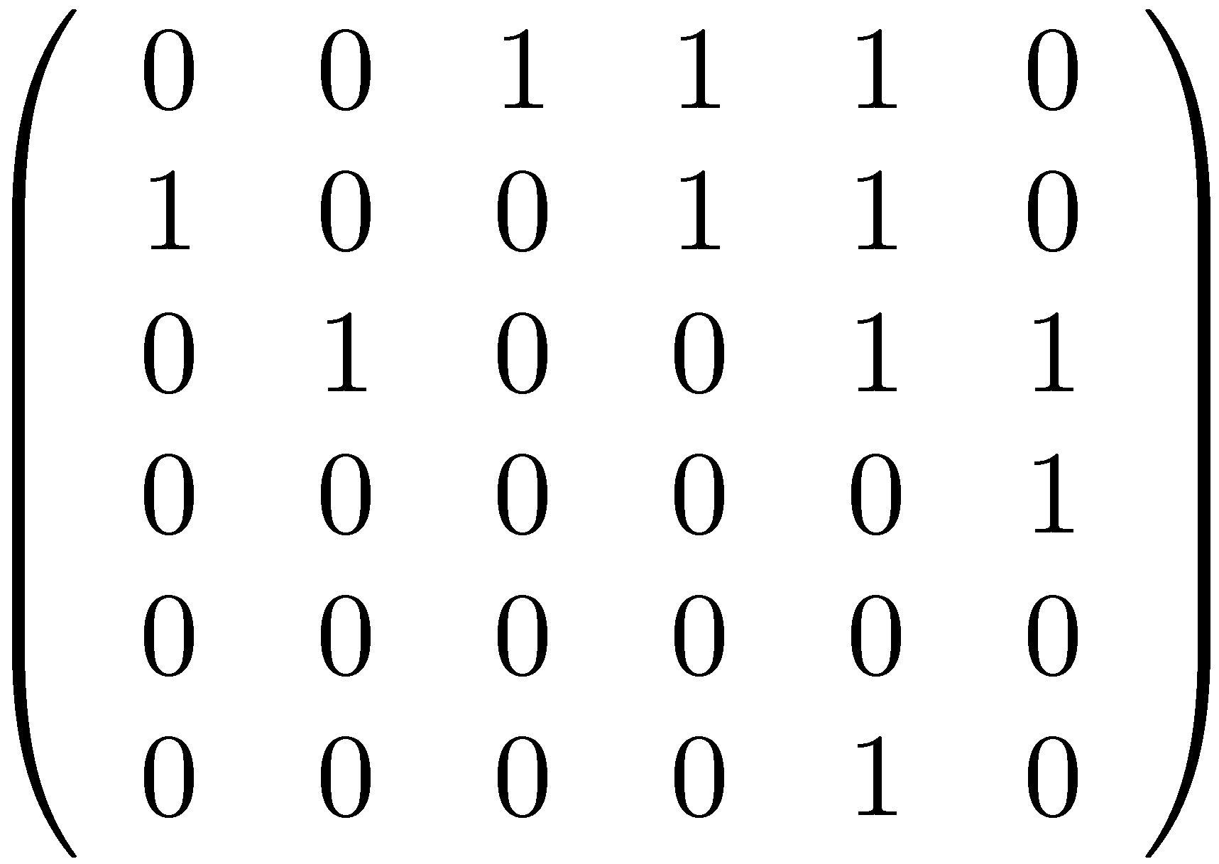
Adjacency matrix of a directed graph
4
1
6
3
2
5
Exercise 0: If A is the adjacency matrix of a graph, then (A^{k})_{ij}=1 iff there is a path of length k from i to j.

Slide 21
Transitive Closure using matrix multiplication
Let G=(V,E) be a directed graph.
If A is the adjacency matrix of G, then (A∨I)^{n−1} is the adjacency matrix of G*.
The matrix (A∨I)^{n−1} can be computed by log n squaring operations in O(n^{ω}log n) time.
It can also be computed in O(n^{ω}) time.

Slide 22
B
A | B
C | D
A
D
X =
C
E | F
G | H
(A∨BD*C)* | EBD*
D*CE | D*∨GBD*
X* =
=
TC(n) ≤ 2 TC(n/2) + 6 BMM(n/2) + O(n²)

Slide 23
Exercise 1: Give O(n^{ω}) algorithms for findning, in a directed graph,
a triangle
a simple quadrangle
a simple cycle of length k.
Hints:
In an acyclic graph all paths are simple.
In c) running time may be exponential in k.
Randomization makes solution much easier.

Slide 24
MIN-PLUS MATRIX MULTIPLICATION and ALL-PAIRS SHORTEST PATHS (APSP)

Slide 25
An interesting special case of the APSP problem
A
B
20
17
30
2
10
23
5
20
Min-Plus product

Slide 26
Min-Plus Products

Slide 27
Solving APSP by repeated squaring
If W is an n by n matrix containing the edge weights of a graph. Then W^{n} is the distance matrix.
By induction, W^{k} gives the distances realized by paths that use at most k edges.
D ← W
for i ←1 to ⎡log₂n⎤ do D ← D*D
Thus: APSP(n) ≤ MPP(n) log n
Actually: APSP(n) = O(MPP(n))

Slide 28
B
A | B
C | D
A
D
X =
C
E | F
G | H
(A∨BD*C)* | EBD*
D*CE | D*∨GBD*
X* =
=
APSP(n) ≤ 2 APSP(n/2) + 6 MPP(n/2) + O(n²)

Slide 29
Algebraic Product
Min-Plus Product
?
min operation has no inverse!
O(n^{2.38})

Slide 30
Fredman’s trick
The min-plus product of two n × n matrices can be deduced after only O(n^{2.5}) additions and comparisons.
It is not known how to implement the algorithm in O(n^{2.5}) time.

Slide 31
Algebraic Decision Trees
a₁₇-a₁₉ ≤ b₉₂-b₇₂
yes
no
…
c₁₁=a₁₇+b₇₁ c₁₂=a₁₄+b₄₂ ...
c₁₁=a₁₃+b₃₁ c₁₂=a₁₅+b₅₂ ...
c₁₁=a₁₈+b₈₁ c₁₂=a₁₆+b₆₂ ...
c₁₁=a₁₂+b₂₁ c₁₂=a₁₃+b₃₂ ...
…

Slide 32
Breaking a square product into several rectangular products
m
B₁
B₂
n
A₁
A₂
MPP(n) ≤ (n/m) (MPP(n,m,n) + n²)

Slide 33
Fredman’s trick
m
n
a_{ir}+b_{rj} ≤ a_{is}+b_{sj}
n
A
B
m
⇔
a_{ir} - a_{is} ≤ b_{sj} - b_{rj}
Naïve calculation requires n²m operations
Fredman observed that the result can be inferred after performing only O(nm²) operations

Slide 34
Fredman’s trick (cont.)
a_{ir}+b_{rj} ≤ a_{is}+b_{sj}
⇔
a_{ir} - a_{is} ≤ b_{sj} - b_{rj}
Generate all the differences a_{ir} - a_{is} and b_{sj} - b_{rj} .
Sort them using O(nm²) comparisons. (Non-trivial!)
Merge the two sorted lists using O(nm²) comparisons.
The ordering of the elements in the sorted list determines the result of the min-plus product !!!

Slide 35
All-Pairs Shortest Paths in directed graphs with “real” edge weights
Running time | Authors
n³ | [Floyd ’62] [Warshall ’62]
n³ (log log n / log n)^{1/3} | [Fredman ’76]
n³ (log log n / log n)^{1/2} | [Takaoka ’92]
n³ / (log n)^{1/2} | [Dobosiewicz ’90]
n³ (log log n / log n)^{5/7} | [Han ’04]
n³ log log n / log n | [Takaoka ’04]
n³ (log log n)^{1/2} / log n | [Zwick ’04]
n³ / log n | [Chan ’05]
n³ (log log n / log n)^{5/4} | [Han ’06]
n³ (log log n)³ / (log n)² | [Chan ’07]

Slide 36
PERFECT MATCHINGS

Slide 37
Matchings
A matching is a subset of edges that do not touch one another.

Slide 38
Matchings
A matching is a subset of edges that do not touch one another.

Slide 39
Perfect Matchings
A matching is perfect if there are no unmatched vertices

Slide 40
Perfect Matchings
A matching is perfect if there are no unmatched vertices

Slide 41
Algorithms for finding perfect or maximum matchings
A matching M is a maximum matching iff it admits no augmenting paths
Combinatorial approach:

Slide 42
Algorithms for finding perfect or maximum matchings
A matching M is a maximum matching iff it admits no augmenting paths
Combinatorial approach:

Slide 43
Combinatorial algorithms for finding perfect or maximum matchings
In bipartite graphs, augmenting paths can be found quite easily, and maximum matchings can be used using max flow techniques.
In non-bipartite the problem is much harder. (Edmonds’ Blossom shrinking techniques)
Fastest running time (in both cases): O(mn^{1/2}) [Hopcroft-Karp] [Micali-Vazirani]

Slide 44
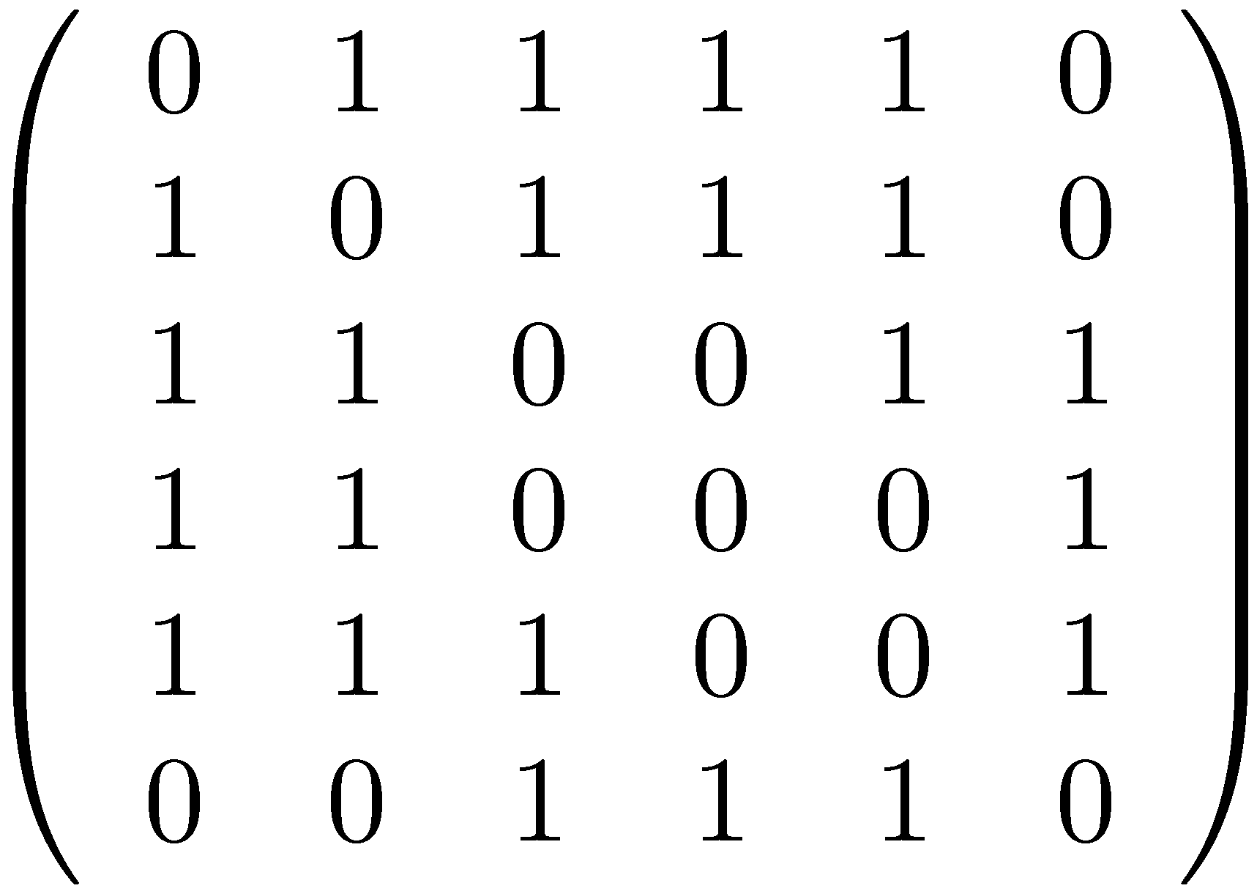
Adjacency matrix of a undirected graph
4
1
6
3
2
5
The adjacency matrix of an undirected graph is symmetric.

Slide 45
Matchings, Permanents, Determinants
Exercise 2: Show that if A is the adjacency matrix of a bipartite graph G, then per(A) is the number of perfect matchings in G.
Unfortunately computing the permanent is #P-complete…

Slide 46
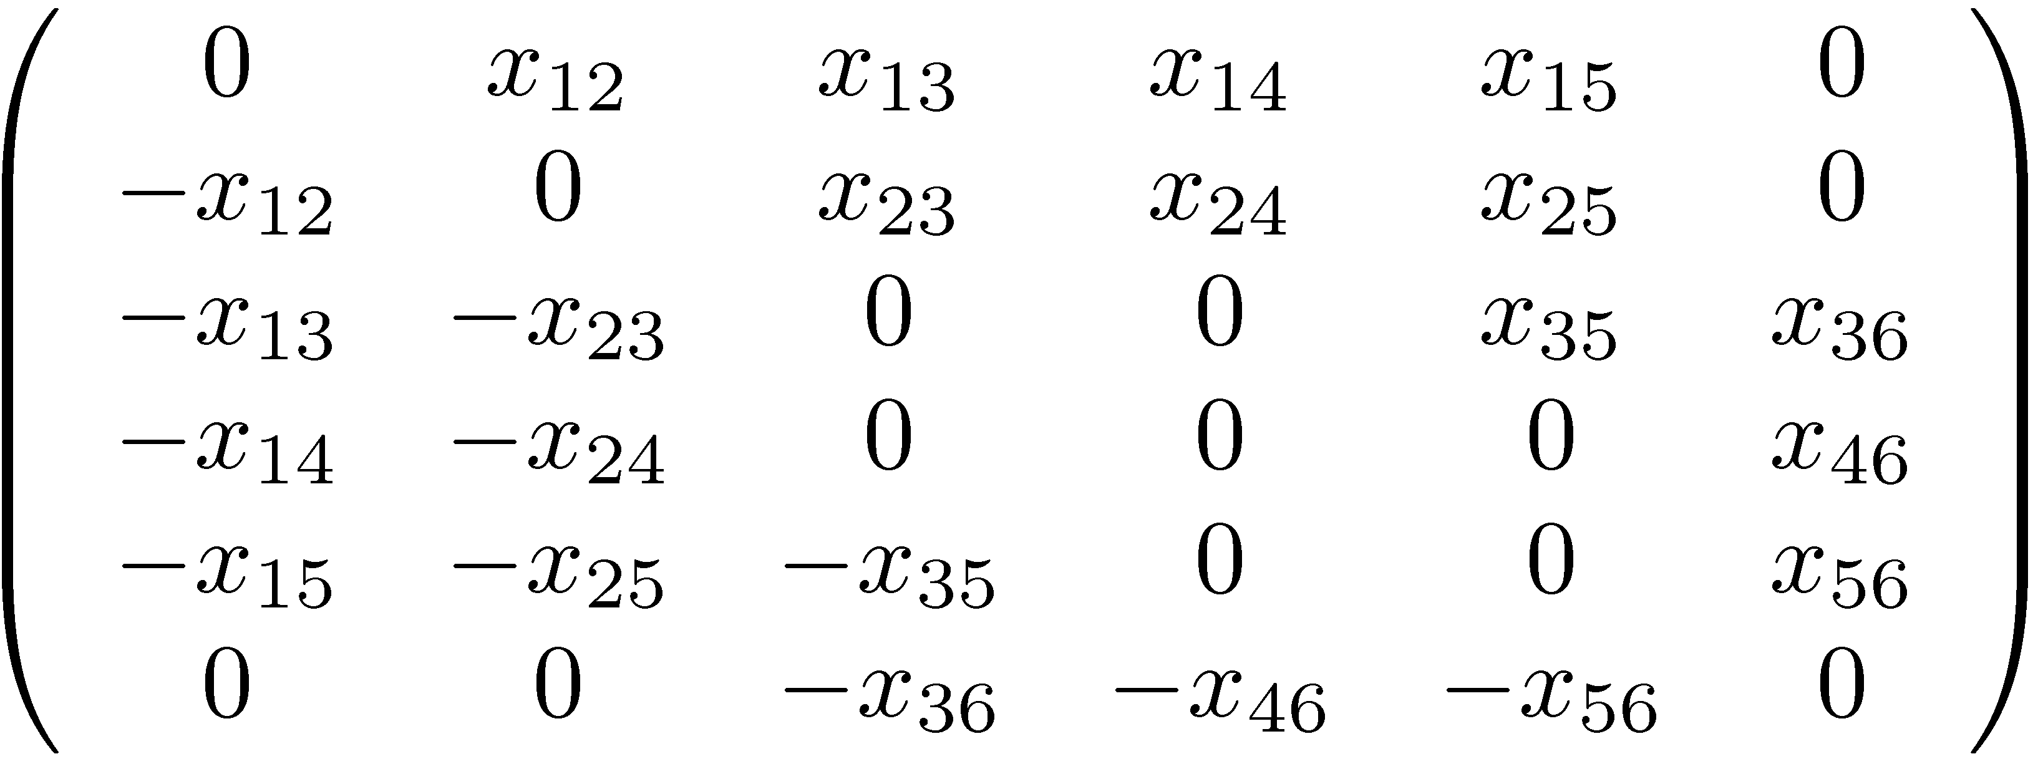
Tutte’s matrix (Skew-symmetric symbolic adjacency matrix)
4
1
6
3
2
5

Slide 47
Tutte’s theorem
Let G=(V,E) be a graph and let A be its Tutte matrix. Then, G has a perfect matching iff det A ≠ 0.
1
2
4
3
There are perfect matchings

Slide 48
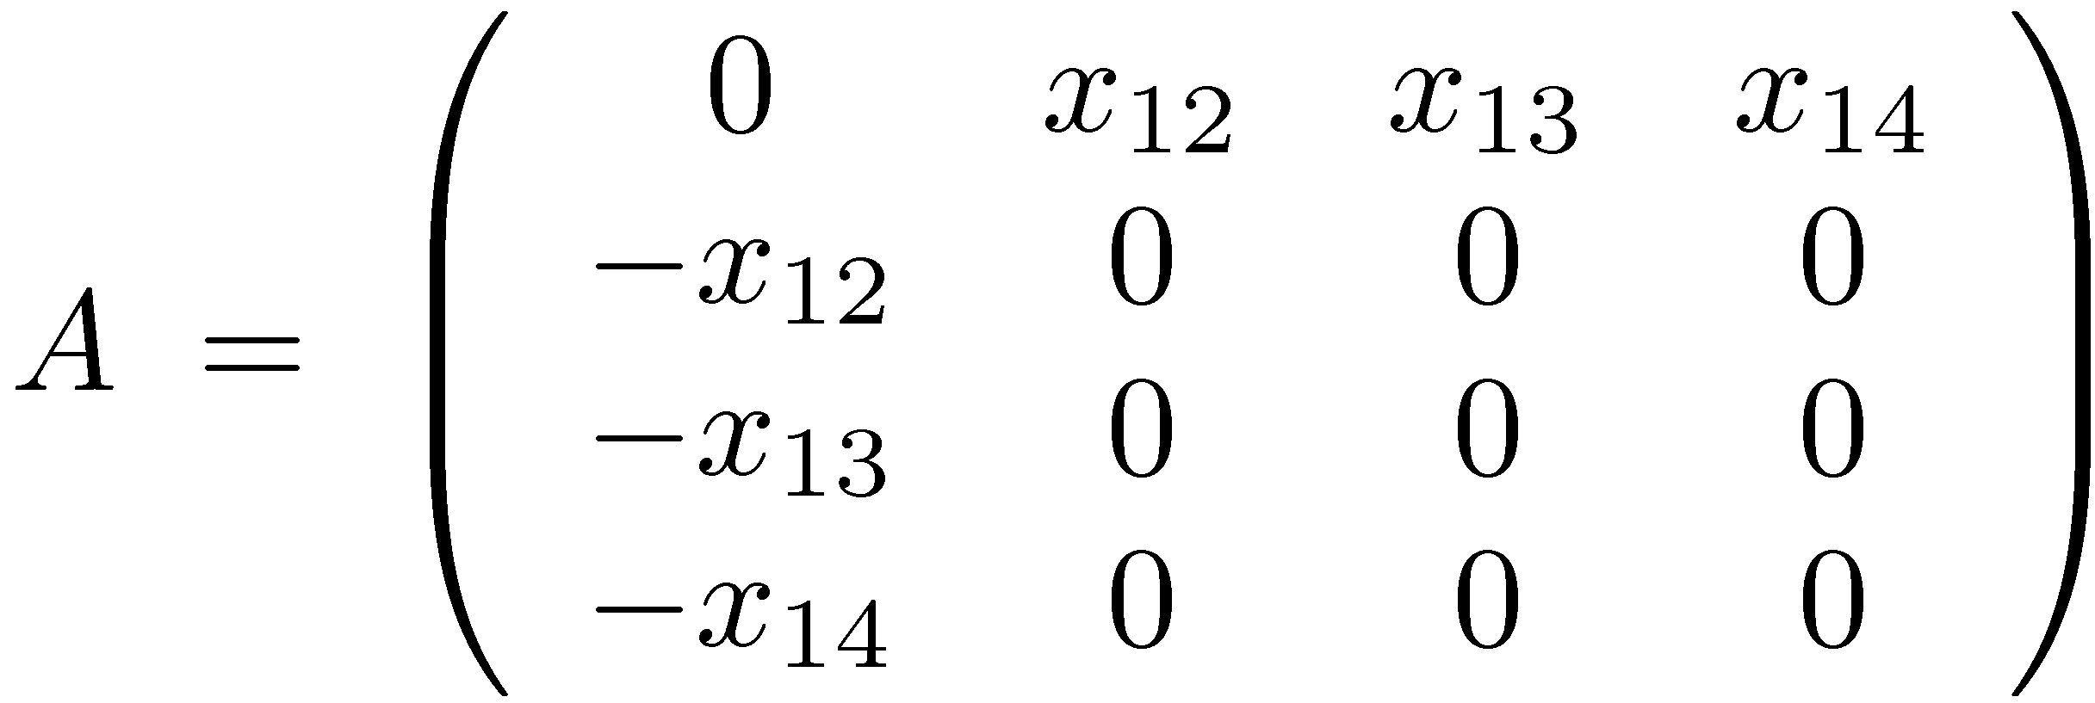
Tutte’s theorem
Let G=(V,E) be a graph and let A be its Tutte matrix. Then, G has a perfect matching iff det A ≠0.
1
2
4
3
No perfect matchings

Slide 49
Proof of Tutte’s theorem
Every permutation π∈S_{n} defines a cycle collection
3
4
7
1
2
10
6
5
9
8

Slide 50
Cycle covers
A permutation π∈S_{n} for which {i,π(i)}∈E, for 1 ≤ i ≤ k, defines a cycle cover of the graph.
3
4
7
1
2
6
5
9
8
Exercise 3: If π’ is obtained from π by reversing the direction of a cycle, then sign(π’)=sign(π).
Depending on the parity of the cycle!

Slide 51
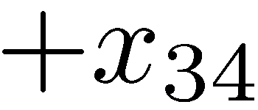
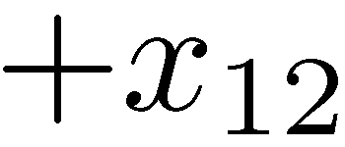
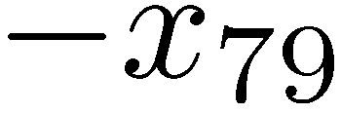
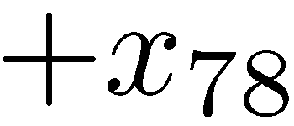
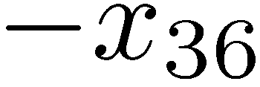
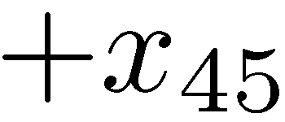
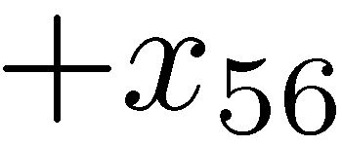
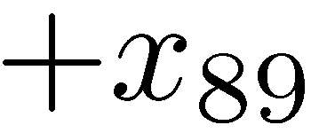
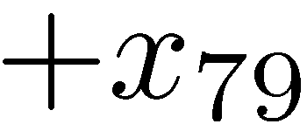
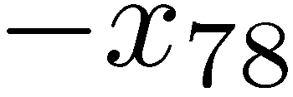
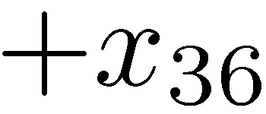
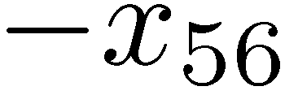
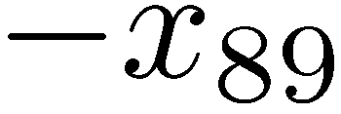
Reversing Cycles
3
4
7
1
2
6
5
9
8
3
4
7
1
2
6
5
9
8
Depending on the parity of the cycle!

Slide 52
Proof of Tutte’s theorem (cont.)
The permutations π∈S_{n} that contain an odd cycle cancel each other!
We effectively sum only over even cycle covers.
A graph contains a perfect matching iff it contains an even cycle cover.

Slide 53
Proof of Tutte’s theorem (cont.)
A graph contains a perfect matching iff it contains an even cycle cover.
Perfect Matching → Even cycle cover

Slide 54
Proof of Tutte’s theorem (cont.)
A graph contains a perfect matching iff it contains an even cycle cover.
Even cycle cover → Perfect matching

Slide 55
An algorithm for perfect matchings?
Construct the Tutte matrix A.
Compute det A.
If det A ≠ 0, say ‘yes’, otherwise ‘no’.
det A is a symbolic expression that may be of exponential size!
Problem:
Replace each variable x_{ij} by a random element of Z_{p}, where p= Θ(n²) is a prime number
Lovasz’s solution:

Slide 56
The Schwartz-Zippel lemma
Let P(x₁,x₂,…,x_{n}) be a polynomial of degree d over a field F. Let S ⊆ F. If P(x₁,x₂,…,x_{n})≠0 and a₁,a₂,…,a_{n} are chosen randomly and independently from S, then
Proof by induction on n.
For n=1, follows from the fact that polynomial of degree d over a field has at most d roots

Slide 57
Lovasz’s algorithm for existence of perfect matchings
Construct the Tutte matrix A.
Replace each variable x_{ij} by a random element of Z_{p}, where p=O(n²) is prime.
Compute det A.
If det A ≠ 0, say ‘yes’, otherwise ‘no’.
If algorithm says ‘yes’, then the graph contains a perfect matching.
If the graph contains a perfect matching, then the probability that the algorithm says ‘no’, is at most O(1/n).

Slide 58
Parallel algorithms
Determinants can be computed very quickly in parallel
DET ∈ NC²
Perfect matchings can be detected very quickly in parallel (using randomization)
PERFECT-MATCH ∈ RNC²
Open problem: ??? PERFECT-MATCH ∈ NC ???

Slide 59
Finding perfect matchings
Self Reducibility
Delete an edge and check whether there is still a perfect matching
Needs O(n²) determinant computations
Running time O(n ^{ω+2})
Fairly slow…
Not parallelizable!

Slide 60
Finding perfect matchings
Rabin-Vazirani (1986): An edge {i,j}∈E is contained in a perfect matching iff (A⁻¹)_{ij}≠0.
Leads immediately to an O(n^{ω+1}) algorithm: Find an allowed edge {i,j}∈E , delete it and its vertices from the graph, and recompute A⁻¹.
Mucha-Sankowski (2004): Recomputing A⁻¹ from scratch is very wasteful. Running time can be reduced to O(n^{ω}) !
Harvey (2006): A simpler O(n^{ω}) algorithm.

Slide 61
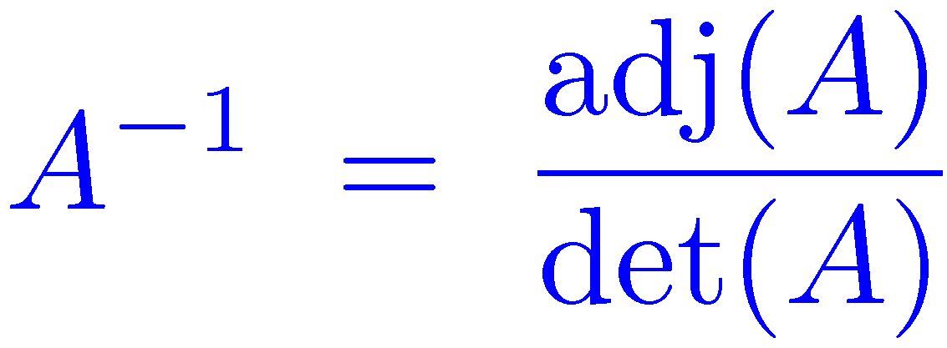
Adjoint and Cramer’s rule
1
A with the j-th row and i-th column deleted
Cramer’s rule:

Slide 62
Finding perfect matchings
Rabin-Vazirani (1986): An edge {i,j}∈E is contained in a perfect matching iff (A⁻¹)_{ij}≠0.
1
Leads immediately to an O(n^{ω+1}) algorithm: Find an allowed edge {i,j}∈E , delete it and its vertices from the graph, and recompute A⁻¹.
Still not parallelizable

Slide 63
Finding unique minimum weight perfect matchings [Mulmuley-Vazirani-Vazirani (1987)]
Suppose that edge {i,j}∈E has integer weight w_{ij}
Suppose that there is a unique minimum weight perfect matching M of total weight W

Slide 64
Isolating lemma [Mulmuley-Vazirani-Vazirani (1987)]
Suppose that G has a perfect matching
Assign each edge {i,j}∈E a random integer weight w_{ij}∈[1,2m]
With probability of at least ½, the minimum weight perfect matching of G is unique
Lemma holds for general collecitons of sets, not just perfect matchings

Slide 65
Proof of Isolating lemma [Mulmuley-Vazirani-Vazirani (1987)]
An edge{i,j} is ambivalent if there is a minimum weight perfect matching that contains it and another that does not
Suppose that weights were assigned to all edges except for {i,j}
Let a_{ij} be the largest weight for which {i,j} participates in some minimum weight perfect matchings
If w_{ij}<a_{ij} , then {i,j} participates in all minimum weight perfect matchings
The probability that {i,j} is ambivalent is at most 1/(2m)!

Slide 66
Finding perfect matchings [Mulmuley-Vazirani-Vazirani (1987)]
Choose random weights in [1,2m]
Compute determinant and adjoint
Read of a perfect matching (w.h.p.)
Is using m-bit integers cheating?
Not if we are willing to pay for it!
Complexity is O(mn^{ω})≤ O(n^{ω+2})
Finding perfect matchings in RNC²
Improves an RNC³ algorithm by [Karp-Upfal-Wigderson (1986)]

Slide 67
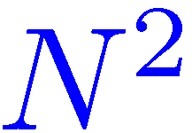
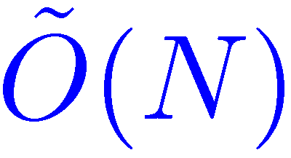
Multiplying two N-bit numbers
``School method’’
[Schöonhage-Strassen (1971)]
[Fürer (2007)] [De-Kurur-Saha-Saptharishi (2008)]
For our purposes…

Slide 68
Finding perfect matchings
We are not over yet…
[Mucha-Sankowski (2004)] Recomputing A⁻¹ from scratch is wasteful. Running time can be reduced to O(n^{ω}) !
[Harvey (2006)] A simpler O(n^{ω}) algorithm.

Slide 69
Using matrix multiplication to compute min-plus products

Slide 70
Using matrix multiplication to compute min-plus products
Assume: 0 ≤ a_{ij} , b_{ij} ≤ M
M operations per polynomial product
Mn^{ω} operations per max-plus product
n^{ω} polynomial products
×
=

Slide 71
SHORTEST PATHS
APSP – All-Pairs Shortest Paths
SSSP – Single-Source Shortest Paths

Slide 72
UNWEIGHTED UNDIRECTED SHORTEST PATHS

Slide 73
APSP in undirected graphs
An O(n^{2.38}) algorithm for unweighted graphs (Seidel)
An O(Mn^{2.38}) algorithm for weighted graphs (Shoshan-Zwick)
APSP in directed graphs
An O(M^{0.68}n^{2.58}) algorithm (Zwick)
An O(Mn^{2.38}) preprocessing / O(n) query answering algorithm (Yuster-Zwick)
An O(n^{2.38}log M) (1+ε)-approximation algorithm
Summary and open problems

Slide 74
Directed versus undirected graphs
y
y
x
x
z
z
δ(x,z) ≤ δ(x,y) + δ(y,z)
δ(x,z) ≤ δ(x,y) + δ(y,z)
Triangle inequality
δ(x,y) ≤ δ(x,z) + δ(z,y)
δ(x,z) ≥ δ(x,y) – δ(y,z)
Inverse triangle inequality

Slide 75
Distances in G and its square G²
Let G=(V,E). Then G²=(V,E²), where (u,v)∈E² if and only if (u,v)∈E or there exists w∈V such that (u,w),(w,v)∈E
Let δ (u,v) be the distance from u to v in G. Let δ²(u,v) be the distance from u to v in G².

Slide 76
Distances in G and its square G² (cont.)
Lemma: δ²(u,v)= ⎡δ(u,v)/2⎤ , for every u,v∈V.
δ²(u,v) ≤ ⎡δ(u,v)/2⎤
δ(u,v) ≤ 2δ²(u,v)
Thus: δ(u,v) = 2δ²(u,v) or δ(u,v) = 2δ²(u,v) −1

Slide 77
Distances in G and its square G² (cont.)
Lemma: If δ(u,v)=2δ²(u,v) then for every neighbor w of v we have δ²(u,w) ≥ δ²(u,v).
Lemma: If δ(u,v)=2δ²(u,v)–1 then for every neighbor w of v we have δ²(u,w) ≤ δ²(u,v) and for at least one neighbor δ²(u,w) < δ²(u,v).
Let A be the adjacency matrix of the G. Let C be the distance matrix of G²

Slide 78
Even distances
Lemma: If δ(u,v)=2δ²(u,v) then for every neighbor w of v we have δ²(u,w) ≥ δ²(u,v).
Let A be the adjacency matrix of the G. Let C be the distance matrix of G²

Slide 79
Odd distances
Lemma: If δ(u,v)=2δ²(u,v)–1 then for every neighbor w of v we have δ²(u,w) ≤ δ²(u,v) and for at least one neighbor δ²(u,w) < δ²(u,v).
Exercise 4: Prove the lemma.
Let A be the adjacency matrix of the G. Let C be the distance matrix of G²

Slide 80
Seidel’s algorithm
Assume that A has 1’s on the diagonal.
If A is an all one matrix, then all distances are 1.
Compute A², the adjacency matrix of the squared graph.
Find, recursively, the distances in the squared graph.
Decide, using one integer matrix multiplication, for every two vertices u,v, whether their distance is twice the distance in the square, or twice minus 1.
Algorithm APD(A)
if A=J then
return J–I
else
C←APD(A²)
X←CA , deg←Ae–1
d_{ij}←2c_{ij}– [x_{ij}< c_{ij}deg_{j}]
return D
end
Boolean matrix multiplicaion
Integer matrix multiplicaion
Complexity: O(n^{ω}log n)

Slide 81
Exercise 5: (*) Obtain a version of Seidel’s algorithm that uses only Boolean matrix multiplications.
Hint: Look at distances also modulo 3.

Slide 82
Distances vs. Shortest Paths
We described an algorithm for computing all distances.
How do we get a representation of the shortest paths?
We need witnesses for the Boolean matrix multiplication.

Slide 83
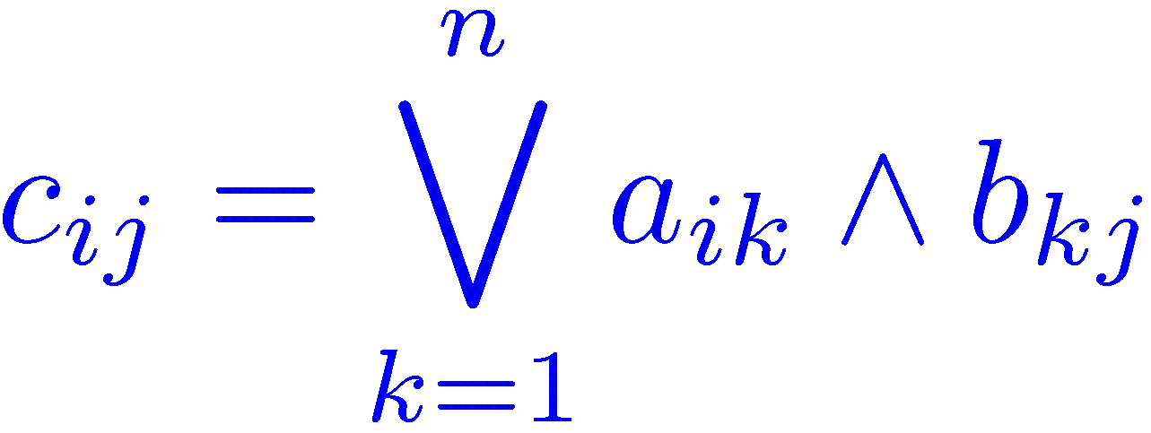
Witnesses for Boolean Matrix Multiplication
A matrix W is a matrix of witnesses iff
Can be computed naively in O(n³) time.
Can also be computed in O(n^{ω}log n) time.

Slide 84
Exercise 6:
Obtain a deterministic O(n^{ω})-time algorithm for finding unique witnesses.
Let 1 ≤ d ≤ n be an integer. Obtain a randomized O(n^{ω})-time algorithm for finding witnesses for all positions that have between d and 2d witnesses.
Obtain an O(n^{ω}log n)-time algorithm for finding all witnesses.
Hint: In b) use sampling.

Slide 85
All-Pairs Shortest Paths in graphs with small integer weights
Undirected graphs. Edge weights in {0,1,…M}
Running time | Authors
Mn^{ω} | [Shoshan-Zwick ’99]
Improves results of [Alon-Galil-Margalit ’91] [Seidel ’95]

Slide 86
DIRECTED SHORTEST PATHS

Slide 87
Exercise 7:
Obtain an O(n^{ω}log n) time algorithm for computing the diameter of an unweighted directed graph.

Slide 88
Using matrix multiplication to compute min-plus products

Slide 89
Using matrix multiplication to compute min-plus products
Assume: 0 ≤ a_{ij} , b_{ij} ≤ M
M operations per polynomial product
Mn ^{ω} operations per max-plus product
n^{ω} polynomial products
×
=

Slide 90
Trying to implement the repeated squaring algorithm
D ← W
for i ←1 to log₂n do D ← D*D
Consider an easy case: all weights are 1.
After the i-th iteration, the finite elements in D are in the range {1,…,2^{i}}.
The cost of the min-plus product is 2^{i} n^{ω}
The cost of the last product is n^{ω+1} !!!

Slide 91
Sampled Repeated Squaring (Z ’98)
D ← W
for i ←1 to log_{3/2}n do
{
s ← (3/2)^{i+1}
B ← rand( V , (9n ln n)/s )
D ← min{ D , D[V,B]*D[B,V] }
}
Choose a subset of V of size ≈ n/s
Select the columns of D whose indices are in B
Select the rows of D whose indices are in B
With high probability, all distances are correct!
The is also a slightly more complicated deterministic algorithm

Slide 92
Sampled Distance Products (Z ’98)
n
In the i-th iteration, the set B is of size ≈ n/s, where s = (3/2)^{i+1}
n
The matrices get smaller and smaller but the elements get larger and larger
n
|B|

Slide 93
Sampled Repeated Squaring - Correctness
D ← W
for i ←1 to log_{3/2}n do
{
s ← (3/2)^{i+1}
B ← rand(V,(9n ln n)/s)
D ← min{ D , D[V,B]*D[B,V] }
}
Invariant: After the i-th iteration, distances that are attained using at most (3/2)^{i} edges are correct.
Consider a shortest path that uses at most (3/2)^{i+1} edges
at most
at most
Failure probability
Let s = (3/2)^{i+1}
:

Slide 94
Rectangular Matrix multiplication
p
n
n
n
×
p
=
n
Naïve complexity: n²p
[Coppersmith (1997)] [Huang-Pan (1998)] n^{1.85}p^{0.54}+n^{2+o(1)}
For p ≤ n^{0.29}, complexity = n^{2+o(1)} !!!

Slide 95
Rectangular Matrix multiplication
n^{0.29}
n
n
n
×
=
n
n^{0.29}
[Coppersmith (1997)] n×n^{0.29} by n^{0.29} ×n n^{2+o(1)} operations!
α = 0.29…

Slide 96
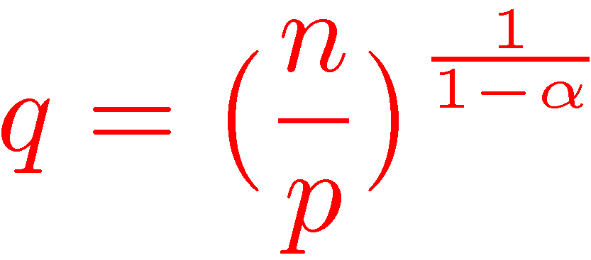
Rectangular Matrix multiplication
p
n
n
n
×
=
n
p
[Huang-Pan (1998)]
Break into q×q^{α} and q^{α} ×q sub-matrices

Slide 97
Complexity of APSP algorithm
The i-th iteration:
n/s
s=(3/2)^{i+1}
n
The elements are of absolute value at most Ms
n
×
Naïve matrix multiplication
n /s
“Fast” matrix multiplication

Slide 98
All-Pairs Shortest Paths in graphs with small integer weights
Undirected graphs. Edge weights in {0,1,…M}
Running time | Authors
Mn^{2.38} | [Shoshan-Zwick ’99]
Improves results of [Alon-Galil-Margalit ’91] [Seidel ’95]

Slide 99
All-Pairs Shortest Paths in graphs with small integer weights
Directed graphs. Edge weights in {−M,…,0,…M}
Running time | Authors
M^{0.68} n^{2.58} | [Zwick ’98]
Improves results of [Alon-Galil-Margalit ’91] [Takaoka ’98]

Slide 100
Open problem: Can APSP in directed graphs be solved in O(n^{ω}) time?
[Yuster-Z (2005)] A directed graphs can be processed in O(n^{ω}) time so that any distance query can be answered in O(n) time.
Corollary: SSSP in directed graphs in O(n^{ω}) time.
Also obtained, using a different technique, by Sankowski (2005)

Slide 101
The preprocessing algorithm (YZ ’05)
D ← W ; B ←V
for i ←1 to log_{3/2}n do
{
s ← (3/2)^{i+1}
B ← rand(B,(9n ln n)/s)
D[V,B] ← min{ D[V,B] , D[V,B]*D[B,B] }
D[B,V] ← min{ D[B,V] , D[B,B]*D[B,V] }
}

Slide 102
The APSP algorithm
D ← W
for i ←1 to log_{3/2}n do
{
s ← (3/2)^{i+1}
B ← rand(V,(9n ln n)/s)
}
D ← min{ D , D[V,B]*D[B,V] }

Slide 103
Twice Sampled Distance Products
n
n
|B|
|B|
n
n
n
|B|
|B|
|B|

Slide 104
The query answering algorithm
δ(u,v) ← D[{u},V]*D[V,{v}]
v
u
Query time: O(n)

Slide 105
The preprocessing algorithm: Correctness
Let B_{i} be the i-th sample. B₁⊇ B₂ ⊇ B₃ ⊇ …
Invariant: After the i-th iteration, if u∈ B_{i} or v∈B_{i} and there is a shortest path from u to v that uses at most (3/2)^{i} edges, then D(u,v)=δ(u,v).
Consider a shortest path that uses at most (3/2)^{i+1} edges
at most
at most

Slide 106
The query answering algorithm: Correctness
Suppose that the shortest path from u to v uses between (3/2)^{i} and (3/2)^{i+1} edges
at most
at most
u
v

Slide 107
Algebraic matrix multiplication
Strassen’s algorithm
Rectangular matrix multiplication
Min-Plus matrix multiplication
Equivalence to the APSP problem
Expensive reduction to algebraic products
Fredman’s trick
APSP in undirected graphs
An O(n^{2.38}) anlgorithm for unweighted graphs (Seidel)
An O(Mn^{2.38}) algorithm for weighted graphs (Shoshan-Zwick)
APSP in directed graphs
An O(M^{0.68}n^{2.58}) algorithm (Zwick)
An O(Mn^{2.38}) preprocessing / O(n) query answering alg. (Yuster-Z)
An O(n^{2.38}logM) (1+ε)-approximation algorithm
Summary and open problems

Slide 108
Approximate min-plus products
Obvious idea: scaling
SCALE(A,M,R):
APX-MPP(A,B,M,R) : A’←SCALE(A,M,R) B’←SCALE(B,M,R) return MPP(A’,B’)
Complexity is Rn^{2.38}, instead of Mn^{2.38}, but small values can be greatly distorted.

Slide 109
Addaptive Scaling
APX-MPP(A,B,M,R) :
C’←∞ for r←log₂R to log₂M do A’←SCALE(A,2^{r},R) B’←SCALE(B,2^{r},R) C’←min{C’,MPP(A’,B’)} end
Complexity is Rn^{2.38} logM
Stretch at most 1+4/R

Slide 110
Algebraic matrix multiplication
Strassen’s algorithm
Rectangular matrix multiplication
Min-Plus matrix multiplication
Equivalence to the APSP problem
Expensive reduction to algebraic products
Fredman’s trick
APSP in undirected graphs
An O(n^{2.38}) anlgorithm for unweighted graphs (Seidel)
An O(Mn^{2.38}) algorithm for weighted graphs (Shoshan-Zwick)
APSP in directed graphs
An O(M^{0.68}n^{2.58}) algorithm (Zwick)
An O(Mn^{2.38}) preprocessing / O(n) query answering alg. (Yuster-Z)
An O(n^{2.38}logM) (1+ε)-approximation algorithm
Summary and open problems

Slide 111
Answering distance queries
Directed graphs. Edge weights in {−M,…,0,…M}
Preprocessing time | Query time | Authors
Mn^{2.38} | n | [Yuster-Zwick ’05]
In particular, any Mn^{1.38} distances can be computed in Mn^{2.38} time.
For dense enough graphs with small enough edge weights, this improves on Goldberg’s SSSP algorithm. Mn^{2.38} vs. mn^{0.5}log M

Slide 112
Approximate All-Pairs Shortest Paths in graphs with non-negative integer weights
Directed graphs. Edge weights in {0,1,…M}
(1+ε)-approximate distances
Running time | Authors
(n^{2.38} log M)/ε | [Zwick ’98]

Slide 113
Open problems
An O(n^{ω}) algorithm for the directed unweighted APSP problem?
An O(n^{3-ε}) algorithm for the APSP problem with edge weights in {1,2,…,n}?
An O(n^{2.5-ε}) algorithm for the SSSP problem with edge weights in {−1,0,1,2,…, n}?

Slide 114
DYNAMIC TRANSITIVE CLOSURE

Slide 115
Dynamic transitive closure
Edge-Update(e) – add/remove an edge e
Vertex-Update(v) – add/remove edges touching v.
Query(u,v) – is there are directed path from u to v?
[Sankowski ’04]
Edge-Update | n² | n^{1.575} | n^{1.495}
Vertex-Update | n² | – | –
Query | 1 | n^{0.575} | n^{1.495}
(improving [Demetrescu-Italiano ’00], [Roditty ’03])

Slide 116
Inserting/Deleting and edge
May change Ω(n²) entries of the transitive closure matrix

Slide 117
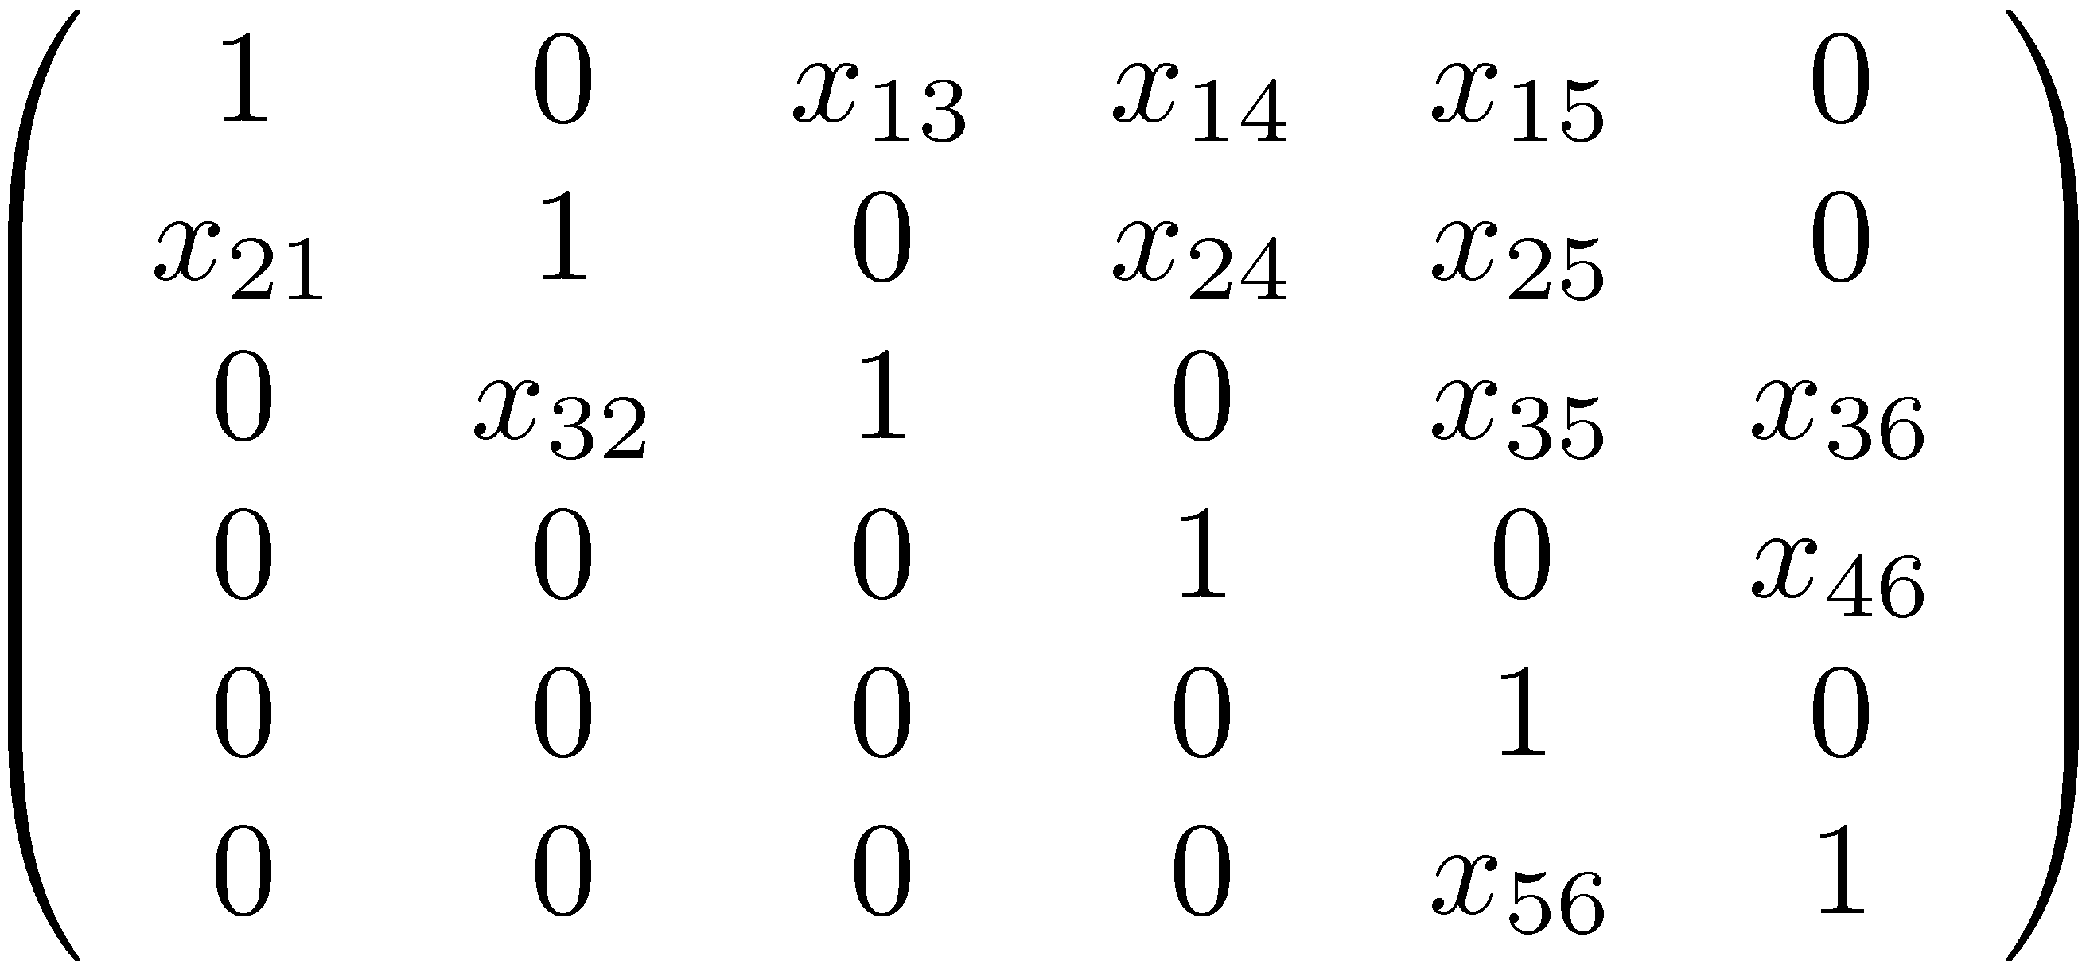
Symbolic Adjacency matrix
4
1
6
3
2
5

Slide 118
Reachability via adjoint [Sankowski ’04]
Let A be the symbolic adjacency matrix of G. (With 1s on the diagonal.)
There is a directed path from i to j in G iff

Slide 119
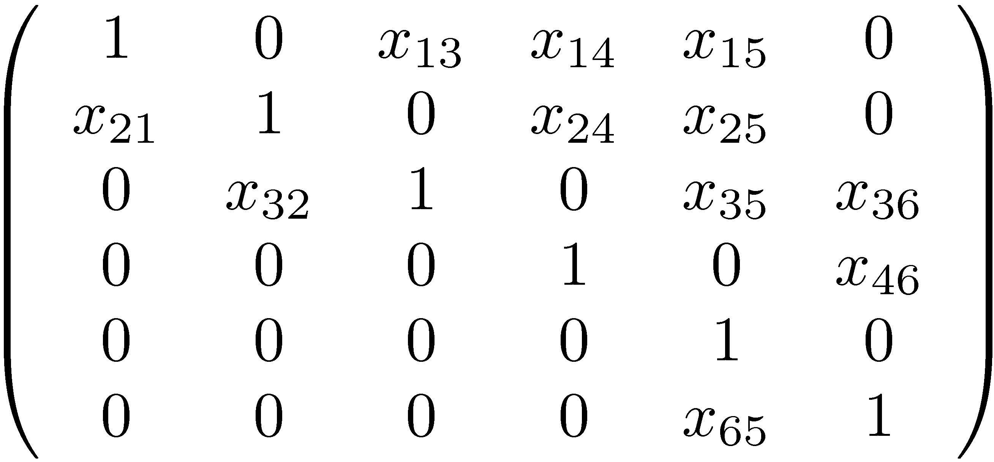
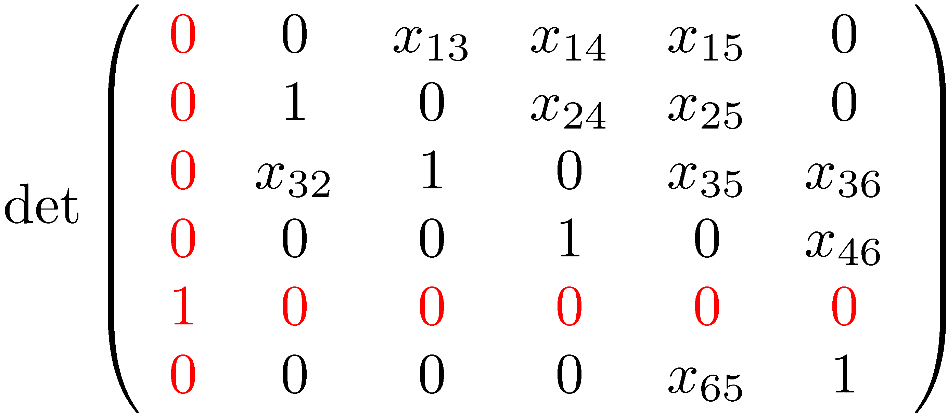
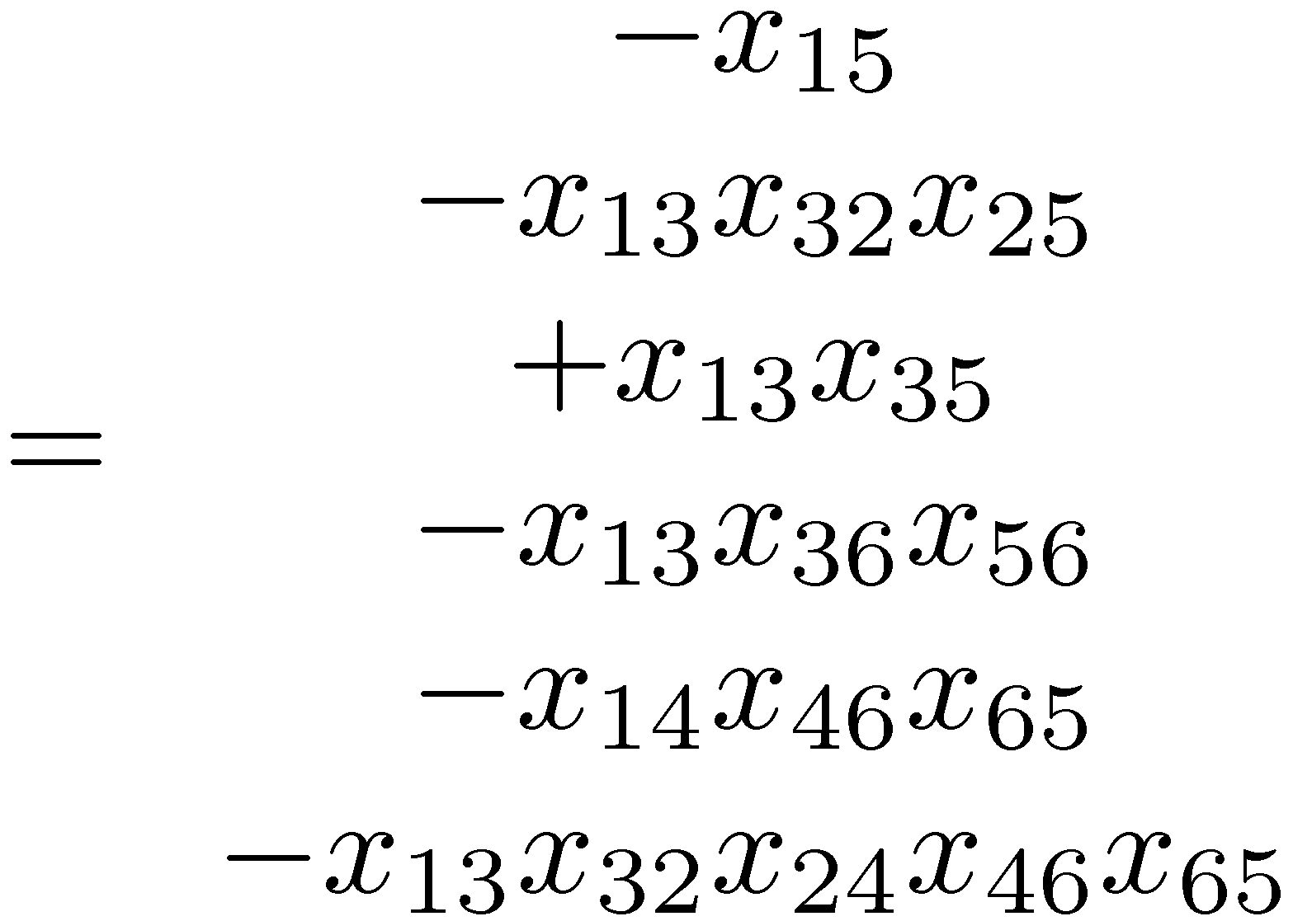
Reachability via adjoint (example)
4
1
6
3
2
5
Is there a path from 1 to 5?

Slide 120
Dynamic transitive closure
Edge-Update(e) – add/remove an edge e
Vertex-Update(v) – add/remove edges touching v.
Query(u,v) – is there are directed path from u to v?
Dynamic matrix inverse
Entry-Update(i,j,x) – Add x to A_{ij}
Row-Update(i,v) – Add v to the i-th row of A
Column-Update(j,u) – Add u to the j-th column of A
Query(i,j) – return (A⁻¹)_{ij}

Slide 121
Sherman-Morrison formula
Inverse of a rank one correction is a rank one correction of the inverse
Inverse updated in O(n²) time

Slide 122
O(n²) update / O(1) query algorithm [Sankowski ’04]
Let p≈n³ be a prime number
Assign random values a_{ij}2 F_{p} to the variables x_{ij}
Maintain A⁻¹ over F_{p}
Edge-Update → Entry-Update
Vertex-Update → Row-Update + Column-Update
Perform updates using the Sherman-Morrison formula
Small error probability (by the Schwartz-Zippel lemma)

Slide 123
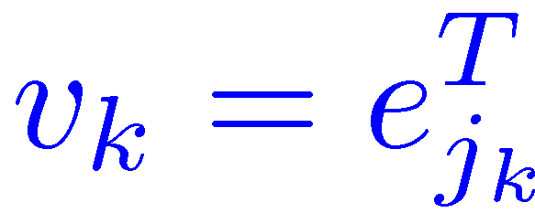
Lazy updates
Consider single entry updates

Slide 124
Lazy updates (cont.)

Slide 125
Lazy updates (cont.)
Can be made worst-case

Slide 126
Even Lazier updates

Slide 127
Dynamic transitive closure
Edge-Update(e) – add/remove an edge e
Vertex-Update(v) – add/remove edges touching v.
Query(u,v) – is there are directed path from u to v?
[Sankowski ’04]
Edge-Update | n² | n^{1.575} | n^{1.495}
Vertex-Update | n² | – | –
Query | 1 | n^{0.575} | n^{1.495}
(improving [Demetrescu-Italiano ’00], [Roditty ’03])

Slide 128
Finding triangles in O(m^{2ω /(ω+1)}) time [Alon-Yuster-Z (1997)]
Δ = m^{(ω-1) /(ω+1)}
Let Δ be a parameter. . High degree vertices: vertices of degree ≥ Δ. Low degree vertices: vertices of degree < Δ.
There are at most 2m/Δ high degree vertices
=

Slide 129
Finding longer simple cycles
A graph G contains a C_{k} iff Tr(A^{k})≠0 ?
We want simple cycles!

Slide 130
Color coding [AYZ ’95]
Assign each vertex v a random number c(v) from {0,1,...,k−1}.
Remove all edges (u,v) for which c(v)≠c(u)+1 (mod k).
All cycles of length k in the graph are now simple.
If a graph contains a C_{k} then with a probability of at least k ^{−k} it still contains a C_{k} after this process.
An improved version works with probability 2 ^{− O(k)}.
Can be derandomized at a logarithmic cost.

Slide 131
Sherman-Morrison-Woodbury formula
Inverse of a rank k correction is a rank k correction of the inverse
Can be computed in O(M(n,k,n)) time.

