Slide 1
Uri Zwick – Tel Aviv Univ.
Simplex Method –
Randomized Pivoting Rules
Recent Advances
​in Parameterized Complexity
December 3-7, 2017
​Tel Aviv, Israel
TexPoint fonts used in EMF.
Read the TexPoint manual before you delete this box.: AAAAAA

Slide 2
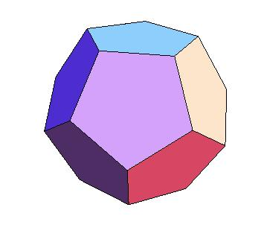
Linear Programming
Maximize a linear objective function subject
to a set of linear equalities and inequalities
Find the highest point in a polyhedron

Slide 3
The Simplex Algorithm
[Dantzig (1947)]
Start at some vertex. Move up, from vertex to vertex,
along edges, until reaching the top.
Obvious upper bound, number of vertices, is exponential.

Slide 4
Preliminaries
Our view will be fairly abstract
We sometimes gloss over some annoyances
$n$ – number of inequalities
$d$ – number of variables
We view $d$ as the parameter
$H$ – collection of inequalities
$h∈H$ – an inequality
${v\left(H\right)=v}_{H}$ – optimal solution subject to $H$
$basis(v_{H})$ – set of $d$ inequalities that determine $v(H)$
$$v\left(basis\left(v_{H}\right)\right)=v_{H}$$
Most algorithms we shall see are dual simplex algorithms

Slide 5

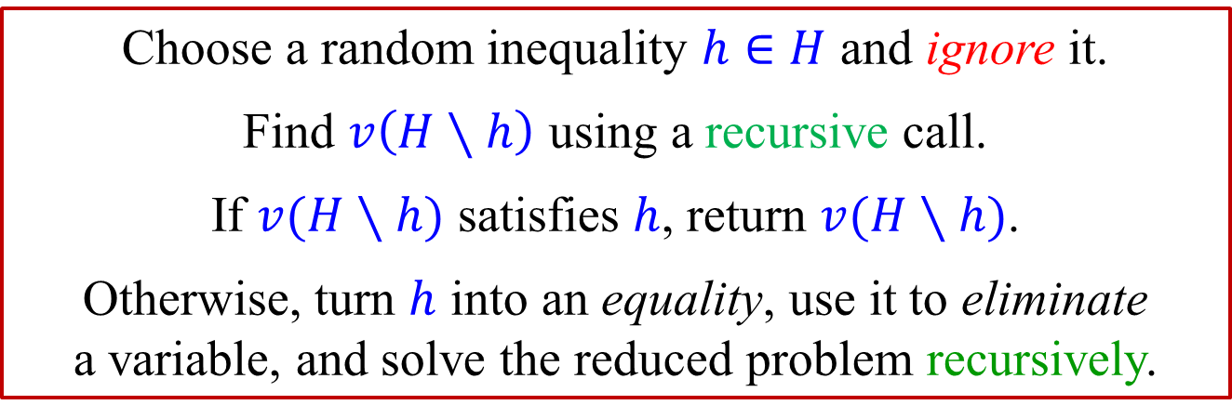
Seidel’s algorithm (1991)
Given a set of $n$ inequalities $H$ in $d$ variables,
return $v\left(H\right)$, an optimal vertex.
Choose a random inequality $h∈H$ and ignore it.
Find $v\left(H∖h\right)$ using a recursive call.
If $v(H∖h)$ satisfies $h$, return $v(H∖h)$.
Otherwise, turn $h$ into an equality, use it to eliminate
a variable, and solve the reduced problem recursively.
If $h∉basis\left(v\left(H\right)\right)$, then $v\left(H∖h\right)=v(H)$.
Probability of a second recursive call is at most $\frac{d}{n}$ !
$$f\left(d,n\right)=f(d,n−1)+\frac{d}{n}⋅f(d−1,n−1)$$
$$f\left(n,d\right)≤d!n$$
$$d!\left(n−1\right)+\frac{d}{n}\left(d−1\right)!\left(n−1\right)<d!n$$

Slide 6

Seidel’s algorithm (1991)
Given a set $H$ of $n$ inequalities in $d$ variables,
return $v\left(H\right)$, an optimal vertex.
Choose a random inequality $h∈H$ and ignore it.
Find $v\left(H∖h\right)$ using a recursive call.
If $v(H∖h)$ satisfies $h$, return $v(H∖h)$.
Otherwise, turn $h$ into an equality, use it to eliminate
a variable, and solve the reduced problem recursively.
$$f\left(n,d\right)≤d!n$$
Some details glossed over…
What is the base case of the recursion?
How do we deal with infeasibility or unboundedness?
Not hard to fill in the details.

Slide 7
Seidel’s algorithm (1991)

Slide 8
Seidel’s algorithm (1991)

Slide 9
Seidel’s algorithm (1991)

Slide 10
Seidel’s algorithm (1991)

Slide 11
Clarkson’s Algorithms (1988)
Reductions to the case $n<9d2$
$$f_{1}\left(d,n\right)=O\left(d^{2}n\right)+2d⋅f(d,3d\sqrt{n})$$
$$f_{2}\left(d,n\right)=O\left(d^{2}n\log{n}\right)+4d\log{n}⋅f(d,6d^{2})$$
Using both algorithms together:
$$f_{12}\left(d,n\right) =O\left(d^{2}n+d\left(d^{2}\left(d\sqrt{n}\right)\log\left(d\sqrt{n}\right)\right)\right)+8 d^{2}\log{n}⋅f(d,6d^{2})$$
$$=O\left(d^{2}n+d^{4}\sqrt{n}\log{n}\right)+8 d^{2}\log{n}⋅f(d,6d^{2})$$
Applying on Seidel’s algorithm:
$$f_{12}\left(d,n\right)=O\left(d^{2}n+d^{2}\log{n}⋅d!d^{2}\right)=O(d^{2}n+\left(d+6\right)!)$$
Applying on Kalai/MSW:
$$f_{12}\left(d,n\right)=O\left(d^{2}n+2^{O\left(\sqrt{d\log{d}}\right)}\right)$$

Slide 12
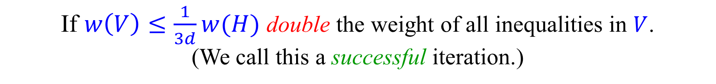
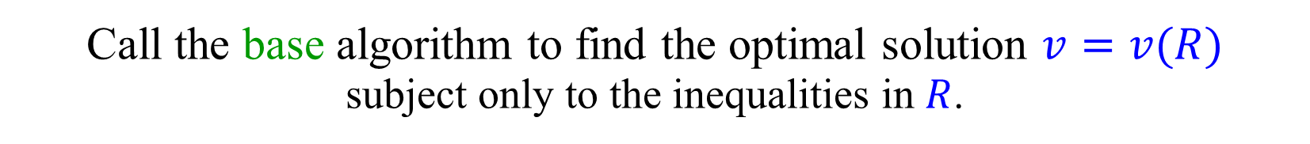
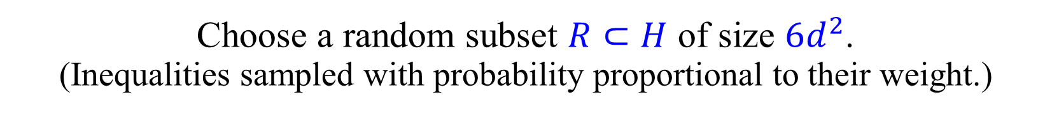
Clarkson’s Second Algorithm
Let $H$ be the collection of $n$ inequalities.
Assign to each $h∈H$ a weight $w(h)$, initially 1.
Repeat:
Choose a random subset $R⊂H$ of size $6d^{2}$.
(Inequalities sampled with probability proportional to their weight.)
Call the base algorithm to find the optimal solution $v=v(R)$
subject only to the inequalities in $R$.
Let $V⊂H$ be the set of inequalities in $H$ violated by $v$.
If $V=∅$ return $v$.
If $w\left(V\right)≤\frac{1}{3d}w(H)$ double the weight of all inequalities in $V$.
(We call this a successful iteration.)

Slide 13
Sampling Lemma
Let $H$ be a multiset of $n$ inequalities in $d$ variables.
Let $R⊂H$ be a random subset of $H$ of size $r$.
Let $v=v(R)$ be the optimal solution subject to $R$.
Let 𝑉⊂𝐻 be the set of inequalities in 𝐻 violated by 𝑣.
Then: $𝔼\left[\left|V\right|\right]≤(n−r)\frac{d}{r+1}$
Let $h$ be a random inequality from $H∖R$.
$$𝔼\left[\left|V\right|\right] = \left(n−r\right) ℙ[v\left(R\right) violates h]$$
Let $R′⊂H$ be a random subset of $H$ of size $r+1$.
Let $h′$ be a random inequality from $R^{′}$.
$\left(R,h\right)$and $(R^{′}∖\left\{h^{′}\right\},h^{′})$ have the same distribution.
$v\left(R^{′}∖\left\{h^{′}\right\}\right) violates h′$ iff $h^{′}∈basis\left(v\left(R^{′}\right)\right).$
$$\left|basis\left(v\left(R^{′}\right)\right)\right|=d.$$

Slide 14



Clarkson’s Second Algorithm - Analysis
Let $B=basis\left(v\left(H\right)\right)$.
Claim: After $kd$ successful iterations: $2^{k}≤w\left(B\right)<ne^{k/3}$.
In each iteration, except the last one, at least one of
the $d$ inequalities in $B$ is violated. In a successful iteration,
the weight of this inequality is doubled.
Thus, after $kd$ successful iterations, at least one of the $d$
inequalities in $B$ has its weight doubled at least $k$ times.
In a successful iteration, $w\left(H\right)$ increased by a factor of at most $1+\frac{1}{3d}$.
Thus, after $kd$ successful iterations:
$$w\left(H\right)≤n{\left(1+\frac{1}{3d}\right)}^{kd}<ne^{k/3}$$

Slide 15
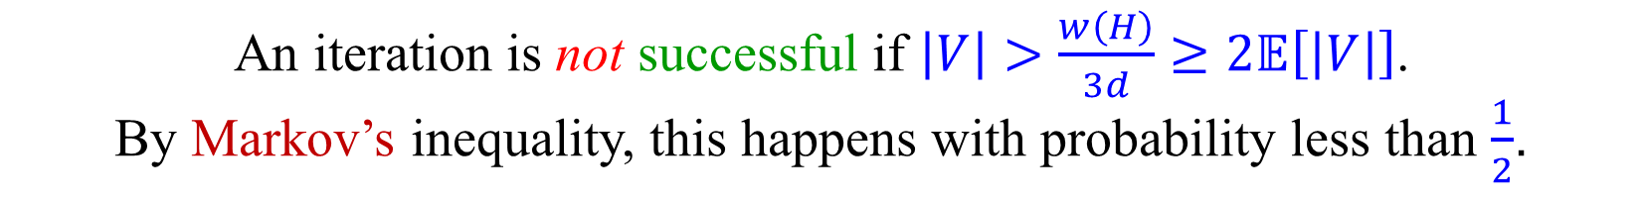
Clarkson’s Second Algorithm - Analysis
Let $B=basis\left(v\left(H\right)\right)$.
Claim: After $kd$ successful iterations: $2^{k}≤w\left(B\right)≤ne^{k/3}$.
$⇒$ $2^{k/2}<{\left(\frac{2}{e^{1/3}}\right)}^{k}≤n$
$⇒$ $k≤2\log{n}$
The algorithm terminates after at most $2d\log{n}$ successful iterations!
By the sampling lemma, $𝔼\left[\left|V\right|\right]≤w\left(H\right)\frac{d}{r+1}≤\frac{w\left(H\right)}{6d}$.
An iteration is not successful if $\left|V\right|>\frac{w\left(H\right)}{3d}≥2𝔼\left[\left|V\right|\right]$.
By Markov’s inequality, this happens with probability less than $\frac{1}{2}$.
Expected number of all iterations is at most $4d\log{n}$.
Cost of each iteration is $f\left(d,6d^{2}\right)+O(dn)$.
$$f_{2}\left(d,n\right)=O\left(d^{2}n\log{n}\right)+4d\log{n}⋅f(d,6d^{2})$$

Slide 16

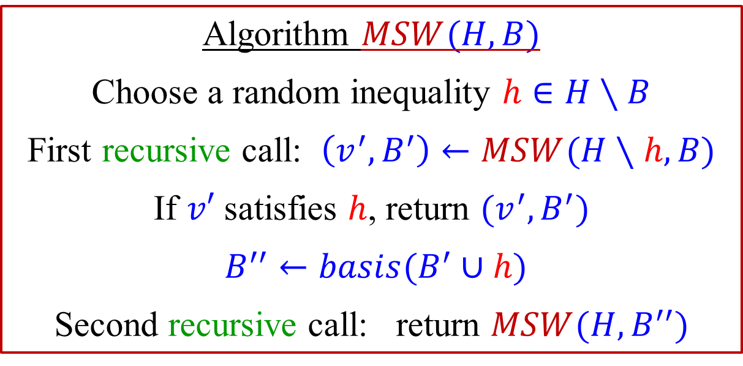
Dual Random-Facet
[Matoušek-Sharir-Welzl (1992)]
Improved version of Seidel’s algorithm.
Given a set of inequalities $H$ and an initial basis $B$,
algorithm $MSW$ returns $v_{H}$ and $basis(v_{H})$.
Algorithm $MSW(H,B)$
Choose a random inequality $h∈H∖B$
First recursive call: $\left(v^{′},B^{′}\right)←MSW(H∖h,B)$
If $v′$ satisfies $h$, return $(v^{′},B^{′})$
$B^{′′}←basis(B^{′}∪h)$
Second recursive call: return $MSW(H,B^{′′})$
Algorithm terminates as $v_{B}≥v_{B^{′}}>v_{B^{′′}}$.

Slide 17



Dual Random-Facet – Analysis
[Matoušek-Sharir-Welzl (1992)]
Order the inequalities $h_{1},h_{2},…,h_{n}$ such that:
$$v_{H∖h_{1}}≥ v_{H∖h_{2}}≥…{≥v}_{H∖h_{d}} ≥v_{H∖h_{d+1}}=v_{H∖h_{d+2}}=…=v_{H∖h_{n}}$$
$$basis\left(v_{H}\right)=\{h_{1},…,h_{d}\}$$
$${=v}_{H}$$
If $h∈\{h_{d+1},…,h_{n}\}$ there is no second recursive call.
$$v_{H∖h_{1}}≥ v_{H∖h_{2}}≥…{≥v}_{H∖h_{d−k}} >v_{B}≥v_{H∖h_{d−k+1}}≥…≥v_{H∖h_{d}}$$
We must have $h_{1},h_{2},…,h_{d−k}∈B$.
$k$ is called the hidden dimension –
how many inequalities of $basis\left(v_{H}\right)$ are either
not in $B$, or not guaranteed to remain in $B′$ and $B′′$.
There is a second recursive call only if $h∈\{h_{d−k+1},…,h_{d}\}$.

Slide 18


Dual Random-Facet – Analysis
[Matoušek-Sharir-Welzl (1992)]
$$v_{H∖h_{1}}≥ v_{H∖h_{2}}≥…{≥v}_{H∖h_{d−k}} >v_{B}≥v_{H∖h_{d−k+1}}≥…≥v_{H∖h_{d}}$$
We must have $h_{1},h_{2},…,h_{d−k}∈B$.
There is a second recursive call only if $h∈\{h_{d−k+1},…,h_{d}\}$.
If $h=h_{d−k+i},$ the first recursive call returns $B′$ s.t. $v_{B^{′}}=v_{H∖h_{d−k+i}}$.
If $v_{B^{′}}=v_{H∖h_{d−k+i}}$ does not satisfy $h_{d−k+i}$, the algorithm
computes $B^{′′}=basis(B^{′}∪h_{d−k+i})$, and $v_{B}≥v_{B^{′}}>v_{B^{′′}}$.
Thus,$v_{H∖h_{d−k+i}}>v_{B^{′′}}$ and the hidden dimension is now $k−i$.
$$f\left(k,n\right)=f(k,n−1)+\frac{1}{n−d}\sum_{i=1}^{min⁡(k,n−d)}{\left(1+f\left(k−i,n\right)\right)}$$
$$k≤d≤n$$

Slide 19
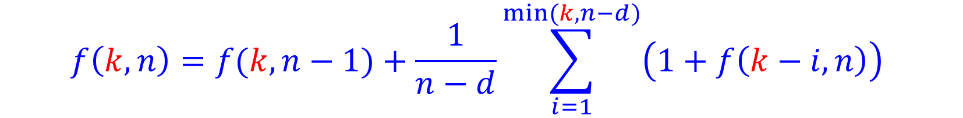
Dual Random-Facet – Analysis
[Matoušek-Sharir-Welzl (1992)]
$$f\left(k,n\right)=f(k,n−1)+\frac{1}{n−d}\sum_{i=1}^{min⁡(k,n−d)}{\left(1+f\left(k−i,n\right)\right)}$$
$$k≤d≤n$$
$f\left(d,n\right)=e^{2\sqrt{d\ln{\frac{n−d}{\sqrt{d}}}}+O\left(\sqrt{d}+\ln{n}\right)}$
$f\left(d,6d^{2}\right)=e^{O\left(\sqrt{d\ln{d}}\right)}$

Slide 20

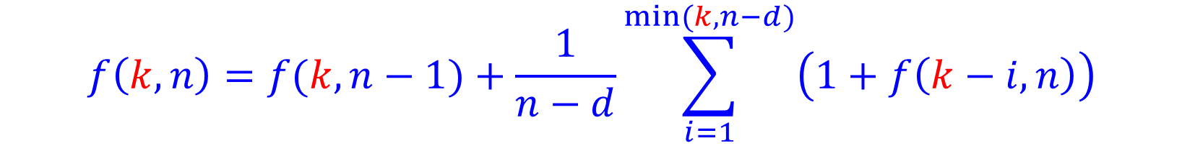
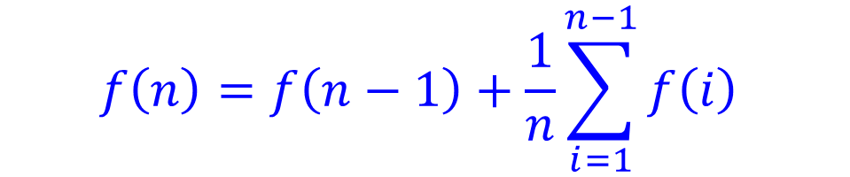
“Unusual” recurrence relations
$$f\left(n\right)=f\left(n−1\right)+f\left(\frac{n}{2}\right)$$
$$f\left(n\right)=n^{O\left(\log{n}\right)}$$
$$f\left(n\right)=f\left(n−1\right)+\frac{1}{n}\sum_{i=1}^{n−1}{f\left(i\right)}$$
$$f\left(n\right)=2^{O\left(\sqrt{n}\right)}$$
$$f\left(k,n\right)=f(k,n−1)+\frac{1}{n−d}\sum_{i=1}^{min⁡(k,n−d)}{\left(1+f\left(k−i,n\right)\right)}$$

Slide 21
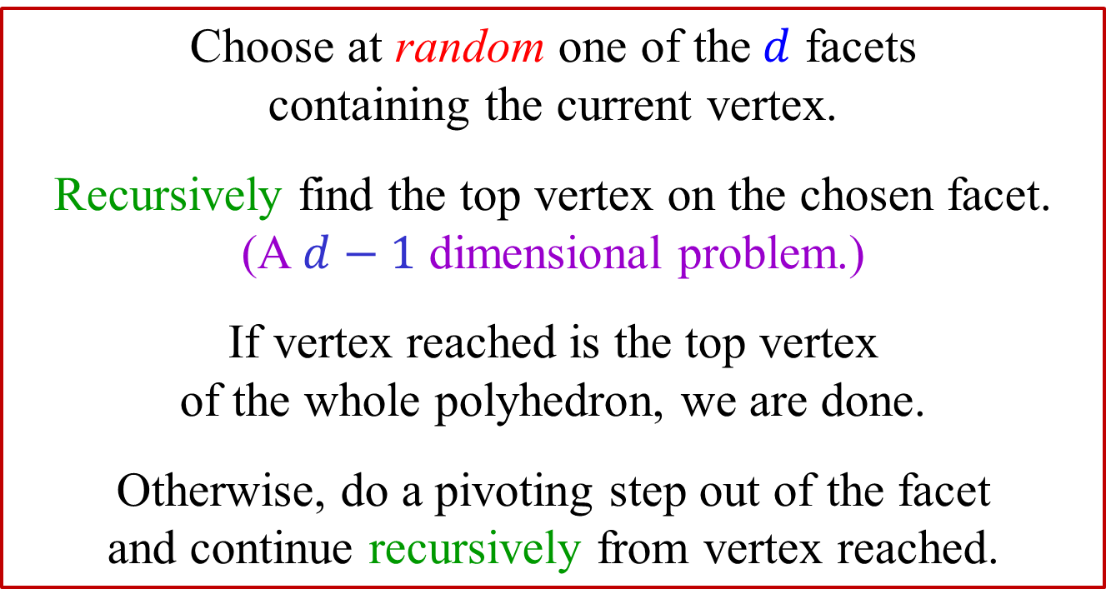

Primal Random-Facet [Kalai (1992)]
Choose at random one of the$d$ facets
containing the current vertex.
Recursively find the top vertex on the chosen facet.
(A $d−1$ dimensional problem.)
If vertex reached is the top vertex
of the whole polyhedron, we are done.
Otherwise, do a pivoting step out of the facet
and continue recursively from vertex reached.
$$f\left(d,n\right)=f(d,n−1)+\frac{1}{d}\sum_{i=1}^{min⁡(d,n−d)}{\left(1+f\left(d,n−i\right)\right)}$$
$n$ – number of active facets

Slide 22
Active facets
A facet is active if it contains a vertex
at least as high as the current vertex
Active
Inactive facets
are not interesting, as
the algorithm would
never reach them.
Inactive

Slide 23
Random-Facet algorithms
Seidel’s randomized
LP algorithm
[Seidel (1991)]
Upper bound
on diameter
[Kalai-Kleitman (1992)]
Random-Facet
dual version
[Matoušek
Sharir-Welzl (1992)]
Random-Facet
primal version
[Kalai (1992)]

Slide 24


The general picture
There are known polynomial time algorithms for LP,
e.g., the ellipsoid algorithm, interior point algorithms etc.
However, it is not known whether there is a
strongly polynomial time algorithm for LP.
Random-Facet is essentially the
fastest known variant of the simplex algorithm.
Random-Facet is the fastest known algorithm when $d$ is small.
Random-Facet is not polynomial.
Random-Facet can solve a wider class of problems, not just LP.
It is not known whether the diameter of a
polyhedron is polynomial in $n$ and $d$.
Best upper bound known on the diameter is
quasipolynomial, i.e., ${\left(n−d\right)}^{\log_{2}{d}}$

Slide 25
THE END

