Slide 1
Uri Zwick Tel Aviv University
Policy Iteration Algorithms (Local Improvement Algorithms)
Equilibrium Computation Schloss Dagstuhl April 26, 2010
TexPoint fonts used in EMF.
Read the TexPoint manual before you delete this box.: AAAAAA

Slide 2
Concrete setting
Turn-based Stochastic Payoff Games (PSGs)
Mean Payoff Games (MPGs)
Markov Decision Processes (MDPs)
Abstract setting
Abstract objective functions (AOFs)
Acyclic Unique Sink Orientations (AUSOs)

Slide 3
Concrete setting
2½ / 2 / 1½ / 1-Player Payoff Games
Policy Iteration Algorithms
Abstract setting
“combinatorial cubes”

Slide 4
A simple Simple Stochastic Game
R
R
R
R

Slide 5
Turn-based Stochastic Payoff Games
20
100
15
0
40
20
Two Players: MAX and min
Objective: MAX/min the expected average reward per turn

Slide 6
Turn-based Stochastic Payoff Games [Shapley ’53] [Gillette ’57] … [Condon ’92]
No sinks
Payoffs on actions
Limiting average version
Discounted version
Both players have optimal positional strategies
Can optimal strategies be found in polynomial time?

Slide 7
Stochastic Payoff Games (SPGs) Strategies
A general strategy may be randomized and history dependent
A positional strategy is deterministic and history independent
Positional strategy for MAX (min): choice of an outgoing edge from each MAX (min) vertex
Both players have optimal positional strategies
Can optimal strategies be found in polynomial time?

Slide 8
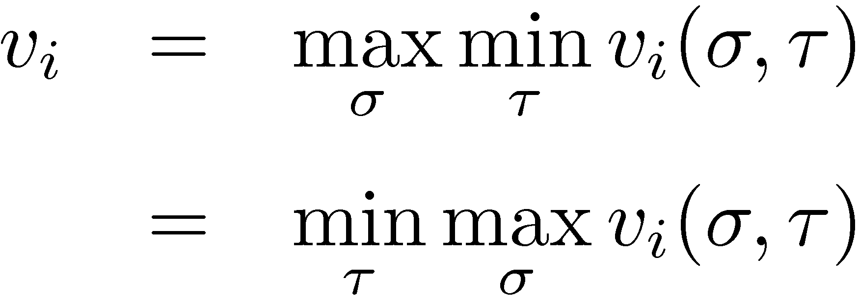
Stochastic Payoff Games (SPGs) Values
Every vertex i in the game has a value v_{i}
positional
general
positional
general
Both players have positional optimal strategies
There are strategies that are optimal for every starting position

Slide 9
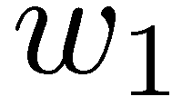
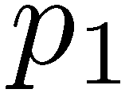
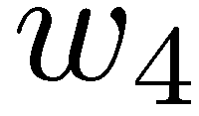
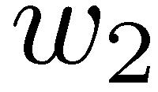
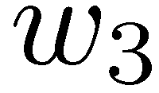
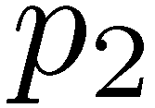
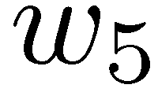
Mean Payoff Games (MPGs) [Ehrenfeucht-Mycielski (1979)]
R
MAX
RAND
min
Limiting average version
Discounted version
Pseudo-polynomial algorithms
(GKK’88) (PZ’96)
Still no polynomial time algorithms known!

Slide 10
Mean Payoff Games (MPGs) [Ehrenfeucht, Mycielski (1979)]
Again, both players have optimal positional strategies.
Value(σ,τ) – average of cycle formed

Slide 11
Markov Decision Processes [Bellman ’57] [Howard ’60] …
Limiting average version
Discounted version
Only one (and a half) player
Optimal positional strategies can be found using LP
Is there a strongly polynomial time algorithm?

Slide 12
Markov Decision Processes (MDPs)
R
MAX
RAND
min
Theorem: [d’Epenoux (1964)]
Values and optimal strategies of a MDP can be found by solving an LP

Slide 13
SPG ∈ NP ∩ co-NP
Deciding whether the value of a game is at least (at most) v is in NP ∩ co-NP
To show that value ≥ v , guess an optimal strategy σ for MAX
Find an optimal counter-strategy τ for min by solving the resulting MDP.
Is the problem in P ?

Slide 14
Deterministic MDPs
Limiting average version
Discounted version
n – number of states/vertices m – number of actions/edges
One player, deterministic actions
O(mn) time
Limiting average version Minimum mean weight cycle [Karp 1978]
Discounted version [Madani, Thorup, Zwick 2009]

Slide 15
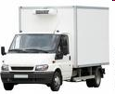
Deterministic MDPs = The truck driver’s problem
Traverse a single edge each day
Maximize profit per day (in the “long run”)

Slide 16
Discounted Deterministic MDPs = The unreliable truck driver’s problem
Traverse a single edge each day
Maximize profit per day (in the “long run”)
At each day, truck breaks down with prob. 1−λ

Slide 17
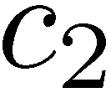
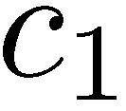
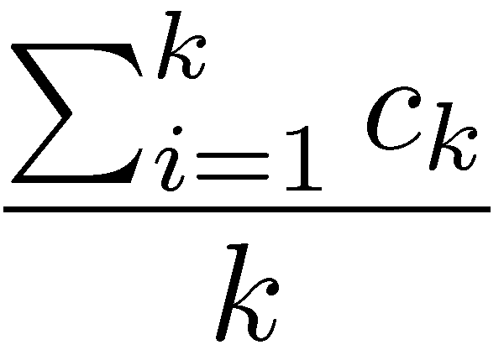
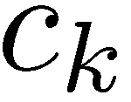
Deterministic MDPs – limiting average version
For each vertex, find a cycle of minimum mean cost reachable from it
[Karp ’78] O(mn)
[Young-Tarjan-Orlin ’91] O(mn+n²log n)
Better performance in practice

Slide 18
Turn-based Stochastic Payoff Games (SPGs) long-term planning in a stochastic and adversarial environment
2½-players
Mean Payoff Games (MPGs) adversarial non-stochastic
Markov Decision Processes (MDPs) non-adversarial stochastic
2-players
1½-players
Deterministic MDPs (DMDPs) non-stochastic, non-adversarial
1-player

Slide 19
Parity Games (PGs) A simple example
Priorities
2
3
2
1
4
1
EVEN wins if largest priority seen infinitely often is even

Slide 20
Parity Games (PGs)
3
8
EVEN
ODD
EVEN wins if largest priority seen infinitely often is even
Equivalent to many interesting problems in automata and verification:
Non-emptyness of ω-tree automata
modal μ-calculus model checking

Slide 21
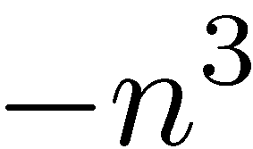
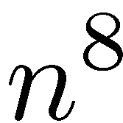
Parity Games (PGs)
Mean Payoff Games (MPGs)
[Stirling (1993)] [Puri (1995)]
8
3
EVEN
ODD
Replace priority k by payoff (−n)^{k}
Move payoffs to outgoing edges

Slide 22
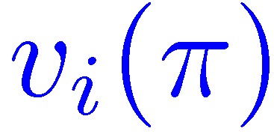
Policies/Strategies and values
1
1
1
…
1
i
n
0
0
0
0
Assume all out-degrees are 2
Policy π for min = Vertex a of an n-cube
= The value of a game starting at i, when min uses π and MAX uses an optimal counter-strategy

Slide 23
(Improving) Switches
1
1
1
…
1
i
n
0
0
0
0
π^{i} = switch π at i
π^{J} = switch π at all i ∈J

Slide 24
Policy Iteration [Howard ’60] [Hoffman-Karp ’66]
Start with some initial policy.
While policy not optimal, perform some (which?) improving switches.
Many variants possible
Easy to find improving switches
Performs very well in practice
What is the complexity of policy iteration algorithms?

Slide 25
Policy evaluation (MDPs)
Policy fixed → Markov Chain
Values of a fixed policy can be found by solving a system of linear equations

Slide 26
Policy improvement (MDPs)
Improving switches can be found in linear time

Slide 27
Policy improvement (MDPs) general outdegrees

Slide 28
From SSGs to AOFs / AUSOs

Slide 29
Abstract setting
Abstract objective functions (AOFs)
Acyclic Unique Sink Orientations (AUSOs)
Concrete setting
Turn-based (Stochastic) Games:
Simple Stochastic Games (SSGs)
Markov Decision Processes (MDPs)
Ludwig (1995) Halman (2004) Björklund, Sandberg, Vorobyov (2004)

Slide 30
Abstract setting
Find the minimum of:
Hypercube
Totally (or partially) ordered set
Every restriction of f has a unique local minimum
a with i-th position switched
Non-degeneracy:

Slide 31
Abstract setting
Completely Unimodular Functions (CUF)
Wiedemann (1985) Hammer, Simone, Liebling, De Werra (1988) Williamson Hoke (1988)
Abstract Objective functions (AOF)
Kalai (1992) Gärtner (1995)
Completely Local-Global (CLG)
Björklund, Sandberg, Vorobyov (2004)

Slide 32
Improving switches
No local minima: If a not global minimum, then I(a)≠∅
a with positions in J switched
Lemma:
Note:
Local Improvement Algorithms: While there are improving switches, perform some of them

Slide 33
Local Improvement Algorithms
Which switches should we perform?
Profitable switch with smallest index
Most profitable switch
A random profitable switch (RANDOM EDGE)
More sophisticated random switch (RANDOM FACET)
All profitable switches (simultaneously)
Each profitable switch with prob. ½
“Best combination of switches”

Slide 34
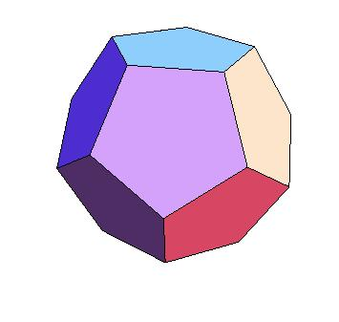
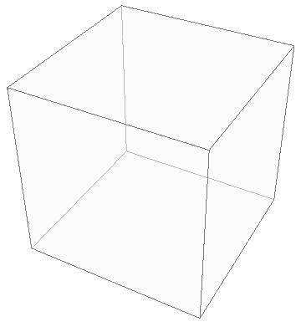
The Simplex Algorithm Dantzig (1947)
Klee-Minty cubes (1972)
Hirsch conjecture (1957)
Many pivoting rules known to be exponential
Is there a (randomized) polynomial pivoting rule?
Is the diameter polynomial?

Slide 35
Acyclic Unique Sink Orientations (AUSOs)
USOs and AUSOs
Stickney, Watson (1978)
Morris (2001)
Szabó, Welzl (2001)
Gärtner (2002)
Every face has a unique sink

Slide 36
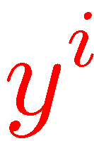
RANDOM FACET Kalai (1992) Matousek,Sharir,Welzl (1992) Ludwig (1995) Gärtner (2002)
Start at some vertex x
Choose a random facet i containing x
Find (recursively) the sink y of this facet, starting from x
If y is not the global sink, then run the algorithm from y^{i}

Slide 37
RANDOM FACET Kalai (1992) Matousek,Sharir,Welzl (1992) Ludwig (1995) Gärtner (2002)
Start at some vertex x
Choose a random facet i containing x
Find (recursively) the sink y of this facet, starting from x
If y is not the global sink, then run the algorithm from y^{i}

Slide 38
Analysis of RANDOM FACET [Kalai (1992)] [Matousek-Sharir-Welzl (1992)] [Ludwig (1995)]
All correct !
Would never be switched !
There is a hidden order of the indices under which the sink returned by the first recursive call correctly fixes the first i bits

Slide 39
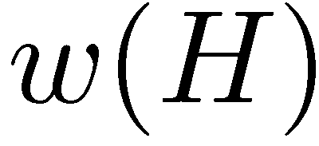
LP-type problems
Compute
Monotonicity
Locality
Basis regularity

Slide 40
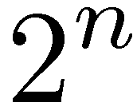
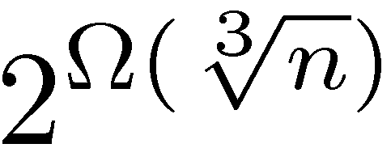
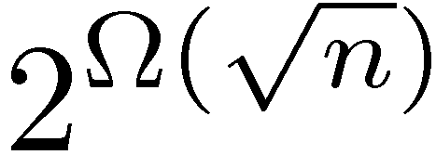
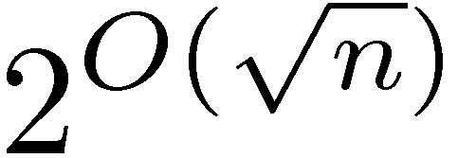
Kalai (1992) Matoušek-Sharir-Welzl (1996) Ludwig (1995) Gärtner (2002)
One switch at a time abstract setting
Klee-Minty cubes (1972)
Upper bound | Lower bound | Algorithm
 |  | First edge
 |  | RANDOM EDGE
 |  | RANDOM FACET
Matoušek, Szabó (2006)
Matoušek (1994)

Slide 41
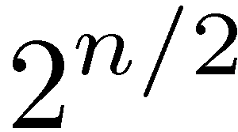
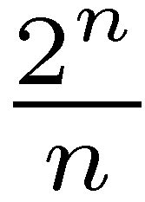
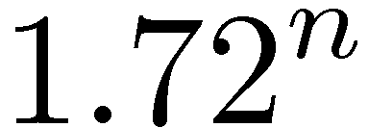
Many switches at once
Mansour, Singh (1999)
Upper bound | Lower bound | Algorithm
 |  | SWITCH ALL
 |  | EACH SWITCH with prob. 1/2
 |  | BEST SET OF SWITCHES
Schurr, Szabó (2005)

Slide 42
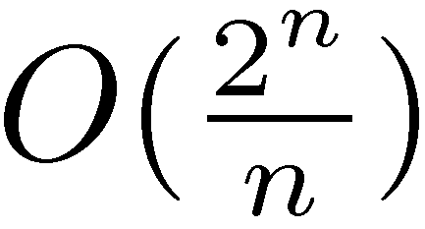
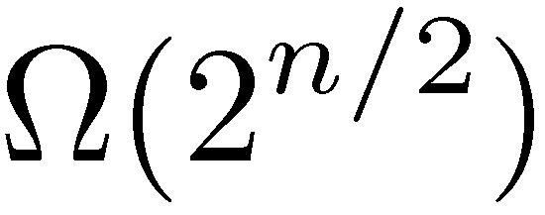
All Profitable Switches
Mansour, Singh (1999)
Schurr, Szabó (2005)
Conjecture / Speculation
Hansen-Z (2009)

Slide 43
Which AUSOs can result from MDPs / PGs / MPGs / SPGs ???
AUSOs
Are all containments strict?
2½-player games
LP on cubes
2-player games
1½-player games
Parity games
1-player games

Slide 44
Policy iteration algorithms for games
SWITCH ALL for Parity Games is exponential [Friedmann ’09]
SWITCH ALL for (non-binary) MDPs is exponential [Fearnley ’10]
RANDOM FACET for (non-binary) PGs is sub-exponential [Friedmann-Hansen-Z ’10]
Is there a polynomial variant?

Slide 45
Policy iteration The non-binary case
Switch to the action that seems to give the largest improvements
Is SWITCH ALL for binary MDPs polynomial?

Slide 46
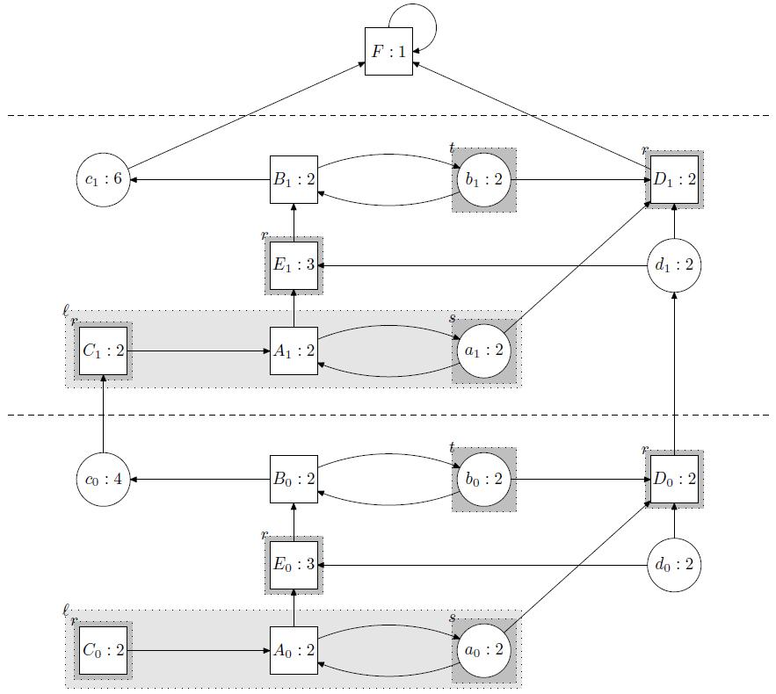
Hard Parity Games for Random Facet [Friedmann-Hansen-Z ’10]

Slide 47
Policy iteration for DMDPs
Might still be polynomial…
Best known lower bounds:
2n-O(1) with 2n edges
3n-O(1) with 3n edges
Θ(n²) with Θ(n²) edges
[Hansen-Z (2009)]

Slide 48
Lower bound for DMDPs
Animation by Thomas Dueholm Hansen

Slide 49
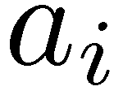
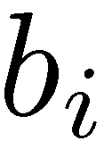
2n lower bound for DMDPs
Animation by Thomas Dueholm Hansen

Slide 50
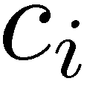
3n lower bound for DMDPs
Animation by Thomas Dueholm Hansen

Slide 51
Ω(n²) lower bound for DMDPs [Hansen-Z ’10]
Animation by Thomas Dueholm Hansen

Slide 52
SWITCH ALL for DMDPs
Conjecture:
SWITCH ALL for DMDPs converges after at most m iterations
Number of edges

Slide 53
Many intriguing and important open problems …
Polynomial Policy Iteration Algorithms ???
Polynomial algorithms for
AUSOs ?
SPGs ?
MPGs ?
PGs ?
Strongly Polynomial algorithms for
MDPs ?

