Slide 1
Union-Find A data structure for maintaining a collection of disjoint sets
Course: Data Structures Lecturers: Haim Kaplan and Uri Zwick
Last Updated: June 11, 2018

Slide 2
Union-Find
$x$ ← Make-Set(info): Create an item $x$, with associated information info, and create a set containing it as its single item.
Union(x,y): Unite the sets containing $x$ and $y$.
Find($x$): Return a representative of the set containing $x$.
Find($x$)=Find($y$) iff $x$ and $y$ are currently in same set.
Variation: Make-Set and Union specify a name for new set Find($x$) returns the name of set containing $x$.

Slide 3
Union Find
a
b
c
d
e
a ← Make-Set()
b ← Make-Set()
Union(a,b)
Find(b) → a
Find(a) → a
c ← Make-Set()
d ← Make-Set()
e ← Make-Set()
Union(c,d)
Union(d,e)
Find(e) → d

Slide 4
Union-Find
Make-Set
Link
Find
$$O(1)$$
$O(\log{n})$
$O(1)$
$O(1)$
$O(1)$
$O(\log{n})$
$O(1)$
$O\left(1\right)$
$O\left(α\left(n\right)\right)$
Amortized
Worst Case
Amortized
Inverse Ackermann “almost constant”
Link($x$,$y$): Unite the sets containing the representative elements $x$ and $y$
Union($x$,$y$) → Link(Find($x$),Find($y$))

Slide 5
Important aplication: Incremental Connectivity
A graph on n vertices is built by adding edges
At each stage we may want to know whether two given vertices are already connected
2
5
1
4
7
3
6
Union(1,2)
Union(2,7)
Find(1)=Find(6)?
Union(3,5)
…

Slide 6
Fun aplication: Generating mazes
c₁ ← Make-Set(1)
1 | 2 | 3 | 4
5 | 6 | 7 | 8
9 | 10 | 11 | 12
13 | 14 | 15 | 16
c₂ ←Make-Set(2)
…
c₁₆ ← Make-Set(16)
find(c₆)=find(c₇) ?
union(c₆,c₇)
find(c₇)=find(c₁₁) ?
union(c₇,c₁₁)
…
Choose edges in random order and remove them if they connect two different regions

Slide 7
Fun aplication: Generating mazes
1 | 2 | 3 | 4
5 | 6 | 7 | 8
9 | 10 | 11 | 12
13 | 14 | 15 | 16

Slide 8
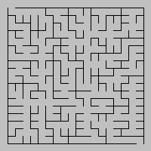
Generating mazes – a larger example
$$n$$
Construction time – $O\left(n^{2}α\left(n^{2}\right)\right)$

Slide 9
More serious aplications:
Maintaining an equivalence relation
Incremental connectivity in graphs
Computing minimum spanning trees
…

Slide 10
Implementation using linked lists
Each set is represented as a linked list
Each item has a pointer to the list
List = Set
first
last
size
k
…
α
χ
β
γ
a
x
Find(x) – $O(1)$ time

Slide 11
Union using linked lists
first
last
size
k₁
α
β
γ
…
ξ
y
x
first
last
size
k₂
δ
ε
η
Concatenate the two lists
Change “list pointers” of shorter list
$Union(x,y)$ – $O(min⁡\{k_{1},k_{2}\})$ time

Slide 12
Union Find using linked lists Analysis
Let $n$ be the total number of Make-Set operations.
Make-Set($x$) and Find($x$) take $O(1)$ worst-case time.
Union($x$,$y$) takes $O(n)$ worst case time
But…
Whenever the list pointer of an item is changed, the size of the list containing it has at least doubled.
Each list pointer can be changed at most $log⁡n$ times.
Total cost of all Union operations is $O(n\log{n})$.

Slide 13
Union-Find using linked lists
Make-Set($x$) and Find($x$) take $O(1)$ worst-case time.
Total cost of all Union operations is $O(n\log{n})$.
If we charge $O\left(\log{n}\right)$ for each Make-Set, we cover the cost of all Union operations.
Can we move the $O(\log{n})$ amortized cost from Make-Set to Union?
Make-Set
Union
Find
$O(\log{n})$
$O(1)$
$O(1)$
$O(1)$
$O(\log{n})$
$O(1)$
Amortized
Amortized

Slide 14
Union-Find using linked lists
To get an amortized cost of $O(1)$ for Make-Set and Find, and $O\left(\log{n}\right)$ amortized cost for Union, we need to show
that the total cost of any sequence of $m$ operations which includes $n$ Make-Set’s and $k$ ($≤n)$ Union’s is
$$O\left(m+k\log{n}\right)$$
If there are $k$ Union’s, at most $2k$ items participate in Union’s, and the total cost of all Union’s is $O\left(k\log{k}\right)≤O\left(k\log{n}\right)$.
Make-Set
Union
Find
$O(\log{n})$
$O(1)$
$O(1)$
$O(1)$
$O(\log{n})$
$O(1)$
Amortized
Amortized

Slide 15
Union-Find
Make-Set
Link
Find
$$O(1)$$
$O(\log{n})$
$O(1)$
$O(1)$
$O(1)$
$O(\log{n})$
$O(1)$
$O\left(1\right)$
$O\left(α\left(n\right)\right)$
Amortized
Worst Case
Amortized
Inverse Ackermann “almost constant”
Link($x$,$y$): Unite the sets containing the representative elements $x$ and $y$
Union($x$,$y$) → Link(Find($x$),Find($y$))

Slide 16
Union Find using Trees
Represent each set as a rooted tree
Union by rank
Path compression
$$x.p$$
$$x$$
The parent of a vertex $x$ is denoted by $x.p$
Find($x$) traces the path from $x$ to the root

Slide 17
Union by rank
$$r+1$$
$$r_{1}<r_{2}$$
$$r_{2}$$
$$r$$
$$r$$
0
$$r_{1}$$
At the moment, $rank=height$.
But later we will only have $rank≥height$.
If $x$ is not a root, then $x.rank < x.p.rank$

Slide 18
Union by rank
$$r+1$$
$$r_{1}<r_{2}$$
$$r_{2}$$
$$r$$
0
$$r_{1}$$
Lemma 0: $height≤rank$.
Lemma 1: A tree of rank $r$ contains at least $2^{r}$ items.
Proofs: By easy induction.
Lemma 2: At any moment, there are at most $\frac{n}{2^{r}}$ nodes of $rank≥r$.
Proof: Assign to each item of $rank≥r$ the items that were in its tree when it got rank $r$. Each item of $rank≥r$ is assigned a disjoint set of size $≥2^{r}$.

Slide 19
Union by rank
$$r+1$$
$$r_{1}<r_{2}$$
$$r_{2}$$
$$r$$
0
$$r_{1}$$
Lemma 0: $height≤rank$.
Lemma 1: A tree of rank $r$ contains at least $2^{r}$ items.
Corollaries:
The $height$ of each tree is at most $\log{n}.$
Find takes $O(\log{n})$ worst-case time.

Slide 20
Path Compression
$$x$$
After climbing to the root, make all the nodes visited point directly to the root!
This increases the cost of Find by at most a constant factor, but may significantly speed-up subsequent Find operations.

Slide 21
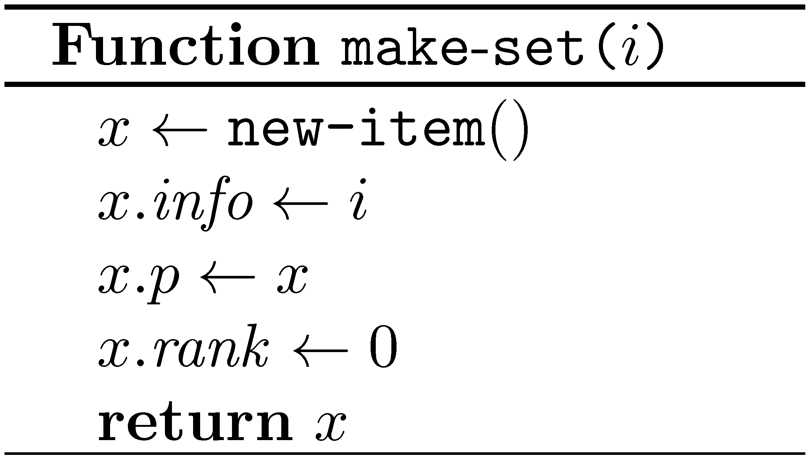
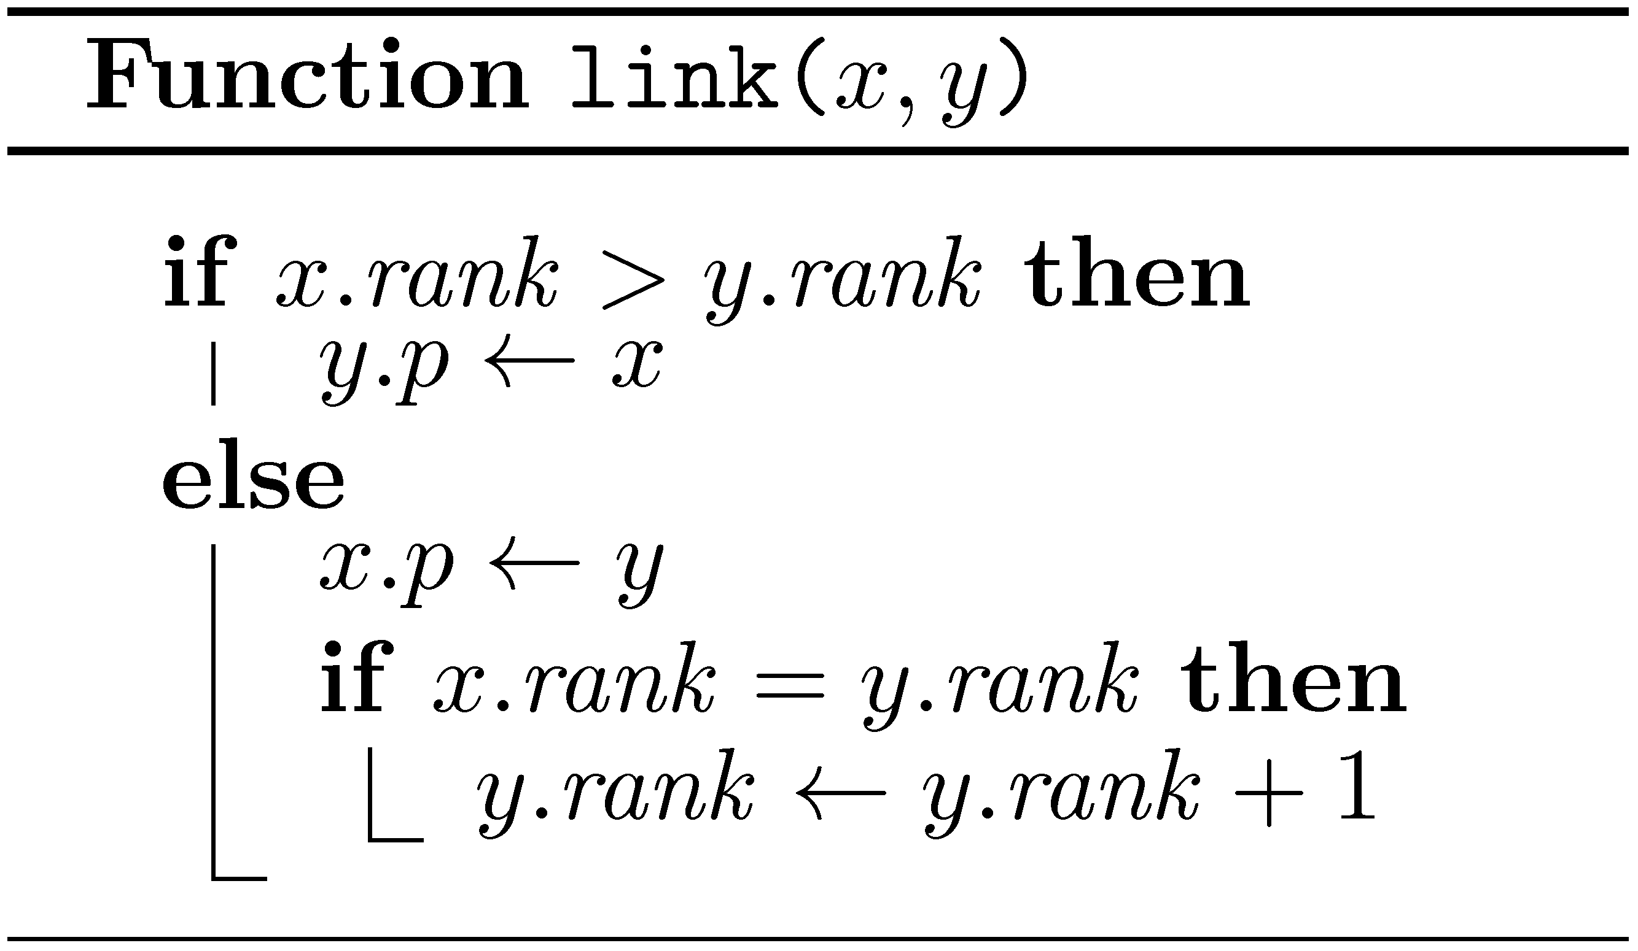
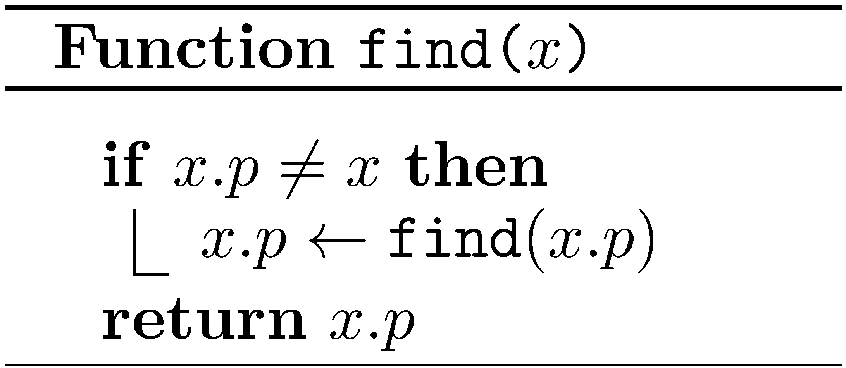
Union Find - pseudocode

Slide 22
Union-Find Union by rank + Path compression
Worst case
Make-set | Link | Find
$$O(1)$$ | $$O(1)$$ | $$O(\log{n})$$
Amortized
Make-set | Link | Find
$$O(1)$$ | $$O(1)$$ | $$O(α(n))$$

Slide 23
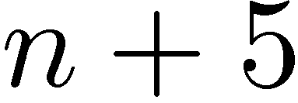
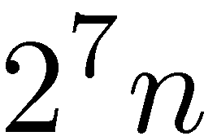
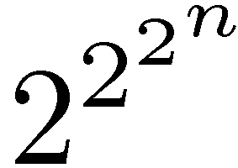
Nesting / Repeated application

Slide 24
Ackermann’s function (one of many variations)

Slide 25
The Tower function
T(n) | n
2 | 1
4 | 2
16 | 3
65,536 | 4
2^{65,536} | 5

Slide 26
Ackermann’s function (modified)

Slide 27
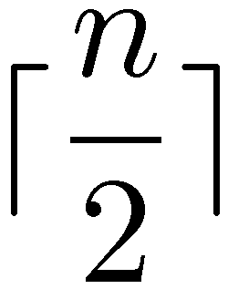
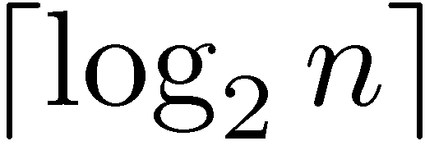
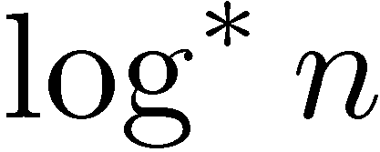
Inverse functions

Slide 28
The $\log^{∗}{n}$ function
log*(n) | n
1 | [ 0 , 2 ]
2 | [ 3 , 4 ]
3 | [ 5 , 16 ]
4 | [ 17 , 65,536 ]
5 | [ 65,537 , 2^{65,536} ]
For all practical purposes $\log^{∗}{n}≤5$

Slide 29
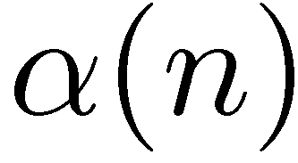
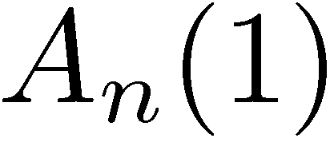
Inverse Ackermann function
is the inverse of the function

Slide 30
Inverse Ackermann function
is the inverse of the function
A “diagonal”
The first “column”

Slide 31
$O(\log^{∗}{n})$ upper bound
For simplicity, we prove an $O(\log^{∗}{n})$ upper bound on the amortized cost of Find
The $O(α(n))$upper bound is more complicated (see a potential based analysis below)
We use a variant of the accounting method in which items accumulate debits

Slide 32
$O(\log^{∗}{n})$ upper bound
The $level$ of a node $x$ is defined to be $$level(x) =\log^{∗}{x.rank}$$
$$level(x)$$ | $$x.rank$$
1 | [ 0 , 2 ]
2 | [ 3 , 4 ]
3 | [ 5 , 16 ]
4 | [ 17 , 65,536 ]
5 | [ 65,537 , 2^{65,536} ]
$$⋮$$ | $$⋮$$
$$i$$ | $$[ T\left(i−1\right)+1 , T\left(i\right) ]$$

Slide 33
$O(\log^{∗}{n})$ upper bound
$$level(x)$$ | $$x.rank$$
$$1$$ | [ 0 , 2 ]
$$i$$ | $$[ T\left(i−1\right)+1 , T\left(i\right) ]$$
The number of nodes of level 1
$$≤n$$
The number of nodes of level $ℓ$, where $ℓ>1$
$$≤ \frac{n}{2^{T\left(ℓ−1\right)+1}} < \frac{n}{T\left(ℓ\right)}$$

Slide 34
$O(\log^{∗}{n})$ upper bound
The ranks along each path are increasing.
Partition the nodes along a search path into levels.
= last node in a level (or a child of the root)
root
$$level<\log^{∗}{n}$$
$level$ $ℓ+1$
$$x$$
$level$ $ℓ$
Not to scale. $level$ $ℓ+1$ may be much wider than $level$ $ℓ$
$level$ $1$
$$level\left(root\right)=\log^{∗}\left(root.rank\right) ≤\log^{∗}\left(\log{n}\right)=\log^{∗}{n} −1$$

Slide 35
$O(\log^{∗}{n})$ upper bound
Consider a Find operation passing through $x$:
If $x$ is not a root, and not a child of the root, and $level$($x$) = $level$($x.p$), we charge $x$.
Otherwise, we charge the Find operation.
(Note that if $level$($x$) < $level$($x.p$), it will remain so, as $level$($x$) does not change while $level$($x.p$) does not decrease.)
Total charge for the Find operation itself ${≤ log}^{∗}{n}$
What is the total charge to all the nodes in an arbitrary sequence of operations ???

Slide 36
$O(\log^{∗}{n})$ upper bound
A node is only charged when it is no longer a root.
When a node is not a root, its $rank$, and hence $level$, remain fixed.
Suppose $level\left(x\right)=ℓ$.
Whenever $x$ is charged, $x.p.rank$ increases.
After at most $T\left(ℓ\right)−\left(T\left(ℓ−1\right)+1\right)$ charges, $x$ and $x.p$ will not be in the same $level$, and $x$ will never be charged again.
Number of nodes at level $ℓ$
Thus, the total charge for $x$ is $<T\left(ℓ\right)$.
Total charge per node at level $ℓ$
The total charge for $x$ all nodes is at most:
$$2n +\sum_{ℓ=2}^{{(log}^{∗}{n}) −1}{\frac{n}{T\left(ℓ\right)}⋅T\left(ℓ\right)}=n\log^{∗}{n}$$

Slide 37
$O(\log^{∗}{n})$ upper bound
Charge to each Find
Total charge to all nodes over all Find’s
amort(Make-Set)
amort(Find)

Slide 38
$O(\log^{∗}{n})$ upper bound
Make-Set
Link
Find
$$O(\log^{∗}{n})$$
$O(1)$
$O(\log^{∗}{n})$
$O(1)$
$O(1)$
$O(\log^{∗}{n})$
Amortized
Amortized
What we proved
What we promised
We can reduce $amort$(Make-Set) to $O\left(1\right)$ using a slightly modified definition of $level$.

Slide 39
$O(\log^{∗}{n})$ upper bound
Modified definition of $level$, with $r=log⁡(\log^{∗}{n})$
$$level\left(x\right)= \left\{\begin{matrix}1 & if x.rank≤r \\ \log^{∗}\left(x.rank−r\right) & otherwise\end{matrix}\right.$$
$level$ $ℓ$, where $ℓ>1$, now contains nodes with $$rank∈(T\left(ℓ−1\right)+r,T\left(ℓ\right)+r]$$
(We shifted the $levels$, making $level$ 1 of size $r$.)
Number of nodes of $level$ $l$ $≤ \frac{n}{2^{T\left(ℓ−1\right)+r+1}}< \frac{n}{T\left(ℓ\right)\log^{∗}{n}}$
We do not charge nodes at $level$ 1. (We charge the Find instead.)
Total charge to each Find is at most $\log^{∗}{n}+r=O\left(\log^{∗}{n}\right)$.
$$≤\sum_{ℓ=2}^{{(log}^{∗}{n}) −1}{\frac{n}{T\left(ℓ\right)\log^{∗}{n}}⋅T\left(ℓ\right)} ≤ n$$
Total charge to nodes

Slide 40
Lowest Common Ancestor (LCA)
LCA_{T}(x,y) – The lowest node z which is an ancestor of both x and y
a
T
LCA(e,k) = a
LCA(f,g) = b
LCA(c,h) = c
…
b
c
d
e
f
g
h
i
j
k

Slide 41
The off-line LCA problem
Given a tree T and a collection P of pairs, find LCA_{T}(x,y) for every (x,y)∈P
Using Union-Find we can get O((m+n)α(m+n)) time, where n=|T| and m=|P|
There are more involved linear time algorithms, even for the on-line version

Slide 42
The off-line LCA problem
Going down: u→v Make-Set(v)
Going up: v→u Union(u,v)
u
We want these to be the representatives (How do we do it?)
v
If w<v, then LCA(w,v) = “Find(w)”

Slide 43
The O(α(n)) upper bound for Union-Find (For those interested)

Slide 44
Amortized analysis (reminder)
Actual cost of i-th operation
Amortized cost of i-th operation
Potential after i-th operation

Slide 45
Amortized analysis (cont.)
Total actual cost

Slide 46
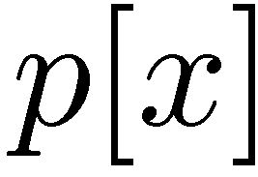
Level and Index
Back to union-find…

Slide 47
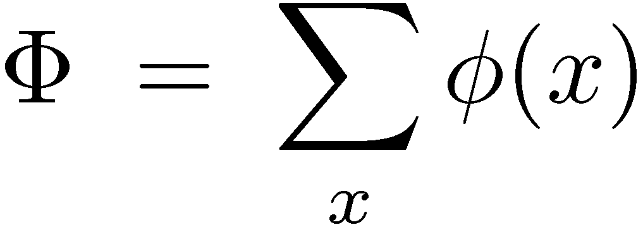
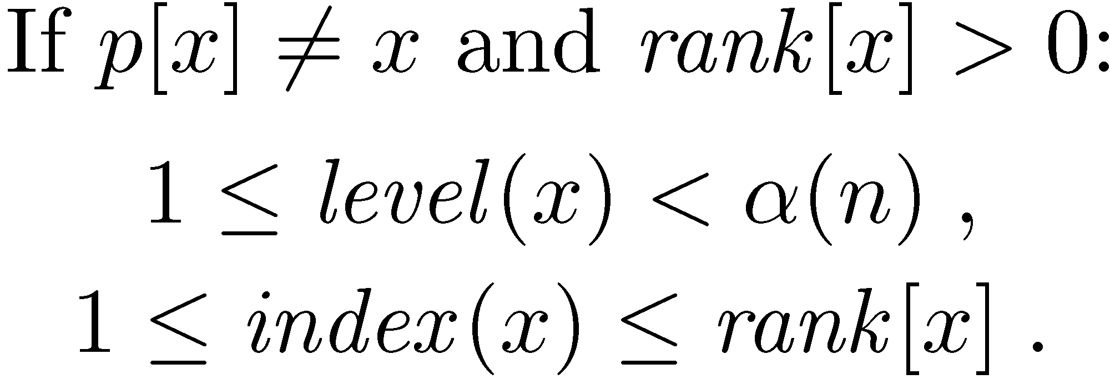
Potentials

Slide 48
Bounds on level
Definition
Proof
Claim

Slide 49
Bounds on index

Slide 50
Amortized cost of make
Actual cost: O(1)
ΔΦ: 0
Amortized cost: O(1)

Slide 51
Amortized cost of link
x
y
Actual cost: O(1)
z₁
…
z_{k}
The potentials of y and z₁,…,z_{k} can only decrease
The potentials of x is increased by at most α(n)
ΔΦ ≤ α(n)
Amortized cost: O(α(n))

Slide 52
Amortized cost of find
y=p’[x]
rank[x] is unchanged
rank[p[x]] is increased
level(x) is either unchanged or is increased
p[x]
If level(x) is unchanged, then index(x) is either unchanged or is increased
x
If level(x) is increased, then index(x) is decreased by at most rank[x]–1
is either unchanged or is decreased

Slide 53
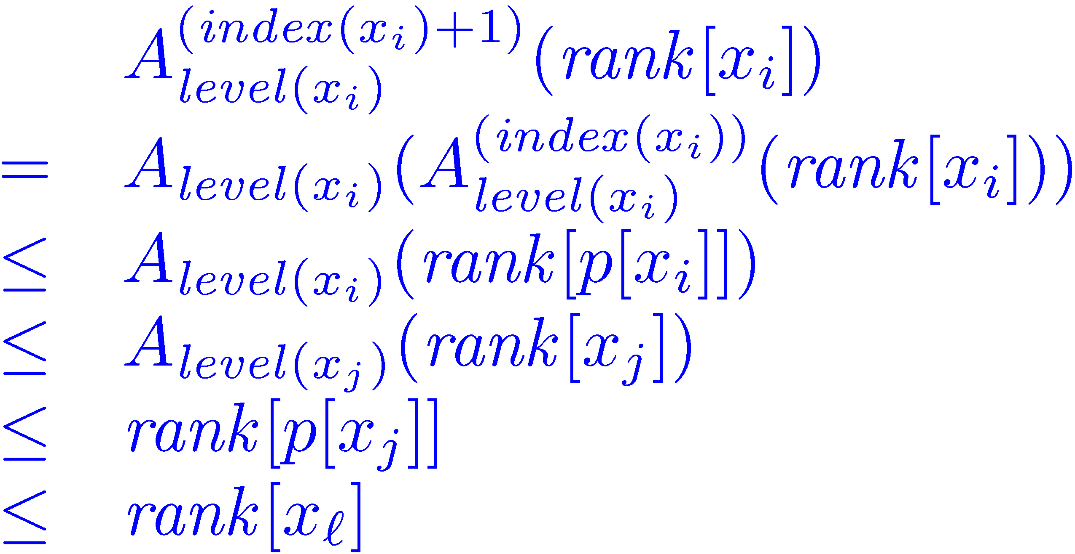
Amortized cost of find
Suppose that:
x_{l}
x_{j}
x_{i}
x=x₀
φ(x) is decreased !

Slide 54
Amortized cost of find
x_{l}
x_{j}
x_{i}
The only nodes that can retain their potential are: the first, the last and the last node of each level
x=x₀
Actual cost: l +1
ΔΦ ≤ (α(n)+1) – (l +1)
Amortized cost: α(n)+1

