Slide 1
Data Structures
Hashing
Haim Kaplan and Uri Zwick
May 2018

Slide 2
Dictionaries
D ← Dictionary() – Create an empty dictionary
Insert(D,x) – Insert item x into D
Find(D,k) – Find an item with key k in D
Delete(D,k) – Delete item with key k from D
(Predecessors and successors, etc., not supported)
Can use balanced search trees O(log n) time per operation
Can we do better?
YES !!!

Slide 3
Dictionaries with “small keys”
Suppose all keys are in [m] = {0,1,…,m−1}, where m = O(n)
Can implement a dictionary using an array D of length m.
Direct addressing
0
1
m-1
Special case: Sets D is a bit vector
O(1) time per operation (after initialization)
(Assume different items have different keys.)
What if m >>n ?
Use a hash function

Slide 4
Hashing
Huge universe U
Hash function h
Collisions
0
1
m-1
Hash table

Slide 5
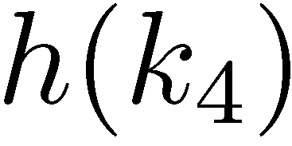
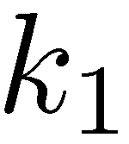
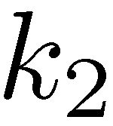
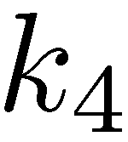
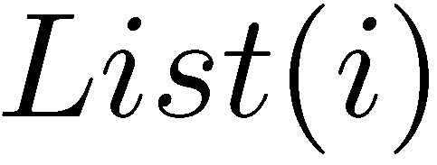
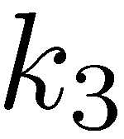
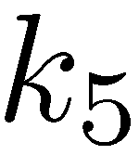
Hashing with chaining [Luhn (1953)] [Dumey (1956)]
Each cell points to a linked list of items
0
1
i
m-1

Slide 6
Hashing with chaining with a random hash function
Balls in Bins
Throw n balls randomly into m bins

Slide 7
Balls in Bins
Throw n balls randomly into m bins
All throws are uniform and independent

Slide 8
Balls in Bins
Throw n balls randomly into m bins
Expected number of balls in each bin is n/m
Probability two particular balls collide 1/m
Many other exciting properties

Slide 9
Balls in Bins
Throw $n$ balls randomly into $m$ bins
Expected number of balls in each bin is $n/m$
When $n=Θ(m)$, with probability of at least $1−\frac{1}{n}$, each bin contains at most $O\left(\frac{\log{n}}{\log{\log{n}}}\right)$ balls

Slide 10
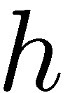
What makes a hash function good?
Behaves like a “random function”
Has a succinct representation
Easy to compute
A single hash function cannot satisfy the first condition

Slide 11
Families of hash functions
We cannot choose a “truly random” hash function
Using a fixed hash function is usually not a good idea
Compromise: Choose a random hash function h from a carefully chosen family H of hash functions
Each function h from H should have a succinct representation and should be easy to compute
Goal: For every sequence of operations, the running time of the data structure, when a random hash function h from H is chosen, is expected to be small

Slide 12
Modular hash functions [Carter-Wegman (1979)]
p – prime number
Form a “Universal Family” (see below)
Require (slow) divisions

Slide 13
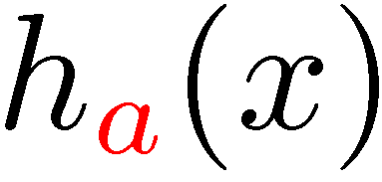
Multiplicative hash functions [Dietzfelbinger-Hagerup-Katajainen-Penttonen (1997)]
0<a<2^{w}, and a is odd
×
Form an “almost-universal” family (see below)
Extremely fast in practice!

Slide 14
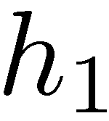
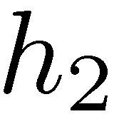
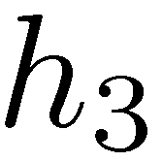
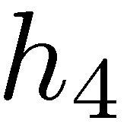
Tabulation based hash functions [Patrascu-Thorup (2012)]
“byte”
A variant can also be used to hash strings
h_{i} can be stored in a small table
+
Very efficient in practice
Very good theoretical properties

Slide 15
Universal families of hash functions [Carter-Wegman (1979)]
A family H of hash functions from U to [m] is said to be universal if and only if
A family H of hash functions from U to [m] is said to be almost universal if and only if

Slide 16
k-independent families of hash functions
A family H of hash functions from U to [m] is said to be k-independent if and only if
A family H of hash functions from U to [m] is said to be almost k-independent if and only if

Slide 17
A simple universal family [Carter-Wegman (1979)]
To represent a function from the family we only need two numbers, a and b.
The size m of the hash table can be arbitrary.

Slide 18
A simple universal family [Carter-Wegman (1979)]

Slide 19
Probabilistic analysis of chaining
$n$ – number of elements in (an arbitrary) dictionary D
$m$ – size of hash table
$α=n/m$ – load factor
Assume that h is randomly chosen from a universal family H
 | Expected | Worst-case
Successful Search Delete | $$1+\frac{1+α}{2}$$ | $$n$$
Unsuccessful Search (Verified) Insert | $$1+α$$ | $$n$$

Slide 20
Chaining: pros and cons
Pros:
Simple to implement (and analyze)
Constant time per operation ($O(1+α)$)
Fairly insensitive to table size
Simple hash functions suffice
Cons:
Space wasted on pointers
Dynamic allocations required
Many cache misses

Slide 21
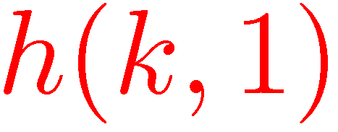
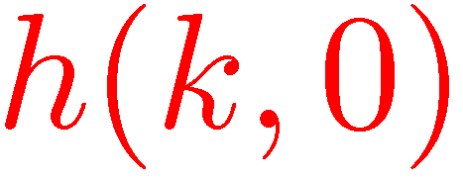
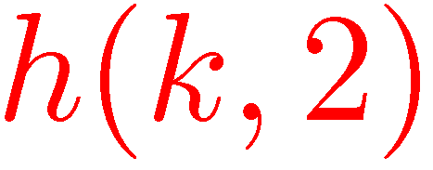
Hashing with open addressing
Hashing without pointers
Insert key k in the first free position among
Assumed to be a permutation
No room found → Table is full
To search, follow the same order

Slide 22
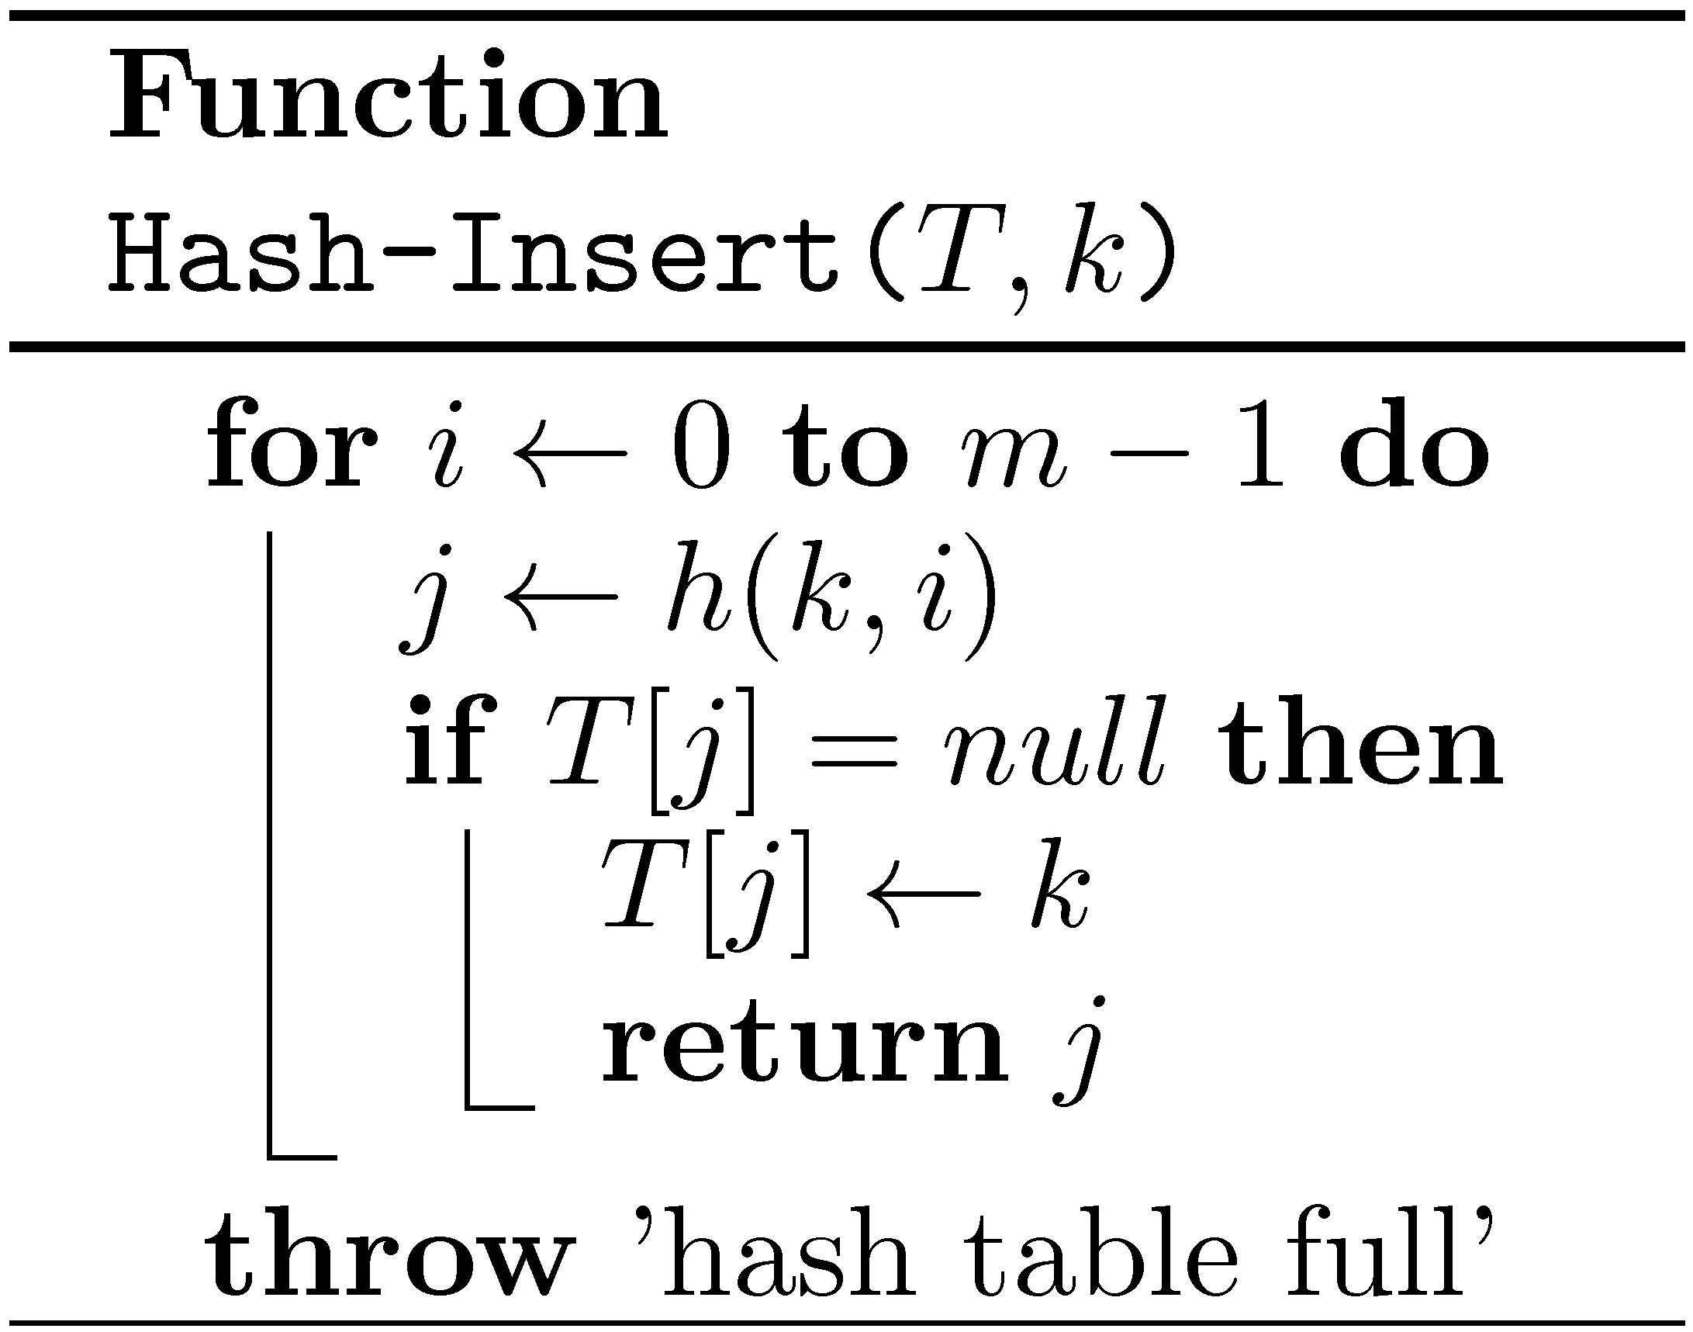
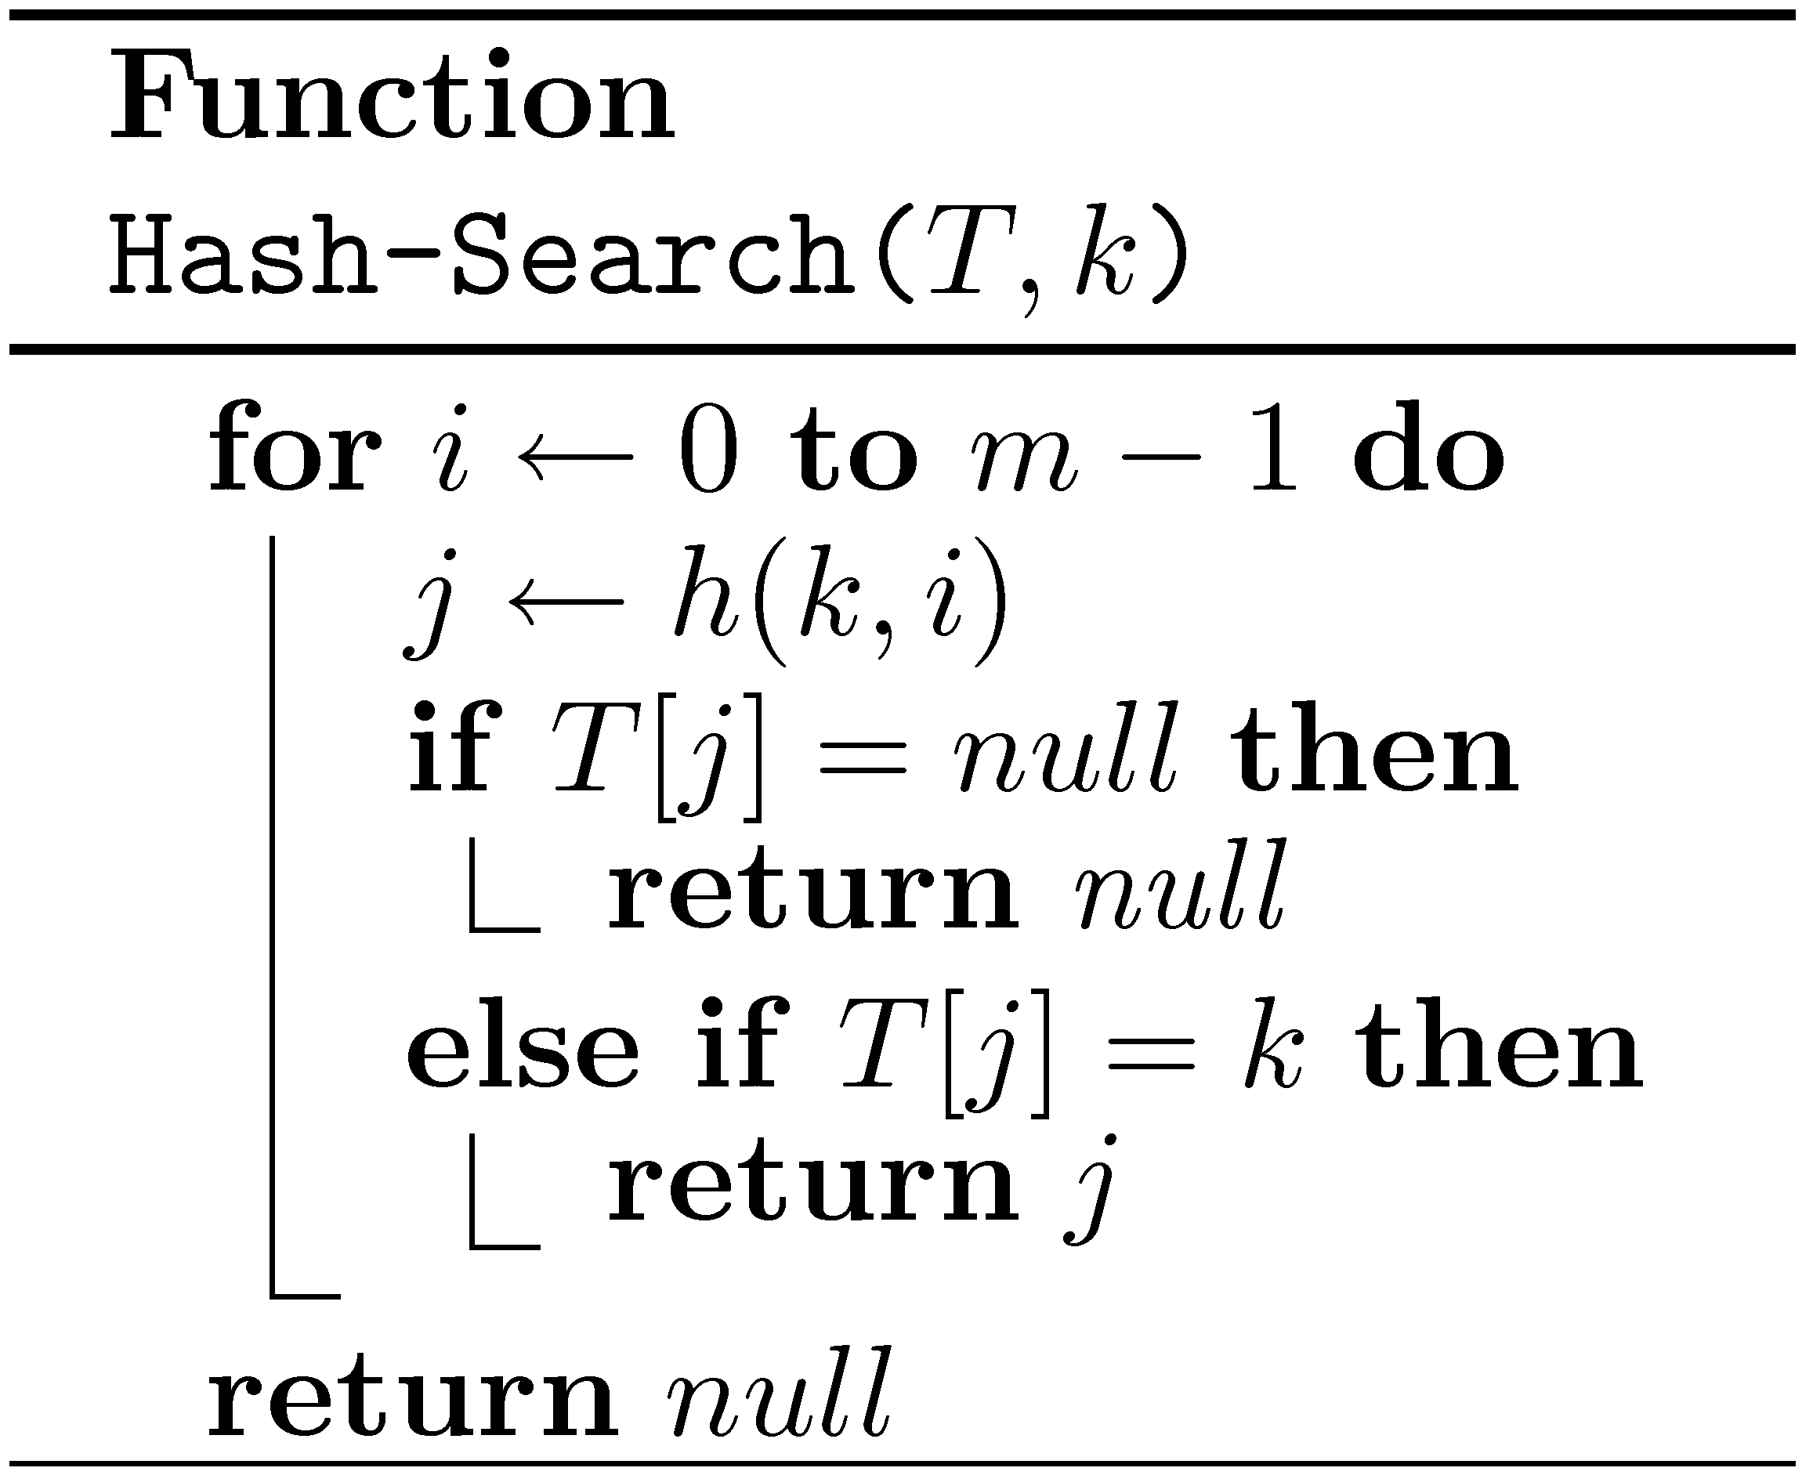
Hashing with open addressing

Slide 23
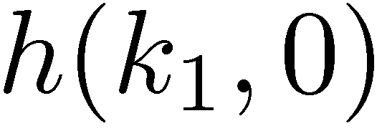
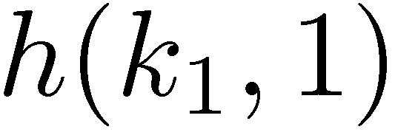
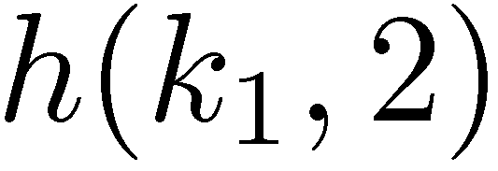
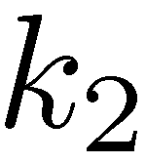
How do we delete elements?
Caution: When we delete an element, do not set the corresponding cell to null!
“deleted”
Problematic solution…

Slide 24
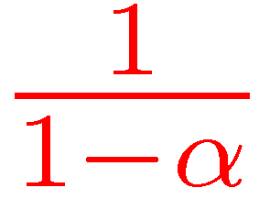
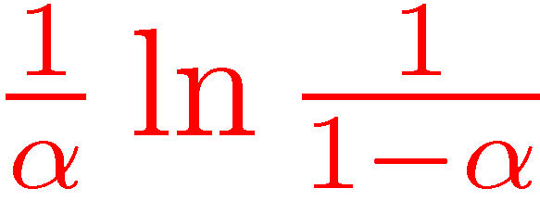
Probabilistic analysis of open addressing
n – number of elements in dictionary D
m – size of hash table
α=n/m – load factor (Note: α≤1)
Uniform probing: Assume that for every k, h(k,0),…,h(k,m−1) is random permutation
Expected time for unsuccessful search
Expected time for successful search

Slide 25
Probabilistic analysis of open addressing
Claim: Expected no. of probes for an unsuccessful search is at most:
If we probe a random cell in the table, the probability that it is full is α.
The probability that the first i cells probed are all occupied is at most α^{i}.

Slide 26
Open addressing variants
How do we define h(k,i) ?
Linear probing:
Quadratic probing:
Double hashing:

Slide 27
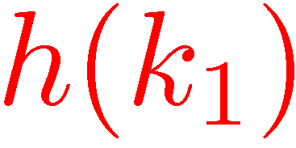
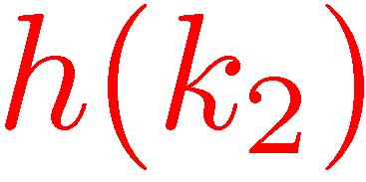
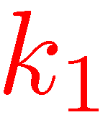
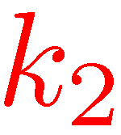
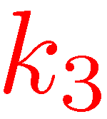
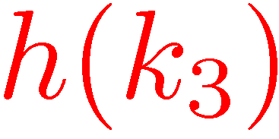
Linear probing “The most important hashing technique”
More probes than uniform probing, as probe sequences “merge”
But, much less cache misses
Extremely efficient in practice
More complicated analysis..

Slide 28
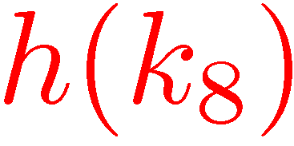
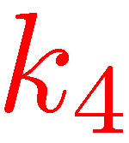
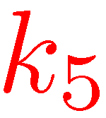
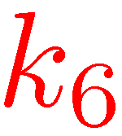
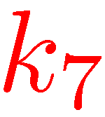
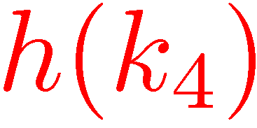
Linear probing – Deletions
Can the key in cell j be moved to cell i?

Slide 29
Linear probing – Deletions
When an item is deleted, the hash table is in exactly the state it would have been if the item were not inserted!

Slide 30
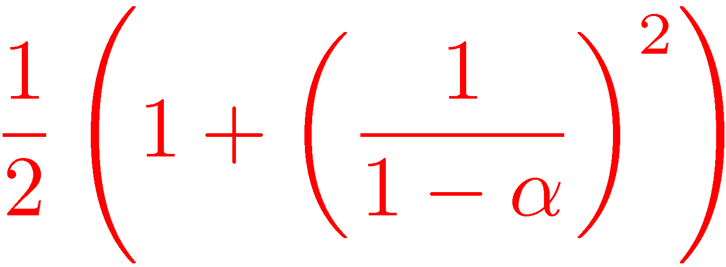
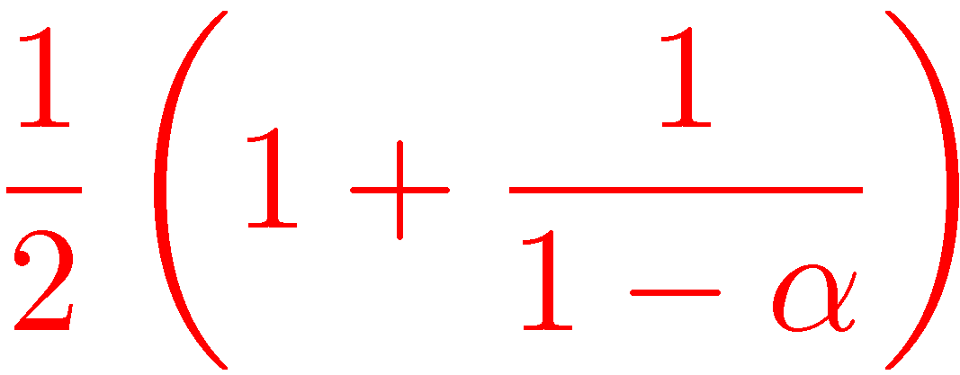
Expected number of probes Assuming random hash functions
Successful Search | Unsuccessful Search
 |  | Uniform Probing
 |  | Linear Probing
[Knuth (1962)]
When, say, α≤0.6, all small constants

Slide 31
Expected number of probes
0.5

Slide 32
Perfect hashing
Suppose that D is static.
We want to implement Find is O(1) worst case time.
Perfect hashing: No collisions
Can we achieve it?

Slide 33
Expected no. of collisions

Slide 34
Expected no. of collisions
If we are willing to use m=n², then any universal family contains a perfect hash function.
No collisions!

Slide 35
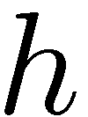
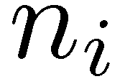
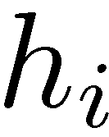
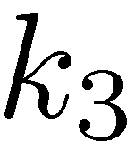
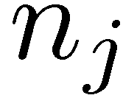
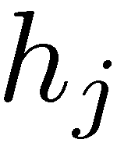
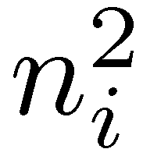
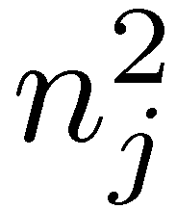
Two level hashing [Fredman, Komlós, Szemerédi (1984)]

Slide 36
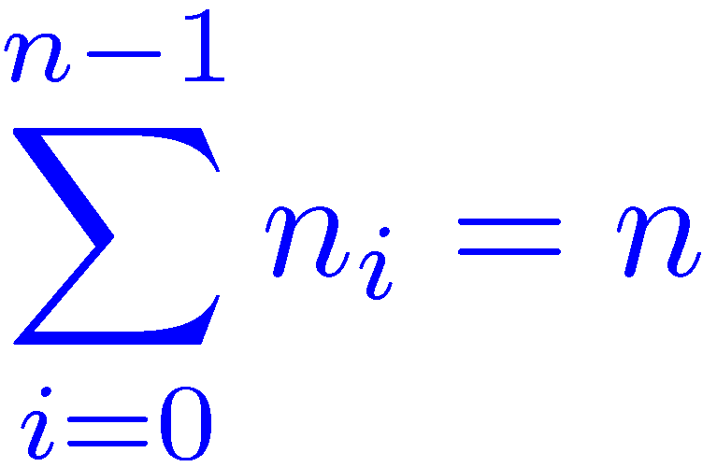
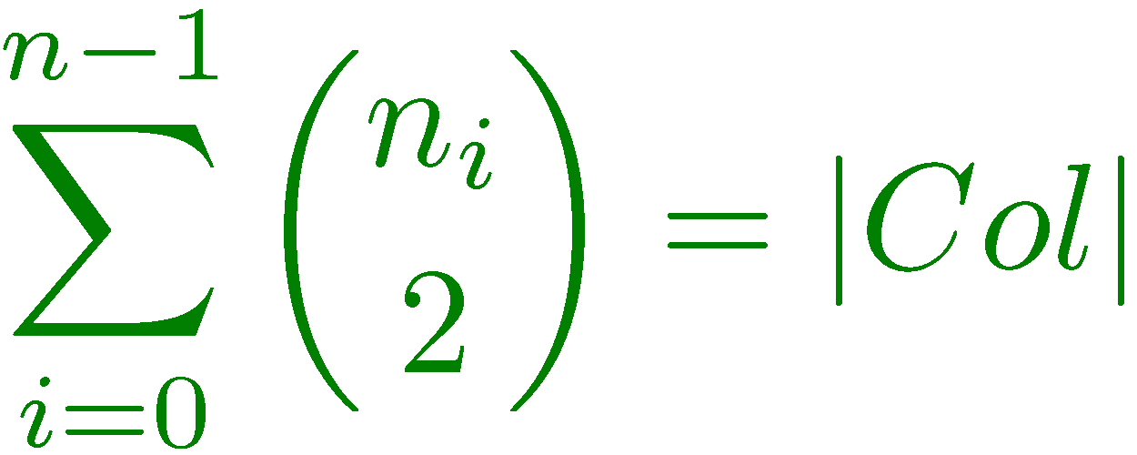
Two level hashing [Fredman, Komlós, Szemerédi (1984)]

Slide 37
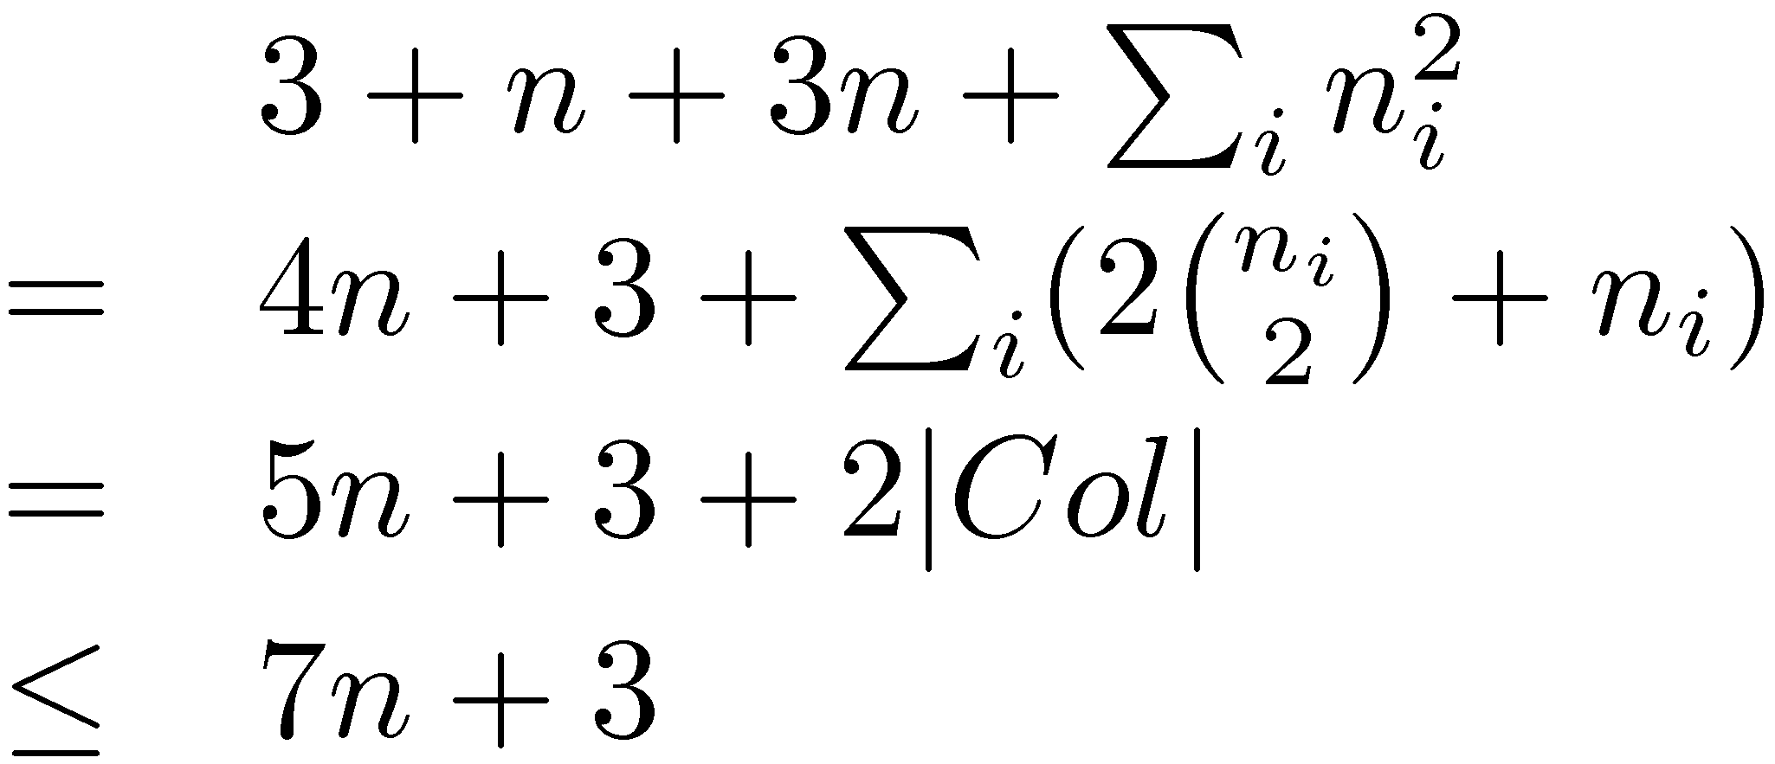
Two level hashing [Fredman, Komlós, Szemerédi (1984)]
Assume that each h_{i} can be represented using 2 words
Total size:

Slide 38
A randomized algorithm for constructing a perfect two level hash table:
Choose a random h from H(p,n) and compute the number of collisions. If there are more than n collisions, repeat.
For each cell i,if n_{i}>1, choose a random hash function h_{i} from H(p,n_{i}²). If there are any collisions, repeat.
Expected construction time – O(n)
Worst case search time – O(1)

Slide 39
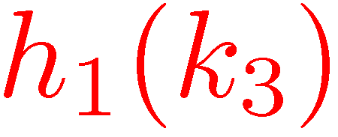
Cuckoo Hashing [Pagh-Rodler (2004)]

Slide 40
Cuckoo Hashing [Pagh-Rodler (2004)]
O(1) worst case search time!
What is the (expected) insert time?

Slide 41
Cuckoo Hashing [Pagh-Rodler (2004)]
Difficult insertion
How likely are difficult insertion?

Slide 42
Cuckoo Hashing [Pagh-Rodler (2004)]
Difficult insertion

Slide 43
Cuckoo Hashing [Pagh-Rodler (2004)]
Difficult insertion

Slide 44
Cuckoo Hashing [Pagh-Rodler (2004)]
Difficult insertion

Slide 45
Cuckoo Hashing [Pagh-Rodler (2004)]
Difficult insertion
How likely are difficult insertion?

Slide 46
Cuckoo Hashing [Pagh-Rodler (2004)]
A more difficult insertion

Slide 47
Cuckoo Hashing [Pagh-Rodler (2004)]
A more difficult insertion

Slide 48
Cuckoo Hashing [Pagh-Rodler (2004)]
A more difficult insertion

Slide 49
Cuckoo Hashing [Pagh-Rodler (2004)]
A more difficult insertion

Slide 50
Cuckoo Hashing [Pagh-Rodler (2004)]
A more difficult insertion

Slide 51
Cuckoo Hashing [Pagh-Rodler (2004)]
A more difficult insertion

Slide 52
Cuckoo Hashing [Pagh-Rodler (2004)]
A more difficult insertion

Slide 53
Cuckoo Hashing [Pagh-Rodler (2004)]
A failed insertion
If Insertion takes more than MAX steps, rehash

Slide 54
Cuckoo Hashing [Pagh-Rodler (2004)]
With hash functions chosen at random from an appropriate family of hash functions, the amortized expected insert time is O(1)

Slide 55
Other applications of hashing
Comparing files
Cryptographic applications
…

