Slide 1
Data Structures
Lecture 2
Amortized Analysis
“Amortized analysis finds the average running time per operation over a worst-case sequence of operations.”
Haim Kaplan, Uri Zwick March 2018

Slide 2
Implementing lists using (circular) arrays with resizing
n=M
L
array
a₀
a₁
…
a_{M−1}
maxlen
M
length
M
M
What do we do when the array is full?
Usually, we cannot extend the array.
Allocate a larger array and copy.
What should be the size of the new array?

Slide 3
Implementing lists using (circular) arrays with resizing
n=M
L
array
a₀
a₁
…
a_{M−1}
maxlen
M
length
M
M
If we start with an empty array and increase its length by 1, then the time to do n Insert-Last is about:
Average/amortized time (charge) per operation = O(n)

Slide 4
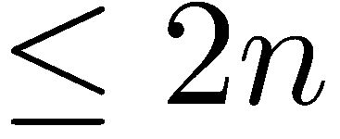
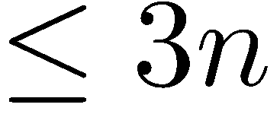
Implementing lists using (circular) arrays with doubling
When the array is full, double its size and copy.
Suppose that final size is $2^{k}<n≤2^{k+1}$
cost of insertion
cost of copying
The amortized cost of each operation is O(1)

Slide 5
Lazy deletions from singly linked lists
A
L
a₀
a₁
…
a_{n-1}
Delete-Node(A) simply sets A.item to null
Retrieve-Node(L,i) deletes empty nodes while scanning for the i-th item
worst(Insert-After) = O(1)
worst(Delete-Node) = O(1)
worst(Retrieve-Node(i)) = unbounded

Slide 6
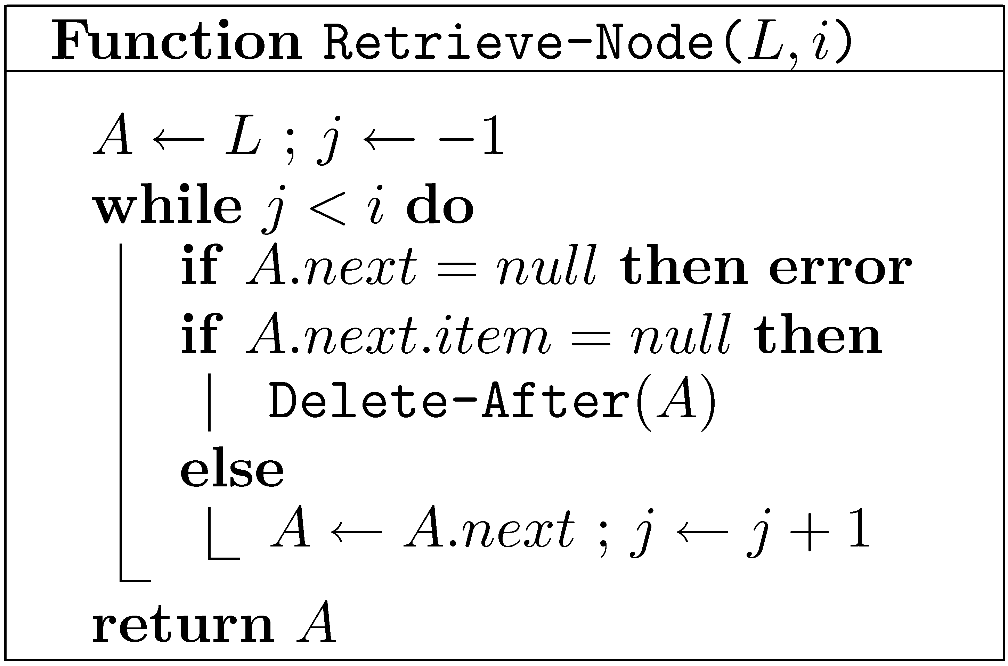
Lazy deletions from singly linked lists
L
a₀
…
a_{n-1}
Insert-Node(L,i) is similar

Slide 7
Lazy deletions from singly linked lists
L
a₀
…
a_{n-1}
What is the total cost of a sequence composed of
$n$ Insert-After operations, $d$ Delete-Node operations,
$m$ Retrieve-Node($i$) operations on positions $i_{1},i_{2},…,i_{m}$,
in any order?
$$O\left(n+\sum_{k=1}^{m}{{(i}_{k}+d_{k}+1) }+d\right)=O\left(n+\sum_{k=1}^{m}{(i_{k}+1)}+2d\right)$$
Total cost =
Number of deleted nodes encountered during Retrieve($i_{k}$)
$$\sum_{k=1}^{m}{d_{k}}≤d$$
amort(Insert-After) = $O(1)$
amort(Retrieve(i)) = $O(i+1)$
amort(Delete-Node) = $O(2)$

Slide 8
Worst-case bounds
Suppose that a data structure supports $k$ different types of operations $T_{1},T_{2},…,T_{k}$
Let $worst(T_{i})$ be the maximal time that a single operation of type $T_{i}$ may take.
Let $op_{1},op_{2},…,op_{n}$ be a sequence of operations that includes $n_{i}$ operations of type $T_{i}$.
$time(o{p_{1},op}_{2},…,op_{n})≤$ $$n_{1}⋅worst\left(T_{1}\right)+n_{2}⋅worst\left(T_{2}\right)+…+n_{k}⋅worst\left(T_{k}\right)$$
Sometimes, this bound is very loose.
$worst($Insert-Last$)=O(n)$
$worst(n×$Insert-Last$)=O\left(n\right)≪O\left(n^{2}\right)$

Slide 9
Worst-case bounds
Suppose that a data structure supports $k$ different types of operations $T_{1},T_{2},…,T_{k}$.
Let $worst(T_{i})$ be the maximal time that a single operation of type $T_{i}$ may take.
For an operation $op$, let $T(op)$ be its type.
For every sequence $op_{1},op_{2},…,op_{n}$ of operations:
$time\left(o{p_{1},op}_{2},…,op_{n}\right)≤\sum_{i=1}^{n}{worst\left(T\left(op_{i}\right)\right)}$
Sometimes, this bound is very loose.
$worst($Insert-Last$)=O(n)$
$worst(n×$Insert-Last$)=O\left(n\right)≪O\left(n^{2}\right)$

Slide 10
Amortized bounds
$$amort\left(T_{1}\right),amort\left(T_{2}\right),…,amort\left(T_{k}\right)$$
are amortized bounds on the cost of operations of types $T_{1},T_{2},…,T_{k}$ iff
for every valid sequence $op_{1},op_{2},…,op_{n}$ that contains $n_{i}$ operations of type $T_{i}$ we have:
$time\left(o{p_{1},op}_{2},…,op_{n}\right)≤$ $$n_{1}⋅amort\left(T_{1}\right)+n_{2}⋅amort\left(T_{2}\right)+…+n_{k}⋅amort\left(T_{k}\right)$$
There can be many possible sets of amortized bounds.
We prefer amortized bounds that give tighter bounds.

Slide 11
Amortized bounds
$$amort\left(T_{1}\right),amort\left(T_{2}\right),…,amort\left(T_{k}\right)$$
are amortized bounds on the cost of operations of types $T_{1},T_{2},…,T_{k}$ iff
for every valid sequence $op_{1},op_{2},…,op_{n}$:
$time\left(o{p_{1},op}_{2},…,op_{n}\right)≤\sum_{i=1}^{n}{amort\left(T\left(op_{i}\right)\right)}$
Worst-case bounds are also amortized bounds.
There can be many possible sets of amortized bounds.
We prefer amortized bounds that give tighter bounds.
Some operations subsidize other operations.

Slide 12
Why do we care about amortized bounds?
Usually, we are more interested in the total cost of a sequence of operations, and not in the individual cost of each operation in the sequence.
Amortized bounds allow us to derive good bounds on the total cost.
There are cases in which it is important that each individual operation is fast. In such cases, amortized bounds are not sufficient.

Slide 13
Simple examples of amortized bounds
Dynamic arrays:
Insert-First/Insert-Last has $O(1)$amortized cost,
even though some operations require expensive resizing.
Lazy deletions from singly linked lists:
Delete-Node has $O(1)$ amortized cost (and worst-case cost).
Retrieve(i) has $O\left(i+1\right)$ amortized cost
(but unbounded worst-case cost)
Push/Pop on a stack:
Suppose Push and Pop require only 1 time unit.
$worst$(Push)$=1 , worst\text{(}\text{Pop}\text{)} =1$
$amort$(Push)$=1 , amort\text{(}\text{Pop}\text{)} =1$
$amort$(Push)$=2 , amort\text{(}\text{Pop}\text{)} =0$
assuming number of Pop’s $≤$number of Push’s

Slide 14
Methods for deriving amortized bounds
We saw some examples of deriving amortized bounds using “bare hands”.
It is not always as easy…
We can use some help!
The accounting method
The potential method

Slide 15
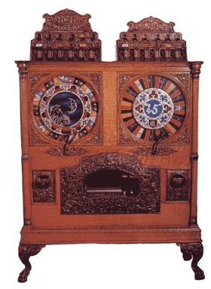
Coin operated computer
A token/coin pays for a constant number of operations.
Each operation may buy tokens and
Use them immediately
Leave tokens for subsequent operations
Use tokens left by previous operations
Number of tokens bought is clearly an upper bound on the cost of operations performed.

Slide 16
The Accounting method
Saving for a rainy day - “Keep something, esp. money, for a time in the future when it might be needed”
Each “normal” insert operations buys three tokens.
It uses one of them to insert the new item.
It leaves the other two in the “bank”
When the array is full, the bank contains enough tokens to pay for the copying!
What about the cost of allocating the new array?

Slide 17
The Accounting method
Theorem: If the array contains M/2+k items, where k≥0, then the bank contains at least 2k tokens.
Easy proof by induction
Corollary: When the array is full, the bank contains enough tokens to pay for copying all the items into a new array
Amortized cost of an operation ≡ number of tokens bought by the operation
Note: Tokens are only used in the analysis!
The data structure doesn’t really manipulate them.

Slide 18
Implementing lists using arrays with doubling
n
L
array
a₀
a₁
…
a_{M−1}
maxlen
M
length
n
M
amort(Insert-Last) = 3
amort(Delete-Last) = 1
amort(Insert(i)) = n−i+3
amort(Retrieve(i)) = 1

Slide 19
The Potential method
Very similar to the accounting method.
The difference:
Instead of specifying in advance how many tokens each operation should buy,
specify how many tokens should be in the bank in each state of the data structure
Potential ≡ Φ ≡ Balance of bank account
$amort\left(op\right)=time\left(op\right)+Φ_{after}−Φ_{before}$
$amort\left(T\right)=\max_{op∈T}{amort\left(op\right)}$

Slide 20
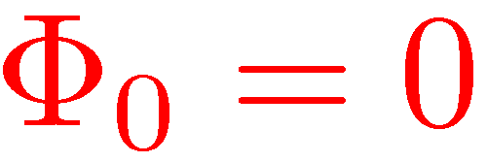
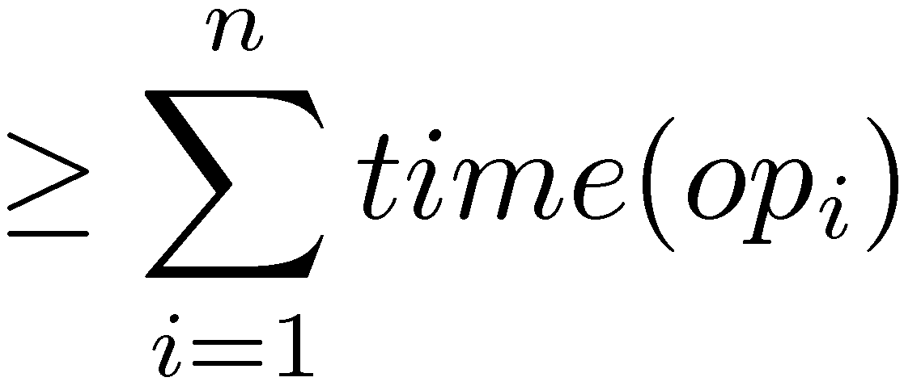
The Potential method
Bank account initially empty
≥ 0
No overdraft!

Slide 21
The Potential method (recap)
Define a potential function $≥0$
This holds for any potential function Φ $≥0$
To get good amortized bounds, we need to choose Φ cleverly

Slide 22
Potentials for expanding arrays
When array is not full
1
≤ 2
When array is full
M+1
2−M
At most 3 in both cases!

Slide 23
Potentials for expanding arrays
1
≤ 0
1
0
The amortized cost of Delete-Last is sometimes negative. When?

Slide 24
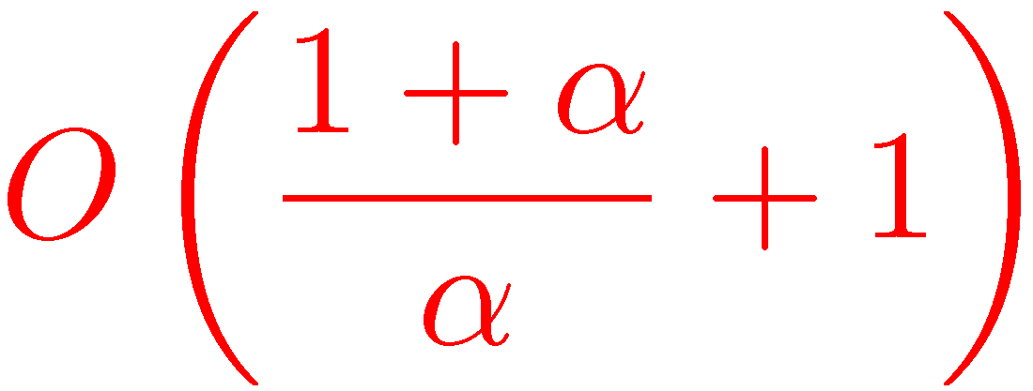
Not only doubling Trade-offs between time and space
Suppose that instead of doubling, we multiply the size of the array by $1+α$, where $α>0$.
Amortized cost of Insert-Last is
Exercise: Find an appropriate potential function.
Python’s implementation of lists essentially uses $α=1/8$.

Slide 25
Expanding and shrinking arrays
What do we do when a very large array contains very few elements?
When $n=M$, double the size
When $n=M/2$, half the size ?
Both worst-case and amortized costs are O(n)

Slide 26
Expanding and shrinking arrays
What do we do when a very large array contains very few elements?
When $n=M$, double the size
When $n=M/4$, half the size !
Amortized cost now O(1)
Which potential function should we use?

Slide 27
Expanding and shrinking arrays (Dynamic arrays)
We always have $\frac{M}{4}≤ n≤ M$

Slide 28
De-Amortization
In some cases, but not all, amortized bounds can be converted into worst-case bounds.
For example, in dynamic arrays, instead of leaving two tokens for future operations, we can actually move two elements.
Can we do something similar with lazy singly linked lists?

Slide 29
De-Amortized dynamic arrays
L.small
$$M/2$$
L.medium
$$M$$
L.large
$$2M$$
L.medium is always up to date
If L.medium is full then L.large is up to date
If L.medium is ¼ full then L.small is up to date
Updates may need to be performed on all three lists

Slide 30
De-Amortized dynamic arrays
L.small
$$M/2$$
L.medium
$$M$$
L.large
$$2M$$
L.medium is always up to date.
If L.medium contains $M/2+k$ items, then L.large contains the first $2k$ items.
If L.medium contains $M/2−k$ items, then L.small contains the first $k$ items.
Insert/Delete-First/Last and Retrieve(i) take O(1) worst-case time, assuming the allocation of new arrays takes O(1) time.
Exercise: Fill in the implementation details.

Slide 31
Amortized vs. Worst-case
Amortization gives worst-case bounds for a whole sequence of operations.
In many cases, this is what we really care about.
In some cases, such as real-time applications, we need each individual operation to be fast
In such cases, amortization is not good enough.

